Slide 1
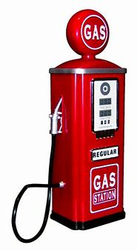
Environmental Share – Gasoline Spill Response
Waste Requirements
Gasoline Debris
as a Waste
Stored in a Closed Container
The Words “Hazardous Waste” and “Gasoline Spill Debris”
Label Must Contain EPA Waste Codes D001 (Ignitable) and D018 (Benzene)
How to respond to a Gasoline Spill
Gasoline contains large amounts of EPA regulated chemicals
Managed as Hazardous Waste
Subject to labeling and storage time requirements
Isolate the area and take steps to mitigate the spill if safe to do so.
Inform your Supervisor
Notify the Spill Hotline at
928-865-7745 (SPIL)
Questions?
Contact Environmental at 928-865-6000
or your Representative
Keep your phone nearby as an Environmental Representative will be contacting you shortly.
Reps.
Are
Resources!

