Slide 1
Morenci Environmental Services
Environmental Awareness Training
2025

Slide 2
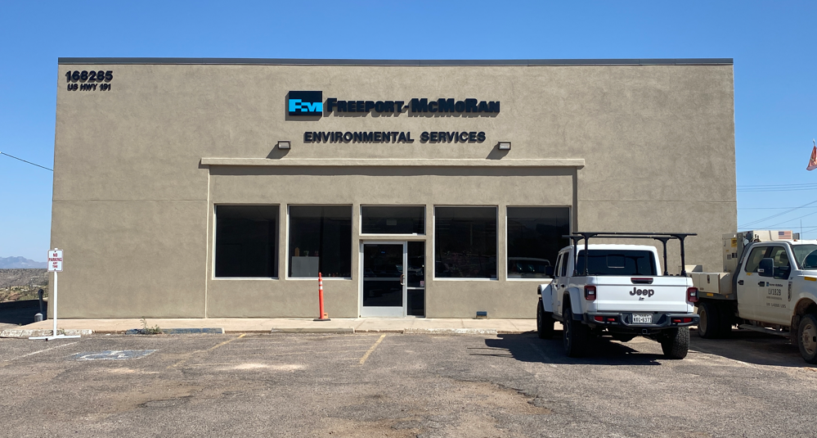
Where we are located…
Hwy 191 & Palo Verde
928-865-6000

Slide 3
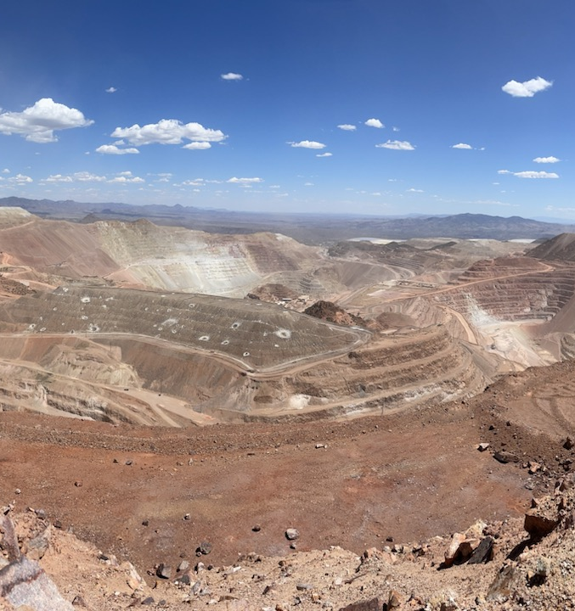
Our Role
Environmental Services supports Morenci Operations by:
Protecting and improving our environment
Assisting with environmental concerns
Ensuring compliance with environmental rules & regulations

Slide 4
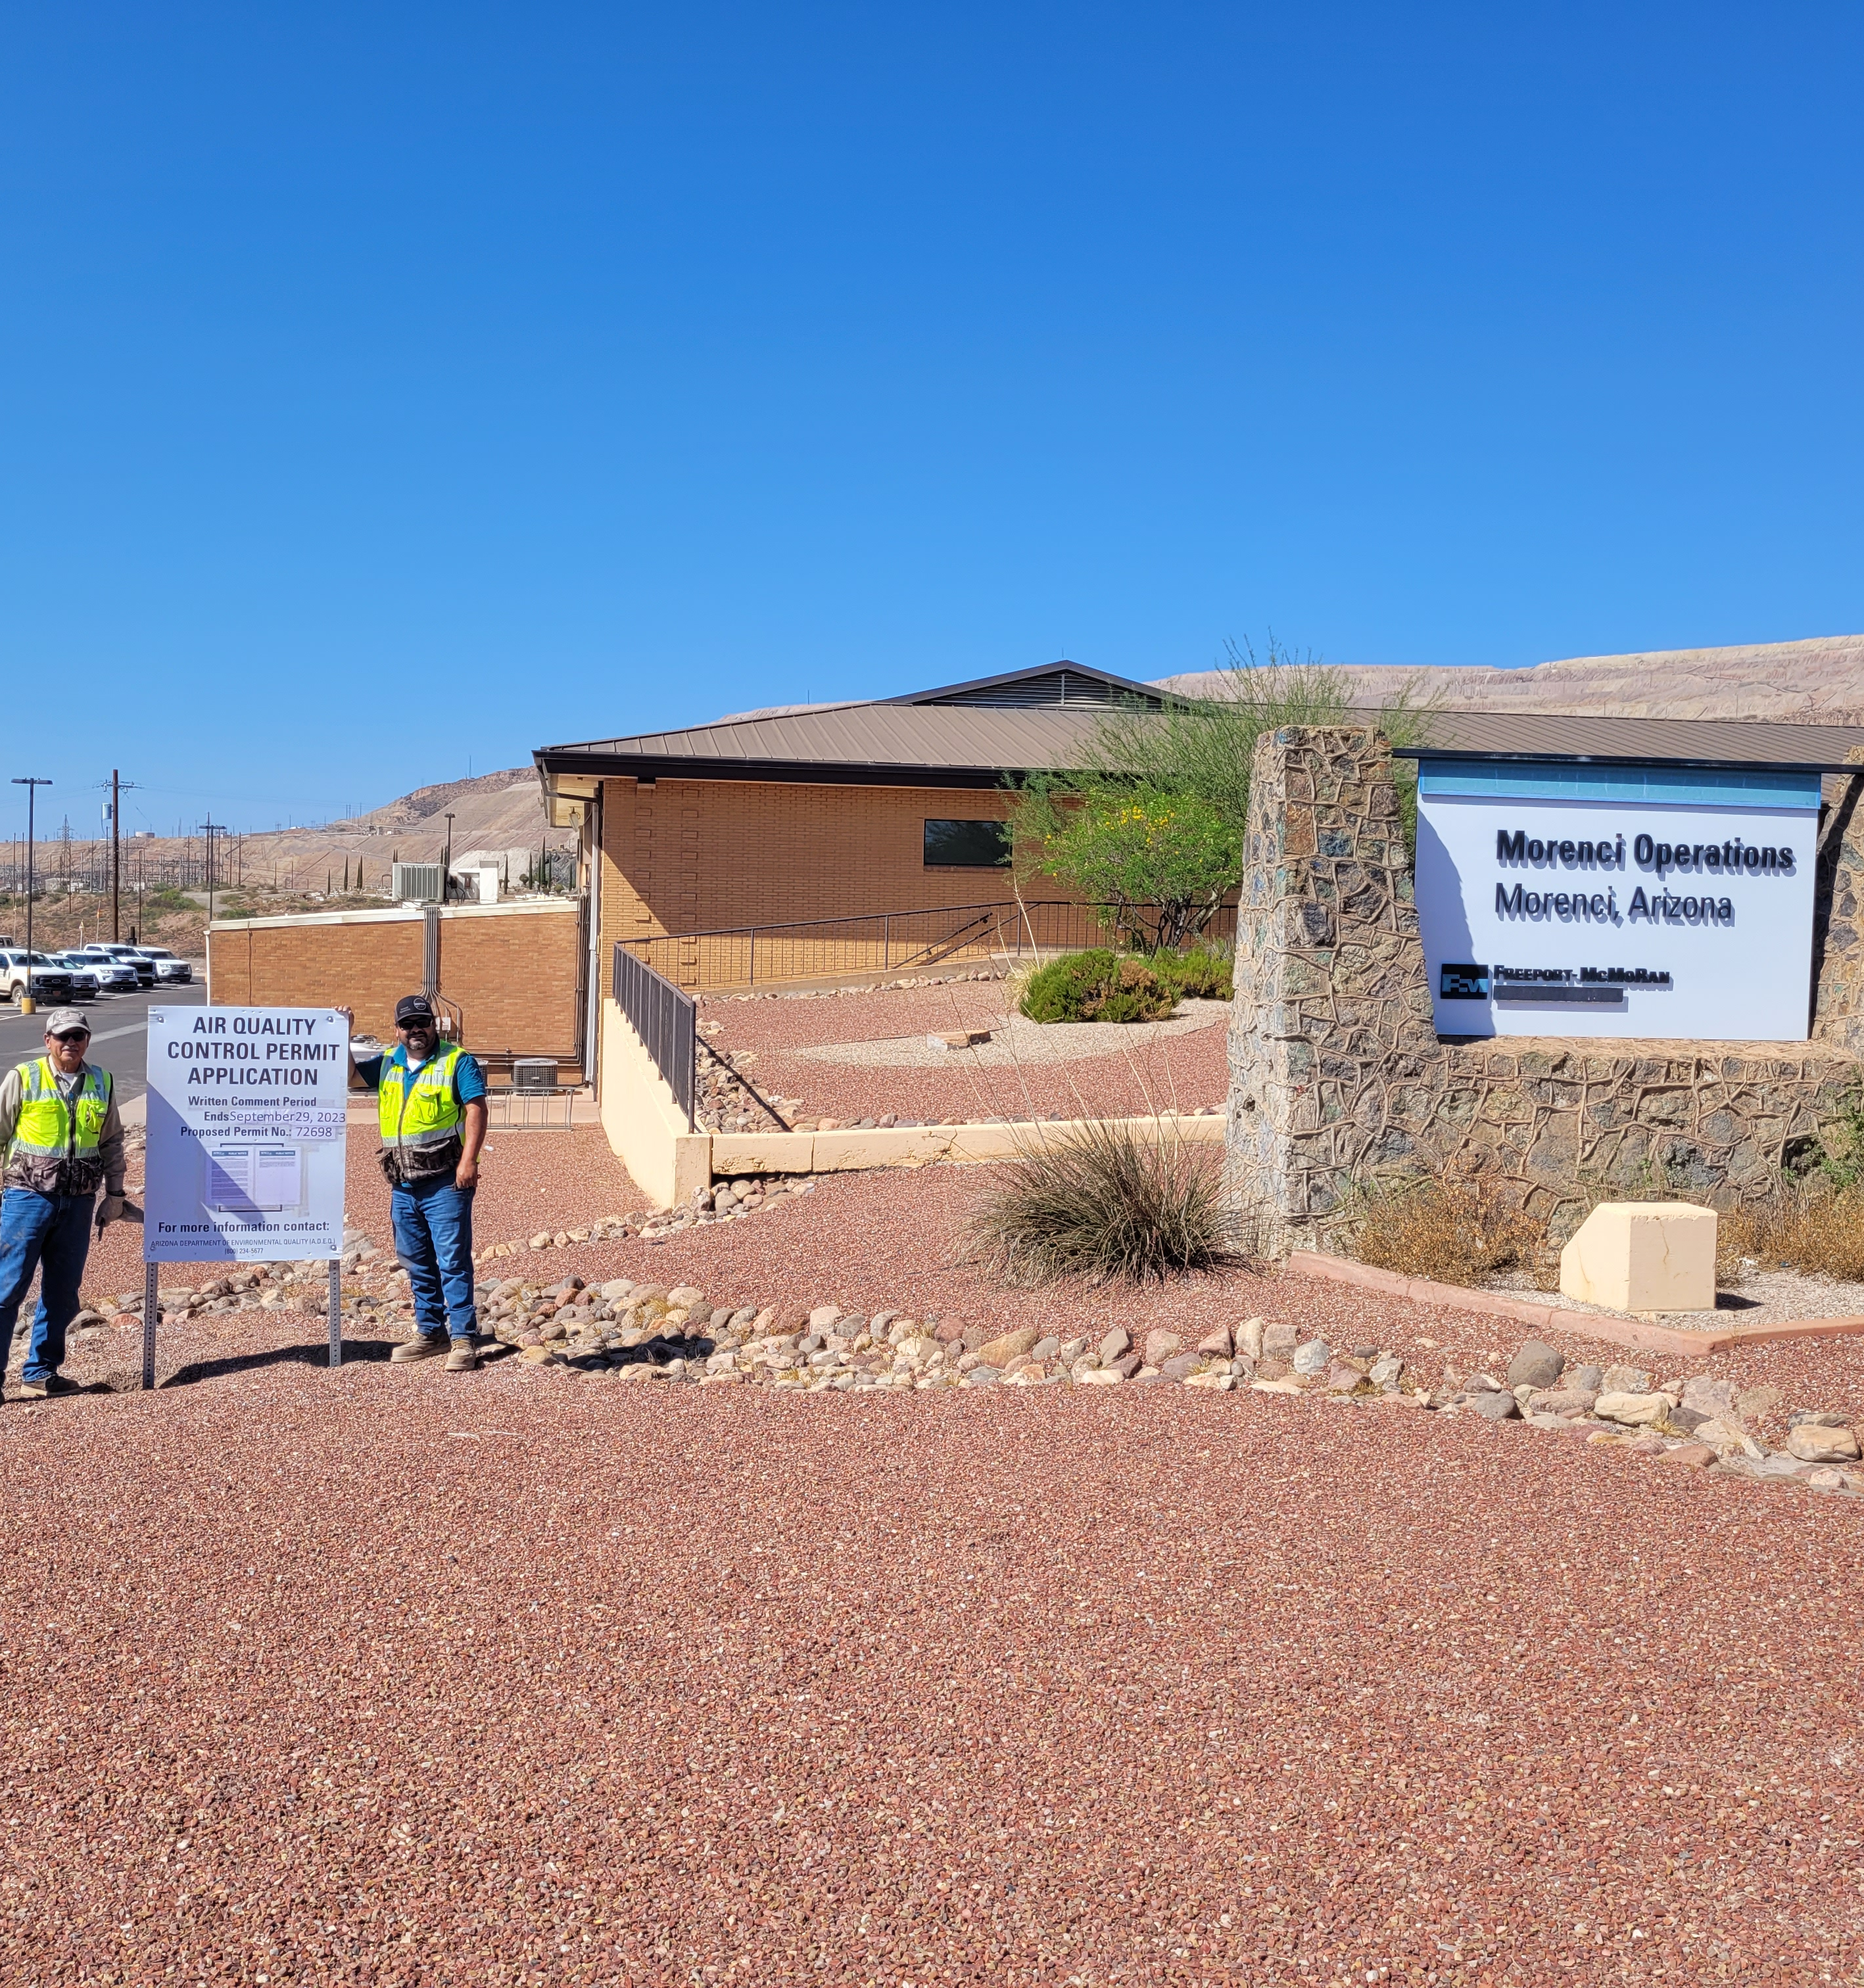
Your role
Help Morenci comply with all environmental laws and regulations.
It is important that you understand how your specific job may impact the environment.​

Slide 5
Environmental Significant Risk (ESR)

Slide 6
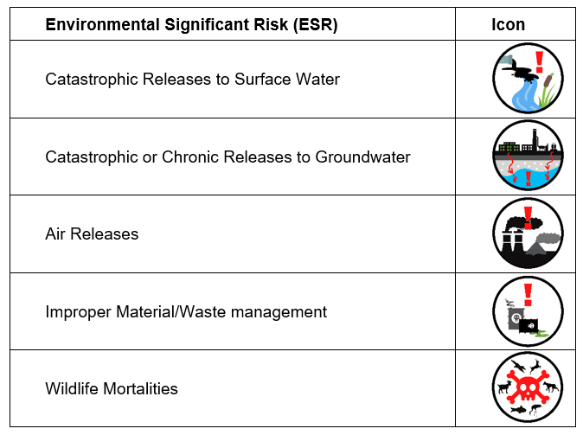
Environmental Significant Risks

Slide 7
ISO 14001
Environmental Management System (EMS)

Slide 8
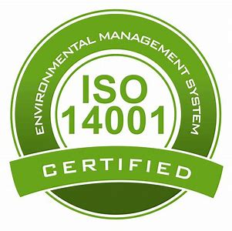
ISO 14001 Environmental Management System
International Standards specify requirements for an organization to develop & implement an Environmental Management System.​
Management program includes all legal requirements, permits, policies, and industry practices.​​
Program includes regular audits.
The ISO 14001 program is used at all Freeport-McMoRan facilities.​

Slide 9
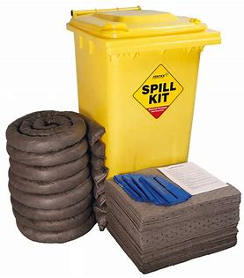
ISO 14001 BMP’s
Environmental Risks are activities that can negatively impact the environment.​
​Examples:
​Dust
Spills
Best Management Practices (BMPs) are developed to manage, reduce or eliminate environmental impacts.​

Slide 10
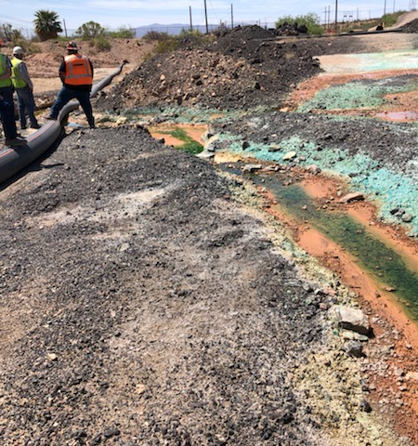
Spills
A spill is any event, outside of normal operations, which results in a loss of products or waste material.​
Spill Hotline phone number:
(928) 865-7745 (SPIL)​
Notify your supervisor of all spills.

Slide 11
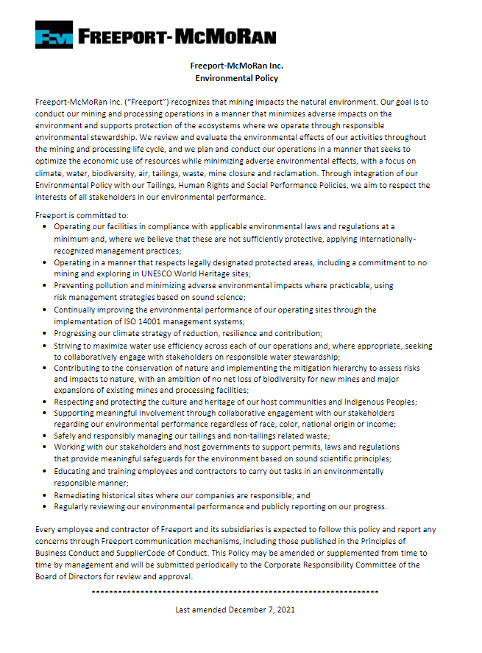
Policy Key Points
Climate
Biodiversity
Indigenous Peoples
Environmental Justice

Slide 12
2025 Environmental Objectives
1. Employee Development & Enrichment
2. Waste Minimization & Pollution Prevention
3. Bring Environmental Social and Governance to the forefront of Environmental Services

Slide 13
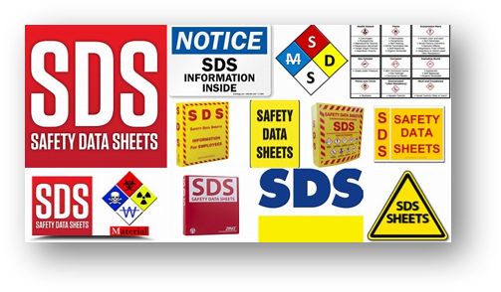
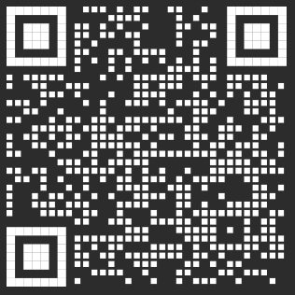
Chemical Inventory and SDSs
All chemicals must be approved by both Health & Safety and the Environmental Department prior to being brought on FMI property.​
Sphera database contains SDS’s for all products that have been approved for use.​
Contact Environmental Services for assistance with new or current products.
SCAN
ME

Slide 14
AIR Quality

Slide 15
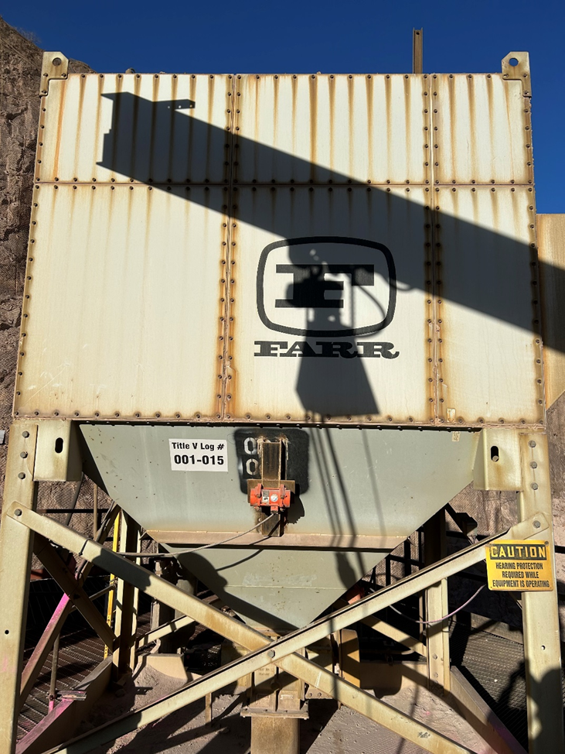
Air Quality
Air Permit: Legally-enforceable documents that outlines air quality requirements for our site. ​
Morenci Mine/Processing
Upper Eagle Creek
Three Open Burn (Mine, Morenci Townsite & Clifton Townsite)

Slide 16
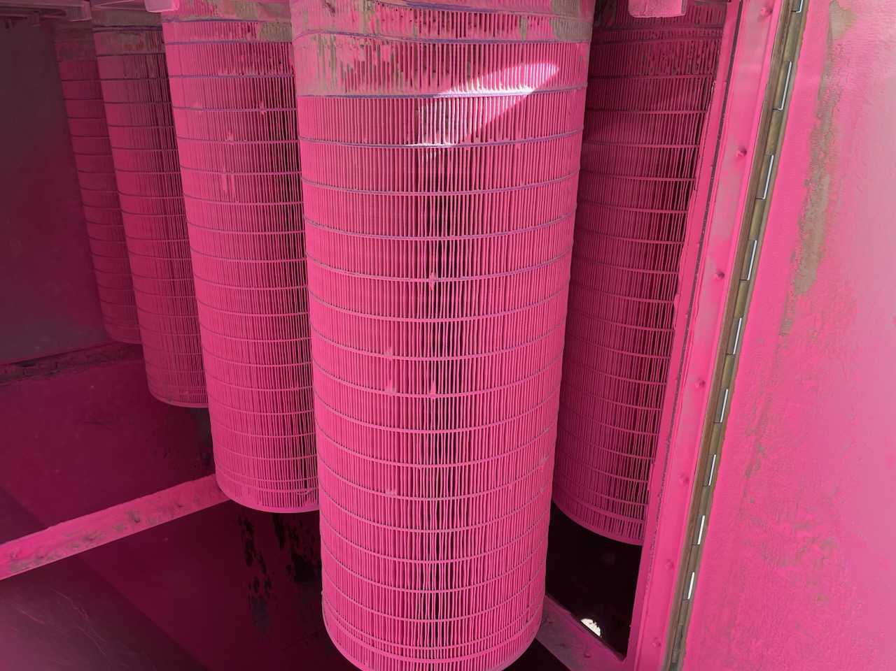
Air Quality
Our emissions are regulated for:​
Dust from roads, blasting, mining, crushing and tailings
Emissions from processing of ore
Stationary Engine​s
Gasoline dispensing​
Accidental Chemical Release​

Slide 17
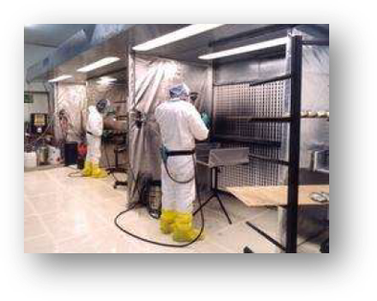
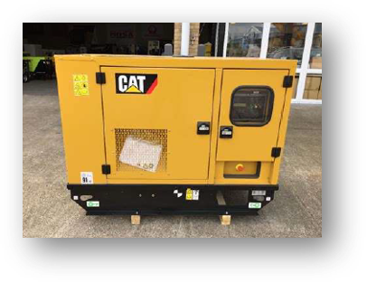
Air Quality
Areas of Concern:​
Dust Emissions (including blasting and haul roads)​
Spray Painting and Grit Blasting Activities​
Generators/Engines – Environmental Services must be notified of any new or removal of generators/engines​
Asbestos Renovation/Demolition​
Process Changes – Physical/Operational Modifications
Chemical evaporation​

Slide 18
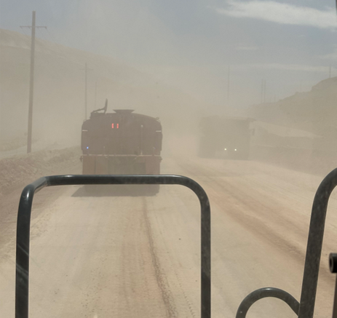
Air Quality – Dust from Haul Roads
Remember!
  Dust is a safety issue that can seriously affect visibility
  Dust is a respiratory health hazard
  Our Air Permit has limits for airborne dust in the mine
Always:
  Follow speed limits
  Slow down in dusty conditions
  Call for water trucks

Slide 19
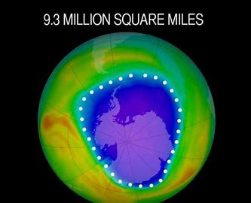
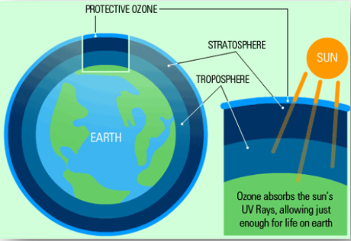
Refrigerants
Do not release refrigerants to the atmosphere
Call Carrier to have it handled properly
It's the law and it protects the Ozone Layer!

Slide 20
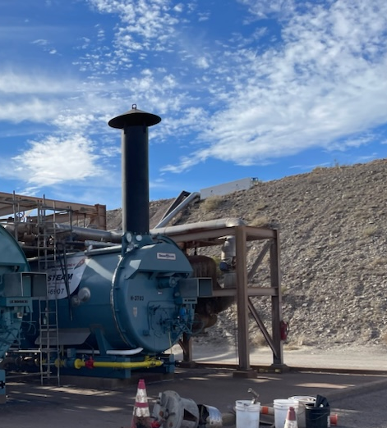
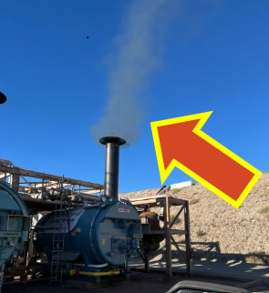
Boiler Emissions Notification
Boilers should have zero visible emissions!
Visible emissions from a boiler means that it needs to be shut down and repaired!

Slide 21
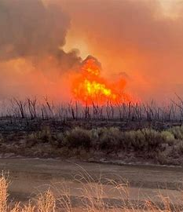
No open burning!

Slide 22
WASTE

Slide 23
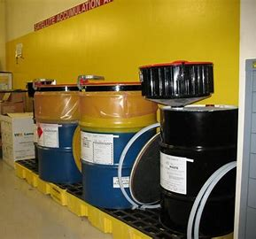
Waste Handling Regulations
Identifying Waste
Below are a few examples we segregate waste:
Hazardous Waste​
Universal Waste​
Solid Waste​
Industrial Waste

Slide 24
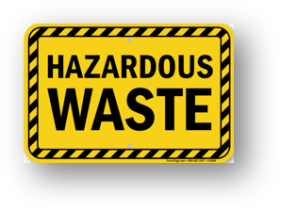
Waste Categories
Hazardous Waste -
Place in Satellite
Accumulation Drums​
Gasoline filters​
Lab wastes​
Broken light bulbs​
Paint related debris

Slide 25
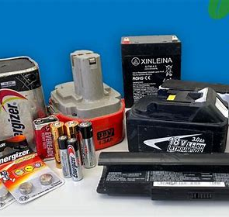
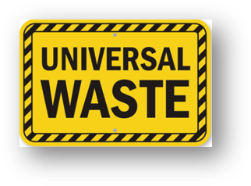
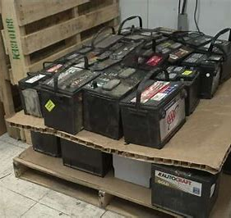
Waste Categories
Universal Waste
Batteries
Pesticides
Mercury-Containing Equipment
Lamps
Aerosol Cans

Slide 26
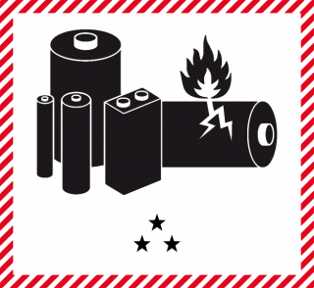
Common Universal Waste
Lamps
  Fluorescent
  Mercury vapor
  High pressure sodium
Batteries
  Ni-Cad
  Metal hydride
  Lead-acid
  Lithium ion
Aerosol Cans
  Foam
  Paint
  Citra-solve

Slide 27
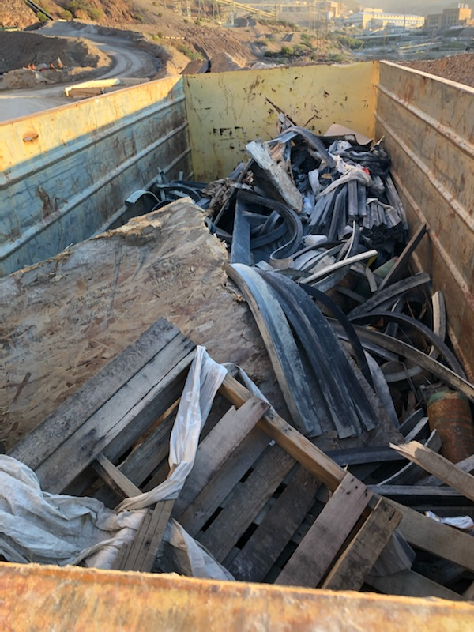
Waste Categories
Municipal Solid Wastes
Cardboard
Lunchroom trash
Wood​
Industrial Wastes​
Electronics
Petroleum contaminated debris
Tires

Slide 28
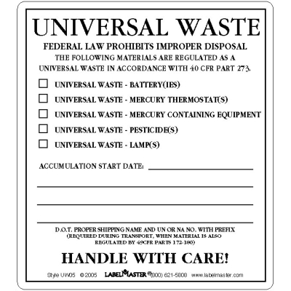
Labeling and Container Requirements
Containers must be
  Labeled
  Dated
  Compatible
  Kept Closed
  structurally sound
  Able to reasonable prevent releases
Labels
  Must state “Universal Waste”
  Must describe the category of Universal
  Have the accumulation start date
Notes:
Do you know where your bins are?
Above label is a BMP

Slide 29
Universal Waste Handling
Minimize the possibility of dropping, crushing
  Broken fluorescent lamps
  Damaged batteries
  Become a hazardous waste
For intact, unpunctured cans, remove actuator to reduce the risk of accidental release
Clean up spills promptly and safely
Report all spills to 928-865-7745 (SPIL)

Slide 30
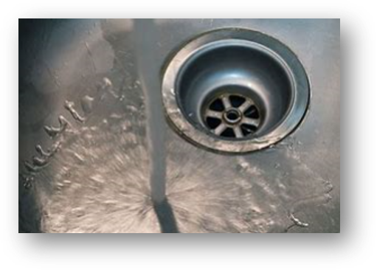
Waste Handling
NEVER dispose of Hazardous Wastes by:​
placing them in the garbage​
letting them evaporate into the atmosphere or​
dumping them down the drain and/or into a sewer system

Slide 31
Pollution Prevention (P2) Plan
What is a P2 Plan?
Required document for all Large Quantity Generators (LQG’s) of hazardous waste.
Outlines goals, and successes in waste minimization or mitigations to our environmental impact.
Goals and reductions must be tracked and maintained.
Goals Focus On:
Reduction of toxic substance use
Minimization of hazardous waste
Energy/Resource Conservation
Water Conservation
Solid Waste Diversion
Recycling Materials
We all play an important role in an effective P2 Plan.

Slide 32
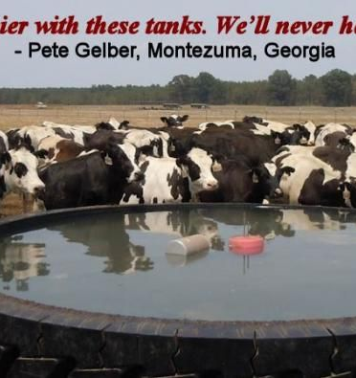
Pollution Prevention (P2) Goals
HDPE Recycling – >3,000,000 Lbs Recycled
L.E.D. Light Implementation
Haul truck tire landfill diversion: livestock water tanks - 1,600,000lbs diverted from landfills in 2022

Slide 33
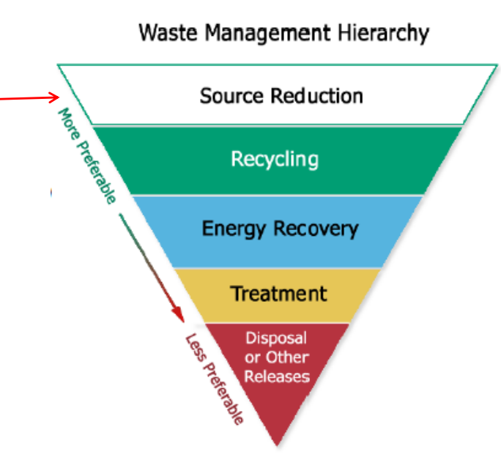
Pollution Prevention (P2) Goals
Here are a few ways to contribute!
Reduce waste at the source
Segregate waste into appropriate containers
Choose nonhazardous chemical alternatives
The Best!
Do you have a P2 Idea? Contact your Environmental Rep!

Slide 34
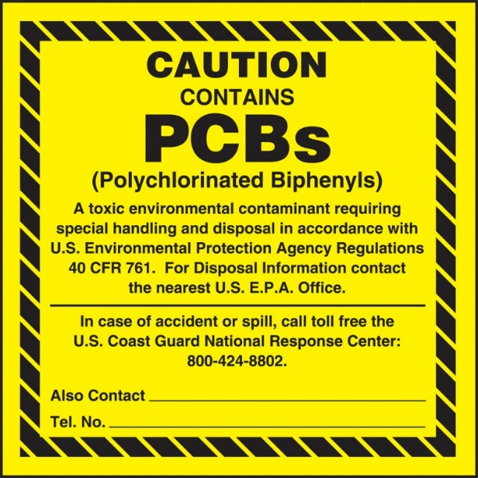
PCB Management
What are PCBs
Where Are PCBs Found?​
PCB - acronym for Polychlorinated Biphenyl(s)
  Man-made chemical
  Manufactured from 1929 until they were banned in 1979 due to adverse health effects
  Known for their non-flammability and chemical stability
In oil-filled electrical equipment (OFEE) such as:​
Transformers (including potential and circuit)​
Capacitors (both small and large)​
Light Ballasts​
Oil-Filled Circuit Breakers (OCBs)​
Oil-Filled Electromagnets​

Slide 35
Oil-Filled Electrical Equipment & PCB Management Plan
Company Goal
PCB-Free (<2 ppm)
  No oil filled electrical equipment should be purchased or brought to a FCX facility if PCBs ≥ 2 ppm
How Do We Achieve These Objectives
  Maintaining an accurate inventory of electrical equipment
  Inspecting and managing equipment => 50 ppm PCBs
  Testing retro-filled equipment or equipment with unknown PCB status
How can I Help?
Notify Environmental When:
  Moving an OFEE
  Planning to purchase
  Dispose or relocate any OFEE
Fill out an Oil Fill Electrical form when moving
  Transformers
  Rectifiers
  Oil filled Magnets
NOTE: Submit a Management of Change (MOC)/Electrical Equipment Form for any new oil-filled electrical equipment purchase.

Slide 36
WATER

Slide 37
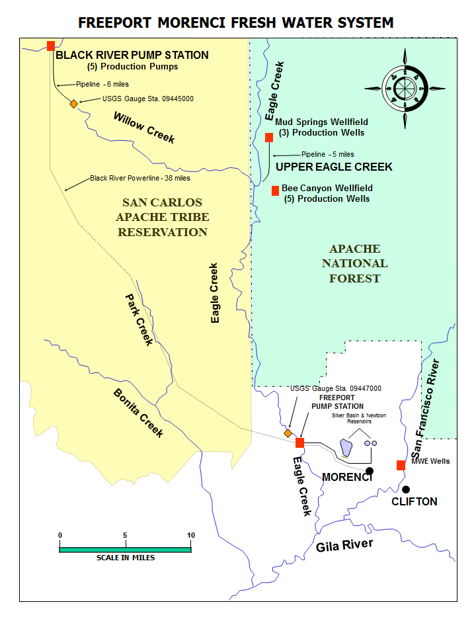
Water
Do you know where our water comes from?

Slide 38

We need your help!
We are always looking for ways to save water and make our processes more water efficient.
Imagine if we only had 4 billion gallons available instead of 6 billion gallons.
  Which processes would change?
  How much copper would we be able to produce?

Slide 39
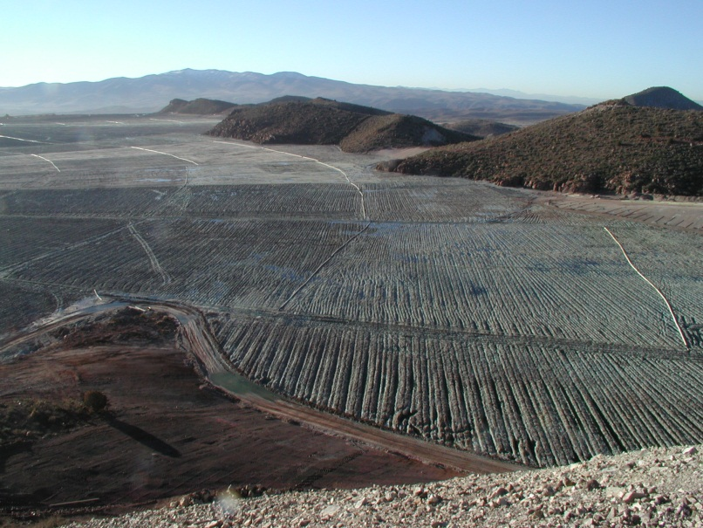
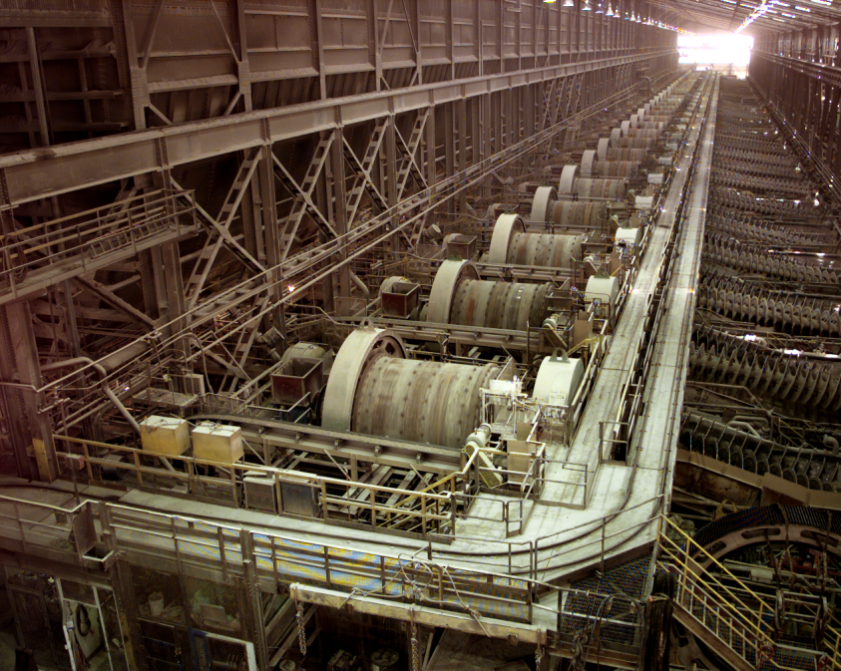
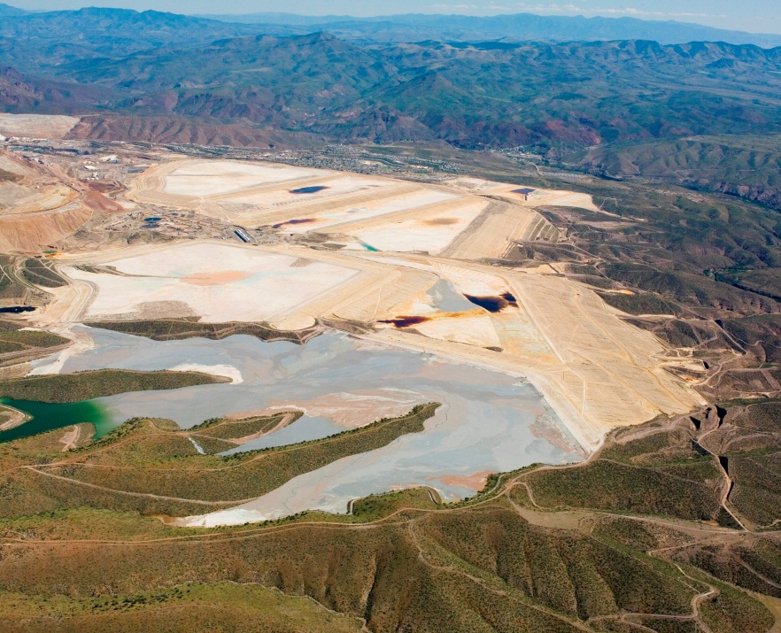
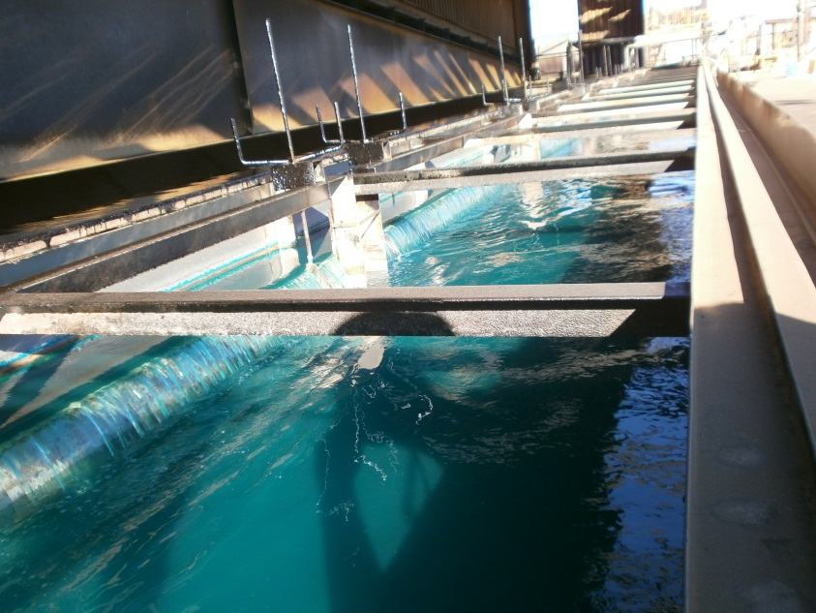
Water Use in Operations
Morenci Operations
New Water

Slide 40
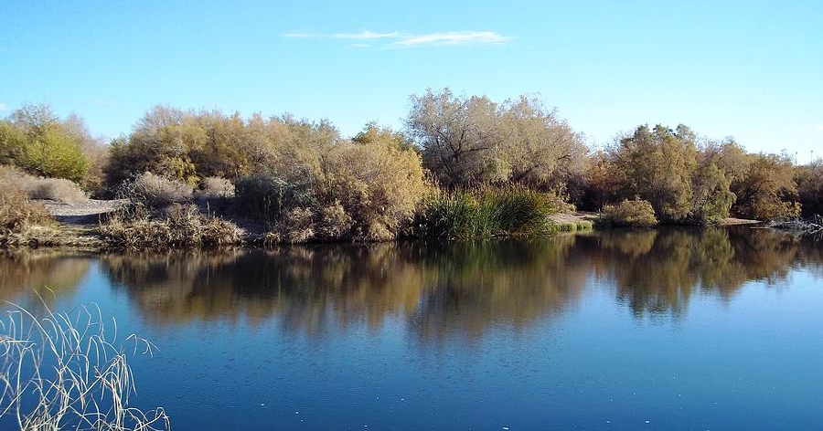
Water Quality Regulations
CWA - Clean Water Act​
Requires a permit for the discharge of a pollutant into​ waters of the US.​
APP - Aquifer Protection Permit
Requires permit for discharge of pollutants into groundwater.​
AZPDES - Arizona Pollutant Discharge Elimination System​
Responsibility to administer the Stormwater program for the EPA

Slide 41

Water Quality Regulations - SWPPP
Morenci is “ZERO Discharge Facility”​
All stormwater that contacts processing activities is not discharged from the property. It is reused.​
Hydrologic Capture Area​s:
Gold Gulches
Bat Canyon​
Tailings Impoundment Canyons​
Central SX/EW Diversions​
Rocky Gulch​

Slide 42
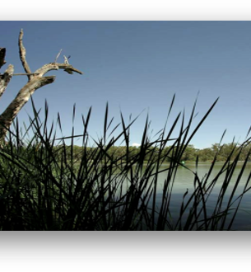
Water Quality Regulations - SPCC
Morenci is required to have a spill prevention and countermeasures (SPCC) plan because it stores high volumes of petroleum products on site.​
The SPCC plan protects “Waters of the U.S.” (rivers, washes, streams)​ from petroleum discharges​
The plan outlines requirements for spill prevention, preparedness, and response to petroleum discharges​
The plan details the equipment, workforce,​ and steps required to prevent, control and mitigate discharges of petroleum products.

Slide 43

Spill Prevention, Control & Countermeasure (SPCC) SPCC (40 CFR 112)
FMMI’s SPCC Plan describes the procedures followed by Morenci to: prevent, control, and mitigate releases of petroleum products to the environment.
Loading/Unloading at Bulk Storage Tanks:
Small, incidental releases resulting from transfer operations are cleaned up using absorbent found in spill kits located at the site.
Drivers are required to follow specific protocol when entering the property and unloading the product to prevent:
  Poor connections
  Overfilling
  Premature departure
  *Please report any behavior inconsistent with this protocol*
Receiving/Accepting Bulk/Portable Petroleum Product Containers:
Visually inspect all containers for signs of leakage and corrosion prior to acceptance
Damaged containers are not accepted.
Fuel/Lube Transfer Procedures at Gasoline Dispensing Facilities (GDFs):
Ensure transfer hoses are stored properly and not leaking
Report gasoline spills promptly and utilize nearby spill kits to clean up spill
Practice good housekeeping and discard of trash appropriately
Report all spills to 928-865-7745 (SPIL)

Slide 44
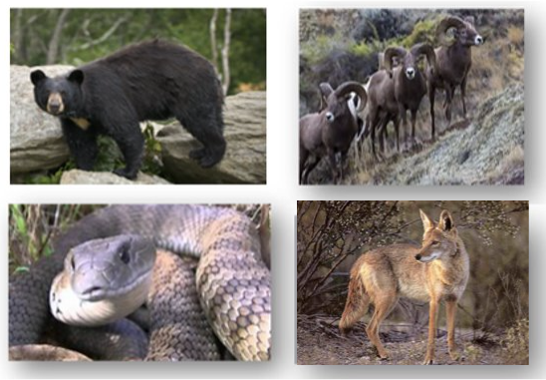
Wildlife Conservation
Do not interact with wildlife of any kind.
Do not feed wildlife.
If you encounter wildlife in your area, call the spill hotline or Environmental.
Report all lingering, injured or deceased wildlife to​ the Spill Hotline
928-865-SPIL

Slide 45
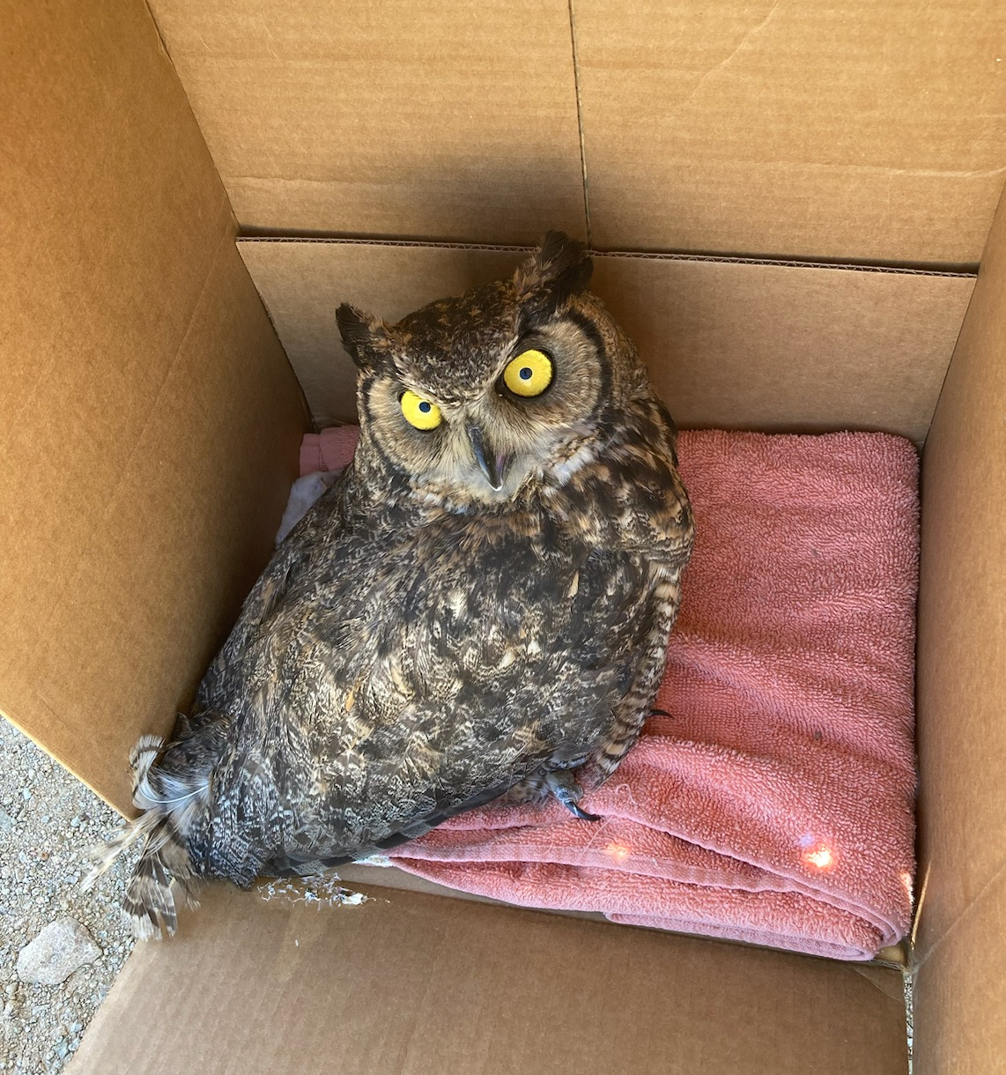
Wildlife Conservation - Birds
Do not handle, disturb, or collect birds.
Immediately report all bird mortalities and injuries to the Spill hotline.​
Migratory birds seen on processing ponds should be reported to the spill hotline.
Pre-job workplace inspections should include locating nests in work areas.
Do not disturb nests that have eggs in them. 928-865-SPIL

Slide 46
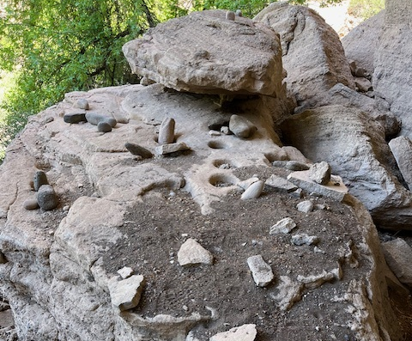
Morenci Cultural Heritage Sites
What is a cultural heritage site?
A cultural heritage site is an area containing ancient artifacts giving evidence the area was once inhabited by native peoples.
Why is Cultural Site Preservation Important?
FMI and Morenci have partnered with local Native American tribes in a commitment to honor, protect, and preserve the rich Native American history and heritage that shaped Arizona and the Morenci mining region.
What is your role/responsibility?
Submit a Management of Change (MOC) on all necessary projects to ensure Environmental review and prevention of cultural heritage site disturbance.
When working or operating equipment in an undisturbed area, look out for artifacts e.g. projectile points, obsidian flakes, stone tools, etc.
If you believe you’ve found a potential cultural heritage site, stop the job immediately and call the environmental office at 928-865-6000.
Do not enter identified cultural sites or remove any Native American artifacts found on FMMI property.
With questions regarding Cultural Heritage Sites, Please call Environmental at 928-865-6000
Notes:
Possible question and suggested answer:
Question: “That site looks really cool! Where is it?”
Environmental Answer: “The site is located in an undisturbed area of FMI Morenci property. In efforts to protect these sites, we disclose exact locations only as direct business needs require.”

Slide 47
For assistance, contact the Environmental Services Department
(928) 865-6000
Or your Department Environmental Representative

