Slide 1

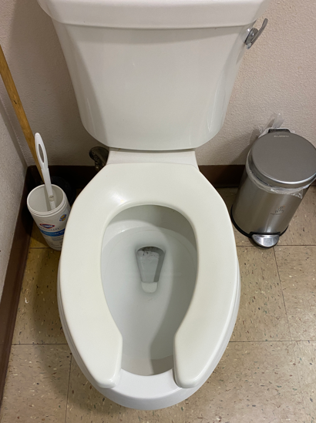
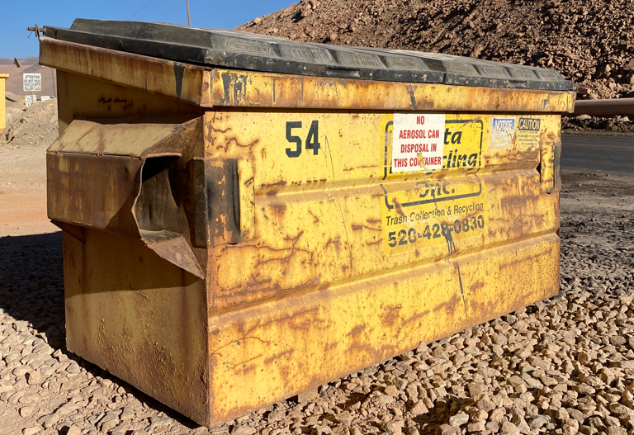


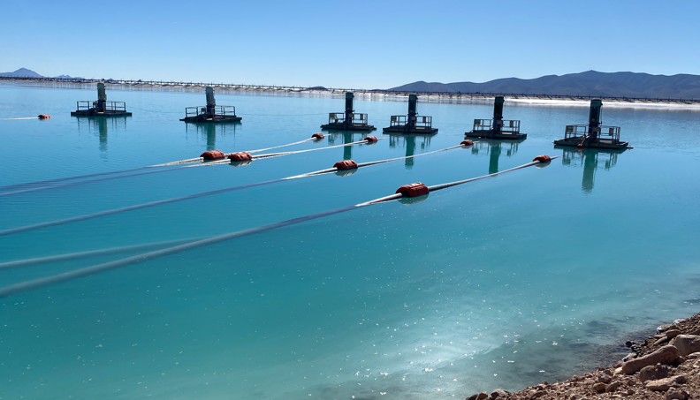
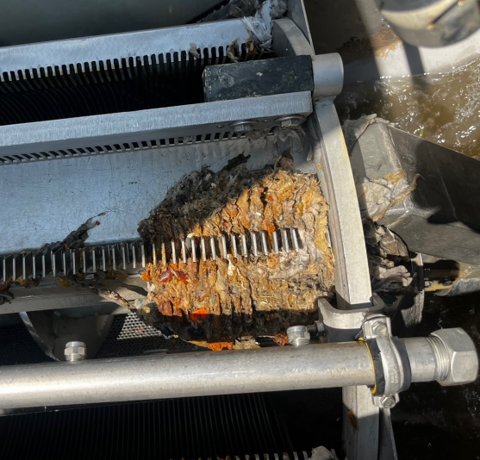
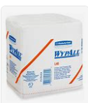
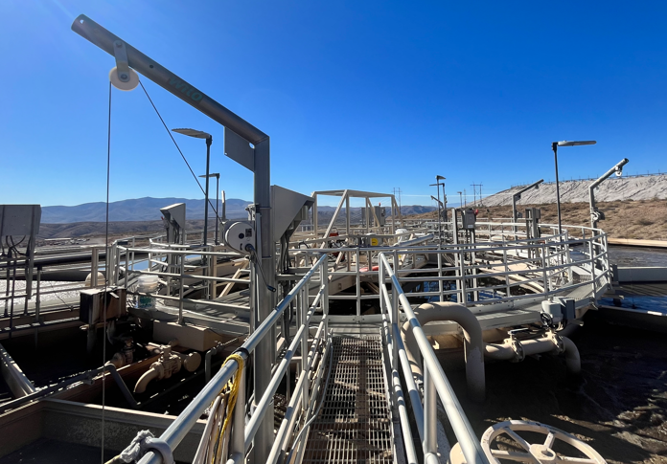
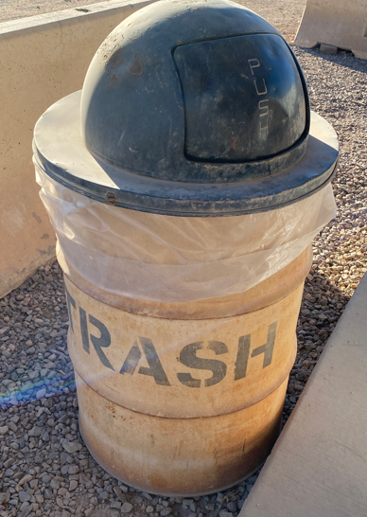
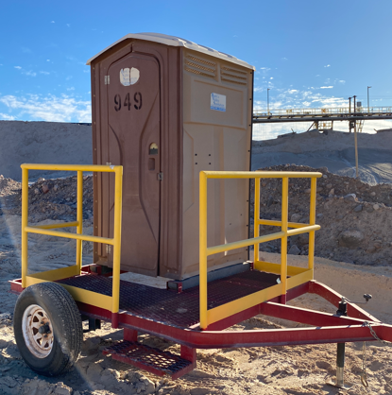

Environmental Share
“Waste Not Want Not”
Water conservation and recovery is an important part of the mining & processing of Copper.
Though the WWTP’s screening systems are robust, when inorganics such as WypAll towels/rags, scrap metal, and wood/plastic debris are introduced into the system, they damage the internal working parts of the facility.
FMI Morenci utilizes the Wastewater Treatment Plant, to recover water and recycle it back into operations.
Please dispose of inorganics in the proper waste stream receptacle.
February 2025

