Slide 1
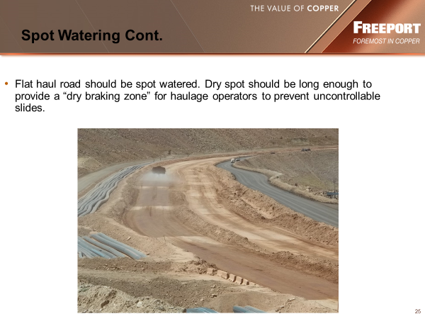

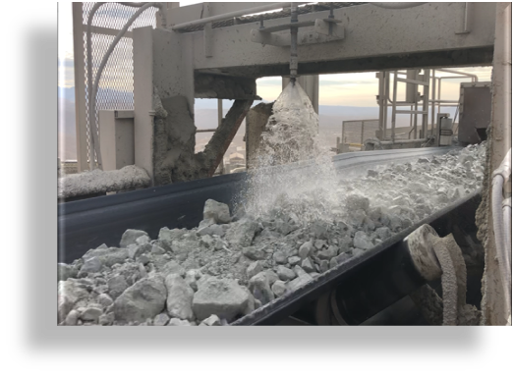
Environmental Share
Fugitive Dust
Morenci Environmental Services
Fugitive Dust is any dust emission emitted from any source other than a stack or vent opening. Typical fugitive sources are haul roads, stockpiles, tailings and blasting dust
Opacity limit of fugitive dust emission is 40%
An effective strategy to control dust emissions include applying water and/or approved dust suppressants on haul roads, stockpiles and conveyor belts.
If you have any Questions, please contact Environmental Services at 928-865-6000 or a Member of the Environmental Air Team.
March 2025

