Slide 1
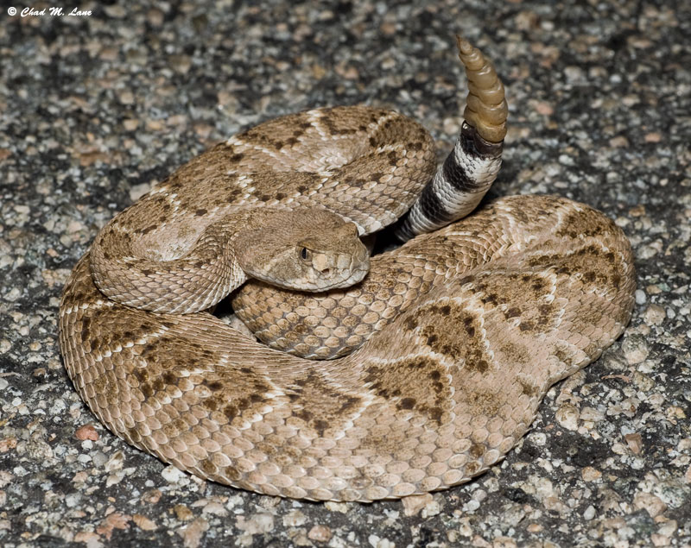
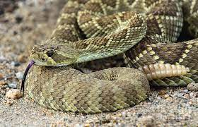
Environmental Share
Snake Awareness
Snake Season
Is here!
IF A SNAKE IS PRESENT IN YOUR WORK AREA, CALL THE MAIN GATE @ 928-865-7931
If You Encounter a Snake:
  Leave the snake alone!
  Inform others of the snake's location (inside or outside)
  Call the mine gate
  DO NOT KILL or HARASS THE SNAKE

