Slide 1
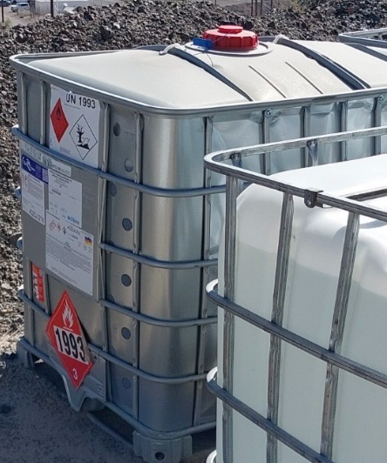
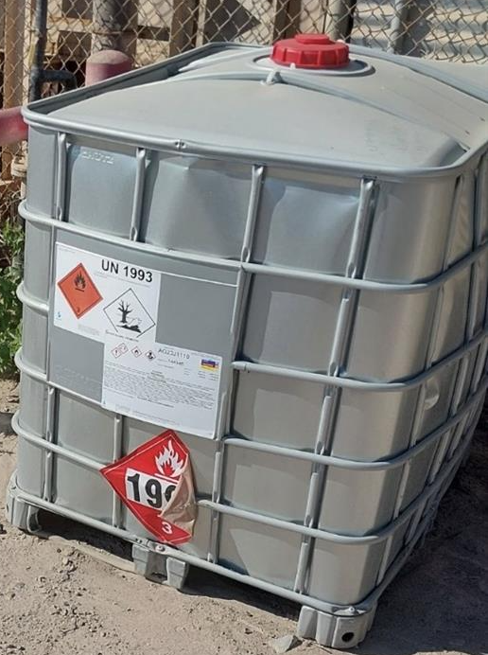
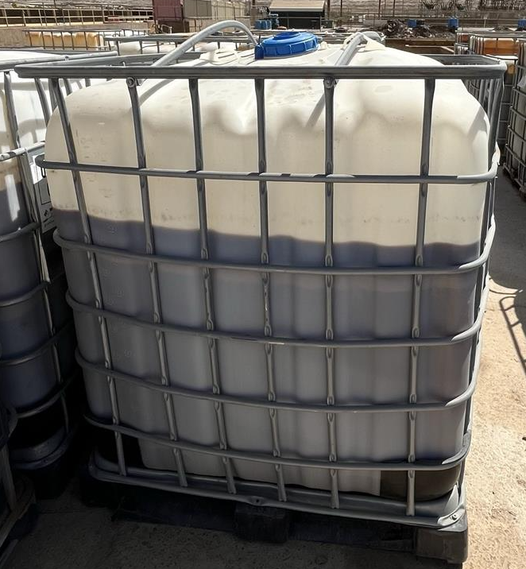
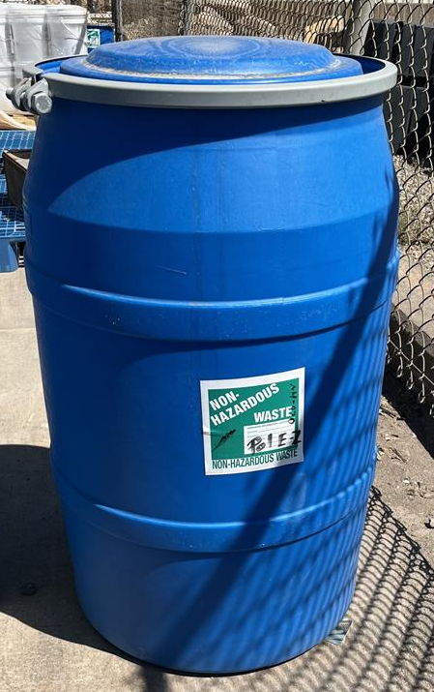
ENVIRONMENTAL SHARE
PROPER MATERIAL STORAGE
As summer temperatures are on the rise, a couple key points to remember are proper segregation and storing material which prevents hazards and safety risks.
Segregate Chemicals by the designated waste stream.
  Proper labeling of containers and disposal.
Inspect storage areas for container integrity checks.
  Dents, Leaks, Pressurized(Swollen), and Damaged Containers
  Proper segregation, no mixed materials.
If you see a tote beginning to swell, address it before it becomes a safety hazard.
If a leak or spill is observed, please call it in to the Spill Hotline 928-865-7745(SPIL).
If you have any disposal or container questions, please reach out to your department Environmental Representative or the general Environmental office 928-865-6000 for additional questions. Thank you!
May 2025

