Slide 1
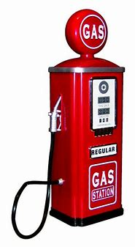
Environmental Share – Gasoline Spill Response
Waste Requirements
How to respond to a Gasoline Spill
Stored in a Closed Container
The Words “Hazardous Waste” and “Gasoline Spill Debris”
Label Must Contain EPA Waste Codes D001 (Ignitable) and D018 (Benzene)
Isolate the Area
Take steps to mitigate the spill if safe to do so.
Inform your Supervisor and notify the Spill Hotline at 928-865-7745 (SPIL).
Clean spill as soon as possible with provided fuel dock spill kit. Containerize and deliver to the Salvage yard.
Keep your Phone nearby as an Environmental Representative will be contacting you shortly.
Gasoline Contaminated Soil and/or debris (including rags) should never be mixed with:
Any other petroleum contaminated waste
Petroleum Contaminated soil
Solvent contaminated rags.
DELIVER TO ENVIRONMENTAL/SALVAGE YARD.
BY LAW, THESE MATERIALS MUST BE MANAGED AS HAZARDOUS WASTE.
Questions?
Contact Environmental at 928-865-6000 or your Representative
June 2025

