Slide 1

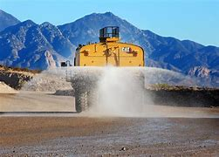

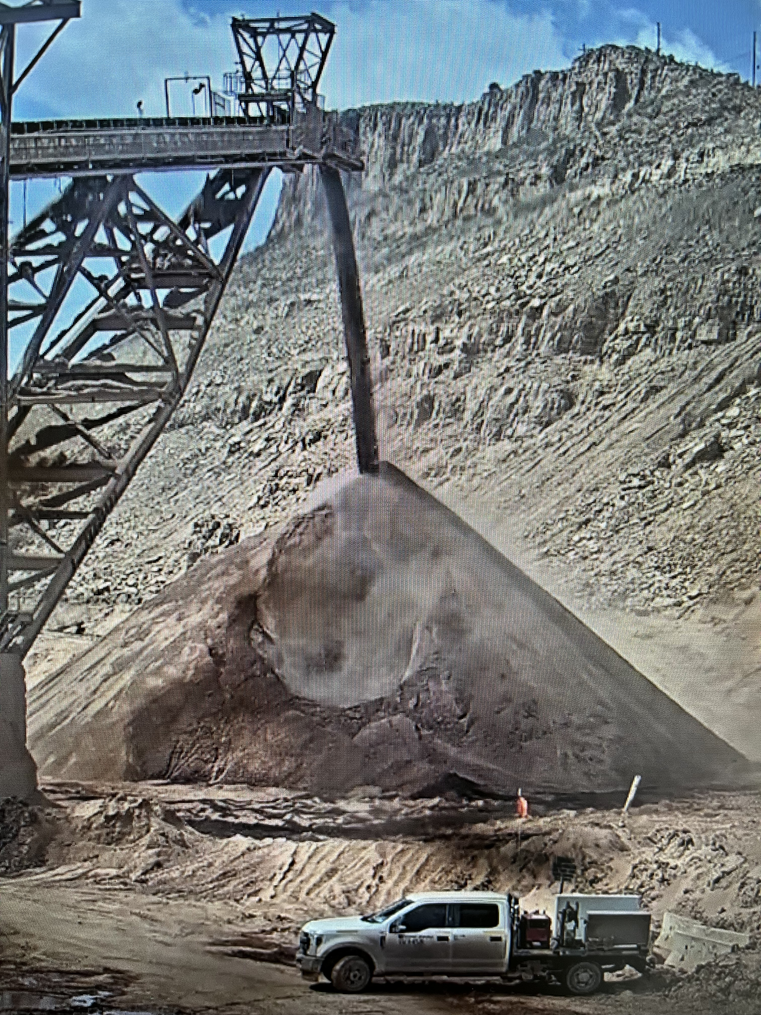
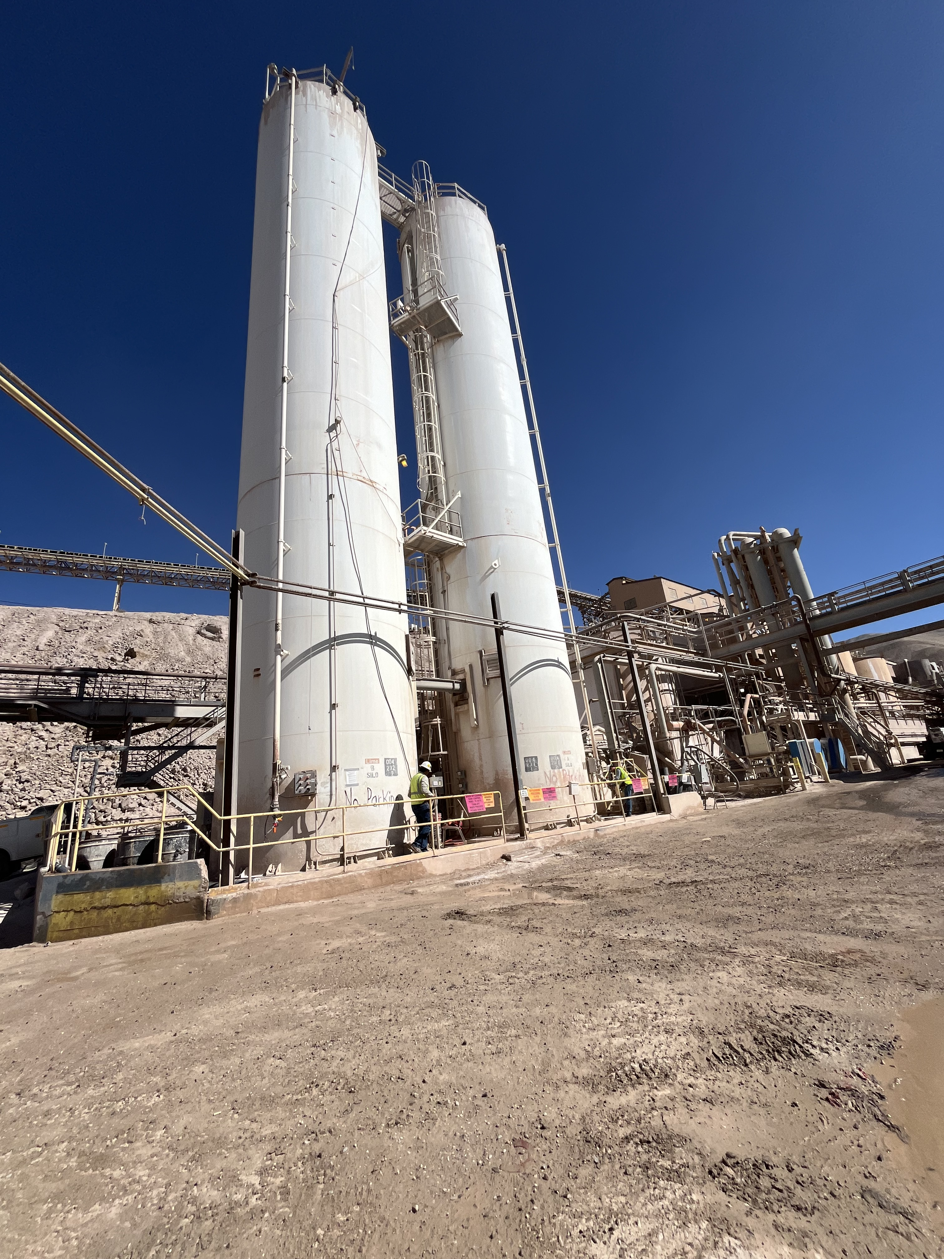
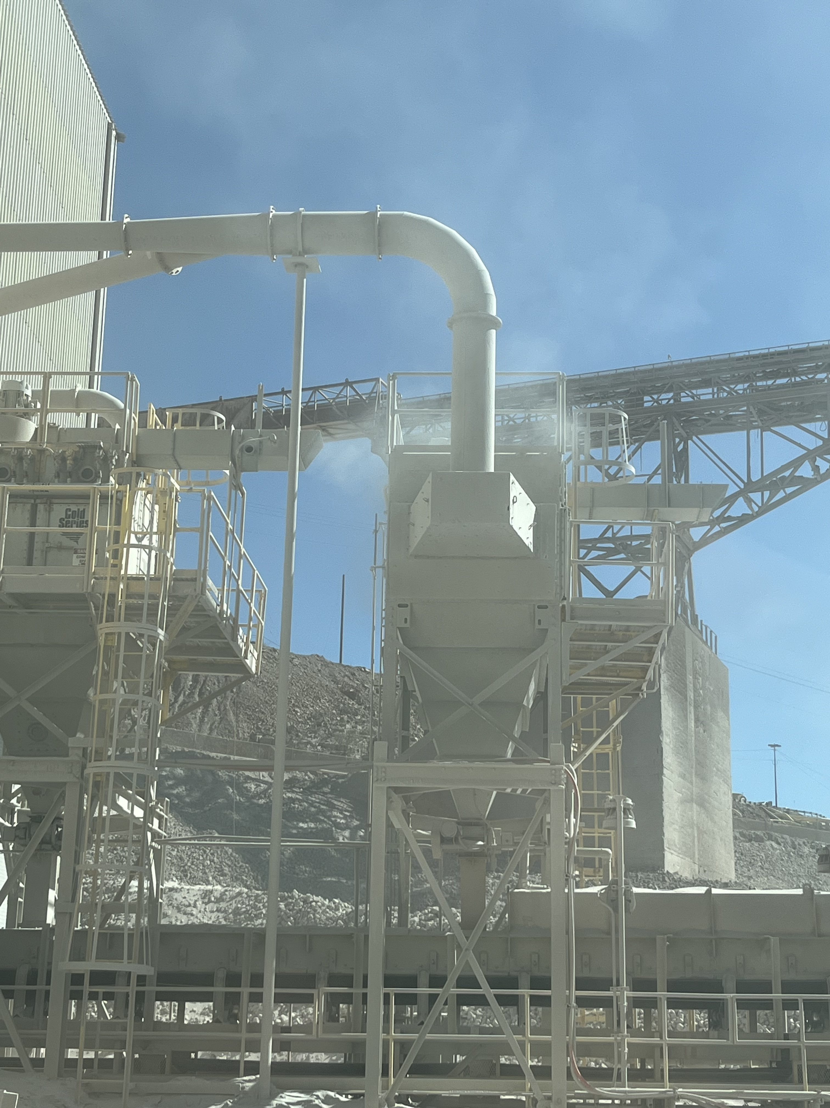
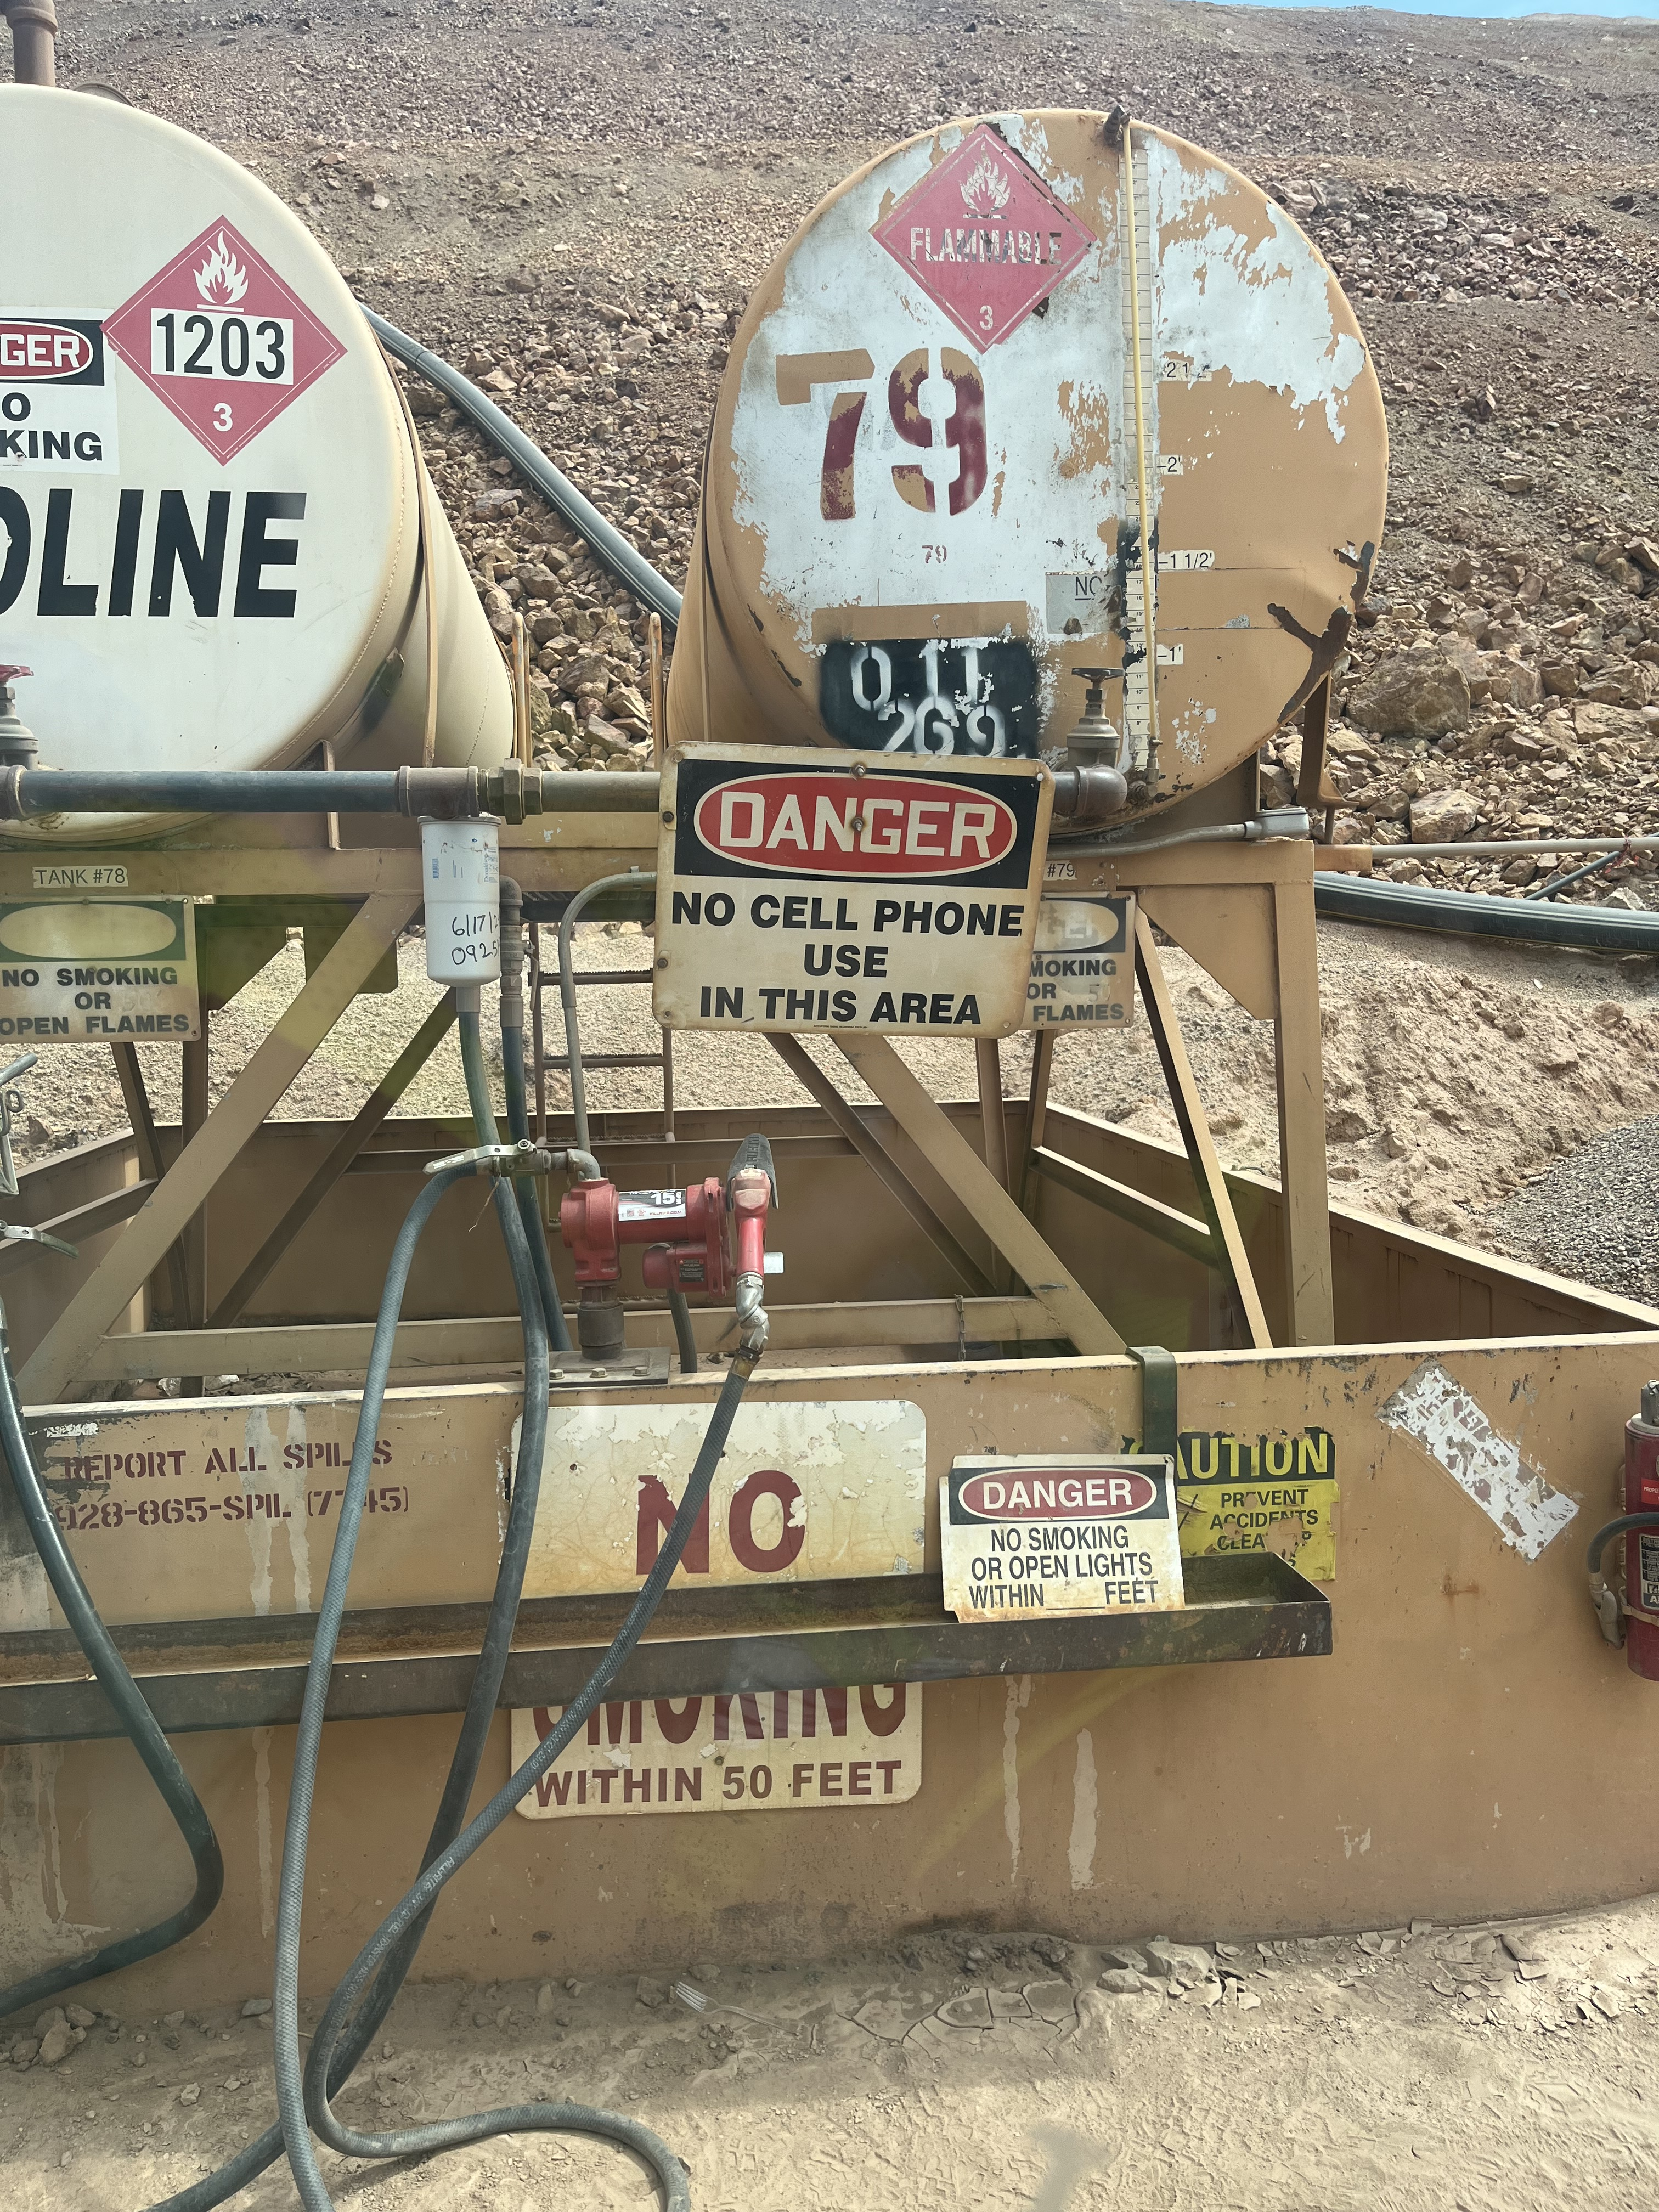
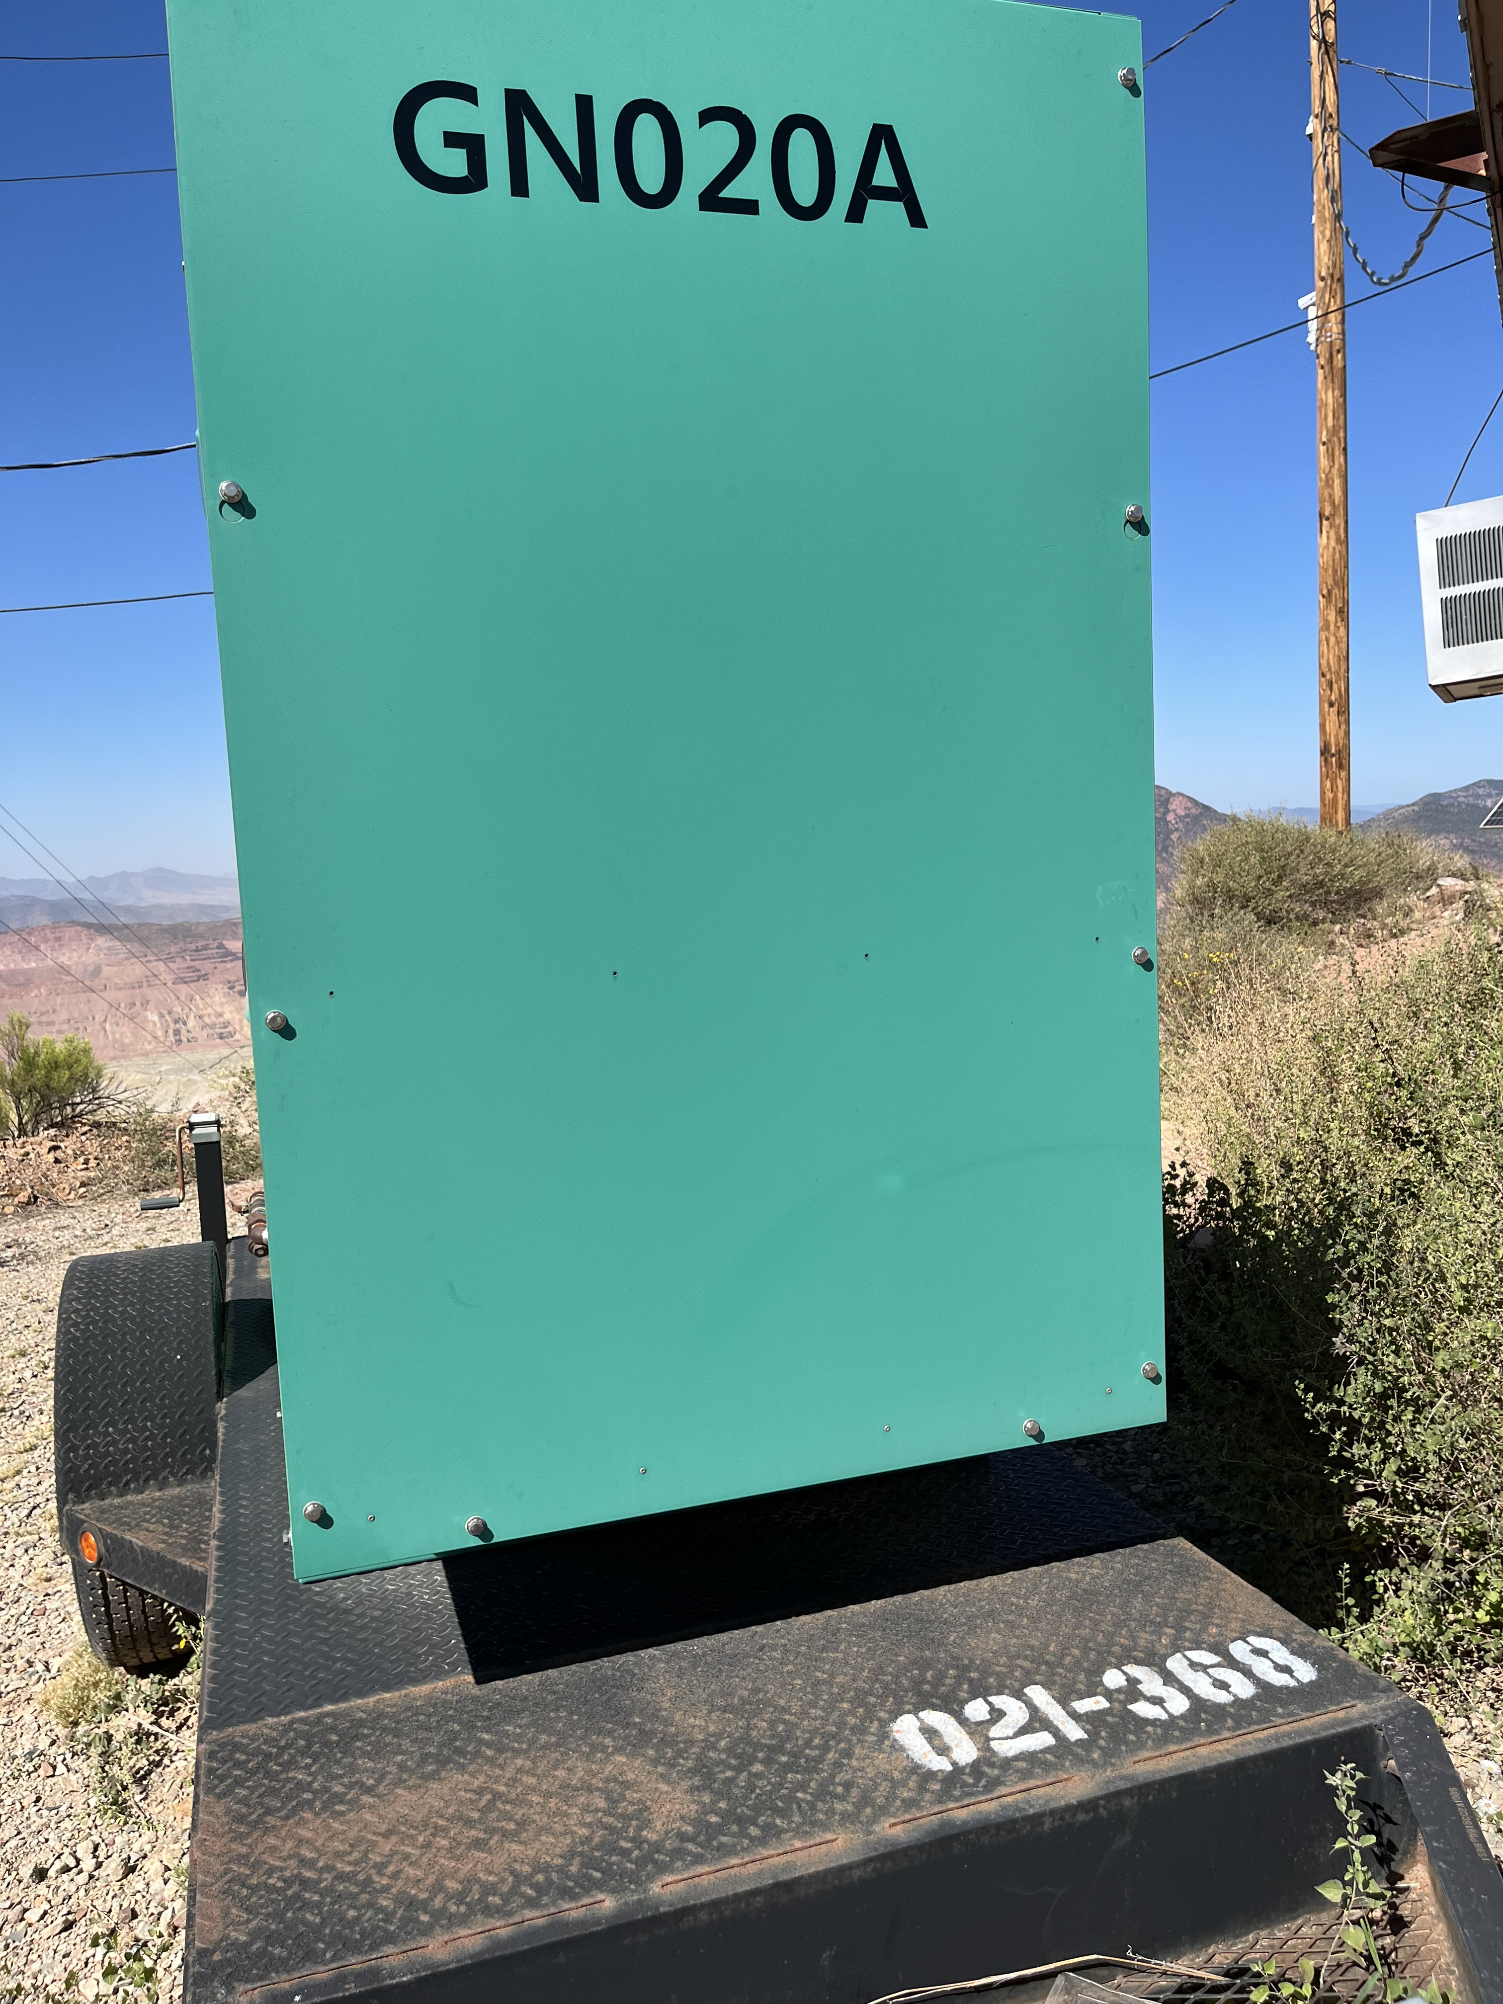
Environmental Share
Air Quality
Air Quality is an Environmental and Health Concern.
Morenci operates under the Title V Air Permit: it is a legally-enforceable document that outlines:
Mine/Processing
Upper Eagle Creek
Open Burn (Mine, Morenci, and Clifton)
 | This includes:
Accidental Chemical Release Dust Emissions | Engines/Generators Gasoline Dispensing Facilities | Process changes (Modifications) Refrigerants
To stay compliant with state regulations and protect the health of all workers. It is important that our equipment is used efficiently and maintained effectively.
If you have any questions, please contact Environmental Services at 928-865-6000 or a member of the Environmental Air Team
ThePhoto by PhotoAuthor is licensed under CCYYSA.
July 2025

