Slide 1
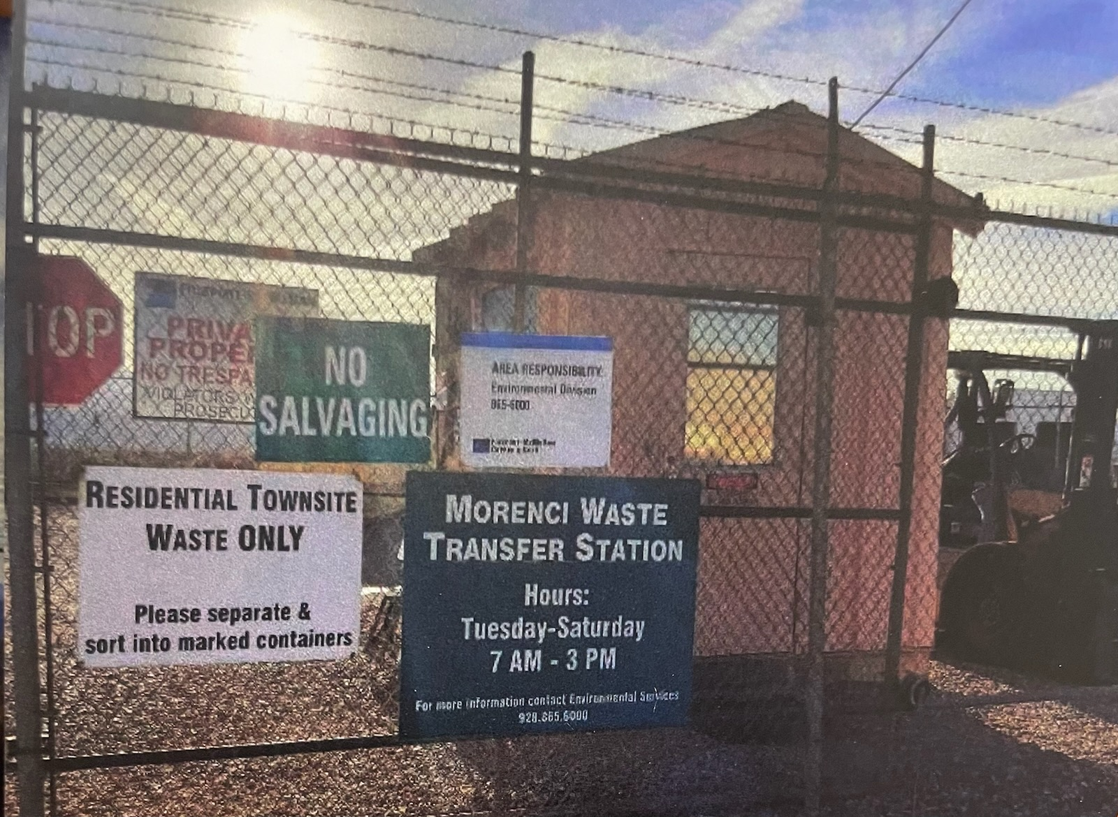
Environmental Share –
Morenci Transfer Station
Hours of Operation: Tuesday-Saturday 7am-3pm
The Transfer Station accepts:
Electronic Wastes
Glass
Cardboard
Plastic
Trash
Tires
Appliances
Household Hazardous Chemicals
Paint
Used/New Oil
Gas/Diesel
Aerosol Cans
Antifreeze
Oil Filters
The Transfer Station does NOT accept:
Animal Carcasses
Weapons
Vehicles
Address
Buena Vista Street
Morenci, Az 85540
August 2025

