Slide 1
Climax Safety Culture and Contractor Safety
Climax Mine 2023

Slide 2
Purpose: Define Our Culture
To introduce all project contractors and consultants to the Climax Mine Safety Culture, to understand:
We believe safety is a personal decision with consequences
We hold each other accountable
We have the authority and responsibility to stop work
We strive to involve all individuals, at all levels
We believe Positive Attitude is paramount
We have an open-door policy to guarantee resolution

Slide 3
Climax Safety Expectations
The Expectation is that each and everyone of us go home every night, tired but healthy, to enjoy our time away from work by continuously achieving:
Zero First Aid Injuries
Zero Reportable Injuries
Zero Lost Time Injuries
Zero Fatalities

Slide 4
The Climax Partnership
We are your safety partner, we care about YOU
We will help resolve issues, our door is open
We would rather dismiss an individual than have them removed in an ambulance
We have the responsibility to hold you accountable by:
Requesting a contract individual be coached, disciplined, temporarily removed, or
Permanently removed from the property:
We pay fair wages for safe work, together we will achieve our safety success…WE ARE CLIMAX!

Slide 5
We Have Each Other’s Back
Our lives depend on it!
EVERYONE has the Authority and Responsibility to Stop Work
Regroup and think through the activity
Have respectful conversations
Discuss unsafe behaviors and/or conditions
Remind each other of your commitments to safe work practices
Bottom line…We hold ourselves and each other accountable because we are a team!

Slide 6
Safety Concepts
Our Brain is the most important safety tool we have!
Stop Work: Everyone has the authority and responsibility to stop any unsafe situation
Safety starts with each of us at a personal level:
Look out for yourself and your teammates
Ask yourself - Why do I want to go home tonight?
Is it My Family?
My Friends?
My Hobbies?
My Social Interest?
My Personal Passions?
What are your
“Personal BIG 5?”

Slide 7
Open-Door Policy
Climax maintains an open-door policy:
Anyone can bring forward any safety issue(s) through this policy
All issues will be resolved
“I told them, but they did not listen” is not an excuse:
Escalate the issue in a respectful manner until the issue is resolved

Slide 8
Focus On Now
Focus on today’s job tasks:
Participate in tailgate safety meetings
Express your concerns
Make sure you understand what you are supposed to do
Keep focused. What am I doing in the next 15 seconds that could hurt me?
Keep yourself and others safe
Have the courage to Stop & Identify, Evaluate and Control all unsafe behaviors and conditions to ensure all can return safely to work
Identify potential fatal risks in your work area and controls to mitigate the risk (Fatal Risk Management)

Slide 9
Fatal Risk Management (FRM)
Purpose of FRM
Identify fatal risks-the things that can kill us and critical controls-the things that can prevent death
Review tools available
Icons for each Fatal Risk
Checklists with Critical Controls for each risk
Expectations
Use icons to identify potential fatal risk of tasks
Reference critical controls based on risk
Communicate in tailgate meetings about fatal risks and critical controls
Verify critical controls are in place prior to performing task

Slide 10
FCX Fatal Risk Icons (common fatal risks)
Entanglement and Crushing
Exposure to Hazardous Substances: Acute
Contact with Electricity
Vehicle Collision or Rollover
Vehicle Impact on Person
Blasting
Confined Space
Underground Hazardous Atmosphere
Falling Objects
Fire
Fall from Heights
Lifting Operations
Uncontrolled Release of Energy
Drowning
Ground Failure
Underground Rock Fall

Slide 11
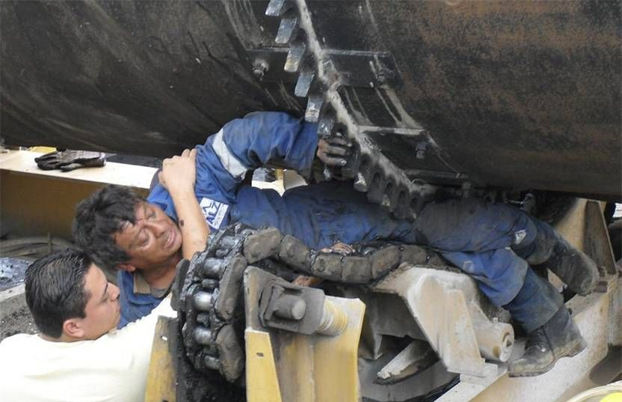
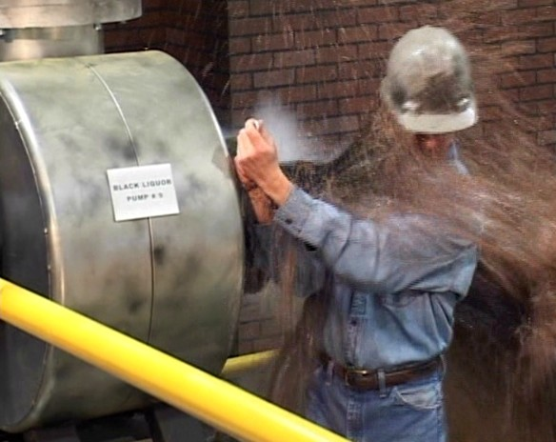
Uncontrolled Release of Energy

Slide 12
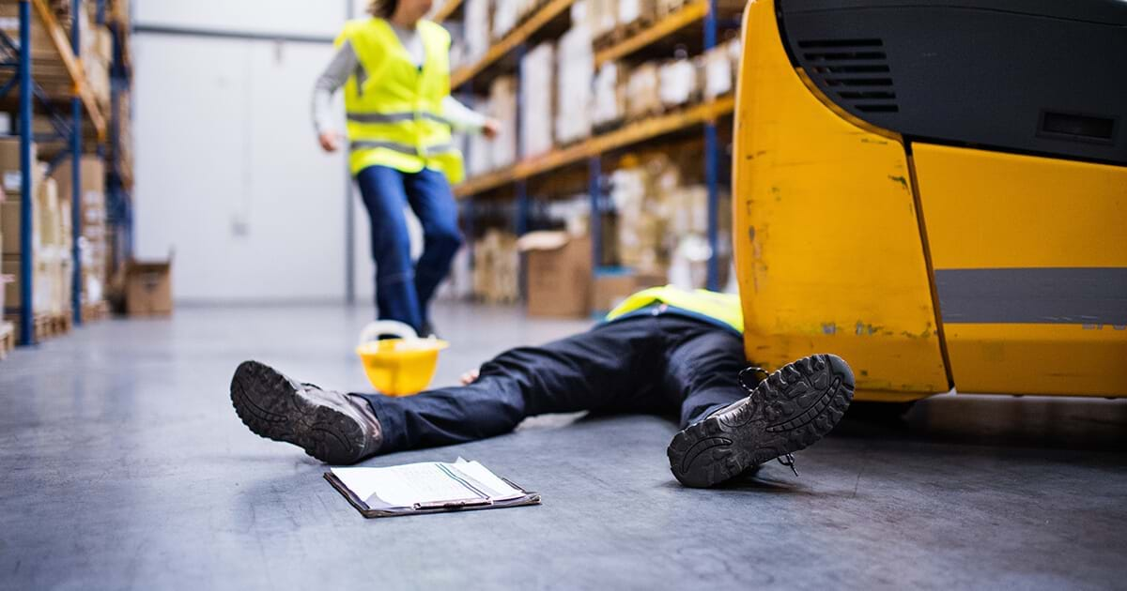
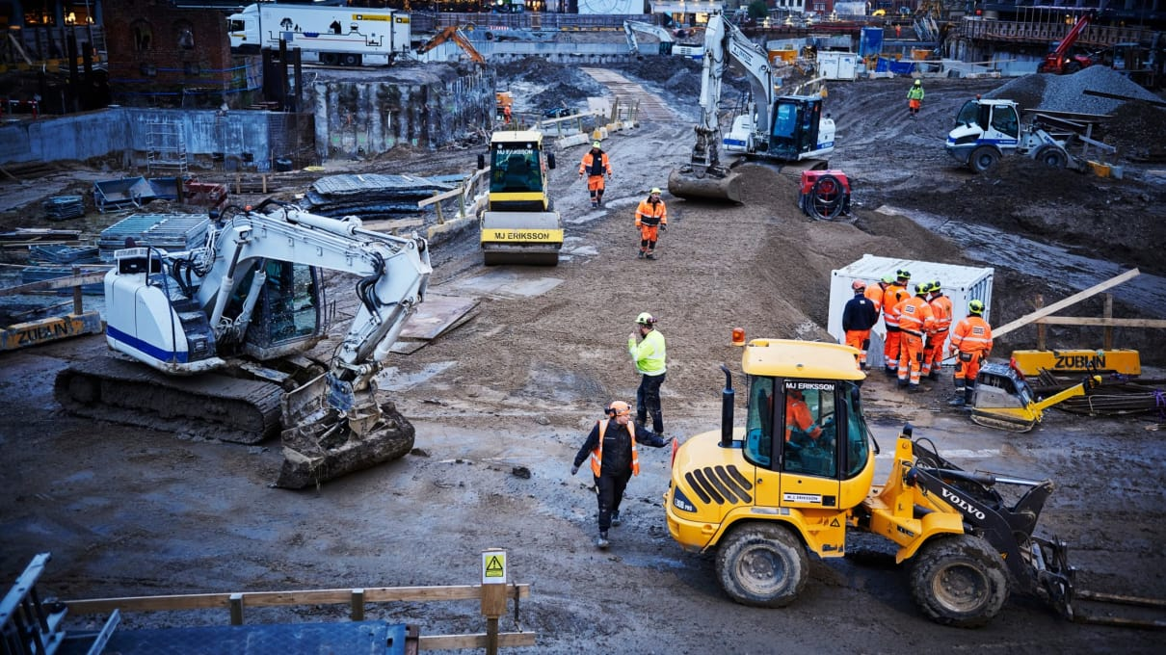
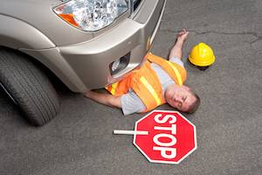
Vehicle Impact on Person

Slide 13
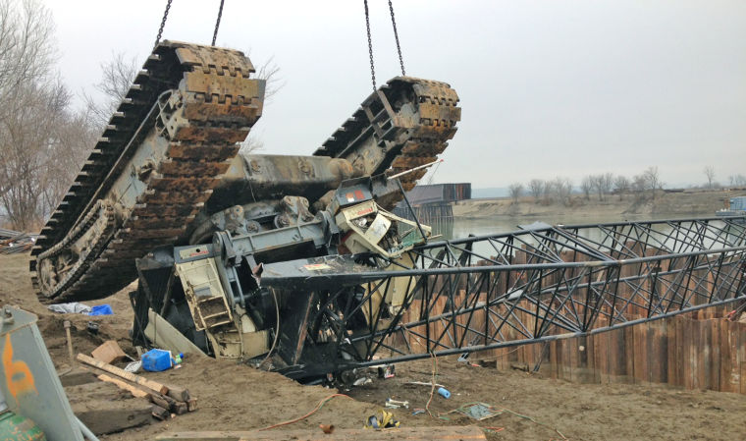
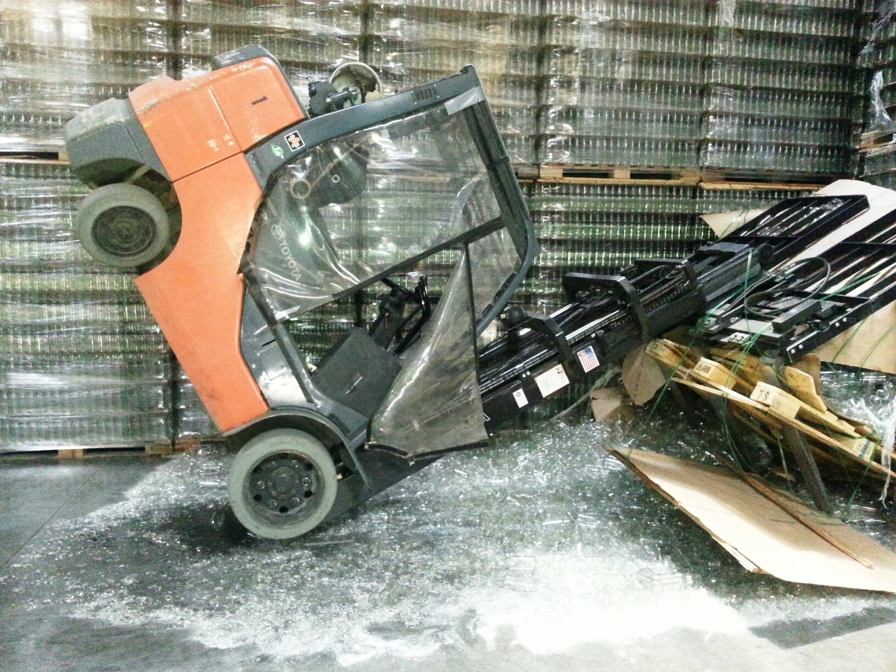
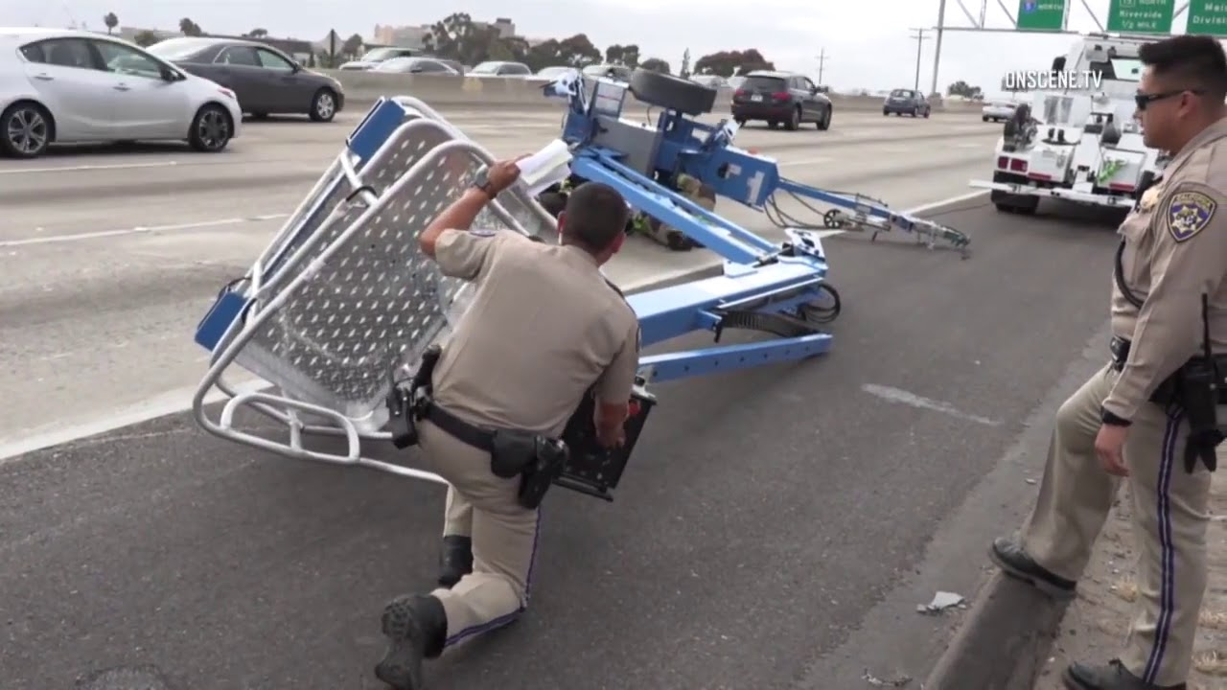
Lifting Operations

Slide 14
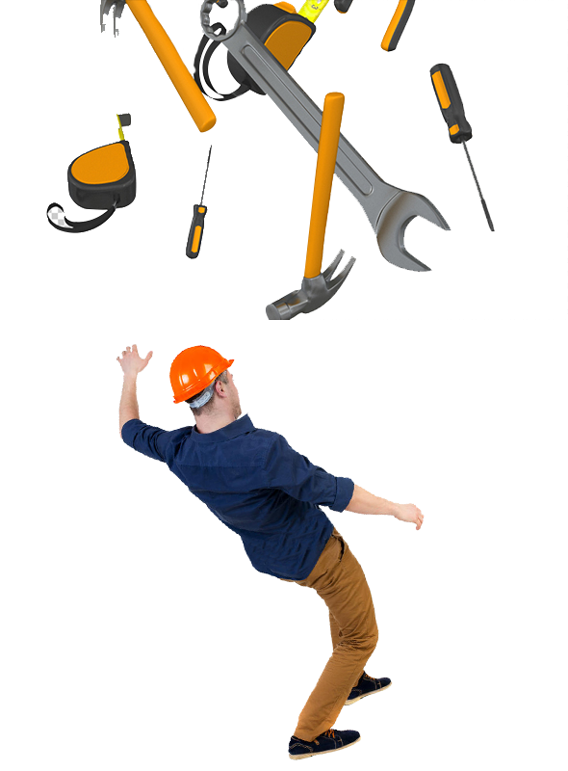
Falling Objects

Slide 15
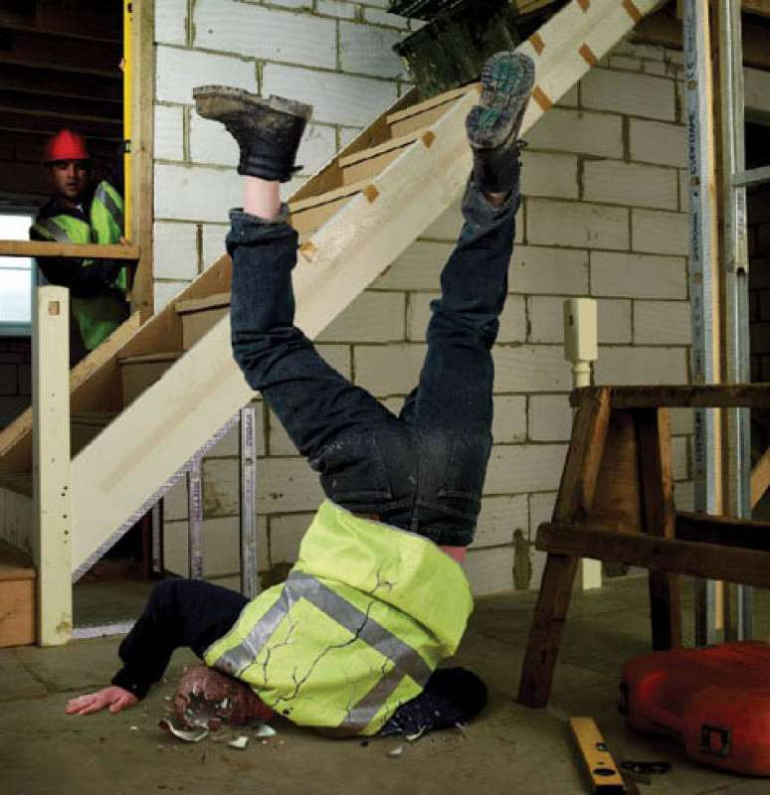
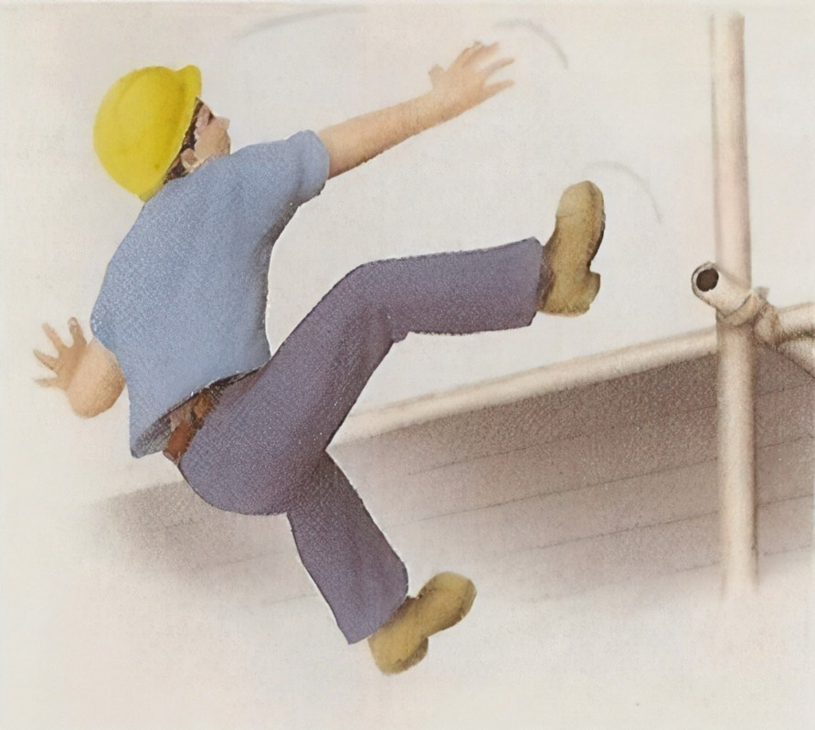
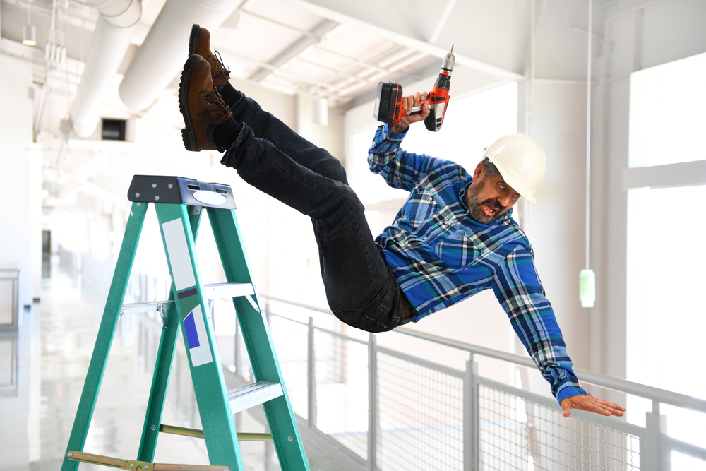
Fall from Heights

Slide 16
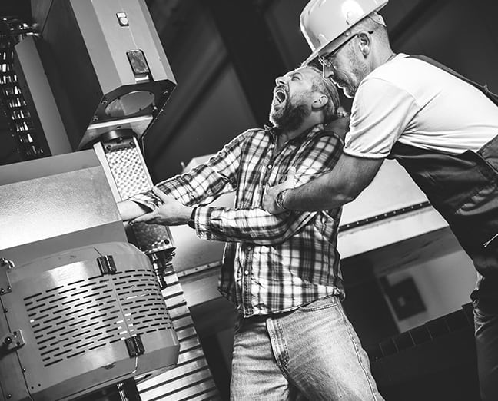
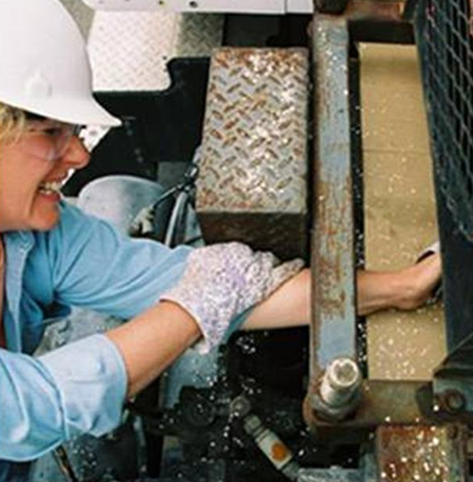
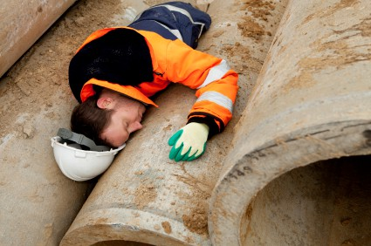
Entanglement and Crushing

Slide 17
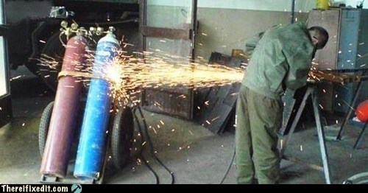
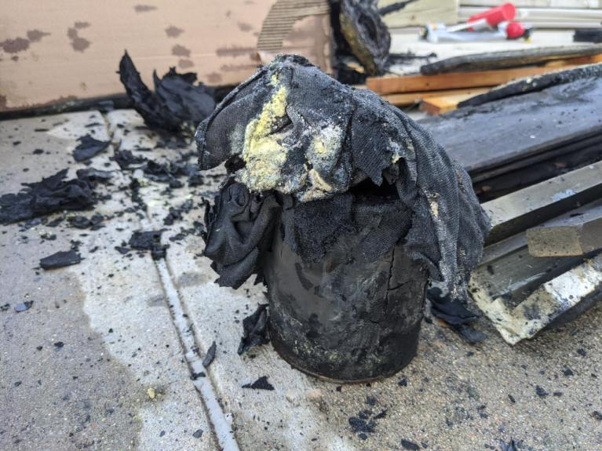
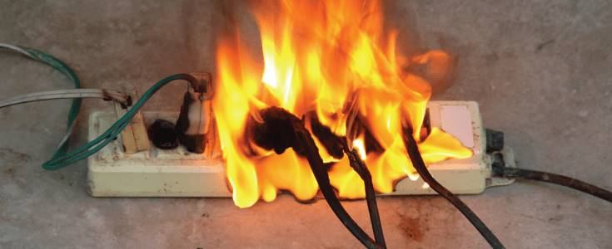
Fire

Slide 18
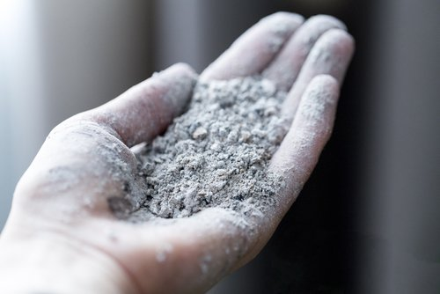
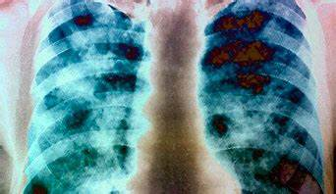
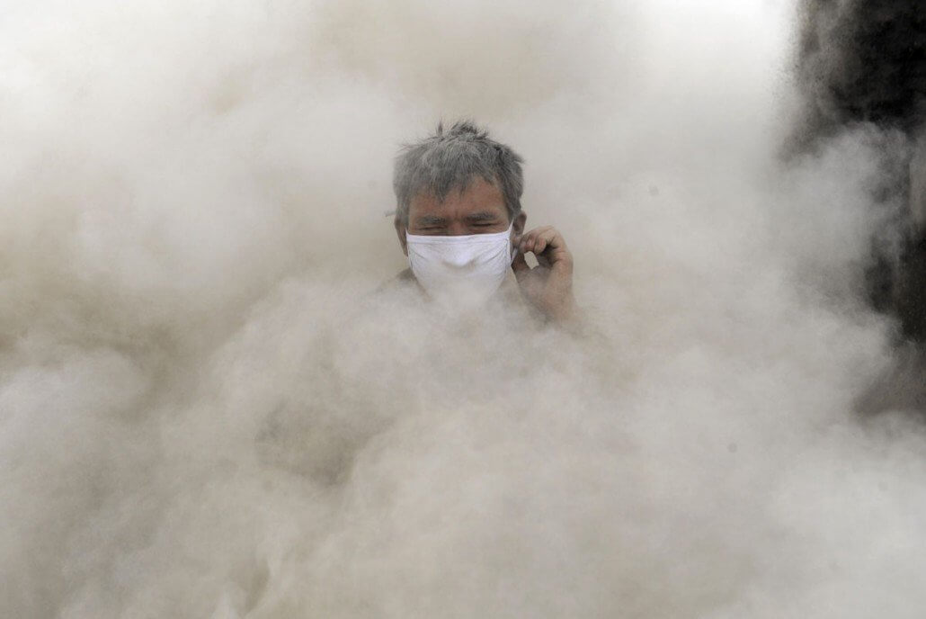
Exposure to Hazardous Substances: Chronic

Slide 19
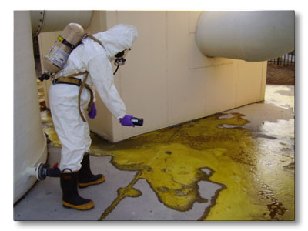
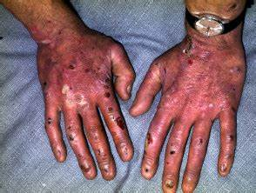
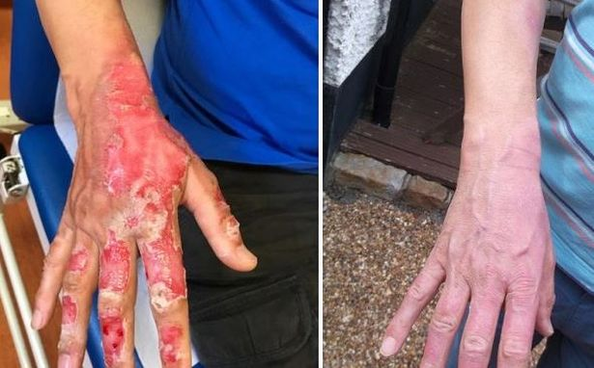
Exposure to Hazardous Substances: Acute

Slide 20
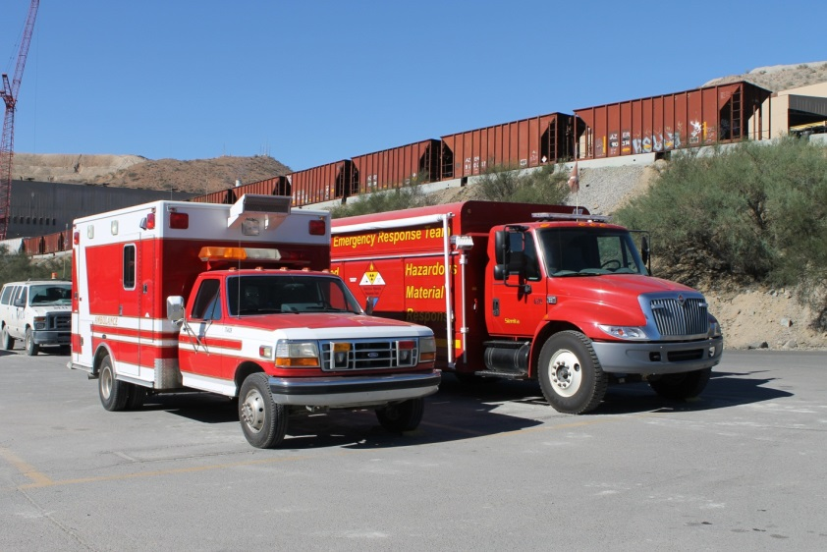
Communication
Incident Management
Do not put yourself in danger
Determine the correct response
When in doubt, contact the ERT
Communicate the emergency
Notes:
Instruction
Be familiar with emergency alarms, procedures, numbers, evacuation routes, and the common name of your work area
If feasible, play your site’s emergency alarms
Report the following to management ASAP
Near misses
Property damage
First-aid incidents
Medical treatments
Explain the first bullet
Whatever the type of incident, if there is an immediate hazard do not put yourself in danger
Explain the second bullet
Sometimes it is not clear if an event is a medical emergency and requires a full mayday response, or simply reporting an incident to your Supervisor is sufficient
Medical emergencies include but are not limited to
Chest pains (any)
Difficulty breathing
Altered mental status/unconsciousness
Seizures
Severe bleeding
Major trauma
Neck/back pain from a recent injury
Complications from a personal medical condition such as allergies and diabetes that may require medications or medical attention
Signs of dehydration such as vomiting, disorientation, and dizziness
Use your best judgment
Err on the side of caution
Explain the third bullet
When in doubt, contact an emergency response team (ERT) member for guidance
ERT determines treatment and the safest mode of transport to the clinic
Explain the last bullet
While sites differ slightly in emergency procedures, some aspects remain consistent
Always report an incident no matter the severity
If an emergency incident occurs in your area, know the steps to take to communicate the emergency

Slide 21
Communication
Emergency procedures
Stay calm
Stay safe
Report the emergency
Control the hazard
Secure the scene
Provide aid
Notes:
Instruction
First responders are available at all sites
Familiarize yourself with your area’s emergency procedures
Do not put yourself in harm’s way
Explain the first bullet
Explain the second bullet
Do not put yourself in danger
Leave the area if there is an immediate hazard
Explain the third bullet
Call for help and do the following:
Provide the location of the emergency
Identify yourself
Identify the nature of emergency
Never use the victim’s name
Explain the fourth bullet
If a hazard exists, control it without putting yourself in harm’s way
Explain the fifth bullet
If the hazard cannot be controlled, secure the scene and do not allow others to access the hazardous area
Explain the last bullet
If an individual needs assistance, neither endanger yourself nor go beyond your level of training in a rescue attempt

Slide 22
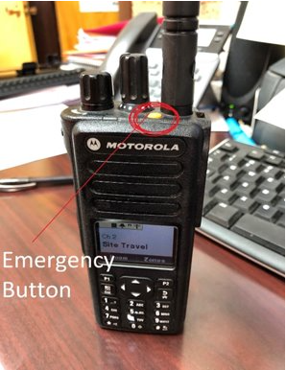
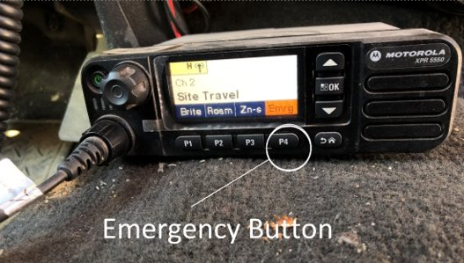
Mayday Procedures
Emergency radio procedures
Call “Mayday, Mayday, Mayday”
State nature of incident and location
Fire, Equipment Rollover, Medical, Injury etc...
Where exactly are you on site?
Do not use names or equipment numbers
Notes:
Instruction
Explain the first set of bullets
Call “Mayday, Mayday, Mayday.”
Stop large mine equipment immediately
Stop radio usage immediately to allow for emergency response coordination
Do not say names or equipment numbers over the radio during a Mayday
Explain the second bullet
In the case of an emergency, each site has an emergency number to call
Communicating non-emergencies
Always report an incident no matter the severity
Individuals or Supervisors determine if an emergency response needs to be activated
If involved in a medical situation that does not constitute a full mayday response, call the appropriate site extension and inform them of the non-emergency situation

Slide 23
Mayday Procedures
Emergency radio procedures
If you hear “Mayday, Mayday, Mayday”
Stop all work and traffic
Observe radio silence

Slide 24
Contractor Compliance Training
Site Driving
Workplace Examination
Blue Stake
Flagging and Barricading
Control of Hazardous Energy
Confined Space
Working at Heights
Hot Work
HDPE
Round Stock

Slide 25
Contractor Compliance Training
Driving on Site
Speed Limit on Site is 25MPH (Main Roads) 15MPH Around Buildings
Unless otherwise posted
Also, must drive to conditions
A Radio is Needed
Channel 1 Security
Channel 2 Site Travel ( Main Channel )
Channel 9 Site Services ( Sub Channel )
Channel 10 Water Services
Channel 11 Environmental
Channel 12 Electrical

Slide 26
Contractor Compliance Training
Driving on Site
Lights on Vehicles and Equipment
Head Lights must be on at all times when driving
All Light Vehicles must have a lit buggy whip light (Green) and must be 12 feet from the ground
Amber Lights are caution lights used for disabled vehicles and slow-moving equipment for general visibility
Red Lights applies to emergency and blasting vehicles. When lit these vehicles can not be passed

Slide 27
Radio Procedure to Pass Equipment
Rubber Tire Dozer (RTD) #2, light vehicle (LV) # 56. May I pass (behind you, on your left, on your right) ?
Light vehicle #56, RTD #2. You may pass behind me
RTD #2, light vehicle #56. I am passing behind you
Passing Haul Trucks, Water Trucks, or Tow Haul PROHIBITED while they are moving.

Slide 28
Radio Procedure to Pass Equipment
You get radio permission to pass but the blue light is still on, now what?
RTD #2, can you turn off your blue light before I pass by please?

Slide 29
No Passing Policy Effective June 19th, 2023
Due to the recent events and to ensure we mitigate any incidents going forward, we will be implementing a No Passing Policy for all Haul Trucks, Water Trucks and the Tow Haul. This applies to pickups, vans, buses, contractors, or any other light vehicles that do not have critical/emergency needs to address an issue directly relating to Mine Operations.
Examples of situations and equipment that can be passed following the passing procedures:
Broken down equipment
Stationary trucks to conduct repairs
Access areas blocked by haulage
Emergency response vehicles allowed to pass during an emergency
Auxiliary equipment (track hoes, crawlers, motor graders, rubber tire dozers, compactors)
If it is necessary and appropriate to pass, the driver of the light vehicle will inform Dispatch of the reason behind needing to pass and then follow passing procedures.
All light vehicles should use light vehicle access (LVA) roads and avoid haul roads, whenever possible. In limited instances, where conditions allow, the passing policy is still required to be followed, with clear radio communication request to pass, verbal confirmation of request received/acknowledge, and confirmation when passing. We will continue to enforce and hold each other accountable to following passing procedures.

Slide 30
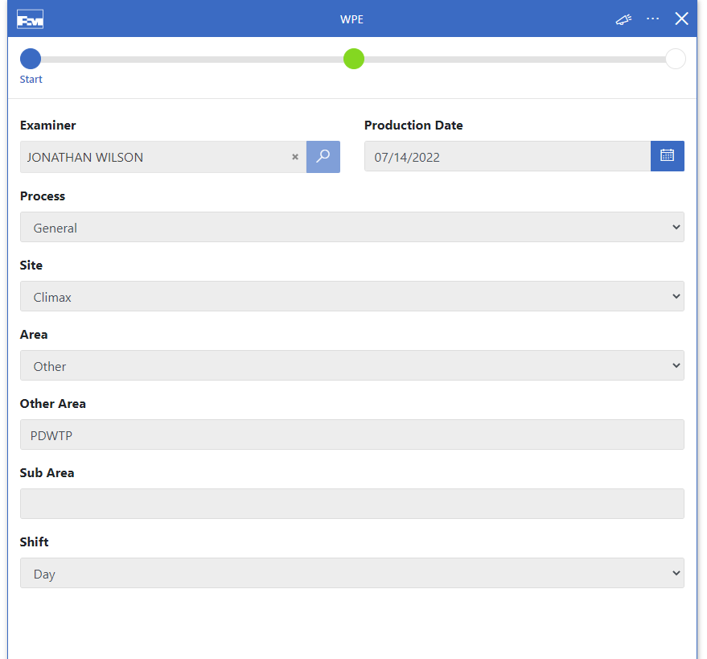
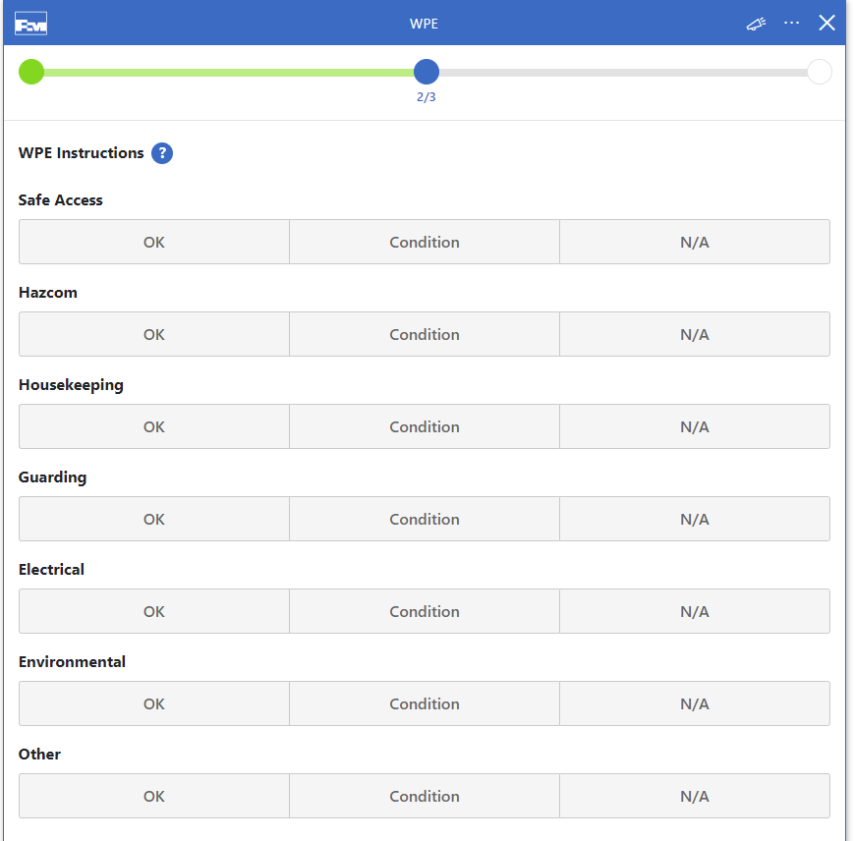
Workplace Exam

Slide 31
Contractor Compliance Training
Not a complete list:
Flagging and Barricading
Control of Hazardous Energy
Confined Space
Working at Heights
Hot Work
HDPE Pipe Handling
Round Stock Management
All Policies and Training apply to all employees and contractors operating on Freeport McMoRan sites.

Slide 32
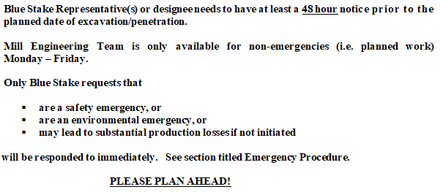
Climax Mine Blue Stake Program

Slide 33
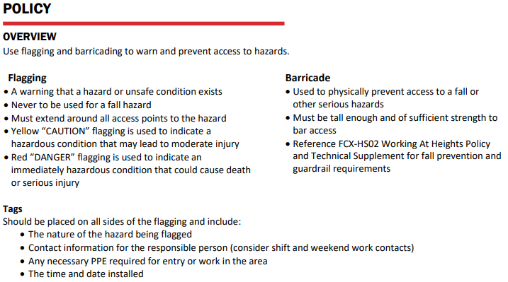
Flagging and Barricading

Slide 34
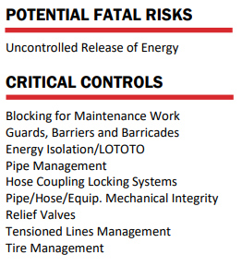
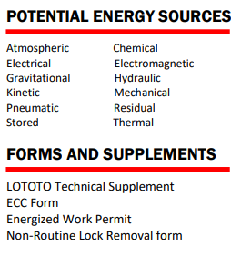
Control of Hazardous Energy

Slide 35
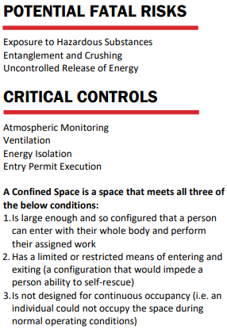
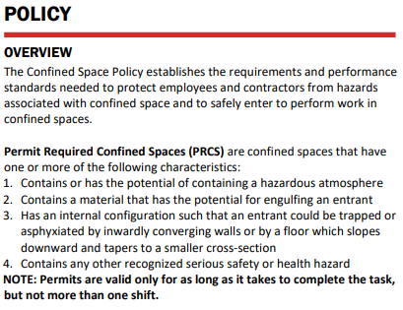
Confined Space

Slide 36
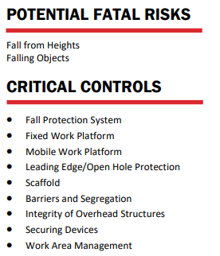
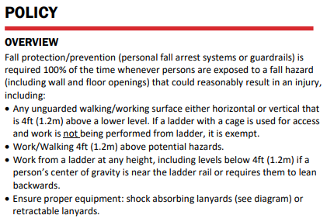
Working at Heights

Slide 37
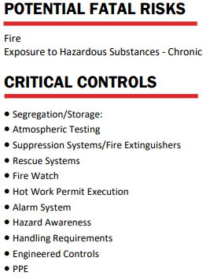
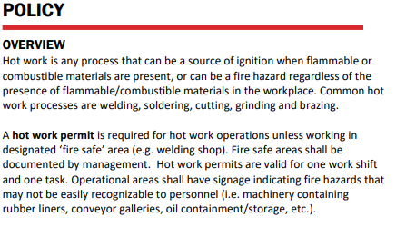
Hot Work

Slide 38
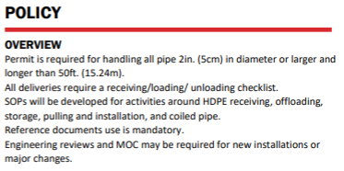
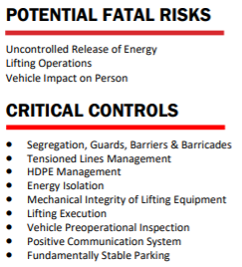
HDPE Pipe Handling

Slide 39
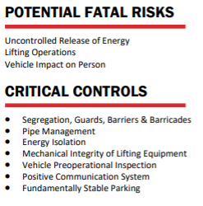
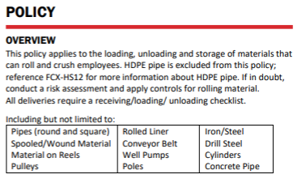
Round Stock Management

Slide 40
Fit for Duty: Fatigue Management
Effects on Health & Well-Being
INHERENT PROBLEMS FOR SHIFT WORKERS
Cardiovascular disease (3 times higher)
Gastrointestinal disorders (3 times higher)
Chronic Sleep disorders (4 times higher)
Lowered immune system response
Accident risks are higher
Irritability
Increased divorce rate
National average divorce rate is 48% - shift workers are at 60%
Education, Training and Behavioral Changes
DOES NOT HAVE TO BE!
Shift workers MUST live a different lifestyle from the straight day worker

Slide 41
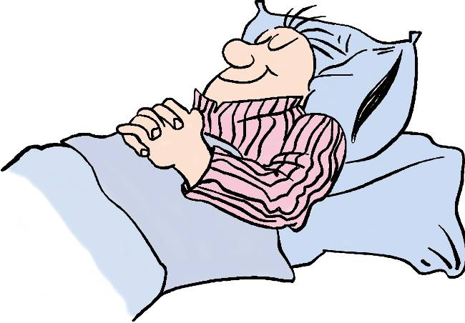
Why Is Sleep Important?
Good quality and quantity sleep allows us to perform at our optimum, both physically and mentally.
1. Physically
The body recuperates and restores energy
The body repairs itself
Helps boost immune system
2. Mentally
Essential part of mental well-being
Sleep deprivation can lead to anxiety and depression
Crucial in memory retention and the learning of new motor skills
Don’t skimp on sleep!
If you feel fatigued or exhausted, notify your supervisor.

Slide 42
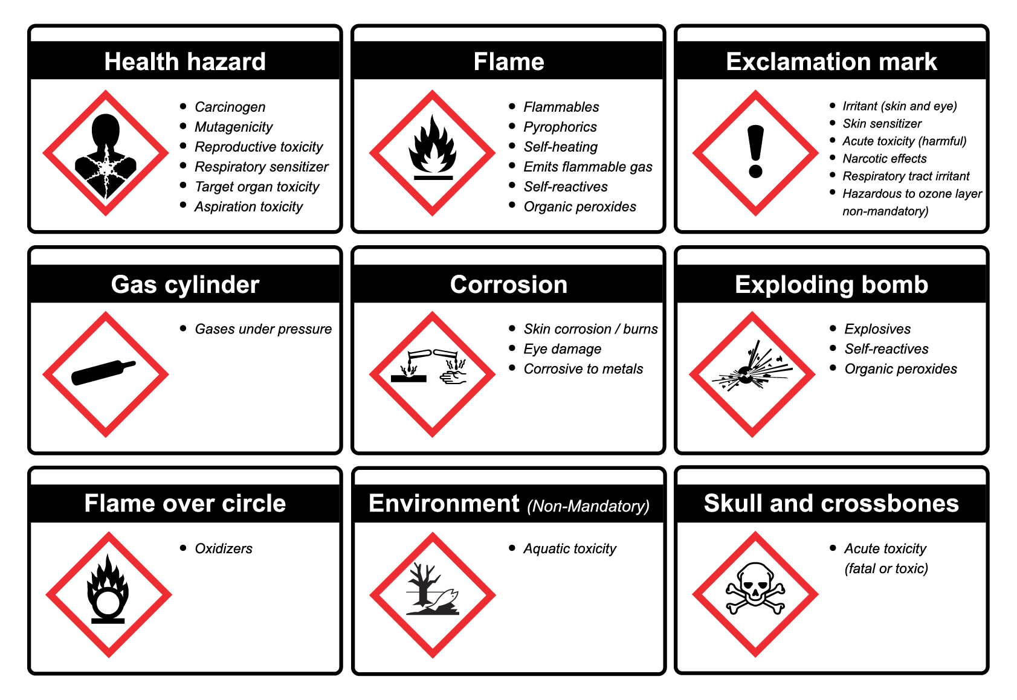
Health and Hazard Communication
Safety includes internal health
For health concerns, contact your site Industrial Hygienist (IH)
Hazard Communication (HazCom) increases awareness and anticipation to prevent incidents

Slide 43
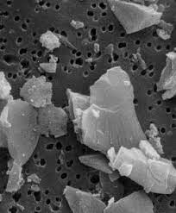
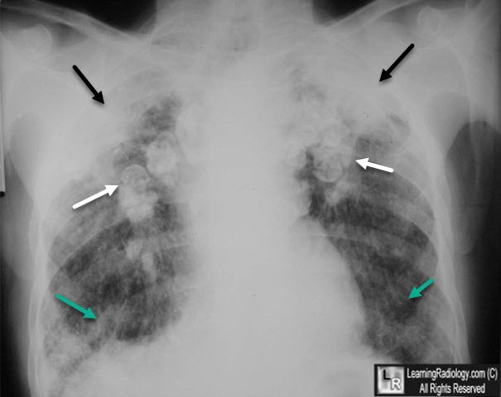
Silica Health Hazard
Crystalline Silica
Abundant in nature
Quartz: Most common form of silica
The ore at Climax is approximately 40-60% quartz
What other types of activities? (non-occupational)
Can cause Silicosis, Lung Cancer, and COPD
Notes:
Instruction
Explain the first bullet
Crystalline Silica (or quartz silica)
Serious health hazard encountered on many sites
Jobs such as drilling, cutting, or crushing material containing silica can result in exposure
Common areas exposed to silicosis include crushers, and tailings dam
Materials containing crystalline silica include but are not limited to concrete, brick, sand, refractory material, stone, and earth
Silicon is the most abundant material in the earth’s crust so most dust contains some amount of it
Respirators are often worn by employees with potential exposure such as geologists to protect against exposure
Explain the second bullet
Silicosis
Crystalline silica gets trapped in the lungs and, over time, creates scar tissue
Scar tissue reduces the elasticity of the lungs making breathing and gas exchange more difficult
Give each student a coffee straw and have them breathe through it for 30 seconds to simulate what it is like to breathe with silicosis
Discuss the effects breathing with silicosis could have on your life
Lung cancer
Irritation to the cells in the lungs by silica dust
When the irritation persists, cells can develop abnormalities that can turn into lung cancer
Often fatal
Chronis obstructive pulmonary disease
Studies suggest a link between COPD and silica dust exposure
Characterized by coughing, shortness of breath, and difficulty breathing that gets worse over time and can lead to death
Explain the last bullet
When working in a department, you may be asked to wear air monitors
Monitors sample airborne contaminants and sound an alarm if unsafe breathing conditions exist
If air contaminant levels reach certain concentrations, evacuation or respirator usage is required
Training is required before using any air monitors
A Health and Safety Representative or IH
Communicates air monitor information for work areas to employees
Answers questions regarding monitors and respirators

Slide 44
Fire Prevention

Slide 45
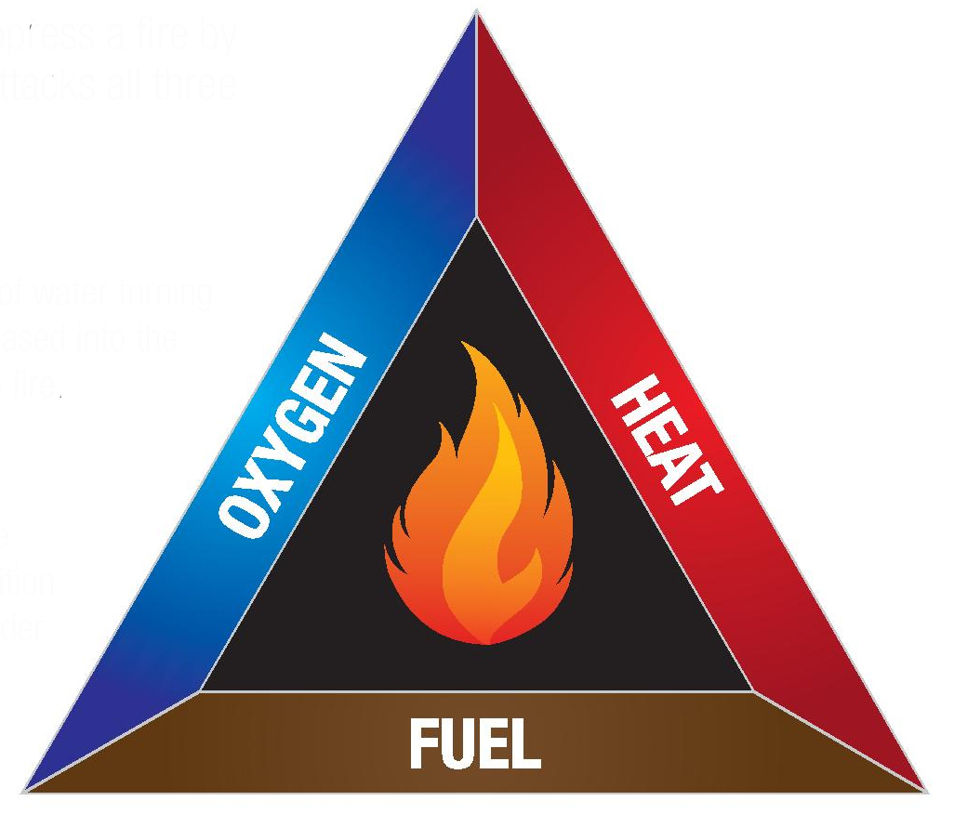
Fire Triangle
All three sides of the triangle must be present for fire to occur.
Removal of a side will extinguish a fire.
Think of sources of fuel in your workplace, can it be mitigated?
Think about sources of heat in your workspace, can it be mitigated?

Slide 46
Smoking and Open Flames
No smoking at or in:
Company vehicles
Company equipment
Buildings Proper disposal of cigarettes
No smoking at posted no smoking signs.
No smoking or open flames within 50 feet of blasting operations, combustible or flammables.
No smoking or open flames at battery charging stations, fuel islands, and compressed gas cylinders.
Turn off engines before fueling.

Slide 47
Checking Fire Extinguishers
Check for foreign material that may hide damage or corrosion
Check for visible damage or corrosion
Check for pin and pin retaining device
Check the gauge or pressure indicator for proper pressure
Check that the hose and nozzle are in good repair and not obstructed.
Check that the monthly inspection tag is up to date.
Check for the presence of an annual inspection tag, see that it’s current.
The extinguisher should be removed from the bracket and inverted to loosen the dry chemical on a monthly basis.

Slide 48
Evacuation Guidelines
Any alarm triggers an evacuation
Exit out nearest door and proceed to your designated assembly area
Check in with your supervisor
In the event of inclement weather, you may assemble in unaffected building
Do not exit through a closed hot door.
Cessation of the alarm is not an “all clear”
Use stairs, do not use elevators Can I go to my vehicle?
Notes:
Its ok to use the radio during a mayday to locate people. The emergency rescue team will be on the Mine rescue channel or security.
If your building is not a part of the mayday or does not have an active alarm it is ok to stay inside. Discuss what your plan is with your supervisor.

Slide 49
3 Mill

Slide 50
Admin Building

Slide 51
Crusher

Slide 52
Lime Plant

Slide 53
PDWTP

Slide 54
Pebble Crusher

Slide 55
Pit Shop

Slide 56
Pond Shop

Slide 57
SDP

Slide 58
Security

Slide 59
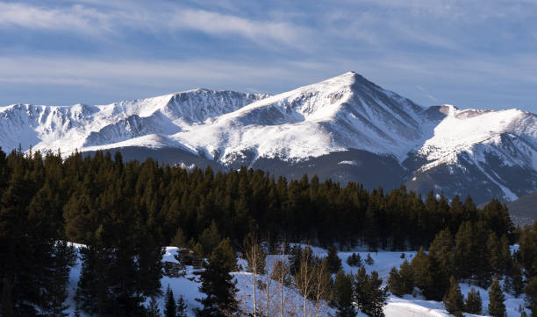
Symptoms of Altitude Sickness
Headache
Nausea/Vomiting
Dizziness
Confusion
Exhaustion/Fatigue
Loss of Appetite
Shortness of Breath
Pressure Behind the Eyes
Rapid Heart Rate

Slide 60
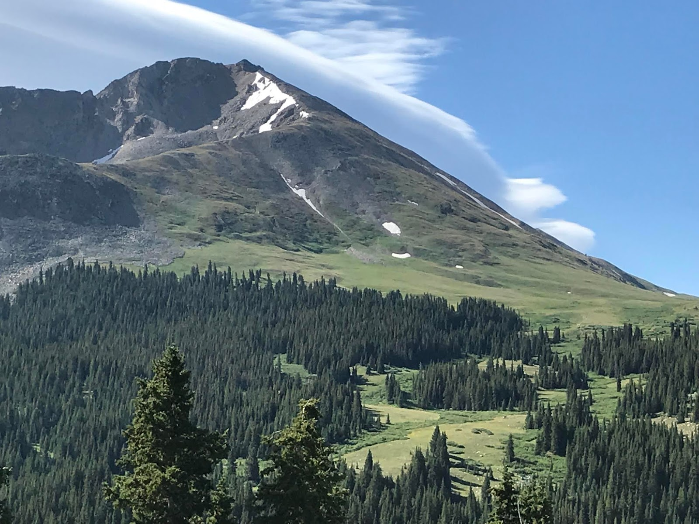
Preventing Altitude Sickness
Prevention:
Acclimate. It takes the average person 6 weeks to acclimate to elevation.
Hydrate. Drink 3 to 4 quarts of water per day.
Avoid alcohol consumption.
Eat a healthy diet high in carbohydrates.
You are especially at risk of altitude sickness if you:
Have a lung or heart condition
Are pregnant
Live primarily at low elevation
Previously had altitude sickness

Slide 61
Questions?

