Slide 1
FCX Safety Updates
January 2024

Slide 2
Meeting Agenda
Successes and Celebrations
Climax 2023 Safety Review
Questions/Comments/Discussion on HSEP & Permits
FCX Incident Information
Other Information
Confined Space Entry Discussion
Announcements/Open Discussion/Other

Slide 3
Successes
Contractor TRIR for Nov. & Dec. < ½ what it was in October

Slide 4
2023 Recordable Injuries
Climax = 12 Injuries
Contractors = 16 Injuries
Slips, Trips, & Fall = 5
Bodily Reaction = 10
Caught in/under/between = 3
Struck by/against = 6
Exposure to = 2
Sprain / Strain = 11
Contusion = 4
Laceration = 3
Object in Eye = 0
Fracture = 4
Dislocation = 2
Burn = 2
Amputation = 1
Back/Neck = 4
Ankle = 2
Arm / Hands = 11
Knee = 6
Shoulder = 2
Face = 2

Slide 5
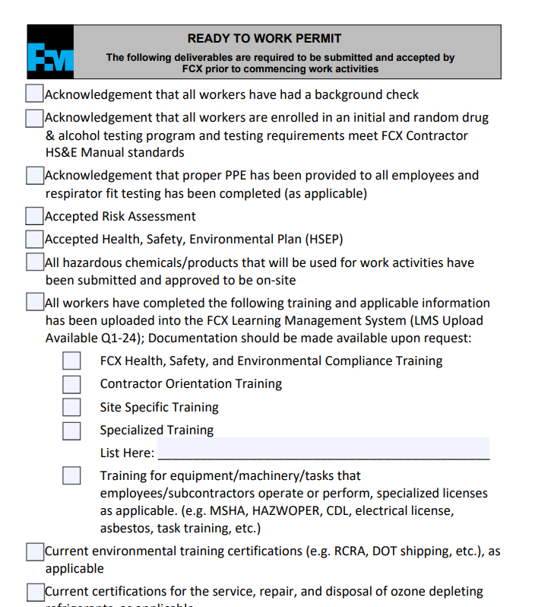
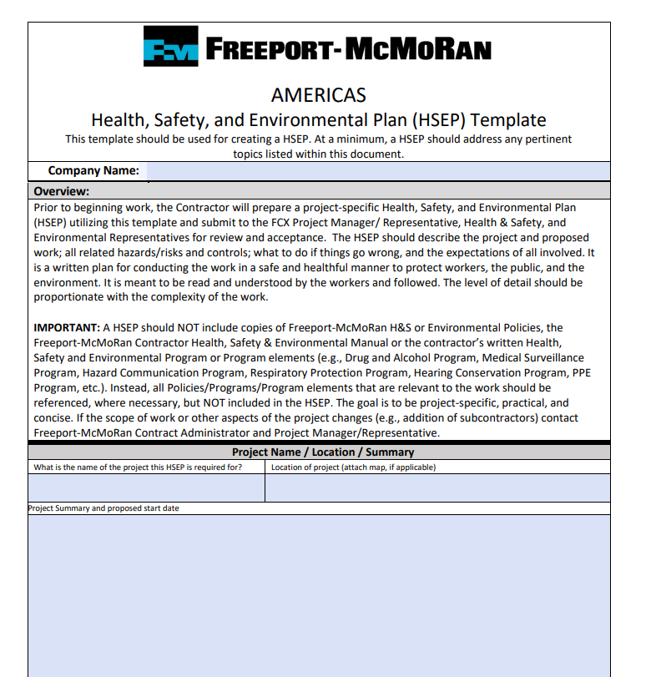
First Steps Discussion
Home | Freeport-McMoRan Public Portal (fmi.com)

Slide 6
FCX Safety Incidents, Successes, & Alerts
January 2024

Slide 7
PFE Events
January 2024

Slide 8
LHD Reverses into a Light Vehicle

Slide 11
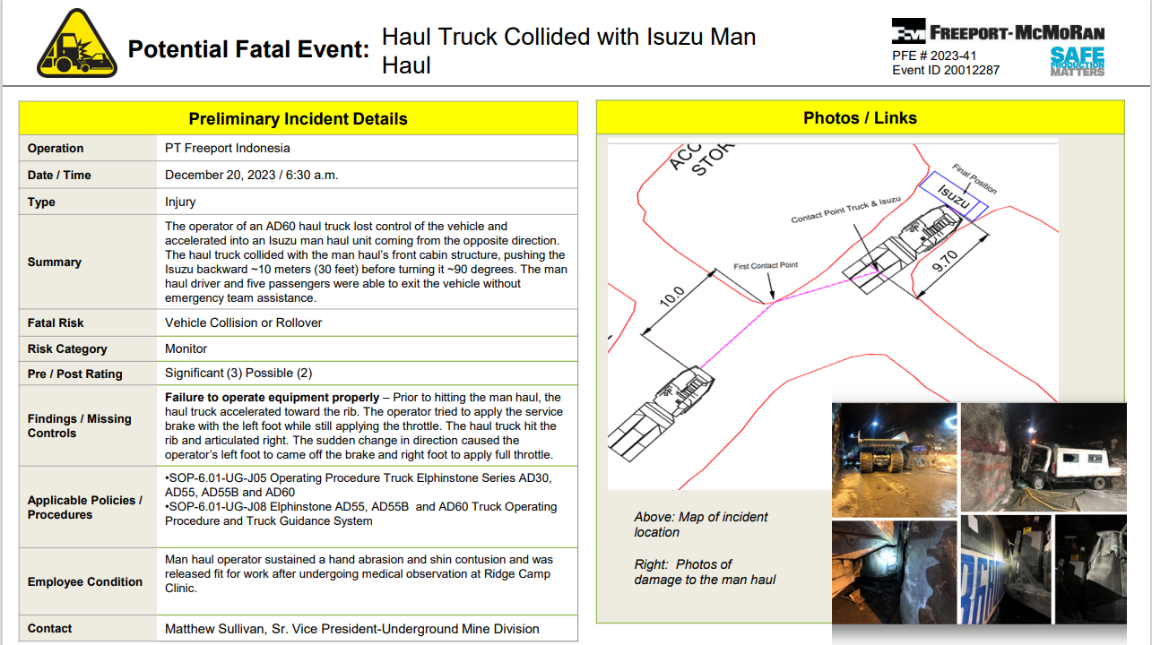
PFE # 2023-32 Event ID # 20011245

Slide 14
Agency Shares
January 2024

Slide 15
OSHA – Winter Weather

Slide 16
Safety Topic – Confined Space Entry Policy
January 2024

Slide 17
CoHE - LOTOTO
Home | Freeport-McMoRan Public Portal (fmi.com)
https://publicportal.fmi.com
Key Elements
Climax Specifics
Discussions
Questions

