Slide 1
FCX Safety Updates
December 2023

Slide 2
2023 Recordable Injuries
Climax = 12 Injuries
Contractors = 15 Injuries
Slips, Trips, & Fall = 5
Bodily Reaction = 9
Caught in/under/between = 3
Struck by/against = 6
Exposure to = 2
Sprain / Strain = 10
Contusion = 4
Laceration = 3
Object in Eye = 0
Fracture = 4
Dislocation = 2
Burn = 2
Amputation = 1
Back/Neck = 3
Ankle = 2
Arm / Hands = 11
Knee = 6
Shoulder = 2
Face = 2

Slide 3
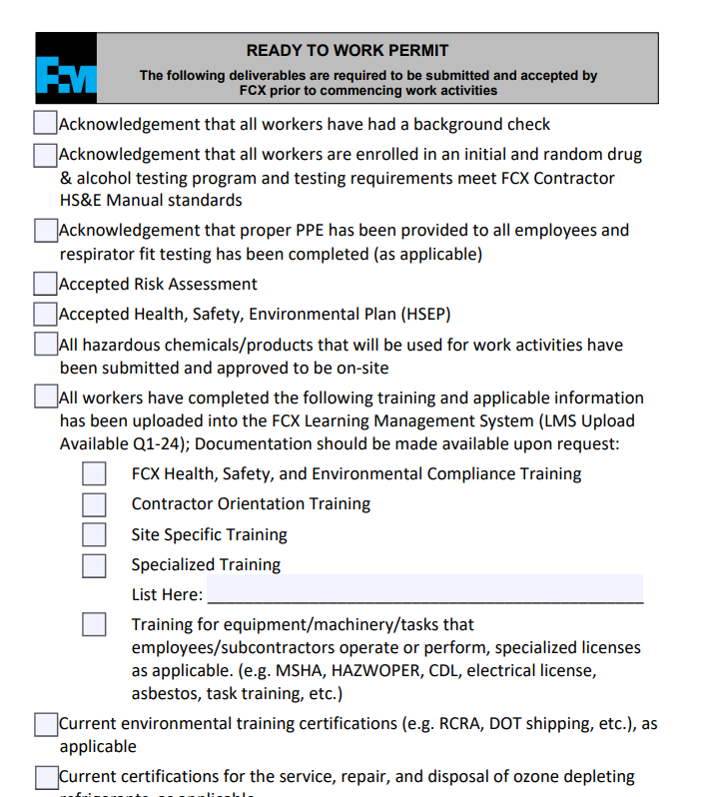
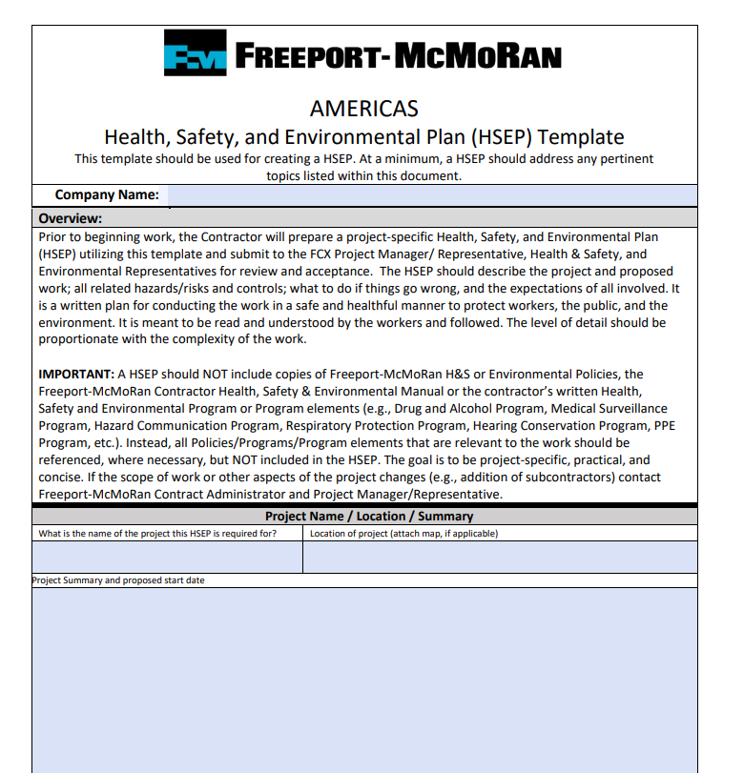
First Steps Discussion
Home | Freeport-McMoRan Public Portal (fmi.com)

Slide 4
Meeting Iterations
Work towards rotating hosting
Focused safety topic each month
Primarily around FRM categories or High Risk Policies
FCX Incident Information
Successes and Celebrations
Announcements

Slide 5
FCX Safety Incidents, Successes, & Alerts
November 2023

Slide 6
Successes
Contractors Completed the McNulty Environmental Projects injury Free in 2023. >50,000 Hours
> 62,000 Contractor Hours injury free in November Site wide.
Mine Haul Road Maintenance improvements including the use of a scraper to spread road base on the snow.

Slide 7
PFE Events
November 2023

Slide 8
LHD Reverses into a Light Vehicle
PFE # 2023-40 Event ID # 20009754

Slide 9
Steering Wheel Came Off Steering Column
PFE # 2023-39 Event ID # 2009518

Slide 10
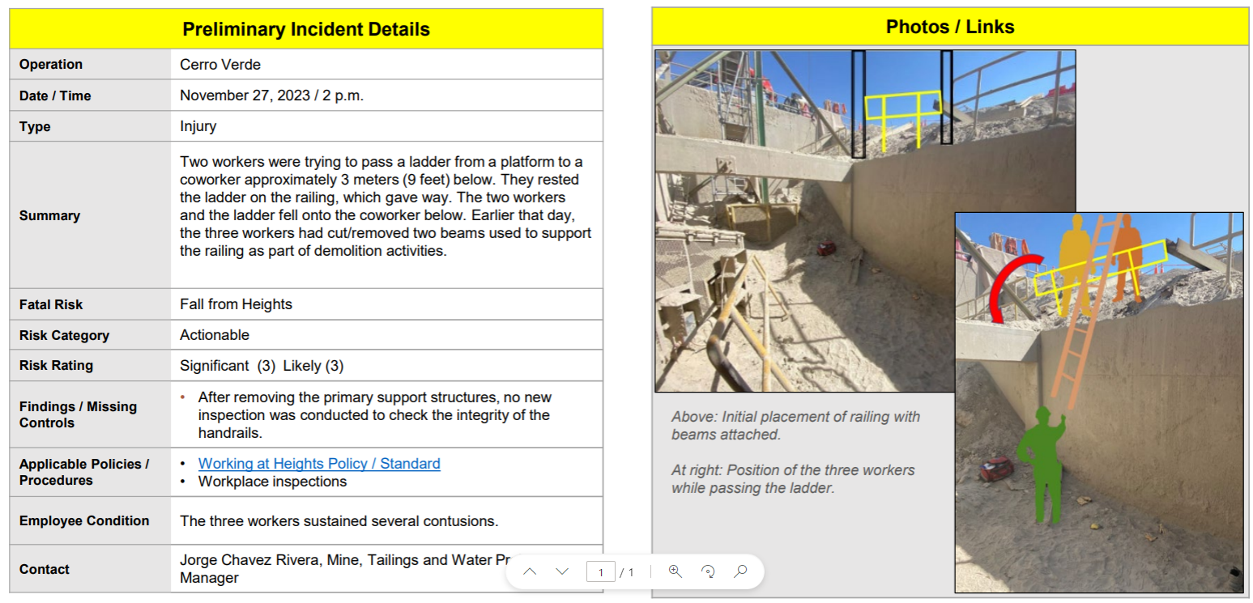
Fall From Heights
PFE # 2023-35 Event ID # 20011698

Slide 11
Fall From Heights
PFE # 2023-32 Event ID # 20011245

Slide 12
Agency Shares
November 2023

Slide 13
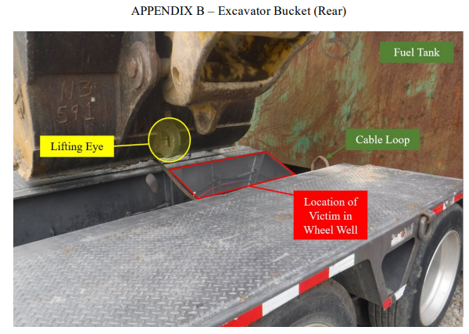
MSHA Fatality Report
What does it mean to be a spotter?

Slide 14
Safety Topic – Control of Hazardous Energy Policy
December 2023

Slide 15
CoHE - LOTOTO
Home | Freeport-McMoRan Public Portal (fmi.com)
https://publicportal.fmi.com
Key Elements
Climax Specifics
Discussions
Questions

