Slide 1
Henderson HSE Contractor Meeting – April 2025
04/10/2025

Slide 2
What is this Meeting?
Purpose:
For Henderson to have the opportunity to reach multiple contractors to discuss best practices when it comes to Health and Safety, Environmental and Contracts Management
Give contractors an open forum to bring up concerns, successes or incidents, learnings, etc. that is shared between all contractors and Henderson personnel
Help improve the safety culture and reduce safety incidents as a group

Slide 3
Safety Topic – Ergonomics

Slide 4
Safety Topic – Ergonomics

Slide 5
Safety Topic – Henderson Dust Projects
What are the high-level project in development for Henderson?
Henderson Mine
Evaluation of 5 Shaft/Production Fan Speeds
Evaluate use of Durasoil and Water truck utilization
Spray Repairs & Maintenance improvements
Equipment Washing Policy
Crush & Convey
Primary Crusher enclosures to direct air
PC2/PC3 enclose dribble pan side walls
Replace skirt enclosures at Head House
Henderson Mill
Bulkhead seals at both ends of tunnel inclines
Entry/exit curtains at primary mill head chutes
Relocate pulley plows from over return trainer idlers
Contact Chief Kolobe, Silica Project Manager, if you have follow-up questions

Slide 6
Environmental Topic – Product Review Process
A Safety Data Sheet (SDS)must be on file for every chemical brought onsite. All chemicals, no matter their container size, need to be approved prior to bringing them on the property. This Process:
Ensures proper material management, use, and disposal.
Maintains complete and thorough information about each product on site and allows Environmental and Safety to be prepared for a spill or emergency response, if needed.
Allows the site to evaluate if there is a less hazardous, effective substitute resulting in safer chemicals to work with and less hazardous waste generated.
Keeps our commitment to reducing impact on the environment.
The Process
To start a product approval, get with a mine or mill planner or Project Manager
Planning or Project Manager will submit the request in Sphera.
The request will go to both Environmental and Health and Safety for approval.
Regulations, chemical characteristics, and exposure / safety considerations are reviewed before approving or denying a request.
The Mill Water Treatment Plant project has had over 150 chemical approval requests so far!

Slide 7
Environmental Topic – Product Review Process
Unapproved Chemicals
NOT all chemicals are allowed on the site. Certain chemicals, such as those that would result in P-Listed waste with acutely hazardous characteristics, are prohibited for use on our properties. If the chemical you request is not allowed, work with Environmental or Safety to find an allowable substitute.
If you have questions on if a chemical is allowed or cannot find the SDS during a spill or emergency, please reach out to Environmental or call the Environmental on-call hotline:(720) 942-3603. Someone is ready to answer this number 24/7.
During the 2025 Internal ISO 14001 audit, three cans of chlorinated brake cleaner were found in a flammable cabinet underground. Chlorinated solvents are NOT an approved chemical due to hazard characteristics and contamination potential with used oil, and the items were removed.
Verifying Approved Chemicals
FMI uses Sphera to store SDS’s for chemicals used on all Freeport properties
Link to Sphera: https://fcx.complyplus.com/

Slide 8
Potential Fatal Events (PFE)

Slide 9
Potential Fatal Events (PFE)

Slide 10
Potential Fatal Events (PFE)

Slide 11
Potential Fatal Events (PFE)

Slide 12
High Risk/Actionable Events

Slide 13
High Risk/Actionable Events

Slide 14
High Risk/Actionable Events

Slide 15
High Risk/Actionable Events

Slide 16
High Risk/Actionable Events

Slide 17
High Risk/Actionable Events

Slide 18
High Risk/Actionable Events

Slide 19
High Risk/Actionable Events

Slide 20
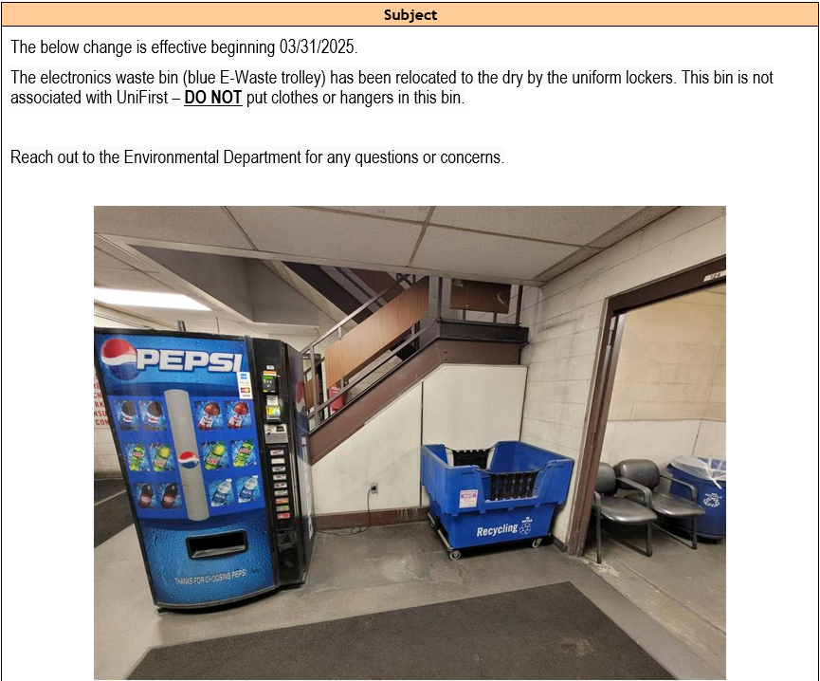
Safety Alerts/Contacts

Slide 21
Safety Alerts/Contacts

Slide 22
MSHA Safety Alerts
Fall Protection
From 2022 to 2024, seven miners died after falling from heights. At the same time, MSHA issued 767 violations that cited fall protection standards. Of those violations, 228 were issued in conjunction with 107(a) imminent danger orders. So far in 2025, three miners were seriously injured by falling from heights.
Best Practices:
Establish an effective fall prevention and protection program.
Provide and ensure proper use of fall protection where there is a danger of falling.
Ensure fall protection has suitable fall arrest connections and secure anchorage systems.
Train miners on fall prevention and protection. Prohibit work in unprotected areas.
Provide and maintain safe access to all working places. Use personnel lifts or ladders to access elevated workplaces safely.
Install adequate warning signals and barricades for openings above, below, or near travelways where miners or materials may fall.
Ensure miners wear slip resistant footwear and use three points of contact when accessing mobile equipment and elevated surfaces.
Conduct workplace examinations to identify and correct conditions that may adversely affect the safety or health of miners.
Find additional information and resources on OSHA’s Fall Protection Webpage.

Slide 23
MSHA Fatality Alerts

Slide 24
MSHA Fatality Alerts

Slide 25
MSHA Fatality Alerts

Slide 26
MSHA Fatality Alerts
March 28, 2025 Fatality
Accident Classification: Powered Haulage
Mine: South Plant - Washington, Kansas (Surface, Sand & Gravel)
Preliminary: A front-end loader operator died when the front-end loader he was operating became engulfed in sand from a highwall.

Slide 27
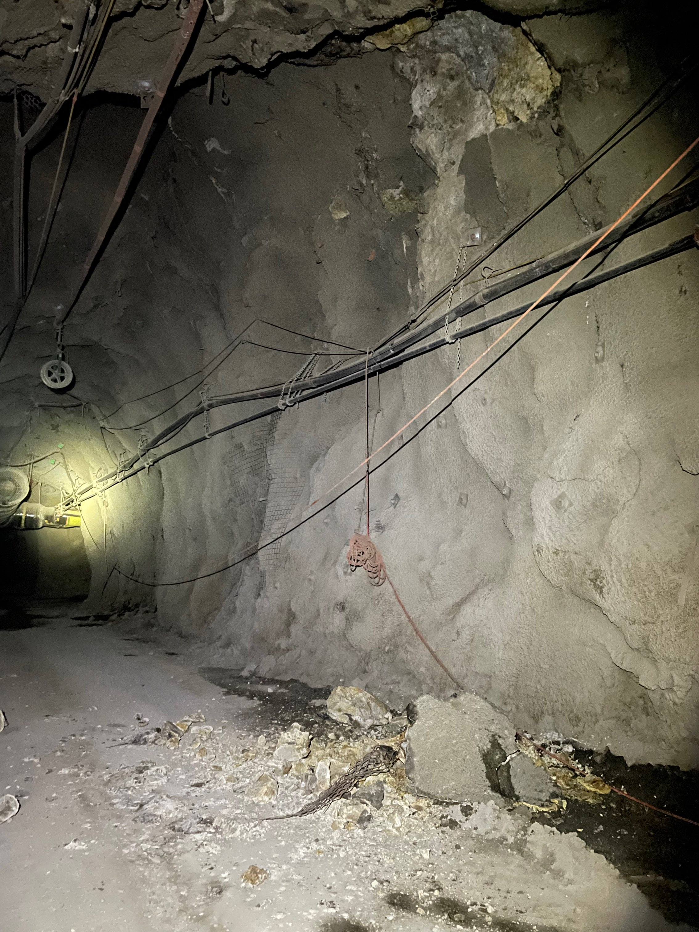
Henderson Incidents – 03/10-03/31
Summary: Near Miss 03/10
Unplanned rock failure in the spring line, on the upper DC1 Ramp
Roughly two yards of material fell. The area is well traveled; however the hazard was off to the side and not in the direct path of equipment or buggies traveling the area.
The area was barricaded off and dispatch was notified of the hazard.
Learnings:
Staying aware older ground support is failing at different rates
Increase bar down and inspection frequency
Re-support with area specific plan

Slide 28
Henderson Incidents – 03/10-03/31
Summary: Near Miss 03/27
Employee drove down DC1 ramp and noticed they were on the back side of a loaded round sign
Employee turned around, traveled back along same path and reported event to supervisor
Learnings:
Consistency of hanging critical signage in the right locations

Slide 29
Henderson FRM Audit Results
134 Forms Submitted in Marsh
Focus in March around Underground Rockfall, Hazardous Substances and Electrical Hazards
Vehicle Impact on Person missing controls increased in March
AUDIT FOCUS FOR APRIL/MAY:
Vehicle Impact on Person
Electrical Hazards
Hazardous Substances – Acute
Underground Rockfall

Slide 30
Henderson FRM Audit Results
Form | Critical Control | Verification Question | # of No Responses
Vehicle Impact on Person | Road Design and Condition | Are segreation protocols between equipment/vehicles and ground personnel well defined and in use? | 4
Exposure to Electrical Hazards | Labeling & Energy Identification | Are arc flash rating labels up to date and reviewed by a competent person? | 2
Vehicle Impact on Person | Ground Personnel | Are ground personnel outside of positions that could be impacted by a vehicle losing control? E.g. Line of fire. | 2
Exposure to Electrical Hazards | Energy Isolation | Has any energized work taking place been reviewed and approved? | 1
Fall from Heights | Fall Protection Systems | Are proper tie off/anchor points readily available and allow for 100% tie off at all times? | 1
Fall from Heights | Leading Edges and Open Holes | Has adequate protection systems been installed and inspected? | 1
Fire | Escape Routes | Are walkways, pathways and exit routes free and clear of debris. | 1
Fire | Hot Work and Fire Watch | Has a dedicated fire watch been assigned to the work. | 1
Hazardous Substances Acute | Storage and Distribution | Are chemical process lines / storage containers in good condition and/or monitored through instrumentation to verify proper function (e.g. leak detection)? | 1
Hazardous Substances Acute | Storage and Distribution | Are high hazard process lines or storage containers clearly labeled to indicate substance and flow direction? | 1
Vehicle Collisions or Rollover | Operator Competency | Is the operator of the equipment/vehicles driving to the current and expected environmental conditions? | 1
Vehicle Collisions or Rollover | Road Design and Condition | Are travelways in good condition and wide enough to safely operate equipment/vehicles? | 1
Vehicle Impact on Person | Road Design and Condition | Is sufficient lighting available in congested areas? | 1

Slide 31
Contractor Management Topic – ISNetworld
ISNetworld Employee Accuracy Request

Slide 32
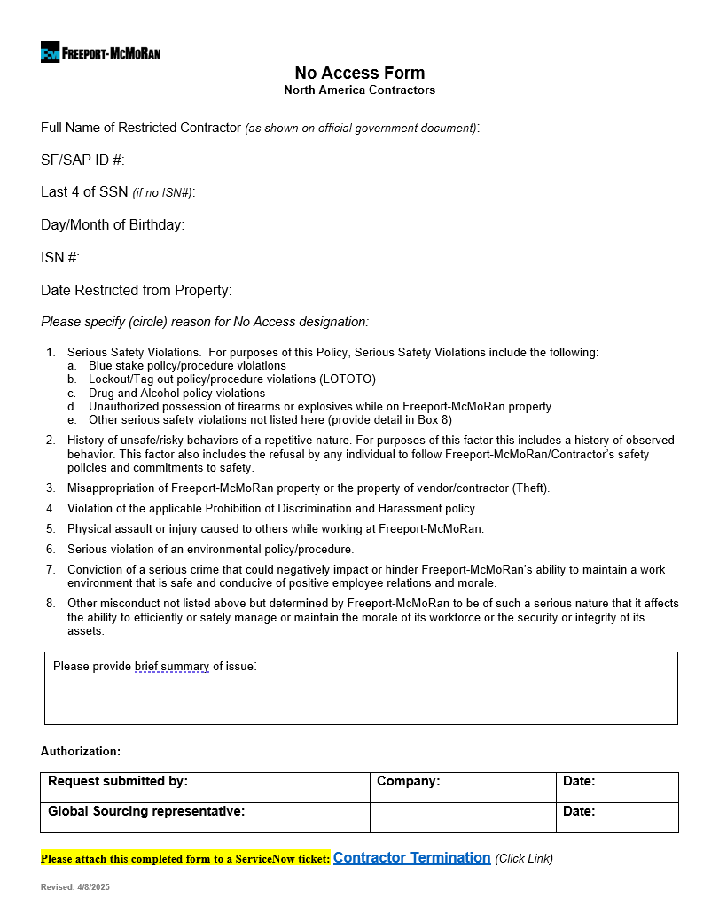
Contractor Management Topic – Contractor No Access Form

Slide 33
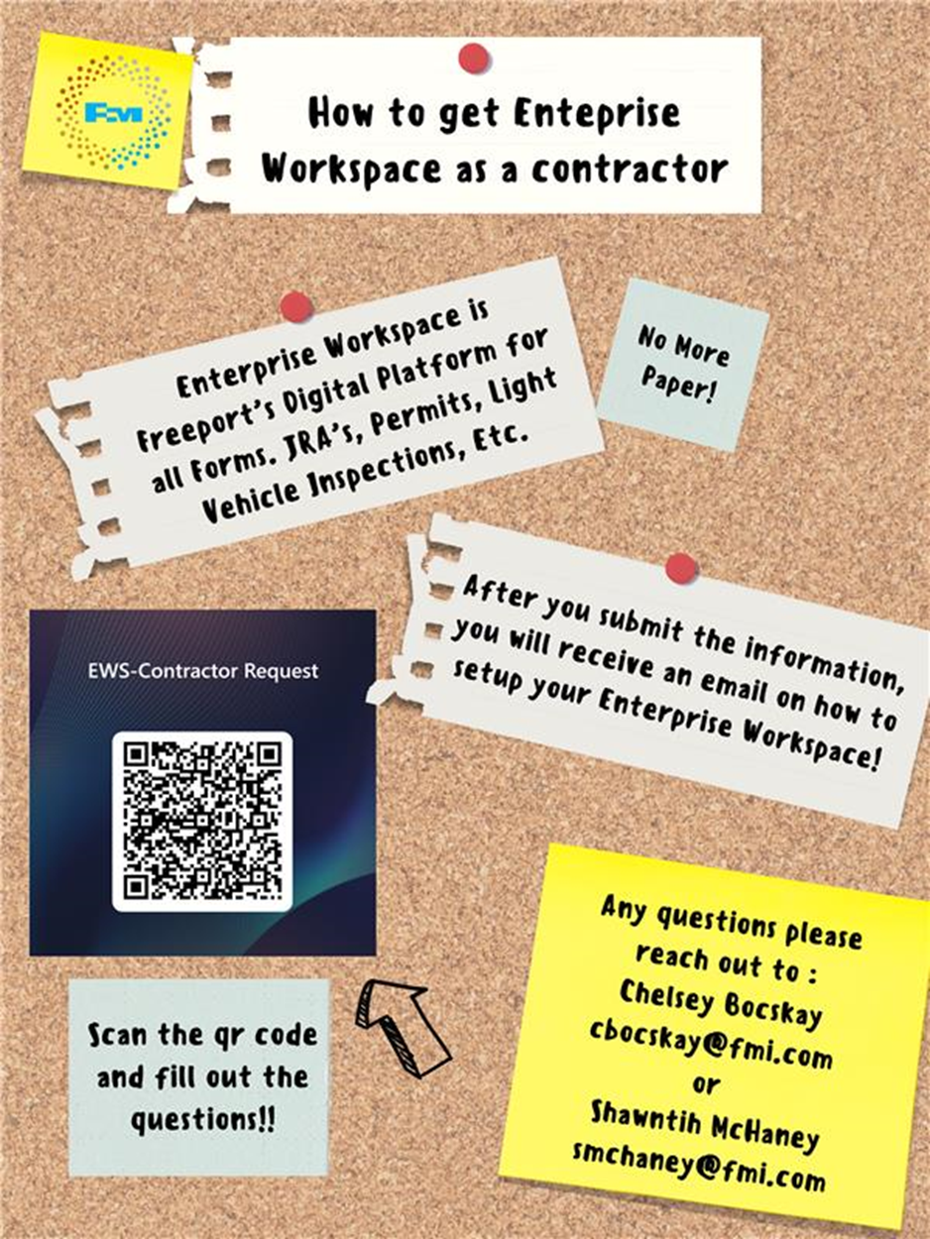
Contractor Management Topic – EWS Access
Access to site digital forms now available to Contractors!
Integration of Contractor submitted forms into internal dashboards
Forms can be used in online and offline modes
Request Access with QR Code or HERE
Reach out to H&S Department with any questions or issues

Slide 34
2025 Contractor Meeting Schedule
May 22nd
July 17th
September 11th
November 20th
June 19th
August 14th
October 9th
December 18th
Meetings begin 1PM Mountain Time
Mine & Mill Room Options Monthly

Slide 35
Open Forum

Slide 36
April Sign-Off Record
_____________________
_____________________
_____________________
_____________________
_____________________
_____________________
_____________________
_____________________
_____________________
_____________________
_____________________
_____________________
_____________________
_____________________
_____________________
_____________________
_____________________
_____________________
_____________________
_____________________

