Slide 1

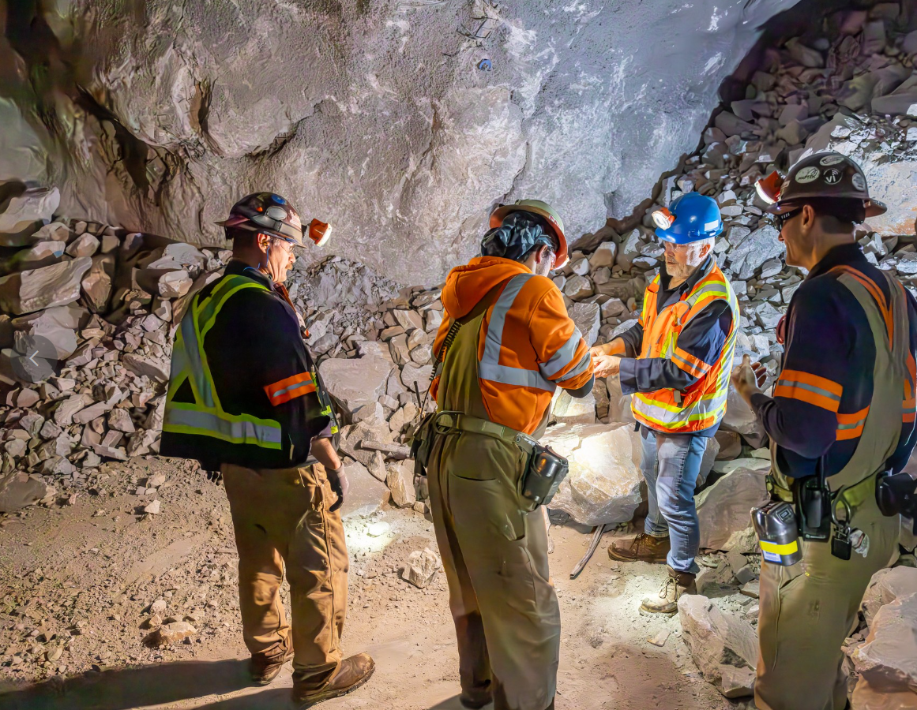


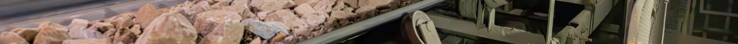
Henderson HSE Contractor Meeting
April 2026

Slide 2


What is the purpose of this Meeting?
- For Henderson to have the opportunity to reach multiple contractors to discuss best practices when it comes to Health and Safety, Environmental and Contracts Management
- Give contractors an open forum to bring up concerns, successes or incidents, learnings, etc. that is shared between all contractors and Henderson personnel
- Help improve the safety culture and reduce safety incidents as a group

Slide 3
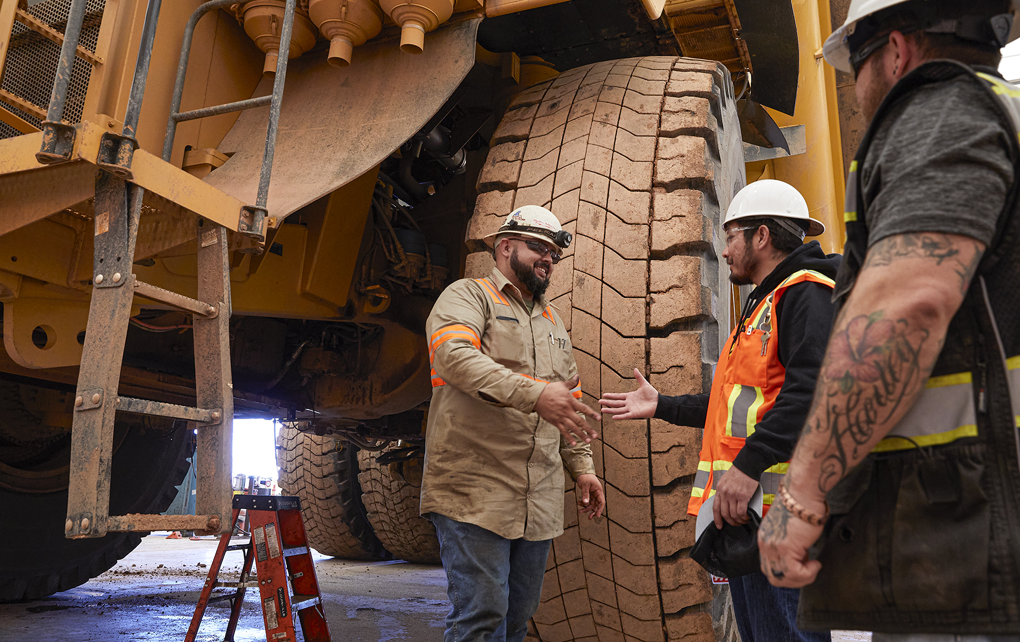
Safety Success

Slide 4

Spotlight On
How High-Risk Incident Reviews Are Strengthening Safety at Steubenville
At Steubenville, revised high‑risk controls - and crews sticking to the action plan - have made a difference not once, but twice when a truck stalled on an incline. Here’s a look at the most recent event and why these steps matter.
Incident Summary
On March 7, 2026, at the Satralloy Remediation Project in Steubenville, Ohio, a 745C haul truck stalled on a switchback due to reduced power. The operator followed training, stopped work and alerted supervision. The team halted traffic, secured the truck with chocks and staged a D6 dozer down grade of the stalled truck to protect personnel and other vehicles.
Action Plan Execution
The response was guided by a recovery plan created after a March 2025 Potentially Fatal Event at the same site. Supervisors and subject matter experts reviewed the Job Safety Analysis Plan, confirmed necessary controls and carried out a safe, efficient recovery. The truck was secured with no injuries or equipment damage, and work resumed only after successful safety checks.
Impact
These incidents exemplify the value of stopping work early, following established action plans and applying corrective actions consistently. The controls put in place through high‑risk incident reviews are helping prevent serious incidents.
Discussion
What steps can we take after an incident to help implement lasting solutions?
How can we continue to utilize lessons learned and incident investigations to reduce risks in our own work?

Slide 5

Spotlight On
Chino: Effective Controls and Emergency Preparedness
Incident: A water truck caught fire when the charge valve from the turbo line to the brake accumulator came loose. The operator was driving when the fire suppression initiated. They followed the proper procedures in shutting down the engine, aimed the wheels towards the berm and safely evacuated the equipment.
Key Takeaway: Injuries and extensive damage were avoided because of effective controls and operator preparedness.
Click here to access Equipment Fire Safety Lineouts – including procedures for drills, haul trucks, loaders, shovels and support equipment.

Slide 6
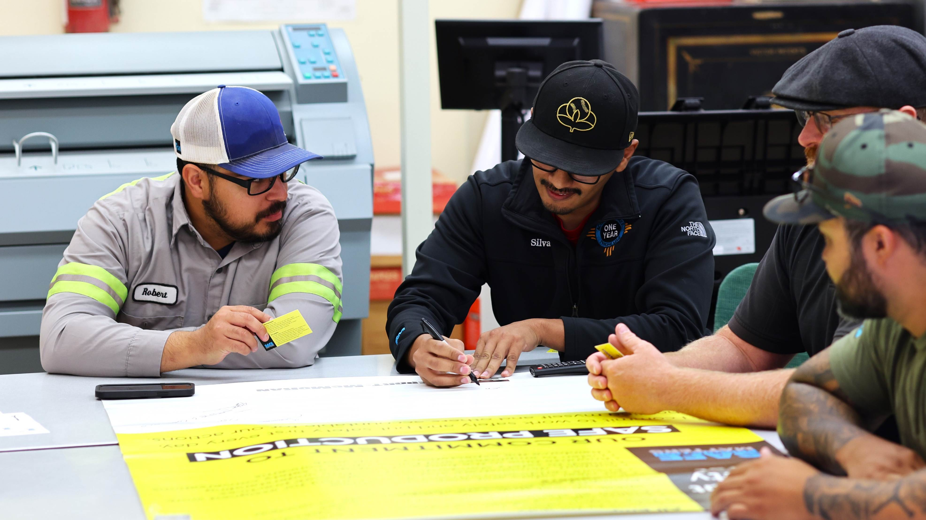
Safety Shares

Slide 7
Wildfire Smoke Hazards
Many of our operations are in areas prone to wildfires. After a dry winter, vegetation dries out sooner, increasing fire risk and making wildfire smoke more common during spring and summer. This smoke contains fine particles (PM2.5) that can impact breathing, visibility and overall health.
Air quality can change quickly, even without a nearby fire, as smoke travels long distances. This reinforces the need to stay aware, monitor conditions and adjust work as needed.
Symptoms to Immediately Report
Wheezing, breathing difficulty or shortness of breath
Asthma attacks
Chest pain or signs of cardiac distress
Nausea or vomiting
Sudden numbness or weakness
Sudden confusion or trouble speaking
Sudden vision changes
Dizziness, loss of balance or coordination issues
Severe headache with no known cause
When Smoke Levels Are Elevated
Use N95s or fitted respirators.
Limit outdoor and high-exposure work.
Utilize cleaner air spaces, such as vehicles, buildings or trailers with functioning air filtration.
Monitor air quality and adjust work plans as conditions change.
Limit outdoor and high-exposure work.
Remember: If you see fire, immediately contact your site emergency services. If you notice smoke that hasn’t been reported or accounted for, report it and notify your supervisor.
Click here to access Wildfire Smoke Guidance including monitoring protocols and smoke alert levels.

Slide 8
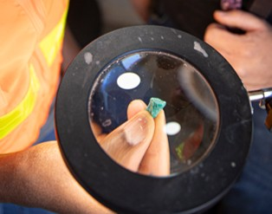



Environmental and Safet Shares:
OHSMS and EMS Assessment Results

Slide 9

Management System Assessments
What is a Management System?
A structured framework that supports us achieving our objectives and improve performance
Connects the strategic goals of the organization to day-to-day operations
Core of our systems are PLAN-DO-CHECK-ACT
What does a Management System assessment look like?
Corporate or 3rd-party team onsite
Review policies, programs, processes that support the system
Go out in the field and verify we do what we say
Follow up on strength and improvements
Share with the site and develop Corrective Actions/Plans make us better
At Henderson:
Occupational Health and Safety Management System (OHSMS) assessment completed on 03/12
Environmental Management System (EMS) assessment completed on 04/02

Slide 10
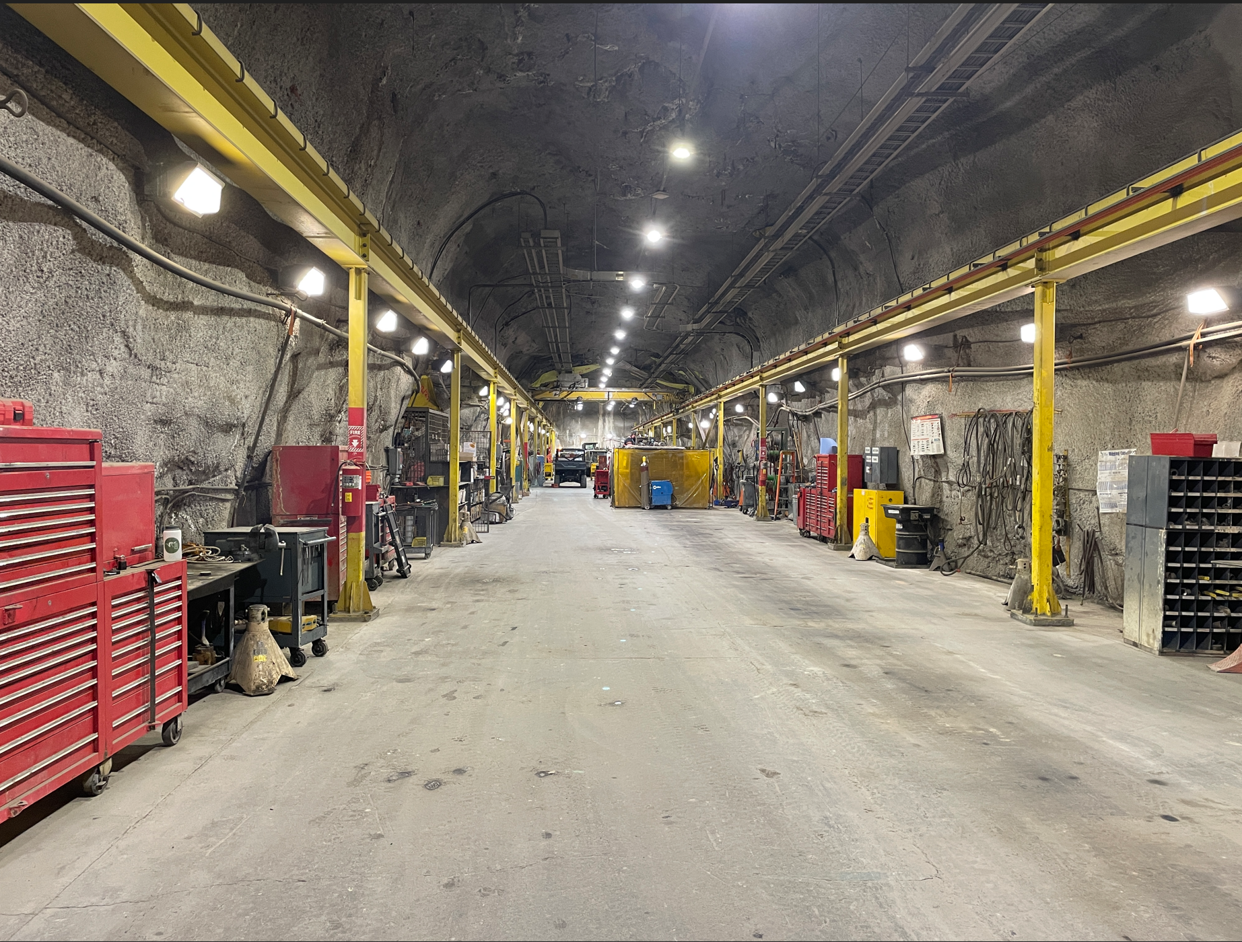
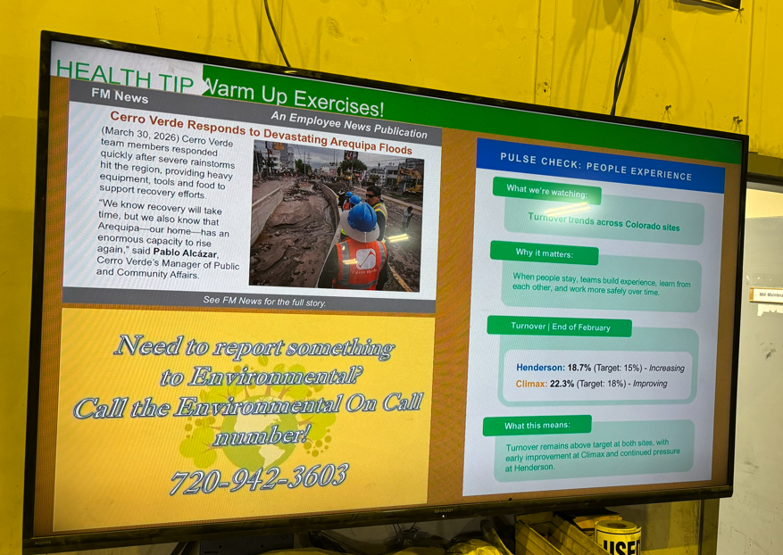
2026 EMS (ISO 14001) Results
Strengths:​
Thorough RCA, RCA Process, and Communication of Results
Improved VNET utilization, contractor and employees HSE meeting, and bulletins for Environmental Communication
Great site wide collaboration, especially surrounding OKRs
Environmental Management reviews are effectively implemented and the EMS clearly supported by leadership
Environmental communication is evident throughout the site, including front line employees.
Site cleanliness is exceptional

Slide 11
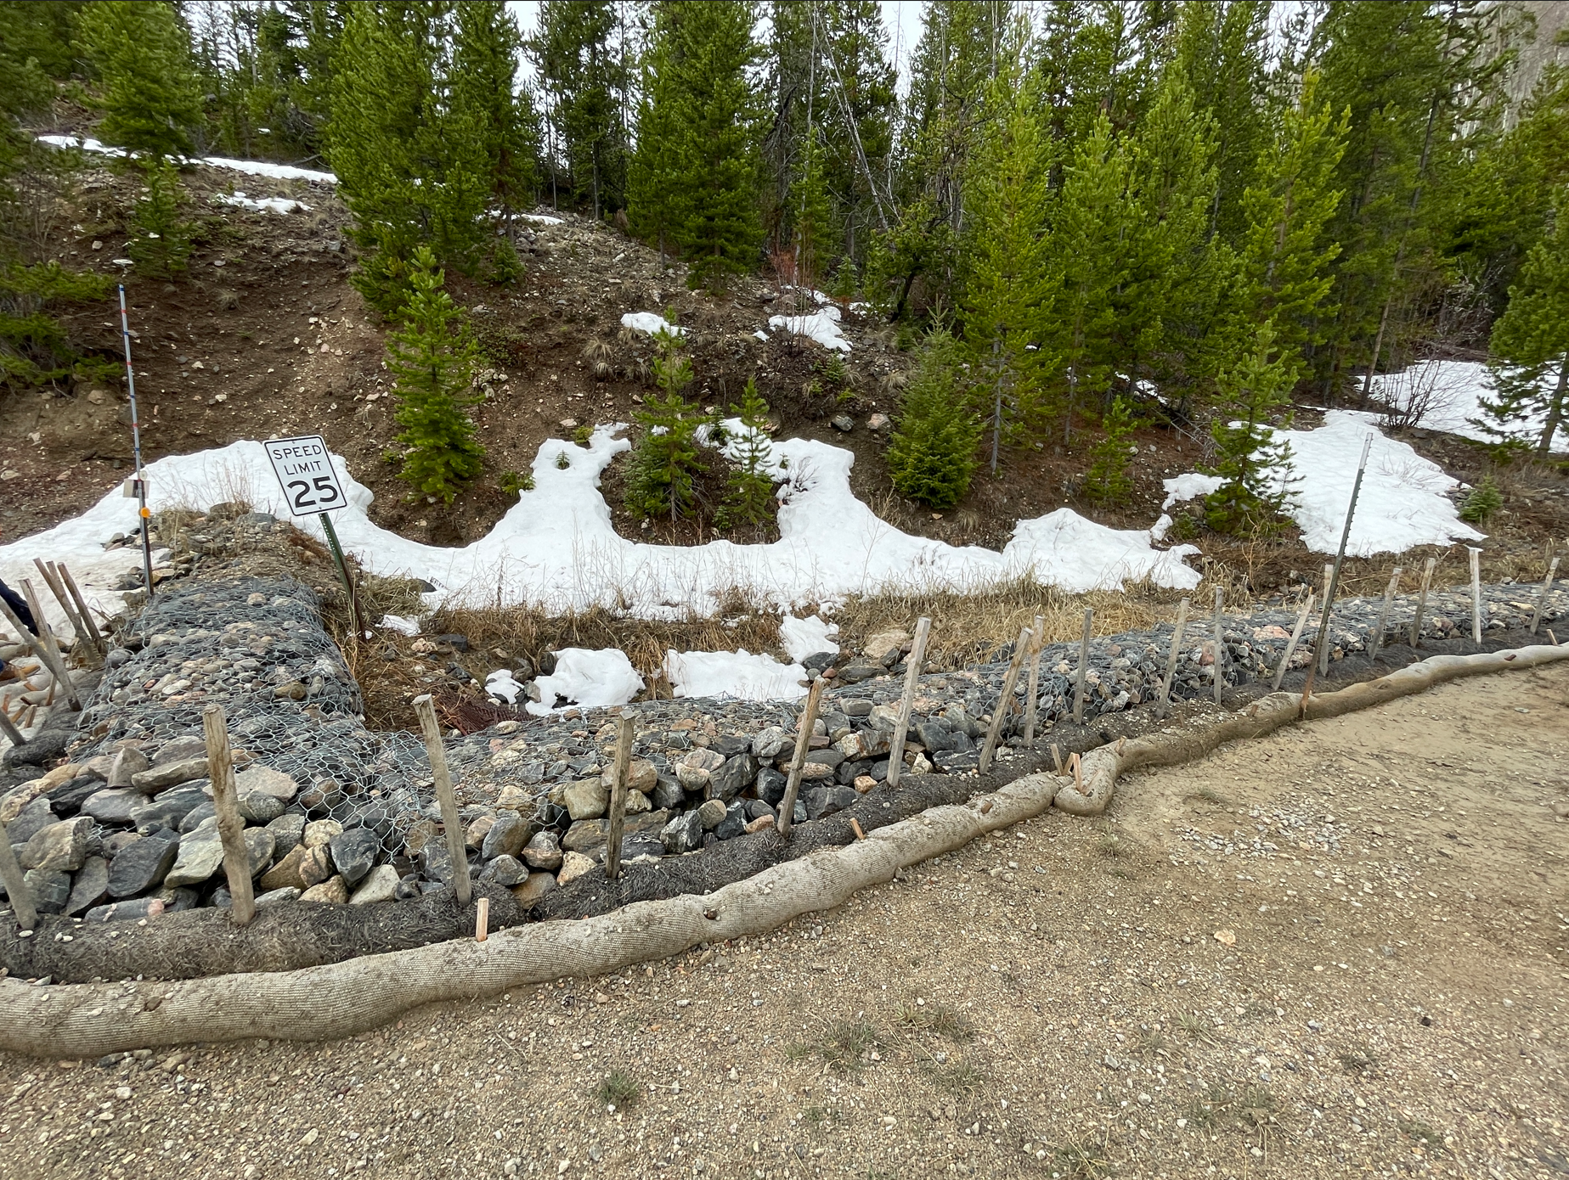
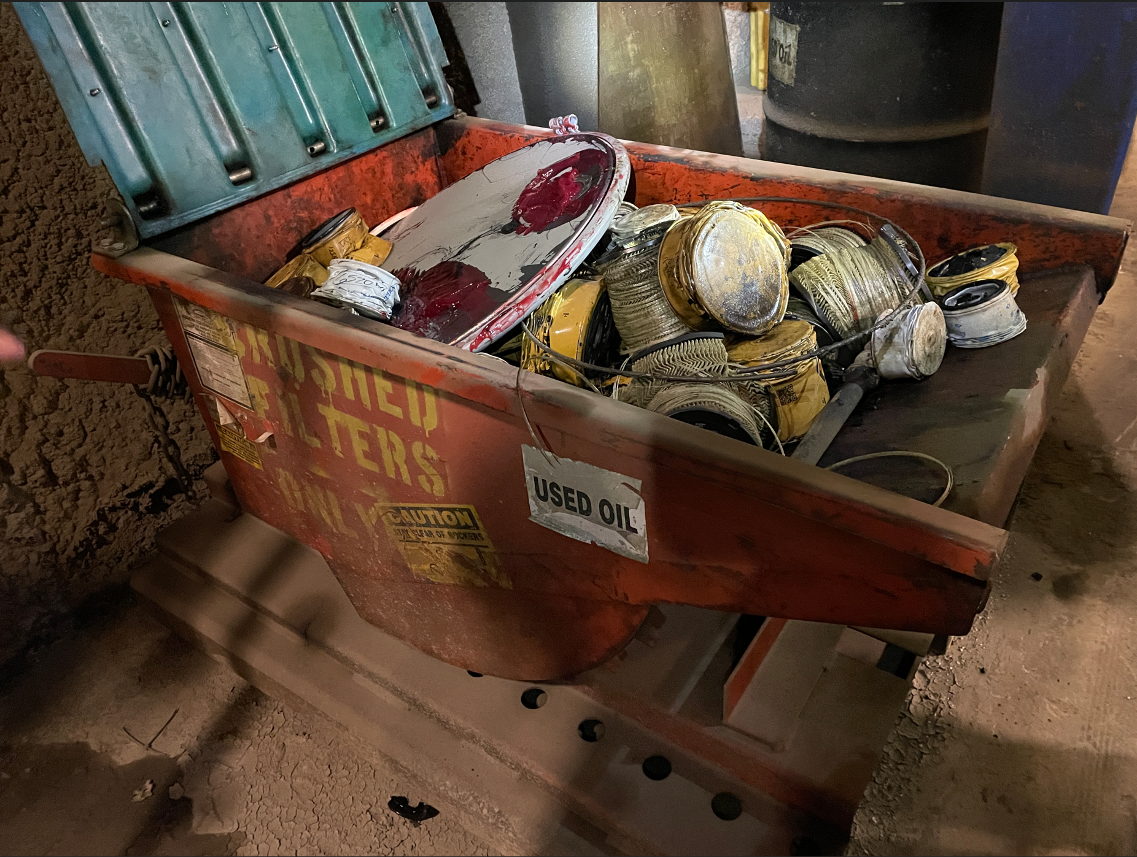
2026 EMS (ISO 14001) Results
Improvements:​
0 Minor Nonconformance
4 Observations
Compliance documentation records, waste building scale calibrations
5 Recommendations
Organizational roles documentation, risk register clarifications, flammable cabinet audits, water meeting action item tracking

Slide 12
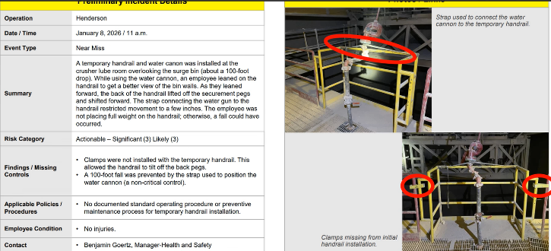
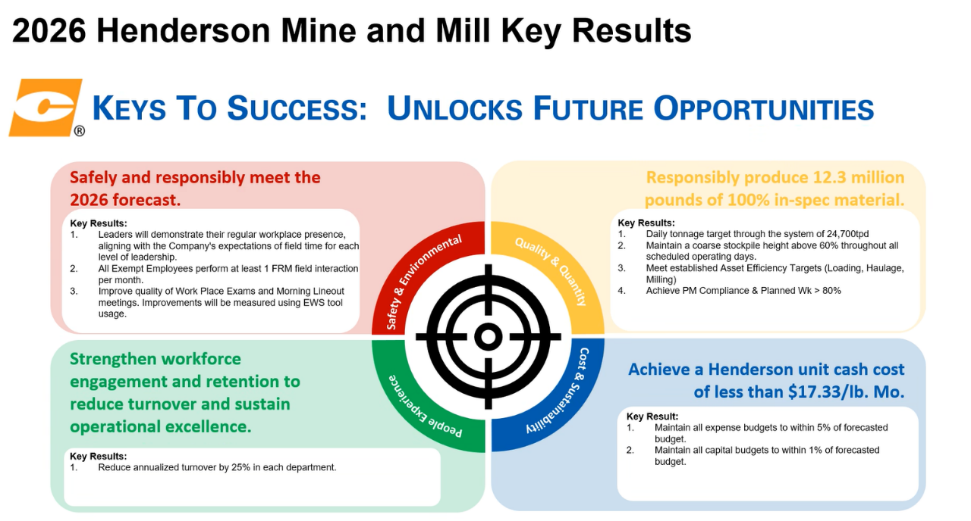
2026 OHSMS (ISO 45001) Results
Strengths:​
Leadership engagement and ownership in the H&S program
Open, candid and passionate H&S & Field personnel
Corporate engagement to support site with tools & resources is also very good
Corrective action tracking and root cause analysis (RCA) is well done using Enablon, Power Bi and Share Point
Henderson key results and objectives trickled down throughout the organization to unlock future opportunities.

Slide 13
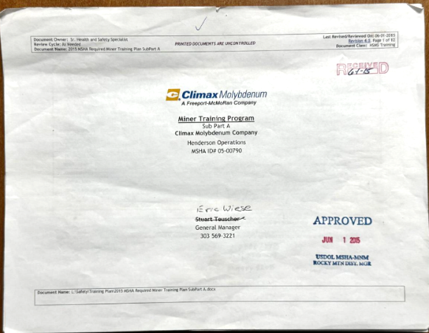
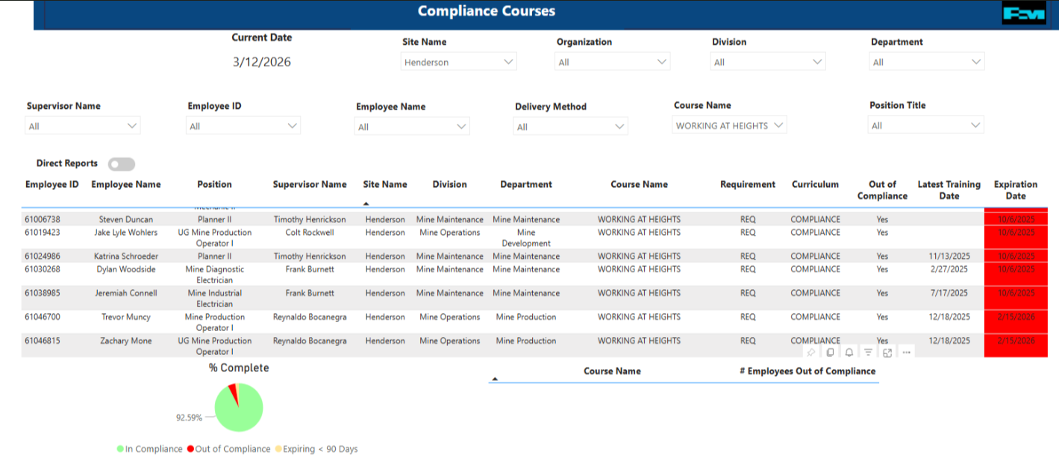
2026 OHSMS (ISO 45001) Results
Improvements:​
2 Minor Weaknesses
Management of Change Process, Effective use of JRA, SOP, WPE
2 Observations
Document control of MSHA-approved Training Plan, overdue compliance training

Slide 14
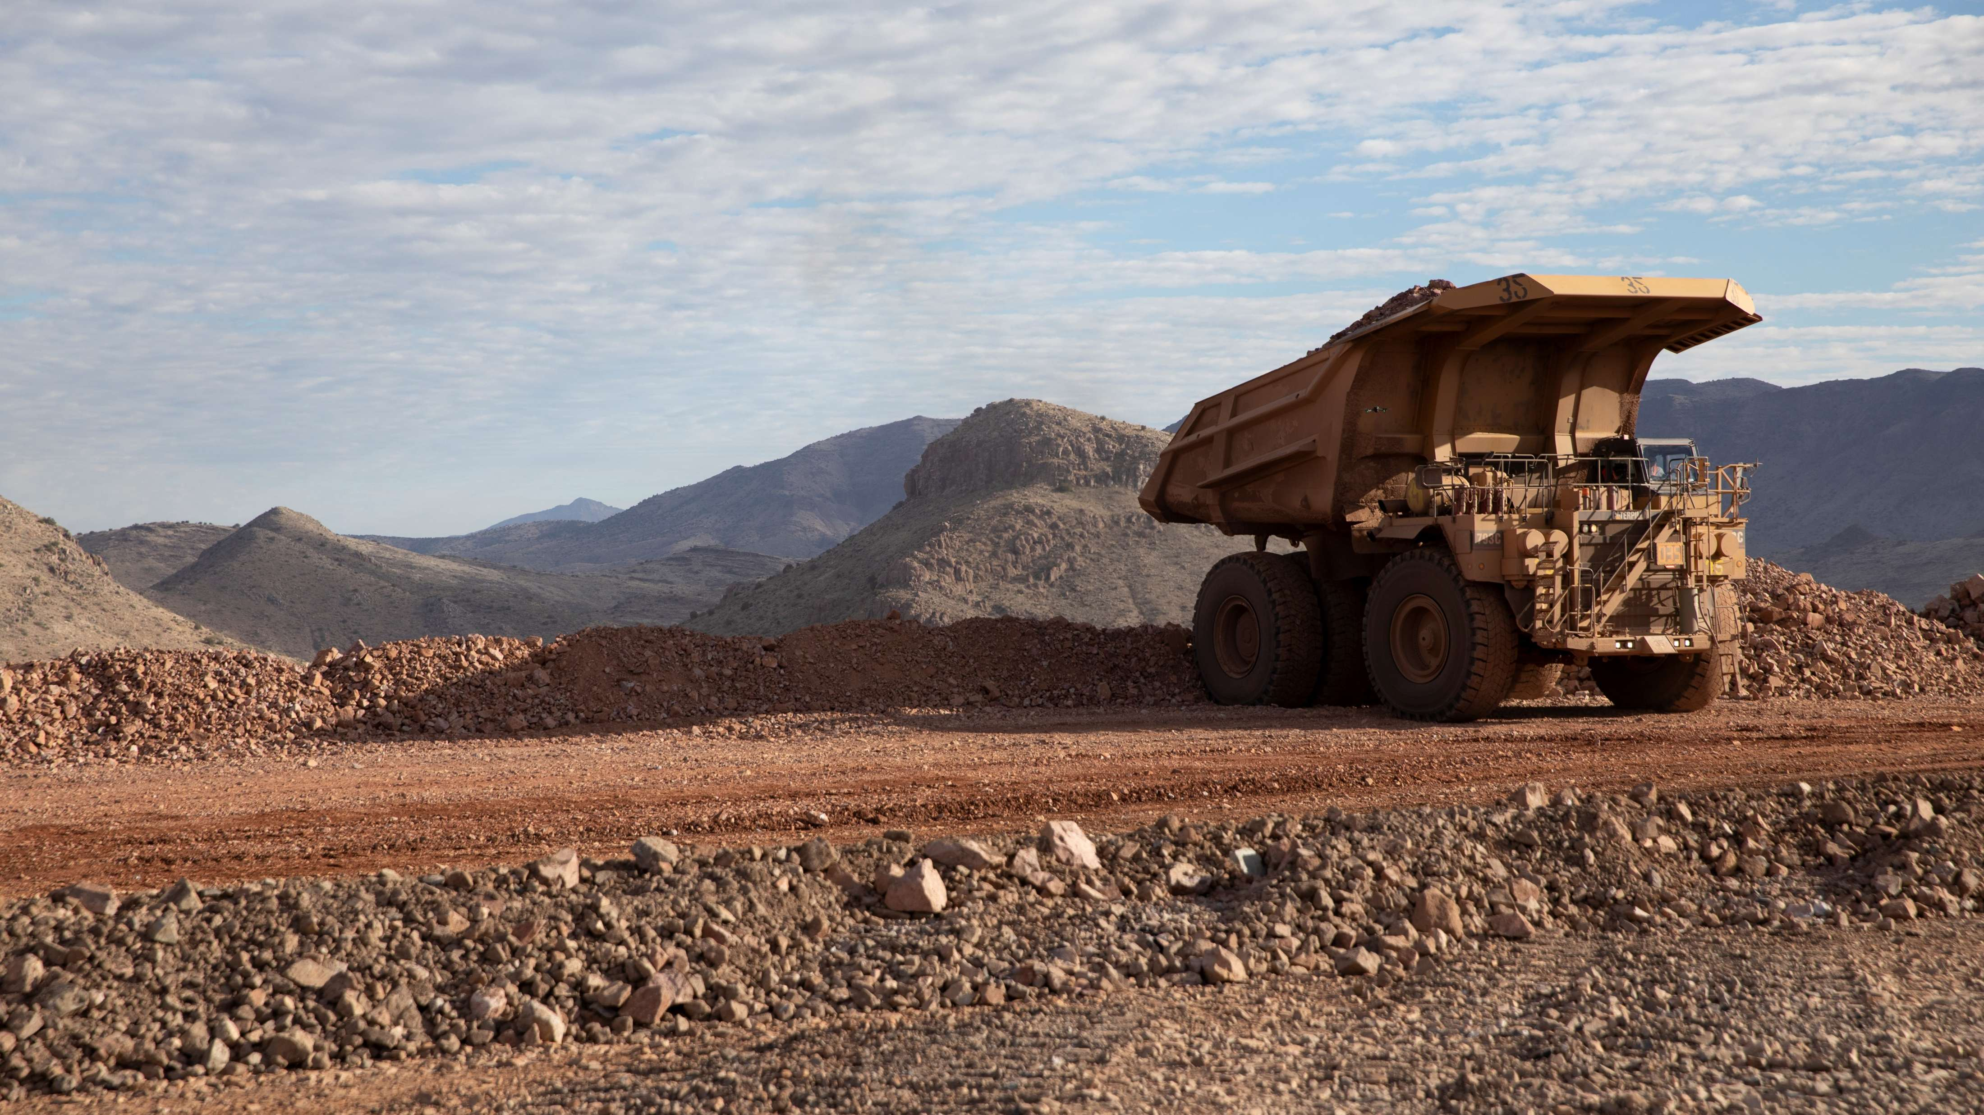
High-risk Incidents
Actionable and PFEs

Slide 15

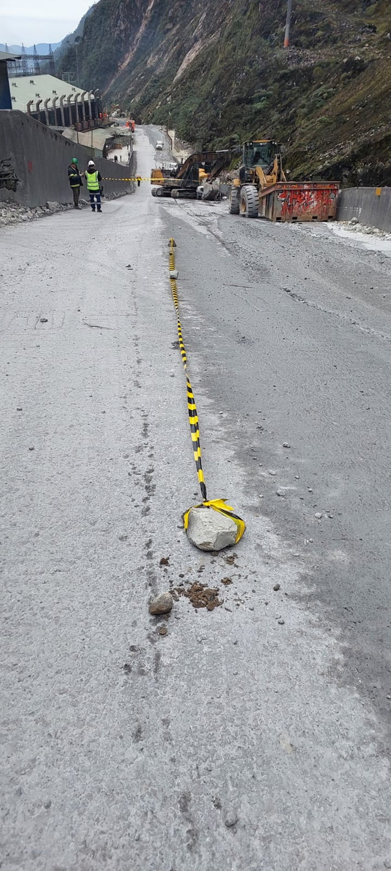
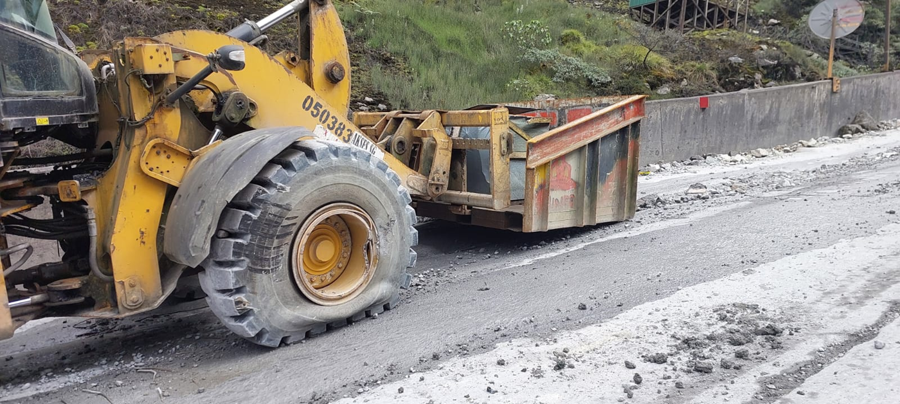
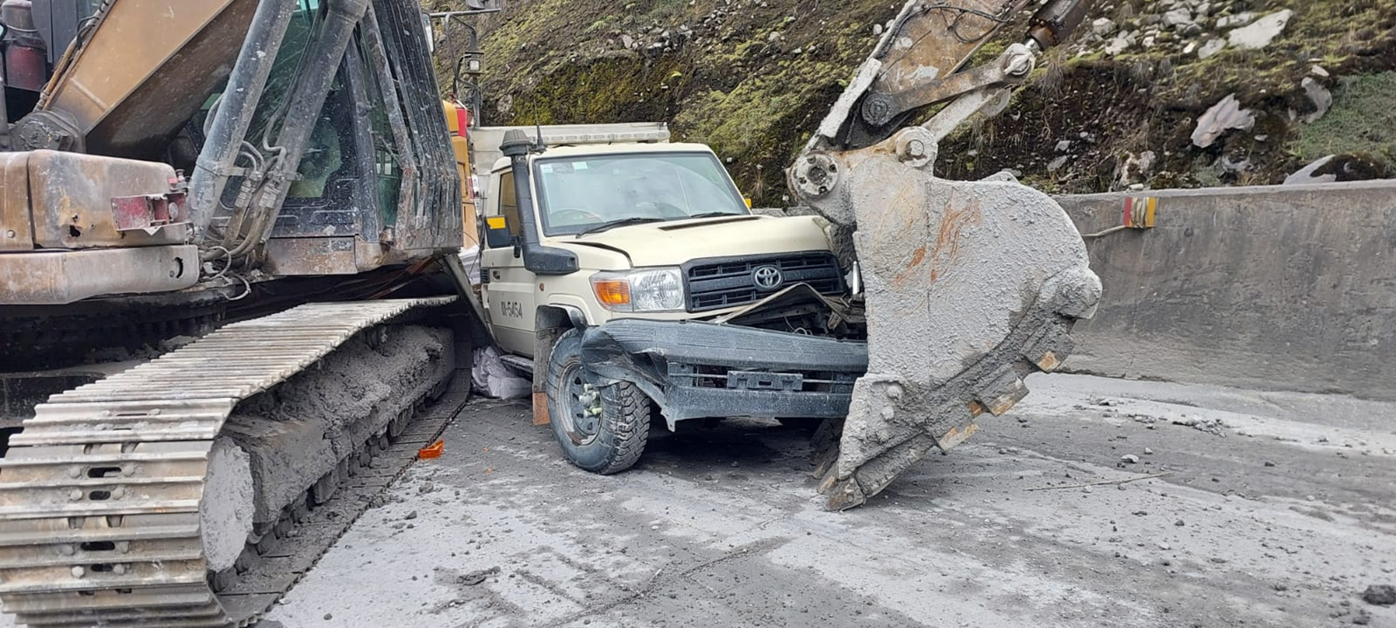
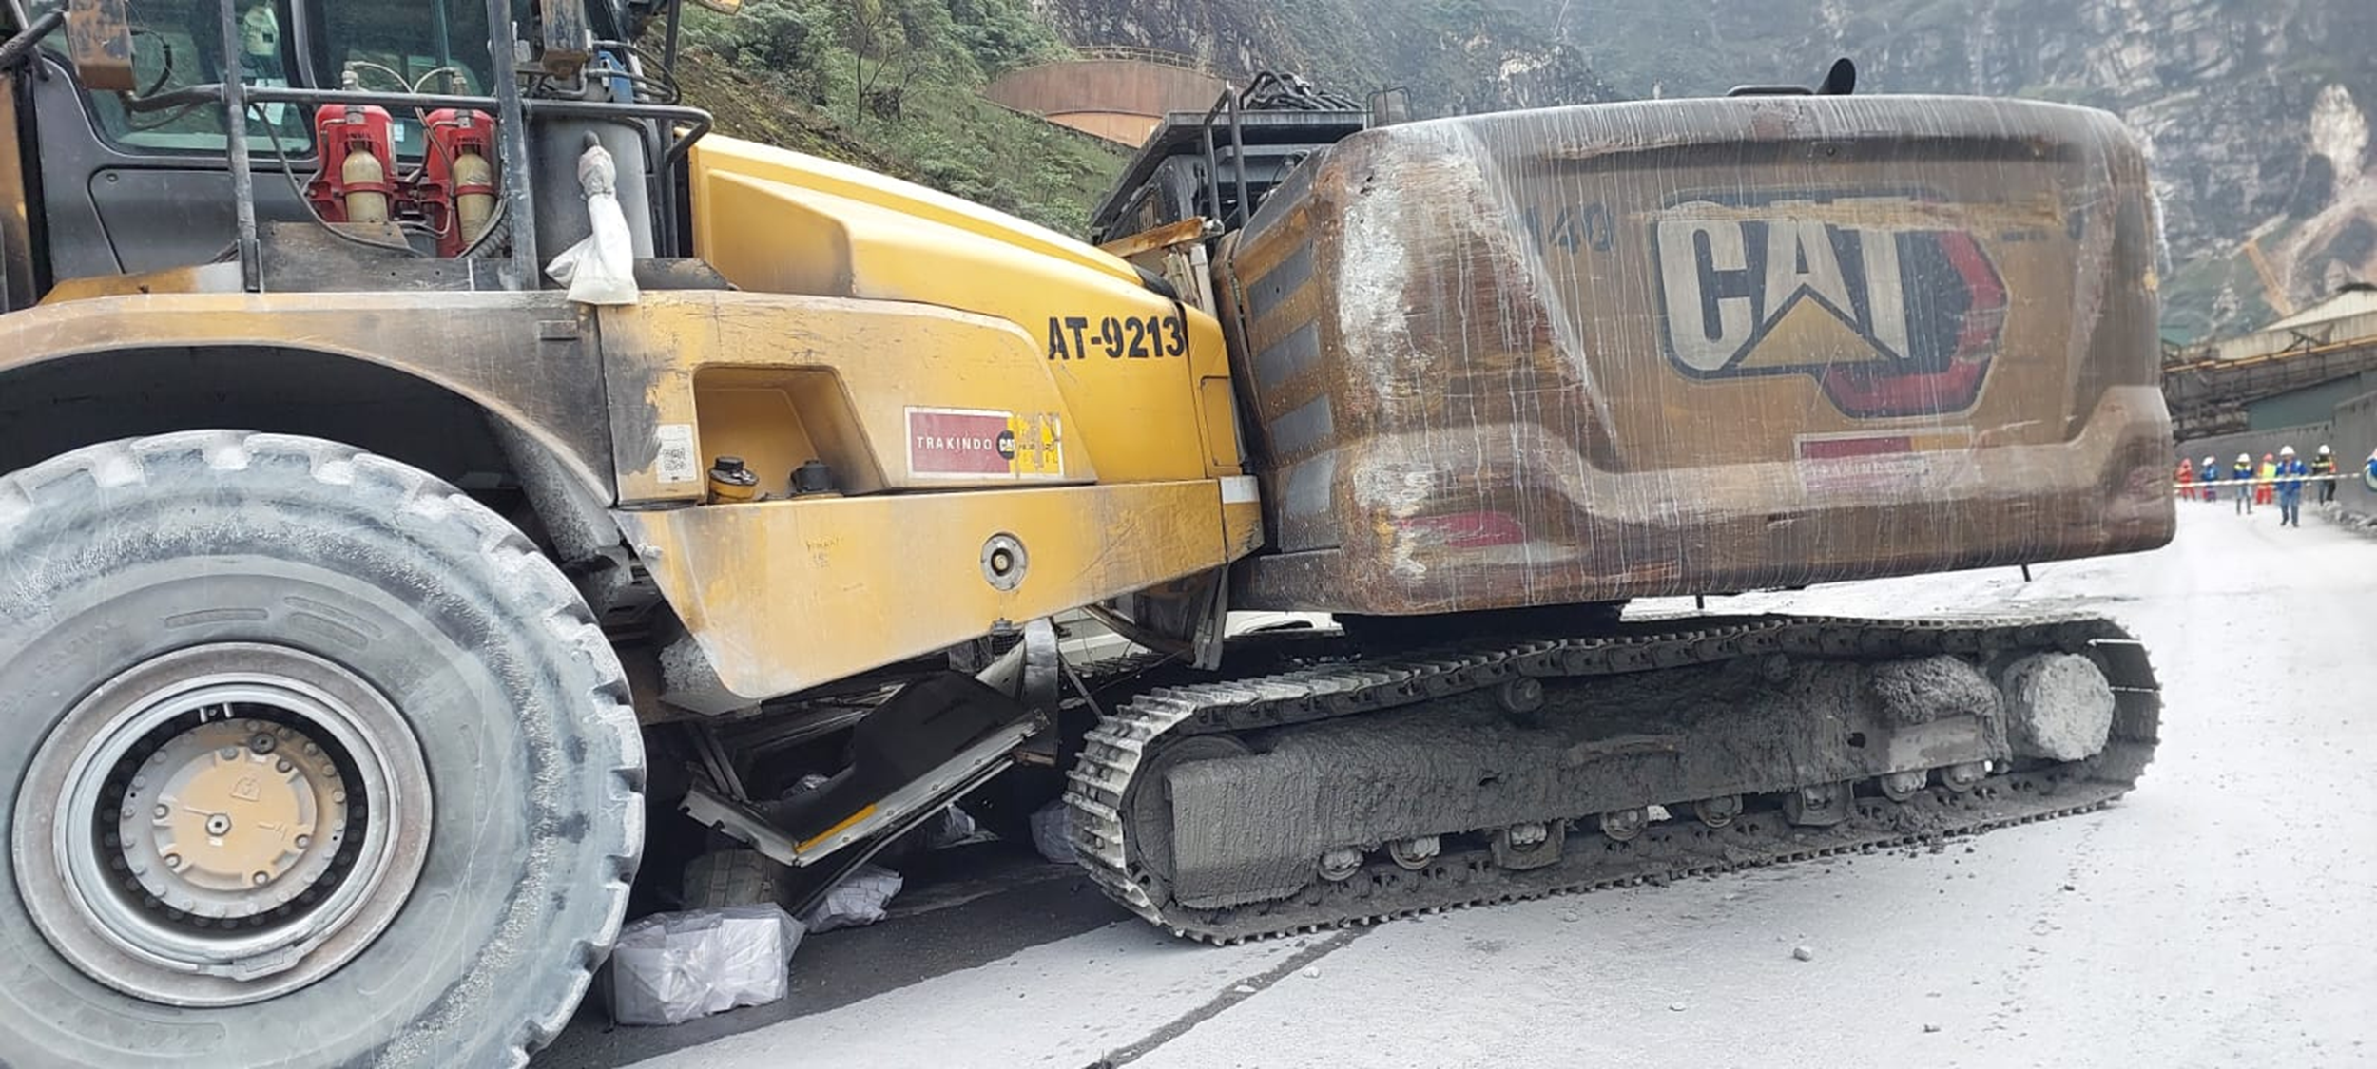
Excavator Uncontrolled Slide
Vehicle Collision or Rollover
PFE # 2026-02 Event ID # 20034164
Preliminary Incident Details
Operation | PTFI
Date / Time | March 4, 2026 / 08:45 a.m.
Event Type | Property Damage
Summary | An excavator was traveling down a concrete access road when it lost traction and began to slide uncontrolled. The operator tried to stop the equipment using the bucket, which caused the rear end to swing left and side-swipe the right side of a nearby forklift, damaging its front tire and wheel. The excavator continued sliding and then hit an occupied light vehicle that was reversing behind the forklift, followed by an articulated truck behind the light vehicle. The articulated truck operator turned the front of the equipment toward the excavator to bring it to a stop. In total, the excavator slid about 58 meters (190 feet) and struck three vehicles.
Risk Category | Actionable – Significant (3) Likely (3)
Findings / Missing Controls | Current procedures and work instructions do not regulate safe practices for excavators tramming on concrete roads with a grade, such as requiring the use of mobile equipment assistance for towing.
Applicable Policies / Procedures | WI-6.01-UG-E71 Operation of Excavator in Underground and Surface Mining Areas
Employee Condition | The two light vehicle passengers received minor cuts and abrasions and were released without restriction. All other operators were uninjured.
Contact | Andri Abdullah, Manager-UG Operational Safety
1st contact - forklift
2nd contact – light vehicle
Approx. 58m (190 ft)
Distance excavator slid down road.
3rd contact – articulated truck
Photos of each vehicle contacted during uncontrolled slide.

Slide 16

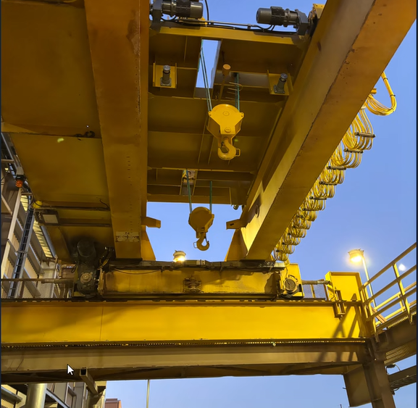
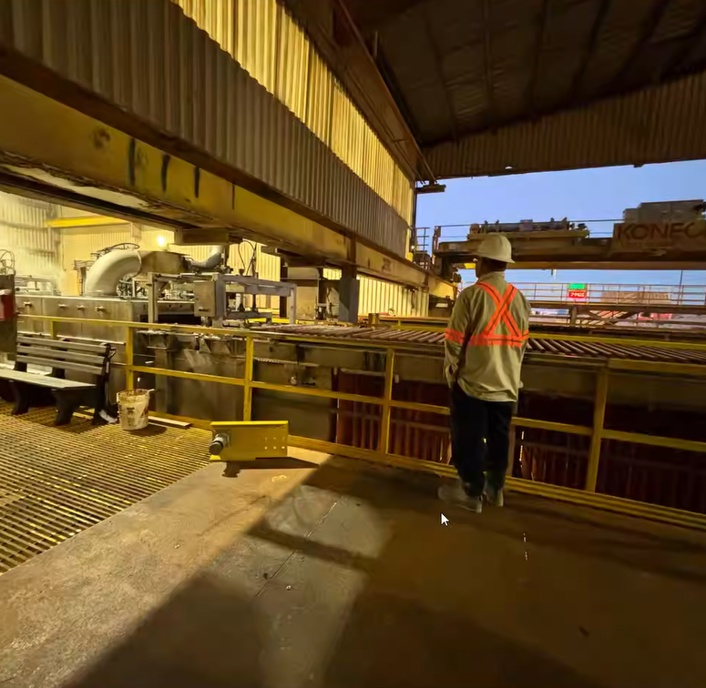
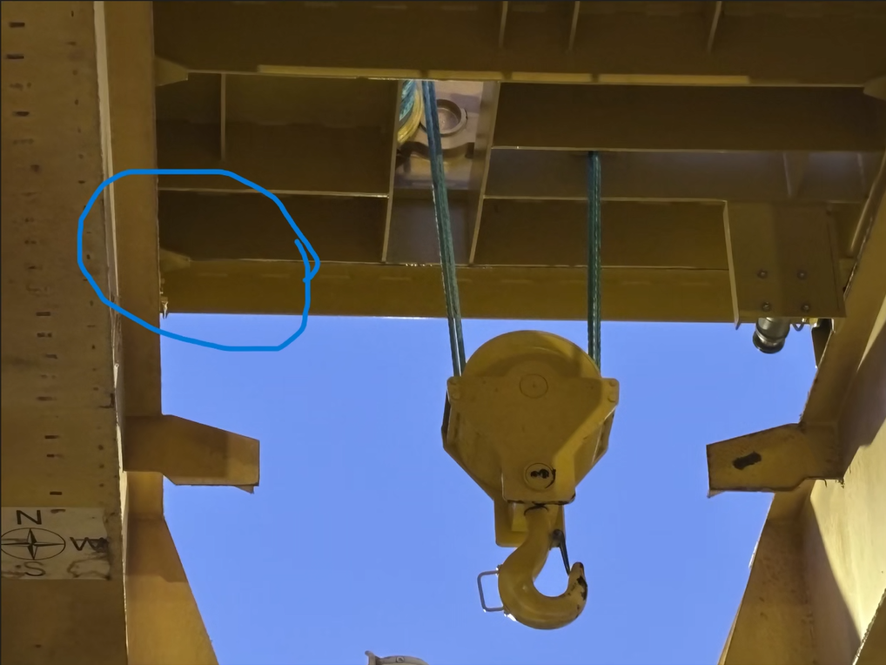
Crane Trolley Stop Failure
ID # 2026-04 Event ID # 20034247
Falling Objects
Preliminary Incident Details
Operation | Safford
Date / Time | March 6, 2026 / 6:15 a.m.
Event Type | Near Miss
Summary | During overhead crane operations, an 80-pound trolley stop broke loose, fell 15 feet and landed approximately 6 feet from the operator. Watch the incident video here.
Risk Category | Actionable – Significant (3) Likely (3)
Findings / Missing Controls | The crane recently had been rebuilt by a contractor. It was released back to site on March 1, 2026. The trolley stop had only been tack-welded at the factory.
Applicable Policies / Procedures | FCX-HS32 Crane and Rigging Policy
Immediate Required Action(s) | Site teams are coordinating prompt action to verify the structural integrity of all stops.
Employee Condition | No injuries.
Contact | Shannon Jeans, Manager-Health and Safety
Overhead crane and trolley stops.
Reenactment of operator position and position of fallen trolley stop.
Location of fallen trolley stop.

Slide 17

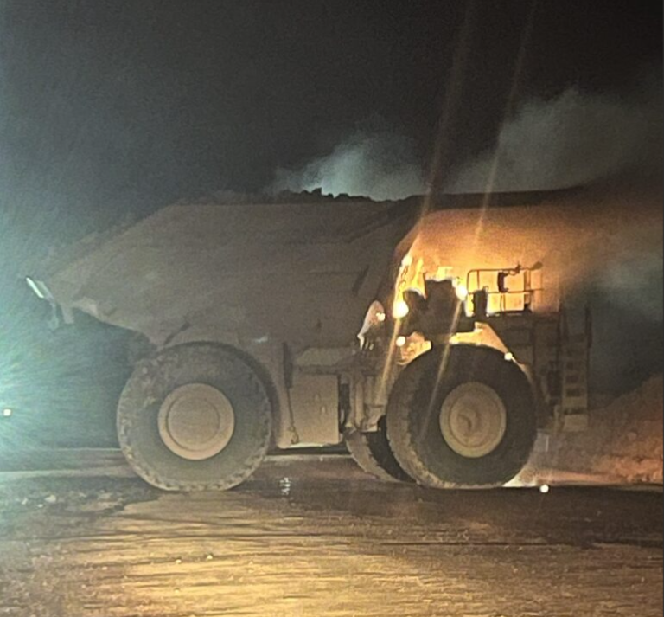
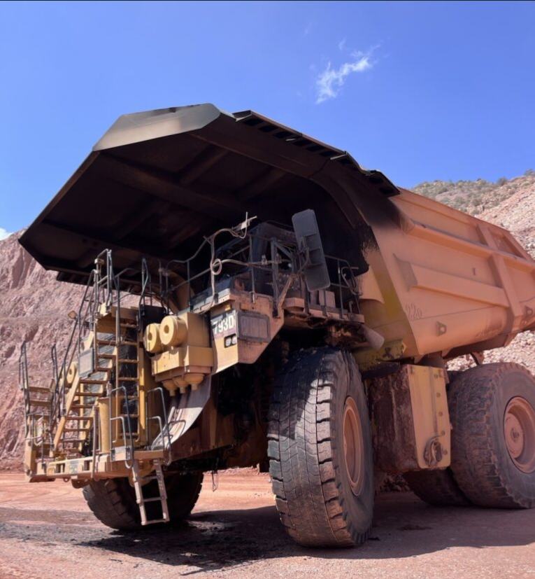
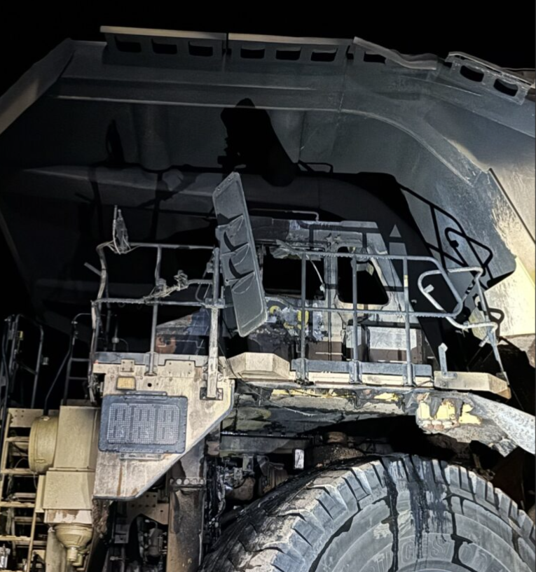
Haul Truck Fire
PFE # 2026-03 Event ID # 20034284
Fire
Preliminary Incident Details
Operation | Morenci
Date / Time | March 9, 2026 / 3:45 a.m.
Event Type | Lost Time
Summary | A loaded haul truck was travelling up a ramp when smoke and flames came from the engine bay. The operator tried to stop the truck after the fire suppression was initiated. The truck rolled backward 143 feet, struck a highwall side berm and kept rolling. Once it stopped, the operator was able to exit the cab and dismount the truck. While exiting, the operator came into contact with the fire and sustained burn injuries.
Risk Category | Pending
Findings / Missing Controls | This incident is still under investigation. The cause of the fire is currently unknown. The operator attempted to use the retarder and secondary brake to stop the truck.
Applicable Policies / Procedures | No applicable policies.
Employee Condition | The operator sustained first- and second-degree burns to the face and hand and was treated for smoke inhalation.
Contact | Jeff Tysoe, Manager-Haulage Belen Lawrence, Manager-Health and Safety Anthony Lujan, Senior Supervisor-Health and Safety
Fire damage to haul truck.

Slide 18
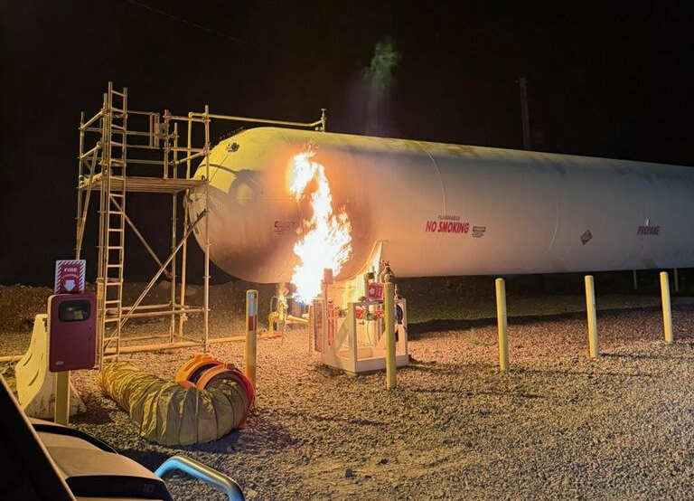
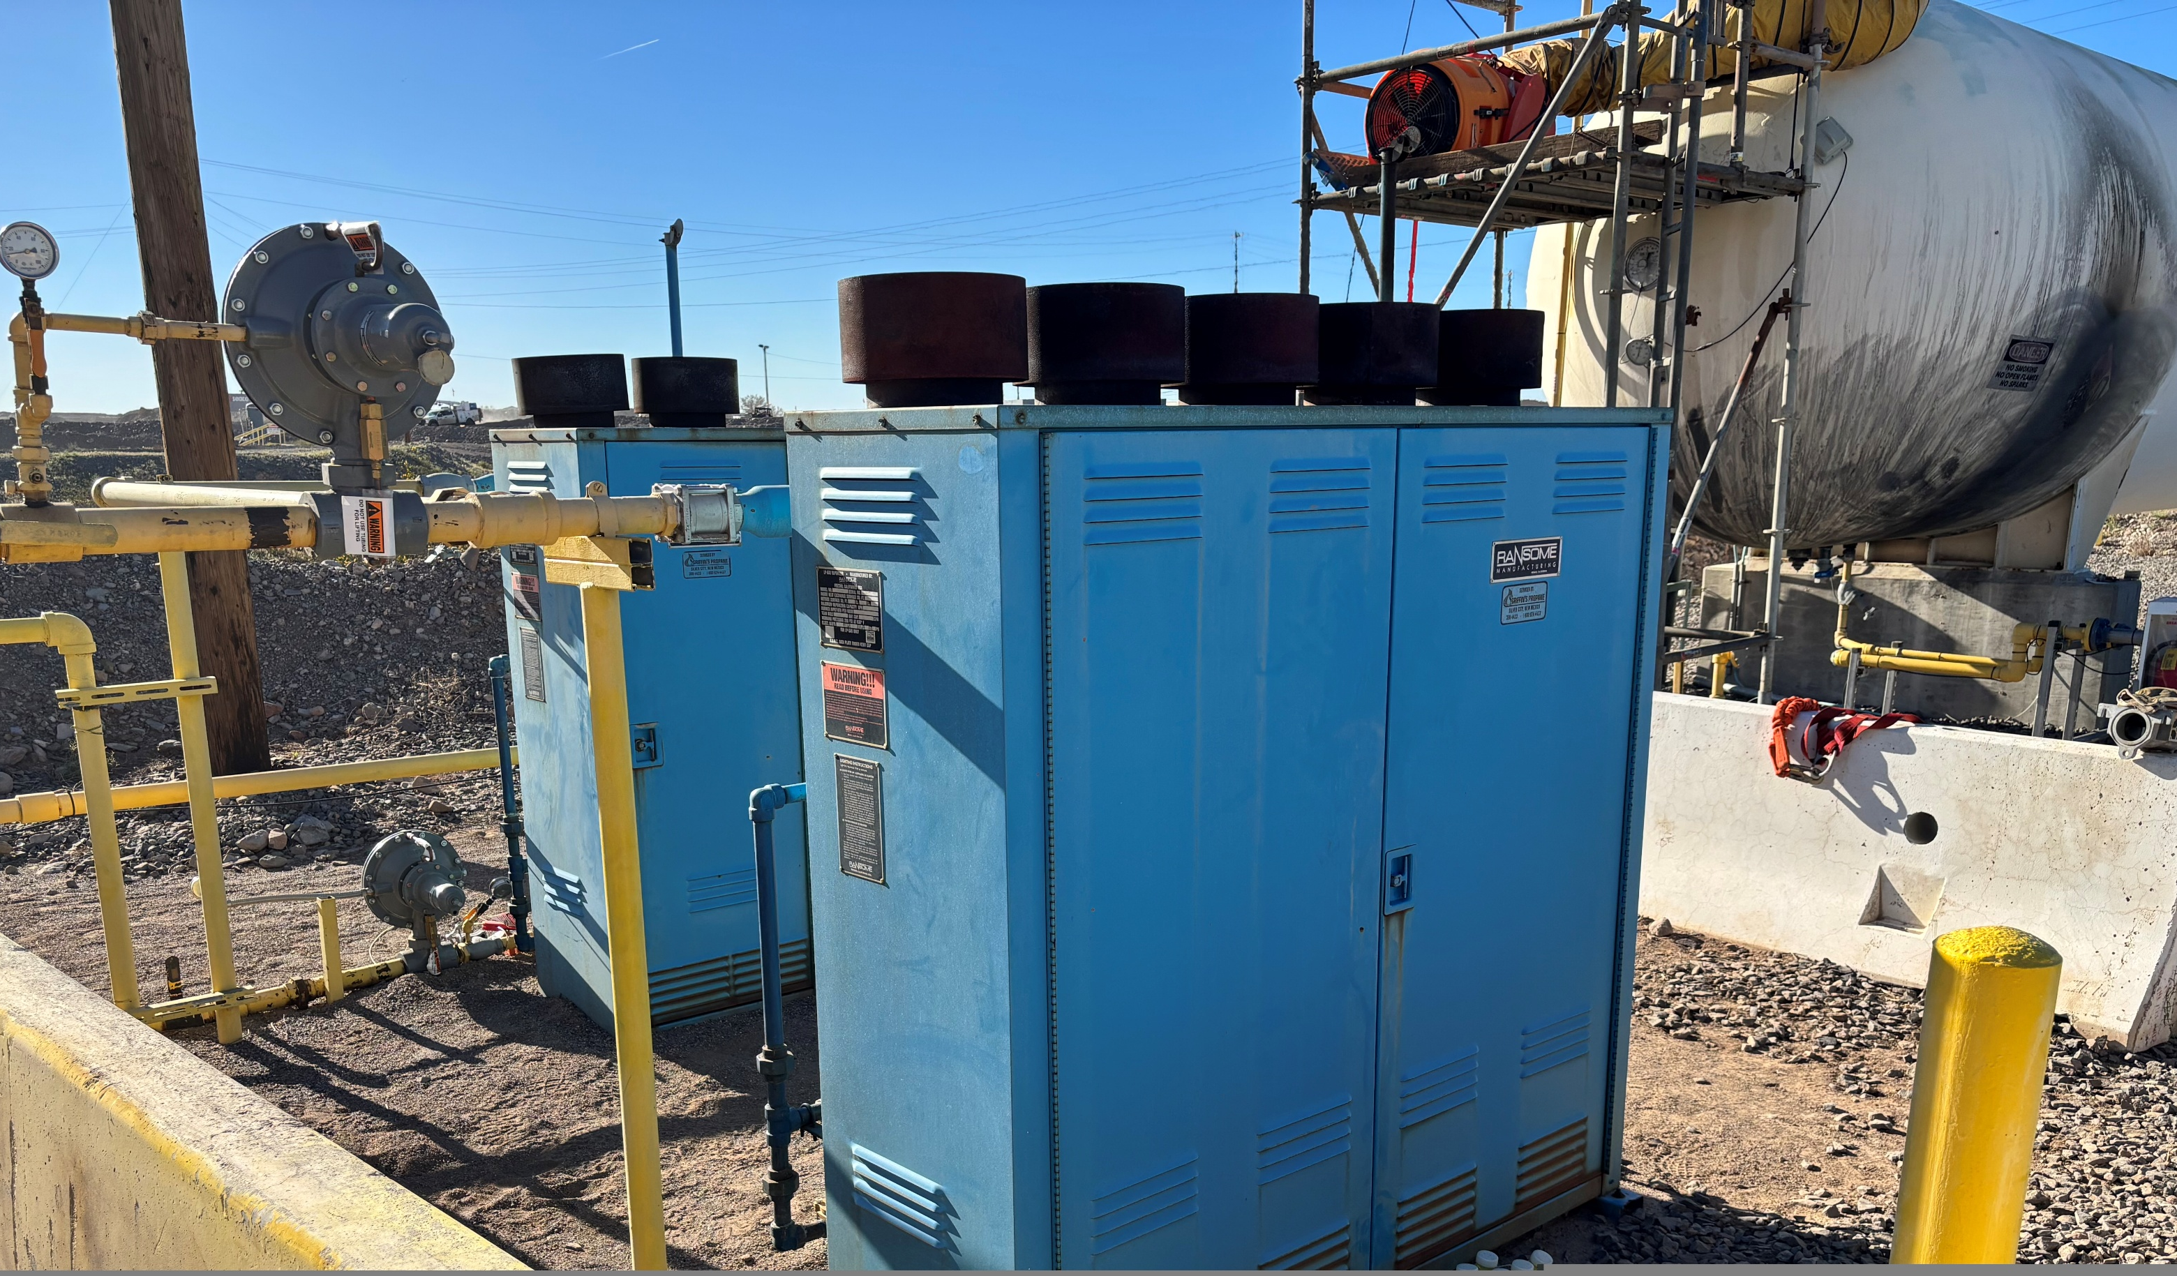
Propane Tank Fire
ID # 2026-05 Event ID # 20034529
Fire
Preliminary Incident Details
Operation | Safford
Date / Time | March 16, 2026 / 9:02 p.m.
Event Type | Property Damage
Summary | A 30,000-gallon propane tank was being prepared for cleaning and emptied by a contractor. After removing the propane from the tank, the contractor left the top access cover (manhole) and a pipe connection point on the bottom of the propane tank open. This allowed residual propane vapors to escape. Nearby propane vaporizers, which are used to heat liquid propane, had not been identified as ignition sources. The escaping vapors migrated toward the vaporizers and ignited, resulting in a fire. A truck driver nearby noticed the fire and called the control room operator. Employees extinguished the fire shortly after.
Risk Category | Actionable – Significant (3) Likely (3)
Findings / Missing Controls | After removing the propane and opening the manhole and bottom pipe connection, the contractor left the site. The area was not being monitored when the fire ignited.
Applicable Policies / Procedures | FCX-HS04 Control of Hazardous Energy Policy
Employee Condition | No injuries.
Contact | Shannon Jeans, Manager-Health and Safety
Propane tank fire.
Propane vaporizers near propane tank.

Slide 19

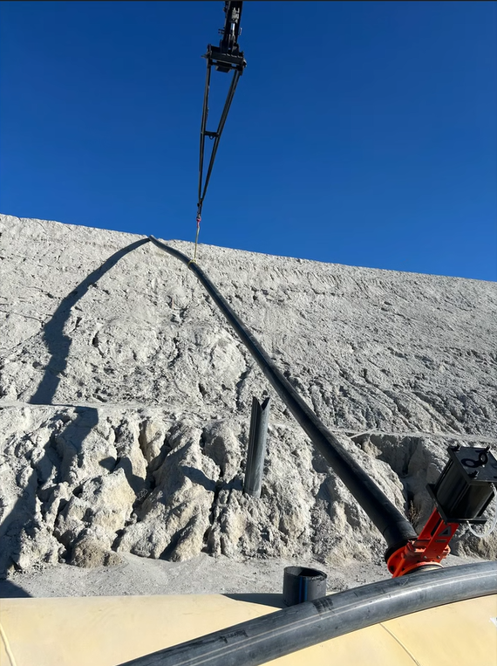

HDPE Pipe Fuse Failure
Uncontrolled Release of Energy
ID # 2026-07 Event ID # 20034774
Preliminary Incident Details
Operation | Sierrita
Date / Time | March 24, 2026 / 10 p.m.
Event Type | Injury – First Aid
Summary | A crew was installing an 8‑inch‑diameter, 110‑foot HDPE bleeder pipe with a load weight of 495 pounds. The pipe was positioned on a slope, which left portions of the pipe elevated. While the pipe was being flanged to the downslope main feed line, a telehandler was used to support it. During this process, an employee was beneath the pipe removing rigging when a fused joint failed at the base of the pipe. When the rigging was removed, the pipe shifted, dropped approximately 2 feet and struck the employee in the head.
Risk Category | Actionable – Significant (3) Likely (3)
Findings / Missing Controls | A gap was identified between the written procedure and the work being performed. Per the standard operating procedure, the impacted employee should not have been in that position during the task.
Immediate Action(s) | Reinforce correct rigging methodology with crews. Verify established procedures are being followed through active field checks, discussions and review of standard operating procedures. Review tasks involving line‑of‑fire exposure and suspended loads with employees to verify risks are recognized and appropriate controls are in place.
Applicable Policies / Procedures | FCX-HS32 Crane and Rigging Policy FCX-HS12 HDPE Pipe Handling Policy
Employee Condition | The impacted employee was assessed on-site and at a local medical facility. No injuries were identified.
Contact | Cara Forbregd, Manager-Health and Safety Graham Cooper, Manager-Concentrator
Reenactment of pipe and employee position during incident.

Slide 20
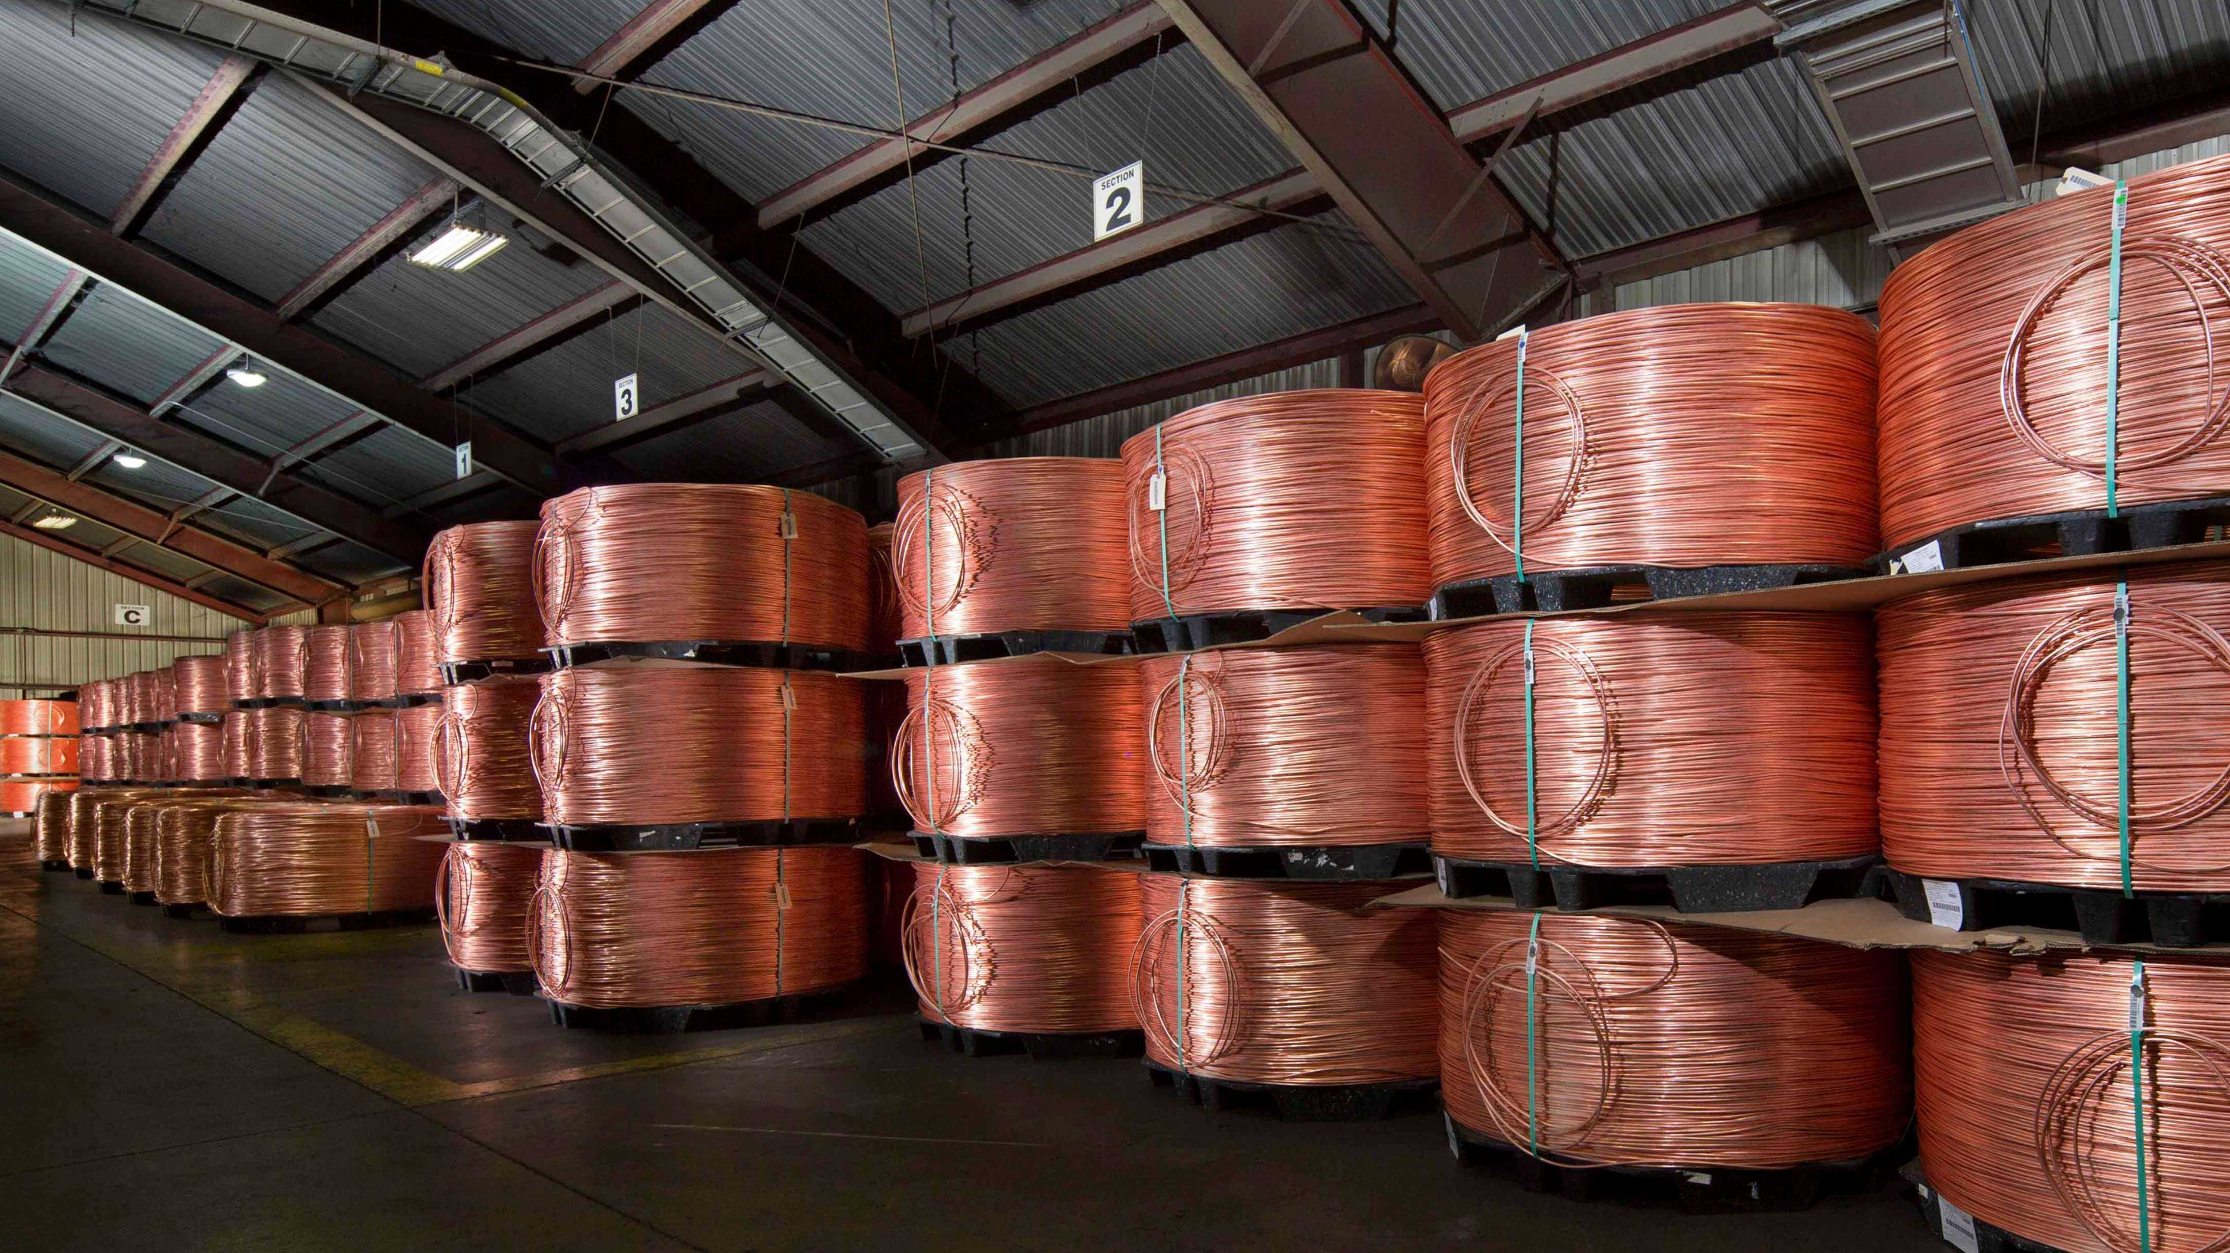
Safety Alerts

Slide 21

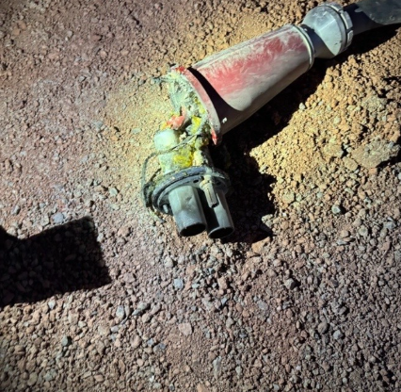
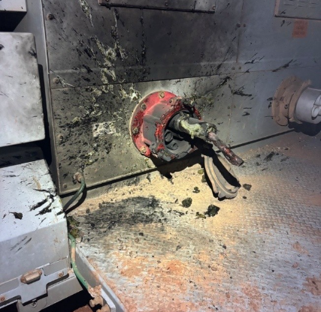
Exposure to Electrical Hazard
Exposure to Electrical Hazards
Event ID # 20034568
Incident Details
Operation | Morenci
Date / Time | March 18, 2026 / 6:46 p.m.
Event Type | Near Miss
Summary | On the southwest Mine for Leach (MFL), electricians were preparing to send power from the 29 sub up through a portable conveyor on the ramp. Electricians verified over the radio personnel were clear. Supervisors and other electricians in the area confirmed they were clear. When power was switched on, the head pot-head from the trailer blew. Electricians immediately locked out the system to inspect what happened. Employees located at the top of the pad, approximately 250 feet away, heard the loud noise. The pot-head side of the trailer was facing opposite of where the employees were located.
Findings / Missing Controls | While this incident is still under investigation, preliminary findings indicate the malfunction may have been caused by moisture in the pot-head. Segregation as a critical control was effective in protecting employees from exposure. Thorough pre-use inspections should be conducted to verify equipment is in good working order.
Immediate Corrective Action(s) | Decommission the RP12 and 1-Trailer Verify neutral ground resistor (NGR) parameters Test in-service and spare cables
Required Action(s) | Conduct a root cause analysis and evaluate current controls for enhancement. Expedite installation of pre-fabricated 13.8kV pot-heads and cables.
Contact | Tim Messick, Manager-Crush and Convey Coly Hansen, Manager-Electrical Maintenance
Failed electrical cable termination pot-head
Failed electrical cable termination at equipment entry

Slide 22

Industry Incidents

Slide 23
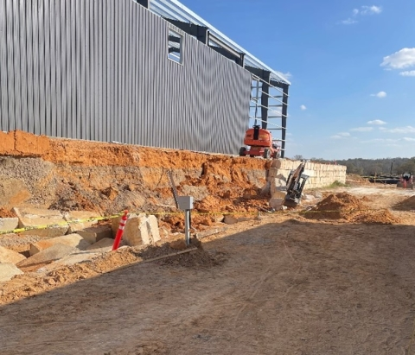
MSHA Fatality Alert
March 3, 2026 – A contractor died while working in an excavated area when the adjacent concrete block retaining wall collapsed.
Eliminate Hazards and Prevent Injuries
Conduct inspections before working near retaining walls or earth-retaining structures. Look for signs of movement, cracking, bulging, loose blocks, seepage, or soil erosion.
Stay clear of potentially unstable areas.
Maintain a safe distance. Keep personnel, equipment, and materials back from the top and base of retaining walls to prevent surcharge loading or vibration that could cause sudden wall failure.
Never work directly below or adjacent to unsupported or unprotected excavations or unstable retaining walls. Use barricades, controlled access, or engineered protection to prevent exposure to falling blocks or wall collapse.

Slide 24
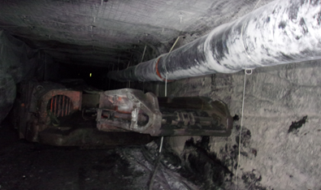
MSHA Fatality Alert
March 5, 2026 – A continuous mining machine operator died after being pinned against the coal rib by a continuous mining machine.
Eliminate Hazards and Prevent Injuries
Operate equipment from a safe location. Stay out of “Red Zone” areas including pinch points, the continuous mining machine (CMM) turning radius and areas between the CMM and the ribs.
Develop and implement procedures for tramming, repositioning, cable handling and moving remote controlled CMMs safely.
Maintain the proximity detection systems (PDS) in the approved operating condition. Perform manufacturer-recommended tests to ensure the PDS is functioning properly.
Position miner wearable components (MWCs) in accordance with the PDS manufacturer’s recommendations so users can see and hear warning lights and sounds.
Mine operators must ensure MWCs are properly worn.
Train miners on the functionality and importance of the PDS.

Slide 25


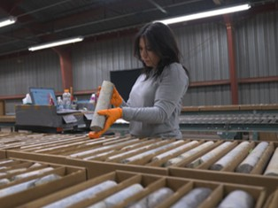
Additional Resources
Health and Safety Dashboard
Safety Toolkits
FCX Policies
MSHA Safety Alerts
OSHA

Slide 26
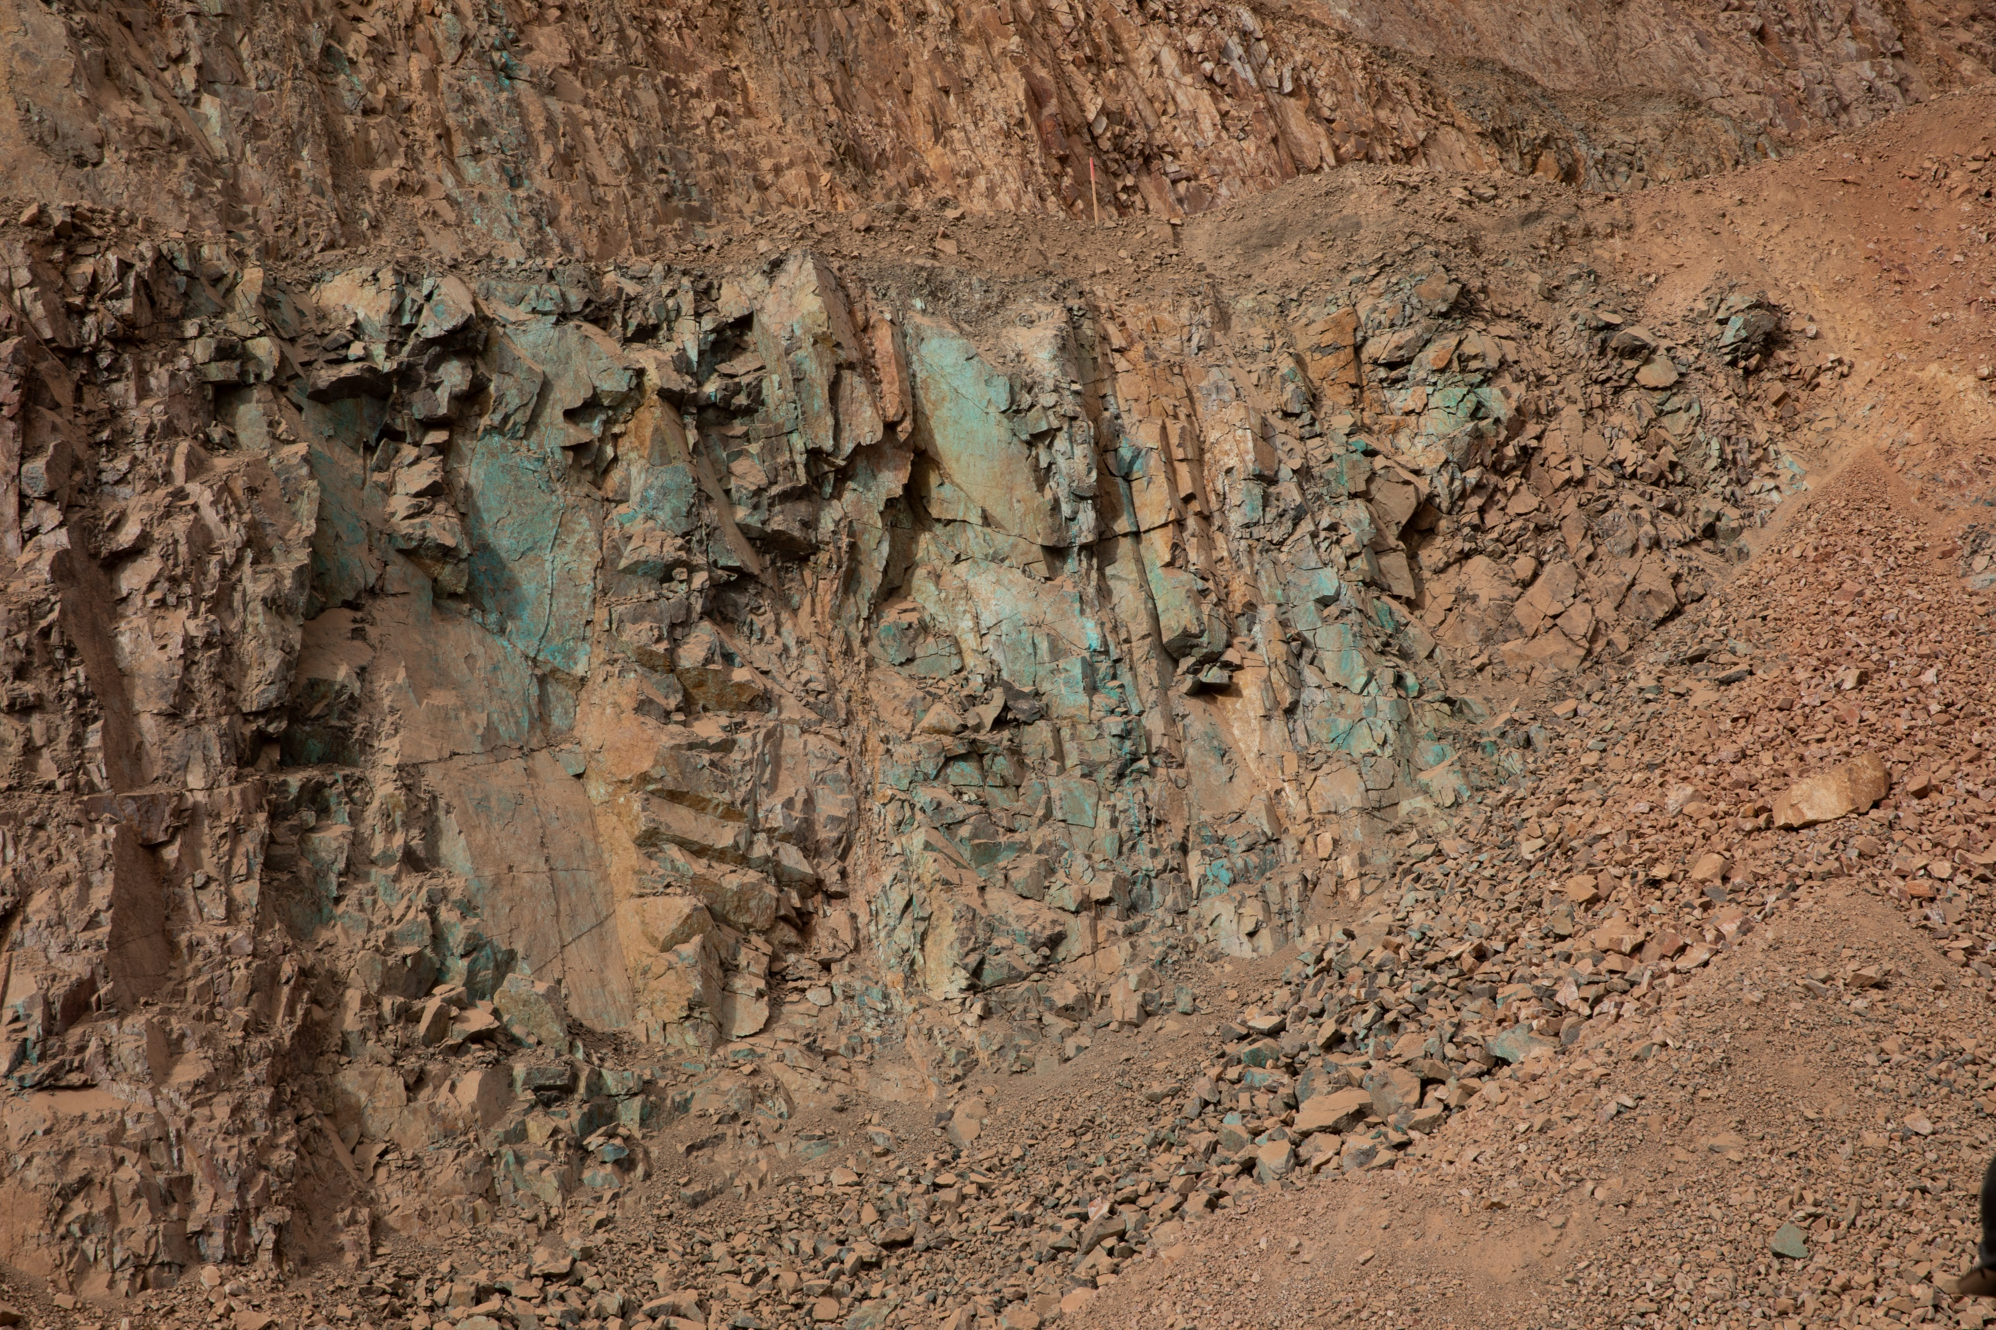

Site Incidents

Slide 27
Henderson Incidents
03/04 – U63 Cave Blast Damaged Electrical Boxes (Property Damage))
Shooting cave blast at U63 when toe of blastholes blet out in unexpected direction
Threw roughly 5 buckets of rock onto hanging wall
Knocked down/damaged multiple electrical boxes/cables
03/16 – Loader Contacted Rib Injuring Employee (Reportable – Restricted Duty)
While cleaning ore pass grizzly, reversed LHD at low speed and hit rock rib
Employee felt sharp pain in right shoulder
Restricted Duty as employee could not return to assigned work duties without accommodation
03/17 – Damage to Light Plant (Property Damage)
Prepping for cell deposition and light plant setup
Employee pulled wrong pin allowing light bar to lean outward and hit ground

Slide 28
FRM Verification Results – March
172 verifications completed in March
Focus for March was around Hazardous Substance – Acute and Chronic
Both Haz Sub - Acute and Haz Sub - Chronic increased missing control ratios
Falling Objects missing controls ratio almost doubled
FOCUS FOR APRIL/MAY:
Hazardous Substance – Acute
Hazardous Substance – Chronic
Falling Objects

Slide 29
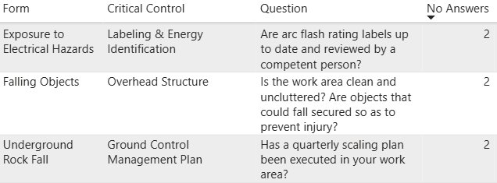
FRM Verification Results – March
Henderson Missing Controls with Multiple No Responses

Slide 30
Contractor Management Topics
ISN Updates

Slide 31
ISNetworld/HSEP Update
Deadline for all training (Core, Compliance and Technical) to be uploaded to ISN is April 6th, 2026
Contractors who have not completed uploads by then will have their employees paused from coming on site
Must include Attestation form upload (when needed)
Deadline for Worker Acknowledgements April 6th, 2026
Contact GSC if you need onsite assistence
ISN Scorecard and HSEP Changes (Effective April 6th, 2026)
HSEP score impact to change from -10 to -100 for unsubmitted or rejected HSEPs
HSEPs associated with specific site for approval/validation
HSEPs will migrate to site scorecard they are valid for
Temporary Upload Freeze
During 2-week migration, Contractors unable to upload new HSEPs
HSEPs for projects occurring during this time must be sent directly to Contractor Governance Team (contractorgovernance@fmi.com)

Slide 32

Open Forum

Slide 33
May 7th
June 18th
July 16th
August 20th
September 10th
October 8th
November 19th
December 17th
2026 Meeting Schedule
Meetings begin 1 PM MST
Mine and Mill In-Person Options Monthly

Slide 34
April Sign-Off Record
_____________________
_____________________
_____________________
_____________________
_____________________
_____________________
_____________________
_____________________
_____________________
_____________________
_____________________
_____________________
_____________________
_____________________
_____________________
_____________________
_____________________
_____________________
_____________________
_____________________

