Slide 1



HSE Contractor Meeting
August 2025

Slide 2
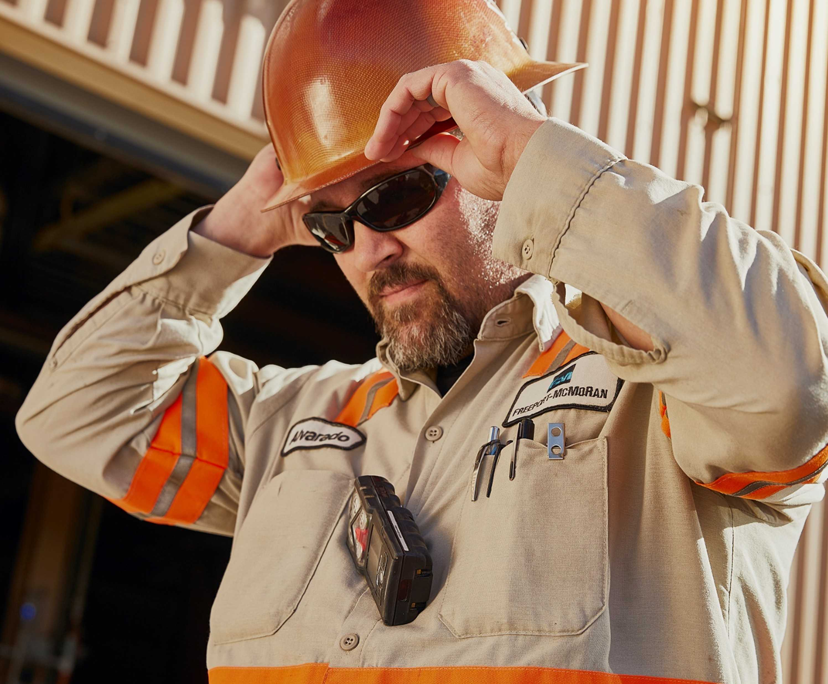

What is the purpose of this Meeting?
- For Henderson to have the opportunity to reach multiple contractors to discuss best practices when it comes to Health and Safety, Environmental and Contracts Management
- Give contractors an open forum to bring up concerns, successes or incidents, learnings, etc. that is shared between all contractors and Henderson personnel
- Help improve the safety culture and reduce safety incidents as a group

Slide 3
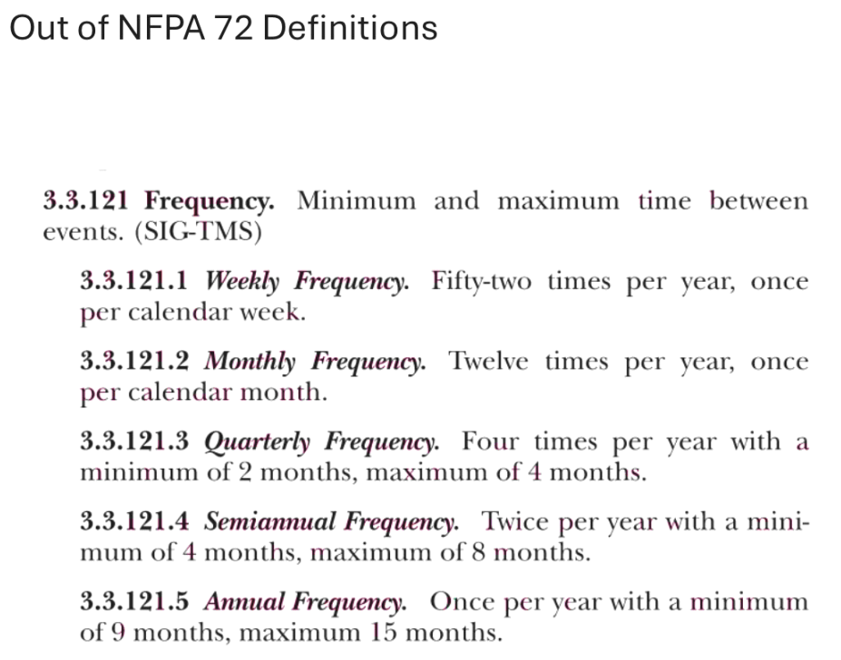
Safety Share – Hiller Fire
NFPA 72 Definitions:

Slide 4
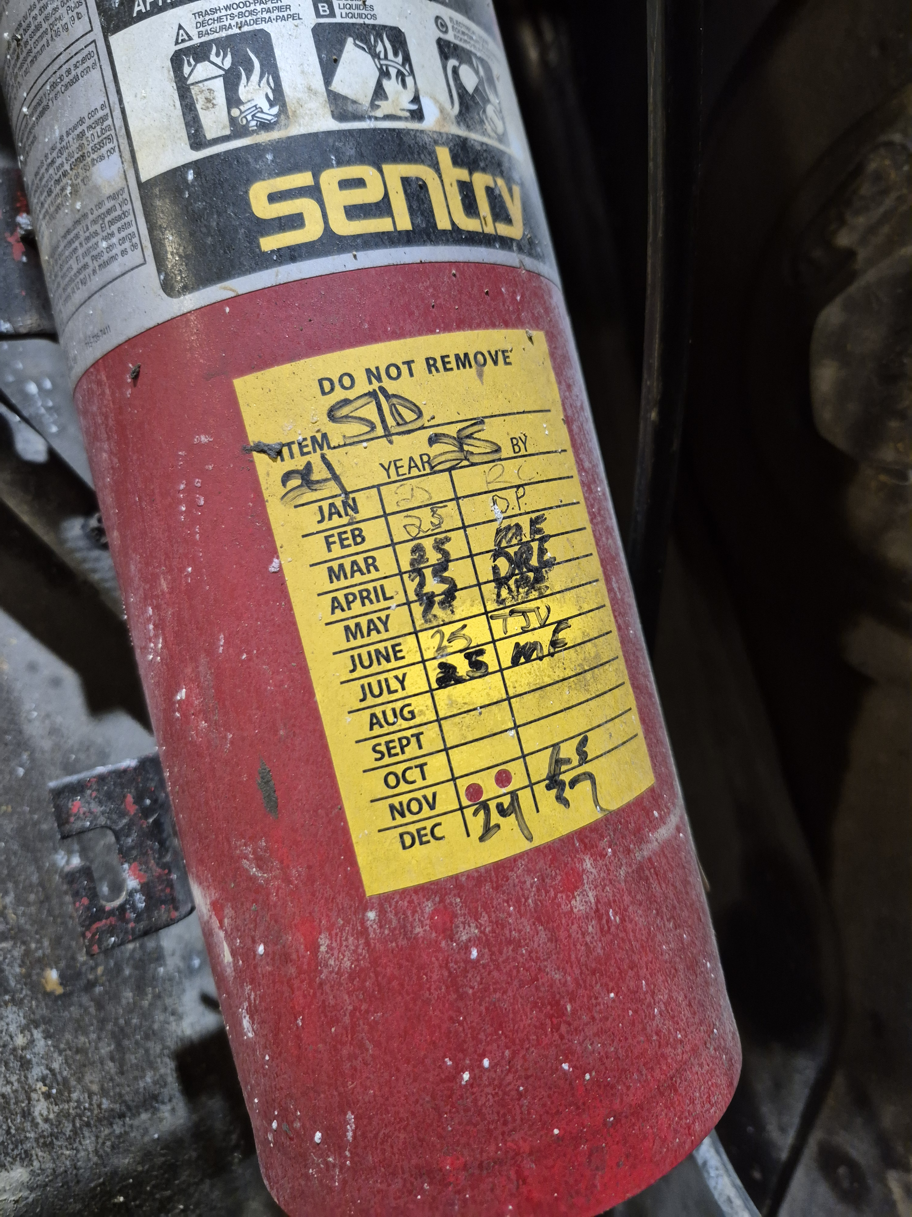
Safety Share – Hiller Fire
Inspection Tags
Double Punch/ Annual

Slide 5
Safety Topic – Right Tools
Tools are a common part of our everyday lives, helping us work efficiently and safely - when used properly. Choosing the right tool, keeping it in good shape and using it the right way helps prevent injuries, protects equipment and ensures quality work.
Here’s a look at how to protect yourself and others by using tools the right way.
Tool Selection
Choosing the right tool isn’t just about personal preference or convenience – it’s about doing the job safely and effectively. Tools are designed for specific tasks, and when you select the right one, they help to:
Enhance production quality, task delivery and efficiency
Save time and effort through better planning and production processes
Prevent damage to equipment and other materials
Reduce mistakes, frustration and stress during re-work
Reinforce proper equipment training
Support personal safety on the job
Wrong Tools
When selecting tools for a task, it’s important to make sure the proper tools, equipment and materials are used as intended. Using the wrong tool or process can lead to accidents and injuries. Examples of improper tool use include:
Using a tool for a task it wasn’t designed for
Using damaged or defective tools
Using the right tool in the wrong way
Modifying tools improperly
Not using the proper safety controls and personal protective equipment
Operating equipment without proper authorization or training
Using tools without safety guards

Slide 6

Safety Topic –
Hazard Recognition
Example questions to ask when identifying hazards
What are the potential hazards associated with my work?
How often do I check for hazards?
Are there hazards present in the work being performed around me?
Are there any changes in equipment, procedures or conditions that could introduce new hazards?
To achieve safe production, we must be able to recognize and understand our risks and hazards.
While our TRIR is below target, we’ve experienced two tragic fatalities this year and an uptick in high-risk safety incidents. These events are stark reminders we need to remain diligent in recognizing and controlling hazards.
We need to control and monitor risks and stop work if controls are missing or ineffective.
Each of us should use Fatal Risk Management and critical controls to help ensure hazards are being identified and then eliminated, mitigated or corrected before work begins.
Click here to access a Hazard Recognition toolkit, including talking points and an employee handout.

Slide 7
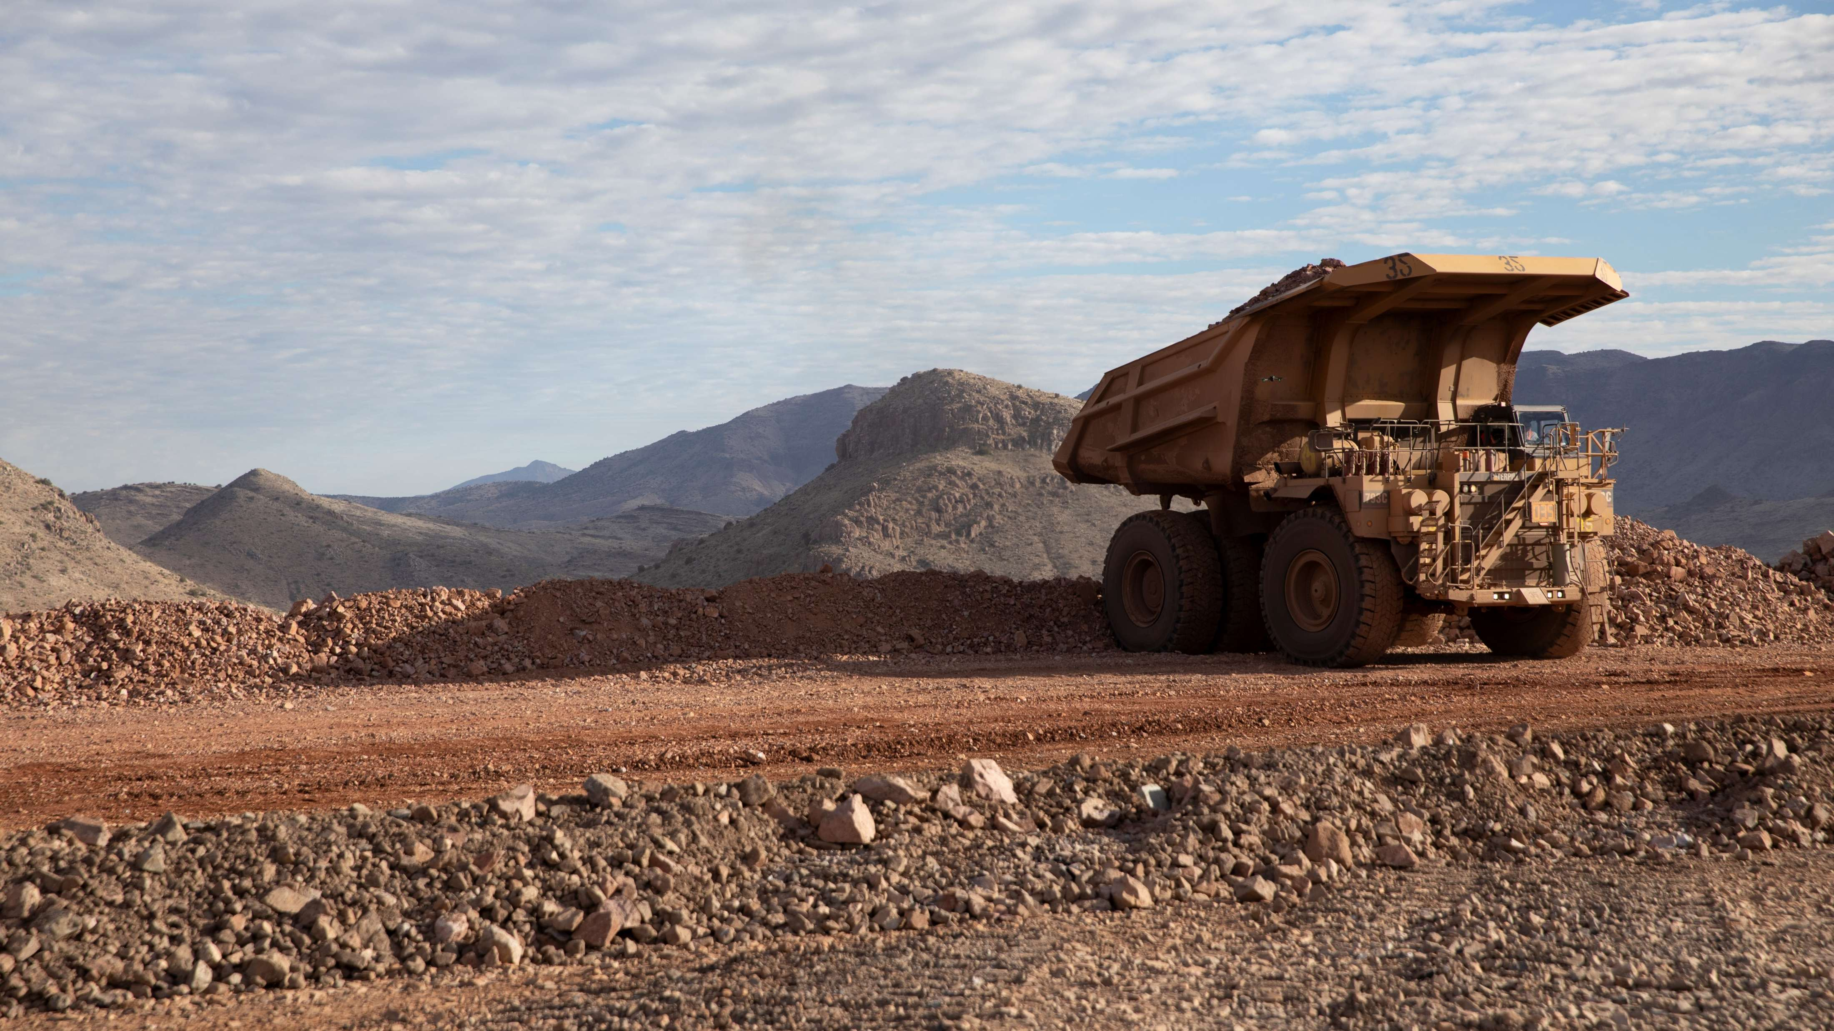
High-risk Incidents
Actionable and PFEs

Slide 8

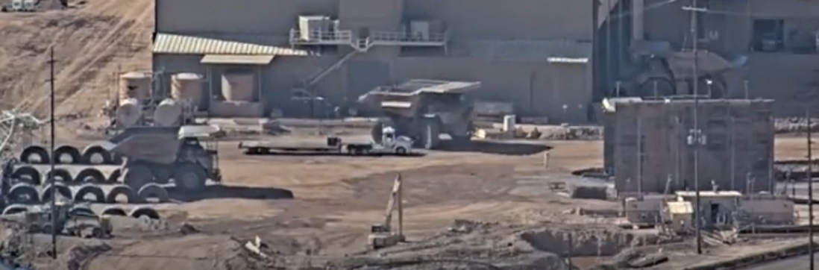
Haul Truck and Semi-Truck Near Miss
Vehicle Collision or Rollover
ID # 2025-19 Event ID # 20027097
Preliminary Incident Details
Operation | Morenci
Date / Time | June 27, 2025 / 8:30 a.m.
Event Type | Near Miss
Summary | A parts transport semi-truck was exiting behind the Heavy Duty Truck Shop. As the same time, a mechanic in a haul truck parked in a designated spot along the side of the truck was preparing to move to the wash rack. After checking the mirrors, the mechanic began to turn the haul truck to the right. The semi-truck was positioned in the haul truck’s blind spot, and the two vehicles came within feet of collision. A nearby employee noticed the trucks moving and signaled the haul truck mechanic to stop, preventing an accident.
Risk Category | Actionable – Significant (3) Likely (3)
Findings / Missing Controls | Lack of segregation between semi-trucks and other heavy equipment in the area. No requirements for designated spotters in this location of the Truck Shop.
Applicable Policies / Procedures | FCX-23 Interaction with Heavy Mobile Equipment - Surface
Employee Condition | No injuries.
Contact | Belen Lawrence, Manager-Health and Safety Gary Anderson, Manager-Support Services
Proximity of haul truck and semi during incident. Click here to view video of the event.

Slide 9

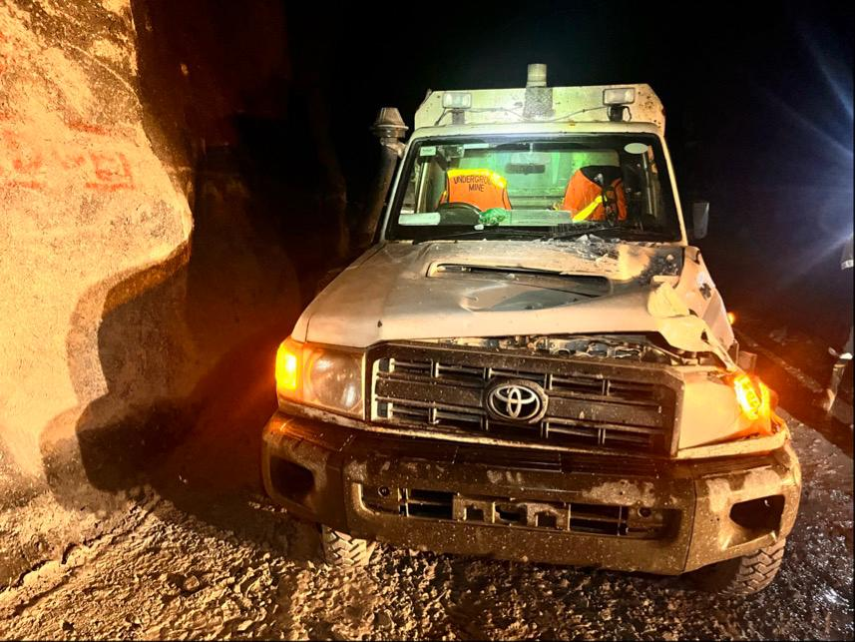
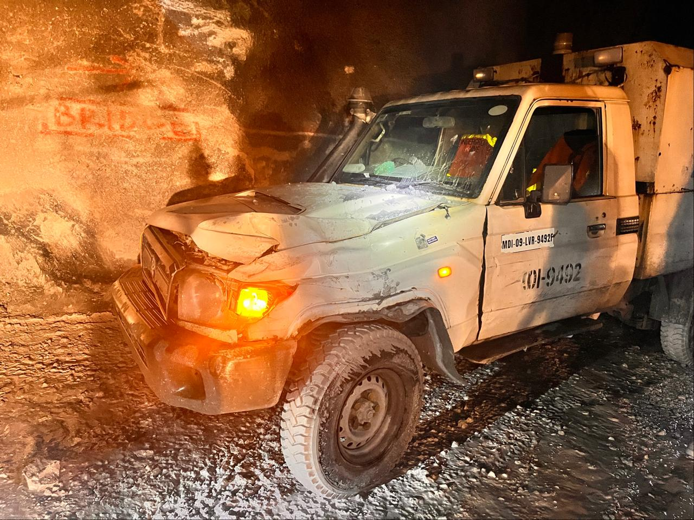
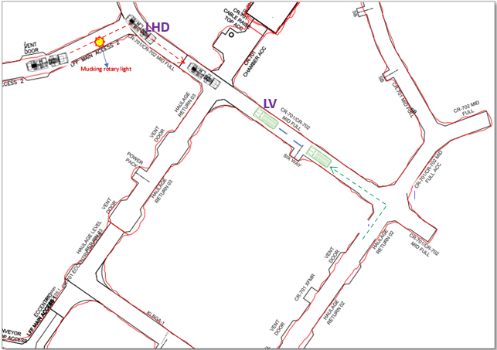
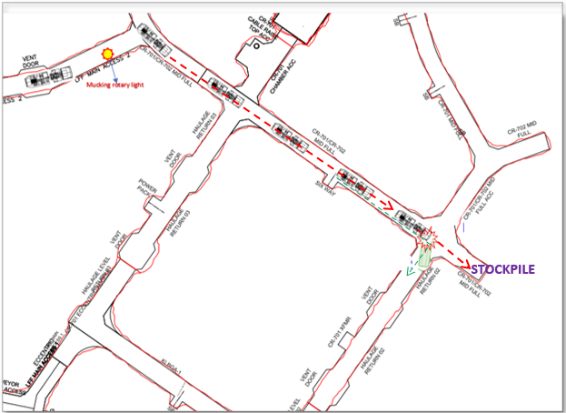
Loader Hit a Light Vehicle in Kucing Liar Mine
Vehicle Collision or Rollover
PFE # 2025-12 Event ID # 20027525
Preliminary Incident Details
Operation | PT Freeport Indonesia
Date / Time | July 12, 2025 / 2:36 p.m.
Event Type | Property Damage
Summary | A light vehicle (LV) entered CR-701/CR-702 travelling east, while a full loader (LHD) was travelling west. The LV reversed to avoid the LHD, continuously honking. The LHD operator didn't see the LV due to the loaded bucket limiting visibility and kept moving. The LHD’s bucket struck the LV’s hood as it reversed around the corner. The LV passenger tried to signal with a cap lamp, but the LHD continued dumping. The LHD operator stopped after reversing and finally noticed the signal.
Risk Category | Actionable – Significant (3) Likely (3)
Findings / Missing Controls | Inadequate Mucking Plans – No clear identification of access points requiring barricading; LHD operators were not properly briefed on the necessary signage, lighting and barricading materials during line-out. Improper Barricading Implementation – Available barricading equipment (chains, rotary lights, tags) were not deployed to the site. Only one rotary light was installed, and it was incorrectly positioned. Lack of Consistent Enforcement – Access control procedures were not consistently audited, applied, verified or enforced in active mucking areas.
Applicable Policies / Procedures | SOP-6.01-UG-J01 LHD Operation Procedure SOP-4.04-PTFI-002 Light Vehicle Operation
Employee Condition | No injuries.
Contact | Andri Abdullah, Manager-UG Operational Safety
Damage to the LV
LHD exiting LFF Main Access 2, traveling towards the LV
LHD contacting the LV (right side of bucket against left front quarter, hood, up to LV passenger pillar)

Slide 10

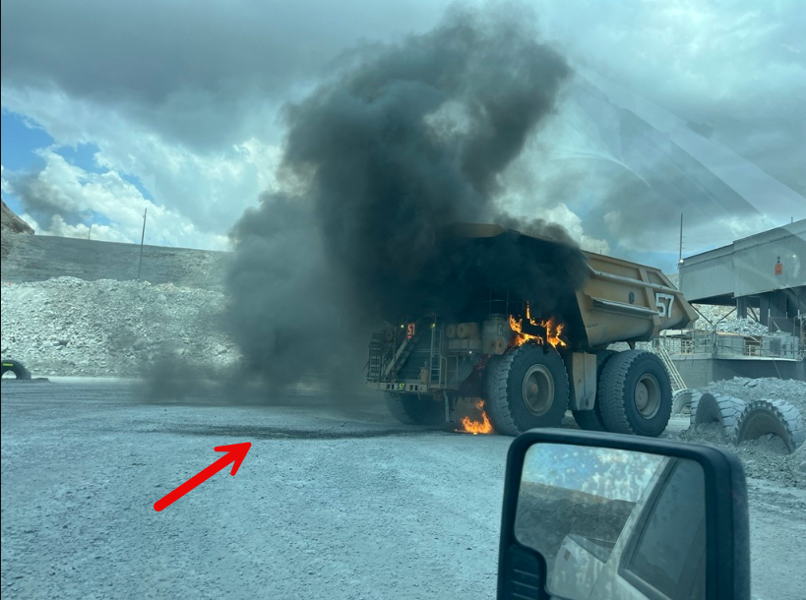
Haul Truck Fire
ID # 2025-21 Event ID # 20027569
Fire
Preliminary Incident Details
Operation | Sierrita
Date / Time | July 15, 2025 / 12:49 p.m.
Event Type | Property Damage
Summary | A haul truck was approaching the primary crusher when smoke was observed coming from the front of the vehicle. Approximately 10 seconds later, visible flames appeared in the truck’s grille area. A nearby supervisor promptly initiated a Mayday call. The operator activated the onboard fire suppression system and evacuated the vehicle using the emergency ladder. Upon reaching the ground, the operator was retrieved by a supervisor in a light vehicle. A water truck began fire suppression efforts and within approximately 40 seconds, white smoke was observed with no visible flames. A rotation of water trucks continued to apply water to the haul truck for approximately one hour.
Risk Category | Actionable – Significant (3) Likely (3)
Findings / Missing Controls | A hydraulic leak started the fire. The fire suppression system activated but failed to extinguish the fire. The truck was not shut off with the key, leaving the accumulators charged.
Applicable Policies / Procedures | Sierrita haul truck operator training.
Employee Condition | No injuries.
Contact | Allen Kinney, Superintendent-Mine Operations Cara Forbregd, Manager-Health and Safety
Hydraulic fluid
Haul truck during fire

Slide 11


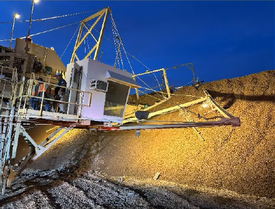
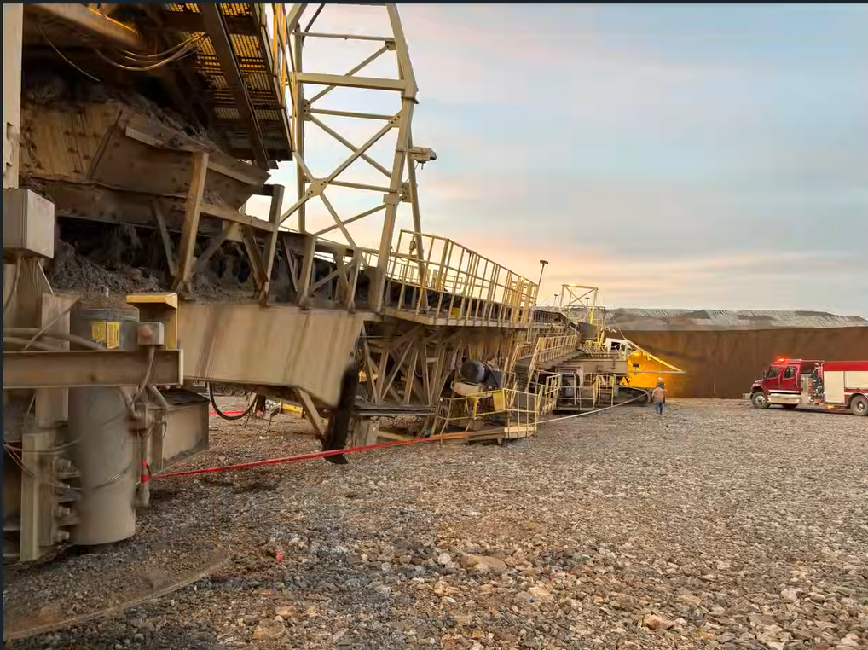
Radial Stacking Conveyor Collapse
Falling Objects
Fall from Heights
ID # 2025-20 Event ID # 20027600
Preliminary Incident Details
Operation | Safford
Date / Time | July 15, 2025 / 4:36 a.m.
Event Type | Property Damage with Injury
Summary | A radial stacking conveyor collapsed at the leach pad after a supporting arm (luffing frame) failed. As a result. the main truss assemblies, belly girders, stinger and main car body frame sustained significant structural damage. At the time of the incident, the stacker operator was in the cab, which fell approximately 20 feet.
Risk Category | Actionable – Significant (3) Likely (3)
Findings / Missing Controls | Incorrect bolts were used – a mix of bolts (grade 8 and A325) were found sheered at the incident scene. Only structural A325 bolts should be used.
Applicable Policies / Procedures | Not applicable policies.
Employee Condition | The operator remained alert and able to walk. They called for assistance and dismounted the equipment once it was safe to do so. They sustained bruising to the left thigh and abdomen.
Contact | Rick Sanchez, Manager-Crush and Convey Shannon Del Curto, Sr. Supervisor-Health and Safety
Operator cab position after structure failure
Collapsed stacker

Slide 12
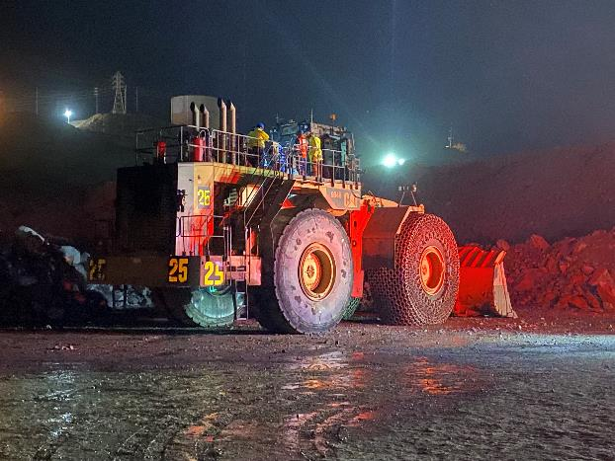
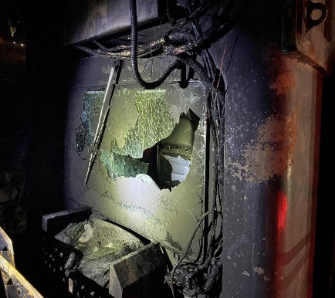
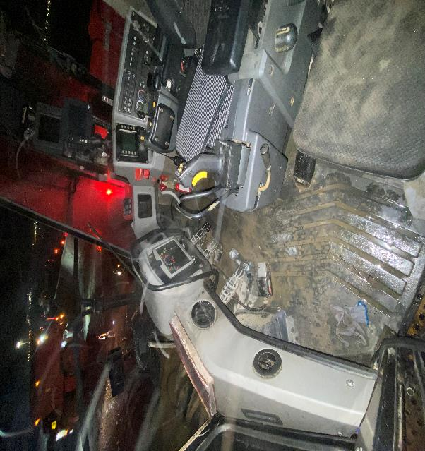
Front Loader Fire
ID # 2025-13 Event ID # 20027577
Fire
Preliminary Incident Details
Operation | Cerro Verde
Date / Time | July 15, 2025 / 04:10 a.m.
Event Type | Injury – Lost time
Summary | While waiting to load a truck at the dynamic stockpile adjacent to the C1 Primary Crusher, a fire ignited between the transmission and under the operator’s cabin on a CAT 994H front loader. A nearby haul truck operator promptly initiated the emergency protocol via radio. A water truck 20 meters away quickly responded and sprayed pressurized water on the flames. A second water truck arrived shortly after, and together they were able to control the fire. The Emergency Response team arrived and safely evacuated the operator from the cabin.
Risk Category | Actionable – Significant (3) Likely (3)
Findings / Missing Controls | This incident is under investigation and controls are being evaluated. Results of the investigation will be shared in the lessons learned.
Applicable Policies / Procedures | No applicable policies.
Employee Condition | The employee sustained second- and third-degree burns on the front of the face, ears and wrist.
Contact | Ronald Ponce, Manager-Fragmentation and Loading
994 front loader
External (left) and internal view of the cabin

Slide 13

Industry Incidents

Slide 14
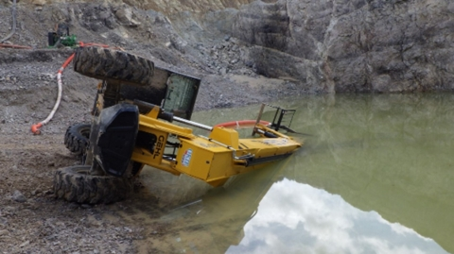
MSHA Fatality Alert
MINE FATALITY – On June 15, 2025, a miner died after the telehandler that he had been operating overturned onto him while he was outside the equipment moving a water pump suction line.
Eliminate Hazards and Prevent Injuries
Ensure miners operate telehandlers perpendicular to the slope and use load stabilizing devices to prevent roll over.
Keep telehandler forks low to the ground unless the surface is level and ground conditions can support the telehandler. Never suspend a load from the forks.
Always lower booms on equipment when unattended and secure the equipment against movement.
Do not exceed the load radius and load limits of lifting equipment.
Do not work alone unless you can communicate with others or they can see you.
Ensure miners position themselves in a safe manner while working around equipment.
Conduct inspections of mobile equipment prior to use. If deficiencies exist, remove the equipment from service.

Slide 15
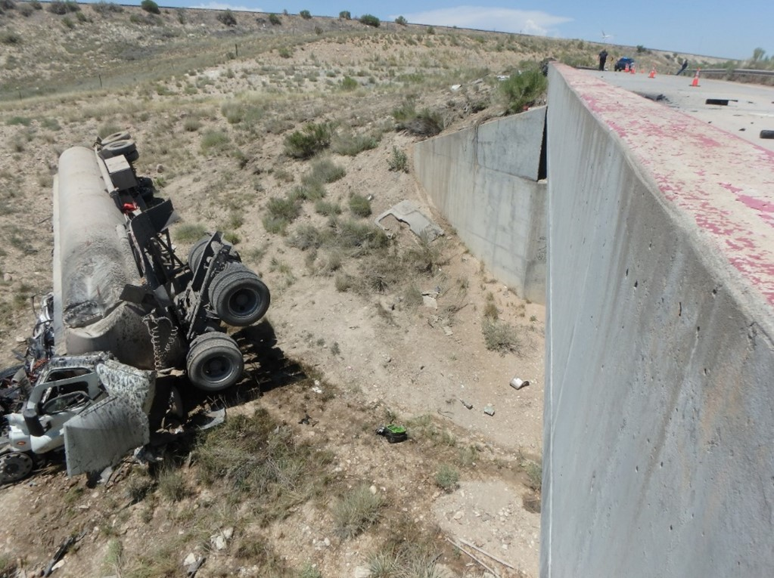
MSHA Fatality Alert
MINE FATALITY – On July 12, 2025, a delivery truck driver died when the truck he was driving traveled off the road and crashed into a ravine.
Eliminate Hazards and Prevent Injuries
Maintain control of mobile equipment and follow all posted speed limit and warning signs.
Ensure berms and guardrails are at least as high as the mid-axle height of the largest mobile equipment using the roadway.
Ensure braking systems can stop and hold the equipment with its typical load on the maximum grade it travels.
Always wear a seatbelt while operating mobile equipment.
Perform thorough pre-operational inspections of mobile equipment. Correct any defects that create a hazard.

Slide 16
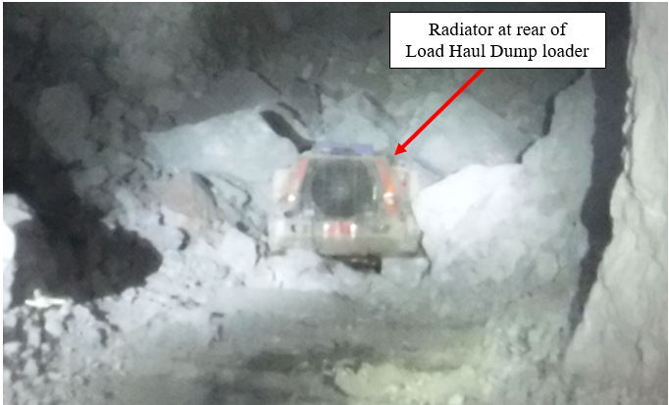
MSHA Fatality Alert
MINE FATALITY – On July 12, 2025, a miner died when material within an active stope caved onto the Load Haul Dump loader he was operating.
Eliminate Hazards and Prevent Injuries
Only travel in areas with a ground support system designed, installed, and maintained to control the ground.
Understand and follow the mine operator’s ground control procedures and mining methods.
Perform work from a safe location.
Only travel within designated safe zones and use signage to indicate hazardous areas. Ensure this signage is highly visible and understood by everyone in the working area.
Conduct thorough examinations of working places/ground conditions before starting any work, after blasting, and as conditions warrant during the shift.

Slide 17


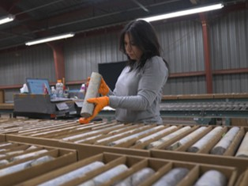
Additional Resources
Health and Safety Dashboard
Safety Toolkits
FCX Policies
MSHA Safety Alerts
OSHA

Slide 18
Henderson Incidents
07/01 – Property Damage
  Normet lift truck contacted rib while tramming on 7700 level near Lube Bay
07/08 – First Aid
  Employee had hot acid “pop” and contact hand while moving sample beaker in lab
07/09 – Property Damage
  Lower glass of 576 mini-ex broken by day shift blasting of headings
07/21 – Lost Time Injury (MSHA Reportable)
  Finger crushed when striker bar assembly of simba drill rolled during troubleshooting
07/29 – Property Damage
  Light plant rolled during transport around 3 dam

Slide 19
FRM Verification Results - July
165 Forms Submitted in July!
Focus in July around Underground Rockfall, Hazardous Substance –Acute and Drowning
Interaction with Aircraft, Underground Rockfall and Falling Objects missing control questions increased in month
AUDIT FOCUS FOR AUG/SEPT:
Drowning
Underground Rockfall
Falling Objects

Slide 20
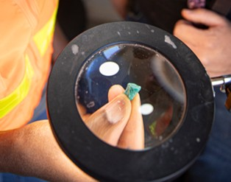



Contractor Management Topics
Badging at Gates
Employee hours reporting

Slide 21

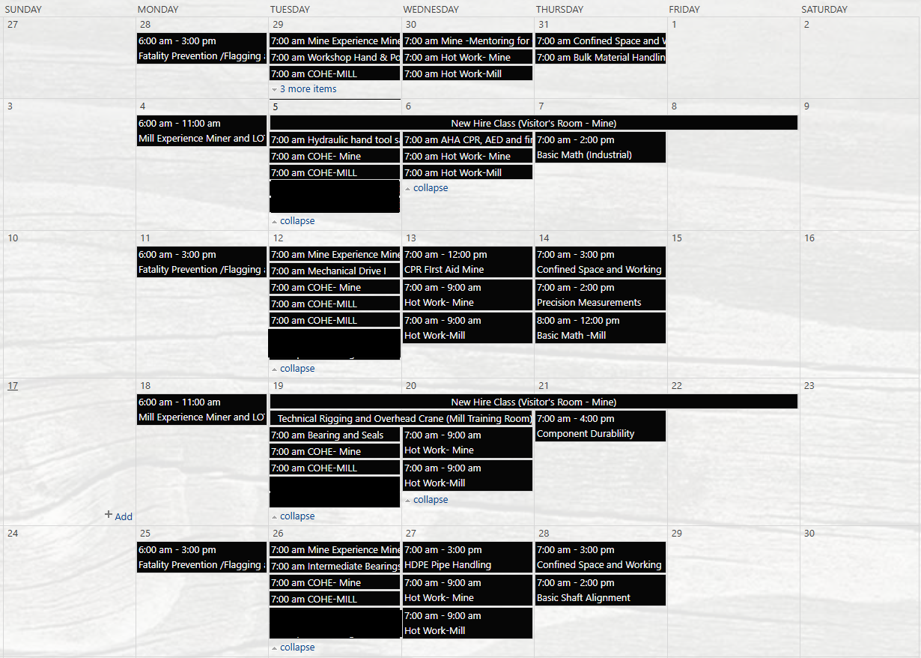

Henderson Training Schedule - AUGUST

Slide 22

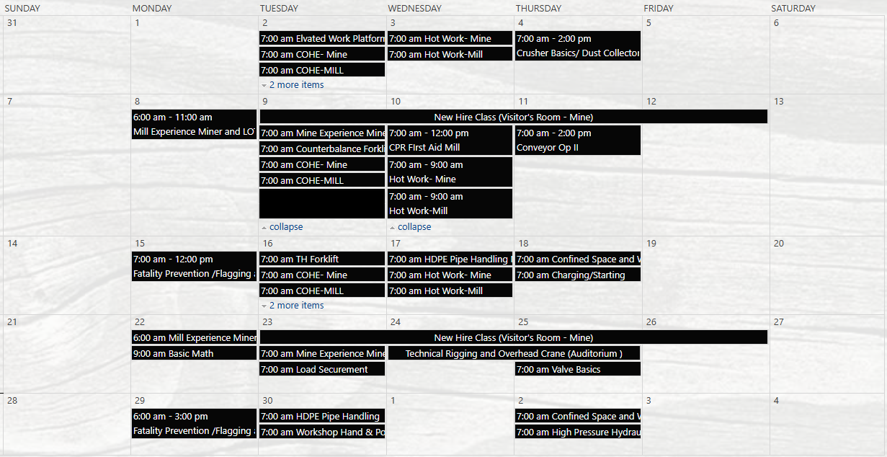
Henderson Training Schedule - SEPTEMBER

Slide 23
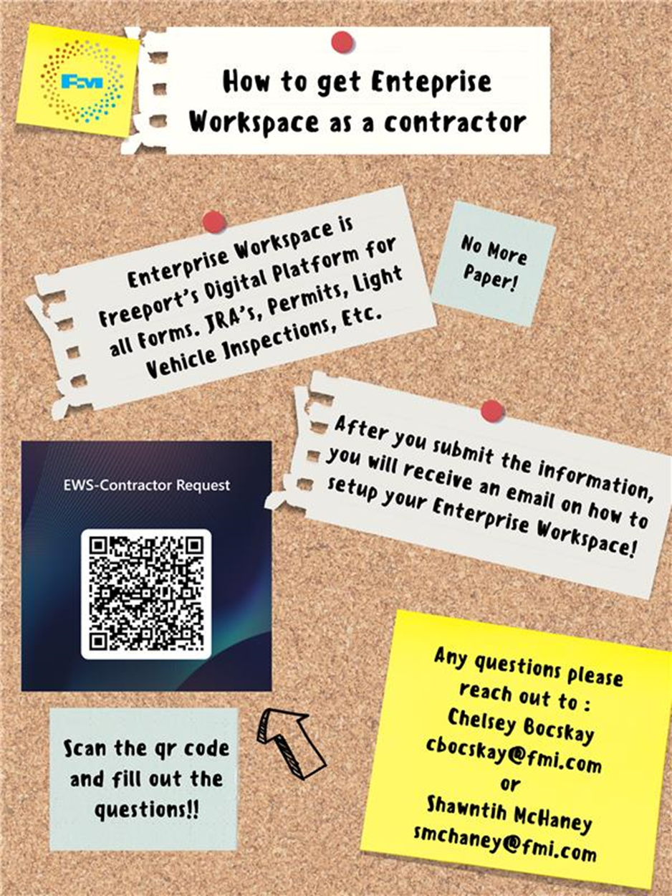
Contractor EWS Access
Access to site digital forms now available to Contractors!
Integration of Contractor submitted forms into internal dashboards
Forms can be used in online and offline modes
Request Access with QR Code or HERE
Reach out to H&S Department with any questions or issues

Slide 24

Open Forum

Slide 25
2025 Meeting Schedule
September 11th
October 9th
November 20th
December 18th
Meetings begin 1 PM MST
Mine and Mill Options Monthly

Slide 26
August Sign-Off Record
_____________________
_____________________
_____________________
_____________________
_____________________
_____________________
_____________________
_____________________
_____________________
_____________________
_____________________
_____________________
_____________________
_____________________
_____________________
_____________________
_____________________
_____________________
_____________________
_____________________

