Slide 1
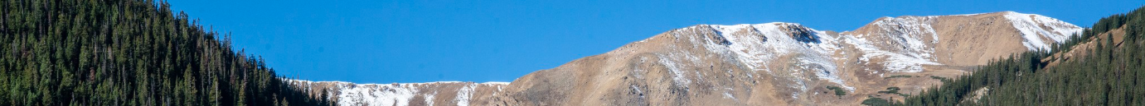
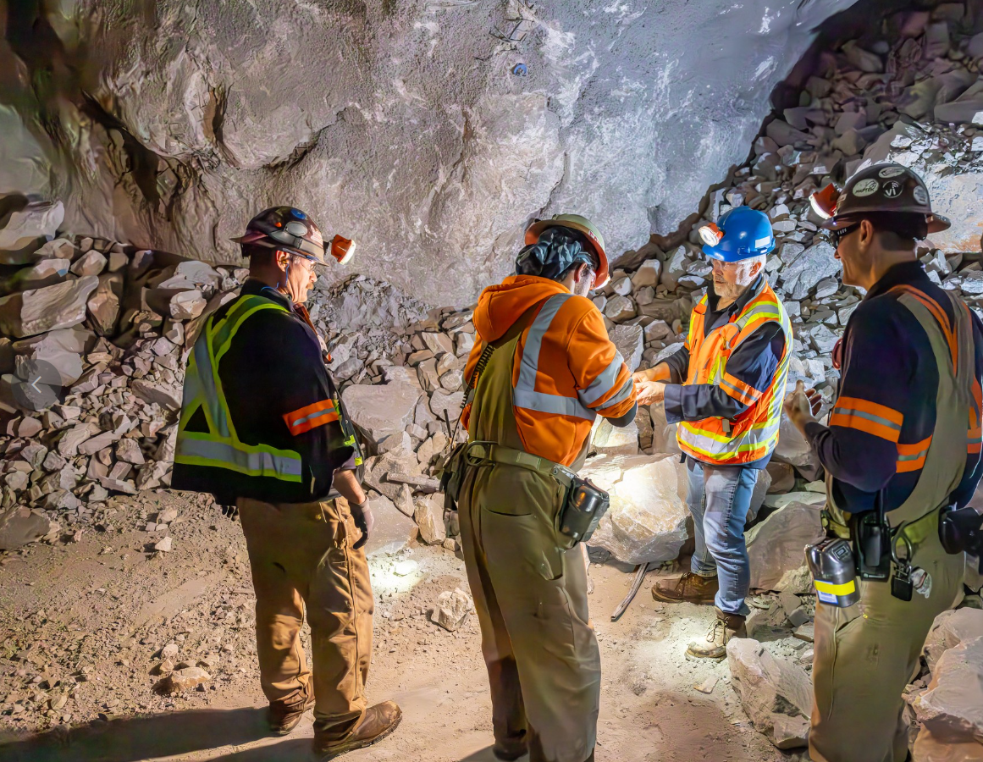

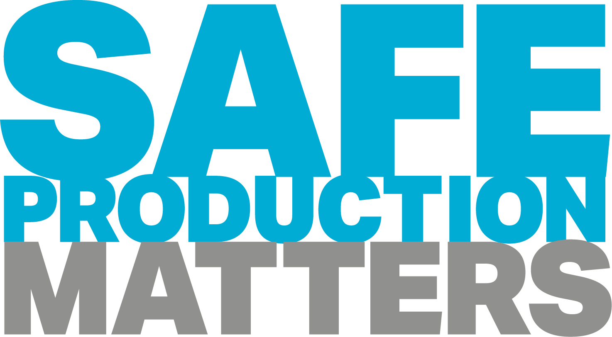
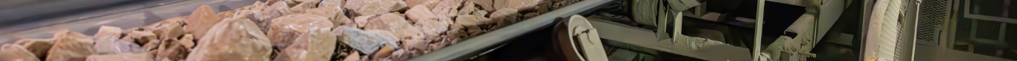
Henderson HSE Contractor Meeting
August 2026

Slide 2
Avoiding Unauthorized AI Tools
FMI has observed an increase in AI “notetaking” bots being added to Teams meetings
The use of these tools and software falls under MIS End User Policies that prohibit Freeport employees, contractors and partners from sharing company data without the company’s consent
To protect company data:
  Contractors and Vendors not to use notetaking bots/recording tools
  If external bot/recorder added to meeting, meeting will be stopped
  Ask the FMI organizer to use approved notetaking tools

Slide 3
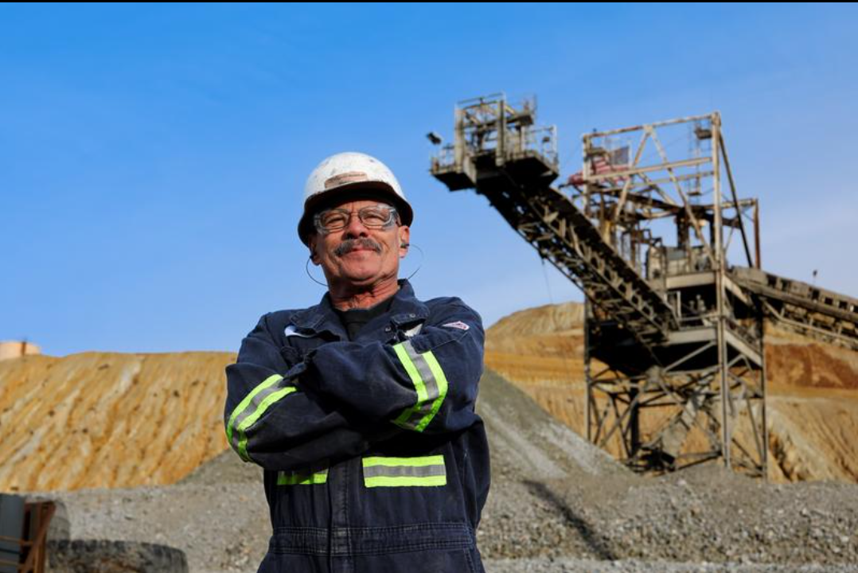

What is the purpose of this Meeting?
- For Henderson to reach multiple contractors and discuss best practices when it comes to Health and Safety, Environmental and Contracts Management
- Give contractors an open forum to bring up concerns, successes or incidents, learnings, etc. that is shared between all contractors and Henderson personnel
- Help improve the safety culture and reduce safety incidents as a group

Slide 4
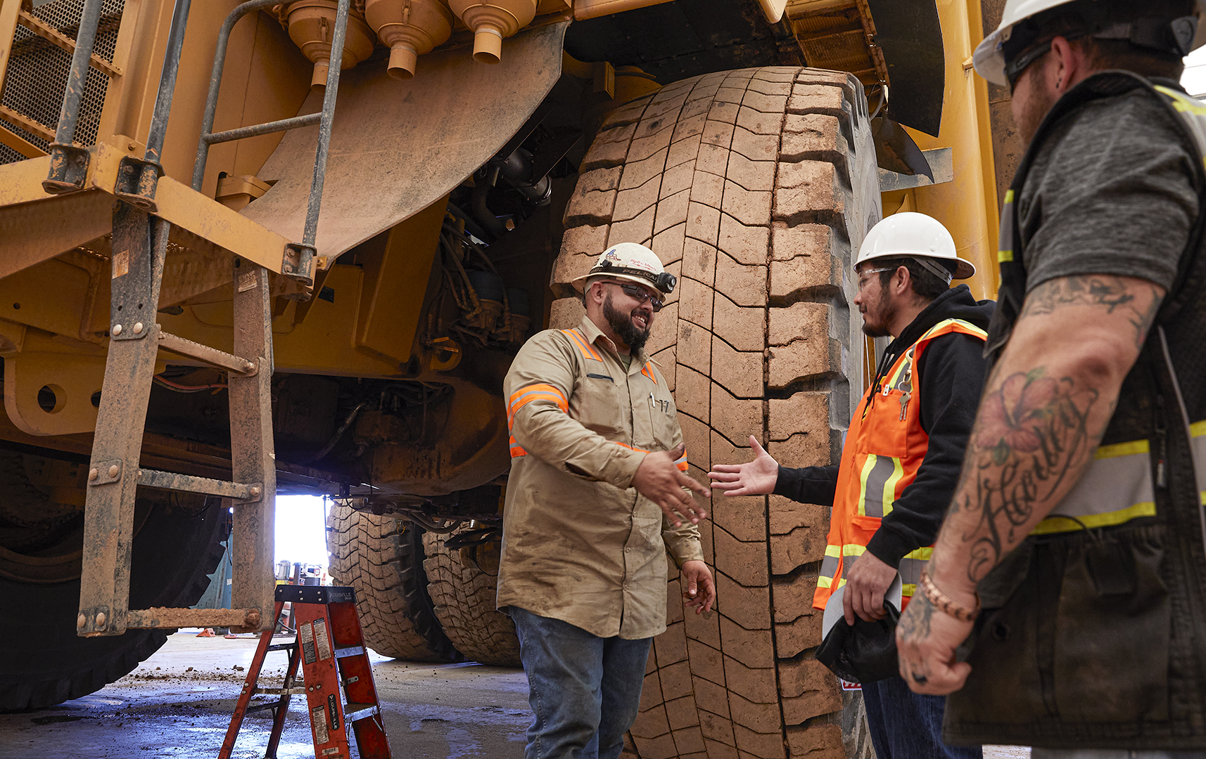

Safety Success

Slide 5
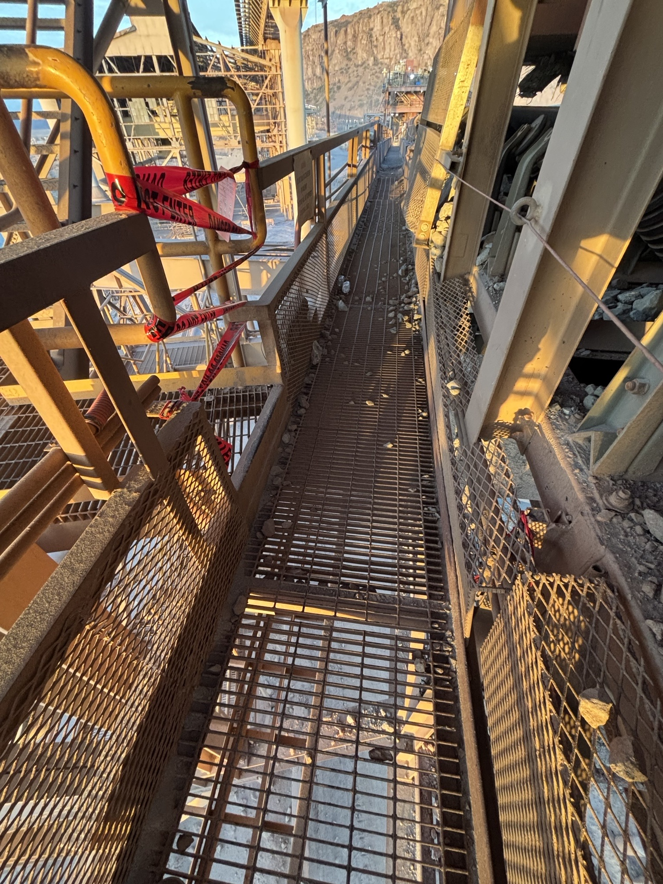
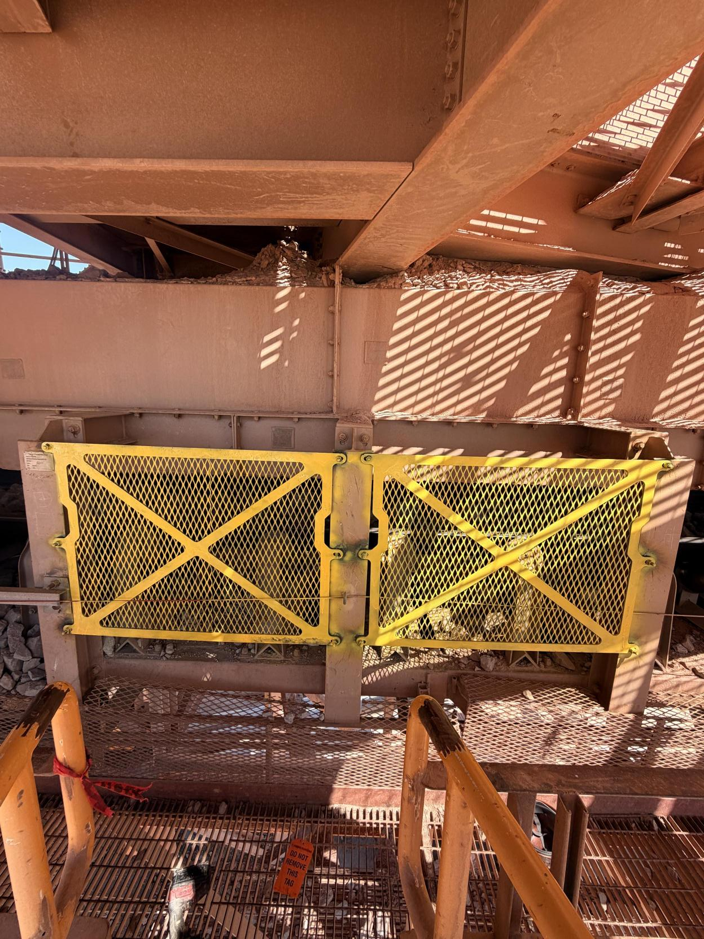
Morenci: Hazard Identification Through Near-Miss Reporting and Follow-Up
Spotlight On
Incident Summary
Near-miss fall: A contractor missed a small step where a grated platform transitioned to a conveyor catwalk and began falling toward a moving conveyor belt and roller.
Injury avoided: The employee stopped the fall by grabbing a nearby structural support, avoiding contact with the moving equipment and preventing a potentially serious injury.
Hazard identified: The incident revealed an unrecognized hazard: while an emergency pull cord was present, no physical barriers or other controls were in place to prevent entry into the conveyor hazard zone if someone stumbled or lost balance.
Reporting and Follow-up
Controls added: The area was evaluated and guarding/barrier controls were installed to reduce exposure to the conveyor and lessen consequences of slips, trips and missteps.
Hazards reviewed: The near miss highlights the value of reporting hazards before injuries occur. Site teams also reviewed other areas for similar step-transition and conveyor exposure hazards, proactively identifying and addressing comparable risks.
Incident location and step transition to catwalk.
Installed guarding to protect employees from conveyor.

Slide 6
Sierrita: Daily FRM Reviews
Spotlight On
Examples of Controls Shared
through FRM Discussions
At Sierrita, Fatal Risk Management (FRM) reviews are now part of daily production planning calls involving supervisors, superintendents and managers.
The reviews have become an opportunity to highlight quality field safety conversations from the previous day, often tied to stop work expectation.
Each day, the team discusses the opportunities identified for hazard conversations, control verifications and corrective actions taken. They also review planned FRM-related work for upcoming shifts to improve collaborative verification and support safe work execution.
The increased communication has strengthened coordination across work activities and improved the timely implementation of controls.
Mill | Vehicle Impact
Identified the need for additional spotters and assigned them before work began.
Concentrator | Working at Heights
Work at scaffolding was paused when employees were missing a fall protection cage. The task resumed after the correct equipment was obtained.
Mill | Uncontrolled Release of Energy / Impact on Person
Railroad crews reviewed lockout requirements and verified proper flagging was in place before work started.
Mine | Vehicle Impact
Freeport supervisors worked with a contractor to
confirm proper signage, training and replacement of a buggy whip.
Moly | Acute Exposure
Identified the absence of a formal evacuation plan for the rhenium reduction furnace area, creating an opportunity to strengthen emergency preparedness controls.

Slide 7
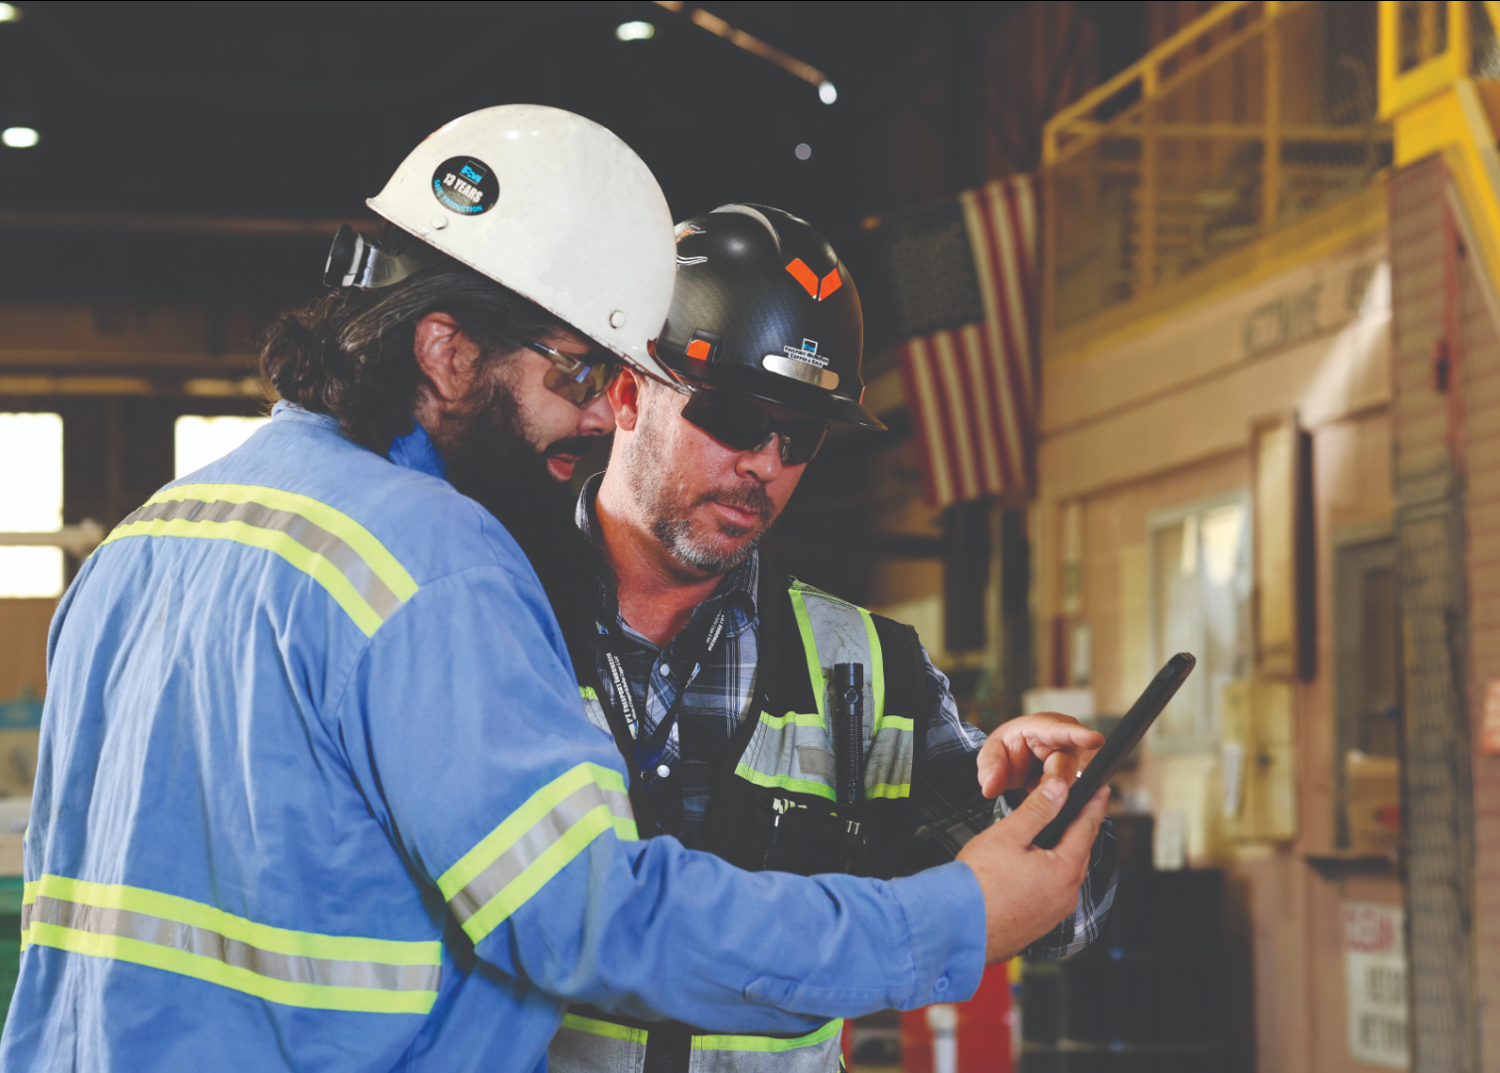
Safety Shares

Slide 8
Critical Control Verification
Critical controls are the safeguards that prevent serious injuries and fatalities. Many incidents occur when a critical control is missing, ineffective, bypassed or no longer matches the work conditions.
Taking the time to verify controls are in place and working as intended helps keep us safe. Ask yourself:
Discussion
What critical control do we rely on most often?
How do we currently verify that control before starting a task?
What would signal a control may not be working as intended?
What changes in our work environment should trigger a re-verification of controls?
How can we support each other in stopping work when a critical control is missing or ineffective?
Have all hazards and the appropriate critical controls been identified?
Are the identified critical controls in place?
Are the controls functioning as intended?
Do work conditions match the assumptions made during planning?
Has anything changed that could impact the effectiveness of the controls?
Does everyone involved understand the critical controls and their purpose?

Slide 9
Concentration at Work
Imagine you are performing a task that requires precision – like operating highly sensitive equipment or operating a vehicle. For just a moment, your mind wanders, you get distracted and suddenly you have made a mistake. That moment of distraction can be the difference between working safely and a possible accident.
Concentration acts like a shield that protects us in the workplace. When we are fully focused, we are aware of our surroundings, risks and the safety measures we must follow.
The Importance of Staying Focused
Preventing Accidents: Most workplace accidents happen when the mind is distracted. From tripping to mistakes while operating machinery, many incidents could be prevented when fully focused on the task.
Quality of Work: Simple errors can lead to bigger problems and, in some cases, put workers' integrity at risk or cause permanent damage.
Shared Responsibility: In a work environment, we are all responsible for safety. A distraction can put not only ourselves in danger but also our coworkers.
Tips for Maintaining Concentration at Work
Strategic Breaks: Schedule short active breaks during the workday to help recharge your mind and improve concentration.
Organized Environment: Keep an organized workspace to reduce distractions and make it easier to concentrate.
Task Prioritization: Focus on one task at a time to avoid cognitive overload.
Speak Up: Take accountability for your own safety and speak up if you are not mentally or physically ready to perform any task.

Slide 10
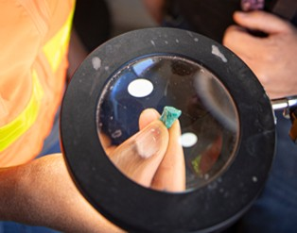

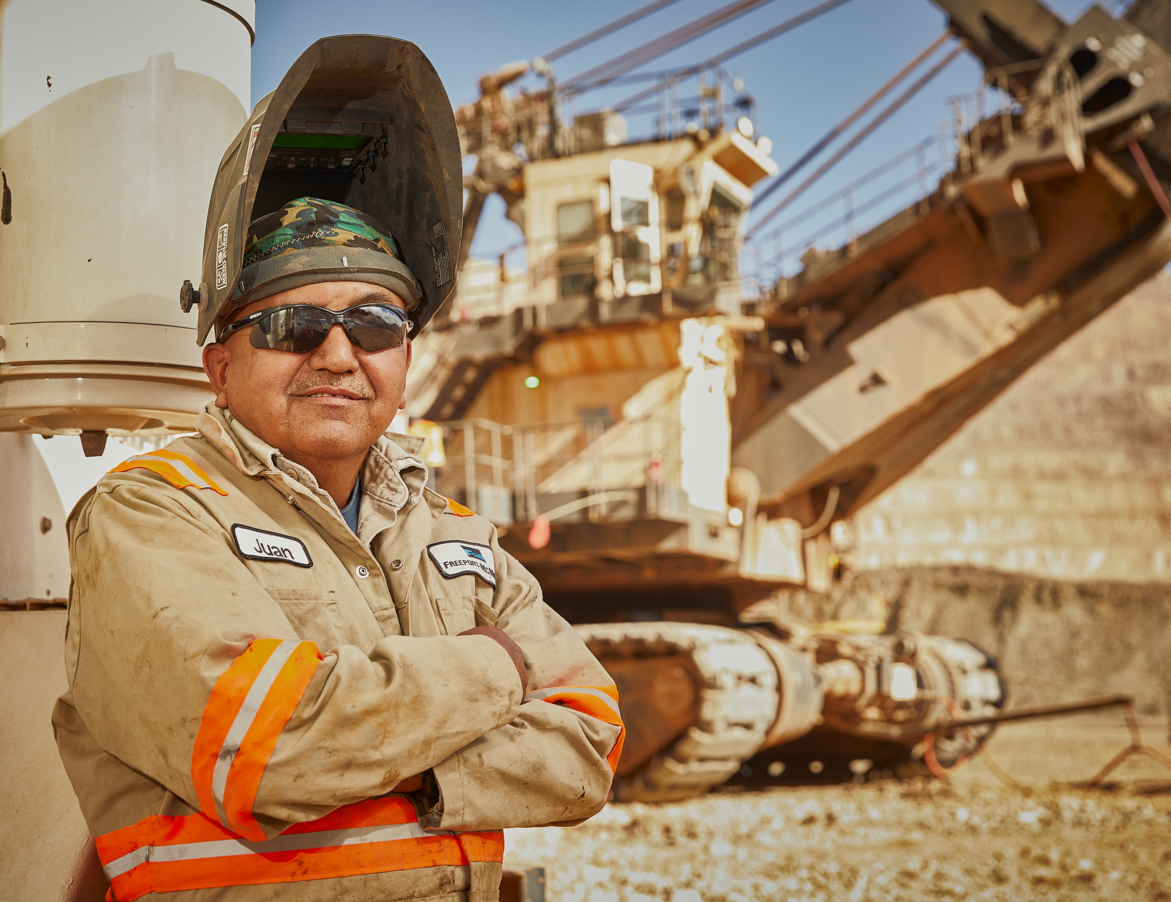

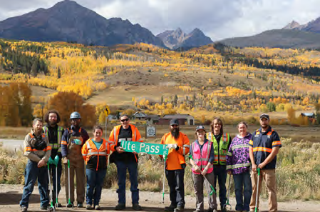

Highway Cleanup: Mark Your Calendars September 29!
Lunch will be provided to those that participate! You
Bring PPE
coordinate with your supervisor or Project Manager and email Shelby Epperson at sepperso@fmi.com before 9/22.
Mine folks welcome too!

Slide 11
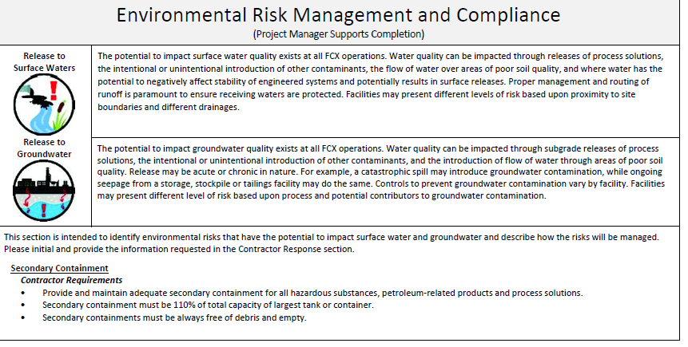
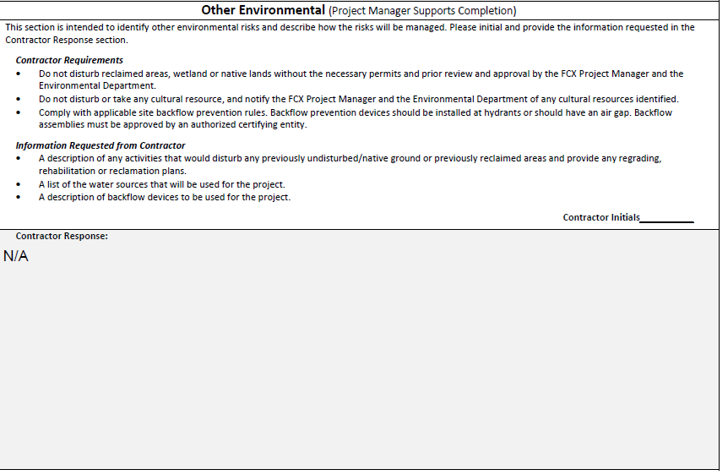
HSEP Open Form:
Please fill out environmental section for project specific information!
Contractor needs to initial several spots in this section
What questions do you have?

Slide 12
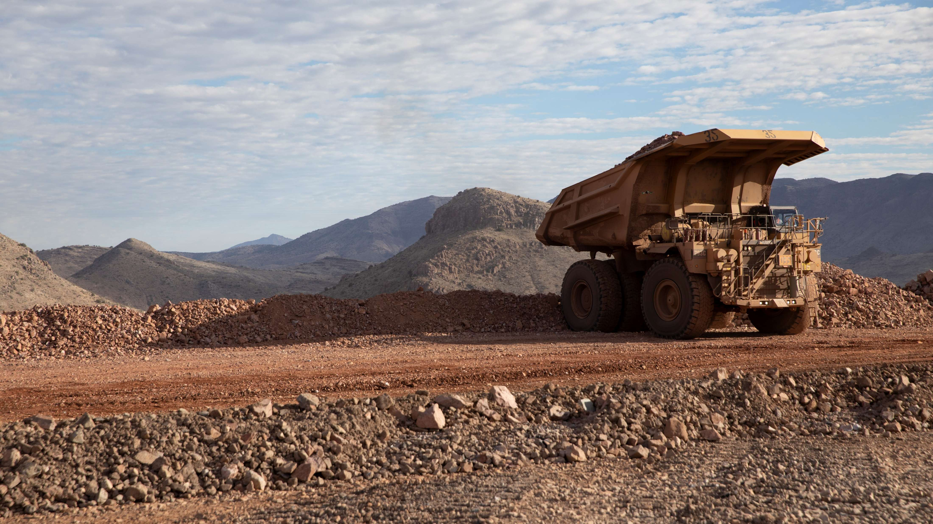
High-risk Incidents
Actionable and PFEs

Slide 13
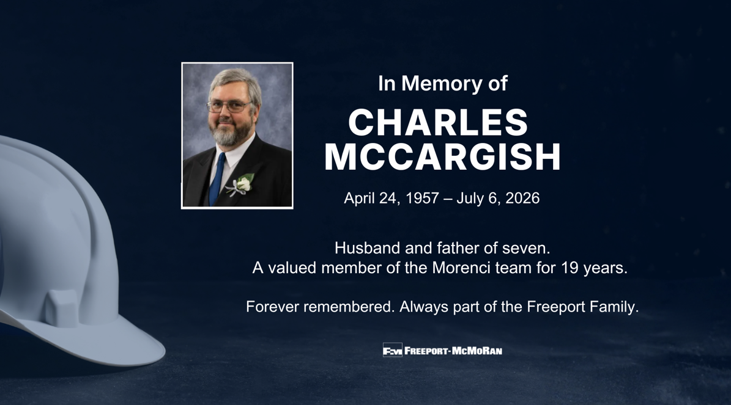
Morenci Haul Truck Fatality
Memo to Employees – July 7, 2026
I am deeply saddened to share that Charles McCargish, 69, a Truck Driver I and a valued member of the Morenci team for 19 years, was fatally injured Monday morning in a rear-end collision involving two haul trucks in the mine.
The incident occurred at about 9:40 a.m. Emergency response personnel were immediately dispatched, and Charles was pronounced dead at the scene. The Mine Safety and Health Administration and the Arizona Mine Safety Inspector were notified immediately and have been on site.
This is a heartbreaking loss for our entire organization, and we extend our deepest condolences to Charles’ family, friends and coworkers.
I recognize this news may be difficult to process and encourage anyone who needs help or support to contact Spring Health, our employee assistance program. Representatives are available to speak with you. Alternatively, you can reach out to your local HR office.
As with any incident, an investigation is underway to determine the cause and contributing factors. During this time, I ask that you refrain from any speculation – both within and outside Freeport – as we work to better understand what led to this tragedy.
Please keep Charles' family, friends and fellow coworkers in your thoughts during this difficult time. Most importantly, stay focused, work safely and continue to look out for one another.
- Cory Stevens, Senior Vice President, President and Chief Operating Officer-Americas

Slide 14

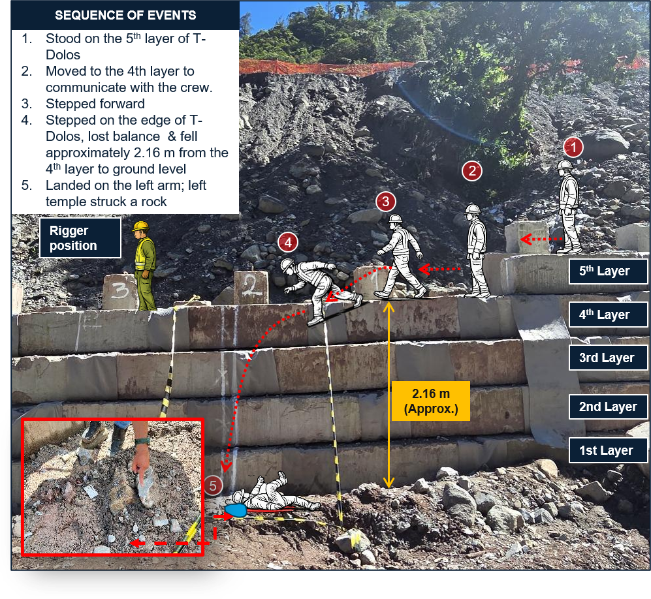
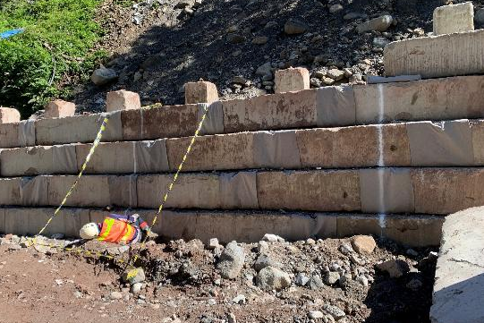
Employee Fell From T-Dolos
PFE # 2026-09 Event ID # 20037926
Fall from Heights
Preliminary Incident Details
Operation | PT Freeport Indonesia
Date / Time | July 11, 2026 / 9 a.m.
Type | Injury – Lost Time
Summary | A field supervisor responded to a report of a boulder obstructing T-Dolos (concrete block) installation. While stepping forward on the edge of the fourth layer of a T-Dolos stack, the employee lost balance and fell approximately 2.16 meters (7 feet) to a lower level, landing on their left arm and striking their left temple against a rock.
Risk Category | Actionable–Significant (3) Likely (3)
Findings / Missing Controls | The employee was exposed to a fall hazard above 1.2 meters (4 feet) without fall protection system in place. No static line or fall-arrest system had been installed to provide protection on the T-Dolos stack. The employee used the stack and a shortcut access route, creating exposure to a fall hazard without protection.
Immediate Action(s) | Stop work and secure the area to reinforce working-at-height controls. Review work-at-height controls and install approved fall protection before resuming work.
Applicable Policies / Procedures | GDL-4.01.10-PTFI-001 Working at Height JSA-CID-031-2025 Bridge Foundation Stabilization Works Using an Excavator
Employee Condition | The employee sustained a fracture to the upper left arm (humerus) and a temple laceration requiring stitches.
Contact | I Nengah Giri, Senior Manager-Grasberg Earthwork
Incident diagram
Fall position re-enactment

Slide 15

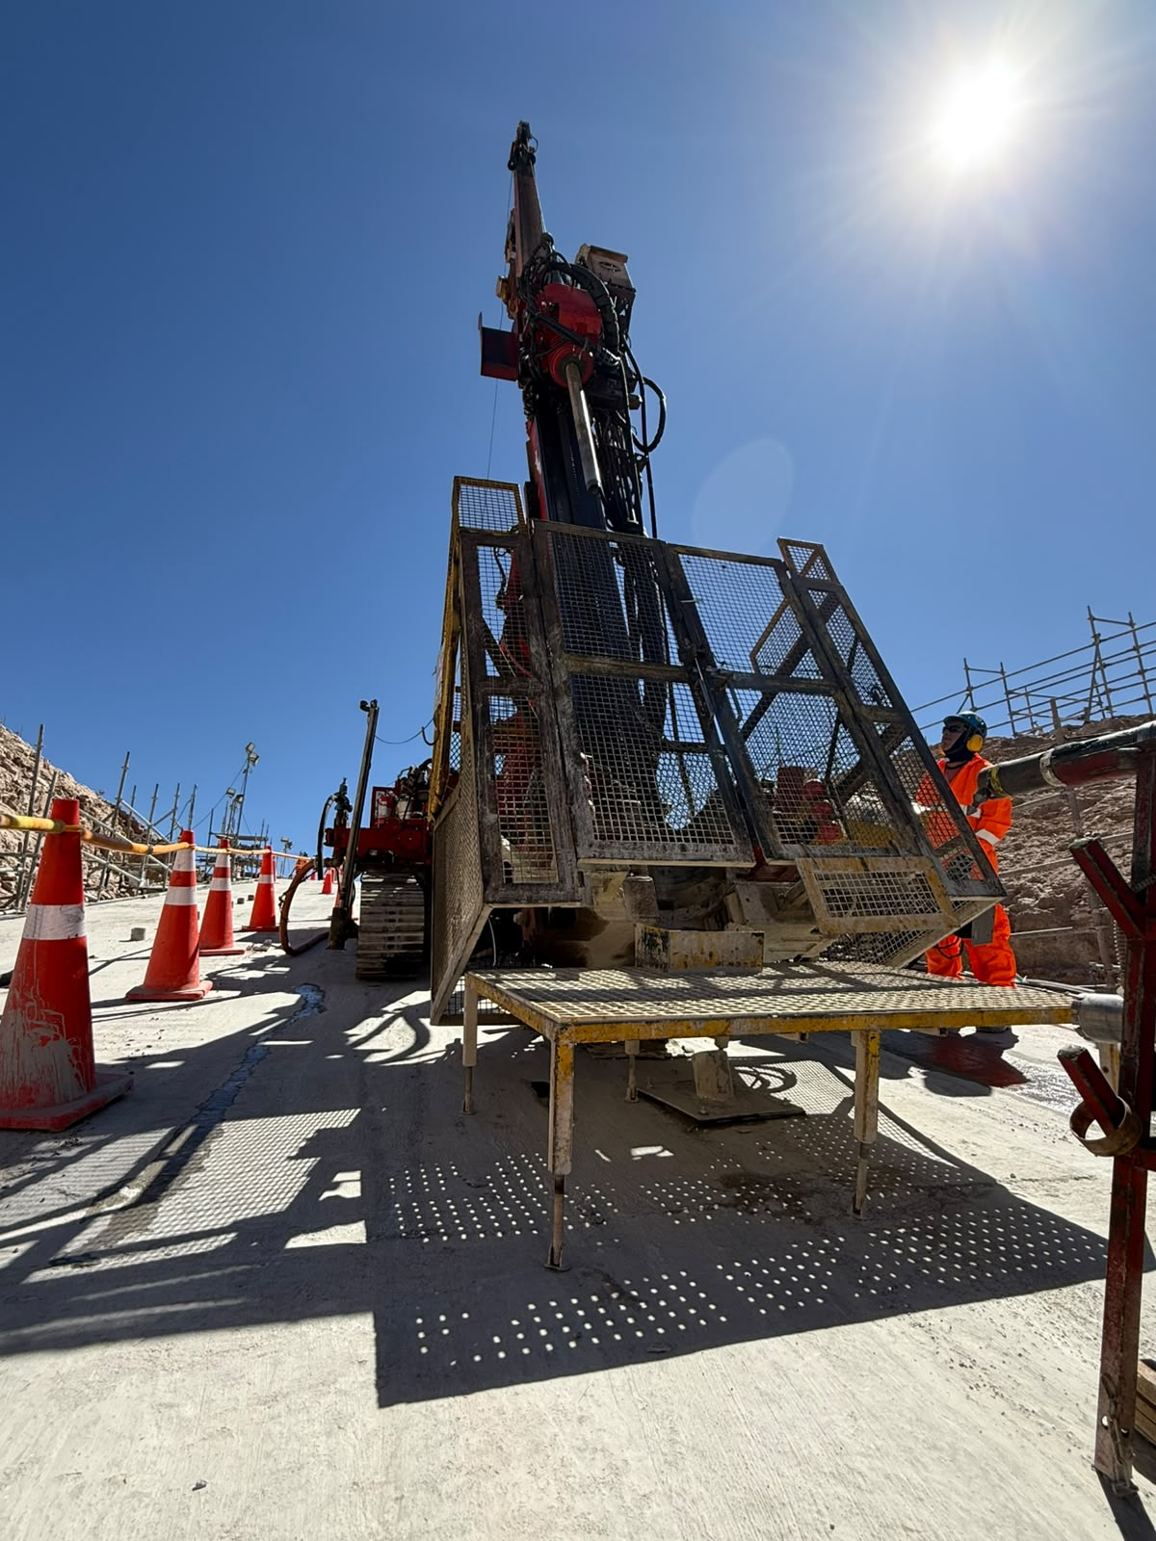
Worker Struck by a Drilling Rod
ID # 2026-15 Event ID # 20037862
Falling Objects
Preliminary Incident Details
Operation | Cerro Verde
Date / Time | July 11, 2026 / 2:25 p.m.
Event Type | Injury – Medical Treatment
Summary | During a rotational diagnostic test of the drill head on a crawler-mounted drill rig, a suspended section of the drill string detached. The drill string, consisting of the barrel and an HQ rod, fell approximately 50 centimeters (1.5 feet) within the protective guard. The 17.25-kilogram (38-pound) HQ rod then separated from the barrel, struck the upper part of the protective guard and deflected toward the operators, striking an operator’s hard hat.
Risk Category | Actionable – Significant (3) Likely (3)
Findings / Missing Controls | The JSA did not identify or consider all hazards associated with the task. The safe work procedure did not include the rotational diagnostic testing activity or the controls required for performing the task.
Immediate Action(s) | Reinforce the importance of thorough JSAs to identify all hazards. Stop work when a task is not covered by a standard procedure. Thoroughly evaluate risks and verify appropriate controls are implemented before proceeding.
Applicable Policies / Procedures | No applicable policies.
Employee Condition | The operator sustained a laceration-contusion injury to the head.
Contact | Gustavo Reynoso, Manager-Engineering and Construction Projects
“Kely” Rod
3.00m
HQ Rod
1.50m
“Barel” Rod
2.60m
Illustration of incident.

Slide 16

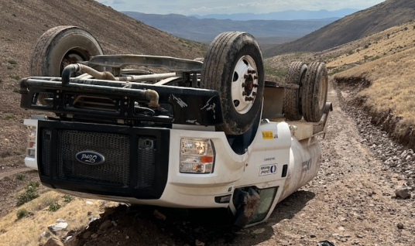
Water Truck Rolled Over
Vehicle Collision or Rollover
ID # 2026-16 Event ID # 20038082
Preliminary Incident Details
Operation | Safford
Date / Time | July 18, 2026 / 8:13 a.m.
Event Type | Property Damage
Summary | An operator hauling a full load of water uphill began losing power. They attempted to back down to a flat area to lighten the water load. While reversing, the truck's tires locked and the vehicle slid sideways. The rear driver-side tire climbed the downslope hillside, causing the truck to roll over. The berm prevented the truck from rolling further down the road or hill. The operator exited the vehicle without injury.
Risk Category | Actionable – Significant (3) Likely (3)
Findings / Missing Controls | The berm was successful in stopping the vehicle. The operator was wearing a seatbelt. Stop work should be used when equipment capabilities are compromised.
Immediate Action(s) | Verify a risk-based approach when constructing roads to help ensure proper grade, berms and vehicle capabilities. Remote work should have plans in place for emergency response times.
Applicable Policies / Procedures | FCX-23 Interaction with Heavy Mobile Equipment
Employee Condition | No reported injuries.
Contact | Shannon Jeans, Manager-Health and Safety
Rolled F750 water truck.

Slide 17

Industry Incidents

Slide 18
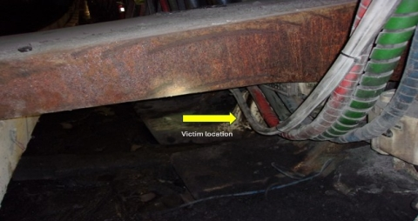
MSHA Fatality Alert
July 1, 2026 – A miner died after a longwall shield hydraulically collapsed on him while performing maintenance on the shield.
Eliminate Hazards and Prevent Injuries
Block shields against hazardous motion before working on components that support the raised portions of the shields. Review and understand the manufacturer’s maintenance and repair procedures.
Be aware of potential pinch points when working on or near hydraulic components. Identify hazards that may be created because of work being performed.
Train miners who install, move or maintain shields on proper procedures and hazard recognition, including manual operation of hydraulic control valves.
Maintain good communication with coworkers. Make sure those around you know your intentions.

Slide 19
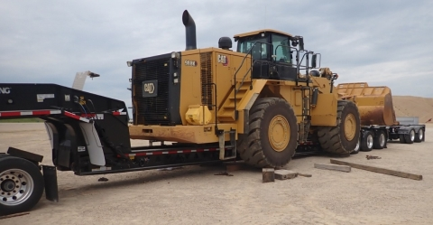
MSHA Fatality Alert
June 26, 2026 – A contract truck driver died while loading a front-end loader onto a trailer for transportation.
Eliminate Hazards and Prevent Injuries
Load equipment in a manner that does not create a hazard to miners from falling or shifting equipment.
Confirm work areas are clear and position yourself away from potential hazards, including potential pinch points, when moving or positioning equipment.
Communicate your presence and intended movements when working near mobile equipment and wait for acknowledgment before moving.
Operators should always give a warning prior to moving equipment.

Slide 20
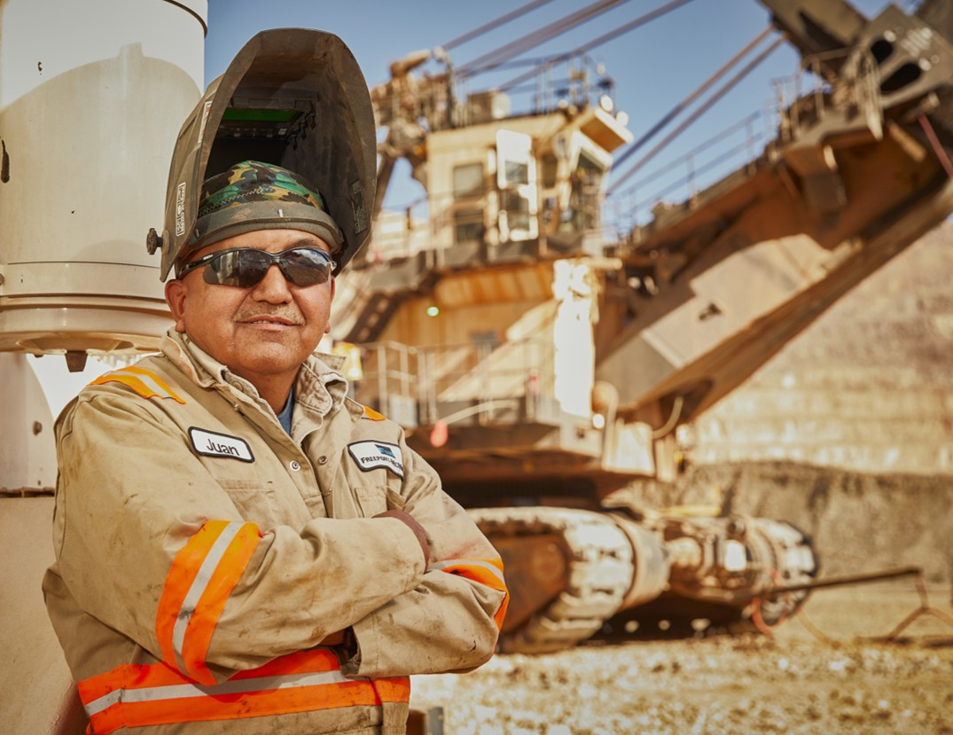
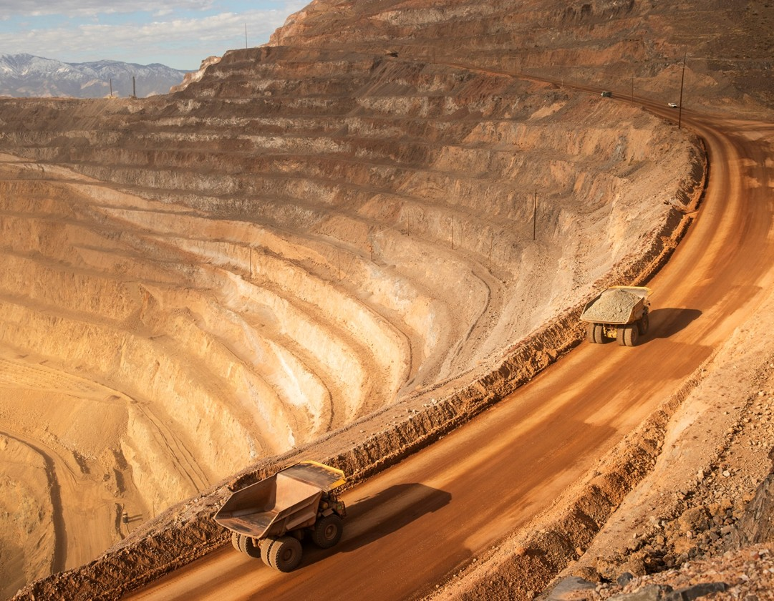
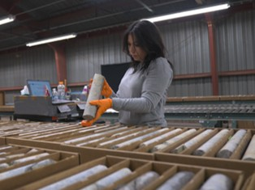
Additional Resources
Health and Safety Dashboard
Safety Toolkits
FCX Policies
MSHA Safety Alerts
OSHA

Slide 21
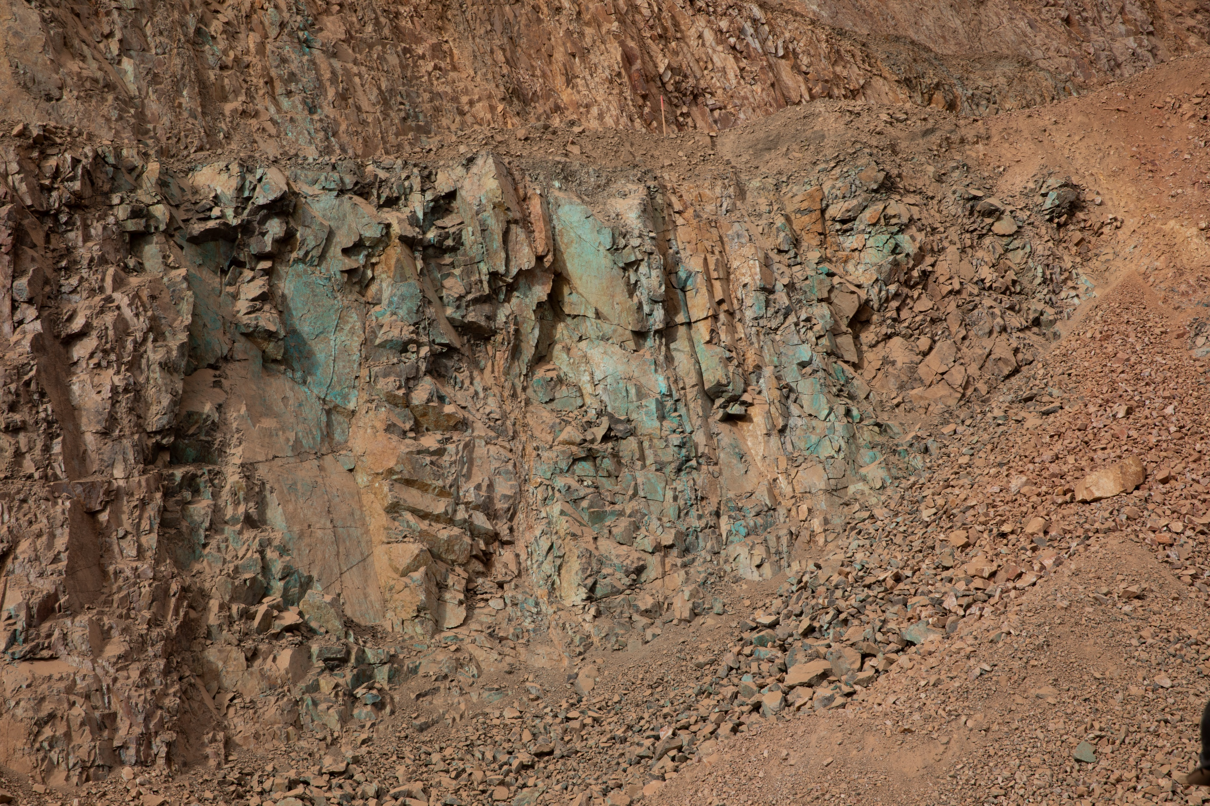
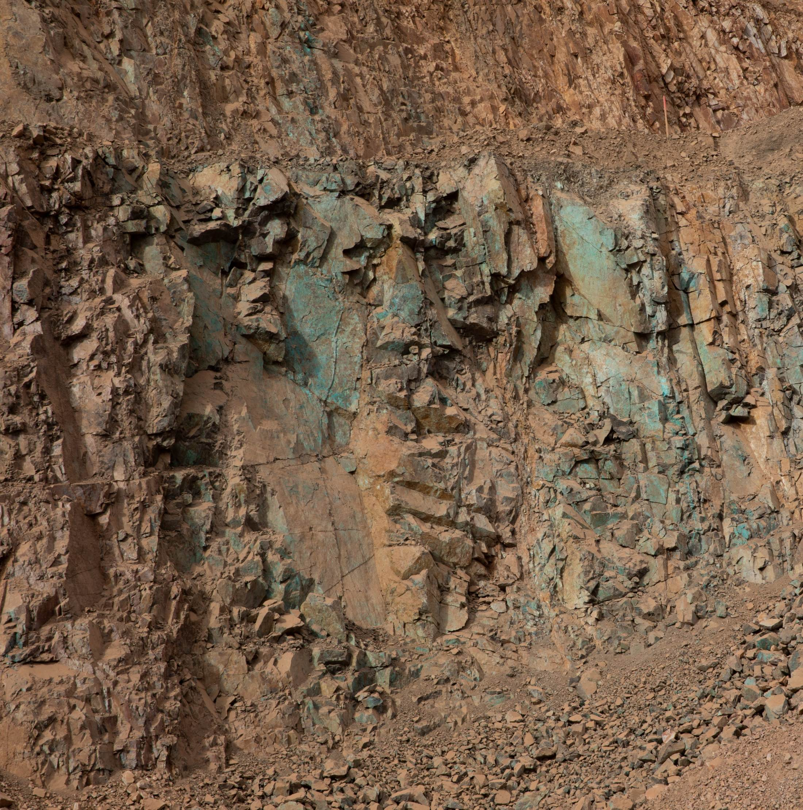
Site Incidents

Slide 22
Henderson Incidents
07/01 – Radiator Punctured by Gate (Property Damage)
  Contractor in LV attempting to access tailings area via East Branch Gate
  Gate began to close when passing through and gate arm punctured radiator
07/17 – Service Truck Struck by Excavator (Property Damage)
  Employee at 3 Dam Stepback replacing hoses on 345 excavator
  Rotated excavator to access difficult to reach hoses
  Counterweight of excavator struck unoccupied service truck when rotated
07/20 – Pine Oil Splashed onto Driver (First Aid)
  Contract driver starting Pine Oil bulk offload
  Removed transport cap on truck valving and splashed in face by Pine Oil
  PPE protected eyes, no serious injury

Slide 23
Henderson Incidents
07/21 – Employee Fall from Equipment (First Aid)
  Operator stepping out and down from excavator when they missed step
  Employee fell backwards and struck hard hat on machine tracks and ground
  Employee returned to equipment but stopped work after experiencing grogginess
07/29 – Employee Injured Shoulder While Shoveling (First Aid)
  Employee shoveling when shovel became jammed under rock
  Attempted to push down on shovel when shovel broke, causing discomfort
  Employee woke up next day with tenderness/discomfort in shoulder
07/30 – Debris in Eye When Griding (First Aid)
  Employee cutting bolt off at boiler when piece of material got in eye
  Individual wearing face shield at time of event
  Debris removed off site

Slide 24
FRM Verification Results – July
211 verifications completed in July
Focus for July was Hazardous
Substance – Acute and Underground
Rock Fall
Haz. Sub. – Acute stayed in Top 3
Underground Rock Fall decreased
Underground Hazardous Atmosphere increased due to Shutdown projects changing vent plans
FOCUS FOR AUG/SEPT:
Underground Hazardous Atmosphere
Hazardous Substances - Acute

Slide 25

FRM Verification Results – July
Henderson Missing Controls with Multiple No Responses

Slide 26
Q3 MSHA Inspection Highlights

Slide 27
Citation Count
Henderson Q3 2026 MSHA Citations | S&S | Non-S&S | All Citations
Mine | 2 | 17 | 19
Mill | 2 | 7 | 9
Contractors | 0 | 3 | 3
Total Henderson | 4 | 27 | 31

Slide 30
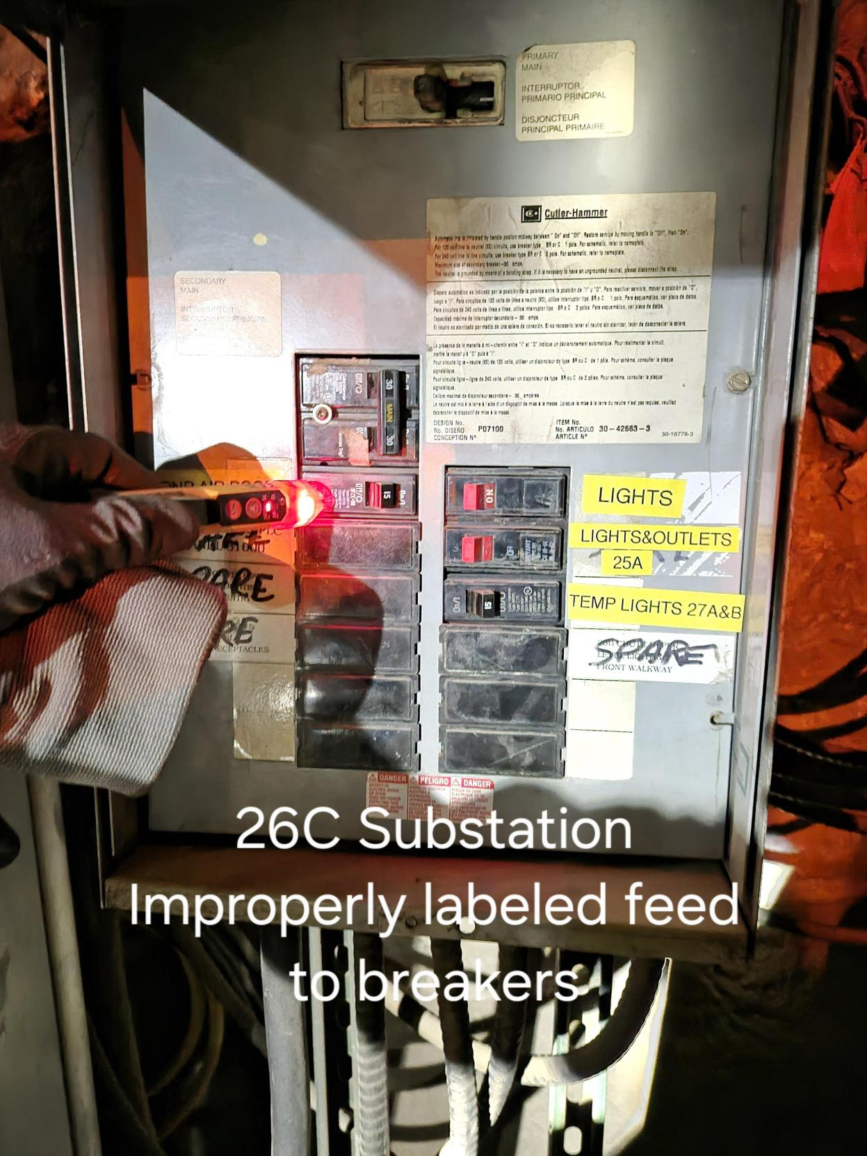
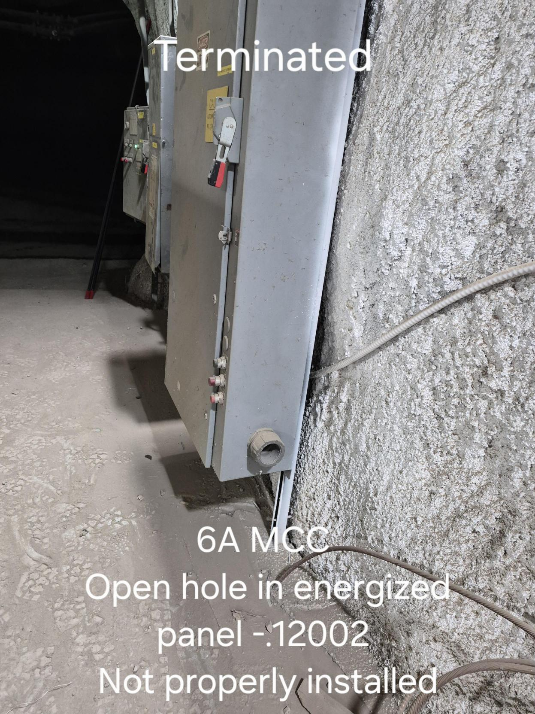
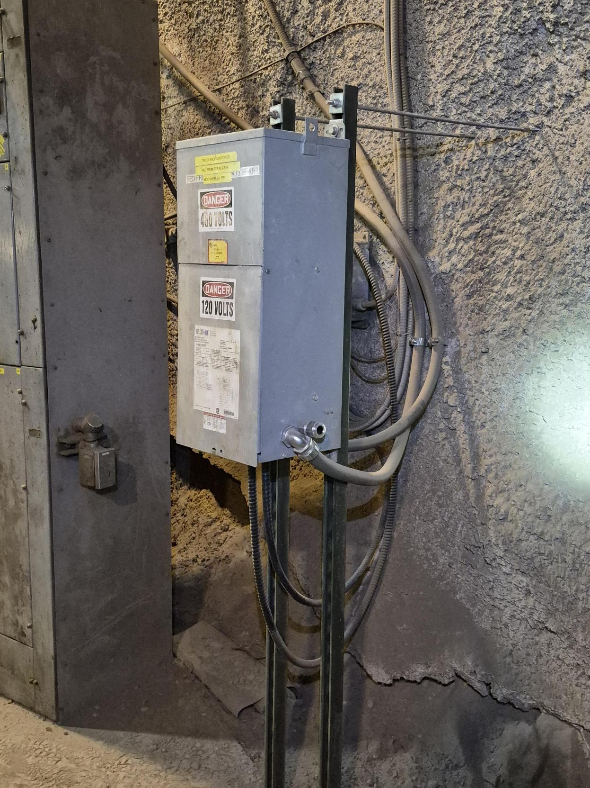
Big Hitters - Electrical

Slide 31
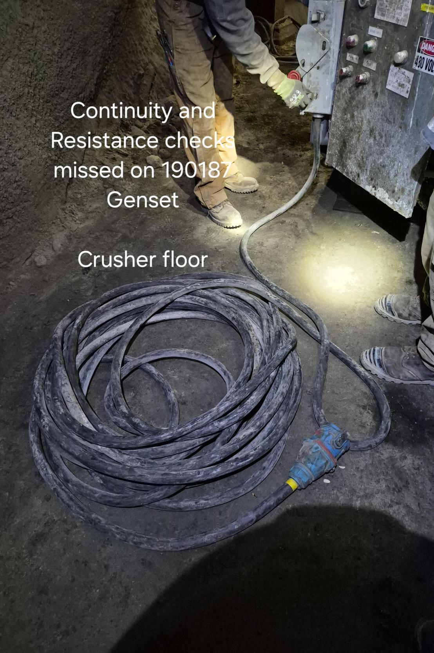
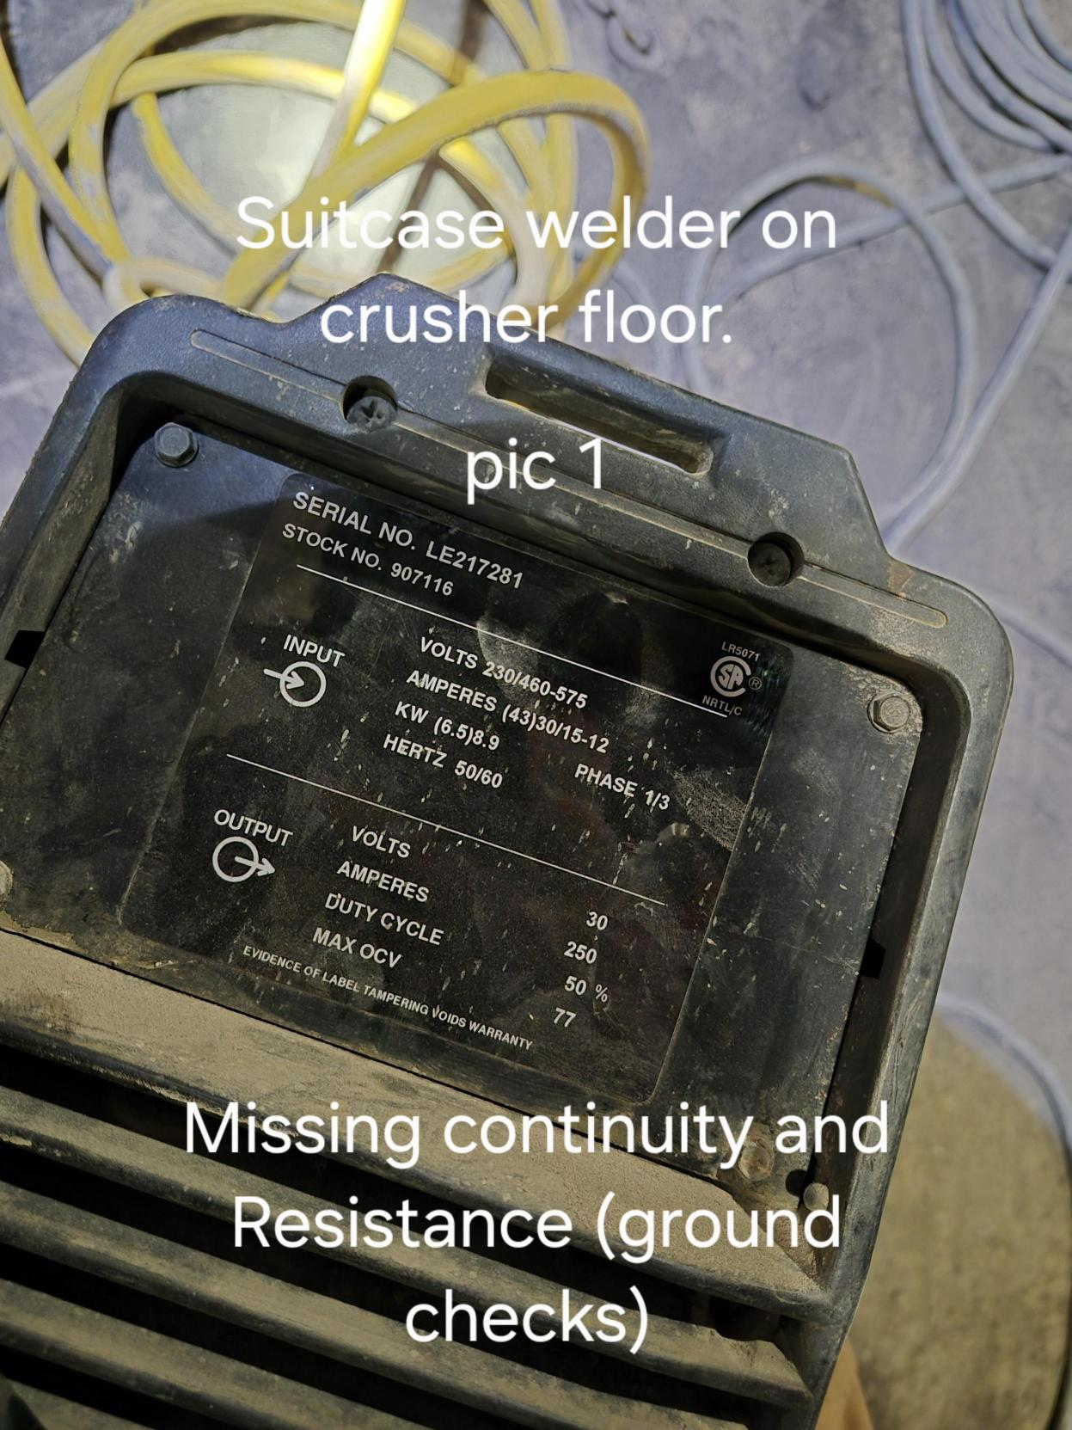
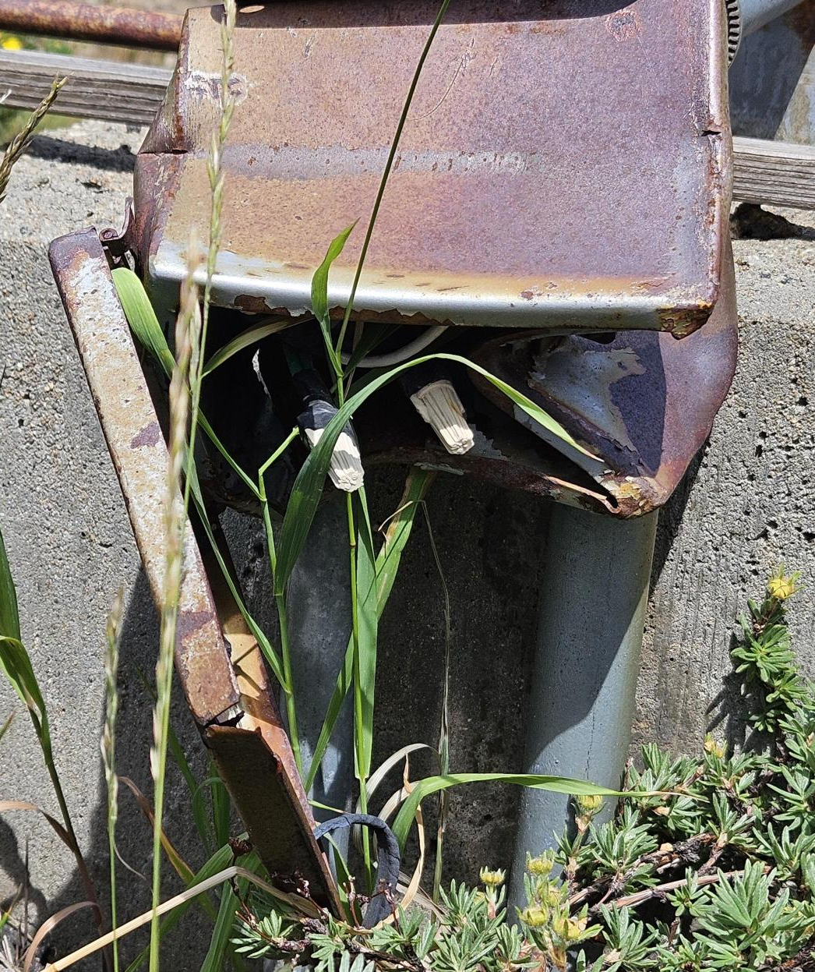
Big Hitters - Electrical

Slide 32
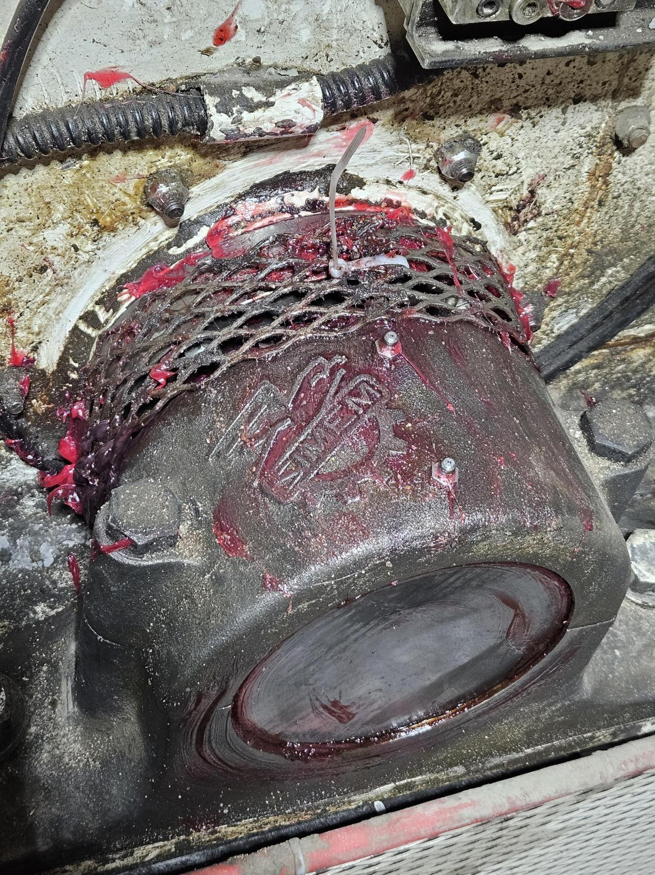
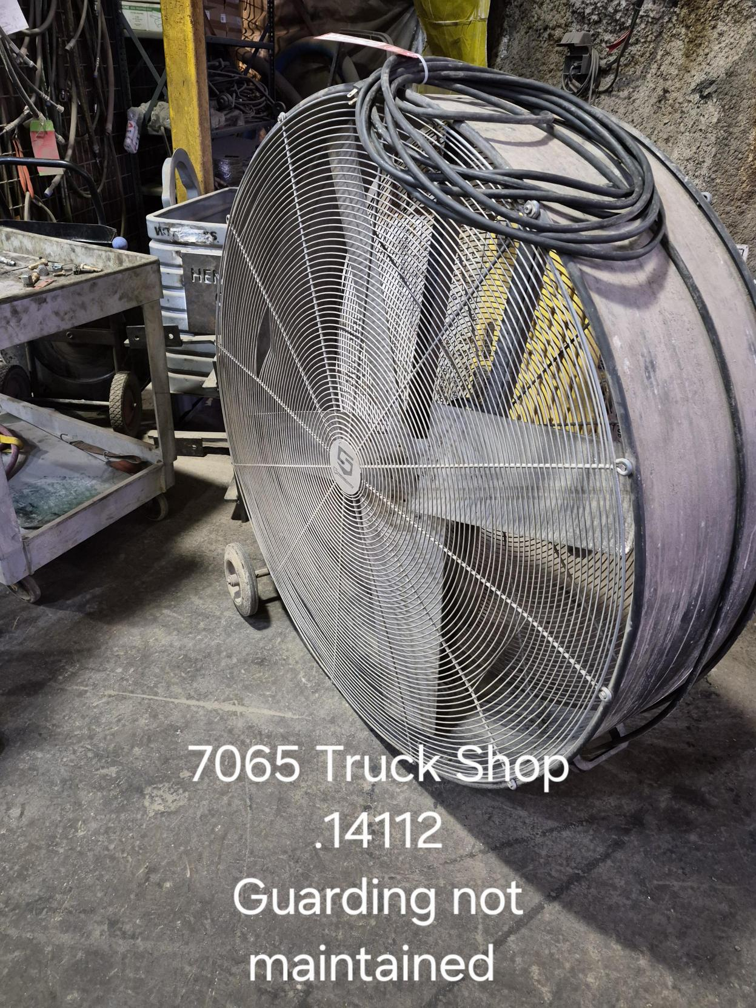
Big Hitters - Guarding

Slide 33
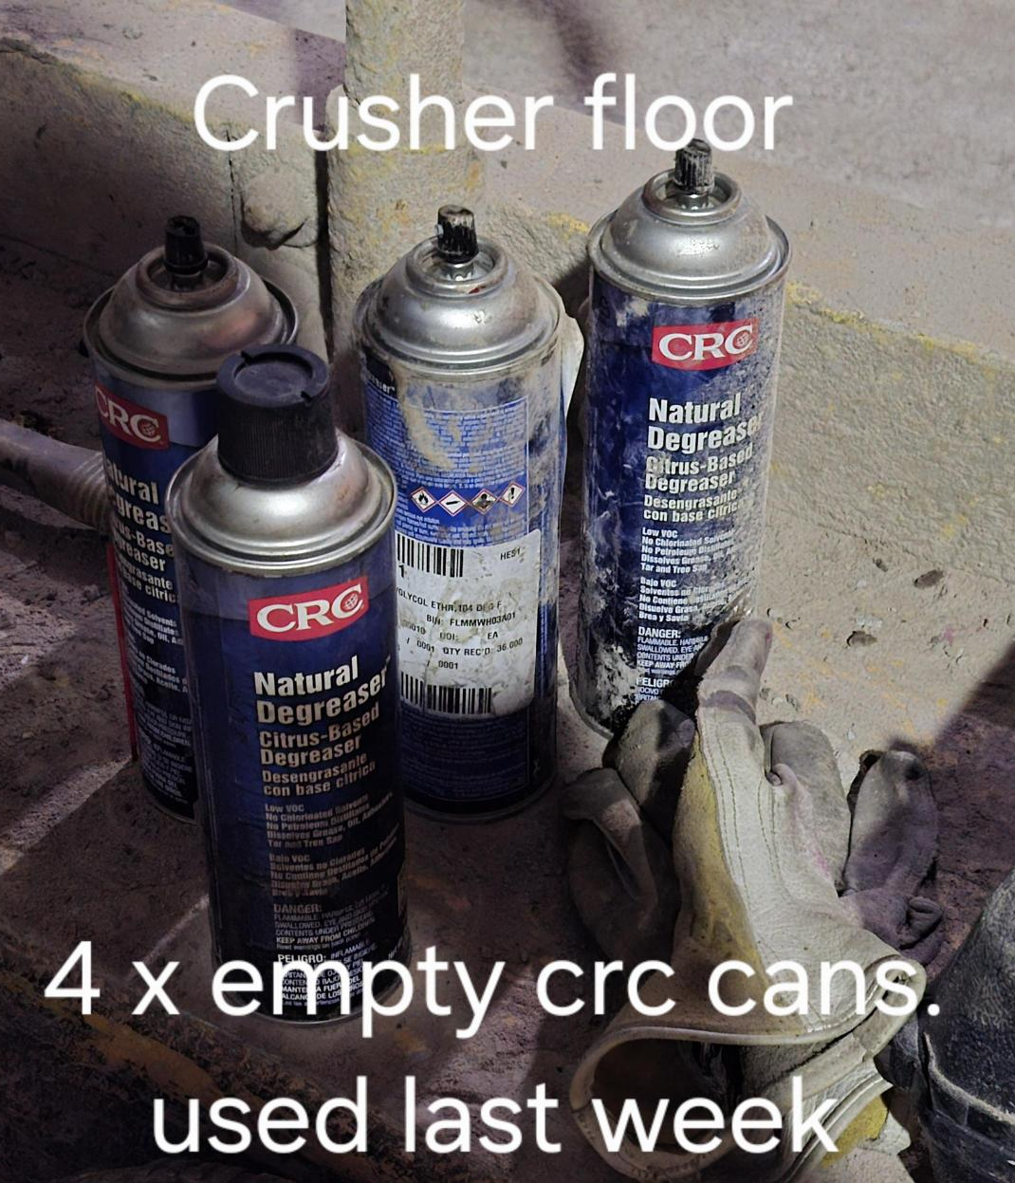
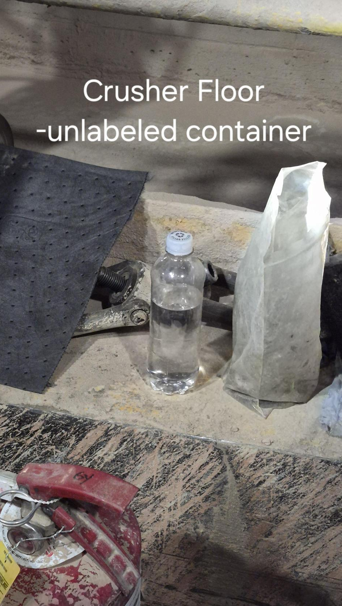
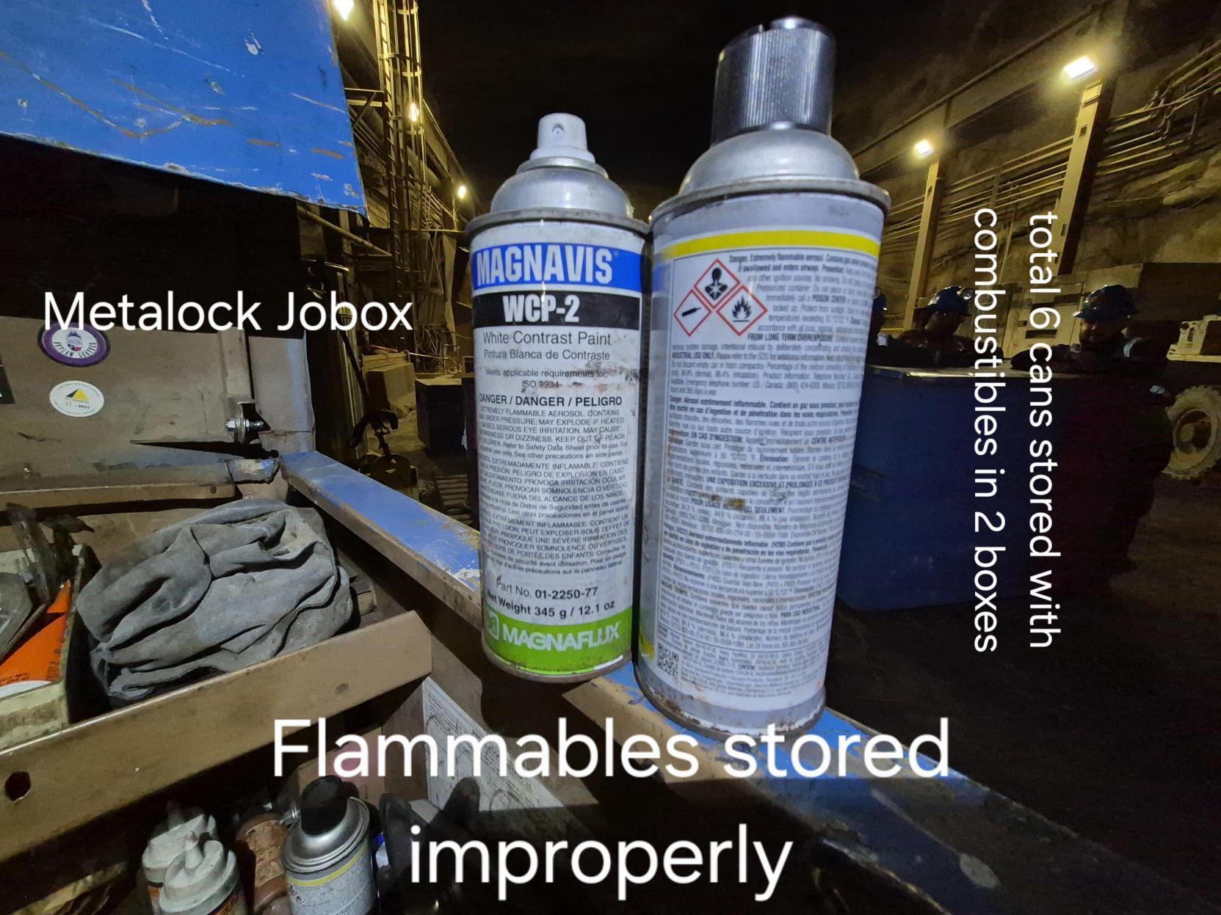
Big Hitters - Flammables

Slide 34
Contractor Management Topics
ISNetworld Update
HSEP Update

Slide 35
ISNetworld Update
ISN Compliance
All contractors must upload and complete every training course (Core, Compliance, and Technical) along with Worker Acknowledgements in ISN by August 31, 2026.
  Contractors will be denied site access effective September 1, 2026 by order of Henderson GM.
  All contractors must maintain current employee training records onsite or readily available through the contractor’s on-site Project Manager. For example, a project binder containing all required training documentation must be available for review at any time.

Slide 36
HESP Update
HESP
Contractors must upload their signed HESP to ISN while keeping the original file name they were provided.
The signed HESP file name is set up so Henderson can readily locate the document within ISN. Updated nomenclature: YYYY-MM_HML_Contractor_Project_PM
  i.e. 2026-08_HML_BTI_Mill Liners_Kippers

Slide 37

Open Forum

Slide 38
September 17th
October 8th
November 19th
December 17th
2026 Meeting Schedule
Meetings begin 1 PM MST
Mine and Mill In-Person Options Monthly

Slide 39
August Sign-Off Record
_____________________
_____________________
_____________________
_____________________
_____________________
_____________________
_____________________
_____________________
_____________________
_____________________
_____________________
_____________________
_____________________
_____________________
_____________________
_____________________
_____________________
_____________________
_____________________
_____________________

