Slide 1



HSE Contractor Meeting
December 2025

Slide 2


What is the purpose of this Meeting?
- For Henderson to have the opportunity to reach multiple contractors to discuss best practices when it comes to Health and Safety, Environmental and Contracts Management
- Give contractors an open forum to bring up concerns, successes or incidents, learnings, etc. that is shared between all contractors and Henderson personnel
- Help improve the safety culture and reduce safety incidents as a group

Slide 3

Safety Success

Slide 4
Safe Production Matters
Congratulations! Your commitment is making a difference in safe production.
This year we continued to reduce our Total Recordable Incident Rate and are on track for the best high-risk incident rate since the metric was created in 2023.
While we won’t hit our ambitious 15% improvement goal over last year, we finished November at 41 high-risk incidents year to date – down from 44 in 2024.
Let’s keep this momentum going and finish 2025 strong – focus on Fatal Risk Management, effective line-out meetings and meaningful discussions on controls to mitigate fatal risks.
Notes:
The provided statistics are for FMA (North and South America operations only).

Slide 5
Spotlight On
Cerro Verde: Turning Action into Impact
After a maintenance incident, the Cerro Verde team took decisive action – transforming a challenge into an industry-leading solution.
Discussion
What steps can we take after an incident to help implement lasting solutions?
How can we use cross-team collaboration to help identify better safety practices?
How can we better use lessons learned to help reduce risks in our own work?
Actionable Incident: A wheel chock failure during maintenance caused a leg fracture.
Action Item: Cerro Verde evaluated new tools and procedures to eliminate movement during maintenance, including alternative brake check methods for Komatsu haul trucks.
Execution: In collaboration with Komatsu and CAT, the team tested five brake check methods. They adopted the Nose Cone “Forward-Reverse” test, which resulted in:
  Smaller crew size
  Reduced time and costs
  Elimination of hazards during testing
Impact: The test was so effective, Komatsu adopted this method for similar haul trucks and, with Cerro Verde, established a standard operating procedure.

Slide 6
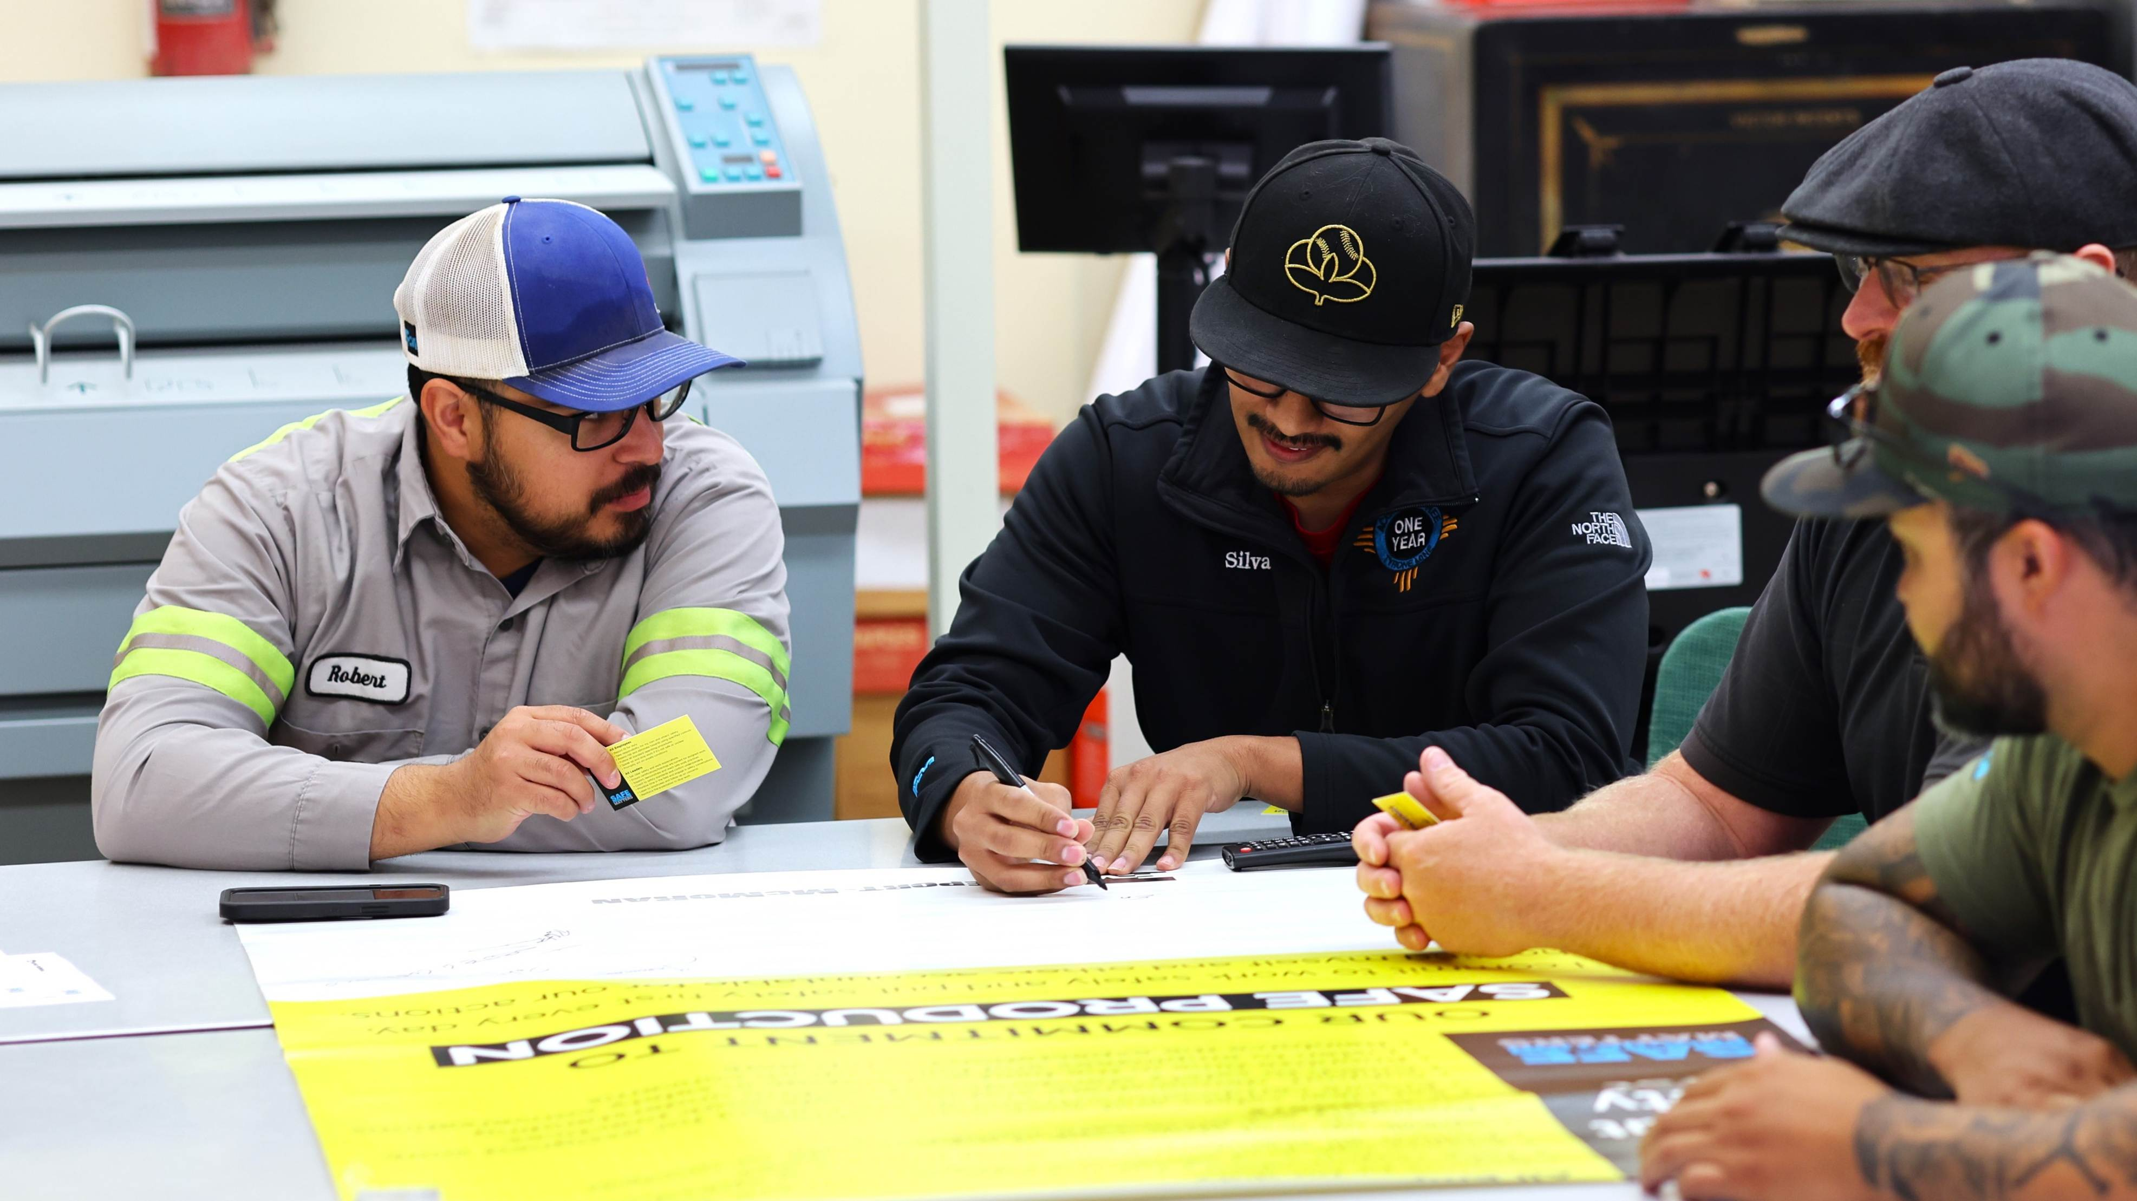
Safety Shares

Slide 7

Staying Focused During the Holidays
Discussion
The holiday season is time for joy and celebration – but it also can bring distractions. Travel, family commitments and financial pressures can make it easy to lose focus, and even a momentary lapse can have serious consequences.
Here are a few key actions you can take to stay safe:
Stay Present: The best gift is being present – at home and on the job. Keep your focus on the task and hazards at hand.
Eliminate Distractions: Keep your eyes and mind on the task. Consider silencing phones, avoiding multitasking and take breaks when needed to maintain concentration.
Fit for Duty: Fatigue and stress spike during holidays. Prioritize sleep, hydration and balanced meals.
Stop Work: If something feels unsafe or unclear, stop and reassess.
Plan Ahead: Consider vacation schedules and labor shortages during task planning. Coordinate planned work early to reduce stress.
What common distractions do you notice toward the end of the year?
How can we adjust work to manage smaller crews during PTO?
How can we support each other in staying focused at work?
What steps do you personally take to eliminate distractions on the job?
What’s one thing you’ll do today to stay focused and safe?
Your mental health matters
Spring Health – Freeport’s employee assistance program – offers mental wellness resources and 24/7 crisis support. Call 1-855-629-0554 or visit fmi.springhealth.com.

Slide 8





Falling Object Prevention – Look Up!
Hazards exist all around us, including overhead. It’s important to stay alert, scan for hazards and keep an eye on what’s overhead when handling tools or equipment.
Protect yourself and others with these tips:
Pause and Observe
Before entering an area or moving equipment, pause, look up and check for hazards overhead.
Remain Vigilant
Situations can change rapidly – continue scanning while you move.
Report Hazards
Alert others immediately
if you notice unsafe conditions.
Respect Safe Zones
Use barricades, flags and signs designed to keep people clear of potential drop zones.
Discussion
  When you look up in your work area today, what hazards might others miss?
  How can we improve at identifying overhead hazards when moving tools and equipment?
  What changes in the environment should prompt us to re-check overhead hazards?
  Why isn’t a hard hat enough protection – and what else prevents injuries?

Slide 9
Environmental Share: Used Oil
Used oil is exactly what the name implies—any petroleum-based or synthetic oil that has been used. At Henderson, we also manage spent grease as used oil. The goal at Henderson is to recycle all our used oil. If not recycled properly, used oil could be regulated as a hazardous waste; however, to encourage recycling of this valuable resource, regulators have developed management standards for used oil
Notes:
HSEP – Contractor Health, Safety and Environmental Plan
FRM – Fatal Risk Management
WPE – Work Place Exam

Slide 10
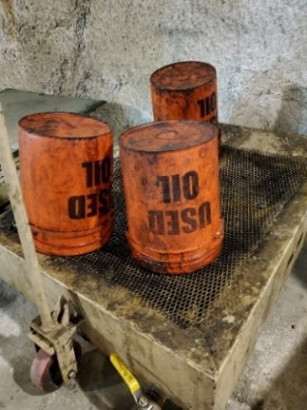
If you generate any used oil, or encounter any unlabeled oil containment, please reach out to site Environmental and your site representative.
Environmental Share: Used Oil
Used oil containers must be labelled “Used Oil”. This includes drip pans, storage tanks, containers, pipelines and secondary containment. Labeling with a sticker or market works well.
Pre-labeled “Used Oil” containers can only be used for used oil. Otherwise, it is a labeling/regulatory issue
Notes:
HSEP – Contractor Health, Safety and Environmental Plan
FRM – Fatal Risk Management
WPE – Work Place Exam

Slide 11

Policy/Process Updates & Reminders

Slide 12
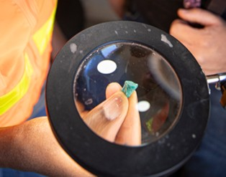



EWS Form Updates
New Equipment Inspections
  Dump Truck
  Loader
  Locomotive
  Operator Field Safety Checks

Slide 13


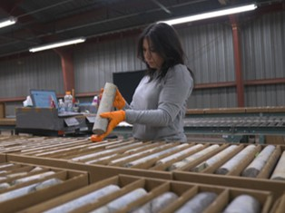
Additional Resources
Health and Safety Dashboard
Safety Toolkits
FCX Policies
MSHA Safety Alerts
OSHA

Slide 14
Contractor Management Topics
Lessons Learned:
Reporting Contractor Hours Using EWS
Safety Program for Surface Mobile Equipment

Slide 15
Hours Reporting: What did we learn?
Up to one week delay when requesting EWS Access
6th deadline a quick turn around (especially when over weekend)
FMI sites have varying hours category expectations
Majority of Contractors got their hours reported
Utilized late reporting form successfully

Slide 16


Contractors Who Reported November Hours
Roxsyle Systems
Cementation USA
The Hiller Companies
Dalco
Moltz Construction
W W Wheeler Associates
Intermountain Electric
Aquionix Inc
Habitat Management
Copper State Bolt Comp.
WSP USA Corp.
Sturgeon Electric
Kumar Associates
Wagner Equipment Co
BODEC Inc
AECOM DCS
Rema Tip Top NA Inc
Logistical Systems LLC
THANK YOU!

Slide 17

Contractor EWS Access
Access to site digital forms now available to Contractors!
Integration of Contractor submitted forms into internal dashboards
Forms can be used in online and offline modes
Request Access with QR Code or HERE
Reach out to H&S Department with any questions or issues

Slide 18
Safety Program for Surface Mobile Equipment
Standard from MSHA requiring program for surface mobile equipment
Applies to all production operators and part 45 Independent Contractors
Enforcement began July 17, 2024
Surface mobile equipment includes:
  Wheeled, skid-mounted, track-mounted, or rail-mounted equipment capable of moving or being moved, and any powered equipment that transports people, equipment, or materials.
  The rule excludes belt conveyors and any manually powered tools such as wheelbarrows, hand carts, push carts, welding carts, cylinder carts, basic hand trucks, or dollies.

Slide 19
Part 45 Independent Contractors
Part 45 independent contractors have the same responsibilities as production operators.
MSHA expects most independent contractors will develop and implement their own safety program or integrate their safety programs into the production operators’ safety program.
MSHA expects production operators and part 45 independent contractors to communicate and coordinate with each other on their respective safety programs.
If they agree to integrate their safety programs, the independent contractor does not need to develop a separate safety program.

Slide 20
What does this mean for Contractors at Henderson?
Henderson Safety Program for Surface Mobile Equipment
If part 45 independent Contractor:
  Share with us your Program
  Have copy ready for MSHA to request
  Contact Ben Goertz if you need to integrate under Henderson
All contractors:
  Update your Project Manager quarterly on the surface mobile equipment you operate on site
  Safety to maintain internal Contractor & Rental SME Inventory list with assistance of PM/Contractor

Slide 21
Henderson Incidents
11/20 – Reportable Injury (Lost Time) and First Aid
  Three employees conducting return roller changeout at PC2 Table 2071 using jack and timber to lift belt from roller
  Jack slipped impacting one employee on leg and causing the belt to pin another employee's hand to the roller
11/26 – Reportable Injury (Lost Time)
  Employee suffered a Personal Medical event while showering
  Injured foot during event leading to MSHA Reportable status

Slide 22
FRM Verification Results – Nov.
160 verifications completed in November
Focus in November around Exposure to Electrical Hazards, Underground Rockfall and Entanglement & Crushing
All 3 focuses dropped in November, increase in Hazardous Substance – Chronic missing controls
FOCUS FOR DECEMBER:
Hazardous Substance – Chronic
Uncontrolled Release of Energy
Underground Rockfall

Slide 23
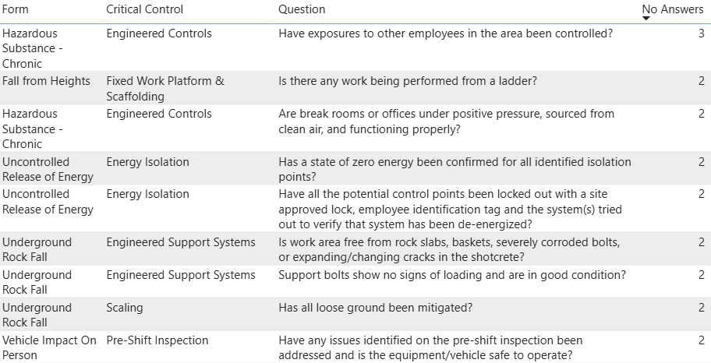
FRM Verification Results – Nov.
Missing Controls with Multiple No Responses

Slide 24

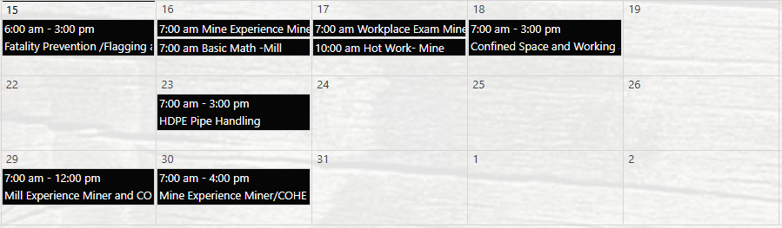

Henderson Training Schedule - December

Slide 25

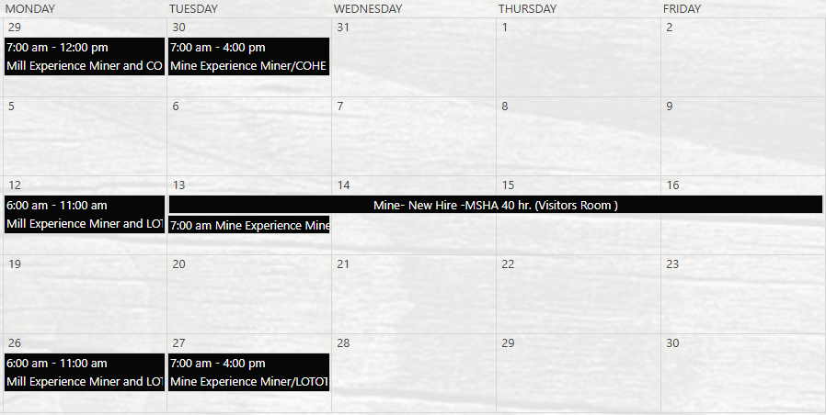
Henderson Training Schedule - January

Slide 26

Open Forum

Slide 27
January 15th
February 12th
March 19th
April 9th
May 7th
June 18th
July 16th
August 20th
September 10th
October 8th
November 19th
December 17th
2026 Meeting Schedule
Meetings begin 1 PM MST
Mine and Mill In-Person Options Monthly

Slide 28
December Sign-Off Record
_____________________
_____________________
_____________________
_____________________
_____________________
_____________________
_____________________
_____________________
_____________________
_____________________
_____________________
_____________________
_____________________
_____________________
_____________________
_____________________
_____________________
_____________________
_____________________
_____________________

