Slide 1
Henderson HSE Contractor Meeting – February 2025
02/27/2025

Slide 2
What is this Meeting?
Purpose:
For Henderson to have the opportunity to reach multiple contractors to discuss best practices when it comes to Health and Safety
Give contractors an open forum to bring up concerns, Health & Safety successes or incidents, learnings, etc. that is shared between all contractors and Henderson personnel
Help improve the safety culture and reduce safety incidents as a group

Slide 3
What are the Key elements?
In-person meeting
Packet/presentation
Sign-Off Record
Contractor Email List

Slide 4
What is the Meeting Content?
Review/discuss monthly H&S topics and environmental topics
Contractor Share*
Review FMI PFEs
Review FMI High Risk Incidents
Review Safety Alerts
Review MSHA Fatality Alerts
Review Henderson Incidents
Review MSHA Inspection findings/citations
Open the floor to everyone in the meeting for questions, concerns, learnings, etc.
Notes:
* Arrange for one of the Contractors to volunteer to give a 5-10 minute presentation on something they want to share regarding Health & Safety

Slide 5
Who needs to attend?
Contractors with 40+ employee hours at Henderson Mine and/or Mill monthly
Representative required to attend in-person meeting
Bring packet/presentation back to your employees for discussion
Scan completed sign-off record and sent to bgoertz@fmi.com
Contact Henderson H&S if unable to attend in-person that month
Contractors with less than 40 employee hours at Henderson
Not required to attend in-person
Packet/presentation will be available digitally to bring back to employees
Scan completed sign-off record and sent to bgoertz@fmi.com
Henderson Leadership
Contracts Controls/GSC
Health and Safety
Environmental
Training
Leadership Steering Team Members or General Manager

Slide 6
Monthly Safety Topic - Working At Heights
Fall Prevention/Protection systems are required:
Above 4’
Working above known hazards
Working in awkward positions
Fall Prevention = Preventing the fall from occurring
Fall Arrest = Preventing the sudden stop at the bottom
Inspect components of all fall prevention / protection systems prior to use. (Trust but verify!)
Don’t forget about the rescue plan!!!! (“May Day” ≠ Rescue Plan)

Slide 7
Working at Heights (Cont.)
Ensure proper training for fall prevention / protection equipment
Don’t forget about equipment training (AWP or Scaffold)
Select the proper ladder for the job and use it properly
Review FRM booklet or complete a JRA prior to working at heights
Know the definition of an Open Hole in the Technical Supplement
Never work alone when working at heights

Slide 8
Safety Topic - MSHA Silica Standard Changes
Background
In June 2024, MSHA issued a final rule to reduce miners' exposure to respirable crystalline silica (silica dust) and improve respiratory protection for airborne hazards. The ruling aims to increase protection for miners from the serious associated health risks, including silicosis, lung cancer and other respiratory diseases.
Why It Matters
Reducing exposure to silica dust is vital for protecting our employees’ health and safety. We are committed to reducing risks associated with airborne hazards, implementing solutions and processes that consistently enhance dust mitigation and abatement performance. Through improved engineered dust controls, increased IH sampling, occupational health monitoring, Freeport upholds the highest safety standards and prioritizes employee well-being.
Resources
For more information on the MSHA Silica Standard, visit Silica Final Rule (30 CFR Part 60) Resources | Mine Safety and Health Administration (MSHA)

Slide 9
Environmental Topic – Gray Wolf Reintroduction
The areas around Henderson Mine and Mill are home to many different types of wildlife from large mammals such as moose, black bears, elk, and mule deer to small amphibians such as the Boreal Toad. Predators include coyote, fox, mountain lions, and now gray wolves.
Colorado Proposition 114, now state statute 33-2-105.8, passed on November 3, 2020. It directed the Colorado Parks and Wildlife Commission to develop a plan to introduce and manage gray wolves in Colorado west of the Continental Divide. As of February 2025, there are 29 gray wolves in Colorado. Suspected wolf tracks were observed in the fall of 2024 on the Henderson Mill Property, and a sighting of a collared wolf was reported on February 16, 2025 along the Ultimate Canal. Although current activity is outside Clear Creek County, it is expected that wolves will explore their new environment and travel widely.
Henderson takes pride in encouraging Biodiversity through a variety of initiatives. Henderson has long-standing relationships with Colorado Parks and Wildlife. Wolves are a federally protected species. Wolves are not normally a danger to humans, but you should treat wolves with the same respect you give any other wild animal.

Slide 10
Gray Wolf Reintroduction (Cont.)

Slide 11
Potential Fatal Events (PFE)

Slide 12
Potential Fatal Events (PFE)

Slide 13
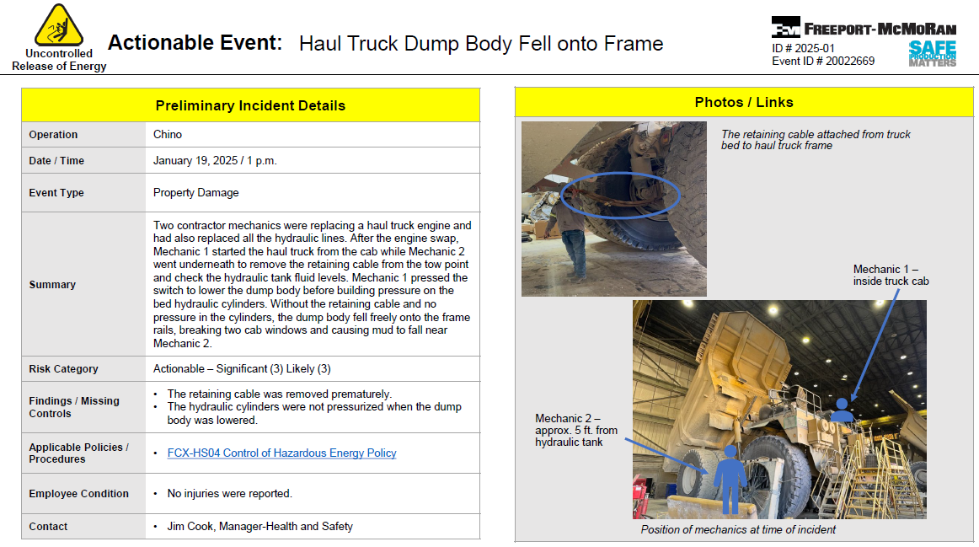
High Risk/Actionable Events

Slide 14
High Risk/Actionable Events

Slide 15
High Risk/Actionable Events

Slide 16
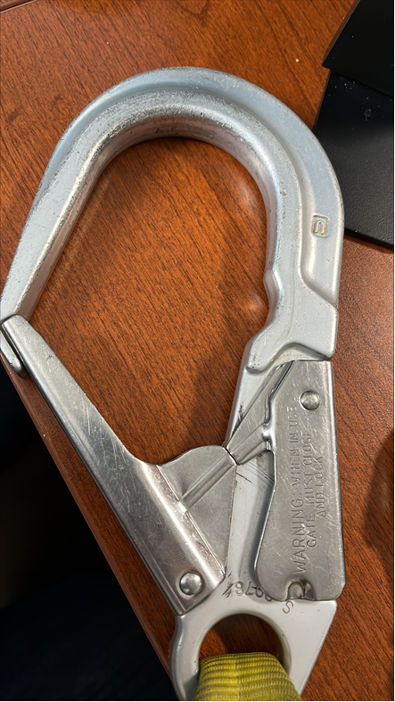
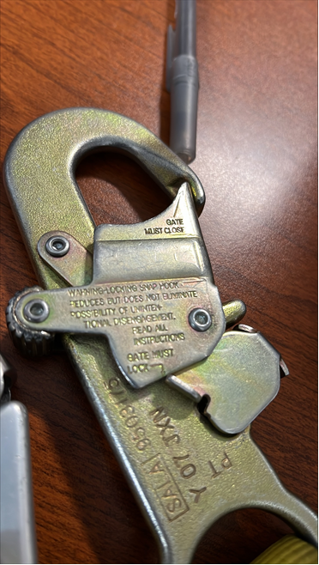
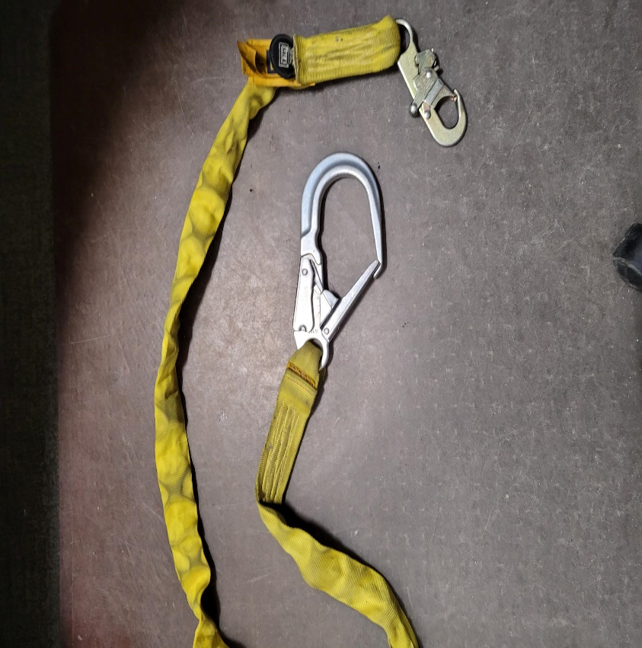
Safety Alerts/Contacts
Henderson found DBI-SALA Shockwave lanyards with fall protection hooks lacking gate strength stamps. These hooks were decommissioned and banned by OSHA in 2016 and ANSI in 2007.
If your lanyard has these hooks, it must be destroyed.
The Shockwave lanyards allow falls greater than the 6' limit in the Working at Heights Technical Supplement (FCX-HS02). They are no longer permitted.
Contact Health and Safety for alternatives or assistance.

Slide 17
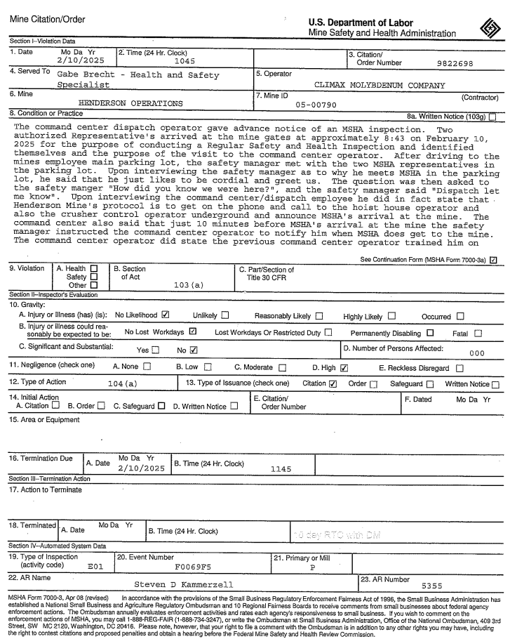
Safety Alerts/Contacts
The below policy is effective 02/13/2025; it replaces and supersedes all prior guidance or training regarding notification of the arrival of MSHA at Henderson Mine or Mill.
If MSHA arrives at the Mine or Mill security gate and requests access, they shall be granted access without any additional notification to site personnel.
REMINDER: The presence of MSHA on site shall not be communicated to anyone.

Slide 18
Safety Alerts/Contacts

Slide 19
MSHA Fatality Alerts

Slide 20
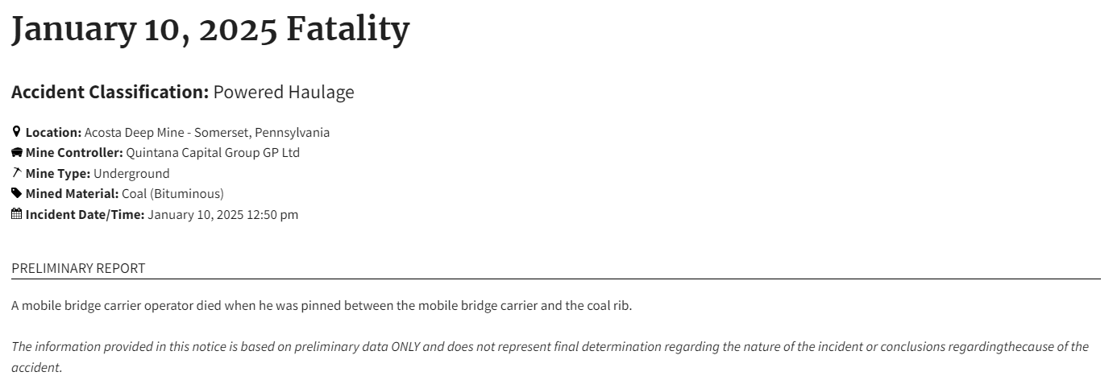
MSHA Fatality Alerts

Slide 21
MSHA Fatality Alerts

Slide 22
Henderson Q1 2025 MSHA Inspection
1st Quarter 2025 | S&S | Non-S&S | All Citations
Mine | 1 | 16 | 17
Mill | 3 | 8 | 11
Contractors | 1 | 1 | 2
Total Henderson | 5 | 25 | 30

Slide 23
Henderson Q1 2025 MSHA Inspection

Slide 24
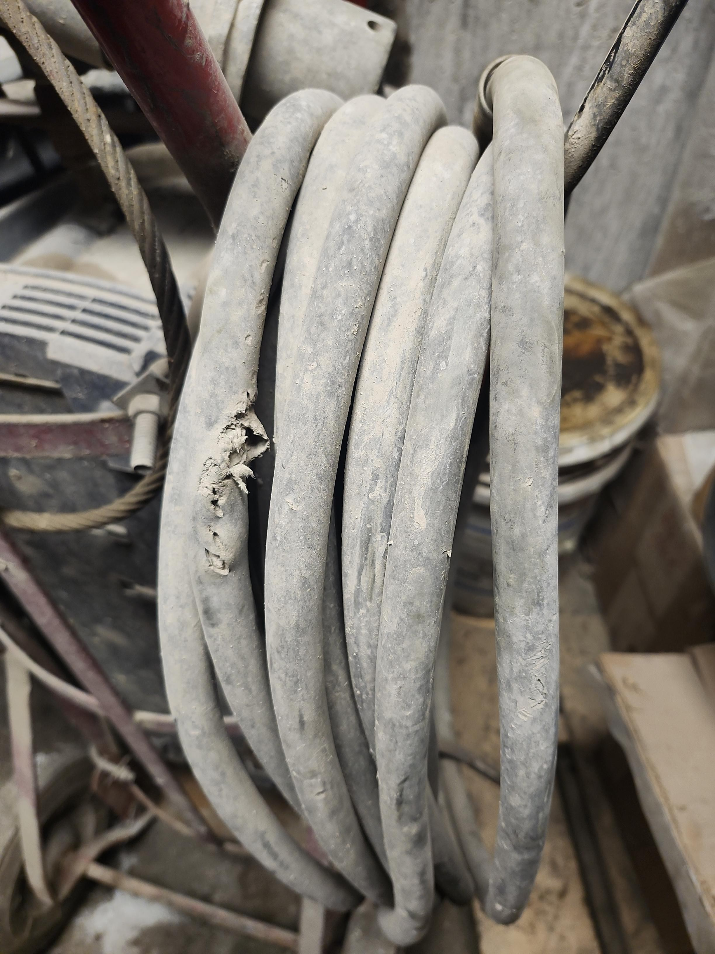
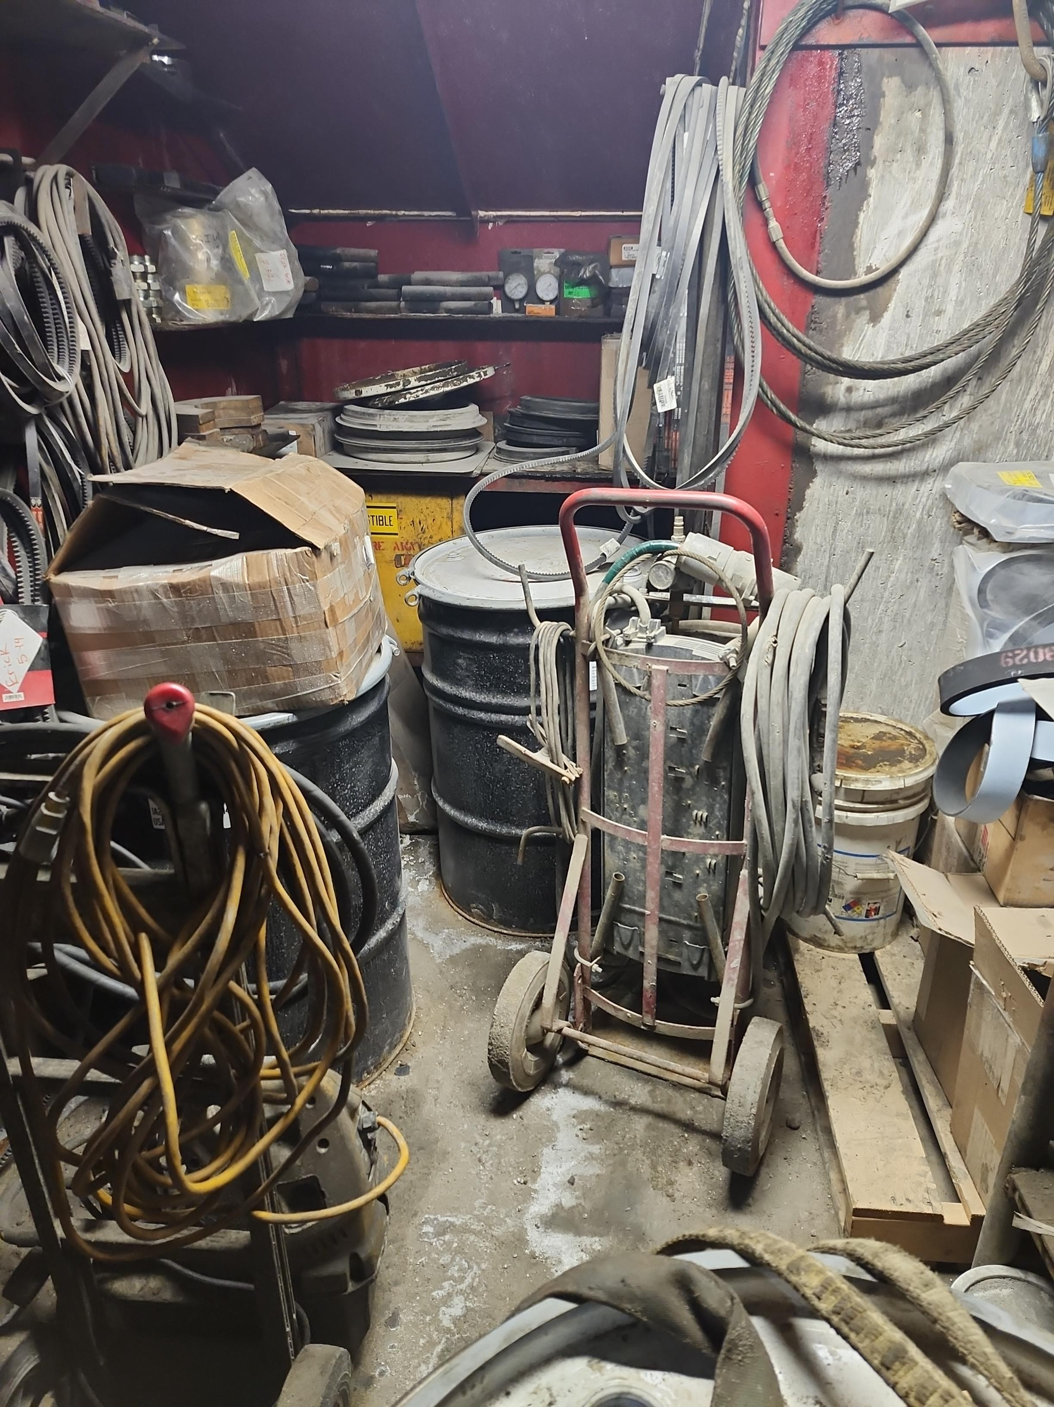
Henderson Q1 2025 MSHA Inspection
Missing Guard at Primary Mill
Unsafe Access to tools/flammables
Damaged Cord on plasma cutter

Slide 25
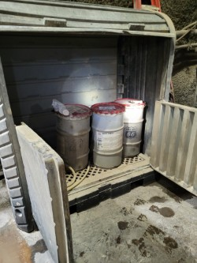
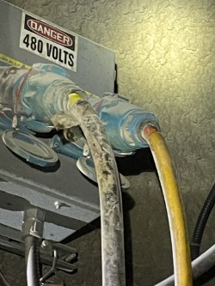
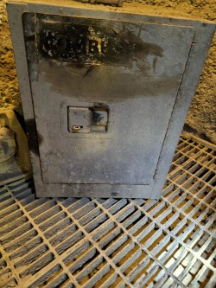
Henderson Q1 2025 MSHA Inspection
Illegible label
Grease storage missing label
Pulling from Bushing w/ exposed conductors

Slide 26
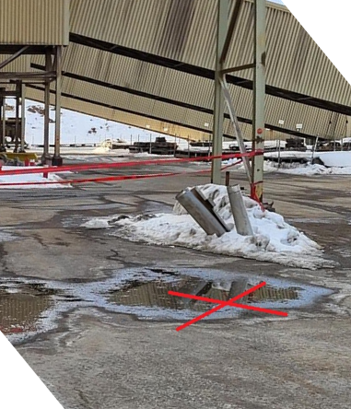
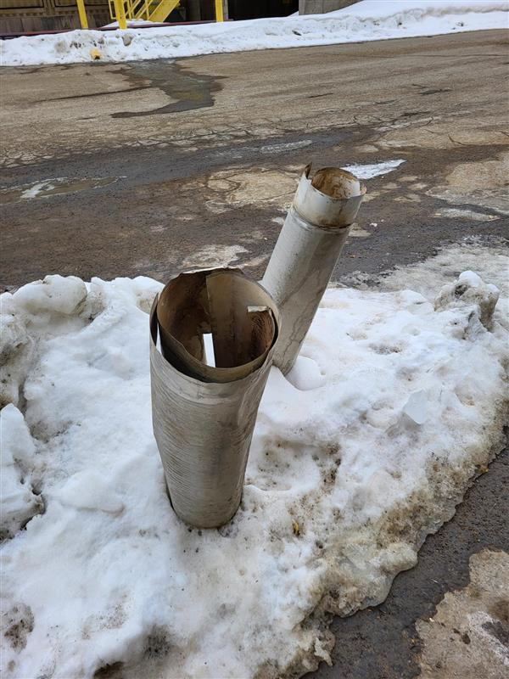
Henderson Incidents
02/05/2025 Near Miss
Summary:
During the offloading of Hydrocal 60, 2 warehouse techs were sitting inside a company truck observing the offloading process. Suddenly a piece of sheet metal dropped from the Nokes Building trestle above and hit the ground 10 feet in front of the truck. Investigation identified the pieces were temporarily secured/wedged on the trestle while awaiting additional personnel to complete a task.
Learnings:
Understand potential impacts of changing conditions (wind)
Ensure securements are substantial even for temporary needs

Slide 27
Additional Information
Access to site digital forms now available to Contractors!
Integration of Contractor submitted forms into internal dashboards
Forms can be used in online and offline modes
Request Access with QR Code or HERE
Reach out to H&S Department with any questions or issues

Slide 28
2025 Contractor Meeting Schedule
March 20th – Henderson Mine
May 22nd – Henderson Mine
July 17th – Henderson Mill
September 11th – Henderson Mine
November 20th – Henderson Mine
April 10th – Henderson Mill
June 19th – Henderson Mine
August 14th – Henderson Mine
October 9th – Henderson Mill
December 18th – Henderson Mine

Slide 29
Open Forum

Slide 30
February Sign-Off Record
_____________________
_____________________
_____________________
_____________________
_____________________
_____________________
_____________________
_____________________
_____________________
_____________________
_____________________
_____________________
_____________________
_____________________
_____________________
_____________________
_____________________
_____________________
_____________________
_____________________

