Slide 1
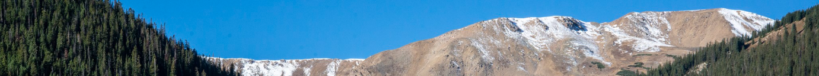
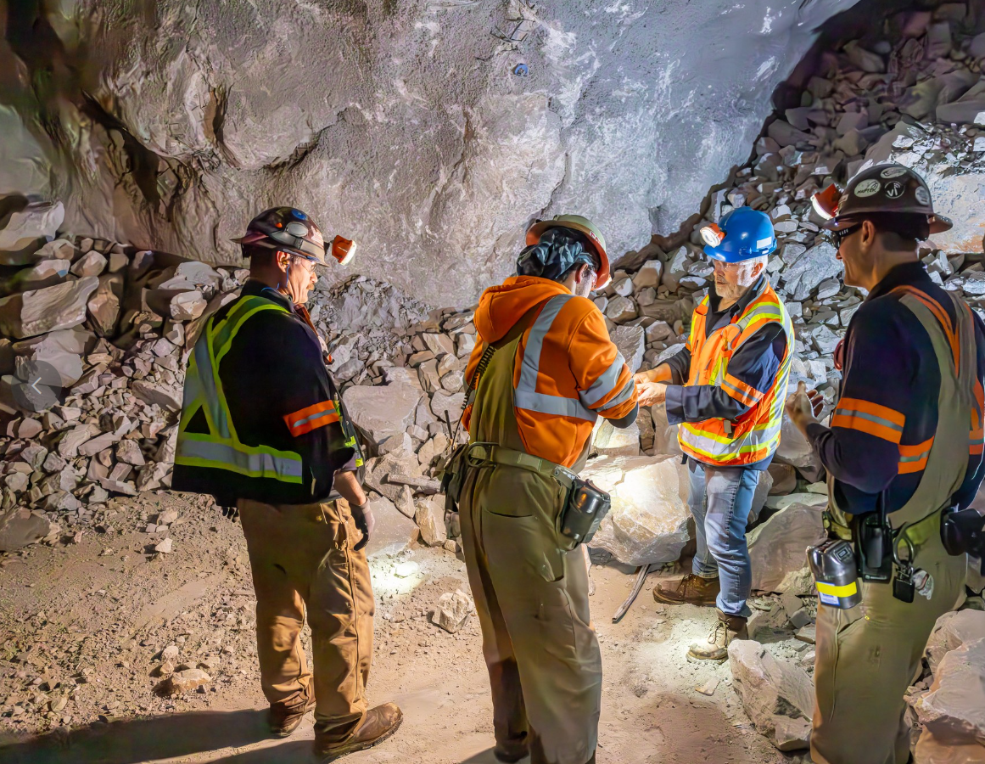


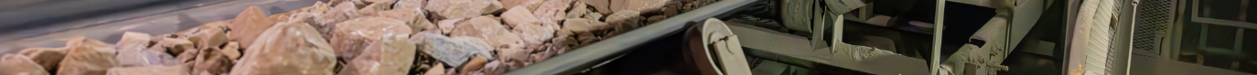
Henderson HSE Contractor Meeting
February 2026

Slide 2


What is the purpose of this Meeting?
- For Henderson to have the opportunity to reach multiple contractors to discuss best practices when it comes to Health and Safety, Environmental and Contracts Management
- Give contractors an open forum to bring up concerns, successes or incidents, learnings, etc. that is shared between all contractors and Henderson personnel
- Help improve the safety culture and reduce safety incidents as a group

Slide 3
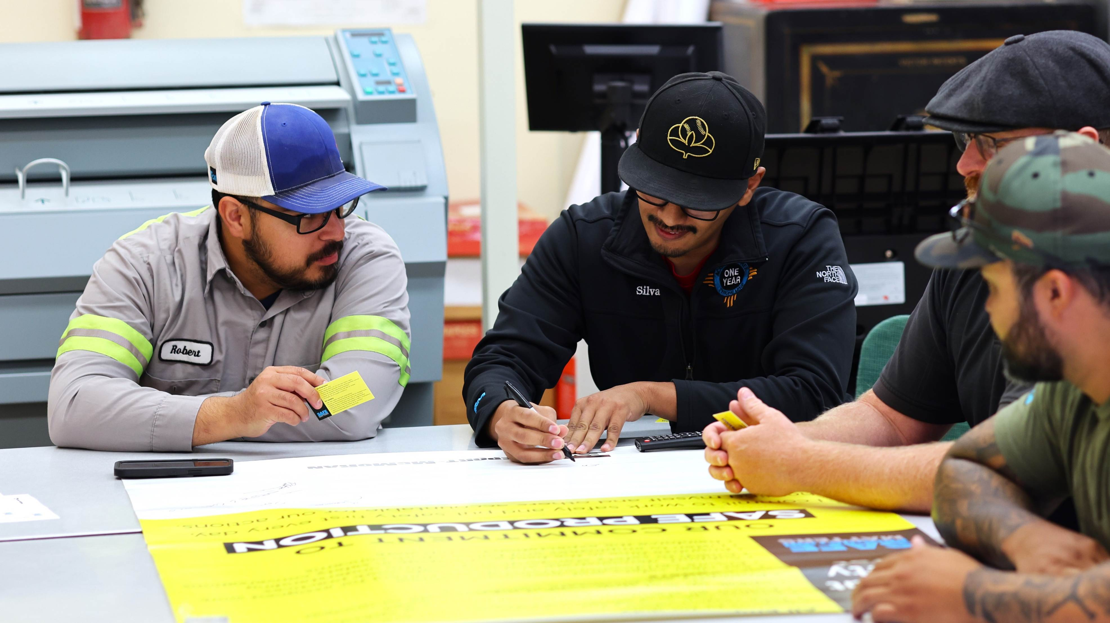
Safety Shares

Slide 4



Safety Trends:
Recurring Fatal Risks
Think About:
Ask Yourself:
Tasks happening overhead, materials stored at height or tools that could drop.
What items aren’t secure that should be?
What would it take to secure them?
In 2025, more than 70% of high-risk incidents came from three fatal risks:
Falling objects
Uncontrolled release of energy
Exposure to electrical hazards
This recurrence highlights the need to better identify and control these risks. Think about how they may show up in your everyday work. Go beyond simply identifying the risk – talk through potential hazards and unexpected conditions to fully understand how these risks can appear and what controls are needed.
Energy that exists around your work, including mechanical, hydraulic and chemical.
What controls do you rely on most? Are they strong enough for the risk level?
How can you create additional distance or barriers?
Your exposure to electrical hazards.
What additional safeguards or controls could you implement?
What conditions could introduce new hazards?
Notes:
Trend data for 2025 FMA only.
Click the link below to access toolkits with additional materials on falling objects, control of hazardous energy and other fatal risks.
Corporate Safety Portal - Health & Safety Documents - Safety Shares & Toolkits

Slide 5

Environmental Share: Drinking Water Impairment Protocol

Slide 6
Drinking Water Systems
Henderson Mine and Mill have individual permitted drinking water systems that supply potable water for consumption, showers and bathrooms, and a variety of industrial uses (Mine boilers, Mill lab, underground dewatering pump gland water, etc..)
Drinking water impairment is defined as a state or condition in which water fails to meet standards due to the risk of contamination or there has been a loss of proper function/ability of the distribution system. An SOP has been developed and is stored on the Environmental SharePoint. In summary:
Henderson goes above and beyond when it comes to workforce safety. Therefore, impairment has been broken down into two classes with different scenarios highlighted under each.
Class 1: An internal impairment, not enforced by the State Regulations. Therefore, water can be used for showering and washing hands while being classified as Non-Potable.
Scenario 1: A potential safety risk outside of scenarios 2-5. This is the most common.
Class 2: A state enforced impairment that requires showers to be roped off in addition to restrictions on consumption
Scenario 2: A building isn’t getting water
Scenario 3: Low chlorine residual at entry point
Scenario 4: Low potable water tank level
Scenario 5: Leak in distribution piping

Slide 7
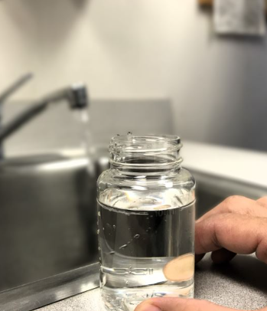

Drinking Water Systems
What does impairment mean?
After an issue has been identified, the system gets out of impairment by following the SOP associated with the determined class/scenario. The key steps that align with every scenario are as follows:
1. Identify the issue - Anyone
2. Fix the issue – Team effort with O&M
3. Collect Bac-T samples - Environmental
4. Notify personnel following results - ORC
Remember: Before completing any work on the drinking water system you must reach out to the environmental team for guidance. Modifications to the drinking water system at the Mine or Mill require and MOC

Slide 8
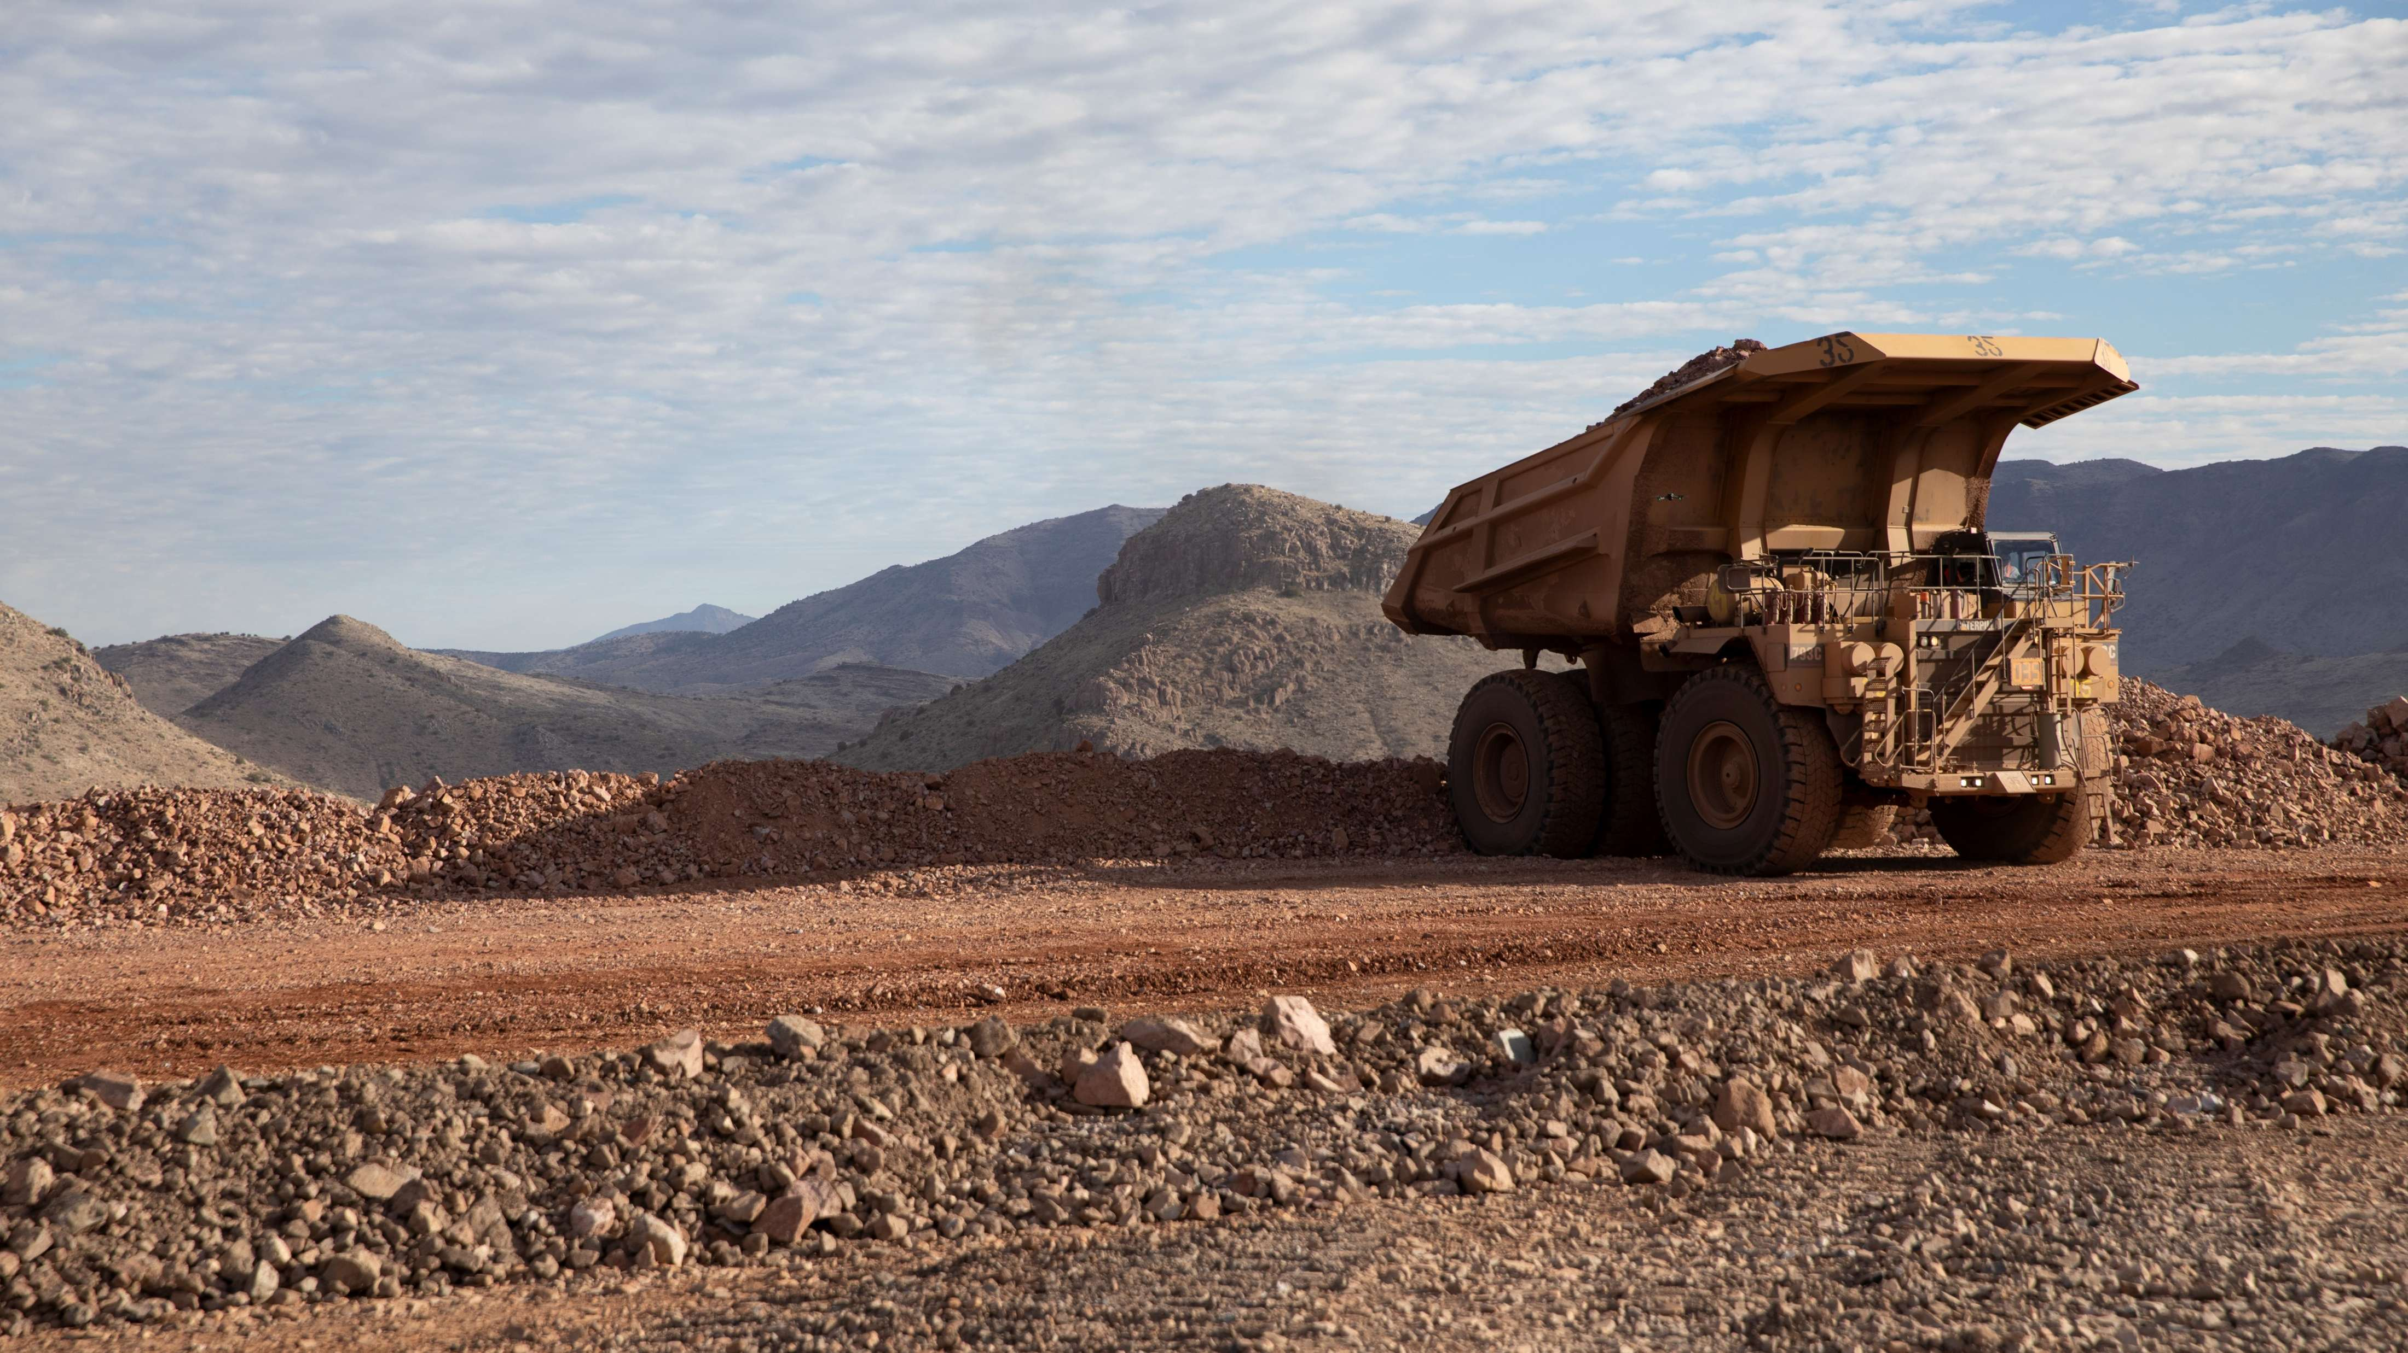
High-risk Incidents
Actionable and PFEs

Slide 9
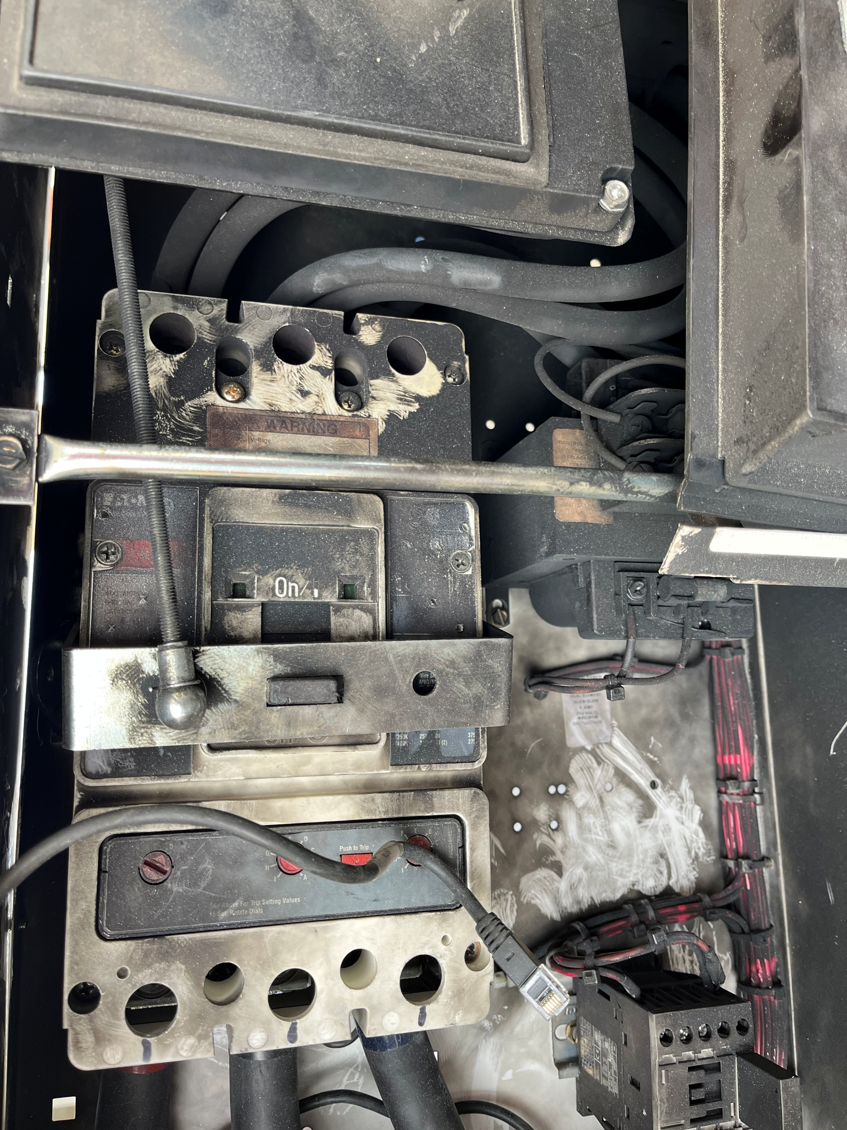
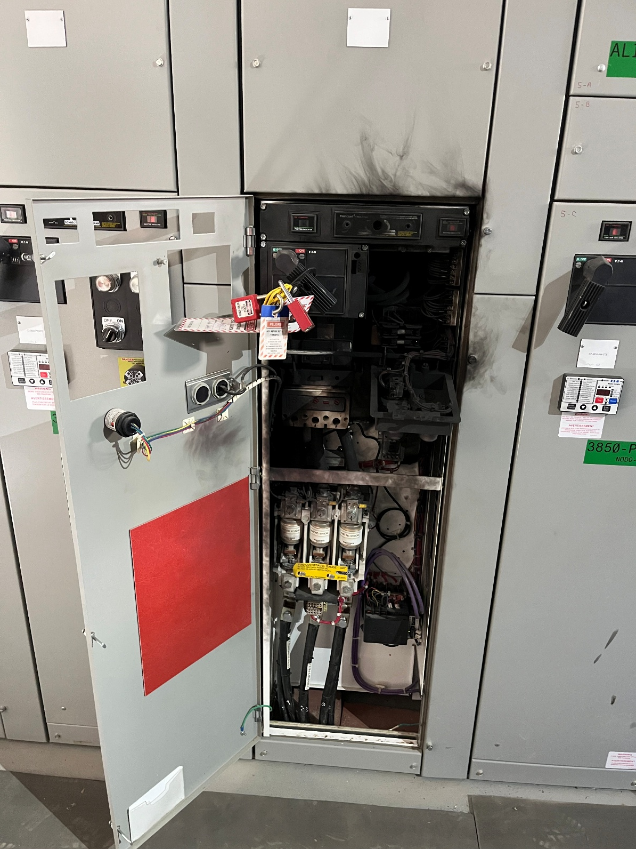


Arc Flash
Exposure to Electrical Hazards
ID # 2025-30 Event ID # 20032133
Preliminary Incident Details
Operation | Cerro Verde
Date / Time | December 23, 2025 / 1 p.m.
Event Type | Injury – Lost Time
Summary | Two electrical technicians were performing maintenance activities. While adjusting the upper terminals of the main switch for the pump starter, an electric arc occurred.
Risk Category | Actionable – Significant (3) Likely (3)
Findings / Missing Controls | Failure to use required dielectric PPE Failure to identify the correct isolation and lockout point to perform the terminal bolt adjustment of the main breaker
Applicable Policies / Procedures | FCX-HS03 Electrical Safety Policy FCX-HS04 Lockout/Tagout/Tryout Technical Supplement
Employee Condition | Both workers sustained burns to the hands and face.
Contact | Rafael Vargas, Reliable Plant Manager–C2
Main switch of pump starter following incident.
Illustration of the terminal adjustment when the arc flash occurred.

Slide 10

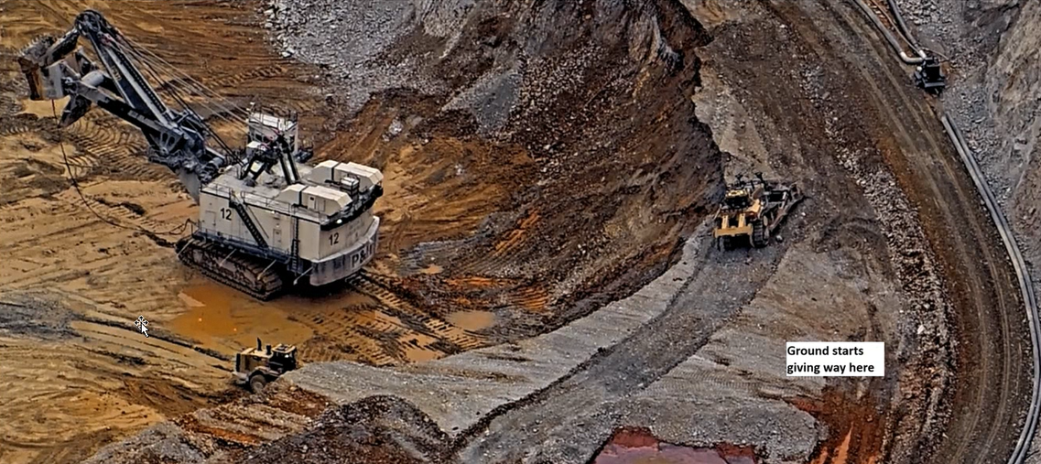
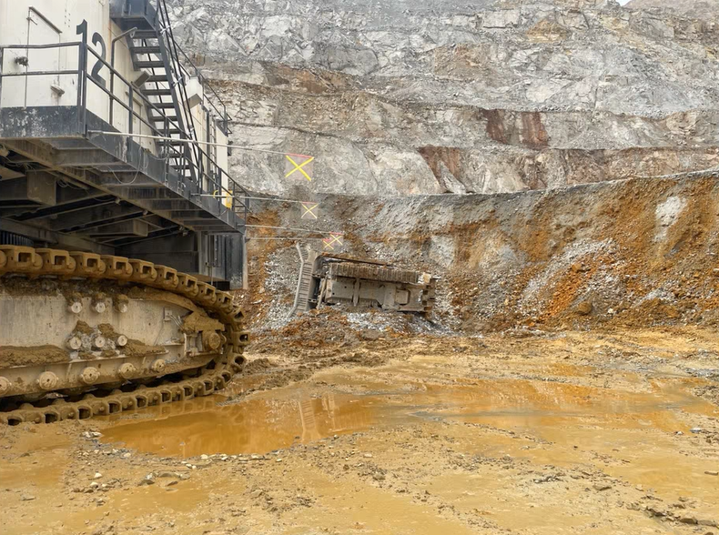
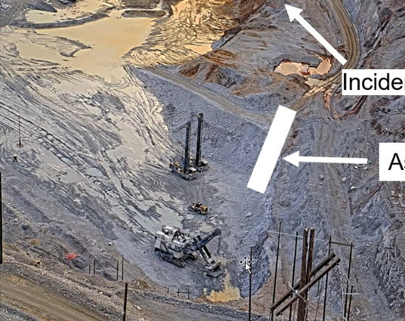
Bulldozer Rolled Off 50-foot Bench
Vehicle Collision or Rollover
ID # 2026-01 Event ID # 20032403
Preliminary Incident Details
Operation | Bagdad
Date / Time | January 7, 2026 / 11:06 a.m.
Event Type | Property Damage
Summary | While pushing material to construct berms, a bulldozer slid and rolled off a 40-foot bench, stopping next to a shovel below. Watch the incident video here.
Risk Category | Actionable – Significant (3) Likely (3)
Findings / Missing Controls | Rollover protection (ROPS) and the seat belt were in place and effective. The operator was addressing an adverse condition (low berms), which was a deviation from the original work plan. The bulldozer was running parallel to an unsupported crest. Inconsistent workplace exams and pre-shift inspections.
Applicable Policies / Procedures | HEO FCX1041C Track Dozer Operations Training
Employee Condition | Operator sustained small scratches, but no major injuries.
Contact | Rachel Adams, Manager-Health and Safety
Location of bulldozer before rolling down the bench toward the shovel.
Incident location
Assigned work area
Final resting location of bulldozer.
Incident location versus assigned work area.

Slide 11

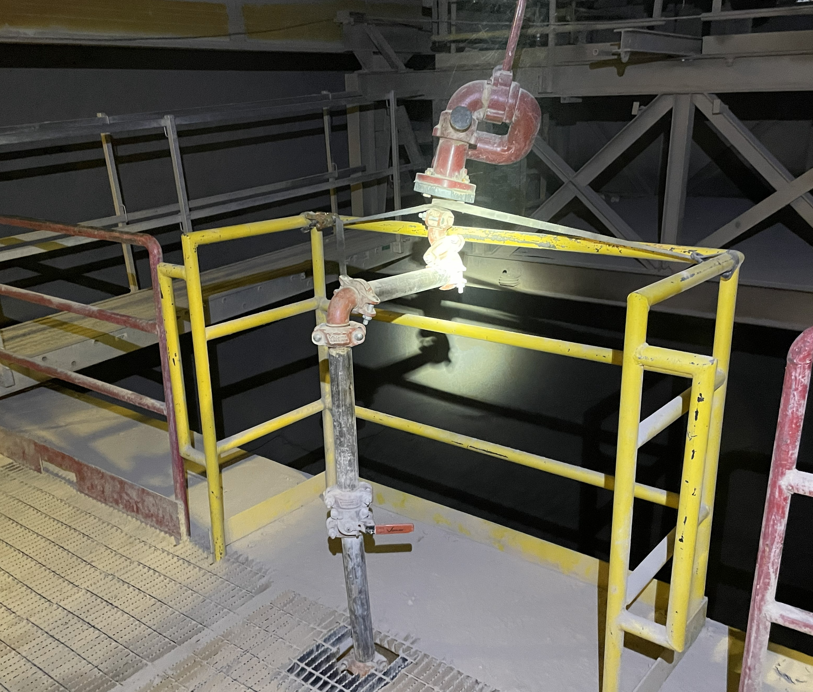
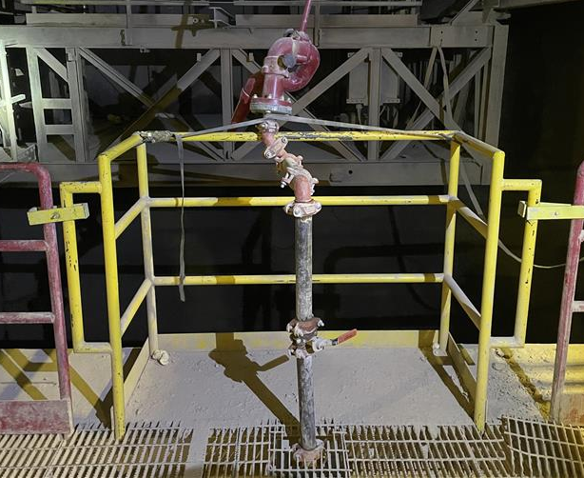
Unsecured Handrail
ID # 2026-02 Event ID # 20032465
Fall from Heights
Preliminary Incident Details
Operation | Henderson
Date / Time | January 8, 2026 / 11 a.m.
Event Type | Near Miss
Summary | A temporary handrail and water canon was installed at the crusher lube room overlooking the surge bin (about a 100-foot drop). While using the water cannon, an employee leaned on the handrail to get a better view of the bin walls. As they leaned forward, the back of the handrail lifted off the securement pegs and shifted forward. The strap connecting the water gun to the handrail restricted movement to a few inches. The employee was not placing full weight on the handrail; otherwise, a fall could have occurred.
Risk Category | Actionable – Significant (3) Likely (3)
Findings / Missing Controls | Clamps were not installed with the temporary handrail. This allowed the handrail to tilt off the back pegs. A 100-foot fall was prevented by the strap used to position the water cannon (a non-critical control).
Applicable Policies / Procedures | No documented standard operating procedure or preventive maintenance process for temporary handrail installation.
Employee Condition | No injuries.
Contact | Benjamin Goertz, Manager-Health and Safety
Strap used to connect the water cannon to the temporary handrail.
Clamps missing from initial handrail installation.

Slide 12

Industry Incidents

Slide 13
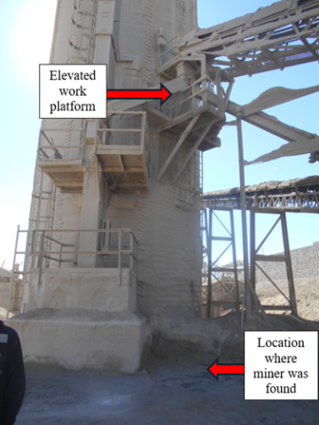
MSHA Fatality Alert
October 16, 2025 – A miner was performing work from an elevated platform when they fell approximately 30 feet. The miner died from his injuries.
Eliminate Hazards and Prevent Injuries
Provide safe access to all work areas by installing handrails, guarding, or the use of fall protection equipment where there is a risk of miners falling.
Provide and ensure proper use of fall protection when a fall hazard exists. Ensure fall protection has a suitable fall arrest and secure anchorage system.
Identify risks and eliminate or control them before beginning activities.
Conduct workplace examinations to identify conditions that may adversely affect the safety or health of miners.

Slide 14
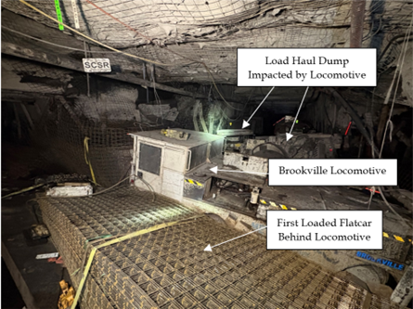
MSHA Fatality Alert
November 6, 2025 – A miner died when the scoop he was operating was struck by the lead locomotive of a supply trip.
Eliminate Hazards and Prevent Injuries
Operate mobile equipment at safe speeds appropriate for the grade, load, and track conditions. Select the proper gear before descending grades to maintain positive control.
Conduct thorough pre-operational examinations of all mobile equipment. Test brake systems, sanders, and communication devices before use and ensure they work properly.
Establish and follow communication protocols that require verification for all mobile equipment operators.
Make sure miners communicate their location and intended movements with the dispatcher.

Slide 15
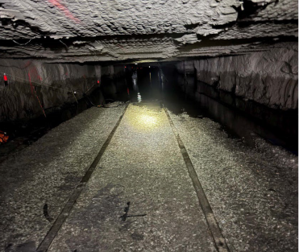
MSHA Fatality Alert
November 8, 2025 – A section foreman died after a mine was inundated with water from an adjacent abandoned mine. The foreman was found on November 13, 2025.
Eliminate Hazards and Prevent Injuries
Determine the location of abandoned mine workings using signed maps and local sources. Abandoned mines are a major flood hazard.
Provide sufficient barrier pillars. Evaluate interburden thickness and compare mine surveys from a common baseline.
Use directional, long-hole drilling to ensure adequate barriers around mining areas.
If necessary, submit permits for "operations under water."

Slide 16
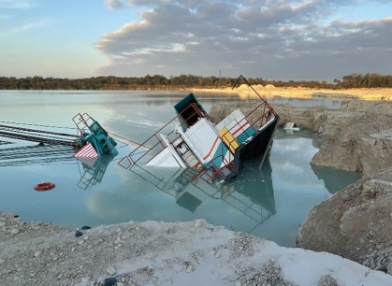
MSHA Fatality Alert
December 10, 2025 – Two contractors died when the dragline they were operating slid into a water-filled pit.
Eliminate Hazards and Prevent Injuries
Establish mining methods based on geological conditions such as soil stability subsurface cavities.
Evaluate all pit, highwall, slope, and bank conditions at least daily or more often, if necessary, to protect the health and safety of the miners. Be especially vigilant after each rain, freeze, or thaw.
Conduct effective workplace examinations in areas where miners are working and traveling. Identify and correct all hazards.
Train miners on equipment risks and to recognize potential hazards that can decrease bank and slope stability.

Slide 17
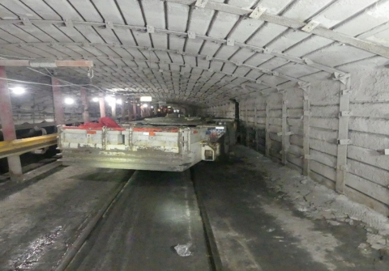
MSHA Fatality Alert
December 18, 2025 – A miner died after a tractor pinned him against the rib.
Eliminate Hazards and Prevent Injuries
Stay out of “red zones” and pinch point areas.
Maintain effective traction on the slope. Control or remove excessive water, mud and other debris.
Obtain proper clearances from the dispatcher prior to starting down the slope to ensure the travel way is clear.
Communicate your presence and intended movements when working around mobile equipment and wait for acknowledgment before moving.
Minimize pedestrian traffic in known haulage routes.

Slide 18
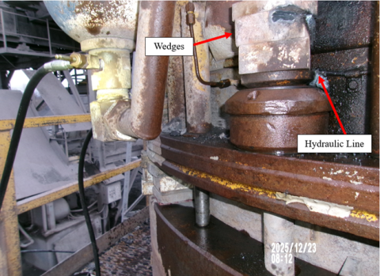
MSHA Fatality Alert
December 22, 2025 – A contractor died after receiving burns from a pressurized hydraulic line that ruptured and caught fire. The contractor was cutting wedges from a cone crusher with a torch.
Eliminate Hazards and Prevent Injuries
Never apply heat to or near pressurized hydraulic lines.
Never apply heat to components when flammable, combustible, or explosive materials are present.
Protect and/or relocate hydraulic lines to prevent physical damage.
Examine all components and surrounding areas before applying heat, cutting or welding. Conduct daily inspections of hydraulic equipment, hoses, and connections for leaks, wear, or damage.
Always use proper protective equipment for the task.

Slide 19
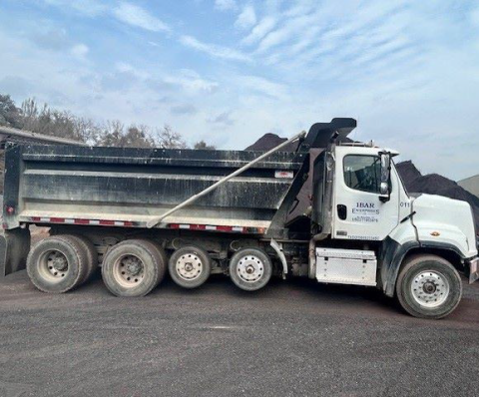
MSHA Fatality Alert
January 8, 2026 - An over-the-road truck driver died after he became pinned between the dump bed and the frame of a truck.
Eliminate Hazards and Prevent Injuries
Establish and discuss safe work procedures before beginning work. Identify and control all hazards associated with the work and use methods to properly protect persons.
Before working on equipment, block all raised components against motion and ensure persons are positioned in a safe location and away from the “red zone” areas.
Never work under a load that is unsupported or inadequately supported. Observe and follow all warning labels and signs on equipment.

Slide 20


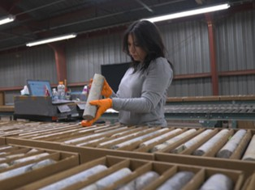
Additional Resources
Health and Safety Dashboard
Safety Toolkits
FCX Policies
MSHA Safety Alerts
OSHA

Slide 21
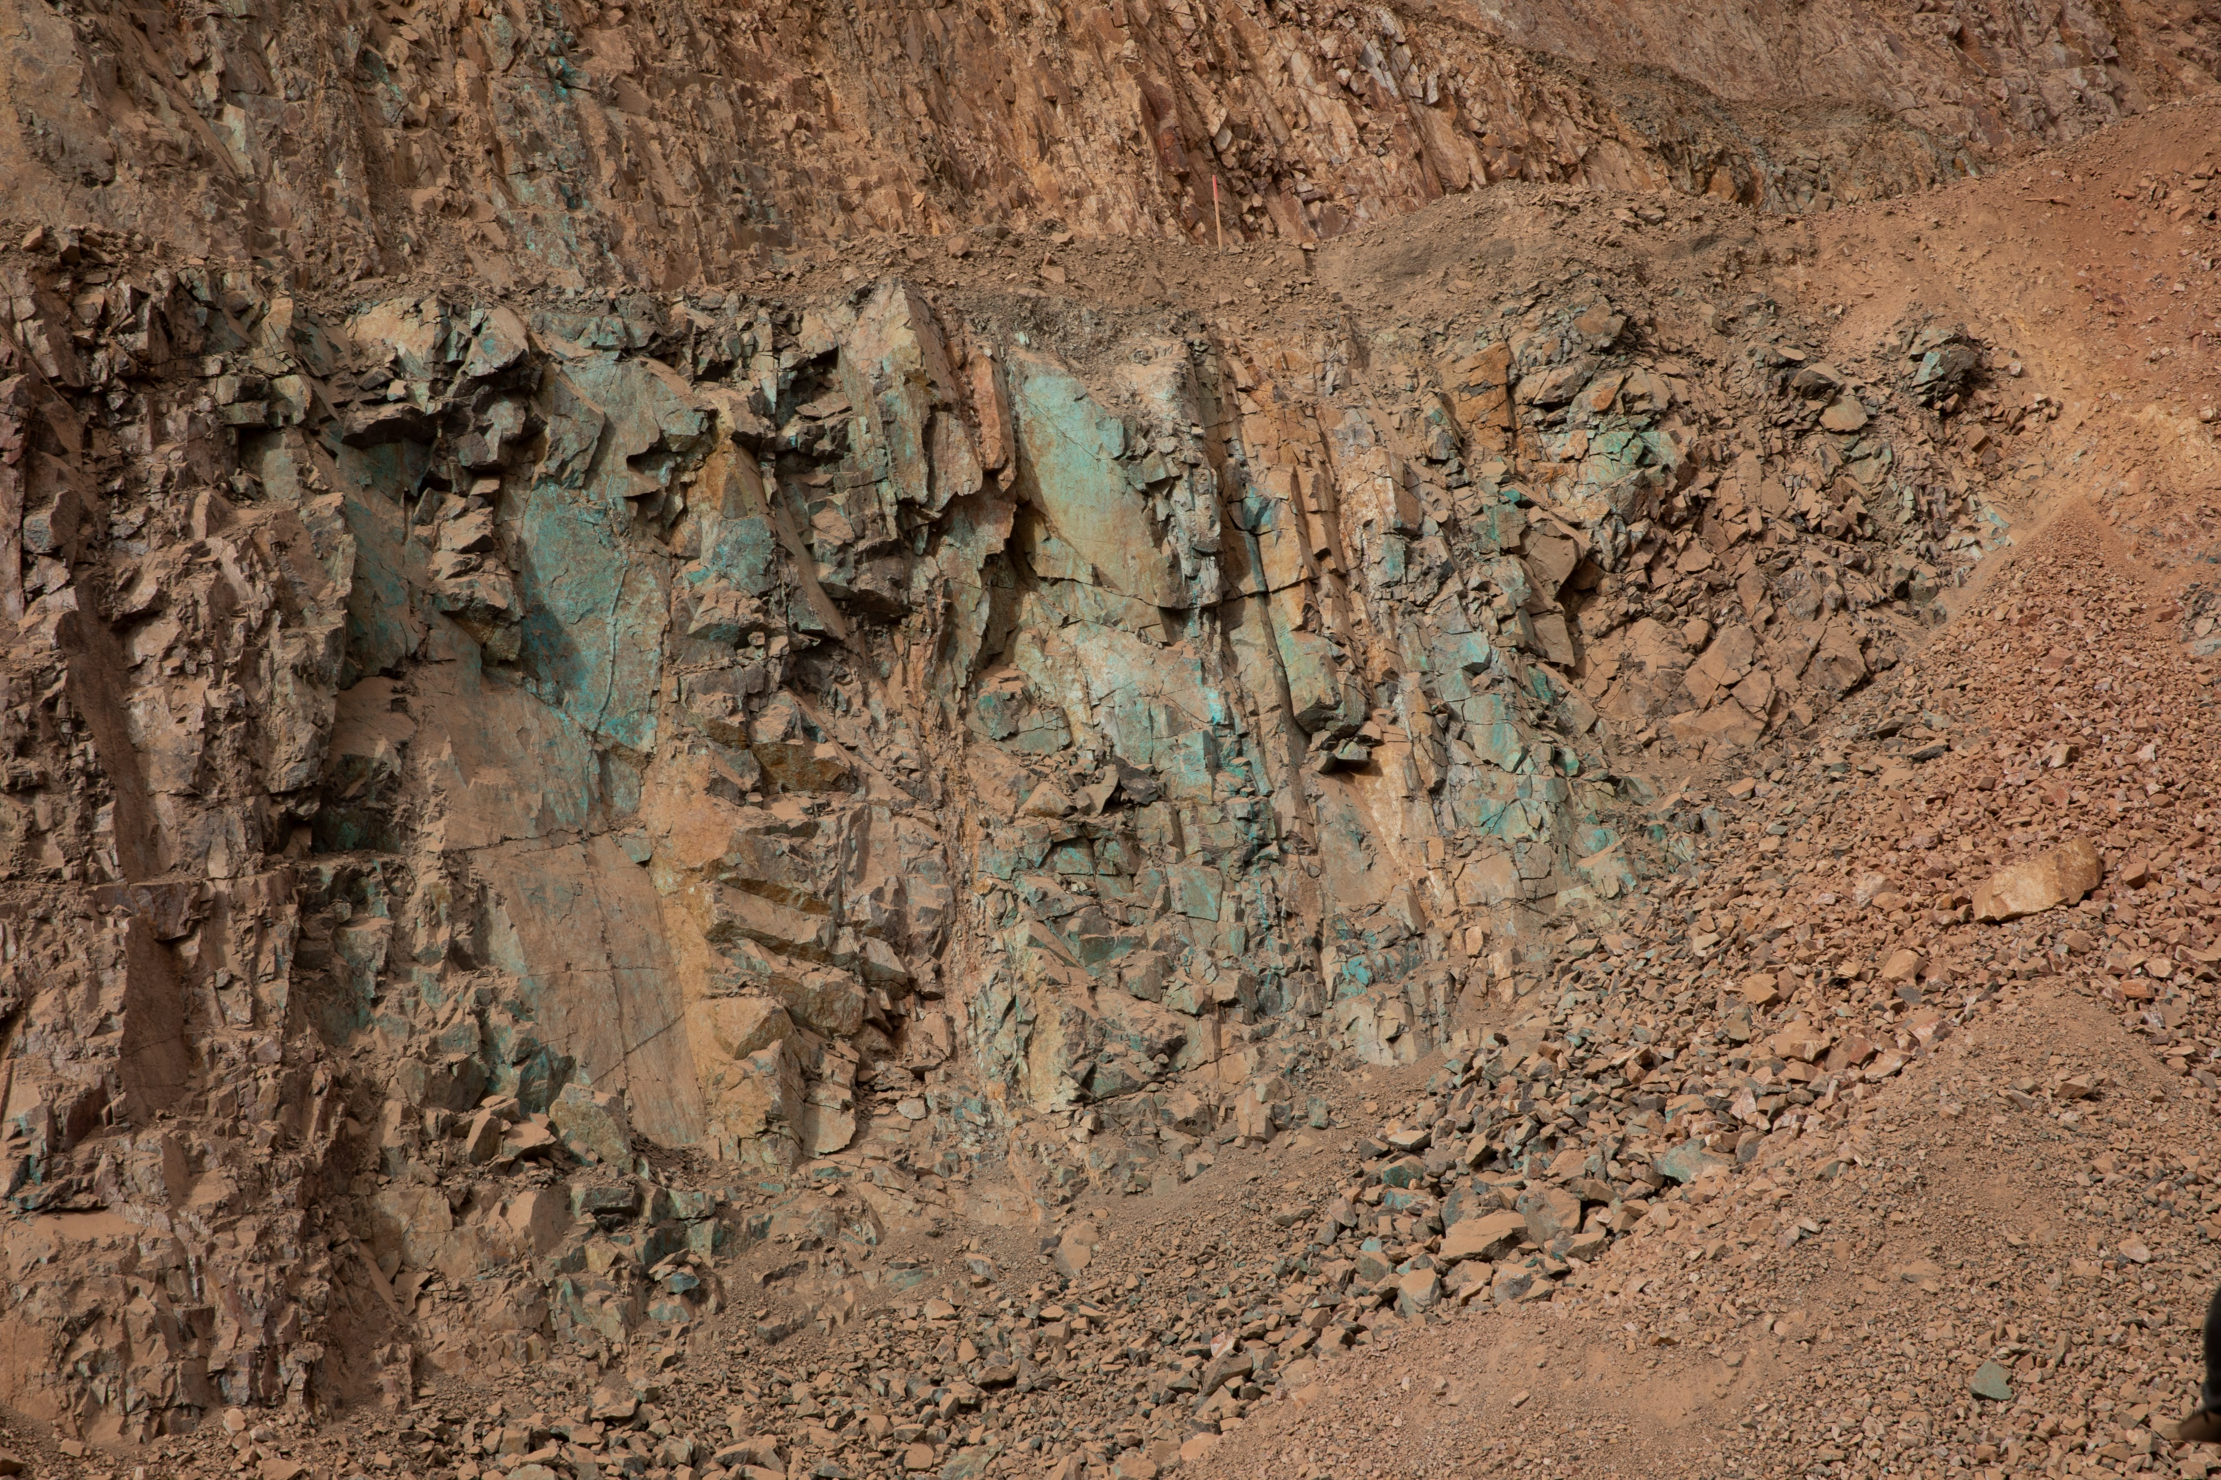
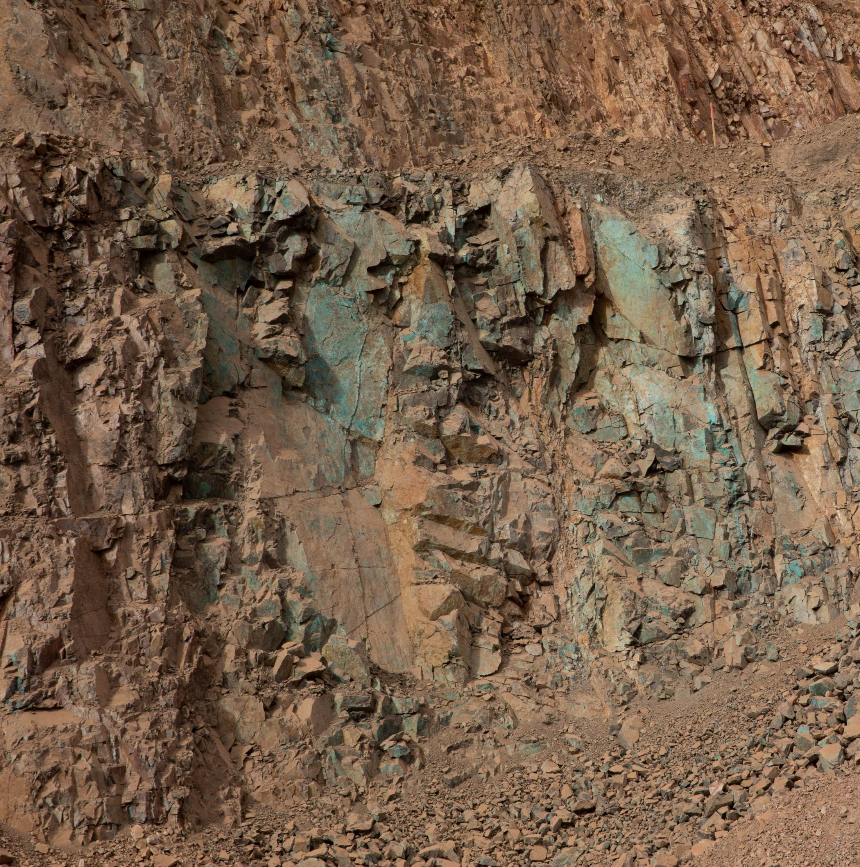
Site Incidents

Slide 22
Henderson Incidents
01/08 – Unsecured Handrail (Near Miss, ACTIONABLE)
Employee almost fell when temporary handrail shifted at Surge Bin
See Event Advisory earlier in slide deck
01/11 – Mill Lab Water Leak (Property Damage)
Water line in Mill assay lab froze causing water leak
Damage to multiple ceiling tiles and infiltration of water into one electrical box
01/23 – Personal Medical Event Results in Fall at Same Height (First Aid)
Employee experienced Personal Medical event while underground
During the event, employee fell sustaining first aid injuries to their head and shoulder
01/27 – Damaged 480V Drill Power Box (Property Damage)
Tramming spraymec at 6xc/625 intersection
Boom light bracket contacted 480V tap box pulling off the spring line, exposing wire

Slide 23
FRM Verification Results – Jan.
149 verifications completed in January
Focus for January around Exposure to Electrical Hazard, Hazardous Substance – Chronic, Underground Hazardous Atmosphere
All Und. Haz. Atmosphere and Exp. To Electrical Hazards dropped, missing controls ratio for Blasting and Haz. Sub. – Chronic increased
FOCUS FOR FEBRUARY:
Blasting
Hazardous Substances – Chronic

Slide 24
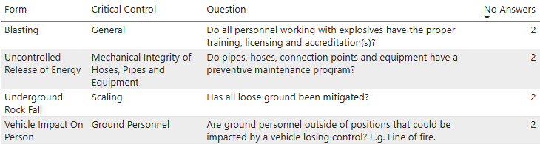
FRM Verification Results – Jan.
Henderson Missing Controls with Multiple No Responses

Slide 25
2025 Safety Highlights

Slide 26
TRIR Historical Trend

Slide 27
2025 Reportable Incidents
Incident Date | Incident Type | Description
April 8th | Injury/Illness | Contract employee injured leg when liner fell
June 4th | Injury/Illness | Employee pinched their finger while checking flotation cells
July 21st | Injury/Illness | Employee pinched their finger while troubleshooting a drill
August 22nd | Injury/Illness | Employee lacerated their leg while exiting the G1 Filter tub
November 20th | Injury/Illness | Employee’s hand pinned between PC2 belt and roller
November 26th | Injury/Illness | Employee injured foot during personal medical event

Slide 28
Reportable Incident Trends
Fatal Risks
2025: 33% Entanglement & Crushing, 33% Uncontrolled Release of Energy, 33% No Fatal Risk
2024: 38% Uncontrolled Release of Energy, 62% No Fatal Risk
PFE/Actionable Events
2025: 0 PFE, 1 Actionable – Contractor injured leg when liner fell
2024: 0 PFE, 1 Actionable – Invalid Motor Lockout at PC2
Nature of Injury
2025: 27% Cut/Laceration, 20% Fracture
2024: 33% Cut/Laceration, 22% Fracture
Part of Body
2025: Hand/Wrist accounts for 50%
2024: Hand/Wrist accounts for 38%
Highest Injury Months (‘17-’25)
February, May, June, November with 6+

Slide 29
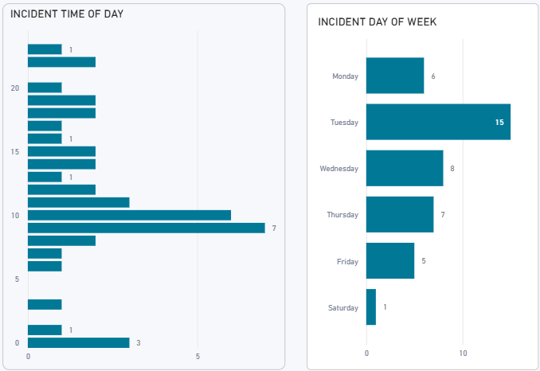
When do injuries occur?

Slide 30
MSHA Citation Results
Main Categories 2024:
Electrical
Guarding
Housekeeping
Fire Extinguisher
Haz Comm
Henderson Total 2024 MSHA Citations | S&S | Non S&S | All Citations
Mine | 5 | 47 | 52
Mill | 7 | 35 | 42
Contractors | 2 | 2 | 4
Total Henderson | 14 | 84 | 98
Main Categories 2025:
Safe Access
Electrical
Guarding
Gas Cylinders
Fire Prevention
Henderson Total 2025 MSHA Citations | S&S | Non S&S | All Citations
Mine | 4 | 53 | 57
Mill | 27 | 42 | 69
Contractors | 2 | 6 | 8
Total Henderson | 33 | 101 | 134

Slide 31
EWS Safety Form Usage
EWS Safety Form Usage Trends
Increase in safety form usage all around
Several high-risk incidents with no JRA and no SOP review
Effectiveness of WPE’s limited by EWS Area framework (focus for 2026)

Slide 32
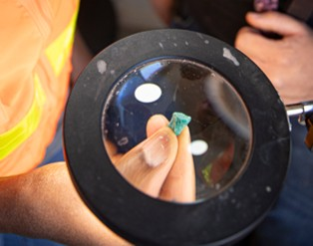



Contractor Management Topics
Contractor Training Policy Update
ISN/HSEP Update
Change Order Process

Slide 33
Contractor Training Policy Update
Over the past 18 months, we have focused on standardizing training materials and delivery methods across Freeport-McMoRan. This initiative aimed to ensure consistency and alignment with our safety and operational standards.
Throughout this process, we received valuable feedback from our contractors. While many appreciated the effort to standardize Freeport-specific training, several indicated that their own training programs were equally effective—and in some cases, even more comprehensive.
Based on this feedback, Freeport is adjusting its approach:
Contractor Training Acceptance: We will now accept contractor-provided training, with exception to training noted in the attached document, provided the contractor attests that their training meets our core safety policies, even if it is not Freeport-specific.
Freeport Training Materials Availability: Freeport training content will remain accessible on the Public Portal for contractors who wish to use it or supplement their existing programs. This ensures that all parties have access to resources that align with our policies.
All training information that is required for your employee’s to perform work (Core, Compliance and Technical) training must be uploaded into ISN no later than April 6 2026. We will be referencing the data uploaded in ISN to verify while in the field
Site Safety and Training are available to provide guidance and answer questions; however, contractor training delivery is the responsibility of the contractor.
We believe this approach benefits everyone involved by maintaining strong safety standards while allowing flexibility where appropriate. Ultimately, leadership presence and engagement in the field will continue to be the most critical factor in driving safety and operational excellence.
LINK TO UPDATE

Slide 34
Contractor Training Policy Update
FCX Core Training Requirements All contractors accessing or completing work at any North American site must complete the following Core Training Requirements additional training might be required before starting work:
1. Area Specific training that covers all facilities where contractor employees will be working within
2. Contractor Orientation North American (Available in ISN)
3. North American Hazard Recognition Video (Available in ISN)
4. FCX Mining – Workplace Examinations (Will be available in ISN soon)
5. FCX Mining – Site Specific Hazard Recognition Brochure, this is a site by site requirement for those that visit multiple sites (Available in ISN)

Slide 35
ISNetworld/HSEP Update
Deadline for all training (Core, Compliance and Technical) to be uploaded to ISN is April 6th, 2026
Contractors who have not completed uploads by then will have their employees paused from coming on site
Must include Attestation form upload (when needed)
Notification of Onsite Employee Changes
Notification of new hires and terminations required to PM and GSC
New Hires: Prior to arrival on site
Termination: Within 72 hours of termination
ISN Scorecard and HSEP Changes (Effective March 3rd, 2026)
HSEP score impact to change from -10 to -100 for unsubmitted or rejected HSEPs
HSEPs associated with specific site for approval/validation
HSEPs will migrate to site scorecard they are valid for
Temporary Upload Freeze
During 2-week migration, Contractors unable to upload new HSEPs
HSEPs for projects occurring during this time must be sent directly to Contractor Governance Team (contractorgovernance@fmi.com)

Slide 36
Henderson Change Order Process
New policy coming regarding Change Orders at Henderson
Formal approval for Scope and cost changes
Policy release will come through email and in upcoming Contractor HSE meeting/packet

Slide 37
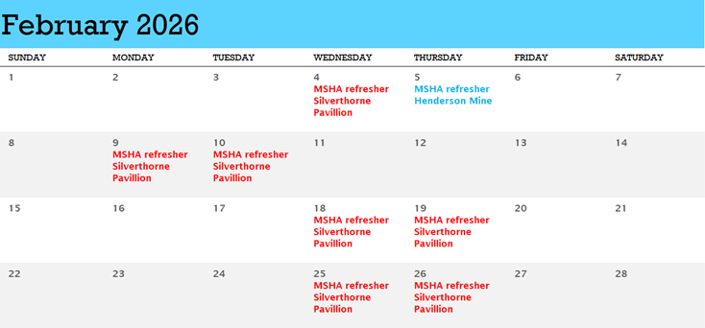
Henderson MSHA Refresher
Project Managers will need to reach out to Jasmin Babeon jbabeon@fmi.com to schedule their contractors for Henderson Operations 2026 MSHA Refresher. If a contractor has an SAP# please provide that.

Slide 38

Open Forum

Slide 39
March 19th
April 9th
May 7th
June 18th
July 16th
August 20th
September 10th
October 8th
November 19th
December 17th
2026 Meeting Schedule
Meetings begin 1 PM MST
Mine and Mill In-Person Options Monthly

Slide 40
February Sign-Off Record
_____________________
_____________________
_____________________
_____________________
_____________________
_____________________
_____________________
_____________________
_____________________
_____________________
_____________________
_____________________
_____________________
_____________________
_____________________
_____________________
_____________________
_____________________
_____________________
_____________________

