Slide 1
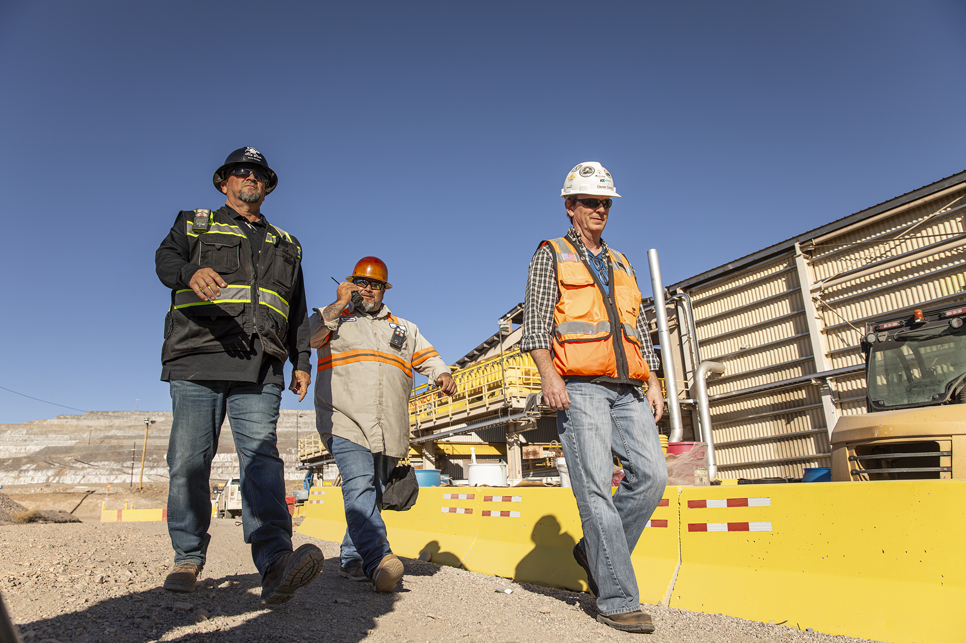


HSE Contractor Meeting
January 2026

Slide 2
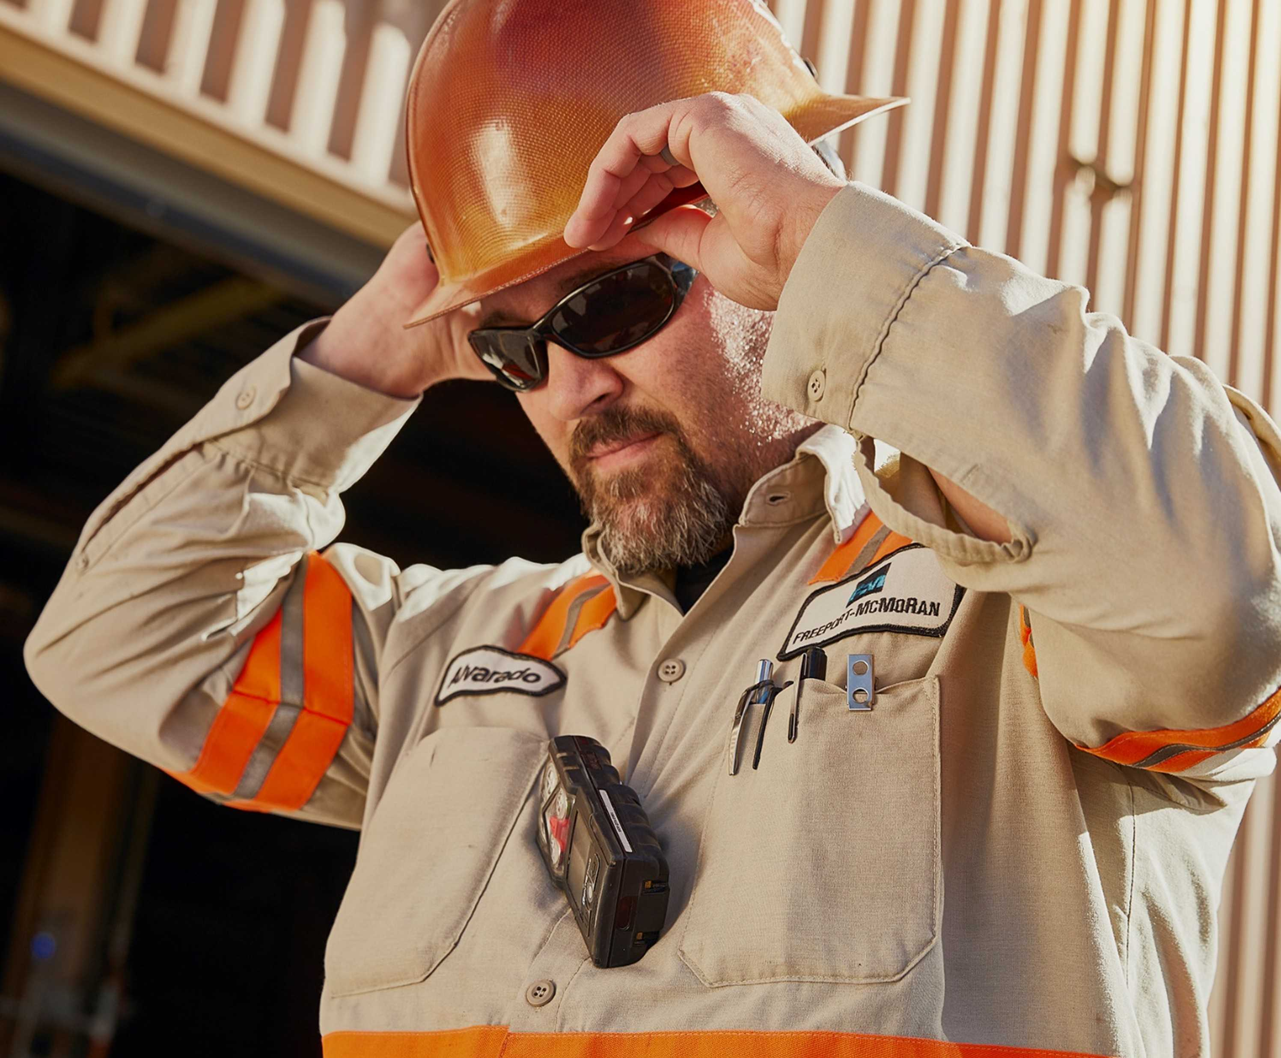

What is the purpose of this Meeting?
- For Henderson to have the opportunity to reach multiple contractors to discuss best practices when it comes to Health and Safety, Environmental and Contracts Management
- Give contractors an open forum to bring up concerns, successes or incidents, learnings, etc. that is shared between all contractors and Henderson personnel
- Help improve the safety culture and reduce safety incidents as a group

Slide 3
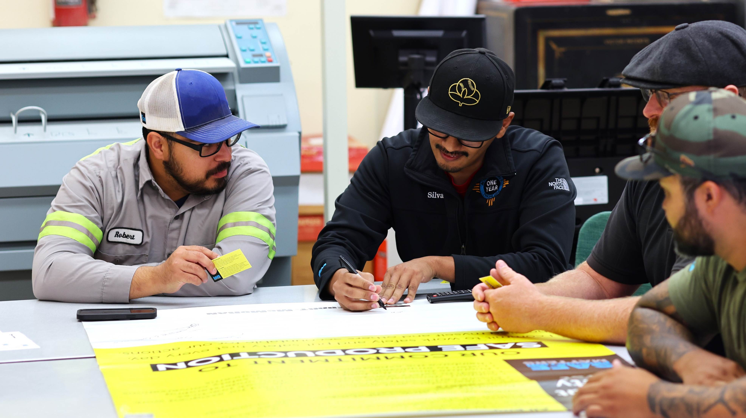
Safety Shares

Slide 4
LOTOTO Lock Removal Incident
At Henderson, a LOTOTO lock for an employee was removed without their authorization or use of a Non-Routine Lock Removal Form. The lock was placed on 12/18/25 at the PC3 upper access road gate and removed sometime before 01/06/26. Given the location and timeframe, no path to identify who removed. A reminder how critical LOTOTO/COHE is to keep our employees and contractors safe and why it’s the first item under Henderson’s Critical Safety Rules.
FMI Control of Hazardous Energy LOTOTO Supplement regarding lock removal:
Only the Authorized Individual who applied the LOTOTO lock is allowed to remove it.
If the Authorized Individual is unavailable, removal must follow the Non-Routine Lock Removal Form, which includes:
  Communication to the affected employee.
  Additional investigation and contact to Supervisor, Safety and ECC (if applicable) if employee not reachable or unknown.
  Documentation of the removal provided to area Superintendent and Safety.

Slide 5




Work Planning
Effective work planning is more than organizing tasks. It’s about creating a safe and efficient environment for everyone involved.
  Involve experienced individuals
Lean on and engage experienced team members in planning and execution. Their insight can help everyone identify hazards early and select safe methods.
  Provide clear instructions and expectations
Before starting work, outline steps, safety requirements and expectations. Clarity is crucial, especially for anyone still learning. If something doesn’t make sense, speak up and ask questions.
  Coordinate activities based on resources and experience
Make sure your team has the right people and tools for the task. Cater tasks to the experience level and number of personnel involved. Confirm equipment, parts and tools are available and ready before starting.
  Stop work if the plan changes or if there’s uncertainty
Stop and re-evaluate the plan if conditions change, controls are not effective or if there’s uncertainty. It’s ok to stop and rethink the original plan to make sure it is safer and more efficient for everyone.

Slide 6
Environmental Reorganization
Beginning in 2026, the organization of the environmental department across Freeport’s North American sites, including Henderson, is changing. This initiative has been implemented to be better organized to support the strategic direction of Freeport and is known as the Future of Work (FoW). Under this new organization, there will be a centralized services team (CST) of environmental professionals who will support Henderson. The objective of this new structure is to transition work that can be done more efficiently and consistently to the CST so that the site staff can focus on supporting our customers (that’s you) at the site and in the field.
Who is changing roles?
Estefany Torres will be transitioning to the CST. She will continue to support Henderson, primarily around management of our water quality data. Ben Bates will be moving to the Engineering Department, where he will continue to support water quality-related projects, among others.

Slide 7
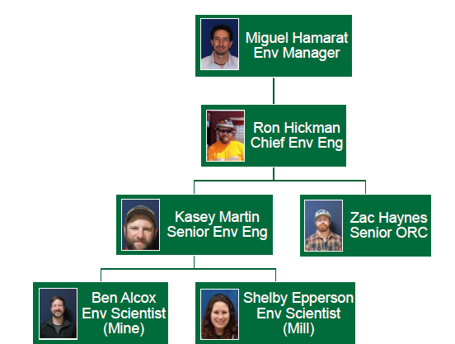
Environmental Team
Some new names from the CST that you may hear:
Whitney Koester (Water)
Adam Bankhead (Air)
Thomas Ashy (Waste)
Sam Madan (Waste)
Jeff Collins (Data Reporting)
You will see site environmental staff in the field on a regular basis supporting the We will, however, have less staff for on-site coverage, so if you need anything, please reach out to any of us individually or through the Environmental on-call hotline at: (720) 942-3603. Someone is available at this number 24/7.
Site Team:

Slide 8
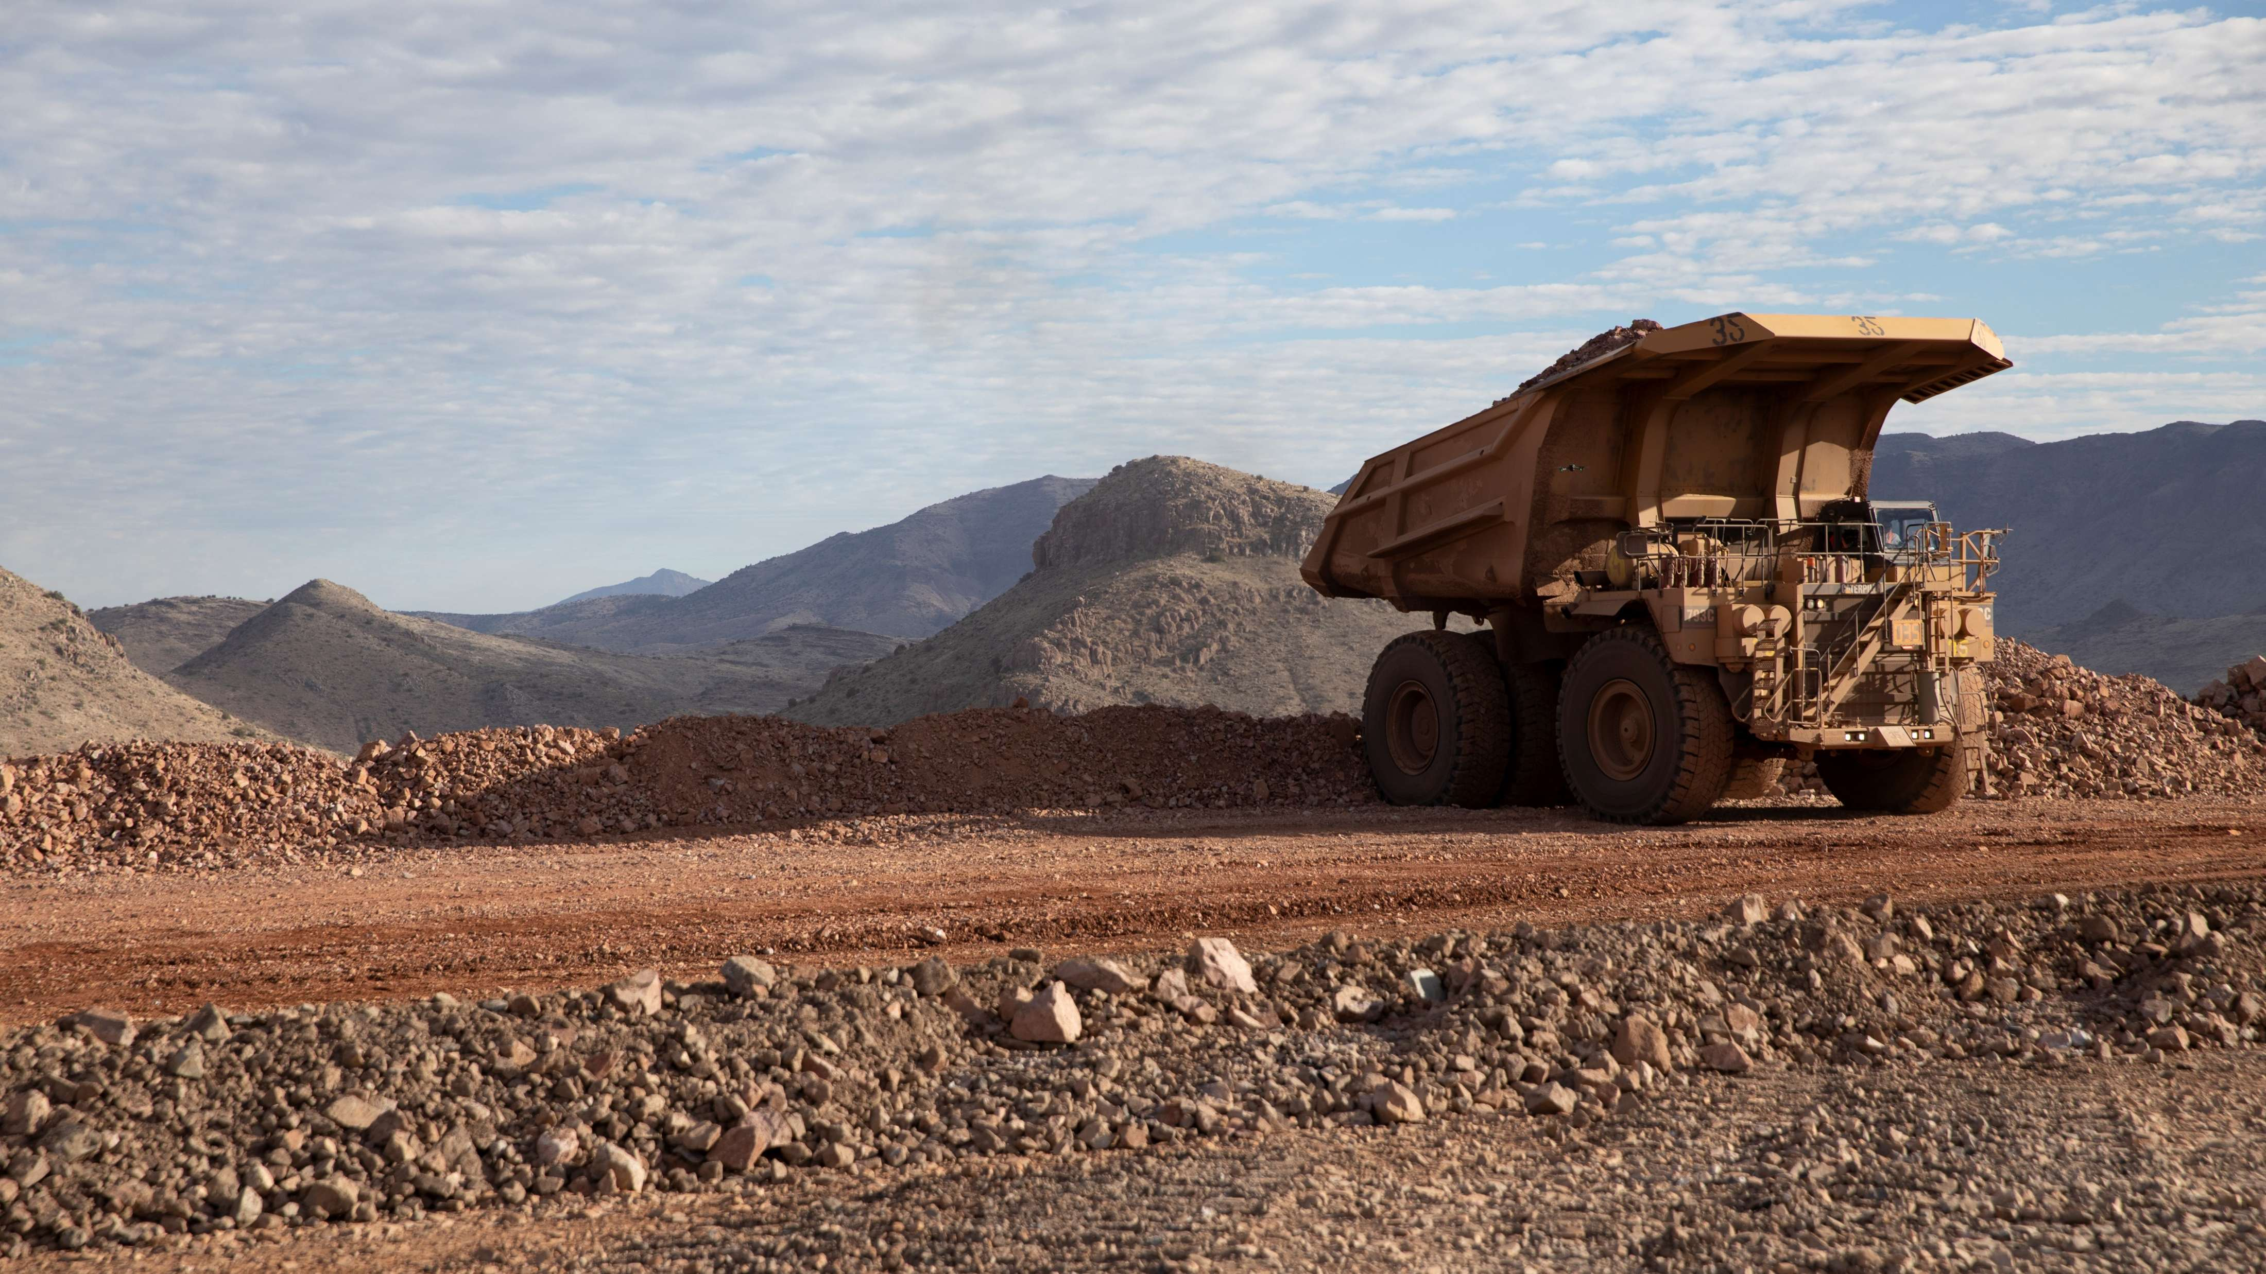
High-risk Incidents
Actionable and PFEs

Slide 9

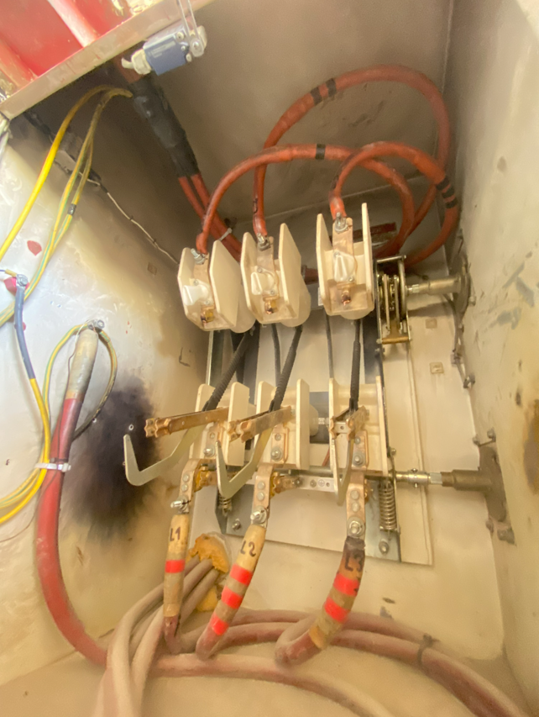

Shovel Electrical Shock
Exposure to Electrical Hazards
PFE # 2025-21 Event ID # 20031359
Preliminary Incident Details
Operation | Cerro Verde
Date / Time | November 21, 2025 / 11:40 a.m.
Event Type | Injury – Lost Time
Summary | Three electricians were performing shovel maintenance. While inspecting the ground wire monitor in the high-voltage lower cabinet (red box), one electrician came close to the energized 7.2 kV main high-voltage switch and received an electric shock.
Risk Category | Actionable – Significant (3) Likely (3)
Findings / Missing Controls | Electricians failed to implement the Lockout, Tagout, Try Out (LOTOTO) procedure at the electrical substation before performing the task in the high-voltage cabinet (red box). The injured electrician failed to notice the presence of energy and approached the main high-voltage switch (7.2 kV).
Applicable Policies / Procedures | FCX-HS03 Electrical Safety Policy FCX-04 Lockout/Tagout/Tryout (LOTOTO) Policy SSOst0036: LOTOTO Lockout Standard SMMpr0117 Preventive maintenance and replacement of minor components on electric shovels.
Employee Condition | The employee sustained burn injuries to the left arm, left hand and a wound on the left leg.
Contact | Hugo Román, Manager-Mine Maintenance
Energized main high-voltage switch (7.2 kV)
Electrical technician hand placement while inspecting the ground wire monitor
Depiction of electric shock

Slide 10

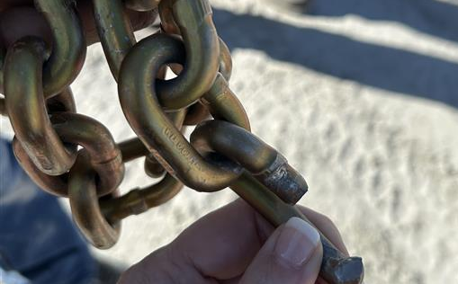
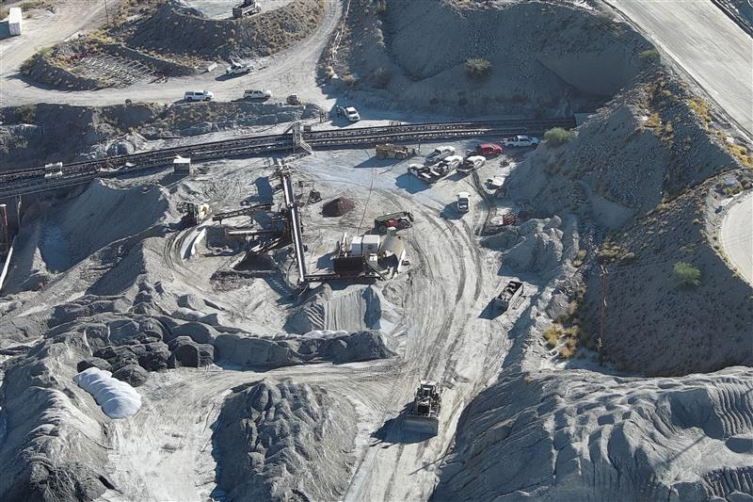
Chain Failure During Belt Replacement
Uncontrolled Release of Energy
ID # 2025-29 Event ID # 20031559
Preliminary Incident Details
Operation | Sierrita
Date / Time | November 30, 2025 / 8:50 a.m.
Event Type | Property Damage
Summary | While replacing the A2 belt, the chain securing the snatch block snapped, dislodging the block and sending it toward a parked forklift. At the same time, the wire cable traveled down the A2 ramp, damaging the pull cord supports and a mobile light plant on the pad. The forklift stopped the snatch block, which halted the belt and allowed the crew to clamp it and relieve cable tension.
Risk Category | Actionable – Significant (3) Likely (3)
Findings / Missing Controls | Lack of clear work procedures Improper rigging with incorrect chain size
Applicable Policies / Procedures | FCX-HS32 Crane and Rigging Policy Site Standard Operating Procedure – A2 Belt Changeout
Employee Condition | No reported injuries
Contact | Cara Forbregd, Manager-Health and Safety Graham Cooper, Manager-Concentrator
Snapped chain
Snatch block location while chained to the structure
Final location of snatch block
Illustration of A2 belt incident site. The yellow arrow shows the belt’s pull direction, while the red arrows show the direction the cable moved when attached to the belt.

Slide 11

Industry Incidents

Slide 12
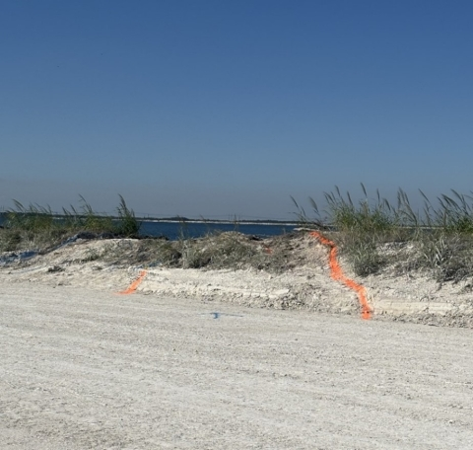
MSHA Fatality Alert
October 28, 2025 – A miner died after the haul truck he was driving went over a berm along the haul road and into a water-filled pit.
Eliminate Hazards and Prevent Injuries
Always operate mobile equipment at safe speeds. Consider the roadways, tracks, grades, clearances, visibility, traffic and type of equipment used.
Confirm berms and guardrails are at least mid-axle height of the largest mobile equipment using the roadway.
Always wear a seatbelt while operating mobile equipment. Never attempt to exit or jump from an out-of-control vehicle.
Perform pre-operation examinations of mobile equipment.

Slide 13
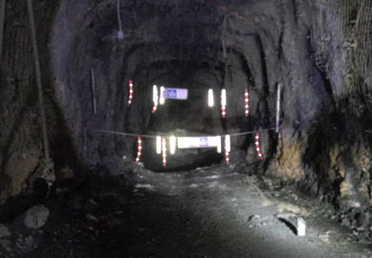
MSHA Fatality Alert
September 29, 2025 – An operator died when the Load Haul Dump loader traveled into an open stope.
Eliminate Hazards and Prevent Injuries
Do not work or travel near open stopes or holes.
Install and maintain signage identifying open holes or stopes. Make sure signage is highly visible, maintained in place and understood by everyone in the working area.
Install and maintain barricades, berms or other restraining devices in front of open holes or stopes.
Establish and discuss safe procedures to prevent working or traveling near open holes.
Make sure you are properly task-trained for your assigned tasks.

Slide 14
MSHA Fatality Alert
November 22, 2025 – A plant operator died after he was struck and engulfed by falling material at a salt silo discharge outlet. He was attempting to clear a blockage with his head and arm inside the silo access door.
Eliminate Hazards and Prevent Injuries
Equip bins and hoppers with mechanical devices such as vibrating shakers or air cannons to loosen blockages. Or provide other effective means so miners are not exposed to caving or sliding materials.
Make sure miners working under hazardous conditions can be seen, heard and able to communicate with others.
Examine working places to identify the potential for falling or sliding materials prior to allowing access to areas in or around bins and hoppers.
Before blocked bins and hoppers are cleared, train miners to recognize and safely remove all potential hazards.

Slide 15
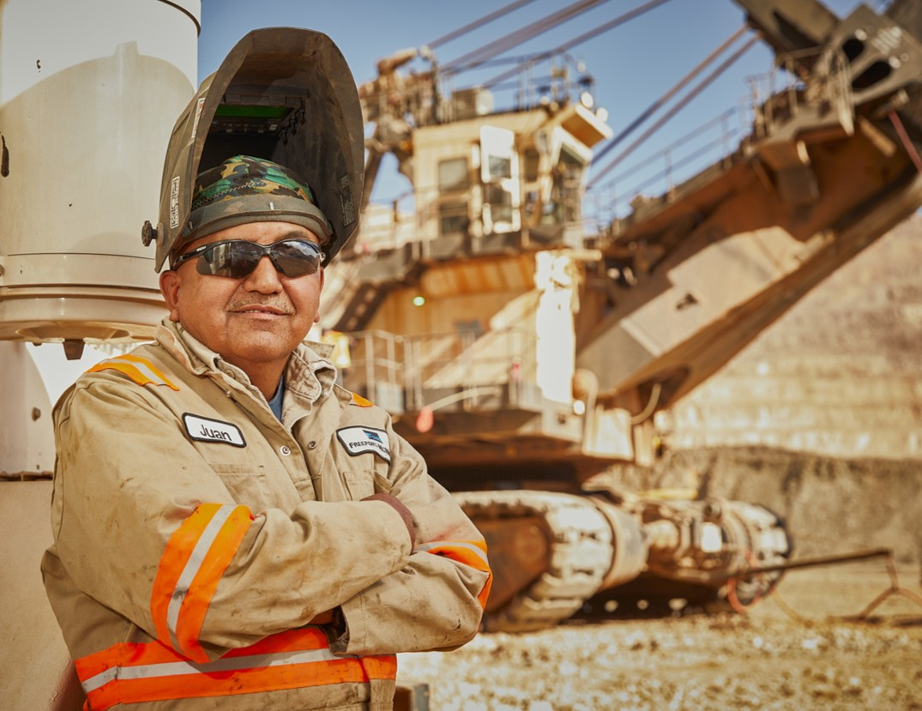
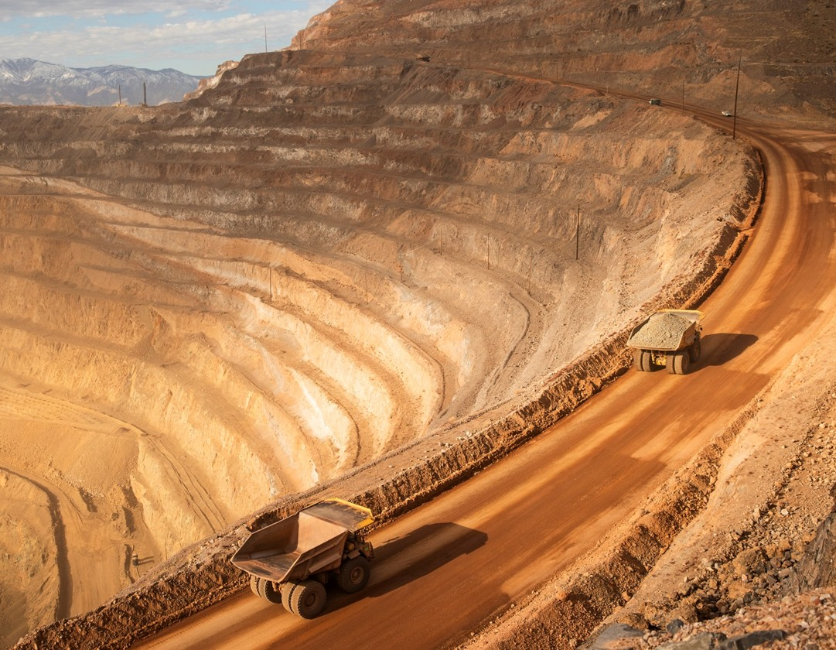
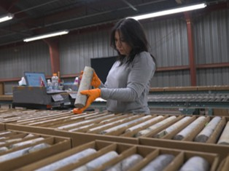
Additional Resources
Health and Safety Dashboard
Safety Toolkits
FCX Policies
MSHA Safety Alerts
OSHA

Slide 16
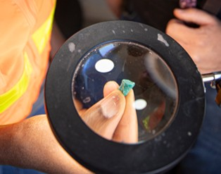
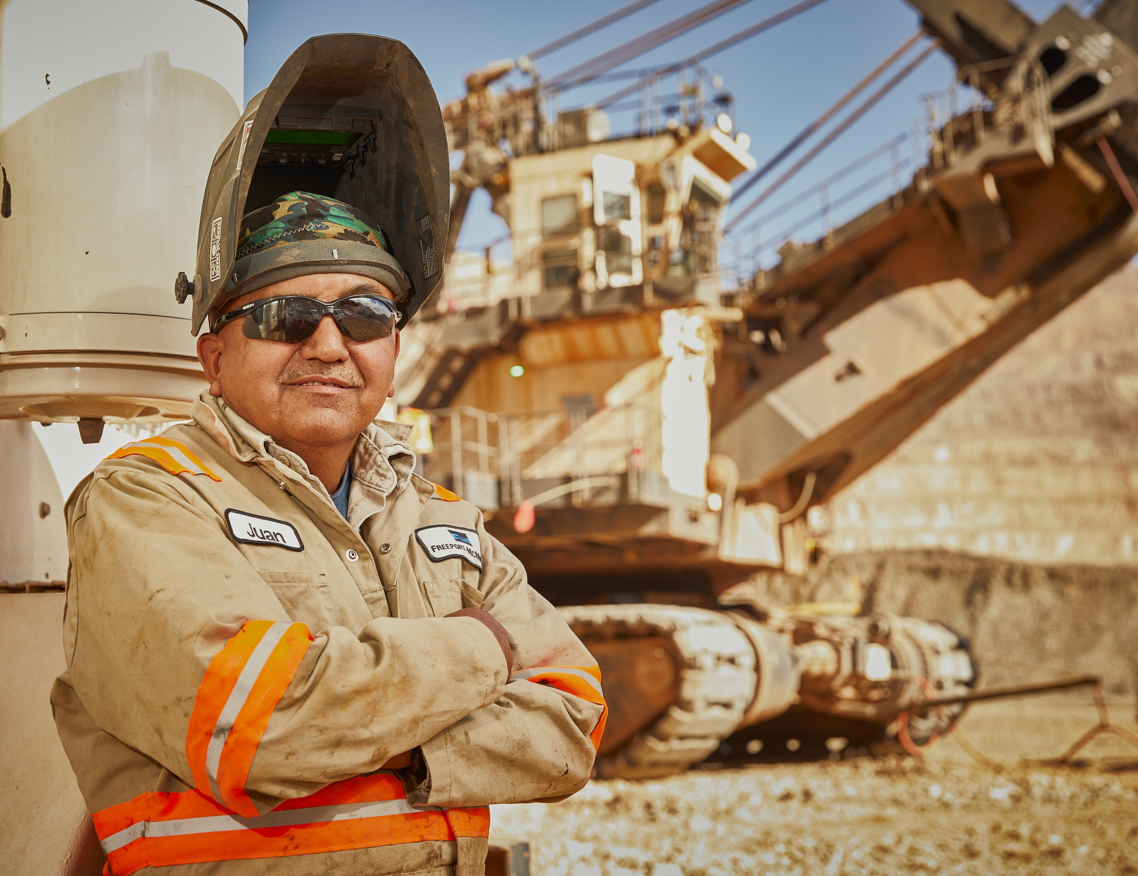


Contractor Management Topics
Contractor Hours Reporting
Contractor Training Policy Update
HSEP Requirements
Colorado Safer Knives Program

Slide 17
Hours Reporting:
Thank you to those submitting their hours in the new system
Technical/access issues still impacting timely reporting
  If access, please resubmit Access Request (linked next slide)
  Keep Ben Goertz informed (bgoertz@fmi.com)
Starting February and monthly thereafter:
  Restrict site access if prior hours not reported by 6th
  If technical issue, email hours to Ben Goertz

Slide 18
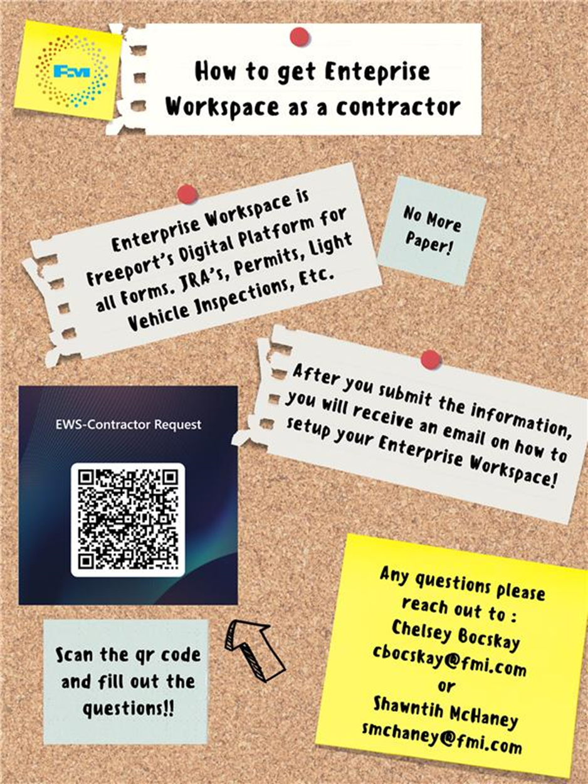
Contractor EWS Access
Access to site digital forms now available to Contractors!
Integration of Contractor submitted forms into internal dashboards
Forms can be used in online and offline modes
Request Access with QR Code or HERE
Reach out to H&S Department with any questions or issues

Slide 19
Contractor Training Policy Update
Over the past 18 months, we have focused on standardizing training materials and delivery methods across Freeport-McMoRan. This initiative aimed to ensure consistency and alignment with our safety and operational standards.
Throughout this process, we received valuable feedback from our contractors. While many appreciated the effort to standardize Freeport-specific training, several indicated that their own training programs were equally effective—and in some cases, even more comprehensive.
Based on this feedback, Freeport is adjusting its approach:
Contractor Training Acceptance:
We will now accept contractor-provided training, with exception to training noted in the attached document, provided the contractor attests that their training meets our core safety policies, even if it is not Freeport-specific.
Freeport Training Materials Availability:
Freeport training content will remain accessible on the Public Portal for contractors who wish to use it or supplement their existing programs. This ensures that all parties have access to resources that align with our policies.
All training information that is required for your employee’s to perform work (Core, Compliance and Technical) training must be uploaded into ISN no later than April 6 2026. We will be referencing the data uploaded in ISN to verify while in the field
Site Safety and Training are available to provide guidance and answer questions; however, contractor training delivery is the responsibility of the contractor.
We believe this approach benefits everyone involved by maintaining strong safety standards while allowing flexibility where appropriate. Ultimately, leadership presence and engagement in the field will continue to be the most critical factor in driving safety and operational excellence.
LINK TO UPDATE

Slide 20
Contractor Training Policy Update
FCX Core Training Requirements All contractors accessing or completing work at any North American site must complete the following Core Training Requirements additional training might be required before starting work:
1. Area Specific training that covers all facilities where contractor employees will be working within
2. Contractor Orientation North American (Available in ISN)
3. North American Hazard Recognition Video (Available in ISN)
4. FCX Mining – Workplace Examinations (Will be available in ISN soon)
5. FCX Mining – Site Specific Hazard Recognition Brochure, this is a site by site requirement for those that visit multiple sites (Available in ISN)

Slide 21
HSEP Expectations
HSEPs are required for every Service Order issued to a Contractor before they are permitted onsite.
Project Managers will support contractors in developing their HSEP.
All HSEPs must be reviewed and approved by Health & Safety and Environmental prior to submission to GSC for signatures.
GSC will use DocuSign to obtain all required signatures.
Please note that if a contractor requires multiple employees to sign, this may delay the overall signing process.
GSC must receive an email address for each individual who is required to sign.
Once the signed HSEP, along with all individual employee training records and worker acknowledgements, are uploaded to ISN, contractor employee badges will be processed and contractors will be granted onsite access.

Slide 22
Colorado Safer Knives Program
We are introducing the Colorado Safer Knives Program, a new safety initiative developed collaboratively by frontline employees, supervisors, safety teams, and site leadership at Henderson and Climax. The goal is to reduce laceration injuries by standardizing the use of safer cutting devices across our Colorado operations.
Why This Change Matters
Our last laceration injury in Colorado was at Climax and happened during a routine task in the mine. An employee was installing a gasbag in a drill hole and used a standard utility knife he carried with him. Due to body positioning and ergonomics at the time, the cutting motion brought the blade across his leg, resulting in a laceration that required stitches.
Incidents like this don’t happen because people don’t care or aren’t skilled – they happen during everyday work, often when conditions, posture, and tools don’t line up. The impact goes beyond the injury itself: pain, medical treatment, time away from work, and stress on families and crews. No task is worth that risk, and no one should be injured doing their job. This program is being implemented to help prevent injuries like this across all Colorado sites.

Slide 23
Colorado Safer Knives Program
What’s Changing & Where to Find Information
The Colorado Safer Knives Program:
Identifies approved safer cutting devices
Defines safe use expectations
Includes a variance process when approved tools are not effective
Program details are available at:
Public Portal – Henderson Site: Colorado Safer Knives Program
Additional communication and field engagement will continue over the next two months, with full implementation by April 1. At that point, employees and contractors are expected to hold one another accountable to the program.
Cut Device Turn-In raffle for FMI employees, contractors excluded.

Slide 24
Henderson Incidents
12/17 – Damaged Buried Water Pipe at Barge (Property Damage)
  New D8T operator forgot to raise rippers and damaged buried barge
  discharge line
12/19 – Cage Gate Fell Down Shaft (Property Damage)
  Mine Service Cage gate pushed out slightly by a pallet
  As cage lowered, tripped out with Open Door indicator, re-engaged sometime later and when Hoistman moved cage up the gate fell between the shaft wall and service cage
  12/30 – Caustic Exposure (First Aid)
  Pipe burst at Mill causing caustic leak
  Employee responding got caustic on their ear

Slide 25
FRM Verification Results – Dec.
152 verifications completed in December
Focus for December around Hazardous Substance – Acute, Uncontrolled Release of Energy, and Underground Rockfall
All 3 focuses dropped in December, increase in Exposure to Electrical Hazards
FOCUS FOR DECEMBER:
Exposure to Electrical Hazard
Hazardous Substance – Chronic
Underground Hazardous Atmosphere

Slide 26
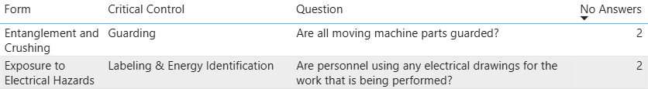
FRM Verification Results – Dec.
Henderson Missing Controls with Multiple No Responses

Slide 27
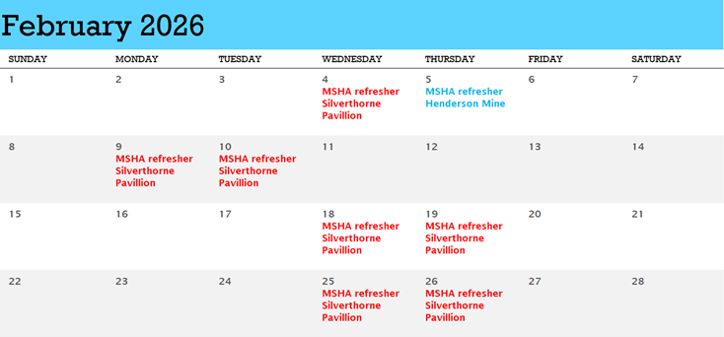
Henderson MSHA Refresher
Project Managers will need to reach out to Jasmin Babeon jbabeon@fmi.com to schedule their contractors for Henderson Operations 2026 MSHA Refresher. If a contractor has an SAP# please provide that.

Slide 28

Open Forum

Slide 29
February 12th
March 19th
April 9th
May 7th
June 18th
July 16th
August 20th
September 10th
October 8th
November 19th
December 17th
2026 Meeting Schedule
Meetings begin 1 PM MST
Mine and Mill In-Person Options Monthly

Slide 30
January Sign-Off Record
_____________________
_____________________
_____________________
_____________________
_____________________
_____________________
_____________________
_____________________
_____________________
_____________________
_____________________
_____________________
_____________________
_____________________
_____________________
_____________________
_____________________
_____________________
_____________________
_____________________

