Slide 1
Henderson HSE Contractor Meeting – July 2025
07/17/2025

Slide 2
What is this Meeting?
Purpose:
For Henderson to have the opportunity to reach multiple contractors to discuss best practices when it comes to Health and Safety, Environmental and Contracts Management
Give contractors an open forum to bring up concerns, successes or incidents, learnings, etc. that is shared between all contractors and Henderson personnel
Help improve the safety culture and reduce safety incidents as a group

Slide 3
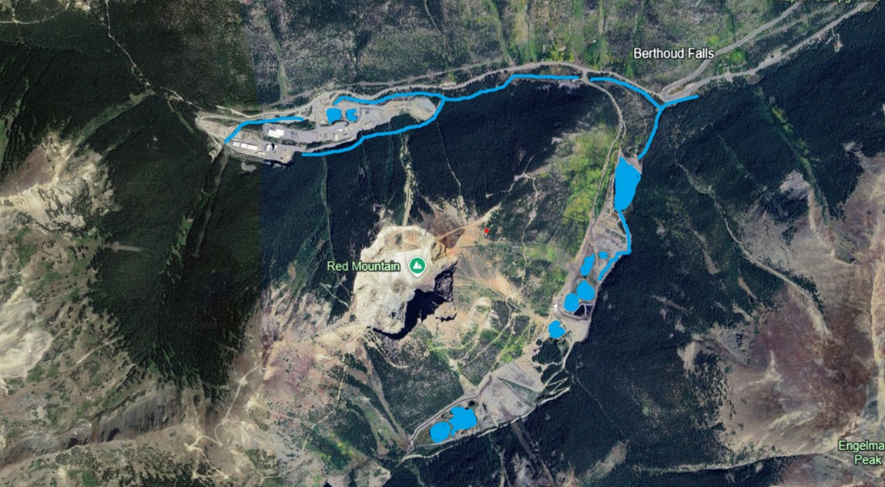
Contractor Share
Danger of Falling into Water
Surface Water Locations at Mine

Slide 4
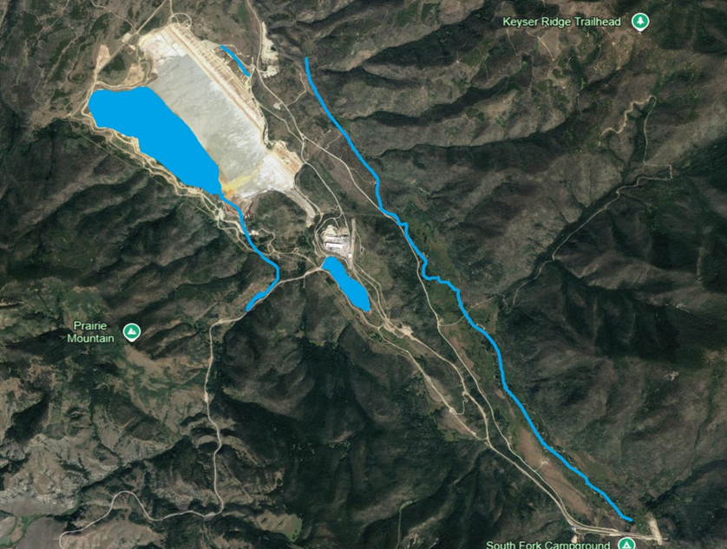
Contractor Share
Danger of Falling into Water
Surface Water Locations at Mill

Slide 5
Contractor Share
Danger of Falling into Water
Risk Intensifiers:
Equipment weight and vibration
Undercut banks
Sloughing ground
Varied water depth
Swift currents
Inadequate berms
Narrow roadways
Electrical Shock
Inclement weather / ice
Working at night / low light conditions
Working while distracted or tired

Slide 6
Contractor Share
Danger of Falling into Water
Best Management Practices:
Conduct daily workplace examinations!
Know water depth, subsurface conditions, and ground conditions before you begin work.
Keep equipment a safe distance back from the water’s edge.
Avoid traveling over ice covered water.
Provide handrails around docks and work boats.
Properly berm roadways near water hazards.
Always wear a Coast Guard approved Type I or Type V personal flotation device (PFD) when working around water, even when inside mobile equipment. Auto-inflatable, if possible.
Keep water rescue equipment easily accessible.
Know where extra PFDs and rescue rings are stored.
Practice good housekeeping and keep all travel ways clear around water hazards.

Slide 7







Safety Share
Common Causes
Falling Objects
Eliminate Hazards and Prevent Injury
Use barriers and flagging to establish safe zones under elevated work
Always wear a hard hat and proper personal protective equipment (PPE)
Use safety nets, barriers, toe boards and guardrails to help prevent or catch falling objects
Coordinate work activities to establish and ensure proper segregation safe zones
Poor Housekeeping
Stacked Materials
Overhead Work
Inadequate Use of PPE
Overloaded Storage Areas
Improperly Secured Tools
Click here to access a Falling Objects toolkit, including talking points and employee handout.

Slide 8
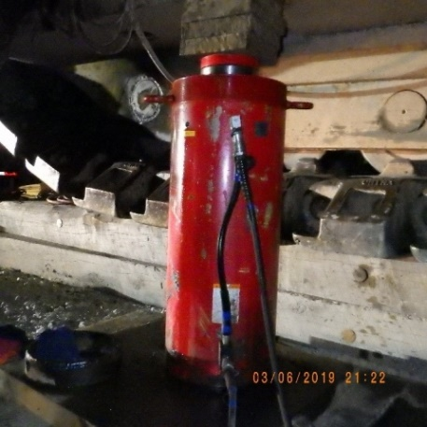
Safety Share
Hydraulic Ram Safety
There have been numerous safety incidents involving pressurized tools throughout our operations. Most notably, a 2019 contractor fatality in Tyrone. We each have the responsibility – and the opportunity – to learn from these events and implement controls wherever hazardous energy is present.
Here are a few key actions you can take:
Ensure a competent person inspects all components of the system (i.e., hoses, gauges, pressure relief valves, couplings).
Verify system components meet the requirements for material, pressure and intended use.
Position hydraulic equipment to eliminate line-of-fire exposure to personnel.
Properly transport and store components to prevent damage.
Click here to for hydraulic ram safety information, including incident examples and best practices.

Slide 9
Henderson Mill Alarm Changes
MayDay MayDay MayDay
WHEN will I hear this?
  Local evacuations like – Acid House, Nokes Building, MERT Call out
WHAT should I do?
  STOP WORK and wait for further instruction.
Demonstration Available at Mill Front Desk

Slide 10
Henderson Mill Alarm Changes
Mill Evacuation
WHEN will I hear this?
  Full Evacuation – Fire, Major Spill
WHAT should I do?
  Evacuate to your nearest muster location for check-in
Demonstration Available at Mill Front Desk

Slide 11

Grand County Stage 1 Fire Ban
Henderson Operations would like to remind all employees performing work at the Mill to follow the Hot Work Outside Mill Site Buildings During Summer Months SOP which includes the following:
Superintendent (or delegate) approval for all Hot Work outside Mill Site Buildings
Approval from Grand County Sheriff’s Department to perform the Hot Work (Superintendent/Safety will submit request)
Follow the DOHS Hot Work Policy while conducting work
Report any Hot Work Incidents to Safety

Slide 12
Environmental Topic – Nonroad Engine Management
Nonroad (stationary – doesn’t move or portable – can be towed or moved around site) engines are tracked by the Environmental Department for considerations in our Spill Prevention, Control, and Countermeasure (SPCC) Plans and for our Air Permits.
If you are brining on a rented or contracted nonroad engine (generators, welders, pumps, power-tools, air compressors, light plants, crushers etc.), please fill out an Engine Information Form and return to the environmental department. If you plan to purchase or significantly move a stationary or portable engine, please go through the Henderson MOC process. Mobile (self-propelled) engines such as haul trucks, loaders, excavators, etc. are not tracked under the same regulations.
If you have questions about engine management or see something around the property that does not look normal, please reach out to us or call the Environmental on-call hotline: (720) 942-3603. Someone is ready to answer this number 24/7.
Stationary Diesel Genset at the Mill
Portable Gas Generator

Slide 13
High-Risk Incidents
Memo Regarding PTFI Fatality
I am deeply saddened to share the news that Guntur Sitorus, 42, a contractor with PT Redpath Indonesia, passed away from injuries suffered in a June 7 accident that occurred when he was cleaning sump areas in the Grasberg Block Cave. Guntur and the medical teams fought hard but tragically without a positive outcome.
On behalf of the entire Freeport family, I extend our deepest condolences to Guntur’s family, friends and the Redpath and PTFI teams.
This is the second fatality at company operations this year – the first occurred at Cerro Verde at the end of April – serving as a tragic and sobering reminder of the very real risks in our daily work and the critical importance of working safely.
While our safety programs are strong, safety is more than a system, a piece of paper or a presentation – it’s a personal commitment to identify risks and to ensure they are fully mitigated before any work takes place. Each and every one of us needs to make this the highest daily priority. I urge us all to take a moment to reflect – and to recommit – to the focus, effort, mindset and daily habits that protect our own lives and the lives of those around us.
An investigation is underway, and the company is working with all relevant authorities and agencies.
Thank you for your continued dedication to safety.
- Mark Johnson, President and COO PTFI

Slide 14

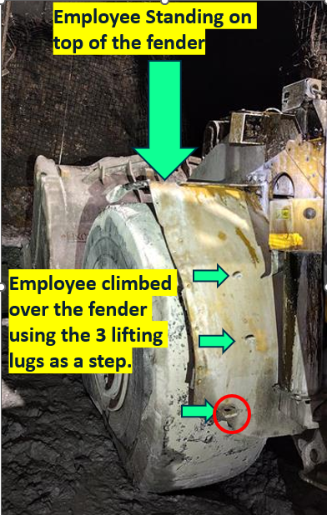
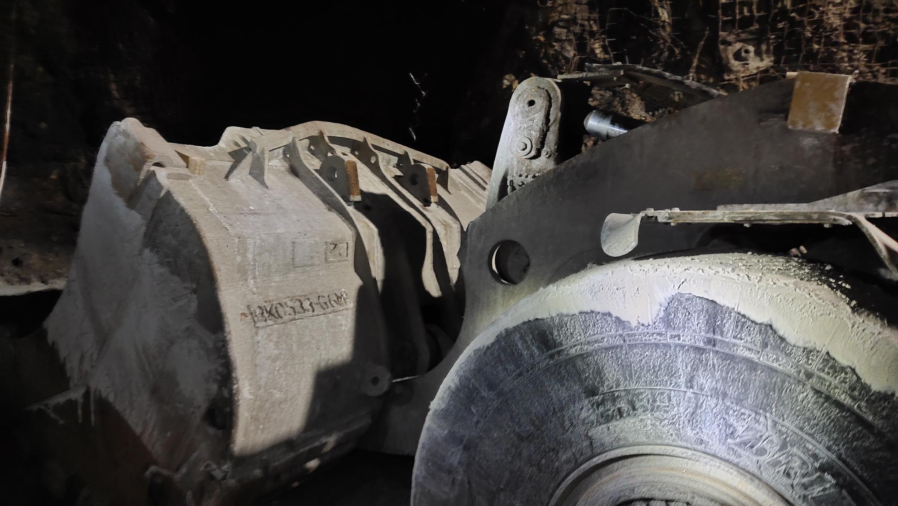
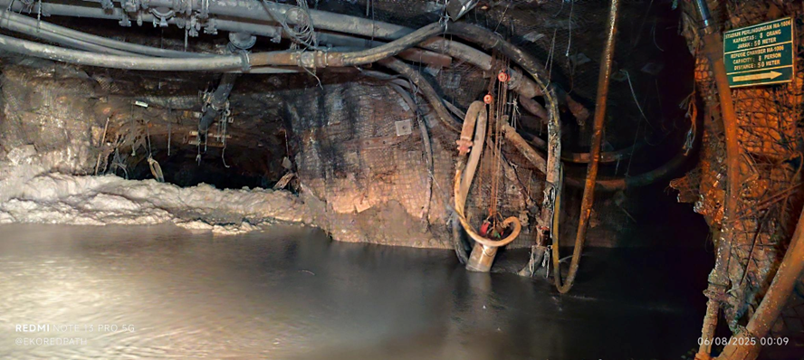
Employee Fell From Loader
Event ID # 20026514
Fall from Heights
Preliminary Incident Details Note: This information has been updated since the ​ initial PFE advisory was distributed on June 17, 2025.
Operation | PTFI - GBC Underground Mine
Date / Time | June 7, 2025 / 2:15 p.m.
Type | Fatality
Summary | While cleaning sump areas, an employee found water levels had risen to the road level, although the water pump (Flygt pump) was running. The employee used a loader (LHD) to remove mud from the sump, which helped lower the water level below the pump. The employee then tried to improve function by lowering the water pump. Due to high water on the road, the employee parked the LHD near the pump and climbed onto the left front fender to reach the chain block via the bucket. While attempting to move from the wheel fender to the bucket (approx. 1.3 meters / 4.3 feet), the employee slipped, hit their lower back on the LHD and fell to the ground.
Findings / Missing Controls | Failure to design proper access and platform to operate the pump in the sump area, especially during flooding. Failure to use an engineered or temporary work at height platform to operate the pump. Failure to use appropriate methods of access. The fender lifting lugs were used to climb to the top of the wheel.
Applicable Policies / Procedures | LHD Operating Procedure (SOP-6.01-UG-J01) Work in Sump and Drain Hole (WI-6.01-UG-L11)
Employee Condition | The employee, Guntur Sitorus, 42, sustained closed rib fractures with segmental displacement and hemothorax. He passed away from the injuries on June 30, 2025.
Contact | Matthew Sullivan, SVP-Underground Mine
Employee foot position before falling. The left foot was on the bucket, the right foot was on the wheel.
Photo caption
Employee position while standing on fender
Sump access and water pump with chain block

Slide 15

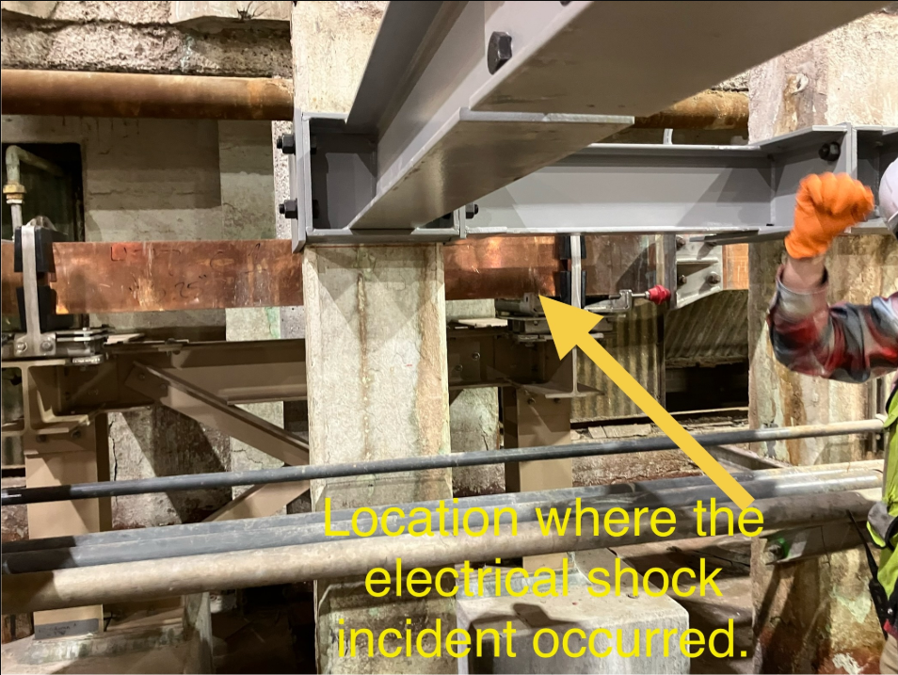
Employee Contact with Bus Bar
Exposure to Electrical Hazards
ID # 2025-15 Event ID # 20026064
Preliminary Incident Details
Operation | El Paso
Date / Time | May 19, 2025 / 6 p.m.
Event Type | Near Miss
Summary | A contract employee suffered an electrical shock when they contacted an exposed bus bar. Updated bus bars had been installed for the Tank House upgrade Permanent Cathode Technology project. Previous guarding did not fit the new bus bar and left the bus bars temporarily exposed. While installing seismic tables on cell columns, the employee unintentionally touched the bus bar with one shoulder and a supporting bracket with the other shoulder, resulting in the electrical shock.
Risk Category | Actionable – Significant (3) Likely (3)
Findings / Missing Controls | Missing guarding on bus bar.
Applicable Policies / Procedures | FCX-26 Electrowinning (EW)/Electrorefining (ER) Electrical Safety Policy
Employee Condition | No injuries reported.
Contact | Roland Ruybe, Manager-Health and Safety

Slide 16

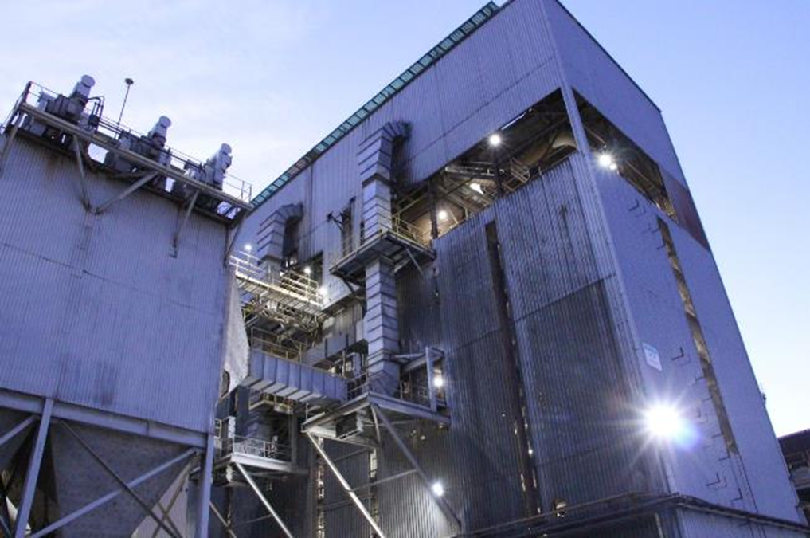
Off-Gas of SO₂
Hazardous Substances – Acute
ID # 2025-16 Event ID # 20026414
Preliminary Incident Details
Operation | Sierrita
Date / Time | June 1, 2025 / 7:30 p.m.
Event Type | Injury – First Aid
Summary | During a power outage, the roaster ventilation went down – causing prolonged off-gassing of sulfur dioxide (SO₂).
Risk Category | Actionable – Significant (3) Likely (3)
Findings / Missing Controls | Inadequate use of personal monitors. Employees continued to work despite multiple SO₂ alarms. Evacuation, monitoring and procedural expectations were not well documented/followed. Fixed SO₂ monitors were inoperable when site power went down.
Applicable Policies / Procedures | FCX-HS17 Hazardous Gas Policy
Employee Condition | Multiple employees were seen at the clinic and cleared to return to work.
Contact | Cara Forbregd, Manager-Health and Safety Brittany Varela, Manager-Moly Processing
Location of incident – roaster building

Slide 17

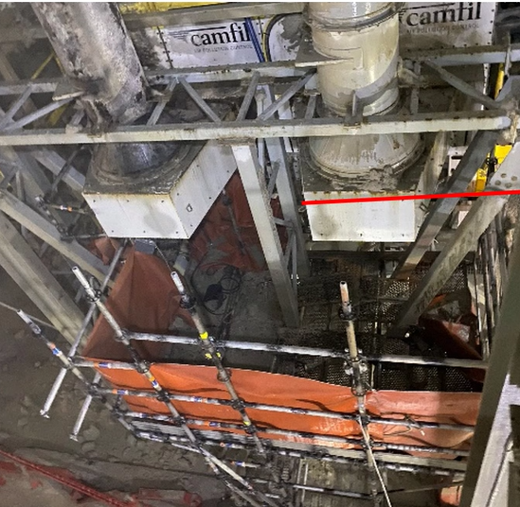
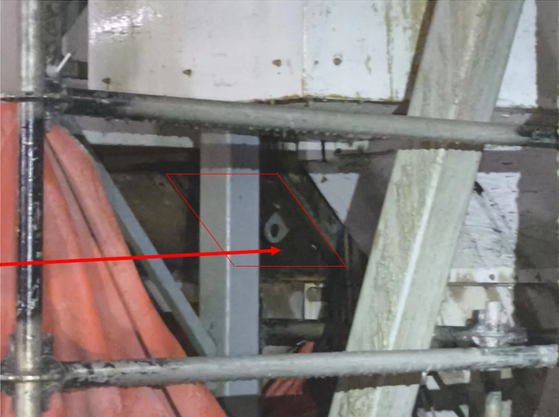
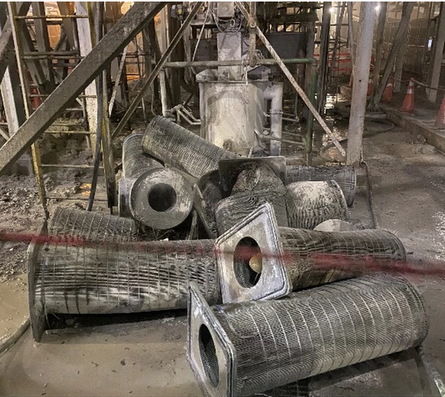
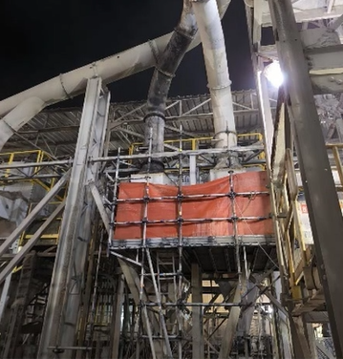
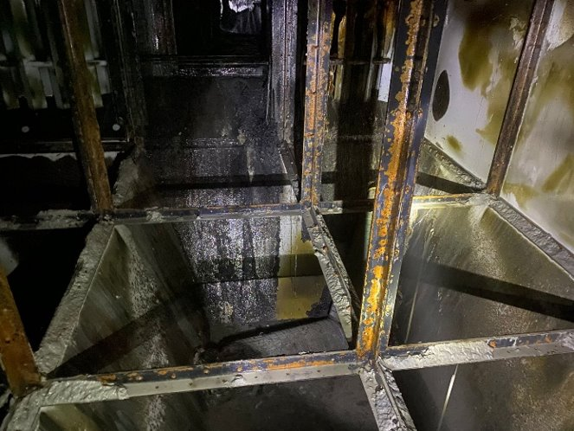
Hopper Fire
ID # 2025-17 Event ID # 20026648
Fire
Preliminary Incident Details
Operation | Cerro Verde
Date / Time | June 12, 2025 / 6 p.m.
Event Type | Property Damage
Summary | After completing welding work on a metal plate (20 in. × 78 in. × 0.2 in) on the outside of a dust collector hopper, the hot work watch noticed smoke and fire inside the hopper. The fire damaged the filters, hopper and discharge piping. The crew controlled the fire by discharging extinguishers into the hopper and applying water to the dust discharge piping until emergency services arrived.
Risk Category | Actionable – Significant (3) Likely (3)
Findings / Missing Controls | Failure to identify a polyethylene deflector inside the box and a polyethylene lining on the internal walls of the box.
Applicable Policies / Procedures | FCX-HS06 Hot Work Policy
Employee Condition | No injuries.
Contact | Eder Pérez Samanez, Reliable Plant Manager-C1
Location of welder and hot work watch during welding
Location of welded metal plate
Damage to dust filers inside the hopper
Damage to discharge pipe
Damage inside the hopper

Slide 18

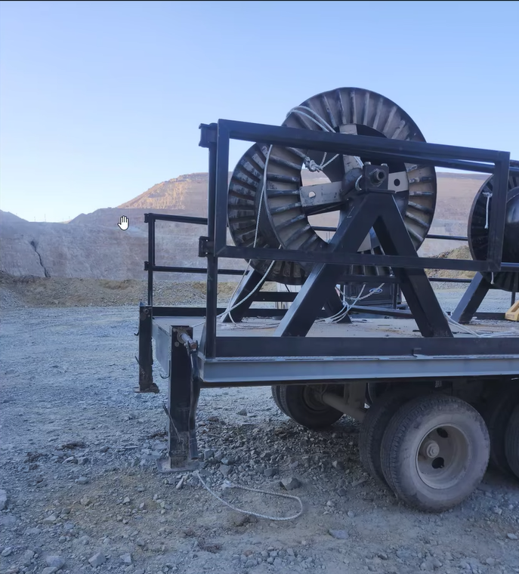
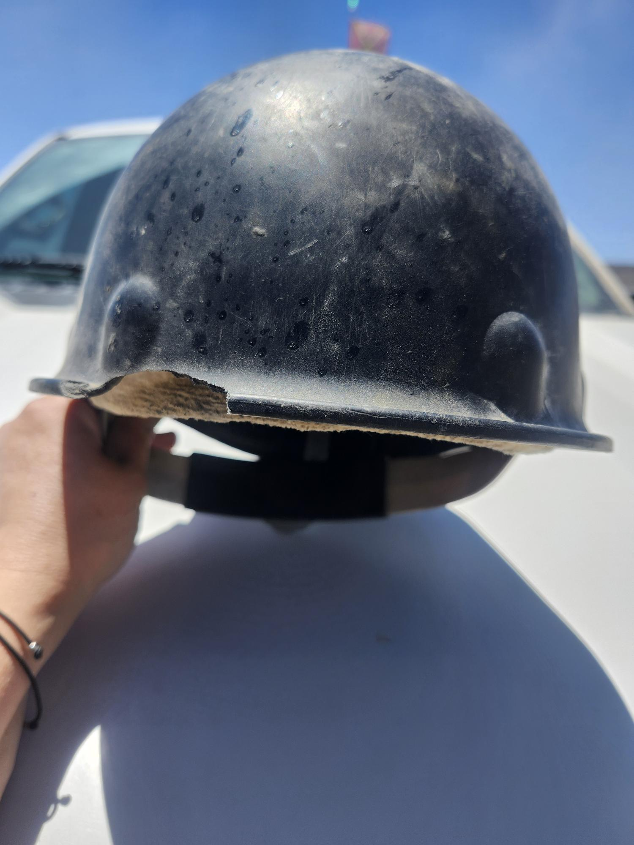
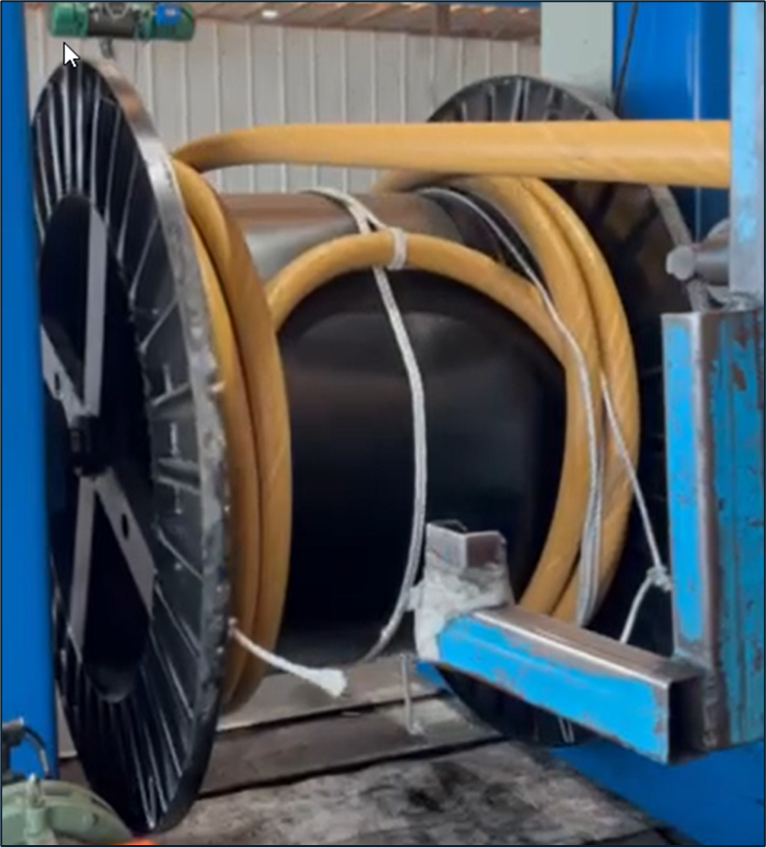

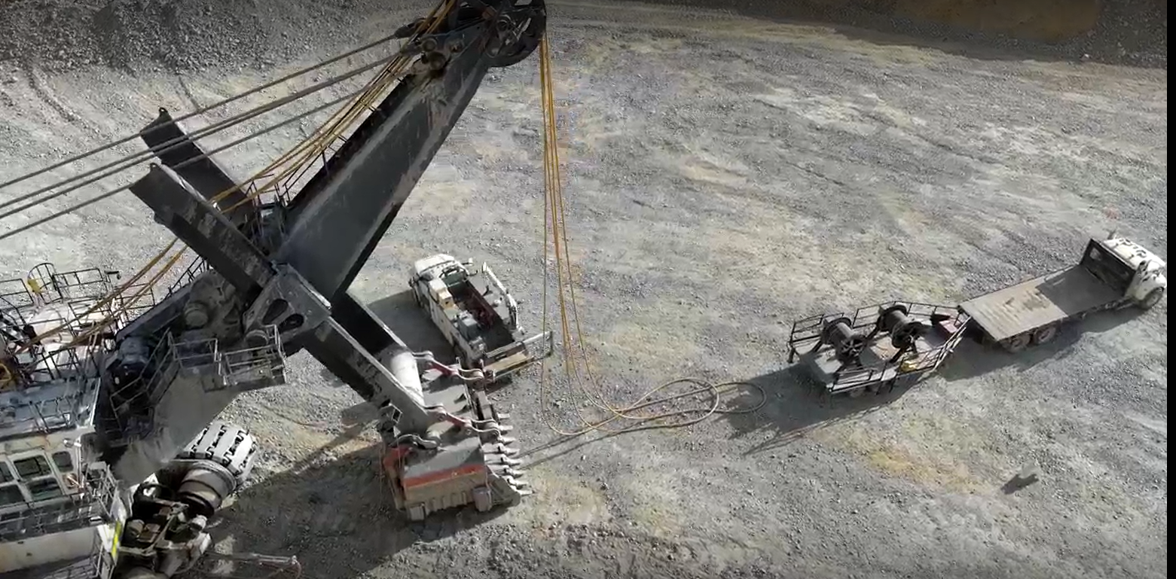

Employee Struck By Shovel Hoist Ropes
Uncontrolled Release of Energy
Fall From Heights
PFE # 2025-11 Event ID # 20026853
Preliminary Incident Details
Operation | Bagdad
Date / Time | June 17, 2025 / 6:30 p.m.
Event Type | Injury – Lost Time
Summary | While mechanics were changing shovel hoist ropes, a nylon rope from the spool became entangled with the hoist rope. This created tension and stored energy in the hoist ropes as they were fed through the shovel. To release the tension, an employee climbed onto the hoist rope trailer to cut the nylon rope from the spool. As the tension was released, the hoist rope swung, striking the employee in the head. The impact knocked the employee off the trailer, and they fell approximately 4 feet to the ground. The hoist rope then retracted toward the shovel, dragging the employee 3 to 5 feet.
Risk Category | Actionable – Significant (3) Likely (3)
Findings / Missing Controls | Failure to identify and reduce stored energy in the hoist ropes.
Applicable Policies / Procedures | FCX-HS04 Control of Hazardous Energy Policy
Employee Condition | Employee sustained a fractured back and wrist.
Contact | Rachel Adams, Manager-Health and Safety
Location of employee while standing on trailer, before fall
Damage to hard hat from impact of hoist ropes
Example of hoist cable spool and nylon rope from manufacturer
Work area as cables were replaced

Slide 19
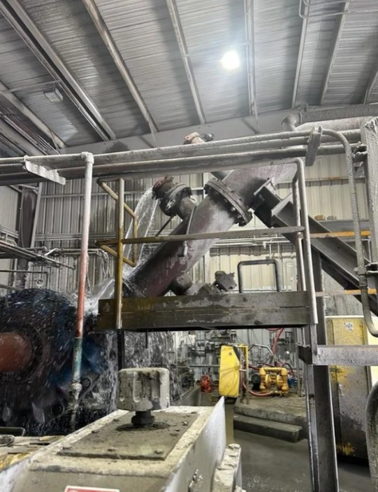
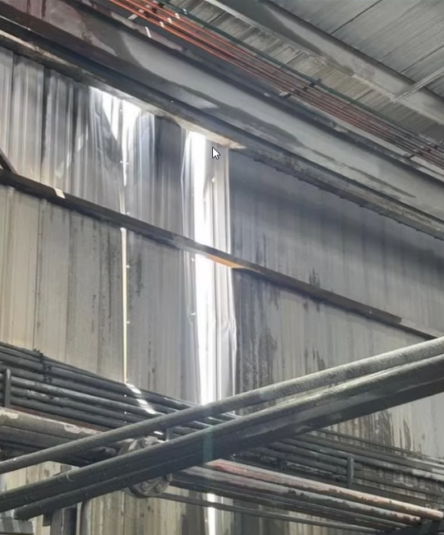
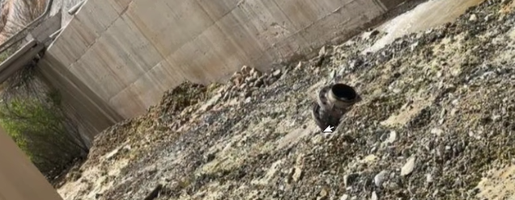
Ruptured Disc in Pumphouse
Uncontrolled Release of Energy
ID # 2025-18 Event ID # 20027022
Preliminary Incident Details
Operation | Chino
Date / Time | June 25, 2025 / 1:06 p.m.
Event Type | Near Miss
Summary | While backflushing a tailings thickener underflow pump train, mill operators noticed the process water tank was low. The operators closed the flush valve, which caused an unexpected increase in water pressure. The sudden pressure spike caused a rupture in a pressure relief disk. As the disk failed, a pressure release pipe fitting broke loose, forcefully ejected through the side of the building and landed on the ground outside.
Risk Category | Actionable – Significant (3) Likely (3)
Findings / Missing Controls | Preventative maintenance or inspection of grooves is inadequate.
Applicable Policies / Procedures | No applicable policies.
Employee Condition | No injuries.
Contact | Jim Cook, Manager-Health and Safety
Original location of the pressure release pipe and fitting.
Location pipe exited the building
Pressure release pipe fitting that went through building and landed outside

Slide 20
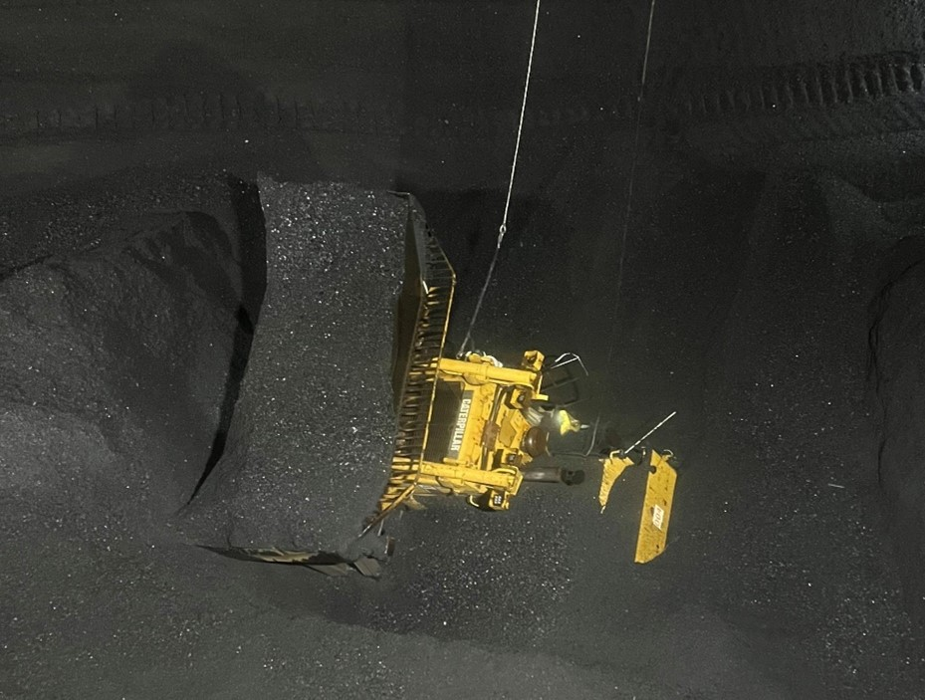
MSHA Safety Alert
On May 22, 2025, a bulldozer fell into a void above a feeder. The loose material from the coal pile collapsed around the bulldozer, engulfing it and trapping the miner inside the cab. The bulldozer was equipped with a “submarine kit” consisting of high-strength glass, self-contained self-rescuers, and two-way communication.
Eliminate Hazards and Prevent Injuries
Maintain stability. Don’t operate equipment directly over feeders. Clearly mark location of draw holes.
Identify and communicate significant changes in feed rate that may
indicate the presence of a void.
Stock equipment cabs with safety equipment – i.e., emergency oxygen, remote shut-offs and two-way communication.
Install high-strength glass certified for at least 40 psi with a frame and supports designed to withstand the added loading of entrapment conditions.
Train miners and other personnel to identify and address or avoid hazards related to surface mobile equipment.
Always wear seatbelts when operating mobile equipment.
Identify emerging technologies that can enhance safety.

Slide 21
Additional Resources
Health and Safety Dashboard
Safety Toolkits
FCX Policies
MSHA Safety Alerts
OSHA

Slide 22
Henderson Incident – 06/10/2025
Summary: Employee attempted to open valve of North Raw Potable Water Tank with pry bar when the bar slipped and struck them in the face [First Aid]
Learnings:
Never use extenders or other tools/bars to “gain leverage” that are not designed for the job at hand

Slide 23
Henderson Incident – 06/13/2025
Summary: Contract Normet Spraymec Operator came into contact with small amount of pressurized concrete [Near Miss]
Learnings:
Individual took appropriate steps to reduce pressure in the line and backstroke the pump. Pressure reliefs present and operational.
Crew uses a Gettman unit normally, but it was down due to a part, Normet unit not used routinely

Slide 24
Henderson Incident – 06/18/2025
Summary: While placing 20-ft by 10-ft trench box, bucket of a CAT 330 excavator came off arm and fell approximately 10-ft below grade [Near Miss]
Learnings:
Bucket attached to arm via 2 pin “quick coupler” that locks via hydraulics
Bottom pin was not secured correctly causing bucket to swing loose
A 50-ft safety zone was being maintained during critical lift ensuring no one was exposed

Slide 25
Henderson Incident – 06/27/2025
Summary: While moving equipment in an underground refuge chamber some debris fell between the employee’s hard hat and safety glasses. They experienced minor irritation and had Gila Health wash out [First Aid]
Learnings:
When moving or shifting items above head best practice is to wear a full face to prevent debris and dust from getting on face or into airways.

Slide 26
Henderson Incident – 06/30/2025
Summary: Underground contractor mucking/doing road work and got too close to the rib near a drawpoint intersection impacting a split set in the rib [Property Damage]
Learnings:
Keep focus on your surrounding while in equipment
Stay cautious and slow down at intersections and other areas where visibility is limited

Slide 27
Henderson FRM Audit Results
155 Forms Submitted in June!
Focus in June around Ground Failure, Drowning and Fall from Heights
Underground Rock Fall and Hazardous Substance - Acute missing controls increased in month
AUDIT FOCUS FOR JULY/ AUGUST:
Underground Rock Fall
Hazardous Substance – Acute
Drowning

Slide 28
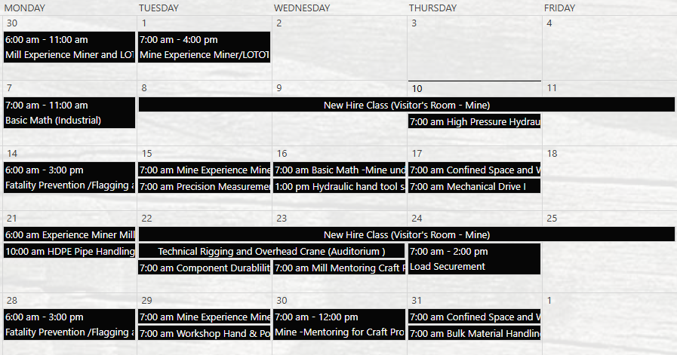
Henderson Training Schedule - JULY

Slide 29
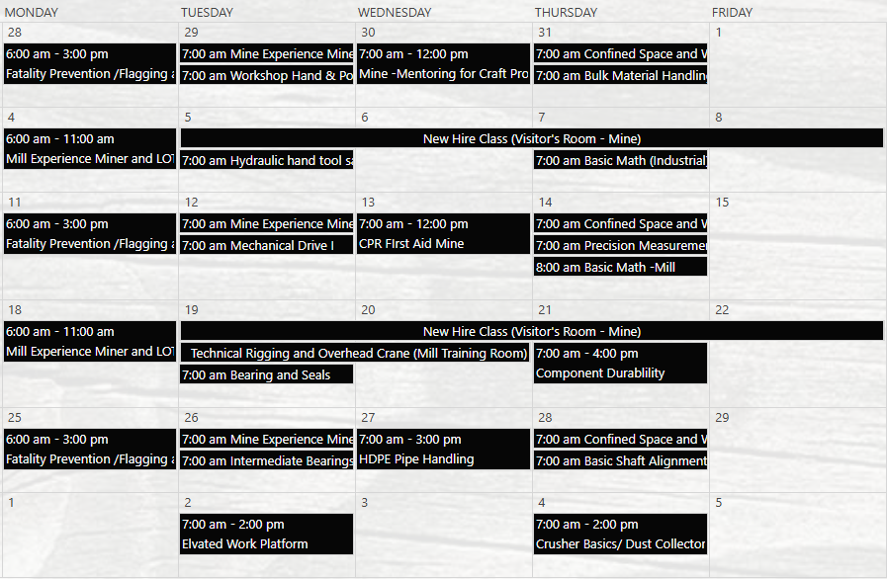
Henderson Training Schedule - AUGUST

Slide 30
Contractor Management Topics
Reminder: All Contractors are required to badge in at Front Gates
Goal is to improve hours tracking and on-site accountability

Slide 31
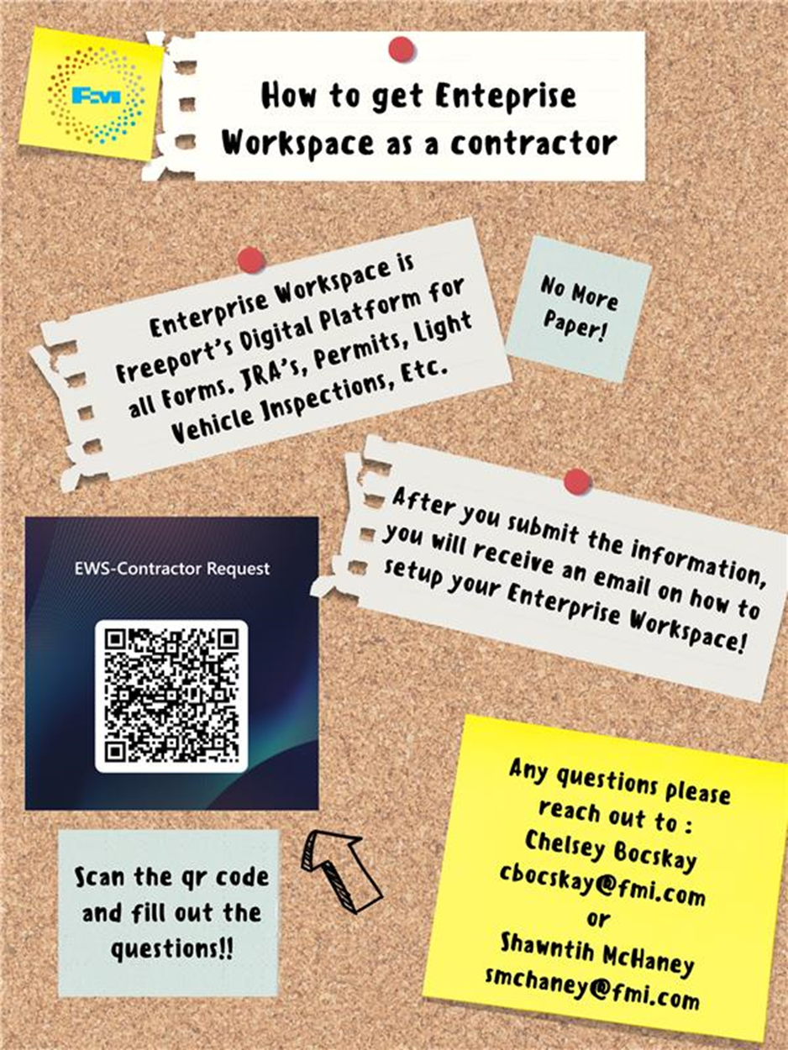
Contractor Management Topic – EWS Access
Access to site digital forms now available to Contractors!
Integration of Contractor submitted forms into internal dashboards
Forms can be used in online and offline modes
Request Access with QR Code or HERE
Reach out to H&S Department with any questions or issues

Slide 32
Open Forum

Slide 33
2025 Contractor Meeting Schedule
August 14th
September 11th
October 9th
November 20th
December 18th
Meetings begin 1PM Mountain Time
Mine & Mill Room Options Monthly

Slide 34
July Sign-Off Record
_____________________
_____________________
_____________________
_____________________
_____________________
_____________________
_____________________
_____________________
_____________________
_____________________
_____________________
_____________________
_____________________
_____________________
_____________________
_____________________
_____________________
_____________________
_____________________
_____________________

