Slide 1
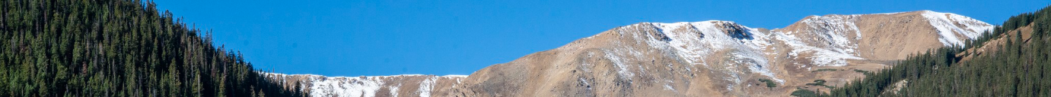
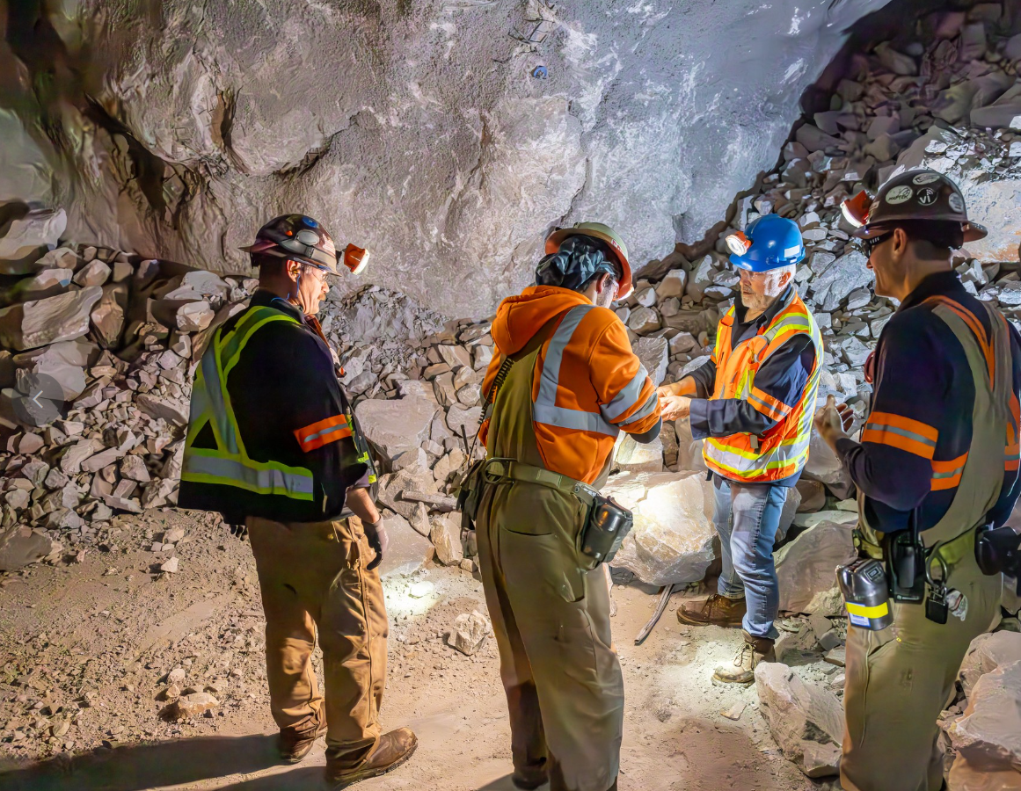

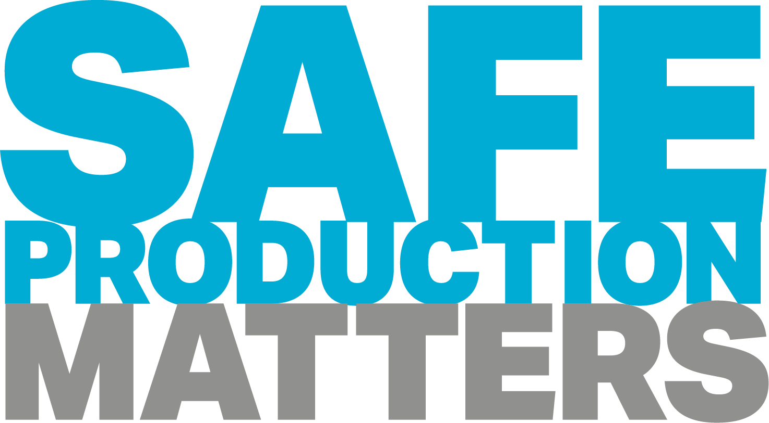
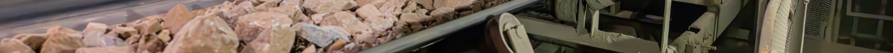
Henderson HSE Contractor Meeting
July 2026

Slide 2
Avoiding Unauthorized AI Tools
FMI has observed an increase in AI “notetaking” bots being added to Teams meetings
The use of these tools and software falls under MIS End User Policies that prohibit Freeport employees, contractors and partners from sharing company data without the company’s consent
To protect company data:
  Contractors and Vendors not to use notetaking bots/recording tools
  If external bot/recorder added to meeting, meeting will be stopped
  Ask the FMI organizer to use approved notetaking tools

Slide 3
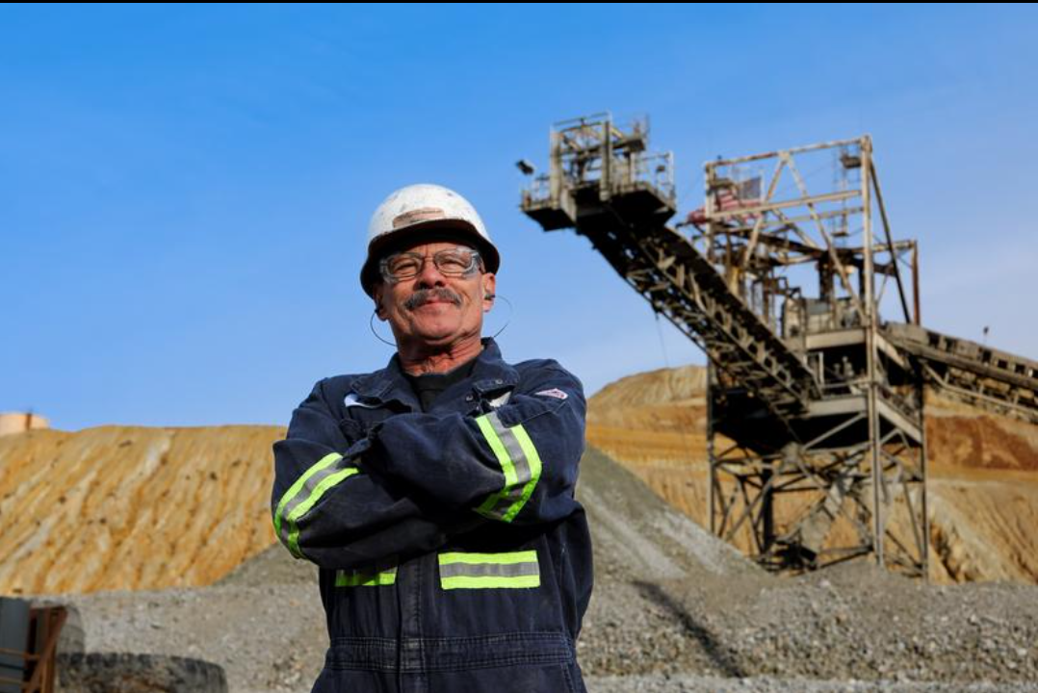
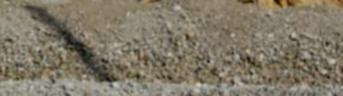
What is the purpose of this Meeting?
- For Henderson to reach multiple contractors and discuss best practices when it comes to Health and Safety, Environmental and Contracts Management
- Give contractors an open forum to bring up concerns, successes or incidents, learnings, etc. that is shared between all contractors and Henderson personnel
- Help improve the safety culture and reduce safety incidents as a group

Slide 4
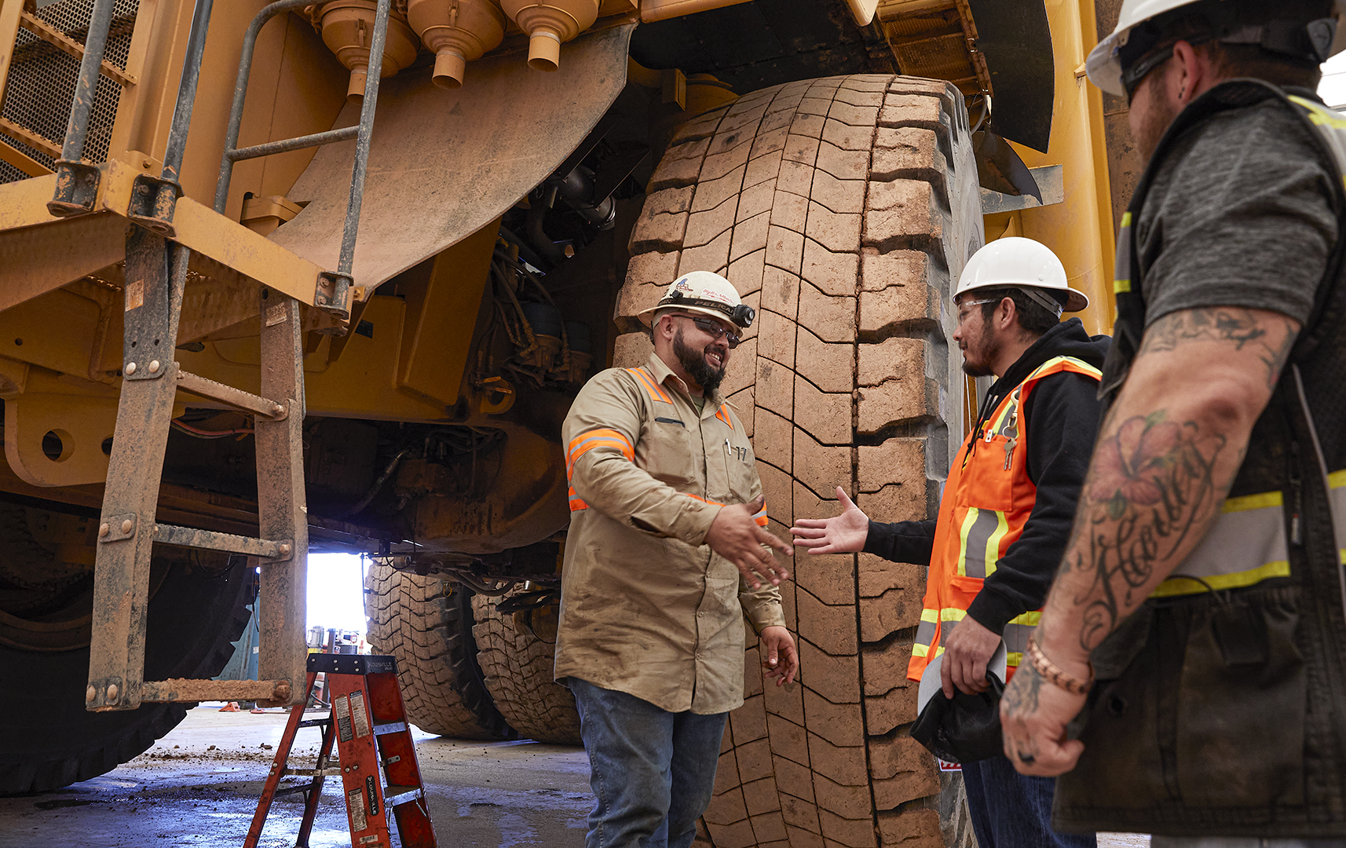

Safety Success

Slide 5
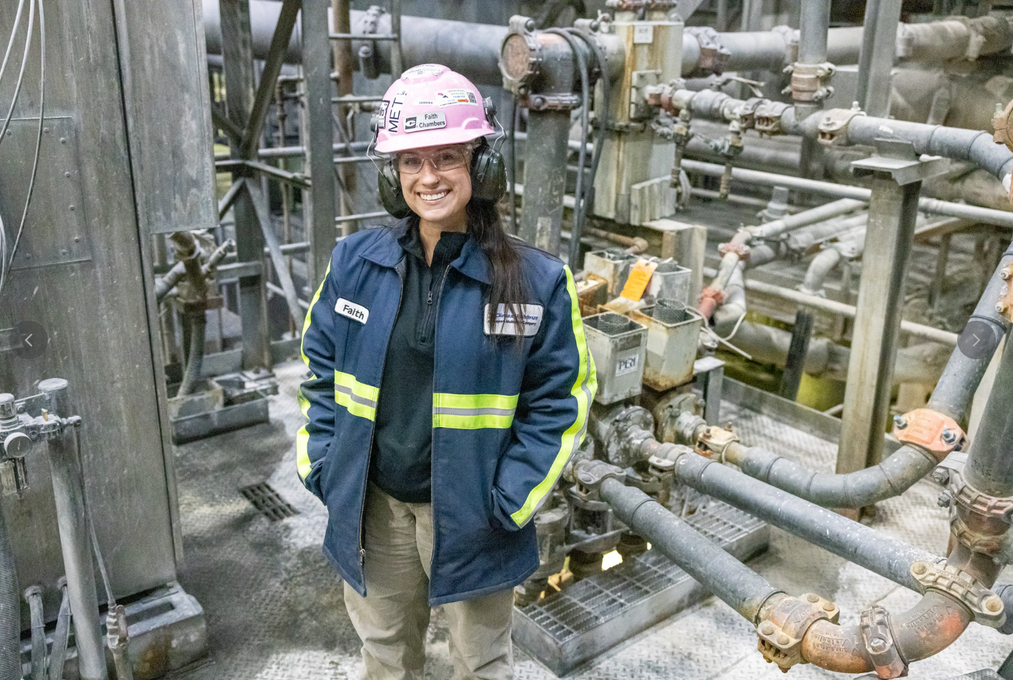
Safe Production Matters
Thanks to everyone for your commitment to safe production – it’s making a difference. At the 2026 mid-year mark:
We’ve continued to reduce our Total Recordable Incident Rate – performing below our target, which is the most ambitious in company history.
We’re on track to achieve our best high-risk incident rate since the metric was introduced in 2023.
The Americas finished June with 19 high-risk incidents year to date, down from 25 at this time in 2025.
While we have many successes to celebrate, we’ve also seen a concerning uptick in falling object incidents – reinforcing the critical importance of recognizing and controlling these risks.
Our progress shows what’s possible when we stay focused. Let’s build on what’s working, learn from experience and prioritize Fatal Risk Management, strong lineouts and effective implementation of critical controls.

Slide 6
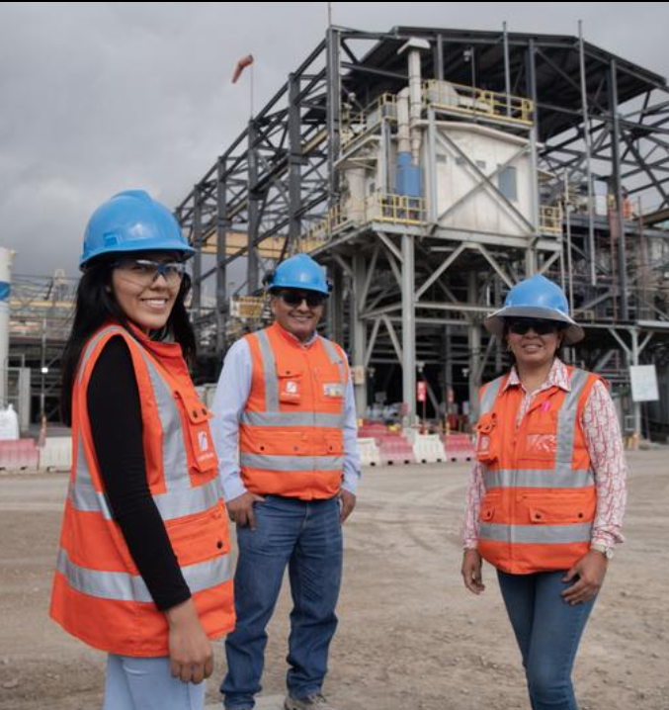
Safety and Environmental
Shares

Slide 7

Safety Trends: Falling Objects
So far this year, there have been eight high-risk falling object events and six additional monitor incidents, making falling objects the most frequent fatal risk in the Americas this year. This recurrence is concerning and shows gaps in how we currently are controlling and recognizing these risks. Preventing exposures starts with consistent execution of critical controls.
Key Reminders
Establish and respect drop zones
Use flagging and barricading to clearly define and protect areas below overhead work.
Never enter barricaded or flagged areas without confirming the hazard is controlled.
Secure tools and materials
Use tool tethers, lanyards and secondary retention where appropriate.
Avoid placing tools or materials near edges where they can shift or fall.
Maintain awareness of exposure
Inspect above, below and around your work area for potential falling object risks.
Recognize that hazards can be created not only by your work, but also by nearby activities.
Coordinate synchronized work
Plan and align tasks to eliminate people working below active overhead work whenever possible.
Verify proper segregation when simultaneous work cannot be avoided.

Slide 8
County Emergency
Alert Sign Up
Know how to receive emergency notifications from the community
Get updates on:
Emergencies
Pre-Evac/Evac Notifications
Don’t forget to look for and sign up with the
Alert system where you live!
Our Local Counties
Clear Creek County
LookoutAlert
Grand County
Smart911
Summit County
EventBridge

Slide 9
Prevent Heat Illness
As temperatures rise, so does the risk of heat-related illness. Take extra precautions this summer to avoid heat exhaustion and heat stroke.
Hydrate before, during and after work.
Monitor yourself and others for signs of heat illness.
Wear light-colored, loose-fitting breathable clothing.
Click here to access an extreme heat toolkit, including talking points and employee handout.
Take breaks as needed based on temperature, humidity and work conditions.

Slide 10
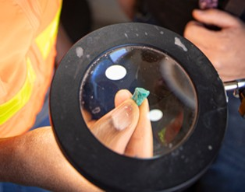
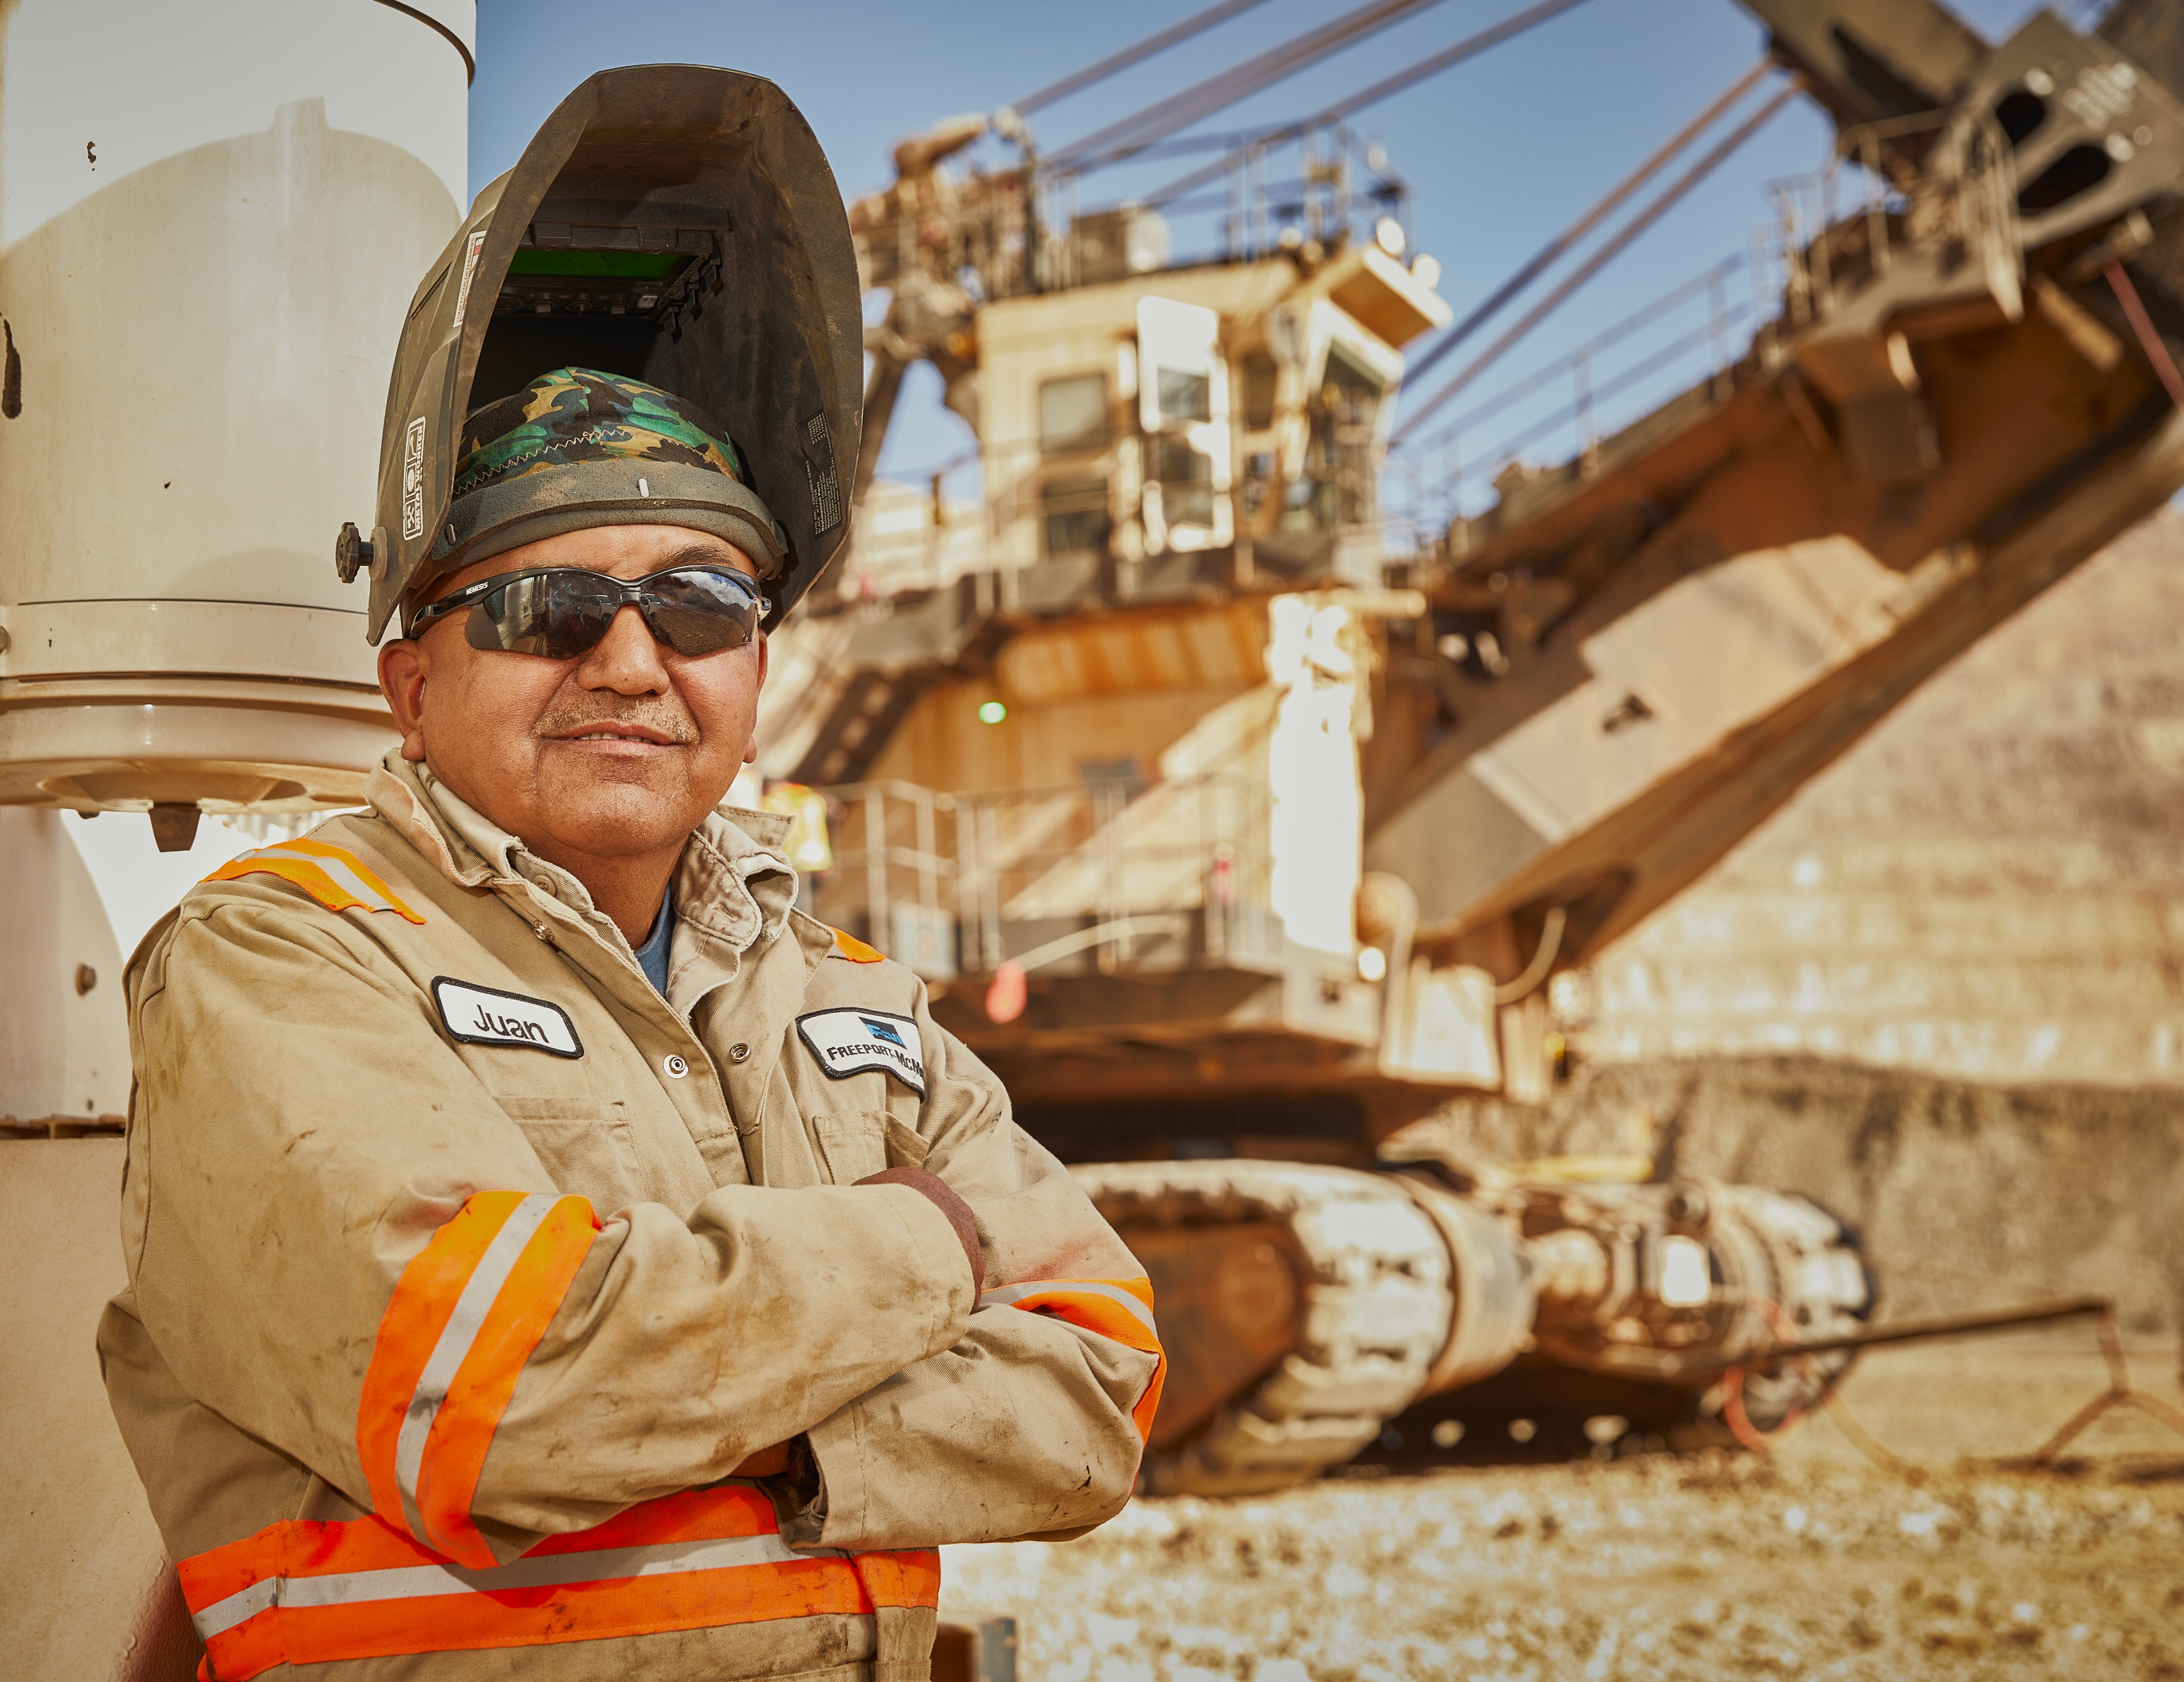


Environmental Share:
Freeport McMoRan published an updated Environmental Policy in May 2026
What is the Same?
While the policy is mostly the same, some topics have been emphasized and updated to align with the current state of our business and to meet the needs of our stakeholders.
What has changed?
• Increased focus on environmental stewardship throughout the mining and processing life cycle.
• Addition of commitment to effectively reclaiming land for which operations have concluded, and responsibly planning for closure of our mining and processing sites.
• Inclusion of goal to respect the rights of others.
• Emphasis on community and stakeholder engagement.
Annual Environmental Training has kicked to the workforce
Why do we require annual refreshers? To ensure everyone has the awareness around environmental significant risks and the critical controls in their work areas
Do contractors have access to the online training? No. If you have contractors working independently on-site for long durations, please reach out to environmental to schedule an in-person training. For short duration projects, please reach out if you need help covering environmental aspects of a project specific training.

Slide 11
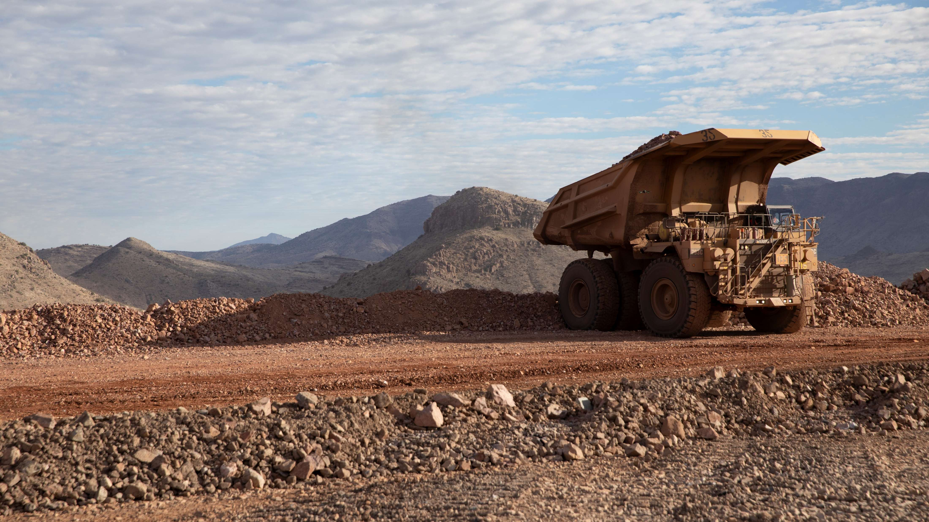
High-risk Incidents
Actionable and PFEs

Slide 12



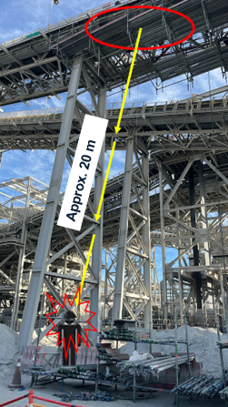
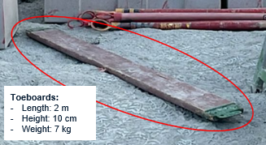
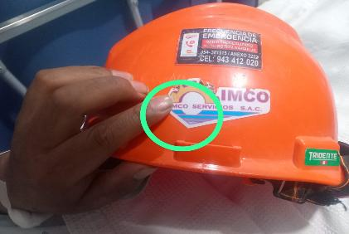
Potential Fatal Event:
Worker Struck by Scaffolding Toe Board
PFE # 2026-07
Event ID 20036416
Falling Objects
Preliminary Incident Details
Operation | Cerro Verde
Date / Time | May 21, 2026 / 3:50 p.m.
Event Type | Injury - Lost Time
Summary | During assembly of a cantilevered scaffold, a toe board fell approximately 20 meters (65 feet) from the upper section, striking a worker below.
Risk Category | Actionable - Significant (3), Likely (3)
Findings / Missing Controls | Lack of an adequate risk assessment to identify hazards. Lack of communication – activities were not stopped while the worker was positioned below. Failure to identify conditions (openings) where items could fall.
Immediate Actions: | Verify critical controls related to restricted areas are in place and being adhered to, especially when working from multiple levels.
Applicable Policies / Procedures | FCX-HS02 Working at Heights Policy
Employee Condition | The employee sustained a head contusion.
Contact | Raúl Ávila, Manager-Projects Process/Administration Helbert Galdos, Manager-Health and Safety
Photos / Links
Dimensions and weight of the scaffold toe board.
Trajectory: The toe board fell from the upper level (approximately 20 meters) and struck the right side of the worker’s helmet.
Area of the helmet that was struck by the falling toe board.

Slide 13

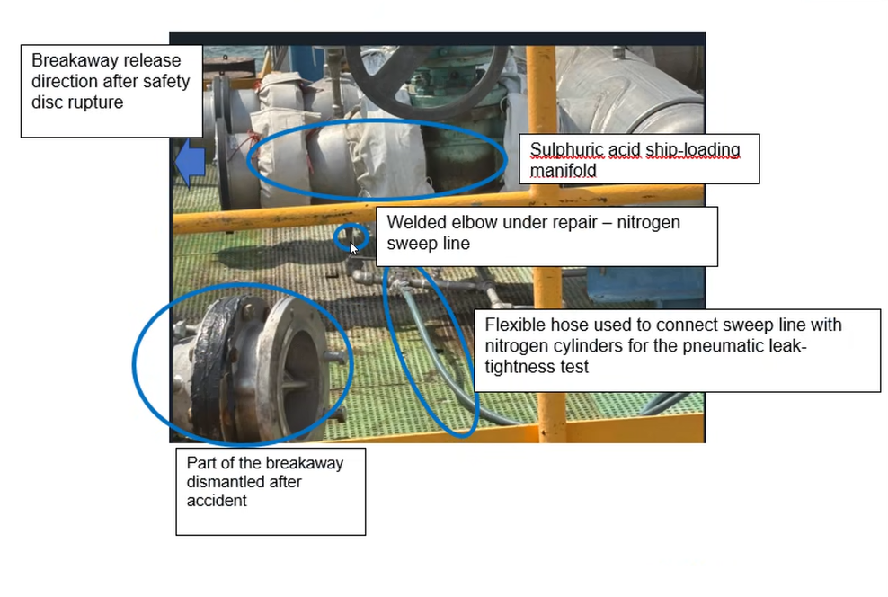
Ruptured Disc Failure
Uncontrolled Release of Energy
ID # 2026-11 Event ID # 20036526
Preliminary Incident Details
Operation | Atlantic Copper
Date / Time | May 25, 2025 / 11:30 a.m.
Event Type | Injury – Lost Time
Summary | A contractor was completing a scheduled welding repair on an elbow of the sulfuric acid ship-loading manifold. Following the repair, the team initiated a pneumatic leak test using nitrogen, which pressurized the system. During this process, a rupture disc failed, detached and struck one employee in the leg.
Risk Category | Actionable – Significant (3) Likely (3)
Findings / Missing Controls | Lack of clear procedures and defined work method for the verification test. Lack of approved work permit prior to execution, leading to inadequate hazard assessment. Personnel remained in the impact zone during the verification test, creating line-of-fire exposure.
Immediate Action(s) | Reinforce the importance of the following with employees and contractors: Strict adherence to permitting requirements. Clear, defined procedures before starting work. Recognition of critical risks associated with pressurized equipment.
Applicable Policies / Procedures | SG-Pr 08 Work Permits
Employee Condition | Employee sustained minor leg injuries.
Contact | Antonio Barrero, Maintenance Group Leader AP/ER Luis Oso Oliva, Director-Health and Safety
Sulphuric acid ship-loading manifold
Representation of incident work area.

Slide 14
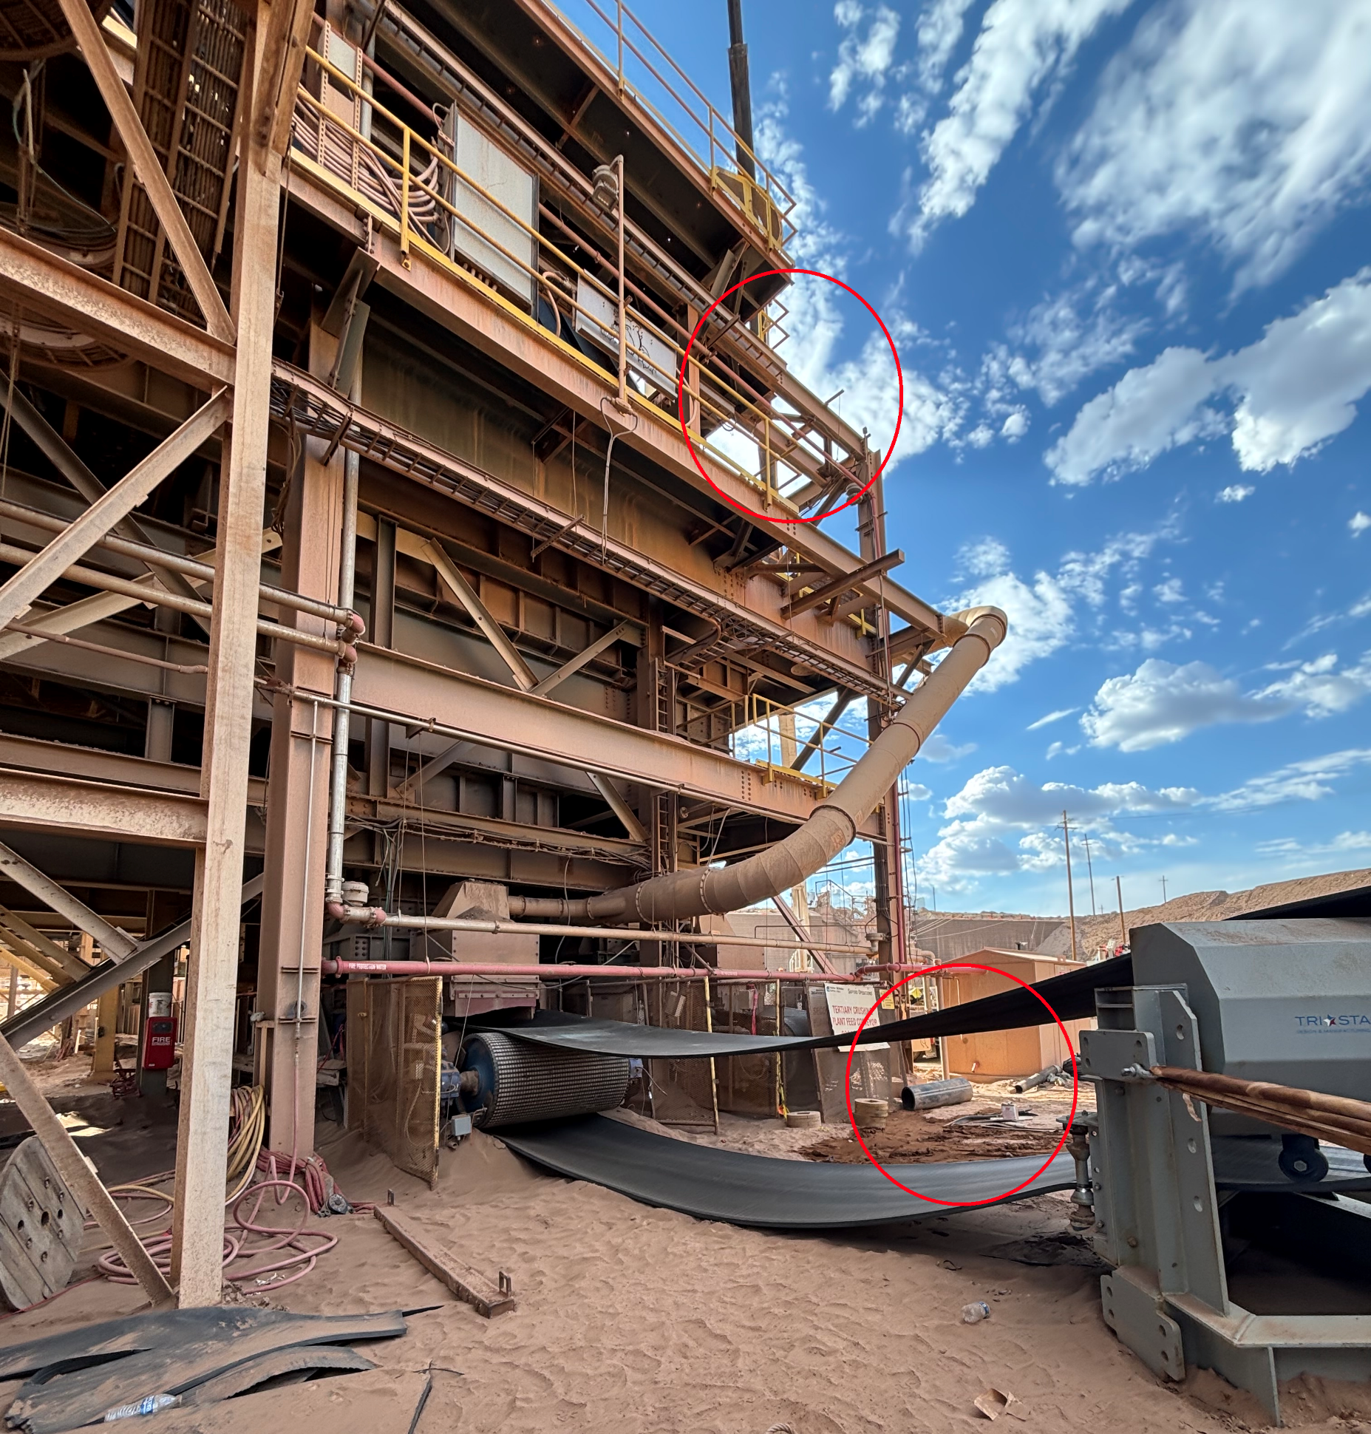
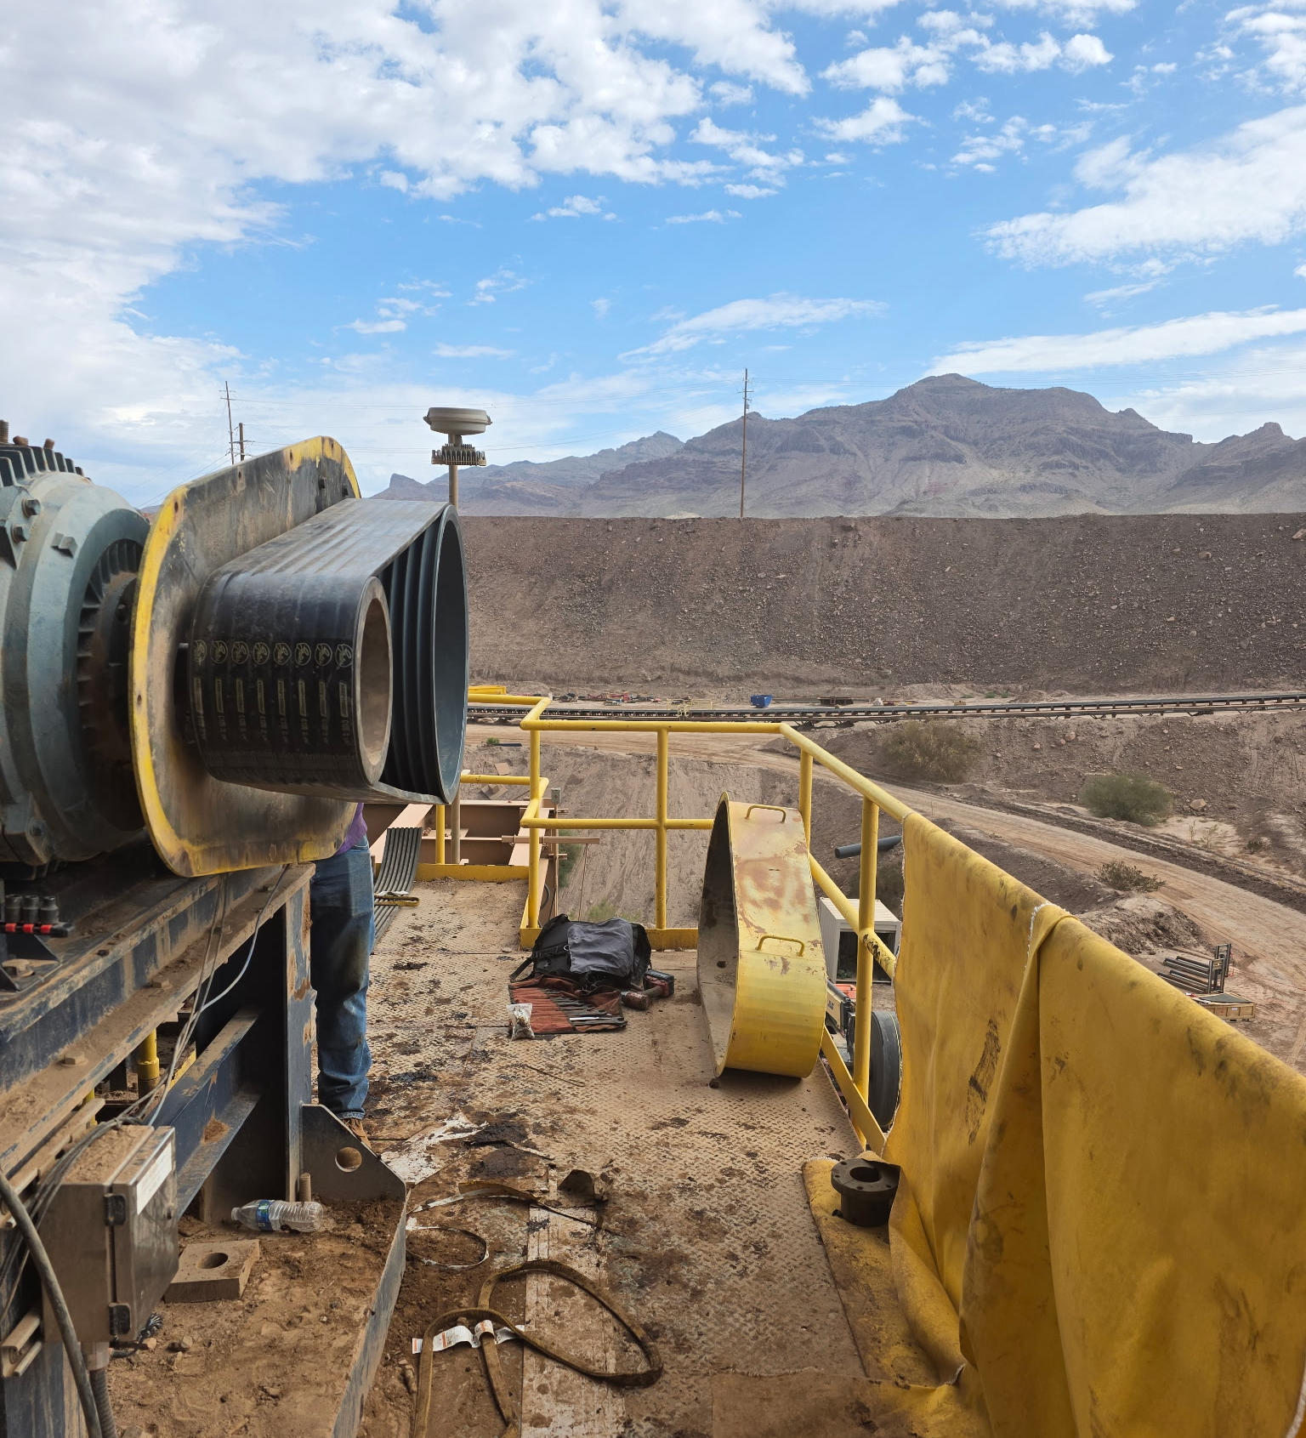
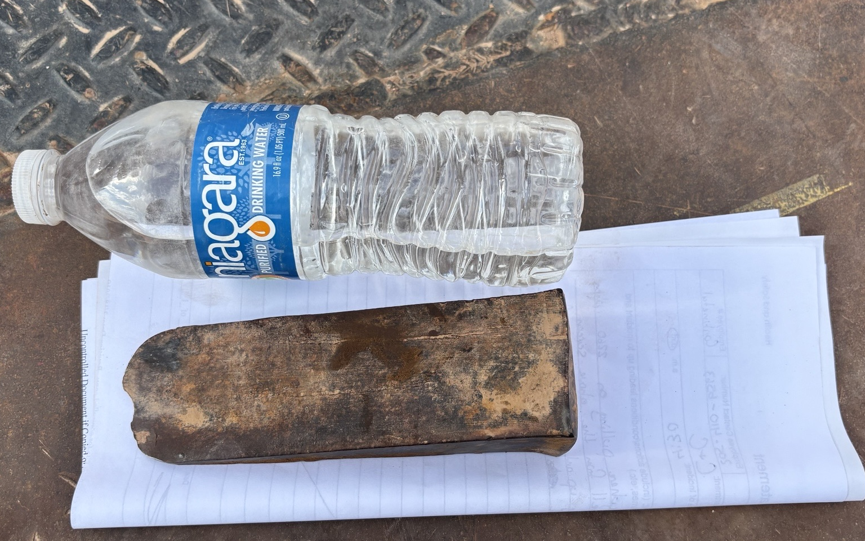
Metal Wedge Fell and Struck Employee
ID # 2026-08 Event ID # 20037181
Falling Objects
Preliminary Incident Details
Operation | Safford
Date / Time | June 17, 2026 / 4:30 p.m.
Event Type | Near Miss
Summary | While removing a coupling on the screening deck, an employee tried to create space by driving a metal wedge weighing about 2.5 pounds into the coupling. When the wedge was struck with a hammer, it became dislodged and was projected about 4 feet horizontally, clearing the handrail and falling approximately 45 feet to the ground. The wedge then bounced and hit an employee in the leg.
Risk Category | Actionable – Significant (3) Likely (3)
Findings / Missing Controls | Lack of segregation and dedicated drop zone. Lack of fall controls between crew working on upper level and those working on the ground.
Immediate Action(s) | Reiterate the importance of critical controls related to: Drop zones Synchronized work Dropped object prevention
Applicable Policies / Procedures | FCX-HS19 Flagging and Barricading Policy FCX-HS02 Working at Heights Policy
Employee Condition | The impacted employee was evaluated and no injuries were reported.
Contact | Shannon Jeans, Manager-Health and Safety
Location of workers above and contract employee below.
Location of work area on screen deck.
Wedge that fell from upper level (approximately 2.5 pounds).

Slide 15
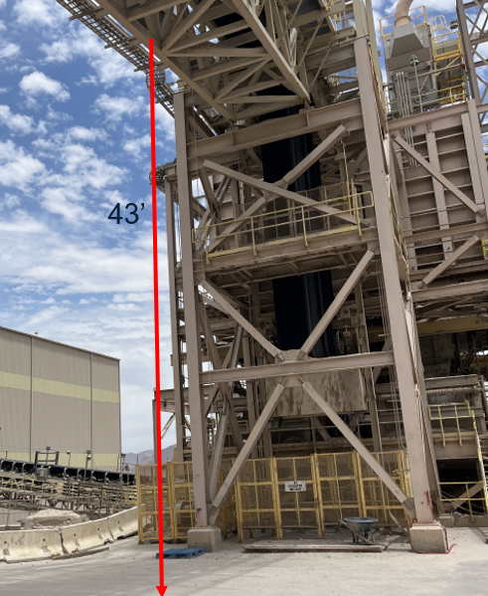
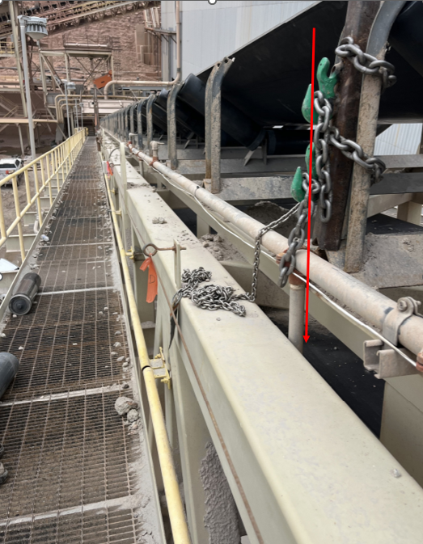
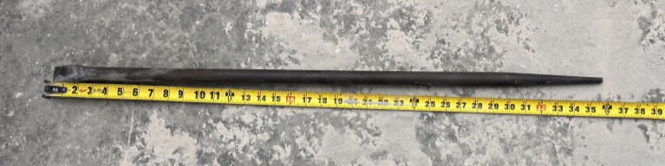
Pry Bar Dropped from Height
ID # 2026-12 Event ID # 20037211
Falling Objects
Preliminary Incident Details
Operation | Morenci
Date / Time | June 18, 2026 / 11:30 a.m.
Event Type | Near Miss
Summary | Contractors used a pry bar to remove an idler during replacement. As the idler came free, one employee placed the 3-foot, 6-pound bar on the return side of the belt while holding the idler. The bar then fell approximately 43 feet to the ground.
Risk Category | Actionable – Significant (3) Likely (3)
Findings / Missing Controls | Falling objects was identified as a fatal risk, but segregation controls were not implemented effectively. Dropped object hazard was not effectively mitigated when staging the pry bar. Simultaneous work above and below was not adequately segregated or controlled.
Immediate Action(s) | Verify segregation controls in elevated work areas. Audit material staging areas to avoid risk of falling materials.
Applicable Policies / Procedures | FCX-HS19 Flagging and Barricading Policy FCX-HS02 Working at Heights Policy
Employee Condition | No injuries.
Contact | Shyra Valdez, Manager-Health and Safety
Area bar fell.
Location bar was placed during staging.
Pry bar – approximately 3-feet long.

Slide 16
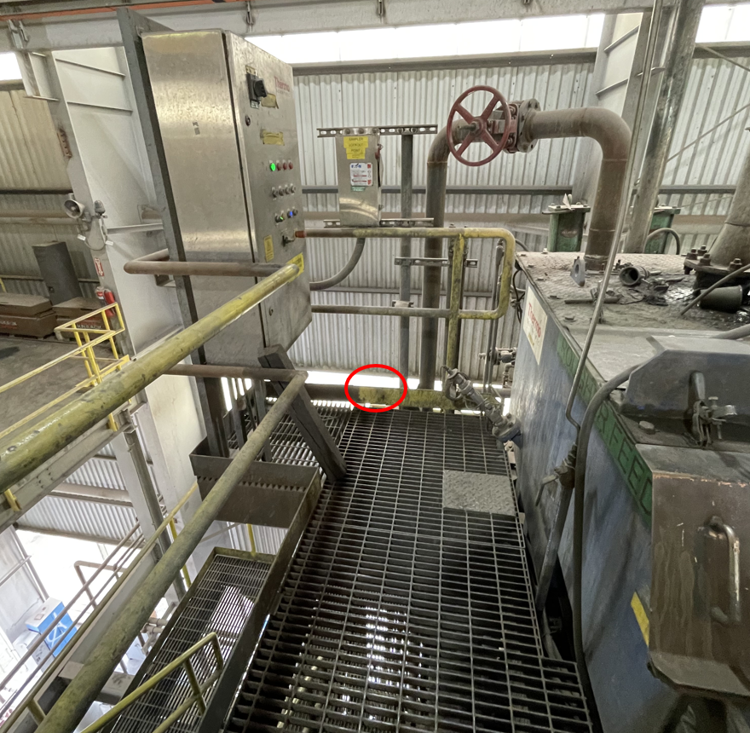
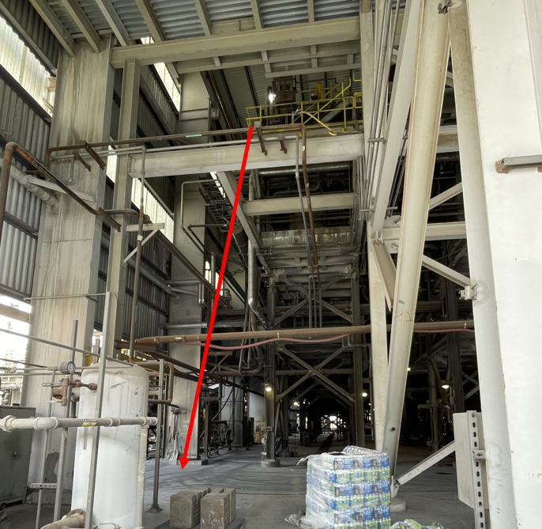
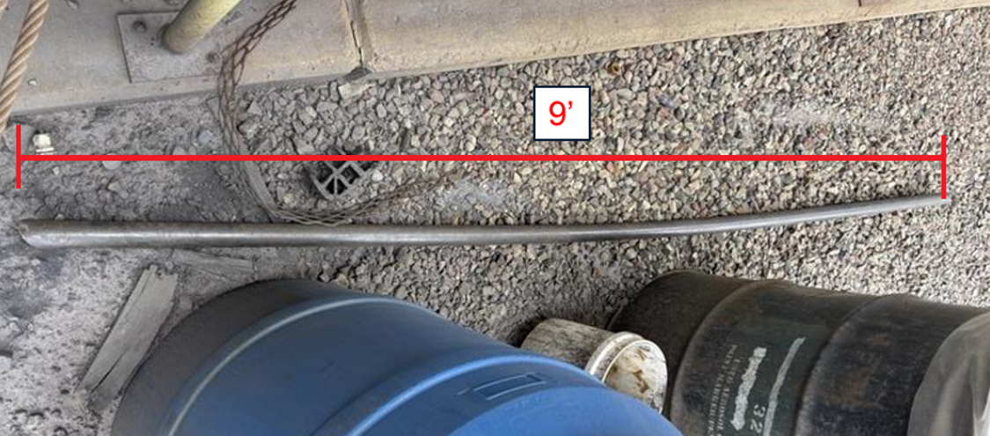
Pipe Fell from Upper Level
ID # 2026-13 Event ID # 20037210
Falling Objects
Preliminary Incident Details
Operation | Morenci
Date / Time | June 18, 2026 / 11:00 a.m.
Event Type | Near Miss
Summary | An employee used a 9-foot section of handrail pipe to pry open an analyzer dart from an elevated surface in the moly plant. After use, it was placed against a slurry box and toe board. The pipe became unstable and fell over the toe board, dropping about 53 feet to the concrete floor below and landing about 16 feet from an employee.
Risk Category | Actionable – Significant (3) Likely (3)
Findings / Missing Controls | Dropped object hazard was not effectively controlled when staging the pipe. Improper tool selection for the task. Hazards were not fully recognized when placing the pipe in an unstable position. Simultaneous work above and below was not adequately segregated. Lack of secondary retention or physical barriers to prevent falling objects.
Immediate Action(s) | Verify implementation of segregation controls for falling object hazards. Confirm proper tool identification and implementation.
Applicable Policies / Procedures | FCX-HS19 Flagging and Barricading Policy FCX-HS02 Working at Heights Policy
Employee Condition | No injuries.
Contact | Shyra Valdez, Manager-Health and Safety
Area where pipe fell over toe board.
Elevated platform and pipe travel path.
Pipe that fell.

Slide 17
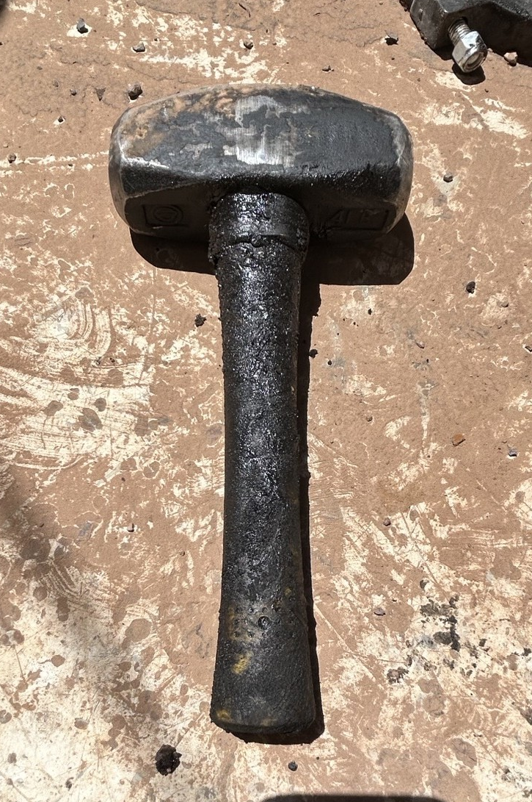
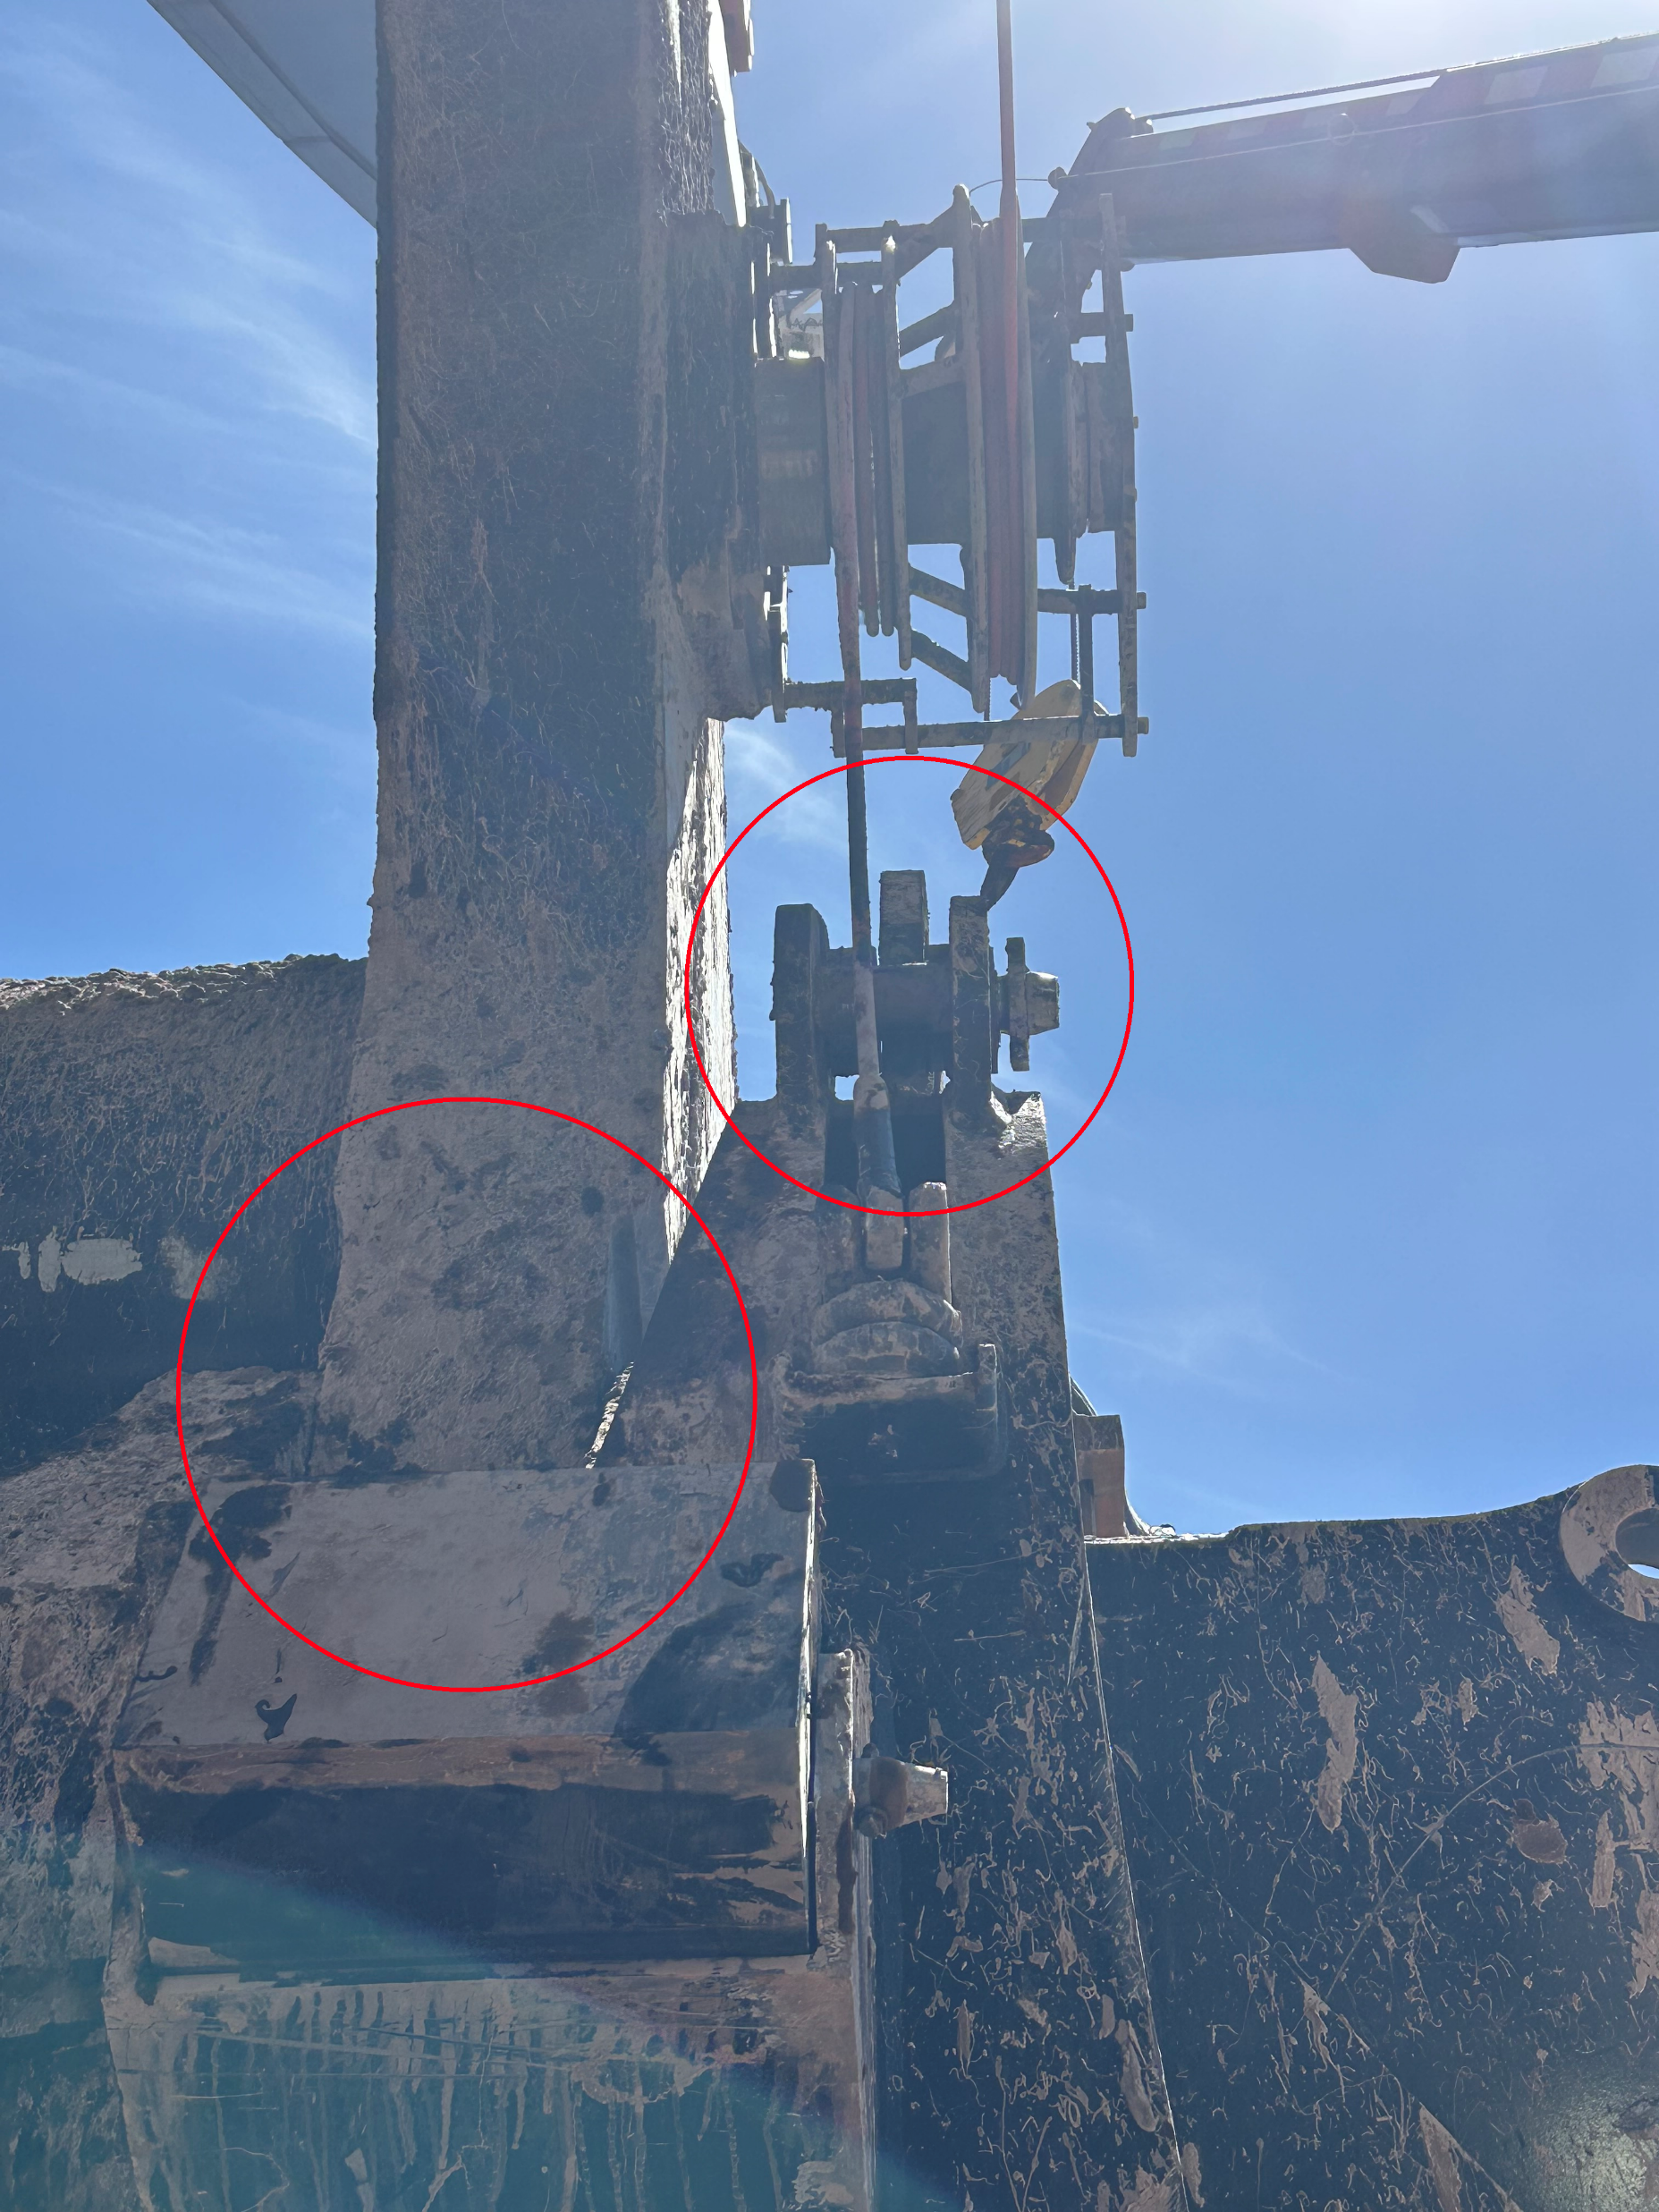
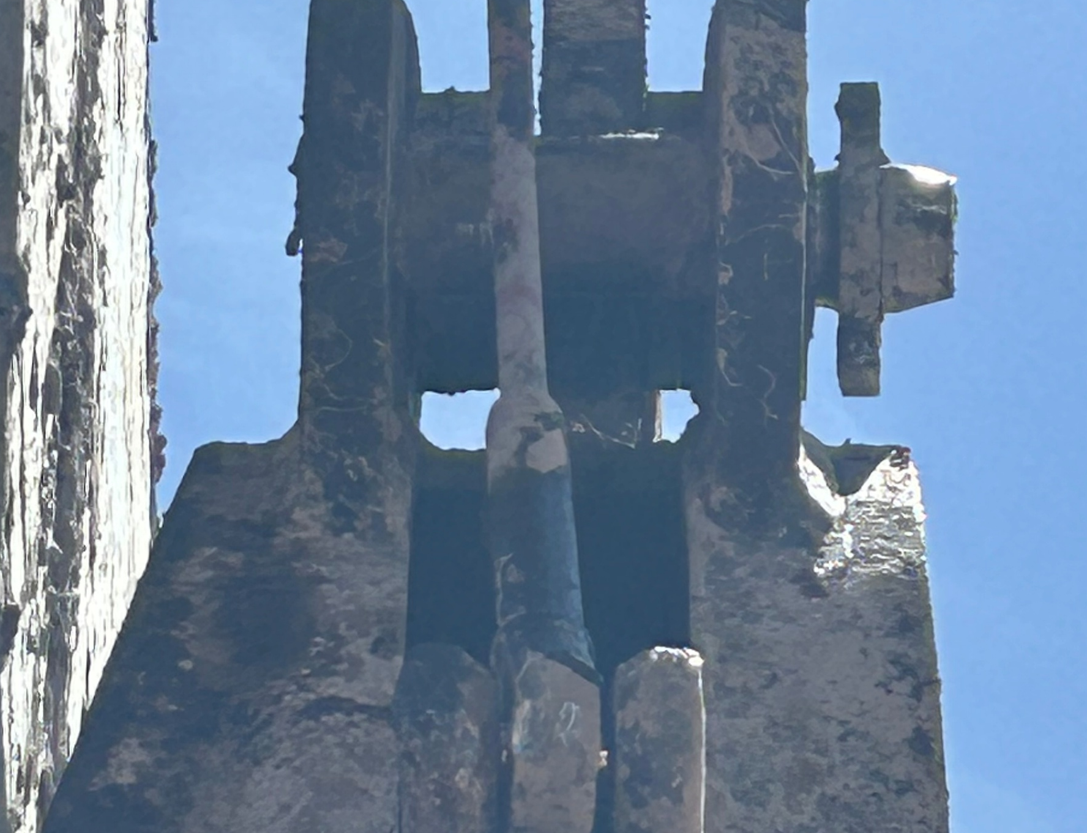
Fly Metal Struck Employee
Uncontrolled Release of Energy
ID # 2026-14 Event ID # 20037314
Preliminary Incident Details
Operation | Safford
Date / Time | June 22, 2026 / 9 a.m.
Event Type | Injury – Medical Treatment
Summary | A shovel and drill mechanic suffered a facial injury while reinstalling a snubber pin on a shovel dipper door. The pin bore was worn and misaligned. While striking the pin with a 4-pound non-soft blow hammer, a fragment of metal broke free and struck the employee in the face.
Risk Category | Actionable – Significant (3) Likely (3)
Findings / Missing Controls | The employee was wearing safety glasses, face shield and gloves but no additional body protection. The wrong tool was selected for the job. The employee should have used a soft blow hammer and additional body protection PPE.
Immediate Action(s) | Never strike hardened or damaged components without confirming condition (risk of fly metal). 4-pound hammers and larger must be soft blow. Additional body protection (leather/kevlar) should be used any time there is impact on hardened steels. Evaluate bore/pin conditions and use proper tooling or engineered methods when alignment is compromised. Maintain safe body positioning—stay out of line-of-fire.
Applicable Policies / Procedures | FCX-HS29 Standard Safety Requirements Policy
Employee Condition | The employee was transported to the hospital and immediately taken into surgery to remove the piece of metal from their cheek.
Contact | Shannon Jeans, Manager-Health and Safety
Snubber pin
Photo of hammer
Location of employee
Incident location on shovel
Photo of pin

Slide 18
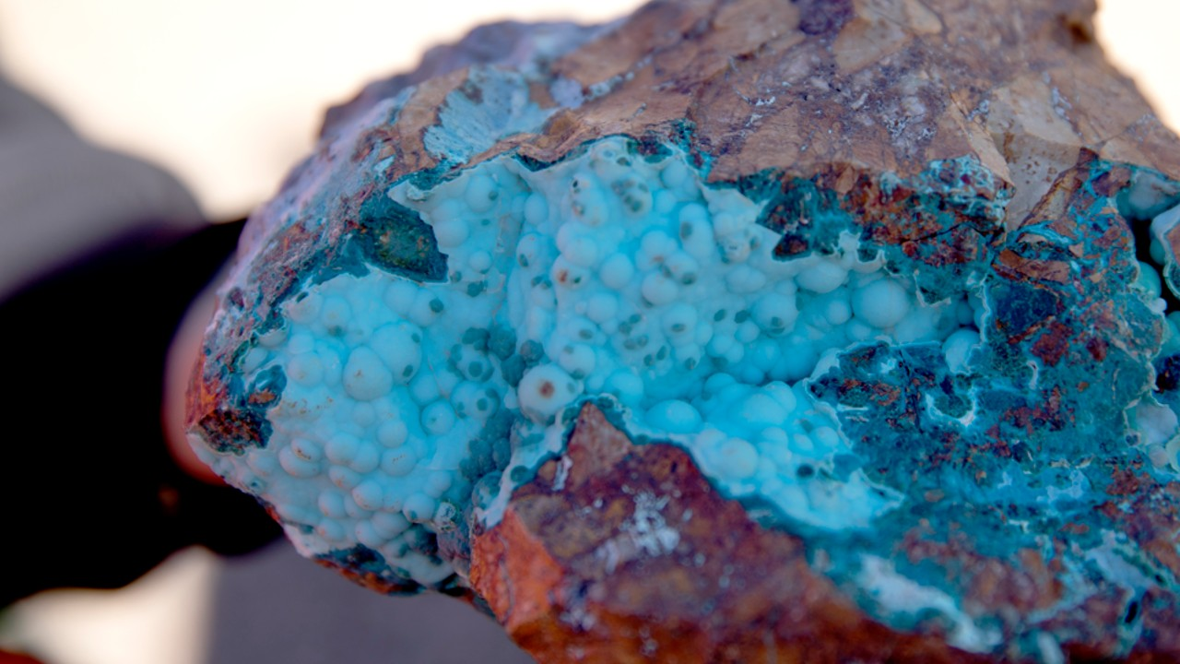
Industry Incidents

Slide 19
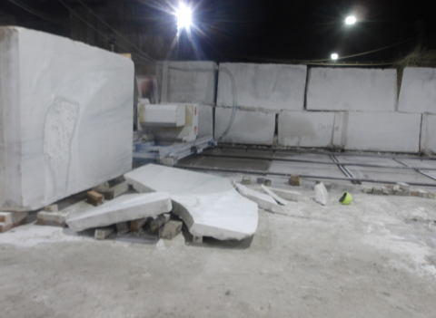
MSHA Fatality Alert
January 19, 2026 – A miner was seriously injured when an unsecured slab of marble struck him. The miner died on April 2, 2026, from complications related to those injuries.
Eliminate Hazards and Prevent Injuries
Secure material and components to prevent hazardous motion while performing work.
Verify miners are positioned where they are not exposed to falling material hazards.
Never stand, travel or work in front of, behind or under improperly supported material where inadvertent movement could cause injury.
Before beginning work, analyze all tasks, establish safe work procedures, train miners and eliminate hazards. Be aware of hazards that may be created while performing work.

Slide 20
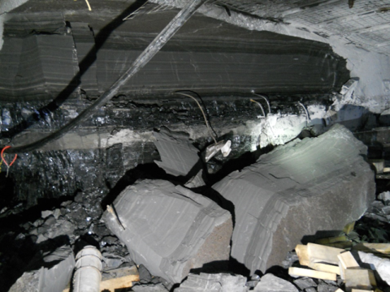
MSHA Fatality Alert
May 19, 2026 – An assistant shift foreman died after a large section of rib fell and struck him. Two contractors were also injured in the accident.
Eliminate Hazards and Prevent Injuries
Conduct thorough pre-shift and on-shift examinations of the roof, face and ribs. Conduct additional examinations as conditions warrant.
Train miners to recognize roof and rib hazards and to stop work in the area until hazards are corrected.
Adequately support loose roof and rib material and scale loose material from a safe location before working or traveling in an area.
Use the proper tool, like a slate bar, when pulling down loose roof or ribs.
Take additional safety precautions where mining conditions change and mining heights increase or thicker rock brows are present.
Always set posts or other floor-to-roof support from a safe location.
Train miners to follow the approved roof control plan.

Slide 21
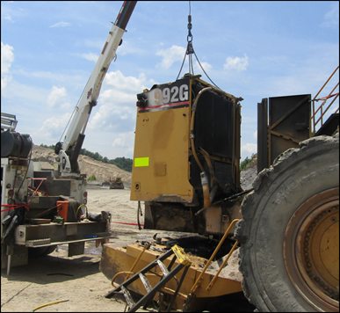
MSHA Fatality Alert
May 20, 2026 – A contract mechanic field technician was fatally injured while removing the radiator guard from a front-end loader when the counterweight fell on him.
Eliminate Hazards and Prevent Injuries
Block machinery components against motion with suitable tools or blocking materials before removing mounting bolts from machinery components that can fall during disassembly.
Review and follow the equipment manufacturer’s recommended maintenance procedures when performing repairs to machinery.
Verify miners are positioned in safe locations away from crushing hazards.
Train miners in safe work procedures related to their assigned tasks.

Slide 22
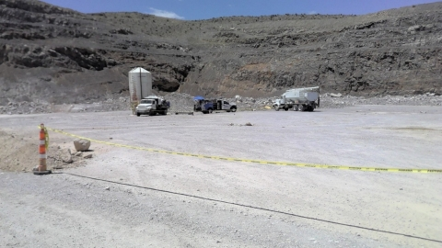
MSHA Fatality Alert
May 21, 2026 – A contractor died when an explosion occurred while he was heating the flights on an auger used to load ammonium nitrate.
Eliminate Hazards and Prevent Injuries
Practice safe-work procedures for hot work on and around reactive material conveyance and storage systems. Never apply heat when reactive materials are present.
Conduct job‑specific hazard assessments and follow manufacturer recommendations for auger removal, repair and welding activities.
Verify all stored energy sources – including mechanical, electrical and thermal – are locked out, tagged out, tried out and secured against motion before removing or repairing augers or drive components.

Slide 23
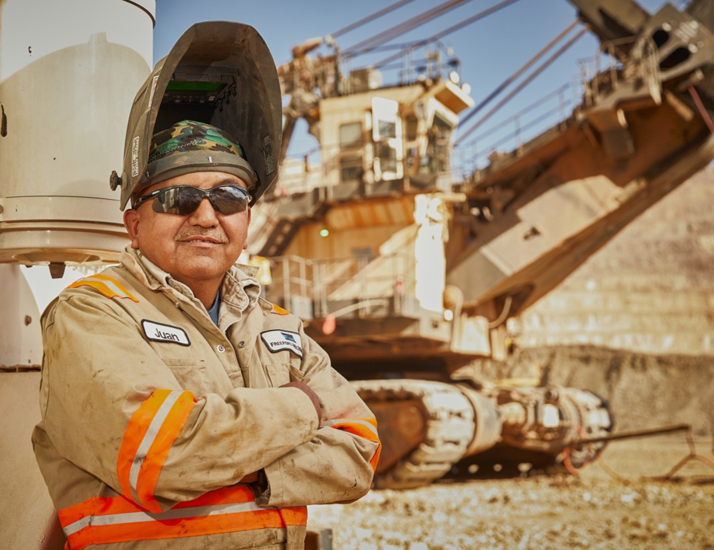
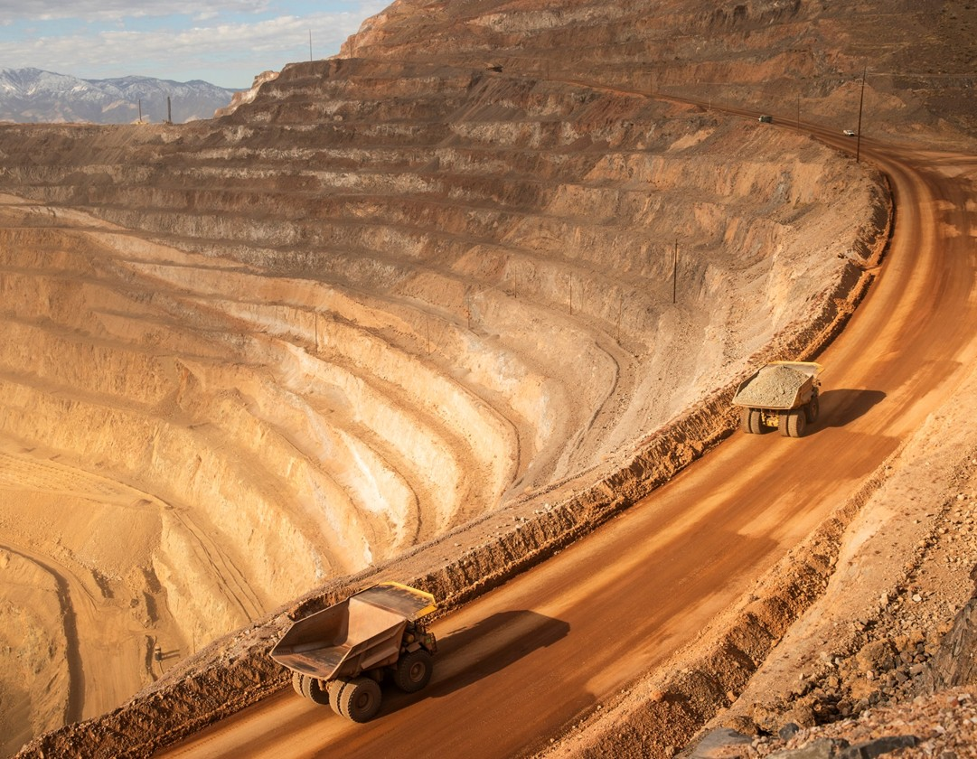
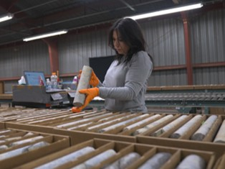
Additional Resources
Health and Safety Dashboard
Safety Toolkits
FCX Policies
MSHA Safety Alerts
OSHA

Slide 24
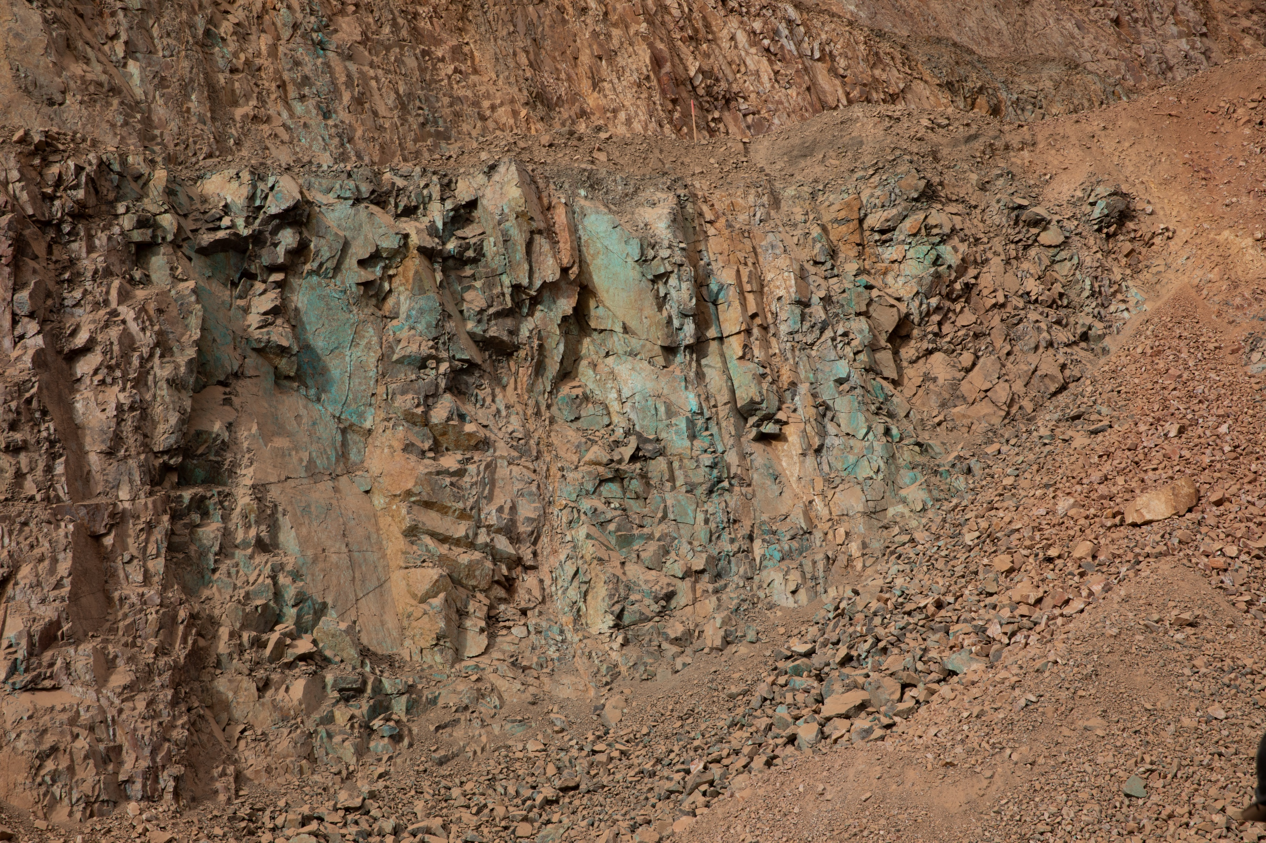
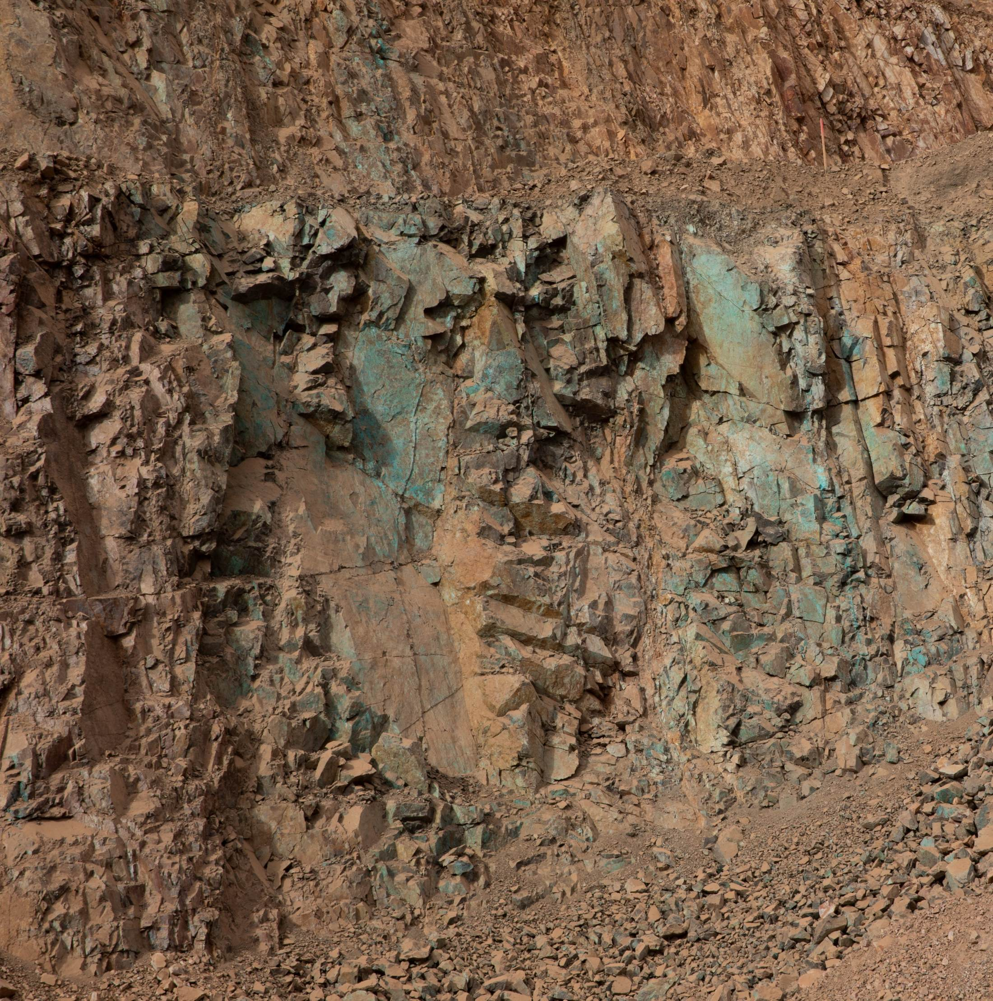
Site Incidents

Slide 25
Henderson Incidents
06/08 – Haul Truck Slid into Rib (Property Damage)
  Operator in Haul Truck came around 66 corner and hit watery patch
  Back tires slid causing driver side front into rib
06/12 – Employee Fell While Lifting Pipe (REPORTABLE – Lost Time)
  Employee at D Loop moving HDPE pipe with second employee
  While moving the length of pipe, foot caught in different pipe causing trip
  Employee fell on right arm causing injury resulting in Lost Time
06/18 – Employee Injured Right Shoulder Installing Mount (First Aid)
  Employee using screwdriver to align screw holes on a rack mount
  They felt a sharp pain in their shoulder and reported to supervisor

Slide 26
FRM Verification Results – June
172 verifications completed in June
Focus for June was around Hazardous Substance – Acute and Exposure to Electrical Hazards
Exposure to Electrical Hazards missing controls decreased
Haz. Sub. – Acute stayed in Top 3
Underground Rock Fall increased
due to ineffective ground control
FOCUS FOR JULY/AUG:
Underground Rockfall
Hazardous Substances - Acute

Slide 27
FRM Verification Results – June
Henderson Missing Controls with Multiple No Responses

Slide 28
Contractor Management Topics
ISNetworld Update
HSEP Update
FCX Policies

Slide 29
ISNetworld Update
ISN Compliance
All contractors must upload and complete every training course (Core, Compliance, and Technical) along with Worker Acknowledgements in ISN by August 31, 2026.
  Contractors will be denied site access effective September 1, 2026 by order of Henderson GM.
  Until employees are fully compliant in ISN, all contractors must keep all employee training documentation available on site or with the contractor’s PM onsite (for example, a project binder containing all training records).

Slide 30
HESP Update
HESP
Contractors must upload their signed HESP to ISN while keeping the original file name they were provided.
The signed HESP file name is set up so Henderson can readily locate the document within ISN. For example: 4.13.2026_HML_Mill Liner Change_Kippers
Badging
As minimal contractor responses were received, we are once again asking contractors to provide a list of employees currently onsite or expected onsite. Please send this list to Tina Michaelis, GSC Superintendent, at tmichael@fmi.com by July 31, 2026.

Slide 31

FCX Policies
2026 Annual Policy Refresher for Contractors — Code of Conduct & Site Policies. Core policies every FCX contractor and supplier must know and uphold — reviewed annually; complete FCX due-diligence when requested.
New Hardhat Sticker — scan for full FCX policies
Business Partner Code of Conduct
Follow FCX policies on site and conduct business with honesty, integrity and ethical, lawful behavior.
Human & Labor Rights
Treat everyone with dignity and respect. Zero tolerance for forced or child labor, trafficking and modern slavery.
Respect & Anti-Harassment
No harassment, discrimination or offensive conduct. Value diversity and an inclusive, courteous workplace.
Safety & Fatigue Management
Arrive fit for duty. Max 60 hrs/week (monthly avg) and 14 hrs/day. You are empowered to stop unsafe work.
Report a Concern
Confidential — no retaliation
Compliance Line 800-295-6783 (anonymous)
compliance@fmi.com
CCO 602-366-7550
Conflicts of Interest
Disclose outside affiliations, personal relationships and gifts. Report potential conflicts to your FCX contact.
Speak Up — Compliance Line
Report suspected violations in good faith. Confidential and anonymous reporting options are available without retaliation.

Slide 32

Open Forum

Slide 33
August 27th
September 10th
October 8th
November 19th
December 17th
2026 Meeting Schedule
Meetings begin 1 PM MST
Mine and Mill In-Person Options Monthly

Slide 34
July Sign-Off Record
_____________________
_____________________
_____________________
_____________________
_____________________
_____________________
_____________________
_____________________
_____________________
_____________________
_____________________
_____________________
_____________________
_____________________
_____________________
_____________________
_____________________
_____________________
_____________________
_____________________

