Slide 1
Henderson HSE Contractor Meeting – June 2025
06/19/2025

Slide 2
What is this Meeting?
Purpose:
For Henderson to have the opportunity to reach multiple contractors to discuss best practices when it comes to Health and Safety, Environmental and Contracts Management
Give contractors an open forum to bring up concerns, successes or incidents, learnings, etc. that is shared between all contractors and Henderson personnel
Help improve the safety culture and reduce safety incidents as a group

Slide 3
Contractor Share – Intermountain Electric
COMMUNICATION

Slide 4
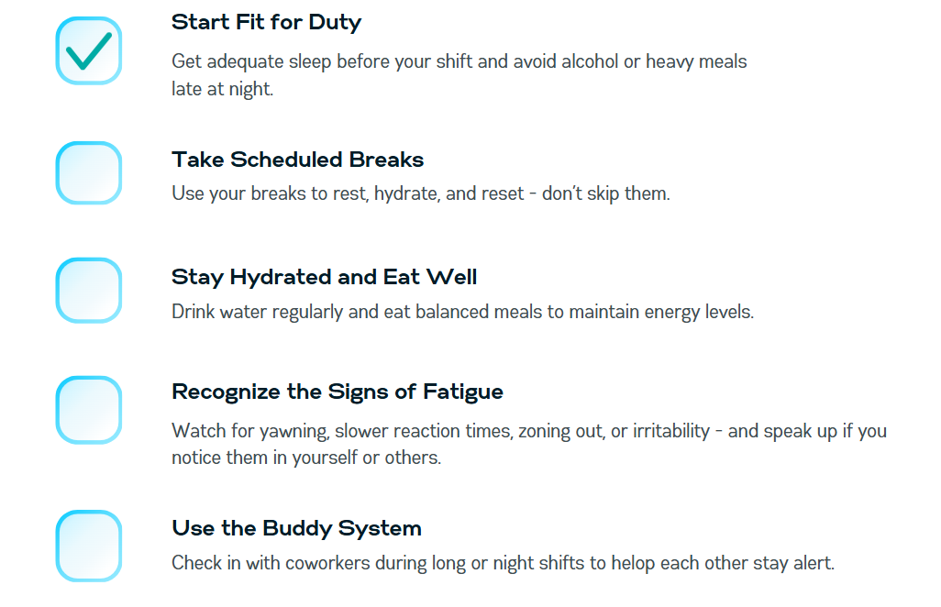
Safety Topic – Fatigue Management

Slide 5
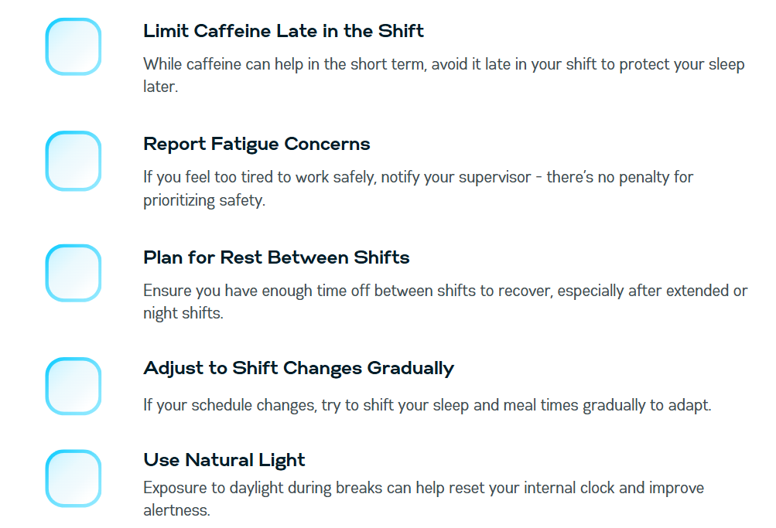
Safety Topic – Fatigue Management

Slide 6
Safety Topic – Heat Related Illness
Heat Exhaustion​
Caused by loss of water through sweating without adequate fluid replacement. It is the most common heat related illness.​
Signs and symptoms: Heavy (excessive) sweating with skin feeling cool and clammy or moist, pale, gray or flushed looking, headache, weakness, dizziness, nausea.​
Treatment: Move the victim to a cool or shady area. Loosen or remove sweat-soaked clothing. Pour water on and fan victim. If conscious slowly drink 4 oz. cool water every 15 minutes. Elevate legs. If possible, avoid strenuous activity for the remainder of the day. Monitor the victim until the symptoms are gone, or medical aid arrives.​

Slide 7
Safety Topic – Heat Related Illness
Heat Stroke​
If heat exhaustion is ignored, this is what may happen. Heatstroke must be considered a medical emergency that may result in death of treatment is delayed.​
Signs/Symptoms: It is caused by failure of the body’s cooling mechanisms. Inadequate sweating is a factor. /skin is red(flushed), hot and dry, changes in consciousness, rapid weak pulse and rapid shallow breathing, may experience weakness, dizziness, confusion, headaches, seizures, nausea.​
Treatment: Cool victim immediately. Loosen or remove victim’s clothing. Spray or pour water on victim; fan to permit a coolant effect of evaporation. Massage extremities and skin which increases the blood flow to those body areas, thus aiding the cooling process. Elevate legs. Slowly drink water if conscious.​

Slide 8
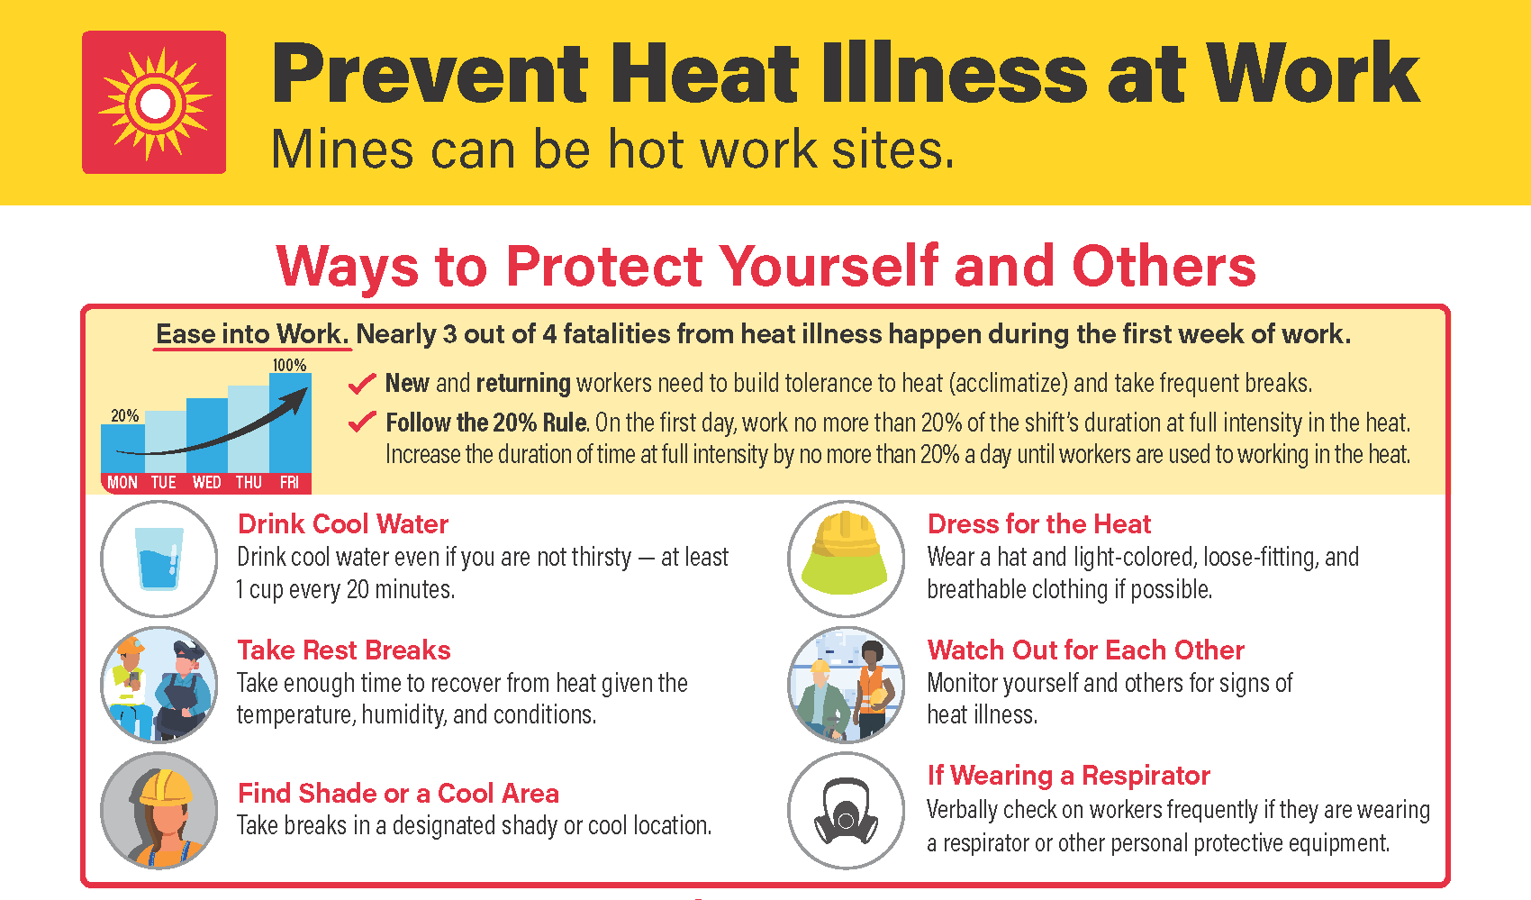
Safety Topic – Heat Related Illness

Slide 9
Environmental Topic – Mill Groundwater Management
One of the Environmental Significant Risks (ESRs) identified at Henderson Mill is Impacts to Groundwater from the Tailings Storage Facility (TSF)
Compliance is managed through our Groundwater Management Plan (GWMP) and regulated by the Division of Reclamation, Mining, and Safety (DRMS)
Henderson Mill has over 30 groundwater wells that are sampled three times a year
Monitor these wells to demonstrate compliance, ensure mitigation efforts are successful and inform when improvements need to be made
Mitigation consists of 4 steps:
Surface Water Bypass
Seepwater Collection
Groundwater Extraction
Treatment
If you have questions or see something that doesn’t look normal, call the environmental on-call hotline: (720) 942-3603

Slide 10
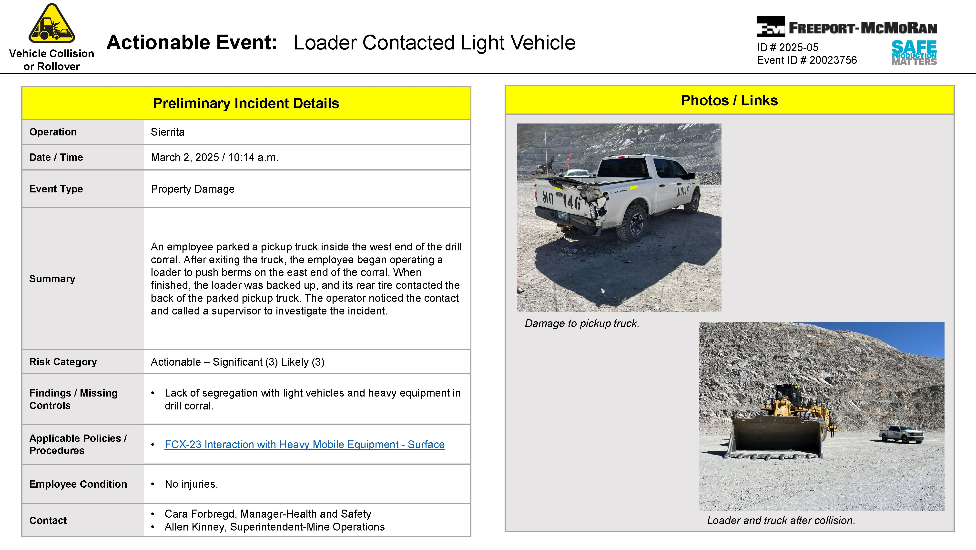
Potential Fatal Events (PFE)

Slide 11
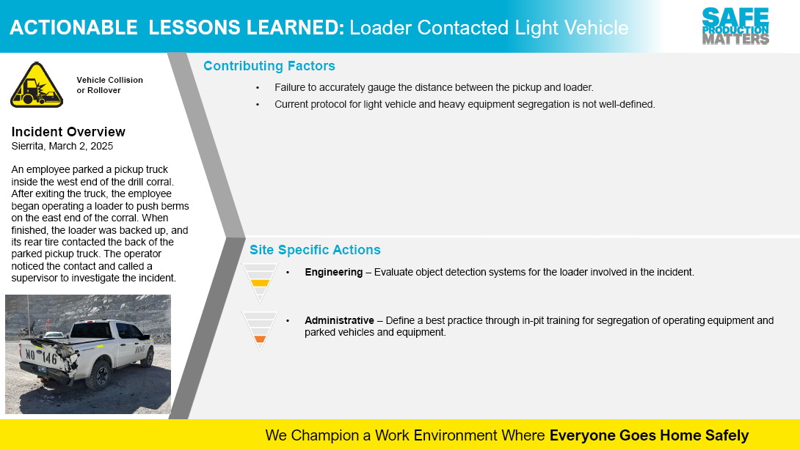
Potential Fatal Events (PFE)

Slide 12
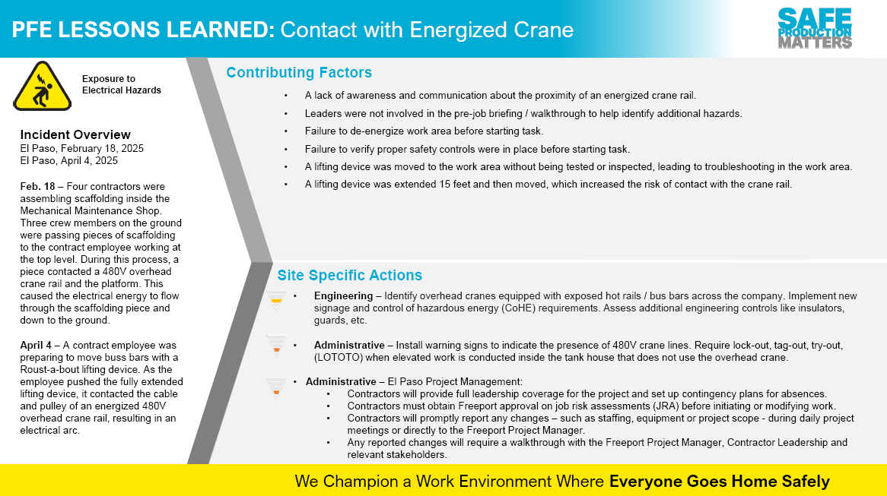
Potential Fatal Events (PFE)

Slide 13
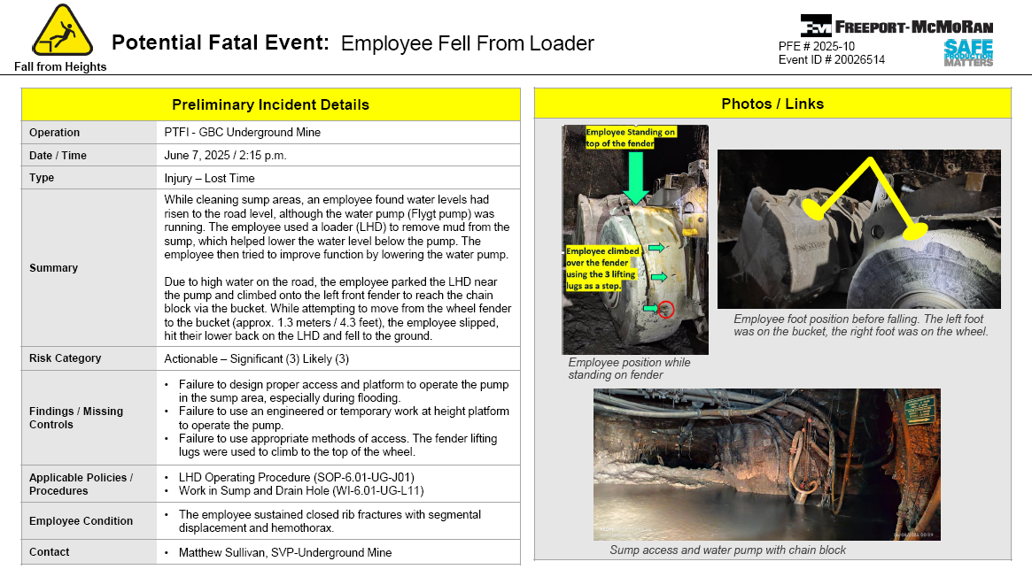
Potential Fatal Events (PFE)

Slide 14
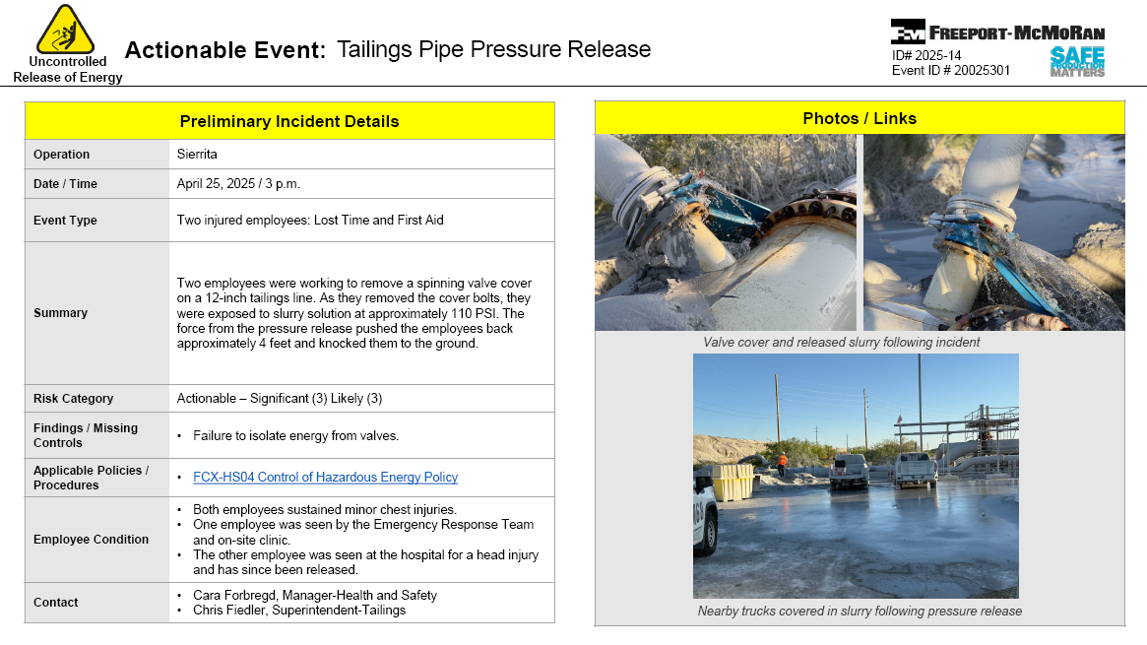
High Risk/Actionable Events

Slide 15
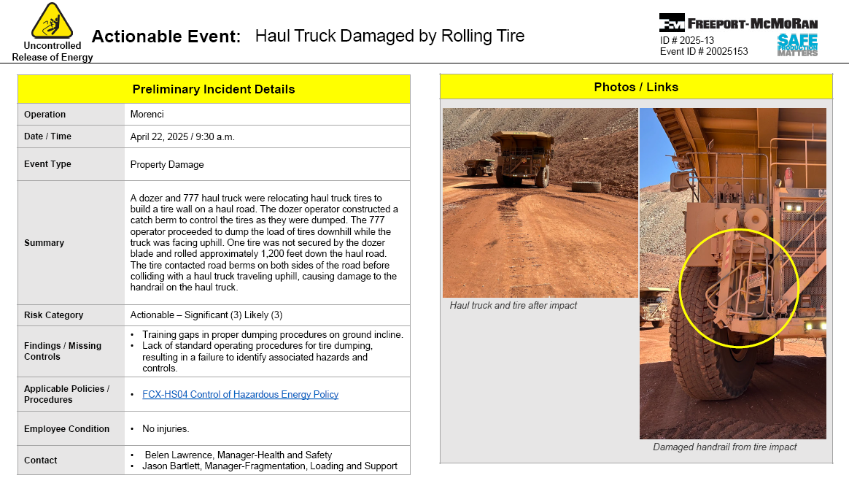
High Risk/Actionable Events

Slide 16
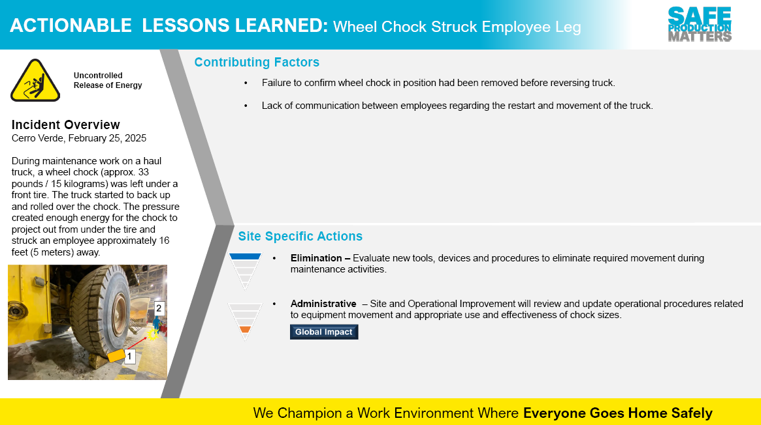
High Risk/Actionable Events

Slide 17
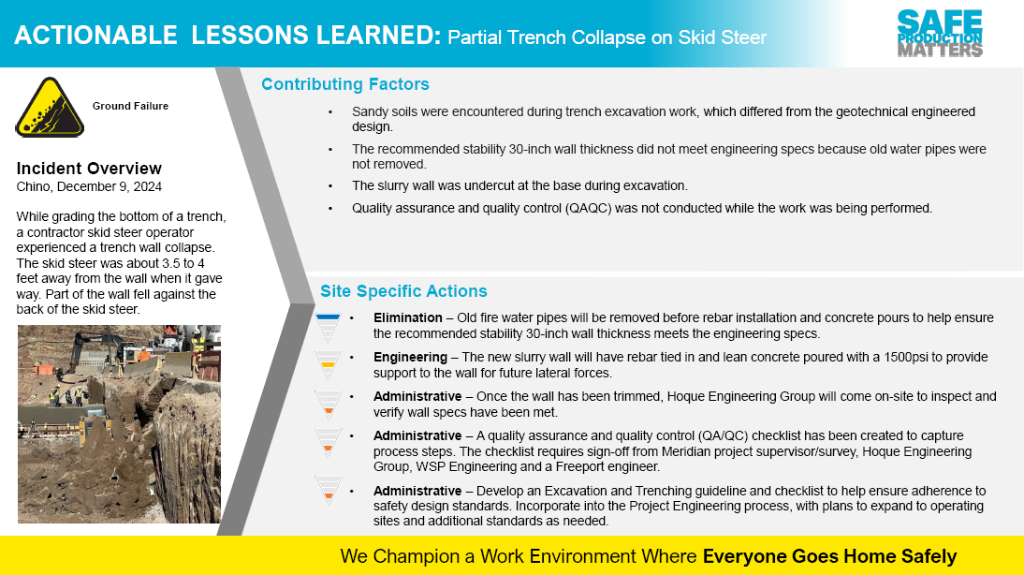
High Risk/Actionable Events

Slide 18
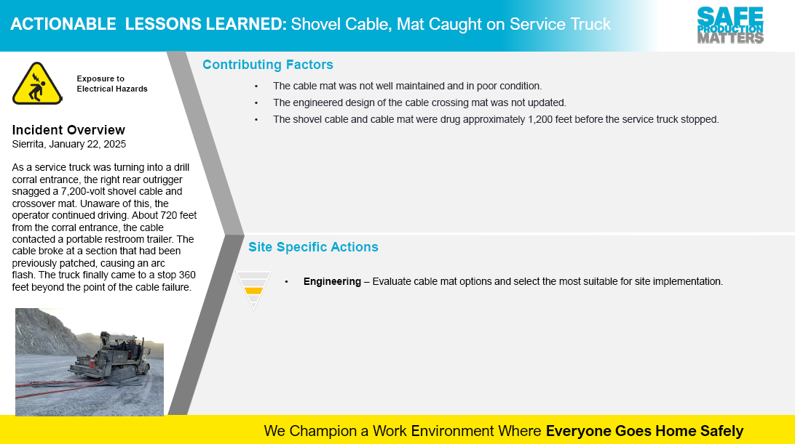
High Risk/Actionable Events

Slide 19
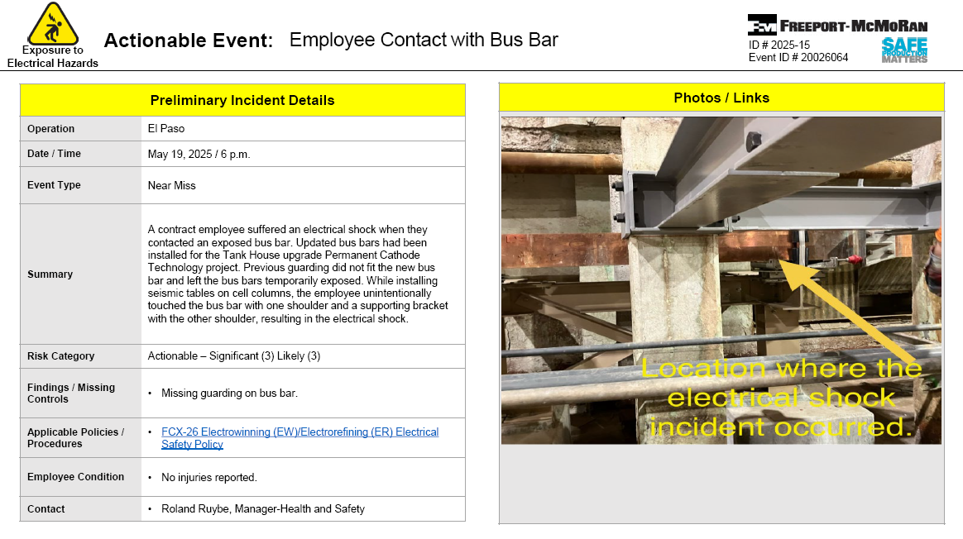
High Risk/Actionable Events

Slide 20
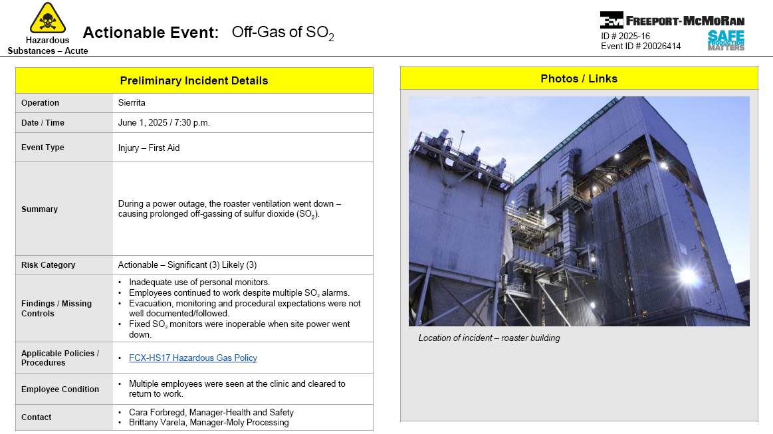
High Risk/Actionable Events

Slide 21
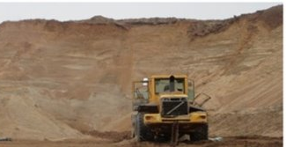
MSHA Fatality Alerts
MINE FATALITY – On March 28, 2025, a miner was fatally injured at a surface mine when sand from the highwall engulfed the front-end loader he was operating. The miner was digging sand from the toe of the highwall.
Eliminate Hazards and Prevent Injuries
Equip front-end loaders with two-way communication systems, high strength glass and an SCSR for breathable air when working on material that has the potential to slide or engulf mobile equipment.
Examine highwalls, spoil banks and ground that slope into working areas. Correct unsafe ground conditions in the affected area and additional examinations as ground conditions warrant, especially during periods of changing weather conditions.
Establish and discuss safe work procedures before beginning work. Identify and control all hazards associated with the work and the methods to properly protect miners.
Train miners to assess risks and hazards, and correct or barricade hazards to prevent access before beginning work activities.

Slide 22
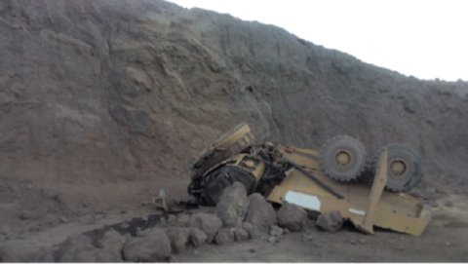
MSHA Fatality Alerts
MINE FATALITY – On May 19, 2025, a miner died when the haul truck he was operating traveled through a berm and over an approximately forty-foot highwall to the bench below.
Eliminate Hazards and Prevent Injuries
Maintain control of self-propelled mobile equipment while it is in motion.
Ensure berms and guardrails are at least as high as the mid-axle height of the largest mobile equipment using the roadway. The effectiveness of a berm depends not only on its height, but also on its base width and compaction.
Always wear a seatbelt and remain in the cab with your seatbelt on while operating mobile equipment. Never attempt to exit or jump from an out-of-control vehicle.
Ensure miners are adequately task trained in the safe operation of all equipment they use.
Perform pre-operational examinations of mobile equipment.

Slide 23
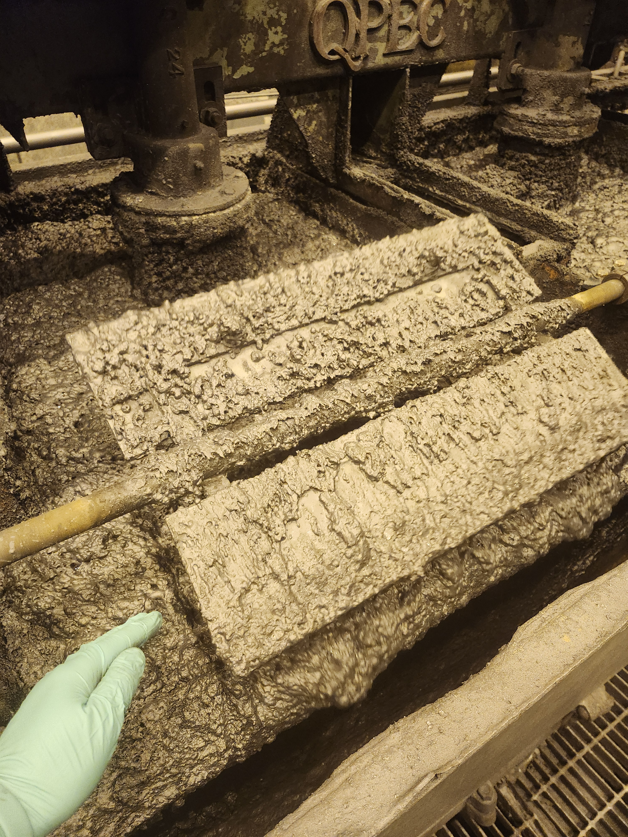
Henderson Incident
Summary: Reportable Injury 6/04
Employee injured finger while checking froth in 6 North Cleaners
Right ring finger caught between froth paddle and weir bar
Wearing nitrile gloves
Suffered fracture and required surgery
Learnings:
Froth paddles are designed to stop with 1 hand but can apply enough force to small area to injure
Trialing new design for paddles with a soft/flexible edge to eliminate pinch point

Slide 24
Henderson FRM Audit Results
153 Forms Submitted in May!
Focus in May around Entanglement & Crushing, Drowning and Hazardous Substances – Acute
Fall from Heights and Ground Failure missing control questions increased in month
AUDIT FOCUS FOR JUNE/JULY:
Drowning
Ground Failure
Fall from Heights

Slide 25
MSHA Q2 Inspection Results
Henderson 2nd Quarter 2025 MSHA Citations | S&S | Non S&S | All Citations
Mine | 1 | 13 | 14
Mill | 16 | 12 | 28
Contractors | 0 | 1 | 1
Total Henderson | 17 | 26 | 43

Slide 26
MSHA Q2 Inspection Results
Organization | Date Issued | Location/ Equipment | Description | Action to Terminate | Terminated | S & S | Hazard
Henderson Mill | 4/22/2025 | PC2/PC3 Transfer Station | At PC2/PC3 Transfer Station, take-up pulley found with missing guarding. | Install guading around take-up pulley. | Yes | No | Guarding
Henderson Mill | 5/9/2025 | PC2/PC3 Transfer Station | Inadequate silica dust bearing survey at PC2/PC3 Transfer Station leading to silica overexposure of 1.32 mg/m3 SWA. | Reduce silica exposure based on engineered and administrative controls. | No | No | Hazardous Substance Exposure
Henderson Mill | 5/19/2025 | Maintenance and welding shop areas | Flammable aerosol cans of spray foam found in job box and not stored in Flammable cabinet. | Relocated product to Flammable Cabinet. | Yes | No | Flammable Storage
Henderson Mill | 5/19/2025 | Maintenance and welding shop areas | Stationary grinder found with tool rest plate set at distance greater than 1/8 inch. | Adjusted tool rest so gap was set to 1/8 inch. | Yes | Yes | Machinery and Equipment
Henderson Mill | 5/20/2025 | Lab | Two brerakers in 120/208 V panel labeled incorrectly. Additionally, source breakers incorrectly labeled at outlet. | Electricians verified power source, labeled the panel list and the outlet correctly. | Yes | Yes | Electrical
Henderson Mill | 5/20/2025 | Floatation | 2nd Cleaner Con Pump East adjustable guarding found bent with 6 inch by 7 inch gap while motor in use. | Repaired guard to lay flat and eleminate gap. | Yes | No | Guarding
Henderson Mill | 5/20/2025 | Floatation | Emergency light in Utility Tunnel under substation BO | New emergency light installed | Yes | Yes | Safe Access
Henderson Mill | 5/20/2025 | Floatation | No signage in utility tunnels to indicate EXIT and inadequate lihgting to see potential hazards when escaping tunnel between substation and mill. | Install adequate lighting in tunnel and exit signage. | No | Yes | Safe Access
Henderson Mill | 5/20/2025 | Floatation | 3CC/4FF West Pump shaft guard had gap approximately 1.5 inches wide exposing shaft while equipment in use. | epair/replace guarding to eleminate gap. | Yes | Yes | Guarding
Henderson Mill | 5/21/2025 | Boiler room | 8 inch stationary grinder found with tool rest plate gap greater than 1/8 inch. | Adjusted tool rest so gap was set to 1/8 inch. | Yes | No | Machinery and Equipment
Henderson Mill | 5/21/2025 | Leach | Near backside of #2 Vacuum Pump, 4 aerosol cans of Choke and Throttle Cleaner flammable product found outside of Flammable Cabinet. | Relocated product to Flammable Cabinet. | Yes | No | Flammable Storage
Henderson Mill | 5/21/2025 | Leach | Outside barrel room entrance, portable oxy/propyline torch set found stored with pressure in the lines and clamshell valve covers not in place. | Valves closed, pressure bled from lines and clamshell covers put back in place. | Yes | Yes | Compressed Gas
Henderson Mill | 5/21/2025 | Leach | Outside barrel room entrance, portable oxy/propyline torch set found with both tanks unsecured. | Tank securing bar of cart found and tanks resecured. | Yes | Yes | Compressed Gas
Henderson Mill | 5/21/2025 | Leach | Outside barrel room entrance, portable oxy/propyline torch set found with missing cover on tank gauge and the prolyline gauge was not functioning. | Gauges removed from tank and disposed of. | Yes | Yes | Compressed Gas
Henderson Mill | 5/21/2025 | Leach | Outside barrel room entrance, near portable oxy/propyline torch set, found unsecured 100 lb oxygen cylinder without valve cover. Later identified tank was empty. | Cylinder removed from location and stored properly in warehouse. | Yes | Yes | Compressed Gas

Slide 27
MSHA Q2 Inspection Results
Organization | Date Issued | Location/ Equipment | Description | Action to Terminate | Terminated | S & S | Hazard
Henderson Mine | 5/21/2025 | 7700 shop | Tire was left elevated and unattended on a forklift. Contractor stated work was being performed, however the forks were not blocked against movement. | Load was lowered to the ground. | Yes | No | Suspended Load
Henderson Mine | 5/21/2025 | 7700 lube bay | Fire extinguisher located in 1 bay had not been signed off since March 2025 | Extinguisher was checked and signed off. | Yes | No | Fire Extinguisher
Henderson Mine | 5/27/2025 | 7625 tool crib | Access to tool crib blocked by forklift, pallets and water hose obstructing drift. | Fork lift removed, water hose put back on wall mount. | Yes | No | Safe Access
Henderson Mine | 5/27/2025 | 8100 station | In the 2R drift, a mechanical ventilation door was found without audible or visual warning devices. | Install audible or visual warning device to MSHA's criteria. | Yes | Yes | Ventilation Doors
Henderson Mine | 5/21/2025 | 7065 Truck Haulage | T68E area had 20 foot 2-inch water hose and a mining curtain were strewn around the access in front of the chute louvers and controls. | Hose and curtain were removed to create safe access. | Yes | No | Safe Access
Henderson Mine | 5/21/2025 | 7065 Truck Haulage | T58 chute restricted clearance had no signage present to indicate a low overhead hazard. | Sign warning of low overhead clearance installed. | Yes | No | Safe Access
Henderson Mine | 5/21/2025 | 7065 Truck Haulage | Area of bad ground at the TAB substation | Loose material removed from wire mesh. | Yes | No | Ground conditions
Henderson Mine | 5/27/2025 | Reclaim | Cabinet found with flammable and combustible checmicals mising warning signage. | Readily visible signage posted. | Yes | No | Fire Prevention
Henderson Mine | 5/27/2025 | PC1 PC2 Transfer | 240/480 V power washer found without current continuity resistance testing (previous year's tag present). | Tagged the washer BO and cut plug off. | Yes | No | Electrical
Henderson Mine | 5/22/2025 |  | P65/704 piece of shotcrete on the back not properly supported or taken down. | Barred down piece of meterial. | Yes | No | Ground conditions
Henderson Mine | 5/22/2025 |  | PWHW/P73 panel for INW had a BO pallet used as a working platform. | Remove palot and stope use as working platform. | Yes | No | Safe Access
Henderson Mine | 5/22/2025 | 7210 production area | P87 & P85 excessive dust/reduced visibility | Safety contact, crew training and spraybar repair in affected area. | No | No | Dust Control
Henderson Mill | 5/27/2025 | Regrind Mills | Plastic spray bottle in a flame cabinet without a label at 1st regrind mill level | Chemical labeled | Yes | No | HazCom
Henderson Mill | 5/27/2025 | Regrind Mills | Regrind tool cage walkway blocked by equipment. | Clean | Yes | No | Safe Access
Henderson Mill | 5/27/2025 | Regrind Mills | 3rd regrind cyclone deck, housekeeping - hoses blocking access to rear of cyclone deck | Clean | Yes | Yes | Safe Access
Citation to be contested

Slide 28
MSHA Q2 Inspection Results
Organization | Date Issued | Location/ Equipment | Description | Action to Terminate | Terminated | S & S | Hazard
Henderson Mill | 5/28/2025 | Leach | Leach dryer deck, holoflight dryer #2 - lighting in area not functioning. | Replace bulb | Yes | No | Illumination
Henderson Mill | 5/28/2025 | Primary Mills | Standing water on mill 2 liner deck at 120 V breaker panel and MB-PP22 | Install platform or insulating mats | No | No | Electrical
Henderson Mill | 5/29/2025 | Primary Mills | Bottom floor at primary mill 4 East pinion pump, tripping hazards (mill liners on pallets blocking access to stair case and 2 flammable cabinets | Move pallets | Yes | Yes | Safe Access
Henderson Mill | 5/29/2025 | Mill Main Aisle | Welding arc created at C40 area/platform with handrail repair was easily seen walking East down main mill aisle; no shield | Welding shield | Yes | Yes | Welding Shield
Henderson Mine | 5/28/2025 | 7500 shop | Fire extinguisher in refuge chamber missing monthly inspection sign off. | Inspect and sign off extinguisher for month. | Yes | No | Fire Extinguisher
Henderson Mine | 5/28/2025 | 7500 shop | 5 fire extinguishers between the welding bay and lube bay missing monthly inspection sign off. | Inspect and sign off extinguishers for month. | Yes | No | Fire Extinguisher
Henderson Mill | 6/2/2025 | Mobile Equipment Shop | Contractor (Aerial Equipment Specialists)service truck with flammable aerosols missing No Smoking or Open Flame signage. | Applied signage to truck in visible location. | Yes | No | Fire Prevention
Henderson Mill | 6/2/2025 | Mobile Equipment Shop | Diesel arc welder on service truck missing covers over 2 30-amp/480 V outlets. | Secured cover over outlets. | Yes | No | Electrical
Henderson Mill | 6/3/2025 | Floatation | Wire feed welding cart had gauges attached, with prssurized lines. | Removed gauge, ordered replacments. | Yes | No | Compressed Gas
Henderson Mill | 6/3/2025 | Floatation | Torch bottle set up had gauges attached, gauges were not legible | Replaced gauges and capped bottle. | Yes | Yes | Compressed Gas
Henderson Mill | 6/3/2025 | Tailings | Unbermed East Branch Access road |  | Yes | Yes | Berms or Guardrails
Henderson Mill | 6/3/2025 | Reclaim Tunnels | In reclaim tunnel #1, four ceiling lights had broken covers within reaching distance. | Replace broken light covers. | Yes | Yes | Electrical
Henderson Mill | 6/3/2025 | Reclaim Tunnels | In Reclaim Tunnel #4, one ceiling lights had broken covers within reaching distance. | Replace broken light covers. | Yes | Yes | Electrical
Henderson Mine | 6/5/2025 |  | Operator failed to take action to terminate citation no 9829766. Vent door area ordered withdrawal of miners from area until audible or visual warning device is installed | Install audible or visual warning device to MSHA's criteria. | Yes
Citation to be contested

Slide 29
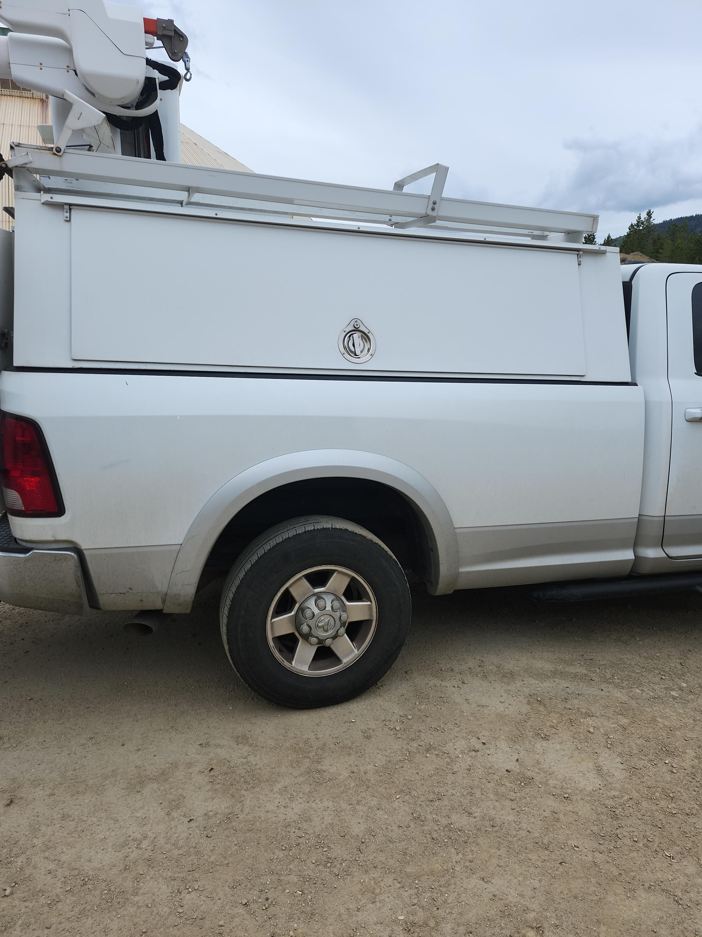
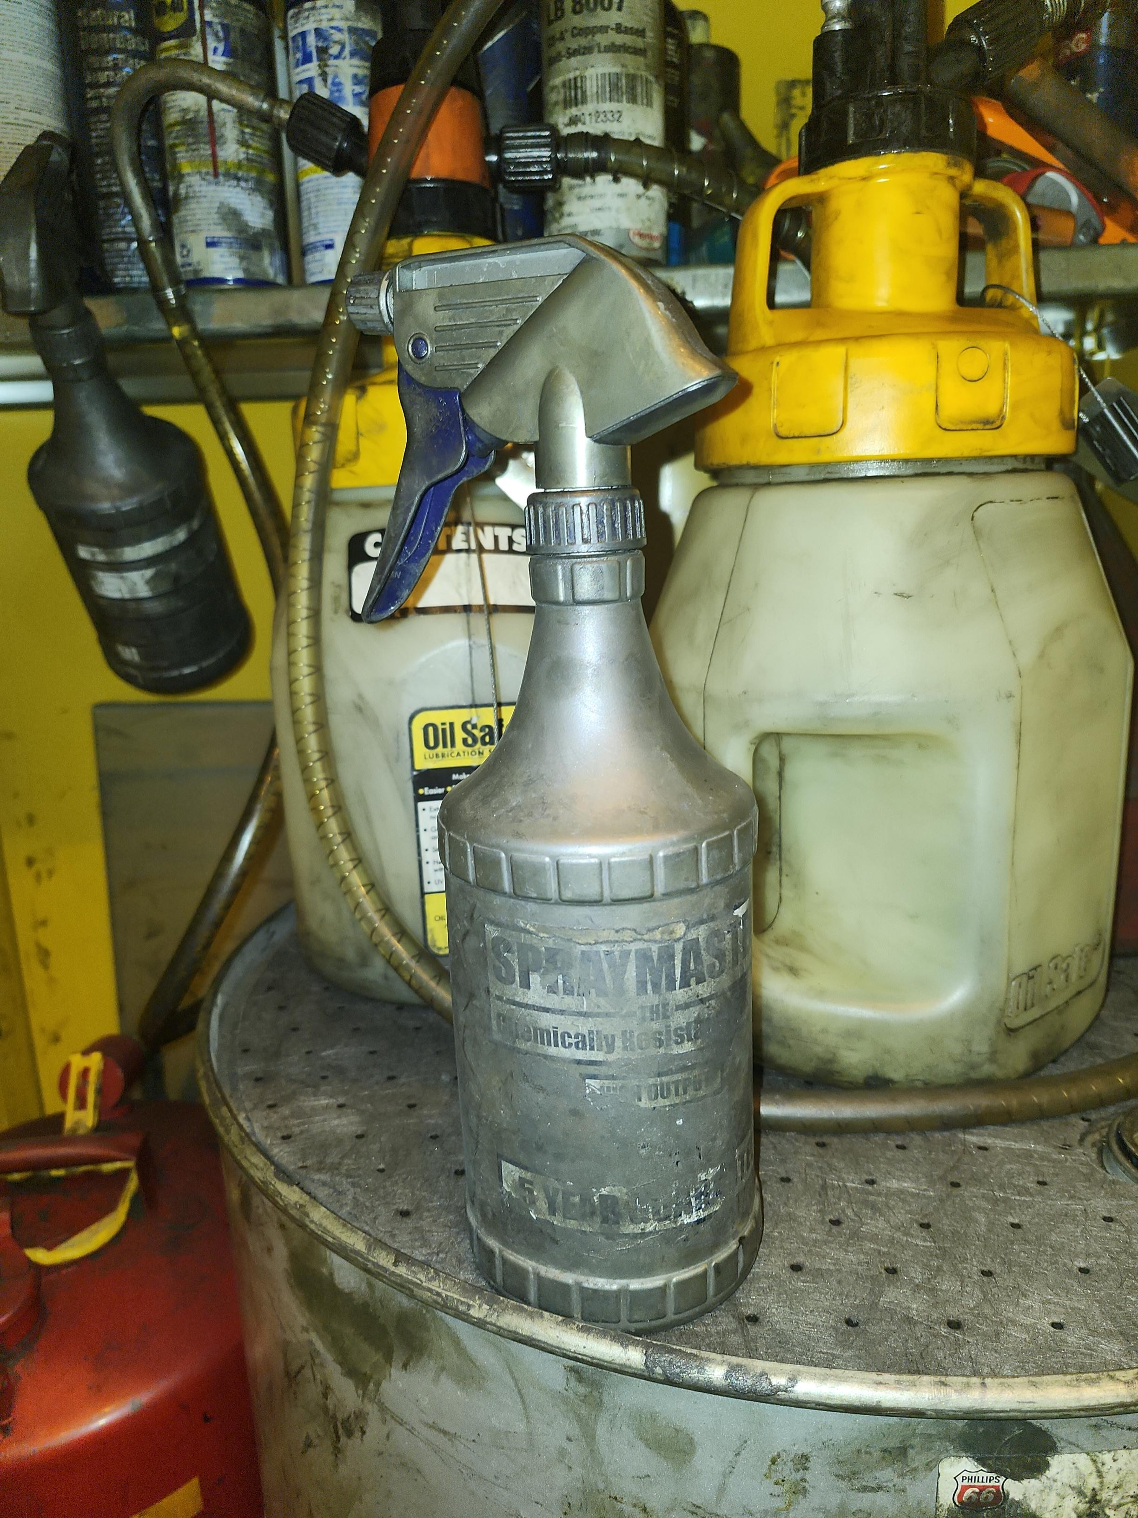
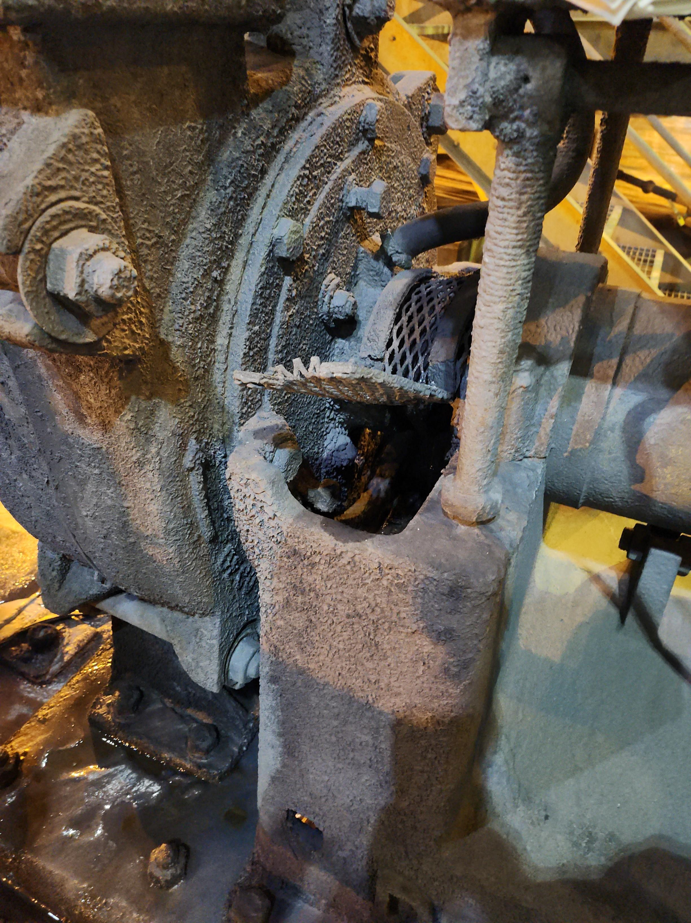
MSHA Q2 Inspection Results
Unlabeled Container
Inadequate Guarding
Missing Flammable/
No Smoking Signage
Notes:
Unlabeled container found in flame cabinet.
Contractor truck that had flammable aerosols in side storage missing Flammable and No Smoking/Flames signage.
Removable guarding allows for adjustments to pumps, but guarding must lay flat to prevent exposure of moving parts to miner.

Slide 30
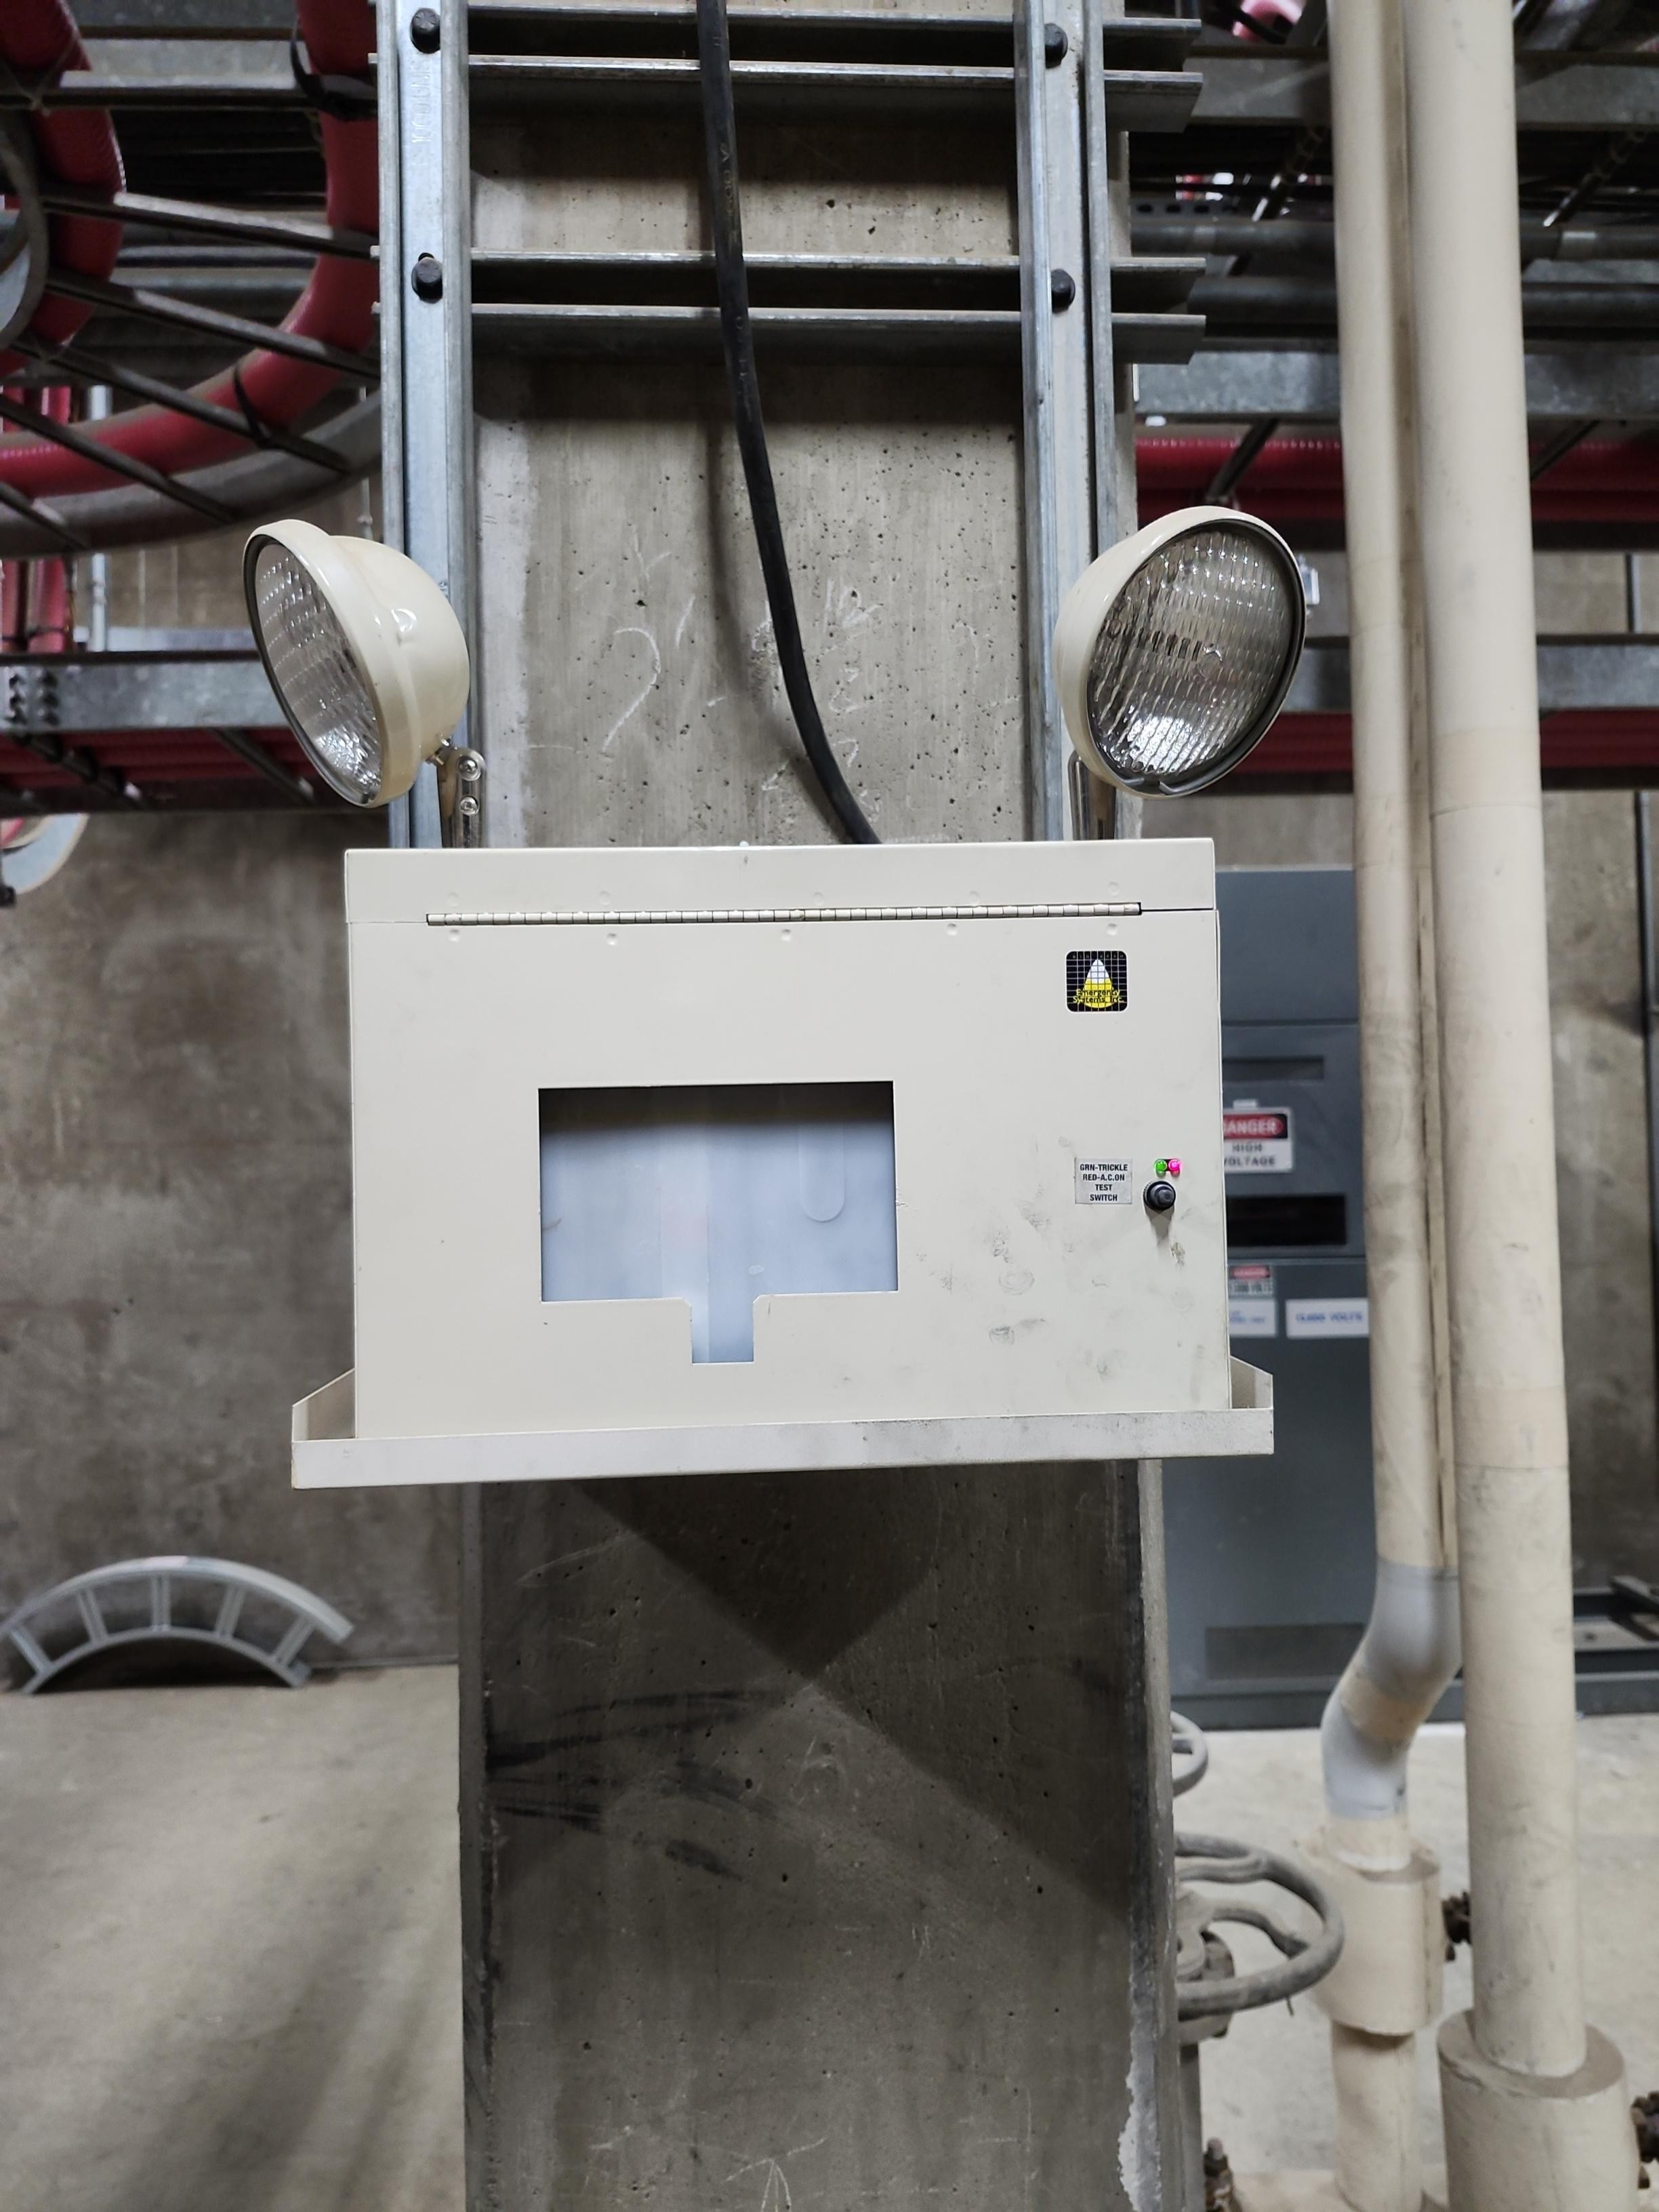
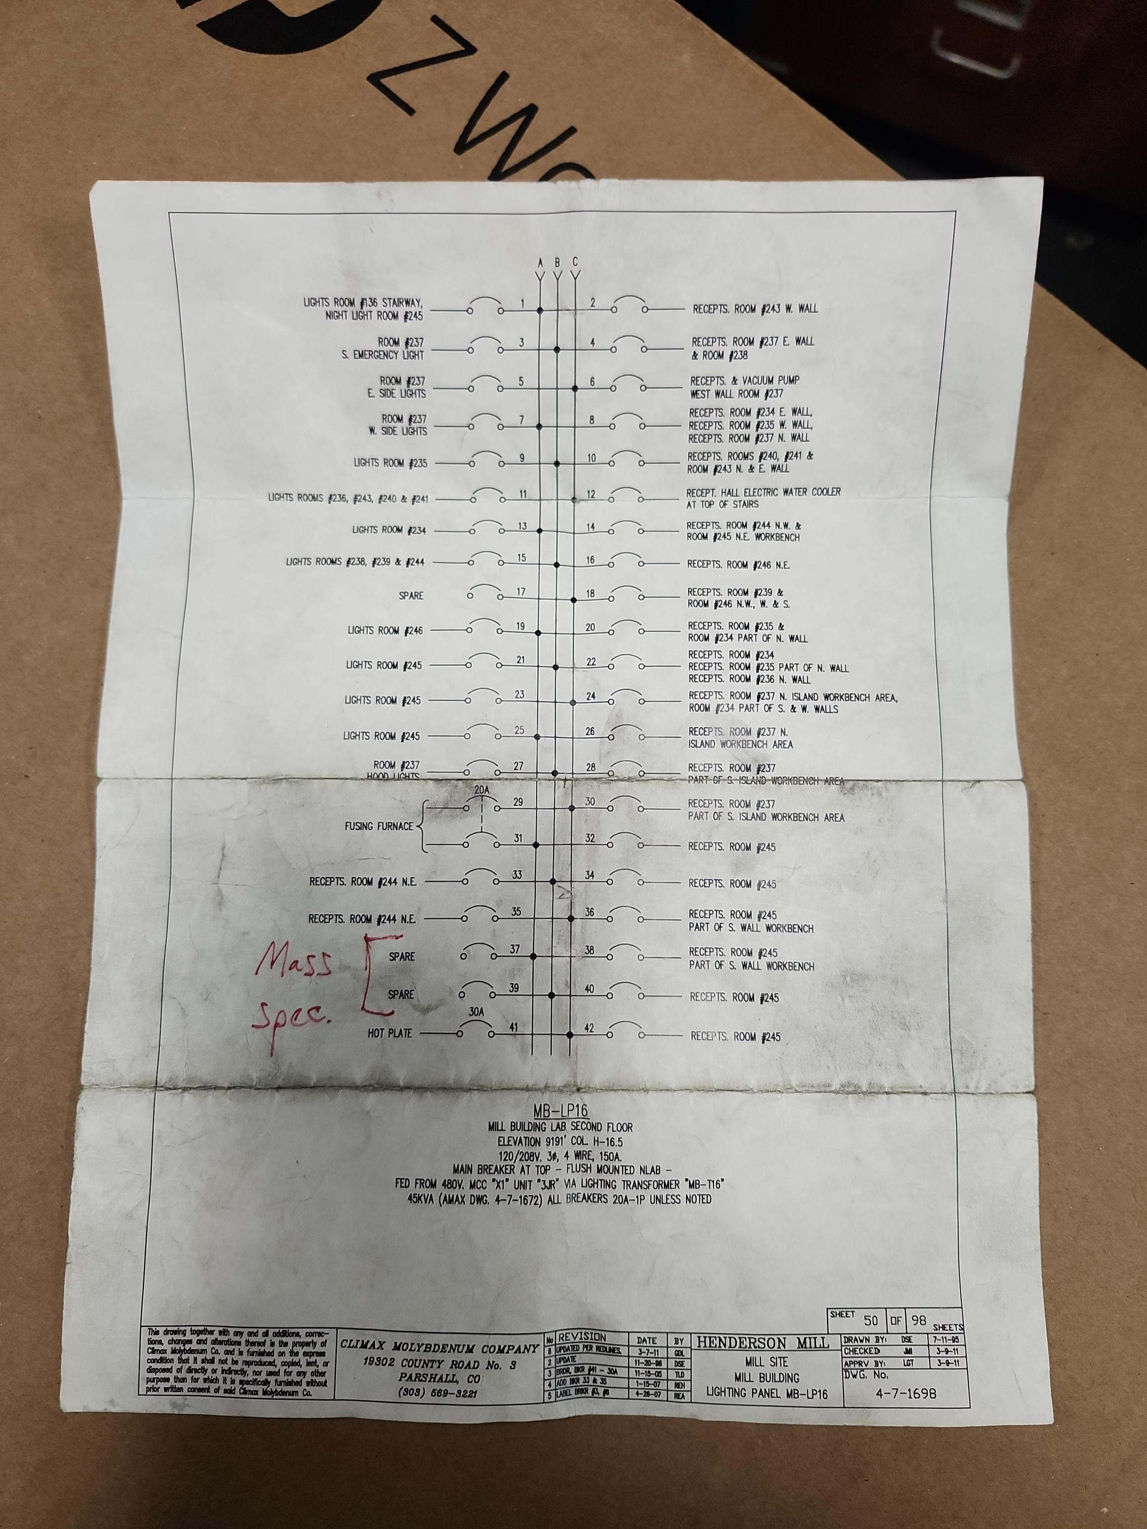
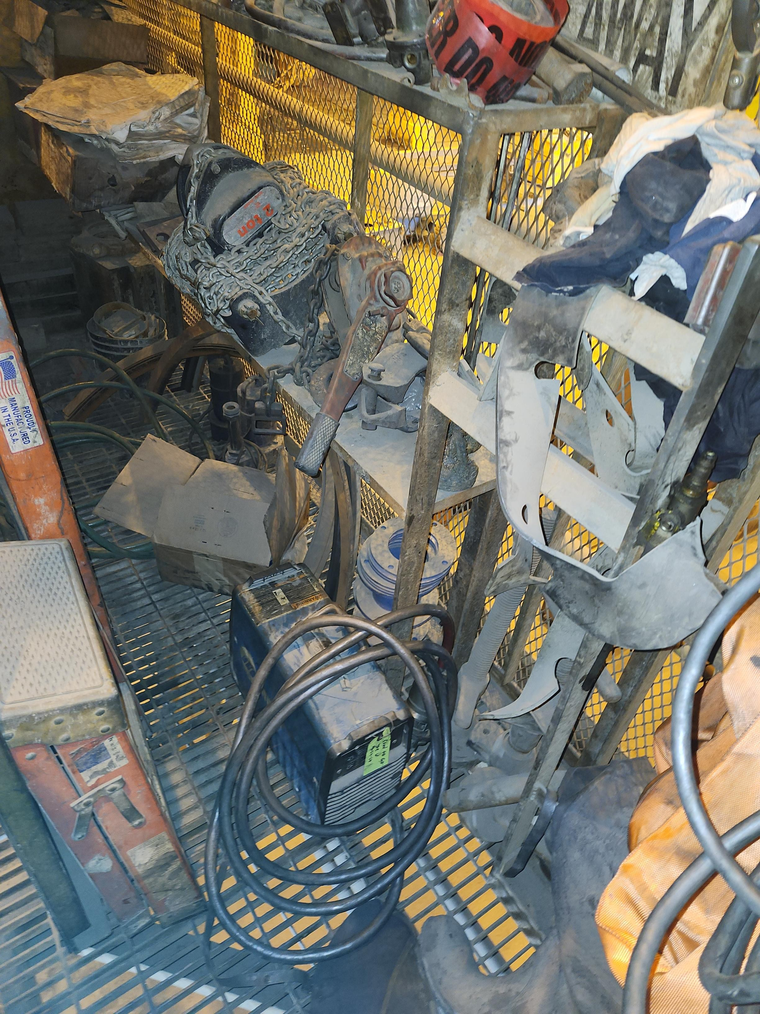
MSHA Q2 Inspection Results
Mislabeled Breakers
Unsafe Access
Emergency Light
Not Working
Notes:
New equipment installed, breaker list in panel not updated.
Emergency light not functioning in utility tunnel.
Accumulation of equipment on floor restricts safe access to back of tool

Slide 31
Workplace Exams (WPE) - MSHA
MSHA Rule (Reinstated 09/30/2019):
A competent person examine each working place for conditions that may adversely affect the safety or health of miners. The working place must be examined at least once each shift, before miners begin work in that place.
Promptly initiate appropriate corrective action when adverse conditions are found.
Promptly notify miners in affected areas if adverse conditions are found and not corrected before miners are potentially exposed.
Withdraw all persons from affected areas when alerted to any conditions that may present an imminent danger, until the danger is abated.
Create an examination record before the end of each shift that includes:
  The name of the person conducting the examination;
  Date of the examination;
  Location of all areas examined;
  A description of each condition found that may adversely affect the safety or health of miners; and
The date when each described condition is corrected.

Slide 32
Workplace Exams (WPE) - Henderson
What is the purpose of performing workplace examination?​
Identify hazards and mitigate or eliminate​
Keeps the focus on safe production​
Promotes a work area that allows for efficient work to be performed​
Lastly and the least important reason is compliance​
What defines a work area?​
Dependent on the work or task​
What work or task are we trying to complete?​
Does it affect other locations or levels?​
Do we need to protect others from the work or task being performed?​
Is a safe distance required to protect other employees?​

Slide 33
Workplace Exams (WPE) - Henderson
Who conducts WPE’s?​
Competent person(s) examines each work area​
  Has the ability and experience to perform the work or task​
  Knowledgeable in all areas of the working area​
Does this imply that the new or inexperienced employees cannot assist?​
  No! Different levels of experience can help identify hazards​
  Fresh sets of eyes, and possibly a different perspective​
  Promotes ownership​
  Opportunity for experienced employees to mentor inexperienced employees
  ​

Slide 34
Workplace Exams (WPE) - Henderson
What is required on the documentation of a WPE?​
The date the examination was performed​
The examiners name​
The work area(s) examined​
Any safety related conditions found​
Any corrective measures taken​
Description of each adverse condition not corrected promptly​
When are we expected to perform WPE’s?​
  At the start of shift​
  Documented before work begins

Slide 35
Henderson Blue Stake Policy Update
High level updates:
  Alignment with FMI on UG utility installations (we have several planned this summer at mill), emphasis on electrical. Added a check list form and dwg to policy for new utility installations.
  A Single Henderson Blue Stake Policy. Additional verbiage was added to help highlight "inter-drift drilling" activities for the mine. Previously only noted on permit itself.
    Clarified "underground" vs "buried" nomenclature in section 2.1
    Added Appendix E - Henderson Mine Underground Inter-Level Drilling Blue Stake Procedure

Slide 36
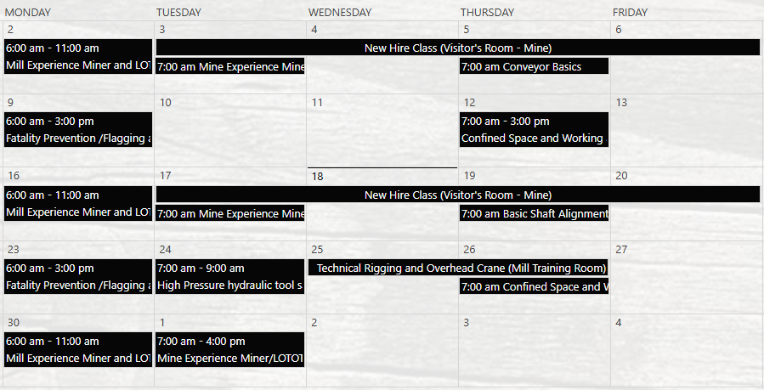
Henderson Training Schedule - JUNE

Slide 37
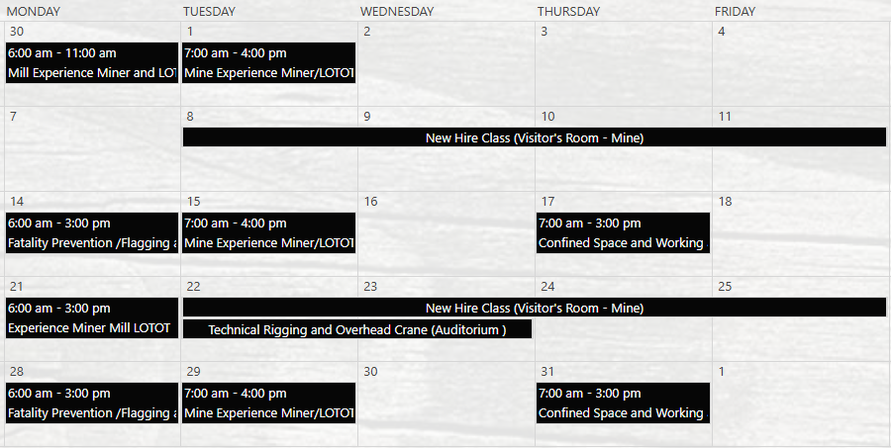
Henderson Training Schedule - JULY

Slide 38
Contractor Management Topics
HSEP Updates
Badging Requirements

Slide 39
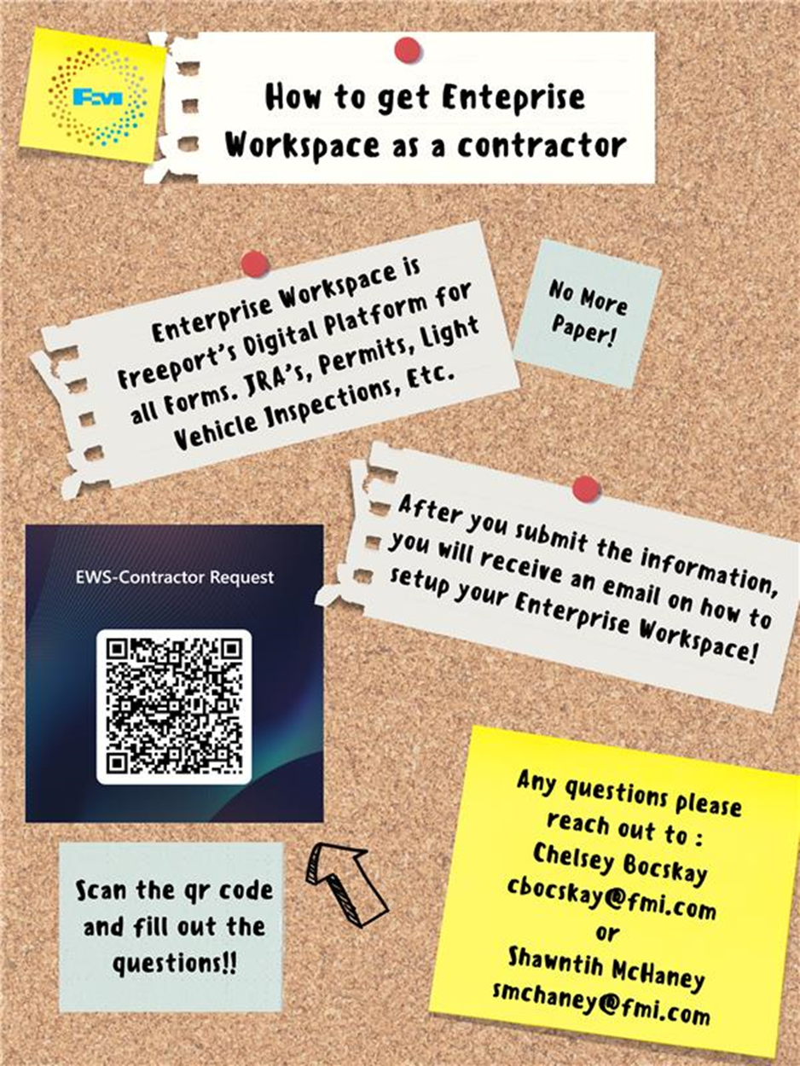
Contractor Management Topic – EWS Access
Access to site digital forms now available to Contractors!
Integration of Contractor submitted forms into internal dashboards
Forms can be used in online and offline modes
Request Access with QR Code or HERE
Reach out to H&S Department with any questions or issues

Slide 40
Open Forum

Slide 41
2025 Contractor Meeting Schedule
July 17th
September 11th
November 20th
August 14th
October 9th
December 18th
Meetings begin 1PM Mountain Time
Mine & Mill Room Options Monthly

Slide 42
June Sign-Off Record
_____________________
_____________________
_____________________
_____________________
_____________________
_____________________
_____________________
_____________________
_____________________
_____________________
_____________________
_____________________
_____________________
_____________________
_____________________
_____________________
_____________________
_____________________
_____________________
_____________________

