Slide 1
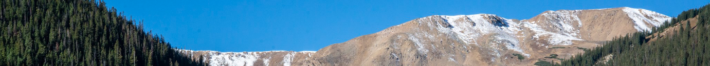
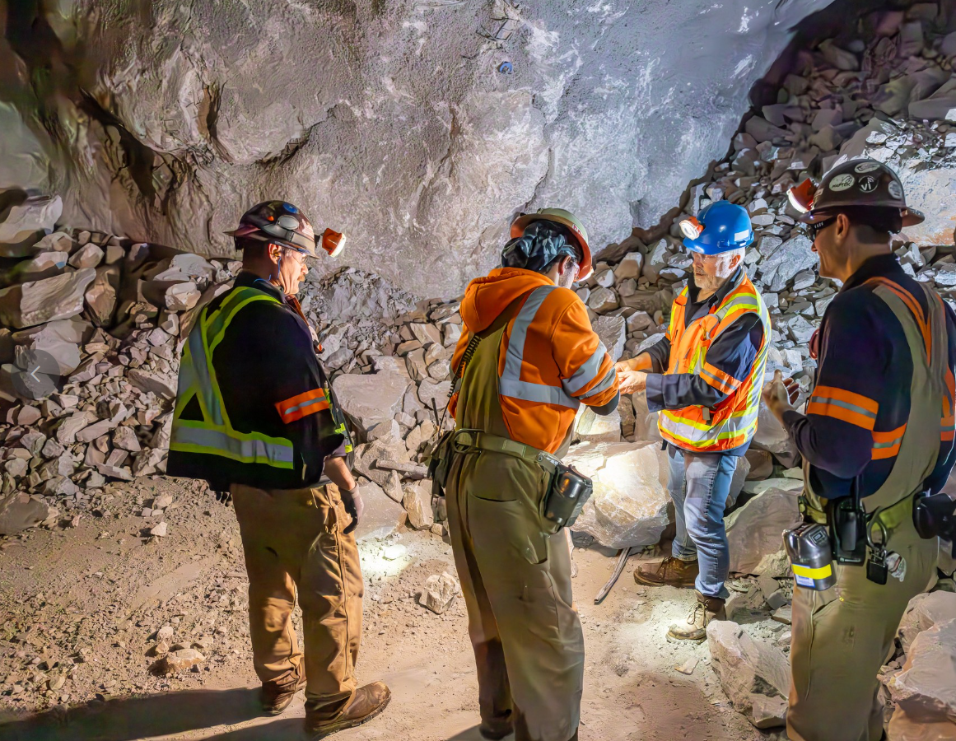


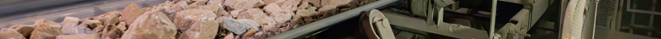
Henderson HSE Contractor Meeting
June 2026

Slide 2
Avoiding Unauthorized AI Tools
FMI has observed an increase in AI “notetaking” bots being added to Teams meetings
The use of these tools and software falls under MIS End User Policies that prohibit Freeport employees, contractors and partners from sharing company data without the company’s consent
To protect company data:
  Contractors and Vendors not to use notetaking bots/recording tools
  If external bot/recorder added to meeting, meeting will be stopped
  Ask the FMI organizer to use approved notetaking tools

Slide 3


What is the purpose of this Meeting?
- For Henderson to reach multiple contractors and discuss best practices when it comes to Health and Safety, Environmental and Contracts Management
- Give contractors an open forum to bring up concerns, successes or incidents, learnings, etc. that is shared between all contractors and Henderson personnel
- Help improve the safety culture and reduce safety incidents as a group

Slide 4
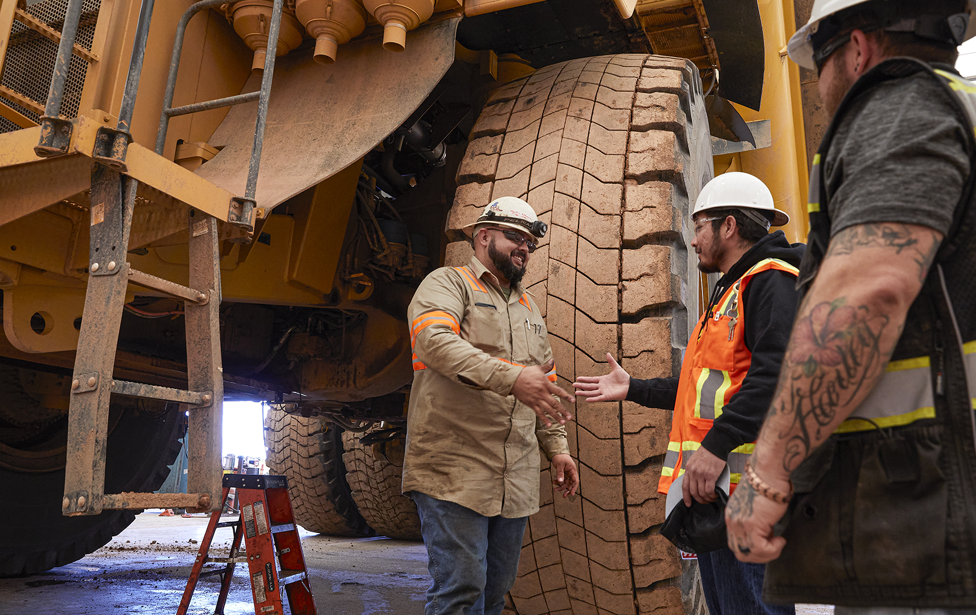

Safety Success

Slide 5
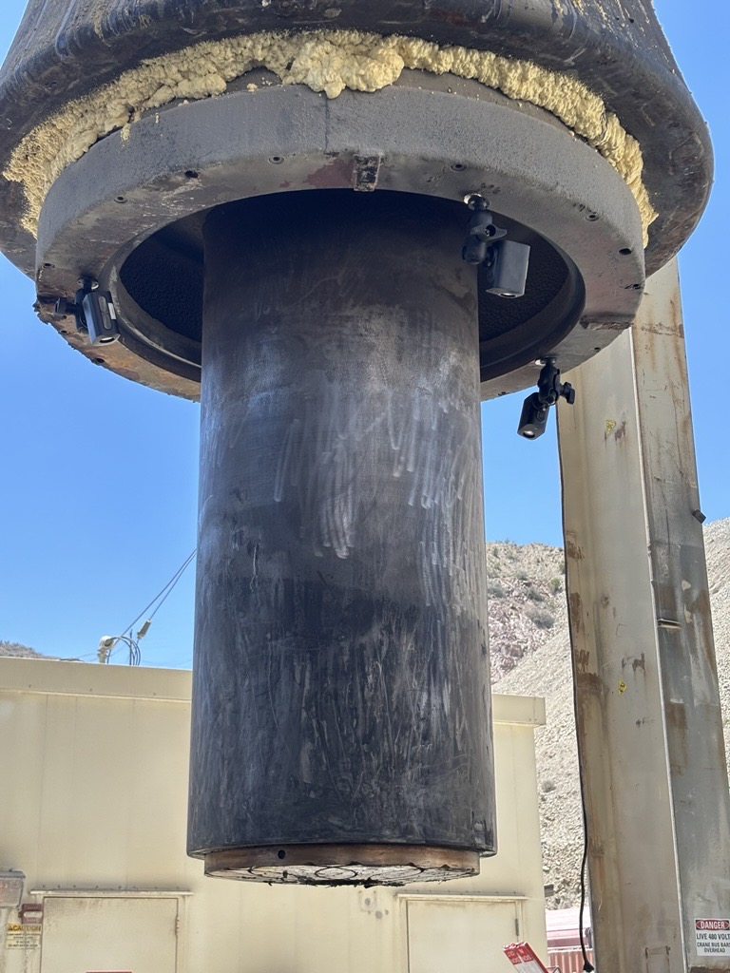
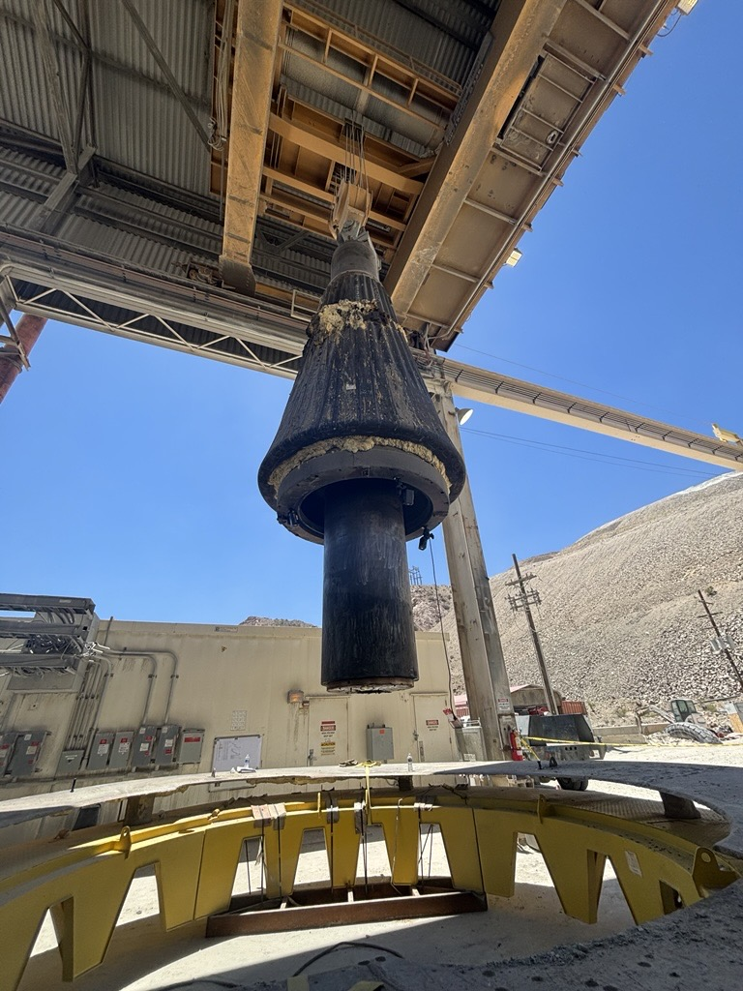
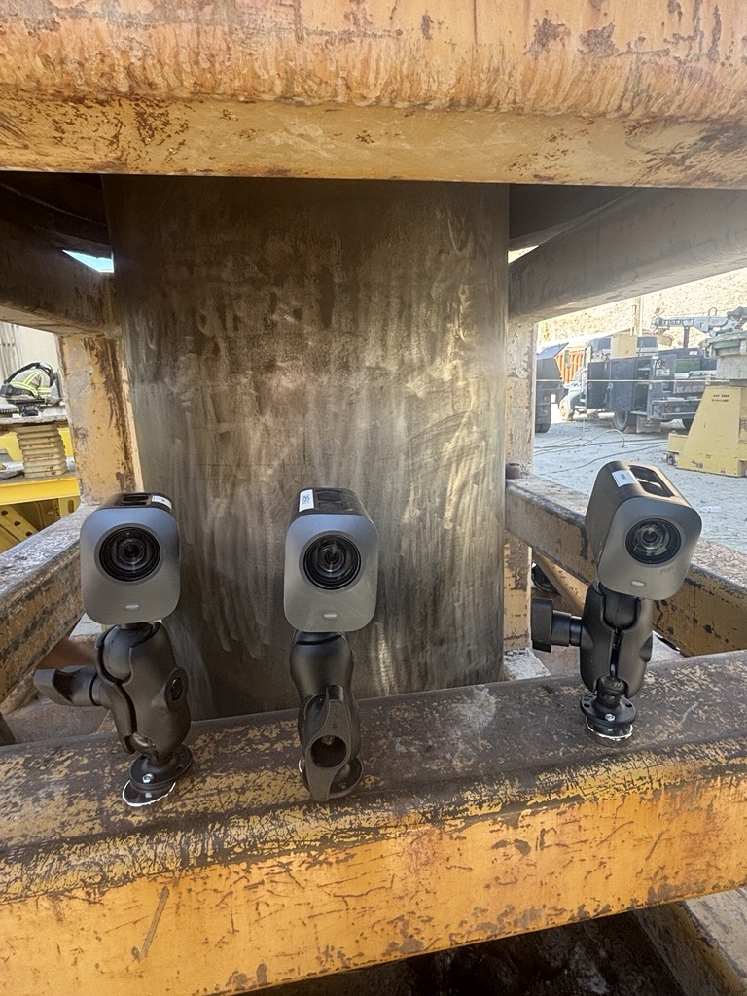
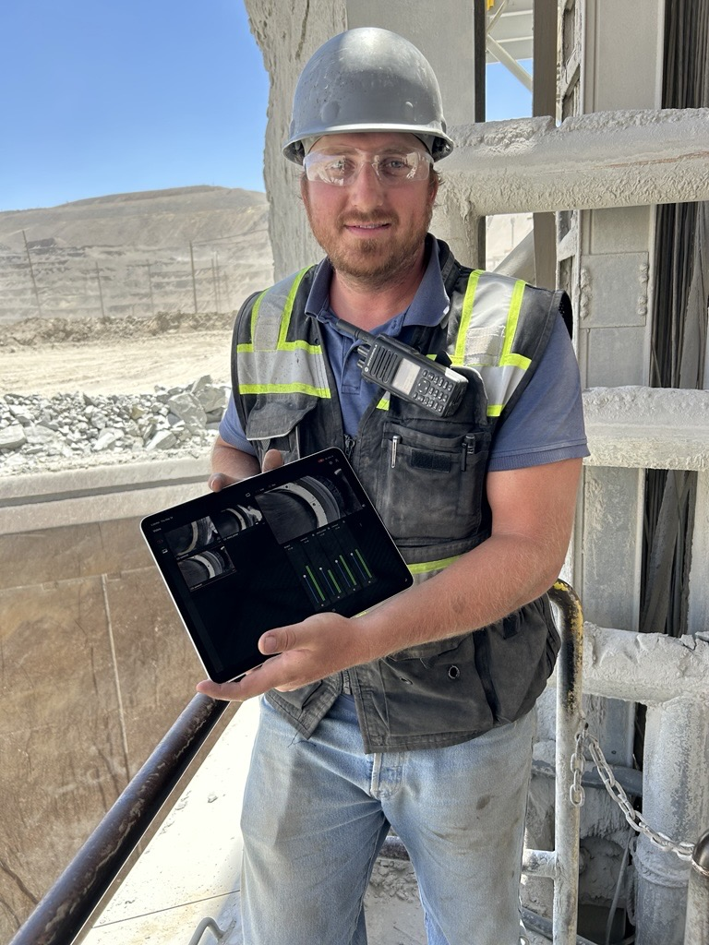
Spotlight On
Safety In Action
Bagdad: Leveraging Innovation and Proactive Collaboration
Cross-functional teams at Bagdad used remote camera technology during primary crusher installation to eliminate worker exposure to suspended loads and line-of-fire hazards.
The Hazard
Employees in the surge chamber previously were exposed to fatal risks while installing and aligning the primary crusher main shaft. They had to work under or near the 80-ton suspended shaft, creating line-of-fire and crushing exposures.
The Solution
The Mill Maintenance, MIS, and Health and Safety teams used their combined field experience to redesign the approach and eliminate risk. They installed cameras directly on the main shaft to provide real-time visibility during lowering and alignment.
The Impact
The cameras enabled remote monitoring and guidance from a safe location. This fully eliminated the need for personnel to be under or near the shaft during critical lift and alignment, removing employees from line-of-fire hazards while maintaining precision and control.
Cameras installed on the main shaft
Photos of the cameras used and remote employee monitoring

Slide 6
Spotlight On
Morenci: Attendants Drive Positive Safety Performance
During a recent outage, the Morenci Metcalf Concentrator team implemented a new Control of Hazardous Energy Attendant process, resulting in increased safety performance.
The Process
Operators staffed LOTOTO stations for full 12-hour shifts – expanding beyond the partial coverage used in the past.
Attendants were responsible for reinforcing critical lockout information, reducing reliance on Energy Control Coordinators (ECC) and allowing them to focus on core duties.
The placement of QR codes provided quick access to equipment-specific lockout procedures and correct lock box use.
The Impact
Attendants helped prevent 18 potential incidents related to complex ECC lockout errors through early gaps identification and stop work. This reduced risks and avoided delays tied to investigations.
The team achieved zero COHE and LOTOTO violations during the outage, compared to nine recorded violations in 2025.
Next Steps
The Morenci team will continue to use the attendant process for major outages and expand to all line, combined and full down-day activities due to proven effectiveness.
Discussion
What risks in our current work processes could be caught earlier if we had a dedicated attendant or added layer of verification?
How can we better use tools like QR codes or mobile resources to make critical safety information easier to access in the field?
What is one change we could test during our next outage or high-risk activity that could improve both safety and efficiency?

Slide 7
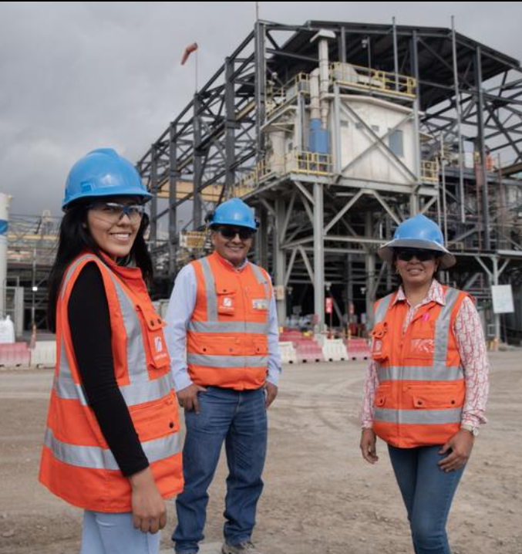
Safety and Environmental
Shares

Slide 8
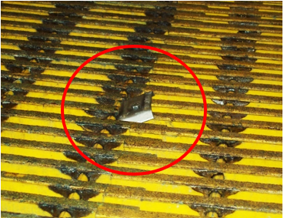
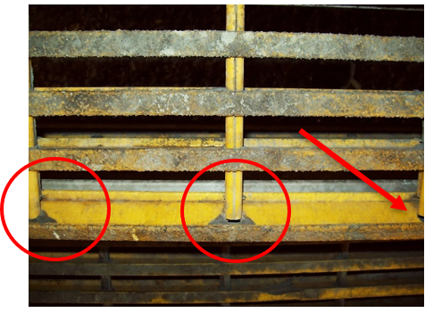
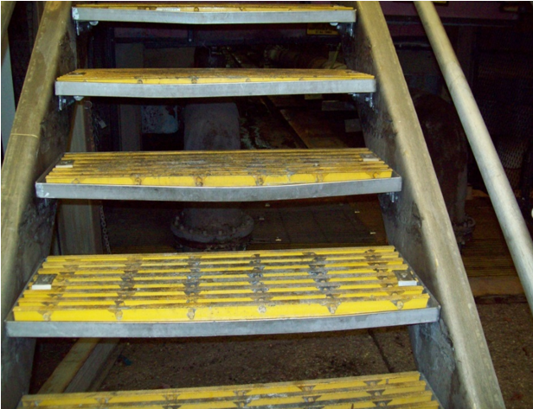
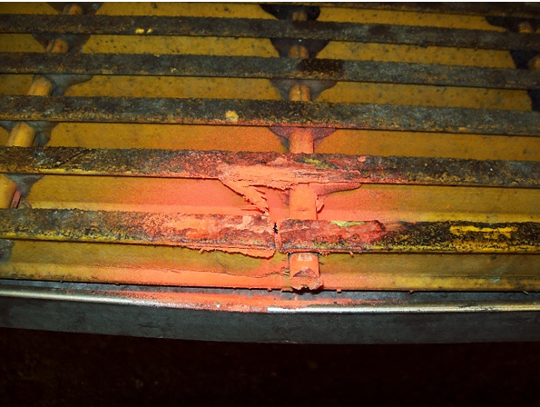
Grating High-Risk Hazards
Recent grating-related incidents reinforce the need for careful monitoring and addressing issues early. Damaged or weakened grating poses significant safety risks. Routine inspections and staying alert help identify potential issues so prompt action can be taken.
Things to look out for:
Tripping Hazards
I-bar separation
Bent Steps
Any damage to be flagged and reported
Click here to access a Grating High-Risk Hazard lineout, including recent events and preventive steps.

Slide 9
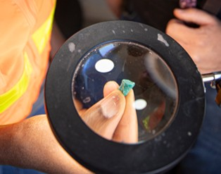



Environmental Share:
Used solvent is defined as any solvent product that has been employed in cleaning and/or degreasing parts or materials.
Henderson Mill generates solvent rags through various activities including laboratory operations and maintenance shop work. Solvent rags must be sampled and analyzed to verify whether regulated contaminants area present and to determine applicability under hazardous waste regulations.
What Solvents Are Found at Henderson?
• Aerosol degreasers – listed constituents
• Parts washer solvent
• Toluene – belt splice kits
• Acetone
• Contact cleaners
Hazardous Waste regulations are tricky. If you have questions about solvents or wastes in your work area, please reach out to environmental!
Proper Disposal of Solvent Rags in Your Work Area:
• All solvent rags generated from maintenance activities must be disposed of in a labeled solvent rags drum.
• Ensure all solvent rag drums remain closed with a latching lid.
• No free liquid can be present in drums.
• Drums must have a yellow Hazardous Waste sticker visible on the exterior of the drum.
Henderson Mill Solvent Rags Drum Locations:
• Maintenance Shop
• Mobile Equipment Shop
• Loci Shop
• Ute Park Pump Station
• Water Treatment Plant
*There are no solvent rag drums at Henderson Mine*

Slide 10
Line of Fire: Stay Out of the Danger Zone
Discussion
Where could you be in the line of fire during today’s work?
What energy sources are in your work area? Could they be better controlled or isolated?
What work is going on around you that may present additional line of fire hazards?
Have all lift areas, drop zones and equipment paths been clearly defined?
What’s your personal trigger to stop work if something doesn’t look right?
Line of fire occurs when you’re in the path of energy – mechanical, hydraulic, electrical, pressure or moving equipment – that could strike, crush, cut or release force. Even brief exposure can result in serious injury.
Common high-risk situations we see in the field:
Entering drop zones or working under suspended loads
Opening or unbolting pressurized systems without verifying zero energy
Using equipment or tools with hands or body in the line of fire
Working in blind spots or near moving heavy equipment
Working without fully considering potential paths of stored energy, especially when acting as a spotter or working nearby
Keep yourself and others safe by:
Identifying energy sources before starting work
Isolate and control energy
Set clear boundaries with barricades and exclusion zones
Position yourself safely and stay aware of your surroundings

Slide 11
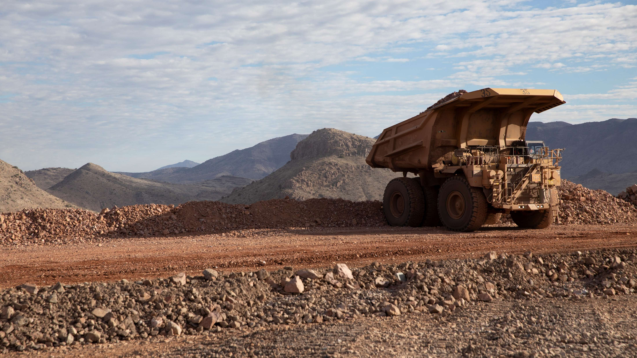
High-risk Incidents
Actionable and PFEs

Slide 12

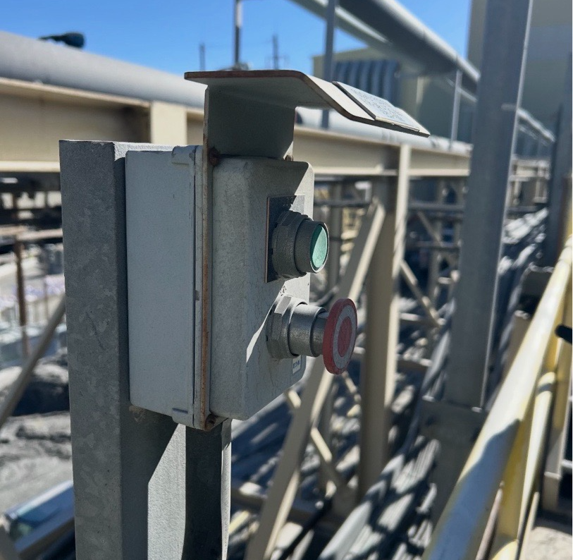
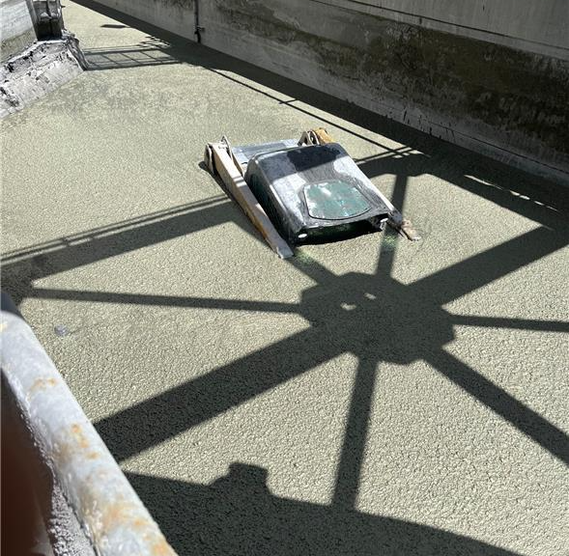
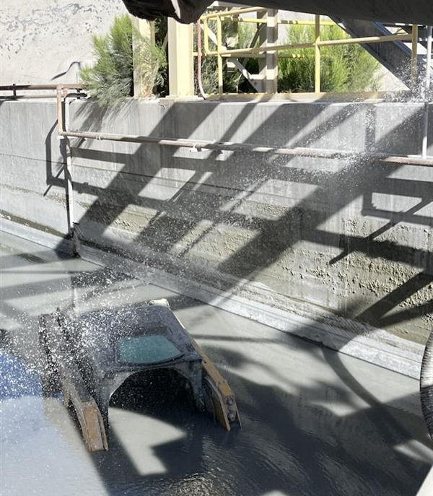
Slurry Buried Skid Steer
ID # 2026-10 Event ID # 20035986
Drowning
Preliminary Incident Details
Operation | Bagdad
Date / Time | May 5, 2026 / 1:40 p.m.
Event Type | Property Damage
Summary | An emergency stop (E-stop) at the rougher was inadvertently activated, causing a cell to plug and the rougher basement to flood with slurry. At the time, a small tracked skid steer was in the basement for cleaning but was inoperable and awaiting recovery. As the rougher concentrate box began to flood, the operator shut down the equipment, exited the cab and climbed onto the equipment. Using a pipe along the wall for support, the operator exited the basement by climbing over the side wall. Approximately 20 minutes after material began to flow, the skid steer was fully submerged in slurry.
Risk Category | Actionable – Significant (3) Likely (3)
Findings / Missing Controls | The estimated spill total was 525 dry tons, 1,751 slurry tons and 262,500 gallons of slurry. The skid steer operator had no indication the E-stop had been activated. The basement is designed to handle overflow; however, there is no warning or indication for personnel in the area when it begins to fill. The E-stop was accidentally activated and is not protected from inadvertent contact.
Immediate Action(s) | Perform audits on E-stop placement and clean-up procedures in sump pumps.
Applicable Policies / Procedures | No applicable policies.
Employee Condition | No injuries.
Contact | Rachel Adams, Manager-Health and Safety
Location of activated E-stop
Submerged skid steer
Path operator took to exit the basement, grabbing the pipe and climbing over the side wall.

Slide 13

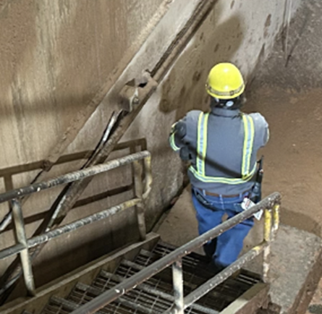
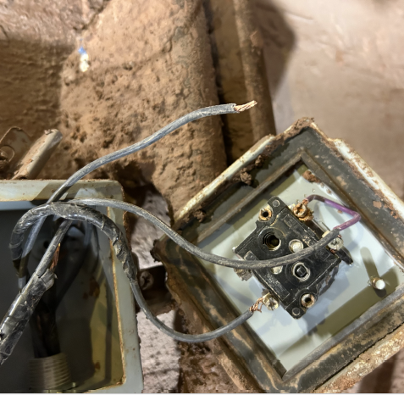
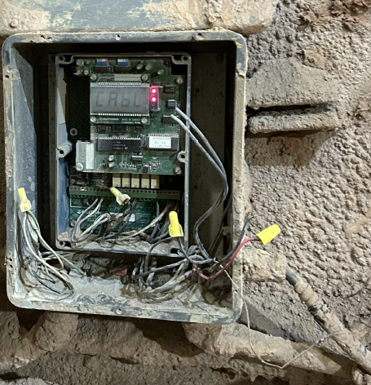
Employee Shocked by Switch
Exposure to Electrical Hazards
ID # 2026-09 Event ID # 20036135
Preliminary Incident Details
Operation | Morenci
Date / Time | May 12, 2026 / 3:30 p.m.
Event Type | Injury – First Aid
Summary | A Shared Services utility employee was performing cleanup in the Metcalf Fine Crushing Plant. While descending the stairs to start the sump pump, the employee contacted the selector switch at the base of the stairs and received an electrical shock to an ungloved hand. The electrical team investigated and identified an open ground at the sump switch, a loose wire contacting the metal switch casing and an open ground in the control panel. The voltage measured at the switch was 112.9 volts.
Risk Category | Actionable – Significant (3) Likely (3)
Findings / Missing Controls | A lever indicator was bridged directly to the selector switch, with exposed wire present upon investigation. Lack of GFCI in a wet area. The grating wall, switch cover and floors had been sprayed down and were wet from the cleaning activities.
Immediate Action(s) | Verify quality installation for all sump pump switches and make corrections to any deficiencies. Initiate process to change switch material from metal to plastic.
Applicable Policies / Procedures | FCX-HS03 Electrical Safety Policy
Employee Condition | Employee received minor shock between pointer finger and thumb.
Contact | Shyra Valdez, Manager-Health and Safety
Position of operator and contacted switch
Exposed wire in selector switch box
Level Indicator control box with open ground

Slide 14

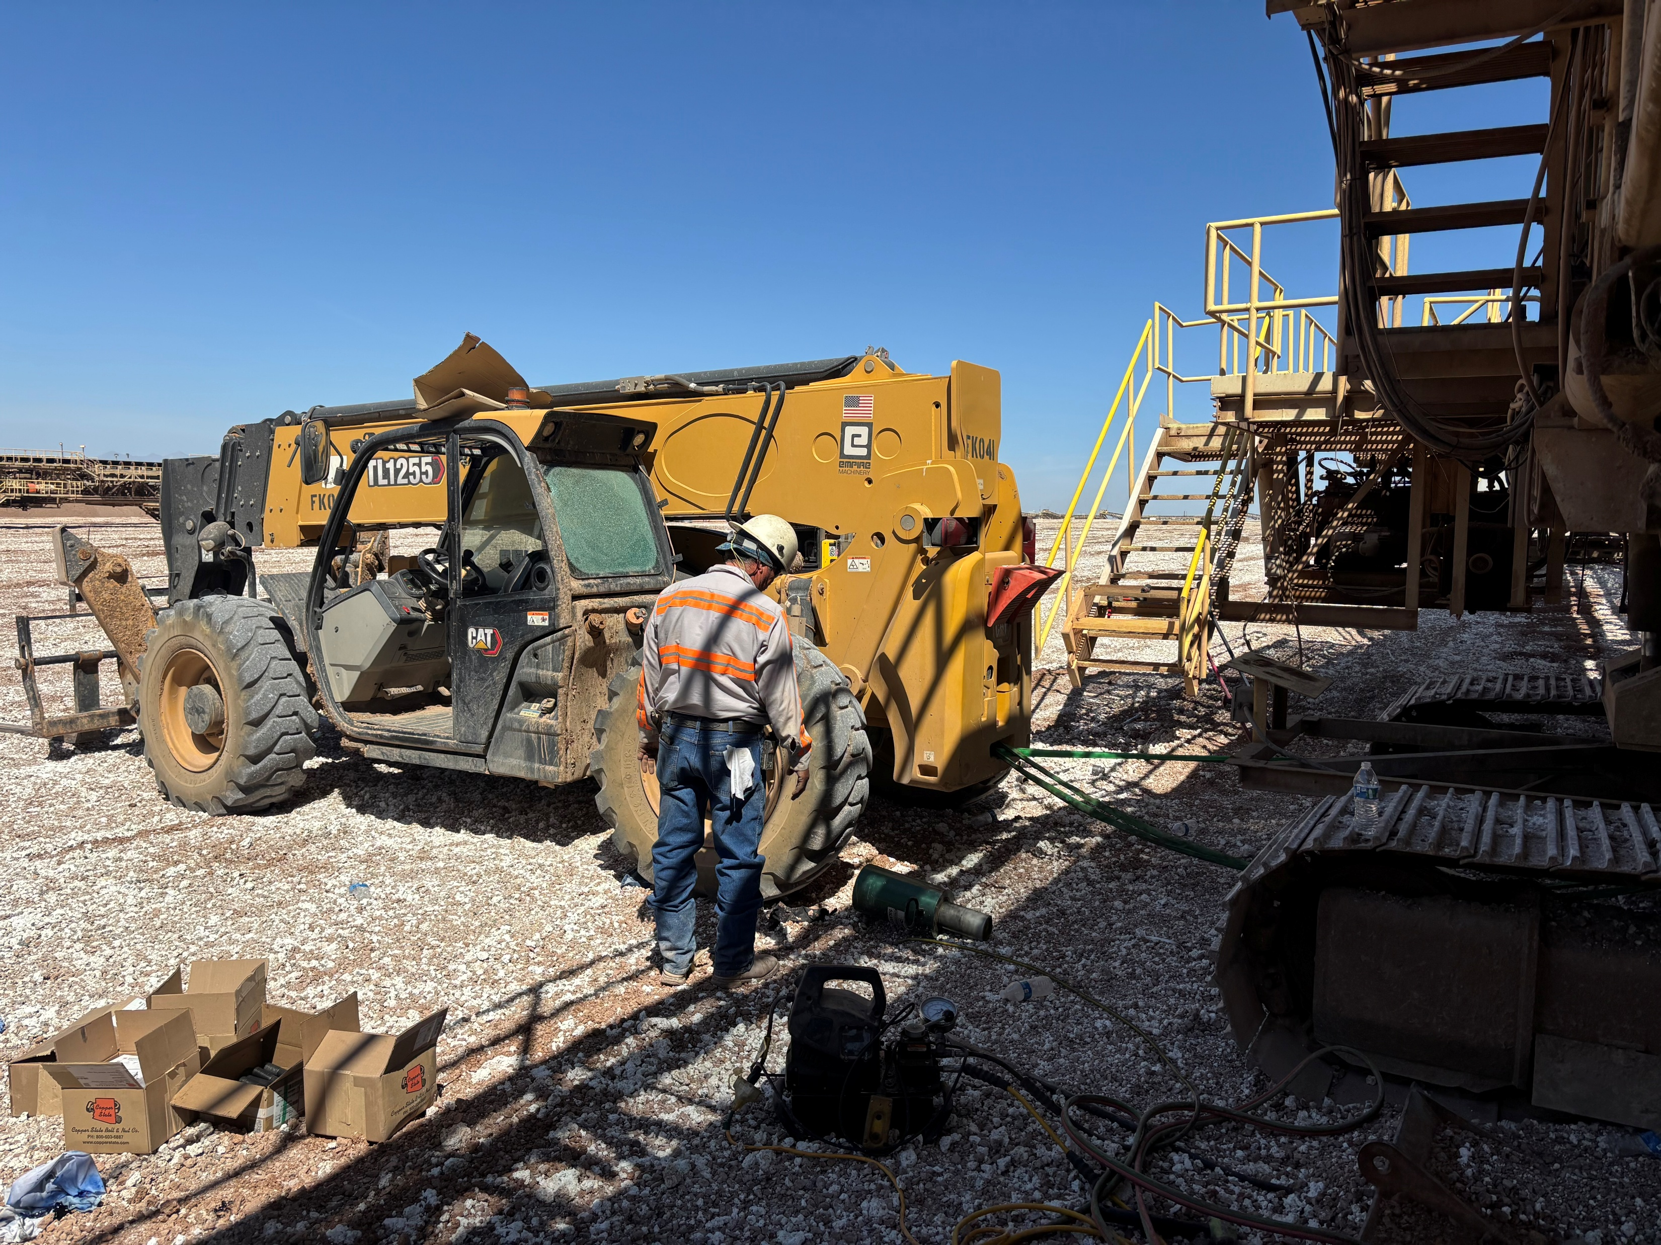
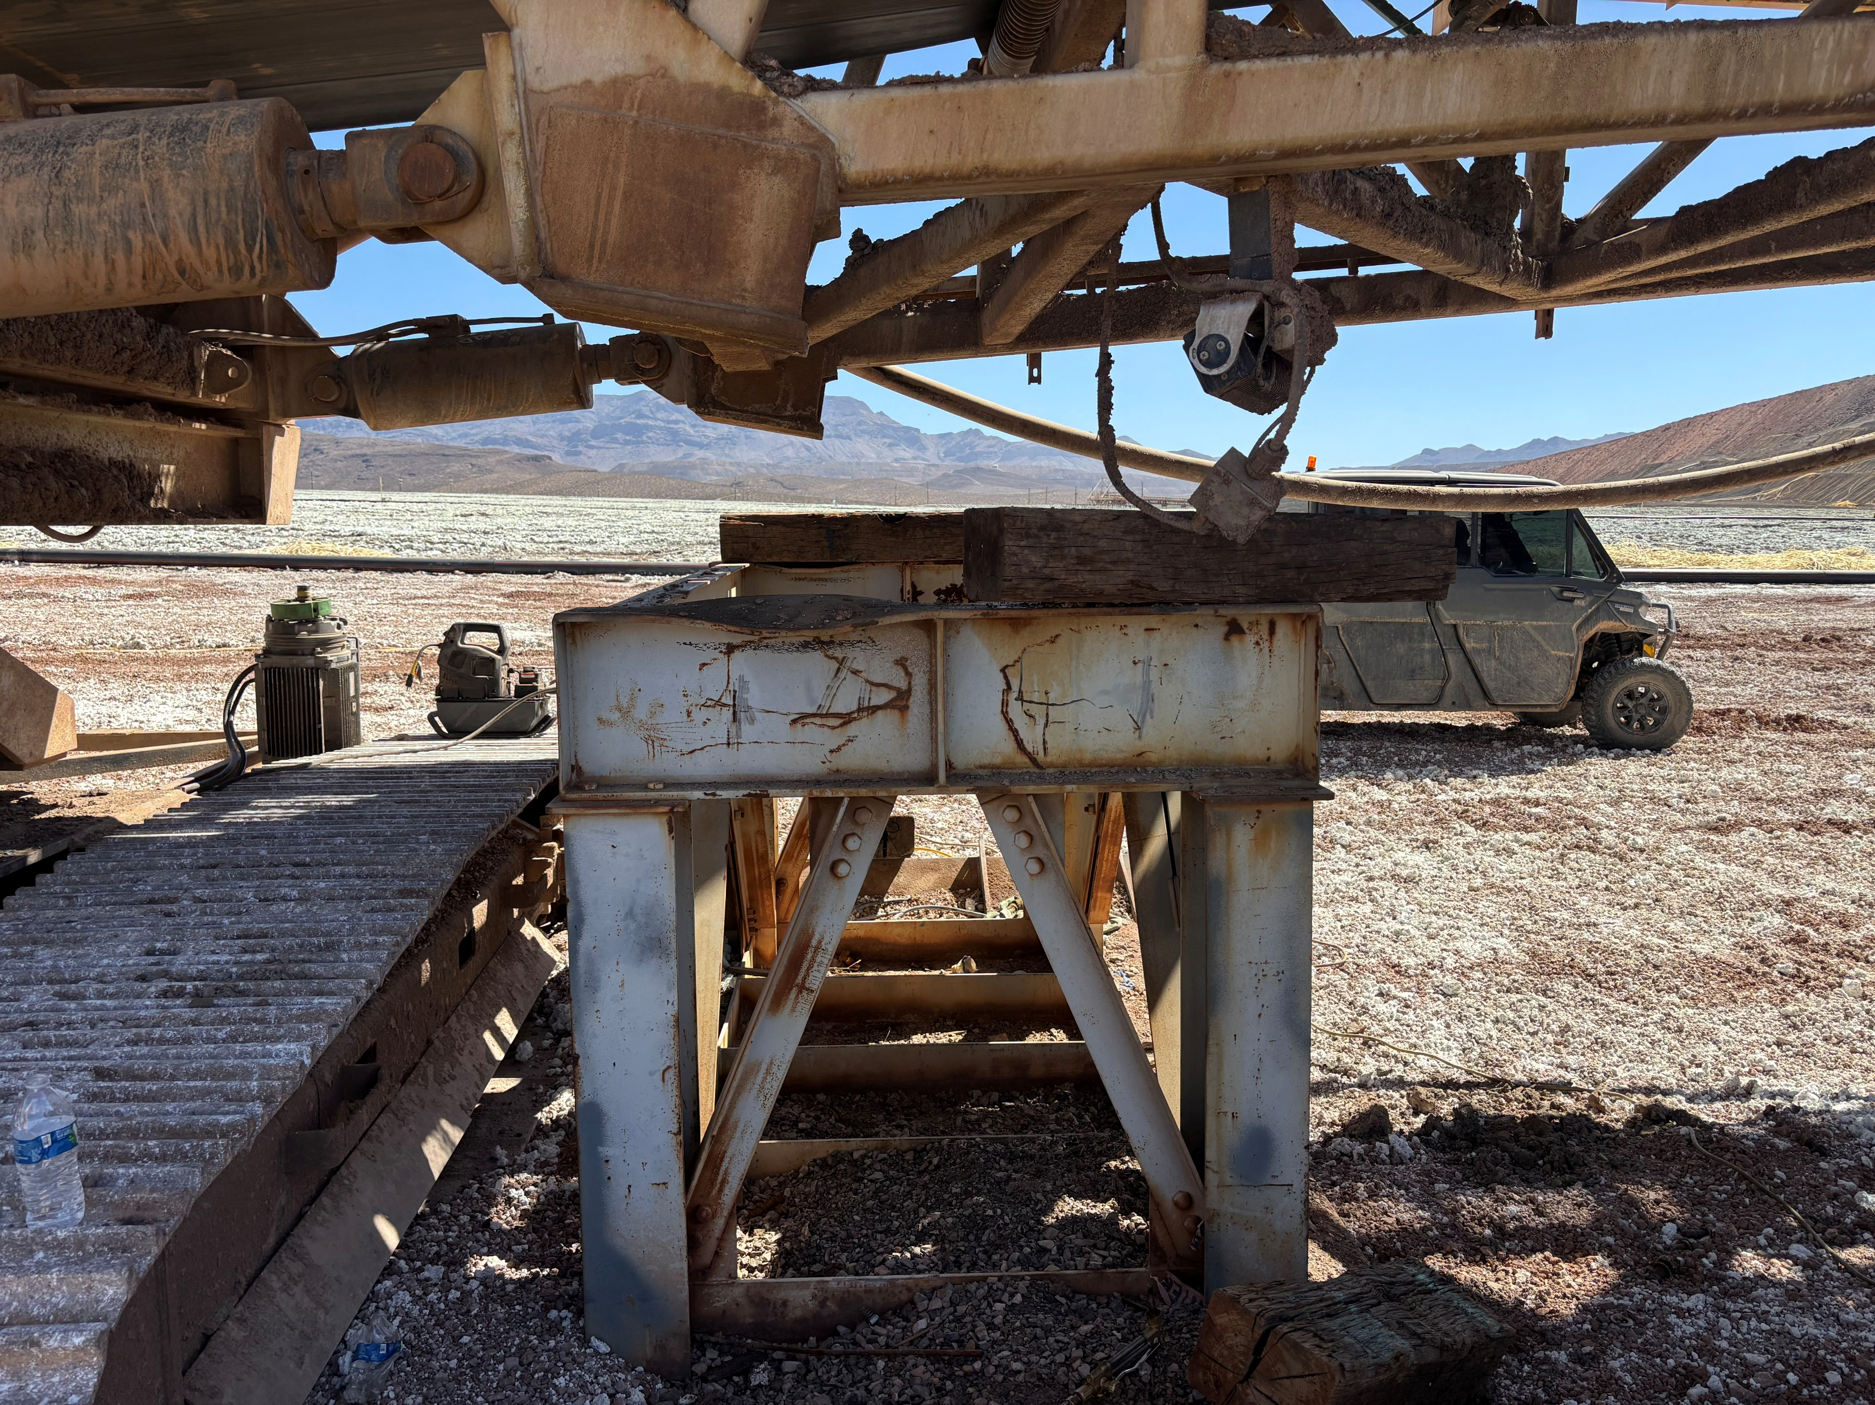
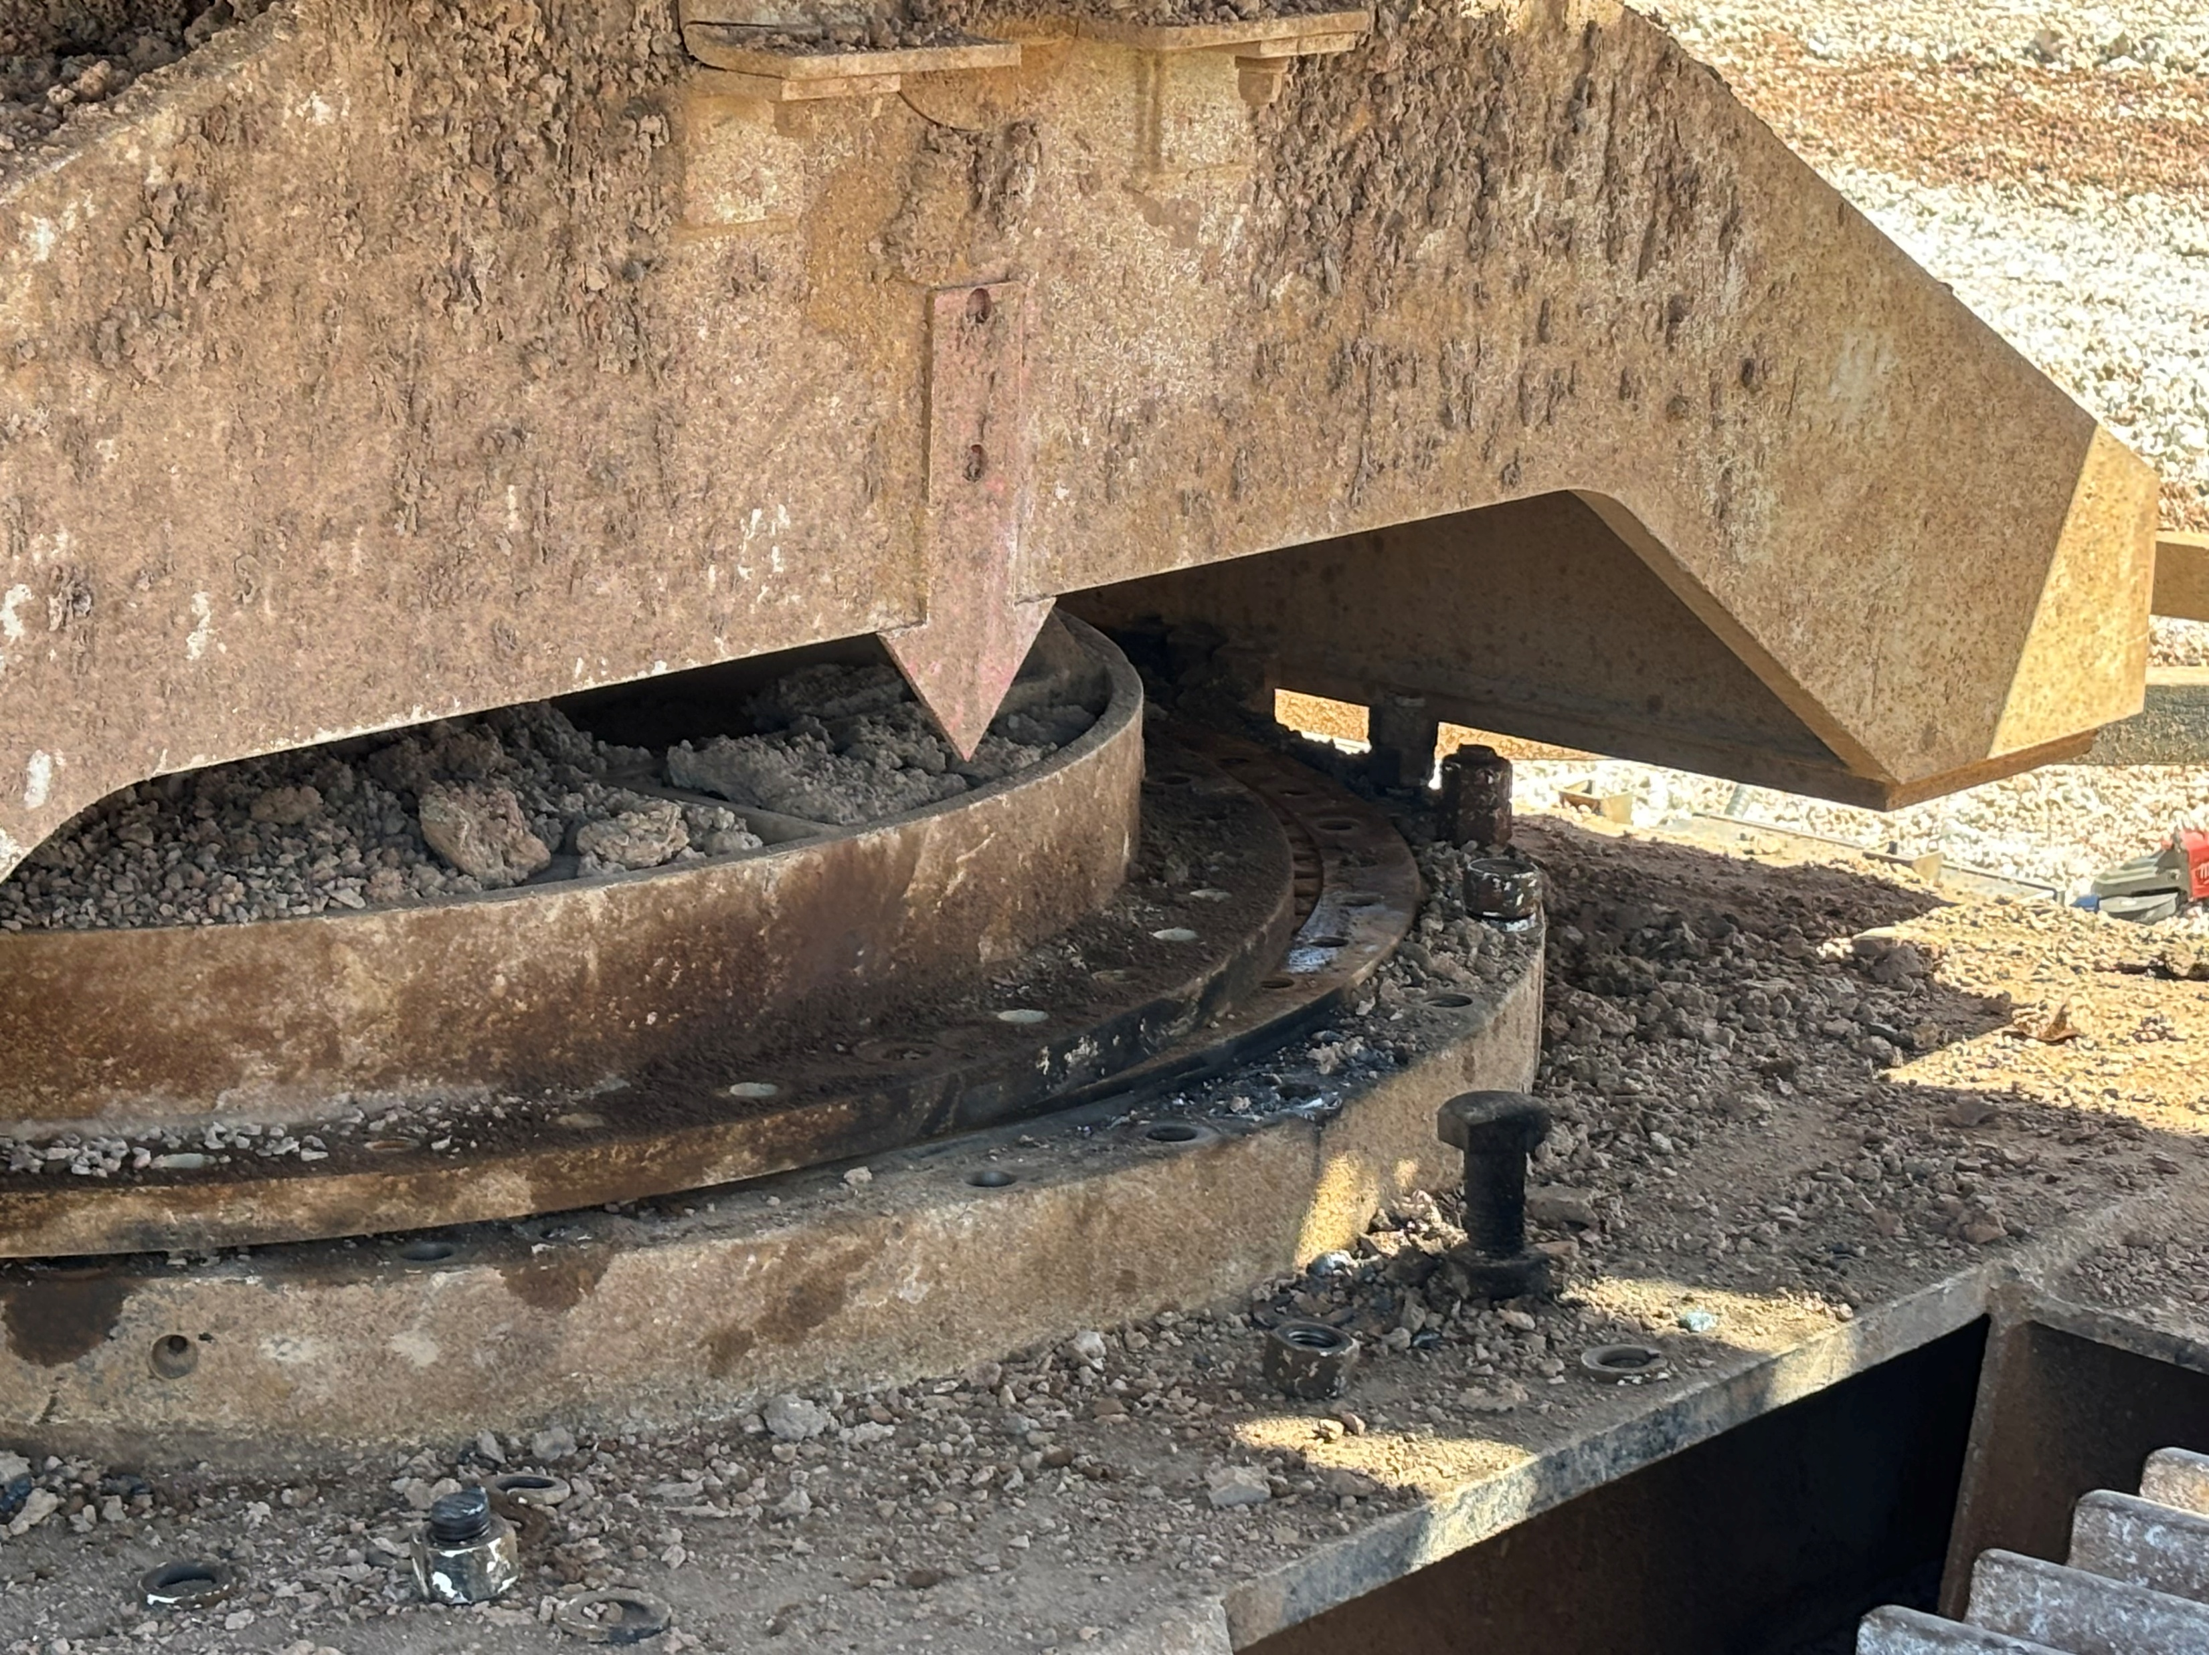
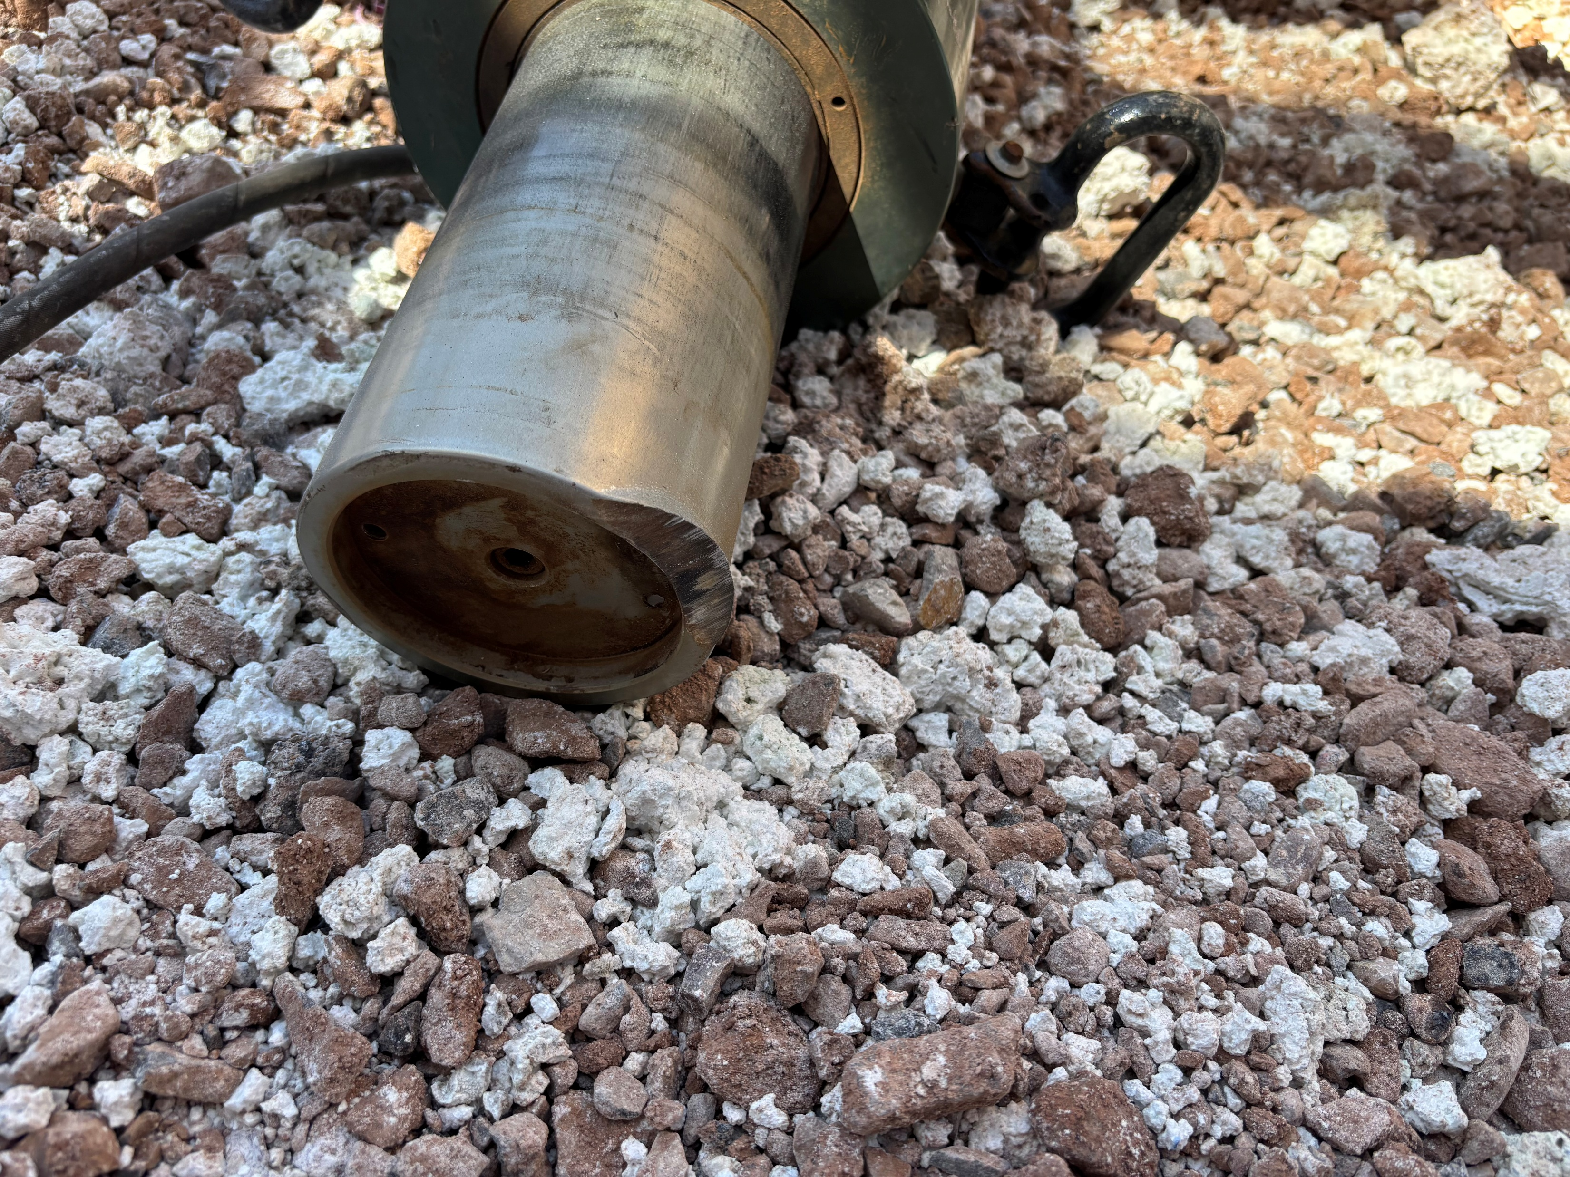
Employee Struck by Jack
Uncontrolled Release of Energy
PFE # 2026-06 Event ID # 20036347
Preliminary Incident Details
Operation | Safford
Date / Time | May 19, 2026 / 9:09 AM
Event Type | Injury - First Aid
Summary | Mechanics were replacing turret bearing on a portable conveyer and needed to remove the front car body. An engineered stand and two 100-ton hydraulic rams were used to lift the conveyor structure off the car body. An off-road reach forklift was used to tow the car body out from under the structure. A mechanic was spotting the rigging for the forklift operator and saw the upper swivel contact a bolt on the car body. They called for a stop, but contact was made causing the structure to shift. This caused the cribbing and jack (68 lbs.) to become dislodged and strike the spotter on the shoulder. The plug pad from the tip of the jack also ejected and broke the back window of the forklift.
Risk Category | Actionable – Significant (3) Likely (3)
Findings / Missing Controls | Failure to identify the potential for uncontrolled release of energy Improper clearance of bolts Improper jack usage Controls in place to manage vertical – not horizontal – movement
Immediate Action(s) | Communication on proper jack usage Re-evaluated job with Engineering and implement additional controls
Applicable Policies / Procedures | FCX-HS04 Control of Hazardous Energy Policy
Employee Condition | The employee sustained bruising on their right shoulder.
Contact | Shannon Jeans, Manager-Health and Safety
Reenactment of employee position during incident. The jack is at their feet.
The stand used to support the jack and cribbing.
Swivel bearing post incident – the point of separation.
The jack (post incident)

Slide 15

Industry Incidents

Slide 16
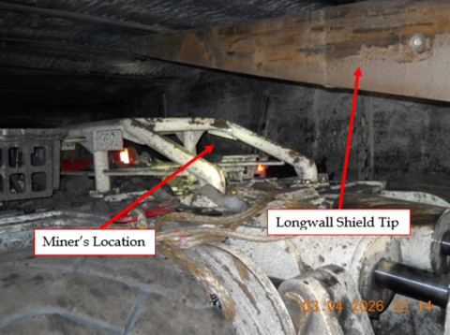
MSHA Fatality Alert
April 3, 2026 – A miner died after a scoop backed into another scoop that was transporting a longwall shield. This collision caused the longwall shield to shift and pin the miner, who was working underneath it.
Eliminate Hazards and Prevent Injuries
Verify work areas are clear and that miners position themselves away from potential hazards, including potential pinch points, when moving or positioning equipment.
Securely block equipment against motion.
Provide adequate illumination for miners performing maintenance.
Wear reflective clothing to aid visibility when working around mobile equipment.
Communicate your presence and intended movements when working near mobile equipment and wait for acknowledgment before moving.

Slide 17
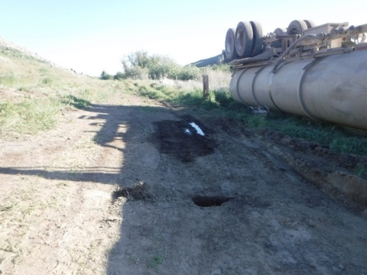
MSHA Fatality Alert
April 30, 2026 – A miner died while filling an uncoupled water tank semi-trailer when it overturned.
Eliminate Hazards and Prevent Injuries
Park mobile equipment and trailers on level ground and properly chock the wheels before beginning any task.
Confirm landing gear of trailers is firmly positioned on stable support.
Conduct examinations of equipment and correct potentially hazardous conditions prior to performing tasks.
Never work on or near equipment that could move unexpectedly; secure equipment against rolling or shifting.

Slide 18
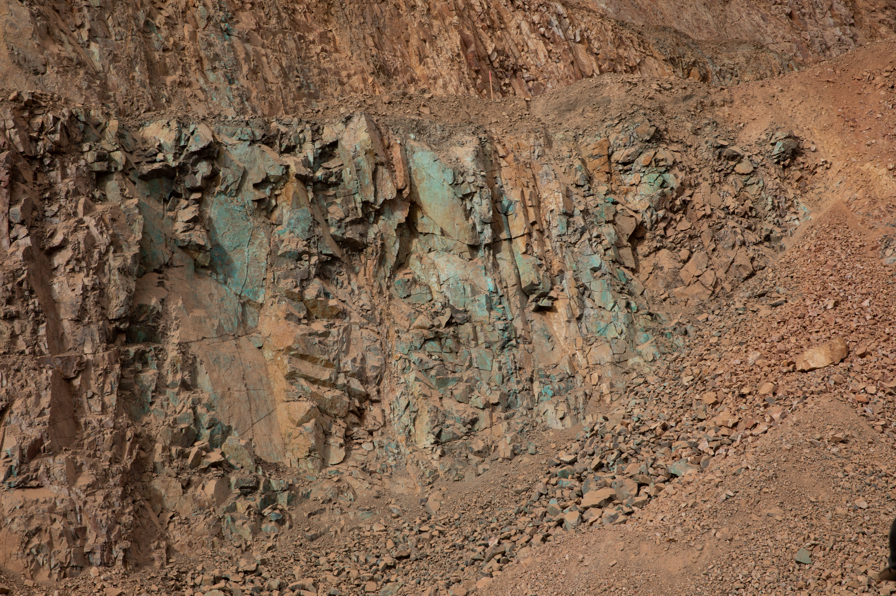
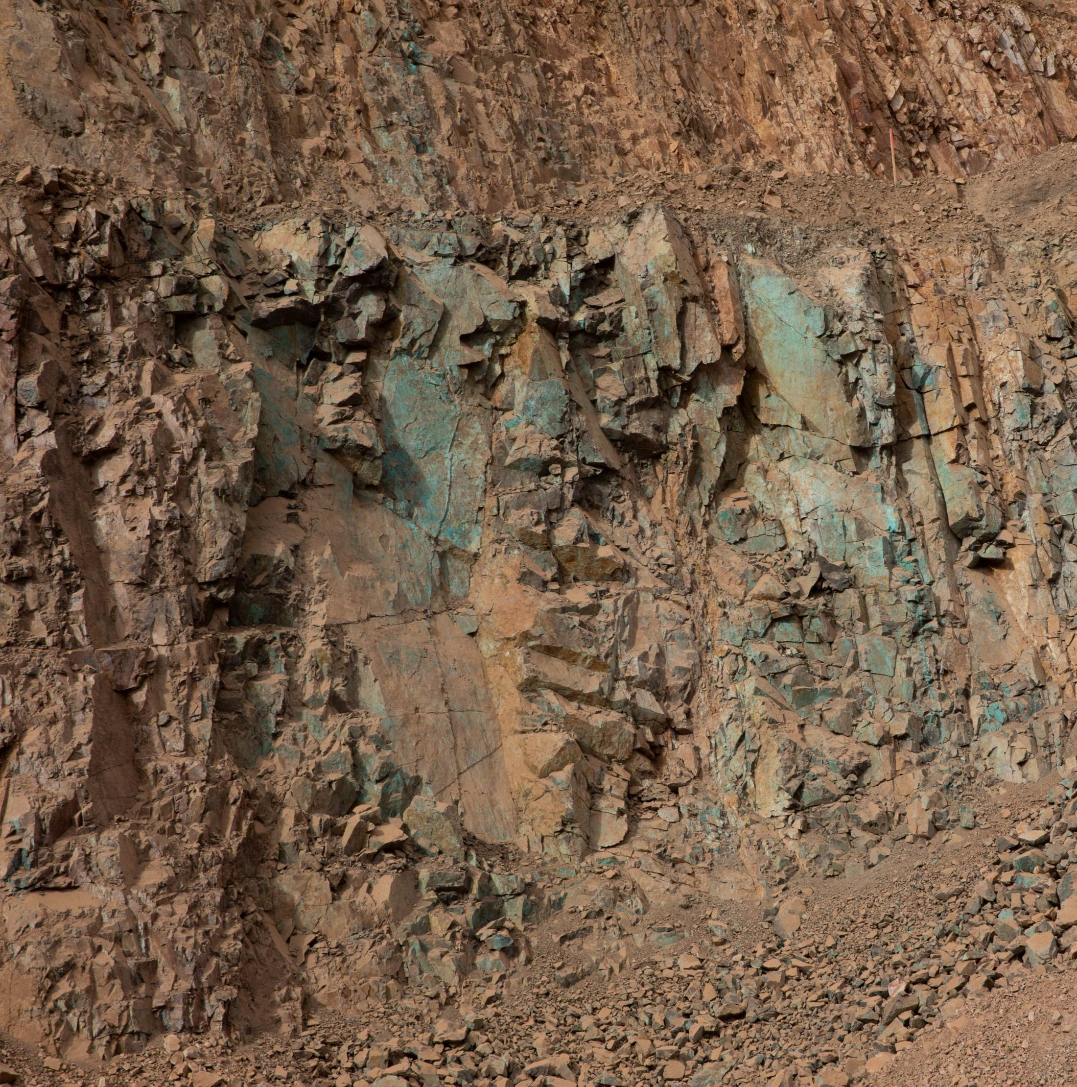
Site Incidents

Slide 19
Henderson Incidents
05/02 – Two Employees exposed to molten material a Crusher (Near Miss)
  Employees air-lance cutting at crusher when gas and molten material ejected from concave liner
  Employees wearing full heat suits/PAPRs and protected from injuries
05/06 – Underground LHD almost reversed into passing buggy (Near Miss)
  Loader mucking in 523 near 5XC-1 when buggy approached thinking loader allowing to pass
  Loader began backing up and buggy operator noticed and reversed to nearby cutout avoiding potential collision
05/14 – Employee opened PT Service Cage gate when cage not at station (Near Miss)
  Employee approached the gate and opened roughly 6 inches before stopping when nearby employees' notices and shouted
  Ongoing initiative to interlock station gates when cage not present

Slide 20
Henderson Incidents
05/28 – Mill North Gate Damaged by CONEX (Property Damage)
  Contractor escorting delivery truck with CONEX noticed damage to gate after passing
  Gate automated timer had initiated and attempted to close gate while CONEX was underneath and moving
05/29 – 50-ton crane moved without operator input while using remote controls (Near Miss)
  Crane remote malfunctioned causing low-speed, unplanned movement while in use aligning bullgear cover at Primary Mill 4
  Site standing down use of crane remote control devices as we evaluate cause

Slide 21
FRM Verification Results – May
183 verifications completed in May
Focus for May was around Hazardous Substance – Chronic and Exposure to Electrical Hazards
Exposure to Electrical Hazards missing controls increased, spurred by multiple missing arc flash labels (to be addressed during Extended Shutdown)
Haz. Sub. – Acute increased from lack of SDS review prior to chemical handling
FOCUS FOR JUNE/JULY:
Exposure to Electrical Hazards
Hazardous Substances - Acute

Slide 22
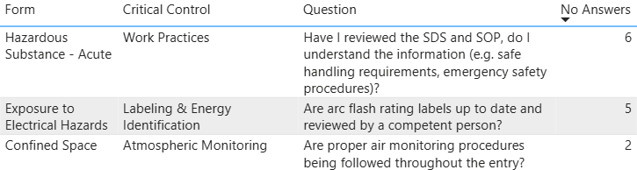
FRM Verification Results – May
Henderson Missing Controls with Multiple No Responses

Slide 23
Q2 2026 MSHA Inspection Review

Slide 24
Citation Count
Henderson Q2 2026 MSHA Citations | S&S | Non-S&S | All Citations
Mine | 4 | 19 | 23
Mill | 4 | 19 | 23
Contractors | 0 | 2 | 2
Total Henderson | 8 | 40 | 48

Slide 26
Notes:
Electrical doubled
Safe Access/Housekeeping level
Fire Extinguisher level
Guarding dropped

Slide 27
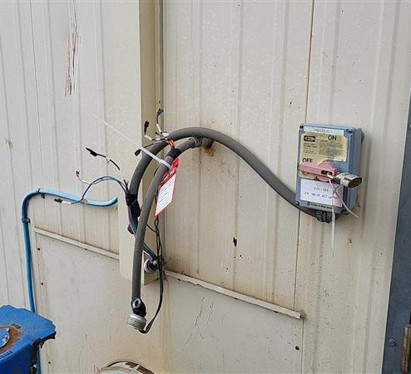
Big Hitters – Electrical (15)
Exposed wiring outside barge had 120V power (repeat from Q1 2026)
Missing light cover in Mill Reclaims with exposed socket
Portable 480V heater with exposed wiring
Damaged extension cord exposed wiring jacket
Shifted/warped electrical panel door could not be closed (ineffective mitigation of hazard)
Notes:
Exposed wires outside barge a repeat citation from Q1 2026

Slide 28
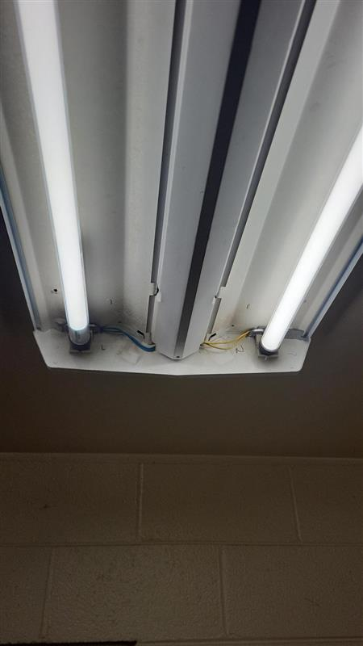
Big Hitters – Electrical (15)
Fluorescent lights missing covers and showing sheathed wires
Two 480V electrical panels access blocked by equipment
Electrical Panel in Dry with 2 mislabeled breakers
240V Inlet aerator not in use at buffer pond dock not current with continuity & resistance test
Pedestal grinder missing continuity and resistance test (repeat from Q3 2025)
Broken reset switches on two electric winches

Slide 29
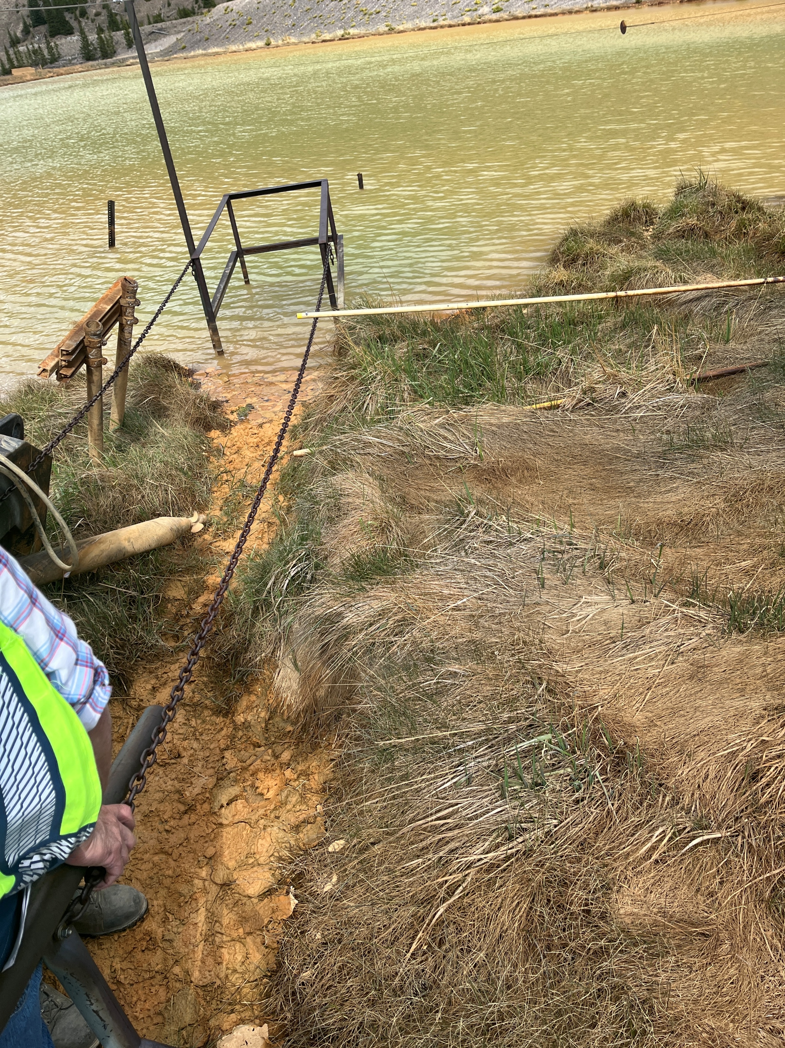
Big Hitters – Safe Access (7)
Safe access at buffer pond
Pallets and container blocking walkway safe access at Mine Haz Waste Building
Pallets with visible footprints blocking access to fuel tank at 7175 lube bay
Hoses in walkway at Cyclone deck
Hose in walkway at Leach Tank 4 upper deck
Hose in walkway at Thickener comb. UF pump
Hose and sump pump left out creating trip hazard at roughers

Slide 30
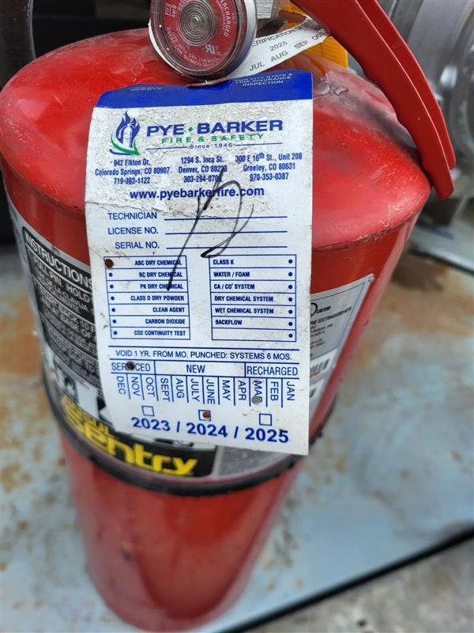
Big Hitters – Fire Extinguishers (6)
Rain for Rent Pump extinguisher out of date for annual
LA Ramp fire extinguisher missing monthly
Mill Reclaim Tunnel 2 with 2 extinguishers out of date for annual
Mill Reclaim Tunnel 3 with 1 extinguisher out of date for annual
Mill Pebble Belt 2 with 1 extinguisher out of date for annual
Mill Pebble Belt 3 with 1 extinguisher out of date for annual

Slide 31
Contractor Management Topics
- ISNetworld Update
- HSEP Update

Slide 32
ISNetworld Update
ISN Compliance
All contractors were required to upload and complete every training course (Core, Compliance, and Technical) along with Worker Acknowledgements in ISN by April.
  Henderson requested that all contractors finish their training uploads by June 15, 2026; otherwise, employees still showing as incomplete in ISN would begin to be denied site access.
    Most contractors are still working to finalize their training requirements in ISN, though very few have completed them.
  All training requirements must be completed no later than July 10, 2026.
    Henderson will then begin contacting contractors to advise that access will be denied to employees who lack the required training.
  Until employees are fully compliant in ISN, all contractors must keep all employee training documentation available on site or with the contractor’s PM onsite (for example, a project binder containing all training records).

Slide 33
HESP Update
HESP
Contractors must upload their signed HESP to ISN while keeping the original file name they were provided.
The signed HESP file name is set up so Henderson can readily locate the document within ISN. For example: 4.13.2026_HML_Mill Liner Change_Kippers
Badging
As no contractor responses were received, we are once again asking contractors to provide a list of employees currently onsite or expected onsite. Please send this list to Tina Michaelis, GSC Superintendent, at tmichael@fmi.com by July 1, 2026.

Slide 34

Open Forum

Slide 35
July 16th
August 20th
September 10th
October 8th
November 19th
December 17th
2026 Meeting Schedule
Meetings begin 1 PM MST
Mine and Mill In-Person Options Monthly

Slide 36
June Sign-Off Record
_____________________
_____________________
_____________________
_____________________
_____________________
_____________________
_____________________
_____________________
_____________________
_____________________
_____________________
_____________________
_____________________
_____________________
_____________________
_____________________
_____________________
_____________________
_____________________
_____________________

