Slide 1
Henderson HSE Contractor Meeting – March 2025
03/20/2025

Slide 2
What is this Meeting?
Purpose:
For Henderson to have the opportunity to reach multiple contractors to discuss best practices when it comes to Health and Safety, Environmental and Contracts Management
Give contractors an open forum to bring up concerns, successes or incidents, learnings, etc. that is shared between all contractors and Henderson personnel
Help improve the safety culture and reduce safety incidents as a group

Slide 3
Safety Topic – Electrical Safety
Authorized Personnel Only
Only electricians are authorized to perform electrical work.
Know Your Switching Limitations
0 – 300 Volts: All employees
300 – 600 Volts: "Green Label" trained personnel
600 Volts or greater: Qualified electricians only
De-Energize Electrical Equipment Before Work
Always de-energize electrical equipment before starting any work.
Lock out switches of de-energized equipment.
Label all breakers and switches properly.
Assume circuits are live until proven de-energized
Stay Aware of Surroundings
Look Up and Stay Alive – Watch for overhead powerlines
Call Before You Dig – Use Bluestake to identify hidden electrical lines
Following these guidelines helps ensure a safe working environment for all employees!

Slide 4
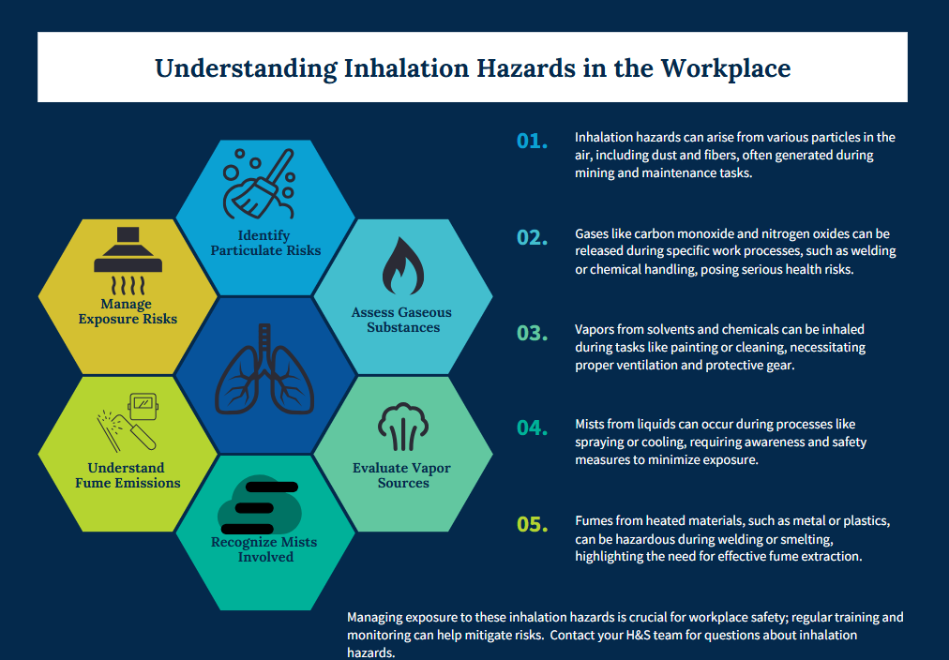
Safety Topic – Respiratory Protection

Slide 5
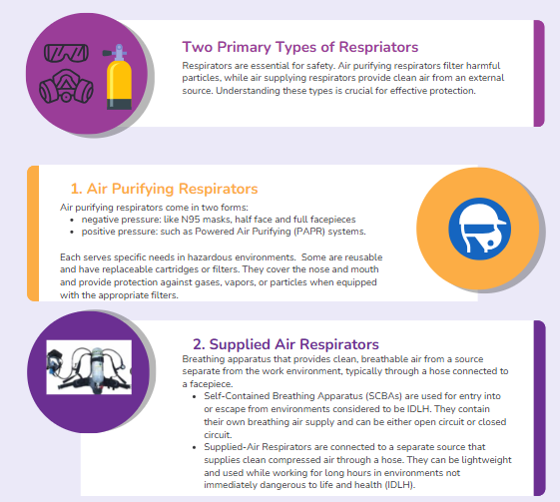
Safety Topic – Respiratory Protection
Henderson Operations Respiratory Protection Program
FCX-HS33 Metal Fume Control Policy

Slide 6
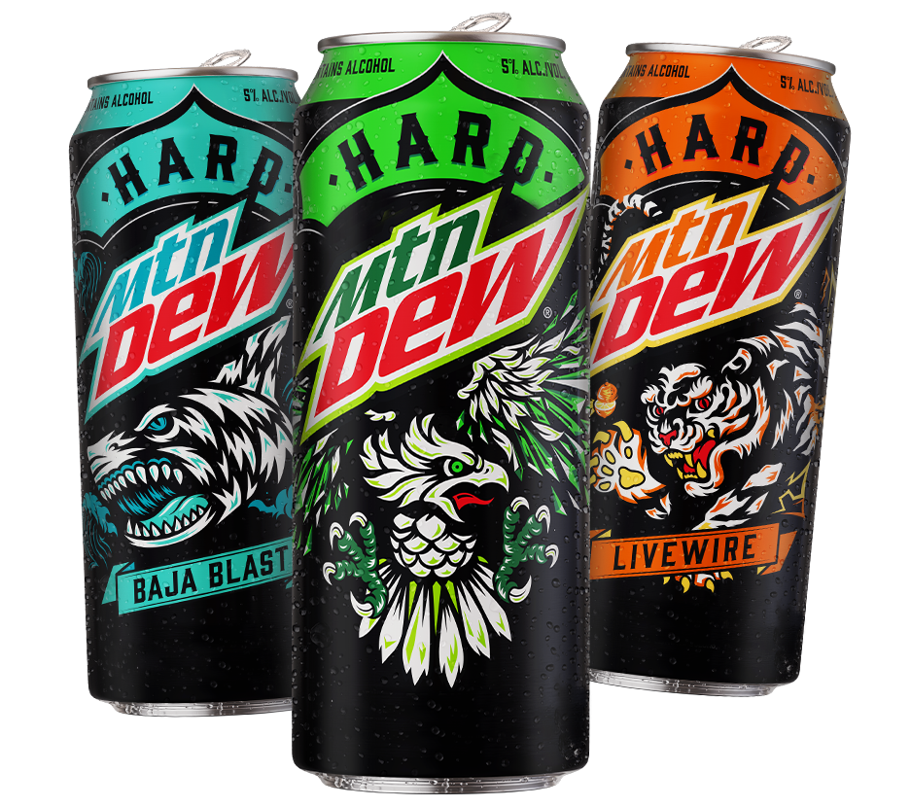
Safety Topic – Alcoholic Energy Drinks/Sodas
Frequently see employee/ contractors use energy drinks to manage long shifts
New products from energy drink and soda manufacturers containing alcohol tough to distinguish at a glance
Stay educated to protect yourself and your crews
Continue to promote healthy lifestyle options to manage Fit for Duty

Slide 7
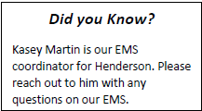
Environmental Topic – Environmental Management System
Henderson Mine and Mill have an ISO 14001:2015 certification for our Environmental Management System
Performance evaluations of the Henderson EMS are conducted in several ways:
Environmental monitoring
Annual internal audit
Annual external audit
2025 Internal Audit conducted this month
0 Non-Conformances!
6 Observations
1 Recommendation

Slide 8
Potential Fatal Events (PFE)

Slide 9
Potential Fatal Events (PFE)

Slide 10
High Risk/Actionable Events

Slide 11
High Risk/Actionable Events

Slide 12
High Risk/Actionable Events

Slide 13
Safety Alerts/Contacts

Slide 14
Safety Alerts/Contacts

Slide 15
MSHA Fatality Alerts

Slide 16
MSHA Fatality Alerts
February 28, 2025 Fatality
Accident Classification: Fall of Face, Rib, Side or Highwall
Mine: Black Eagle – Raleigh, West Virginia (Underground, Coal)
Preliminary: Miner died when a piece of rock fell from an unsupported pillar rib and struck him.
March 5, 2025 Fatality
Accident Classification: Powered Haulage
Mine: ARROWOOD - Mecklenburg, North Carolina (Surface, Granite)
Preliminary: A miner died while clearing strips of old belt rubber from a belt conveyor tail roller. During this process, the belt conveyor started to operate, causing the miner to become entangled in between the fluted tail roller and the belt.
March 5, 2025 Fatality
Accident Classification: Explosives and Breaking Agent
Mine: Calhoun Quarry #1 - Jersey, Illinois (Surface, Limestone)
Preliminary: Victim was exiting the Front End Loader when he was struck by a piece of fly rock from a detonated shot.

Slide 17
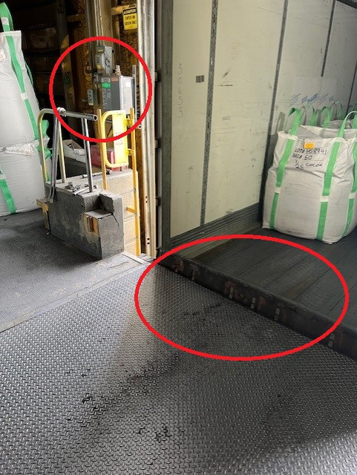
Henderson Incidents – 02/10-03/10
Summary: Property Damage 03/06
Packing Dock ramp damaged after employee raised the ramp to remove loose straps in the back of a trailer. Ramp not fully extended after straps removed causing damage to ramp and “Safe to Enter” light to give a false positive.
Learnings:
Take the time to verify controls are returned to effective state if deviating from process/SOP
Trust but verify indicator lights

Slide 18
Henderson Incidents – 02/08-03/08
Summary: Property Damage 03/08
Mucker operator was mucking out of 615 North and hit 480 nip (electrical cable) in 6XC. Roadway was slick in area.
Learnings:
Slow down equipment operation to meet driving conditions

Slide 19
Henderson FRM Audit Results
137 Forms Submitted in February
Focus in January and February around Electrical Hazards and Underground Rockfall
Hazardous Substances Acute and Chronic missing controls increased in February
AUDIT FOCUS FOR MARCH AND APRIL:
Underground Rockfall
Hazardous Substances – Acute
Hazardous Substances – Chronic
Electrical Hazards

Slide 20
Contractor Management Topic – HSEP
Health, Safety and Environmental Plan (HSEP)
New process going into effect May 1st, 2025
Use FMI HSEP provided by GSC (HSEP EXAMPLE)
Approvals handled through DocuSign
Initial review meeting with Contractor, Project Manager and GSC
Signed off by Project Manager, Safety, Environmental and GSC
Existing HSEPs for projects do not need to be resubmitted
More info to be shared with Project Managers in April

Slide 21
Contractor Management Topic – Human Rights Impact
Our Approach
FCX believes respect for human rights is a business imperative
We believe all stakeholders should be treated with dignity and respect
Our core values of safety, respect, integrity, excellence and commitment underpin this imperative
We are dedicated to the recognition and respect of human rights wherever we do business.
FCX Human Rights Homepage
Embedding Respect & Due Diligence

Slide 22
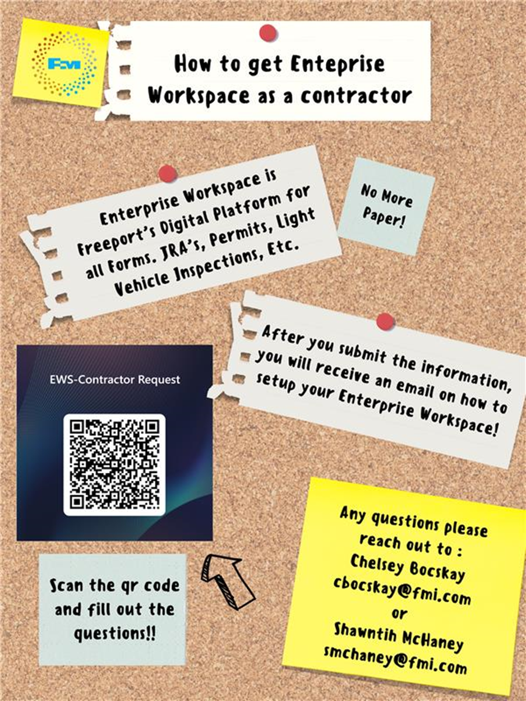
Contractor Management Topic – EWS Access
Access to site digital forms now available to Contractors!
Integration of Contractor submitted forms into internal dashboards
Forms can be used in online and offline modes
Request Access with QR Code or HERE
Reach out to H&S Department with any questions or issues

Slide 23
2025 Contractor Meeting Schedule
April 10th
June 19th
August 14th
October 9th
December 18th
May 22nd
July 17th
September 11th
November 20th
Meetings begin 1PM Mountain Time
Mine & Mill Room Options Monthly

Slide 24
Open Forum

Slide 25
March Sign-Off Record
_____________________
_____________________
_____________________
_____________________
_____________________
_____________________
_____________________
_____________________
_____________________
_____________________
_____________________
_____________________
_____________________
_____________________
_____________________
_____________________
_____________________
_____________________
_____________________
_____________________

