Slide 1
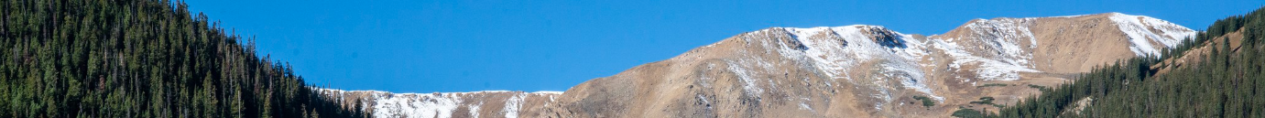
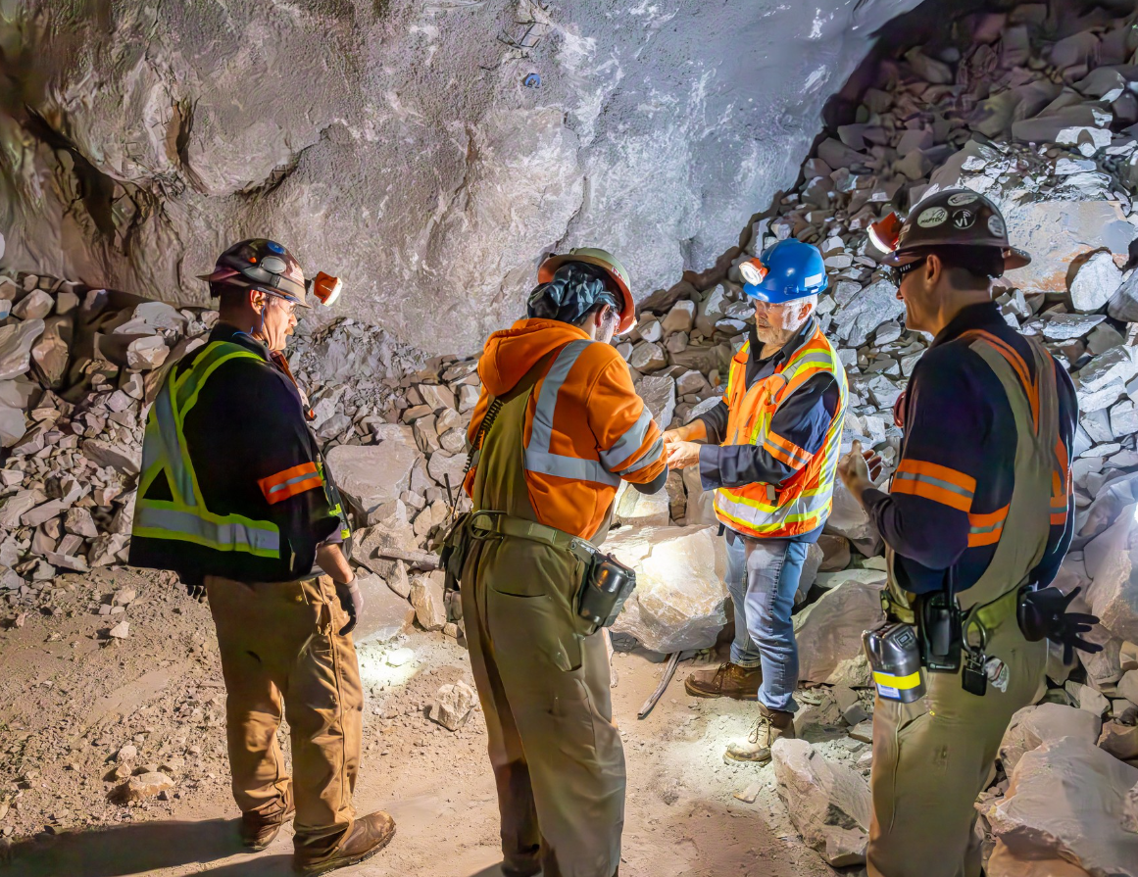

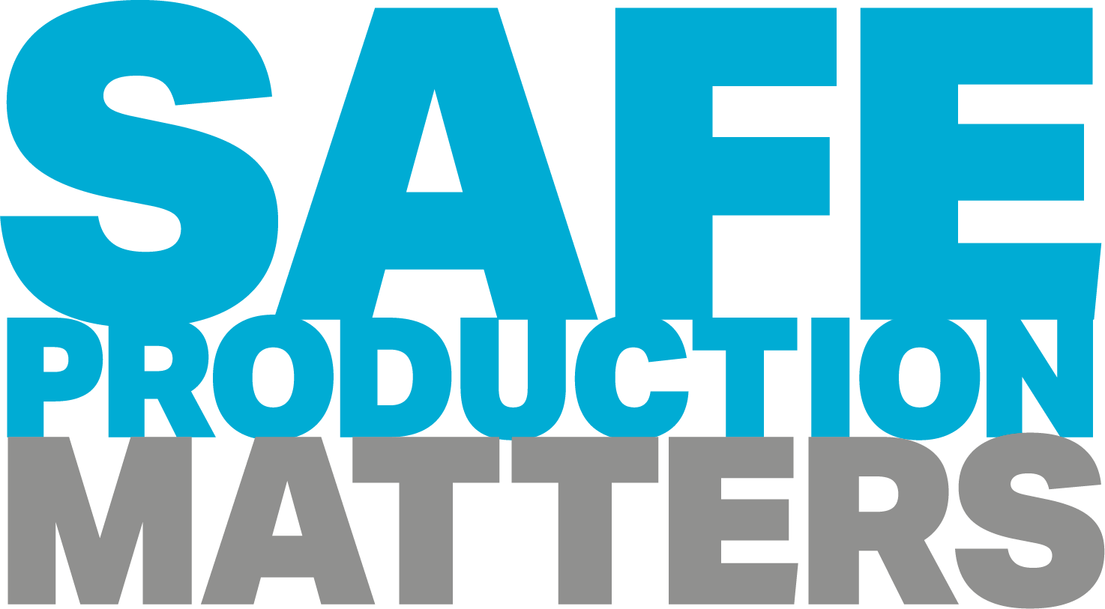
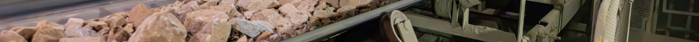
Henderson HSE Contractor Meeting
March 2026

Slide 2


What is the purpose of this Meeting?
- For Henderson to have the opportunity to reach multiple contractors to discuss best practices when it comes to Health and Safety, Environmental and Contracts Management
- Give contractors an open forum to bring up concerns, successes or incidents, learnings, etc. that is shared between all contractors and Henderson personnel
- Help improve the safety culture and reduce safety incidents as a group

Slide 3
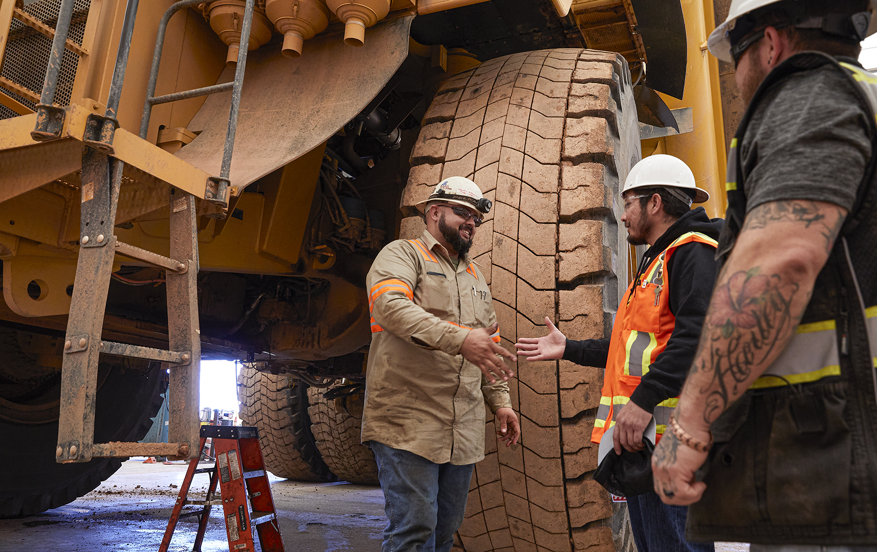
Safety Success

Slide 4

Spotlight On
Stop Work Success at Chino and Sierrita
REMEMBER
Across our operations everyday, employees speak up and stop work when if it’s unsafe or unclear. Stop work doesn’t have to be a grand gesture or big event – here’s two recent examples of stop work in daily work:
At Chino, Hydromet employees stopped work after spotting a failed light-fixture mount and secured the area until it was fixed. The light was hanging from the wires.
At Serrita, an employee identified a booster while prepping a dump, stopped work and immediately notified the appropriate people.
Each of us is responsible – and expected – to speak up and stop work if it’s not safe or unclear.
You can stop work any time, anywhere, under any circumstance.
No job is considered so important or so urgent that time cannot be taken to perform work safely.

Slide 5
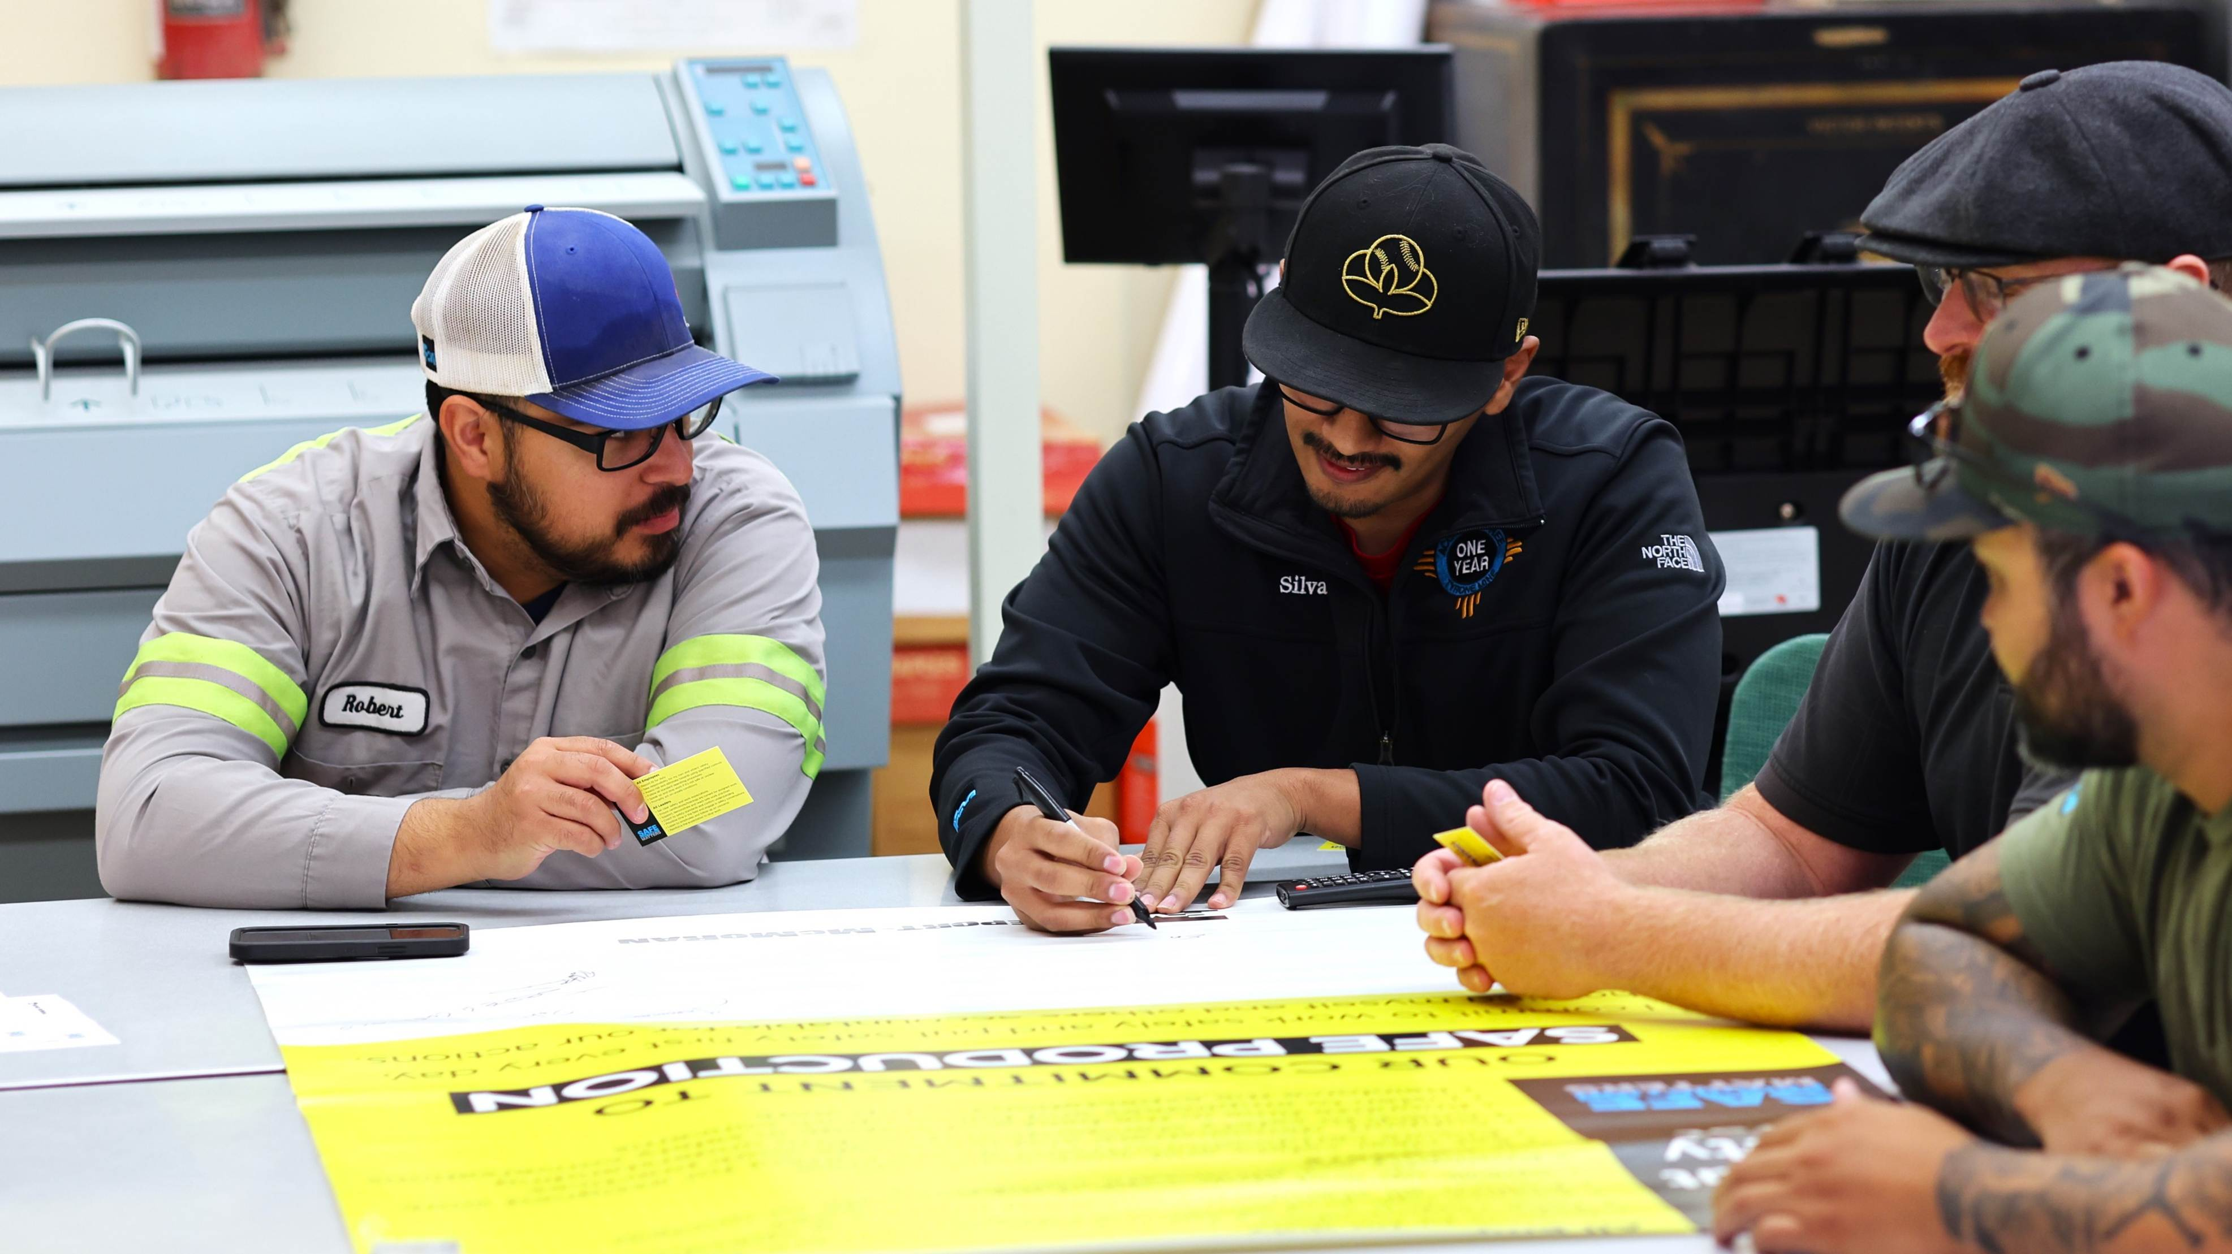
Safety and Environmental Shares

Slide 6

Protect Your Feet, Protect Your Ankles
Healthy feet and ankles are valuable to everyday work.
Uneven ground, ladders, heavy equipment and slick surfaces all increase the risk of slips, twists and sprains.
Wearing the right foot protection is one of the simplest ways to prevent ankle injuries.
Choose approved safety footwear that fits the job:
Wear boots with proper ankle coverage, a defined heel for stability and soles designed for site and task conditions.
Worn‑out tread, loose laces, or damaged boots reduce support and increase the chance of rolling an ankle.
Before you start work:
Check your boots are in good condition.
Make sure they’re laced and secured properly.
Replace footwear that no longer provides sufficient support or traction.

Slide 7

Coordination of Simultaneous Work
Every day, we have high‑risk tasks happening at the same time – lifting, hot work, working at heights, electrical work and moving heavy equipment. Because these tasks overlap, they require careful planning and attention. Think of it like an orchestra. Each instrument has its moment. If one starts too early or overlaps another, it creates noise instead of music. In the mine, each crew must work in harmony with others. Poor coordination can cause increased risks and unintended hazards.
Planning ahead is important. Before starting work, teams should know what tasks will be done, where, when, and how the task may overlap with others. This helps to identify risks and implement controls like restricted zones, barriers and communication protocols. It’s like tuning the instruments before the concert: if everyone knows when and where they should act, the result will be safe and efficient.
Everyone must stay alert, observe their surroundings and make sure planned conditions are maintained. If something changes during the work, teams need to stop and re-evaluate to avoid new hazards. Each activity must consider not only its own risks but also those it may create for nearby tasks. Like a musical group keeping time - if one instrument gets ahead or falls behind, it can affect the whole ensemble.
Good communication is key. Using radios, signals, signs and markings helps teams move safely, share updates and avoid confusion. This communication should happen all day, especially when starting tasks or when new teams arrive.
Safety is not improvised. It’s built like a well-tuned orchestra, where each member knows when to act, how to do it, and with whom they must coordinate and synchronize.

Slide 8
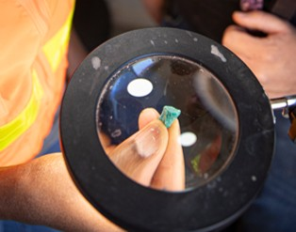
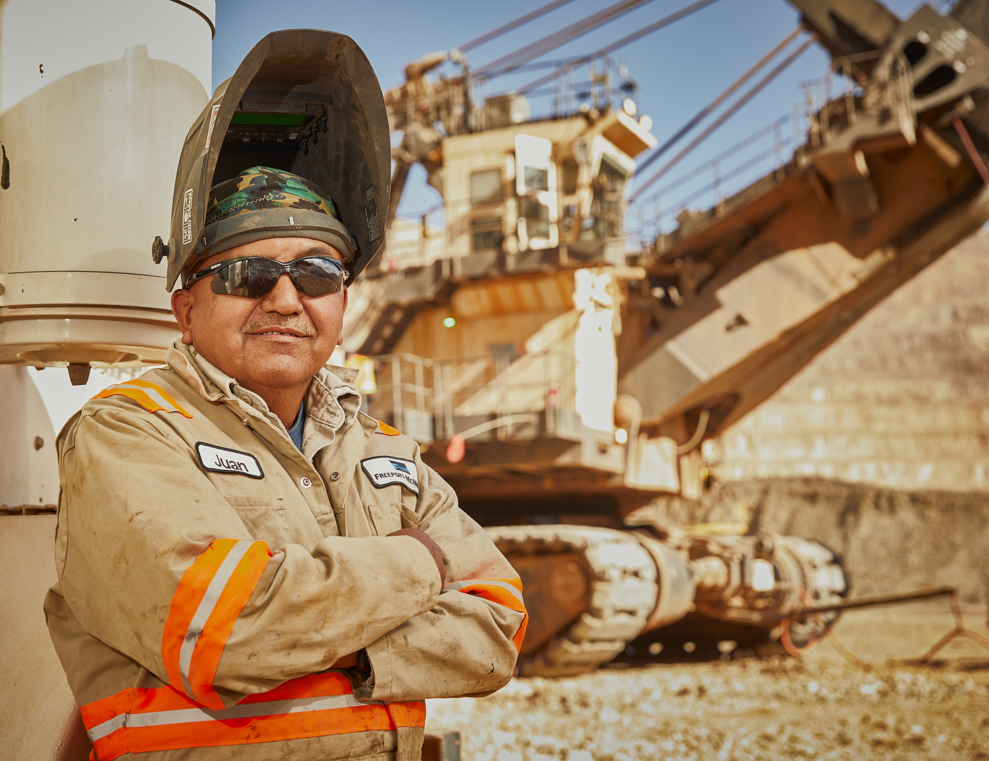

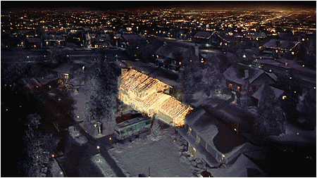

Environmental Share: Dark Skies

Slide 9

What are “Dark Skies”?
Henderson and Climax have collaborated to develop a Dark Sky Policy for our Colorado Operations. This policy establishes guidelines for Dark Sky initiatives that minimize light pollution at our sites. Climax’s goal with this policy is to opportunistically establish sustainable lighting practices that protect local wildlife, preserve astronomical visibility by reducing light pollution, and recognize local and regional community initiatives that promote responsible outdoor lighting.
What is Light Pollution?
Human-made alteration of outdoor light levels from those occurring naturally.

Slide 10
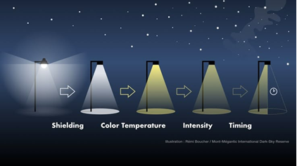
What does that mean for me?
Incorporate dark sky compliant lighting as safe opportunities arise.
Dark sky compliant lighting typically considers:
Shielding/Shrouds
Color Temperature
Intensity
Timers
Motion Sensors
Needs and Uses
Have a job or project to replace or add new lighting? Work with Environmental, H&S, and Electrical to look at incorporating dark sky compliant lighting.
See lighting that looks damaged or not illuminating the correct area? Write a Maintenance Request for electrical to troubleshoot, let a supervisor know, or contact environmental by coming to see us or giving on call 942-3603 a ring!

Slide 11
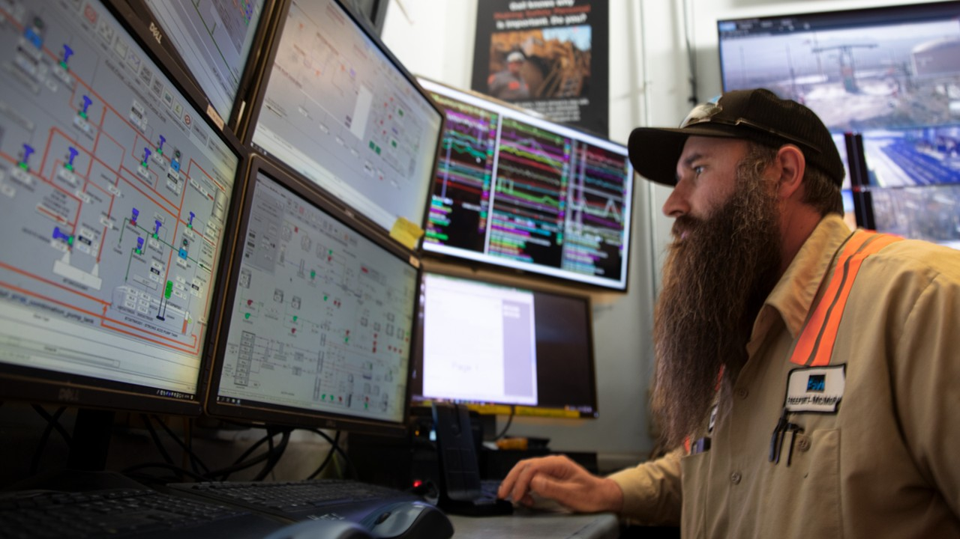
Policy/Process Updates & Reminders

Slide 12
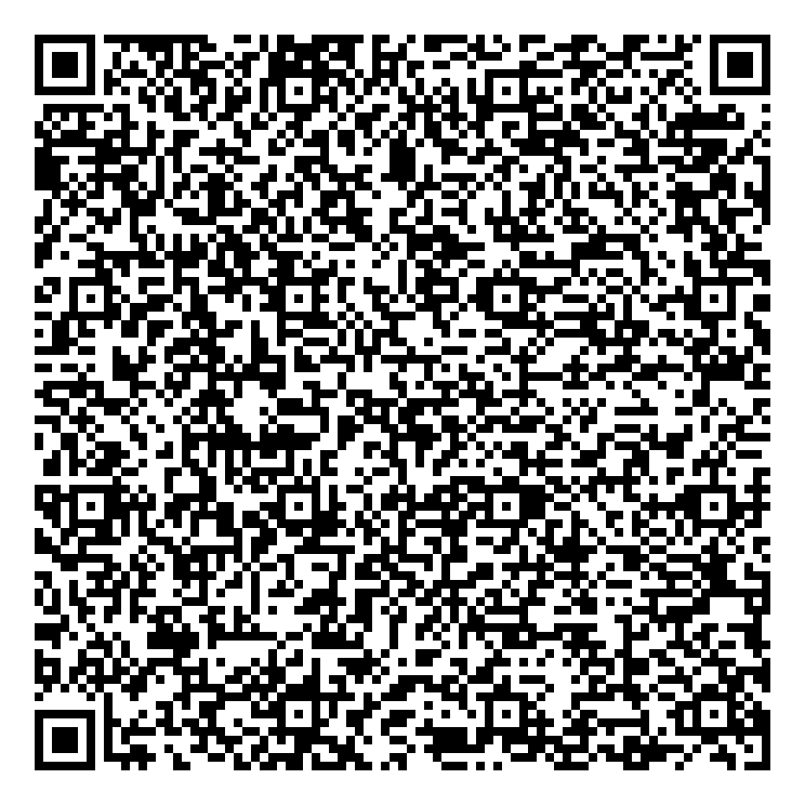
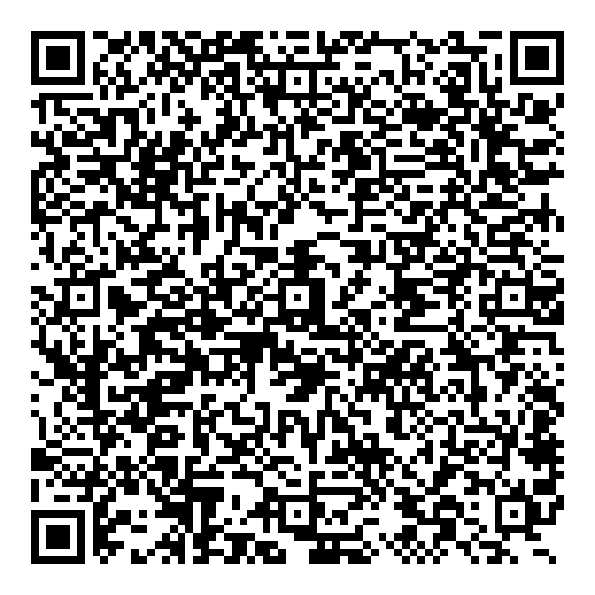
Form Update Workplace Exam Form
Learning Resources
Effective February 16, 2026 – Changes to the Workplace Exam (WPE) process were implemented to better support timely corrections of unsafe conditions in the field.
2-minute Video Tutorial
Scan or click here
Key Updates
WPEs now go directly to an employee’s assigned supervisor, with the option to send to an alternate – if needed – once the form has been submitted.
Supervisors receive forms for review when someone on their team submits a WPE.
Supervisors are required to review each WPE and verify risks are managed and corrective actions have been initiated.
Once reviewed, supervisors must sign the form to acknowledge all appropriate corrective steps have been taken and the WPE was reviewed.
Step-by-Step Instructions
Scan or click here

Slide 13
Policy Update FCX-23 Interaction with Heavy Mobile Equipment
Effective February 16, 2026 – FCX‑23: Interaction with Heavy Mobile Equipment-Surface has been revised.
Key Updates
This update is intended to further strengthen controls associated with vehicle collision and rollover, and vehicle–person interaction risks.
The revision addresses prior global action items, including new in‑pit passing procedures and a prohibition on backing down auxiliary ramps.
A new standard has been established for managing fatigue events detected through the Driver Safety System (DSS).
The Mine Community of Practice has set an expectation of a 12‑week window for sites to assess gaps and achieve compliance with the updated requirements.
Henderson is in progress of its gap analysis and roll-out led by Elie Poimboeuf (Mill H&S). Reach out to Elie with feedback.

Slide 14
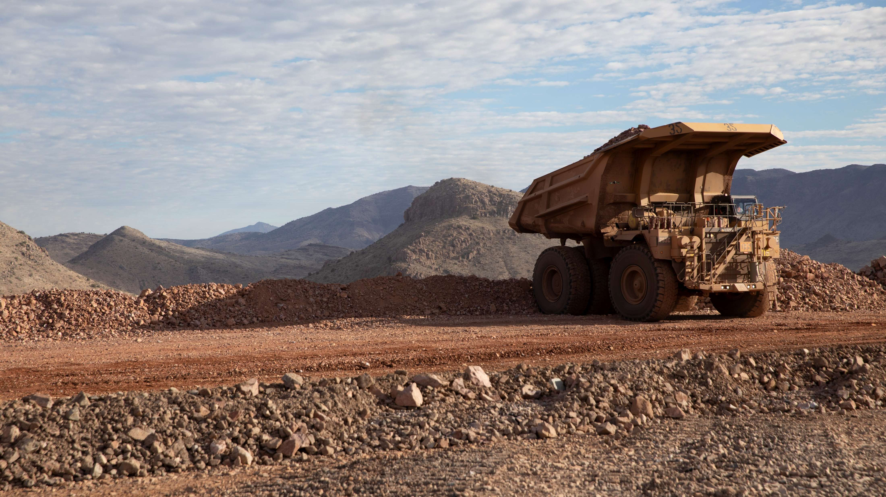
High-risk Incidents
Actionable and PFEs

Slide 15

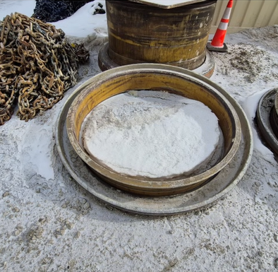
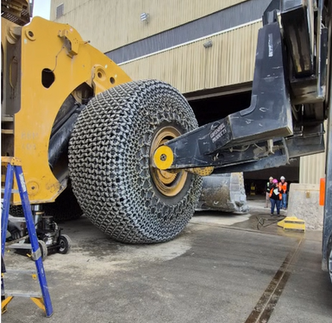
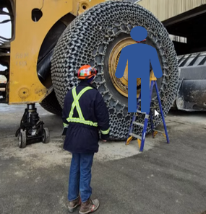
Loader Wheel Ring Fell During Maintenance
ID # 20033240 Event ID # 2026-04
Falling Objects
Preliminary Incident Details
Operation | Climax
Date / Time | January 26, 2026 / 10:30 a.m.
Event Type | Near Miss
Summary | While trying to change a tire on a 995 loader, the mounting flange and outer ring weighing about 900-pounds fell, struck and damaged a ladder. The ladder was placed in front of the wheel where a technician had been working.
Risk Category | Actionable – Significant (3) Likely (3)
Findings / Missing Controls | There is no standard operating procedure sequencing this task.
Applicable Policies / Procedures | FCX-23 Interaction with Heavy Mobile Equipment FCX-HS02 Working at Heights Policy FCX-HS31 Guidelines for Reporting Incidents
Employee Condition | No injuries.
Contact | Matt Main, Manager-Health and Safety Amber Fife, Lead-Health and Safety
Example of the outer ring that fell.
Reenactment of tire handler installing the ring and flange. During the incident, the tire handler arms were holding the outside diameter of the tire.
Image depicts the ladder position before the ring fell and where a technician would stand for this task.

Slide 16


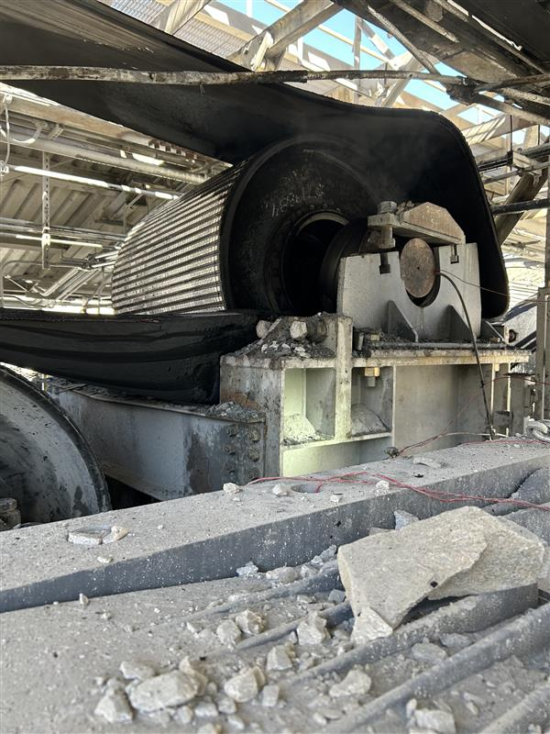
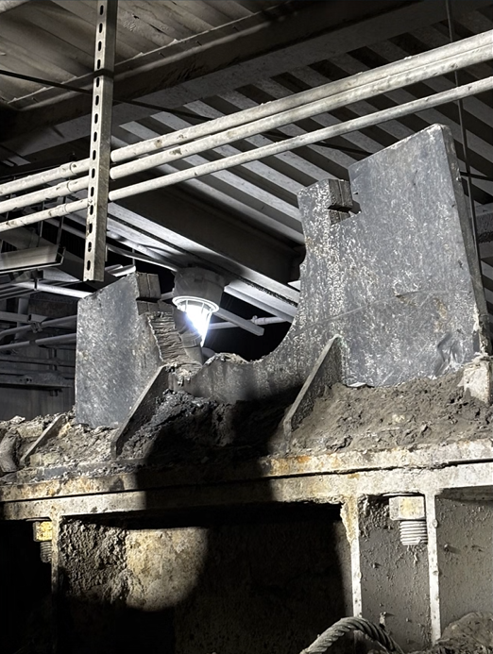
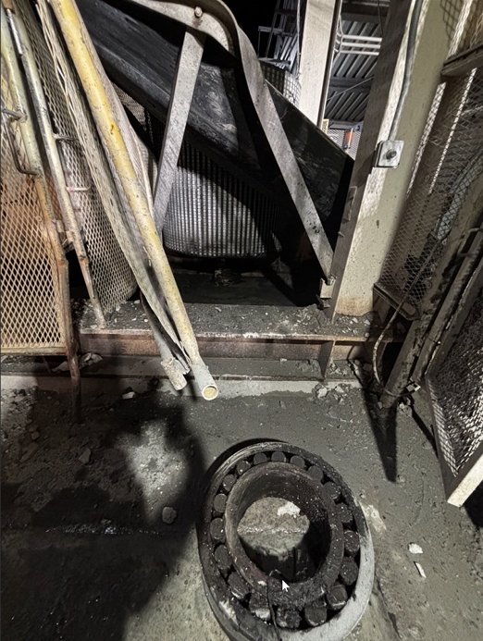
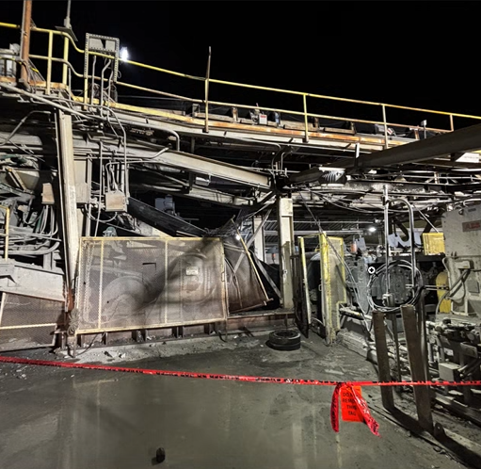
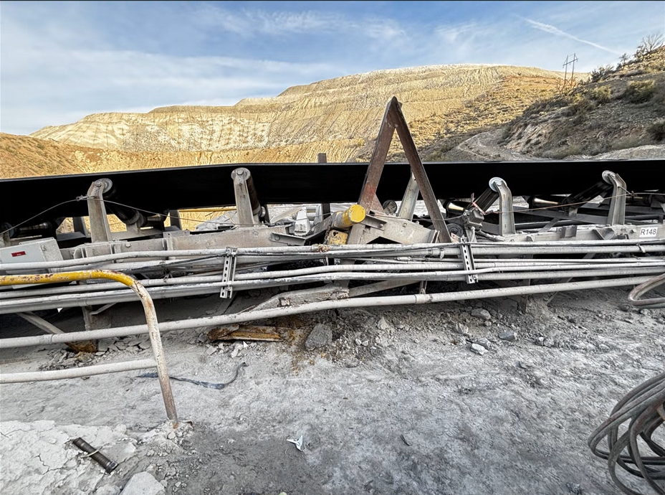
Pulley Fire and Belt Rolled During Maintenance
Uncontrolled Release of Energy
Fire
ID # 20033063 Event ID # 2026-03
Preliminary Incident Details
Operation | Bagdad
Date / Time | January 28, 2026
Event Type | Property Damage
Summary | A conveyor belt was fully loaded when it shut down due to a motor overload triggered by a side-traveling belt. The responding electricians and operator saw smoldering material, smoke and small flames at the primary drive snub pulley, which were extinguished immediately. As a result of the fire, employees were assigned that evening to replace the primary drive snub pulley. To facilitate the changeout, the counterweight was raised to create slack in the belt, and belt clamps were installed to secure the system. During removal, employees were unable to extract the pulley because it was lodged in the saddle block. After cutting the pulley free from the saddle block, the structure anchoring the belt clamp failed, allowing the belt to roll back 30-feet.
Risk Category | Actionable – Significant (3) Likely (3)
Findings / Missing Controls | The belt was fully loaded during maintenance. The structural integrity of the belt clamp frame was buried in material and in poor condition. The pulley that caught fire was being monitored by the Reliability Centered Maintenance team as the recommended replacement pulley was not currently available.
Applicable Policies / Procedures | FCX-25 Material Handling Conveyance Management Policy
Employee Condition | No injuries.
Contact | Rachel Adams, Manager-Health and Safety
Damage following fire.
Pulley saddle block after cut.
Pulley after being dislodged.
Location of pulley and damage structure following pulley removal.
Damage to belt line at belt clamps.

Slide 17
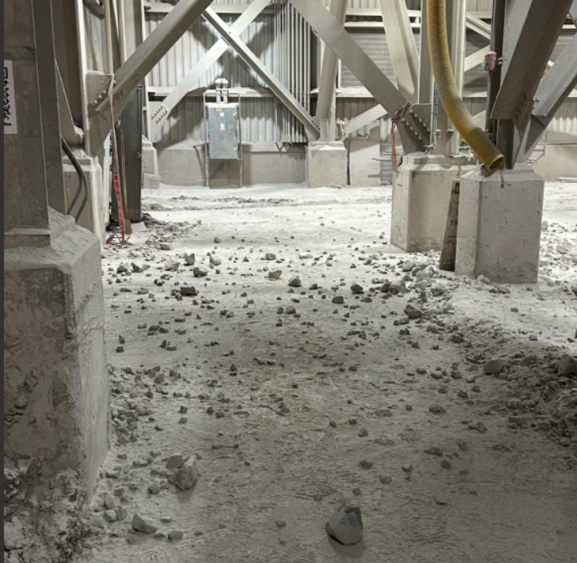
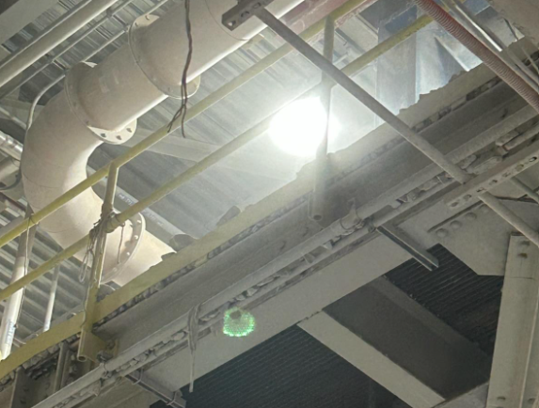
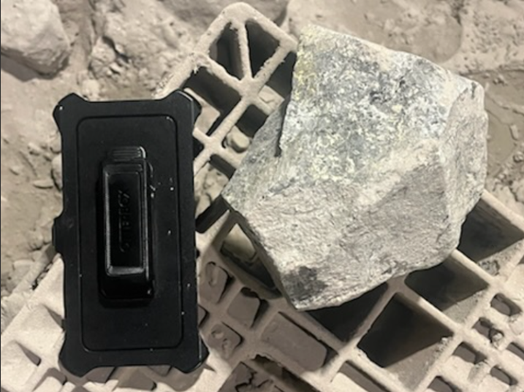
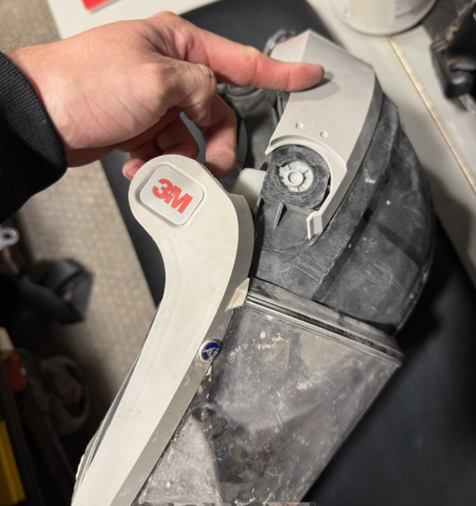
Rock Fell on Employee From Upper Deck
ID # 20033346 Event ID # 2026-01
Falling Objects
Preliminary Incident Details
Operation | Morenci
Date / Time | February 6, 2026 / 8:15 p.m.
Event Type | Injury – lost time
Summary | Two employees were checking a belt rip at the Metcalf screening plant. While exiting the screening plant on the lower level, a rock weighing about 6 lbs. fell an estimated 18.5 feet from the upper level over the toe board. The rock struck one employee on the head/PAPR, breaking the hinge on the PAPR.
Risk Category | Actionable – Significant (3) Likely (3)
Findings / Missing Controls | The skirting was popped off the screen on the upper level, allowing material to fall onto the grading walkway. The upper area was flagged off, but the area below was not.
Applicable Policies / Procedures | FCX-HS19 Flagging and Barricading Policy
Employee Condition | Employee sustained a minor concussion.
Contact | Shyra Valdez, Manager-Health and Safety
Incident area.
View of upper-level the rock fell from.
Size of fallen rock.
Damaged PAPR.

Slide 18

Industry Incidents

Slide 19
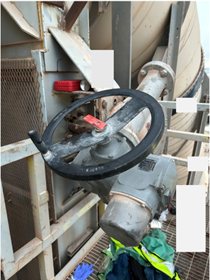
MSHA Fatality Alert
January 6, 2026 – A contractor was fatally struck by the motor and gearbox assembly while removing a baghouse slide gate.
Eliminate Hazards and Prevent Injuries
Block machinery or equipment against hazardous motion before beginning maintenance or repairs. Verify miners are in a safe location and away from potential “red zone” areas.
Secure assemblies to prevent unexpected movement and use proper tools.
Identify and control all stored energy sources, including gravity.
Train miners in safe work procedures and hazard recognition.

Slide 20
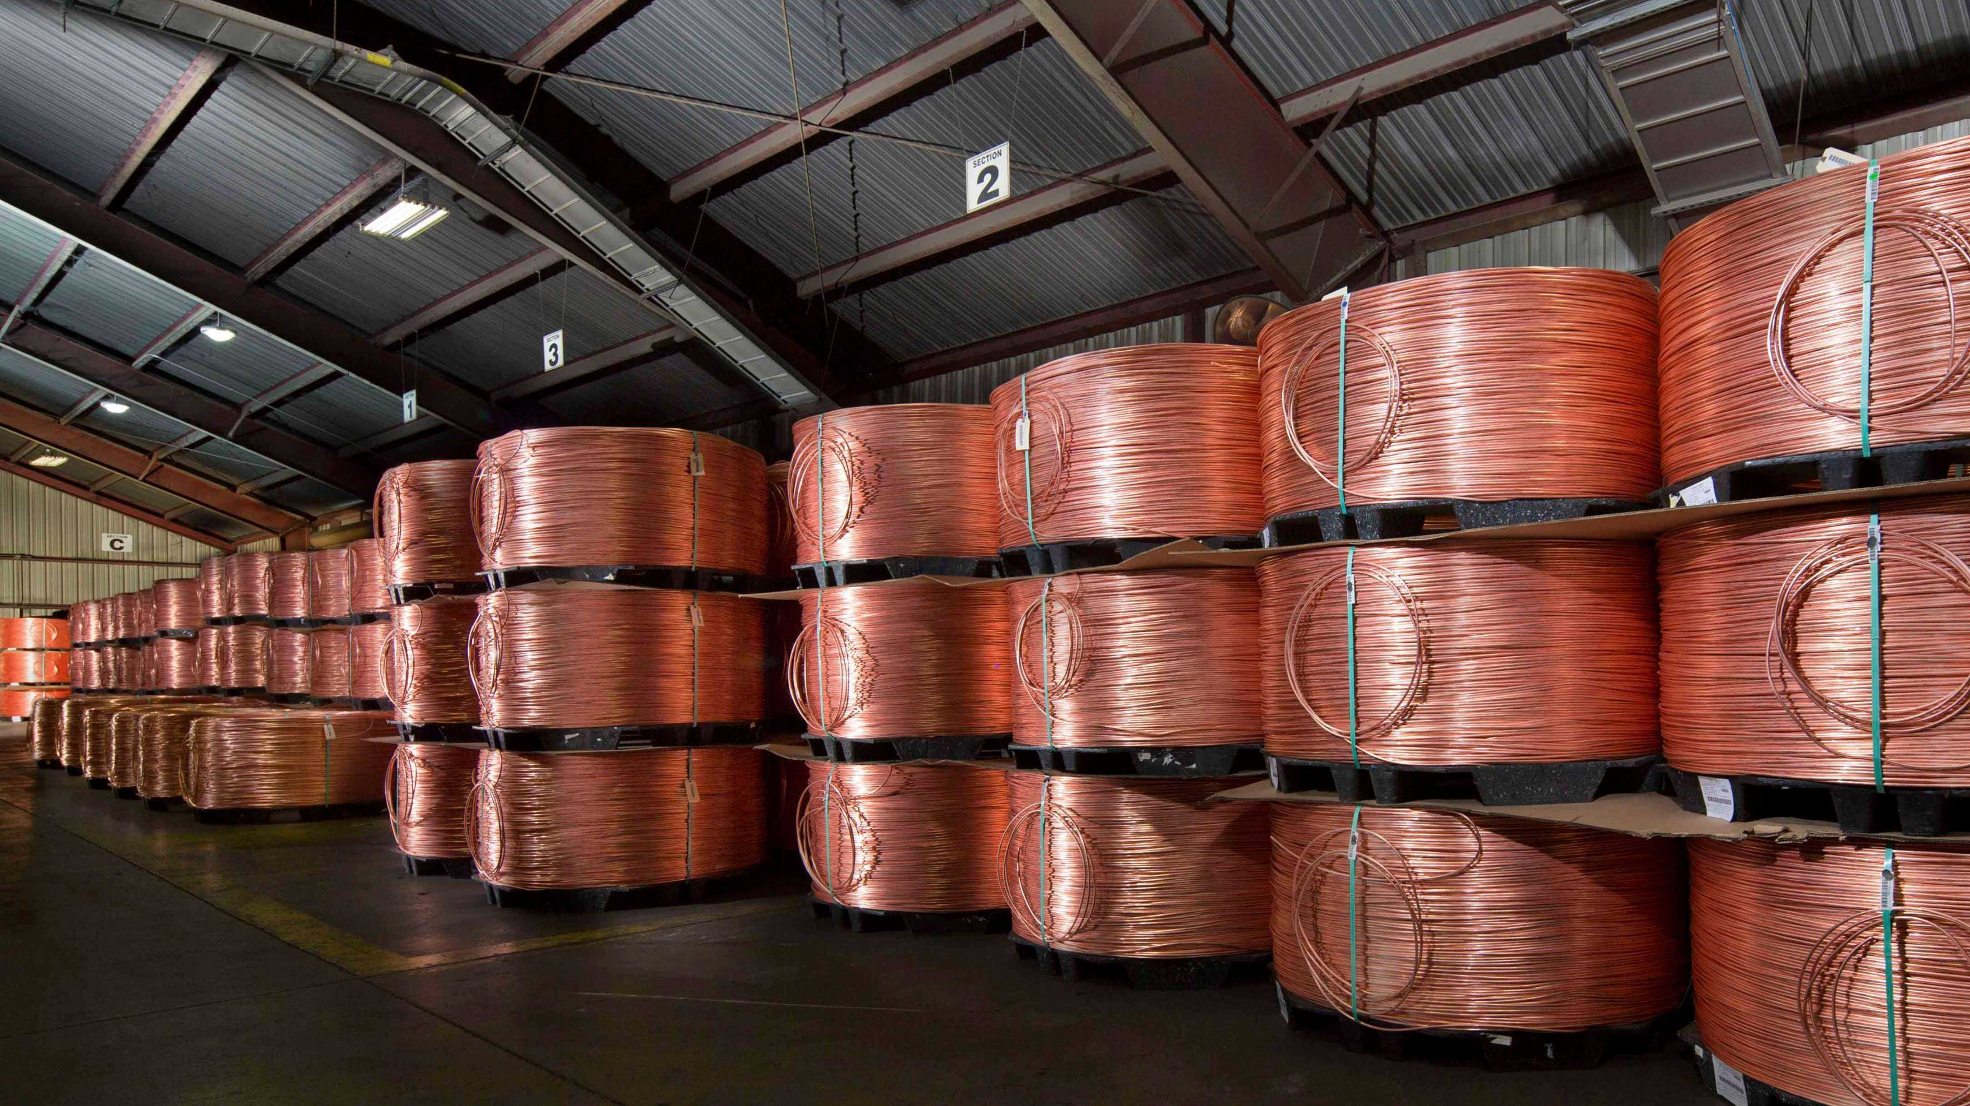
Safety Alerts

Slide 21
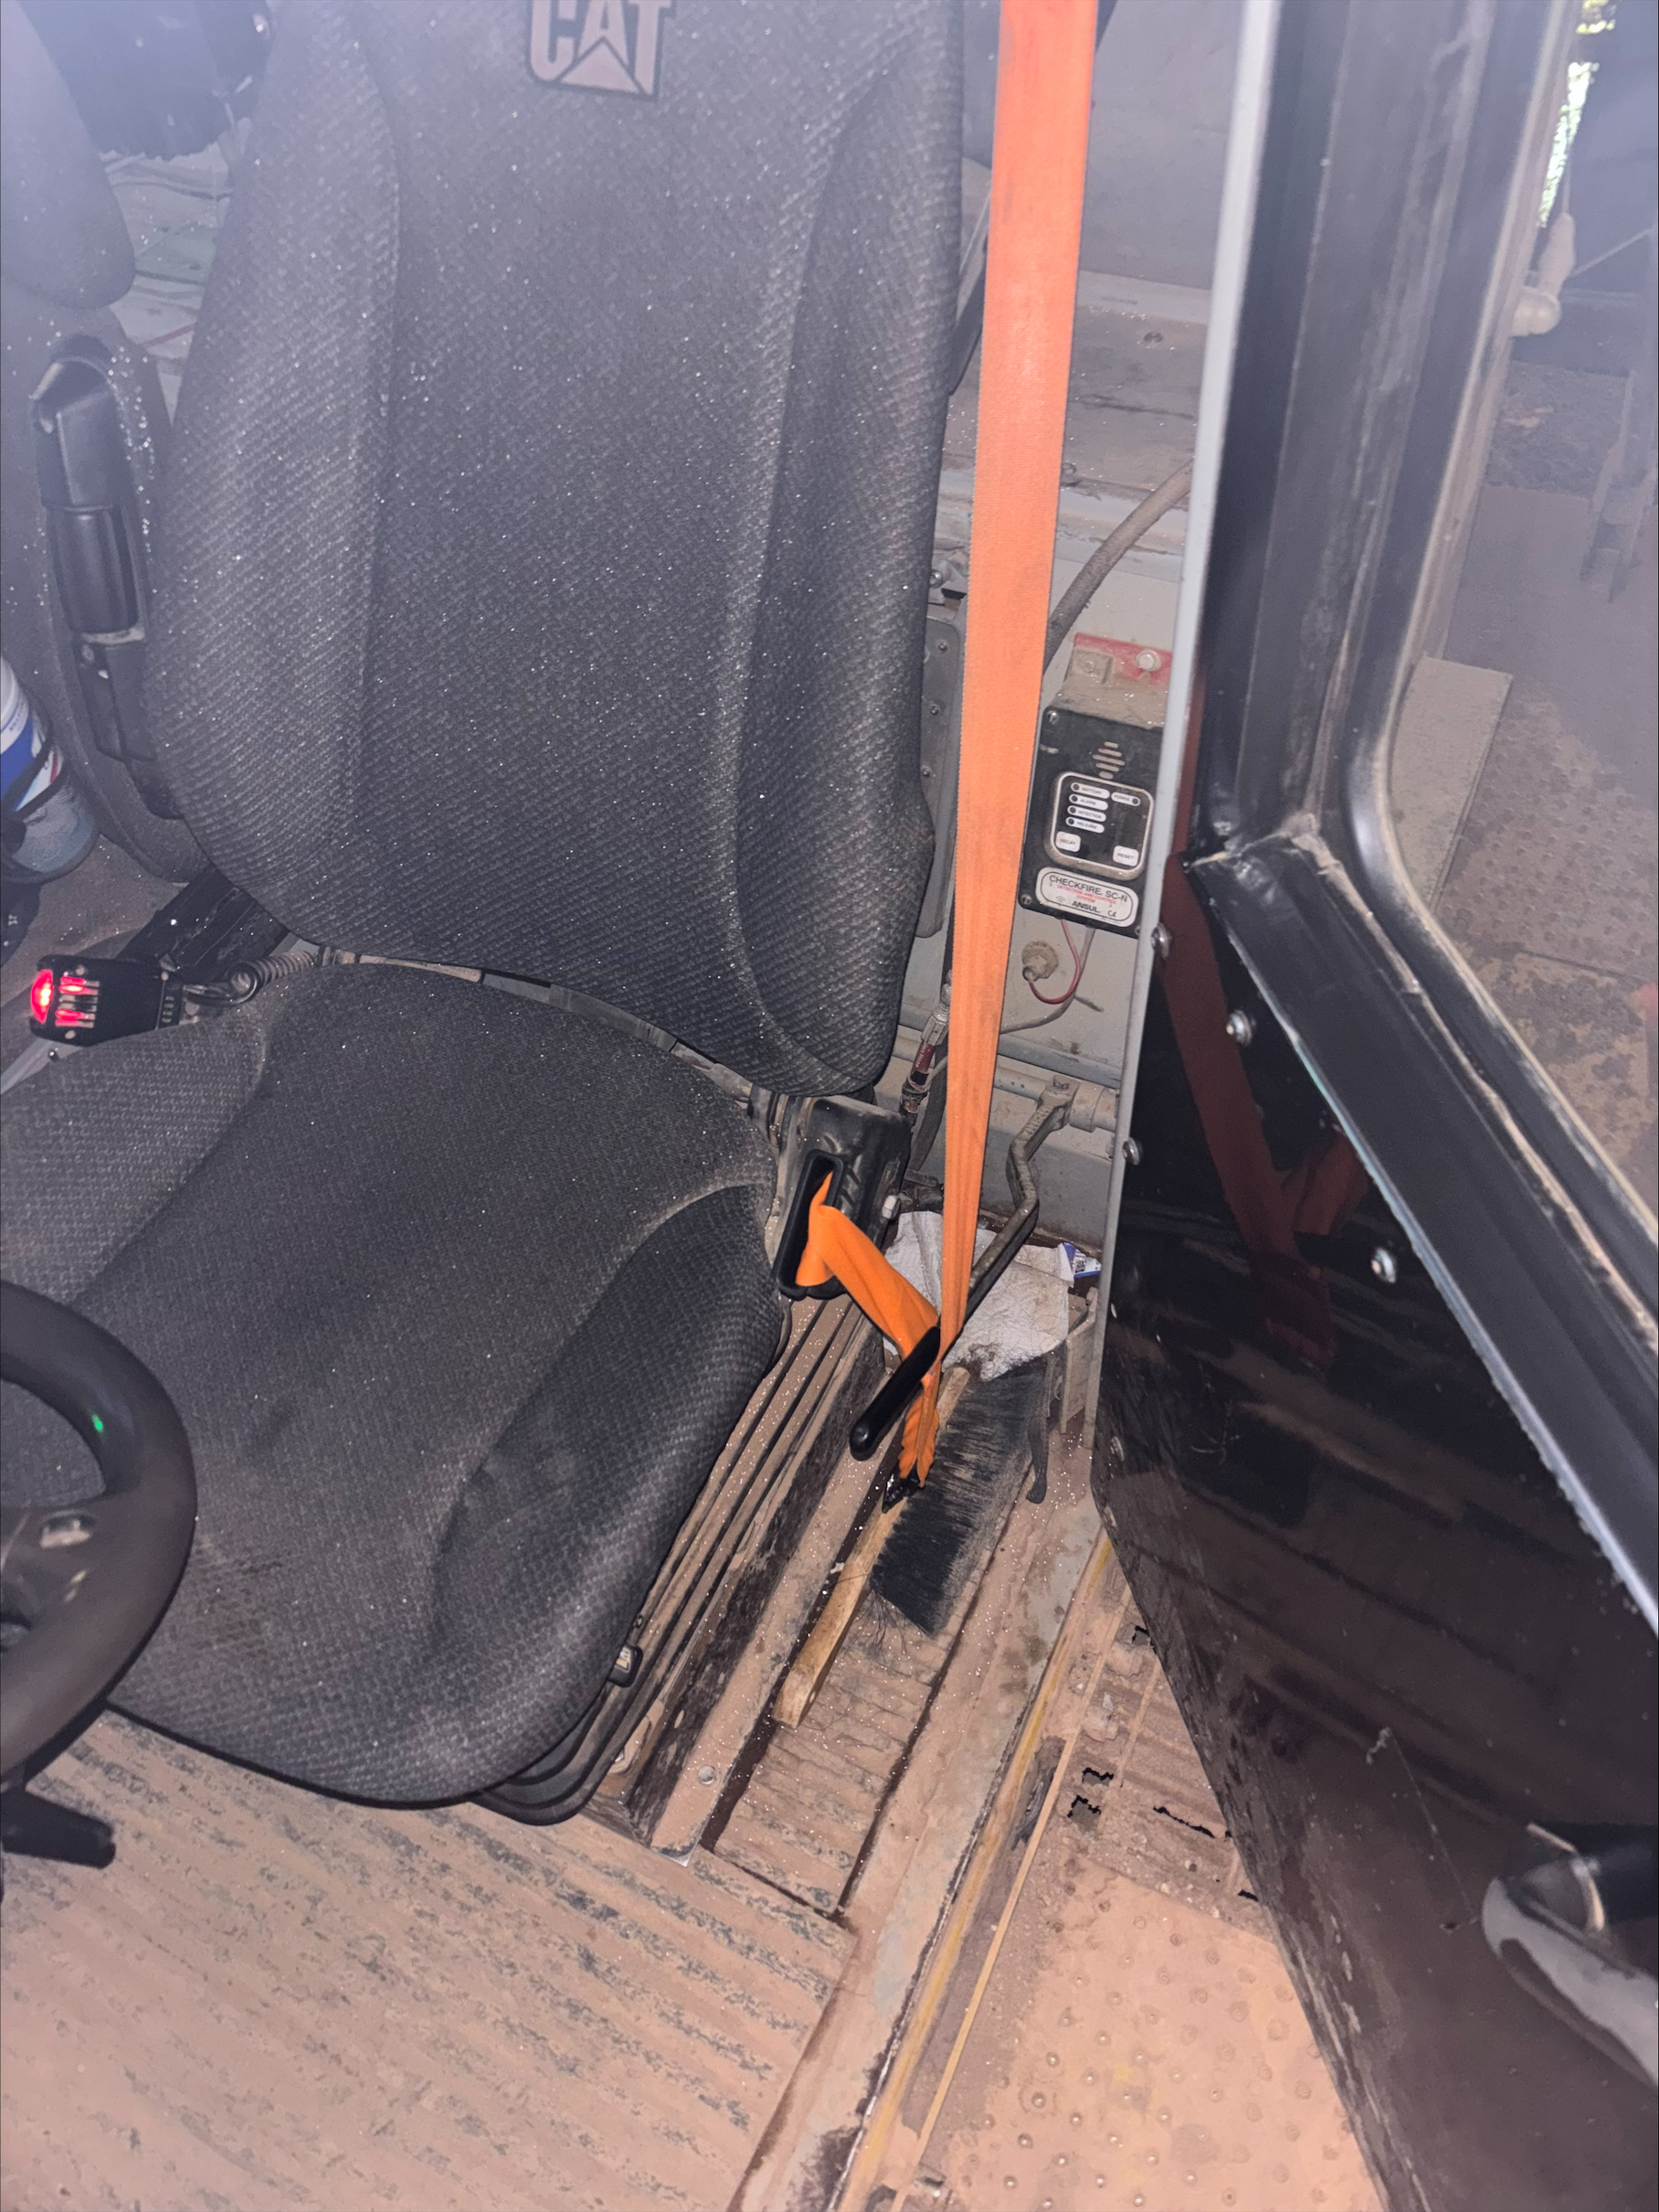
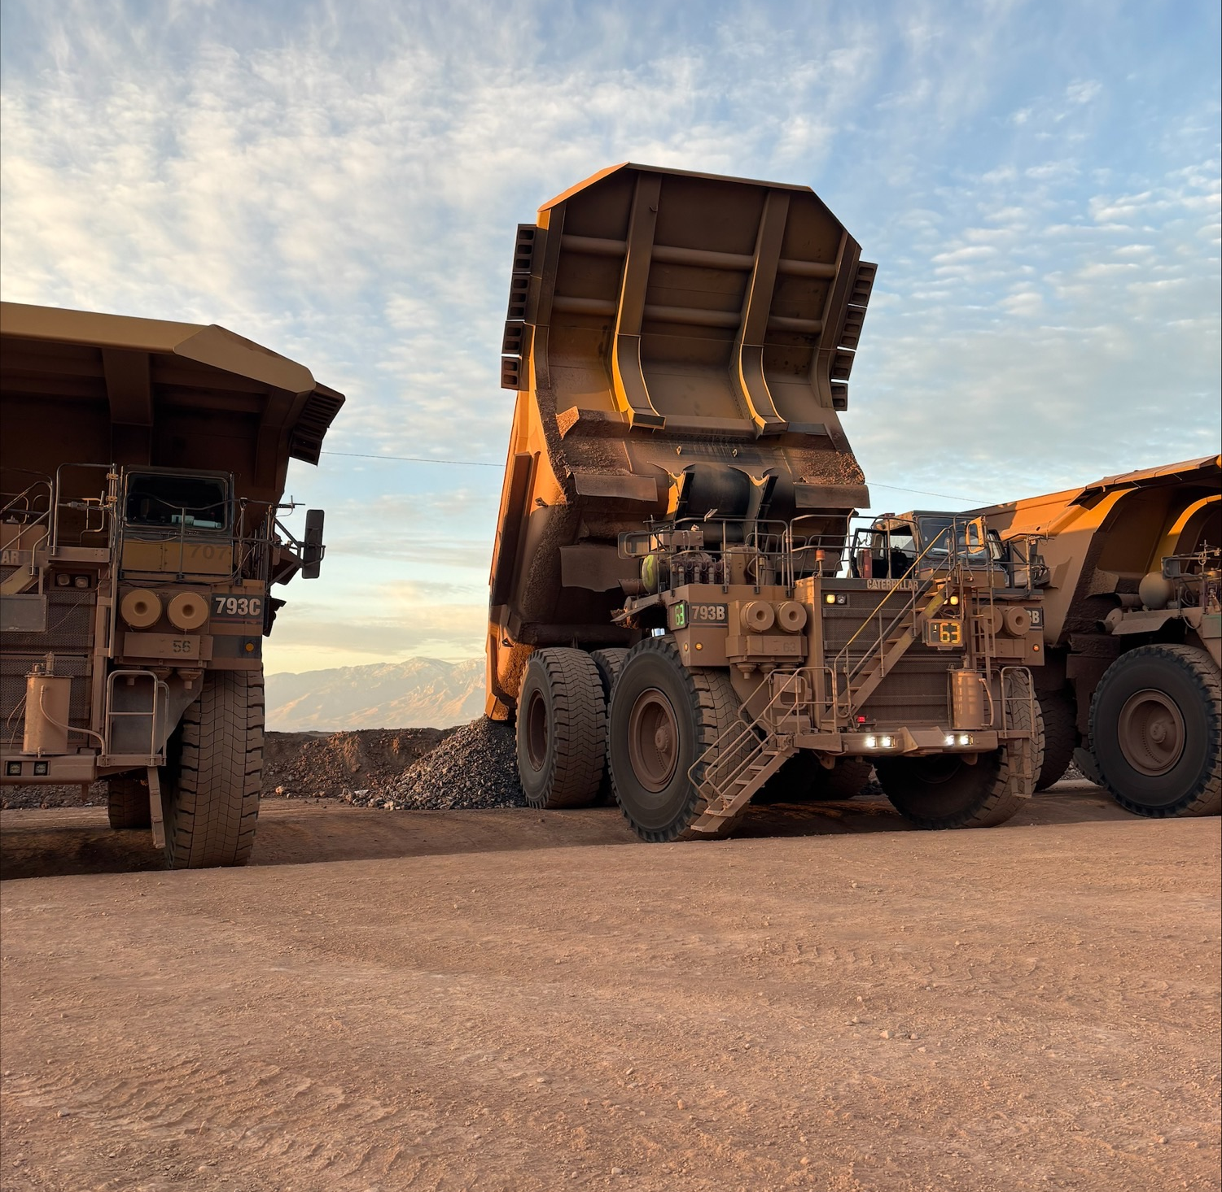
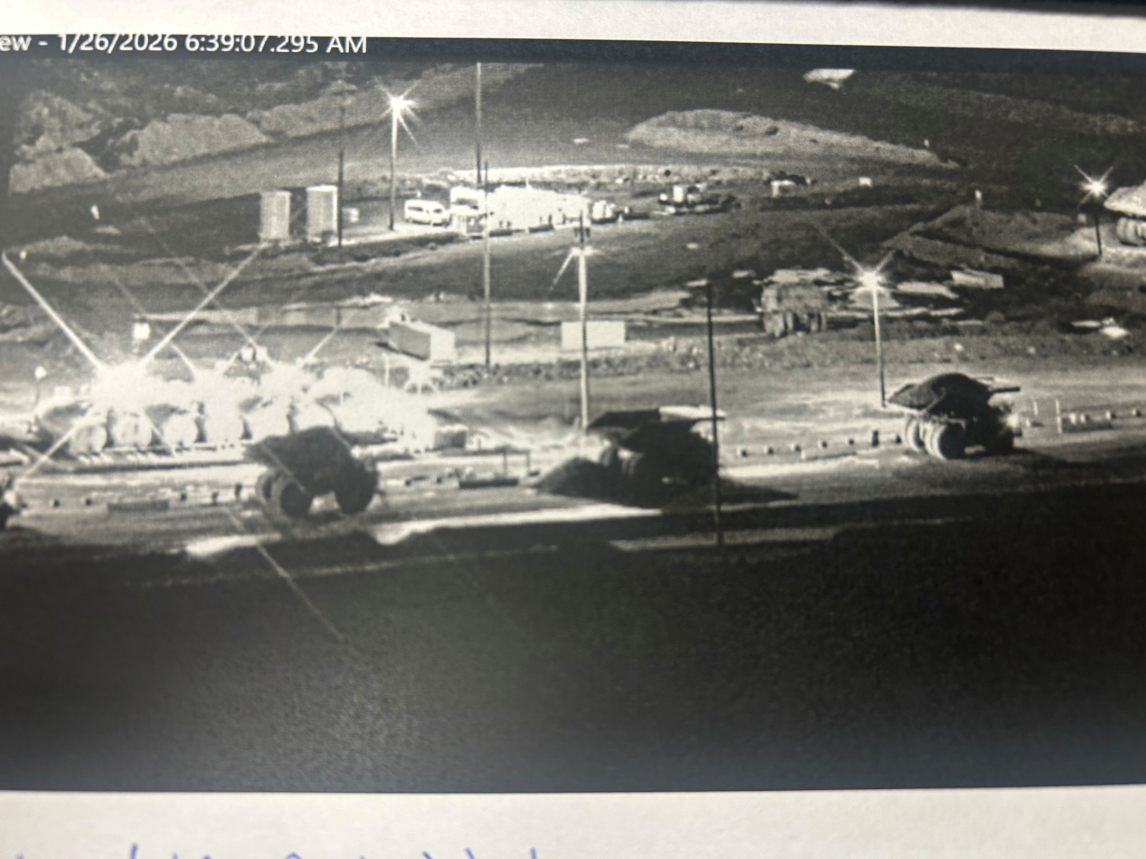
Seat Belt Engaged Haul Truck Dump Lever
Uncontrolled Release of Energy
Incident Details
Operation | Safford
Date / Time | January 26, 2026 and February 2, 2026
Event Type | Near Miss
Summary | Over the course of a week, two loaded 793B haul trucks were accidentality dumped when a seat belt wrapped around the dump lever: 1/26/2026 – As an operator climbed off a haul truck for a pre‑shift inspection, they noticed dust and rocks falling. From the ground, they saw the truck bed rising and quickly remounted the truck, discovering the seat belt caught on the dump lever. 2/2/2026 - During shift change, an operator started the truck at a tie‑down and dismounted for a pre‑shift inspection. While under the truck, they noticed it went into high idle and the bed lifted. They alerted nearby operators and supervision, who found the seat belt wrapped around the dump lever.
Findings / Missing Controls | Site testing proved that all 793B haul trucks at Safford will raise the bed if the truck is started and the seat belt is wrapped around the dump lever. Incident investigations found that when the truck starts and the seat raises with air, there is enough pressure for a wrapped seat belt to lift the dump lever.
Suggested Action(s) | Evaluate pre-inspection procedures for loaded trucks. Reduce line of fire exposure for operators in the event a bed unexpectedly raise. Evaluate guards or controls to eliminate the possibility of a seat belt engaging a dump lever.
Contact | Shannon Jeans, Manager-Health and Safety
Seat belt wrapped on lever
Position of truck at tie-down on 2/2/2026
Dumped load at fuel station on 1/26/2026

Slide 22
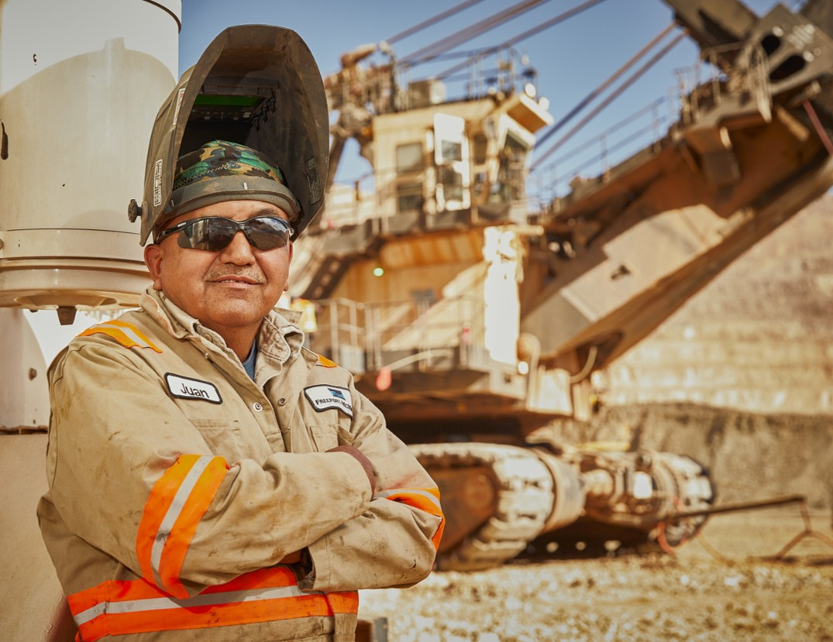

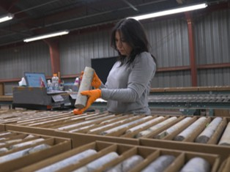
Additional Resources
Health and Safety Dashboard
Safety Toolkits
FCX Policies
MSHA Safety Alerts
OSHA

Slide 23
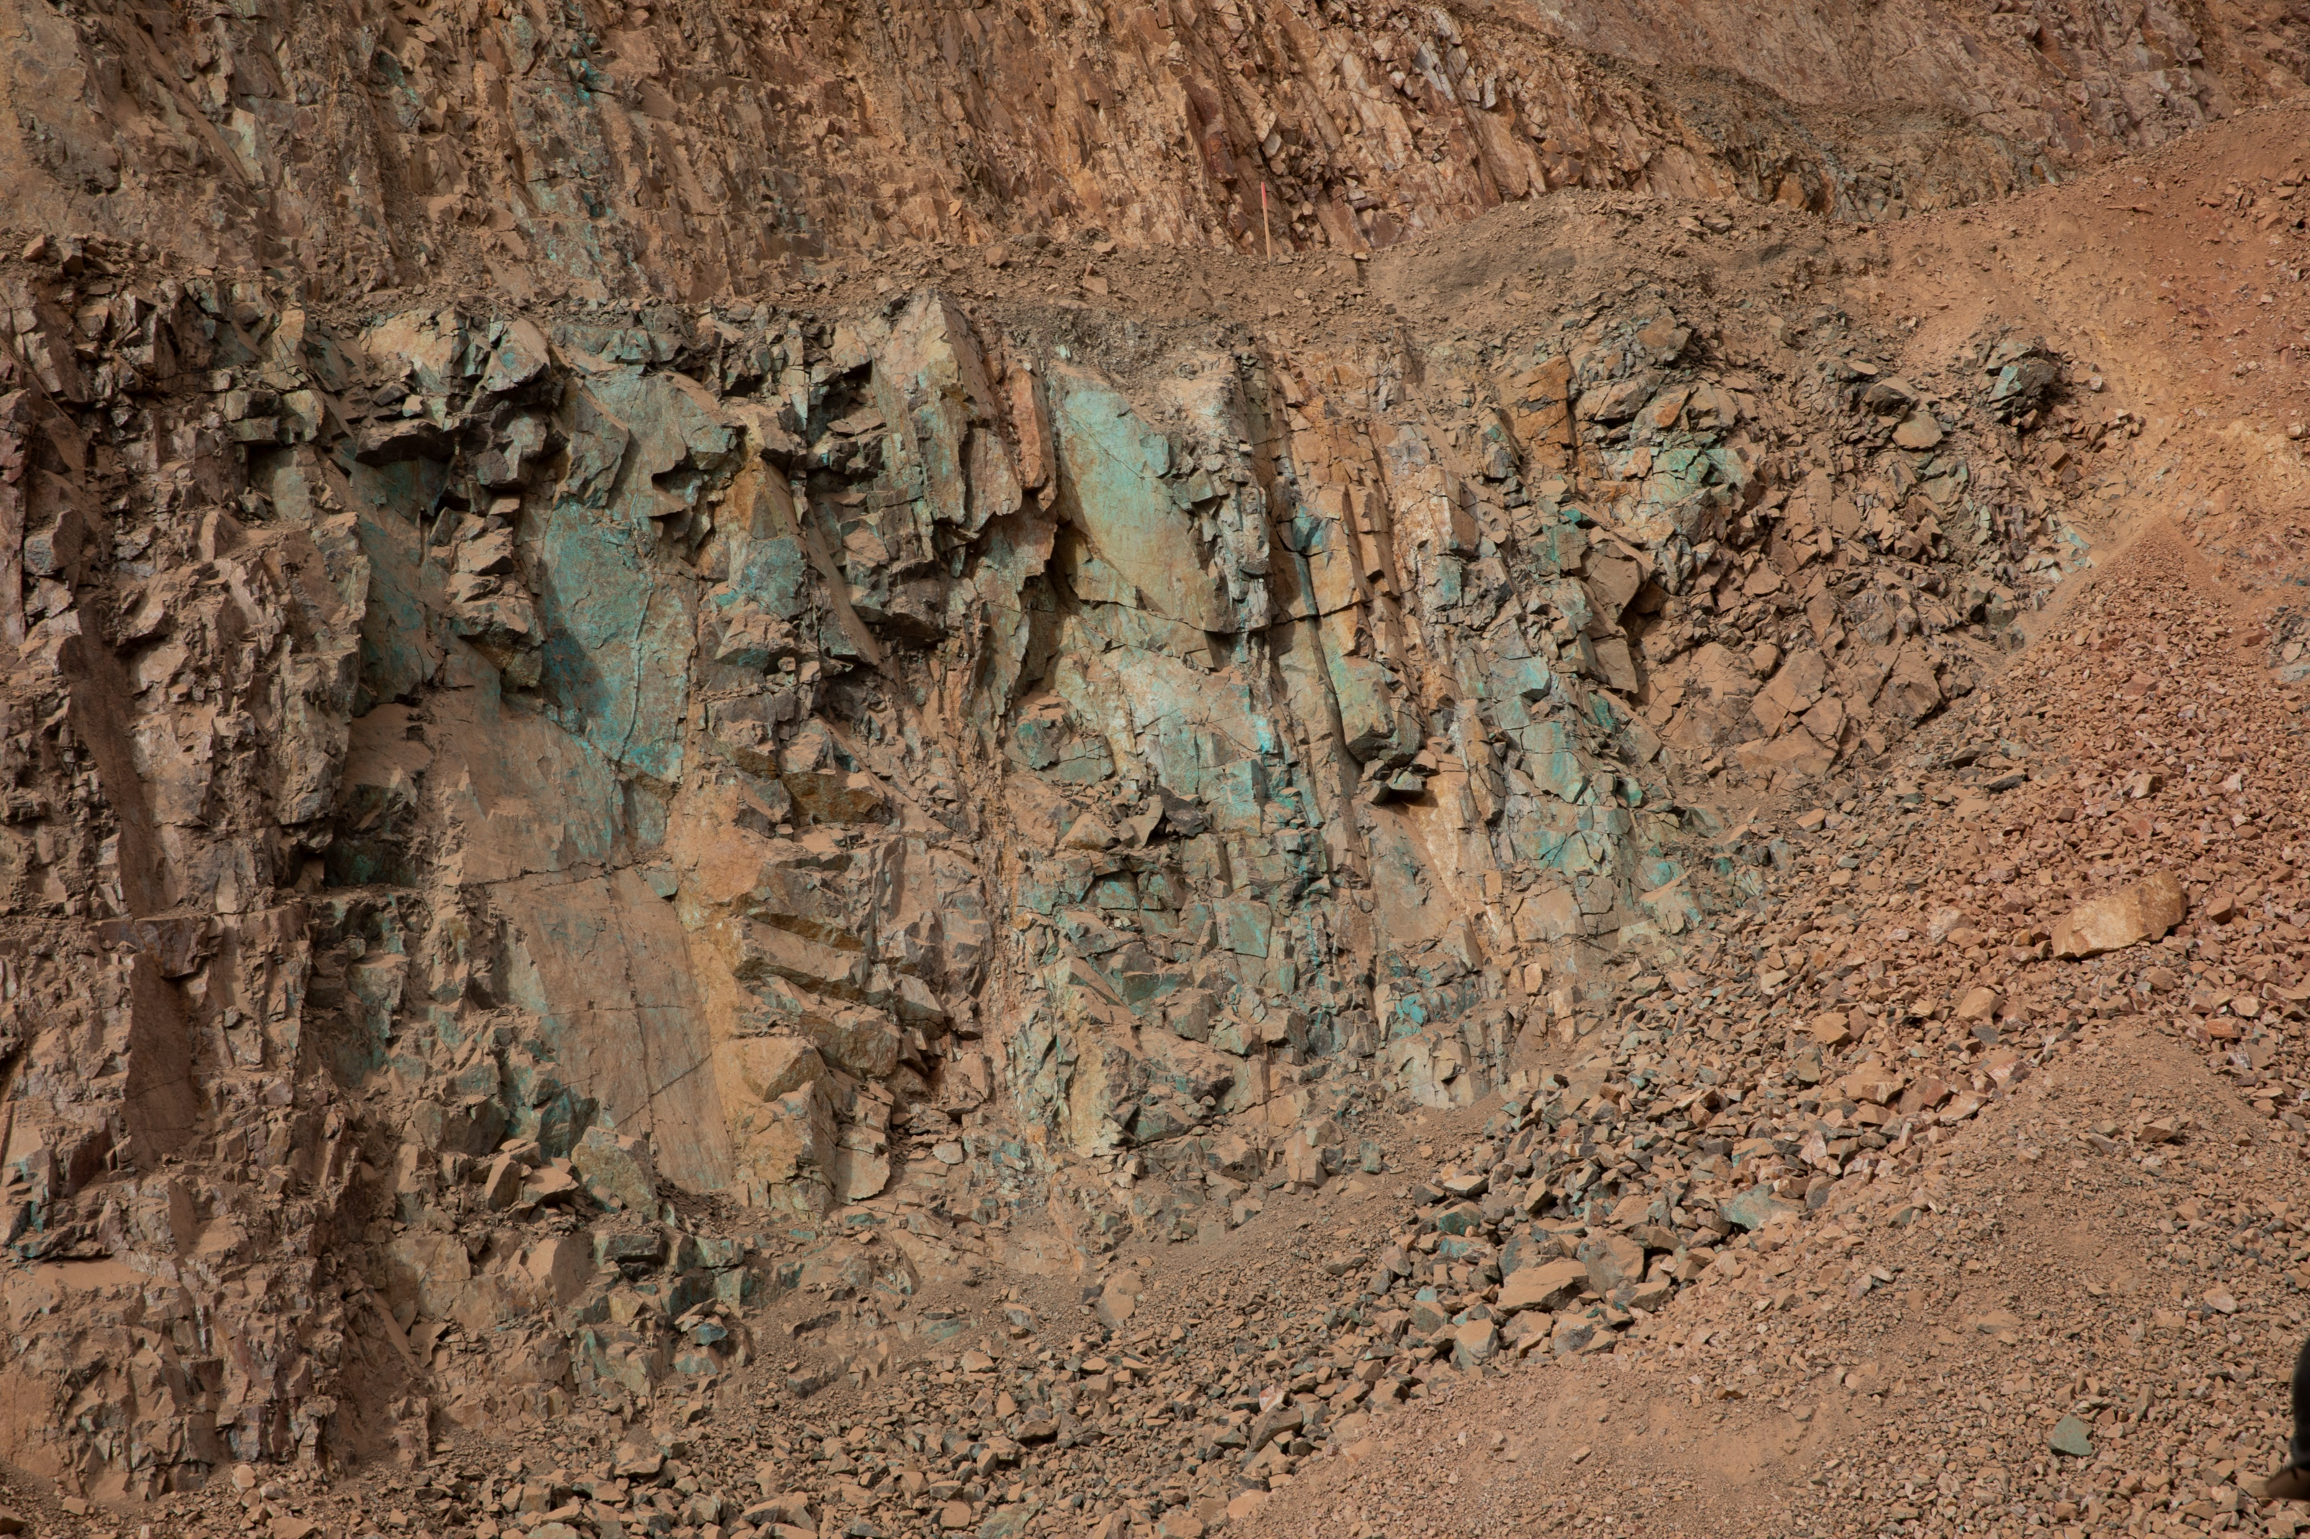
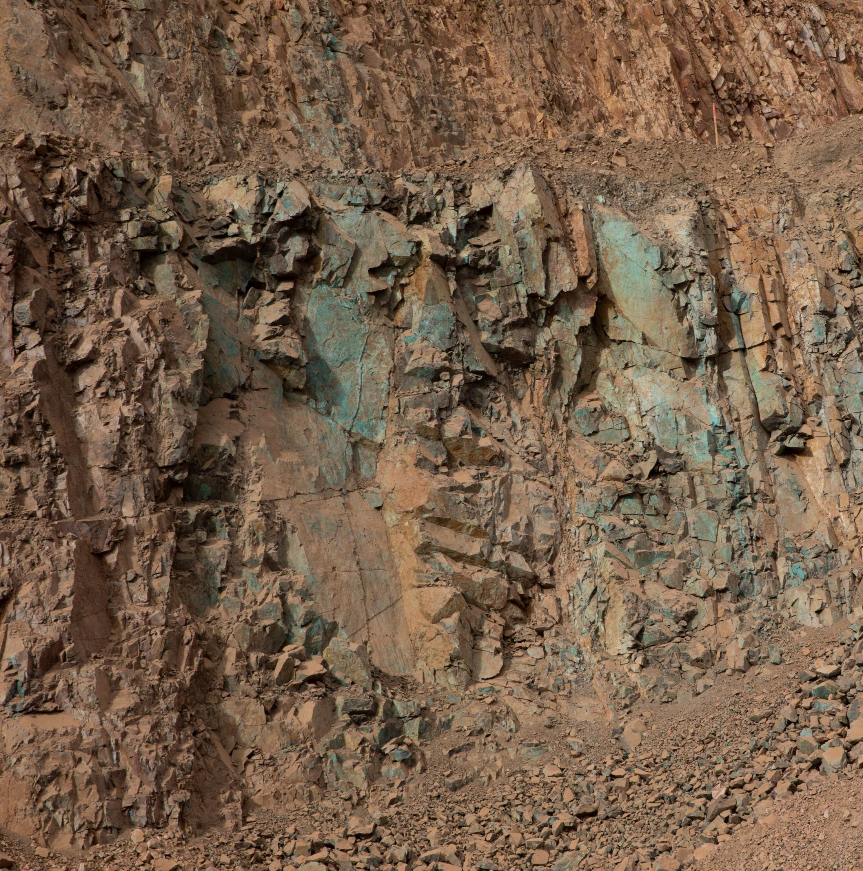
Site Incidents

Slide 24
Henderson Incidents
02/05 – Bruising from Counterweight Release (First Aid)
employee received a minor bruise on their face when a counterweight released from an underground loader
02/07 – Slip at Bottom of Stairway (First Aid)
employee slipped when they reached the bottom landing of stairs
Caused a slight pain in their lower abdomen
02/16 – Crosscut Released Rock Next to Powder Truck (Near Miss)
Contract employee and supervisor loading face
Cross cut released rock next to a powder truck
02/17 – Mini-Ex Front Window Blow Out (Property Damage)
End of shift blast blew out front window of mini-excavator
Cab is pressurized and operator closed door before blast creating pressure difference

Slide 25
FRM Verification Results – Feb.
150 verifications completed in February
Focus for February was around Blasting and Hazardous Substance - Chronic
Blasting dropped from Top 3
Haz. Sub. – Chronic dropped but still high
Haz. Sub. – Acute jumped from bottom of list to the top
FOCUS FOR MARCH/APRIL:
Hazardous Substance – Acute
Hazardous Substance - Chronic

Slide 26
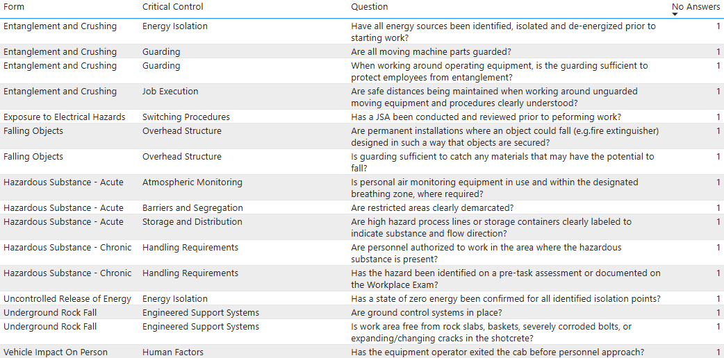
FRM Verification Results – Feb.
Henderson Missing Controls with No Responses

Slide 27
Q1 MSHA Inspection Summary

Slide 28
Citation Count
 | S&S | Non-S&S | All Citations
Mine | 1 | 17 | 18
Mill | 6 | 12 | 18
Contractors |  | 1 | 1
Total Henderson | 7 | 31 | 37

Slide 30
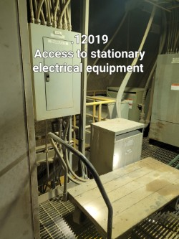
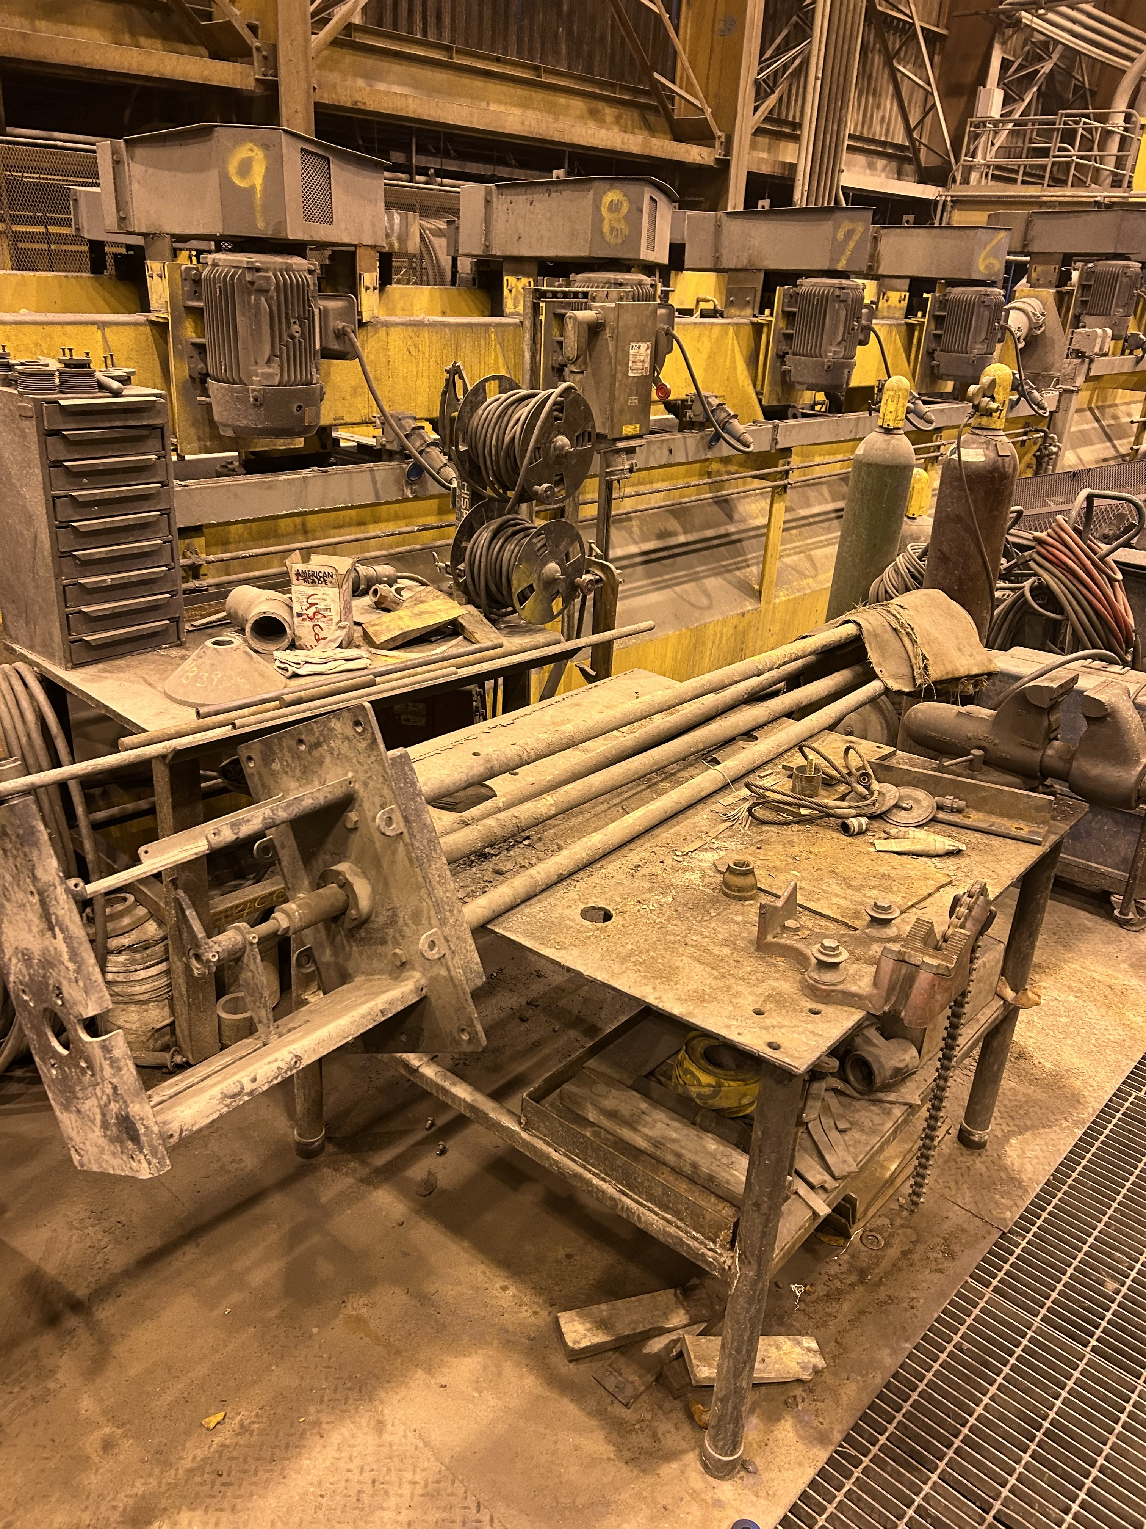
Big Hitters – Safe Access (7)
Roughers Maintenance /Welding Area
When storing equipment, be sure to pay attention to what is around. Safe access citations are easily caught and corrected with a proper WPE.
Electrical panels/Disconnects need clear access for emergencies.
Maintain clear access to all tools
Notes:
Connect WPE expectations with gaps in found conditions.

Slide 31
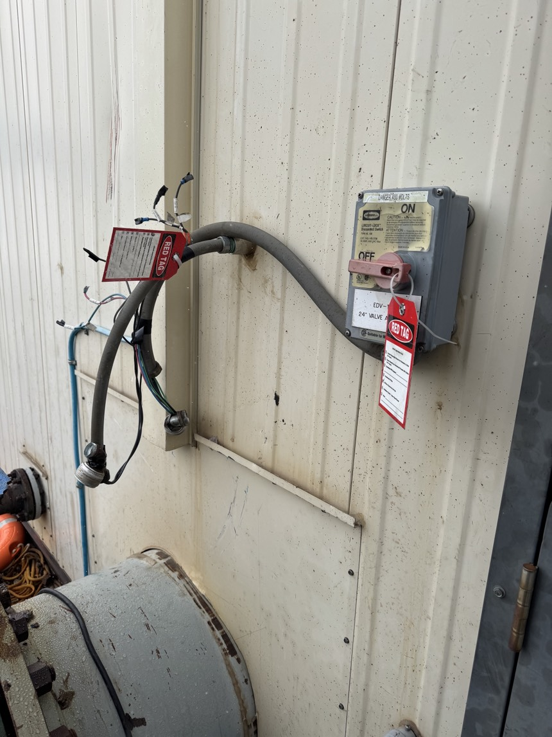
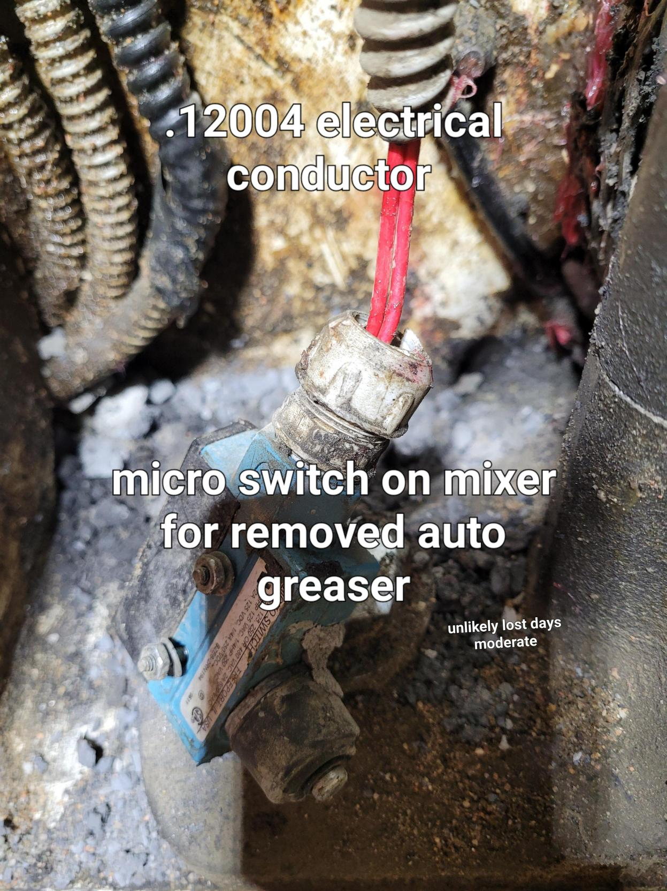

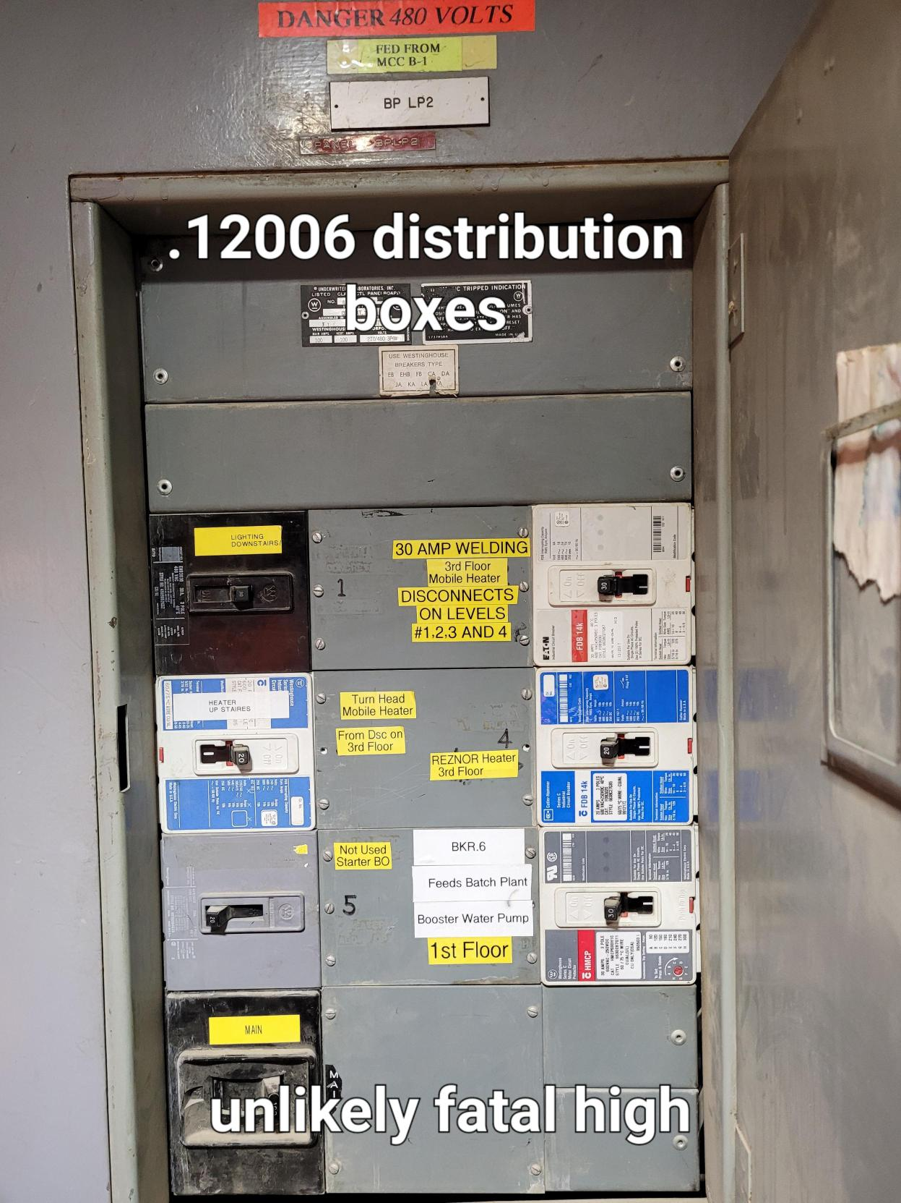
Big Hitters – Electrical (6)
Is this a proper lockout device? Does this meet our policy?
Distribution boxes and the devices they control need labeling
Follow up on WO's
Corporate Safety Portal - DOHS Policies - By Policy and Purpose

Slide 32
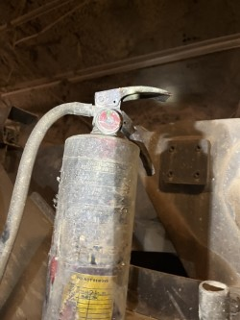
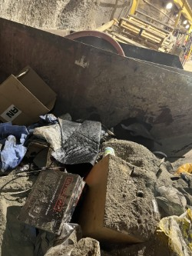
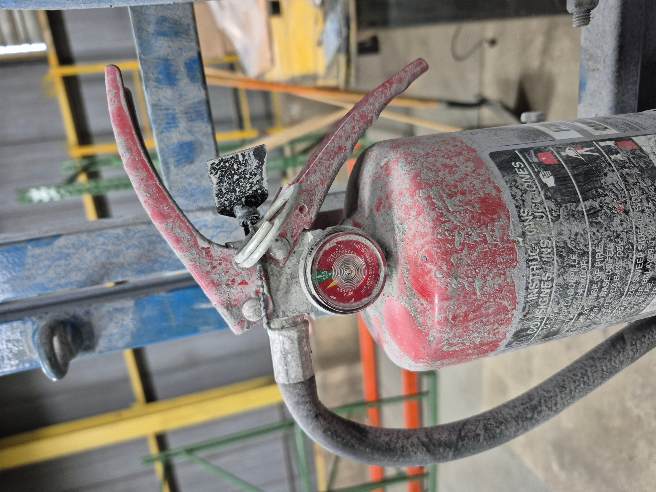
Big Hitters – Fire Prevention and Control (5)
57.4201 Inspection of firefighting equipment
57.4104 Combustible Waste
57.4201 Inspection of firefighting equipment
The biggest threat to U/G miners is a FIRE.

Slide 33
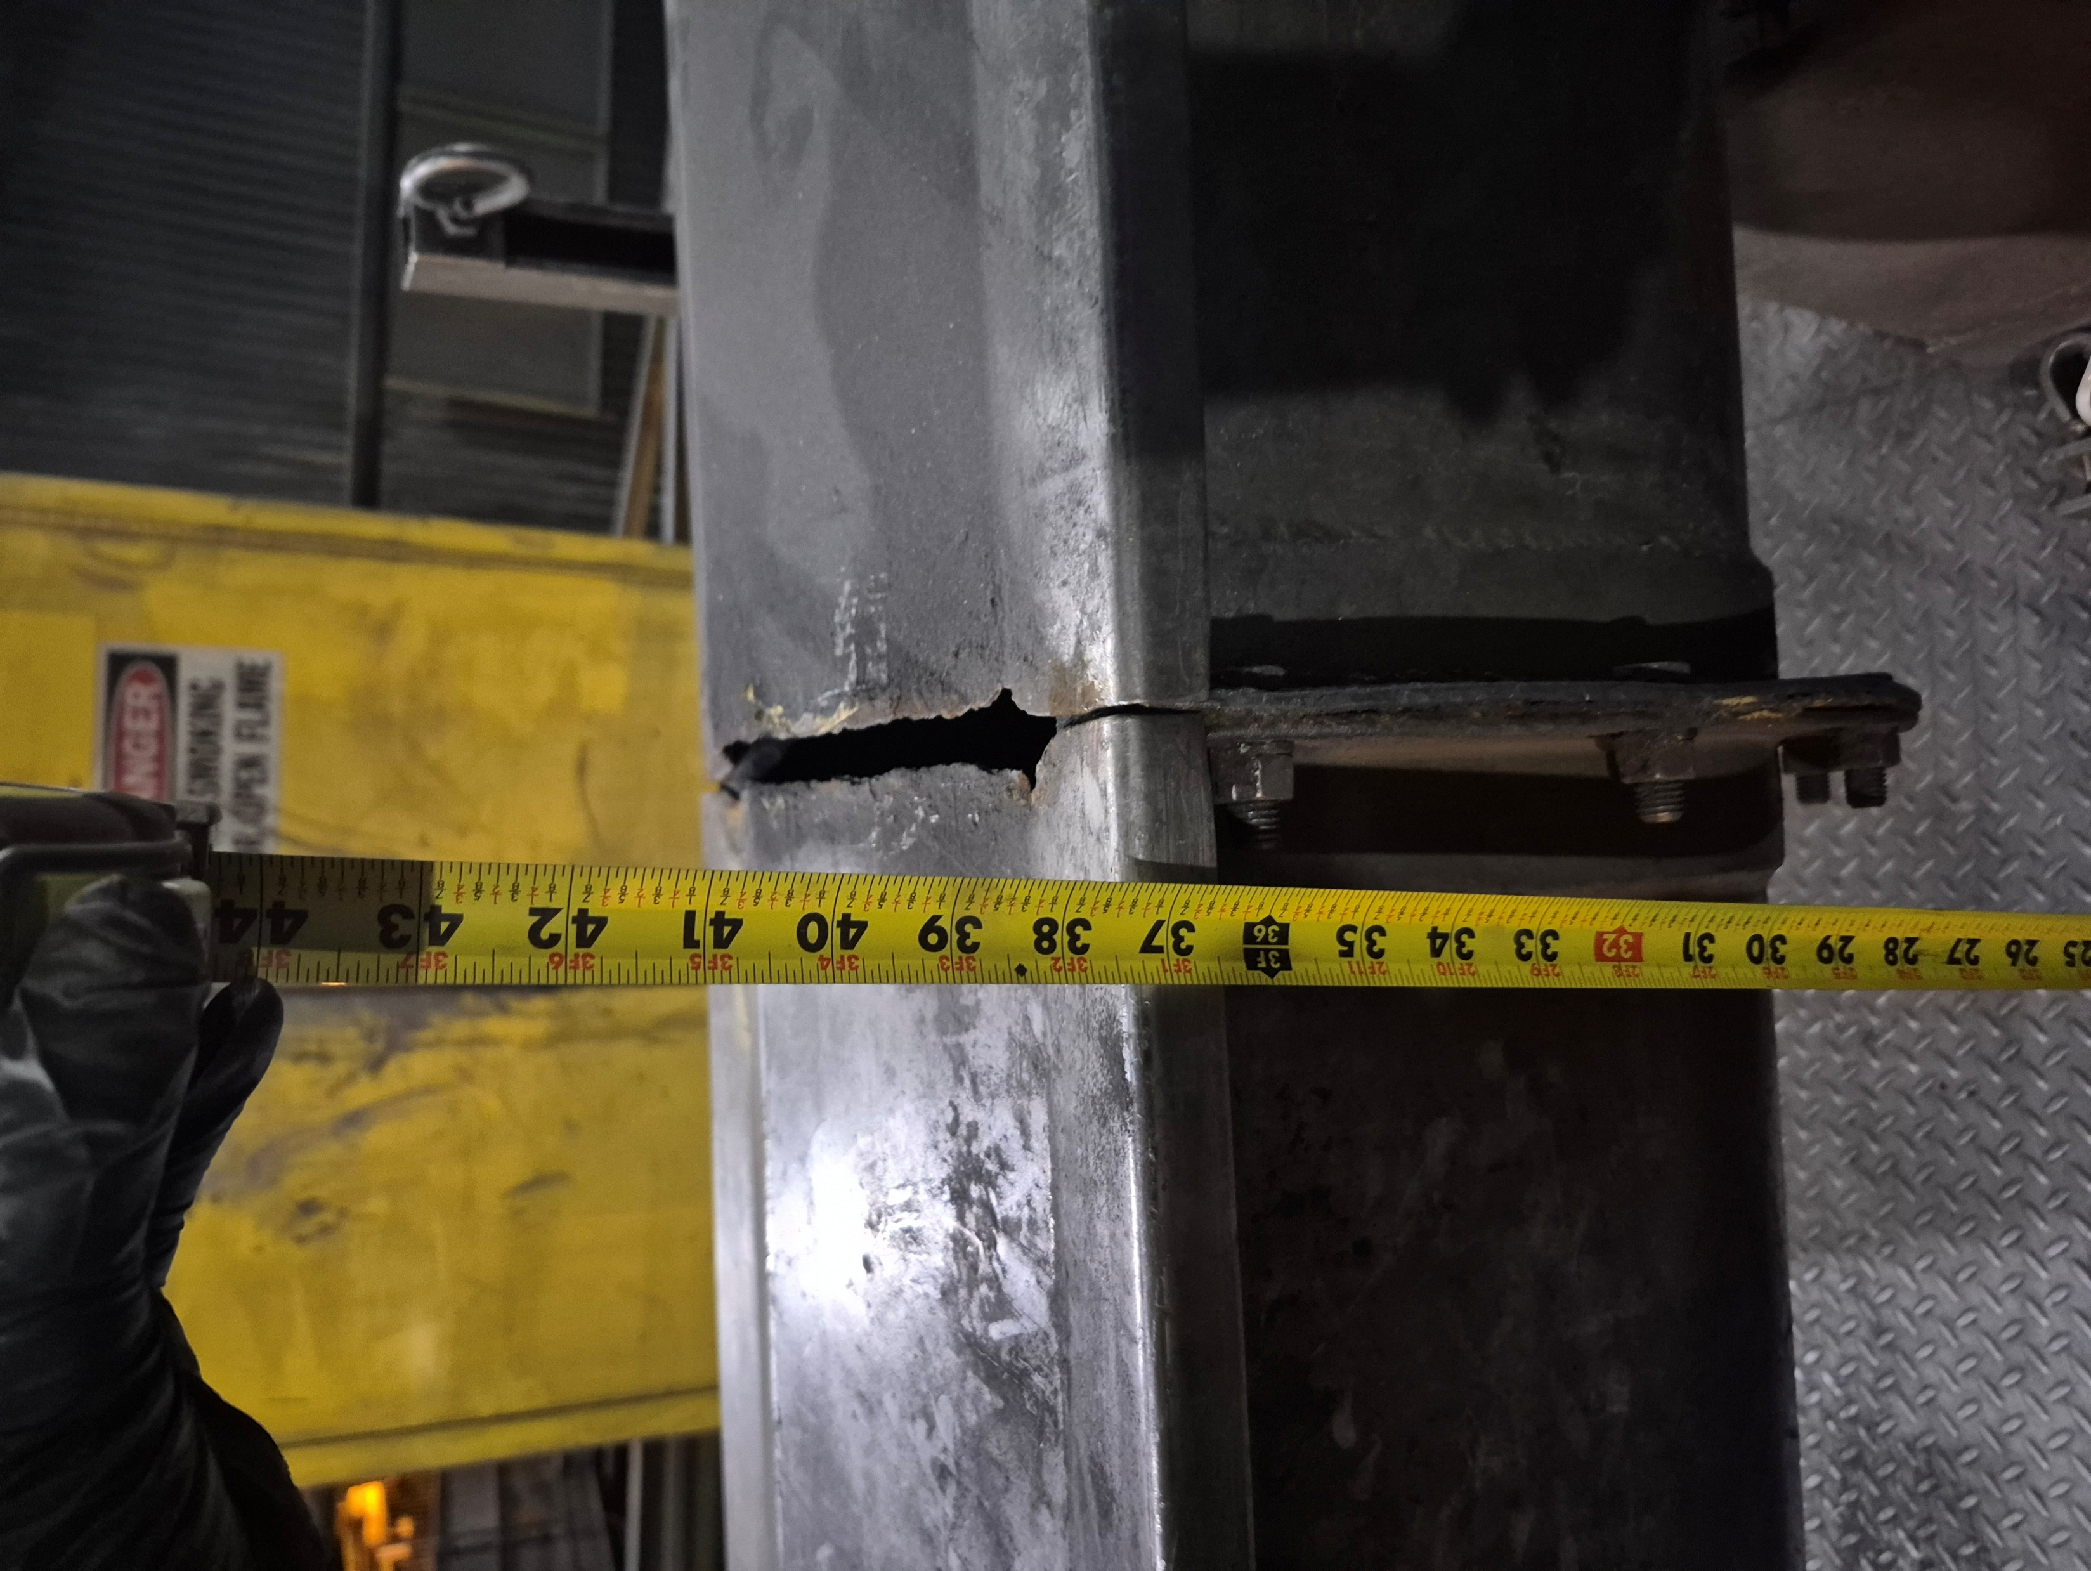
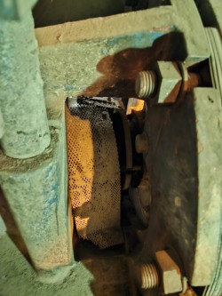
Big Hitters – Guarding (4)
UNSECURED

Slide 34
Safe Access
Clear definition with examples
Check tool locations/availability
Review flagging/tagging expectations
Electrical
Demonstrate hands-on cord checks
Breaker/source labeling
Fire Prevention & Control
Full checks on fire extinguishers/gauges (not tags only)
Waste management/segregation
Take Photos (WPE/MSHA)
2Q26 Workplace Exam Focus

Slide 35
Contractor Management Topics
Contractor Training Policy Reminder
ISN Updates

Slide 36
Contractor Training Policy Update
Over the past 18 months, we have focused on standardizing training materials and delivery methods across Freeport-McMoRan. This initiative aimed to ensure consistency and alignment with our safety and operational standards.
Throughout this process, we received valuable feedback from our contractors. While many appreciated the effort to standardize Freeport-specific training, several indicated that their own training programs were equally effective—and in some cases, even more comprehensive.
Based on this feedback, Freeport is adjusting its approach:
Contractor Training Acceptance: We will now accept contractor-provided training, with exception to training noted in the attached document, provided the contractor attests that their training meets our core safety policies, even if it is not Freeport-specific.
Freeport Training Materials Availability: Freeport training content will remain accessible on the Public Portal for contractors who wish to use it or supplement their existing programs. This ensures that all parties have access to resources that align with our policies.
All training information that is required for your employee’s to perform work (Core, Compliance and Technical) training must be uploaded into ISN no later than April 6 2026. We will be referencing the data uploaded in ISN to verify while in the field
Site Safety and Training are available to provide guidance and answer questions; however, contractor training delivery is the responsibility of the contractor.
We believe this approach benefits everyone involved by maintaining strong safety standards while allowing flexibility where appropriate. Ultimately, leadership presence and engagement in the field will continue to be the most critical factor in driving safety and operational excellence.
LINK TO UPDATE

Slide 37
Contractor Training Policy Update
FCX Core Training Requirements All contractors accessing or completing work at any North American site must complete the following Core Training Requirements additional training might be required before starting work:
1. Area Specific training that covers all facilities where contractor employees will be working within
2. Contractor Orientation North American (Available in ISN)
3. North American Hazard Recognition Video (Available in ISN)
4. FCX Mining – Workplace Examinations (Will be available in ISN soon)
5. FCX Mining – Site Specific Hazard Recognition Brochure, this is a site by site requirement for those that visit multiple sites (Available in ISN)

Slide 38
ISNetworld/HSEP Update
Deadline for all training (Core, Compliance and Technical) to be uploaded to ISN is April 6th, 2026
Contractors who have not completed uploads by then will have their employees paused from coming on site
Must include Attestation form upload (when needed)
Deadline for Worker Acknowledgements April 6th, 2026
Contact GSC if you need onsite assistence
ISN Scorecard and HSEP Changes (Effective April 6th, 2026)
HSEP score impact to change from -10 to -100 for unsubmitted or rejected HSEPs
HSEPs associated with specific site for approval/validation
HSEPs will migrate to site scorecard they are valid for
Temporary Upload Freeze
During 2-week migration, Contractors unable to upload new HSEPs
HSEPs for projects occurring during this time must be sent directly to Contractor Governance Team (contractorgovernance@fmi.com)

Slide 39

Open Forum

Slide 40
April 9th
May 7th
June 18th
July 16th
August 20th
September 10th
October 8th
November 19th
December 17th
2026 Meeting Schedule
Meetings begin 1 PM MST
Mine and Mill In-Person Options Monthly

Slide 41
March Sign-Off Record
_____________________
_____________________
_____________________
_____________________
_____________________
_____________________
_____________________
_____________________
_____________________
_____________________
_____________________
_____________________
_____________________
_____________________
_____________________
_____________________
_____________________
_____________________
_____________________
_____________________

