Slide 1
Henderson HSE Contractor Meeting – May 2025
05/22/2025

Slide 2
What is this Meeting?
Purpose:
For Henderson to have the opportunity to reach multiple contractors to discuss best practices when it comes to Health and Safety, Environmental and Contracts Management
Give contractors an open forum to bring up concerns, successes or incidents, learnings, etc. that is shared between all contractors and Henderson personnel
Help improve the safety culture and reduce safety incidents as a group

Slide 3
Contractor Share – Cementation
Management of Change

Slide 4


Contractor Share – Cementation
Fatal/Critical Risk Management - FIRE
Preventative Controls?
Reactive Controls?
Which are more important?
Why?
Challenge: Evaluate your work area. Are your escape routes/exits marked well enough to follow signs to safety?
  (?Ask someone unfamiliar with the area to find their way out?)
  Add signage as needed!

Slide 5
Safety Topic – Wildfire Awareness

Slide 6
Safety Topic – Wildfire Awareness

Slide 7
Safety Topic – Wildfire Awareness

Slide 8

Safety Topic – Lightning Alerts

Slide 9
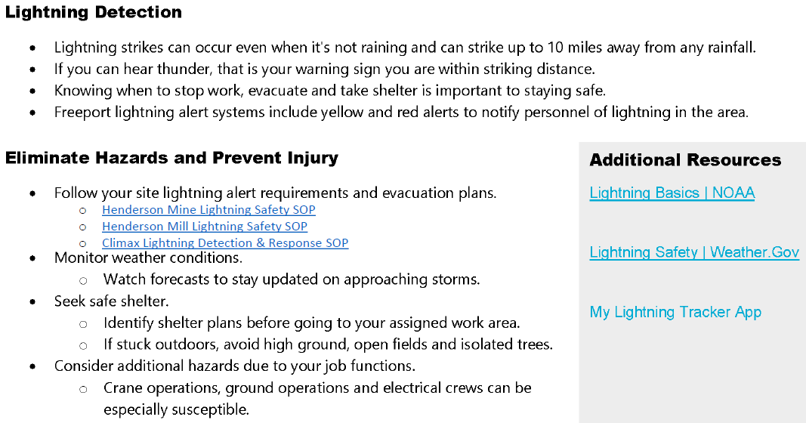
Safety Topic – Lightning Alerts

Slide 10
Environmental Topic – “Hard to Recycle” Events and Town Cleanup Days
Household Hazardous Waste Event in Summit

Slide 11
Fatal Events

Slide 12
Fatal Events

Slide 13
Potential Fatal Events (PFE)

Slide 14
Potential Fatal Events (PFE)

Slide 15
High Risk/Actionable Events

Slide 16
High Risk/Actionable Events

Slide 17
High Risk/Actionable Events

Slide 18
High Risk/Actionable Events

Slide 19
High Risk/Actionable Events

Slide 20
MSHA Safety Alerts

Slide 21
MSHA Safety Alerts

Slide 22
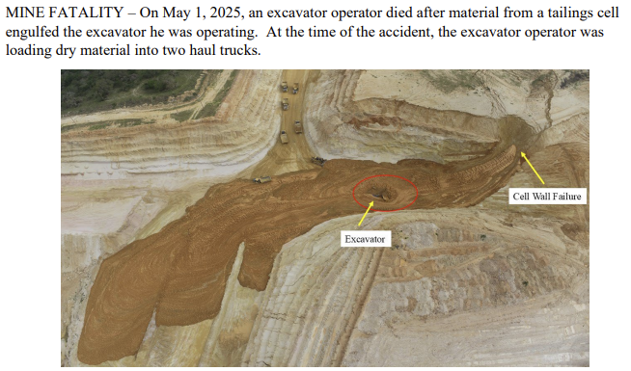
MSHA Fatality Alerts

Slide 23
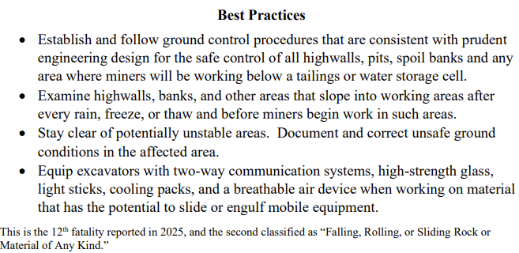
MSHA Fatality Alerts

Slide 24
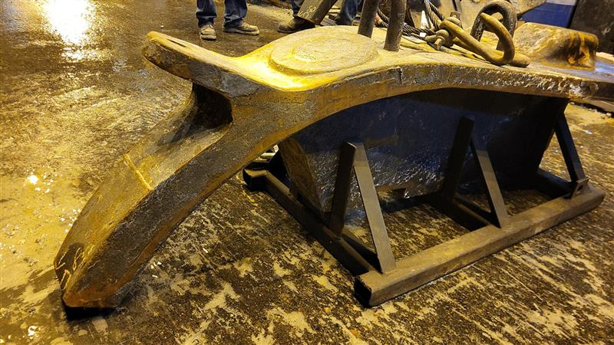
Henderson Incidents –
Summary: Reportable Injury 4/8
Contractor injured when primary mill discharge cover liner fell outside Mill
Liner was improperly cribbed causing it to shift and fall while moving along rollers
Line pinned their leg between liner and roller structure
Sustained soft tissue damage and bruising and received Medical Treatment
Learnings:
Thoroughly review SOPs with all involved employees and contractors
Stop Work when a plan changes and ensure new plan has same level of control effectiveness

Slide 25
Henderson FRM Audit Results
125 Forms Submitted in April
Focus in April around Vehicle Impact on Person, Hazardous Substances and Electrical Hazards
Entanglement & Crushing and Drowning missing control questions increased in month
AUDIT FOCUS FOR MAY/JUNE:
Entanglement & Crushing
Hazardous Substances – Acute
Drowning

Slide 26
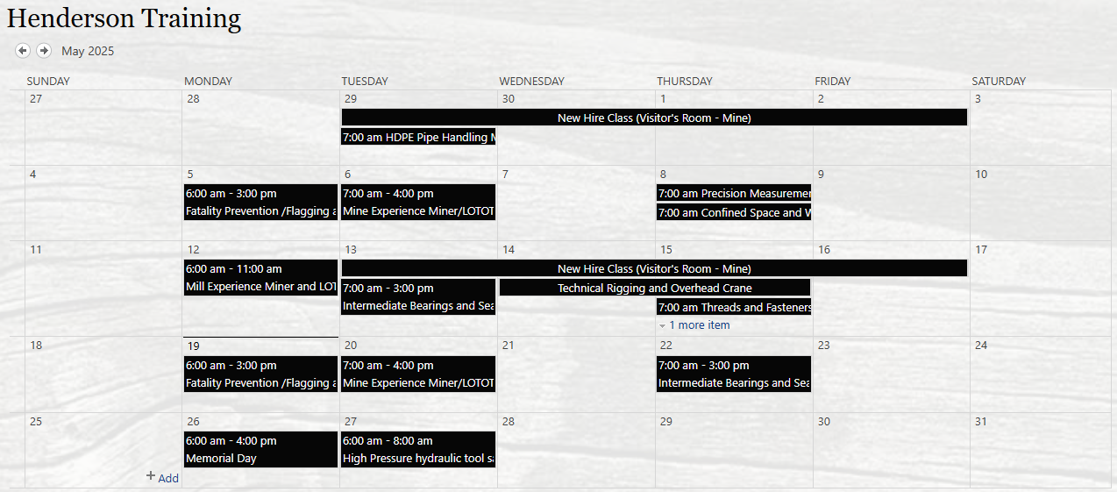
Henderson Training Schedule

Slide 27
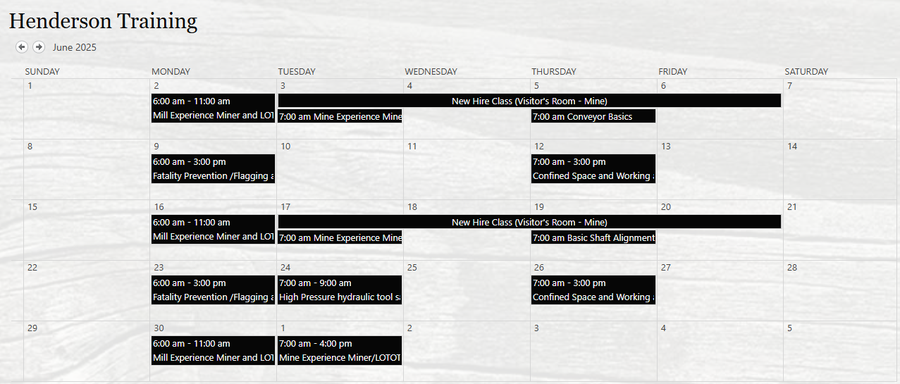
Henderson Training Schedule

Slide 28
Contractor Management Topic – Hours Reporting and Contractor Badges
Conversation on Hours Reporting
Conversation on Contractor Badges

Slide 29
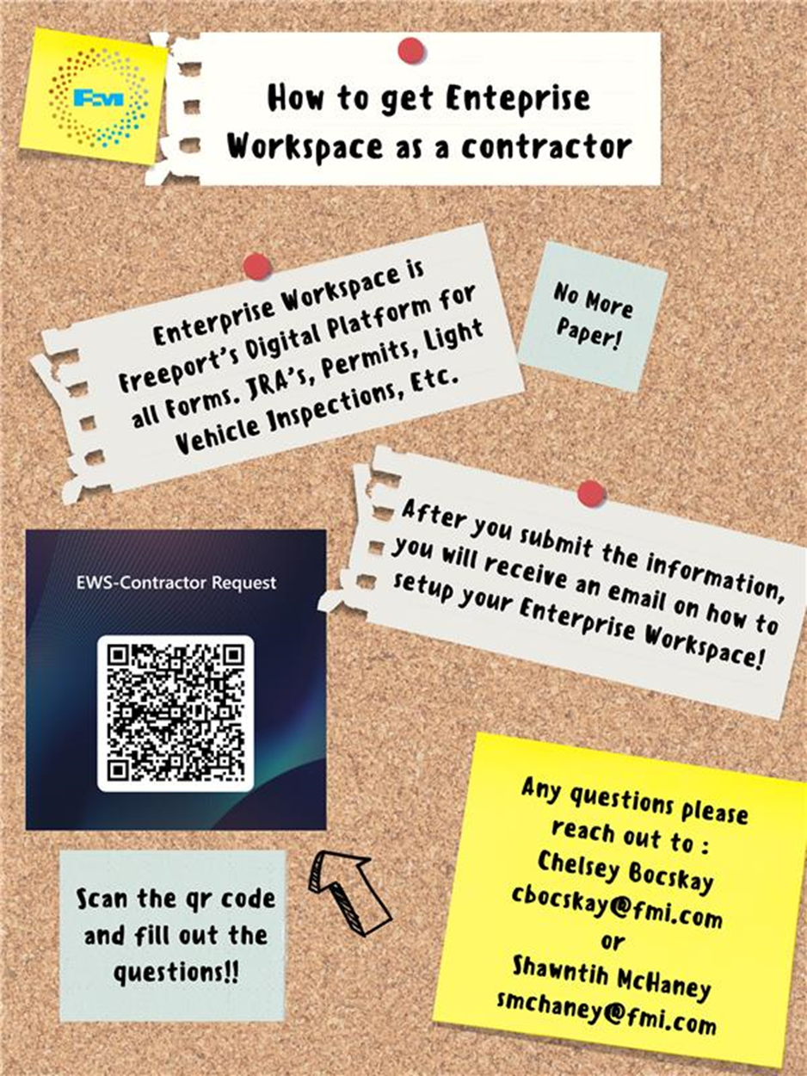
Contractor Management Topic – EWS Access
Access to site digital forms now available to Contractors!
Integration of Contractor submitted forms into internal dashboards
Forms can be used in online and offline modes
Request Access with QR Code or HERE
Reach out to H&S Department with any questions or issues

Slide 30
2025 Contractor Meeting Schedule
June 19th
August 14th
October 9th
December 18th
July 17th
September 11th
November 20th
Meetings begin 1PM Mountain Time
Mine & Mill Room Options Monthly

Slide 31
Open Forum

Slide 32
May Sign-Off Record
_____________________
_____________________
_____________________
_____________________
_____________________
_____________________
_____________________
_____________________
_____________________
_____________________
_____________________
_____________________
_____________________
_____________________
_____________________
_____________________
_____________________
_____________________
_____________________
_____________________

