Slide 1
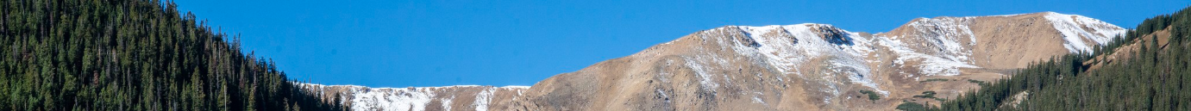
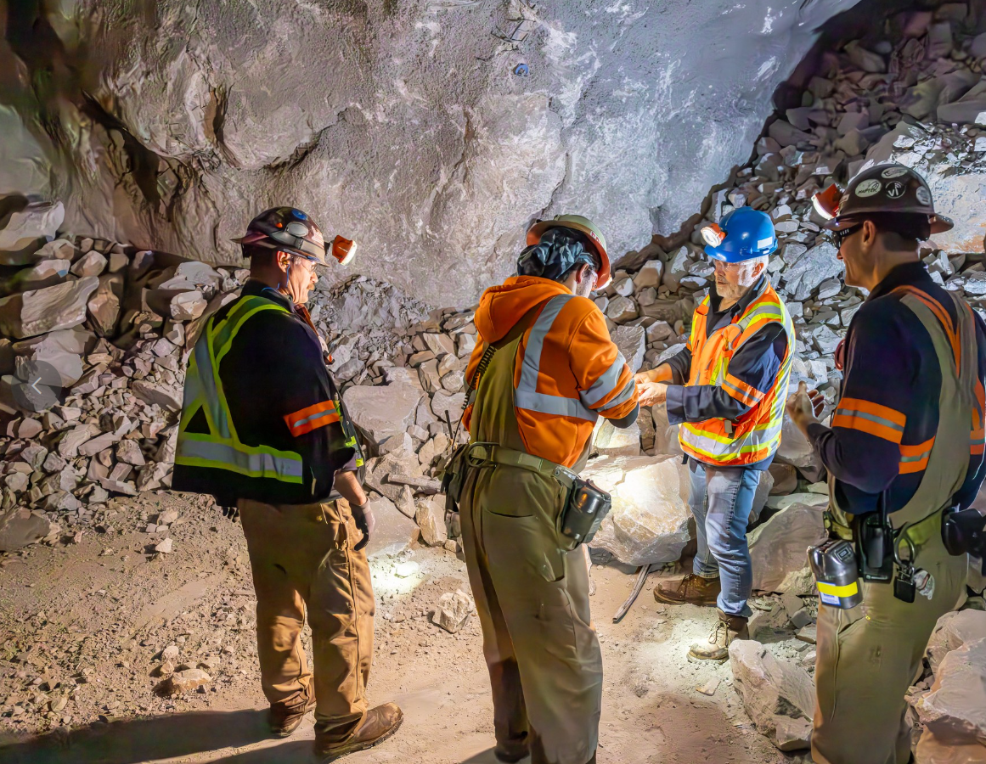


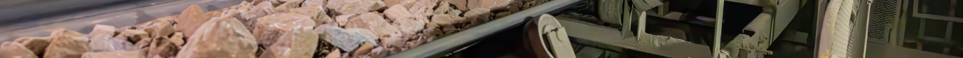
Henderson HSE Contractor Meeting
May 2026

Slide 2
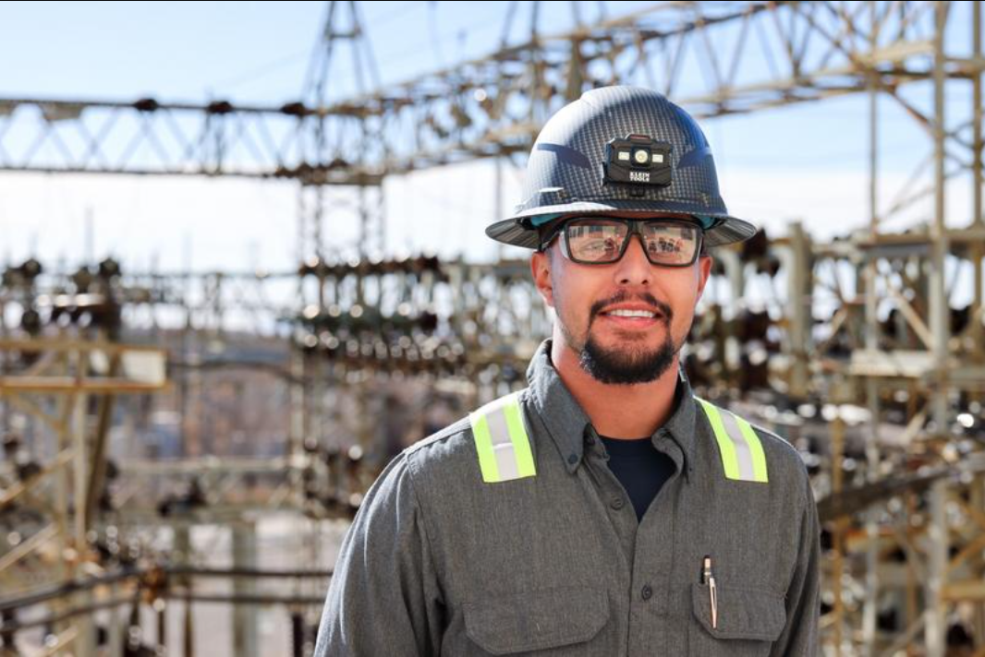

What is the purpose of this Meeting?
- For Henderson to have the opportunity to reach multiple contractors to discuss best practices when it comes to Health and Safety, Environmental and Contracts Management
- Give contractors an open forum to bring up concerns, successes or incidents, learnings, etc. that is shared between all contractors and Henderson personnel
- Help improve the safety culture and reduce safety incidents as a group

Slide 3
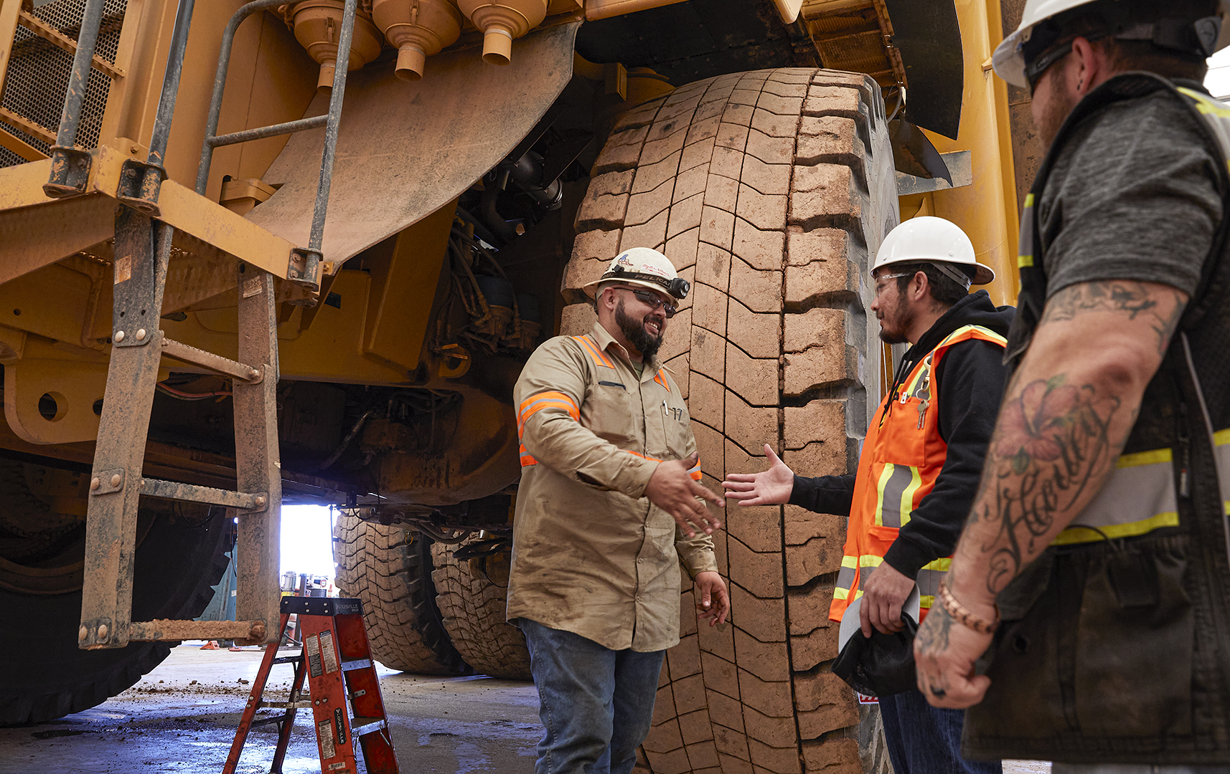
Safety Success

Slide 4
Spotlight On
Miami: Proactive Communication and Quick Action
The Miami Health and Safety team took proactive action to protect worker safety as they prepared for a smelter shutdown.
A potential hazard was identified when flagging was discussed in an area where a hard barricade would provide a stronger level of protection. The team responded quickly, verified conditions in the field and ensured a hard barricade was installed.
This action created a clear physical barrier, reduced the risk of unauthorized access to a high‑hazard area and strengthened protection for workers and contractors in preparation for shutdown activities.
The proactive communication and mitigation efforts demonstrate the importance of taking ownership of work areas and speaking up when opportunities exist to improve safety.
Discussion
How am I empowered to make improvements in my work area?
How do I take action to help improve conditions for myself and others?
What would help me feel prepared to act and make suggestions on better work planning and execution?

Slide 5
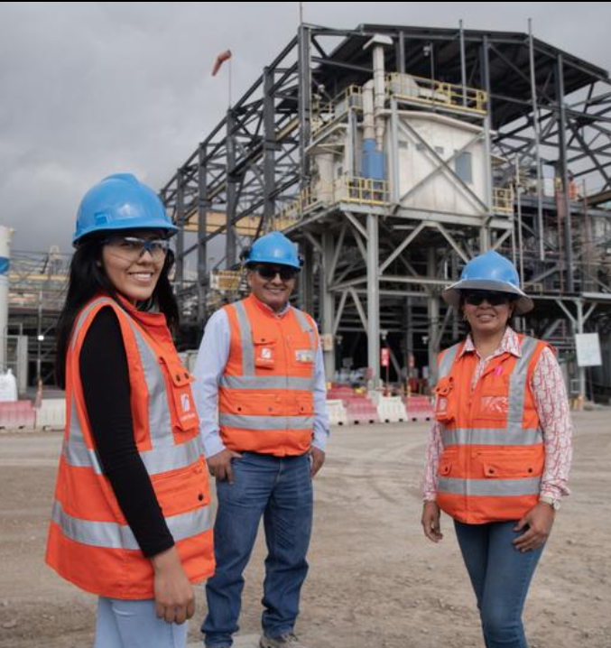
Safety Shares

Slide 6

Safety Trends:
Recurring Fatal Risks
Consider Common Causes of Falling Objects:
Overhead work
Stacked materials
Improperly secured tools and materials
Overloaded shelves or storage areas
Poor housekeeping practices
Build up from conveyor carry-back
Spillage from crush and convey systems
This year, incidents involving falling objects have emerged as the leading cause of fatal accidents.
The frequency of these occurrences underscores the importance of enhancing our ability to detect and manage falling and dropped objects. It’s crucial to revisit these risks and consider how we can improve effective prevention measures to minimize these dangers.
Ask Yourself:
Where am I most at risk for falling objects?
What steps do I take to prevent dropped objects?
How do I identify areas that need to be barricaded to help prevent people from entering drop zones?
How can I make sure tools and equipment are securely stored and won't fall from height?
What other strategies can we implement to minimize the risk of falling or dropped objects?
Click here to access a Falling Object toolkit, including talking points and employee handout.
Notes:
Trend data for 2025 FMA only.
Click the link below to access toolkits with additional materials on falling objects, control of hazardous energy and other fatal risks.
Corporate Safety Portal - Health & Safety Documents - Safety Shares & Toolkits

Slide 7
Simultaneous Work
Across our sites, multiple high‑risk tasks often happen at the same time: lifting, mobile equipment movement, hot work, electrical work and work at heights. When work overlaps, risks can multiply. Poor coordination can introduce falling object hazards, unexpected equipment interactions or expose workers below to risks they didn’t anticipate.
Key Risks With Elevated and Simultaneous Work
Falling or dropped objects exposing workers below
Equipment or lifts operating near active work zones
Changes in work sequence that affect barricades or controls
Workers entering an area without knowing overhead work is underway
Before Starting Work
Clearly identify all tasks happening nearby and above your work area
Confirm who else will be in the area, including contractors or support crews
Communicate directly with the crews working around you – discuss identified and potential hazards
Establish controls for elevated work including barricades and restricted zones, tool and material securing, designated walkways, and exclusion zones
Align on communication methods and stop‑work triggers if conditions change

Slide 8
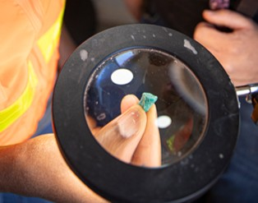
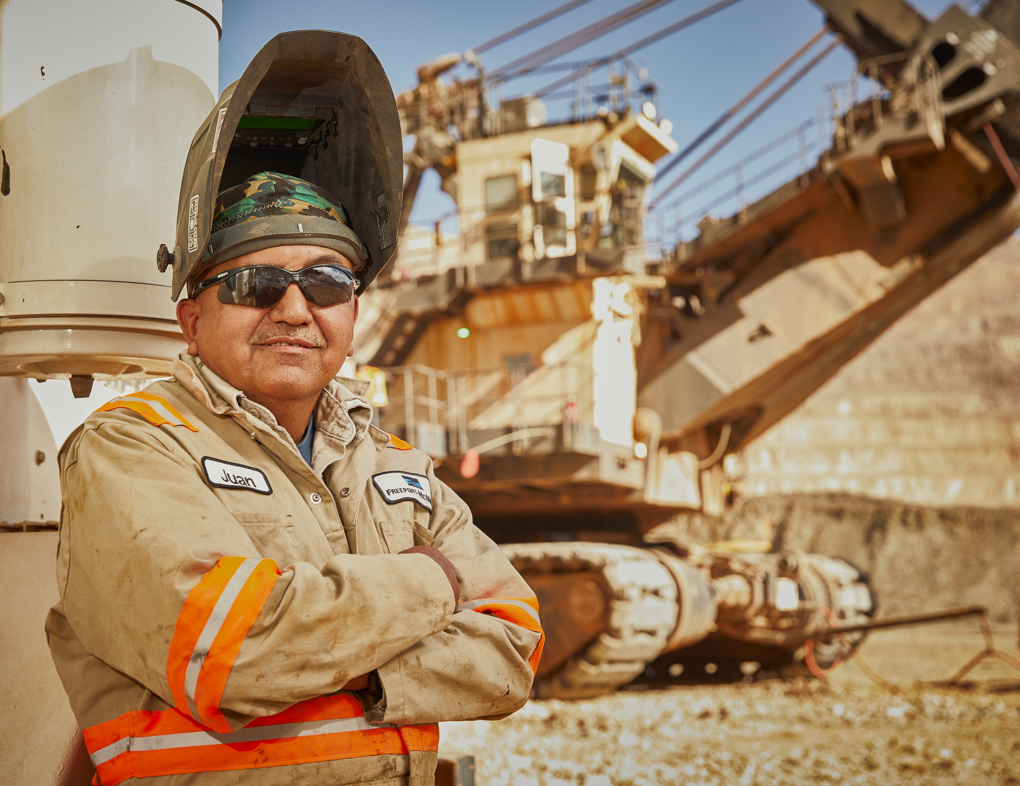


Environmental Share:
Earth Day 2026 took place on Wednesday, April 22, 2026, marking the 56th anniversary of the global movement.
Climax Molybdenum’s goal is to operate the safest and most sustainable mine sites to produce Molybdenum for a better future. Freeport has a robust environmental policy, and the Environmental Department has developed objectives for 2026 that help Henderson meet goals for safe and responsible production.
Earth day is a chance to reflect on the commitment from Henderson to have clean air and safe water. It’s also a chance to highlight how Molybdenum is essential to the green energy transformation.

Slide 9
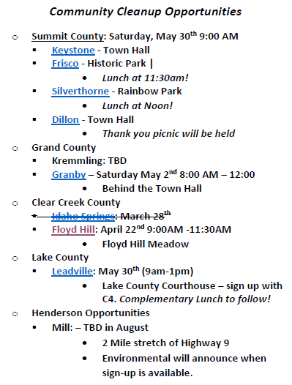
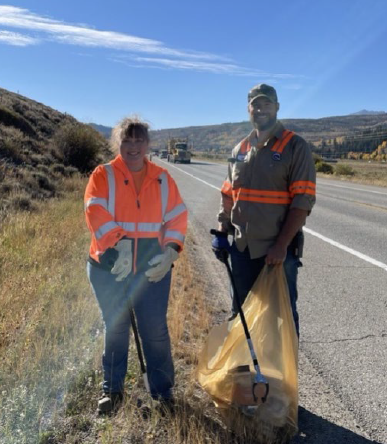
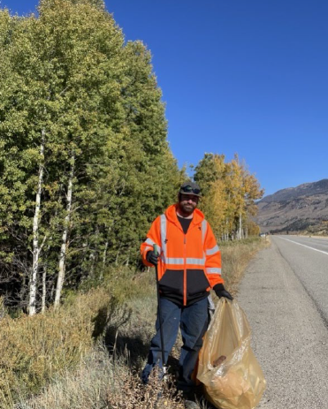
Community cleanup events are volunteer-driven initiatives to remove litter and improve public spaces like parks, trails, and neighborhoods.
When snow melts, it exposes months of accumulated winter litter, pet waste, and debris, revealing a heavily polluted landscape. This "hidden" trash includes food wrappers, plastics, broken sleds, and road salt, often washing into storm drains and contaminating waterways. It is one thing we can all do to keep the area we live, recreate, and work clean!

Slide 10

Workplace Exam (WPE) Update
Effective May 25th, 2026, we will change the WPE process so only adverse conditions will be recorded. As part of this change, the Adverse / Non-Adverse condition toggle will no longer be available in any EWS forms. WPEs are one of our best frontline safety tools. These changes will help make sure we are protecting our employees, meeting regulatory expectations and preventing injuries.
Why make this change?
Ensure we only record conditions that could
adversely affect the safety or health of employees
Meet MSHA regulatory requirements and remove
confusion around Adverse/Non-Adverse on our WPEs
This approach helps improve visibility of meaningful risks
and supports better follow-up and corrective action
What this means for employees/contractors
WPEs are intended to capture safety hazards, not general observations or minor imperfections
When a condition is recorded on a WPE, it signals that the issue requires immediate attention

Slide 11
Understanding Adverse Conditions
An adverse condition is any condition that could reasonably affect the health or safety of employees if left unaddressed.
Examples of conditions that should be documented include:
Berm deficiencies
Hazardous ground conditions
Excessive dust or airborne contaminants
Missing, damaged or ineffective guards
Combustible material buildup or spillage
Electrical conductor damage
Slip, trip or fall hazards
Falling object hazards
Structural integrity concerns
Mobile equipment defects
Examples of conditions that should not be documented as an adverse condition include:
Cosmetic issues that do not affect safety or health
Minor housekeeping items with no reasonable potential to cause harm
Conditions that are normal, controlled and not hazardous

Slide 12
Understanding Adverse Conditions
When an Adverse Condition is Identified…
Reinforce Workplace Exams Expectations:
Thoroughly examine your work area
Identify and record all adverse conditions that could reasonably harm you or someone else
If a condition is not adverse, address through supervisor notification and a work order
Person completing the WPE should:
Document the condition on the WPE
Protect others by guarding, flagging, tagging or barricading the hazard
Resolve the issue if it is safe to do so
Immediately notify your supervisor
REMEMBER – If conditions are found and corrected by employees, they must still be noted on the WPE
Supervisor should:
Initiate corrective action, including maintenance requests
Evacuate the area as necessary if there is an imminent danger hazard identified
Verify all employee are protected until the hazard is corrected and appropriate controls are in place

Slide 13
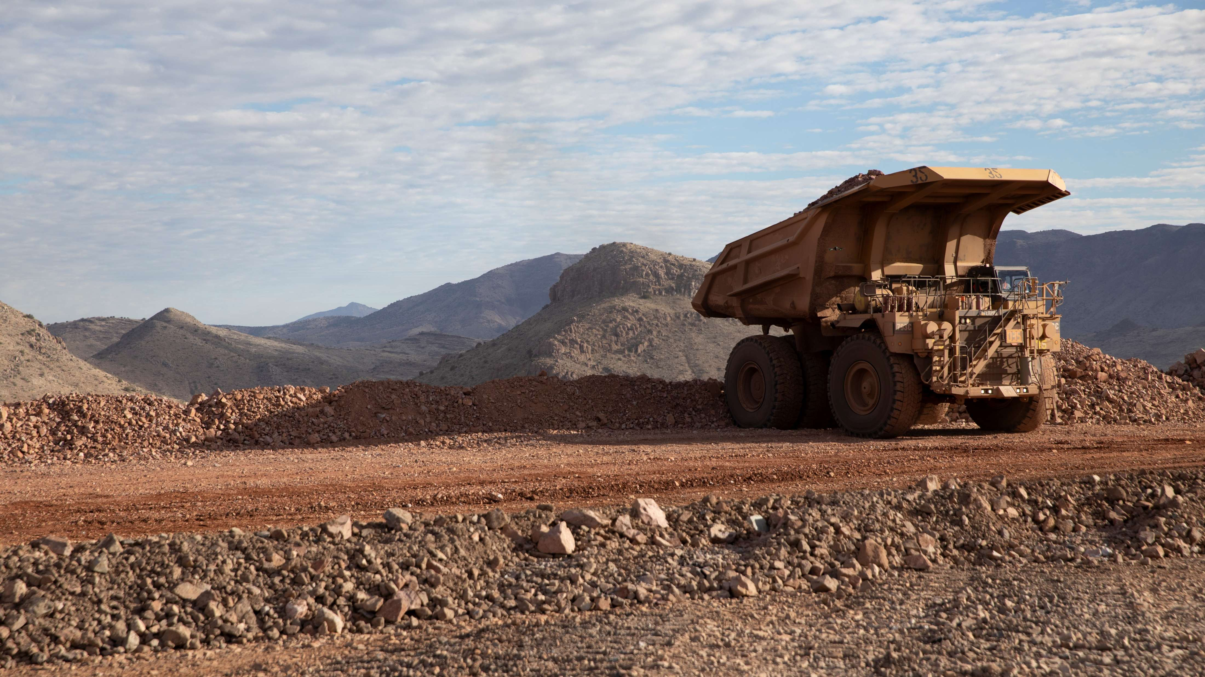
High-risk Incidents
Actionable and PFEs

Slide 14

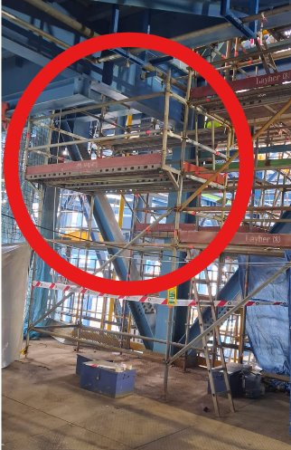
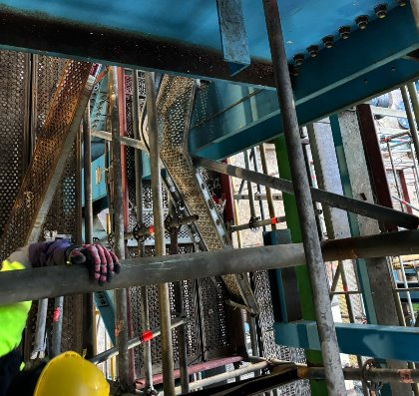
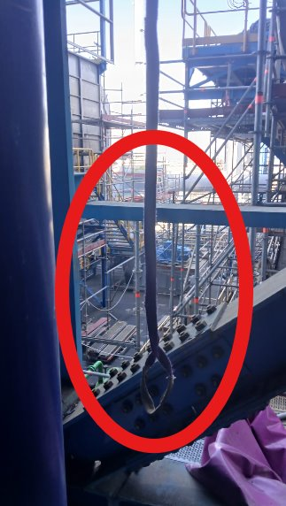
Pipe Fell During Lift
PFE # 2026-04 Event ID # 20034824
Falling Objects
Preliminary Incident Details
Operation | Atlantic Copper
Date / Time | March 23, 2026 / 9:30 a.m.
Event Type | Injury – First Aid
Summary | During lifting, a 6‑meter (20‑foot), 2‑inch pipe weighing about 45 kilograms (99 pounds) slipped from the sling and fell from about 10 meters (33 feet). On the way down, the pipe hit a scaffolding platform, causing it to move and strike another nearby platform. That second platform then struck an employee’s foot.
Risk Category | Actionable – Significant (3) Likely (3)
Findings / Missing Controls | Incorrect lifting method. No secure element was used to prevent the pipe from sliding during the lift. The impacted employee was in the line of fire.
Immediate Action(s) | Use clamps on pipes to be lifted. Use double-choking method to secure piping.
Applicable Policies / Procedures | FCX-HS32 Crane and Rigging Policy FCX-HS19 Flagging and Barricading Policy
Employee Condition | The impacted employee sustained an ankle contusion.
Contact | Luis Fernando Oso Oliva, Director-Health and Safety Miguel González Gómez, Supervisor-Health and Safety
Platform hit by the pipe
Pipe
Location of impacted employee on scaffold
Platform that struck the employee
Employee position
Reenactment of incident
Sling used during lift

Slide 15
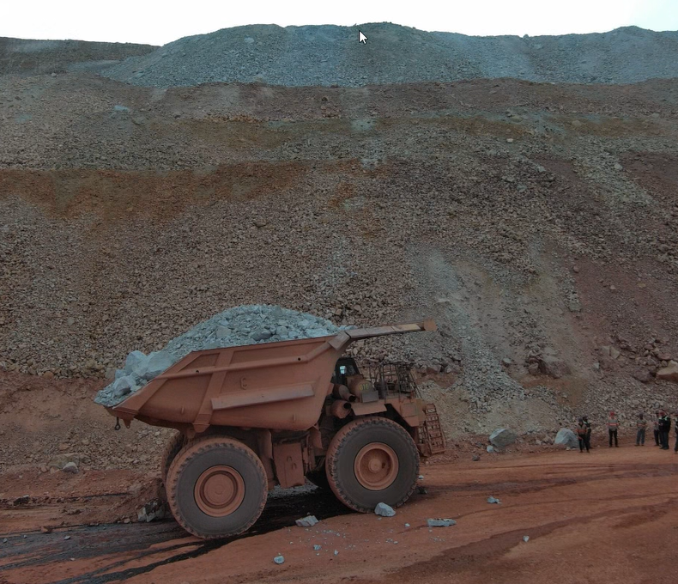
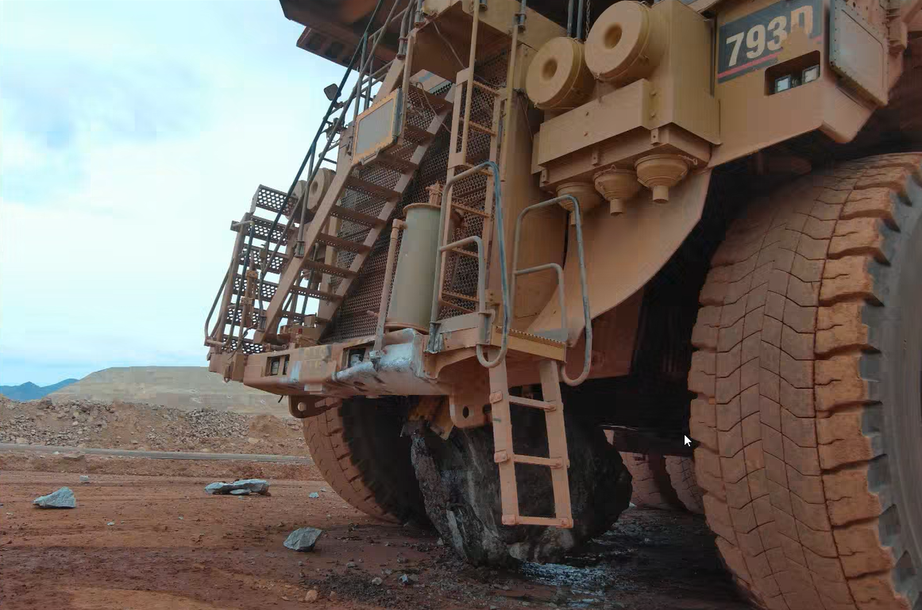
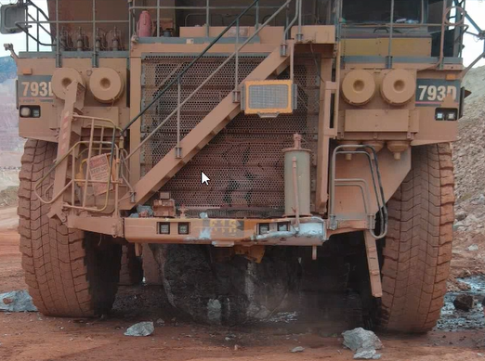
Haul Truck Ran Over Large Boulder
ID # 2026-08 Event ID # 20035024
Falling Objects
Preliminary Incident Details
Operation | Morenci
Date / Time | April 5, 2026 / 9 p.m.
Event Type | Property Damage
Summary | While driving a haul truck, a trainee and mentor heard a loud bang and discovered they had driven over a large boulder approximately 6-feet high (1.8-meters) and 8-feet wide (2.4-meters), causing significant damage to the engine and underside of the truck. The investigation identified a clear path from the adjacent dump, where the boulder fell about 200-feet (61-meters) to the haul road.
Risk Category | Actionable – Significant (3) Likely (3)
Findings / Missing Controls | The exact cause of the rockfall is unknown; however, it is believed to be related to stockpile dumping or pushing. There were no catch berms on the high wall to prevent rocks from falling onto the active haul road. There was no segregation on the roadway to prevent exposure during dumping activities.
Immediate Action(s) | Verify positive communication and coordination where there are simultaneous dumping and hauling activities. Implement spotters or segregation where dumping activities present active hazards to nearby haul roads.
Applicable Policies / Procedures | No applicable policies.
Employee Condition | No injuries.
Contact | Belen Lawrence, Manager-Health and Safety Ken Kindle, Manager-Mine Fragmentation, Loading and Support
Path boulder fell down benches
Position of boulder under haul truck.

Slide 16

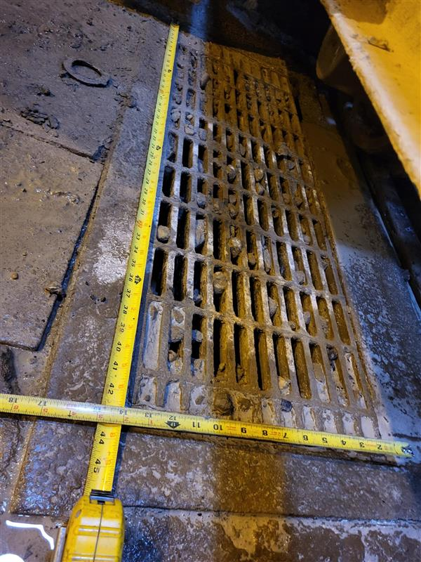
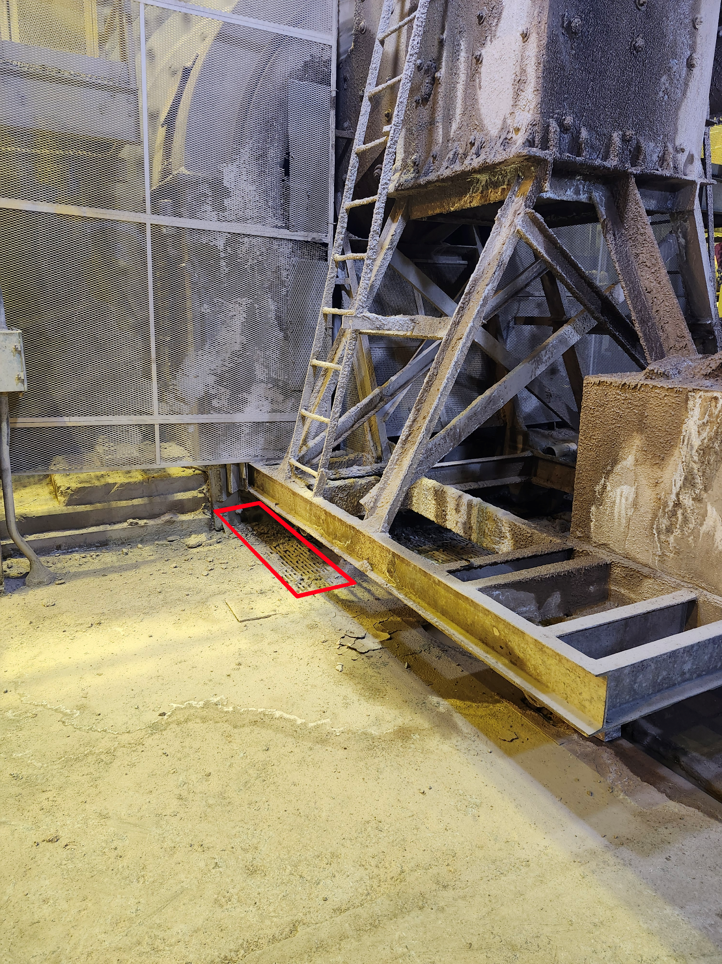
Grating Open Hole Fall
ID # 2026-05 Event ID # 20035513
Fall from Heights
Preliminary Incident Details
Operation | Henderson
Date / Time | April 21, 2026 / 7:30 a.m.
Event Type | Injury – First Aid
Summary | Two mill repair employees were preparing the primary mill liner deck for a liner change when a section of floor grating became obstructed with debris during washdown. A 14x42-inch section of grating was removed, creating a temporary open hole for material flow. One employee remained positioned over the opening and lost their footing, partially falling into the opening. The employee caught themselves at the opening and avoided a 20-foot fall.
Risk Category | Actionable – Significant (3) Likely (3)
Findings / Missing Controls | Employees did not identify the open hole hazard. Both were trained and compliant in Hazard Recognition and Working at Heights. Fall prevention controls – such as barricading, flagging and fall protection – were not acknowledged or used.
Immediate Action(s) | Validate team competency through structured in‑field exercises, including reinforcement of established procedures and expectations when engineering controls are created, modified or removed resulting in open‑hole conditions.
Applicable Policies / Procedures | FCX-HS02 Working at Heights Policy
Employee Condition | The employee sustained minor abrasions and bruising on the elbows and abdomen.
Contact | Benjamin Goertz, Manager-Health and Safety
Size of grating that was removed to create opening.
Area where grating was removed (feed chute trolley was not present when event occurred)

Slide 17
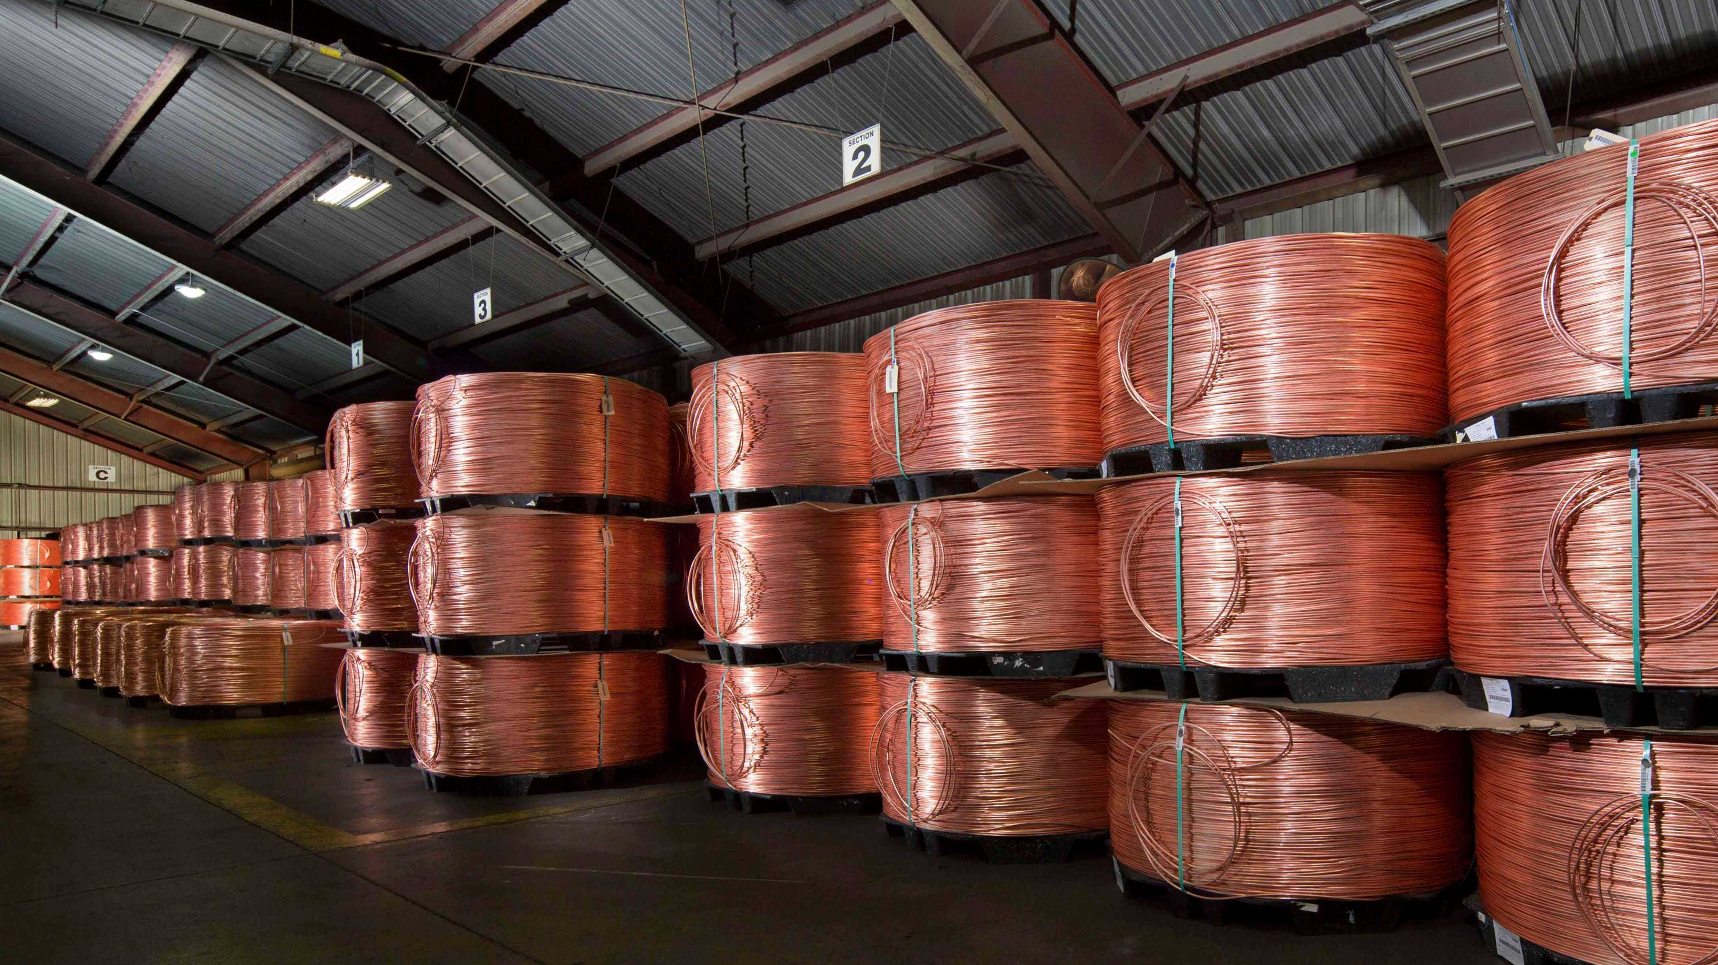
Safety Alerts

Slide 18
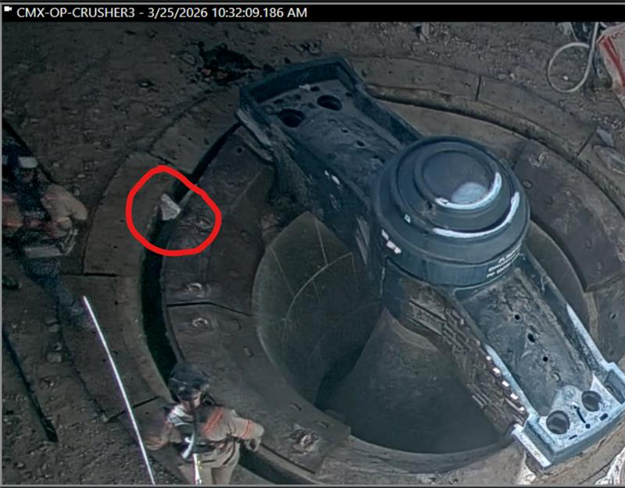
Concrete Block Fell into Dump Pocket
Event ID # 20035905
Falling Objects
Preliminary Incident Details
Operation | Climax
Date / Time | March 25, 2026 / 10:32 AM
Event Type | Near Miss
Summary | Contractor employees were chipping concrete on the upper level of the crusher door frame. Two additional employees were working in the crusher dump pocket below. During chipping, a concrete block fell from the upper level (approximately 30 feet) into the crusher.
Findings / Missing Controls | Lack of communication and task coordination between contractors working on the upper level and the crew working below in the dump pocket.
Immediate Corrective Action(s) | Work was stopped until tasks could be coordinated to prevent simultaneous operations. For upcoming shutdowns, task coordination will be evaluated against the schedule before work begins.
Applicable Policies / Procedures | FCX-HS19 Flagging and Barricading Policy Freeport Health Safety and Environmental Plan (HSEP) FCX Ready to Work Permit
Contact | Matthew Main, Manager-Health and Safety
Position of employees and the block that fell into the dump pocket.

Slide 19

Industry Incidents

Slide 20
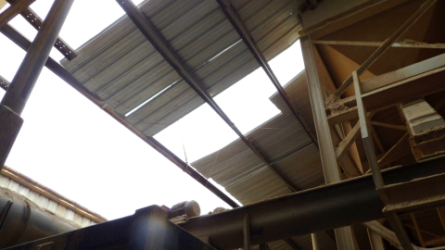
MSHA Fatality Alert
March 28, 2026 – A contractor died after falling approximately 37-feet through an unsecured roof panel of a shaker screen deck while conducting roof repairs.
Eliminate Hazards and Prevent Injuries
Provide and maintain safe access to all work areas.
Always use approved fall protection systems when working at heights where a fall hazard is present. Confirm fall protection has a suitable fall arrest connection and secure anchorage system.
Make sure miners are properly trained for the assigned task, including the proper use of Personal Protective Equipment (PPE) and recognizing fall hazards.
Conduct a thorough inspection of the workplace and all required PPE before commencing any work activities to identify and mitigate potential hazards.

Slide 21
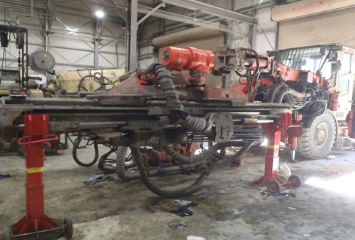
MSHA Fatality Alert
March 12, 2026 - A contract mechanic died after the boom of a drill mast rolled, struck and pinned him.
Eliminate Hazards and Prevent Injuries
Block equipment, including components or assemblies, from unexpected movement before beginning work.
Follow manufacturer-recommended maintenance procedures.
Bleed off all air prior to hooking up hydraulic lines. Use bleed valves when installed and fully cycle actuators in all directions.
Train miners in safe work procedures and hazard recognition. Monitor personnel routinely to verify they follow safe work procedures.

Slide 22
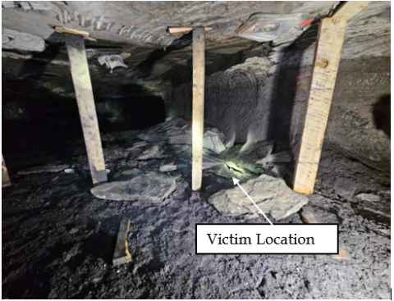
MSHA Fatality Alert
April 2, 2026 – A shuttle car operator was struck by falling rock from the mine roof while setting timber posts during retreat mining.
Eliminate Hazards and Prevent Injuries
Know and follow all provisions in the approved roof control plan.
The use of mobile roof supports provides greater support and eliminates the need for miners to install posts.
Never go under unsupported roof. Consider a roof with damaged or incomplete support as unsupported.
Danger-off hazardous areas until appropriate corrective measures are taken.
Conduct thorough examinations of the roof, face and ribs where miners will be working or traveling.

Slide 23
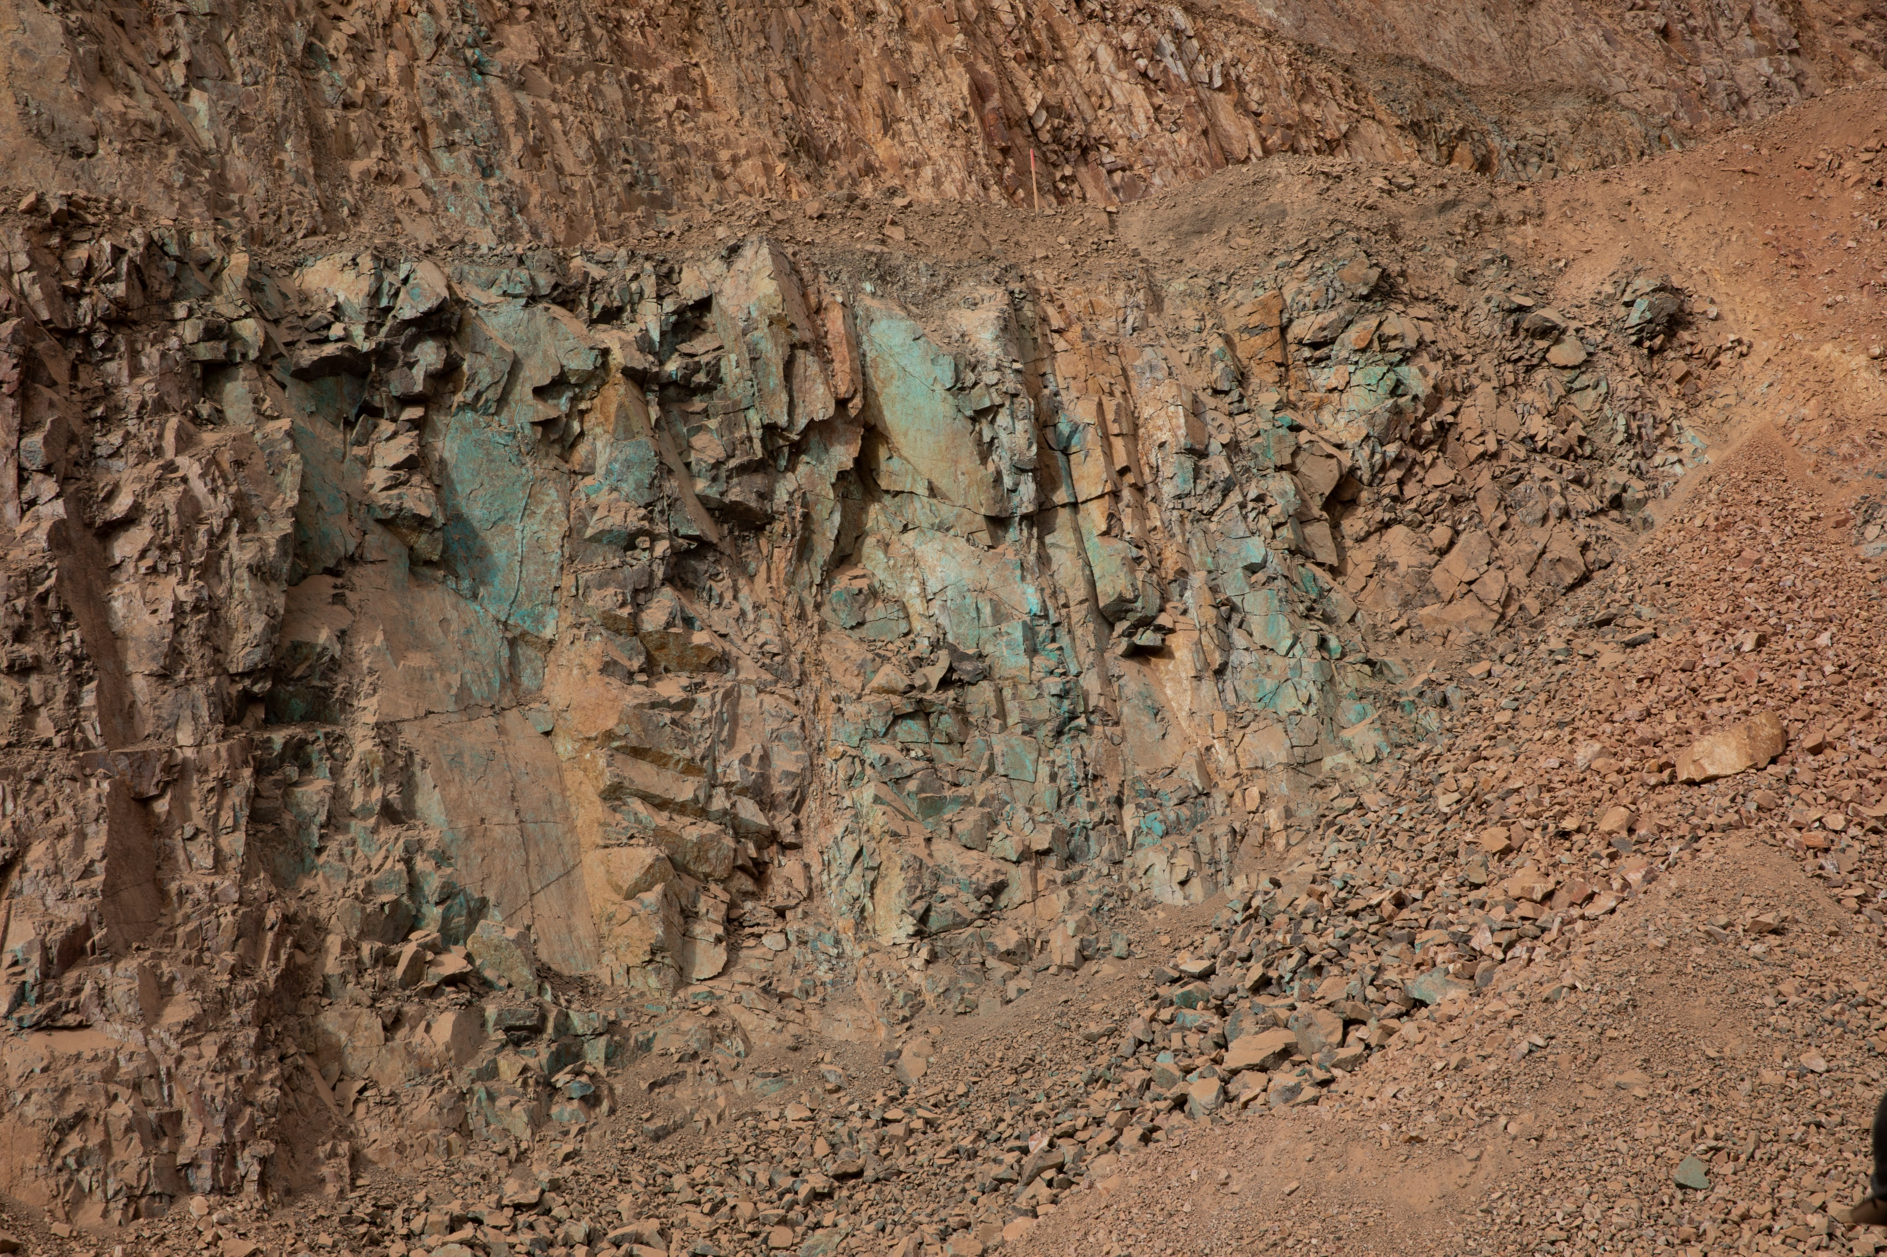
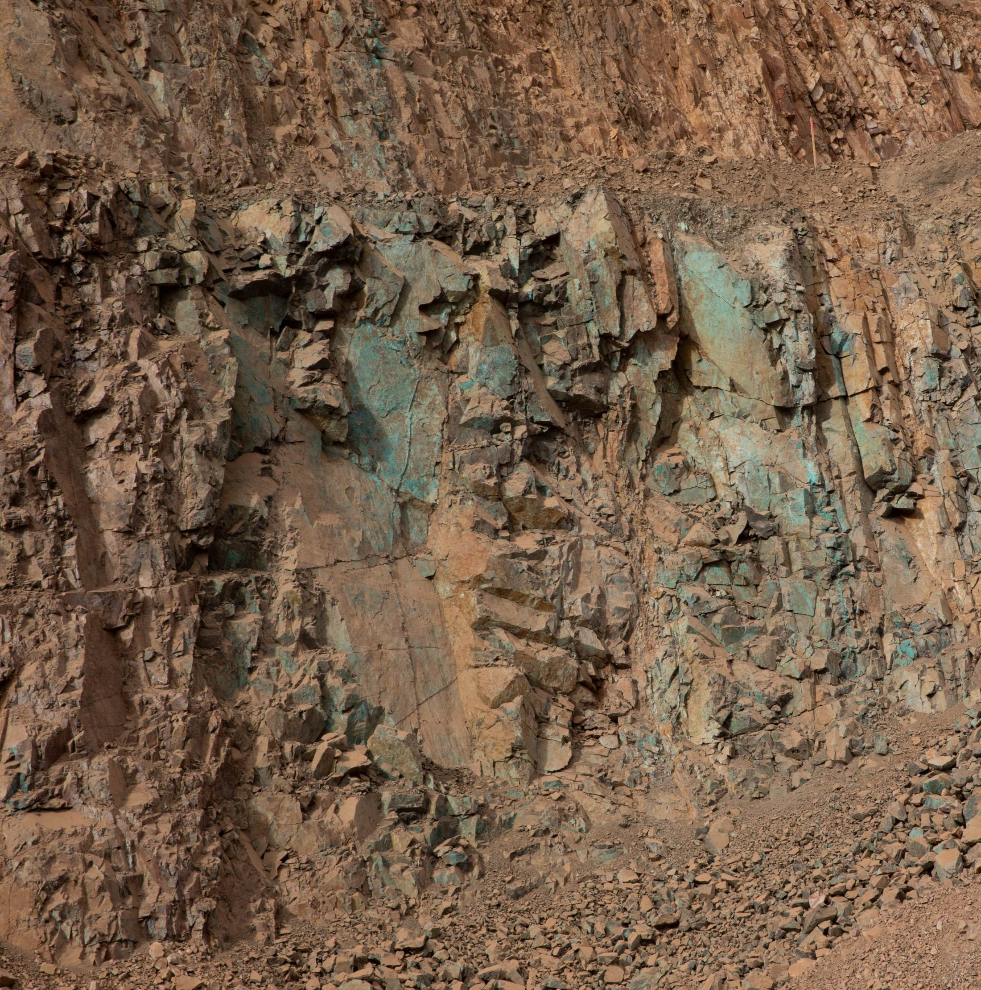
Site Incidents

Slide 24
Henderson Incidents
04/08 – REPORTABLE Employee overextended left arm repairing vent door (Lost Time)
  Employee repairing ventilation door reached for tool while holding part to door
  Arm overextended causing bicep rupture
04/21 – PFE Employee partially fell into open hole (See PFE Advisory Slide)
  RCA ongoing, Lessons Learned and Action Plan release soon
04/21 – Employee rolled ankle while stepping out of buggy (First Aid)
  Employee exiting buggy at PC1 counterweight near drainage ditch
  Water present above ditch level made difficult to see transition from ground to ditch
  Employee stepped on transition, slipped into ditch and rolled ankle

Slide 25
Henderson Incidents
04/23 – Seal at Williams Fork Pumphouse failed causing arc flash event (Property Damage)
  2 employees followed a pump shutdown process at Williams Fork Pumphouse
  Shutdown of makeup pump caused flange connection failure, releasing high-pressure water spray inside pump house
  Water spray reached electrical equipment, causing transformer arc, breaker trip, and power outage
  Employees exited pumphouse after connection failure, no exposure to arc flash
04/29 – Primary Mill 3 cyclone feeder header bent with crane (Property Damage)
  Two employees changing seat and pipe on Clarkson valve after rebuilding cyclone
  Crane Operator lowered hook for the other employee to remove chocker
  Before chocker removed, crane operator raised hook causing header to bend and chocker cable to break
  Inconsistent communication practices with crane led to injury Near Miss and PD

Slide 26
FRM Verification Results – April
220 verifications completed in April
Focus for April was around Hazardous Substance – Acute/Chronic and Falling Objects
Both Haz Sub - Acute and Haz Sub - Chronic decrease missing control ratios, Chronic still in top 3
Exposure to Electrical Hazards identified multiple missing Arc Flash labels
FOCUS FOR MAY/JUNE:
Exposure to Electrical Hazards
Hazardous Substances - Chronic

Slide 27
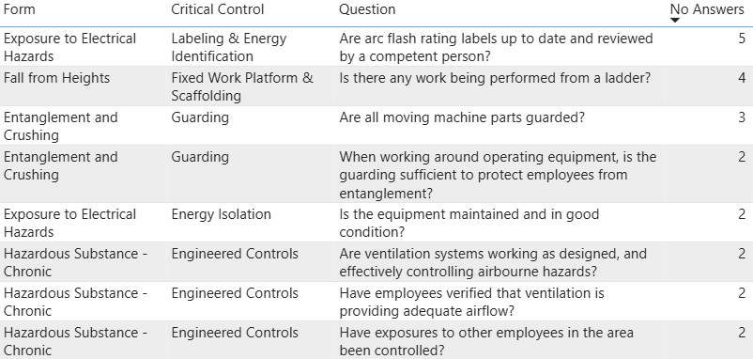
FRM Verification Results – April
Henderson Missing Controls with Multiple No Responses

Slide 28
Contractor Management Topics
ISN Updates
  MSHA Part 48 Training
Site Badging

Slide 29
ISNetworld / Training Update
Training and ISN Compliance
All contractors were required to have all training (Core, Compliance and Technical) and Worker Acknowledgements to be uploaded/completed in ISN by in April
  If Contractors do not have this completed by June 15, 2026, Henderson will deny access to employees who are showing as incomplete in ISN
  If you need assistance, please call or email:
    Anna Nab
    GSC Superintendent – Contractor Compliance
    719-427-0033
    anab1@fmi.com
  Until your employees are fully compliant in ISN, all contractors must have all employee training documentation available on site or held by the contractor’s PM onsite (e.g. a project binder with all the training documentation).
Part 48 New-Miner Single-File Training Upload
  Contract employees may have multiple 5000-23’s for New Miner, specifically the Introduction to Work Area portion on a separate records
  Must upload to ISN all 5000-23’s showing completed New Miner training in 1 file, not separate files

Slide 30
Badging Update
Badging
All contractor employees are required to badge in and out of the gate at both the Henderson Mine and Mill.
Requesting Contractors submit a list of current employees onsite or will be onsite. Send this list to Tina Michaelis, GSC Superintendent at tmichael@fmi.com

Slide 31

Open Forum

Slide 32
June 18th
July 16th
August 20th
September 10th
October 8th
November 19th
December 17th
2026 Meeting Schedule
Meetings begin 1 PM MST
Mine and Mill In-Person Options Monthly

Slide 33
May Sign-Off Record
_____________________
_____________________
_____________________
_____________________
_____________________
_____________________
_____________________
_____________________
_____________________
_____________________
_____________________
_____________________
_____________________
_____________________
_____________________
_____________________
_____________________
_____________________
_____________________
_____________________

