Slide 1
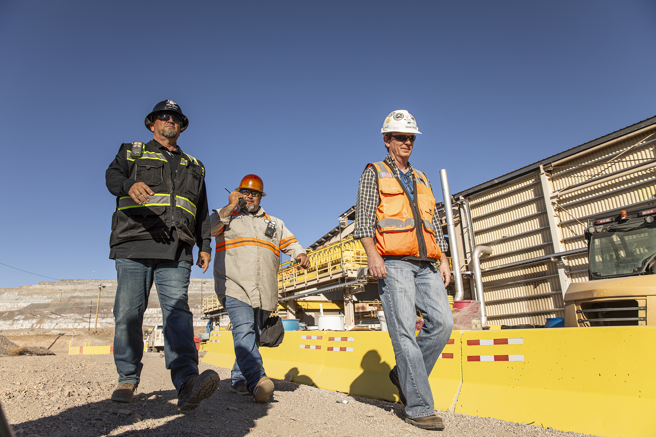


HSE Contractor Meeting
November 2025

Slide 2
Avoiding Unauthorized AI Tools
FMI has observed an increase in AI “notetaking” bots being added to Teams meetings
The use of these tools and software falls under MIS End User Policies that prohibit Freeport employees, contractors and partners from sharing company data without the company’s consent
To protect company data:
  Contractors and Vendors not to use notetaking bots/recording tools
  If external bot/recorder added to meeting, meeting will be stopped
  Ask the FMI organizer to use approved notetaking tools

Slide 3
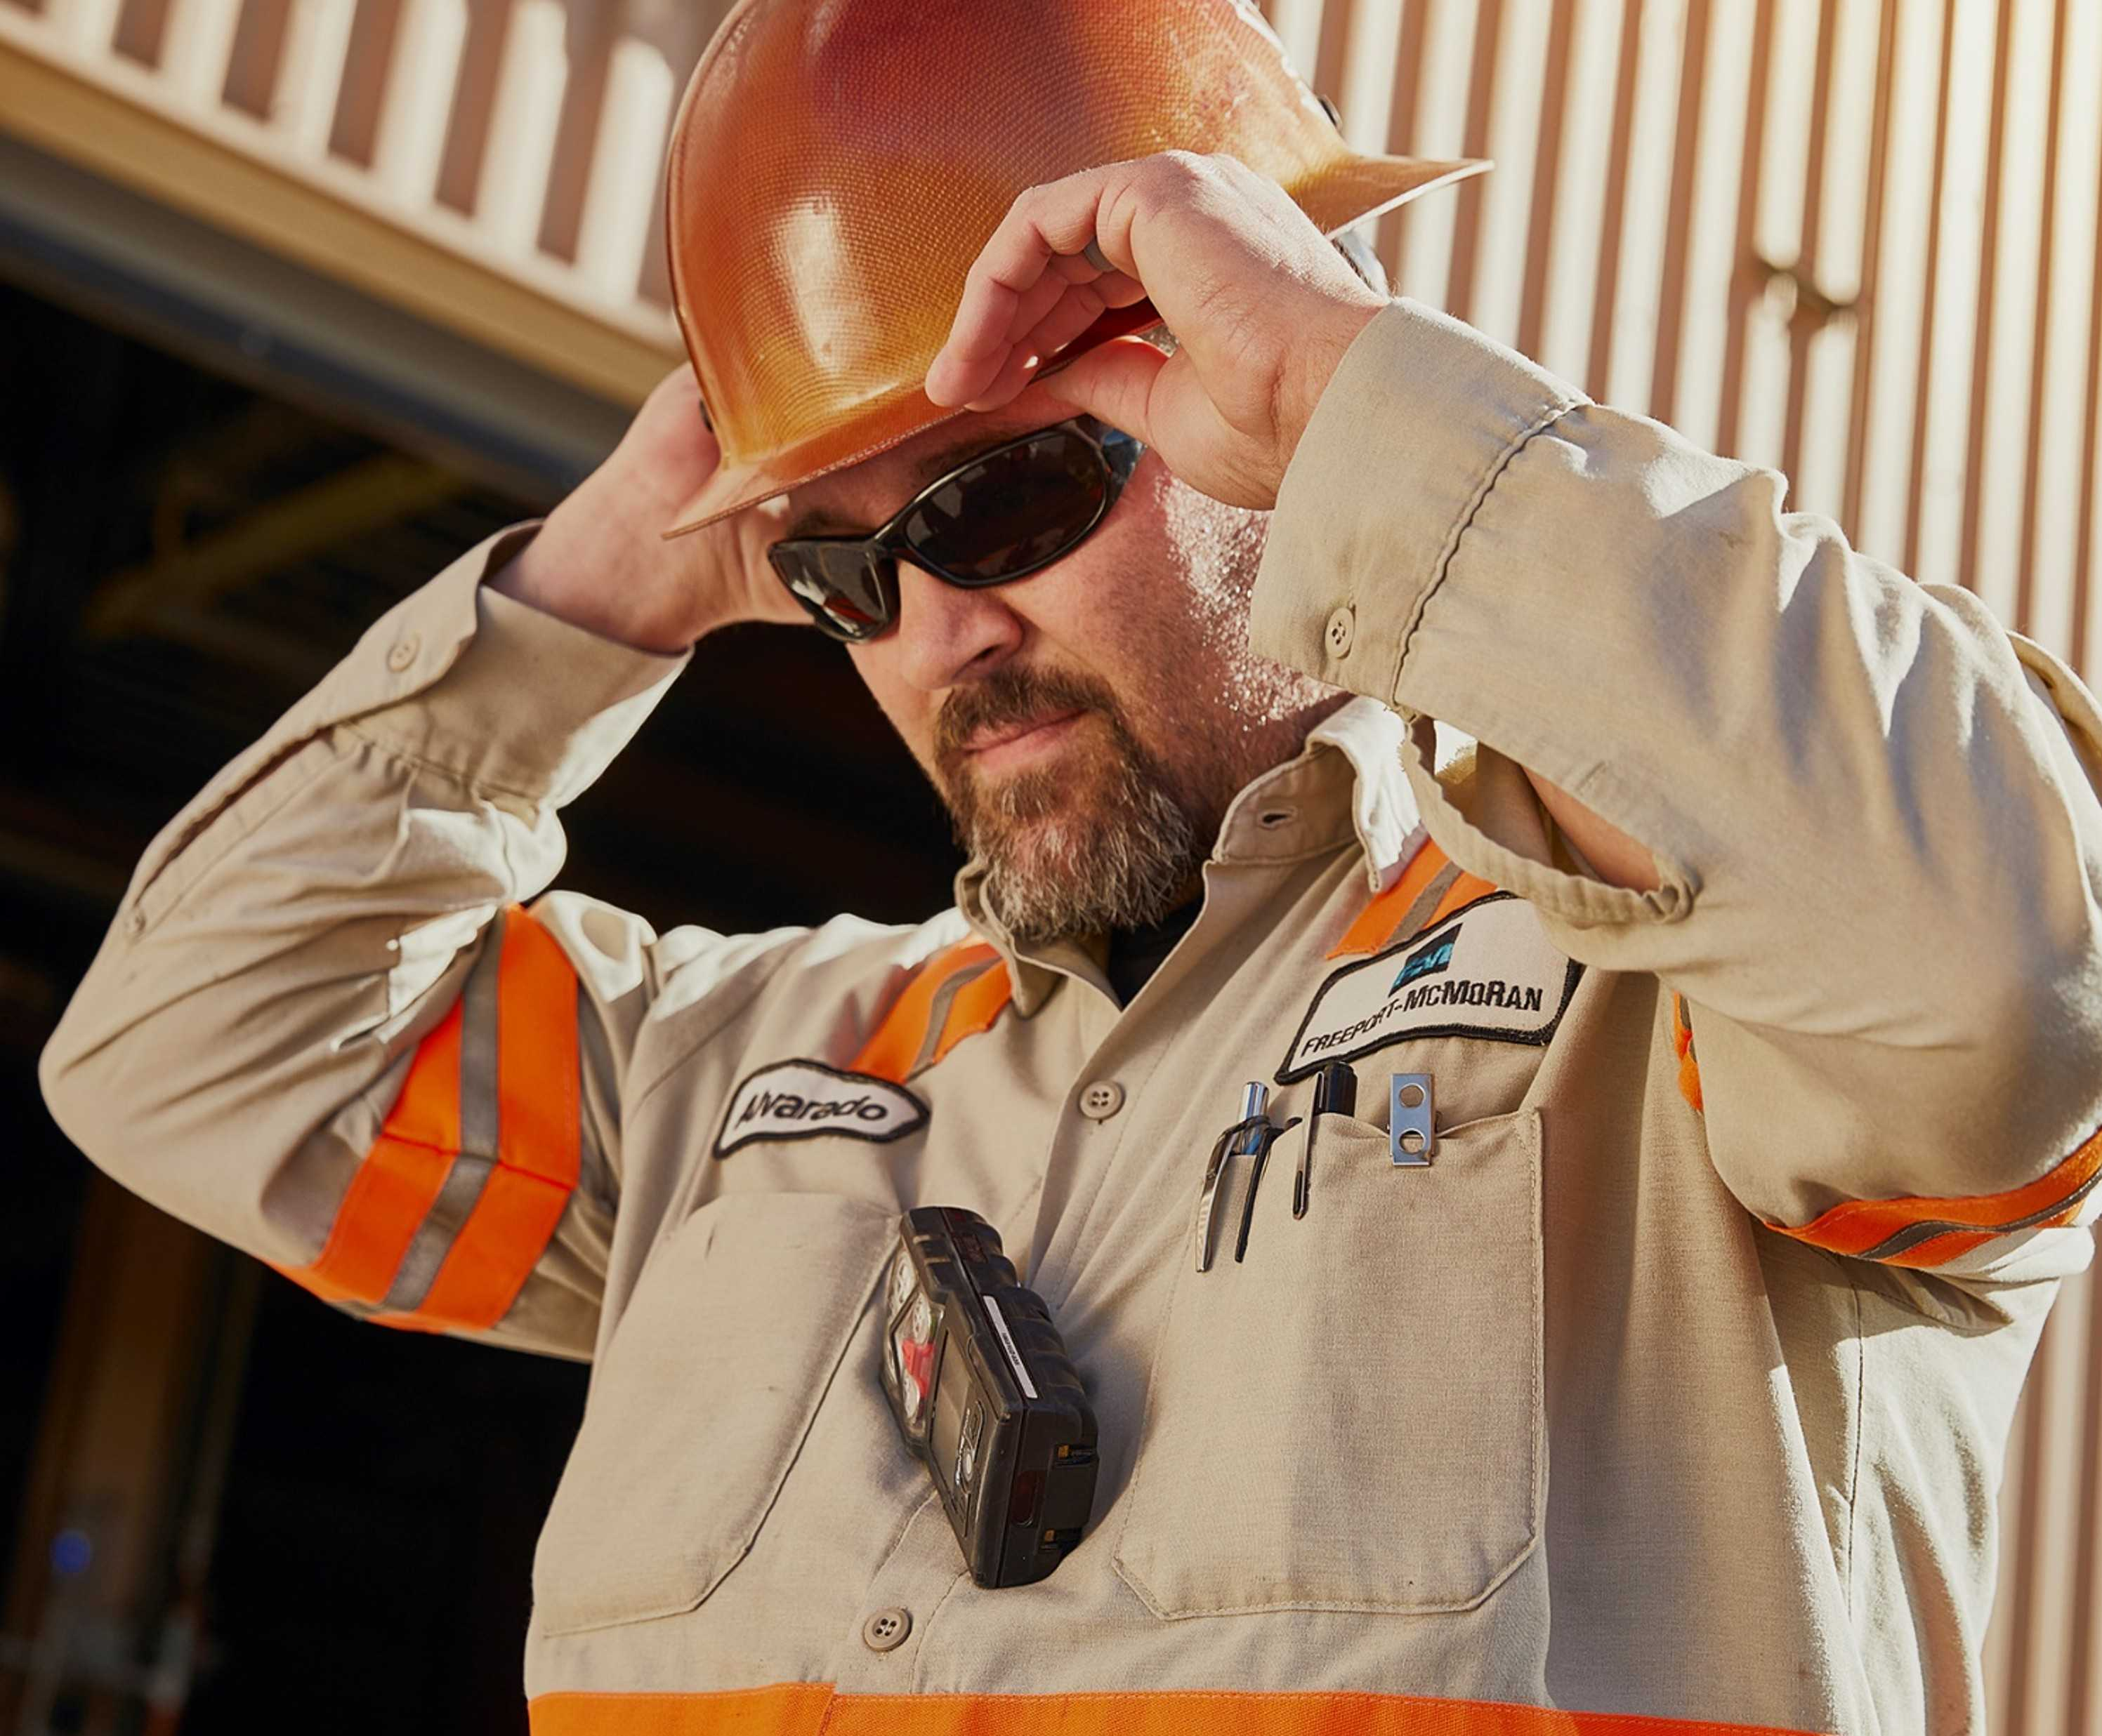

What is the purpose of this Meeting?
- For Henderson to have the opportunity to reach multiple contractors to discuss best practices when it comes to Health and Safety, Environmental and Contracts Management
- Give contractors an open forum to bring up concerns, successes or incidents, learnings, etc. that is shared between all contractors and Henderson personnel
- Help improve the safety culture and reduce safety incidents as a group

Slide 4
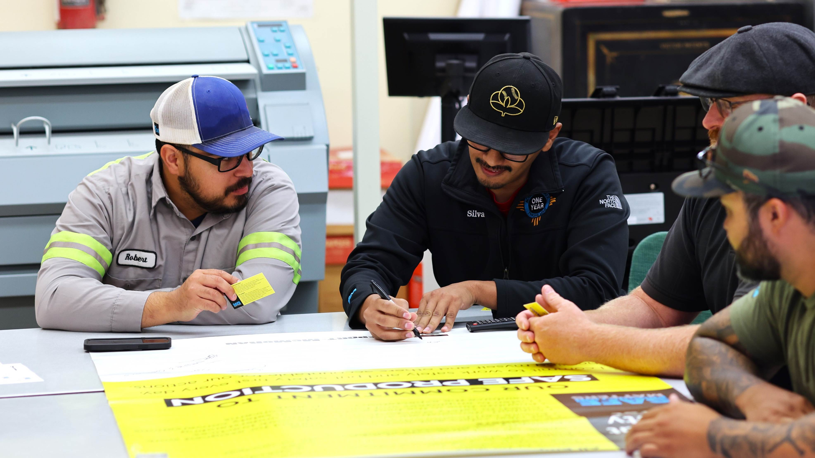
Safety Shares

Slide 5




Control of Hazardous Energy
Discussion
Where have you encountered hazardous energy sources that aren’t immediately obvious?
What are some red flags that suggest hazardous energy might be present?
What steps do you take to verify energy has been fully isolated before starting work?
Besides LOTOTO, what are other controls we can use to control hazardous energy?
Hazardous energy isn’t always obvious. You can’t see electricity, and you may not feel hydraulic pressure until it’s too late. Always assume energy is present until you personally verify isolation and zero energy state.
When in doubt, stop and ask.
Recent examples of high-risk hazardous energy events:
A loaded conveyor belt rolled backward during maintenance | Stored hydraulic pressure in a ram released unexpectedly | An electrical panel was mistakenly assumed to be de-energized, leading to arc flash | Slurry was projected from a tailings line when a valve was removed before energy was isolated

Slide 6
Environmental Share:
Spill Management
Spills happen!
Even though we try to eliminate all spills, sometimes stuff happens.
In this event, please reach out to your Project Manger and site environmental
  On call 720-942-3603
Report all spills, environmental will determine how to dispose
Clean up and contain only if it is safe to do so
Call a mayday on the radio or phone to Boiler / Hoist if the spill causes an immediate safety concern
Notes:
HSEP – Contractor Health, Safety and Environmental Plan
FRM – Fatal Risk Management
WPE – Work Place Exam

Slide 7
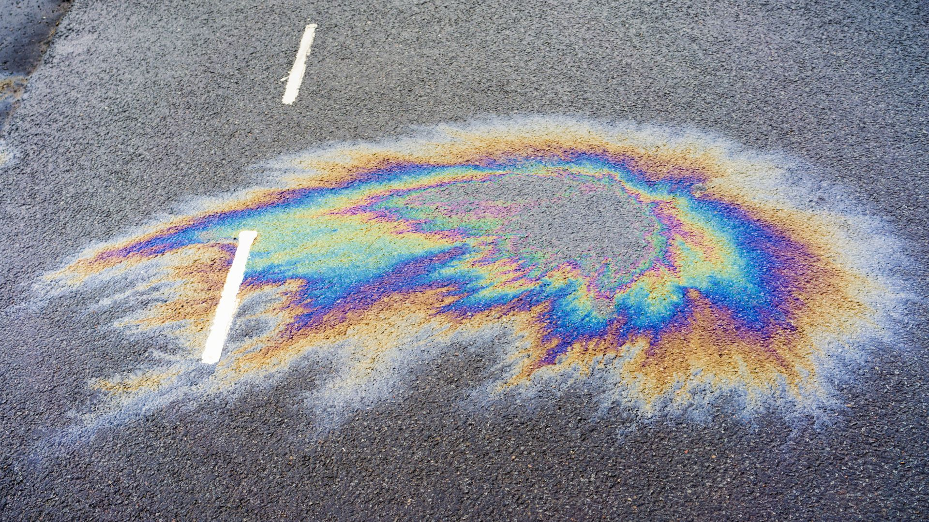
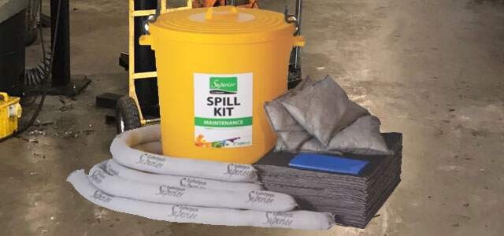
Spill Management
WHY EVERY SPILL NEED TO BE REPORTED:
-Environmental determines if the product or quantity
spilled is reportable to outside entities (State, EPA, etc.).
This is especially critical for spills near bodies of water.
Certain chemicals may also be subject to reporting for
Toxic Release Inventory (TRI).
-Environmental documents spill quantities, chemical
ingredients, and causes. This helps us focus on the root
causes and how we can help prevent them.
-Environmental can determine the best way forward for
cleanup and disposal.
Cleanups must occur immediately after the spill only if it
is safe to do so.
SPILLS INCLUDE, BUT ARE NOT LIMITED TO: Hydraulic Oil,
Used/New Oil, Glycol, Petron, Coherex, Tailings, any
product or chemical that is released where it is not
serving its purpose.
Notes:
HSEP – Contractor Health, Safety and Environmental Plan
FRM – Fatal Risk Management
WPE – Work Place Exam

Slide 8
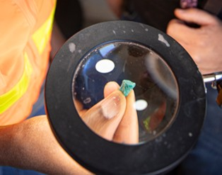



EWS Form Updates
New Forms
Area Ownership Audit
Escorting of Vehicles onto Mine Properties
Drill Site Acceptance
HSEP Field Audit
FRM Task/WPE
  CASC Concentrate
  CASC Line 5 & 6
  CASC Nucomat
  CASC SX Lab
  Drill Steel Changeout
  Pouring Copper Mold
  Tire Handling
Notes:
HSEP – Contractor Health, Safety and Environmental Plan
FRM – Fatal Risk Management
WPE – Work Place Exam

Slide 9
Contractor Management Topics
Reporting Contractor Hours Using EWS

Slide 10
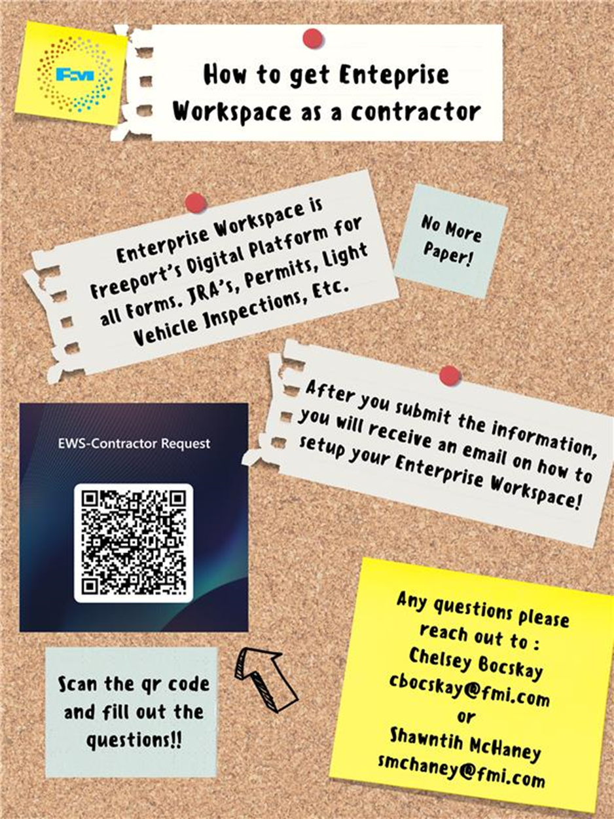
Contractor EWS Access
Access to site digital forms now available to Contractors!
Integration of Contractor submitted forms into internal dashboards
Forms can be used in online and offline modes
Request Access with QR Code or HERE
Reach out to H&S Department with any questions or issues

Slide 11
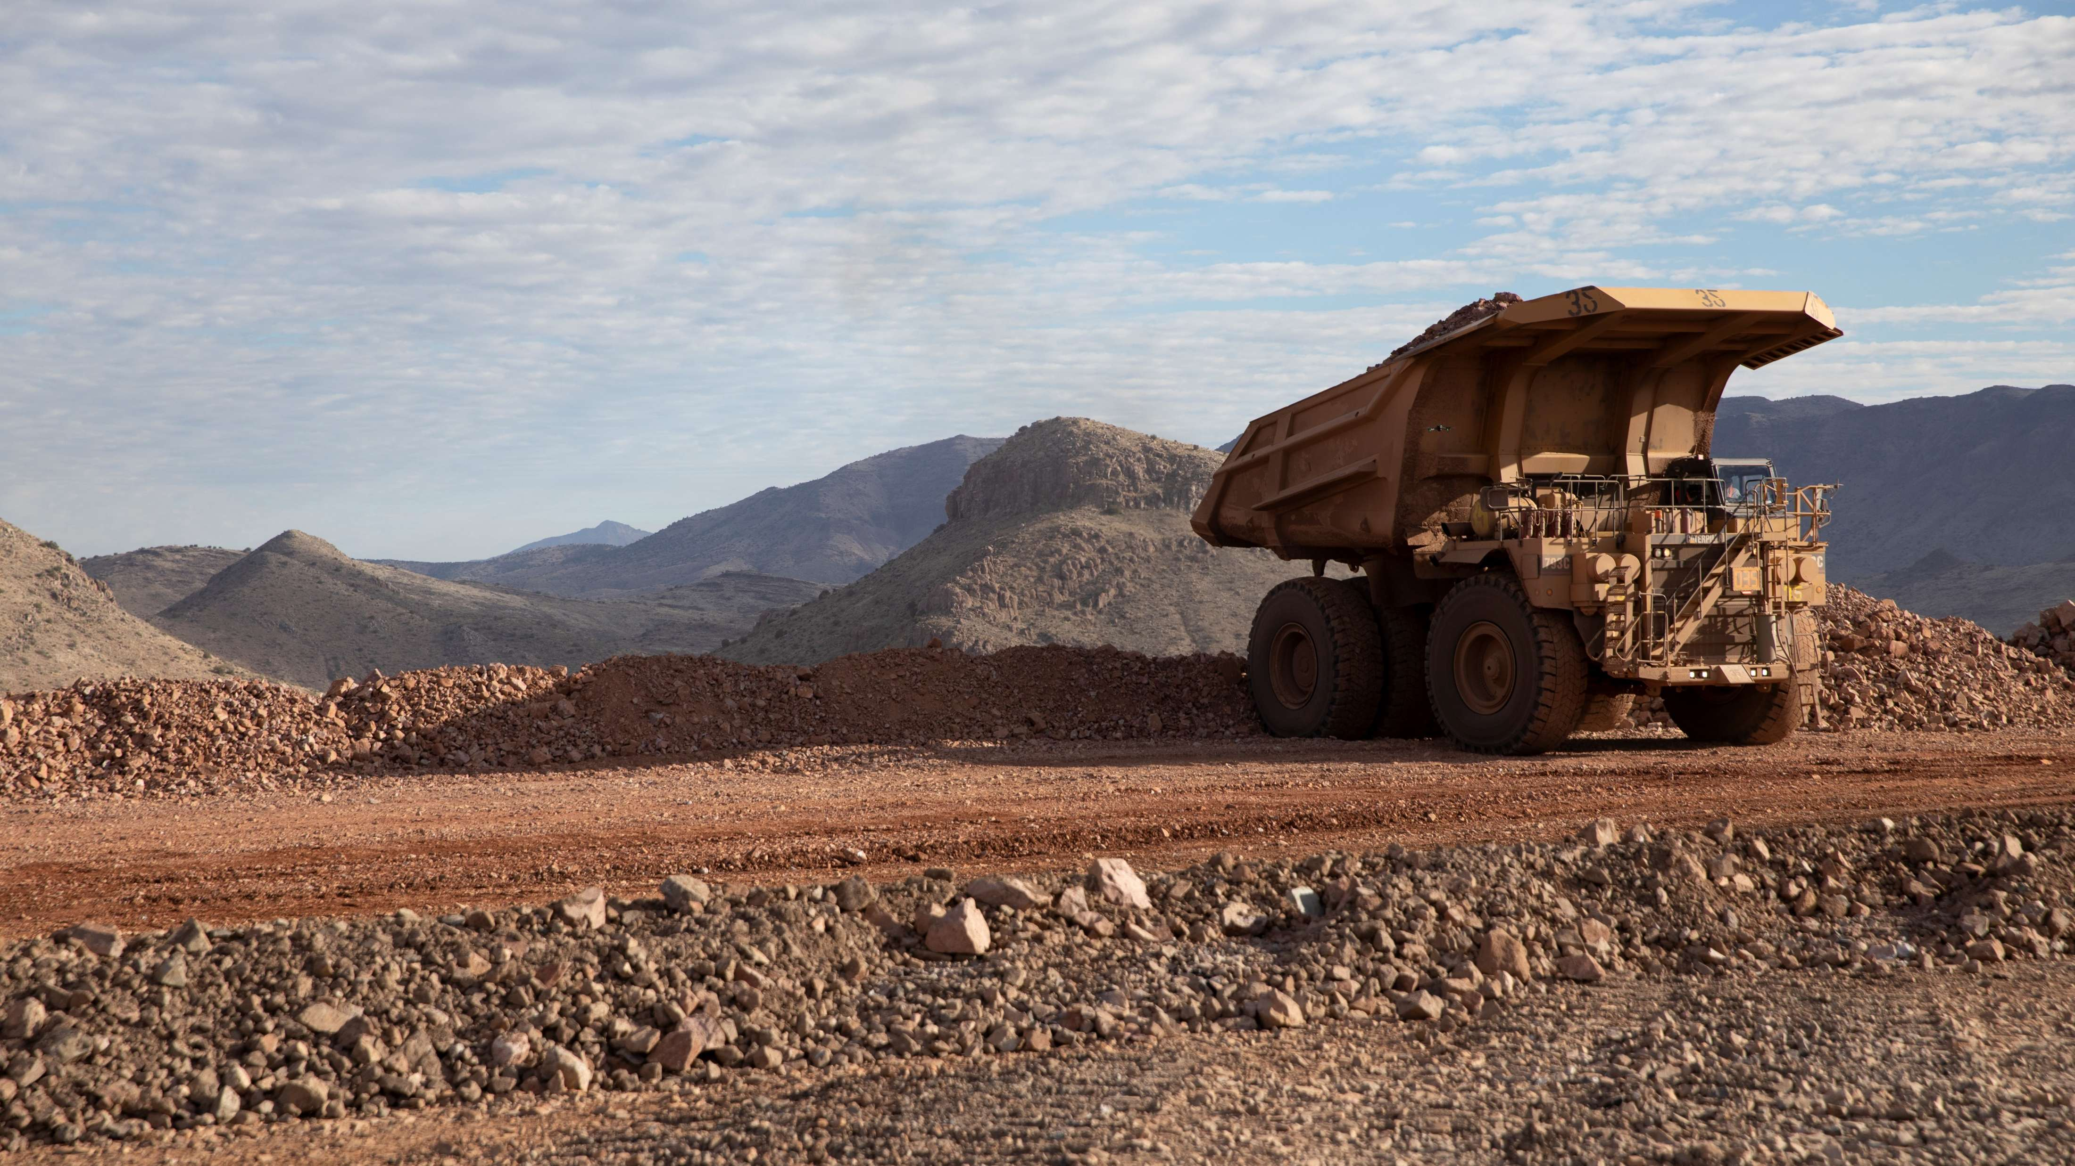
High-risk Incidents
Actionable and PFEs

Slide 12

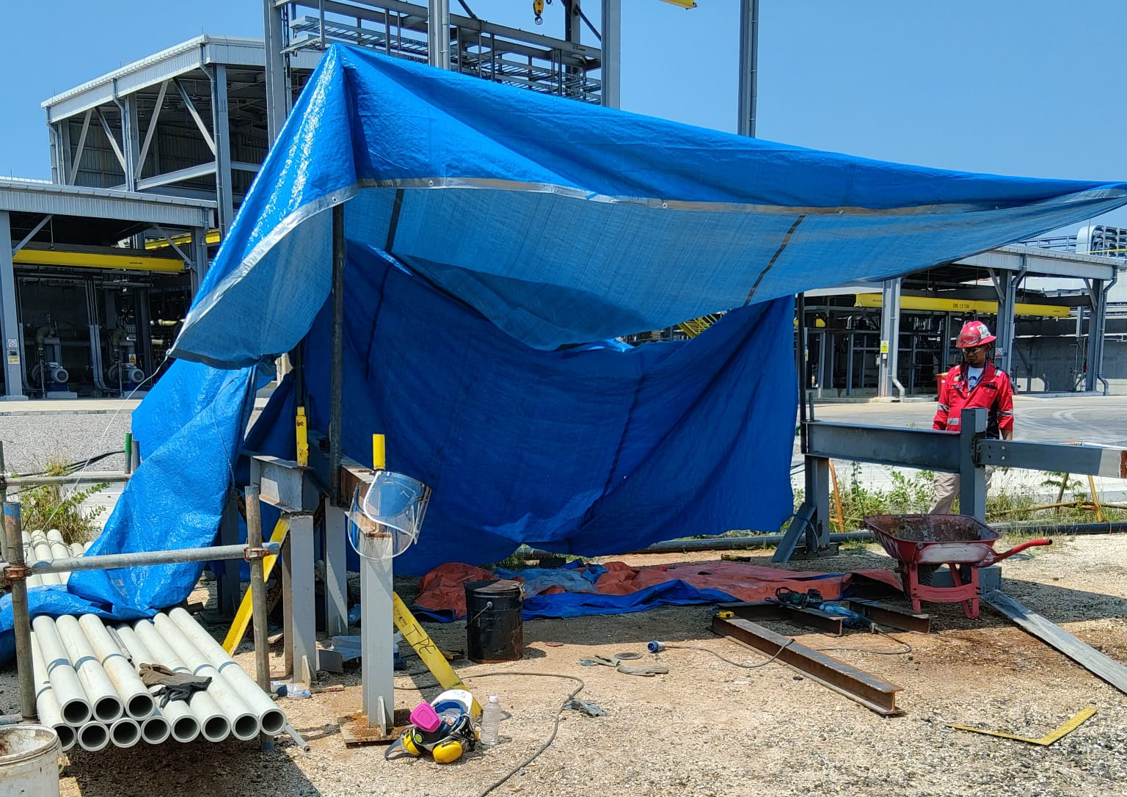
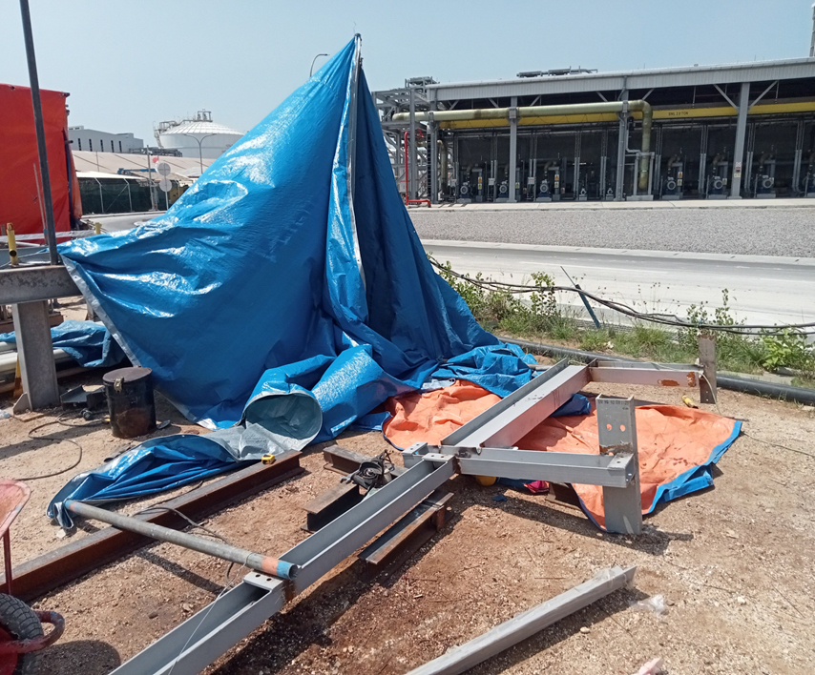
Contractor Struck on Head by Beam
PFE # 2025-20 Event ID # 20030085
Falling Objects
Preliminary Incident Details
Operation | Manyar Smelter
Date / Time | October 2, 2025 / 11:50 a.m.
Event Type | Injury – Restricted Work Case
Summary | Four contractors set up a temporary shade shelter by stretching a tarp over spare steel beams. As the contractors were on break and resting under the structure, a wind gust pulled the tarp up, causing a steel beam (approx. 567 lbs. / 258 kg.) to fall approximately 1 meter (3 ft.) and strike one employee on the head.
Risk Category | Actionable – Significant (3) Likely (3)
Findings / Missing Controls | Temporary structure was not adequately constructed or supported. Inadequate inspection procedure for temporary shelters.
Applicable Policies / Procedures | No applicable policies.
Employee Condition | The injured employee sustained a linear skull fracture and received several stitches to treat a forehead wound.
Contact | Setianus, Manager-Manyar Health and Safety
Recreation of temporary structure prior to the beam falling.
Location of employee after the beam fell and shelter collapsed.
The scaffolding tube used as the shelter pole.

Slide 13
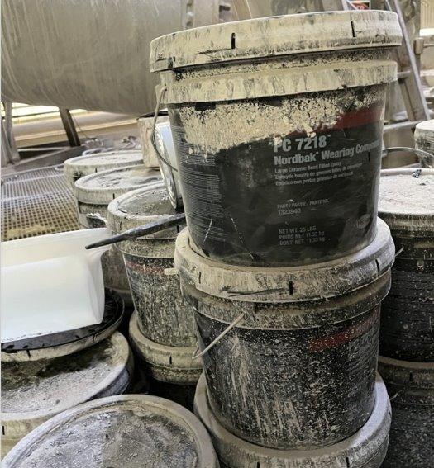
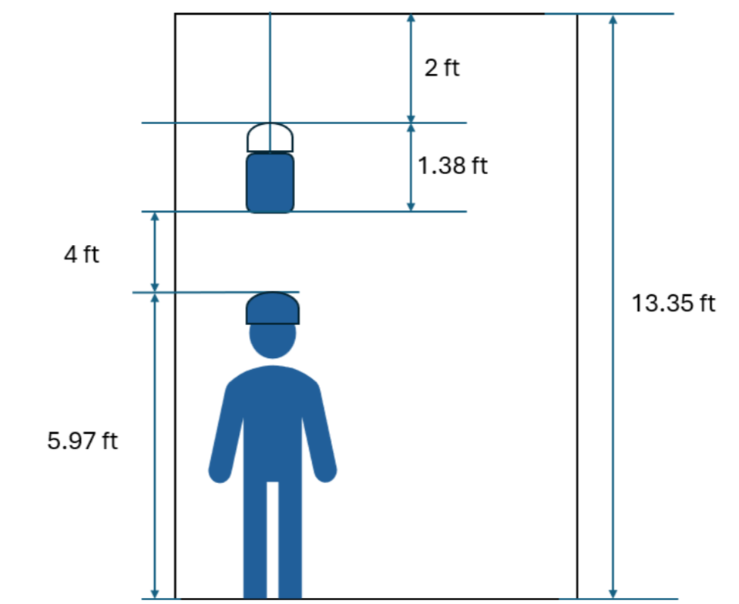
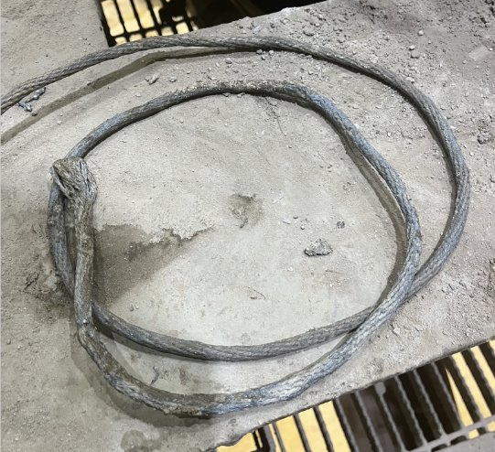
Employee Hit with 25-Pound Bucket
ID # 2025-28 Event ID # 20030389
Falling Objects
Preliminary Incident Details
Operation | Morenci
Date / Time | October 17, 2025 / 1:45 p.m.
Event Type | Injury – Restricted Duty
Summary | An employee was positioned at the base of the cyclone feeder awaiting the delivery of a 25-pound bucket of material. The bucket was being lowered using a rope attached to the handle. During the descent, the rope detached from the handle, causing the bucket to fall approximately four feet and strike the employee standing below.
Risk Category | Actionable – Significant (3) Likely (3)
Findings / Missing Controls | No bucket lifting sling or hook with a safety latch was used. The bucket was lowered using a rope tied to the handle. Materials were not lowered into the cyclone feeder – a confined space – before employee entry.
Applicable Policies / Procedures | No applicable policy
Employee Condition | The employee sustained bruising on the shoulder and left knee along with sprains to the cervical, thoracic and lumbar regions.
Contact | Sunil Nannepaga, Manager-Maintenance Services Tony Lujan, Sr. Supervisor-Health and Safety
Bucket of material that was lowered and struck employee
Depiction of bucket and employee heights
Detached rope used to lower the bucket

Slide 14

Industry Incidents

Slide 15
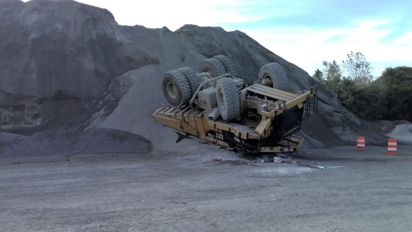
MSHA Fatality Alert
September 8, 2025 – A contract haul truck driver was injured while dumping a load of material at the top of a stockpile. The ground under the truck failed causing the truck to overturn onto its cab. The driver died later from his injuries.
Eliminate Hazards and Prevent Injuries
Construct berms, bumper blocks, safety hooks or similar impeding devices at dumping locations where there is a hazard of overtravel or overturning.
Conduct workplace and ground condition examinations before beginning work.
Always dump material from a stable and safe location. If examinations indicate the ground conditions are not reliable, dump loads at a safe distance and push the material over the edge using a bulldozer.
Never load material from the toe of a stockpile that is below an active dump point.
Maintain stockpile slopes no steeper than the angle of repose.

Slide 16


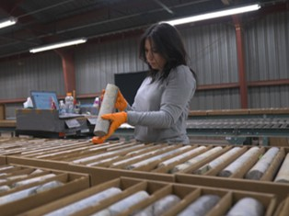
Additional Resources
Health and Safety Dashboard
Safety Toolkits
FCX Policies
MSHA Safety Alerts
OSHA

Slide 17
Henderson Incidents
10/03 – First Aid
  Employee bruised their knee when attempting to pull a stuck jetter hose from drain line
10/06 – Property Damage
  An improperly rigged pipe damaged a valve motor at the Barge at the Mill
10/06 – Property Damage
  An underground haul truck damaged two water pipes requiring repairs to roadway
  10/08 – Property Damage
  An underground drill had its windows broken when oversized blast initiated at shift change

Slide 18
Henderson Incidents
10/08 – Property Damage
  A forklift at the mine warehouse damaged a sprinkler head causing the fire suppression system to discharge
  10/09 – Property Damage/Near Miss
  A water truck at the Mill reversed into and damaged a jetter unit
  10/14 – First Aid
  An employee was sprayed by D-8 when a delivery line ruptured leading to eye irritation

Slide 19
FRM Verification Results – Oct.
190 verifications Submitted in October
Focus in October around Exposure to Electrical Hazards, Fire and Uncontrolled Release of Energy
Exposure to Electrical Hazards stayed in the top 3 from Sept. to Oct. with Underground Rockfall elevating to highest missing control ratio
FOCUS FOR NOVEMBER:
Exposure to Electrical Hazards
Underground rockfall
Entanglement and Crushing

Slide 20
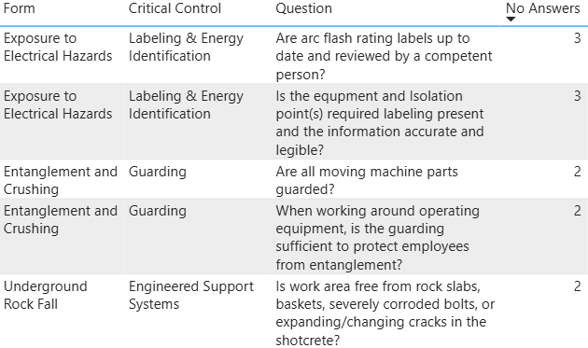
FRM Verification Results – Oct.
Missing Controls with Multiple No Responses

Slide 21

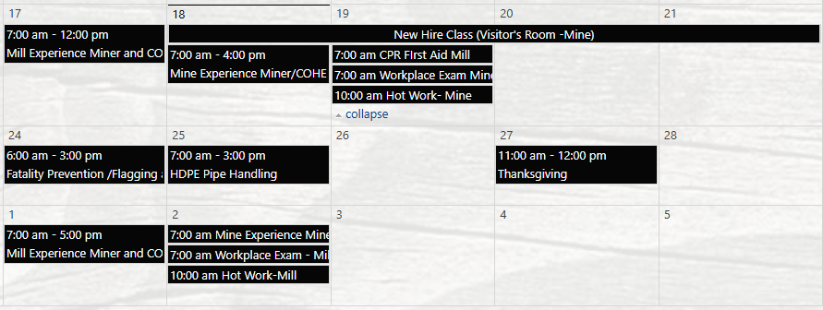

Henderson Training Schedule - November

Slide 22

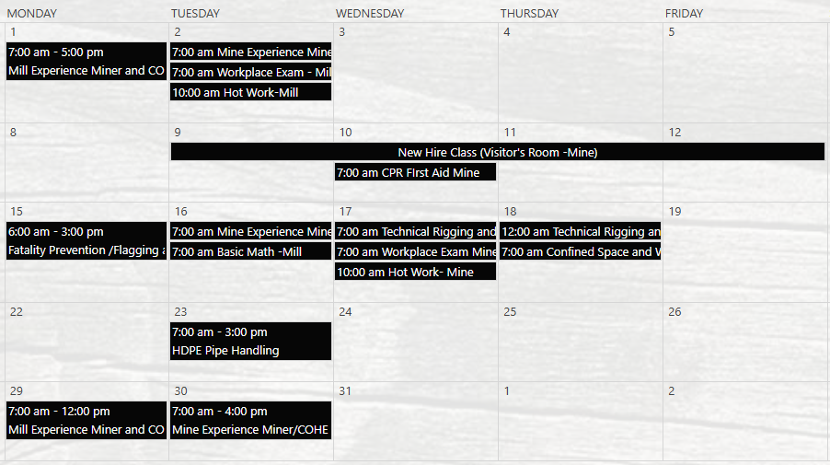
Henderson Training Schedule - December

Slide 23

Open Forum

Slide 24
2025 Meeting Schedule
December 18th
January 15th
2026 Schedule out next month
Meetings begin 1 PM MST
Mine and Mill In-Persons Options Monthly

Slide 25
November Sign-Off Record
_____________________
_____________________
_____________________
_____________________
_____________________
_____________________
_____________________
_____________________
_____________________
_____________________
_____________________
_____________________
_____________________
_____________________
_____________________
_____________________
_____________________
_____________________
_____________________
_____________________

