Slide 1



HSE Contractor Meeting
October 2025

Slide 2
Avoiding Unauthorized AI Tools
FMI has observed an increase in AI “notetaking” bots being added to Teams meetings
The use of these tools and software falls under MIS End User Policies that prohibit Freeport employees, contractors and partners from sharing company data without the company’s consent
To protect company data:
Contractors and Vendors not to use notetaking bots/recording tools
If external bot/recorder added to meeting, meeting will be stopped
Ask the FMI organizer to use approved notetaking tools

Slide 3
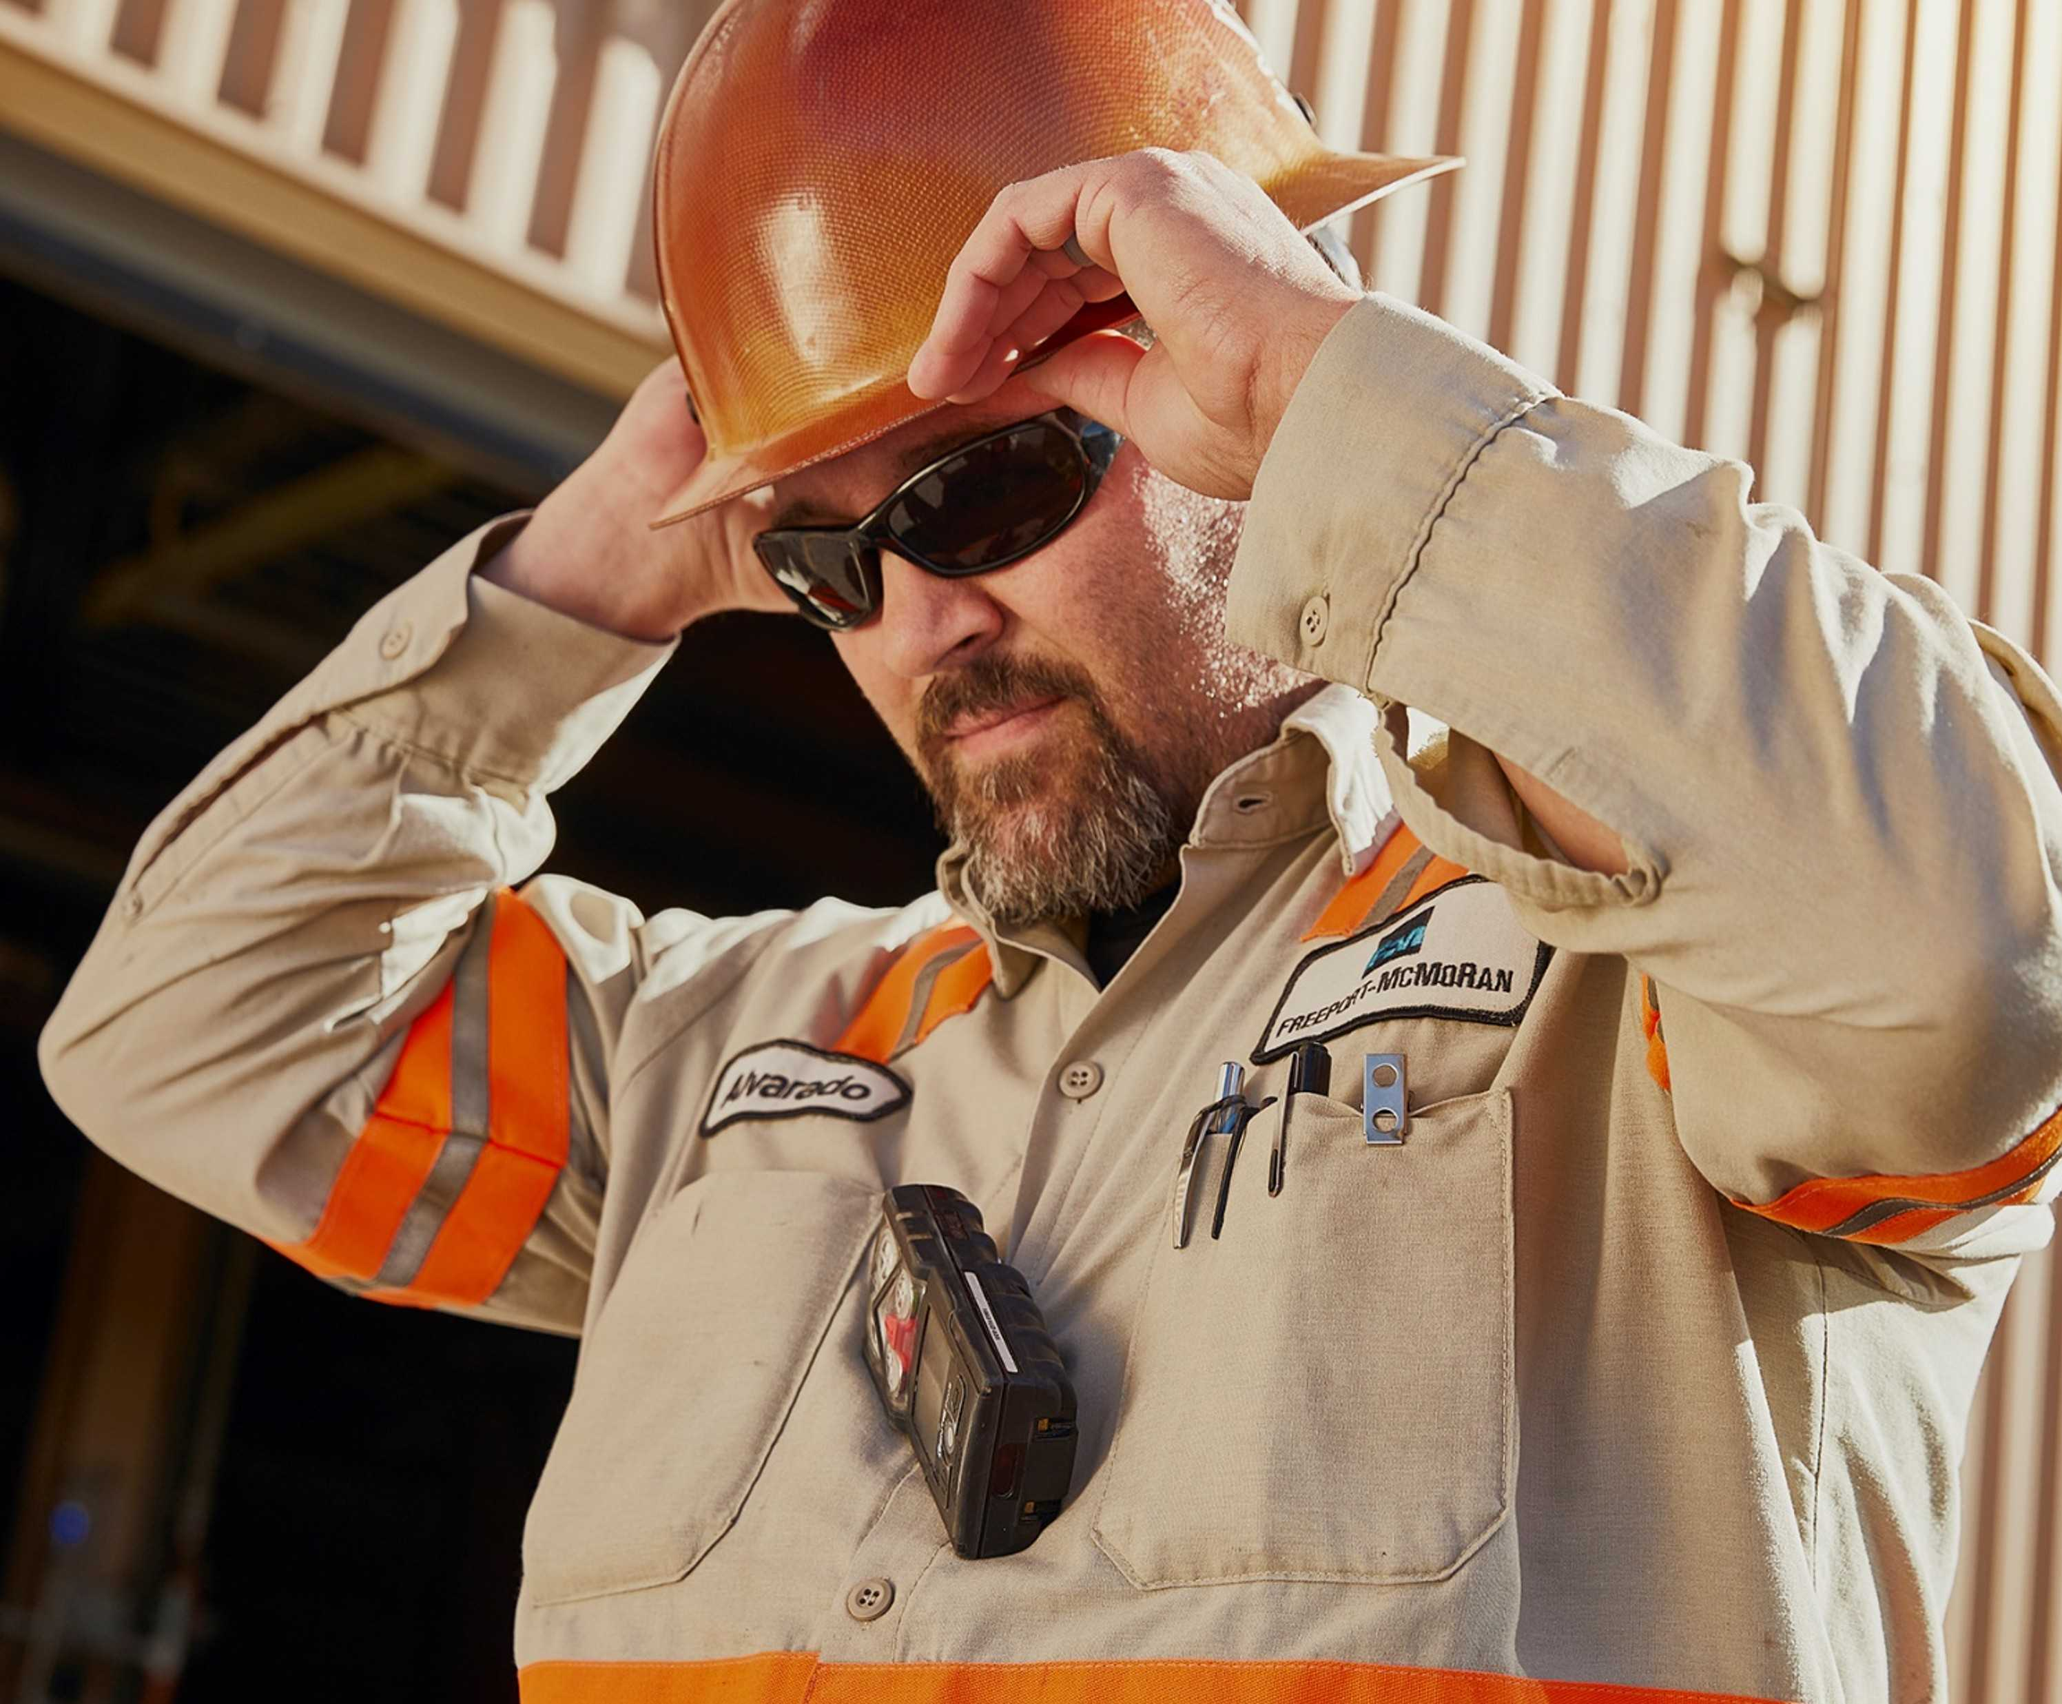

What is the purpose of this Meeting?
- For Henderson to have the opportunity to reach multiple contractors to discuss best practices when it comes to Health and Safety, Environmental and Contracts Management
- Give contractors an open forum to bring up concerns, successes or incidents, learnings, etc. that is shared between all contractors and Henderson personnel
- Help improve the safety culture and reduce safety incidents as a group

Slide 4
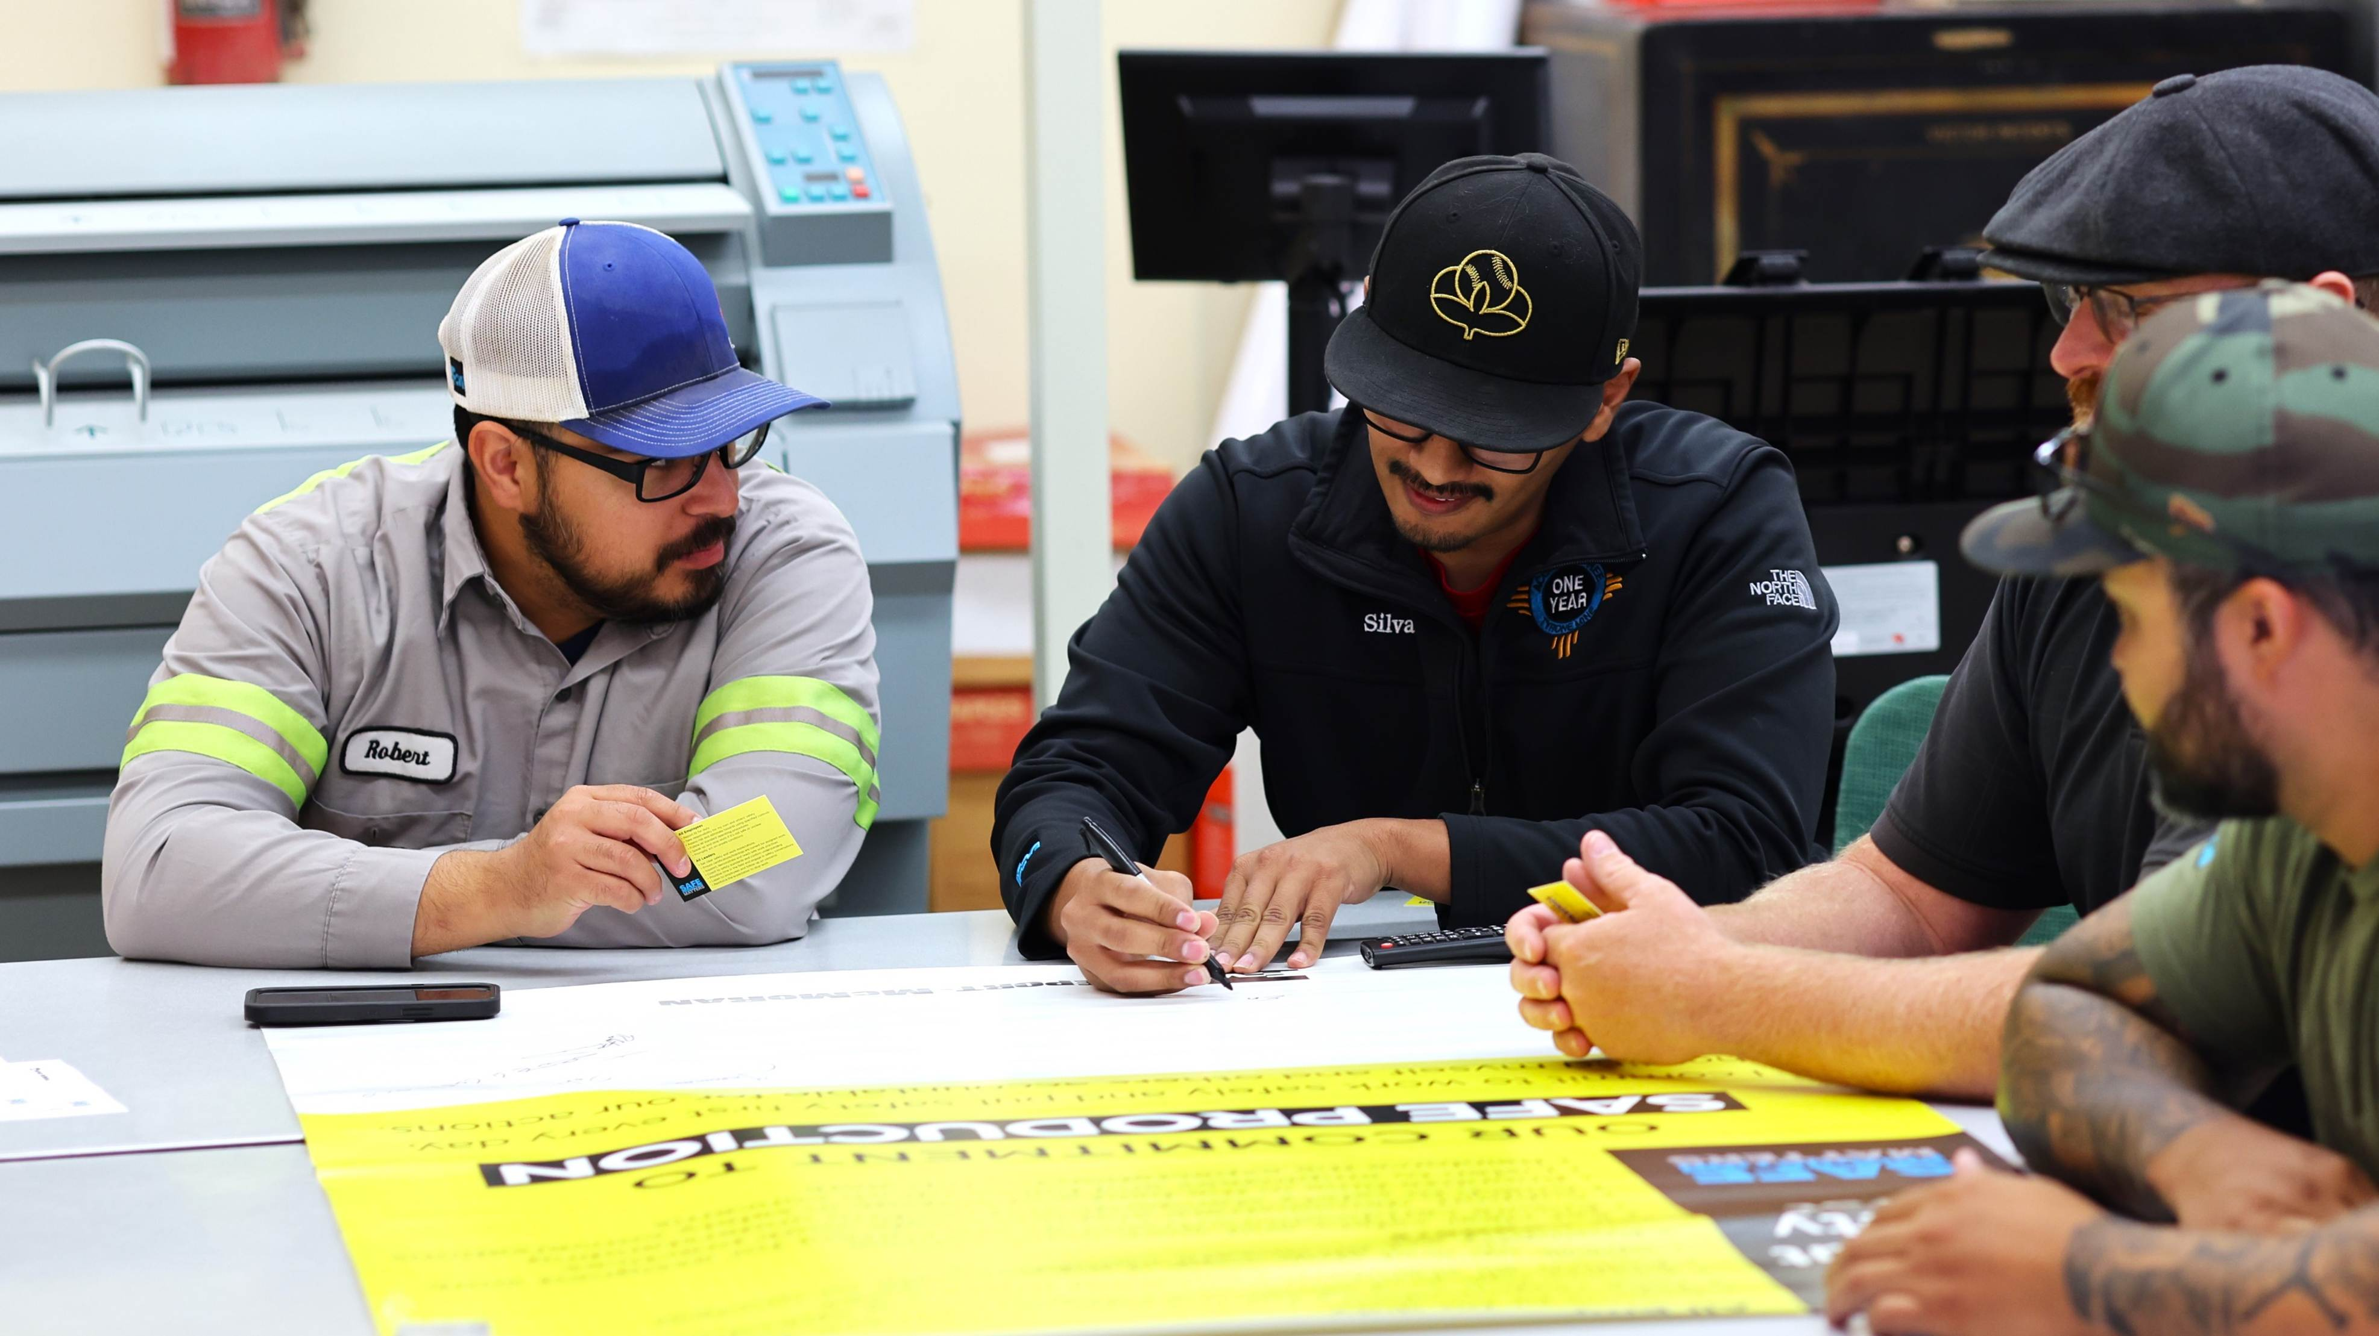
Safety Shares

Slide 5
Contractor Share – Concrete Handling
Equipment failure
Chemical burns
Complacency
Line of fire
Site traffic
Limited work areas
Fall from heights

Slide 6
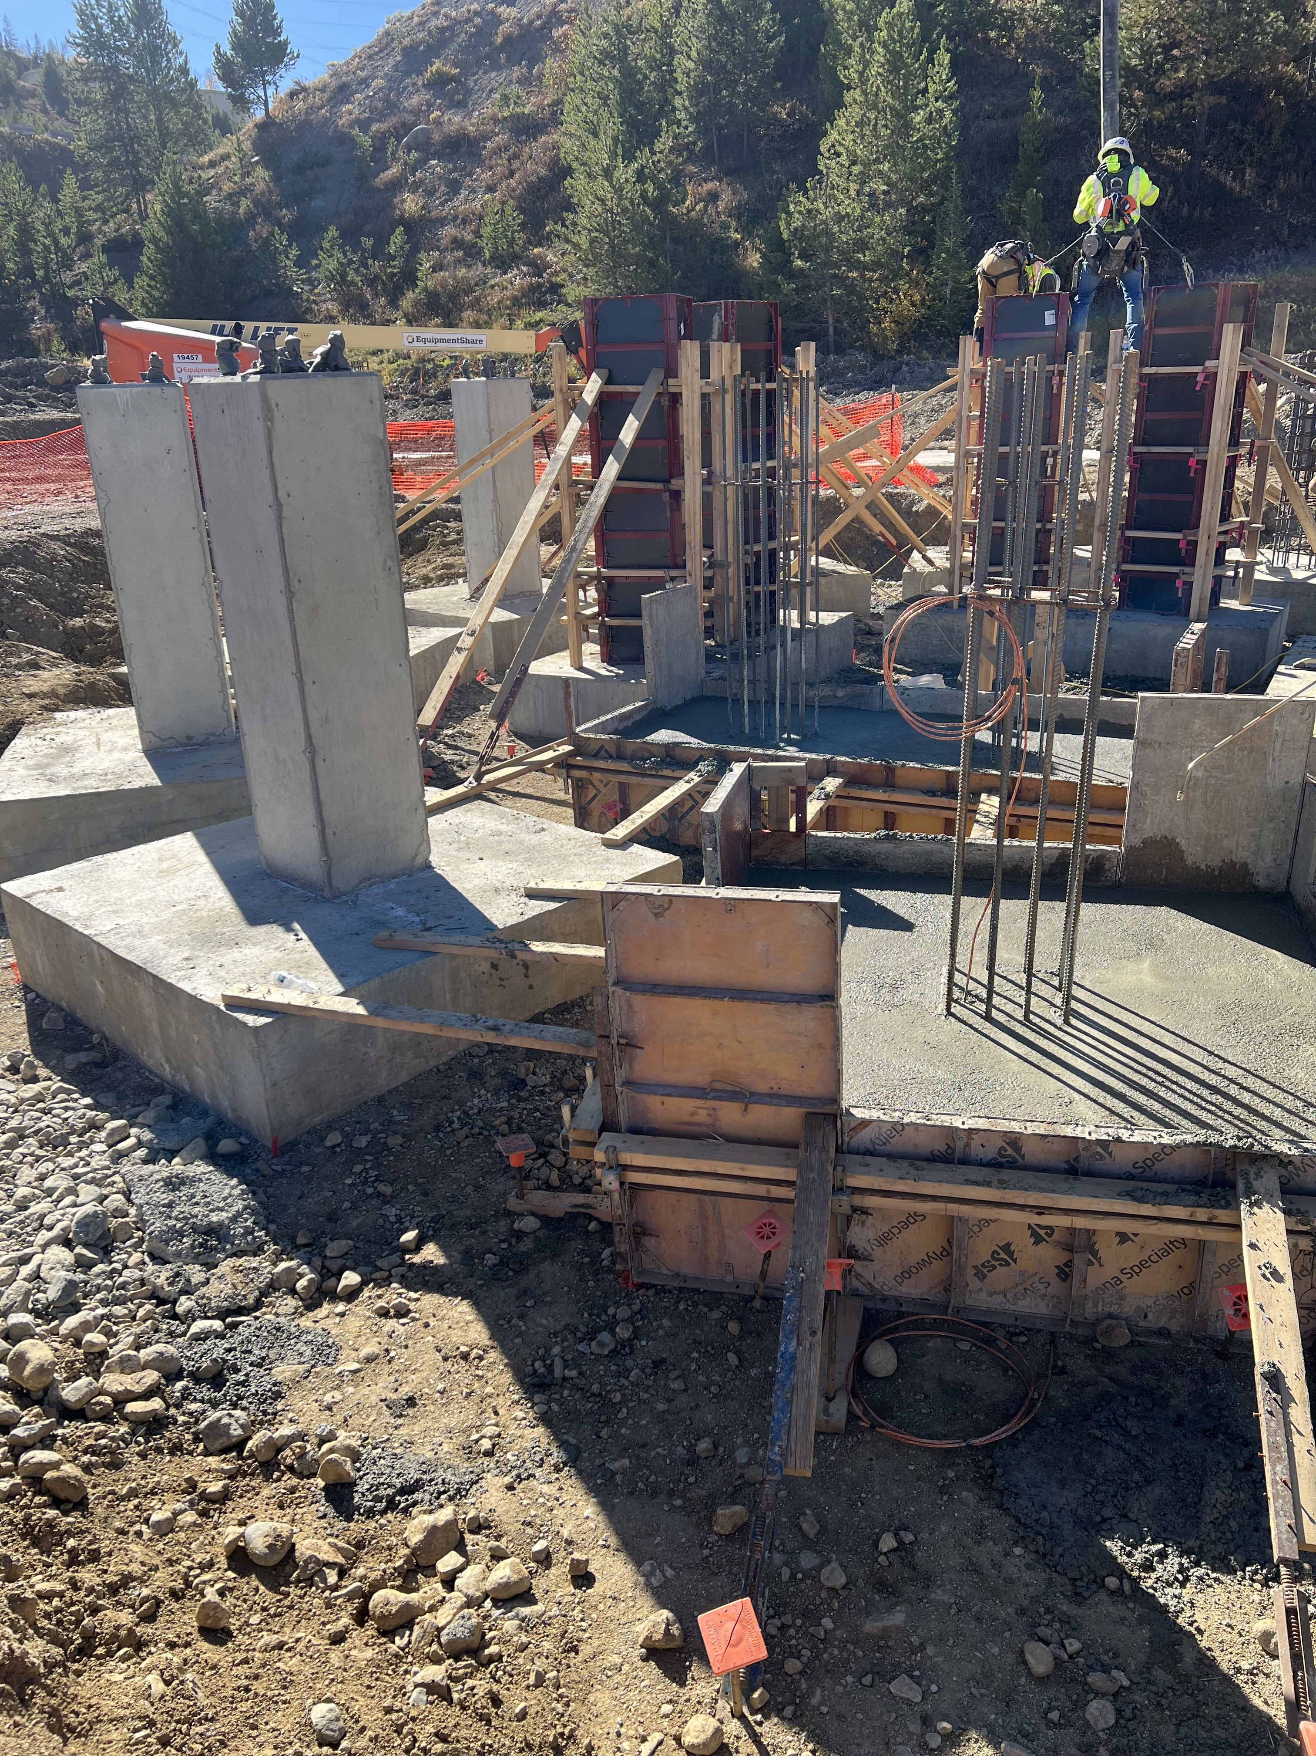
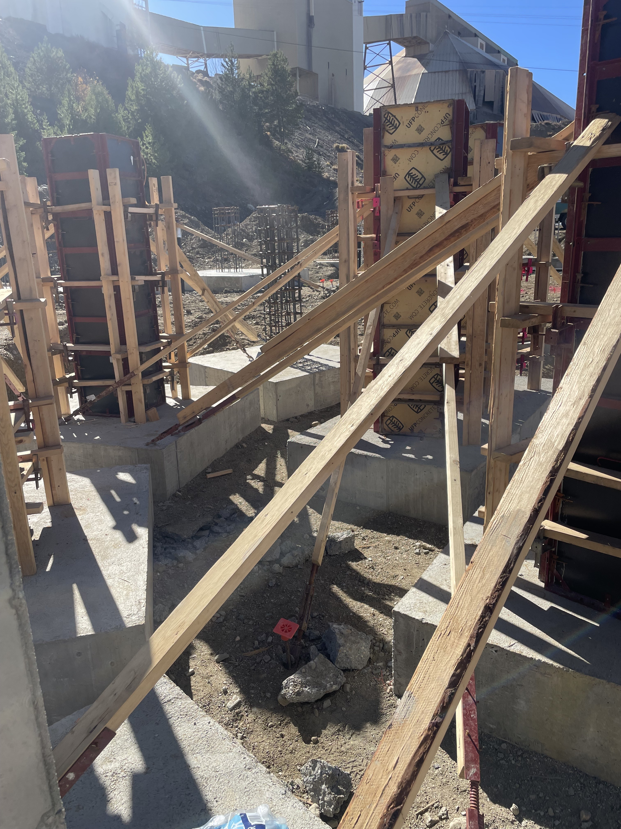

Slide 7
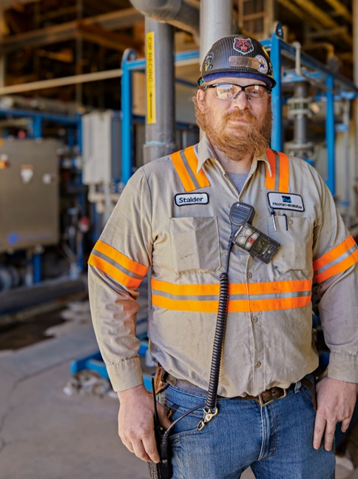
Concrete Handling SOP
As part of our shared commitment to safety and prevention, the following Concrete Handling materials were developed based on learnings from a recent incident investigation at Cerro Verde. We encourage you to review each document and consider how these resources can support safety efforts while working at Freeport/Climax Molybdenum sites.
Concrete Handling Standard Operating Procedure
Concrete Placement Plan
Concrete Pumping Field Guide
Freeport Dos and Don’ts of Concrete Pumping

Slide 8


Best at the Basics: Situational Awareness
Discussion
What’s one hazard that often gets overlooked?
How do changing conditions affect your ability to stay aware?
What are the most common distractions we face most often, and how can we reduce them?
What’s one thing we can do today to improve our team’s safety awareness?
Staying aware of your surroundings is key to recognizing what’s happening and anticipating what could go wrong. Situational awareness means being proactive and constantly looking for hazards.
Look up
for overhead hazards such as loose material, equipment, power lines or active work above you
Look down
for trip, fall, ground hazards and any personnel working below
Look around
for moving equipment, people or changing conditions
Remember 20-20-20
Every 20 minutes, take 20 seconds to check 20 feet around you.

Slide 9

Is it time to replace your PPE?
Personal Protective Equipment (PPE) is your last line of defense against workplace hazards. Before each use, check your PPE is in safe working condition. Perform regular inspections to monitor wear, damage and expiration dates. Replace any outdated equipment according to the manufacturer guidelines.
PPE | Typical Lifespan | Inspect
Hard Hat | 5 years | Check for cracks and fading
Safety Glasses/Goggles | 2–3 years | Replace if scratched or loose
Respirators Cartridge | 3–5 years 6–12 months | Check for cracks, tears, holes, warping or signs of degradation
Chemical Gloves | 6 months –2 years | Check for holes and extensive wear
Fall Protection Harness | 5 years | Inspect stitching and buckles
Hearing Protection | 6 months–1 year | Replace foam inserts regularly
Protective Clothing | Varies by material | Inspect for tears and contamination

Slide 10

Environmental Share
Hazardous waste is subject to extensive regulation related to the generation, characterization, accumulation, storage, treatment, shipment, and ultimate disposal. Due to strict hazardous waste regulations, it is critical that proper hazardous waste management practices are followed. RCRA (Resource Conservation and Recovery Act) guidance maintains that hazardous waste is to be managed by the generator from “cradle-to-grave” (generation-to-disposal). If hazardous wastes are not handled according to RCRA guidance, Henderson could be subject to regulatory, civil, or criminal penalties. Henderson needs the help from everyone to accurately track all waste generation to ensure proper disposal once the waste goes to an approved disposal facility.

Slide 11

Hazardous Waste at Henderson
Reach out to Environmental for questions on what is or isn’t a Hazardous Waste. Below are common hazardous wastes at our sites.
Mine: Gasoline contaminated debris, ignitable or corrosive project waste
Mill: Used Acetone, Solvent rags

Slide 12
Used Oil
The goal at Henderson is to recycle all our used oil. If not recycled (through refining or burning for energy recovery), used oil could be regulated as a hazardous waste. If used oil is contaminated with a hazardous waste, it is deemed a hazardous waste and cannot be recycled. All containers used to capture, contain, store, transport or handle used oil generated by Henderson must be labeled with the words “USED OIL.”

Slide 13
EWS Form Updates
New Forms
Contractor Equipment Safety Inspection
Forklift Inspection
Water Stand Inspection
Renamed Forms
Blast Design Modifications (previously Blasting Variance)
Now Available In Spanish
FRM Task/WPE - Pushing Crusher Stockpiles
FRM
Drowning
Fall from Heights
Fire
Hazardous Substance - Acute
Hazardous Substance - Chronic
Lifting Operations
Personnel Hoisting
Rail Collision
Rail Impact on Person
Underground Hazardous Atmosphere
Underground Rock Fall
Underground Shaft Hoisting
Vehicle Impact on Person

Slide 14
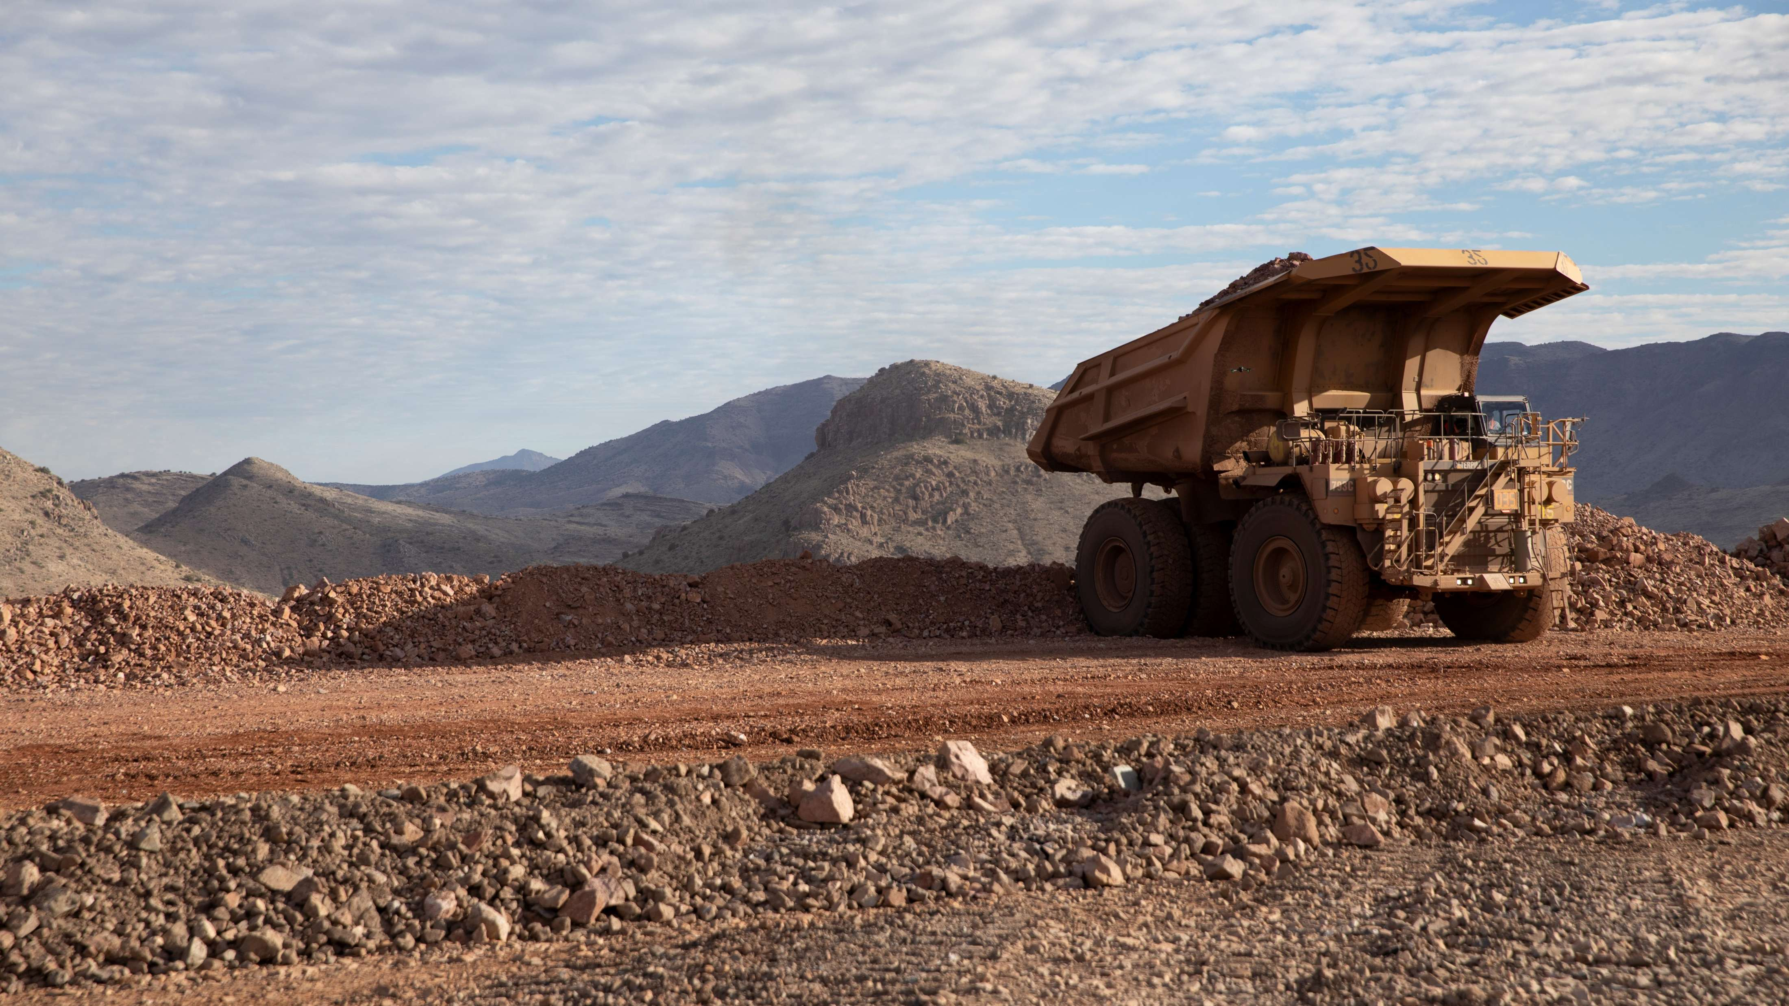
High-risk Incidents
Actionable and PFEs

Slide 15

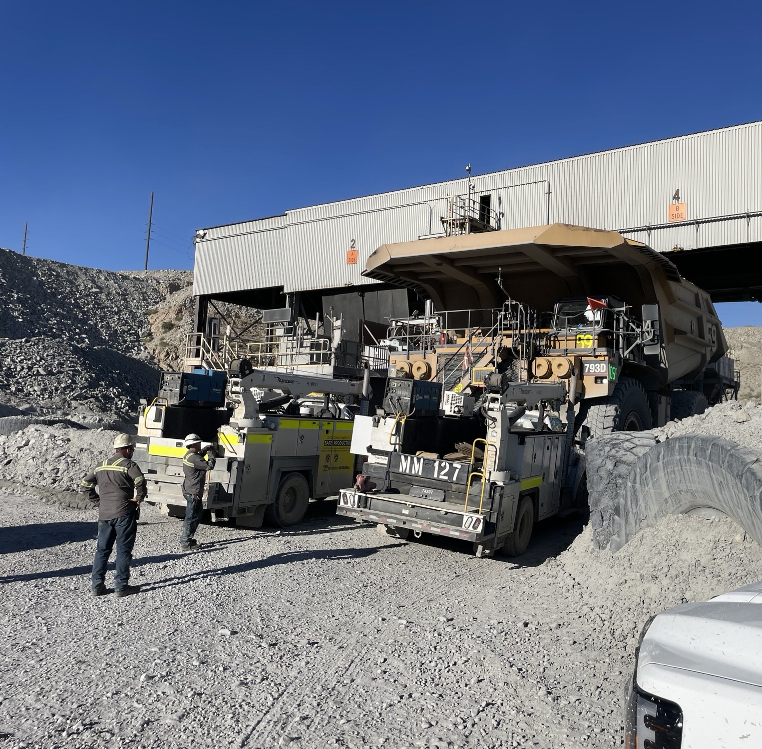
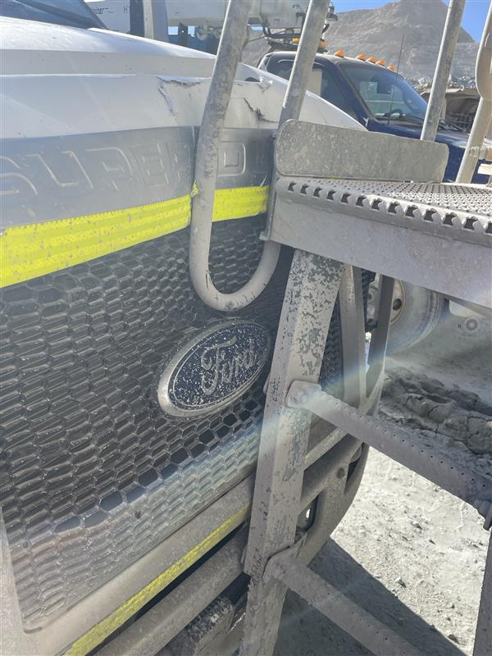
Haul Truck Contacted Service Truck
Vehicle Collision or Rollover
ID # 2025-24 Event ID # 20028984
Preliminary Incident Details
Operation | Sierrita
Date / Time | August 30, 2025 / 4 p.m.
Event Type | Property Damage
Summary | A haul truck lost power while dumping at the primary crusher. Mechanics arrived and parked service trucks nose-to-nose in front of the haul truck. After exiting their vehicles, the mechanics climbed onto the haul truck deck to diagnose the issue. Once the electrical issue was believed to be fixed, a mechanic started the haul truck for testing. The truck rolled forward approximately 20 feet into the front of one of the parked service trucks. No employees were on the ground when the truck began to roll.
Risk Category | Actionable – Significant (3) Likely (3)
Findings / Missing Controls | The haul truck had been locked out, but energy sources were not isolated. Wheel chocks were not used and the parking brake was not set. Both help prevent a truck from rolling while being serviced.
Applicable Policies / Procedures | FCX-23 Interaction with Heavy Mobile Equipment – Surface
Employee Condition | No injuries.
Contact | Cara Forbregd, Manager-Health and Safety Bret Hunt, Manager-Mine
Location of haul truck and parked service vehicles.
Haul truck contact with service truck.

Slide 16
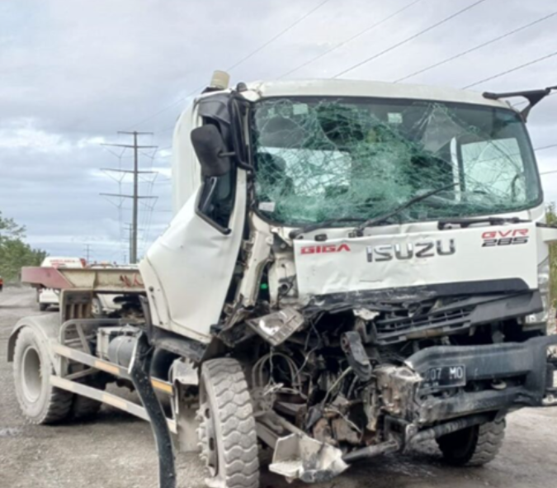
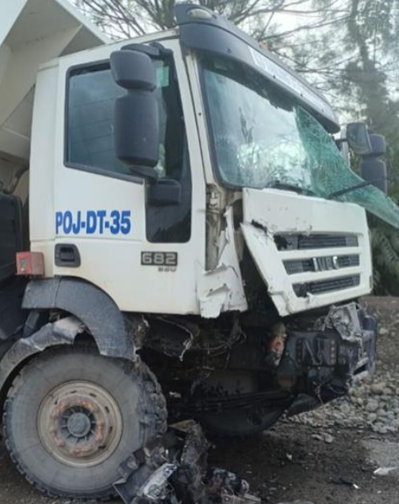
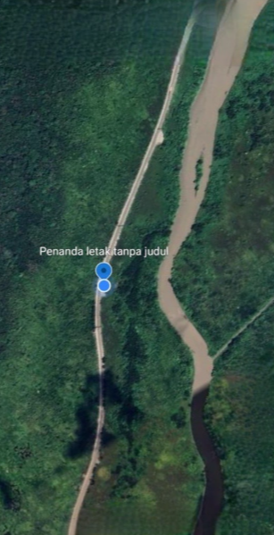
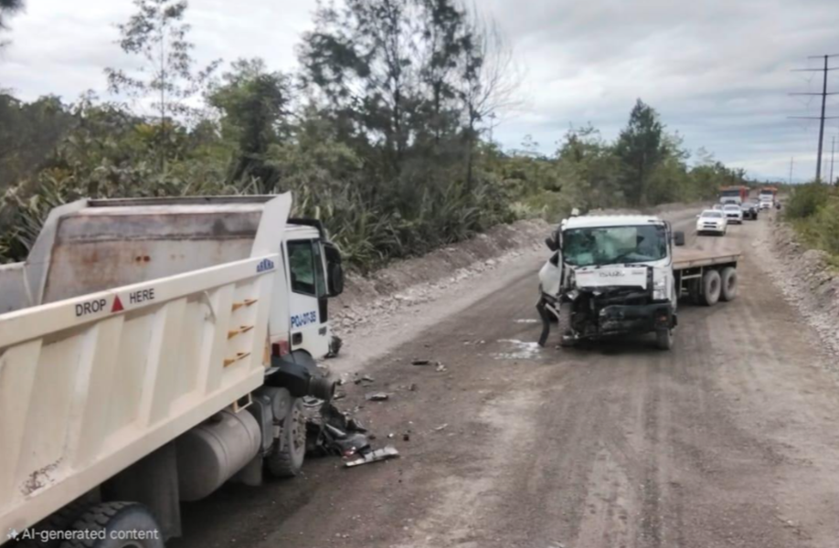
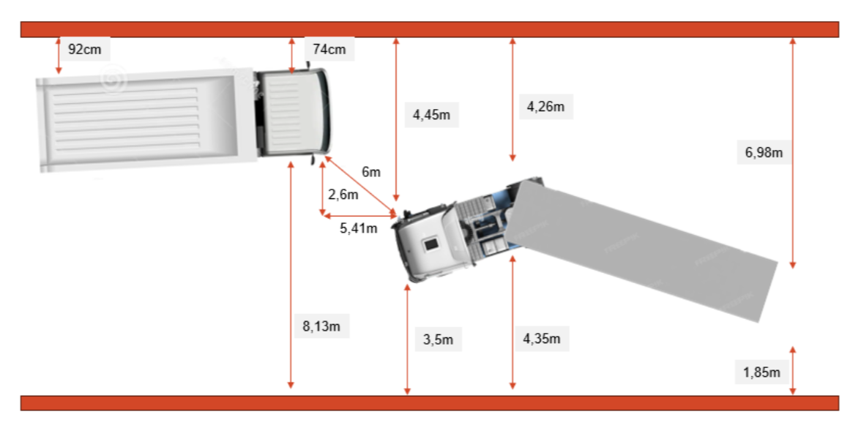
Head-on Vehicle Collision
Vehicle Collision or Rollover
PFE # 2025-18 Event ID # 20029089
Preliminary Incident Details
Operation | PT Freeport Indonesia
Date / Time | September 2, 2025 / 2:09 p.m.
Type | Property Damage
Summary | An empty dump truck, operated by a solo driver, was travelling from the Cargo Dock towards Milepost 25 on the Main Supply Road. Meanwhile, an empty Isuzu trailer with both a driver and passenger was heading in the opposite direction, from LIP MP-21 toward the Cargo Dock. As the two vehicles approached each other near MP-17, the Isuzu trailer lost control and collided with the truck.
Fatal Risk | Vehicle Collision or Rollover
Risk Category | Actionable – Significant (3) Likely (3)
Findings / Missing Controls | Isuzu trailer occupants weren’t focused on the task. Individuals failed to recognize driving risks on the MSR. Speed limiter/governor wasn’t programmed on Isuzu trailer. Isuzu trailer was speeding. Isuzu trailer SOP was inadequate.
Applicable Policies / Procedures | SOP/4.04.10/POJ/002/2024 – Material Hauling Standard Operating Procedure
Employee Condition | All three employees sustained minor injuries and were treated, then released for the local health clinic.
Contact | James Spitzer Cano, Vice President-Global Supply Chain Suharto Sitorus, Manager-Lowland Warehouses GSC
Damage to Isuzu trailer (deformed chassis, severe damage to the right front cabin)
Damage to dump truck (damage to right front cabin)
Aerial of incident area
The location at MP-17 where the dump truck and Isuzu trailer were involved in a head-on collision
Final position of vehicles after collision

Slide 17

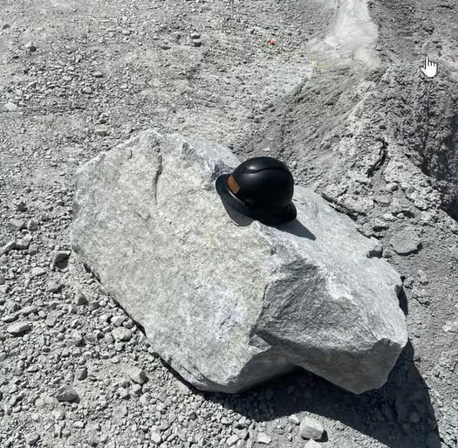
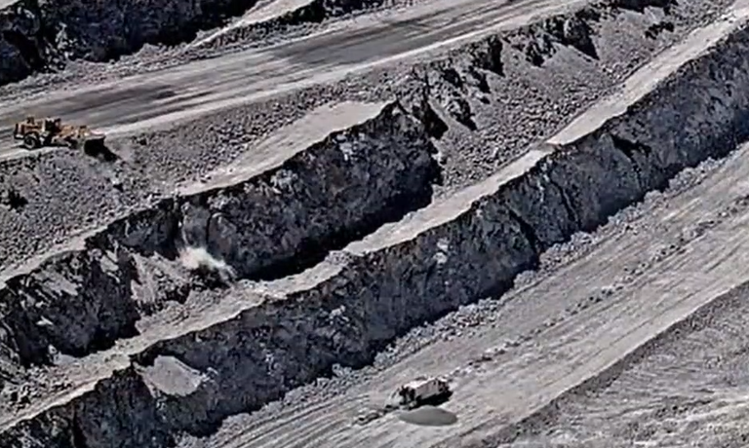
Rock Cascade Near Slurry Truck
ID # 2025-25 Event ID # 20029445
Falling Objects
Preliminary Incident Details
Operation | Sierrita
Date / Time | September 15, 2025 / 12:20 p.m.
Event Type | Near Miss
Summary | A loader operator was cleaning the rock slot above the 397-blast pattern. During operation, material was dumped over an edge, resulting in rock debris cascading down three benches. A slurry truck with two employees was located on a blast pattern below the third bench. A boulder measuring approximately 4 feet by 3 feet and weighing an estimated 900 pounds landed approximately seven feet from the truck.
Risk Category | Actionable – Significant (3) Likely (3)
Findings / Missing Controls | Lack of activity coordination between loader and crews working below.
Applicable Policies / Procedures | FCX23 - Interaction with Heavy Mobile Equipment
Employee Condition | No injuries
Contact | Cara Forbregd, Manager-Health & Safety Allen Kinney, Superintendent-Mine Operations
A hard hat placed on the boulder that landed seven feet from the slurry truck provides a clear sense of scale.
Loader
Falling debris
Slurry truck
Position of the loader and slurry truck as debris fell.

Slide 18
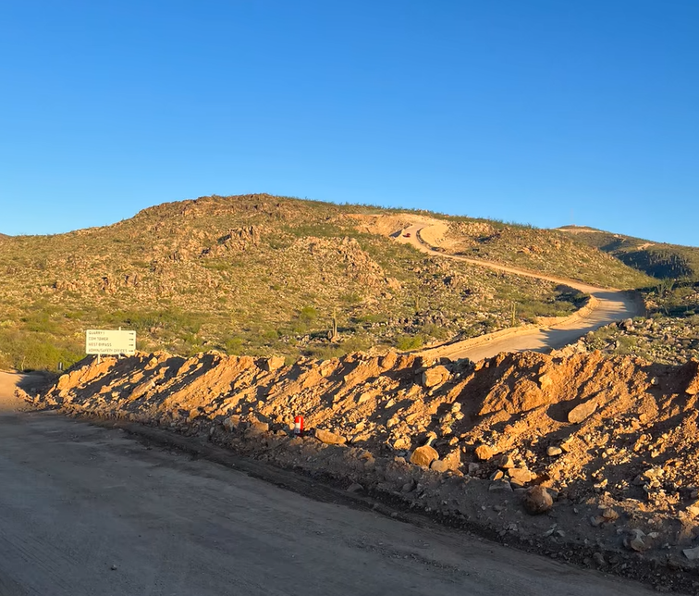
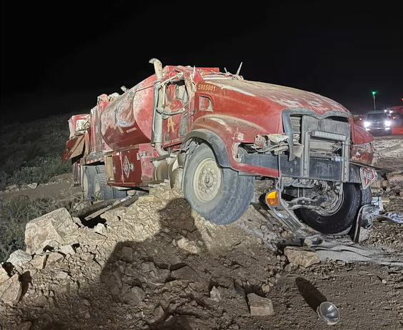
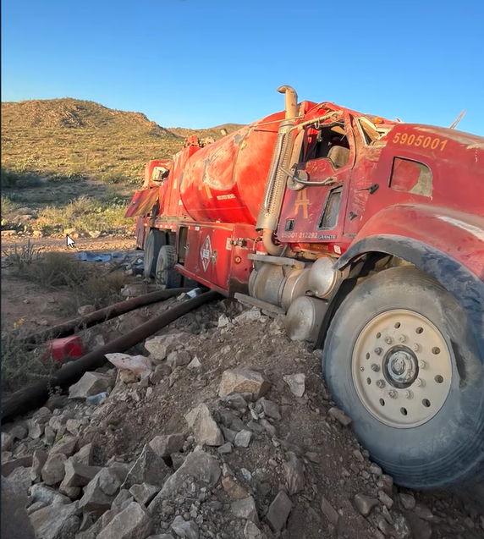
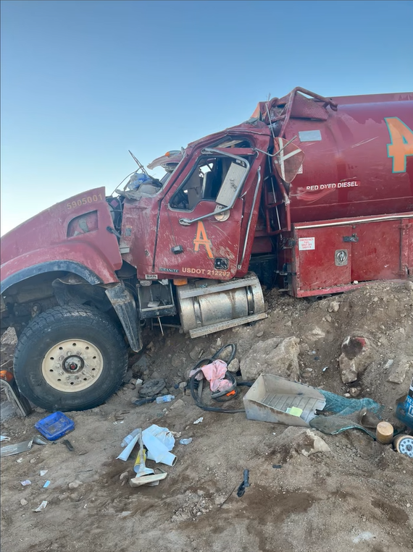
Fuel Truck Rollover
Vehicle Collision or Rollover
ID # 2025-26 Event ID # 20029488
Preliminary Incident Details
Operation | Bagdad
Date / Time | September 15, 2025 / 8:48 p.m.
Event Type | Injury – First Aid
Summary | While operating a manual transmission lube truck on a downhill road with grades ranging from 11% to 22%, the operator reported brake failure. At the bottom of the hill, the operator engaged the emergency brake, causing the truck to slide sideways. The operator lost control, and the truck struck a berm, rolled over once and landed upright on top of the berm. The contractor was able to exit the truck without assistance.
Risk Category | Actionable – Significant (3) Likely (3)
Findings / Missing Controls | Operator was wearing a seatbelt at the time of the incident. Operator had previously noted brake issues on equipment inspections but continued to operate the truck.
Applicable Policies / Procedures | FCX23 - Interaction with Heavy Mobile Equipment - Surface
Employee Condition | Operator sustained minor scrapes and bruising.
Contact | Rachel Adams, Manager-Health and Safety
View of road
Truck position after landing on berm
Passenger side view
Driver side view

Slide 19
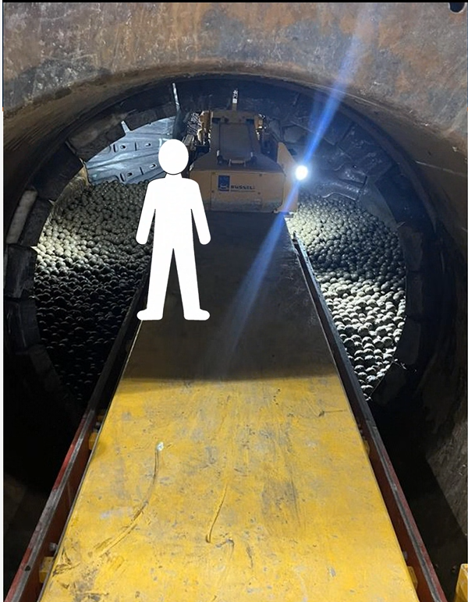
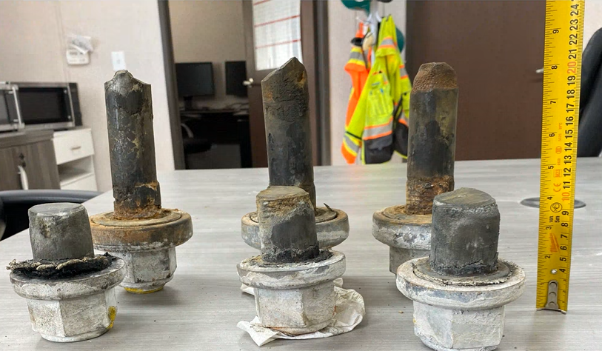
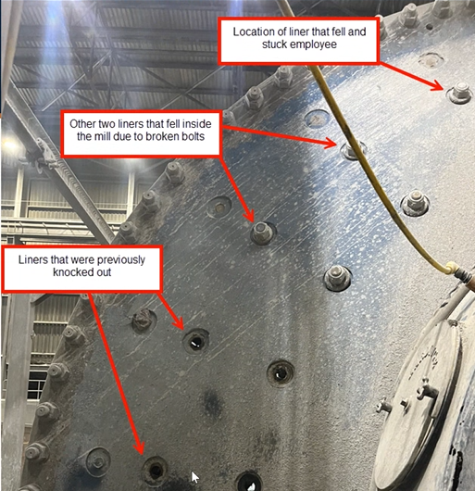
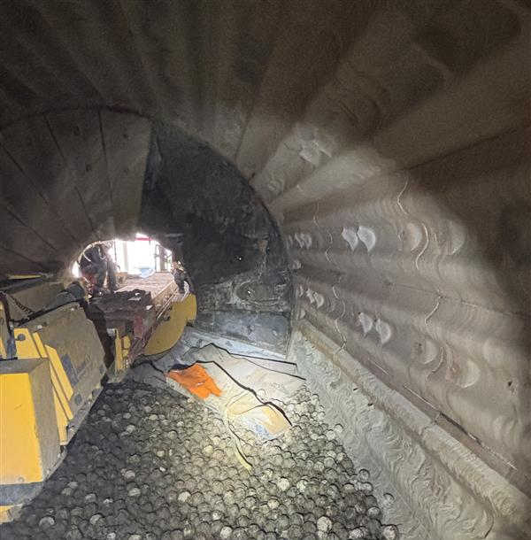
Mill Liner Struck Employee
PFE # 2025-19 Event ID # 20029575
Falling Objects
Preliminary Incident Details
Operation | Bagdad
Date / Time | September 18, 2025 / 4 a.m.
Event Type | Injury – Restricted Duty
Summary | While removing mill liners, a contractor was standing on a liner handler in the throat (entrance) of the mill, when three liners fell approximately 9.5 feet to the ground. One liner weighing 787 pounds deflected off the handler, striking and pinching the contractor’s leg.
Risk Category | Actionable – Significant (3) Likely (3)
Findings / Missing Controls | Liner bolts were broken, causing them to fall off the wall
Applicable Policies / Procedures | No applicable policy
Employee Condition | Contractor sustained swelling and bruising
Contact | Rachel Adams, Manager-Health and Safety
Damaged bolts
Position of contractor while standing on the liner handler
The liners after falling
Red arrows point to the positions of the fallen liners as seen from the outside of the mill

Slide 20

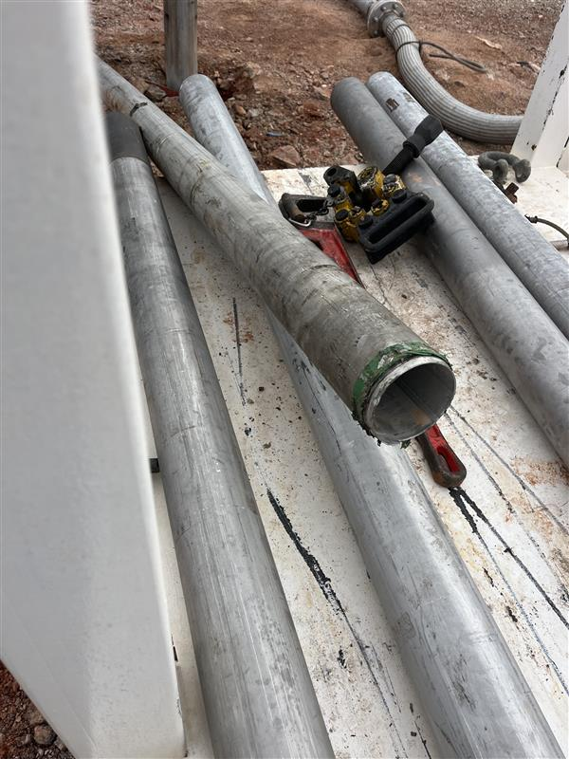
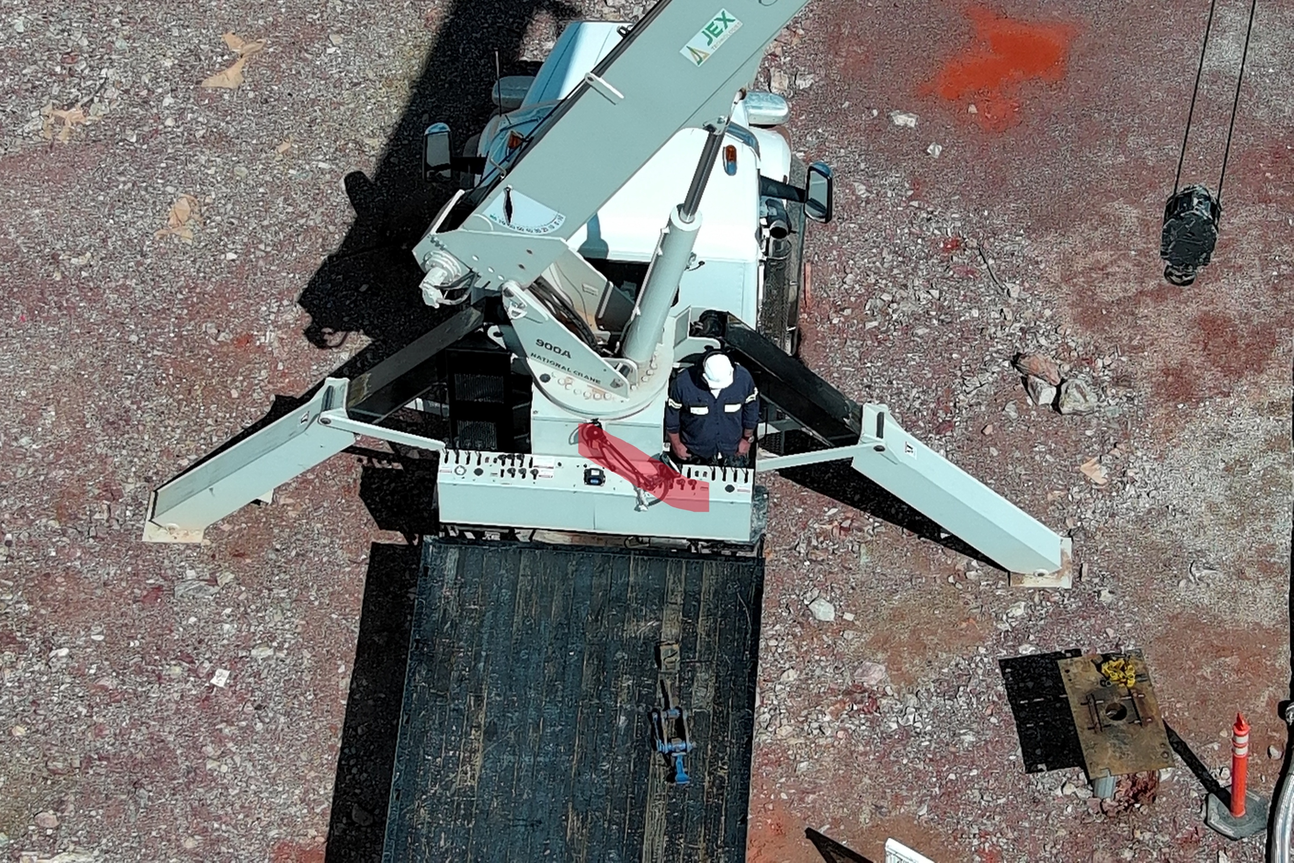
Boom Truck Lifting Failure
ID # 2025-27 Event ID # 20029567
Lifting Operations
Preliminary Incident Details
Operation | Morenci
Date / Time | September 17, 2025 / 7:30 p.m.
Event Type | Property Damage
Summary | Contractor employees were using a boom truck to raise a solution injection tool using threaded pipe sections inside a well casing. The total depth was approximately 740 feet. During removal, the piping became stuck. Tension was applied to the pipe to extract the tool. The pipe threads at the connection joint – about 6 inches below the well table – sheared. This caused the pipe (about 166 lbs) to be expelled from the well casing. The expelled pipe swung back toward the boom operator, striking the truck’s computer and control panel.
Risk Category | Actionable – Significant (3) Likely (3)
Findings / Missing Controls | Lack of communication between night shift and day shift. Lack of inspection on piping when day shift started. No standard operating procedure for the task.
Applicable Policies / Procedures | FCX-HS32 Crane and Rigging Policy
Employee Condition | No injuries.
Contact | Corina Rodriguez, Manager-Health and Safety William Paddock, Manager-Leaching
10-foot stainless pipe and sheered threads following incident
Overhead view of the site showing the location of pipe impact (yellow arrow) and the well from which the pipe was pulled (blue arrow)

Slide 21
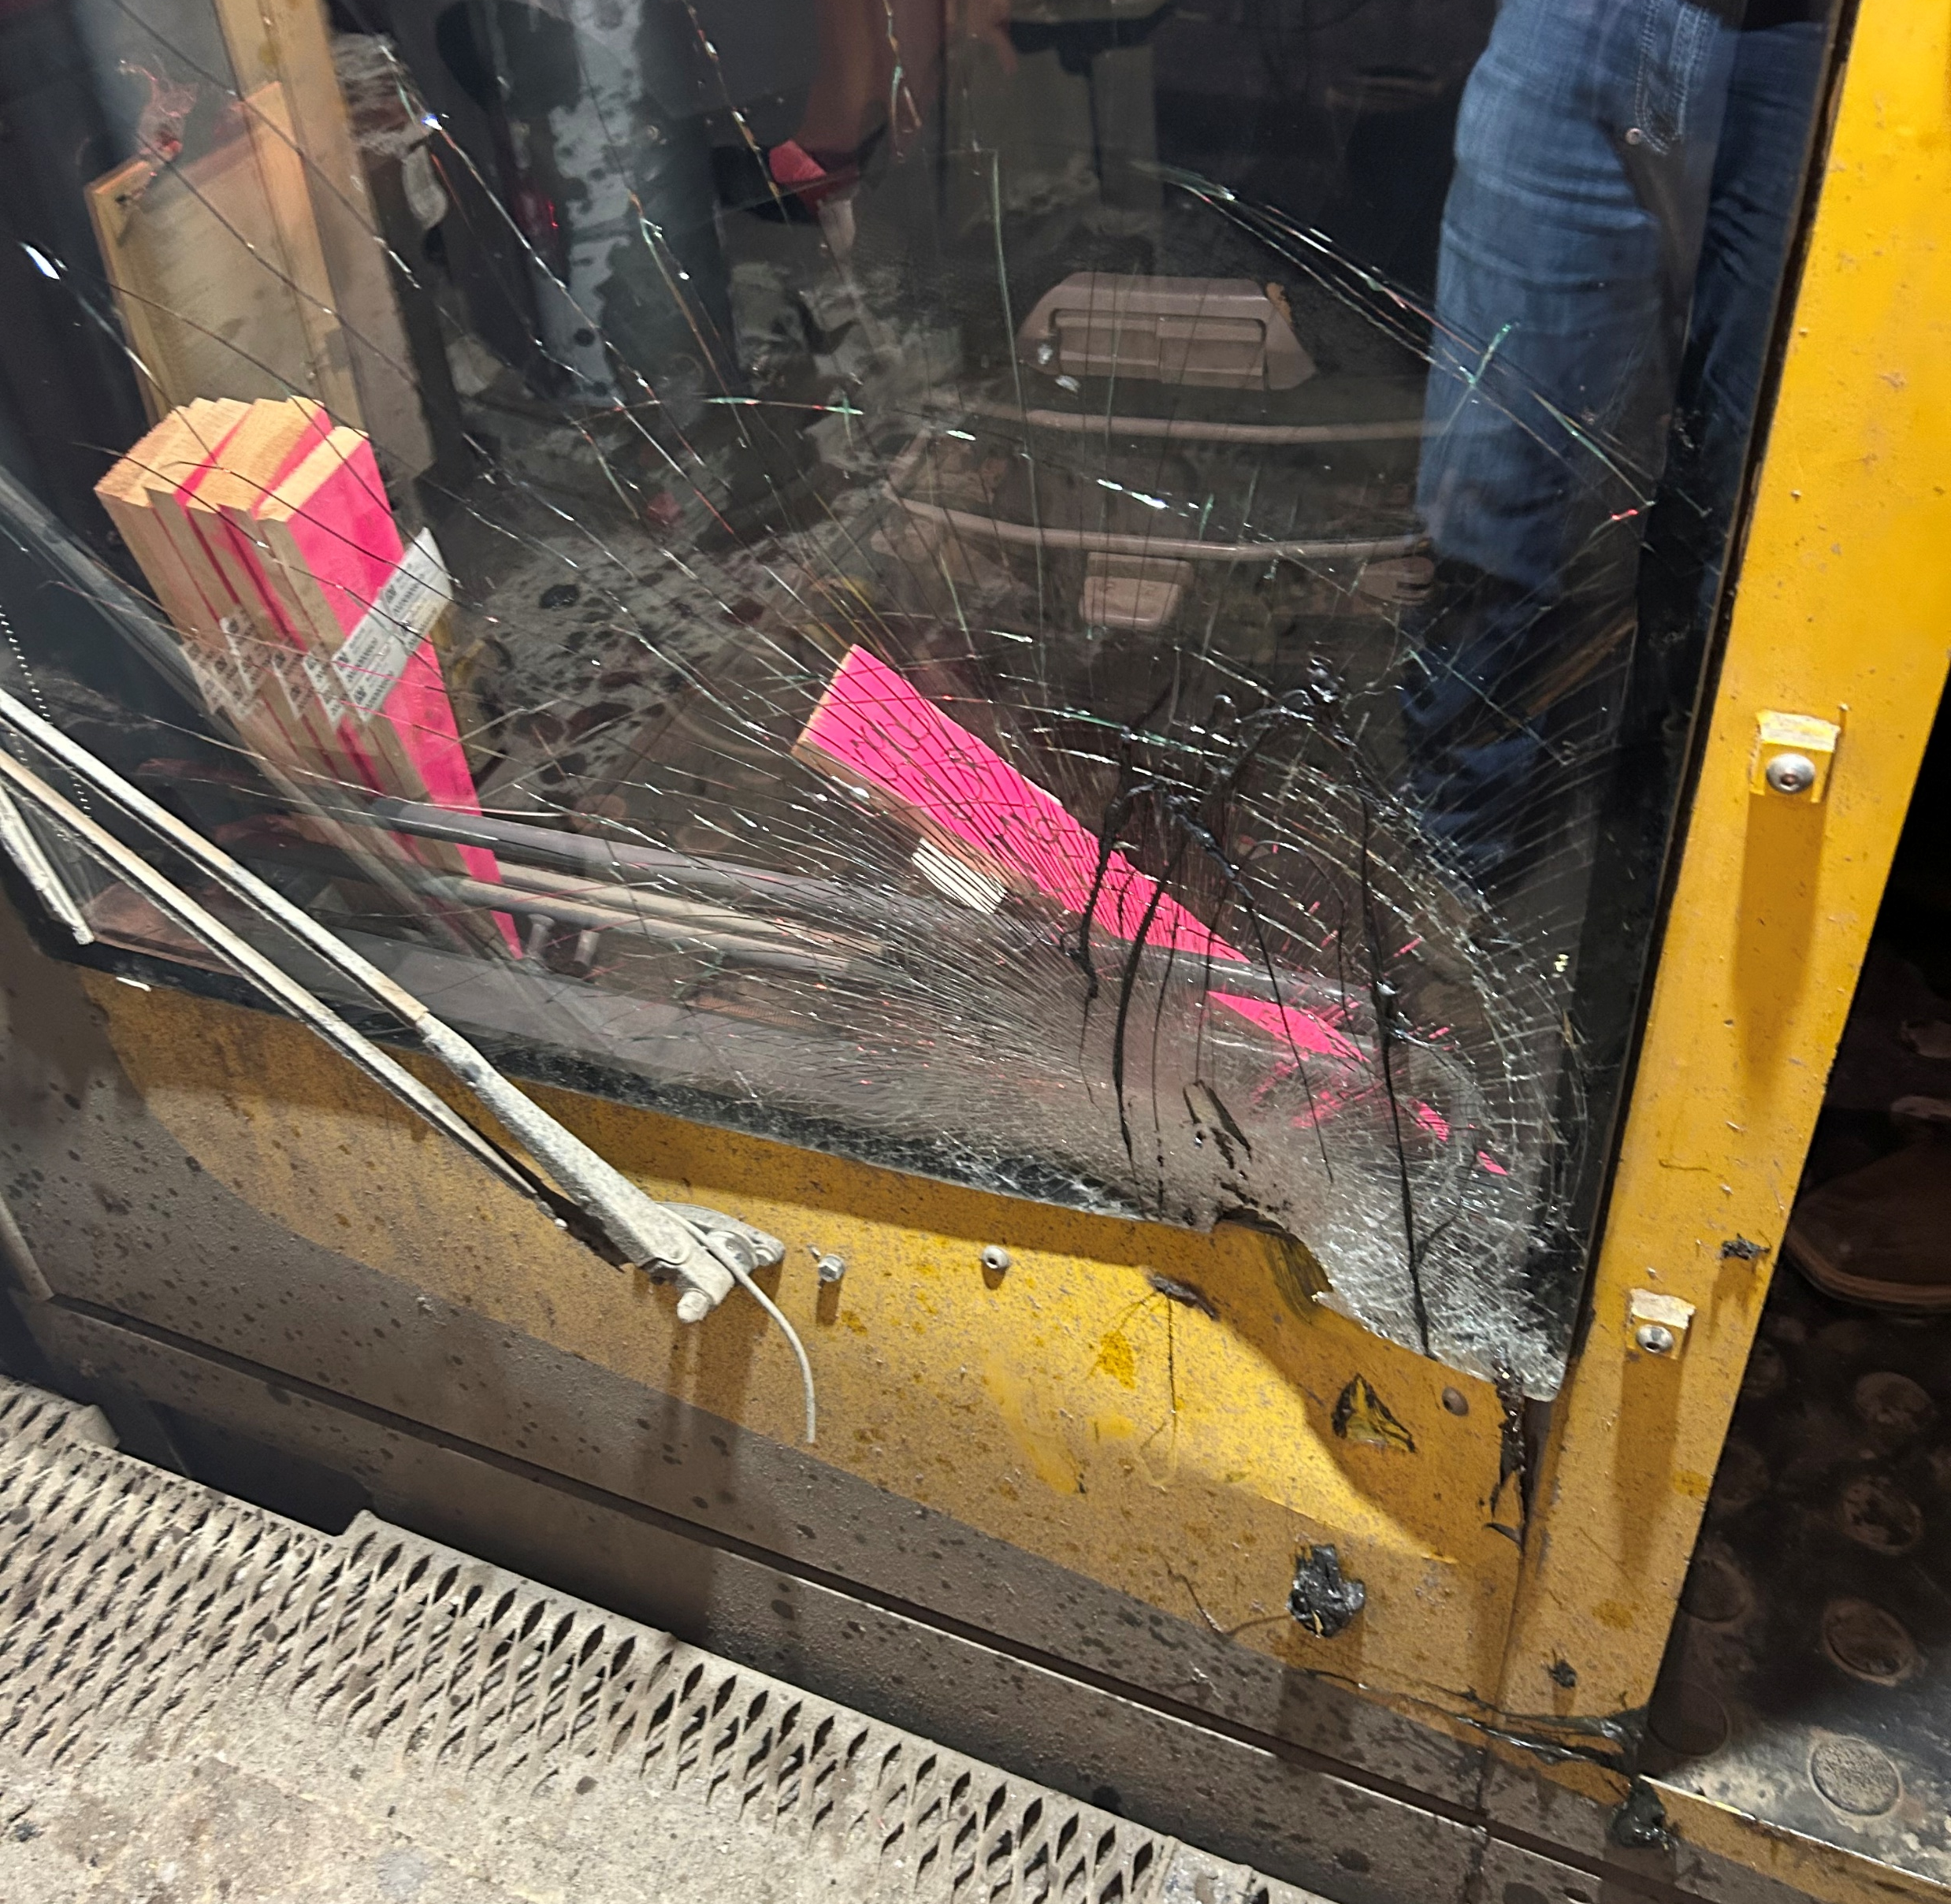
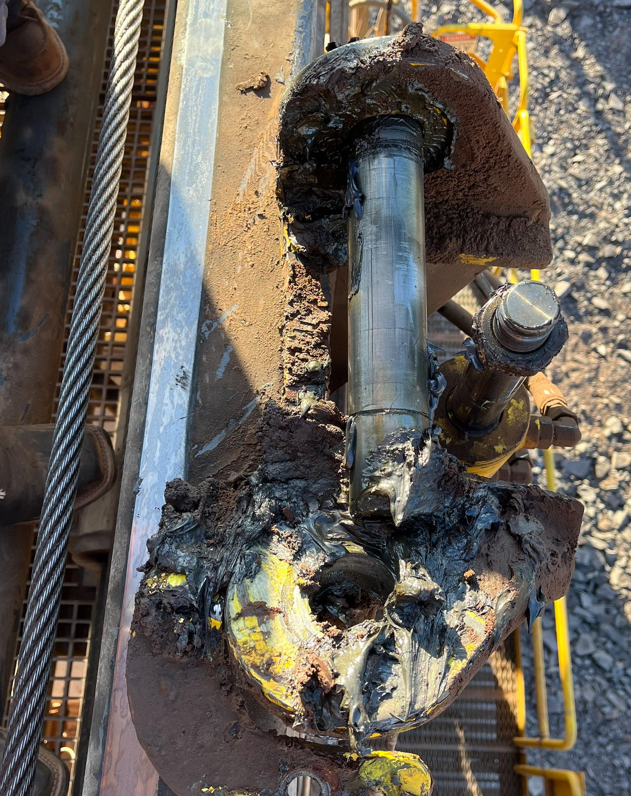
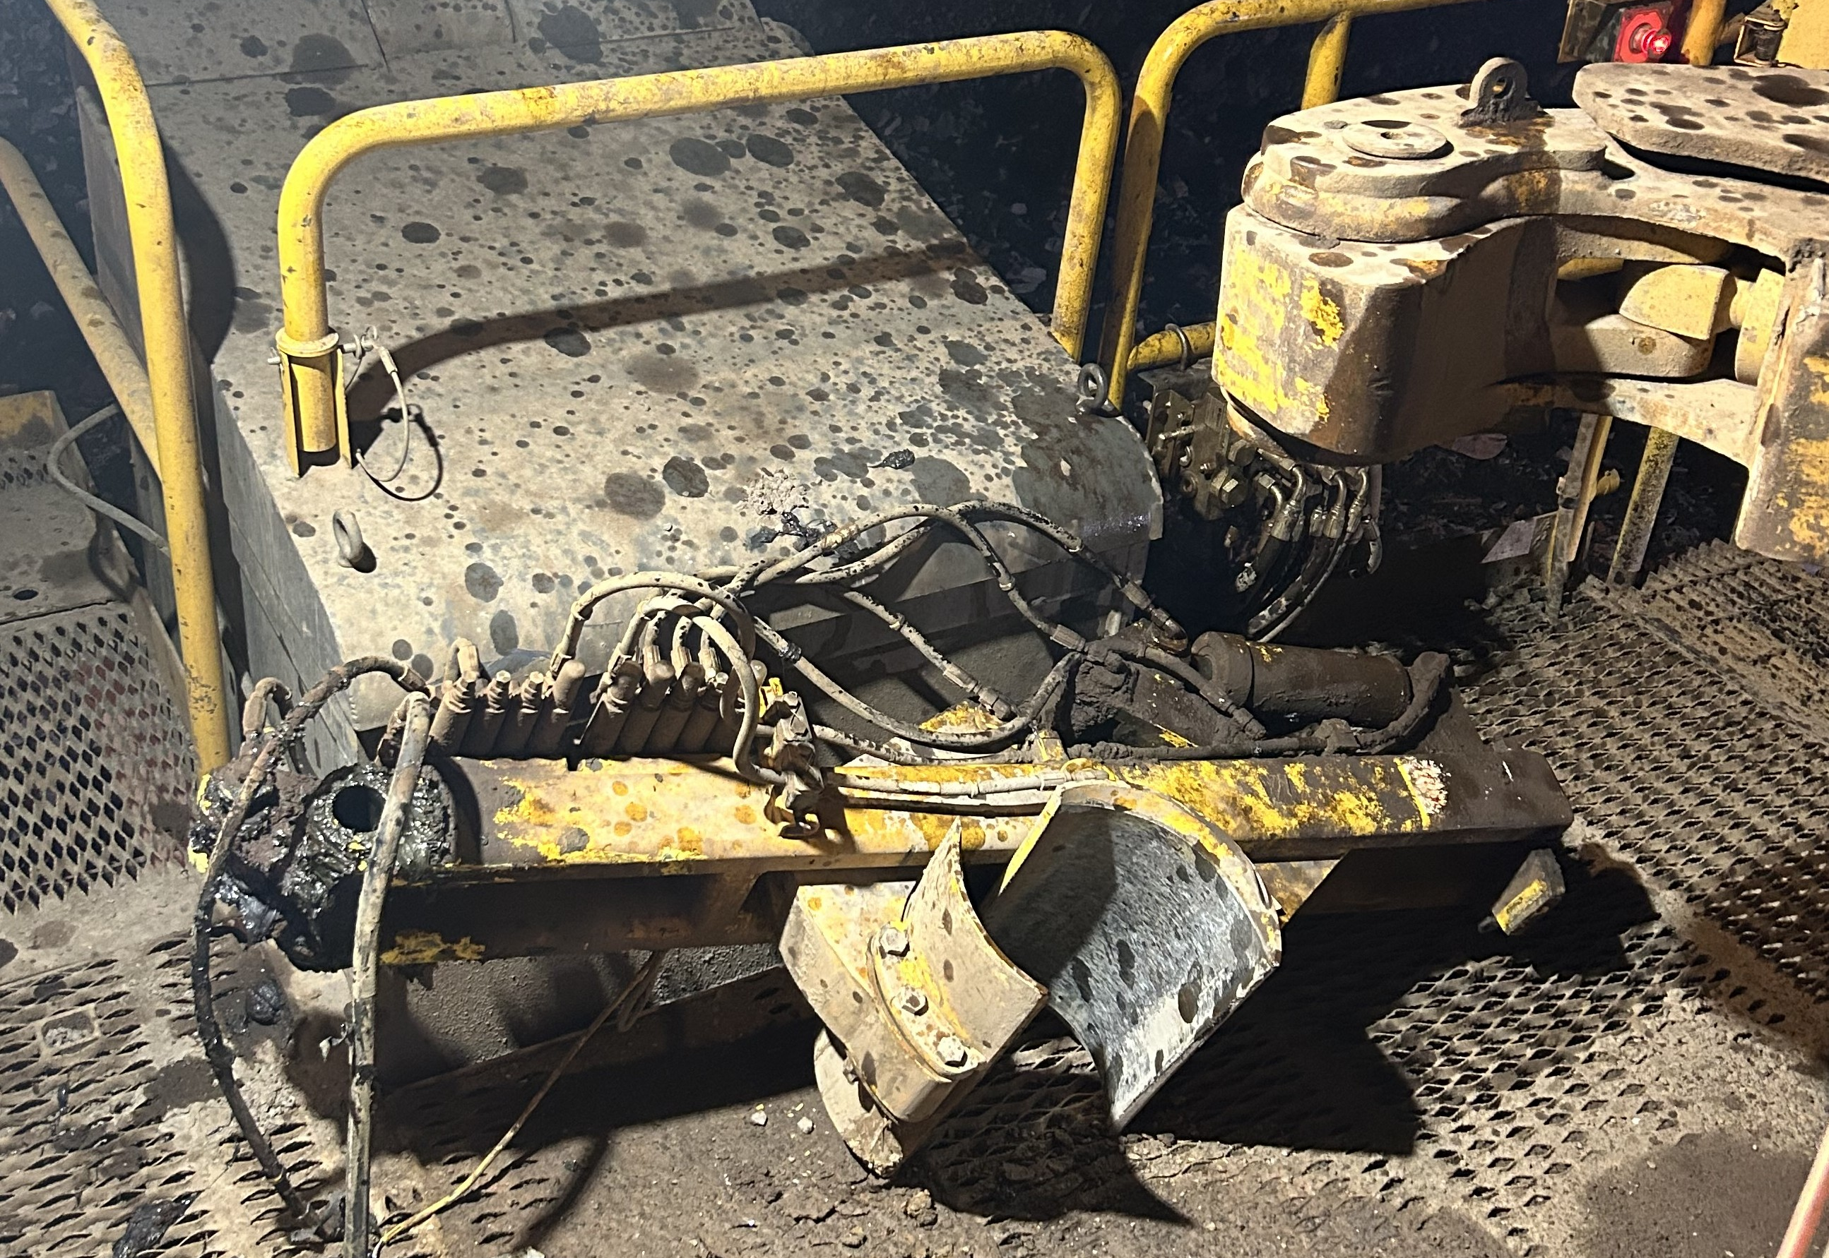
Drill Rod Support Fell Onto Cab
ID # 2025-26 Event ID # 20029484
Falling Objects
Preliminary Incident Details
Operation | Safford
Date / Time | September 15, 2025 / 7:45 a.m.
Event Type | Property Damage
Summary | A drill operator was in position to start drilling the first hole of the pattern when the rod support mechanism weighing about 500 pounds fell 18 feet from the drill mast. The rod support broke the safety cable, struck and dented the drill cab, and shattered the front cab window.
Risk Category | Actionable – Significant (3) Likely (3)
Findings / Missing Controls | Rod support safety cable failed
Applicable Policies / Procedures | Drill operating standard operating procedure
Employee Condition | No injuries
Contact | Shannon Jeans, Manger-Health and Safety
Damage to cab window
Bent lower bracket
Location of fallen rod support on drill deck

Slide 22

Industry Incidents

Slide 23
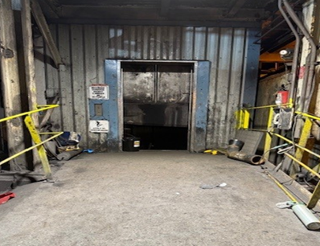
MSHA Fatality Alert
On August 26, 2025, an electrician died while performing elevator testing. The elevator car descended and struck the electrician on the first-floor elevator platform.
Eliminate Hazards and Prevent Injuries
De-energize, lock out, tag out, and block machinery against hazardous motion, including unintended movement, before conducting maintenance.
Install audible and visual alarms to warn of impending equipment movement. Ensure the alarms are functional through testing and maintenance.
Stay clear of moving equipment during testing procedures.
Train miners to safely perform testing procedures and ensure the procedures are followed.

Slide 24
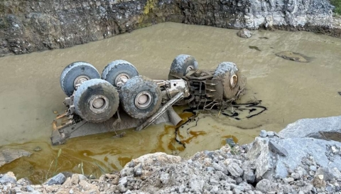
MSHA Fatality Alert
On August 25, 2025, a miner died after the haul truck he was driving went over a berm along the haul road, over a highwall, and overturned into water in the pit.
Eliminate Hazards and Prevent Injuries
Operate mobile equipment at safe speeds. Consider the roadways, tracks, grades, clearances, visibility, traffic, and type of equipment being used.
Clearly mark hazards along roadways with signs and signals.
Always wear a seatbelt while operating mobile equipment. Never attempt to exit or jump from an out-of-control vehicle.
Maintain control of mobile equipment while it is descending, especially around tight turns.
Perform pre-operational examinations of mobile equipment.

Slide 25


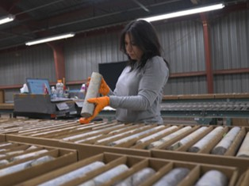
Additional Resources
Health and Safety Dashboard
Safety Toolkits
FCX Policies
MSHA Safety Alerts
OSHA

Slide 26
Henderson Incidents
09/04 – Near Miss
Delivery driver failed to depressurize oil delivery line from delivery vehicle causing oil to spray individual and onto roadway. Driver had appropriate PPE that prevented exposure to face and eyes.
09/09 – Near Miss
Employee noticed small steam leak at Johnson joint and attempted to fix. Union failed releasing steam and employee turned avoiding line of fire.
09/22 – Property Damage
Employee driving light vehicle followed water truck through ultimate canal gate and vehicle struck by gate arm. Scratches and dent/hole left on passenger side of vehicle.

Slide 27
FRM Verification Results – Sept.
167 verifications Submitted in September
Focus in September around Exposure to Electrical hazards, Ground Failure and Blasting
Fire, Exposure to Electrical Hazards and Uncontrolled Release of Energy increased missing control ratio compared to August
FOCUS FOR OCTOBER:
Exposure to Electrical Hazards
Fire
Uncontrolled Release of Energy

Slide 28
MSHA Q3 Inspection Results
Henderson 3rd Quarter 2025 MSHA Citations | S&S | Non S&S | All Citations
Mine | 1 | 10 | 11
Mill | 1 | 3 | 4
Contractors | 0 | 0 | 0
Total Henderson | 2 | 13 | 15
Reduction in overall Citations compared to 2nd Quarter (43 -> 15)
Fire Prevention overtook as #1 cited hazard
Safe Access continues to be in Top 3

Slide 29
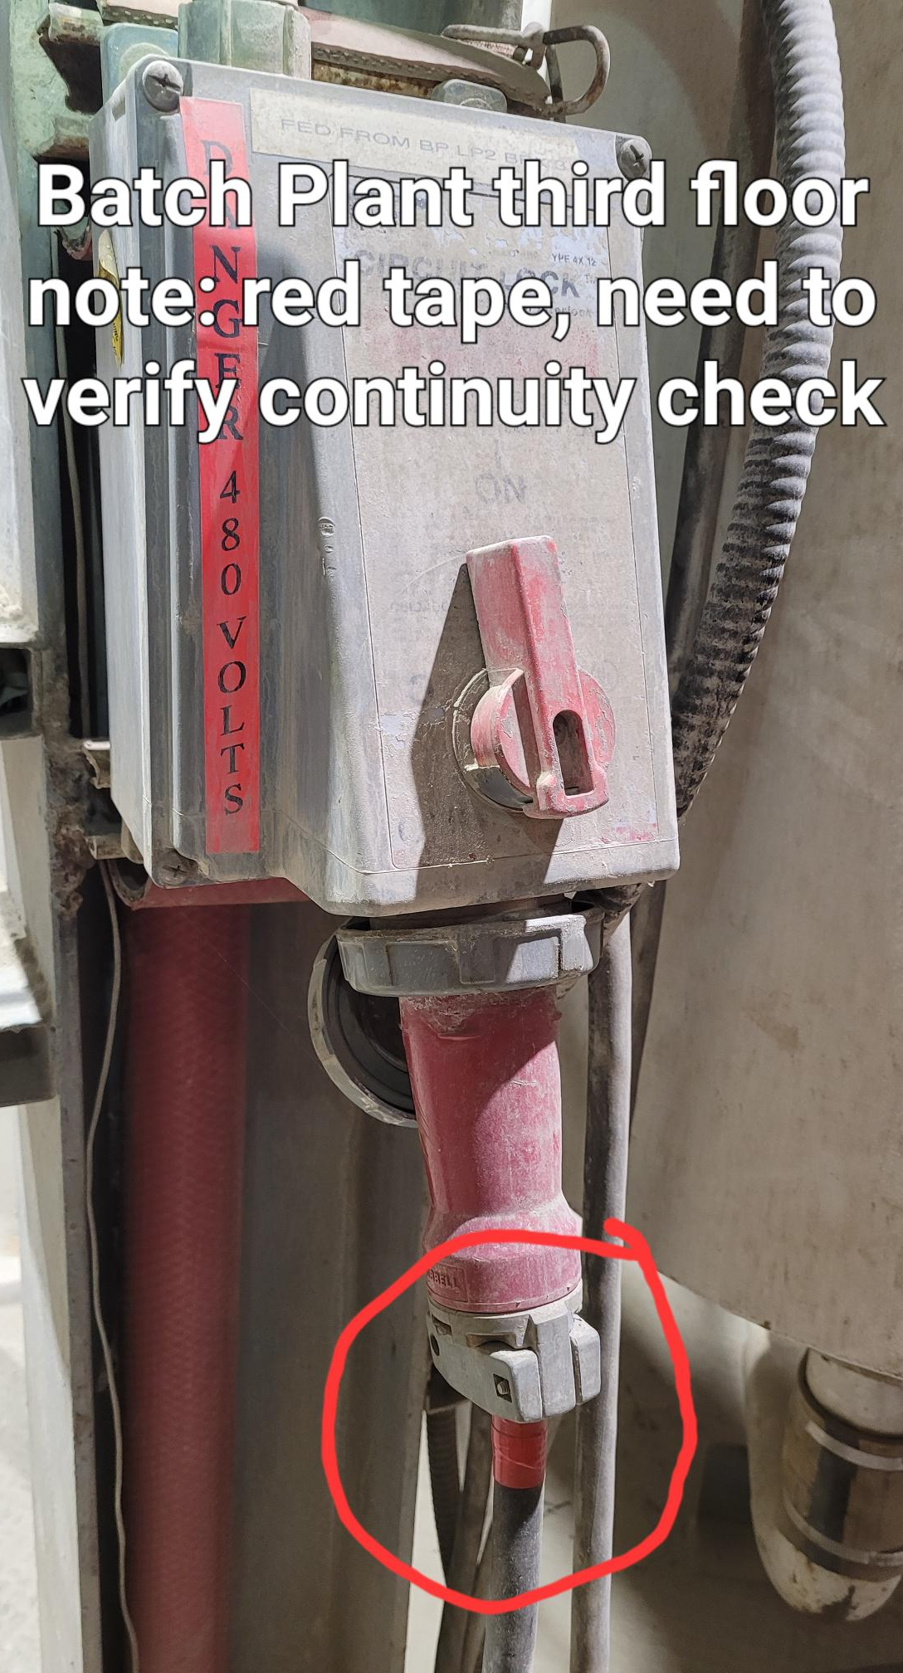
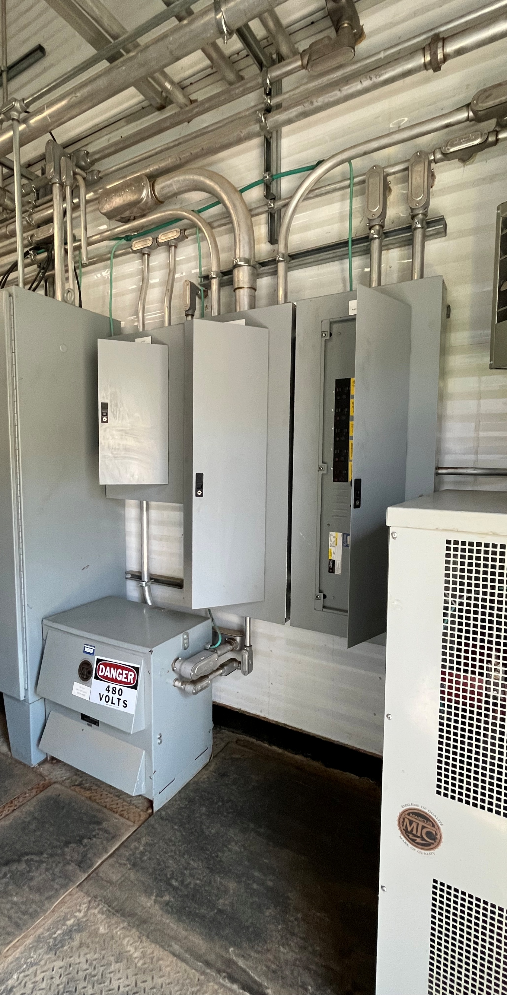
MSHA Q3 Citation Examples

Slide 30
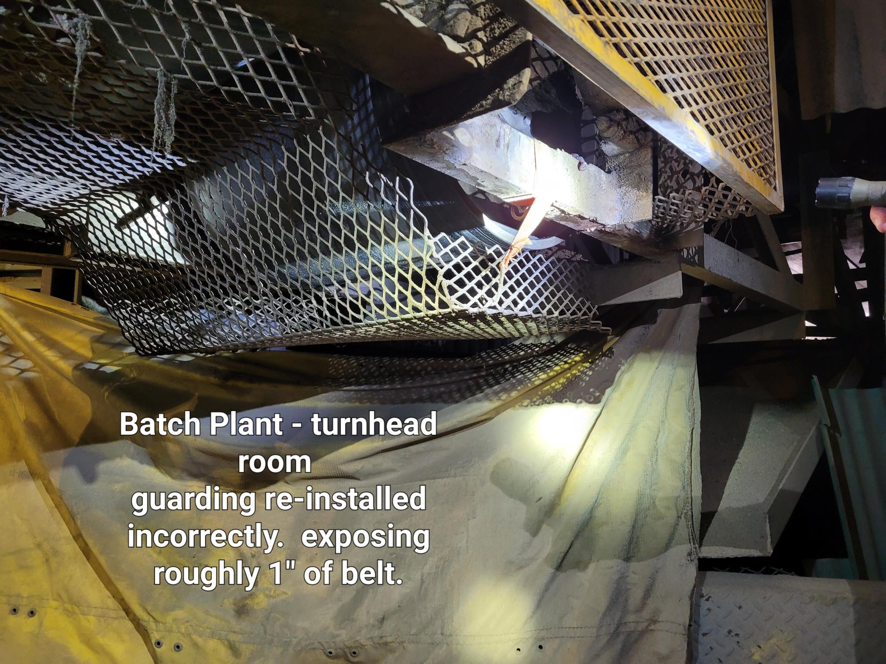
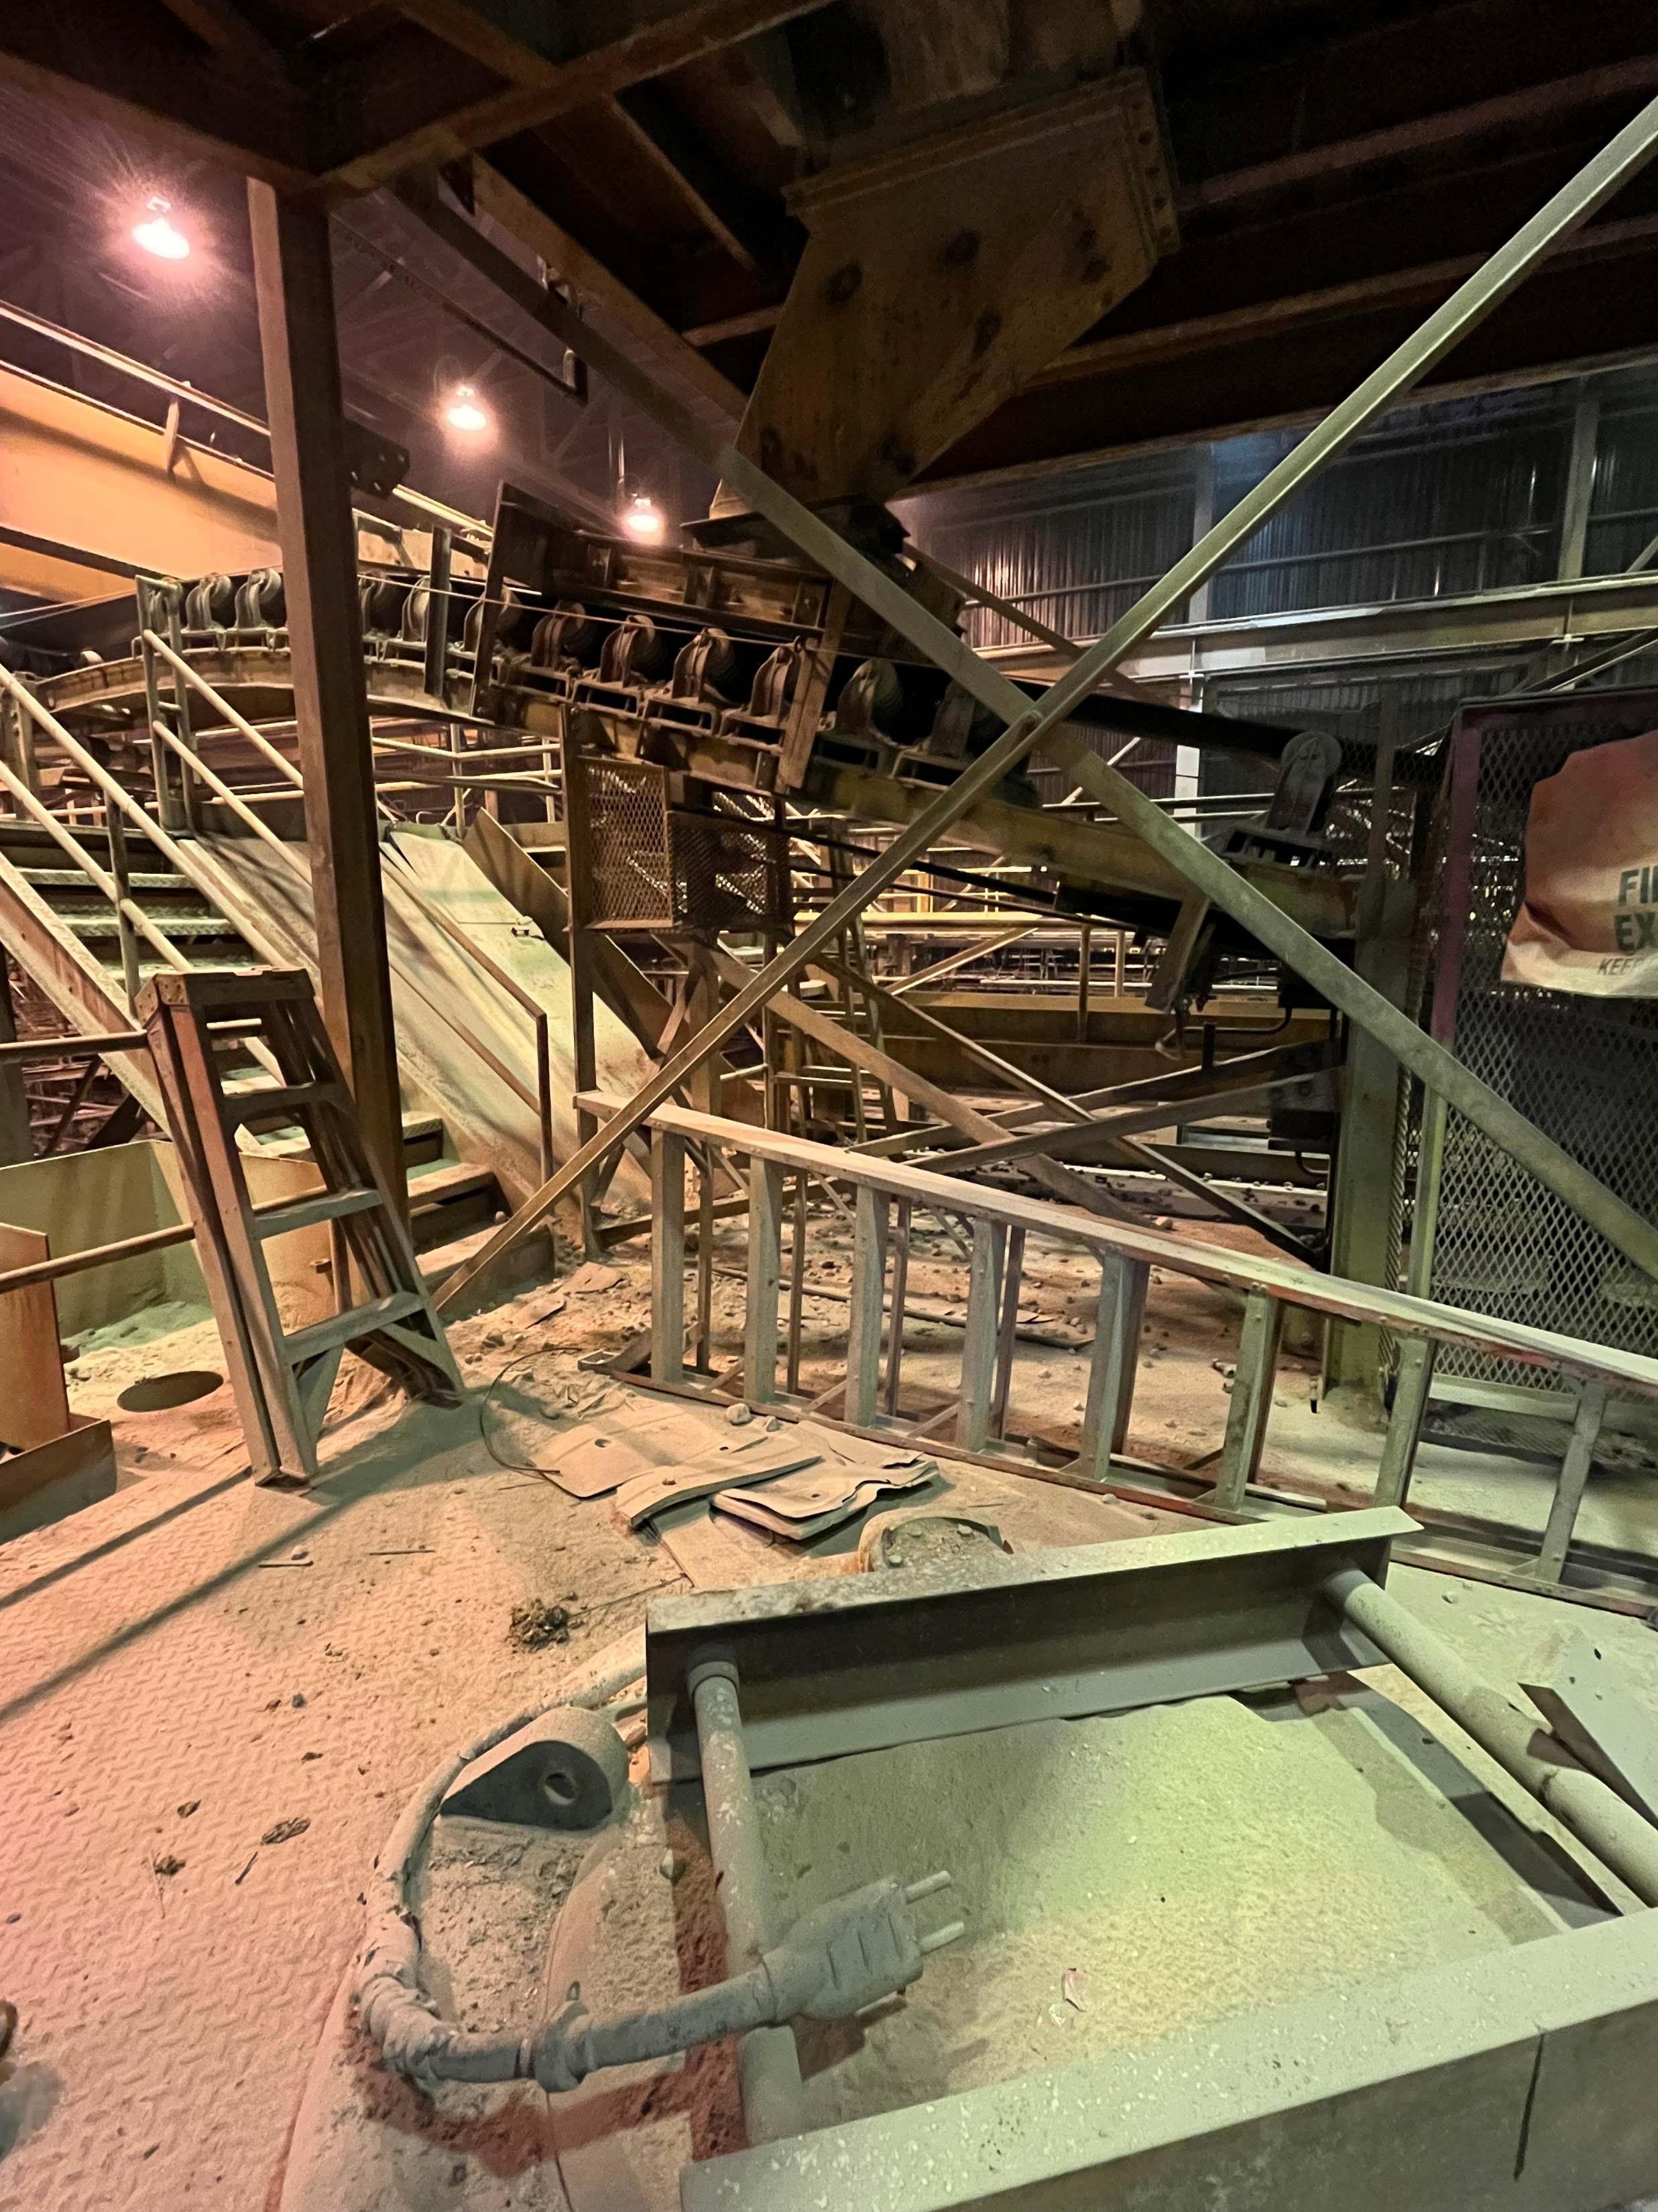
MSHA Q3 Citation Examples

Slide 31
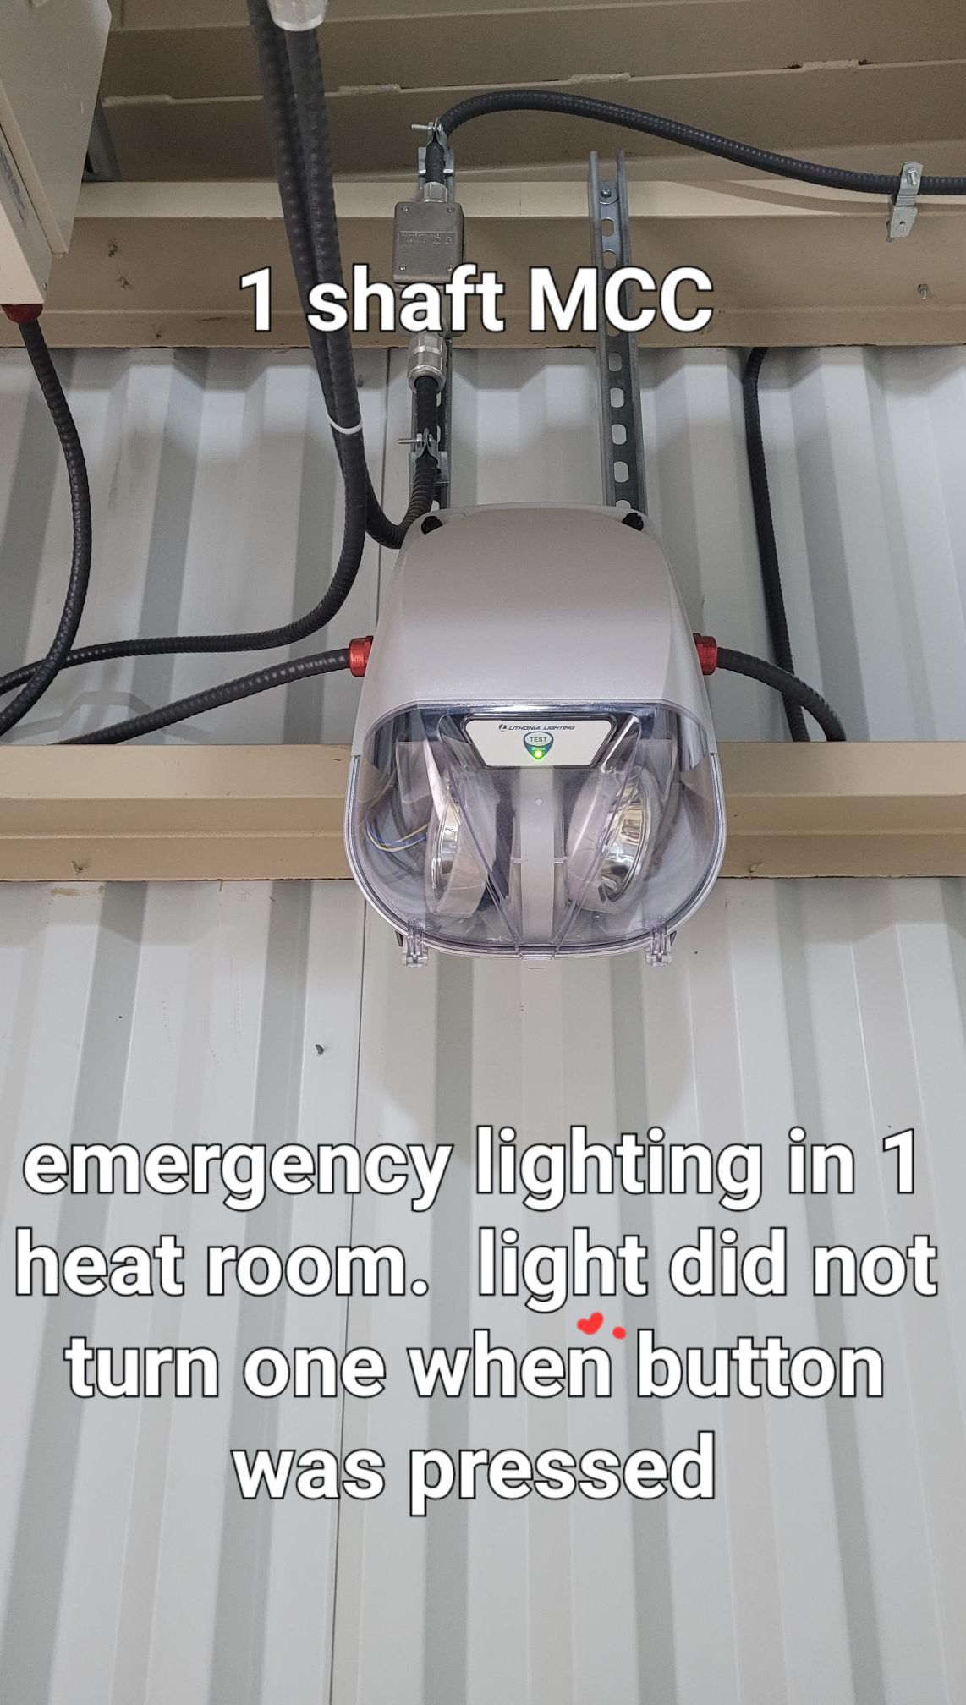
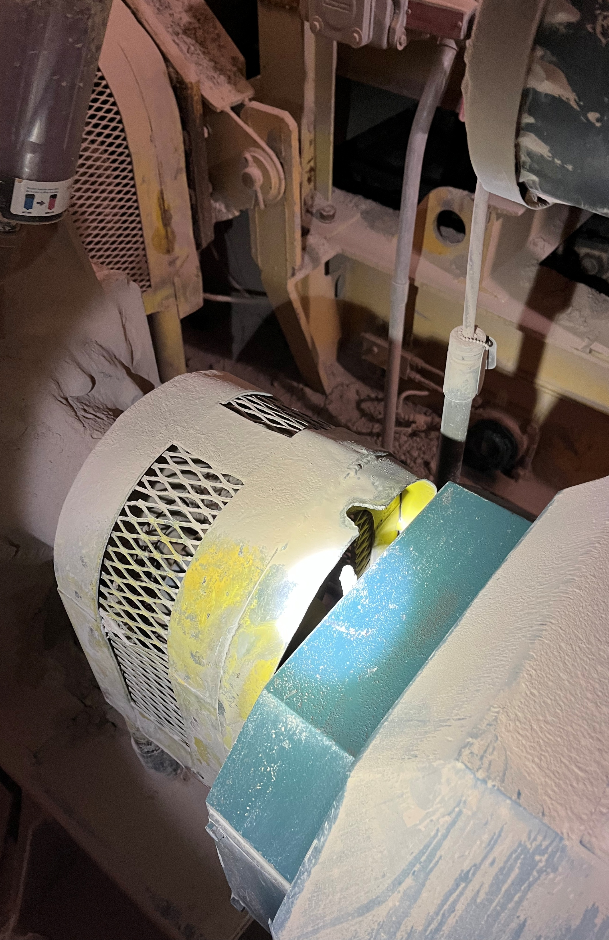
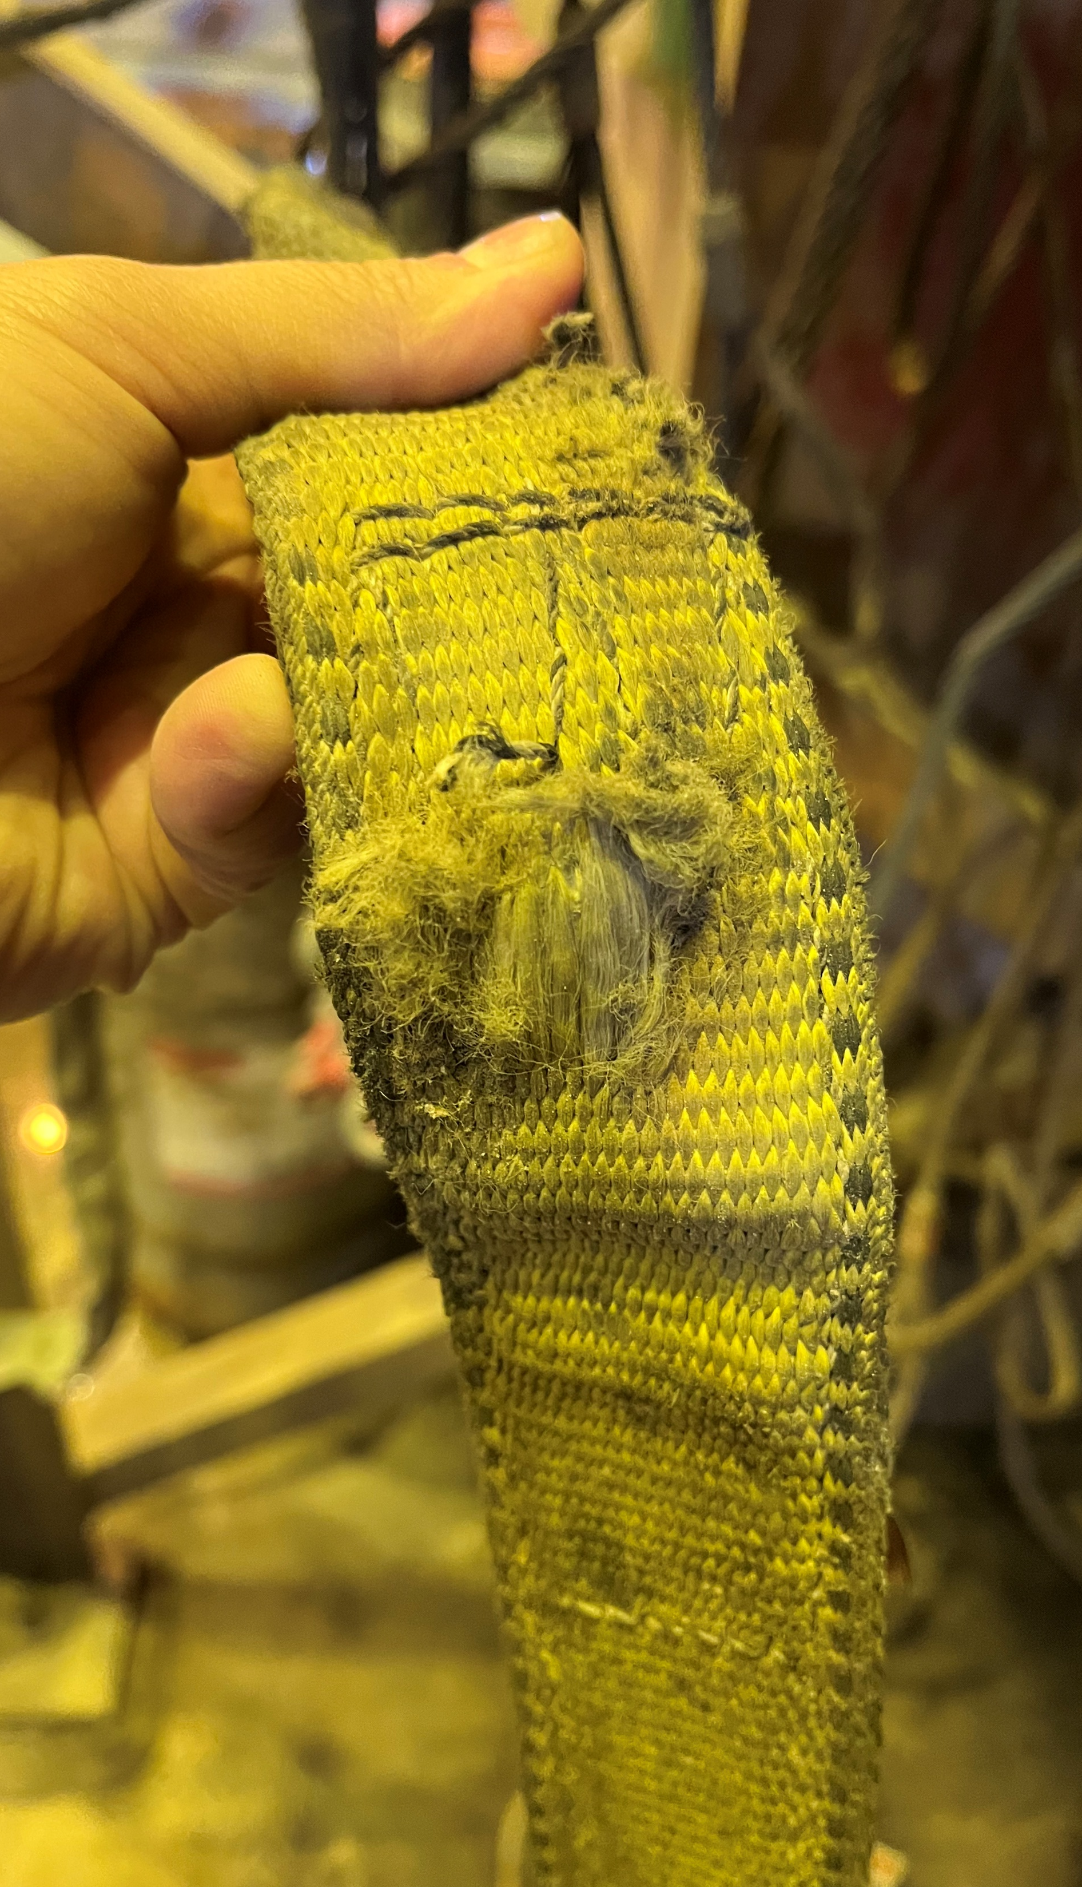
MSHA Q3 Citation Examples

Slide 32
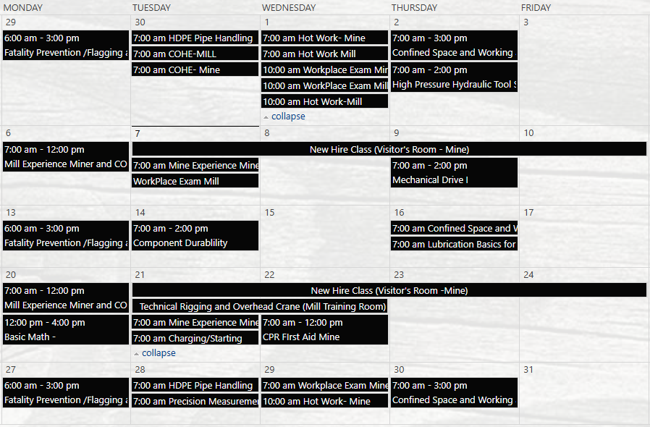

Henderson Training Schedule - OCTOBER

Slide 33

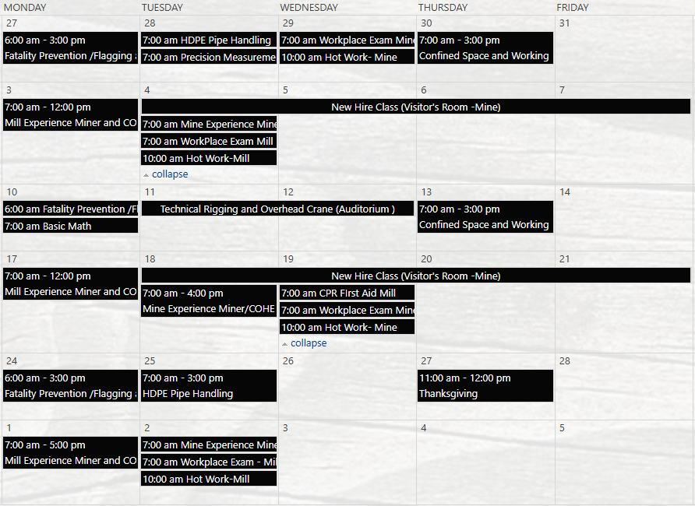
Henderson Training Schedule - November

Slide 34
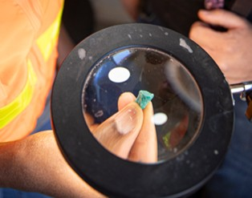



Contractor Management Topics
TRIR Hours by 3rd of Month
Local Suppliers
QR Code for Contractor Portal

Slide 35


Community- Local Procurement & Ways We Support Local
As a member of ICMM, FCX is committed to enabling access by local enterprises to procurement and contracting opportunities across the project life-cycle, both directly and by encouraging larger contractors and suppliers, and by supporting initiatives to enhance economic opportunities for local communities.
Below are some ways we support local procurement:
Participating in supplier fairs, roundtables, chamber of commerce meetings, and open house events.
DreamBuilder program- an online business training program designed to help female entrepreneurs build and grow their own business.
Keeping local supplier lists and making those available to larger contractors who may need additional resources or support during projects.
Utilizing Ariba, which provides local suppliers with the benefit of participating in the Discovery tool, which connects suppliers and buyers through the broader Ariba network.
https://dreambuilder.org/

Slide 36

Open Forum

Slide 37
2025 Meeting Schedule
November 20th
December 18th
Meetings begin 1 PM MST
Mine and Mill In-Persons Options Monthly

Slide 38
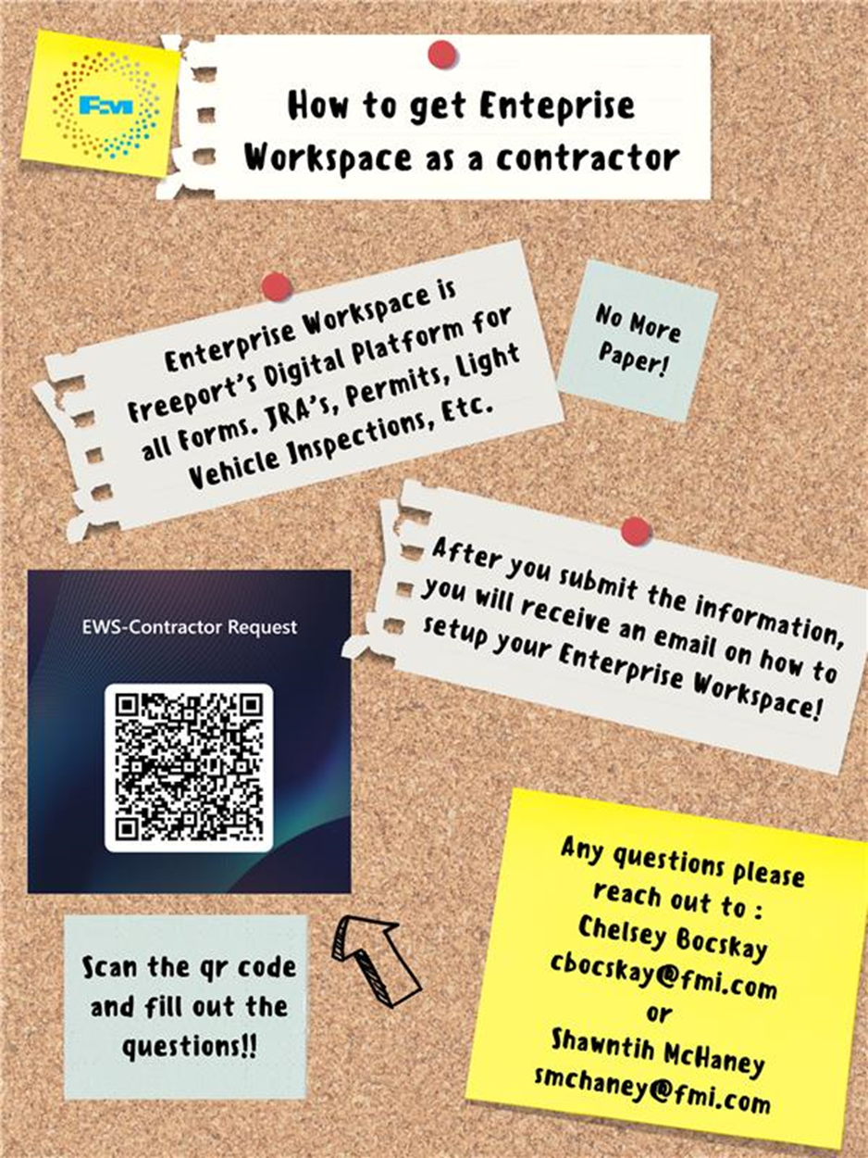
Contractor EWS Access
Access to site digital forms now available to Contractors!
Integration of Contractor submitted forms into internal dashboards
Forms can be used in online and offline modes
Request Access with QR Code or HERE
Reach out to H&S Department with any questions or issues

Slide 39
October Sign-Off Record
_____________________
_____________________
_____________________
_____________________
_____________________
_____________________
_____________________
_____________________
_____________________
_____________________
_____________________
_____________________
_____________________
_____________________
_____________________
_____________________
_____________________
_____________________
_____________________
_____________________

