Slide 1
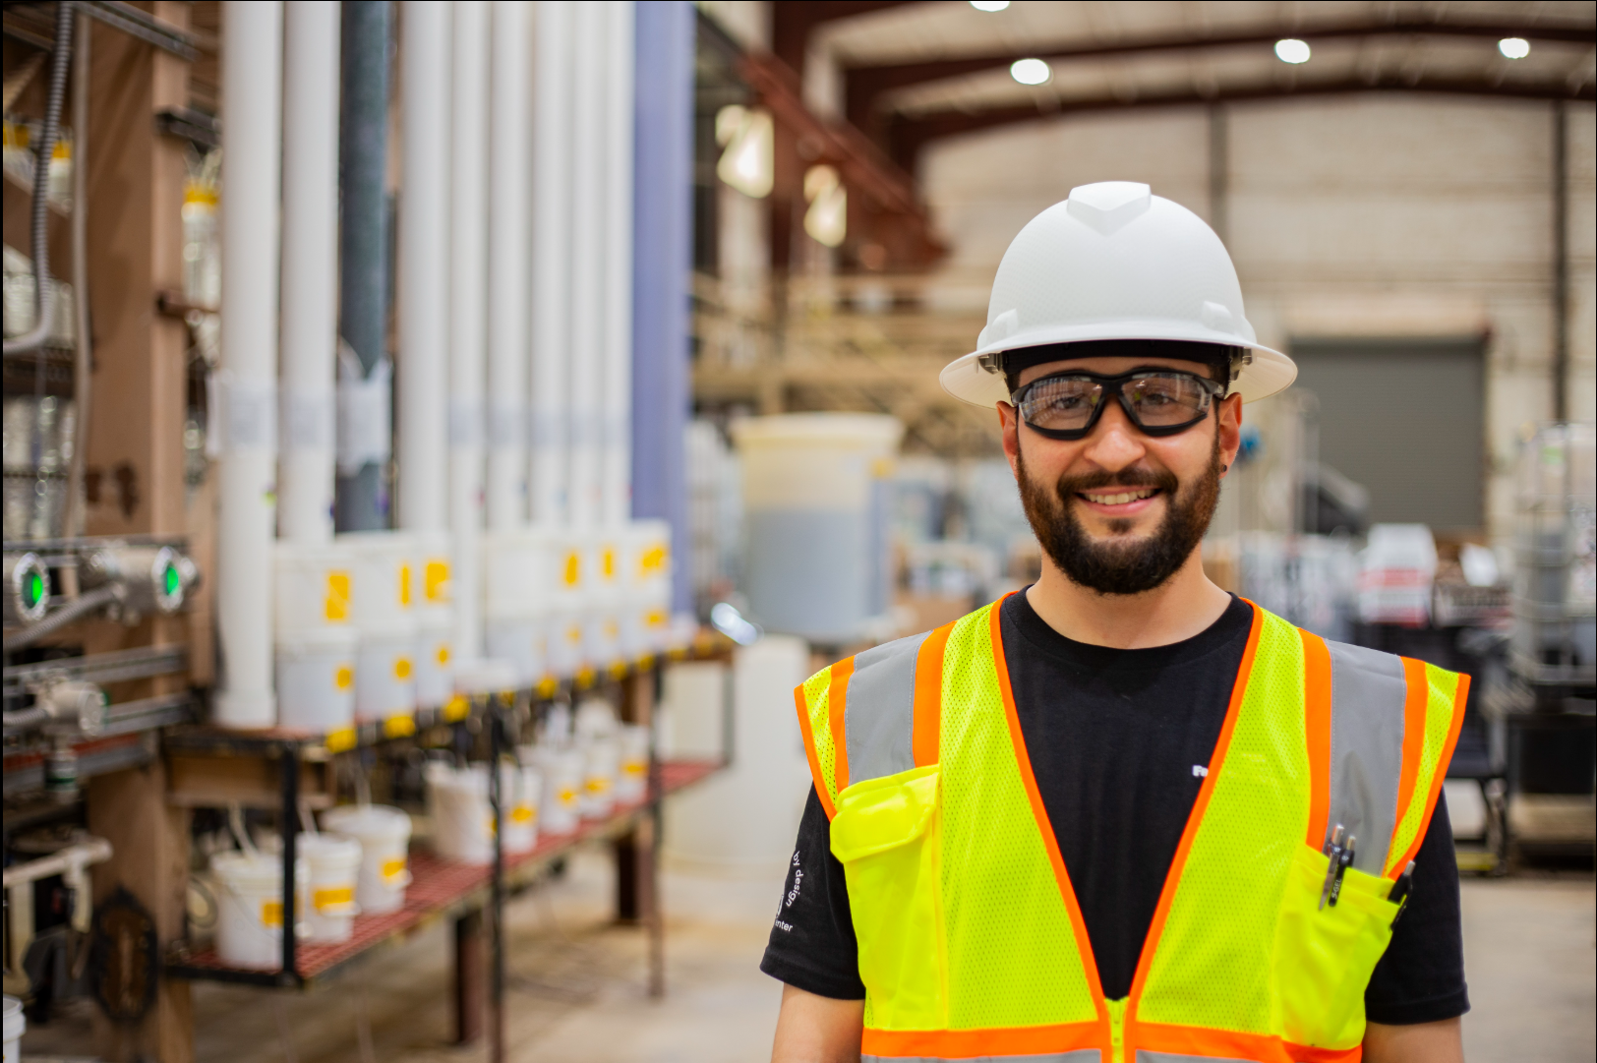

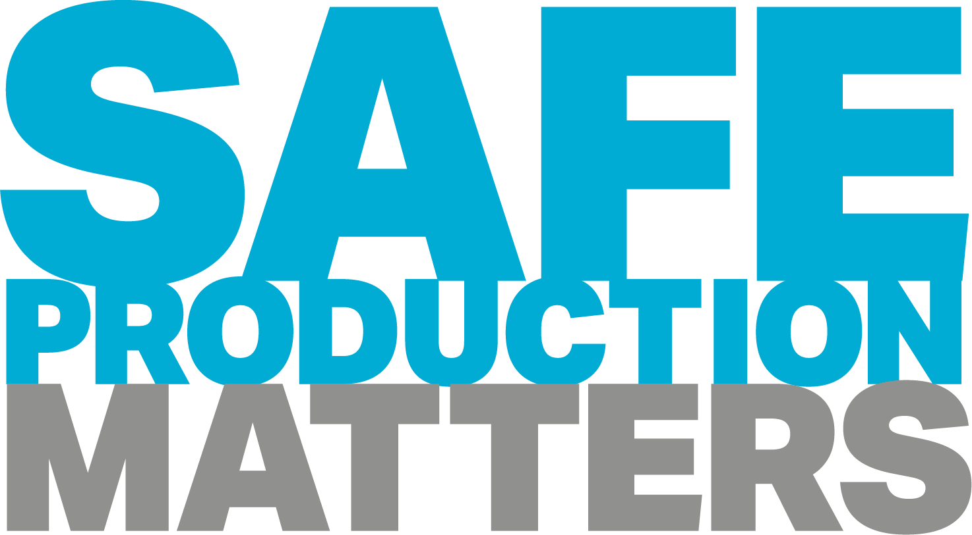
Henderson HSE Contractor Meeting
October 2026

Slide 2
Avoiding Unauthorized AI Tools
FMI has observed an increase in AI “notetaking” bots being added to Teams meetings
The use of these tools and software falls under MIS End User Policies that prohibit Freeport employees, contractors and partners from sharing company data without the company’s consent
To protect company data:
  Contractors and Vendors not to use notetaking bots/recording tools
  If external bot/recorder added to meeting, meeting will be stopped
  Ask the FMI organizer to use approved notetaking tools

Slide 3
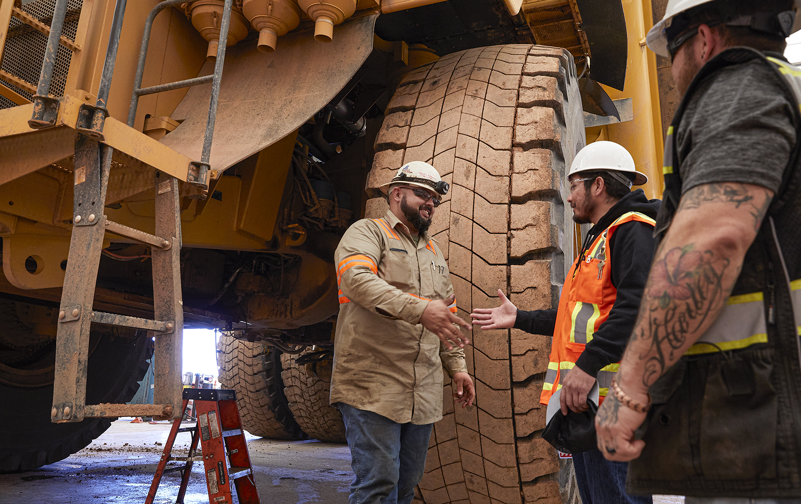

Safety Success

Slide 4
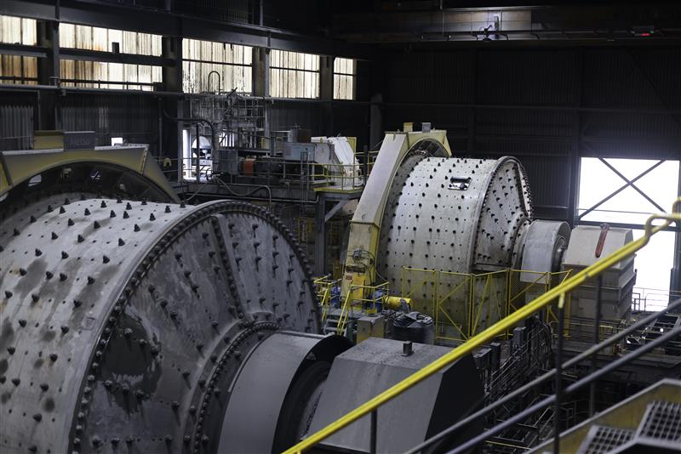
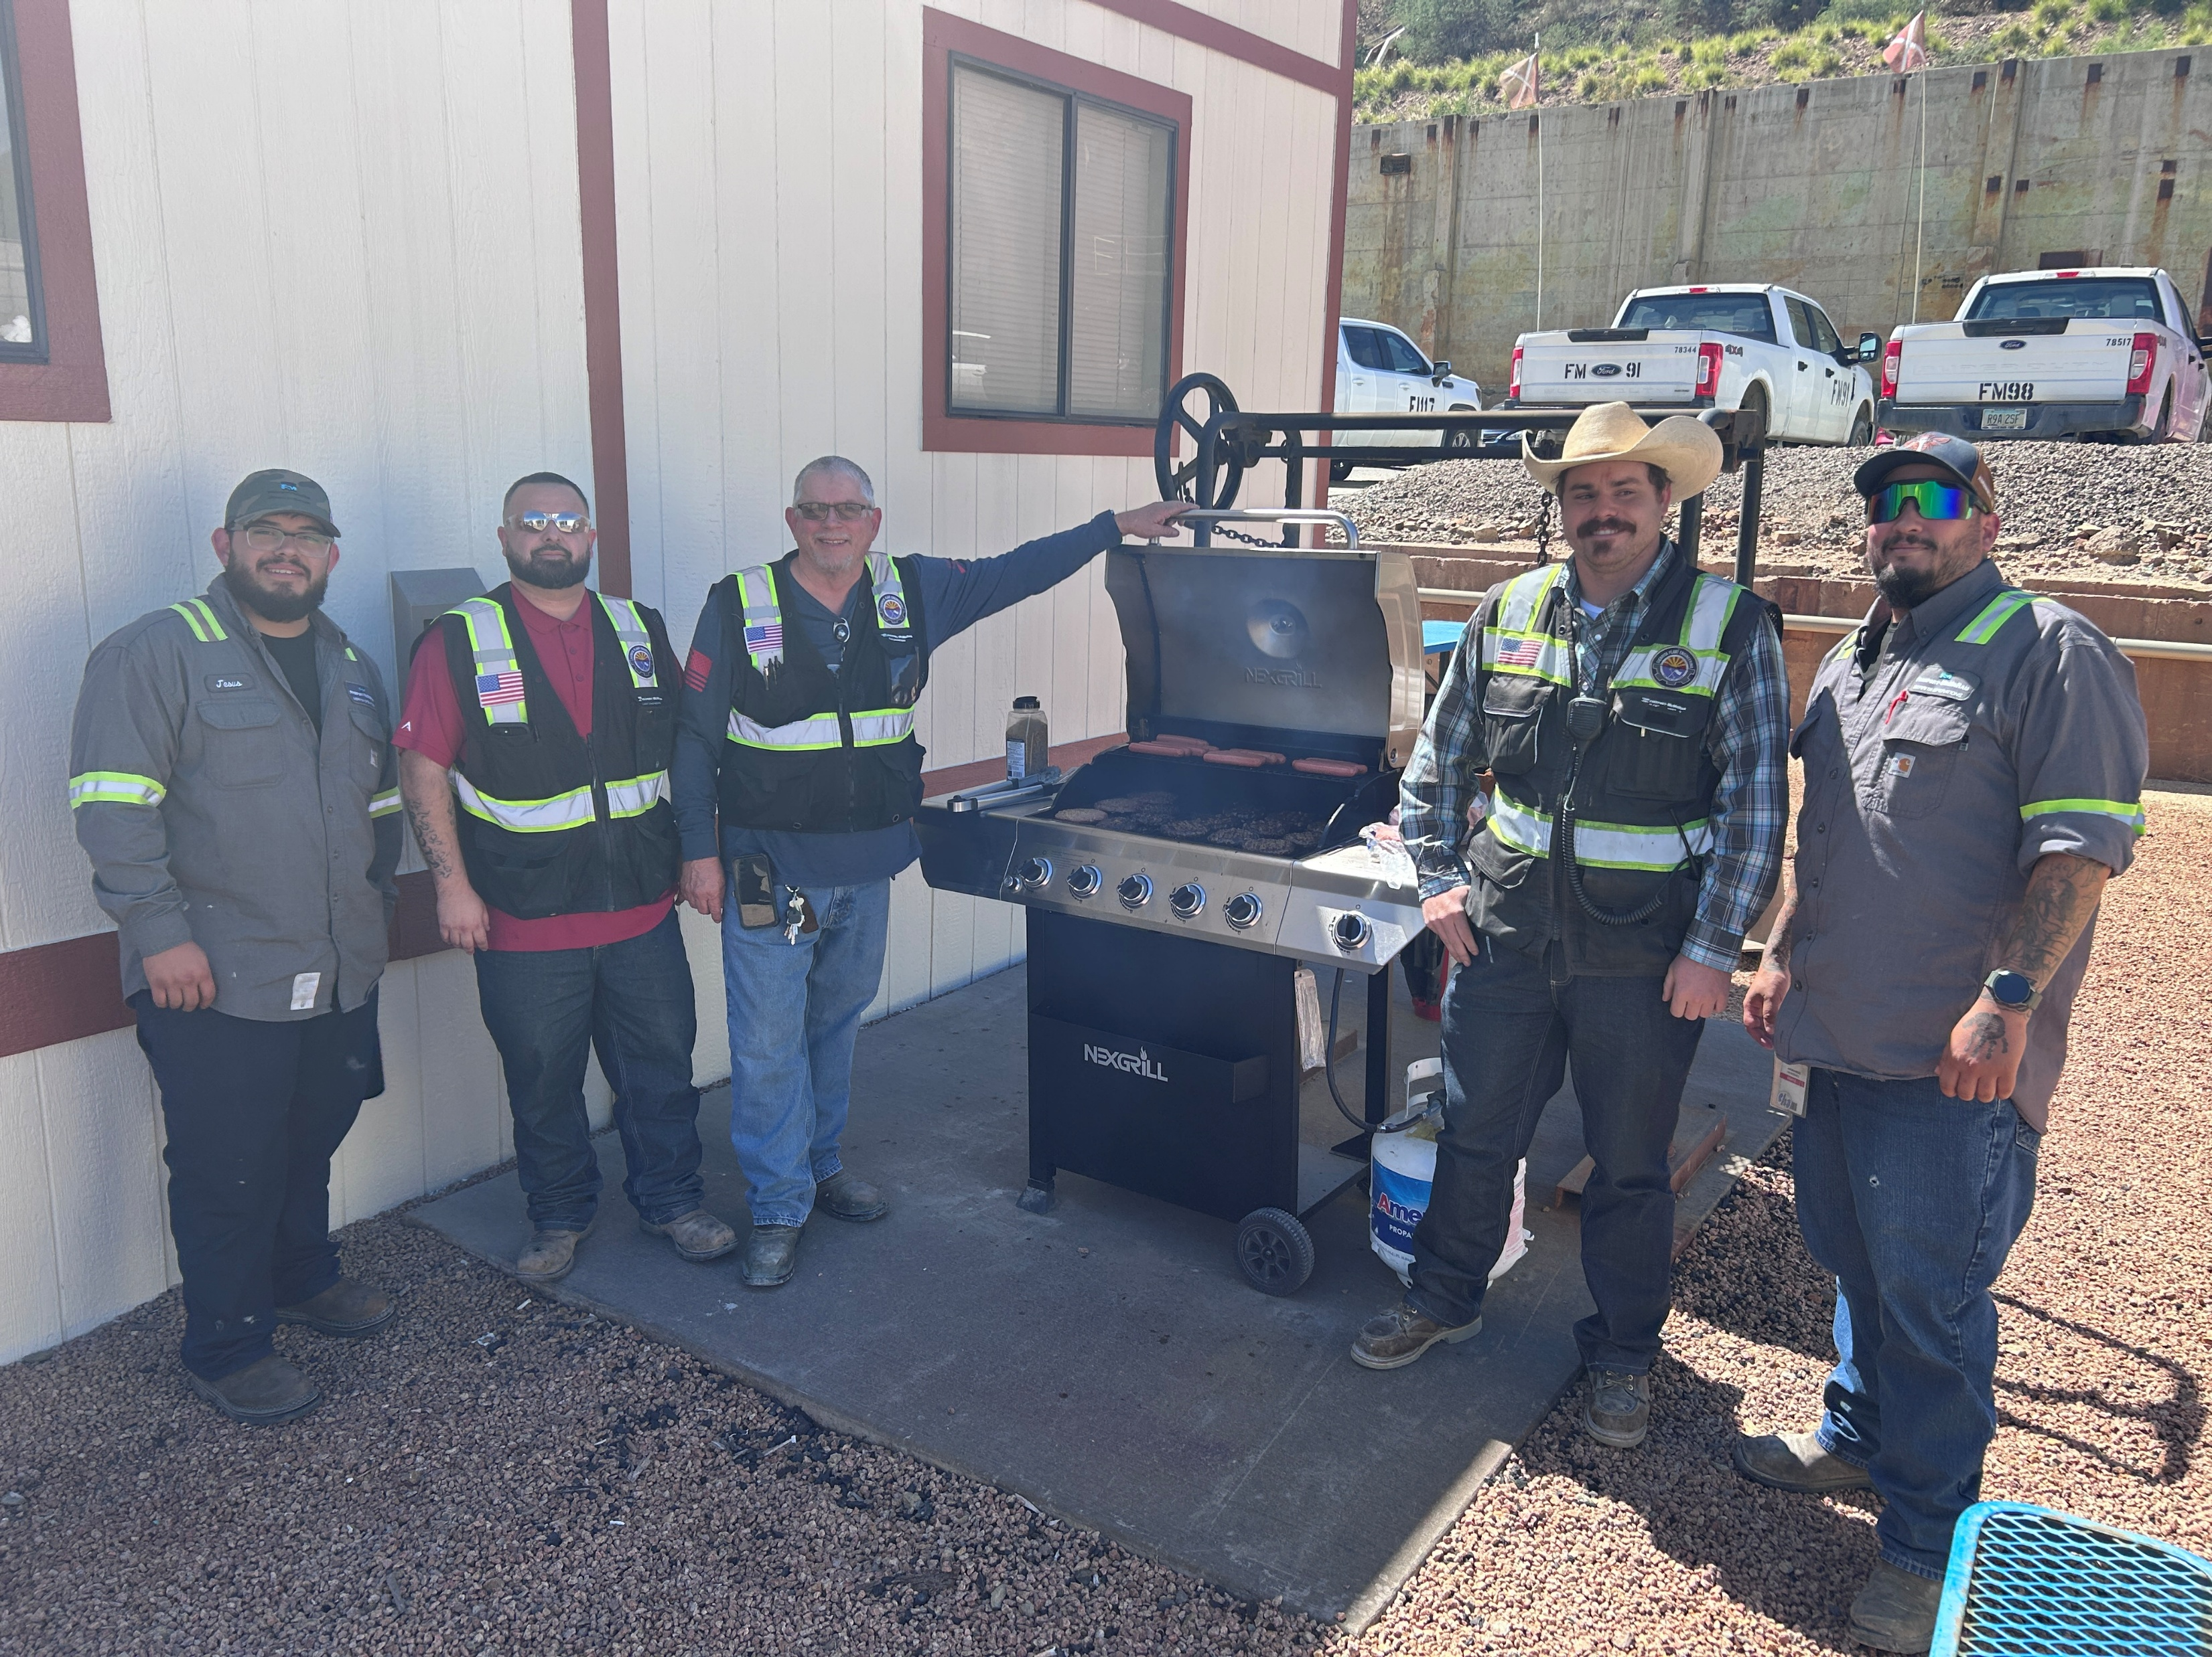
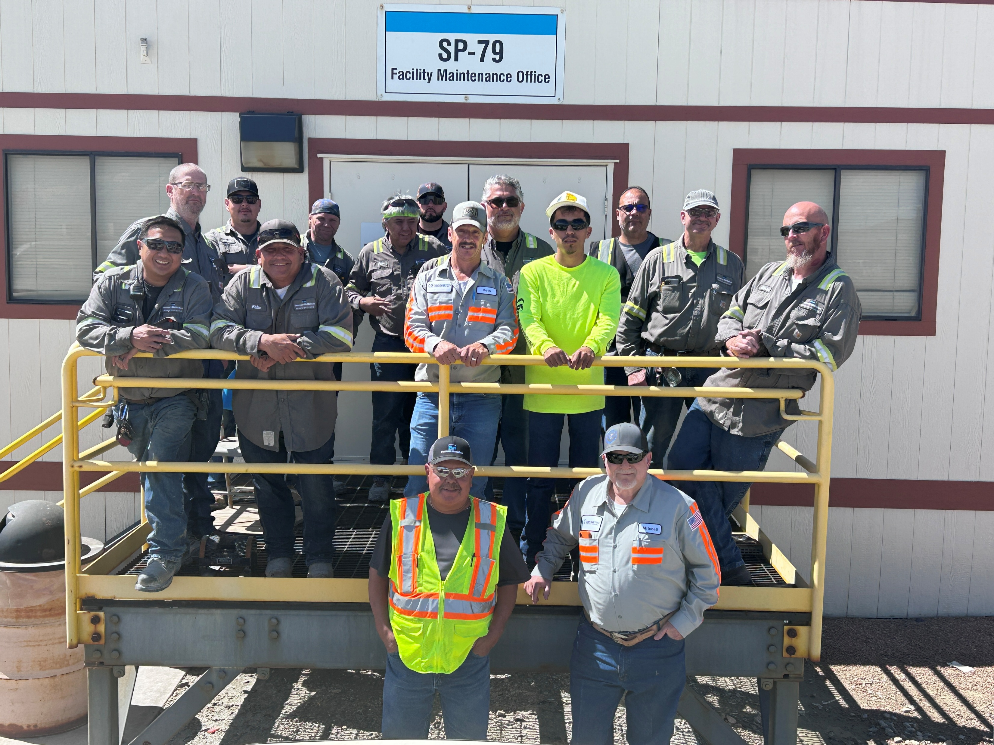
Congratulations
New Mexico Mill Electrical and Instrumentation team achieved 3 years of safe production.
to everyone achieving safety milestones this month
Here are some recent team accomplishments
Sierrita Facilities Maintenance achieved 6 years of no reportables.
Notes:
Accomplishments as of September 2026.

Slide 5
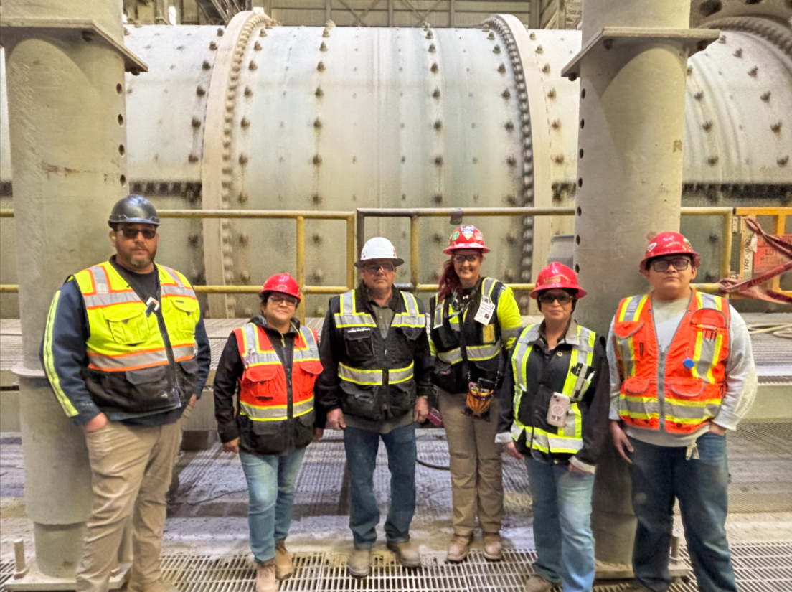
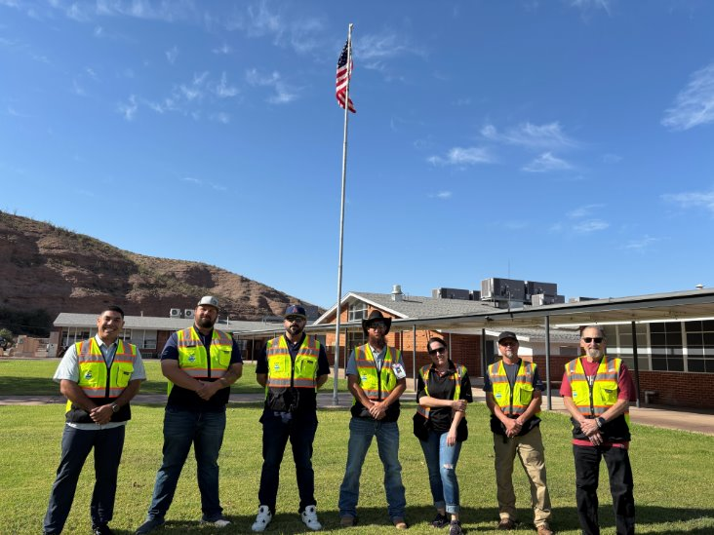
Training: Investing in People and Strengthening Safety
Spotlight On
Building a safer workplace starts with equipping people with the knowledge, skills and support they need to succeed. A new Health and Safety Onboarding Program does just that.
About the Program: Two cohorts (11 employees total) participated in three weeks of classroom instruction and field mentoring. Through structured training, hands-on learning and personalized mentorship, they built confidence and developed practical job skills
Early Results: Multiple pilot cohorts show employees gained a deeper understanding of H&S expectations, strengthened field skills and developed greater confidence engaging with leaders and frontline workers.
The Impact: Every employee benefits when teammates understand expectations, recognize hazards and have the confidence to speak up and act. The new program is helping build a stronger pipeline of safety professionals who are better prepared to partner with operations, support risk management efforts and drive a safer, more consistent safety culture.
Cohort 1 participants
Cohort 2 participants

Slide 6
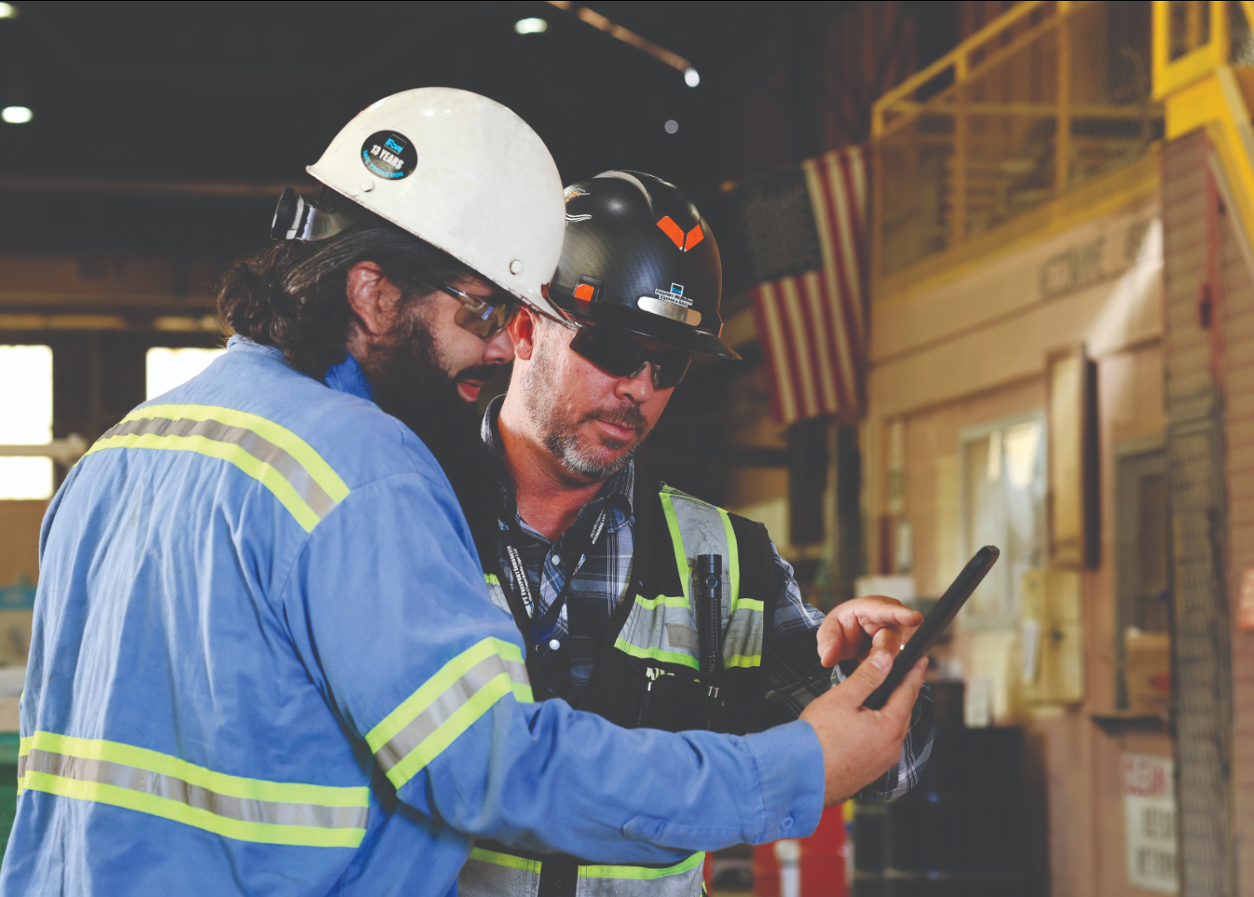
Safety Shares

Slide 7
Embedding Safety Into Production
At Freeport, we are committed to safely managing fatal risks every time we perform work.
Reliably managing fatal risks means verifying critical controls are in place, effective and understood before work begins.
By taking time to confirm those controls, we protect ourselves, our coworkers and our families.
Every employee and contractor has a role in creating a workplace where nothing is more important than safety.
If we cannot reliably manage a fatal risk, do not proceed with the work. Safety is a condition of production, not a tradeoff.
Take Action
Stop work if a critical control is missing, ineffective or cannot be verified.
Take the appropriate time needed to identify and address hazards before starting work.
Speak up when production pressures begin to influence safety decisions.
Escalate issues when resources, equipment, or conditions do not allow work to be completed safely.
Discuss
Have you ever felt pressure to continue work when conditions were not right? If so, what should you do?
What fatal risks are present in today's work? How will we verify critical controls are in place before we begin?
If a critical control failed or could not be verified today, would we be prepared to stop work? What challenges might make that difficult?
How can we support one another in speaking up and stopping work when a fatal risk is not being effectively managed?

Slide 8
Take Care of What Helps Us Work Safely
Safety goes beyond protecting lives – it encompasses everything that enables us to work with excellence. Each tool and piece of equipment represents an investment by the company and a commitment from all of us.
Misuse or damage of equipment can create risks for personal and collective safety. Responsible care shows respect for our work, our work areas and our coworkers.
Discussion
What can we do today to better protect the equipment and resources our team relies on?
What is one equipment issue we might be tempted to overlook, and what could happen if we do?
What habits do you use to protect your own tools, vehicle or belongings that could also help protect company equipment?
What You Can Do:
Responsible Use – Use equipment only for work purposes and avoid improper use.
Report Incidents – In the event of loss, damage or theft, immediately inform your supervisor and the support area.
Preventive Maintenance – Perform pre-operational checks and follow procedures according to the established maintenance schedule.
Respect for Facilities – Do not manipulate systems without authorization and avoid actions that could cause failures.

Slide 9
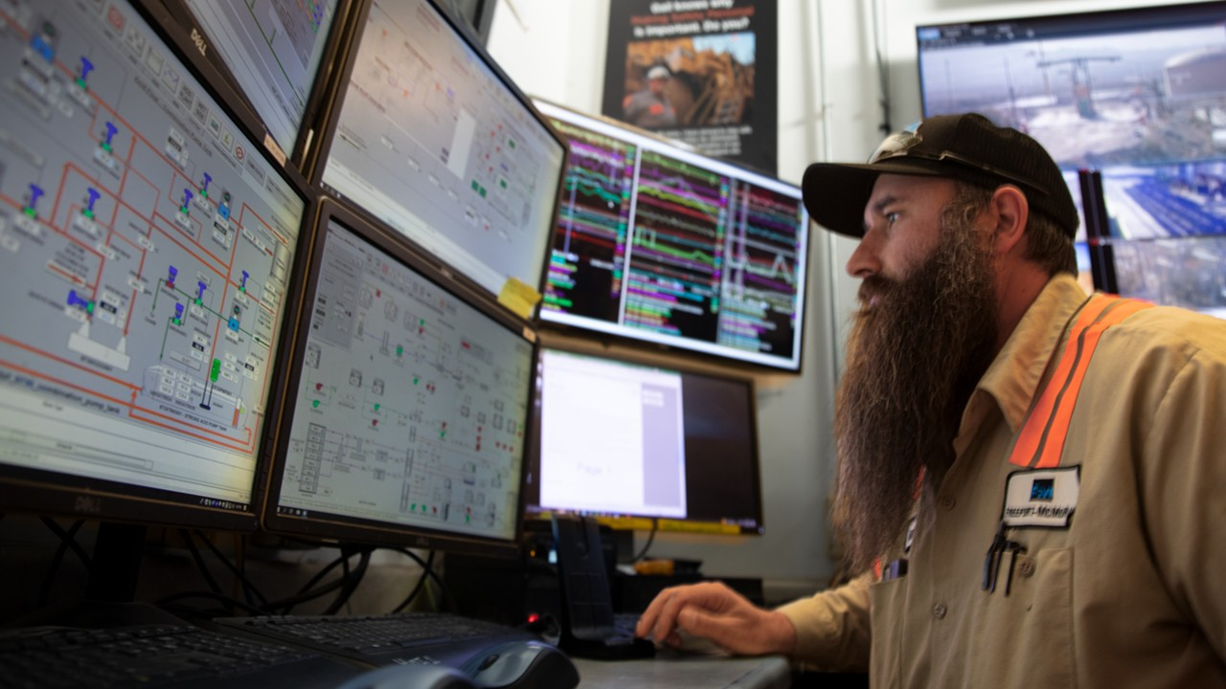
Policy/Process Updates & Reminders

Slide 10
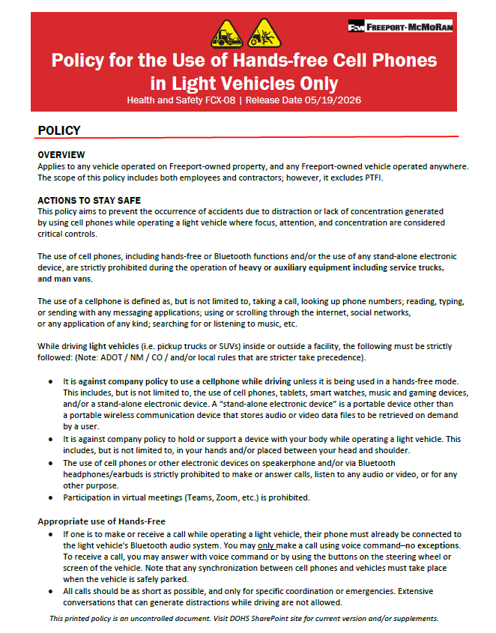
FCX-08 Policy for the Use of Hands-free Cell Phones
To help reduce vehicle and distracted driving risks, an updated FCX-08 Use of Hands-free Cell Phones in Light Vehicles Only policy goes into effect October 1, 2026.
Updates include:
The new policy supersedes all existing cell phone policies
Clear expectations and stronger controls for cell phone use while operating vehicles and equipment
Reinforced driver attention
A focus on critical safety controls and alignment with industry best practices for reducing risks related to cell phone use
Reach out to your PM or go to H&S policies on the Public Portal for the full policy.

Slide 11
FCX-08 Policy for the Use of Hands-free Cell Phones
Henderson Underground HME Variance (10/1/2026 - 9/30/2027)
Why Was the Variance Approved?
Underground equipment cannot receive FM/AM or satellite radio. Audio content supports fatigue management during 10-12 hour shifts while maintaining risk controls equivalent to surface operations.
What is Allowed
What Remains Prohibited
In-cab mounted Bluetooth speakers with downloaded/offline audio content in HME
Secured/mounted portable Bluetooth speakers
allowed until permanent units are installed
Can only interact with phone/device when
HME is safely stopped and parking brake applied
• Calls, texting, apps, internet access and virtual
meetings while operating heavy mobile equipment
• Any device use other than audio playback while operating equipment
Key Message: The variance allows audio playback for fatigue management in underground heavy mobile equipment but distracted-driving controls stay in place. Equipment operators may not use devices for texting, internet access, meetings or to change audio while operating equipment.

Slide 12

Hot Work Permit Updates
To maintain consistency between the EWS digital hot work permit and the paper permit, several updates have been made to the digital form. These changes are intended to improve alignment, reinforce critical controls and help ensure key information is consistently captured.
Updates include:
Addition of a reminder to evaluate and use cold work alternatives before initiating hot work.
Clarification that hot work permits are valid for one shift only and must be reissued if work is delayed by 90 minutes or more.
Inclusion of floor/location information on the permit.
Documentation of whether a fire watch has been assigned.
Verification that the work area has been inspected before work begins.
Addition of an Emergency Contact field.
Inclusion of air testing requirements for work near flammable liquids and gases, including oxygen and LEL readings.
Addition of work suspension criteria when oxygen levels exceed 23% or LEL reaches 10%.

Slide 13
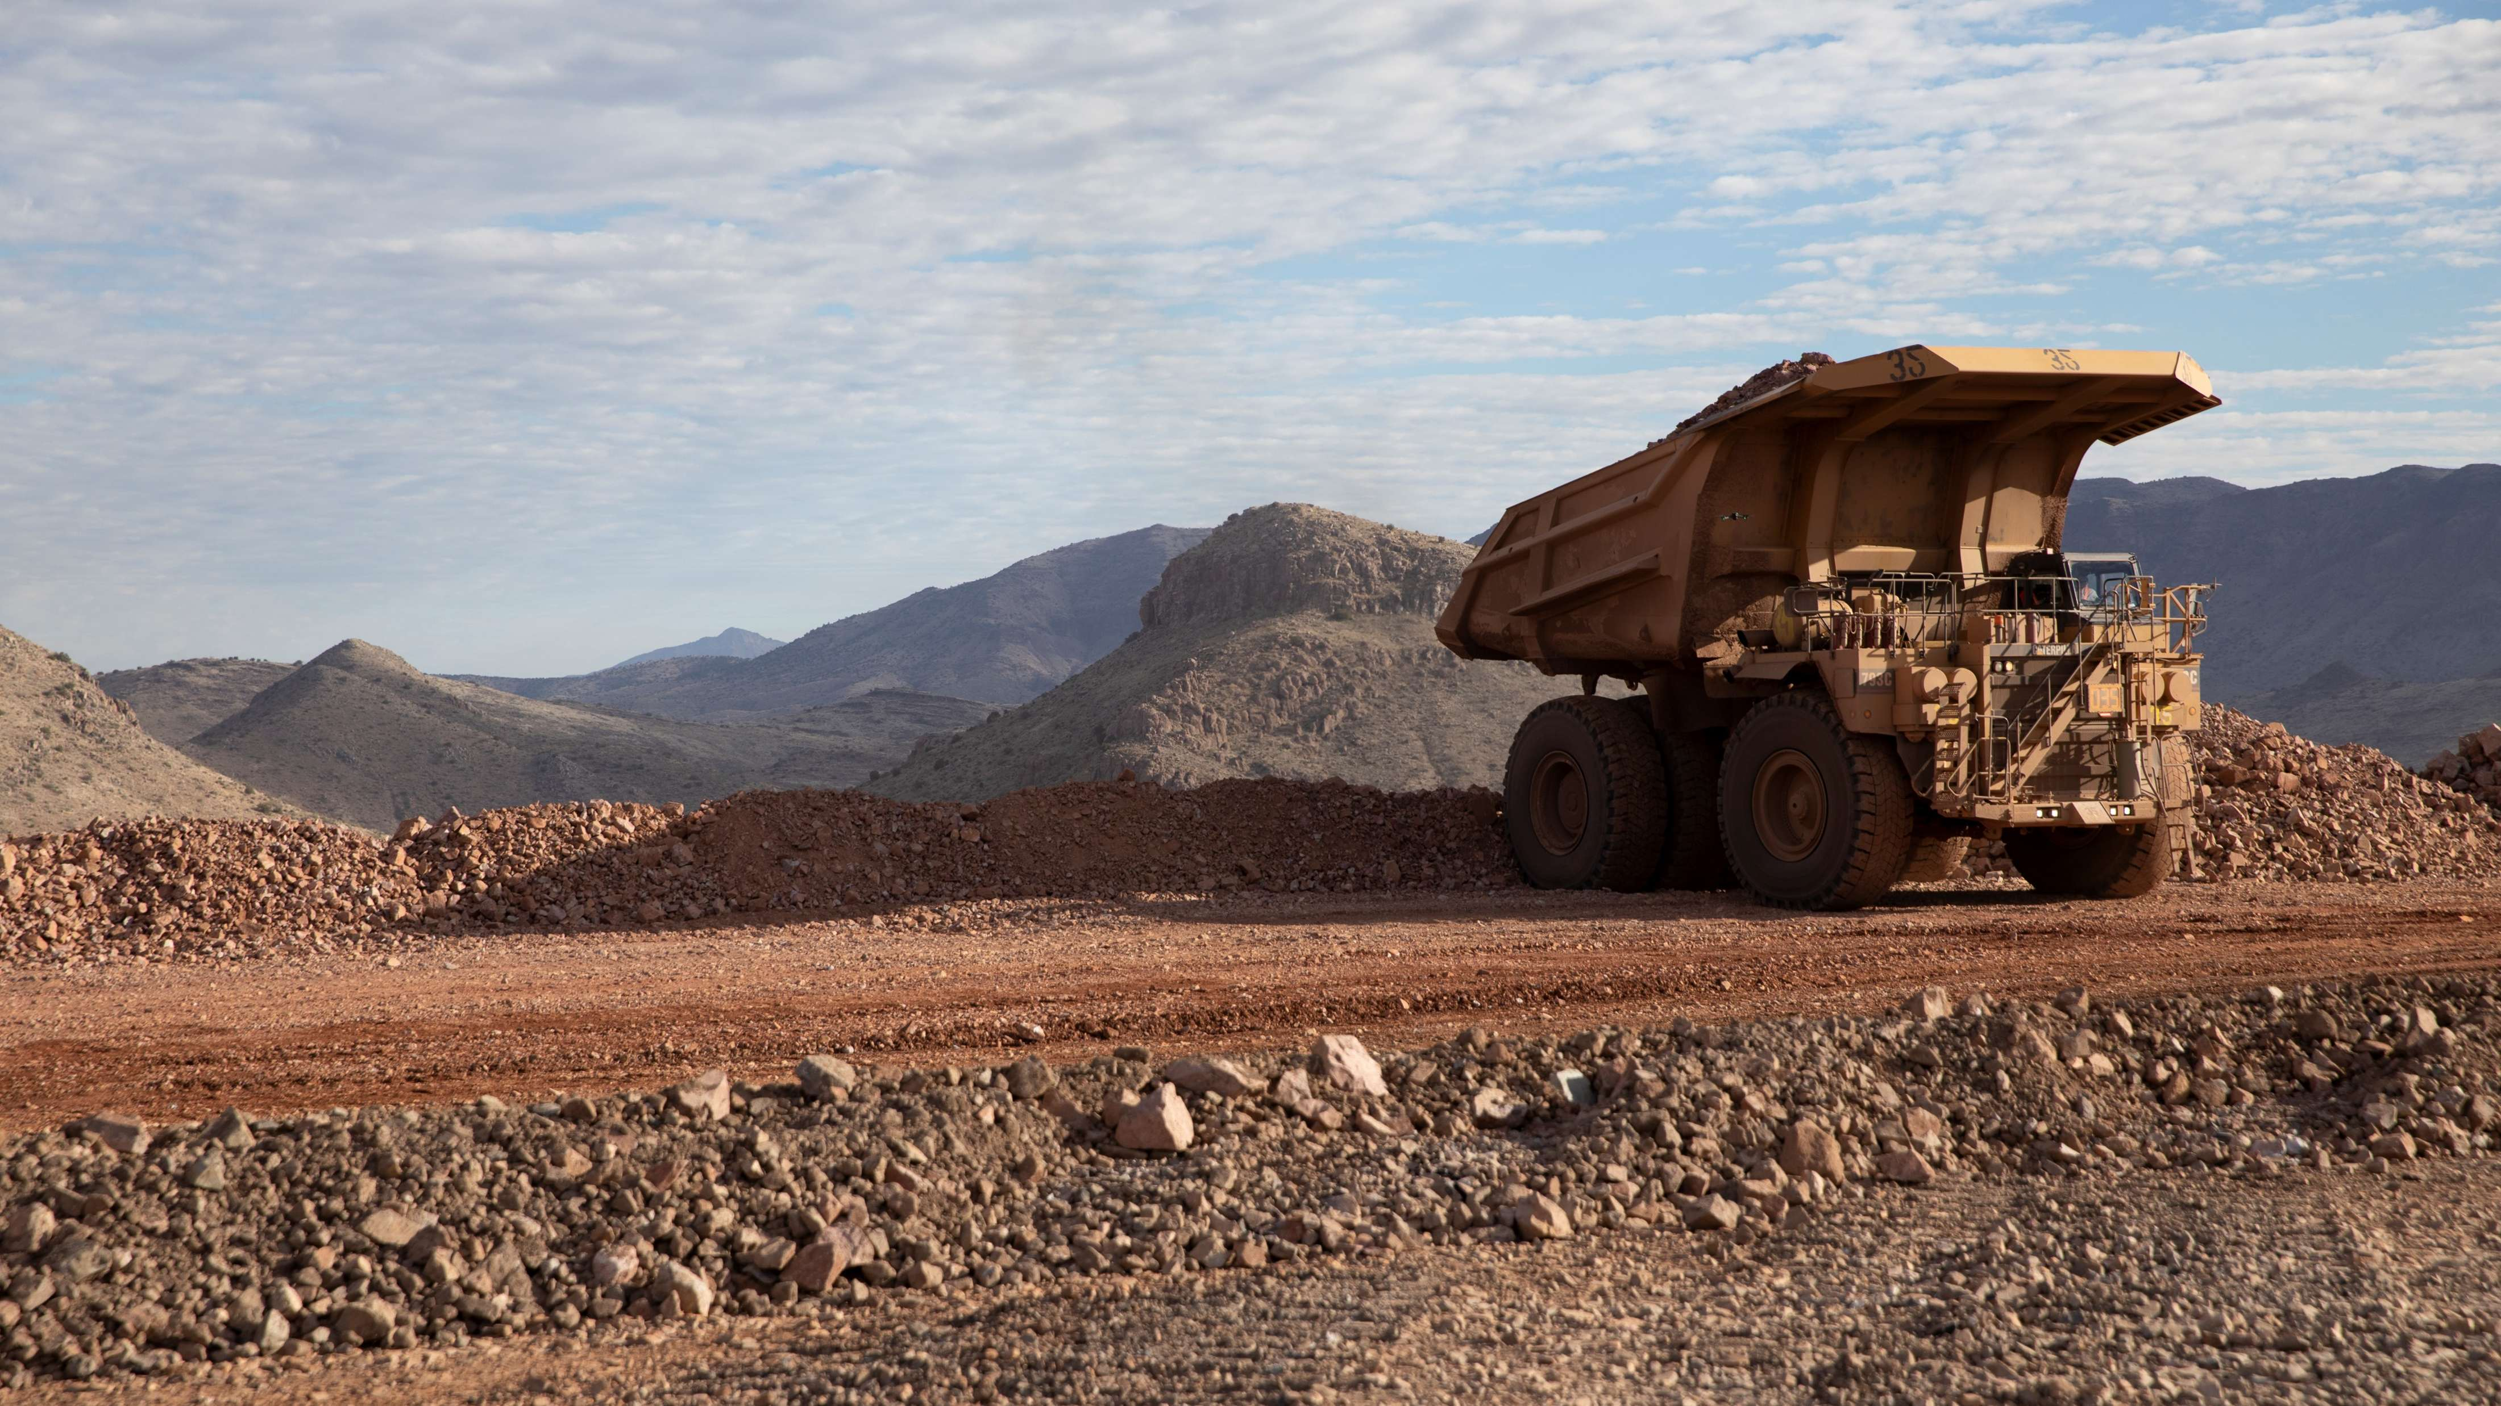
High-risk Incidents
Actionable and PFEs

Slide 14

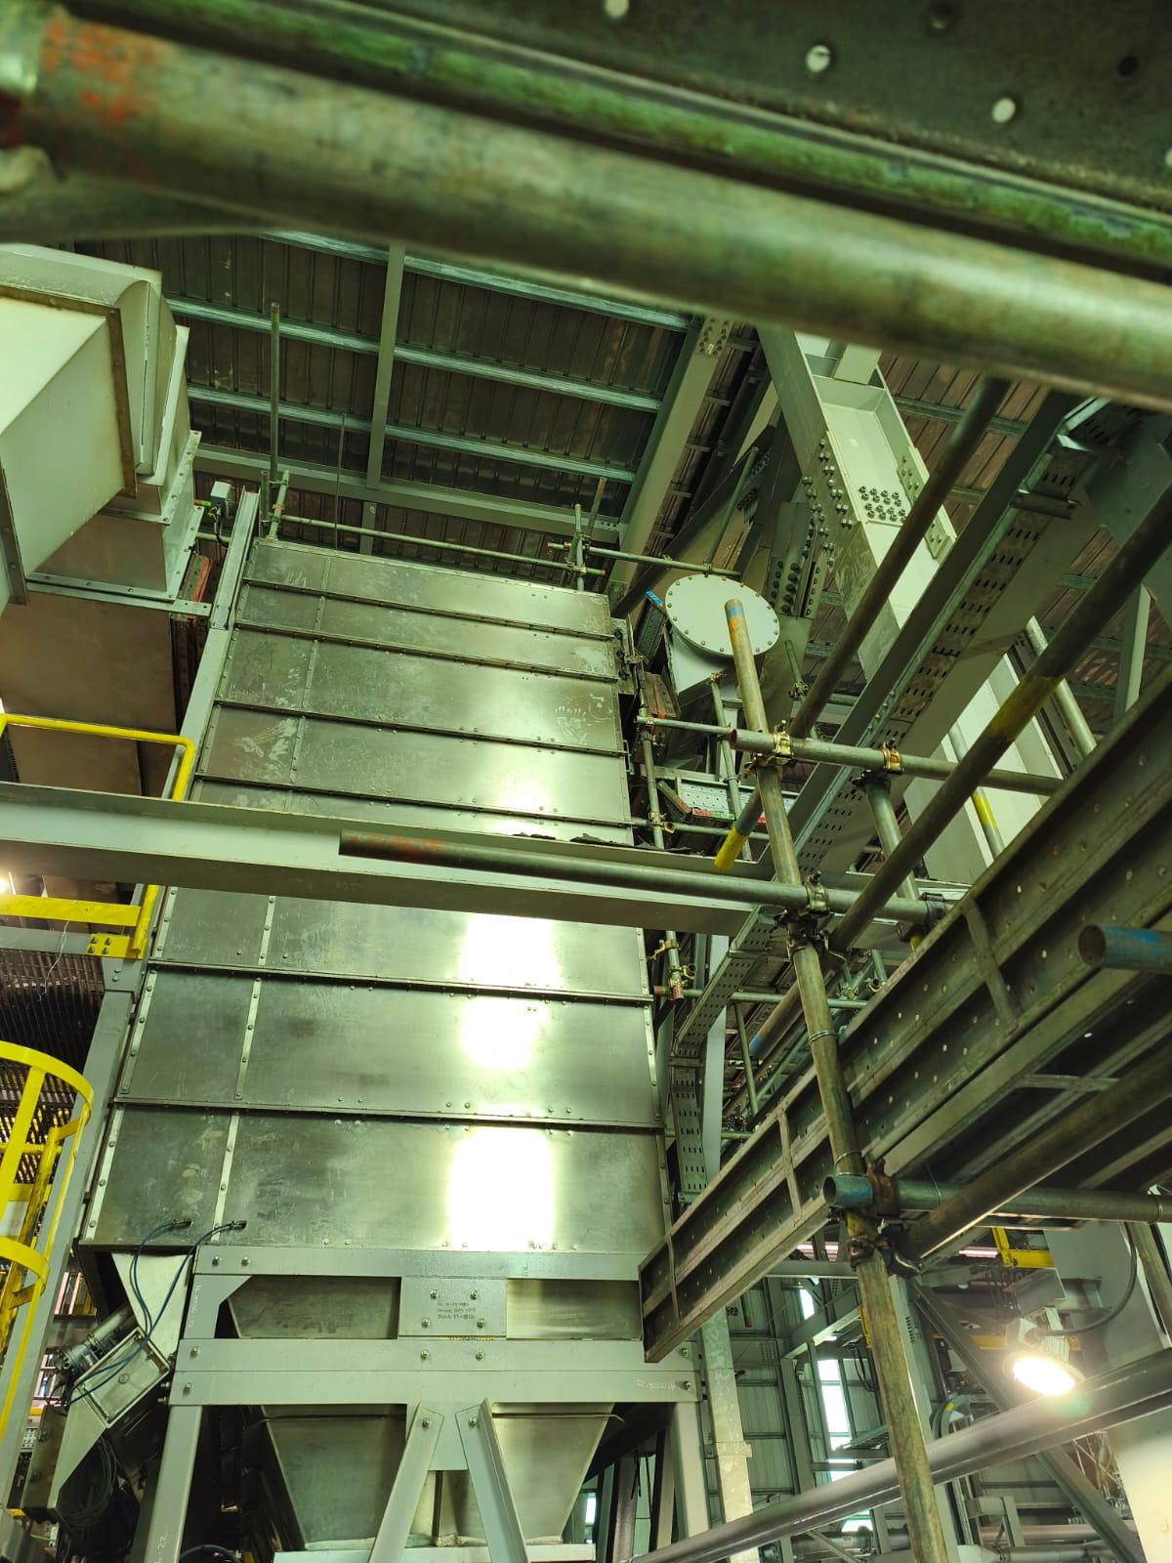
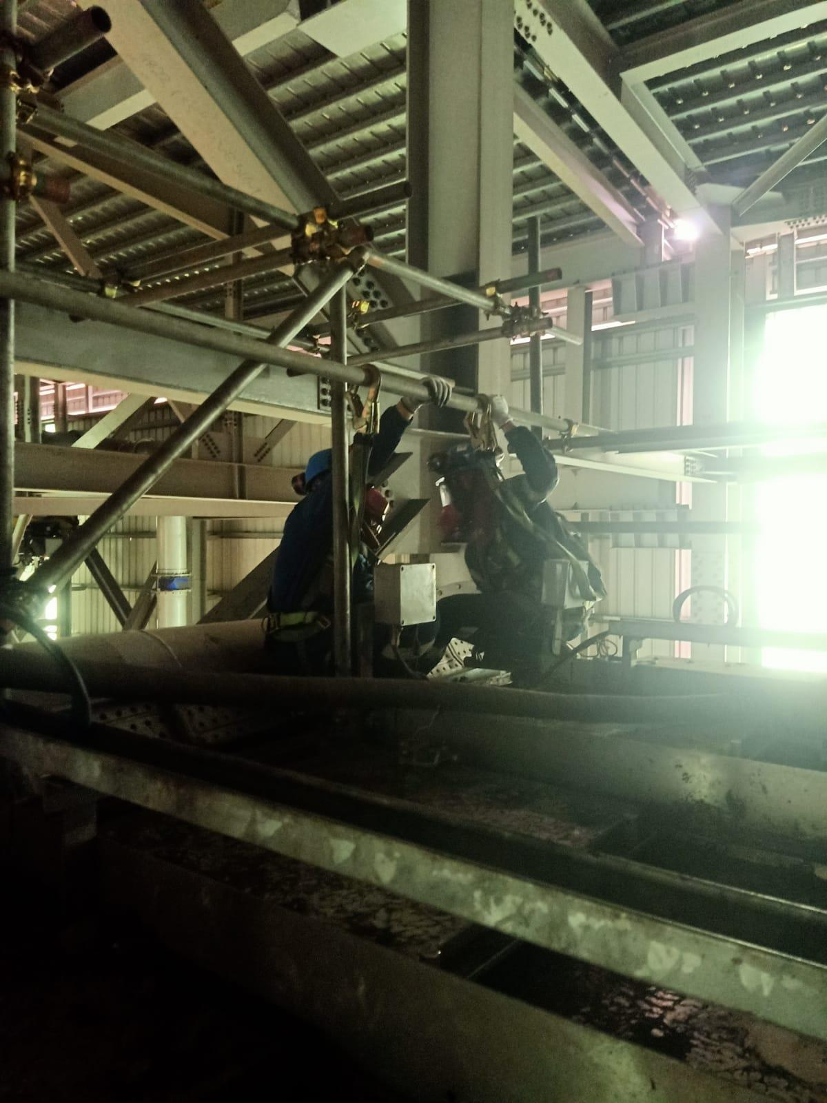
Exposure to Low Oxygen Environment
Exposure to
Hazardous Substances
PFE # 2026-12 Event ID # 20038975
Preliminary Incident Details
Operation | Manyar Smelting & Refining
Date / Time | August 15, 2026 / 10:12 a.m.
Event Type | Injury - Medical Treatment
Summary | While repairing a damper handle on the 8th floor flash smelting furnace flue dust bin silo filter, a contractor was exposed to an oxygen-deficient environment, collapsed and briefly lost consciousness. The exposure occurred when an interlock tied to the bin temperature sensor activated a nitrogen purge, which was released through an opening in the expansion joint near the work area.
Risk Category | Actionable – Significant (3) Likely (3)
Findings / Missing Controls | The nitrogen purge from the flash converting furnace (FCF) side of the baghouse system was not initially considered part of the energy control lock-out required for the task. Workers in the area were not expected to wear personal gas monitors. The nitrogen line from FCF surge bin was not isolated and depressurized before the work began.
Immediate Action(s) | Verify process engineer reviews and approvals of all energy controls, especially on systems involving nitrogen, oxygen, natural gas or cooling water.
Applicable Policies / Procedures | FCX-HS04 Control of Hazardous Energy Policy FCX-HS17 Hazardous Gas Policy
Employee Condition | Emergency responders gave oxygen to the affected worker, who was taken to the on-site clinic for evaluation and released.
Contact | Karel Pramono, Manager-Hot Metal Operations Setianus, Manager-Health and Safety
View of incident location and expansion join being dismantled.
Re-enactment showing positioning of the contractors above the expansion joint at the time of nitrogen

Slide 15
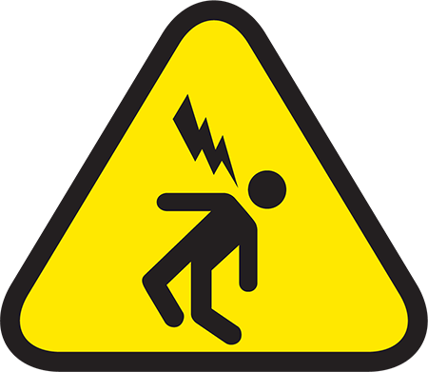
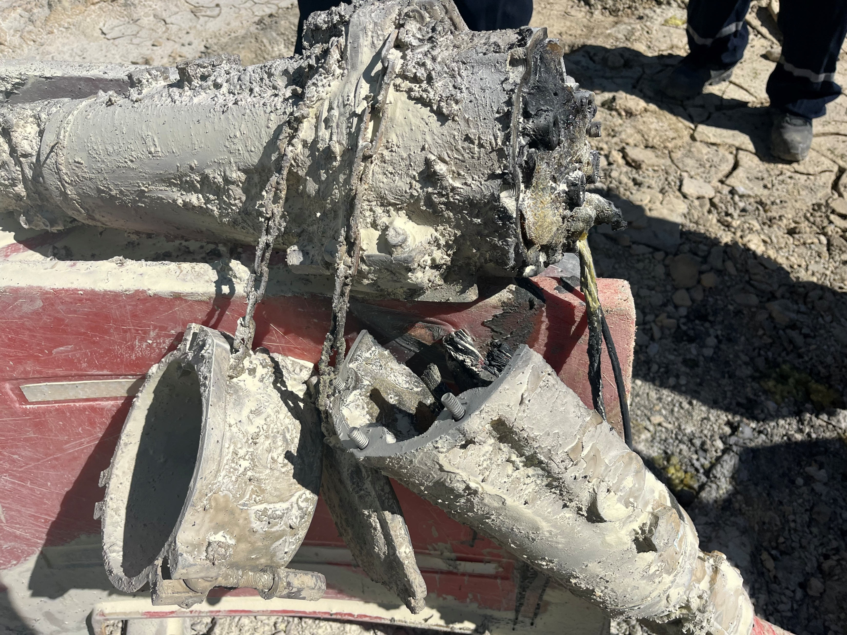
Shovel Pothead Fire
Exposure to Electrical Hazards
ID # 2026-21 Event ID # 20039283
Preliminary Incident Details
Operation | Chino
Date / Time | August 26, 2026 / 9:55 a.m.
Event Type | Property Damage
Summary | A crew was assigned to move a shovel cable so the haul road could be repositioned near the drill site. During the initial pull, the shovel lost power shortly after movement began. The crew continued handling the cable using cable-handling tools, treating it as an energized cable. After the pothead was repositioned on the stand, the crew moved approximately 124 feet away. After 10 minutes, they heard a loud pop and observed the pothead on fire.
Risk Category | Actionable – Significant (3) Likely (3)
Findings / Missing Controls | Electrical personnel determined the cable had burned open near the 755 cable/pothead connection. Although the shovel lost power, a portion from the switch to the failed connection remained energized – causing the circuit to trip from instantaneous overcurrent. Mud/moisture found in the pothead points to a possible crack.
Immediate Action(s) | Verify cable handling practices align to HEO FCX1112C Basic Cable Handling for Open Pit Mine Operation Non-Electrician Personnel . De-energize the shovel before handling an unprotected pothead, following the approved interim process, and continue treating the cable and pothead as energized.
Applicable Policies / Procedures | New Mexico Operations Power Cable Handling
Employee Condition | No injuries.
Contact | Jim Cook, Manager-Health and Safety
Pothead following fire

Slide 16
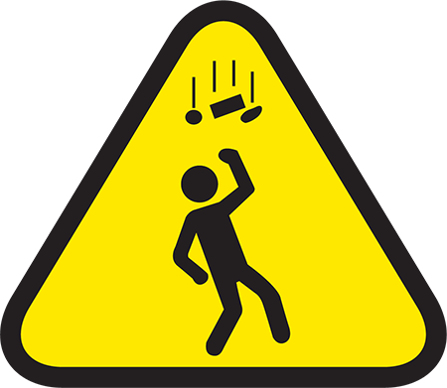
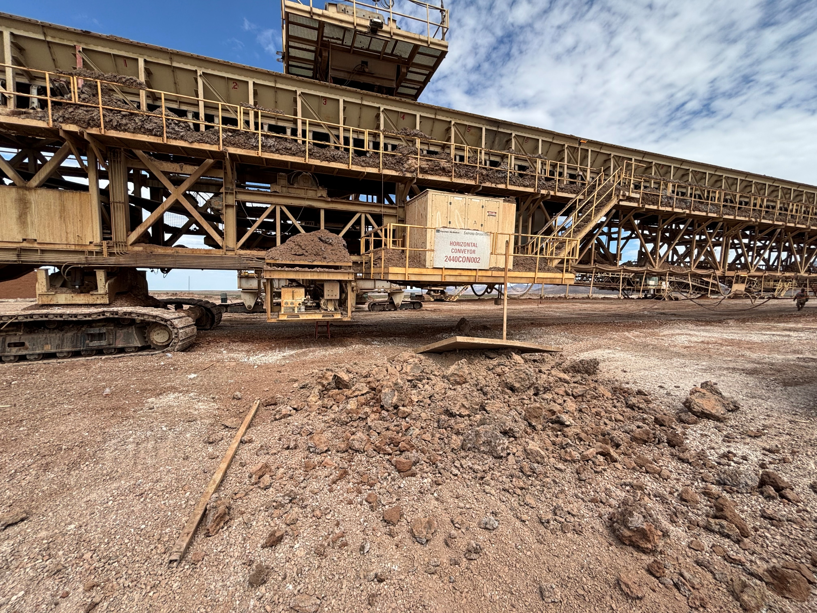
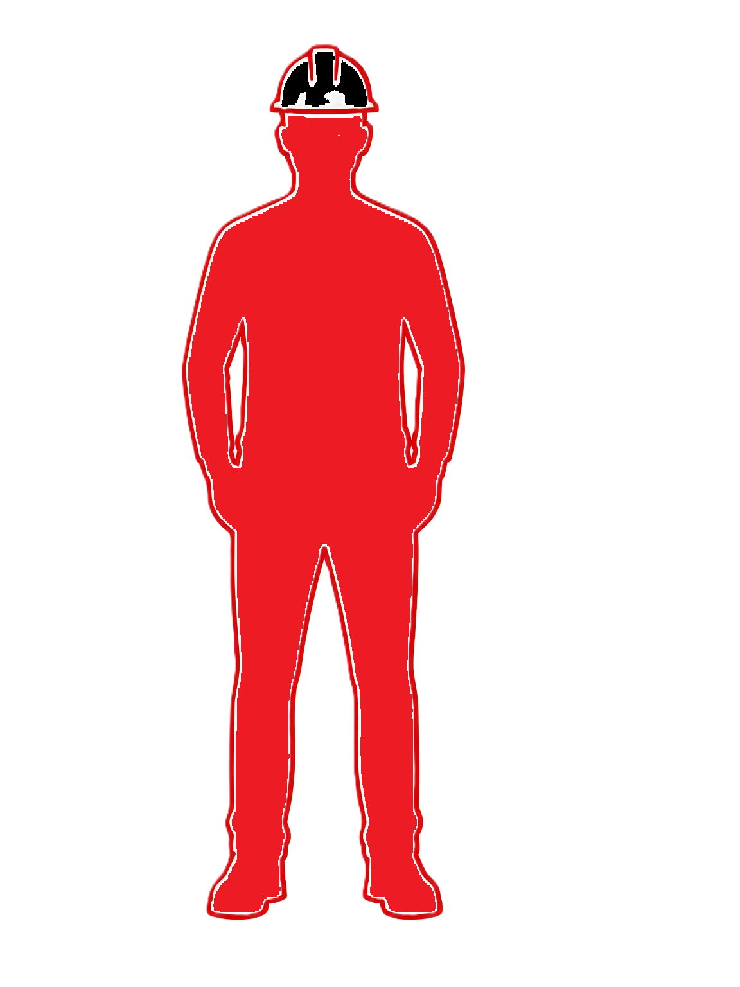
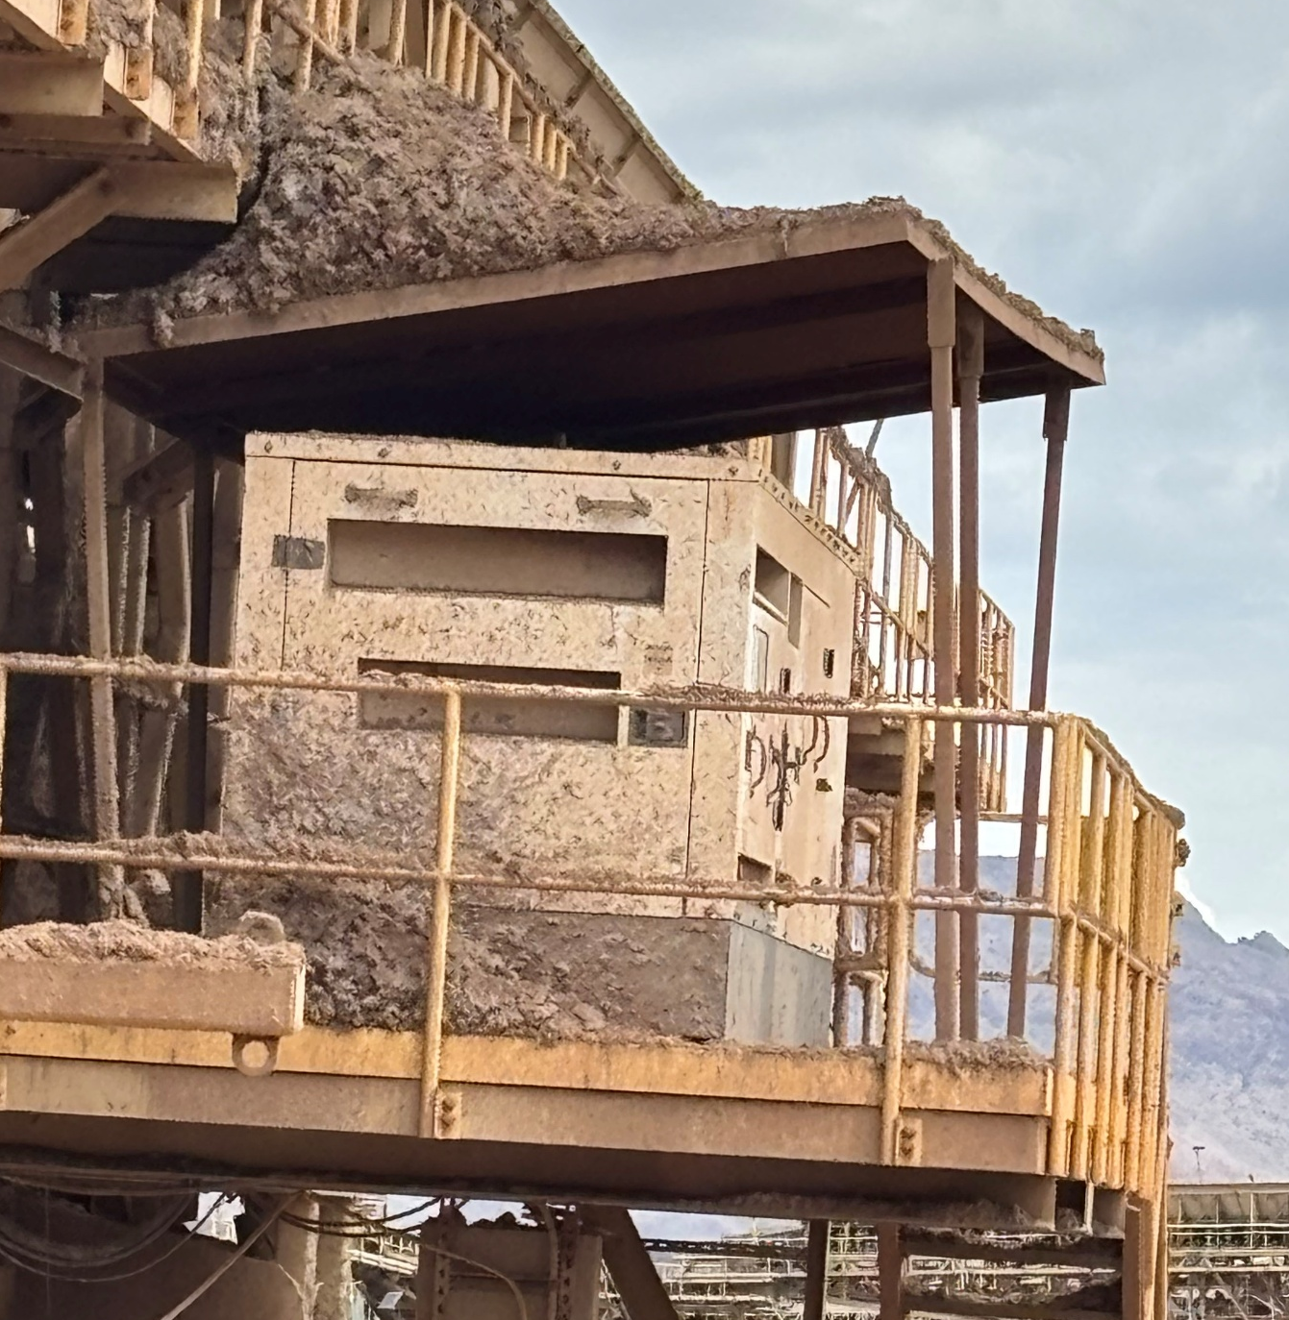
Fallen Objects from Conveyor Structure
ID # 2026-22 Event ID # 20039525
Falling Objects
Preliminary Incident Details
Operation | Safford
Date / Time | September 3, 2026 / 11:00 AM
Event Type | Near Miss
Summary | A maintenance employee was inspecting the leveling cylinders on a horizontal conveyor when a transformer canopy with material buildup on the roof unexpectedly fell from the conveyor structure. The employee was working approximately 15 feet away at the time.
Risk Category | Actionable – Significant (3) Likely (3)
Findings / Missing Controls | Significant material buildup had accumulated on elevated structures. The canopy support was unable to withstand the load. Employees were working in proximity to overhead structures with material accumulation. Potential falling object hazards were not fully recognized or controlled prior to the inspection activity.
Immediate Action(s) | Inspect conveyor and elevated structures for material buildup. Verify housekeeping and cleanup plans prevent excessive accumulation. Confirm buildup hazards are identified, prioritized and corrected before personnel work beneath affected structures. Evaluate structural components (roofs, covers canopies, platforms) for signs of damage or overloading. Include structures in preventive maintenance process. Review falling object hazards during pre-task risk assessments and workplace examinations. Reinforce exclusion zone requirements where overhead hazards exist.
Applicable Policies / Procedures | FCX-HS19 Flagging and Barricading Policy.pdf
Employee Condition | No injuries.
Contact | Shannon Jeans, Manager-Health and Safety
Fallen transformer canopy and material and location of employee
Photo of other side of conveyor to show what canopy looks like in place

Slide 17
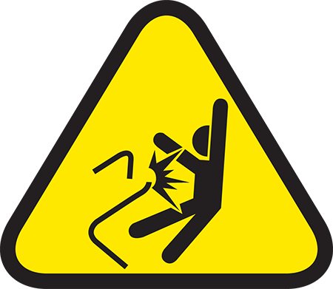
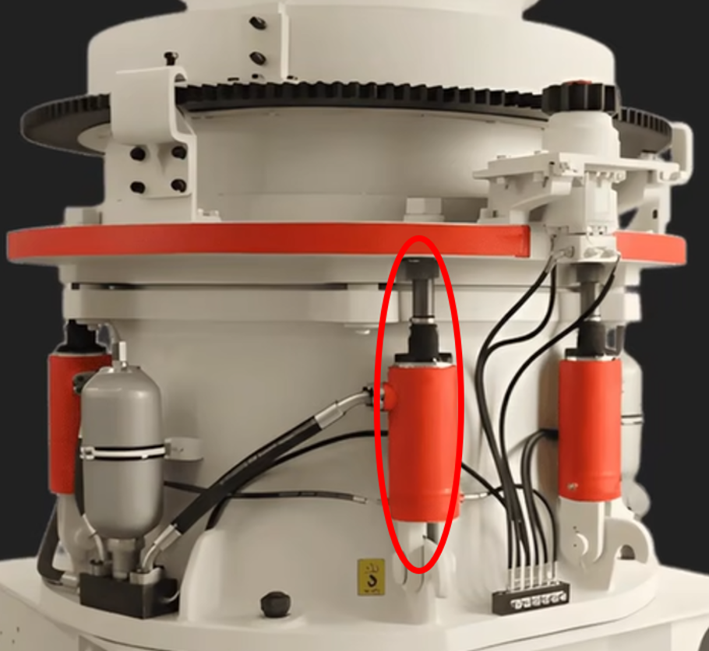
Impact Gun Struck Employee
Uncontrolled Release of Energy
ID # 2026-14 Event ID # 20039739
Preliminary Incident Details
Operation | Morenci
Date / Time | September 14, 2026 / 1 a.m.
Event Type | Injury – Medical Treatment
Summary | Four contractors and two Freeport employees were dismantling a shorthead in the Secondary Crusher and replacing the seat liners, which required removing nuts from the tramp cylinders. When using an impact gun to remove a difficult cylinder nut, the nut seized in the threads and backed the cylinder shaft out with it. Stored pressure behind the cylinder shaft caused it to eject upward with the impact gun, which struck an employee in the chest and face. The force also broke the air hose from its fitting, causing it to whip. Team members secured the hose, shut off the air and began assisting the employee.
Risk Category | Actionable – Significant (3) Likely (3)
Findings / Missing Controls | Part of the system was still energized. Lockout and depressurization of the system was not properly conducted.
Immediate Action(s) | Before beginning maintenance, isolate equipment and release stored pressure from hydraulic systems and accumulators. Verify zero energy before work begins.
Applicable Policies / Procedures | FCX-HS04 Control of Hazardous Energy Policy
Employee Condition | The employee sustained a laceration to the right cheek requiring multiple stiches and was released after medical examination.
Contact | Corina Rodriguez, Manager-Health and Safety
Seized nut
Cylinder shaft
Pressurized nitrogen tank
Example of shorthead including the pressurized nitrogen tank, cylinder shaft and location of seized nut

Slide 18
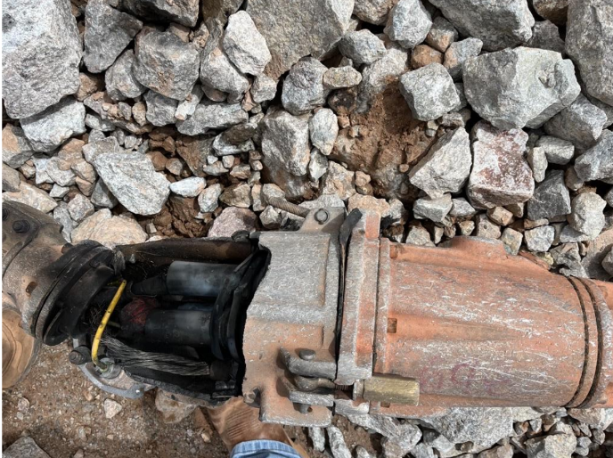
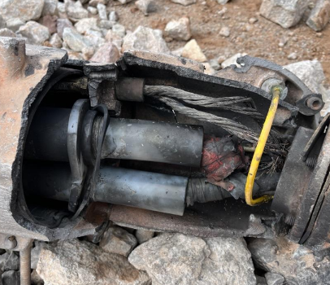
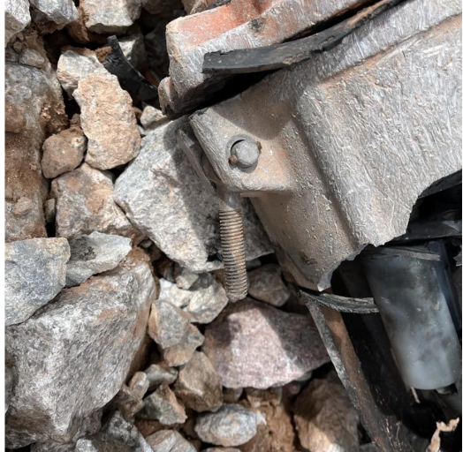
Shovel Cable Pothead Blew
Uncontrolled Release of Energy
ID # 2026-23 Event ID # 20039773
Preliminary Incident Details
Operation | Morenci
Date / Time | September 15, 2026 / 10 a.m.
Event Type | Property Damage
Summary | A maintenance supervisor and shovel mechanics were working at the 44 shovel when an explosion was heard. One mechanic observed smoke behind a berm. The supervisor drove to the berm area and found a cable pothead had exploded. The nearest employee was more than 300 feet away at the time of the event.
Risk Category | Actionable – Significant (3) Likely (3)
Findings / Missing Controls | After the power source was locked out, electricians picked up the pothead for inspection and water began to drain out of both potheads. The potheads were not on pothead stands at the time of the event. There was a brass nut missing on one of the toggle bolts, which left a gap in the two potheads.
Immediate Action(s) | Reinforce existing cable-handling policies and procedures. De-energize shovels before handling or repositioning a pothead that is not protected within a rabbit box. Lift exposed potheads from the ground when repositioning rather than dragging.
Applicable Policies / Procedures | HEO FCX1112C Basic Cable Handling for Open Pit Mine Operation Non-Electrician Personnel
Employee Condition | No injuries.
Contact | Tony Lujan, Senior Supervisor-Health and Safety
Condition of pothead following the incident.
Toggle bolt that was missing a brass nut, creating a gap between the potheads.

Slide 19
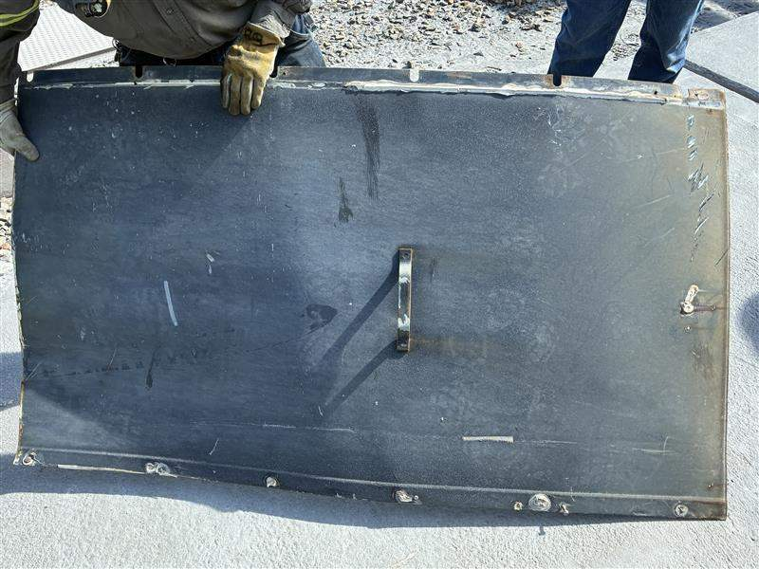
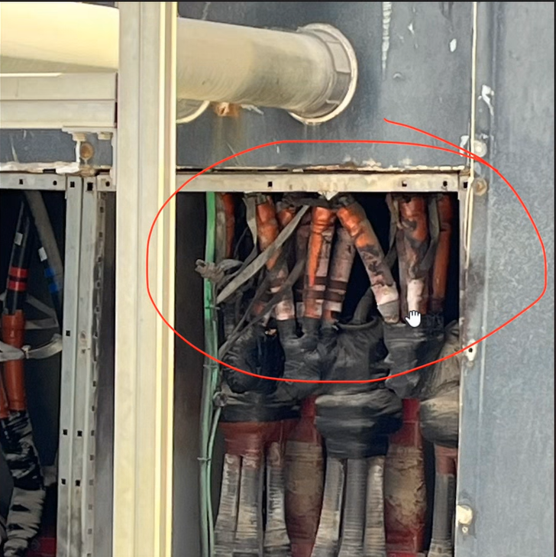
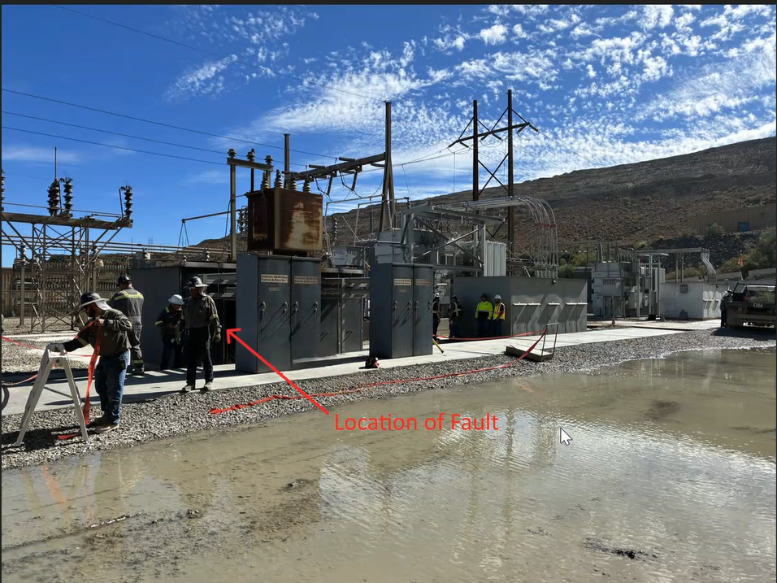
Feeder Cable Arc Flash
Exposure to Electrical Hazards
ID # 2026-24 Event ID # 20039854
Preliminary Incident Details
Operation | Sierrita
Date / Time | September 17, 2026 / 12:49 p.m.
Event Type | Property Damage
Summary | A major failure occurred in a splice on a feeder cable connected to the mill main vault. The failure caused an arc flash that blew the cover door off and tripped a breaker on the transformer. There were electrical technicians in the area, but all were more than 100 feet away and in vehicles at the time of the incident.
Risk Category | Actionable – Significant (3) Likely (3)
Findings / Missing Controls | The arc flash was the result of water and condensation in the raceway. Conduits within the raceway are not sealed and therefore exposed to moisture. While preventive maintenance plans exist for other components, there is no designated maintenance plans for this raceway.
Immediate Action(s) | Audit areas to verify raceways are sealed. Incorporate preventive maintenance plans for raceway locations.
Applicable Policies / Procedures | FX-HS03 Electrical Safety Policy
Employee Condition | No injuries.
Contact | Alex Pfarr, Superintendent-Power Distribution Cara Forbregd, Manager-Health and Safety
Cover door that was blown off
Moisture within the cables/conduit
Location of fault

Slide 20
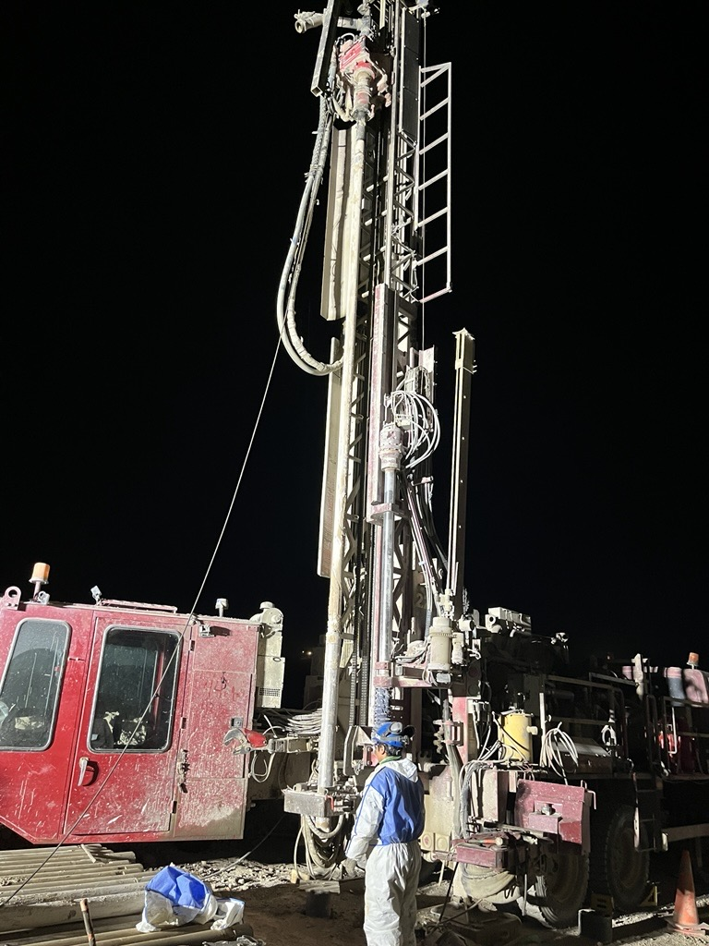
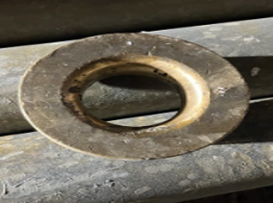
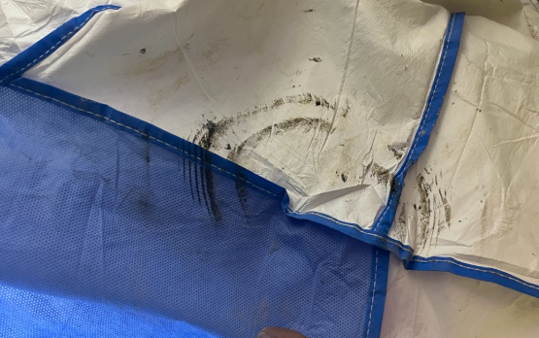
Employee Struck by Bronze Disc
PFE # 2026-15 Event ID # 20039879
Falling Objects
Preliminary Incident Details
Operation | Cerro Verde
Date / Time | September 18, 2026 / 1:50 a.m.
Event Type | Injury – Lost Time
Summary | With the drill rods stopped, a bronze disc used to protect the fiberglass cable fell from the "T" section of the drill head and struck the right shoulder of a drill assistant standing next to the equipment. The disc was approximately 14 centimeters. (5.5 inches) in diameter, weighed 2.7 kilograms (6 pounds) and fell from an approximate height of 9 meters (30 feet).
Risk Category | Actionable – Significant (3) Likely (3)
Findings / Missing Controls | The disc was not sufficiently secured to prevent it from coming loose. While all other components were fitted with safety cables, this specific disc was not because it’s typically removed at ground level. It was left in place while the crew was addressing a down-hole instrument failure. The disc did not have an additional securing system to provide protection in the event it became detached.
Immediate Action(s) | Verify similar conditions to identify similar components that could fall on other drill rigs.
Applicable Policies / Procedures | No applicable policies.
Employee Condition | Employee sustained a right shoulder contusion.
Contact | Helbert Felix Galdos Valdivia, Manager-Health and Safety David Vásquez, General Mine Manager
Bronze disc that fell.
Re-enactment of the incident. The bronze disc fell from the drill rotation head and struck the drill assistant on the right shoulder.
Mark left by the disc on the injured employee's disposable coverall.

Slide 21
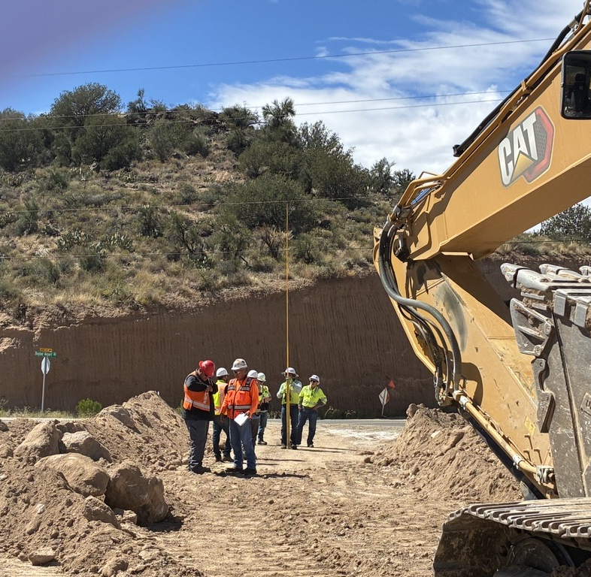
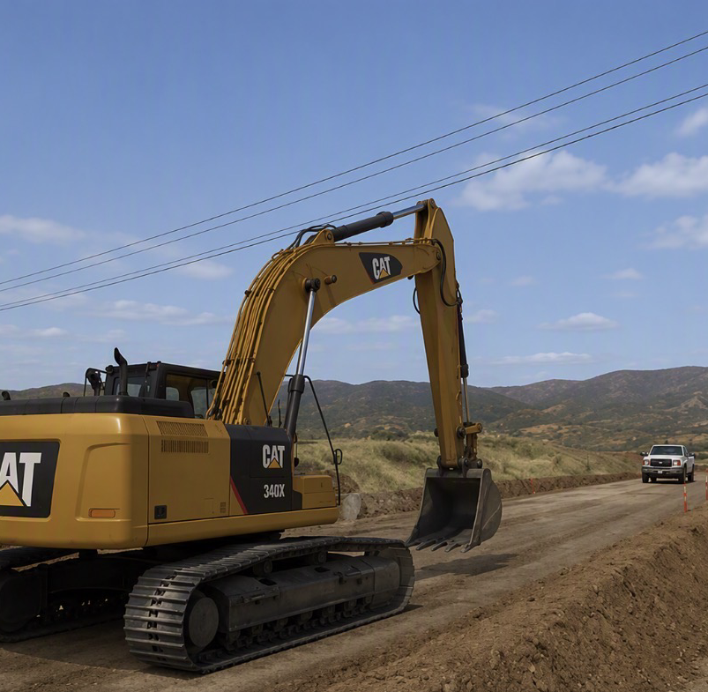
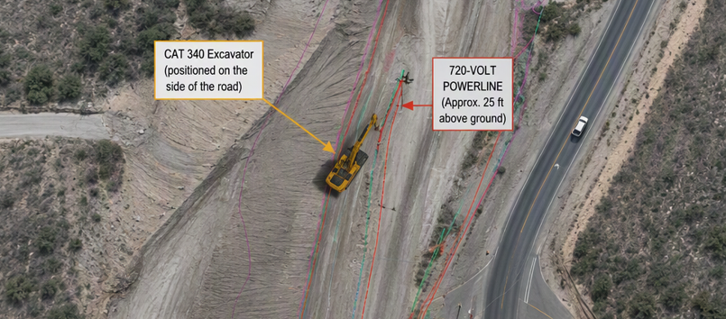
Excavator Contacted Energized Powerline
Exposure to Electrical Hazards
ID # 2026-25 Event ID # 20040004
Preliminary Incident Details
Operation | Bagdad
Date / Time | September 21, 2026 / 10:50 a.m.
Event Type | Property Damage
Summary | While performing berm enhancements as part of a road construction project, a CAT 340 excavator was backing up and contacted an energized 7200-volt overhead power line. The power line was approximately 25 feet above ground and was hit by the excavator boom. The contact resulted in damage to the power line and superficial damage halfway up the boom. The operator was working from within the fully enclosed cab and was unaware that contact with the power line had occurred.
Risk Category | Actionable – Significant (3) Likely (3)
Findings / Missing Controls | A job risk assessment (JRA) was completed prior to work that identified the need for spotters and the need to avoid working near overhead power lines. A lack of signage and clear markings around powerline.
Immediate Action(s) | Review overhead power line clearance requirements with equipment operators and spotters. Verify overhead hazards are identified and discussed during pre-task planning and JRA reviews. Use clear signage and clearly mark exclusion zones where equipment could encroach electrical hazards.
Applicable Policies / Procedures | FCX-HS03 Electrical Safety Policy
Employee Condition | No injuries.
Contact | Glenn Marte, Manager-Health and Safety Projects
Roadway where incident occurred
Simulation of road, equipment and work area
Incident diagram

Slide 22
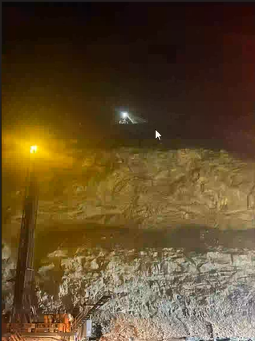
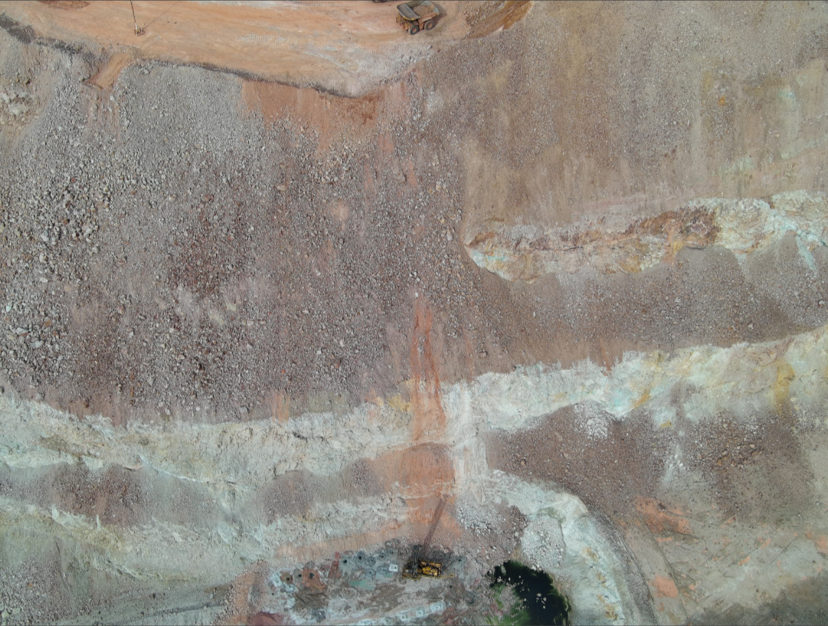
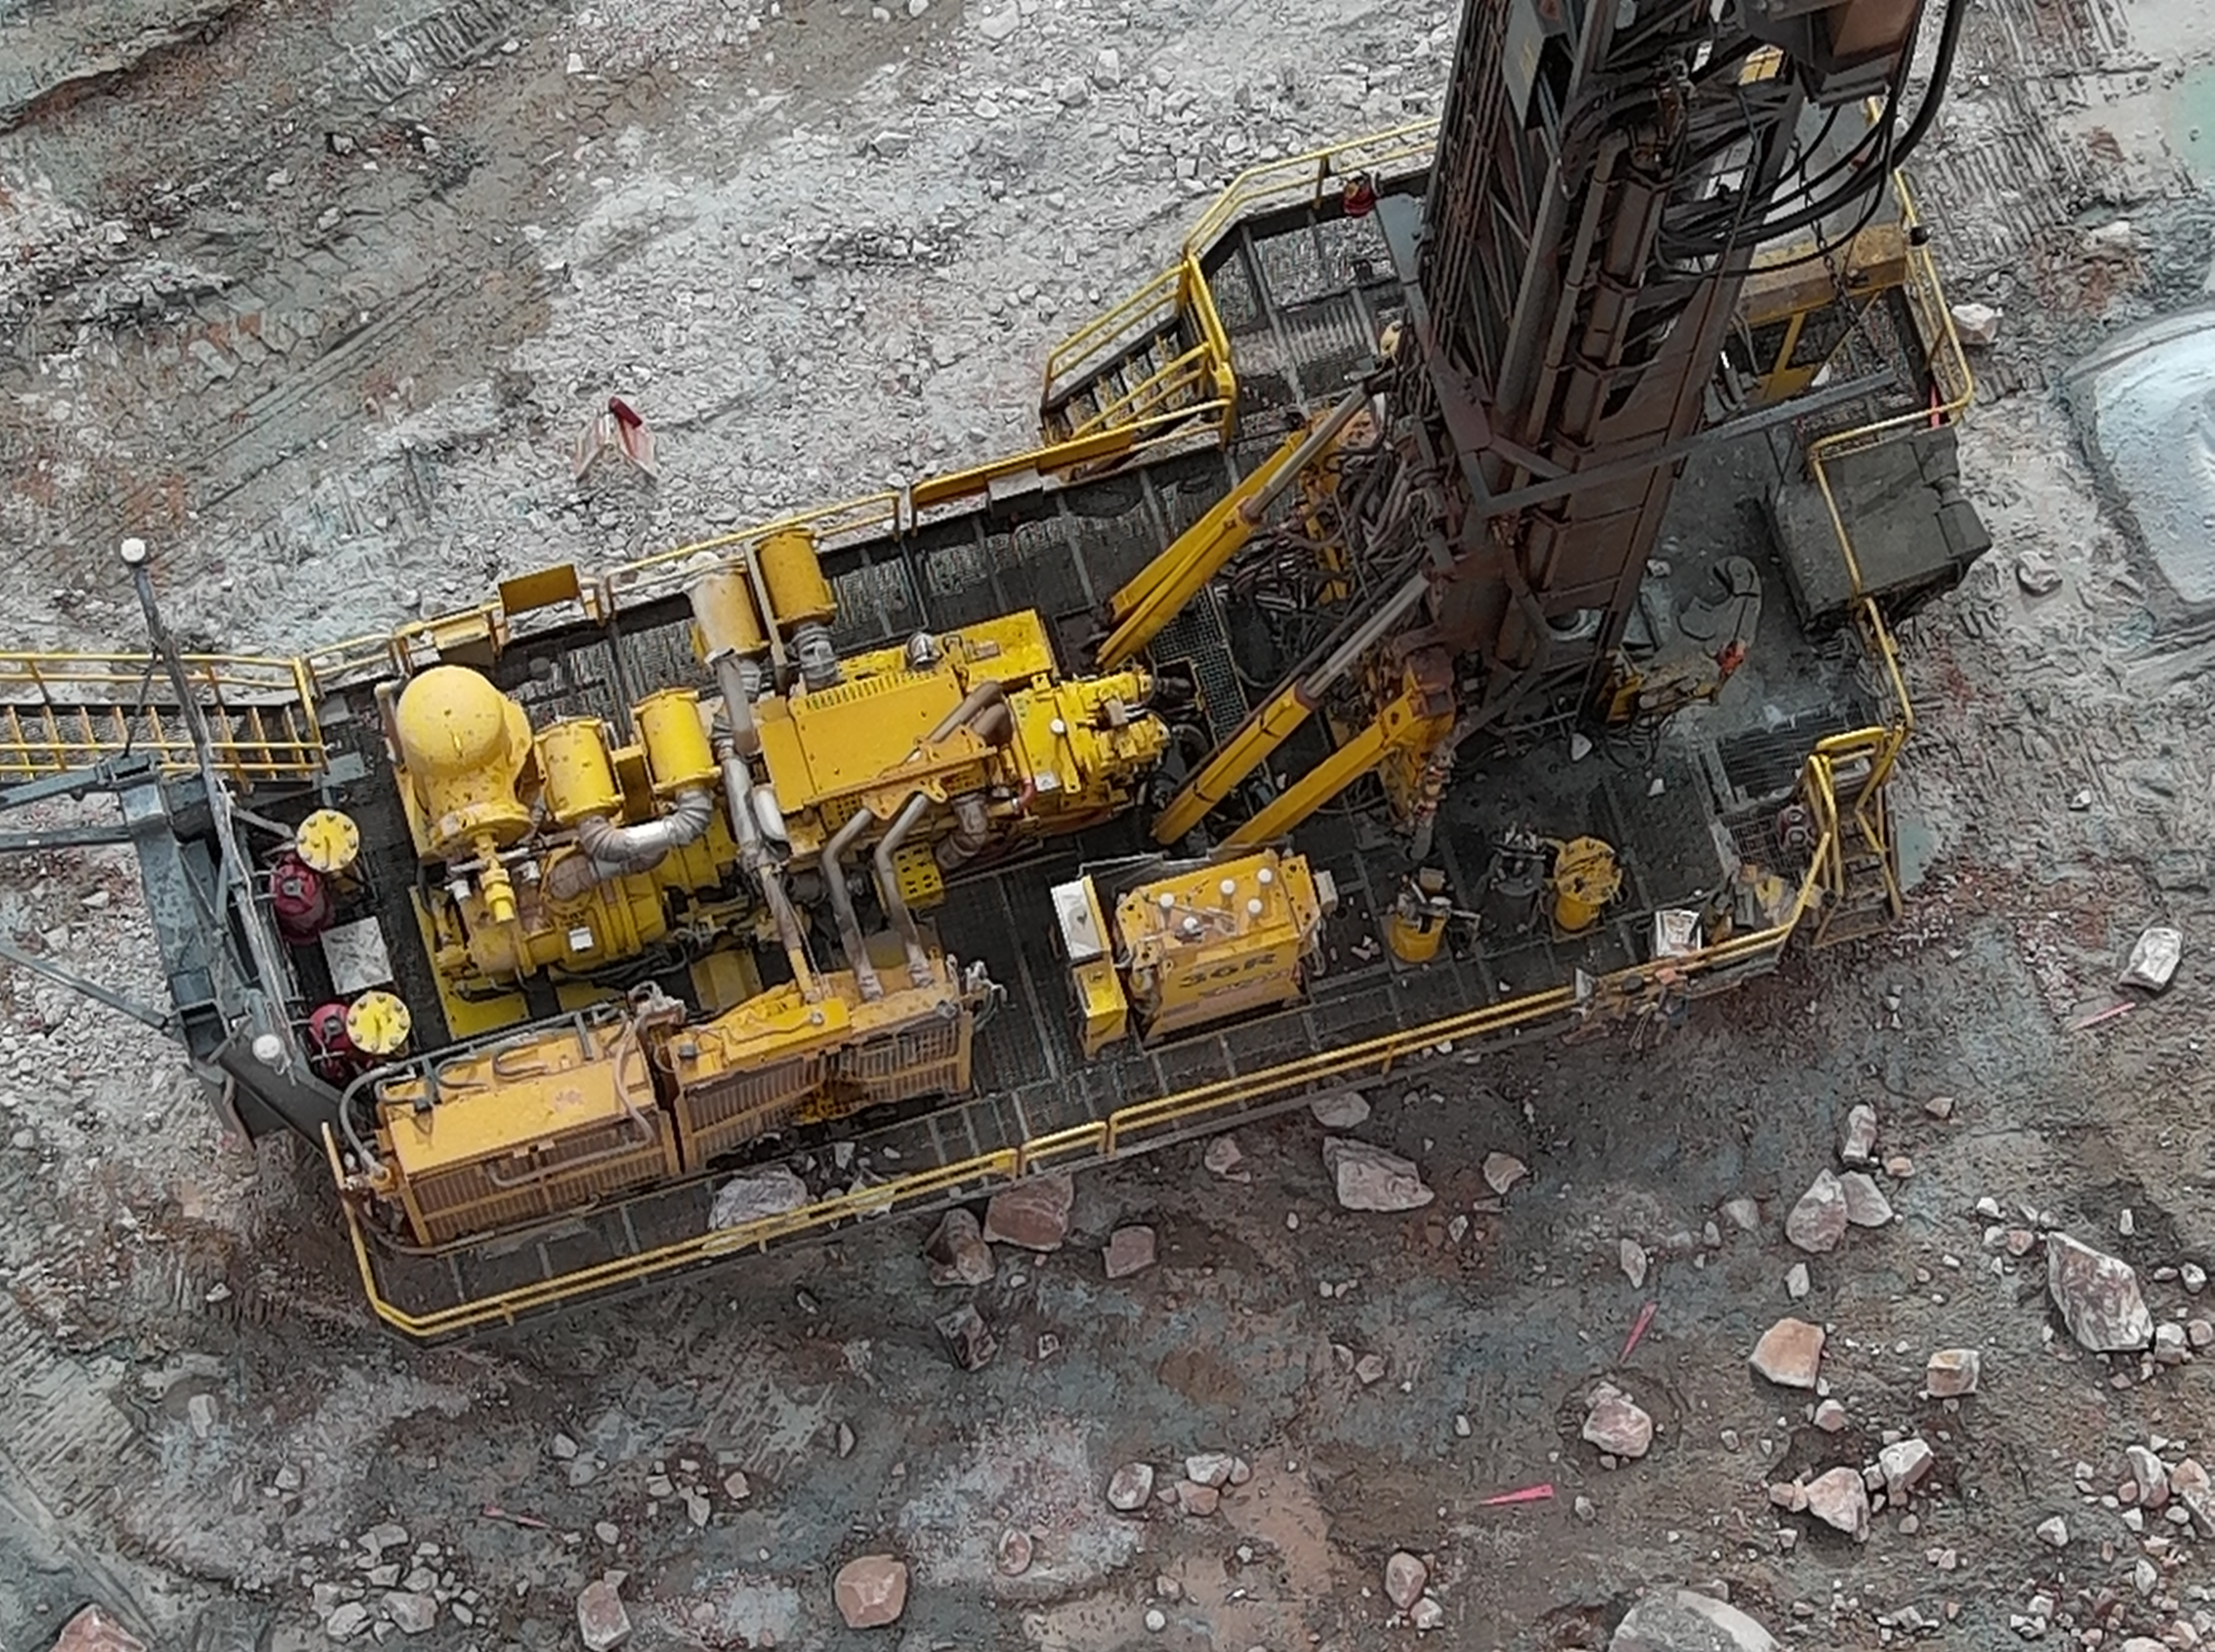
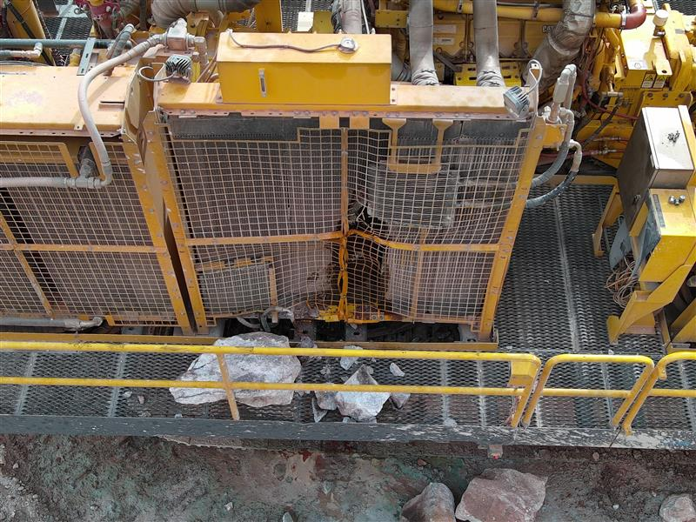
Drill Hit by Falling Rock
ID # 2026-26 Event ID # 20039993
Falling Objects
Preliminary Incident Details
Operation | Morenci
Date / Time | September 22, 2026 / 2:45 a.m.
Event Type | Property Damage
Summary | A drill rig was operating near the high-wall when rocks fell from above and struck the equipment, causing damage. At the time of the event, a shovel was performing outside edge work approximately 300 feet above the drill location. After breaking on impact, the largest rock was estimated to be 3 ft × 2 ft × 1.5 ft.
Risk Category | Actionable – Significant (3) Likely (3)
Findings / Missing Controls | No operations should have been conducted under active outside edge mining. Ineffective communication and coordination of mining activities.
Immediate Action(s) | Shovel operators –verify no personnel or equipment are positioned below active outside edge mining activities prior to commencing work. Area supervision – conduct field verifications to confirm work locations are free from hazards created by simultaneous operations.
Applicable Policies / Procedures | Outside Edge Mining Standards
Employee Condition | No injuries.
Contact | Belen Lawrence, Manager-Health and Safety
Operating drill (lower left) and shovel working above
Travel path of falling material
Bird’s-eye view of fallen rocks and damage to drill

Slide 23
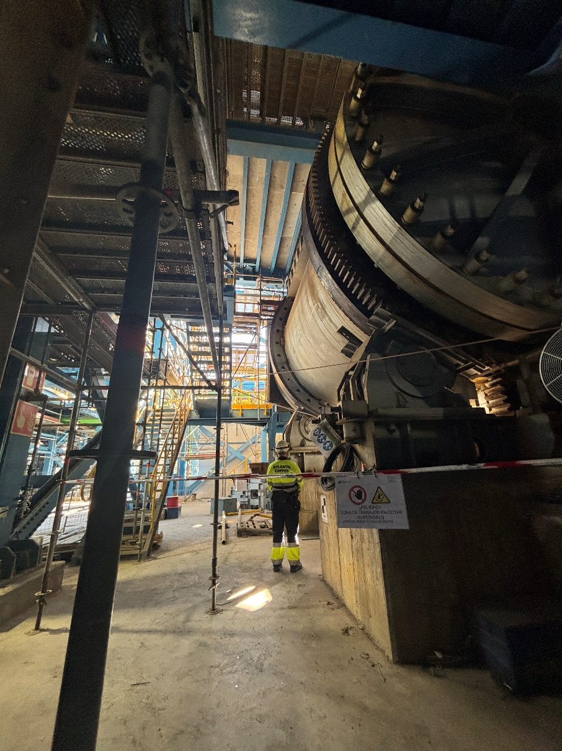
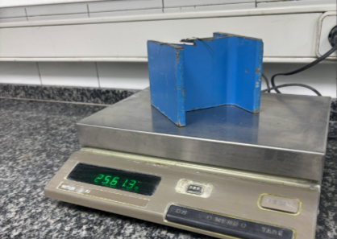
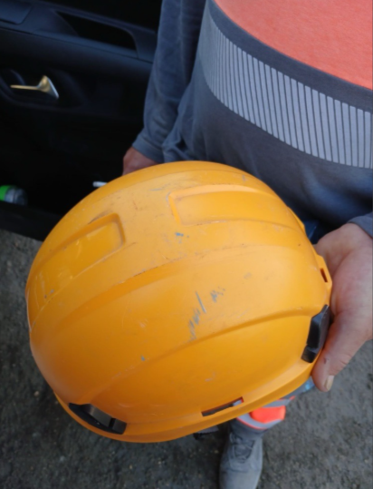
Piece of Steel Beam Fell on Contractor
PFE # 2026-16 Event ID # 20039998
Falling Objects
Preliminary Incident Details
Operation | Atlantic Copper
Date / Time | September 22, 2026 / 8 a.m.
Event Type | Injury – First Aid
Summary | A contractor was cutting a support beam at the top of a furnace on a scaffolded work platform. After the beam segment was cut free, it fell through an opening measuring approximately 320 x 140 mm (12.5 x 5.5 in.), dislodging a fire-resistant blanket that was being used as a barrier. The 2- to 3-kilogram (4.5-6.5 pounds) steel piece then struck the top of the cylindrical furnace before continuing to ground level, where it hit a contractor on the helmet. The beam segment fell an estimated 5 meters (16.4 feet) from the scaffold to the ground level.
Risk Category | Actionable – Significant (3) Likely (3)
Findings / Missing Controls | Inadequate protection of scaffold platform opening. No exclusion zone below the task.
Immediate Action(s) | Establish and enforce a barricaded drop zone beneath all overhead work activities. Inspect all openings, penetrations and temporary barriers to verify they can prevent falling tools and materials. Verify a falling object prevention plan is in place.
Applicable Policies / Procedures | FCX-HS19 Flagging and Barricading Policy
Employee Condition | The employee reported cervical pain and received medical evaluation.
Contact | Luis Fernando Oso Oliva, Manager-Health and Safety
Hole in scaffold platform
Fall Distance: Approximately 16.4 ft.
Piece of beam (approx. 5.5 pounds) that fell and struck the employee.
Reenactment of incident location.
Condition of the safety helmet and impact area.

Slide 24
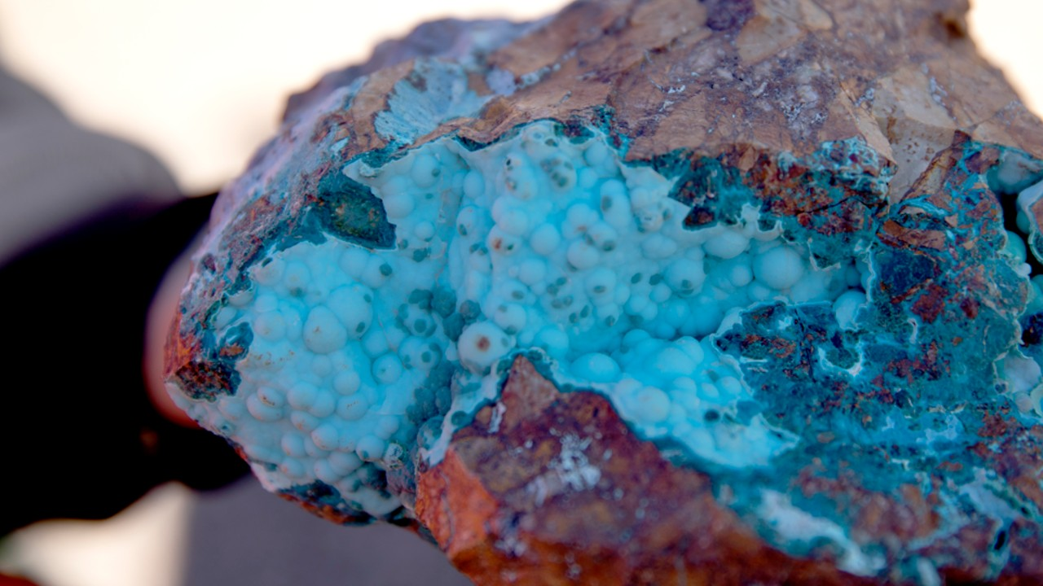
Industry Incidents

Slide 25
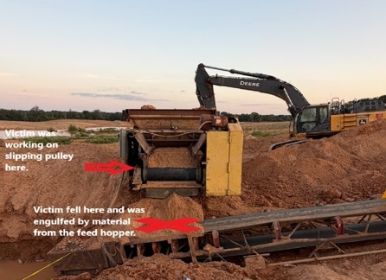
MSHA Fatality Alert
August 13, 2026 – A miner was performing maintenance on a slipping head pulley of a hopper. During the task, the miner fell onto the discharge conveyor, where he became engulfed as the belt began feeding material from the hopper.
Eliminate Hazards and Prevent Injuries
De-energize, lock-out, tag-out and block machinery against motion before performing repairs or maintenance.
Provide and maintain safe access to all working places. Use personnel lifts or ladders to access elevated workplaces safely.
Provide and verify proper use of fall protection where there is a danger of falling. Confirm fall protection has a suitable fall arrest connection and secure anchorage system.
Conduct workplace examinations to identify conditions that may adversely affect the safety or health of miners. Identify risks and eliminate or control hazards before beginning work.

Slide 26
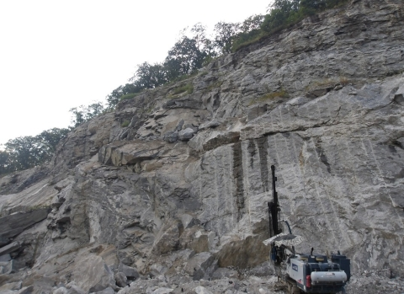
MSHA Fatality Alert
August 24, 2026 – A miner died when rocks fell from the highwall and struck him the while he was operating a drill.
Eliminate Hazards and Prevent Injuries
Scale highwalls from a safe location to eliminate hazards such as loose, unconsolidated rocks and overhangs.
Install benches to reduce exposure to falling rock. Verify adequate bench width based on the type of equipment used for routine clearing or scaling operations.
Provide falling object protection structures on mobile equipment that operates near highwalls.
Conduct highwall examinations prior to working or traveling near the highwall and more frequently as ground conditions warrant, especially after periods of rain, freezing and thawing.
Examine highwalls from multiple perspectives (bottom, sides, and top/crest) and look for signs of cracking and other geologic features that could lead to instability.

Slide 27
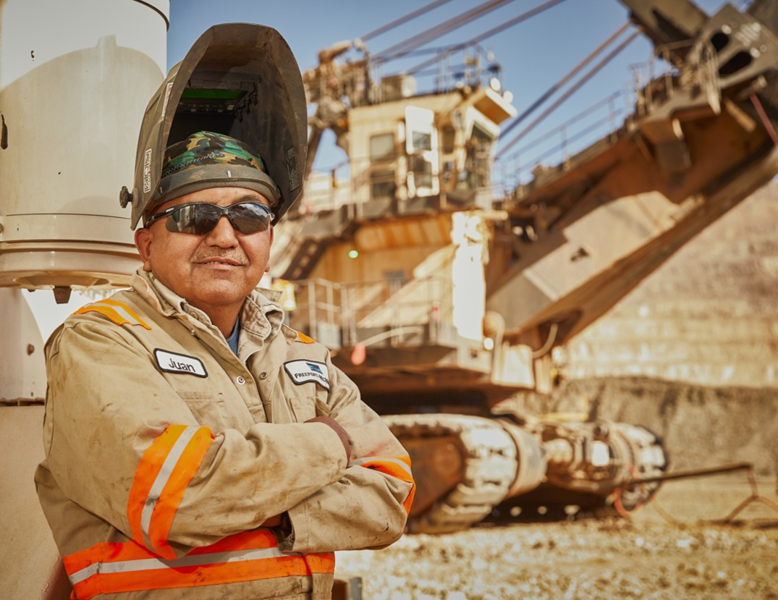
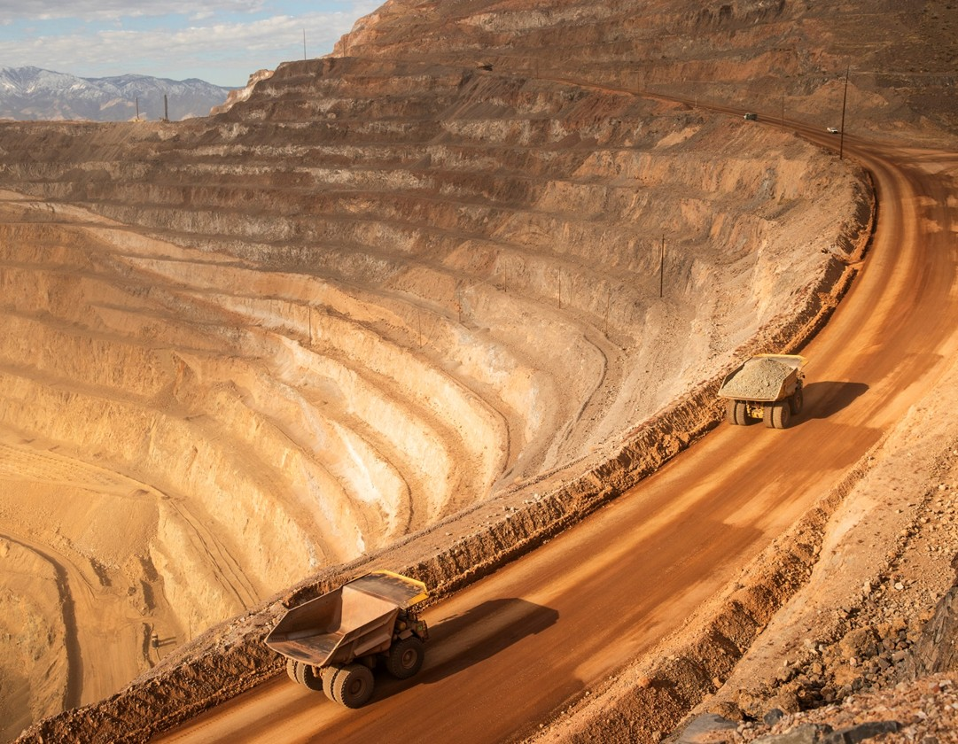
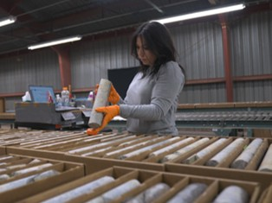
Additional Resources
Health and Safety Dashboard
Safety Toolkits
FCX Policies
MSHA Safety Alerts
OSHA

Slide 28
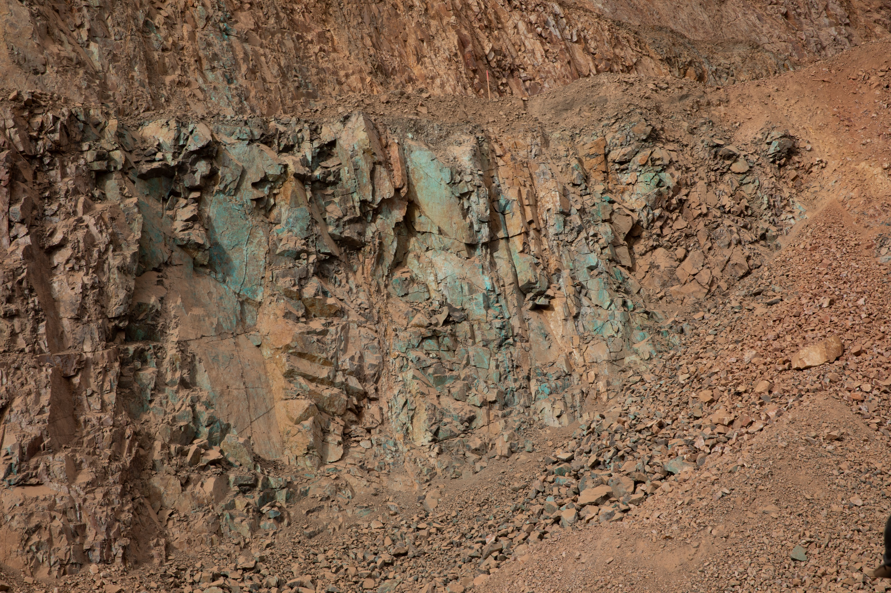
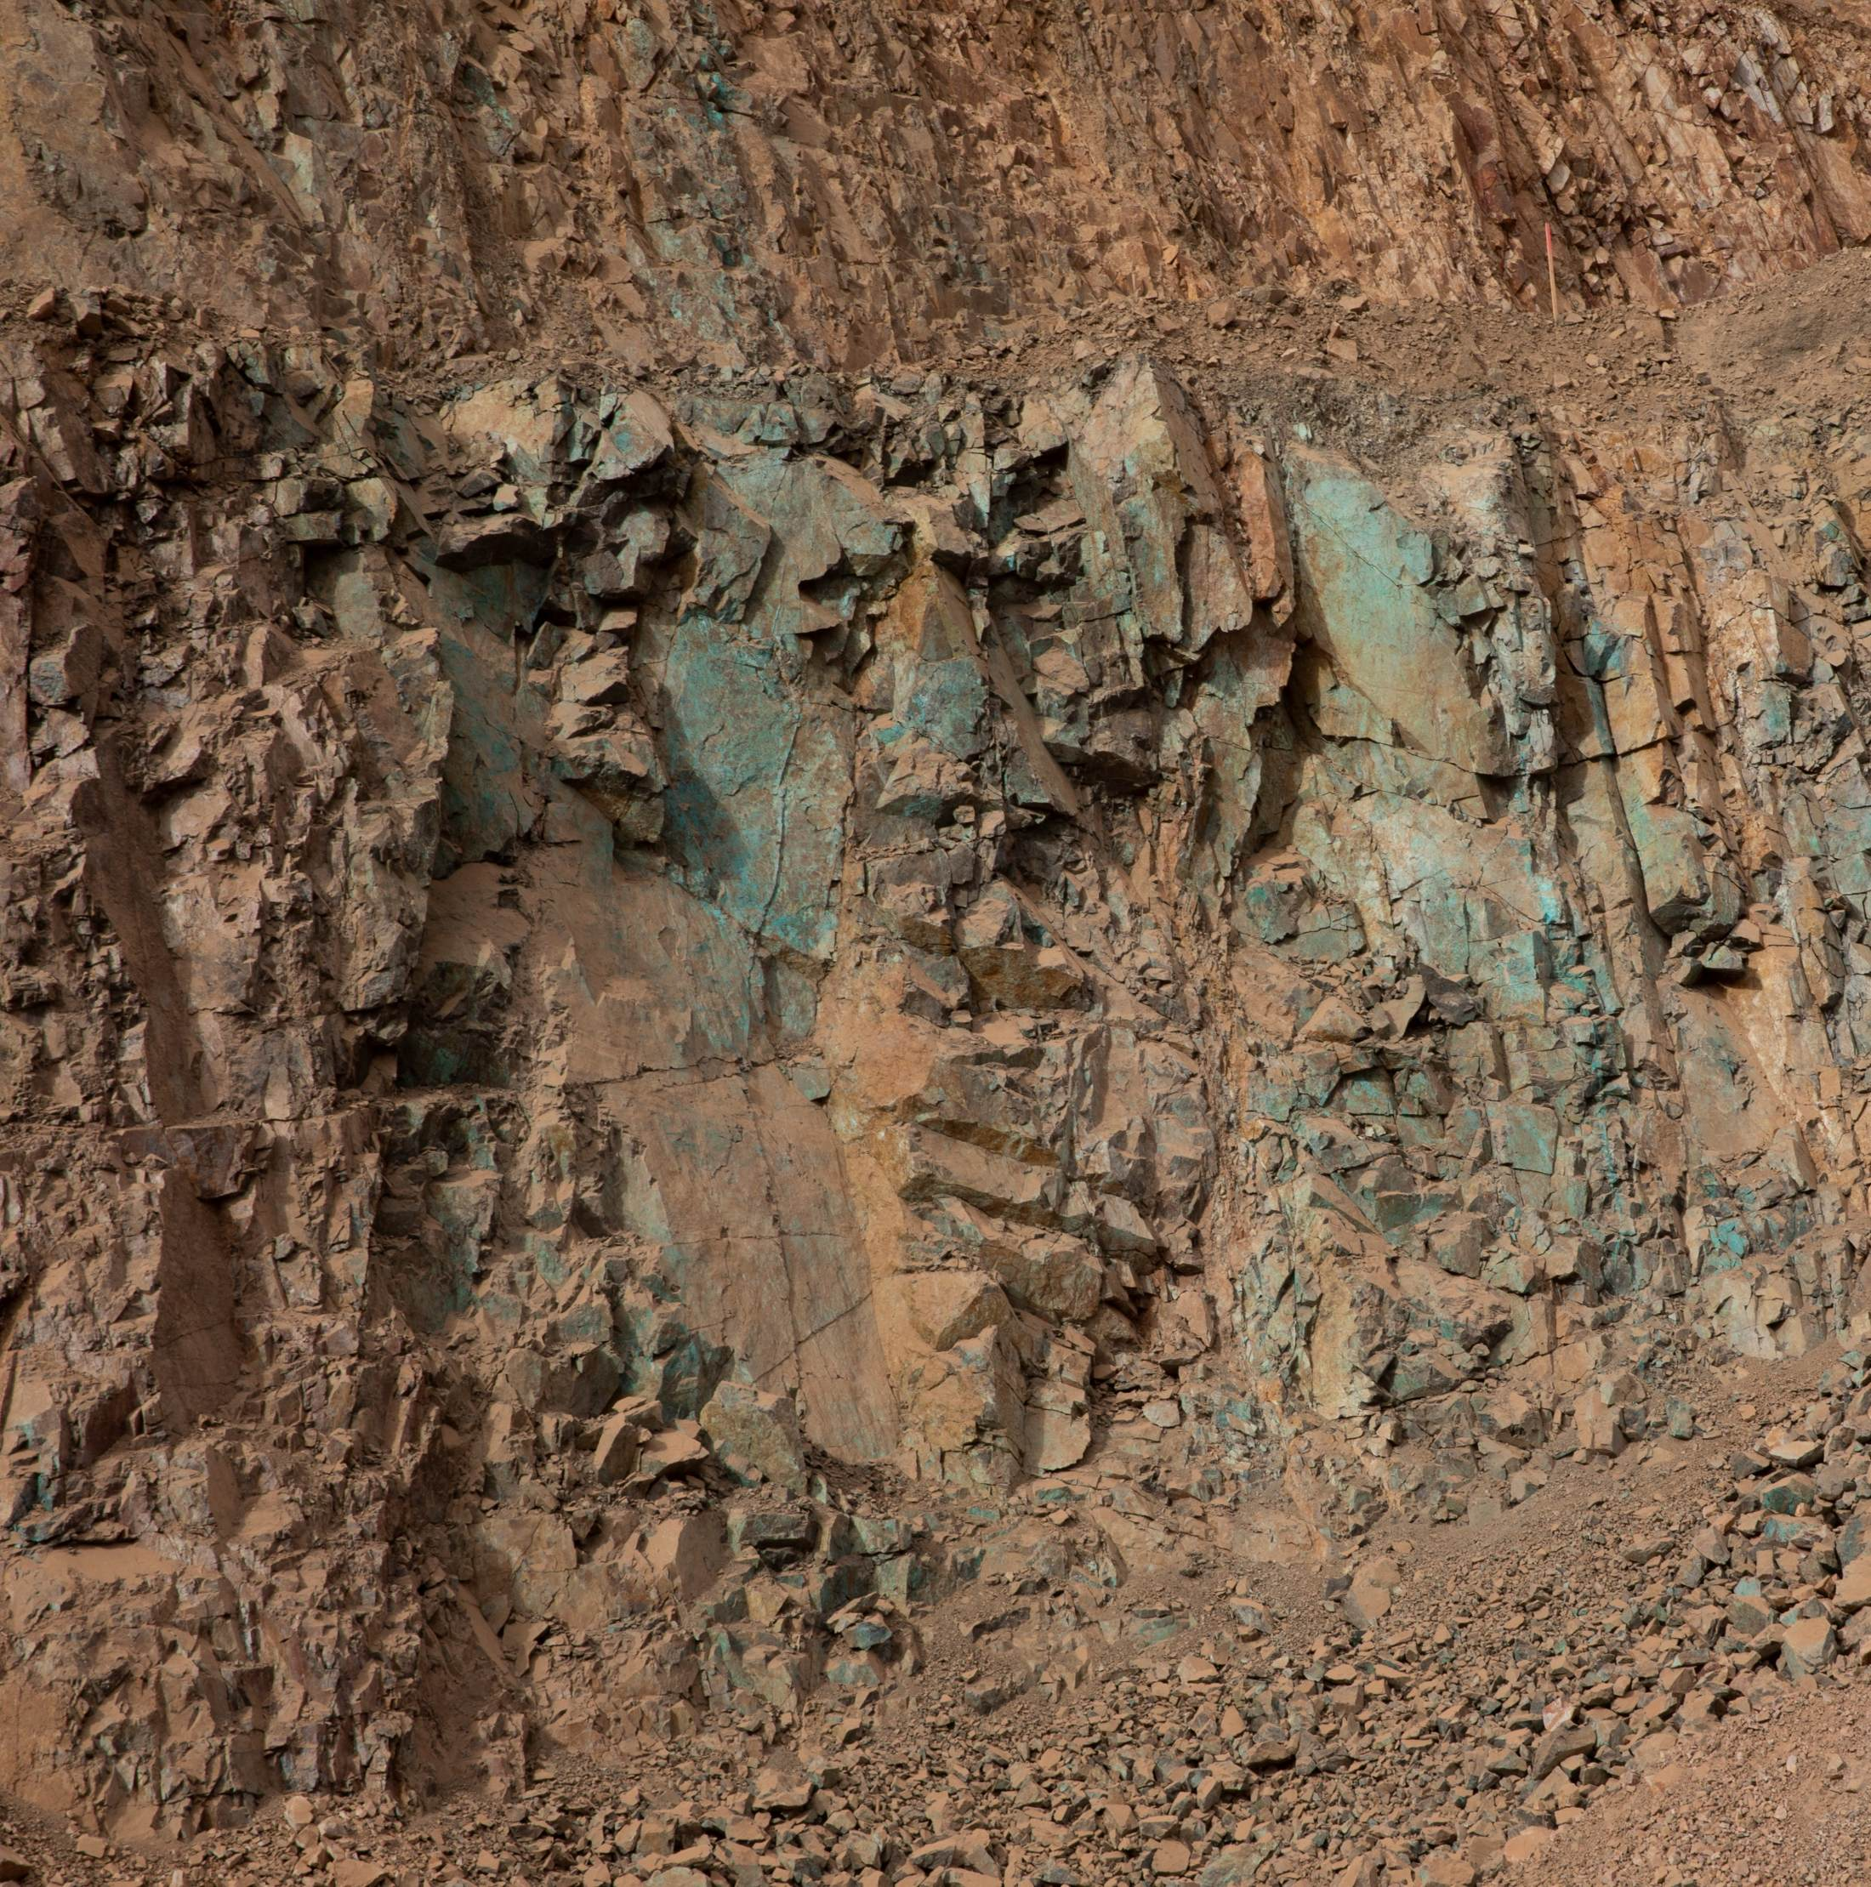
Site Incidents

Slide 29

Henderson Incidents
09/09 – Underground employee sprained ankle
(Reportable – Lost Time)
  Employee clearing oversize drifts with 2
  other employees
  Employee felt pain in ankle and continued
  clearing current drift
  When returned to buggy, realized they
  sprained their ankle
  Lessons Learned:
  Wear boots that provide good ankle support; know what options are available through Safety Boot Stipend or Henderson PPE Policy

Slide 30
Henderson Incidents
09/15 – Water Truck Damaged After Equipment Malfunction (Property Damage)
  Getman water truck steering stopped responding while on LA Ramp
  Driver safely stopped equipment and set park brake, later brake would not release
  Team positioned LHD downhill to release equipment
  When released, the Getman contacted bucket of LHD and broke its windshield
09/23 – Contractor Light Vehicle Struck Jersey Barrier (Property Damage)
  Contractor pulling into Mill main parking lot in contractor LV
  Did not see the jersey barrier and struck it pushing 1 side back 5 feet
  Medium scratches to LV, cosmetic damage only

Slide 31
FRM Verification Results – Sept.
210 verifications completed in September
Focus for September was Underground Rockfall and Falling Objects
Underground Rock Fall missing controls decreased significantly
Falling Objects ratio stayed similar
Exposure to Electrical Hazards increased due to Arc Flash labels missing
FOCUS FOR OCT/NOV:
Exposure to Electrical Hazards
Underground Rockfall
Falling Objects

Slide 32
FRM Verification Results – Sept.
Henderson Missing Controls with Multiple No Responses
Form | Critical Control | Question | No Answers
Exposure to Electrical Hazards | Labeling & Energy Identification | Are arc flash rating labels up to date and reviewed by a competent person? | 10
Falling Objects | Barriers and Segregation | Are the barricades/flagging appropriate for the hazard(s) present and placed 360 degrees around the hazard(s)? | 3
Fall from Heights | Fall Protection Systems | Has the right fall protection been selected for the task? | 2
Underground Hazardous Atmosphere | Gas Monitoring | Is personal air monitoring equipment in use, functioning properly, and within the designated breathing zone, where required? | 2
Underground Rock Fall | Engineered Support Systems | Are ground control systems in place? | 2

Slide 33
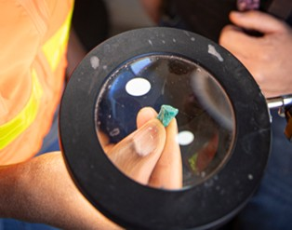



Contractor Management Topics
Contractor Site Access
Human & Labor Rights

Slide 34
Contractor Site Access
Contractors will only be allowed onsite if the following conditions are met:
All contractors must have a site approved HSEP.
All contractors must have an ISN grade of C or above.
No site-approved HSEP and / or a C+ grade =
NO WORK ONSITE.

Slide 35

HSEP-Required Service Order’s: Current Status

Slide 36


Slide 37

Open Forum

Slide 38
November 19th
December 17th
2026 Meeting Schedule
Meetings begin 1 PM MST
Mine and Mill In-Person Options Monthly

Slide 39
October Sign-Off Record
_____________________
_____________________
_____________________
_____________________
_____________________
_____________________
_____________________
_____________________
_____________________
_____________________
_____________________
_____________________
_____________________
_____________________
_____________________
_____________________
_____________________
_____________________
_____________________
_____________________

