Slide 1
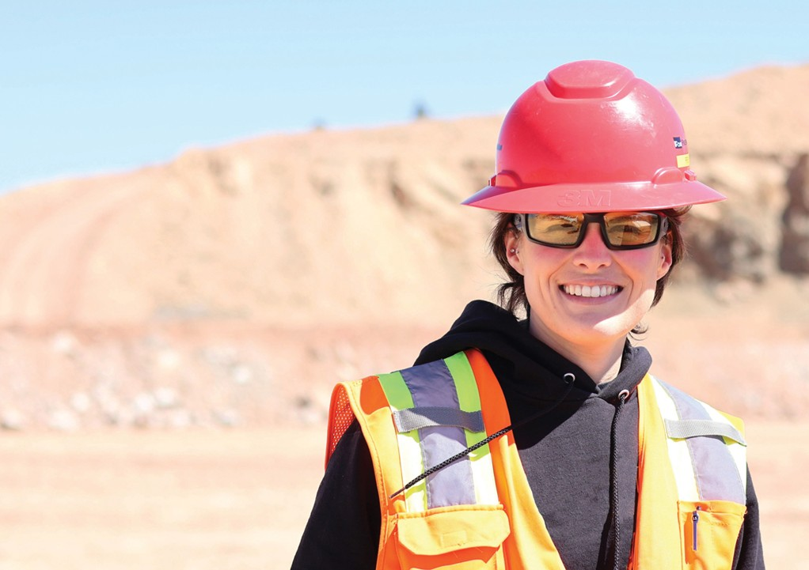


HSE Contractor Meeting
September 2025

Slide 2
Avoiding Unauthorized AI Tools
FMI has observed an increase in AI “notetaking” bots being added to Teams meetings
The use of these tools and software falls under MIS End User Policies that prohibit Freeport employees, contractors and partners from sharing company data without the company’s consent
To protect company data:
  Contractors and Vendors not to use notetaking bots/recording tools
  If external bot/recorder added to meeting, meeting will be stopped
  Ask the FMI organizer to use approved notetaking tools

Slide 3
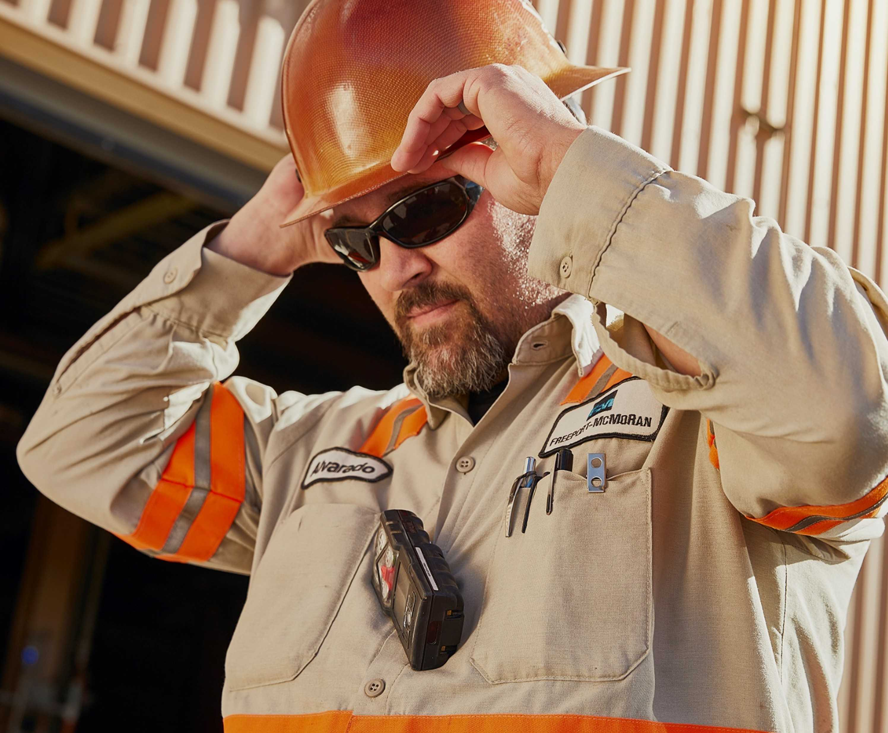

What is the purpose of this Meeting?
- For Henderson to have the opportunity to reach multiple contractors to discuss best practices when it comes to Health and Safety, Environmental and Contracts Management
- Give contractors an open forum to bring up concerns, successes or incidents, learnings, etc. that is shared between all contractors and Henderson personnel
- Help improve the safety culture and reduce safety incidents as a group

Slide 4
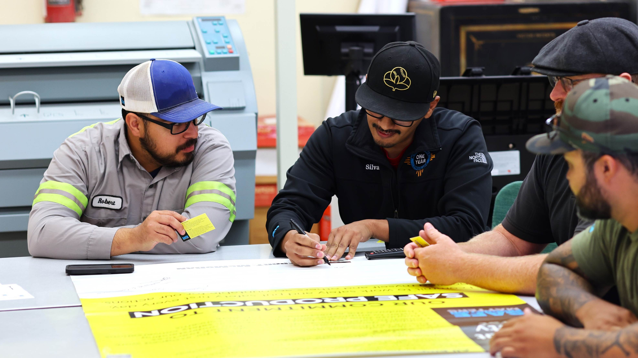
Safety Shares

Slide 5







Fire Safety & Prevention
A small flame can become a fire in less than 30 seconds.
Protect yourself and others from fire hazards with these tips:
Use workplace exams and permits to identify and control fire hazards
Locate safety devices throughout your work area
Verify that fire suppression tools are accessible, inspected and tested
Identify your evacuation routes and muster points prior to work
Clear obstructions from exits, stairwells, aisle and corridors
Click here to access Equipment Fire Safety handouts for haul trucks, drills, loaders, shovels and support equipment.

Slide 6
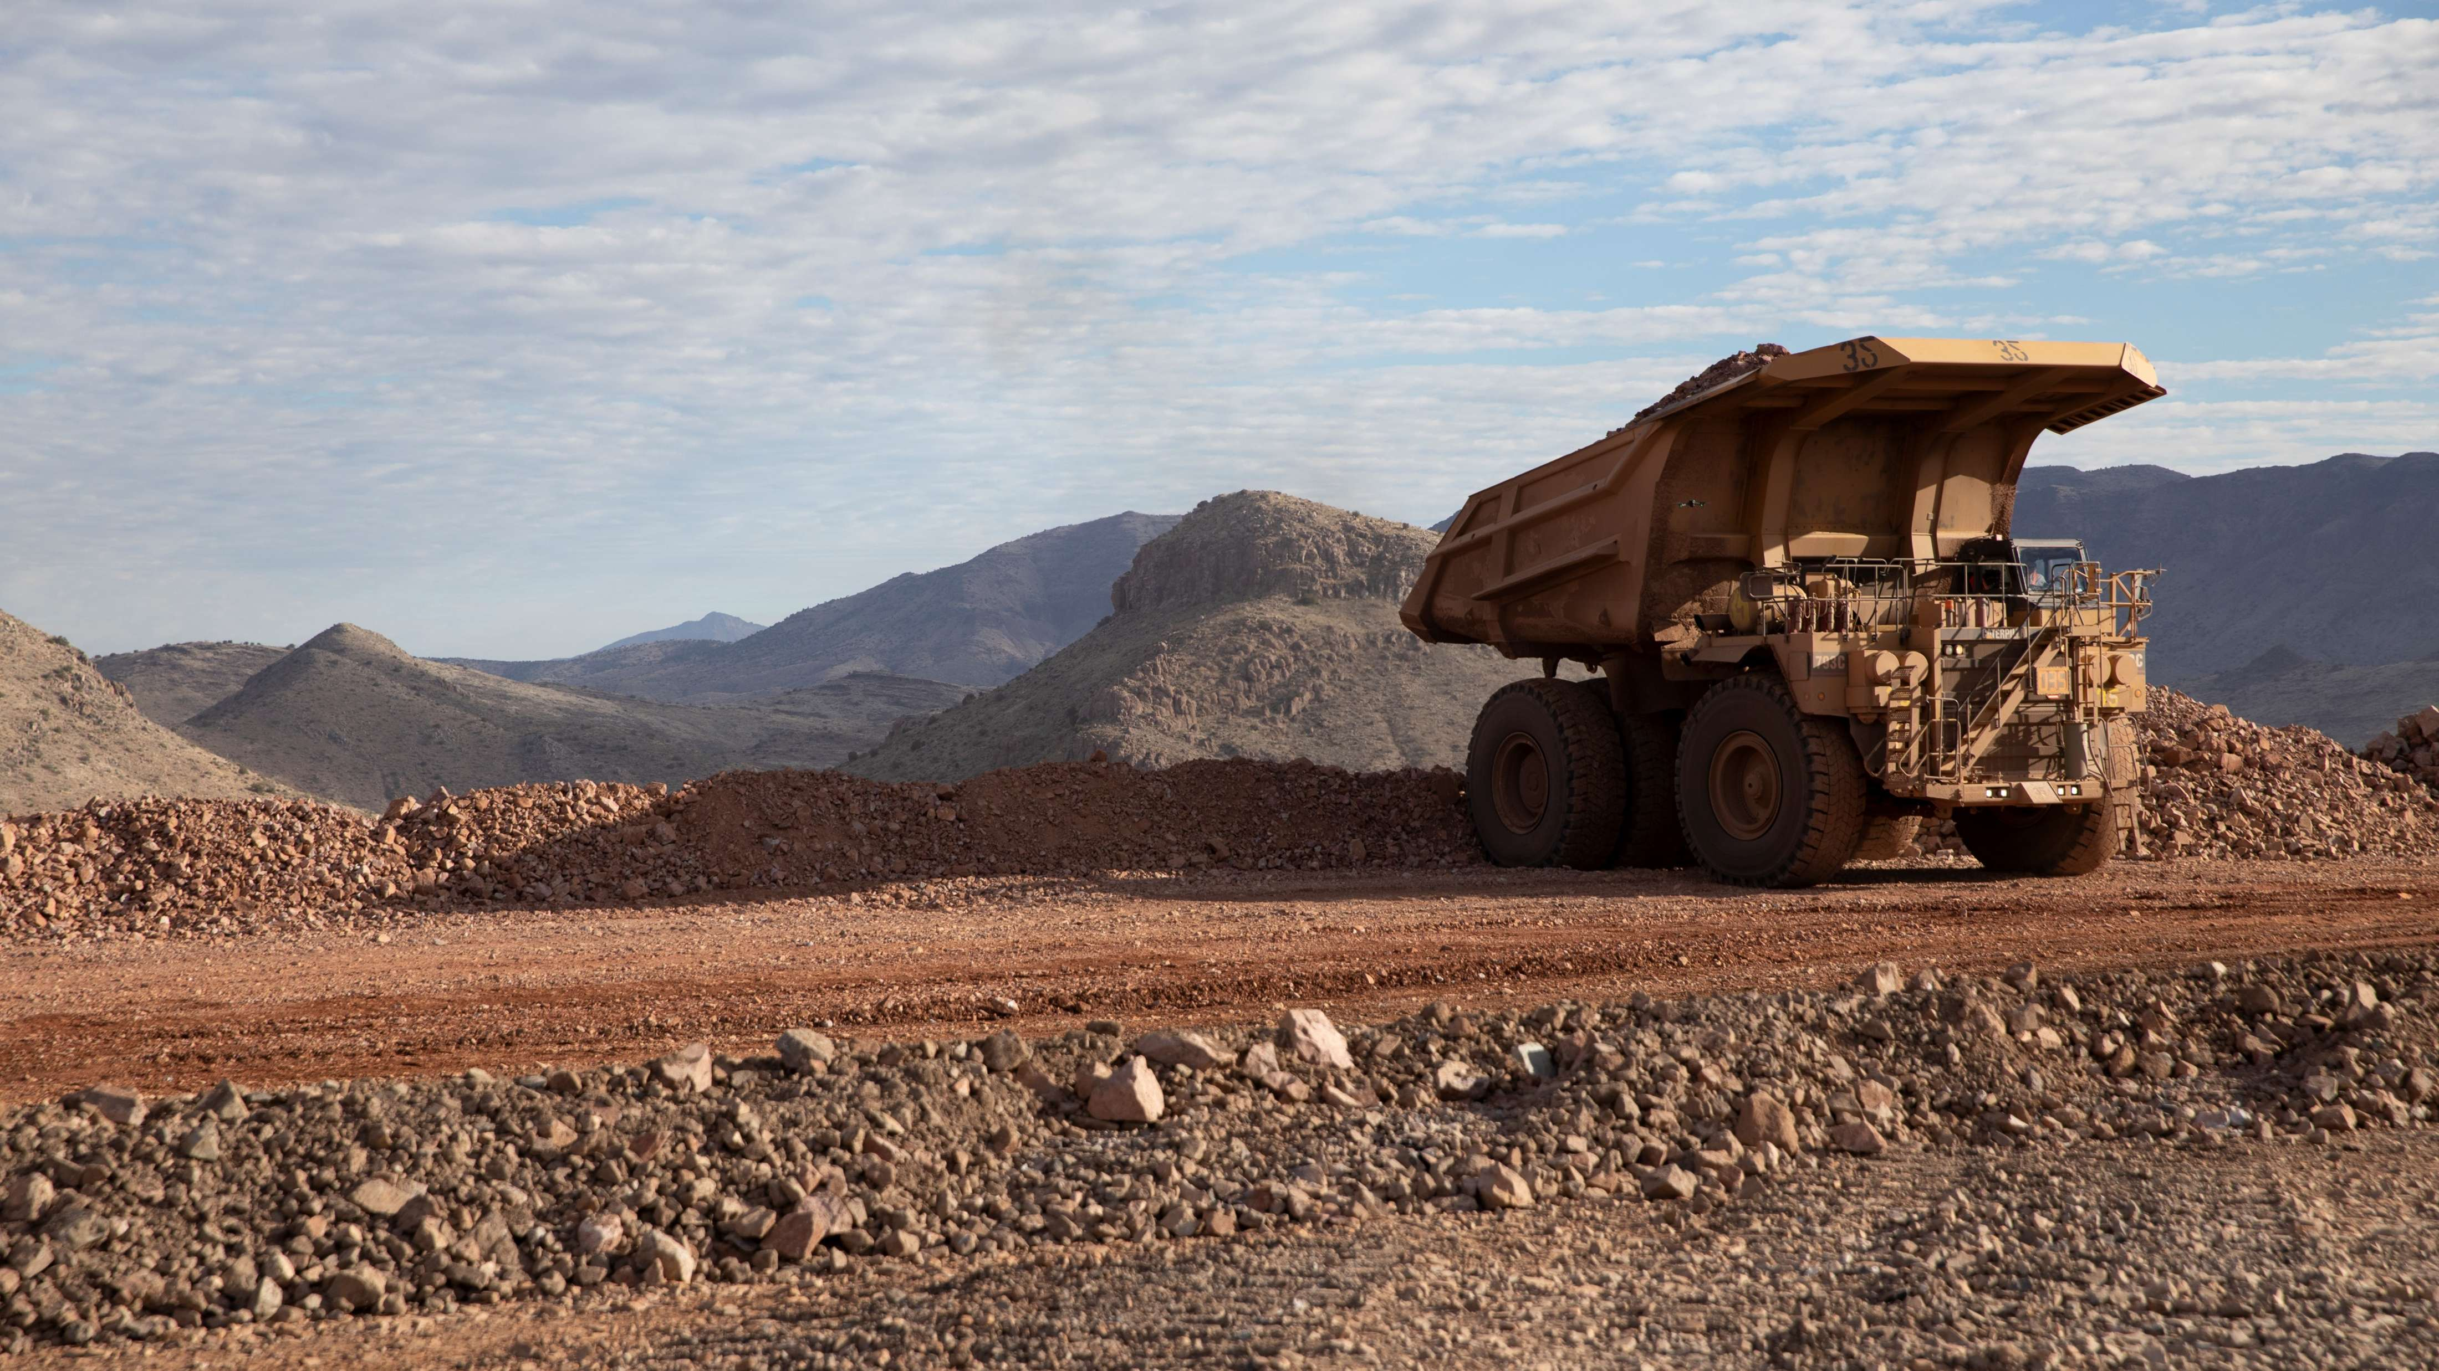
High-risk Incidents
Actionable and PFEs

Slide 7

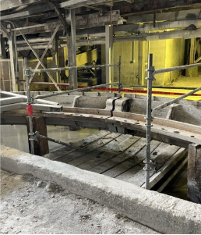
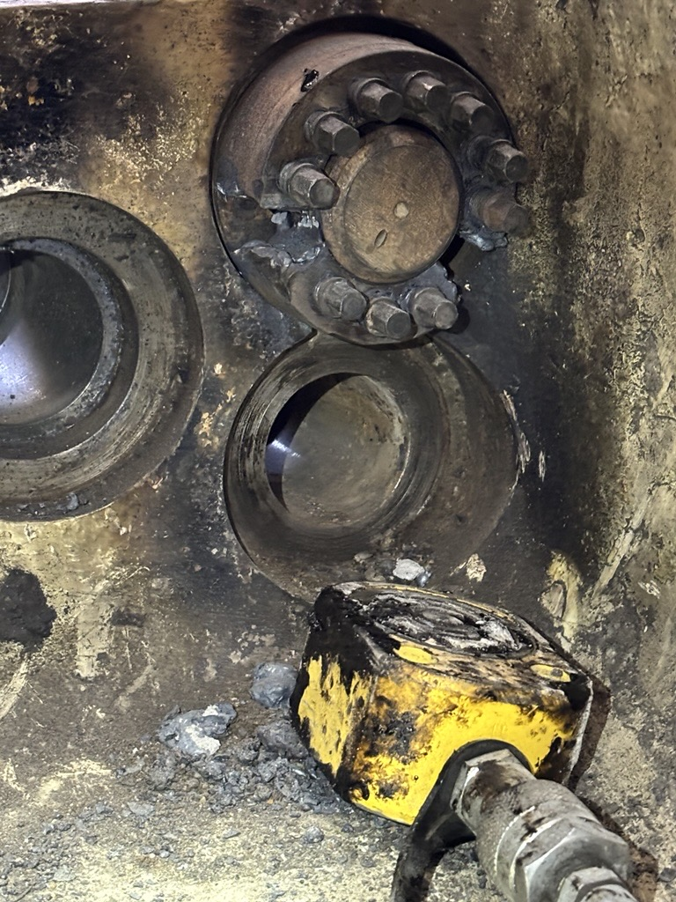
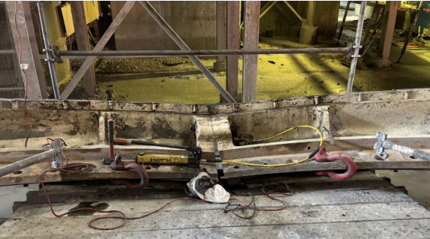
Collapsed Bull Gear
Entanglement and Crushing
PFE # 2025-14 Event ID # 20028070
Preliminary Incident Details
Operation | Bagdad
Date / Time | July 29, 2025 / 9 a.m.
Event Type | Injury – Medical Treatment
Summary | During mill replacement activities, a bull gear had been removed and placed on the ground in two halves to allow mechanics to further separate the ring into quarters. While a contractor was making the final cut on the mud ring, the two gear quarters separated and fell approximately one foot to the ground. The contractor was positioned under the left gear, which weighed approximately 13 tons, while cutting. As the gear fell, it clipped the contractor’s hardhat and pinned their hand.
Risk Category | Actionable – Significant (3) Likely (3)
Findings / Missing Controls | Failure to follow cribbing and load securement standards. Failure to identify risk of employee positioning during task. Failure to follow protocol while performing cuts. A bolt holding the gear together had been removed with a torch during night shift and reinstalled for day shift to continue work. Day shift was unaware of the compromised bolt.
Applicable Policies / Procedures | FCX-HS29 Standard Safety Requirements
Employee Condition | The employee suffered abrasions to the head and hand.
Contact | Rachel Adams, Manager-Health and Safety
Position of gear on scaffolding prior to collapse.
Compromised bolts
Position of gear and contractor’s PPE following the collapse

Slide 8

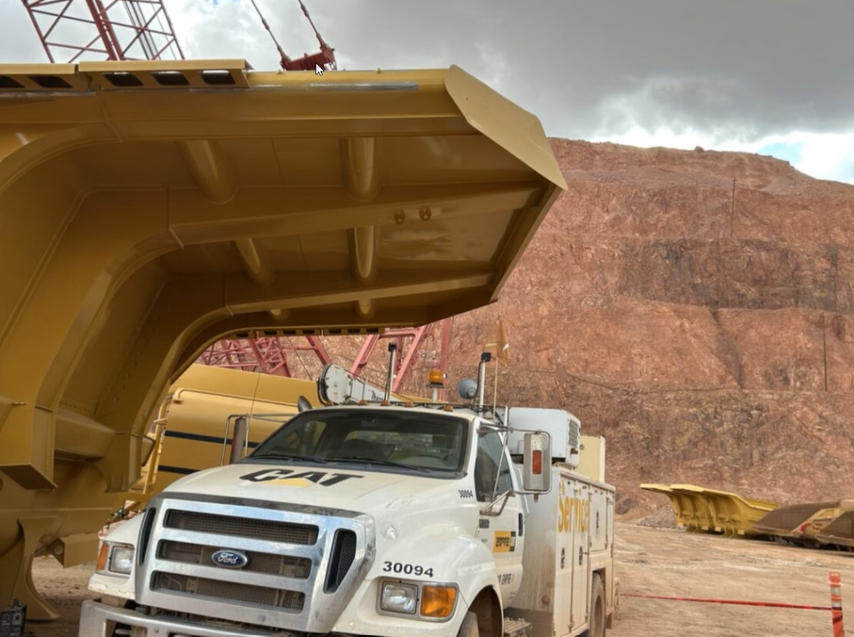
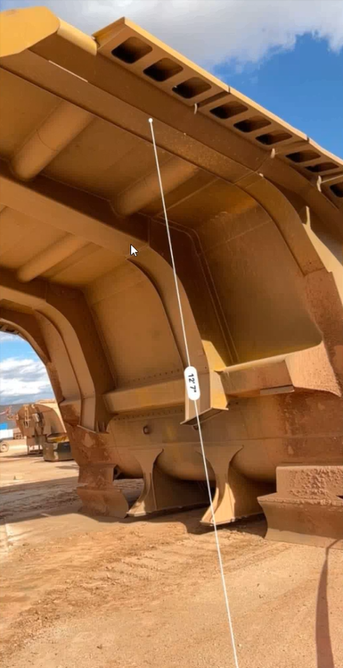
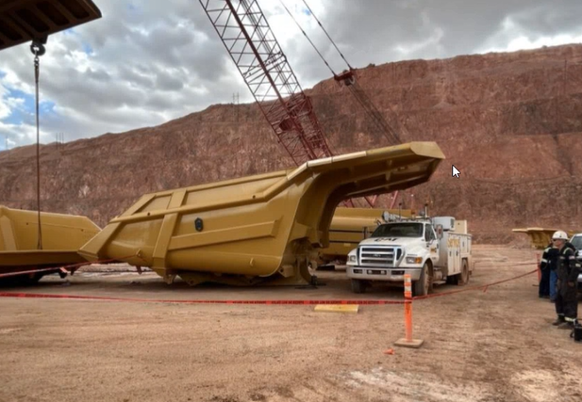
Deflector Fell on Service Truck
ID # 2025-22 Event ID # 20028010
Falling Objects
Preliminary Incident Details
Operation | Morenci
Date / Time | July 29, 2025 / 3:30 p.m.
Event Type | Property Damage
Summary | A contractor mechanic was installing rock deflectors (eyebrows) on a new truck bed. A crane mounted on the mechanic’s service truck was used to lift and position the eyebrows, which would then be stitch welded in place using a manlift. While the service truck was parked beneath the truck bed canopy – and before the eyebrows had been welded in place – one of the eyebrows (approximately 80 lbs) fell. It dropped about 9.5 feet, striking the fiberglass hood of the truck, then bounced approximately 9 feet 3 inches to the ground. The mechanic was inside the cab at the time, about six feet from the impact point.
Risk Category | Actionable – Significant (3) Likely (3)
Findings / Missing Controls | No standard operating procedure for this task. Eyebrows were not identified as a Falling Objects hazard during this job. No segregation or allocated drop zone
Applicable Policies / Procedures | FCX-HS32 Crane and Rigging Policy
Employee Condition | No injuries.
Contact | Belen Lawrence, Manager-Health and Safety Gary Anderson, Manager-Support Services
12’ 7”
Location of fallen eyebrow
Fall distance to ground
Location of eyebrow after fall

Slide 9

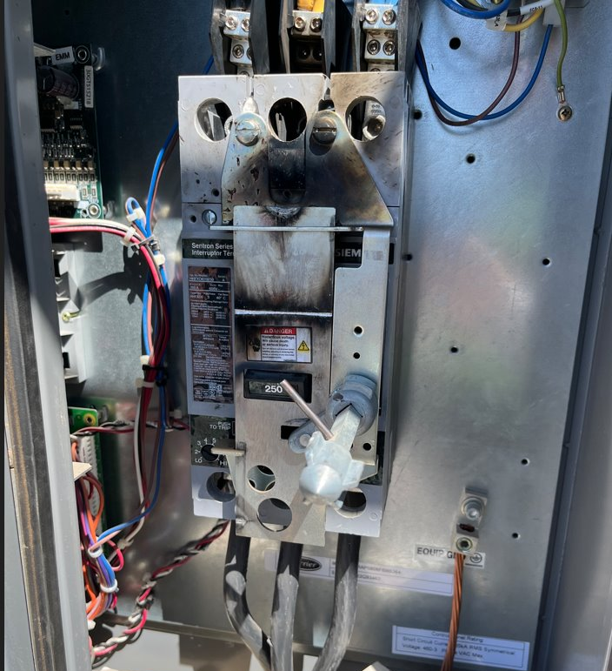
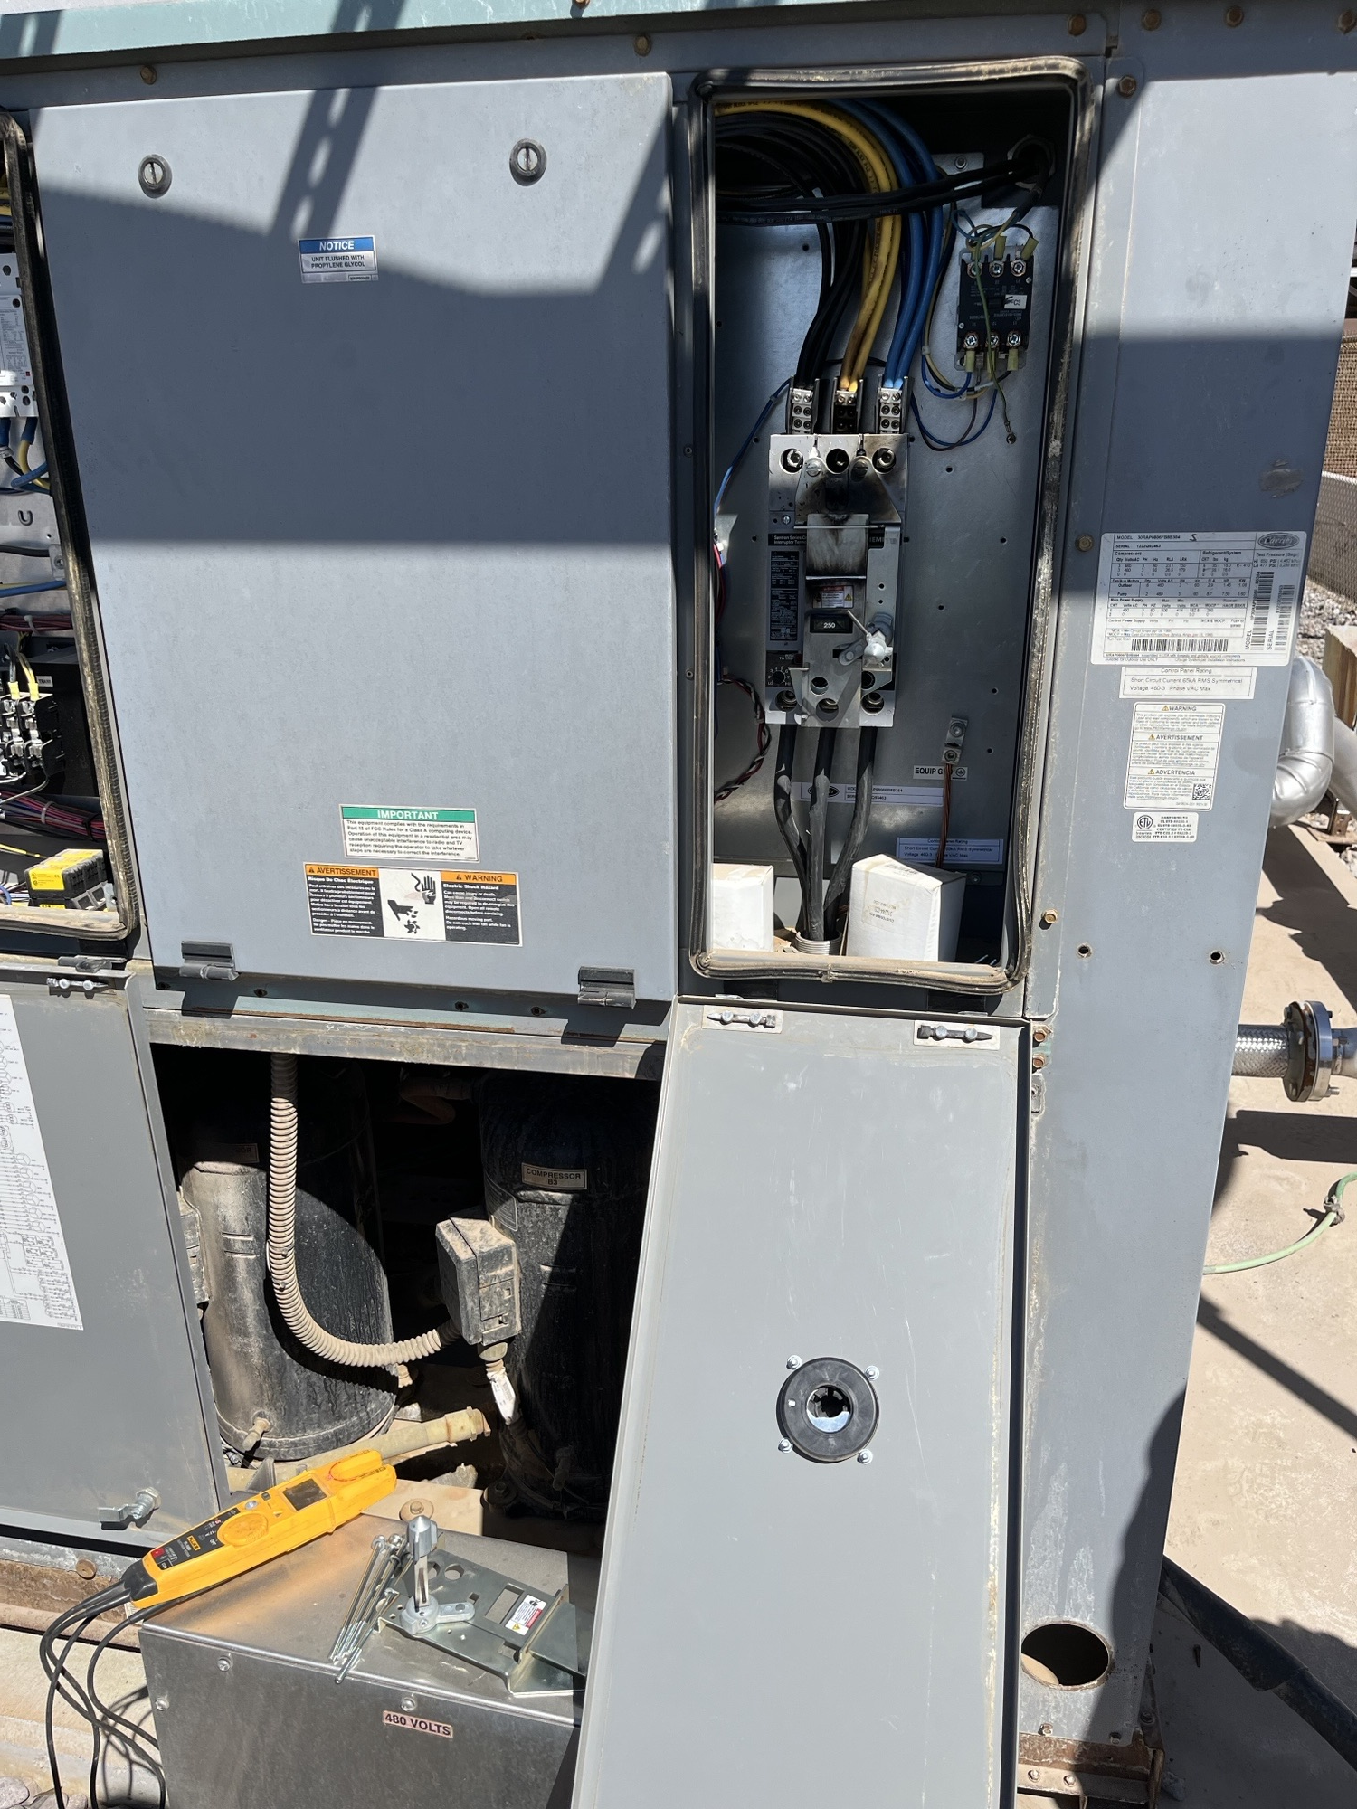
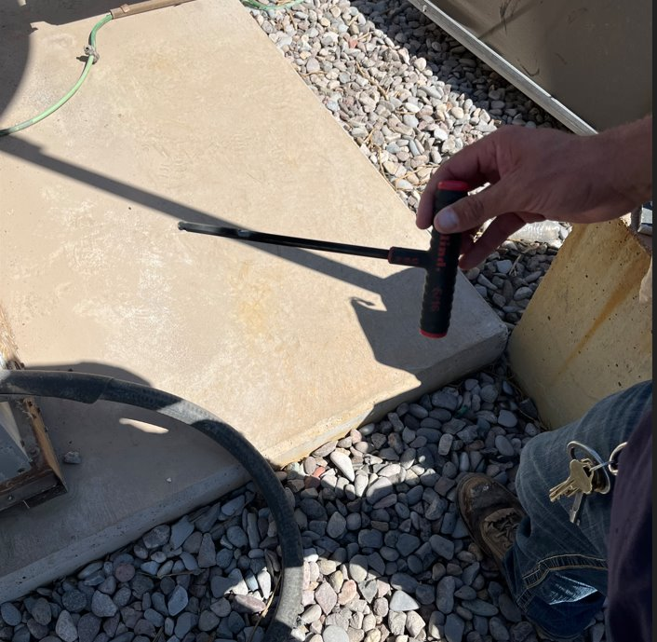
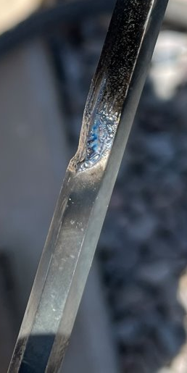
Chiller Arc Flash
Exposure to Electrical Hazards
ID # 2025-23 Event ID # 20028012
Preliminary Incident Details
Operation | Safford
Date / Time | July 29, 2025 / 2 p.m.
Event Type | Near Miss
Summary | Two electricians were replacing the main breaker on a chiller when a long T-handled Allen wrench contacted the mechanical door lock mechanism. This created an electrical arc between the lug and the door lock mechanism. Work was stopped, and further investigation revealed that the lockout was performed incorrectly – the main breaker feeding the chiller had been locked in the ON position.
Risk Category | Actionable – Significant (3) Likely (3)
Findings / Missing Controls | Failure to properly lock out. Failure to verify zero energy. The load (top) side of the breaker was tested, but the line (bottom) side of the breaker was not.
Applicable Policies / Procedures | FCX-HS03 Electrical Safety Policy FCX-HS04 Control of Hazardous Energy Policy
Employee Condition | No injuries.
Contact | Shannon Del Curto, Senior Supervisor-Health and Safety
Chiller #1, main breaker after arc
Photo of T-handled Allen wrench and damage from incident
Chiller #1, main breaker

Slide 10
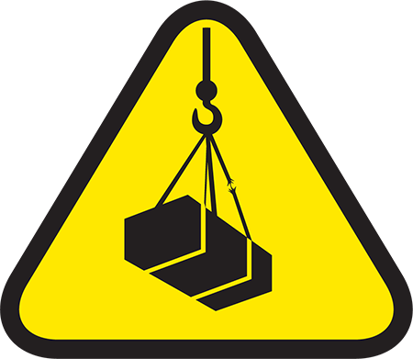
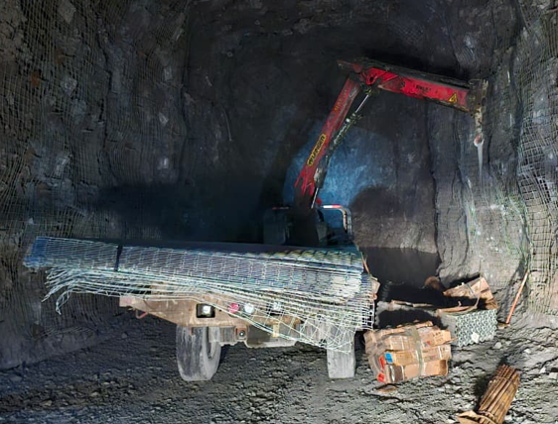
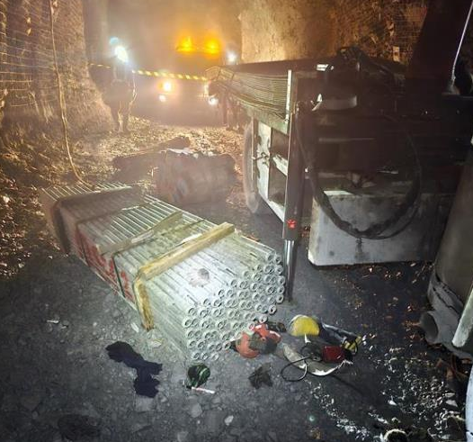
Operator Struck and Pinched by Load
PFE # 2025-15 Event ID # 20028081
Lifting Operations
Preliminary Incident Details
Operation | PT Freeport Indonesia
Date / Time | July 31, 2025 / 10:58 p.m.
Type | Injury – Medical Treatment
Summary | A boom truck operator was unloading an 892.5 kg (1,968 lb) split-set bundle using a 1,000 kg (2,205 lb) webbing sling, without taglines or push sticks. After attaching the sling, the offsider moved to the rear of the boom truck. During unloading, the sling failed, causing the bundle to fall. It struck and pinched the operator’s leg.
Risk Category | Monitor - Significant (3) / Possible (2)
Findings / Missing Controls | Line of Fire Exposure: Operator positioned on the same side as the load; no taglines or push/pull stick; unauthorized personnel in drop zone. Inadequate Lifting Plan: Sling Working Load Limit (1,000 kg) may have been exceeded due to reduced capacity from choked configuration lifting an 892.5 kg load; poor communication of drop zone and travel path. Improper Rigging: The single choke method is likely to cause load imbalance, resulting in material sagging and sling breaking due to contact with the sharp edge of the split set. Equipment Deficiencies: Lifting gear not inspected or stored properly, leading to failure.
Applicable Policies / Procedures | SOP-6.01-UG-N03: Operating utility vehicle in underground mine SOP-6.01-UG-I04: Material handling procedure in underground mine area
Employee Condition | The operator suffered multiple fractures and crush injuries to the leg.
Contact | Andri Abdullah, Manager-UG Operational Safety
Position of operator and offsider during lifting
Operator position
Offsider position
Split-set bundle that fell and hit the operator
Operator position

Slide 11
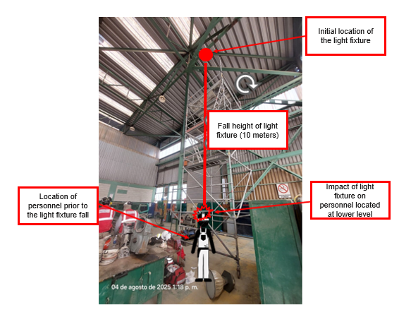
Light Fixture Fell on Employee Head
PFE # 2025-16 Event ID # 20028174
Falling Objects
Preliminary Incident Details
Operation | Cerro Verde
Date / Time | August 4, 2025 / 1:05 p.m.
Event Type | Injury – Lost Time
Summary | During manual movement of a rolling scaffold, the upper vertical bar contacted a hanging light fixture. The fixture (15 kg / 33 lbs) detached and fell approximately 10 meters (33 ft), striking an employee in the head.
Risk Category | Actionable – Significant (3) Likely (3)
Findings / Missing Controls | Failure to perform a proper risk assessment to identify hazards. Failure to identify potential interferences before moving the scaffold. Failure to verify the scaffold's relocation.
Applicable Policies / Procedures | FCX-HS02 Working at Heights Policy
Employee Condition | The impacted employee lost consciousness and sustained a skull fracture and contusion to the head and right shoulder.
Contact | Guillermo Canchis, Manager-Hydromet
Illustration of event. Light fixture (15 kg / 33 lbs) circled in red.

Slide 12

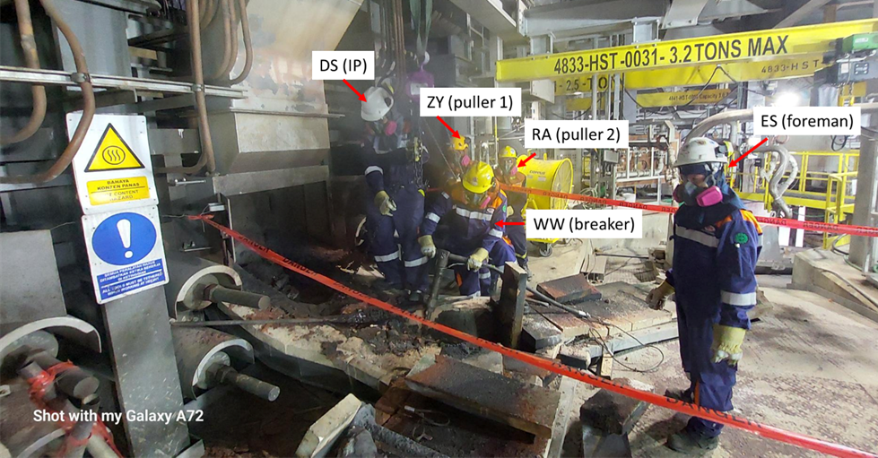
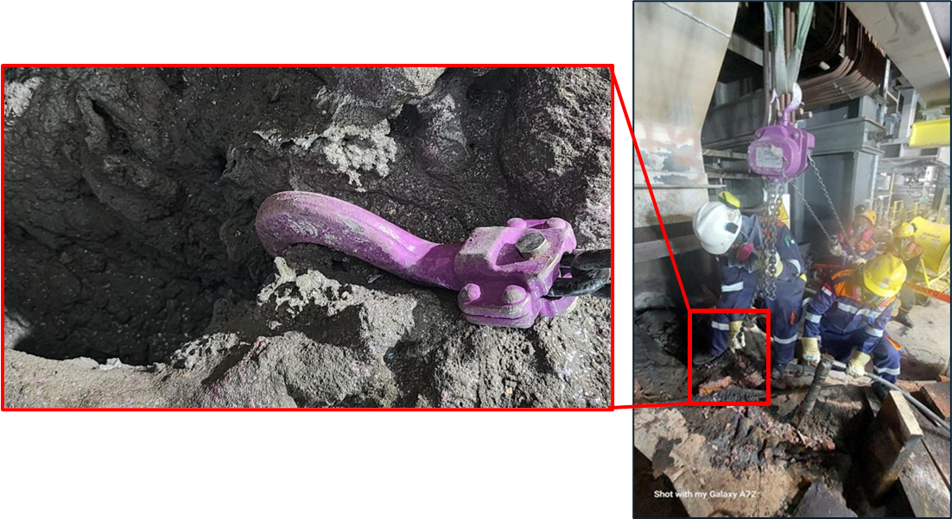
Employee Hit by Chain Block Hook
PFE # - 2025-17 Event ID # 20028276
Lifting Operations
Preliminary Incident Details
Operation | Manyar Smelter
Date / Time | August 09, 2025 / 04:49 a.m.
Type | Injury – Lost Time
Summary | Three employees were using a chain block hook to remove copper buildup at the Blister Tap Hole launder. One employee put their foot on the hook to keep it in place while the other two employees tried to operate the chain block. The hook detached and struck the employee on the left side of the face. It weighed 1.2 kg (2.6 lb).
Risk Category | Actionable – Significant (3) Likely (3)
Findings / Missing Controls | Hazard Exposure: "Line of Fire“ Operators were positioned directly in front of the chain block hook, with one employee using their foot to keep it in place. Failure to Follow Rules, Manual or Procedures: The chain block hook was used to remove copper buildup without adequate securing methods, such as choking with wire rope. Tasks including cleaning, breaking and lifting the copper buildup were done simultaneously, rather than sequentially. The chain block was used beyond its design capacity.
Applicable Policies / Procedures | ​FCX-HS32 Crane and Rigging Policy FCX-HS32 TS Rigging Requirements GDL-4.04.10-PTFI-002 Gears & Crane Management​ AZM-SOP-FCF-005 Safe Working Instruction For Blister Launder Repair Maintenance UNISTEEL Chain Block Manual
Employee Condition | The injured employee sustained a hairline fracture to the sinus cavity, along with swelling around the eye and head.
Contact | Karel Pramono, Manager-Hot Metal Operation Sony Suryanto, Sr. Manager-Occupational Health and Safety
Accident reenactment – position of employees during task.
Accident reenactment – photo of chain block hook and employee position when hook detached.

Slide 13

Industry Incidents

Slide 14

Seismic Event at Underground Mine
Ground Failure
Incident Details
Operation | El Teniente (non-Freeport)
Date / Time | July 31, 2025 / 5:35 p.m.
Event Type | Multiple Fatalities
Summary | Seismic activity at a new section of the underground copper mine caused a tunnel collapse and triggered emergency and evacuation protocols in all underground sectors. The 4.2 magnitude quake occurred 500 meters (1,640 feet) deep in the mine and damaged approximately 3,700 meters (12,000 feet) of tunnel. The origins of the event (mining-related or other) are under investigation. During the evacuation, a worker was struck by falling debris and died at the scene. At the same time, five workers who were carrying out ground support activities were trapped after a gallery collapsed. Rescue efforts lasted 72 hours and concluded when the bodies of the five trapped workers were recovered.
Best Practices | Assess geomechanical risk areas and reinforce preventive evacuation criteria. Utilize geotechnical experts to assess mining method risks, including seismicity. Utilize real-time monitoring systems (sensors, alarms, communication). Increase the frequency and depth of inspections in critical sectors. Verify all work is subject to rigorous analysis of prior conditions.
Freeport’s Proactive Risk Management
Mining-induced seismicity is a recognized risk at some Freeport operations, and we have effective controls and monitoring in place to help manage it, including:
Hydrofracking Operations: Freeport operates hydrofracking equipment to precondition future mining areas in underground operations where mining-induced seismicity is a risk. This process creates fractured ground, making the caving process smoother than it would occur naturally. It also helps control underground pressure movement which can improve seismic response.
Microseismic Monitoring Systems: These systems enable engineers and geotechnical specialists to monitor evolving conditions in real time. This supports proactive decision-making - including evacuations - if potentially hazardous situations are detected.
Evacuation Protocols and Alerting Systems: Freeport has evacuation and alerting systems in place to drive prompt evacuation and manage safe re-entry when actionable seismic activity is detected.
Industry Advisory Groups: Freeport actively engages with industry advisory groups composed of world-renowned experts in seismicity and geotechnical engineering. Through routine meetings, the company shares operational insights, collaborates on best practices and contributes to the advancement of seismic risk management and geotechnical innovation.

Slide 15

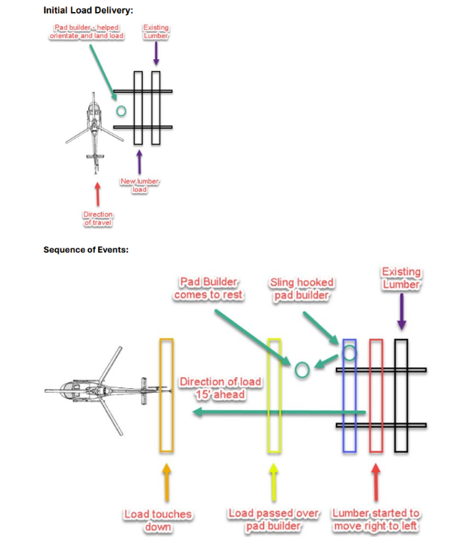
Employee Injured During Helicopter Staging
Interaction with Aircraft
Incident Details
Operation | Amarc – British Columbia (joint venture with Freeport exploration)
Date / Time | August 15, 2025
Event Type | Injury – Medical Treatment
Summary | A helicopter landed for load staging, and an employee approached to remove the rigging. The pilot, thinking the load was clear, lifted off and moved about 15 feet forward. During this movement, the employee’s hand was pinned. The employee freed their hand and fell to the ground. The pilot, realizing the load was still attached, tried to set it down – narrowly missing the employee. The employee sustained a thumb injury.
Findings / Missing Controls | Failure to receive a clear hand signal from ground personnel confirming the load was fully disconnected from the helicopter. Failure to visually confirm all ground personnel were clear before aircraft was repositioned. Failure to disconnect the rigging from the longline before removing it from the load, increasing the risk of an unintended lift.
Immediate Corrective Action(s) | All sling loads must be removed from the longline hook immediately after being set down, eliminating the potential for inadvertent lift-off. Pilots are not permitted to depart until they receive a direct hand signal from ground personnel confirming the area is clear, along with visual confirmation that all ground crew are at a safe distance.
Required Action(s) | A second helicopter and a BARS-certified pilot will be sourced for project support and to help manage operational workload safely effectively.
Contact | Zach Scrivner, Manager-Corporate Project Engineering Safety
Diagram of initial load delivery
Diagram of sequence of events

Slide 16
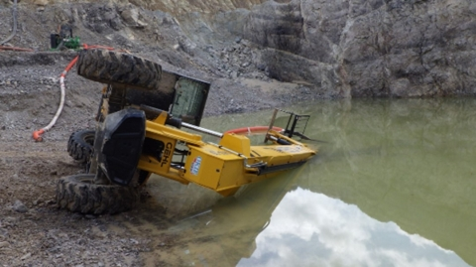
MSHA Fatality Alert
MINE FATALITY – On June 15, 2025, a miner died after the telehandler that he had been operating overturned onto him while he was outside the equipment moving a water pump suction line.
Eliminate Hazards and Prevent Injuries
Ensure miners operate telehandlers perpendicular to the slope and use load stabilizing devices to prevent roll over.
Keep telehandler forks low to the ground unless the surface is level and ground conditions can support the telehandler. Never suspend a load from the forks.
Always lower booms on equipment when unattended and secure the equipment against movement.
Do not exceed the load radius and load limits of lifting equipment.
Do not work alone unless you can communicate with others or they can see you.
Ensure workers position themselves in a safe manner while working around equipment.
Conduct inspections of mobile equipment prior to use. If deficiencies exist, remove the equipment from service.

Slide 17
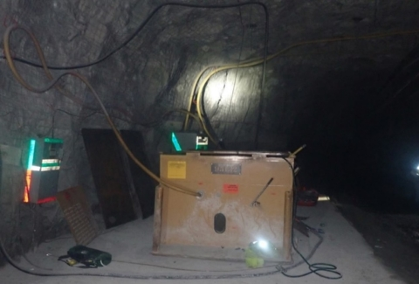
MSHA Fatality Alert
MINE FATALITY – On July 26, 2025, an electrician was electrocuted when he came in contact with one phase of a 13,200-volt, three-phase power source.
Eliminate Hazards and Prevent Injuries
Always lock out, tag out and try out electrical equipment prior to work.
Verify circuits are de-energized using properly rated test equipment.
Leave protective covers in place until electrically powered equipment is de-energized.
Always ensure high-voltage equipment conductors are grounded before beginning work.
Always use proper tools and personal protective equipment when working with electricity.

Slide 18
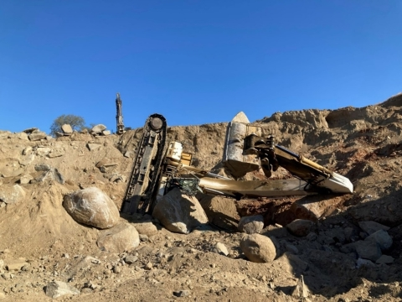
MSHA Fatality Alert
MINE FATALITY – On July 29, 2025, a contractor died when the excavator he was tramming toppled forward, causing the cab to land on a boulder.
Eliminate Hazards and Prevent Injuries
Maintain the boom in the direction of travel when tramming.
Maintain control of self-propelled mobile equipment while it is in motion.
Ensure miners operate excavators perpendicular
to the slope.
Task train miners in the safe operation and potential hazards of all equipment, including avoiding ground conditions that can cause the equipment to tip over.
Conduct workplace examinations of all work areas prior to beginning work.

Slide 19
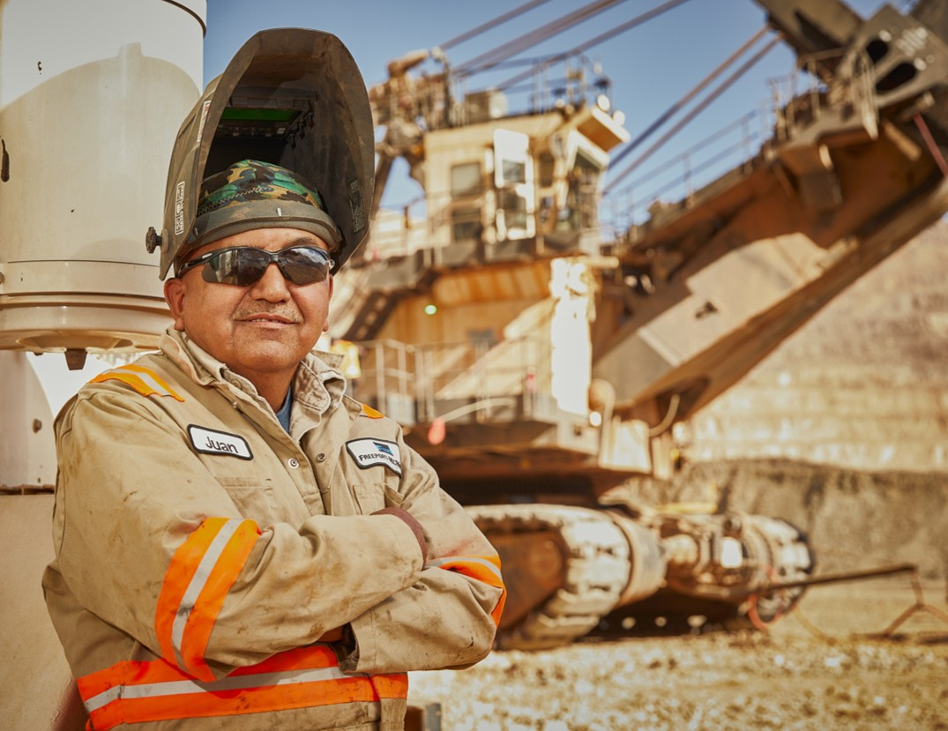
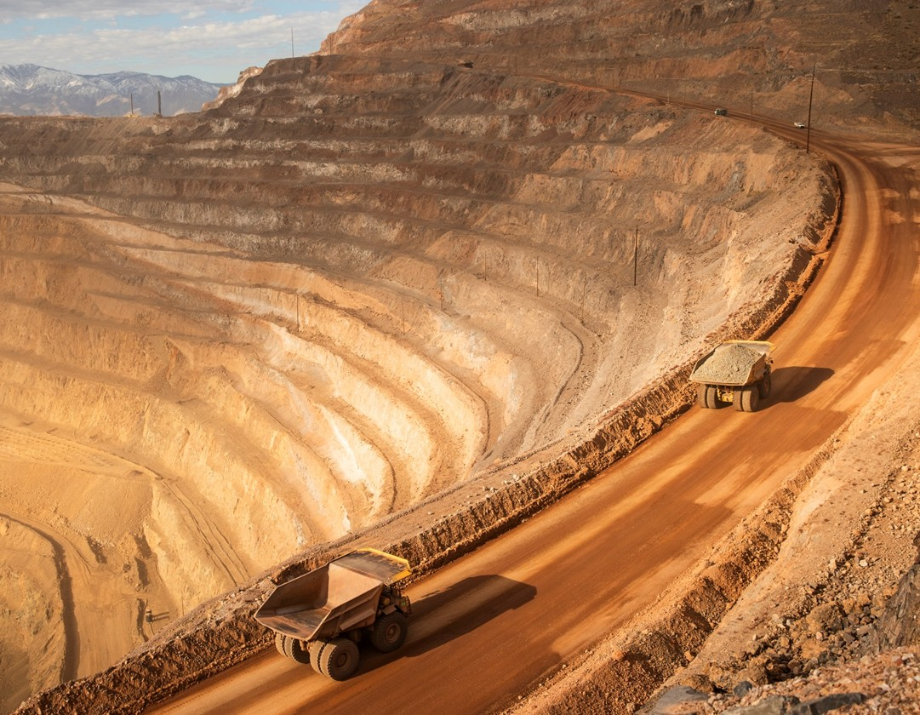
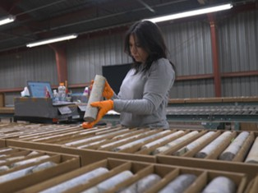
Additional Resources
Health and Safety Dashboard
Safety Toolkits
FCX Policies
MSHA Safety Alerts
OSHA

Slide 20
Henderson Incidents
08/05 – Property Damage
  Contractor cut through de-energized power cable while trenching with excavator
08/12 – Property Damage
  Underground PC1/PC2 plugged chute caused chain of trips and equipment damage
08/19 – Property Damage
  Moly transport truck reversed into garage door at loading dock
08/22 – Medical Treatment Injury (MSHA Reportable)
  Employee inside tub of Grade B disc filter when they moved their leg against an agitator fin and cut their upper thigh. Sutures used to close wound.
08/26 – First Aid
  Forklift seat dropped onto employees' hand during pre-op inspection

Slide 21
FRM Verification Results – Aug.
156 Forms Submitted in August
Focus in August around Underground Rockfall, Falling Objects and Drowning
Hazardous Substances - Chronic, Underground Blasting and Exposure to Electrical Hazards increased missing control ratio compared to July
FOCUS FOR SEPT/OCT:
Exposure to Electrical Hazards
Ground Failure
Blasting

Slide 22

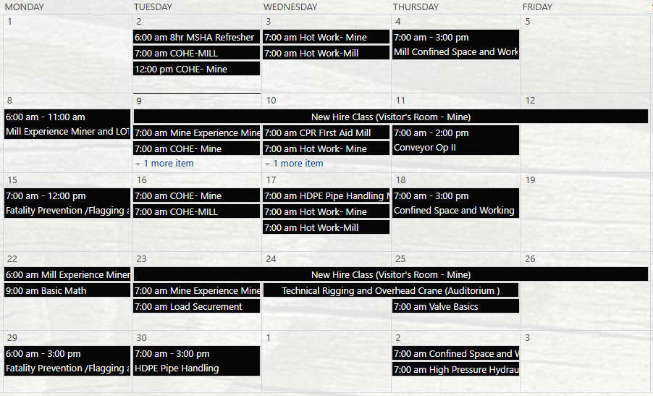
Henderson Training Schedule - SEPTEMBER

Slide 23

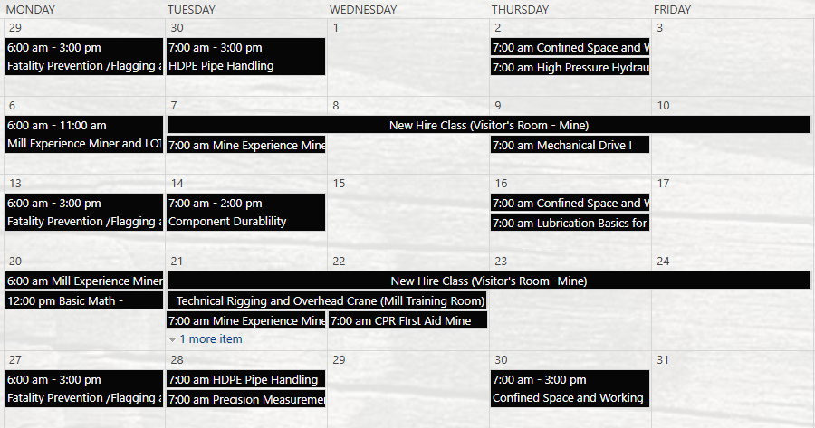

Henderson Training Schedule - OCTOBER

Slide 24
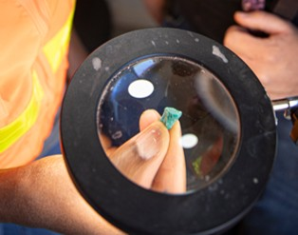
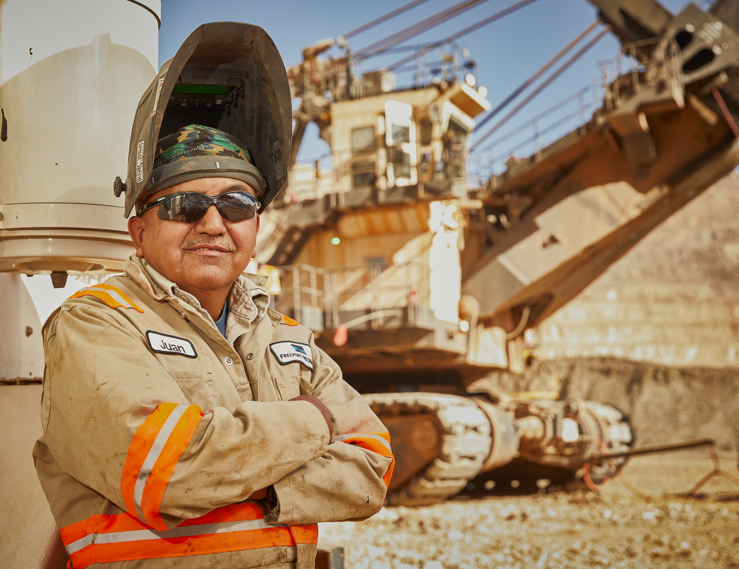


Contractor Management Topics
Badging at Gates
Employee hours reporting
FMI Meeting Recordings

Slide 25
FCX Policies Overview
2025

Slide 26
Business Partner Code of Conduct
Business Partner Code of Conduct
  The Business Partner Code of Conduct must be communicated to all staff working with Freeport.
  bpcc_eng.pdf (fcx.com)
Anti-Corruption Policy
  The Anti-Corruption Policy helps to ensure compliance by FCX & affiliates with applicable global anti-corruption laws.
  Anti-Corruption Policy (fcx.com)
Health and Safety Policy
  Safe Production Matters - A fundamental tenet of our policy is that there will be compliance with applicable internal and external safety and health standards.
  FINAL FCX Safety and Health Policy.docx [Read-Only].docx
Environmental Policy
  Operating our facilities in compliance with applicable environmental laws and regulations at a minimum and, where we believe that these are not sufficiently protective, applying internationally - recognized management practices.
  Freeport McMoRan Inc. Environmental Policy (fcx.com)

Slide 27
Business Partner Code of Conduct Continued
FCX believes in doing business with organizations and individuals who:
  Share our core values
  Demonstrate a high level of ethical and legal conduct
Strength in Values:
Our Company
Strength in Values:
Our Market
The Importance of Speaking Up
Promoting a Safe & Healthy Workplace
Avoiding Conflict of Interest
Fighting Corruption and Bribery
Promoting Fair Competition
Adhering to Trade Restrictions
Contributing to Our Communities
Human Rights and Labor
Responsible Sourcing of Minerals & Metals
Environmental Stewardship
FCX Compliance Line
Resources for Getting Help and Reporting Possible Violations
Marinating Accurate Books & Records
Protecting Confidential Information and Intellectual Property
Sound business decisions and fair dealings
Value Inclusion & Diversity
Drug- and Alcohol-Free Environment
Strength in Values:
Our People
Strength in Values: Our Stakeholders

Slide 28
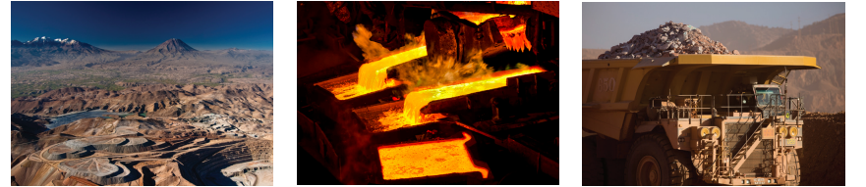
Expectations for Suppliers
    Abide by the laws of the countries in which the supplier operates
    Conduct business according to Freeport’s Business Partner Code of Conduct
    Follow FCX policies & procedures when on our property or acting on our behalf
    When requested, complete an online questionnaire focused on issues of anti-corruption, international trade controls, human rights compliance and general responsible sourcing practices via the Freeport Compliance eXchange (FCeX) online due diligence compliance platform

Slide 29
Human Rights
Respect for human rights has been a long-standing commitment of FCX. We are dedicated to the recognition, respect and promotion of human rights wherever we do business. We respect the rights of all individuals, including employees, suppliers, community members and other stakeholders who may be impacted by our business activities. We do not tolerate human rights abuses at our operations, and we conduct human rights due diligence in our value chain.
Our Requirements:
Treat everyone in and around our operations with dignity and respect
Uphold human rights principles
Report any acts that may violate human rights
Conduct business with partners, suppliers and customers who share our commitment to respecting human rights
What We Don’t Do:
Tolerate human rights abuses, such as human trafficking; forced, compulsory or child labor; and unsafe or unfair work practices, at our operations
Look the other way when we see or suspect human rights violations
Retaliate against any employee who in good faith reports a human rights violation
FCX Human Rights Policy - English

Slide 30
Human & Labor Rights, Including Modern Slavery
Civil & Political Rights
Right to life, liberty and security of person
Core Labor Standards
Economic, Social & Cultural Rights
Right to an adequate standard of living – housing, food, water (living wage)
Right to non-discrimination & equality
Right to an effective remedy
Freedom from arbitrary arrest, detention or exile
Freedom of opinion & expression
Freedom of assembly
Right to privacy
Right to own property
Freedom from discrimination in employment
Freedom of association & collective bargaining
Freedom from forced or compulsory labor
Freedom from child labor
Right to non-discrimination and equality
Right to rest & leisure
Right to a family life
Right to work – just and favorable conditions at work
Right to education
Right to water
Modern slavery is not defined by law… used as an umbrella term covering practices such as forced labor, debt bondage, forced marriage & human trafficking. Situations of exploitation that a person cannot refuse or leave because of threats, violence, coercion, deception and/or abuse of power.

Slide 31
Respect - Harassment & Discrimination
FCX promotes a positive work environment in which everyone is respected. FCX does not tolerate any form of harassment or discrimination. Harassment includes violent/threatening behavior, derogatory words or gestures, such as making comments to a coworker based on race, color, sex, religion, national origin, sexual orientation, gender identity or expression, disability, age, veteran’s status or any other characteristic protected by law.
Our Requirements:
Think before we act or speak — recognizing how actions and comments might be received or misunderstood by others
Act in a considerate, courteous and appropriate manner
Report harassment or discrimination without fear of retaliation
What We Don’t Do:
Make comments or gestures, or engage in violent or threatening behaviors, that create an intimidating, hostile or offensive work environment
Verbally abuse others or make sexual, ethnic or racist jokes and comments
Use inappropriate or offensive language
Display pornography or any kind of offensive pictures, objects or symbols
Pursue unwanted physical contact or unwanted sexual or personal advances
Offer job benefits in exchange for sexual or other favors

Slide 32
Respect - Diversity & Inclusion
The many cultures, perspectives and life experiences of our people are a source of strength at FCX. We are committed to a workplace where everyone feels like they belong, where they are treated with respect and their opinions are valued, and that encourages people to speak up and share ideas. These ideas help drive innovation and operational excellence.
Our Requirements:
Treat each other with respect and are courteous to each other and those with whom we engage
Seek out and value diverse points of view and the unique contributions of everyone with whom we work
Encourage and reward teamwork
Make employment decisions based on facts and business needs rather than favoritism and bias
What We Don’t Do:
Allow personal opinions of a person’s culture, appearance or lifestyle to affect our ability to make smart business decisions
Show favoritism or bias based on personal beliefs

Slide 33
Conflicts of Interest
At FCX, we have an obligation to mitigate potential conflicts of interest and make business decisions based on sound business judgment.
Examples of conflicts of interest include:
  Outside affiliations with suppliers/contractors, competitors, or government
  Supervising or awarding contractor work to friends or relatives
  Having an intimate relationship with another employee (or contractor) for whom you influence decisions, such as awarding work
  Serving as a board member or having a financial stake in another organization
  Giving or receiving gifts on behalf of FCX
If a potential conflict of interest arises during work, please report it to your FCX contact. Appropriate risk mitigation steps will be taken to ensure fair business conduct is maintained.

Slide 34

Compliance Line
At FCX, our Compliance Officers oversee a grievance mechanism for reporting, documenting and following up on violations of business conduct (including conflicts of interest).
If you ever suspect that a policy has been violated, we encourage you to discuss it with your FCX contact or internal compliance department first. As FCX contractors, you may also utilize the below confidential options (without fear of retaliation):
Contact the FCX Compliance Department via email at compliance@fmi.com
Contact one of FCX’s Chief Compliance Officers at 602-366-7550 or via email at Compliance_Officer@fmi.com
Contact FCX’s Compliance Line at 800-295-6783 (you can remain anonymous)

Slide 35
Appendix

Slide 36
Key Takeaways from the Fatigue Management Policy
All FCX current shifts schedules are in compliance with the updates!
Cannot exceed 60 hours per week monthly average
Must average at least one rest day in seven in a calendar month
Scheduled days worked shall not exceed either 92 hours per work-set during normal operations or 182 hours per work-set during outages without a rest day.
Once a scheduled work-set is complete, there shall be a minimum of 24 hours of rest for 8 to 10 hour shifts and for shifts greater than 10 hours at least 34 hours of rest if the immediately preceding work set did not include 4 or more night shifts or at least 46 hours if the immediately preceding work set included 4 or more night shifts.
Total hours, including OT should not exceed 14 hours per day
On extended shifts, total hours should not exceed 16 hours per day with a minimum of 8 hours off before the next shift
Overtime beyond the scheduled shift should be voluntary unless there is an exceptional requirement to meet short-term business need
Where overtime is required, provide employees as much advance notice as possible.
Applies to employees and on-site contractors

Slide 37
Fatigue Management Critical Controls
Critical Controls
  Fit for Duty checks
  Provide time for and get adequate rest
  Immediately reporting any unsafe conditions or behaviors
You are Empowered to Act
  Follow the actions to stay safe
  Arrive to work fit for duty
  Recognize signs of fatigue and stop work, when necessary
  What other things can you do to ensure you adequately manage fatigue?

Slide 38


Community- Local Procurement & Ways We Support Local
As a member of ICMM, FCX is committed to enabling access by local enterprises to procurement and contracting opportunities across the project life-cycle, both directly and by encouraging larger contractors and suppliers, and by supporting initiatives to enhance economic opportunities for local communities.
Below are some ways we support local procurement:
Participating in supplier fairs, roundtables, chamber of commerce meetings, and open house events.
DreamBuilder program- an online business training program designed to help female entrepreneurs build and grow their own business.
Keeping local supplier lists and making those available to larger contractors who may need additional resources or support during projects.
Utilizing Ariba, which provides local suppliers with the benefit of participating in the Discovery tool, which connects suppliers and buyers through the broader Ariba network.
https://dreambuilder.org/

Slide 39

Open Forum

Slide 40
2025 Meeting Schedule
October 9th
November 20th
December 18th
Meetings begin 1 PM MST
Mine and Mill Options Monthly

Slide 41
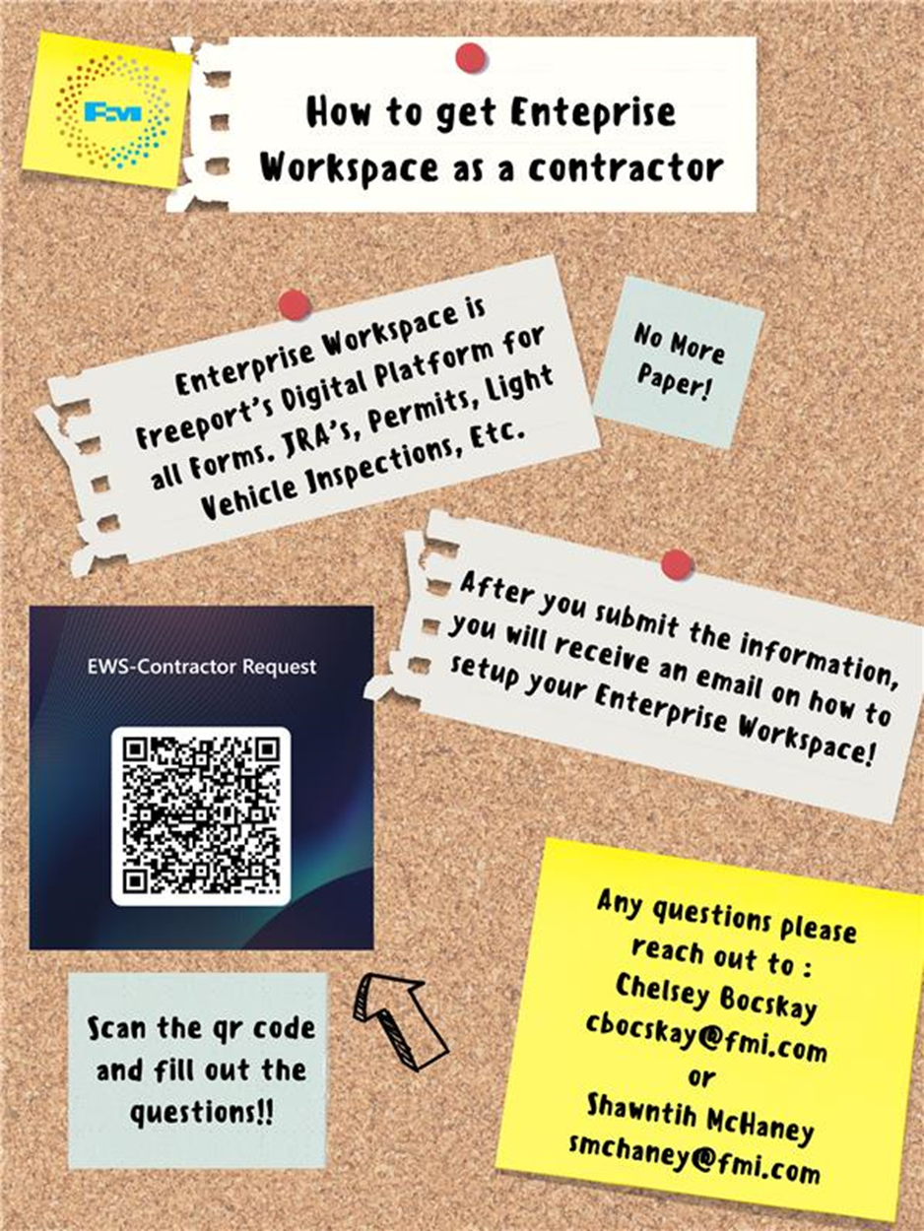
Contractor EWS Access
Access to site digital forms now available to Contractors!
Integration of Contractor submitted forms into internal dashboards
Forms can be used in online and offline modes
Request Access with QR Code or HERE
Reach out to H&S Department with any questions or issues

Slide 42
September Sign-Off Record
_____________________
_____________________
_____________________
_____________________
_____________________
_____________________
_____________________
_____________________
_____________________
_____________________
_____________________
_____________________
_____________________
_____________________
_____________________
_____________________
_____________________
_____________________
_____________________
_____________________

