Slide 1
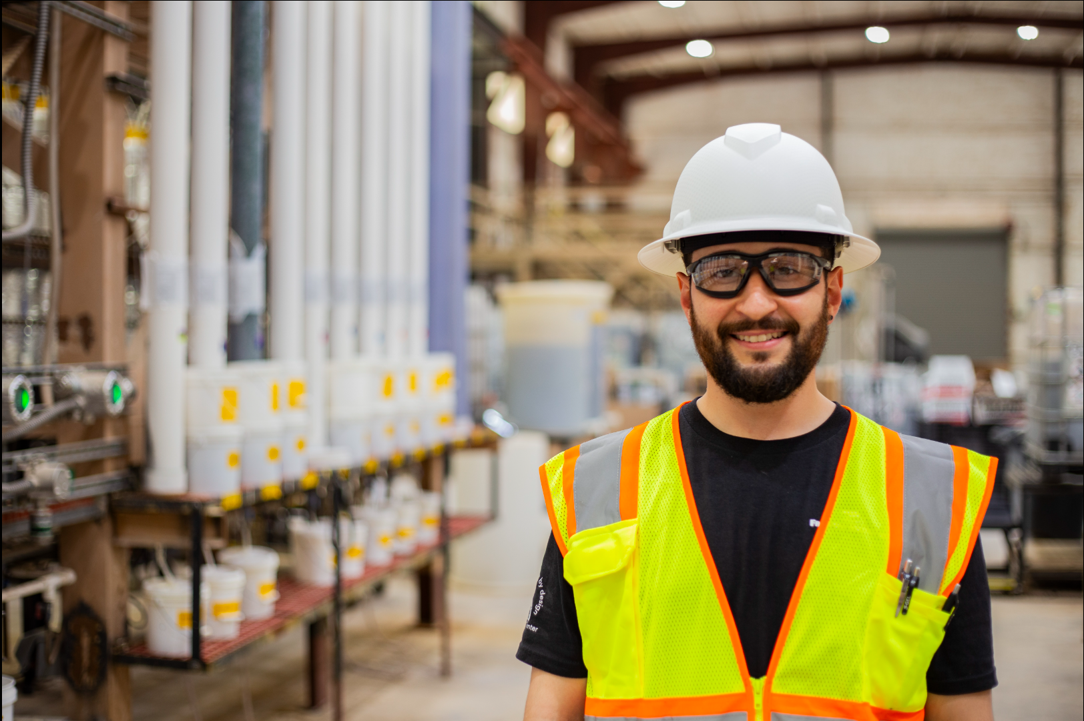


Henderson HSE Contractor Meeting
September 2026

Slide 2
Avoiding Unauthorized AI Tools
FMI has observed an increase in AI “notetaking” bots being added to Teams meetings
The use of these tools and software falls under MIS End User Policies that prohibit Freeport employees, contractors and partners from sharing company data without the company’s consent
To protect company data:
  Contractors and Vendors not to use notetaking bots/recording tools
  If external bot/recorder added to meeting, meeting will be stopped
  Ask the FMI organizer to use approved notetaking tools

Slide 3
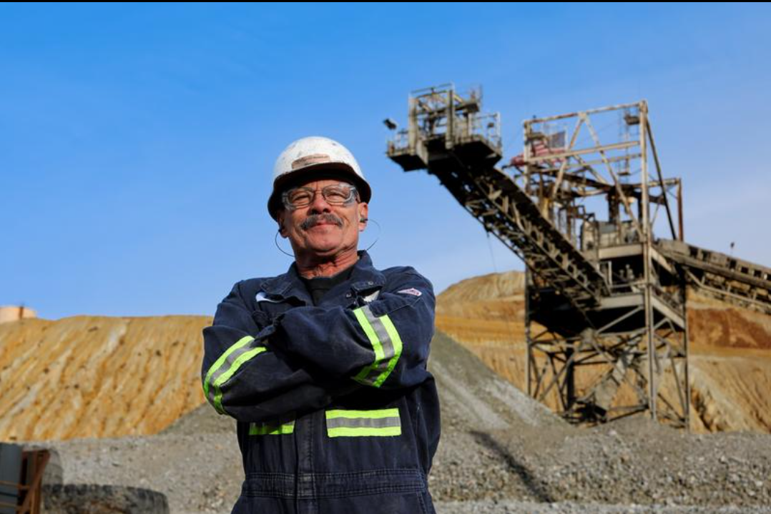
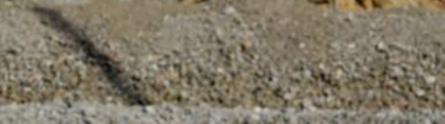
What is the purpose of this Meeting?
- For Henderson to reach multiple contractors and discuss best practices when it comes to Health and Safety, Environmental and Contracts Management
- Give contractors an open forum to bring up concerns, successes or incidents, learnings, etc. that is shared between all contractors and Henderson personnel
- Help improve the safety culture and reduce safety incidents as a group

Slide 4
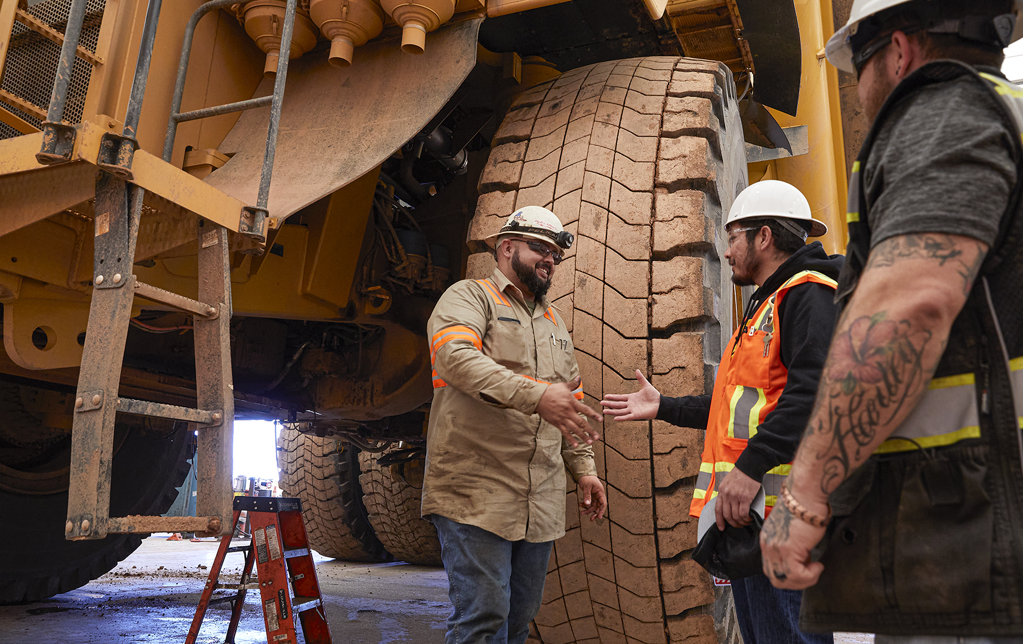

Safety Success

Slide 5
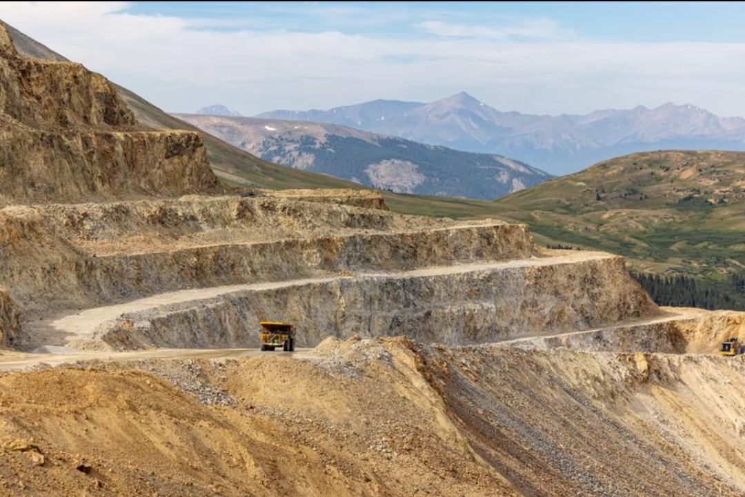
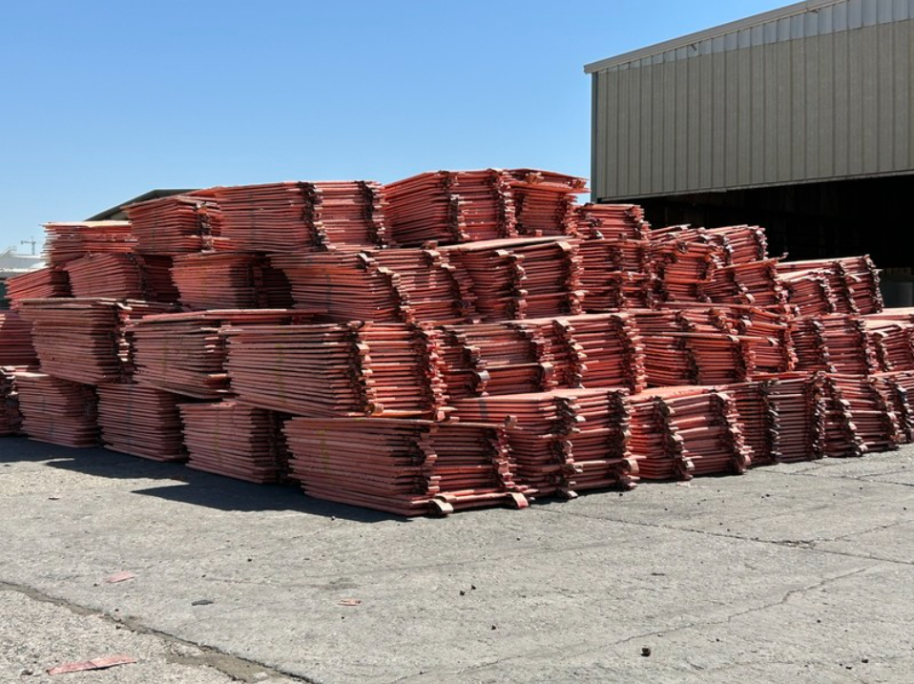
Congratulations
Climax operations have achieved over 100 days without a reportable incident.
to everyone achieving safety milestones this month
Here are some recent team accomplishments
Contractors at El Paso operations have worked approximately 721,000 hours and 690 days without a recordable injury.
Notes:
Accomplishments as of August 25, 2026.

Slide 6
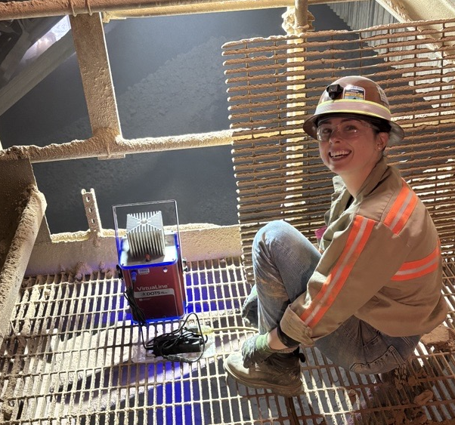
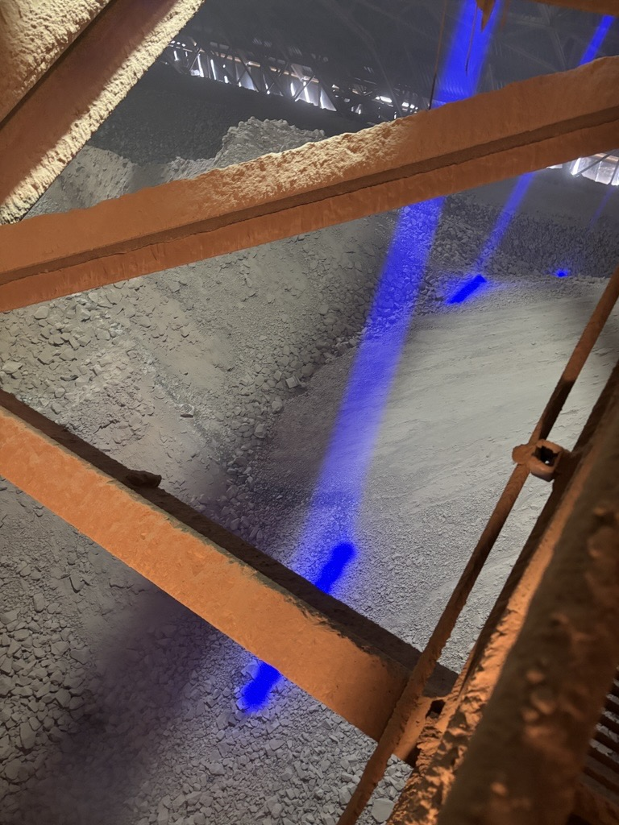
Henderson: Making Apron Feeders
More Visible
Spotlight On
A Closer Look
The Challenge
When ore stockpiles are drawn down during shutdowns, dozers are used to push material into apron feeders. A key fatal risk during this time is a dozer getting too close to the feeder edge.
The Solution
The Henderson team installed high-powered LED guide lights that clearly mark apron feeder locations, giving operators a visual reference while working on stockpiles.
The Impact
Feeder visibility has improved during dozing activities.
Operators can maintain a safe distance from hazard zones.
An extra layer of protection has been added against a high-risk exposure.
Discussion
What simple visual controls could help our team better identify and stay clear of high-risk areas?
Have you ever seen a simple idea or field innovation make a job safer? What was it, and what made it effective?

Slide 7
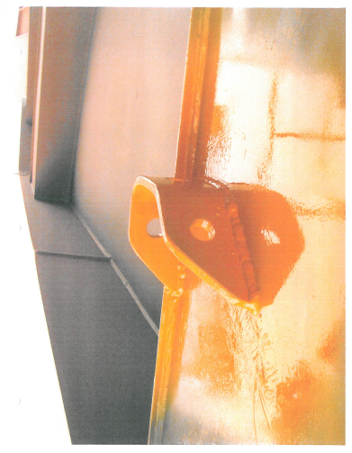
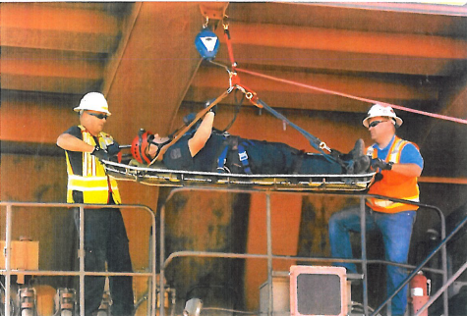
Spotlight On
Climax: Field Observations Drive Organizational Safety Improvements
While planning a haul truck rescue exercise at Climax, a team member identified the need for dedicated anchor points on CAT 789 haul trucks to safely recover operators from truck beds.
The initial focus was on adding anchor points to the Climax 789 fleet but quickly expanded to incorporate the new Schlam truck beds arriving later this year.
This concept, along with installing tie-off points during manufacturing, are now being evaluated as a standardized solution across Freeport operations.
Why It Matters:
A simple observation from the field sparked conversations that could improve emergency response and worker protection across the organization.
Never underestimate the impact of raising a safety concern. One question, observation or idea can lead to meaningful improvements that create a more consistent and safer approach for all Freeport fleets and employees.
Anchor point installed on haul truck
Emergency haul truck rescue exercise using anchor points

Slide 8
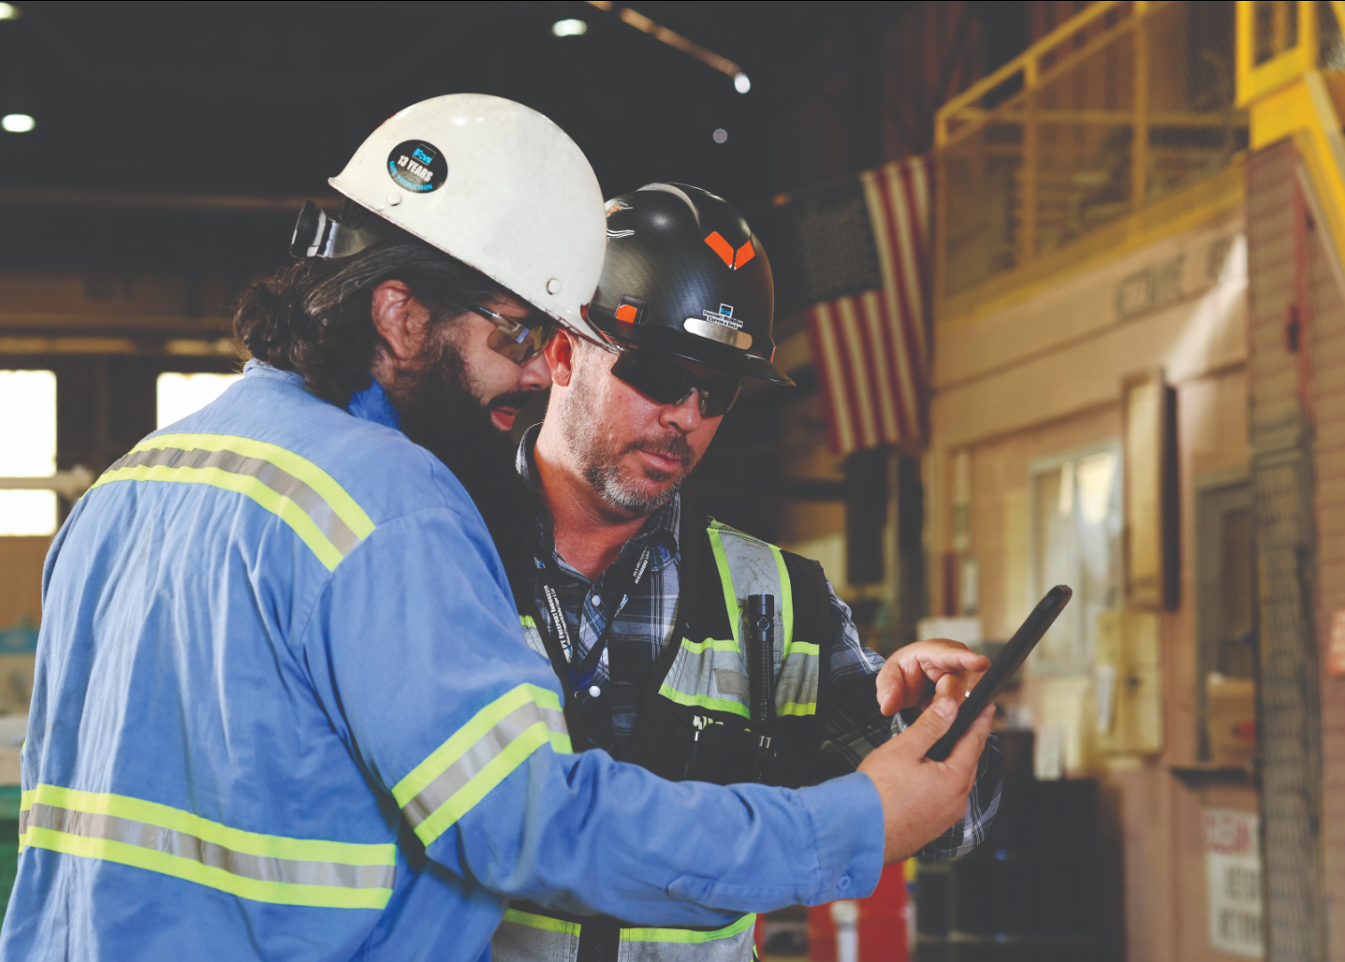
Safety Shares

Slide 9
Extreme Weather Preparedness
Conditions can change quickly. Extreme heat or cold, high winds, lightning, heavy rain, and snow can create new hazards, even during routine work.
Discussion
What weather hazards could affect our work today?
Where should we go, and how will we communicate, if conditions require us to stop work or seek shelter?
What are our emergency response procedures for our work area?
Before and During Work
Emergency Preparedness
Stay informed: Monitor weather alerts and changing conditions.
Plan ahead: Address weather-related hazards in pre-task planning and identify shelter or evacuation routes.
Stay connected: Maintain communication with your supervisor and work group.
Secure the area: Secure tools, equipment and loose materials that could shift or become airborne.
Monitor yourself and others: Watch for signs of heat stress, cold stress, fatigue or distress.
Stop work: Pause the task and notify your supervisor if conditions become unsafe or uncertain.
Follow site-specific emergency procedures and instructions from emergency personnel.
Know your designated shelter, evacuation route and assembly area.
Use established site communication or emergency radio process.
Do not enter or re-enter an affected area until hazards have been assessed and it has been declared safe.

Slide 10
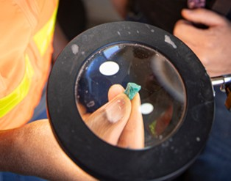
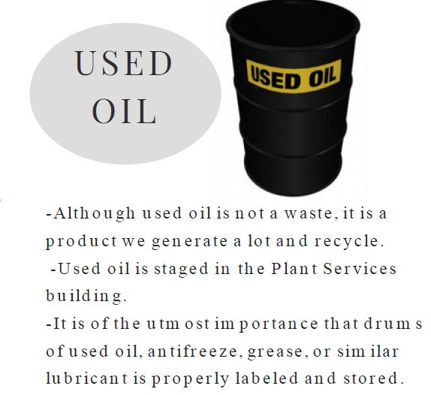
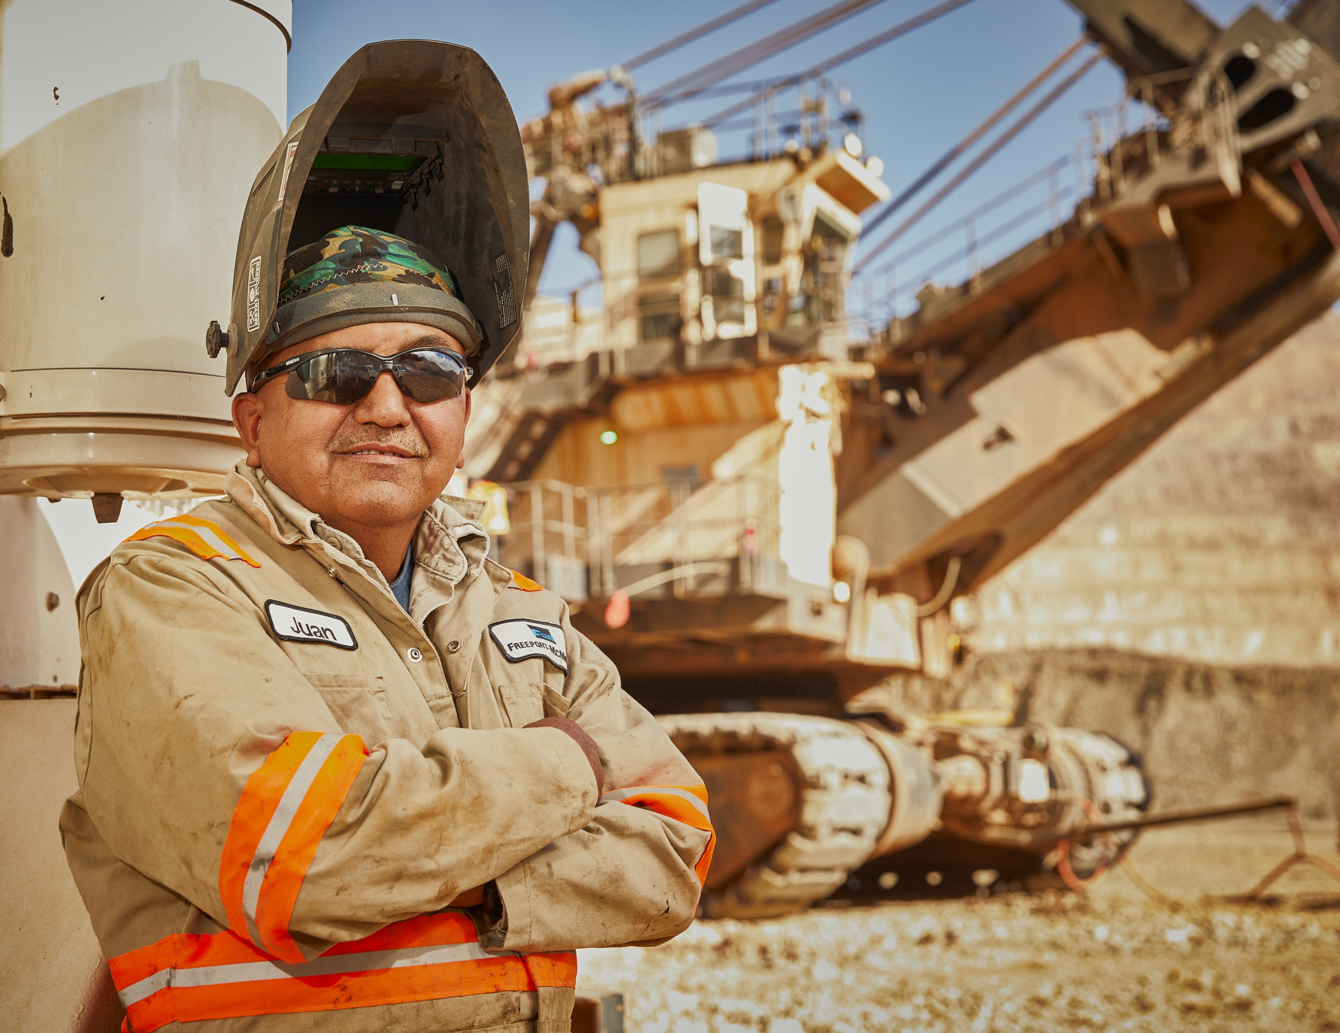
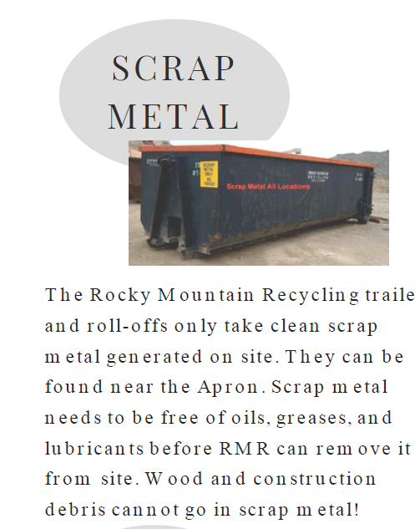

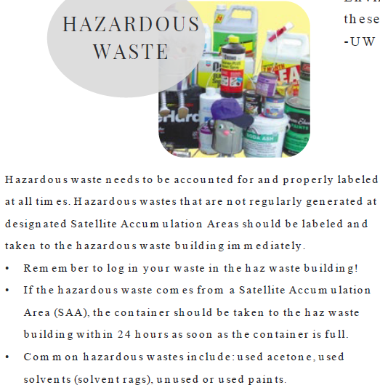
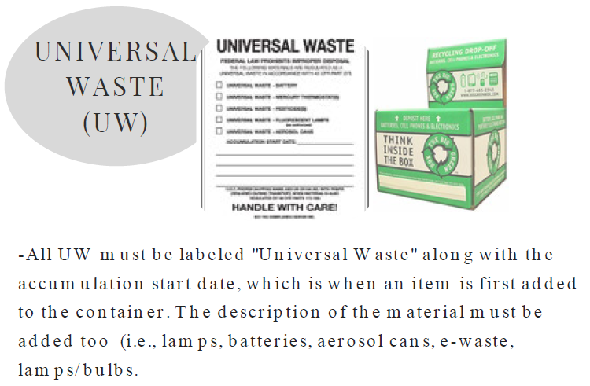
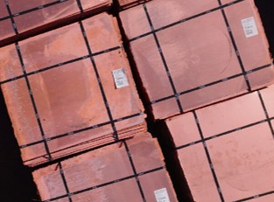
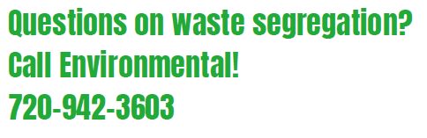
Waste Segregation
Keeps us SAFE and in Compliance!

Slide 11
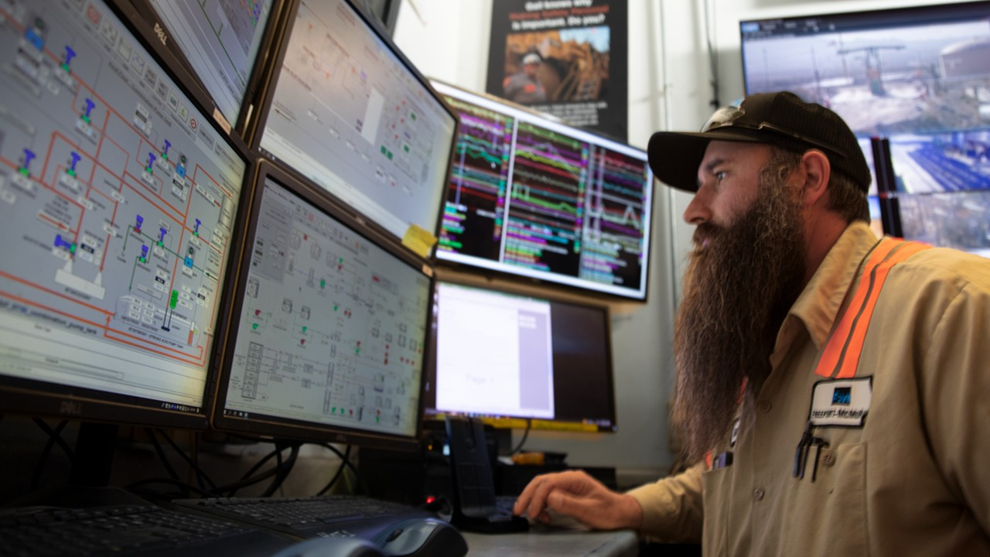
Policy/Process Updates & Reminders

Slide 12
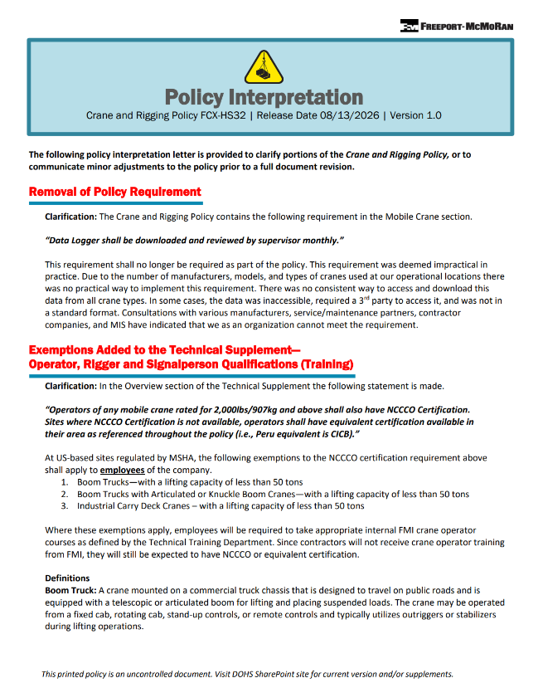
FCX-HS32 Rigging Interpretation Letter
To address questions and promote consistent application of the FCX-HS32 Crane and Rigging Policy, a new policy interpretation letter has been issued.
The letter clarifies existing policy requirements and outlines minor adjustments including:
Removal of the requirement for monthly downloading and supervisor review of mobile cranes data logger information due to implementation challenges across equipment types and manufacturers.
Clarification of NCCCO certification requirements for certain company-operated boom trucks and industrial carry deck cranes at U.S. MSHA-regulated sites, including exemptions and associated training expectations.
Touch base with your Project Manager for access.

Slide 13
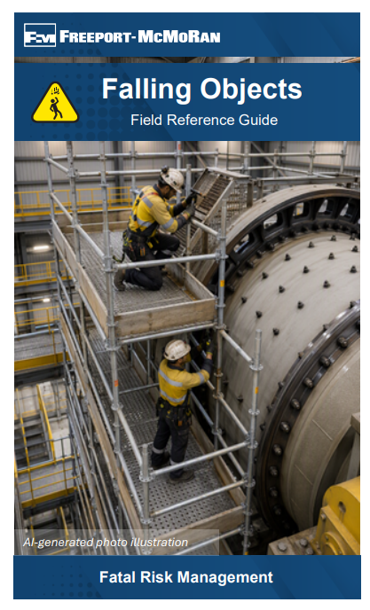
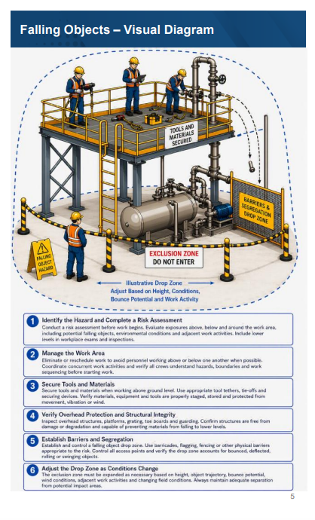
Falling Objects Field Reference Guide
To support ongoing efforts to prevent high-risk incidents related to falling objects, FMI has developed a new Falling Objects Field Reference Guide.
The guide is designed as a practical field tool to help identify hazards, verify controls and facilitate meaningful conversations with crews about falling object risks. It includes:
Hazard recognition tips
Verification questions
Visual examples
Recent high-risk incident examples
Touch base with your PM for access.

Slide 14
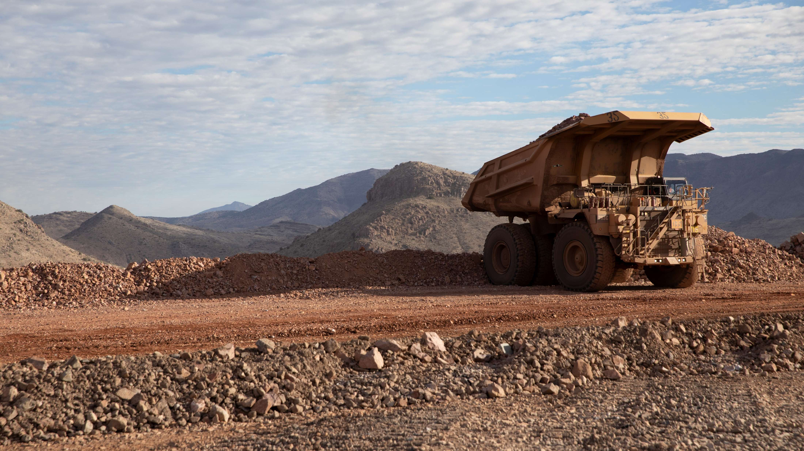
High-risk Incidents
Actionable and PFEs

Slide 15
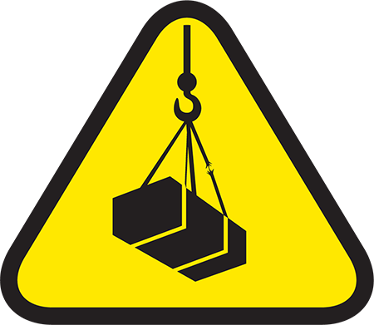
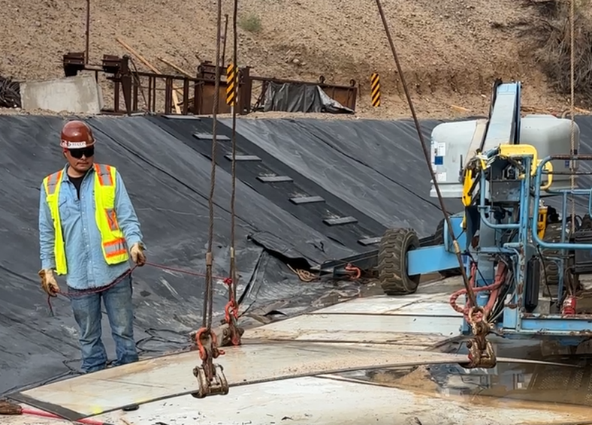
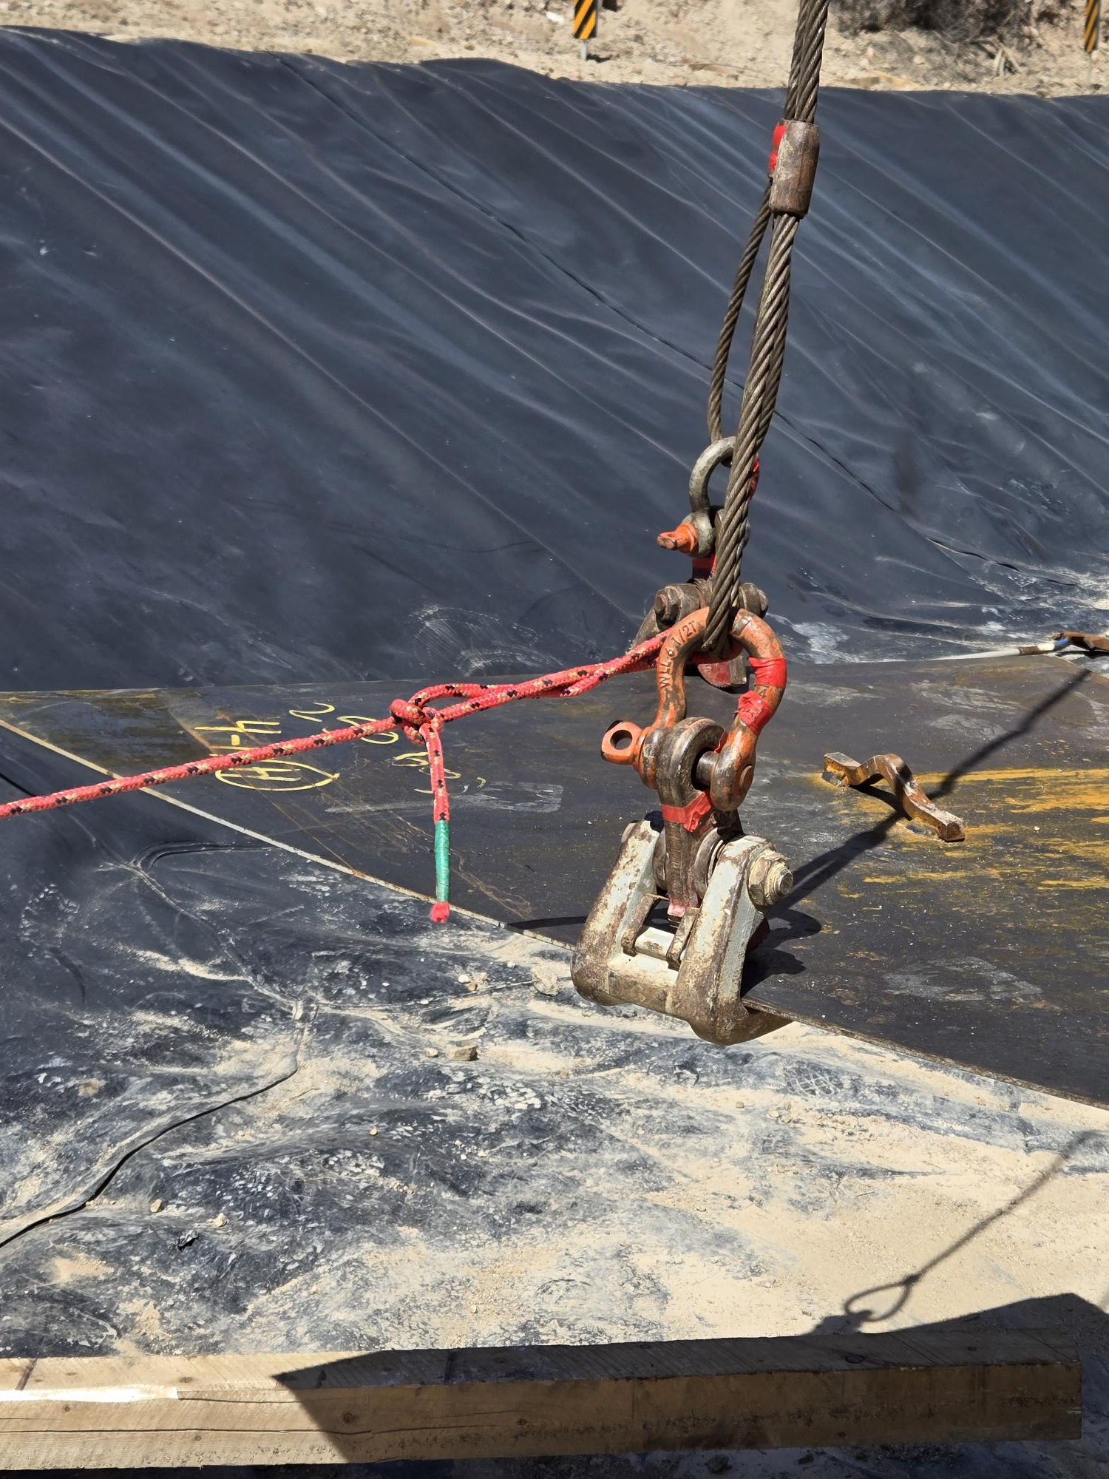
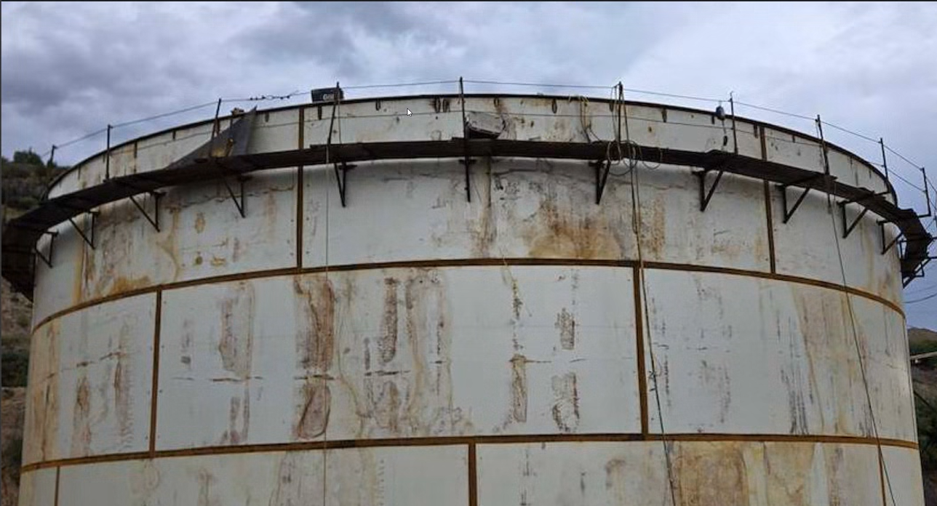
Employee Struck by Steel Plate
PFE # 2026-10 Event ID # 20038371
Lifting Operations
Preliminary Incident Details
Operation | Miami
Date / Time | July 27, 2026 / 3:30 p.m.
Event Type | Injury – Medical Treatment
Summary | A contractor was lifting a 3x6-foot, 140-pound triangular carbon steel plate approximately 30 feet to the top of a tank. One welder was on top of the tank, and a second welder was on an installed work platform near the top. When the welder on top grabbed the tagline – which was anchored to the plate clamp rigging for proper positioning – the plate clamp released. The plate slid approximately 3-4 feet out of the other two clamps, striking the welder on the platform. The plate came to rest on the platform, where it was secured to prevent it from falling.
Risk Category | Actionable – Significant (3) Likely (3)
Findings / Missing Controls | The risk of falling objects/lifting operations was identified in the JSA and known by the crew. During the lift, the injured employee was positioned in the line of fire. An exclusion zone was established (red flagging) to prevent entry to the general work area. No exclusion zone was established for the workers near the top of the tank. The tagline was attached to the rigging for one of the clamps. Pulling the tagline may have relieved the tension required to keep the plate clamp secure.
Immediate Action(s) | Audit rigging materials, tagline locations and clamps for plate lifts. Do not attached taglines to rigging hardware. Verify specialized contractors are competent and qualified for their assigned tasks.
Applicable Policies / Procedures | FCX-HS32 Crane and Rigging Policy
Employee Condition | The employee sustained superficial abrasions and bruising.
Contact | Justin Taylor, Manager-Health and Safety
Re-enactment of plate and rigging set up for lift. See tagline location
Clamp, rigging and tagline setup
Employee positions and plate location on top of tank and on catwalk.

Slide 16

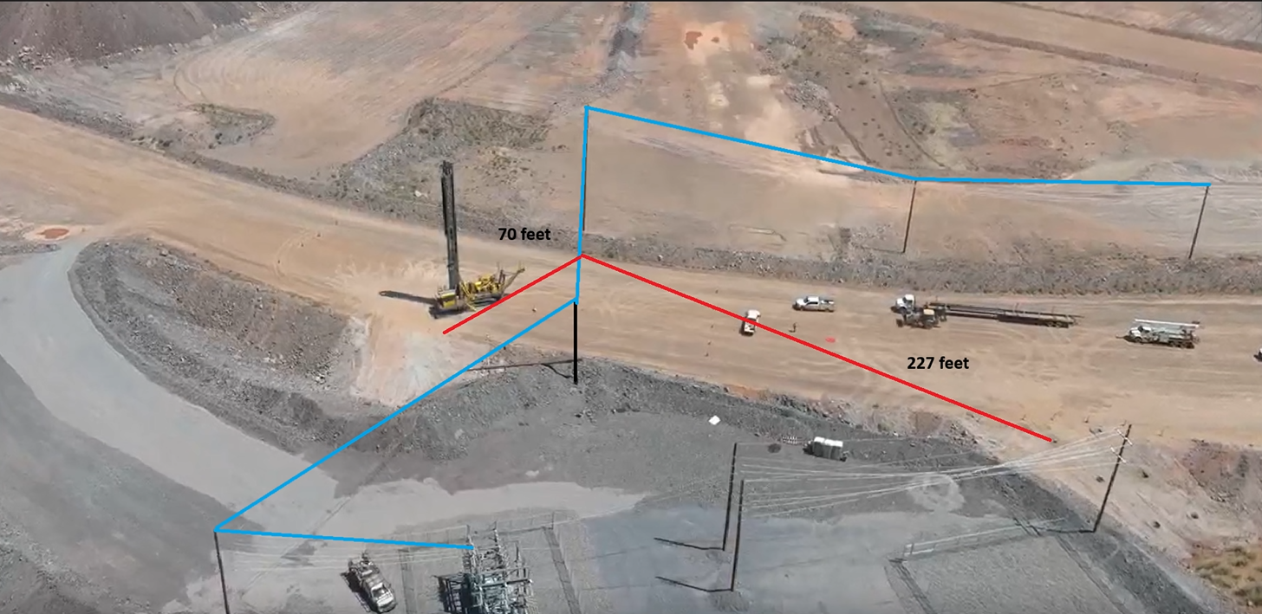
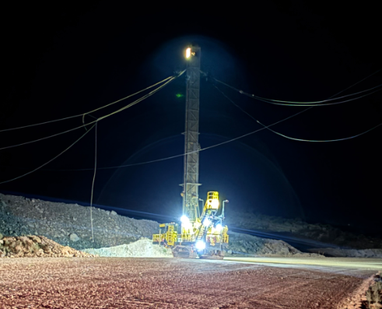
Drill Contacted Power Line
Exposure to Electrical Hazards
ID # 2026-17 Event ID # 20038706
Preliminary Incident Details
Operation | Safford
Date / Time | August 6, 2026 / 9:30 p.m.
Event Type | Property Damage
Summary | A production drill was drilling grounding holes for the B15 electrical substation relocation project. While tramming to the second drill pad, the drill contacted an overhead power line that had been installed the day before. The line had not yet been tied into power. The impact from the drill caused one pole to snap at the base and fall. The operator noticed they had contacted the line when they heard the pole break. They stopped work and called for supervision. The SIG alarm was operational in the drill.
Risk Category | Actionable – Significant (3) Likely (3)
Findings / Missing Controls | The power line was not attached to the substation and was not energized. Standard process for this task was not followed, including use of a production drill which is not typical. The power line was not visible nor communicated to the night shift.
Immediate Action(s) | Take time to assess non-routine tasks and identify hazards. Thoroughly note hazards and new developments on planning documents. Communicate new installations or changes in the area and stop work when plans change.
Applicable Policies / Procedures | FCX-HS04 Control of Hazardous Energy Policy
Employee Condition | No injuries.
Contact | Shannon Jeans, Manager-Health and Safety
Incident location: The drill tramming path is noted in red and the impacted power line is represented in blue.
Photo of drill and powerline

Slide 17

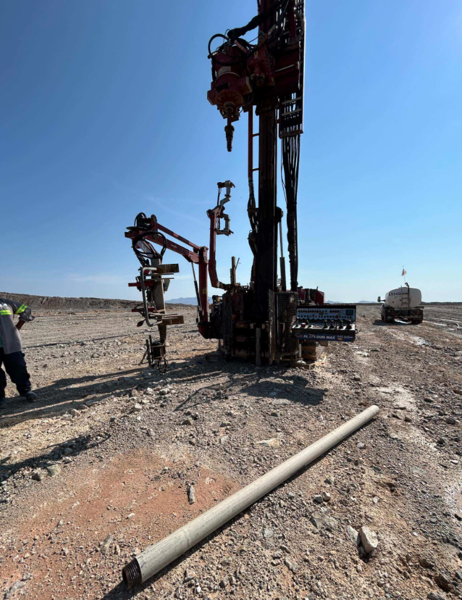
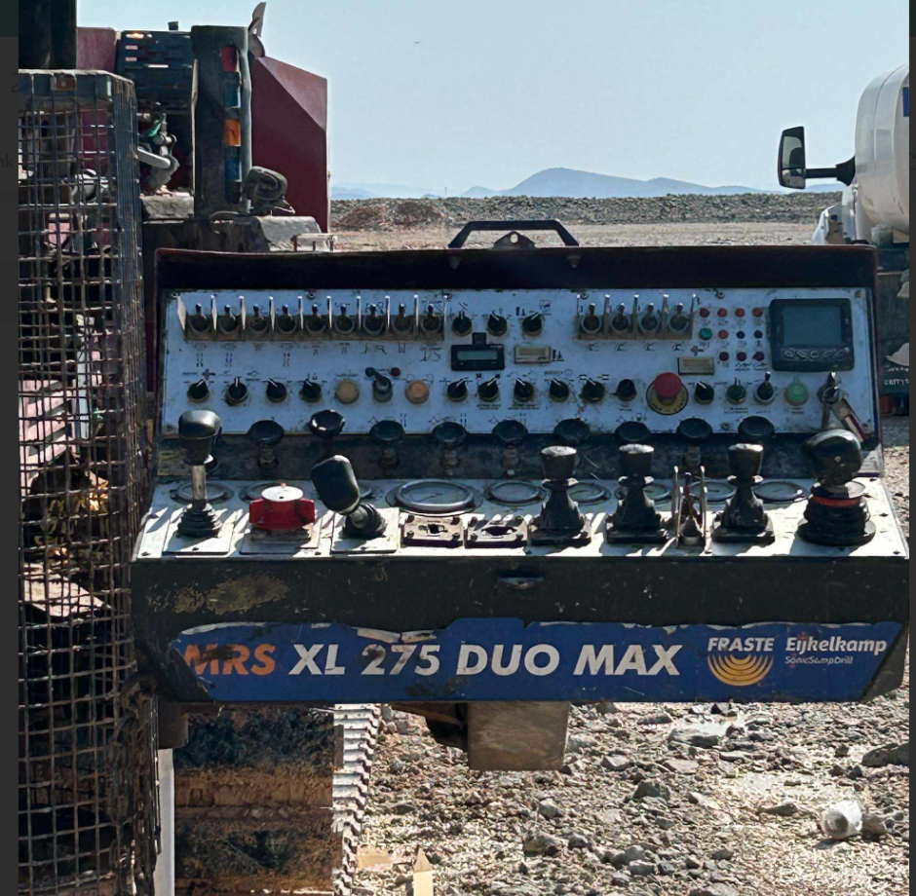
Drill Steel Fell from Clamp
ID # 2026-19 Event ID # 20038799
Falling Objects
Preliminary Incident Details
Operation | Miami
Date / Time | August 10, 2026 / 8:55 a.m.
Event Type | Property Damage
Summary | A drill steel rod was removed from the drill hole and moved over to the clamp to unscrew it. Once it was disconnected from the drill head and the head was moved out of the way, it slowly fell out of the clamp. The operator was able to move out of the line of fire before the drill steel struck the equipment's control panel.
Risk Category | Actionable – Significant (3) Likely (3)
Findings / Missing Controls | Pipe clamp was not fully engaged or secured around the pipe.
Immediate Action(s) | Evaluate operator positioning to remove line-of-fire exposure. Miami changed the process for taking pipe and placing it back on the trailer. Moving forward, the control panel will be rotated out and to the side.
Applicable Policies / Procedures | No applicable policy.
Employee Condition | No injuries.
Contact | Justin Taylor, Manager-Health and Safety
Damaged control panel
Drill and steel that fell

Slide 18

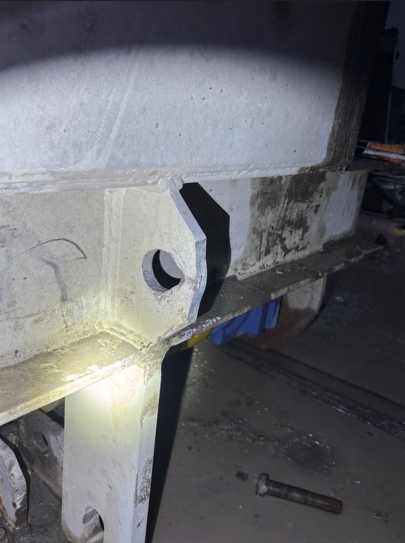
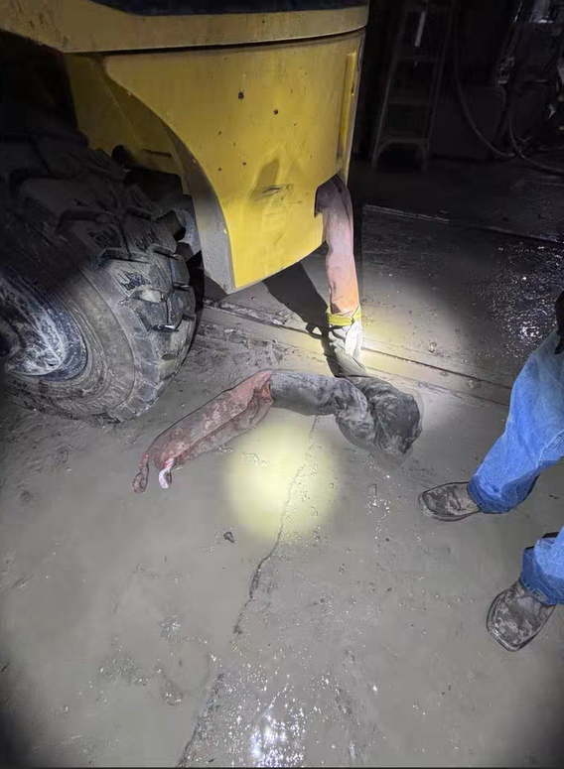
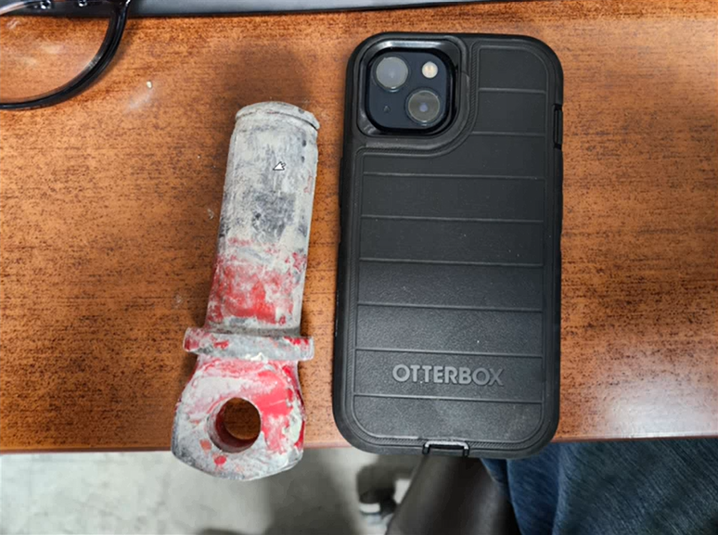
Clevis Pin Struck Employee Leg
Uncontrolled Release of Energy
ID # 2026-18 Event ID # 20038843
Preliminary Incident Details
Operation | Chino
Date / Time | August 11, 2026 / 10:30 p.m.
Event Type | Injury – Lost Time
Summary | Mechanics were using a forklift to remove a feed cart from the SAG mill that was blocked by material buildup in the chute. A Kevlar sling connected the forklift to a shackle on the cart. When the forklift tugged on the cart, it shock-loaded the rigging, causing the clevis pin to fail. The pin was ejected and struck a mechanic in the shin approximately 15 feet away.
Risk Category | Actionable – Significant (3) Likely (3)
Findings / Missing Controls | There was no standard operating procedure for this task. Employees were positioned in the line of fire. The rigging was shock-loaded, resulting in failure.
Immediate Action(s) | Update procedure to open the cart door and wash out material prior to removing the feed cart. If a cart or piece of equipment doesn’t want to rollout freely, stop work and reassess. Do not try and jerk the cart. This will shock load the shackles and straps.
Applicable Policies / Procedures | No applicable policy.
Employee Condition | Employee sustained a fractured leg.
Contact | Jim Cook, Manager-Health and Safety
Location of clevis and pin.
Blockage at feed cart.
Size of the pin that was dislodged and struck employee.

Slide 19

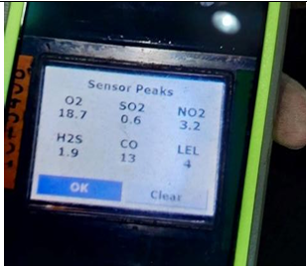
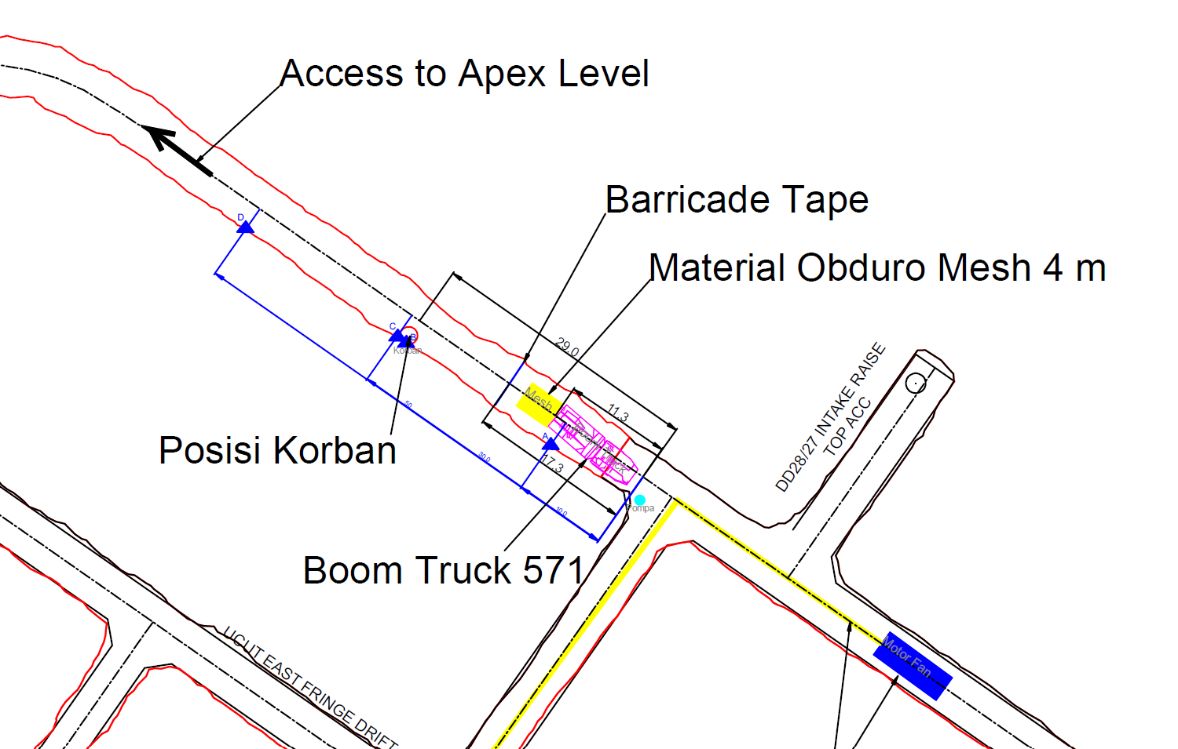
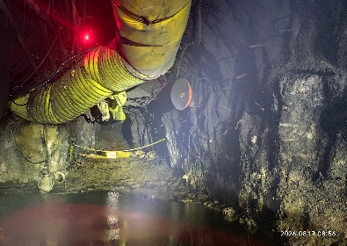
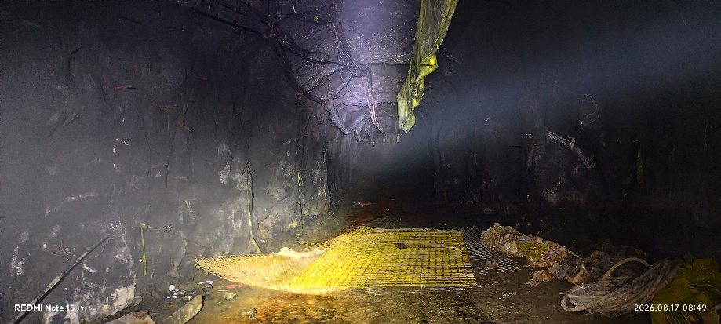
Employee Exposure to CO Gas
Underground Hazardous Atmosphere
PFE # 2026-11 Event ID # 20038973
Preliminary Incident Details
Operation | PTFI
Date / Time | August 16, 2026 / 9:36 a.m.
Event Type | Injury - Medical Treatment
Summary | An unauthorized employee entered a barricaded, non-ventilated heading with low oxygen levels and was overcome by the hazardous atmosphere. After receiving no response to calls and signals, a supervisor crossed the barricade to investigate and found the employee weak and crawling. While running to get help, the supervisor fell and sustained minor facial injuries.
Risk Category | Actionable – Significant (3) Likely (3)
Findings / Missing Controls | Employee entered an unventilated heading without a gas detector. Supervisor was assigned a gas detector but left it in the boom truck. The no-ventilation area was barricaded with caution tape rather than a chain as required by the standard operating procedure.
Immediate Action(s) | Respect barricades. Do not enter any area unauthorized. Carry and use gas detection equipment as intended. Audit work areas to confirm areas without ventilation are properly barricaded.
Applicable Policies / Procedures | SOP-6.01-UG-C16_Sign & Barricade in UG SOP Eng Protect Employees from Hazardous Gas
Employee Condition | Employee with COHb levels of 0% was released from the hospital Supervisor COHb levels of 0% remained under observation for a pre-existing medical condition.
Contact | Matthew Sullvan, Operations-Mine Underground
Gas detector reading
Incident location map
Incident location with plastic barricade
Incident location with no ventilation

Slide 20
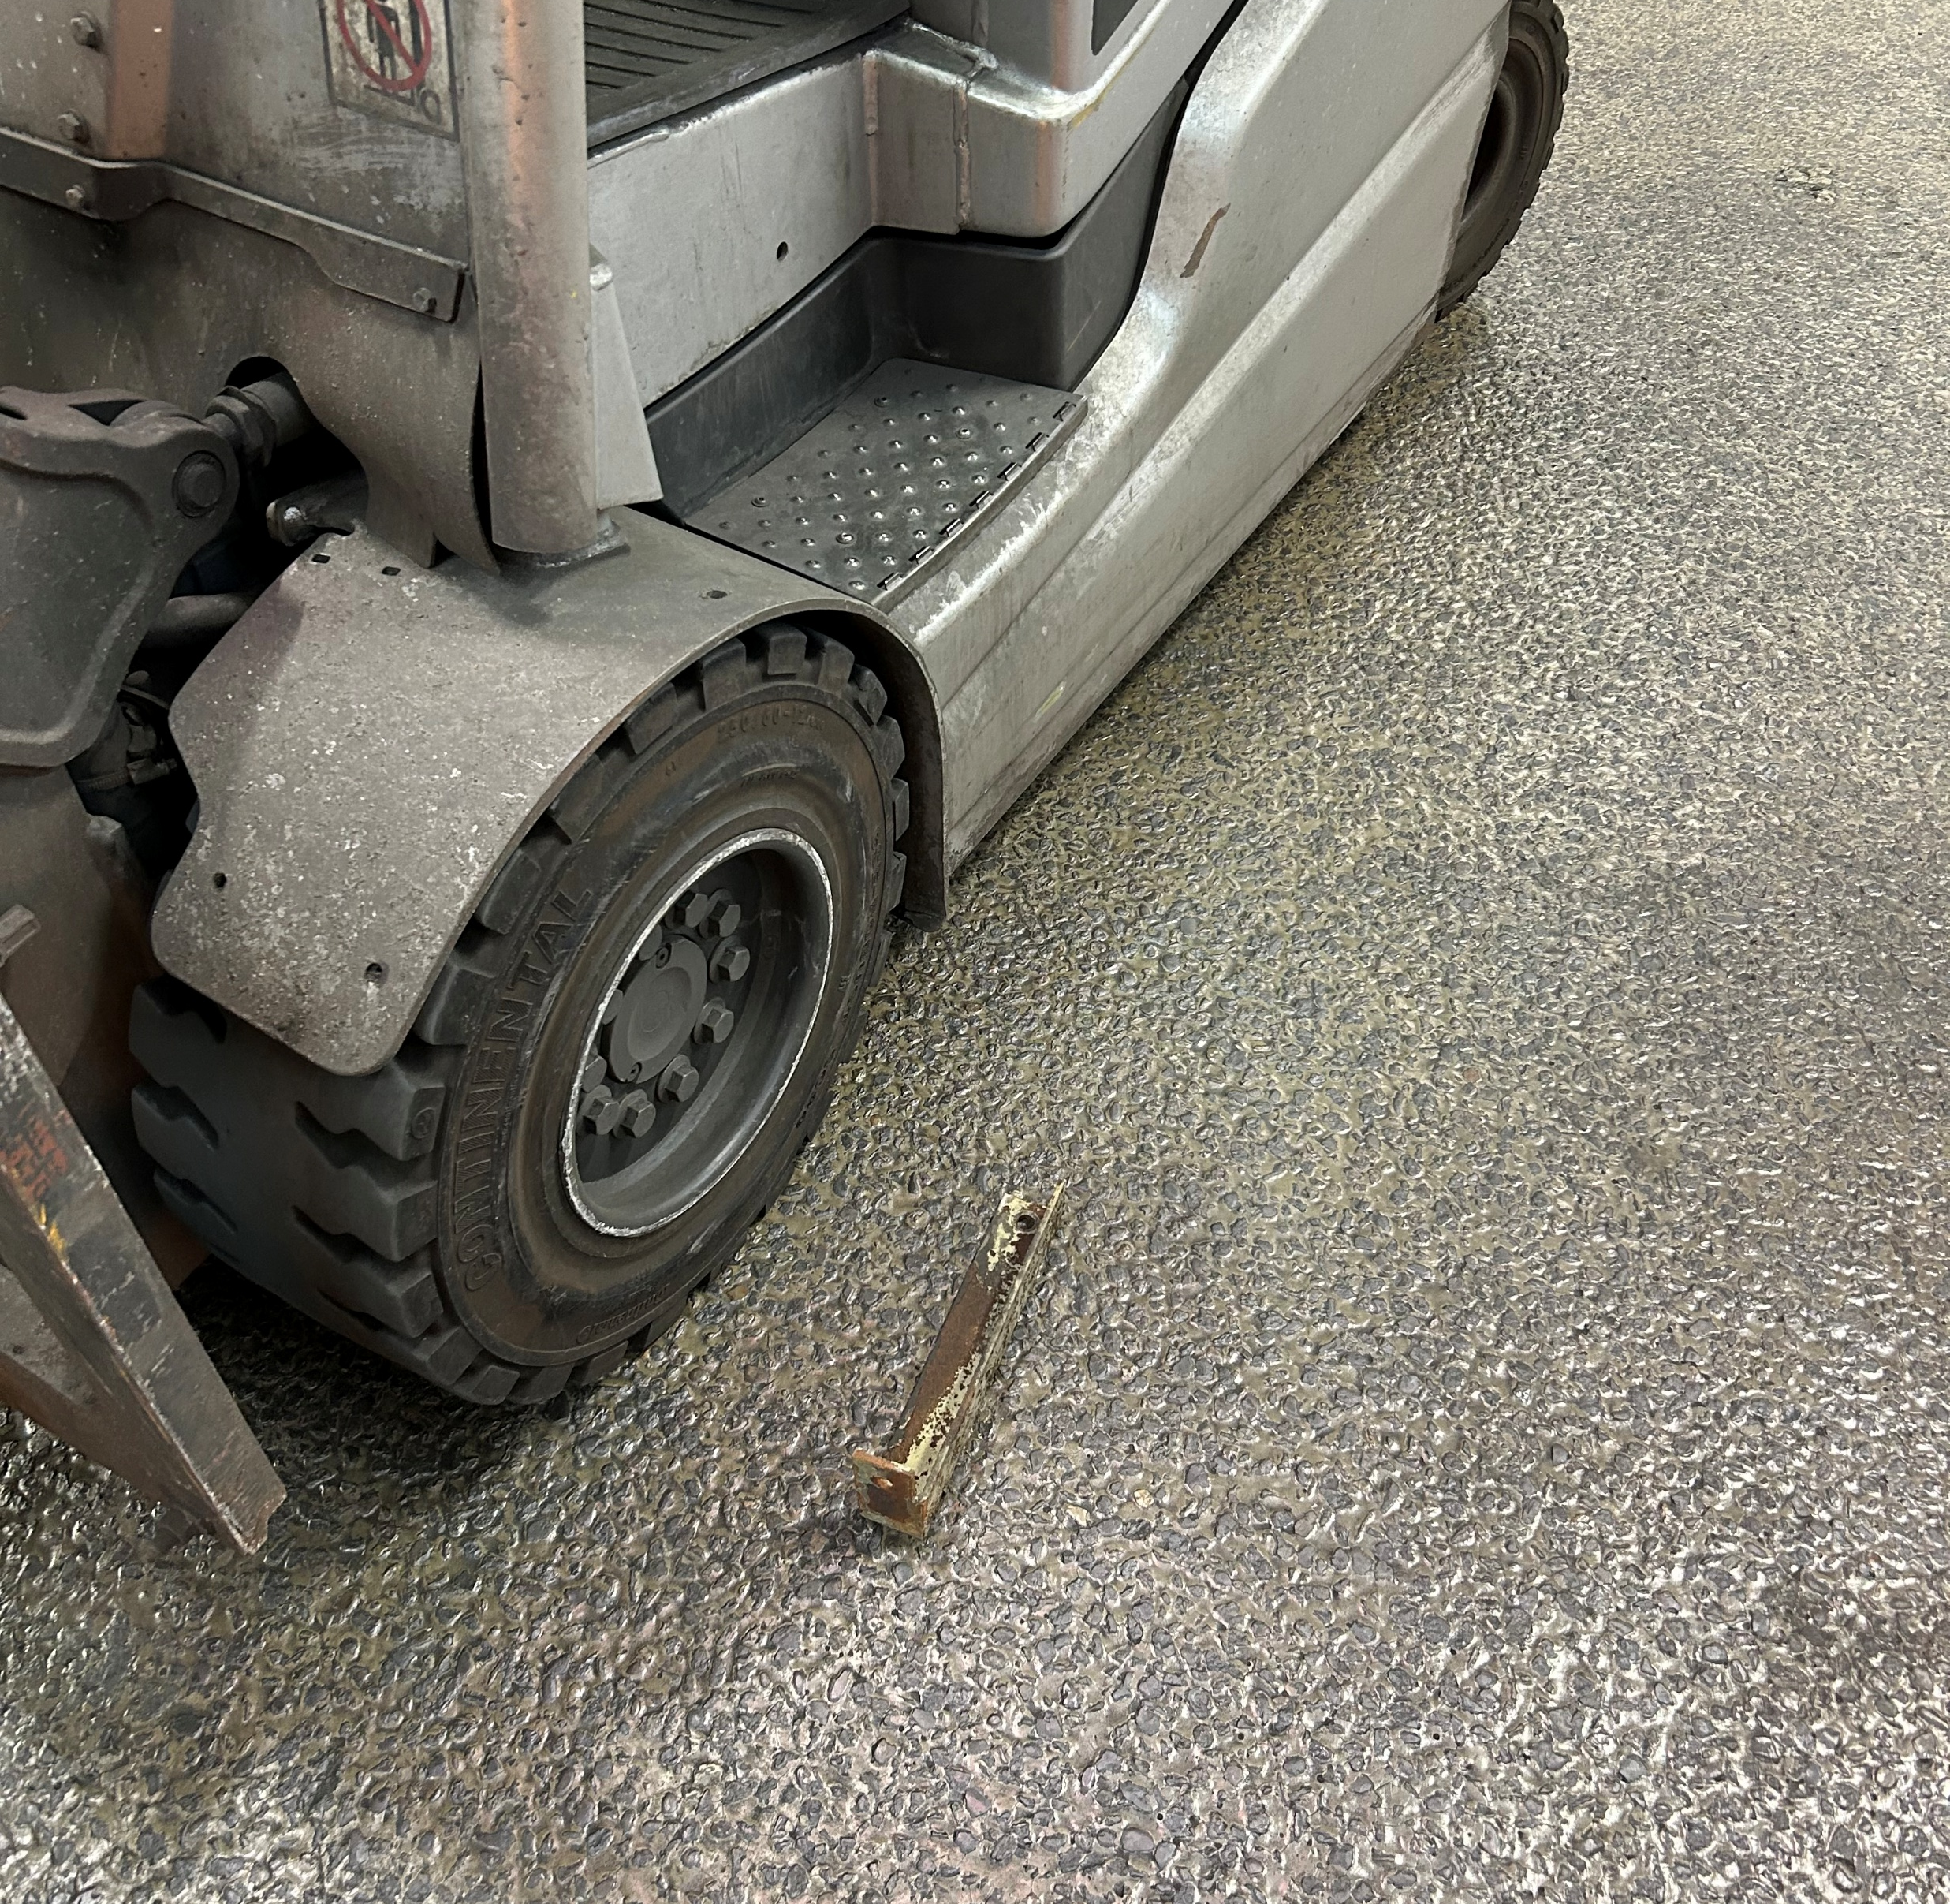
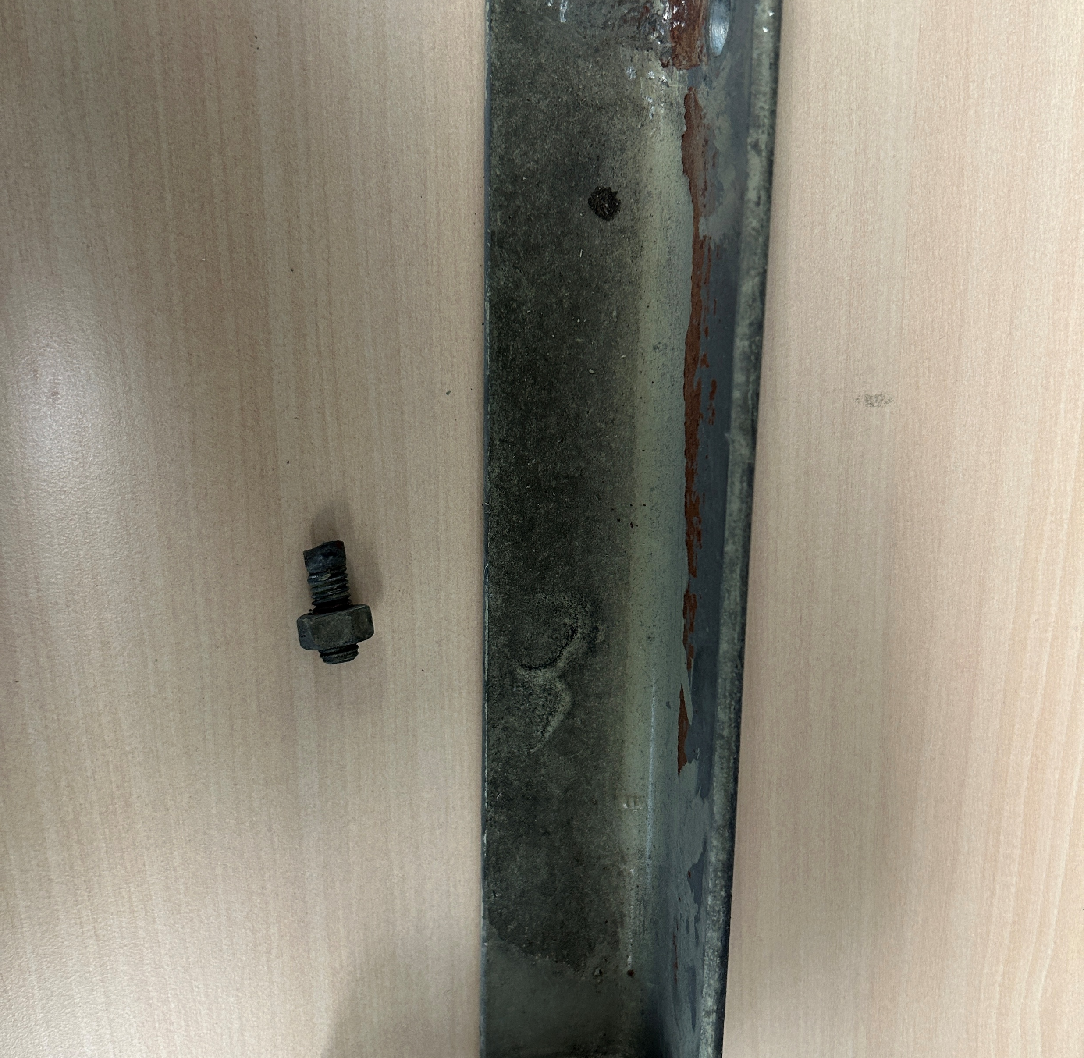
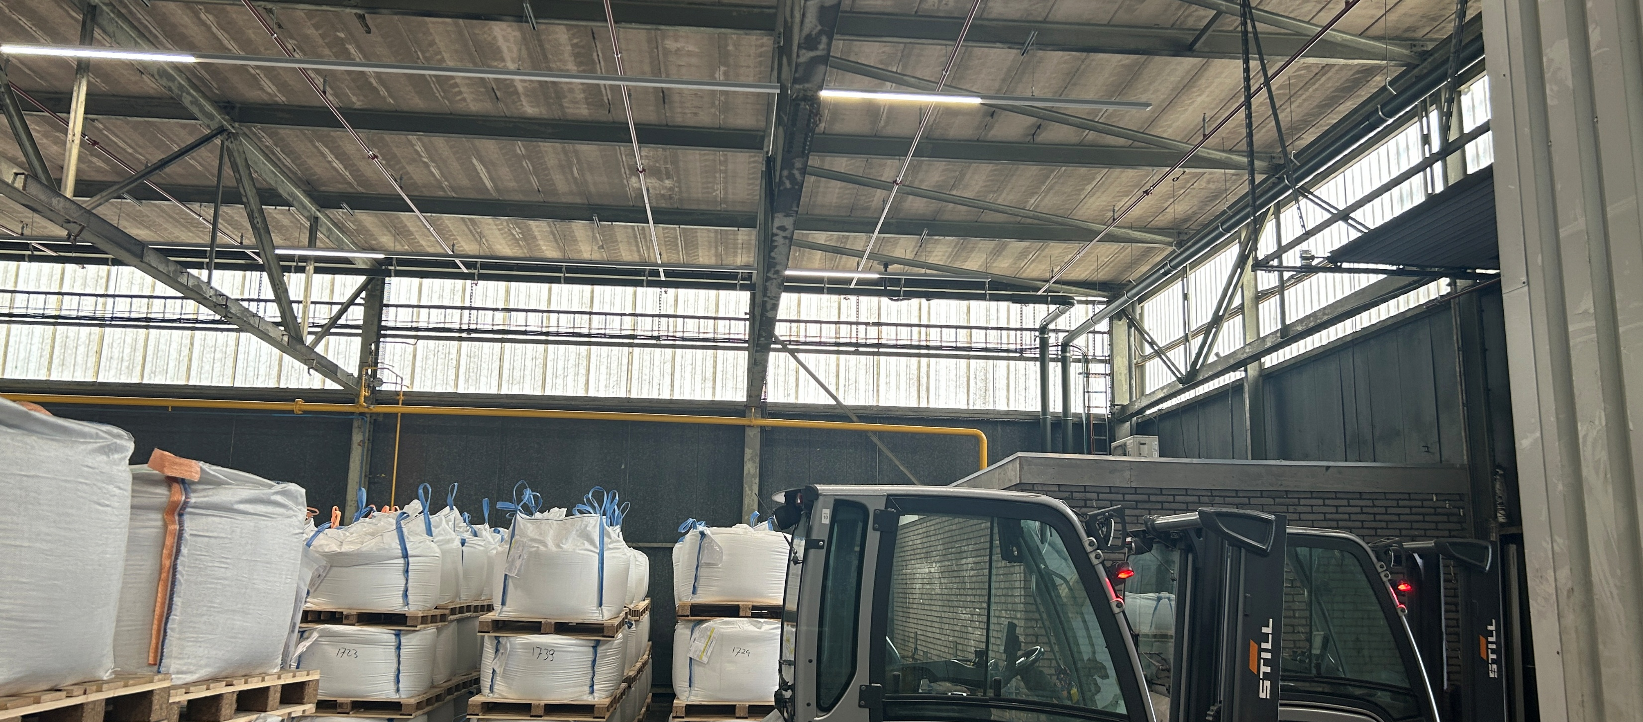
Piece Of Metal Fell From Roof
ID # 2026-20 Event ID # 20039015
Falling Objects
Preliminary Incident Details
Operation | Rotterdam
Date / Time | August 17, 2026 / 10:20 a.m.
Event Type | Near Miss
Summary | During asbestos remediation work, a steel support fell from the roof and landed next to a forklift. The support was part of an old fire suppression system that had not been identified during planning. During inspection and removal activities, one remaining support was inadvertently overlooked. When the final section of the ventilation structure was being dismantled, the bolt securing the missed support was cut, causing the support to fall.
Risk Category | Actionable – Significant (3) Likely (3)
Findings / Missing Controls | The work area was not barricaded as it was believed all supports were removed. Old fire suppression system impact was not identified during the planning phase.
Immediate Action(s) | Review work plans, procedures and risk assessments to verify hazards are adequately identified and appropriate controls are in place before beginning work.
Applicable Policies / Procedures | FCX-HS02 Working at Heights Policy
Employee Condition | No injuries.
Contact | Bryan Provacia, Manager-Health, Safety and Quality Systems
Fallen piece of metal next to the forklift.
Fallen piece of metal.
Location of incident.

Slide 21
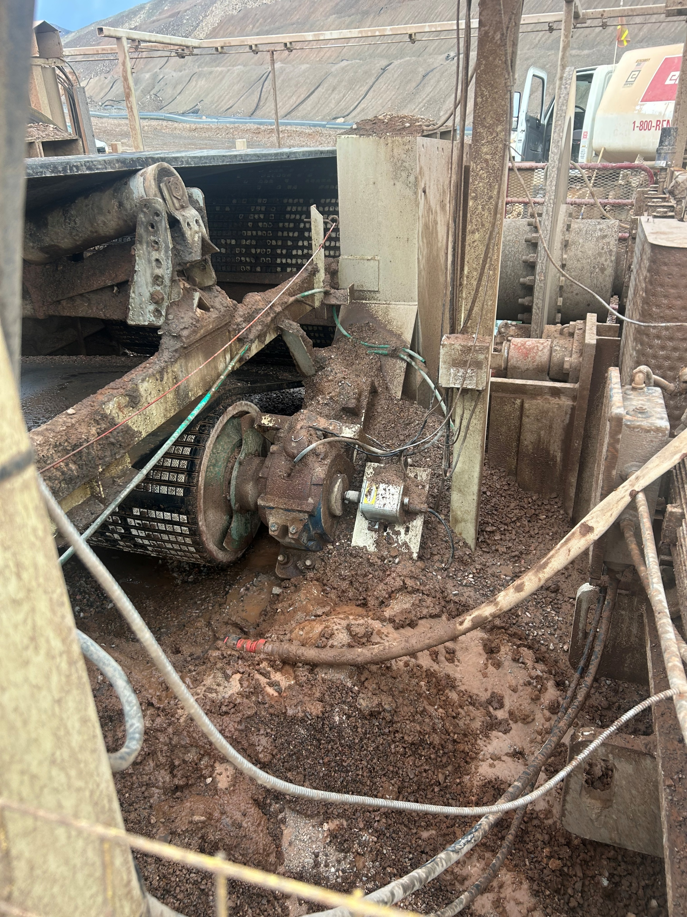
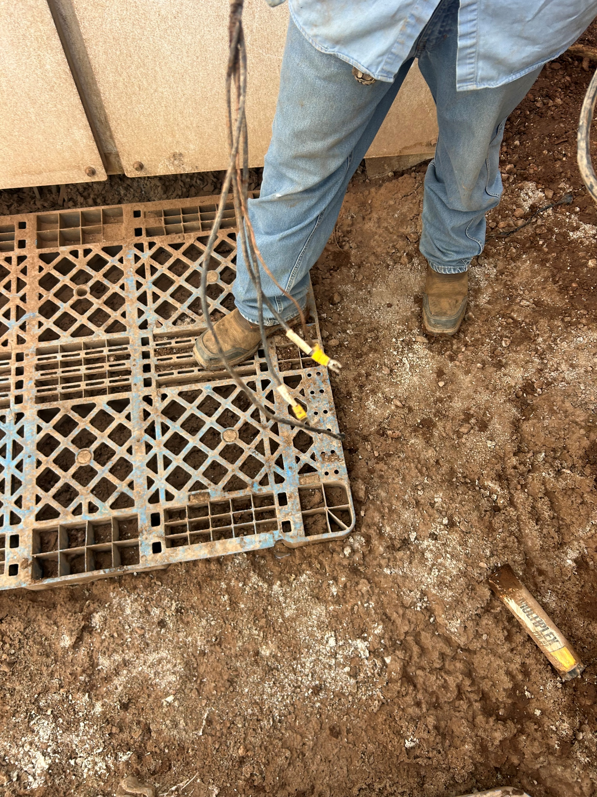
Employee Shocked by 120-Volt Cable
Exposure to Electrical Hazards
PFE # 2026-13 Event ID # 20039086
Preliminary Incident Details
Operation | Safford
Date / Time | August 19, 2026 / 4:00 PM
Event Type | Near Miss
Summary | A maintenance employee in the Crush Convey area experienced an electrical shock while cleaning beneath a tail pulley using a water hose. The employee was crouched in a wet, muddy area when they felt a tingling sensation that traveled from their finger through the back and leg. The employee immediately stopped work, exited the area and notified supervision. A post-event investigation found a 120-volt energized cable buried beneath the work area. The cable was output wiring associated with a PLC-controlled heater that remains installed but is no longer in service. The cable had exited the cable tray and was buried approximately 3 feet below the surface in the work area. Electricians de-energized the circuit, tagged it Out of Service and secured the cable in the cable tray.
Risk Category | Actionable – Significant (3) Likely (3)
Findings / Missing Controls | The work area contained standing water, mud and uneven ground conditions, increasing the potential consequences of electrical contact. Maintenance activities are routinely performed in the work area every two weeks.
Immediate Action(s) | Treat hidden energy sources as a potential hazard, even after equipment is removed from service. Use thorough work planning, effective inspections, proper electrical system management, continual questioning and verification to prevent serious injuries and fatalities. Review breakers routinely for unused circuits that may still be hot.
Applicable Policies / Procedures | FCX-HS04 Control of Hazardous Energy Policy
Employee Condition | The employee was evaluated and released with no reported injury.
Contact | Shannon Jeans, Manager-Health and Safety
Location of incident
120-volt energized cable

Slide 22
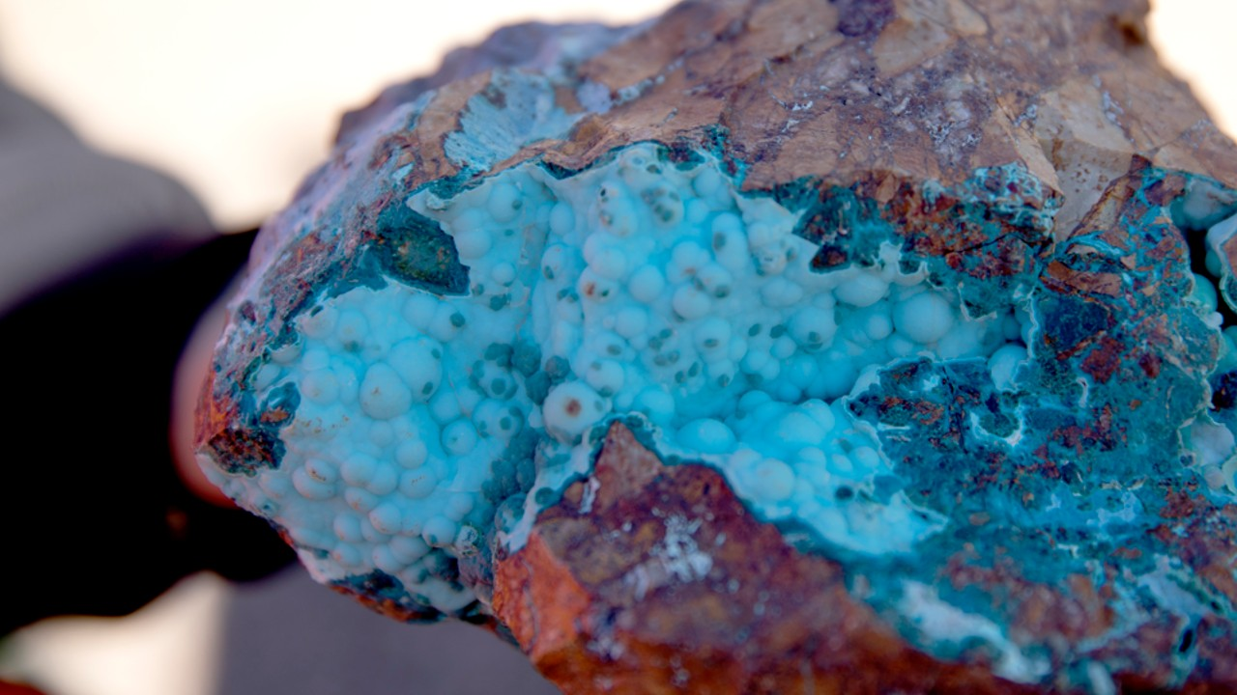
Industry Incidents

Slide 23

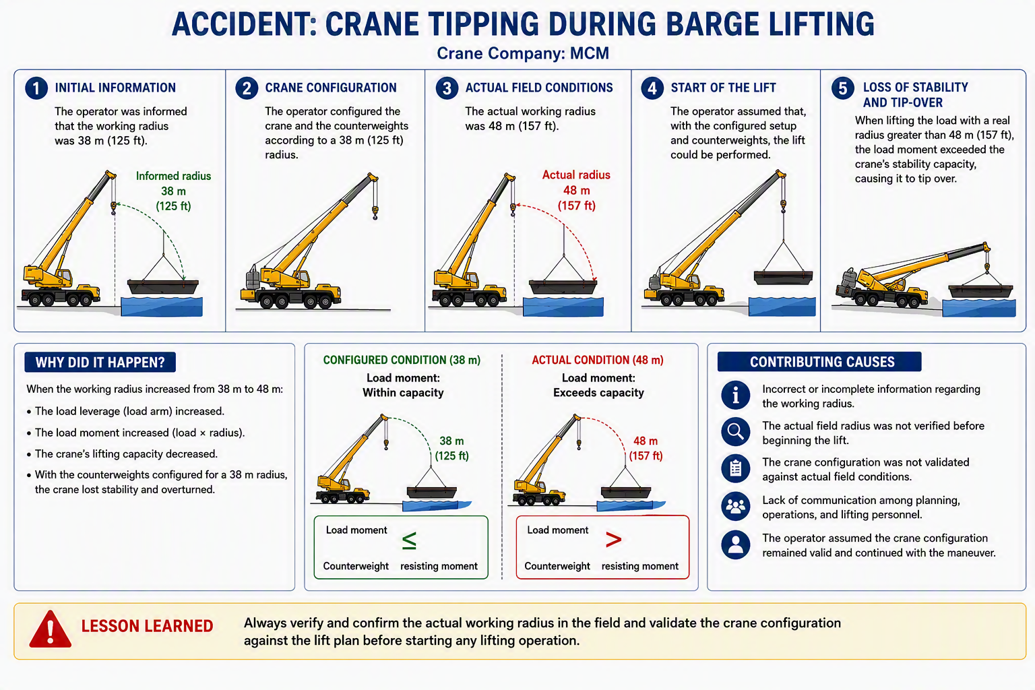
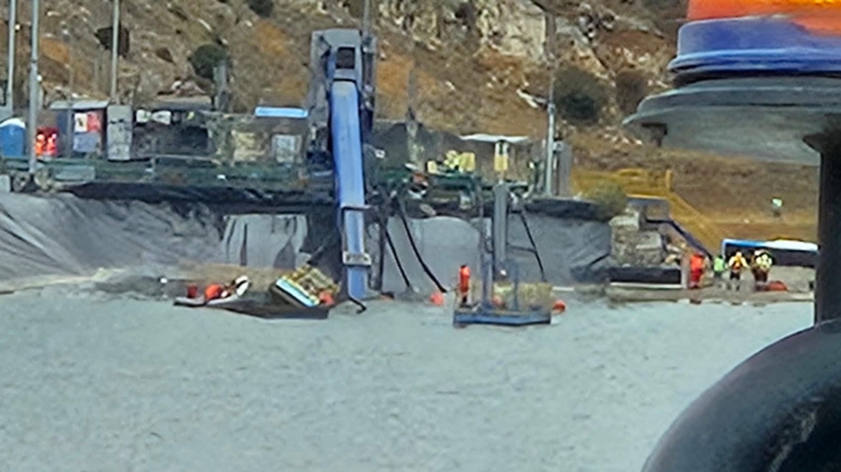
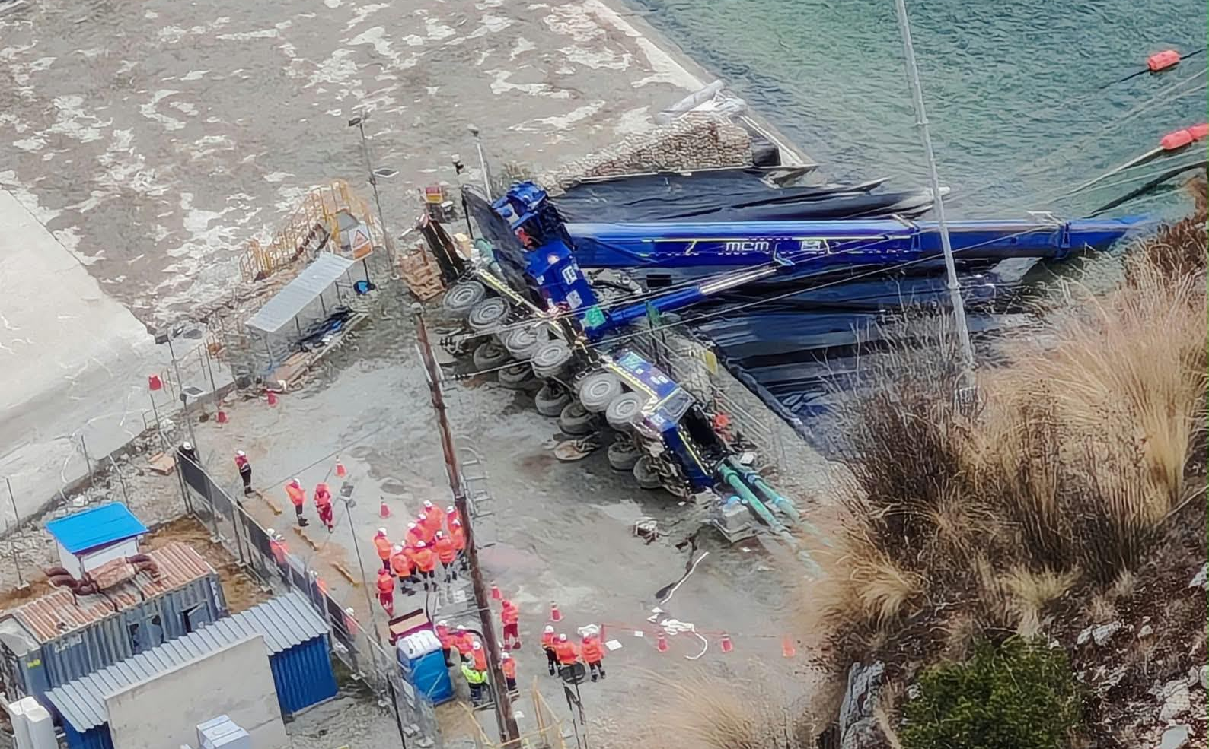
Crane Tipped During Barge Lift
Drowning
Lifting Operations
Incident Details*
Operation | Minera Las Bambas – non-Freeport site
Date / Time | August 18, 2026 / 11:30 a.m.
Event Type | Fatality
Summary | A 300-ton crane truck was replacing a pump at a clarification pond. The crane truck made a quarter-turn, and the boom struck a barge where five workers were located. Three workers were able to escape. The other two workers became trapped and submerged inside the pond.
Findings / Missing Controls | When the working radius increased from 38 meters to 48 meters: The load leverage (load arm) increased The load moment increased (load x radius) The crane’s lifting capacity decreased The crane lost stability and overturned (counterweights were configured for 38-meter radius)
Contributing Factors | Incorrect or incomplete information regarding the working radius. The actual field radius was not verified before beginning the lift. The crane configuration was not validated against actual field conditions. Lack of communication among planning, operations and lifting personnel. The operator assumed the crane configuration remained valid and continued with the maneuver.
Immediate Action(s) | Always verify and confirm the actual working radius in the field. Validate the crane configuration against the lift plan before starting any lifting operation.
Applicable Freeport Policies / Procedures | FCX-HS32 Crane and Rigging Policy
Photos of non-Freeport site incident scene
*Information compiled from published external sources.

Slide 24
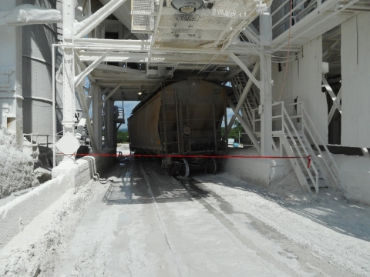
MSHA Fatality Alert
July 6, 2026 – A miner died when a covered hopper railcar derailed and pinned him against a structural beam of a train load out silo.
Eliminate Hazards and Prevent Injuries
Maintain railroad track and load-out areas to help ensure safe operating conditions consistent with the speed and type of haulage used.
Control drainage where wet processes are used.
Confirm workplace examinations are conducted to identify and correct hazardous conditions before work begins.
Always provide and maintain a reliable communication system.

Slide 25
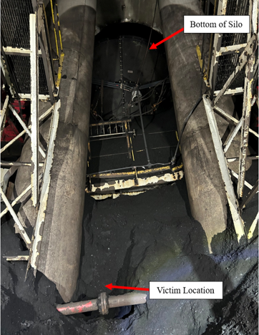
MSHA Fatality Alert
July 11, 2026 – A contract miner was seriously injured after being engulfed by coal spillage while shoveling beneath a silo. On July 20, 2026, the miner died from complications related to those injuries.
Eliminate Hazards and Prevent Injuries
From a safe location, remove all loose material that could fall or slide before working or traveling beneath bins and silos.
Verify miners are positioned where they are not exposed to falling or sliding material hazards.
Examine working places to identify the potential for falling or sliding materials.
Train miners to recognize and safely remove all potential hazards before beginning work.

Slide 26

MSHA Fatality Alert
July 29, 2026 – A contractor miner was injured after falling approximately 18 feet through an opening located on the fifth floor of the surface portion of the #3 hoist and landing on the floor below. On August 1, 2026, the contractor miner died from complications related to those injuries.
Eliminate Hazards and Prevent Injuries
Provide and maintain safe access to all working places.
Protect miners from unguarded openings above, below or near travelways through which persons may fall, by installing and maintaining guardrails, barriers or covers for openings.
Make sure miners wear safety belts and lines where there is a danger of falling. Confirm fall protection has a suitable fall arrest connection and secure anchorage system.
Conduct complete and thorough examinations of working places.

Slide 27



Additional Resources
Health and Safety Dashboard
Safety Toolkits
FCX Policies
MSHA Safety Alerts
OSHA

Slide 28


Site Incidents

Slide 29
Henderson Incidents
08/28 – Mechanic impacted by Object (First Aid)
  Contractor performing maintenance to replace transducers on Getman A64 Proshot
  Pressure valve confirmed off
  Residual release of pressure occurred causing a transducer to hit the mechanic’s arm
  Work stopped, minor abrasion observed and individual transported for med evaluation
  RCA identified equipment had different chassis than other A64 unit, required different steps to relive hydraulic pressure
  Corrective actions in place/in-progress to prevent future incidents

Slide 30
FRM Verification Results – Aug.
166 verifications completed in August
Roughly 21% drop in FRMS from July
Focus for August was Underground Hazardous Atmosphere and Haz. Substance Acute
Haz. Sub. – Acute had no missing controls observed in month
Underground Rock Fall increased
Falling Objects increased significantly due to missing flagging, barricading and/or tags
FOCUS FOR SEPT/OCT:
Underground Rockfall
Falling Objects

Slide 31
FRM Verification Results – Aug.
Henderson Missing Controls with Multiple No Responses
Form | Critical Control | Question | No Answers
Exposure to Electrical Hazards | Labeling & Energy Identification | Are arc flash rating labels up to date and reviewed by a competent person? | 3
Underground Rock Fall | Engineered Support Systems | Are ground control systems in place? | 3
Falling Objects | Barriers and Segregation | Are proper notifications (tagging) legible on the barricades to inform personnel of the hazards? | 2
Underground Rock Fall | Engineered Support Systems | Is work area free from rock slabs, baskets, severely corroded bolts, or expanding/changing cracks in the shotcrete? | 2
Underground Rock Fall | Engineered Support Systems | Support bolts show no signs of loading and are in good condition? | 2

Slide 32
Contractor Management Topics
Contractor Site Access
Business Partner Code of Conduct

Slide 33
Contractor Site Access
Contractors will only be allowed onsite if the following conditions are met:
All contractors must have a site approved HSEP.
All contractors must have an ISN grade of C or above.
No site-approved HSEP and / or a C+ grade =
NO WORK ONSITE.

Slide 34

HSEP-Required Service Order’s: Current Status
54%
SO’s with a completed HSEP
22%
SO’s routing a HSEP through approvals
24%
SO’s with no HSEP submitted for site approval

Slide 35

Business Partner Code of Conduct

Slide 36

Business Partner Code of Conduct Continued…

Slide 37

Expectations for Suppliers

Slide 38

Open Forum

Slide 39
October 8th
November 19th
December 17th
2026 Meeting Schedule
Meetings begin 1 PM MST
Mine and Mill In-Person Options Monthly

Slide 40
September Sign-Off Record
_____________________
_____________________
_____________________
_____________________
_____________________
_____________________
_____________________
_____________________
_____________________
_____________________
_____________________
_____________________
_____________________
_____________________
_____________________
_____________________
_____________________
_____________________
_____________________
_____________________

