Slide 1
SFT FCX1017C
Sulfuric Acid Bulk Handling
VERSION 1 / APRIL 2019
Notes:
SG N/A
Instruction
Welcome students to class
Facilitator introduces self by stating
your position at FMI
how long you have worked for FMI
how long you have worked in mining
Ask students what they want from the course
Discuss what they want to gain from the course
WIFM – “What’s in it for me?”
This increases engagement by getting students vocalizing their opinions from the start of the course
This increases motivation by showing students their ideas matter
Option – Write down or remember what they want to learn. In a few slides, connect their responses to the learning objectives

Slide 2
Expectations
Before We Start
Safety
Breaks/Restrooms
Technology
Participation
Course Evaluation
Class Ground Rules
Notes:
SG N/A
Instruction
Administrative/Classroom policies
Safety – Identify items such as evacuation procedures, gathering areas, emergency exits, and fire extinguisher locations
Breaks and Restrooms
Establish and announce a break schedule to the class. Take breaks after about every hour of instruction
Identify the location of restrooms and smoking areas
Technology policy – Review expectations on cell phone and laptop use during the training
Participation
This course requires significant participation
Students should be prepared for discussions and small group activities
Class ground rules – Verbalize expectations. Suggestions include
Participate
Be on time
Stay on task
Listen when others talk
Respect the opinions and attitudes of others
Student Course Evaluation
Direct students to the Student Course Evaluation at the end of the SG
Tell students to work on this throughout the course
This helps students write ideas down as they have them
Filling it out as they go, also helps gather more substantial feedback as they are not rushed to complete the entire evaluation at the conclusion of the course when they are anxious to leave

Slide 3
Icebreaker
Directions
Participate in an activity getting to know each other
Activity 1
Notes:
SG N/A
Time
Approximately 10 minutes
Materials
Choose an icebreaker from the FG and gather appropriate materials
Purpose
Successful icebreakers encourage students to contribute ideas and experiences thus increasing motivation and engagement in the class
The FG has many icebreakers to use now, after breaks, or any other time

Slide 4
Learning Objectives
Module 1: Risks and Hazards
Identify potential hazards associated with acid handling
Module 2: Controls
Determine appropriate Critical Controls
Summarize “Actions to Stay Safe”
Notes:
SG page iii
Instruction
State objective(s) for each module
Learning objectives are also located at the beginning of each module
Option – If you wrote down or remember the student’s ideas of what they want to learn in the course, connect each response they gave to an objective (even if it is a vague connection). This increases motivation by showing students their ideas matter

Slide 5
Learning Objectives
Module 3: Communication
Explain the communication process while on Freeport-McMoRan property
Module 4: Operations
Discuss the different types of loading and unloading
Outline procedures for entry
Notes:
SG page iii
Instruction
State objective(s) for each module
Learning objectives are also located at the beginning of each module
Option – If you wrote down or remember the student’s ideas of what they want to learn in the course, connect each response they gave to an objective (even if it is a vague connection). This increases motivation by showing students their ideas matter

Slide 6
Learning Objectives
Module 5: Inspections and Audits
List various inspection processes
Module 6: Emergency Responses
Discuss action plan for an emergency situation
Notes:
SG page iii
Instruction
State objective(s) for each module
Learning objectives are also located at the beginning of each module
Option – If you wrote down or remember the student’s ideas of what they want to learn in the course, connect each response they gave to an objective (even if it is a vague connection). This increases motivation by showing students their ideas matter

Slide 7
Fatal Risks and Critical Controls
Fatal Risk Management Program
Fatal Risk – uncontrolled risk that will kill you
Critical Control – implemented to eliminate or reduce the risk for a task/job
Notes:
SG page iv
Instruction
Fatal Risk Management
Continuation of the Fatality Prevention Program
Focus is placed on identifying Fatal Risks and Critical Controls in an attempt to safeguard all employees
Standardizes communication for twenty-three Fatal Risks by implementing icons, definitions, and Critical Controls
Fatal Risks are based on safety issues that have resulted in catastrophic events such as severe injury or death
For each identified Fatal Risk a list of necessary Critical Controls was developed to prevent or mitigate the most serious consequences of these risks. Once the Fatal Risk is identified, applying the most effective Critical Control is crucial
A Critical Control is a device, system, or process implemented to eliminate or reduce the risk for a task/job, and if missing or overlooked has the potential to lead to catastrophic outcomes such as serious injury or death
These Critical Controls are considered the most impactful on preventing a fatality or injury and have been previously established based on data
The absence or failure of a Critical Control significantly increases the risk of severe injury or death despite the existence of other controls
The Fatal Risk(s) and Critical Controls relevant to this course are provided next

Slide 8
Exposure to Hazardous Substances – Acute
Immediately toxic, asphyxiating, or corrosive substances
Critical Controls
Notes:
SG page iv
Instruction
The Exposure to Hazardous Substances Acute Fatal Risk is defined as workplace exposure to substances that are immediately toxic, asphyxiating or corrosive (e.g. H₂S gas, NO₂ gas, CO gas, concentrated acids, caustics, etc.)
Discuss the Critical Controls
Access Control
Alarm Systems
Engineered Controls
Handling Requirements
Loading and Unloading Protection
Mechanical Integrity of Storage and Distribution
PPE

Slide 9
Rail Impact on Person
Rail equipment contacting person
Critical Controls
Notes:
SG page v
Instruction
The Rail Impact on Person Fatal Risk is defined as locomotive, rolling stock, or other rail equipment coming into contact with a person
Discuss the Critical Controls
Access Control
Equipment Maintenance
Positive Communication System
Securing Rolling Stock
Segregation
Signaling and Signage

Slide 10
Uncontrolled Release of Energy
Stored energy from pressure
Items under tension or compression
Critical Controls
Notes:
SG page v
Instruction
The Uncontrolled Release of Energy Fatal Risk is defined as exposure to stored energy from pressure (e.g., pneumatic systems, hydraulic systems, steam, tires, etc.); Items under tension or compression (e.g., mooring lines, springs, counterweights, etc.)
Discuss the Critical Controls
Energy Isolation/LOTOTO
Guards, Barriers and Barricades
HDPE Management
Hose Coupling Lock System
Piping Hoses and Equipment Mechanical Integrity
Relief Valves
Tensioned Lines Management
Tire Management

Slide 11
Vehicle Impact on Person
Person struck by vehicle/mobile equipment
Critical Controls
Notes:
SG page v
Instruction
The Vehicle Impact on Person Fatal Risk is defined as person struck by vehicle/mobile equipment
Discuss the Critical Controls
Fundamentally Stable Parking
Positive Communication System
Segregation
Signage and Demarcation
Vehicle Preoperational Inspection

Slide 12
Introduction
Educate personnel
Safe procedures
Handling Requirements: Site SOPs
Audits
Notes:
SG page vii
Instruction
This course is intended to educate personnel on standardized operating and safety procedures for loading, unloading, and transporting bulk concentrated sulfuric acid
Handling Requirements
Operators need to be familiar with site SOPs (Standard Operating Procedures) when completing the task
NOTE: Contractor drivers get site SOPs from their employer. If you do not have an SOP, ask for one at site security
Contact Training department for additional training requirements for additional site-specific courses
Audits
During loading or unloading activities, site personnel may be present to observe the process
NOTE: What they might look for: PPE in good working order, verification that safety showers and eyewashes are being tested, facial hair does not interfere with the seal on the respirator (operators must be clean shaven if wearing a tight fitting respirator), etc.

Slide 13
Module 1: Risks and Hazards
Notes:
SG page 1
Instruction
Review learning objectives for the module
Upon completion of this module, students will be able to
Identify potential hazards associated with acid handling

Slide 14
Hazard Identification
Hazard Control
Risk Assessment
Risks Associated with Acid Handling
Notes:
SG page 5
Instruction
Hazard Control
Hazard control begins with recognition
A hazard is “any source of potential damage, harm, or adverse health effects on something or someone under certain conditions at work”
Throughout this training, different hazards encountered in the workplace are addressed. Even though there are specific processes in place for risk analysis, every employee must be able to evaluate the risks associated with any given hazard
Some hazards such as slips, trips, and falls are easily recognized. However, other hazards such as some chemical exposures are not as easy to identify. Therefore, being able to recognize hazards helps determine and implement controls to reduce risk
With so many hazards in each workplace, it is difficult to be knowledgeable of them all, so ask questions of your coworkers, supervisors, health and safety representative, and other area experts
Risk Assessment
Using Hazard Identification, Risk Assessment, and Determination of Controls (HIRDAC), project managers and contract management work with site supervision and Health and Safety to identify fatal risks associated with the work and tasks being performed
Employees and contractors are also responsible for using HIDRAC
Risks Associated with Acid Handling
Safety is of utmost importance when handling a chemical like sulfuric acid
The acid itself is highly corrosive and can cause irreversible damage if the acid comes into contact with skin or eyes or if ingested

Slide 15
Contact with Sulfuric Acid
Effects of Exposure
Inhalation
Contact with Skin
Contact with Eyes
Ingestion
Notes:
SG page 5-6
Instruction
Have students study the chart on page 6 of the Student Guide. Point out that the effects can range from mild to severe depending on the severity of the exposure
Operators should immediately seek medical attention after any exposure with eyes, skin, inhalation, or ingestion
Use care in the process to avoid exposure of sulfuric acid

Slide 16
Fatigue
Effects on performance
Actions to manage fatigue
Notes:
SG page 7
Instruction
Fatigue is commonly described as feeling tired, worn out, run down, or lacking energy
Fatigue is a common reaction to exertion, lack of sleep, boredom, or stress and often results in less than optimal performance on the job
Fatigue is a workplace hazard that can jeopardize the health and safety of a worker
Each person is affected by fatigue in different ways such as reduced performance, lack of judgement, reduced reaction time, etc.
Acid handling may be a task that is likely to cause fatigue
The physical nature of the task coupled with environmental factors such as extreme temperatures from working outside contribute to workplace fatigue
Follow Freeport-McMoRan or your regulatory agency or company fatigue management policies to ensure adequate rest between shifts
To manage fatigue:
Eat healthy meals and snacks
Drink fluids throughout the day
Take breaks
Seek medical help for persistent fatigue

Slide 17
Heat-Related Issues
Dehydration
Loss of electrolytes
Acclimatization
Personal fitness
Past illness
Medical conditions
Notes:
SG page 8
Instruction
Have students look at the chart on page 8 of the Student Guide
Ask participants what they can do to replenish loss of electrolytes. Provide examples if necessary
The best way to prevent heat-related issues is to avoid one in the first place
Immediately contact your supervisor or site contact if you or a coworker is experiencing any heat-related symptoms
Listed are a few measures for heat-related issues that may occur on the job
Heat-related issues can become progressively worse if not addressed
Take precautions with early signs of heat-related issues

Slide 18
Heat-Related Illness
Heat rash
Heat cramps
Heat exhaustion
Heat stroke
Notes:
SG page 8-9
Instruction
Have students review the chart on page 9 of the student guide
Ask participants if they have ever experienced or witnessed any heat-related illness
Heat cramps are the earliest sign of heat stress
If precautions to cool off and rehydrate at this point are not made, the more severe stages of heat-related illness can occur in a rapid progression
The chart shows the causes, symptoms, and treatment of heat-related illnesses

Slide 19
Unsafe Working Conditions
Red Alert/Weather
Gas Hazards
Leaks
Housekeeping
Defective Equipment
Fit for Duty
Notes:
SG pages 10-12
Instruction
Unsafe working conditions come in many forms.
It is important to be aware of hazardous conditions and to make good choices about what actions to take to stay safe
Possible Unsafe Conditions:
Red Alerts/Weather
Acid loading/unloading stations are located outdoors where workers are exposed to the elements
Weather events can create potentially hazardous conditions
Alerts and warning systems vary from site to site. Familiarize yourself with warning systems at each site
Gas Hazards
Hazardous gases may be present when loading or unloading
In extreme situations, this can be Immediately Dangerous to Life and Health
In an evacuation, check the direction of the wind using the windsock
Ask participants how to read a windsock and ask what the windsock is telling them about direction during an evacuation
Travel in the opposite direction of the wind and uphill if possible
Leaks
Secure fittings so that leaks do not develop
Contact control room if leaks are present
Housekeeping
Keep the work area orderly
Defective Equipment
Incidents involving faulty or damaged equipment are a common cause of injury in the workplace
Before loading or unloading acid, check that safety showers and eyewashes are operational. If any problems are noted, communicate with the control room, and all work must be stopped until the showers and eyewashes are fully operational
Personal protective equipment or PPE is worn to help minimize exposure to hazards. If PPE is defective or damaged, all work must be stopped until proper PPE can be worn
Fit for Duty
Individuals that are not fit for duty may present a safety risk to themselves and others
Individuals need to perform duties safely

Slide 20
Stopping Work
Stop the job in unsafe conditions
Evaluate the situation
Focus attention to task
Notes:
SG page 12
Instruction
Everyone has the responsibility to stop the job when conditions are unsafe. Taking the time to stop work is a critical component of stopping incidents
Many of our past incidents could have had a much safer outcome if someone had taken the time to stop work and discuss what the hazards are and how to control them
Stopping the job may be uncomfortable, but it keeps employees safe. It allows us to take a step back, evaluate the situation calmly, and focus our full attention on the job and task. We all are empowered to stop the job when conditions are unsafe or if Critical Controls are not in place
When work is stopped because of unsafe conditions, report your findings to the control room, FMI employee, Health and Safety, or site security if the situation cannot be immediately corrected
Ask students if they have ever stopped a job. Have them explain the circumstances and the outcome

Slide 21
Module 1 Quiz
Directions
Complete the quiz in the Student Guide
Discuss the answers as a class
Quiz
Notes:
SG page 13
Instruction
Give students time to write answers to the quiz questions in the SG
Review the answers as a class using the slides

Slide 22
Module 1 Quiz
During an inspection of an eye washing station, you determine one of the sprayers is not working. What should you do?
In an emergency, use the side that is working
Stop the job and report the problem to the control room or security
Report the problem to security when you exit the property
Use care when unloading
Notes:
SG page 13
Instruction
Discuss answer as a class
Click to circle the answer (SG p. 11)

Slide 23
Module 1 Quiz
Put the heat-related illnesses in order from least severe to most severe.
Least Severe: | Heat Rash
 | Heat Cramps
 | Heat Exhaustion
Most Severe: | Heat Stroke
Notes:
SG page 13
Instruction
Discuss answer as a class
Click to show the answer (SG pgs. 8-9)

Slide 24
Module 1 Quiz
What is one function of a windsock?
Alerts workers of dangerous wind events
Gives guidance on the direction to take in an evacuation
Alerts workers when hazardous gases are present
Notes:
SG page 13
Instruction
Discuss answer as a class
Click to circle the answer (SG p. 10)

Slide 25
Module 1 Quiz
4. What are some hazards that may be associated with acid handling? Circle all that apply.
Fatigue
Heat rash
Red alerts/Weather
Gas hazards
Inhalation of vapor
Contact with eyes or skin
*This is not an
all–inclusive list
of hazards.
Notes:
SG page 13
Instruction
Discuss answer as a class
Click to circle the answer (SG pgs. 10-12)

Slide 26
Debrief
What are some key concepts learned in this module?
What do you need to understand better?
What information surprised you?
Notes:
SG N/A
Instruction
Discuss questions on slide

Slide 27
Module 2: Controls
Notes:
SG page 15
Instruction
Review learning objectives for the module
Upon completion of this module, students will be able to
Determine appropriate Critical Controls
Summarize “Actions to Stay Safe”

Slide 28
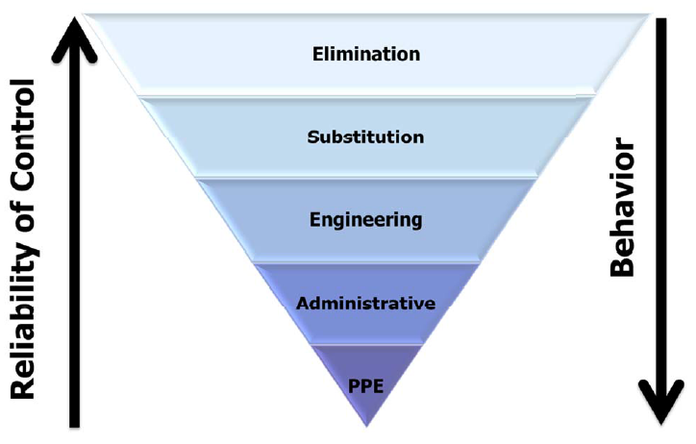
Hazard Control
Hierarchy of Controls
Notes:
SG page 19
Instruction
The five types of controls are shown in order from most effective (Elimination) to least effective (PPE)
Controls are most effective when they do not rely on individual worker behaviors as behaviors may vary from worker to worker
Controls at the bottom (such as PPE and Administrative) are less reliable because worker behavior plays a larger role than the controls at the top

Slide 29
Elimination
Physically remove the hazard
Most effective way to reduce hazards
Challenging to implement
Vent Valve
Notes:
SG page 20
Instruction
Explain Elimination
Physically remove the hazard from the workplace
Most effective way to reduce hazard but sometimes difficult to implement
Elimination Example Used in Acid Handling:
Vent valves are an example of an elimination control used in acid handling
The vent valves are utilized to avoid the need to climb on the tanker platform to open the lid during the unloading process

Slide 30
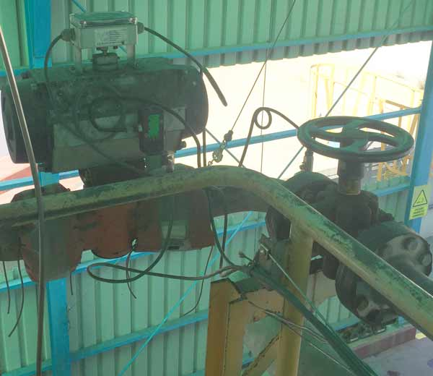
Substitution
Replaces with safer alternative
Sometimes grouped with elimination
Flow Control Valve
Notes:
SG page 20
Instruction
Explain Substitution
Replaces a chemical, substance, material, or practice with something less hazardous
Is sometimes grouped with elimination; both ultimately remove the identified hazard
Substitution Example Used in Acid Handling: At Atlantic Copper, the visual tank level indicator has been substituted with a flow control valve for acid unloading to isolate acid hazards

Slide 31
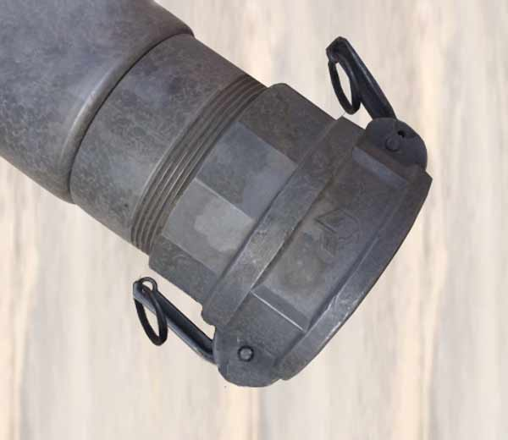
Engineering
Focus on exposure
Block access with barrier
Examples:
Wheel chocks
Hose coupling system
Sight glass
Flange covers (Diapers)
Splash guards
Emergency stop
Gangways
Hose Coupling Lock System
Notes:
SG page 21
Instruction
Explain Engineering
Blocks access with a barrier thus preventing the hazard from coming into contact with the affected individuals
If complete enclosure is not feasible, reduce exposure to the hazard with a barrier (handrail) or ventilation
Does not have to be expensive or complicated
Engineering Example Used in Acid Handling:
Wheel chocks
Hose coupling system
Sight glass
Flange covers (Diapers)
Splash Guards
Emergency stop
Gangways
Ask participants if they have seen these in the field

Slide 32
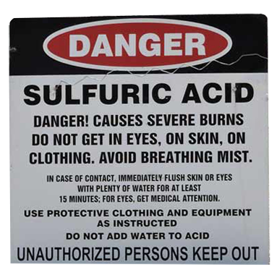
Administrative
Change in work procedures
Individuals must follow the rules
Examples:
Policies and procedures
Signage
Restricted access
Training
Housekeeping
Notes:
SG page 22
Instruction
Explain Administrative
Implement rules that change the way employees and contractors do their jobs
Includes policies and procedures, SOPs, signage, training, restricted access, equipment maintenance, housekeeping, and personal hygiene practices
Administrative Example Used in Acid Handling:
Policies and procedures
Signage
Restricted access
Training
Housekeeping
Personal hygiene practices
Ask participants why personal hygiene practices are important

Slide 33
PPE
Personal Protective Equipment
Layer of protection
Effectiveness based on behavior
Notes:
SG page 23
Instruction
Explain PPE
Personal Protective Equipment
Designed to offer the wearer’s body a layer of protection from hazards in the work environment
Includes (but not limited to) hard hats, protective clothing, gloves, face shields, safety glasses, safety boots, and respirators
Seems like a simple solution to a hazard and can offer protection. Its effectiveness depends on individuals choosing to wear the appropriate PPE correctly
Any system dependent on an individual’s behavior is inherently unreliable
Both administrative controls and PPE methods have proven to be less effective than other controls as they require effort by everyone involved
PPE Example Used in Acid Handling: When loading and unloading sulfuric acid, wearing the appropriate personal protective equipment such as an Acid suit will help decrease the severity of exposure due to an acid spray

Slide 34
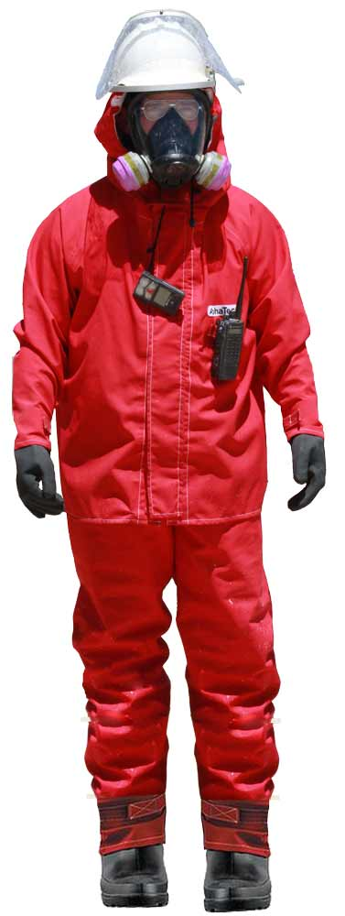
Acid Protective Garment Requirements
Acid Protective Garment
Gloves
Boots
Head, Eye, and Face Protection
Respirator
Cleaning and Storage
Notes:
SG page 24-25
Instruction
Have students review the charts on SG p. 24-25 or the Sulfuric Acid Bulk Handling Personal Protective Equipment Technical Supplement. The chart details the PPE requirements for acid handling.
All personal protective equipment must be cleaned and stored per manufacturer recommendations
NOTE: If contract/carrier organizations choose to use other protective garments that meet the above standards, they may do so; however, the driver must have the specifications from the manufacturer of the protective garment readily available and be able to provide when requested by site personnel
NOTE: Instructor should stress that alterations to garments are not permitted

Slide 35
Actions to Stay Safe
Proper precautions
Eyewash stations
Emergency stop buttons
Proper PPE
Visual inspection
Leaks
Vehicle chocks
Splash-guards
Notes:
SG page 26
Instruction
Have students review the list on SG p. 26 or the Sulfuric Acid Bulk Handling Policy FCX-HS28
Sulfuric acid can be handled safely if proper precautionary measures are observed
Maintain unobstructed access between the task and shower/eyewash
Verify the location of the emergency stop button for acid transfer pumps
Maintain unobstructed access between task and emergency stop
Ensure tanks have storage capacity before offloading
Acid-resistant PPE is to be inspected and properly worn prior to entering the Hot or Warm Zones. Reference the PPE Technical Supplement for additional details
Employees and contractors will wear personal gas monitors in designated areas and be trained in their use
Offloading of acid by gravity should be used whenever possible
Visually inspect all hoses and fittings prior to unloading
Ensure all lines are drained after loading/unloading
Be vigilant for leaking acid. Contact appropriate personnel immediately
Ensure chocks, blocks or stops are in place for all railcars and trucks as required
Isolate loading/unloading rail sections from other sections of rail to prevent incoming cars as required
Always review site-specific processes and procedures prior to starting work
Ensure camlock splash-guards are in place and serviceable for truck offloading

Slide 36
Actions to Stay Safe
Directions
Review the Fatal Risks and Actions to Stay Safe in the Sulfuric Acid Bulk Handling Policy
For each scenario, identify a potential Fatal Risk and any Actions to Stay Safe that may have been overlooked.
Activity 2
Notes:
SG page 27
Instruction
Give students time to write answers to the in the SG
Have students work in groups or individually
Review the answers as a class using the slides

Slide 37
Actions to Stay Safe #1
A carrier arrives to a Freeport-McMoRan property to unload his tanker. Security personnel advises the carrier to unload at a specific location. The carrier proceeds to the assigned location and begins the procedures to safely unload the acid. The driver hooks up the acid hose and pressurizes the line. Control room contacts the driver to let them know that the acid tank is full.
Notes:
SG page 27
Instruction
Discuss answer as a class
Answers may vary. Possible answers:
Fatal Risks: Exposure to Hazardous Substances
Actions to stay safe: Always review site-specific processes and procedures prior to starting work, ensure tanks have storage capacity before offloading

Slide 38
Actions to Stay Safe #2
During an area inspection, an operator notices a missing camlock and makes note of it on the area inspection form. The operator proceeds to connect the hose and offload the tanker. During the unloading process, acid is dripping from the connection. After the unloading is complete, the operator reports the camlock to site security upon exiting the property.
Notes:
SG page 27
Instruction
Discuss answer as a class
Answers may vary. Possible answers:
Fatal Risks: Exposure to Hazardous Substances
Actions to stay safe: Always review site-specific processes and procedures prior to starting work, visually inspect all hoses and fittings prior to unloading

Slide 39
Actions to Stay Safe #3
An authorized individual is offloading acid from a rail car. The individual removed the acid discharge hose before ensuring the Acid Tanker was at atmospheric pressure.
Notes:
SG page 27
Instruction
Discuss answer as a class
Answers may vary. Possible answers:
Fatal Risks: Exposure to Hazardous Substances
Actions to stay safe: Always review site-specific processes and procedures prior to starting work, a pre-task review, workplace exam and equipment inspection must be completed prior to loading/unloading bulk concentrated acid

Slide 40
Debrief
What are some key concepts learned in this module?
What do you need to understand better?
What information surprised you?
Notes:
SG N/A
Instruction
Discuss questions on slide

Slide 41
Module 3: Communication
Notes:
SG page 29
Instruction
Review learning objectives for the module
Upon completion of this module, students will be able to
Explain the communication process while on Freeport-McMoRan property

Slide 42
Communication
Positive communication system
Backup communication
Site Contacts
Notes:
SG page 33
Instruction
Communication plays a critical role in disaster prevention
A method for communication is to be provided for the carrier, contractor, or FMI employees working in concentrated acid transport and handling areas
A positive communication system allows for two way dialogue
Each site is required to have a positive communication system with clear and obvious signage in an acid loading/unloading area
In addition, each site is required to maintain a backup form of communication in the event of a failure of one type of communication method
Any fixed communication device must have conspicuous signage. Signage must include an emergency contact number, name of responsible person, and site radio channel information
Communication methods vary from site to site, so a carrier needs to be aware of the various methods of communication used by each site

Slide 43
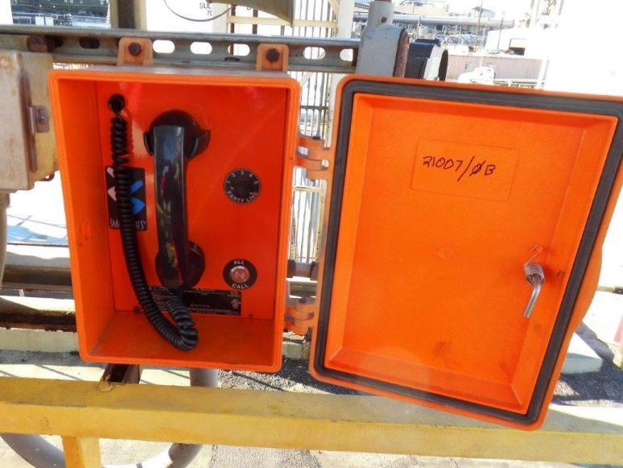
Positive Communication
Portable handheld device
Two-way radio
Mobile phone
Exercise caution
Device guidelines
GAI-Tronics
GAI-Tronics Handset
Notes:
SG page 33-35
Instruction
Positive Communication (Two Way Communication) Examples
Mobile phones, two-way radios and other portable handheld communication devices are one of the most convenient ways to communicate when we are away from our workstations
Handheld Device Guidelines:
Never allow handheld communication devices to distract your concentration while operating a vehicle or mobile equipment
Always give full attention to driving and road conditions and never place or receive a call while driving
Sending/receiving text messages, emails, or conducting web searches are prohibited while operating equipment or vehicles
Outgoing calls are made only while equipment or vehicles are stationary
Incoming calls are taken while equipment or vehicles are stationary or when using hands-free devices
If you work in operations of a surface or underground mine operations, do not stop on haulage travel roads
Handheld communication devices are a quick means for communicating in an emergency. In the event of an emergency, always pull off the road before placing an emergency call
The use of display screens for GPS navigation devices, tracking systems, collision avoidance systems, instruments, gauges, and systems providing information about the status of mobile equipment is permissible
Emphasize that handheld and Bluetooth devices should not be used when operating a vehicle on property
GAI-Tronics
GAI-Tronics is an intercom Page/Party communication system used at some sites
The page function provides speaker placement where announcements can be made over the intercom speakers
The party line function allows two or more individuals to converse privately without using the paging speakers
This communication system may be used to report any issues employees or carriers may encounter, such as pump leaks, pipe leaks, low flow
NOTE: Talk to the site area supervisor for information about how to use the system

Slide 44
Site-Specific Communication
Process varies from site to site
Need to know proper procedure
Notes:
SG page 36
Instruction
Sites are required to implement a hazard communication process
The process may vary from site to site, and individuals need to be aware of the process taken at each site
If you are unsure of the proper procedures, talk to site security or Health and Safety

Slide 45
Critical Control Improvements
Improve the process
Sight glass
Notes:
SG page 36
Instruction
A Critical Control is a device, system, or process implemented to eliminate or reduce the risk for a task/job, and if missing or overlooked has the potential to lead to catastrophic outcomes such as serious injury or death
Critical Controls are only a subset of the myriad safety controls that exist in our operations. The intent is to focus attention on these most important controls in our day-to-day activities
Acid handling is inherently dangerous because of the nature of the substance. If an operator has a suggestion for a Critical Control improvement, Freeport-McMoRan is open for recommendations on how to improve the process. In some cases, recommendations for Critical Control improvements were not directly applied but generated ideas for similar controls
NOTE: If operators have an idea, encourage them to submit the idea to site security or their own management
One example of a Critical Control improvement for acid handling is the use of sight glass
Have a student read the Description/Details of Improvement of the Critical Control Improvement, Safford Acid Unloading Sight Glass
Ask if they are familiar with sight glass and how they feel about this improvement

Slide 46
Critical Control Improvement
Brainstorm
Directions
In your group, come up with an idea for a Critical Control Improvement that may be applied to sulfuric acid handling
Explain how communicating a Critical Control Improvement idea may help improve safety when loading or unloading sulfuric acid.
Write a brief description and details for the improvement
Be prepared to share out
Activity 3
Notes:
SG page 37
Time
Approximately 15 minutes
Materials
Student Guide p. 37
Pen/Pencil
Purpose
This activity gives students the opportunity to brainstorm an idea for a Critical Control Improvement that might be used in acid handling
Encourage students to come up with an idea for a Critical Control Improvement that can be used in Acid Handling
Tell them to be creative
Instruction
In groups of 3 or more students, come up with an idea for a Critical Control Improvement that may be applied to sulfuric acid handling
Write a brief description and details for the improvement
Be prepared to share out

Slide 47
Debrief
What are some key concepts learned in this module?
What do you need to understand better?
What information surprised you?
Notes:
SG N/A
Instruction
Discuss questions on slide

Slide 48
Module 4: Operations
Notes:
SG page 39
Instruction
Review learning objectives for the module
Upon completion of this module, students will be able to
Discuss the different types of loading and unloading
Outline procedures for entry

Slide 49
Expectations of Drivers
Comply with policies
Obey traffic signage
Travel to designated area only
Review site SOPs
Notes:
SG page 43
Instruction
Comply with all FMI driving standards and policies and obey all traffic signage
Drive to road conditions at all times and yield to heavy mine equipment
Travel to and from the designated load/unload facility only; travel to any other location is not authorized
Travel in the mine areas where mixing with heavy off-road mine equipment is possible and requires a valid Pit Driver license
Left hand driving may be required at some sites
Use identified roads
Passing of an operating haul truck is strictly prohibited, even if the haul truck is stopped
Follow proper passing protocols including proper radio clearance
Drivers/operators are expected to:
Be fit for duty and trained for the task
Report any safety or environmental concerns/issues
Return any equipment picked up on entry
Return completed inspection form(s)
Secure transport vehicle to prevent leaks to the environment
NOTE: Pit driving may not apply to all sites. In-Pit training will be covered in detail in the Pit Driving Safety course

Slide 50
Entry Procedures
May vary from site to site
Present documents
Area inspection document
Tare weight
FMI equipment
Notes:
SG page 43
Instruction
Operators must have participated in all on-boarding training and specialized acid handling training. They must follow the Contractor Health & Safety Manual and any FMI procedures about the work activities to be performed, including, but not limited to, this policy
Upon arrival at the site gate, operators will do the following:
Present all documents requested by security attendant (example: vehicle inspection, company or regulatory agency training, hazard awareness card, pit driving card, Commercial Driver’s License, bill of lading, etc.)
Be given an area inspection document (NOTE: Every site has their own, security issues to the driver who must turn it back in before exiting property)
Drive across the scale to document tare weight
Take possession of any specific FMI equipment as determined by each specific site
NOTE: Any operator who cannot provide the required documents will be denied entry to FMI property

Slide 51
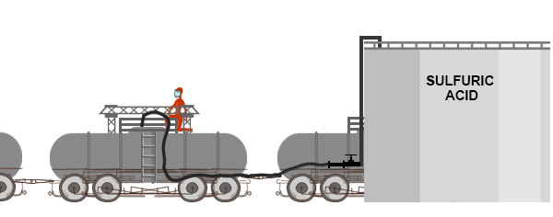
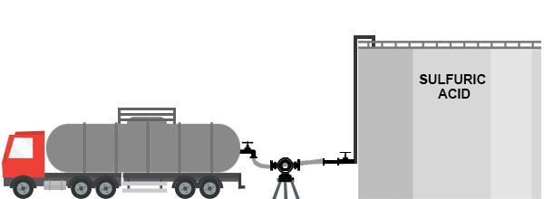
Loading and Unloading
Pump
Gravity
Pressure
Pump
Gravity
Pressure
Pump
Gravity
Pressure
Notes:
SG page 44-45
Instruction
The safe handling of sulfuric acid from tanker trucks and rail cars by the application of air pressure, gravity feed, or pumps requires careful attention to proper procedures and should be conducted by trained personnel wearing proper protective clothing
Truck tanks are loaded through an open fill hole on the top of the truck, but unloading may vary due to design or piping arrangement. Truck tanks may be unloaded from the top or the bottom
Pump: Acid truck tanks are unloaded from the bottom using a pump
Click once: Gravity: When tanker unloading stations are located at an area above the storage tanks, acid may be unloaded using gravity
Click again: Pressure: Acid may be unloaded using air pressure if the storage tank is at level with the tanker. Pressure is used when unloading acid from a railcar

Slide 52
Hot and Warm Zones
Hot Zone
Risk of exposure high
PPE
Follow site-specific training
Warm Zone
Less hazardous
PPE
Notes:
SG page 45
Instruction
A Hot Zone is an area where all acid PPE must be correctly worn at all times. Risk of acid exposure to personnel is high
Risk of exposure is less hazardous in warm zone
As outlined in the Sulfuric Acid Bulk Handling Technical Supplement, it is a requirement that specially designed PPE shall be worn by personnel handling or working near concentrated sulfuric acid
Any person entering into this “Hot Zone,” where concentrated sulfuric acid may make contact with persons, must properly wear all specialized PPE, as defined within the policy

Slide 53
Minimum PPE Requirements
Hot Zone vs. Warm Zone
Hot Zone requirements
Warm Zone requirements
Notes:
SG page 45
Instruction
Drivers must follow the minimum PPE requirements for hot and warm zones while loading or unloading acid
The potential for contamination is the greatest in the hot zone
The warm zone is less hazardous than the hot zone, and personnel can wear lower levels of PPE
Hot Zone Minimum Requirements: The following minimum PPE requirements must be properly worn in Hot Zones:
Acid Protective Garment
Chemical Resistant Boots and Gloves
Head, Eye, and Face Protection meeting one of the three options listed below
Respiratory protection meeting the requirements
Protective garments will be worn with all closures fastened, hood donned, and wrist and ankle openings cinched
NOTE: No tape is permitted on garments
Warm Zone Minimum Requirements
The following minimum PPE requirements must be properly worn in Warm Zones:
Acid Protective Garment (jacket may be removed, or overalls/coveralls unzipped and open to waist)
Chemical Resistant Boots
Hard hat
Safety glasses
The following minimum PPE requirements must be readily available in Warm Zones:
Chemical Resistant Gloves
Head, Eye, and Face Protection
Respiratory protection

Slide 54
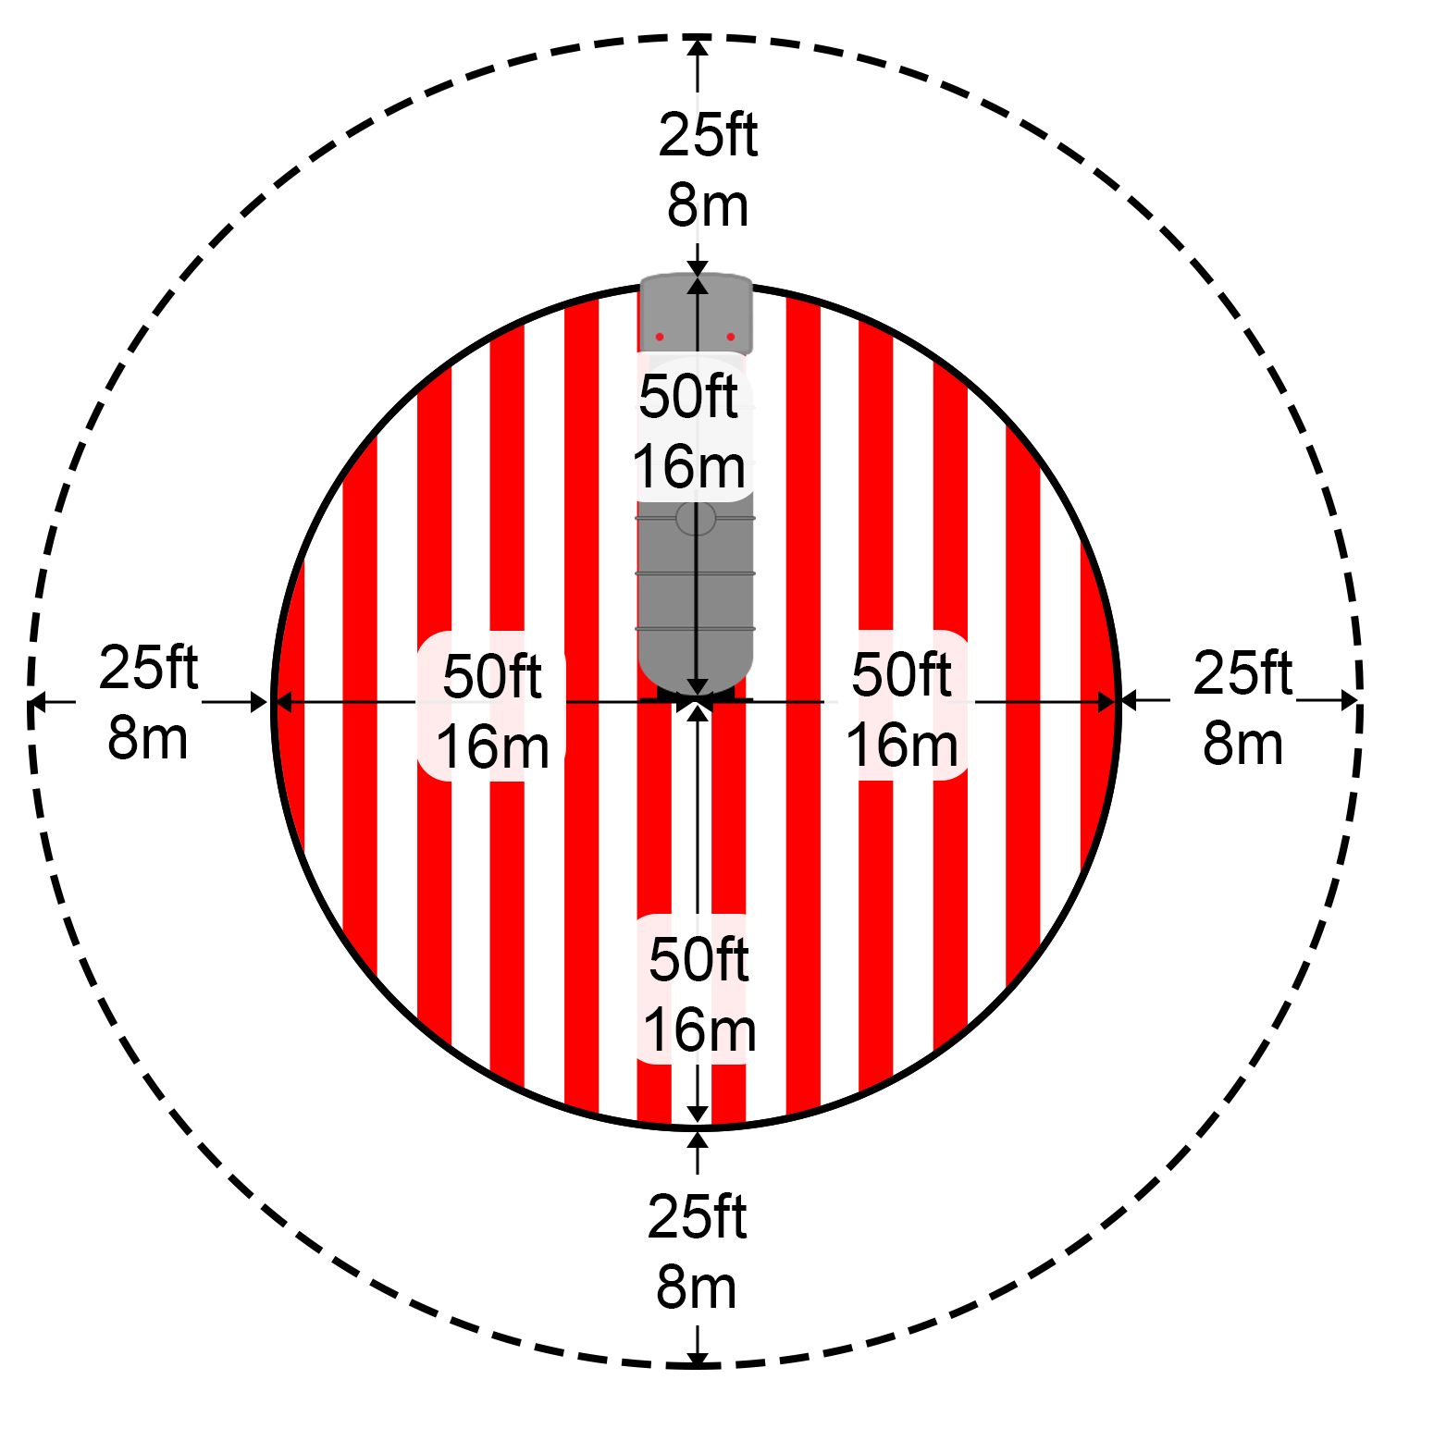
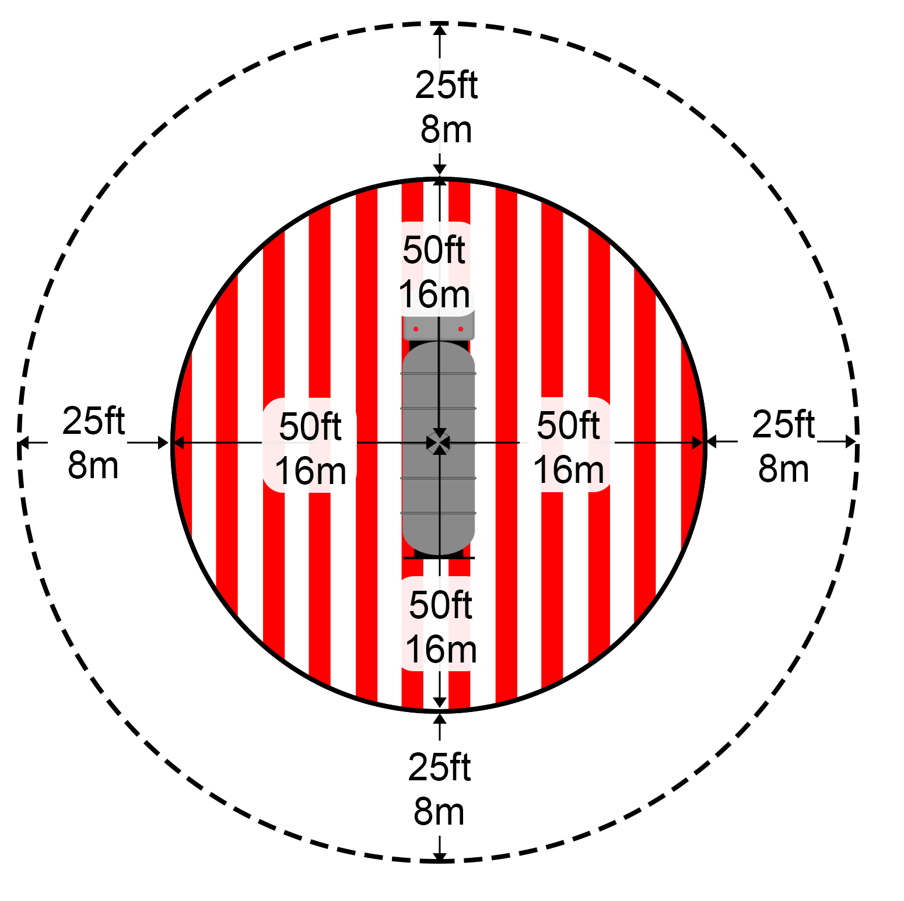
Loading and Unloading
Hot Zone Rail
Hot Zone Tankers
Loading
Unloading
Hot Zone Rail
Hot Zone Tankers
Loading
Unloading
Hot Zone Rail
Hot Zone Tankers
Loading
Unloading
Notes:
SG page 46
Instruction
Drivers/operators may exit the Hot Zone during the unloading process but must maintain a line of sight and be attentive to the task and ensure that before re-entry to the Hot Zone all specialized PPE is properly donned
Hot Zone Rail Car loading
Click once: Hot Zone Tanker loading
Click again: Hot Zone Tanker unloading

Slide 55
Hot and Warm Zones
Directions
Fill in the hot zone and warm zone measurements using both feet and meters SG pgs. 47-48
Explain the requirements for PPE in a Warm Zone and a Hot Zone
Activity 4
Notes:
SG page 47-48
Time
Approximately 15 minutes
Materials
Student Guide pages 47-48
Pen/Pencil
Purpose
This activity gives students the opportunity to review the hot and warm zone measurements and required PPE for each zone
Instruction
Fill in the hot zone and warm zone measurements using both feet and meters
Explain the requirements for PPE in a Warm Zone and a Hot Zone

Slide 56
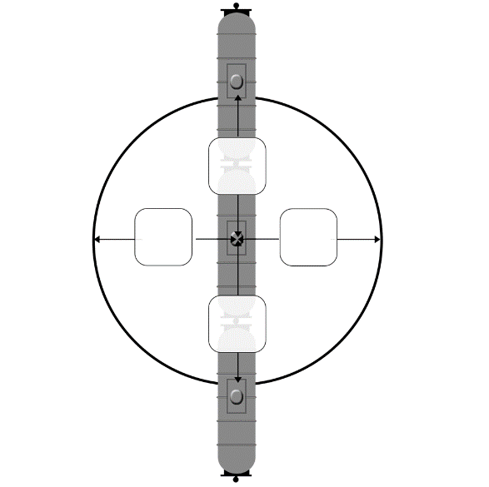
Module 4 Activity
100ft 31m
100ft 31m
100ft 31m
100ft 31m
Notes:
SG page 47-48
Instruction
Discuss answer as a class
Click to show the answer

Slide 57
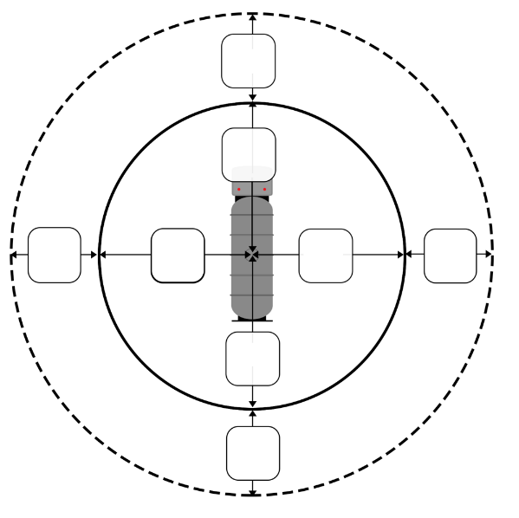
Module 4 Activity
2.
25ft 8m
50ft 16m
25ft 8m
50ft 16m
50ft 16m
25ft 8m
50ft 16m
25ft 8m
Notes:
SG page 47-48
Instruction
Discuss answer as a class
Click to show the answer

Slide 58
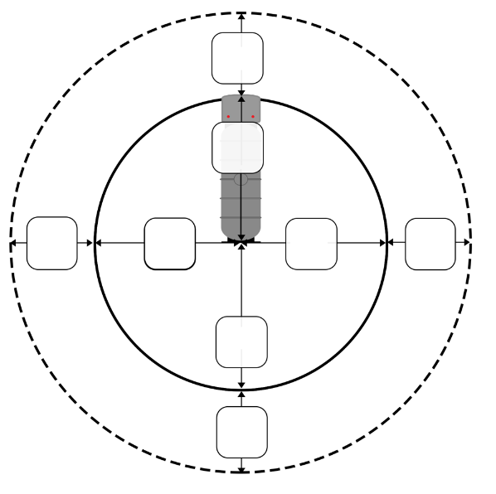
Module 4 Activity
3.
25ft 8m
50ft 16m
25ft 8m
50ft 16m
50ft 16m
25ft 8m
50ft 16m
25ft 8m
Notes:
SG page 47-48
Instruction
Discuss answer as a class
Click to show the answer

Slide 59
Module 4 Activity
4. Using your own words, explain the requirements for PPE in a Warm Zone and a Hot Zone.
In a Warm Zone, Acid Protective garment, chemical resistant boots, hard hat and safety glasses must be worn. Chemical resistant gloves, head/eye/face protection and respiratory protection must be readily available.
In a Hot Zone, Acid Protective garment, chemical resistant boots and gloves, head/eye/face protection and respiratory protection must be properly worn.
Notes:
SG page 47-48
Instruction
Discuss answer as a class
Click to show the answer

Slide 60
Debrief
What are some key concepts learned in this module?
What do you need to understand better?
What information surprised you?
Notes:
SG N/A
Instruction
Discuss questions on slide

Slide 61
Module 5: Inspections and Audits
Notes:
SG page 49
Instruction
Review learning objectives for the module
Upon completion of this module, students will be able to
List various inspection processes

Slide 62
Inspections and Audits
Help identify deficiencies
Physical conditions
Work practices
Hazard categories
Chemical
Biological
Physical
Changing conditions
Notes:
SG page 53
Instruction
A safety inspection looks at the physical conditions and work practices in a workplace
Equipment is examined to determine whether all safeguards are in place and whether its operation presents any hazards
Work practices are observed to identify unsafe actions
The overall goal of a safety inspection is to identify hazards so they can be eliminated, guarded, or protected against
A workplace examination may also be referred to as an area inspection, pre-shift inspection, and workplace inspection
Workplace examinations are the first line of defense in protecting yourself and others
The backbone of an effective workplace examination is hazard recognition. Hazards generally fall under one of three categories:
Chemical (e.g., H₂S, lime, solvents)
Biological (e.g., bacteria, animal waste, venom)
Physical (e.g., noise, radiation, impact injuries)
Depending on your work area, the hazards to which you are exposed can fall under one or all three of these categories.
Being skilled at recognizing hazards associated with your work area is a lifelong pursuit
Be aware of changing conditions

Slide 63
Workplace Inspection
Operators must perform work area inspection
Common inspection items
Eyewash stations/Safety showers
Hose fittings
Safe access
Housekeeping
Cables and hoses
De-icing salt
Notes:
SG page 54-55
Instruction
It is a requirement to complete a workplace inspection to identify hazards, mitigate hazards to the extent that you are qualified, and to communicate to authorized FMI employees as required by the policy
Do not proceed if equipment is not operable. Notify Control Room, Security, or Area Supervisor immediately
Every driver/operator is expected to perform a work area inspection prior to beginning work
Common inspection items include the following (NOT an all-inclusive list):
Safety Showers and Eye Wash Stations
Hose fittings—C-clamp, 4-bolt flange, or other
Safe Access & Egress
Travel Ways
Handrails
Tie-off Points
Lighting
Cables/hoses
Housekeeping Hazards
Environmental Conditions
Fire Extinguishers
Level indicator lights and Digital displays function
Derailleur and Chocks for rail systems
Ensure that De-icing Salt is not present (NOTE: When salt and acid combine, they form Chlorine gas. Call security if de-icing salt is present)

Slide 64
Post Workplace Inspection
Unloading Complete
Follow site-specific protocols
Bleed residuals
Wash down connections
Loading Complete
Follow site-specific protocols
Bleed off residuals
Check for leaks
Wash down connections
Notes:
SG page 55
Instruction
Unloading complete:
Bleed off residuals which include the tank, hose, and connecting equipment
Wash down fittings and connections
Loading complete:
Follow site protocols to check tanker for leaks
Bleed off residuals
If a leak is found, stop, contact FMI representative
If no leak is found, wash down fittings and connections
NOTE: Drivers/operators must NEVER enter the tank of an acid truck or a rail car

Slide 65
Checklist Monitoring
Checklists vary from site to site
Always follow site-specific processes
Example Checklist
Notes:
SG page 56
Instruction
The purpose of a checklist is to reduce or eliminate the potential safety hazards associated with sulfuric acid handling
A checklist is not intended to replace any other area work inspection or procedure
Site-specific checklists may vary from site to site. Always follow site-specific processes

Slide 66
Module 5 Quiz
Directions
Complete the quiz in the Student Guide
Discuss the answers as a class
Quiz
Notes:
SG page 57
Instruction
Give students time to write answers to the quiz questions in the SG
Review the answers as a class using the slides

Slide 67
Module 5 Quiz
During a safety inspection, hazards generally fall into one of three categories. Name the three categories and give an example for each.
Categories: | Examples:
Chemical | Lime, Solvents
Biological | Bacteria, Venom
Physical | Noise, Radiation
Notes:
SG page 57
Instruction
Discuss answer as a class
Click to show the answer

Slide 68
Module 5 Quiz
Circle items that need to be inspected during a pre-area workplace exam. This is not an all-inclusive list.
Showers
Tire pressure
Housekeeping hazards
Fire extinguisher
Eye wash
Weather conditions
Handwashing stations
Notes:
SG page 57
Instruction
Discuss answer as a class
Click to circle the answer

Slide 69
Debrief
What are some key concepts learned in this module?
What do you need to understand better?
What information surprised you?
Notes:
SG N/A
Instruction
Discuss questions on slide

Slide 70
Module 6:
Emergency Responses
Notes:
SG page 59
Instruction
Review learning objectives for the module
Upon completion of this module, students will be able to
Discuss action plan for an emergency situation

Slide 71
Crisis/Emergency Management
Crisis/emergency plan
On-property
Safety showers/eyewash stations
Incidents of varying levels
Off-property
Transportation
Environmental
Compliance
Notes:
SG page 63
Instruction
Crisis/emergency preparedness involves a plan on how to respond to incidents at varying levels, such as using a safety shower or eyewash station, and extends to emergency responses in case of a major spill
Individuals need to know the location of emergency equipment, such as eyewash stations, and they need to ensure they are in proper working order
A crisis/emergency management plan is a plan that is developed, maintained, and practiced to respond to crises and emergencies that may arise on site. Each site has a crisis management plan in place
Off-Property
Transportation
The transport of sulfuric acid is subject to rules which must be complied with by all drivers involved
Follow your company requirements and regulatory agencies’ requirements on reporting incidents
Environmental
Prevent entry to sewers and public waters
Notify authorities if sulfuric acid enters sewers, public waters, or low areas
Follow with your company requirements and regulatory agencies’ requirements on reporting incidents
Compliance
Comply with your company requirements and regulatory agencies’ requirements on reporting incidents

Slide 72
Emergency Action
Emergency action
Activate emergency response system
Emergency telephone numbers
Emergency radio channels
Off-Property emergency
Comply with company or regulatory agency’s requirements
Notes:
SG page 64
Instruction
Information on emergency action and incident reporting information is found in the Contractor Health and Safety Manual. (NOTE: When referencing this document, make sure it is the current version as the document is updated annually. Discard any copies that are published before and up to the expiration date and reference only the latest document)
In the event of a serious incident or injury on Freeport-McMoRan-owned property, immediately activate the emergency response/notification system and maintain scene safety. This will be site specific and is dependent on the communication device used
Trained Contractor personnel should render first aid to any incident victims
FCX will address any media inquiries or announcements and make other decisions critical to the overall site and project
Emergency telephone numbers/radio channels must be posted in areas accessible to Contractor employees
For emergencies off Freeport-McMoRan-owned properties, comply with your company requirements and regulatory agencies’ requirements on crisis management

Slide 73
Incident Reporting
Comply with Contractor Health and Safety Manual
Initial written report
Final written report
Off-property
Comply with regulatory agencies requirements
Notes:
SG page 64
Instruction
For incidents on Freeport-McMoRan-owned properties, comply with the Contractor Health and Safety Manual on incident management
All incidents shall be reported to the FCX Health and Safety Department immediately with the initial written report to be submitted by shift end. Initial reports will include, at a minimum:
Location of incident
Name of persons involved
Equipment involved
Time/date of incident
Nature of incident: occupational injury, occupational illness, near miss, property damage
Brief description of incident
Where injured (body part)
Name of person contacted for report
Written final report is due to the Health and Safety Department within 48 hours of the incident, unless otherwise extended based on severity of incident
For incidents off Freeport-McMoRan-owned properties, comply with your regulatory agencies’ requirements on incident management. If the incident involves any damage to Freeport-McMoRan property, a report of damage is required

Slide 74
Emergency Information
Emergency information
Evacuation points
Evacuation Signage Example
Notes:
SG page 65
Instruction
Emergency Information
Each site will provide carriers with relevant information for emergency evacuation and response
Speak with your point of contact for additional information
Evacuation Points
Evacuation and muster points are located throughout sites. When arriving to site, ensure you know the location of these points
In the event of an emergency while loading or off-loading acid, note the direction of the wind by checking the windsocks in the area, and proceed to the muster point in the upwind direction
If you are unsure of muster point locations, consult site security, health and safety, or operators at the loading/unloading locations

Slide 75
Module 6 Quiz
Directions
Complete the quiz in the Student Guide p. 66
Discuss the answers as a class
Quiz
Notes:
SG page 66
Instruction
Give students time to write answers to the quiz questions in the SG
Review the answers as a class using the slides

Slide 76
Module 6 Quiz
In the case of an emergency on Freeport-McMoRan-owned property, what are drivers expected to do? Circle all that apply.
Immediately activate the emergency response system
Maintain scene safety
Trained personnel should render first aid to incident victims
Contact the media to announce the emergency
Notes:
SG page 66
Instruction
Discuss answer as a class
Click to circle the answer

Slide 77
Module 6 Quiz
List all items that need to be included in an initial incident report.
Location of incident
Name of persons involved
Equipment involved
Time/date of incident
Nature of incident
Brief description of incident
Where injured (body part)
Name of person contacted for report
Notes:
SG page 67
Instruction
Discuss answer as a class
Click to show the answer (SG p. 64)

Slide 78
Module 6 Quiz
3.
If an incident occurs on-property, a written report is required. What is the time frame to submit the initial report and to whom should the report be submitted?
The report should be submitted to the local media immediately.
The report should be submitted to the FCX Health and Safety Department within 48 hours.
The report should be submitted to the FCX Health and Safety Department by the end of the shift.
The report should only be submitted to your employer when applicable and within the carrier indicated timeframe.
Notes:
SG page 67
Instruction
Discuss answer as a class
Click to circle the answer (SG p. 64)

Slide 79
Debrief
What are some key concepts learned in this module?
What do you need to understand better?
What information surprised you?
Notes:
SG N/A
Instruction
Discuss questions on slide

Slide 80
Conclusion
Notes:
SG N/A
Instruction
The conclusion covers
Course review
Student Course Evaluation
Facilitator Course Evaluation

Slide 81
Conclusion
Focus on Safety
Safe Procedures for Handling Sulfuric Acid
Notes:
SG page 67
Instruction
Freeport-McMoRan’s expectation as a company is for every employee to return home safely at the end of their shift
This course was designed to educate personnel on standardized operating and safety procedures for loading, unloading, and transporting bulk concentrated sulfuric acid

Slide 82
Debrief
What are some of the key concepts in each module?
Module 1: Risks and Hazards
Module 2: Controls
Module 3: Communication
Module 4: Operations
Module 5: Inspections and Audits
Module 6: Emergency Responses
Are there any additional questions, comments, or concerns?
Notes:
SG N/A
Instruction
As objectives for each module are reviewed, discuss the students’ lingering questions, comments, or concerns
Module 1
Identify potential hazards associated with acid handling
Module 2
Determine appropriate Critical Controls
Summarize “Actions to Stay Safe”
Module 3
Explain the communication process while on Freeport-McMoRan property
Module 4
Discuss the different types of loading and unloading
Outline procedures for entry
Module 5
List various inspection processes
Module 6
Discuss action plan for an emergency situation

Slide 83
Student Course Evaluation
Directions
Complete the Course Evaluation in the Student Guide p. 77
Carefully tear out the evaluation
Return the completed form to the facilitator
Evaluation
Notes:
SG p. 77
Instruction
Have students complete the Student Course Evaluation

