Slide 1
Fatal Risk Management
VERSION 2 / JULY 2018
Notes:
Instruction
Throughout the presentation, work to encourage participation among the students. The purpose of this training is to shift the way that we think about risk from all hazards, to what can kill us and how to protect ourselves. To increase understanding, student participation is necessary.
Above all else, have fun interacting with participants and this new material.

Slide 2
Agenda
Introductions and Icebreaker activity
Reasons for Rolling Out FRM
Explanation of the FRM Concept
How FRM Works
FRM Exercises
FRM Implementation & Progression
Questions
Notes:
Instruction
Review the agenda with the class
Administrative/Classroom policies
Safety
Identify the appropriate evacuation procedures, gathering areas, and emergency exits and fire extinguisher locations, etc.
Breaks and Restrooms
Establish a break schedule and announce it to the class. Suggested break times are included throughout the FG and occur approximately every hour and often occur at the end of each module. Breaks should last 5-10 minutes to give students time to rest and relax before beginning the next learning session.
Identify the location of restrooms and smoking areas.
Technology policy
Review your expectations on cell phone and laptop use during the training.
Participation
This course requires significant participation. Students should be prepared for discussions and small group activities.
Set the class ground rules by verbalizing your expectations. Some suggestions are provided below.
Participate
Be on time
Stay on task
Listen when others talk
Respect the opinions and attitudes of others

Slide 3
Introductions
Write your name on a table tent
Introduce yourself to the group
Name
Position
Length of time with the Company
Notes:
Instruction
Conduct introductions with the class
Facilitator should begin introductions with their information

Slide 4
Icebreaker
Directions
In your group, create a list of five things that everyone has in common
Cannot be related to work, body parts, or clothes
Designate one person to write down the responses
Designate one person to speak for the group
Be prepared to share your responses
Activity 1
Notes:
Time
Approximately 10 minutes
Materials
Paper
Pens/pencils
Purpose
Successful icebreakers encourage students to contribute their ideas and experiences thus increasing motivation and engagement in the class.
Instruction
Break the class into small groups. Depending on the size of the class, this could be pair or groups of 3-4.
Direct the groups to create a list of five things that the entire group has in common
The five things cannot be related to work, body parts, or clothes.
Direct each group to designate one person to write down the responses and another person to speak for the group.
Allow 5 minutes for groups to discuss.
Discuss responses as a class.

Slide 5
Learning Objectives
Upon completion of this course, students will be able to:
Select the appropriate Fatal Risk Management icons based on the hazards associated with the task and environment
Identify appropriate Fatal Risk Management tools specific to the needs of the work area and employees
Differentiate the roles and responsibilities of employees, supervisors, and managers
Demonstrate effective communication skills for transferring program concepts to employees
Notes:
Instruction
Upon completion of this course, students will be able to:
Select the appropriate Fatal Risk Management icons based on the hazards associated with the task and environment
Identify appropriate Fatal Risk Management tools specific to the needs of the work area and employees
Differentiate the roles and responsibilities of employees, supervisors, and managers
Demonstrate effective communication skills for transferring program concepts to employees

Slide 6
Reasons for Rolling Out FRM
Notes:
Instruction
Ask the class if they know why Fatal Risk Management is being rolled out
This section will address any unanswered questions
The idea of this section is to stress that the company remains committed to Fatality Prevention. Fatality Prevention is not a “flavor of the month” activity. This is already a multi-year commitment and we are looking ahead with FRM to the next several years.
Fatalities and PFEs are continuing to happen at an unacceptable rate. They continue to happen across the globe and at sites of all sizes and functions. They continue to happen with people with both lots or experience and limited experience. They continue to happen with numerous types of risks. They are happening in both routine and non-routine tasks. In other words there is no pattern to these events and no one can afford to be numb to the Fatal Risks that are present every day! Everyone needs to be engaged and vigilant when it comes to fatality prevention.

Slide 7
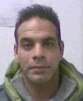
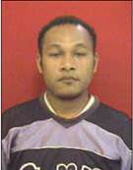
Work-related Fatalities
Antonio Jesús Ruiz Martín
Atlantic Copper - 4/3/2017
Fatally injured after being struck by a Kress hauler.
Fatal Risk:
Vehicle Impact on Person
Frank Axel Cohen Ruiz
Cerro Verde - 2/24/2017
Fatally injured when a ground failure event on a double bench caused a large boulder to strike the operator cabin of a shovel.
Fatal Risk:
Ground Failure
Peter Winston Arratea Ale
Cerro Verde - 2/23/2017
Fatally injured after becoming entangled in the tail pulley of a moving feed belt.
Fatal Risk:
Entanglement & Crushing
Nelson Pondayar
PTFI - 10/17/2016
Dozer slid while operating on a bench and rolled over causing fatal injuries.
Fatal Risk:
Vehicle Collision or Rollover
Notes:
Instruction
Review the four employee fatalities
Be sensitive to the fact that a friend/relative may be in the audience
The purpose of this is to reinforce the importance of Fatal Risk management and fatality prevention
Background:
Antonio Martin: While training in an active haul area to operate an overhead crane, Antonio and his trainee were so focused on their task, they stepped into the path of an oncoming Kress hauler and the trainee was bumped by the equipment, while Antonio was crushed by the tires.
Frank Ruiz: Supervisor of shovel operations. He was in the cab of a shovel helping to direct the work of the operator. They were attempting to pull down a large rock, and had the shovel positioned incorrectly with the cab toward the bench. The rock came loose and came into the cab through the door and Frank was crushed to death.
Peter Ale: Peter removed the guards around a moving tail pulley for reasons unknown and was pulled into the tail pulley.
Nelson Pondayar: When the supervisor took over operating the dozer in a difficult location, Nelson stayed on the deck. The dozer rolled on its side and slid down the embankment, causing Nelson to fall and hit his head, ultimately killing him.

Slide 8
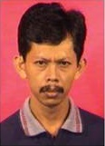
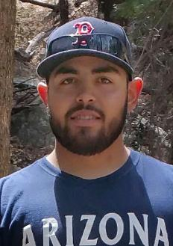
Work-related Fatalities
Lukas Rapi
PTFI - 8/30/2016
Fatally injured when struck by a loader moving a shipping container.
Fatal Risk:
Vehicle Impact on Person
Benyamin Pasang
PTFI - 8/7/2016
Received fatal injuries when the cable tray he was working on collapsed causing a 7M fall.
Fatal Risk:
Fall from Heights
Patricio Bobadilla Gallardo
El Abra - 8/30/2016
Suffered fatal injuries when a moving train struck a parked acid tanker car he was unloading.
Fatal Risk:
Rail Collision
Bryan Ortiz
Safford - 4/9/2016
Presumed to have come in contact with stray electrical current outside the tankhouse causing fatal injuries.
Fatal Risk:
Contact with Electricity
Notes:
Instruction
Review the four employee fatalities
Be sensitive to the fact that a friend/relative may be in the audience
Background:
Lukas Rapi: Lukas was the area supervisor and walked into an active loading area and into the path of a loader with forks moving a large shipping crate. He was struck and killed. That morning he had lined out the loader operator and discussed the hazards of the area and the work they were going to perform.
Benyamin Pasang: Ben was a fill in foreman for the day. He and his crew were working to inspect and repair electric cables. He was wearing his fall protection when he climbed onto the cable tray, but he did not tie off, and had left the hooks on his lanyard connected back to the d-rings on his harness. The supports for the cable tray failed under the weight, and Ben fell to his death.
Patricio Gallardo: Patricio and the crew were unloading acid from rail cars. They were standing on top of platforms. An over-speed train came into the area and struck the car he was working on. He was doing what he was supposed to do, where he was supposed to it. In the collision, he suffered fatal injuries.
Bryan Ortiz: During maintenance work in the tankhouse yard, Brian was working alone. He had extended contact with stray current after making contact with a flange.

Slide 9
Fatalities
36
Incidents with a fatality
70
People Fatally Injured
Fatal Incidents
2
4
4
8
4
3
6
5
People Fatally Injured
2
6
6
35
7
3
6
5
2010 | 2011 | 2012 | 2013 | 2014 | 2015 | 2016 | 2017
1/1/2010 - 7/3/2017, counts from IMS including all active and divested sites.
Notes:
Instruction
Review the information on the slide
This data was collected between January 2010 and December 2017
One of the major points here is that while most of us are aware of fatalities as they happen, it is often not recognized how many people have lost their lives in the last several years. This slide illustrates that we as a company have not gone a single year without a fatality in many years.
Draw the distinction that not every fatal event is one fatality, but we have had several fatalities over the years where more than one employee lost their life.
In 2013, the collapse of the underground training room at PTFI cost the lives of 27 miners in one incident. The other 7 incidents resulted in the death of the other 8 people.
Ask the group: are you surprised by these numbers?

Slide 10
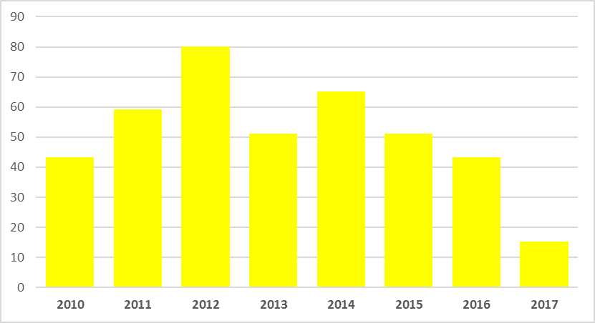
Potential Fatal Events (PFEs)
PFEs by Fatal Risk
414
PFEs
Vehicle Collision or Rollover | 166
Exposure to Electrical Hazards | 48
Uncontrolled Release of Energy | 30
Fall from Heights | 29
Falling Objects | 28
Lifting Operations | 20
Ground Failure | 17
Vehicle Impact on Person | 14
Entanglement and Crushing | 16
Blasting | 11
Exposure to Hazardous Substances | 7
Contact with Molten Material | 6
Interaction with Aircraft | 4
Undetermined | 3
Underground Inrush | 3
Rail Collision | 3
Underground Rock Fall | 2
Drowning | 2
Confined Space | 1
Personnel Hoisting | 1
Underground Hazardous Atmosphere | 1
Rail Impact on Person | 1
Fire | 1
Grand Total | 414
PFEs by Year
Notes:
Instruction
Review the information on the slide
Speak to the number of PFEs per Fatal Risk
This data was collected between January 2010 and July 2017

Slide 11
Across Operations
Incidents with a fatality
People
Fatally Injured
PFE’s
1
10
1
3
155
3
24
139
58
2
49
6
61
2
6
Notes:
Instruction
Review the information on the slide
Reinforce that location is not necessarily a cause for the higher number of PFEs

Slide 12
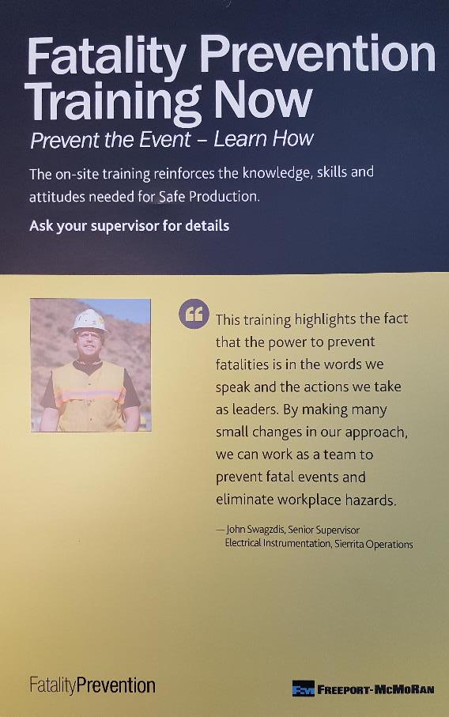
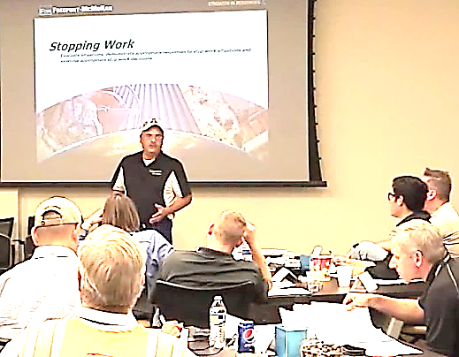
Fatality Prevention
Time spent training the entire workforce
Core elements of the Fatality Prevention program
Communication
Messaging and Perception
Accountability
Stopping Work
Situational Risks and Outcomes
Pre-job Planning
Evaluating and Improving Controls
Notes:
Instruction
Review the information on the slide
Briefly discuss the core elements of Fatality Prevention

Slide 13
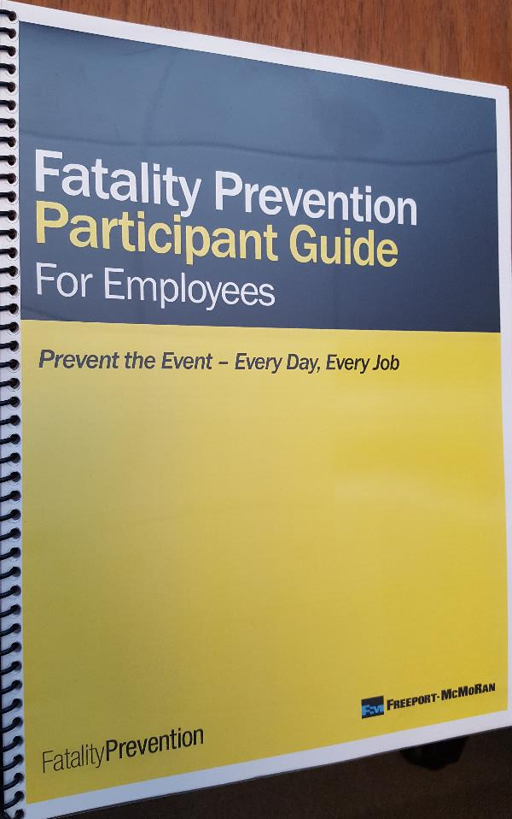
Fatality Prevention
What is next for the Fatality Prevention program?
How do we build on the program?
Is there new material?
How can the concepts be refreshed?
Are there additional tools for use in the field?
Notes:
Instruction
Discuss the questions on the slide

Slide 14
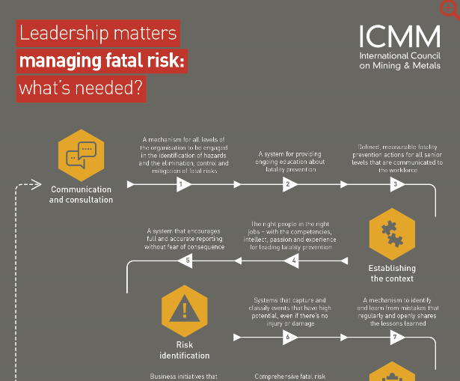
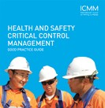
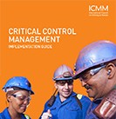
Expectations
Our employees, industry, trade groups, regulators, partners, and investors expect it
Freeport Indonesia union plans one-month strike at copper mine
Notes:
Instruction
Reinforce the relationships within the Company and industry
The International Council on Mining and Metals (ICMM )is made up of 25 different international mining companies it purpose is to ensure safe and sustainable mining practice for the mining industry through 10 core principals.
Principle
Ethical business practices
Sustainable development
Respect of human rights
Implement effective risk strategies
Continual improvement Health and safety performance
Pursue continual environmental improvement
Contribute to the conservation of biodiversity and integrated approaches to land use planning
Facilitate and support the knowledge-base and systems for responsible design, use, re-use, recycling and disposal of products containing metals and minerals
Pursue continual improvement in social performance and contribute to the social, economic and institutional development of host countries and communities
Proactively engage key stakeholders on sustainable development challenges and opportunities in an open and transparent manner. Effectively report and independently verify progress and performance.

Slide 15
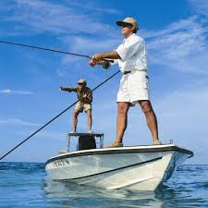
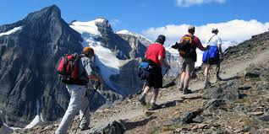
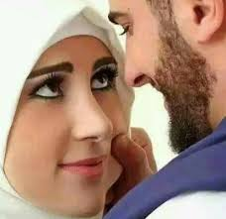
Expectations
Everyone has a reason to go home safely
Notes:
Instruction
Reinforce the reason to work safely

Slide 16
Explanation of the FRM Concept
Notes:
Instruction
This section contains introductory information about the concept of the Fatal Risk Management Program

Slide 17
FRM Concept
Fatal Risk Management (FRM) is the next step in the Fatality Prevention Program
It builds on the core elements presented in Fatality Prevention Training
Focused on improving identification of Fatal Risks and implementing Critical Controls
It consists of several tools to be used in the field
Notes:
Instruction
Standardizing communication means understanding the same message
In order to accomplish this, we need to be speaking in the same terms, or a common language
DOHS recognized the need for commonality amongst the highest priority Fatal Risks
Fatal Risk Management bridges the gap between the properties by introducing a common set of icons used to identify Fatal Risks (what will kill you)

Slide 18
FRM Concept
FRM was developed to:
Clarify the potential for Fatal Risks
Identify Critical Controls to manage those risks
Standardize communication
Notes:
Instruction
Review the information on the slide
The intent of this training is to increase awareness and education around Fatal Risks and Critical Controls

Slide 19
FRM Concept
Fatal Risks versus other risks
Fatal Risks are the risks that will get you killed; When not controlled, they have the potential to cause serious injury or death
Other risks are still potentially harmful, but carry a lesser risk
Notes:
Instruction
While all risks have danger to some degree, the intent of this training is to focus in on the Fatal Risks, or the risks that will get you killed.
These are risks that when not controlled have the potential to cause serious injury or death.
It is important to note that these Fatal Risks are the risks that will get you killed, versus what may kill you.
For example, to understand the difference between Critical Controls and other controls, we will look at the task of driving a light vehicle. The Critical Control is the operator competency, while the other control would be a valid insurance card. If the Critical Control (operator competency) is overlooked or not in place, the risk for this task has greatly increased.

Slide 20
FRM Concept
An example is provided to show the relationship between job role, tasks, and Fatal Risks
Job Role | Task | Fatal Risks
Heavy Equipment Operator | Stockpile Maintenance | Vehicle impact on person Ground failure Vehicle collision or rollover
Lineman | Electrical Line Repair | Exposure to Electrical Hazards Fall from heights
Hydromet Diagnostic Mechanic | HDPE Handling and Repair | Lifting operations Uncontrolled release of energy
Notes:
Instruction
Review the example on the slide by clicking through each column
Explain how the Fatal Risks are associated with each task

Slide 21
FRM Concept
Critical Controls were developed for each Fatal Risk. A Critical Control is
A device, system, or process crucial to preventing death or mitigating the consequences of the event
Previously established based on data
Notes:
Instruction
For each identified Fatal Risk, a list of necessary Critical Controls was developed to prevent or mitigate the most serious consequences of these risks
These Critical Controls are considered the most impactful on preventing a fatality or preventing an injury
Critical Controls have been previously established based on data
Once the Fatal Risk is identified, applying the most effective Critical Control is crucial
A Critical Control is a control that is crucial to preventing death or mitigating the consequences of the event
The absence or failure of a Critical Control significantly increases the risk of death despite the existence of other controls. In addition, a control that prevents more than one high energy or high risk event, or mitigates more than one consequence is normally classified as critical.
The Hierarchy of Controls should be utilized when selecting, reviewing, and evaluating Critical Controls. This will ensure the most effective control is being implemented to mitigate the Fatal Risk

Slide 22
FRM Concept
Critical Controls versus other controls
Task – Shoveling under a belt
What is a “Critical Control”?
LOTOTO
What is an “other control”?
Housekeeping
What is another example?
Notes:
Instruction
To understand the difference between Critical Controls and other controls, we will look at the task of shoveling under a belt
The Critical Control is LOTOTO, while the other control would be housekeeping
If the Critical Control (LOTOTO) is overlooked or not in place, the risk for this task has greatly increased.
Review the table in the SG to answer the final question.

Slide 23
FRM Concept
Fatal Risk Management
Identify the "risks that will kill you"
Implement the "things that will keep you safe"
Verify Critical Controls are in place in the field
Track successes and failures to trend progress
Stop the work if something is not safe
Notes:
Instruction
The goal of Fatal Risk Management is to standardize the communication around Fatal Risks (the things that will kill you) and teach employees how to control those risks in any task prior to beginning work.
Standardizing the message and meaning behind every hazard is no small feat.
In order to implement Fatal Risk Management on each property, the basic concept of the program needs to be understood.
The following graphic shows the relationship between the primary components of the process and how they each support Fatal Risk Management.
The idea around FRM is
to use the tools to discuss the controls “what can keep you safe”.
to have supervisors verify that all the controls are effectively implemented in the field by asking questions (field verification process).
stop the work when the controls are missing or not effective.
to provide tools that will help us gather data that can be used to identify trends in the application of controls.
One of the keys of FRM is to provide tools to help everyone feel more empowered to stop the work when Critical Controls are missing or not implemented correctly. Facilitators should work to stress the stop the work point on this slide and throughout the course.

Slide 24
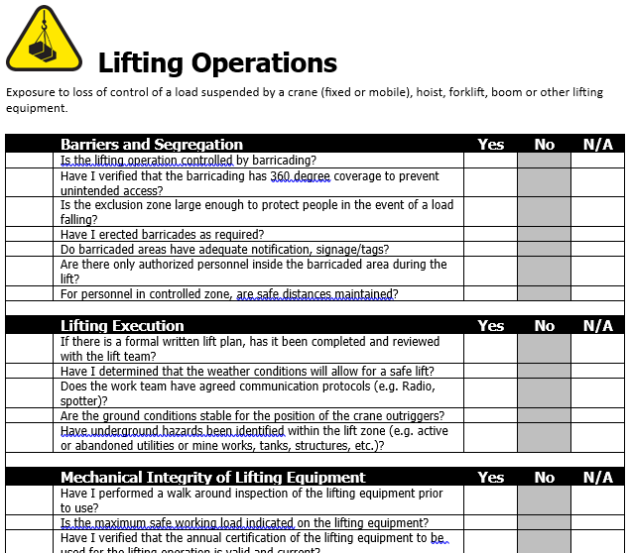
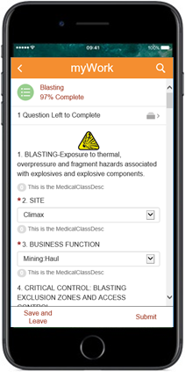
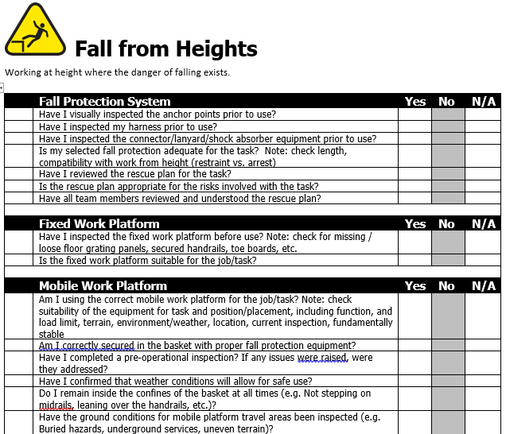
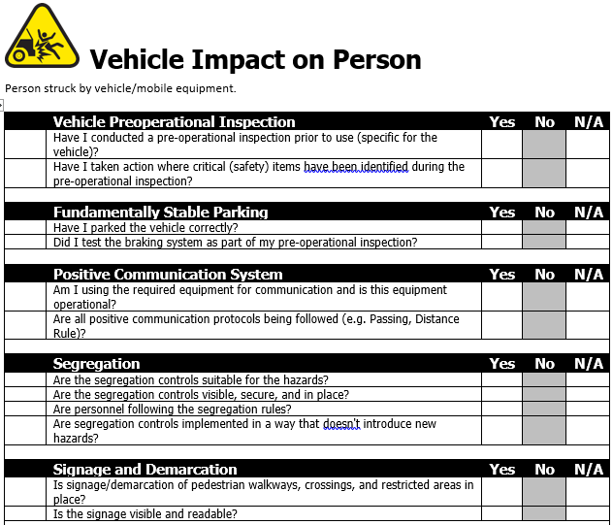
FRM Tools
A set of tools are provided to address the gaps in Fatality Prevention, and make the skills more usable in the field
Lifting Operations
Fall from Heights
Vehicle Impact on Person
Notes:
Instruction
Briefly discuss the available tools: the icons, verification questions, and the software tracking system.
These will be addressed in more depth in the next section.

Slide 25
FRM Icons
Purpose of icons
Visually recognizable
Standardize message
To ensure success of the message, the icons need to be understood (consider language barriers and culture)
An in-depth analysis of the past ten years aided in the selection of the twenty-three most significant Fatal Risks
Notes:
Instruction
Communication does not necessarily include only speech. We utilize images or visual triggers to receive other messages. Think of the many signs you see along the roads you travel. Each sign is posted to deliver a message or warning when human interaction is not possible
To ensure success of the message, the images or icons need to be understood. By presenting this information globally, the sender and receiver of the message can translate the same meaning and react appropriately
Between January 2010 and July 2017, 68 fatalities have occurred on our properties. In short, 68 people never returned home that day

Slide 26
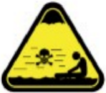
FRM Icons
Present at all sites
Present at many sites
Present at few sites
Exposure to Electrical Hazards
Entanglement and Crushing
Exposure to Hazardous Substances - Acute
Blasting
Confined Space
Interaction with Aircraft
Contact with Molten Material
Exposure to Hazardous Substances - Chronic
Drowning
Ground Failure
Personnel Hoisting
Underground Hazardous Atmosphere
Fall from Heights
Falling Objects
Rail Collision
Rail Impact on Person
Underground Inrush
Underground Rock Fall
Fire
Lifting Operations
Uncontrolled Release of Energy
Vehicle Collision or Rollover
Vehicle Impact on Person
Notes:
Instruction
Discuss the icons that are present at all sites, many sites, and few sites.
Ask if any of this information is surprising. Are there any missing Fatal Risks? Do any of these not make sense? You must understand all the Critical Controls for each Fatal Risk to facilitate this conversation.
Routinely participants will suggest items that represent hazards in our workplace such as tripping, mosquito causing malaria, rattlesnakes, lightning, flooding, etc. Have a discussion with the group about any suggestions. Let them know that new icons can be added after review by the corporate office. But focus the group on the idea that we are trying to represent Fatal Risks that have killed people in the past, that large groups of people encounter on a regular basis, and that these are things that “will” kill you rather than “could” kill you if the perfect set of circumstances arises.
For example, while rattlesnakes do represent a hazard, we have never had a fatality related to an animal attack. Not that it couldn’t happen in the perfect circumstance, it is just not certainly something that will kill you. But, standing under a crane and having a load of steel beams fall on you will most likely kill you. Lightning on the other hand has killed people in the past, but was not included because the controls in place to prevent this are mostly not something that an individual employee has to implement themselves. Slipping or tripping scenarios might come up where someone can explain a wild scenario where an unusual set of events results in a fatality, but by and large while slips and trips do cause injuries it is extremely rare that they would cause a fatality.

Slide 27
Introduction to Each Icon
Directions
As a class, discuss 2-4 Fatal Risks and answer the question in the SG for each icon
In small groups, discuss the Fatal Risks you are assigned and answer the question in the SG for each icon
You have 10 minutes to complete
Share your responses (2 minute max for each Fatal Risk)
Activity 2
Notes:
Time
Approximately 15 minutes
Materials
Worksheet in the SG (pp. 9-20)
Pens, pencils
Purpose
This activity gives students the opportunity to apply their knowledge of the Fatal Risk icons to their job site.
Instruction
As a class, discuss 2-4 Fatal Risks and answer the question in the SG for each icon
Break the class into small groups, and tell them to discuss the Fatal Risks assigned to them and answer the question in the SG for each icon
Give them 10 minutes to complete
Give each group two minutes to present each of their Fatal Risks (advance to the correct slide as groups present)

Slide 28
Interaction with Aircraft
Interaction with manned, unmanned, fixed and rotary wing aircraft.
What jobs or tasks are related to this Fatal Risk?
Read the Incident in the SG
Notes:
Instruction
Read definition for Fatal Risk
Discuss the two questions
Have students read PFE on their own or ask for a volunteer to read out loud
Discuss Critical Controls for the PFE
Allow a moment for students to write notes in their SG
Critical Controls
Qualified personnel
Aircraft suitability and maintenance
UAS/UAV Pre Mission Planning
Positive communication system
Fixed/Rotary Aircraft Pre Mission Planning
Jobs or Tasks
Piloting UAS
Piloting manned aircraft

Slide 29
Blasting
Exposure to thermal, overpressure and fragment hazards associated with explosives and explosive components
What jobs or tasks are related to this Fatal Risk?
Read the Incident in the SG
Notes:
Instruction
Read definition for Fatal Risk
Discuss the two questions
Have students read PFE on their own or ask for a volunteer to read out loud
Discuss Critical Controls for the PFE
Allow a moment for students to write notes in their SG
Critical Controls
Blasting Exclusion Zones and Access Control
Execution of Charging and Handling Protocol
Inspection of Explosives Transportation Vehicle
Management of Misfires
Segregation of Explosives During Transportation
Storage Exclusion Zones and Access Control
Jobs or Tasks
Transporting explosives
Clearing blasts
Blasting

Slide 30
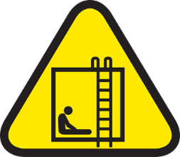
Confined Space
Exposure to a hazardous environment in a confined space
What jobs or tasks are related to this Fatal Risk?
Read the Incident in the SG
Notes:
Instruction
Read definition for Fatal Risk
Discuss the two questions
Have students read PFE on their own or ask for a volunteer to read out loud
Discuss Critical Controls for the PFE
Allow a moment for students to write notes in their SG
Critical Controls
Atmospheric monitoring
Energy isolation / LOTOTO
Entry permit execution
Jobs or Tasks
Utility work
Trenching/excavation
Entering into machinery
Pits and sumps
Tanks

Slide 31
Exposure to Electrical Hazards
Exposure to electrical shock or arc flash
What jobs or tasks are related to this Fatal Risk?
Read the Incident in the SG
Notes:
Instruction
Read definition for Fatal Risk
Discuss the two questions
Have students read PFE on their own or ask for a volunteer to read out loud
Discuss Critical Controls for the PFE
Allow a moment for students to write notes in their SG
Critical Controls
Access Control
Barriers and Segregation
Drawings and Labels
Electrical PPE
Energized Electrical Work Permit Execution
Energy Isolation/LOTOTO
Jobs or Tasks
Line work
Electrical installation
Demolition
Tankhouse activities

Slide 32
Contact with Molten Material
Coming in contact with molten metal
What jobs or tasks are related to this Fatal Risk?
Read the Incident in the SG
Notes:
Instruction
Read definition for Fatal Risk
Discuss the two questions
Have students read PFE on their own or ask for a volunteer to read out loud
Discuss Critical Controls for the PFE
Allow a moment for students to write notes in their SG
Critical Controls
Access Control
Cooling Element Monitoring
Engineered Molten Metal Conveyance System
Fire Suppression Systems (Molten Metal Hauler)
Furnace and Taphole Integrity
Hot Metal PPE
Pot Level Controls
Process Controls
Slag Chemistry Management
Jobs or Tasks
Smelting
Work around furnaces, converters, and anode plants
Refining
Rod mill
Tapping

Slide 33
Drowning
Exposure to the risk of drowning in natural or manmade bodies of water or other vats, cells, vessels and other open containers of liquid
What jobs or tasks are related to this Fatal Risk?
Read the Incident in the SG
Notes:
Instruction
Read definition for Fatal Risk
Discuss the two questions
Have students read PFE on their own or ask for a volunteer to read out loud
Discuss Critical Controls for the PFE
Allow a moment for students to write notes in their SG
Critical Controls
Access control
Access integrity
Barrier and segregation
Flotation devices
Jobs or Tasks
Boat usage
Tailings work
Pools/ponds/catchments
Sumps
Vats
Tanks

Slide 34
Entanglement and Crushing
Contact with machinery/moving parts (entanglement, crushing, pinching, penetrating, and cutting forces)
What jobs or tasks are related to this Fatal Risk?
Read the Incident in the SG
Notes:
Instruction
Read definition for Fatal Risk
Discuss the two questions
Have students read PFE on their own or ask for a volunteer to read out loud
Discuss Critical Controls for the PFE
Allow a moment for students to write notes in their SG
Critical Controls
Blocking for maintenance work
Energy isolation/LOTOTO
Guards, barriers, and barricades
Jobs or Tasks
Conveyor work
Vehicle maintenance
Equipment maintenance
Proximity to any of the above

Slide 35
Exposure to Hazardous Substances - Acute
Workplace exposure to substances that are immediately toxic, asphyxiating or corrosive (e.g. H₂S gas, NO_{x} gas, CO gas, concentrated acids, caustics, etc.)
What jobs or tasks are related to this Fatal Risk?
Read the Incident in the SG
Notes:
Instruction
Read definition for Fatal Risk
Discuss the two questions
Have students read PFE on their own or ask for a volunteer to read out loud
Discuss Critical Controls for the PFE
Allow a moment for students to write notes in their SG
Critical Controls
Access control
Alarm systems
Engineered controls
Handling requirements
Loading and unloading protection
Mechanical integrity of storage and distribution
PPE
Jobs or Tasks
Chemical handling
Acid loading and unloading
Smelter work
Tankhouses
Moly circuits
Processing plants
Laboratories

Slide 36
Exposure to Hazardous Substances - Chronic
Workplace exposure to substances that can cause lethal disease overtime (e.g. silica, arsenic, lead, welding fumes, asbestos, acid mist, etc.)
What jobs or tasks are related to this Fatal Risk?
Read the Incident in the SG
Notes:
Instruction
Read definition for Fatal Risk
Discuss the two questions
Allow a moment for students to write notes in their SG
Critical Controls
Access control
Engineered controls
Handling requirements
PPE
Jobs or Tasks
Chemical handling
Acid loading and unloading
Smelter work
Tankhouses
Moly circuits
Processing plants
Laboratories

Slide 37
Fall from Heights
Working at height where the danger of falling exists
What jobs or tasks are related to this Fatal Risk?
Read the Incident in the SG
Notes:
Instruction
Read definition for Fatal Risk
Discuss the two questions
Have students read PFE on their own or ask for a volunteer to read out loud
Discuss Critical Controls for the PFE
Allow a moment for students to write notes in their SG
Critical Controls
Fall protection system
Fixed Work Platform
Leading edge/open hole protection
Mobile work platform
Scaffold
Jobs or Tasks
Roof work
Climbing
Exposure to unprotected edges

Slide 38
Falling Objects
Exposure to falling objects (e.g. tools, materials, equipment, structures, etc.)
What jobs or tasks are related to this Fatal Risk?
Read the Incident in the SG
Notes:
Instruction
Read definition for Fatal Risk
Discuss the two questions
Have students read PFE on their own or ask for a volunteer to read out loud
Discuss Critical Controls for the PFE
Allow a moment for students to write notes in their SG
Critical Controls
Barriers and segregation
Integrity of overhead structure and equipment
Securing devices
Work area management
Jobs or Tasks
Work overhead
Stacked materials

Slide 39
Fire
Exposure to thermal, particulate, gas or vapor hazards from a fire
What jobs or tasks are related to this Fatal Risk?
Read the Incident in the SG
Notes:
Instruction
Read definition for Fatal Risk
Discuss the two questions
Have students read PFE on their own or ask for a volunteer to read out loud
Discuss Critical Controls for the PFE
Allow a moment for students to write notes in their SG
Critical Controls
Alarm systems
Evacuation plan
Fire suppression systems
Hot work permit execution
Rescue systems
Segregation and storage
Jobs or Tasks
Hot work
Receiving of potentially flammable or combustible materials
Startup or maintenance of smelter/furnace/dryer operations

Slide 40
Ground Failure
Exposure to failure of natural slopes and temporary or permanent slopes which are excavated or constructed in relation to mining activities or associated supporting infrastructure
What jobs or tasks are related to this Fatal Risk?
Read the Incident in the SG
Notes:
Instruction
Read definition for Fatal Risk
Discuss the two questions
Have students read PFE on their own or ask for a volunteer to read out loud
Discuss Critical Controls for the PFE
Allow a moment for students to write notes in their SG
Critical Controls
Geotechnical inspection and monitoring
Slope plan execution
Awareness and reporting
Excavation/trenching execution
Jobs or Tasks
Trenching and excavation
Work around highwalls, benches and slopes
Stockpiles
Dumps

Slide 41
Lifting Operations
Exposure to loss of control of a load suspended by a crane (fixed or mobile), hoist, forklift, boom or other lifting equipment
What jobs or tasks are related to this Fatal Risk?
Read the Incident in the SG
Notes:
Instruction
Read definition for Fatal Risk
Discuss the two questions
Have students read PFE on their own or ask for a volunteer to read out loud
Discuss Critical Controls for the PFE
Allow a moment for students to write notes in their SG
Critical Controls
Barriers and segregation
Mechanical integrity of lifting equipment
Lifting execution
Jobs or Tasks
Crane use
Forklift use
Other rigging/hoisting operations

Slide 42
Personnel Hoisting
Contact with, exposure to, or unintended consequences related to the movement of people or equipment via underground hoisting or aerial tramways
What jobs or tasks are related to this Fatal Risk?
Read the Incident in the SG
Notes:
Instruction
Read definition for Fatal Risk
Discuss the two questions
Have students read PFE on their own or ask for a volunteer to read out loud
Discuss Critical Controls for the PFE
Allow a moment for students to write notes in their SG
Critical Controls
Engineered hoisting system
Positive communication system
Jobs or Tasks
Hoist/tram operations
Hoist/tram inspection
Hoist/tram maintenance

Slide 43
Rail Collision
Locomotive, rolling stock, or other rail equipment colliding with or being hit by other vehicles, buildings, or equipment
What jobs or tasks are related to this Fatal Risk?
Read the Incident in the SG
Notes:
Instruction
Read definition for Fatal Risk
Discuss the two questions
Have students read PFE on their own or ask for a volunteer to read out loud
Discuss Critical Controls for the PFE
Allow a moment for students to write notes in their SG
Critical Controls
Access Control
Fit for work and fatigue management
Operator competency
Positive communication system
Scheduling, separation, and traffic control
Signaling and signage
Jobs or Tasks
Work in and around rail yards and tracks
Train operations

Slide 44
Rail Impact on Person
Locomotive, rolling stock, or other rail equipment coming into contact with a person
What jobs or tasks are related to this Fatal Risk?
Read the Incident in the SG
Notes:
Instruction
Read definition for Fatal Risk
Discuss the two questions
Have students read PFE on their own or ask for a volunteer to read out loud
Discuss Critical Controls for the PFE
Allow a moment for students to write notes in their SG
Critical Controls
Access control
Equipment maintenance
Positive communication system
Securing rolling stock
Segregation
Signaling and signage
Jobs or Tasks
Work in and around rail yards, and tracks, where personnel are in the area

Slide 45
Uncontrolled Release of Energy
Exposure to stored energy from pressure; items under tension or compression
What jobs or tasks are related to this Fatal Risk?
Read the Incident in the SG
Notes:
Instruction
Read definition for Fatal Risk
Discuss the two questions
Have students read PFE on their own or ask for a volunteer to read out loud
Discuss Critical Controls for the PFE
Allow a moment for students to write notes in their SG
Critical Controls
Energy Isolation/LOTOTO
Guards, Barriers and Barricades
Hose Coupling Lock System
Pipe Management
Piping Hoses and Equipment Mechanical Integrity
Relief Valves
Tensioned Lines Management
Tire Management
Jobs or Tasks
Work including maintenance, testing, diagnostics, and commissioning of live systems
HDPE activities
Pressurized vessels and systems
Unloading of materials (straps)
Pneumatic tire work

Slide 46
Underground Hazardous Atmosphere
Exposure to toxic atmosphere or oxygen deprivation underground
What jobs or tasks are related to this Fatal Risk?
Read the Incident in the SG
Notes:
Instruction
Read definition for Fatal Risk
Discuss the two questions
Have students read PFE on their own or ask for a volunteer to read out loud
Discuss Critical Controls for the PFE
Allow a moment for students to write notes in their SG
Critical Controls
Refuge chambers/Escape Routes
Self-rescuer
Ventilation monitoring
Ventilation system
Jobs or Tasks
Drilling operations
Blasting operations
Chemical/hazardous material use (paint, epoxy, etc.)
Vehicle operations underground (emissions and diesel particulate matter)

Slide 47
Underground Inrush
Exposure to crushing forces or oxygen deprivation caused by the sudden ingress of liquids or solids underground
What jobs or tasks are related to this Fatal Risk?
Read the Incident in the SG
Notes:
Instruction
Read definition for Fatal Risk
Discuss the two questions
Have students read PFE on their own or ask for a volunteer to read out loud
Discuss Critical Controls for the PFE
Allow a moment for students to write notes in their SG
Critical Controls
Backfill management and control
Draw point management and control
Entry point barriers
Ore passes, chutes, and raise controls
Probe drilling
Jobs or Tasks
Work in and around wet muck areas

Slide 48
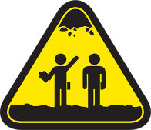
Underground Rock Fall
Exposure to rock that falls from the back or sidewalls underground
What jobs or tasks are related to this Fatal Risk?
Read the Incident in the SG
Notes:
Instruction
Read definition for Fatal Risk
Discuss the two questions
Have students read PFE on their own or ask for a volunteer to read out loud
Discuss Critical Controls for the PFE
Allow a moment for students to write notes in their SG
Critical Controls
Engineered support systems
Geotechnical inspections and monitoring systems
Ground control management plan execution
Scaling
Jobs or Tasks
Jumbo operations
Panel development
Barring down/scaling activities
Rock bolting activities

Slide 49
Vehicle Collision or Rollover
Collision with another vehicle or fixed/moving object; driving over an edge; rolling over
What jobs or tasks are related to this Fatal Risk?
Read the Incident in the SG
Notes:
Instruction
Read definition for Fatal Risk
Discuss the two questions
Have students read PFE on their own or ask for a volunteer to read out loud
Discuss Critical Controls for the PFE
Allow a moment for students to write notes in their SG
Critical Controls
Operator competency
Fit for work and fatigue management
Vehicle pre-operational inspection
Positive communication system
Access control
Segregation
Signage and demarcation
Road design and maintenance
Jobs or Tasks
Mobile equipment and light vehicle interaction
Driving on uneven surfaces (dumps, benches, edges/cliffs)

Slide 50
Vehicle Impact with Person
Person struck by vehicle/mobile equipment
What jobs or tasks are related to this Fatal Risk?
Read the Incident in the SG
Notes:
Instruction
Read definition for Fatal Risk
Discuss the two questions
Have students read PFE on their own or ask for a volunteer to read out loud
Discuss Critical Controls for the PFE
Allow a moment for students to write notes in their SG
Critical Controls
Vehicle pre-operational inspection
Positive communication system
Segregation
Signage and demarcation
Fundamentally stable parking
Jobs or Tasks
Personnel in or around vehicles or vehicle Travelways
Vehicles operating off roads (lots, warehouses, storage areas)

Slide 51
How FRM Works
Notes:
Instruction
This section contains introductory information about the tools specific to Fatal Risk Management

Slide 52
How FRM Works
What are some of the tools we use in the field to plan work?
SOP
JSA
Risk assessment
Work instruction
The Fatal Risk Management system can combine and eliminate some of the repetition
Toolbox Talk
Critical Control Audits
Field Verifications
Others?
Notes:
Instruction
Ask the students to answer the question
Ask the students about opportunities to combine some of the repetitive work, and explain that the Fatal Risk management systems aim to do that.
DOHS is not trying to add another safety requirement to those activities that you are doing, but trying to enhance them or replace them, if necessary.

Slide 53
How FRM Works
Watch the video to see utilization of the FRM tools
Think of ways you can implement some of the ideas at your property
https://web.microsoftstream.com/video/29b89c5f-1a6c-408f-a743-ed410e14f6a9
Notes:
Instruction
Before you play the video, ask the students to either see if any of the ideas are realistic for their site or if they can think of other ways to implement the icons
Discuss responses after the video ends
The video is an example of how leaders can utilize the FRM tools in their tailgate meetings and how they can verify Critical Controls in the field
It does not mean that all tailgate meetings must be operated like the one in the video

Slide 54
How FRM Works
Fatal Risk Management tools
Icons
Cority System
Verification questions
Supervisors can use these tools to
Enhance tailgate meetings
Improve field verification of Critical Controls
Empower employees to stop work
Notes:
Instruction
There are three tools available within the Fatal Risk Management: the icons, verification questions, and the Cority system

Slide 55
FRM Tools
Icons
Visual cue to communicate a potential risk
Implementation of icons will vary site to site
Intended to represent the most critical Fatal Risks
Notes:
Instruction
Icons can be used in a number of ways. Each method of use will vary from site to site and each site is responsible for determining how the icons are implemented.
Icons represent the most critical Fatal Risks, or their roots, for all operating locations, however it is possible not all risks will be captured. If a site believes a Fatal Risk is missing or an additional icon should be created, it is imperative that this concern is addressed with supervision or management who can then bring it to the attention of DOHS.
Note: Do not attempt to modify, alter, or create any portion of the Fatal Risk Management program, such as icons, Critical Controls, or verification questions.

Slide 56
FRM Tools
Verification Questions
Tasks can have multiple Fatal Risks
As an operator, the verification questions help identify if appropriate controls are in place and effective
Supervisors can use the verification questions to help prioritize their time in the field
Notes:
Instruction
Discuss the bullets on the slide.
Review the examples provided.
The intent here is every day operators will identify their Fatal Risks and review Critical Controls prior to beginning their task(s).
Reiterate the focus on stopping work if controls are missing or ineffective.
Critical Controls are pre-defined and listed for each Fatal Risk.
The verification questions help ensure that Critical Controls are in place. In some cases, a single task might have multiple Fatal Risks associated with it. Verification Forms are one way the verification questions can be implemented. The idea is that each of these questions is answered yes, no, or not applicable for this task. A no answer indicates that the control is missing or is not effective, and the job must be stopped until the control is either in place or functioning correctly. Completing the verification questions gives employees and supervisors a quick overview of how safely the job or task can and is being performed. These can be used in multiple ways, as talking points during tailgates, as conversations in the field when looking at a job in progress, or as an audit for Critical Controls. The verification questions are an additional layer of accountability that the Critical Controls are in place. It is important to keep these lines of communication open, so that safety stays at the forefront of every decision.
Prior to performing a job, the operator and/or crew should identify any potential Fatal Risks and ask themselves the relevant questions. If a Critical Control is not in place or implemented in an effective manner, then the job will be stopped until the issue is addressed.

Slide 57
FRM Tools
Icons
Critical Controls
Verification Questions
Has the scaffold design and work plan been approved by a competent person?
Is the scaffold constructed according to the approved design and work plan?
Does the scaffold have the load capacity posted?
Has the inspection of the scaffold been completed by a competent person prior to use? Note: Daily inspection is required when a scaffold is in use.
Is the scaffold protected from being hit by moving vehicles/equipment?
Does the scaffolding have complete floors, toe boards, mid rails and handrails?
Is installed edge protection adequate to prevent falls?
Am I adequately protected from falling into or off of openings or leading edges?
Have I inspected the edge protection devices to ensure they are maintained and in good working order?
Have I visually inspected the anchor points?
Have I inspected my harness?
Have I inspected the connector/lanyard/shock absorber equipment prior to use?
Is my selected fall protection adequate for the task and am I wearing it correctly?
Has the team reviewed the rescue plan for this task? Does everyone know and understand the plan?
Is the rescue plan appropriate and are all necessary tools and equipment available?
Can I maintain 100% tie-off, if needed?
Have all team members reviewed and understood the rescue plan?
Have I inspected the fixed work platform before use?
Is the fixed work platform suitable for the job/task?
Am I using the correct mobile work platform for the job/task
Am I correctly secured in the basket with proper fall protection equipment?
Have I completed a pre-operational inspection and addressed any critical safety issues?
Have I confirmed that weather conditions will allow for safe use?
Do I remain inside the confines of the basket at all times (e.g. Not stepping on midrails, leaning over the handrails, etc.)?
Have the ground conditions for mobile platform travel areas been inspected
Are the platforms travelling over the designated and inspected areas for the task?
Fall Protection System
Leading Edge/Open Hole Protection
Fixed Work Platform
Mobile Work Platform
Scaffold
Fall from Heights
Notes:
Instruction
Click through the example for “Fall from Heights”
The concept of this slide is to illustrate how for each Fatal Risk icon we have created a set of Critical Controls. For each Critical Control we have created a set of simple verification questions that can be used for discussion purposes or as a reminder of what needs to be considered before the job. Each question is meant to be answered with either a Yes, No, or Not Applicable. These are not set in stone and we are open to suggestion for adding and modifying these items. The idea is that they help remind people quickly what they need to consider before proceeding with work. In many cases not all of the Critical Controls will apply to every job. Same with the verification questions. That is when Not Applicable is appropriate. Any time a No is given to a question work should be stopped immediately until the issue can be resolved. The idea is that the Critical Controls and the verification questions are available to everyone as part of empowering the workforce to stop work when something critical is missing.
Many of the Critical Controls are somewhat general in nature because they need to apply to a range of different job tasks and work settings across the company. These are also not meant to be an exhaustive list of controls for every job. Nor are they meant to replace an SOP. Again, they are there to remind people what is critical based on past fatalities and to encourage conversations during pre-job assessments.
Note: There is a process for adding or changing elements of the FRM program. Take any questions or concerns to supervision or health and safety. Changes will be evaluated and implemented annually as needed.

Slide 58
FRM Tools
Cority
Used to input data, analyze trends, and generate reports
Relies on self-reporting
Vital in identifying gaps within our current procedures and practices
Can be compared and shared across the sites
Notes:
Instruction
Cority is a relatively new system to the Company. It was primarily used for Industrial Hygiene purposes, but has recently been adapted for other uses. When an issue with a Critical Control is reported, the information is recorded in Cority.
When used appropriately, the system can help track leading indicators to help managers and health and safety determine where controls are failing, missing, ineffective or can be strengthened to create safer working spaces and safer jobs for our employees. It is important to note that the software is not a way to identify people who are underperforming, but rather to identify jobs that can be made safer. There is no punishment, there is no name tracking associated with this software, or with any of the verification questions.
By querying specific data, supervisors can track the use or misuse of Critical Controls. This aids in Critical Control concerns and improvements. This information can be compared and shared across the sites
Field verifications conducted with verification questions by Supervisors or Management can be loaded into the Cority system

Slide 59
FRM Tools
Application of the Tools
Each location will implement the tools in a way most effective for their employees
Possible suggestions
Laminating checklists
Displaying posters
Creating icon stickers/magnets
Building notebooks with relevant checklists
Key to success is to educate and communicate
Notes:
Instruction
Discuss the bullets on the slide

Slide 60
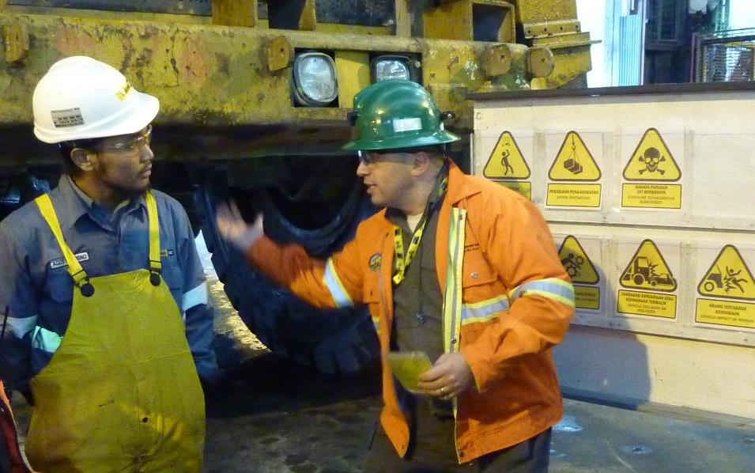
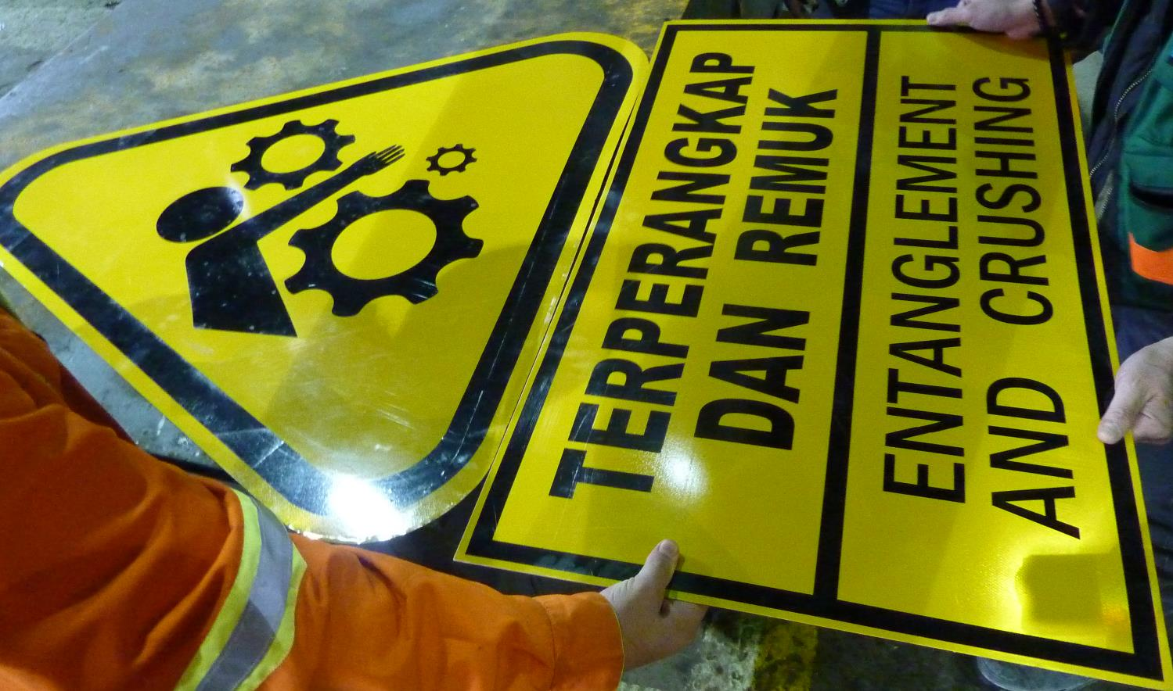
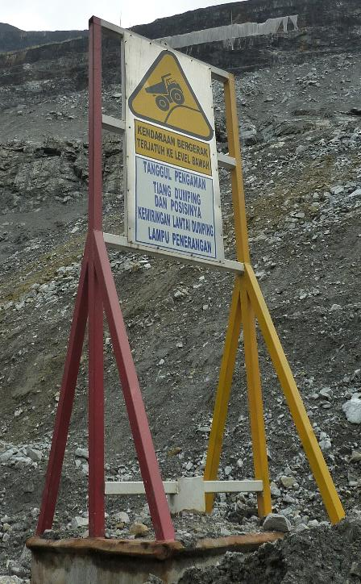
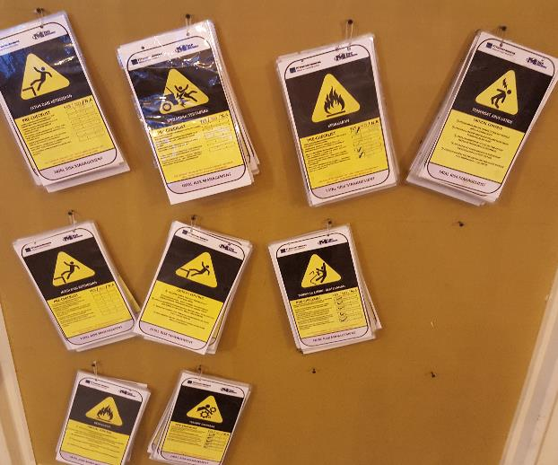
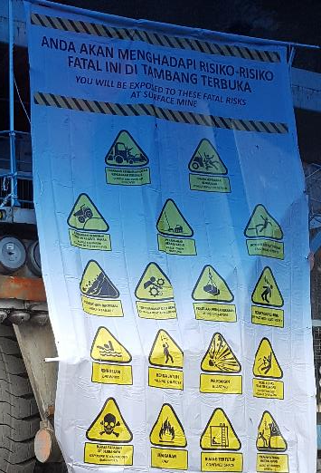
PTFI Field Implementation
Notes:
Instruction
These images show icons being used at PTFI.
Banners were used to introduce the program at the Grasberg mine area
Laminated verification forms- are available in the shop and then when a job is performed. They take those applicable verifications to the work location, discuss the Fatal Risks and complete a verification of Critical Controls
Metal signs were posted around the mine areas and shops to communicate Fatal Risks in the area
Be cautious not to plaster the entire site. Oversaturation will dilute the intent of the program.

Slide 61
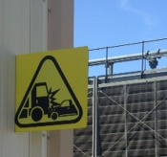
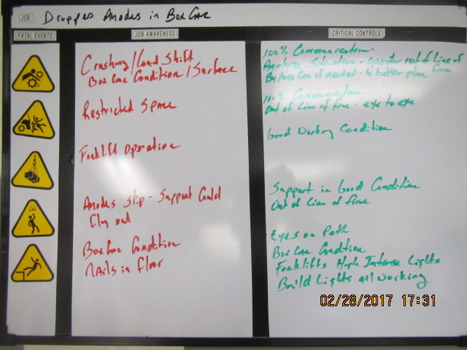
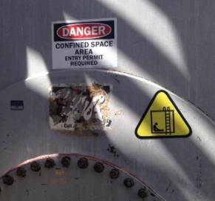
El Paso Field Implementation
Notes:
Instruction
These images show icons being used at El Paso.
Task Specific Fatal Risk Documents- customized to their work assignments, keeping the same Critical Controls as the verification questions, etc… (this is important that they are consistent)
Line Out Room Task board- utilized in the work area or tailgate meeting similar to the video that was viewed earlier. Some El Paso teams have this in the middle of the work area.
Signs and stickers, when placed appropriately and sparingly can help enhance messages or draw attention to specific areas of concern.
Ask for additional examples that students may have seen.

Slide 62
FRM Expectations
Each Fatal Risk has a set of Critical Controls that should be known by all applicable employees
The Critical Controls must be in place prior to beginning work
If a Critical Control is missing or not working, immediately stop the job until controls are implemented
Prioritization can take many forms; should not be limited to only those tasks that are more controlled by behavior
Notes:
Instruction
Review the bullets on the slide.
The expectations are intended to reiterate that the tools should be utilized in ways that make sense for the site, the division, dept., etc.
There shall not be modifications to the icons, Critical Control questions, etc.
If there are changes needed, a discussion with DOHS will need to be scheduled.
The program is intended for Fatal Risk Management and only that. Not for bruised knees, not for a sore back, etc.
It is absolutely crucial that we be disciplined about managing it with Fatal Risks.

Slide 63
FRM Expectations
All approved FRM material is found on the DOHS SharePoint site
Utilize only approved icons and verification questions in the field
Be creative with how they are utilized but remember overuse can make them ineffective
Do not modify or add verification questions unless approved by DOHS
Notes:
Instruction
Review the bullets on the slide.
The expectations are intended to reiterate that the tools should be utilized in ways that make sense for the site, the division, dept., etc.
There shall not be modifications to the icons, Critical Control questions, etc.
If there are changes needed, a discussion with DOHS will need to be scheduled.
The program is intended for Fatal Risk Management and only that. Not for bruised knees, not for a sore back, etc.
It is absolutely crucial that we be disciplined about managing it with Fatal Risks.

Slide 64
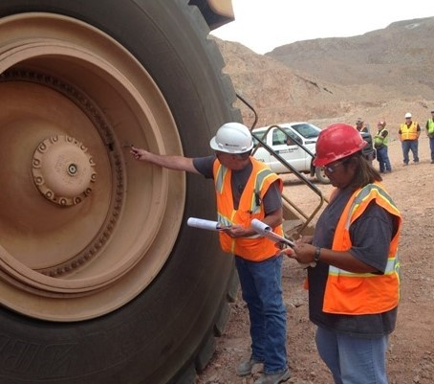
Roles and Responsibilities
Am I aware of the Fatal Risks?
Am I implementing Critical Controls?
Am I stopping work if something is missing?
Do employees feel empowered to stop the job when Critical Controls are not in place?
Have I communicated the use and meaning of the icons?
Am I taking the time to review the verification questions throughout the day?
Employee
Supervisor
Notes:
Instruction
Review the questions on the slide
If any of these are answered with a “no”, stop the job

Slide 65
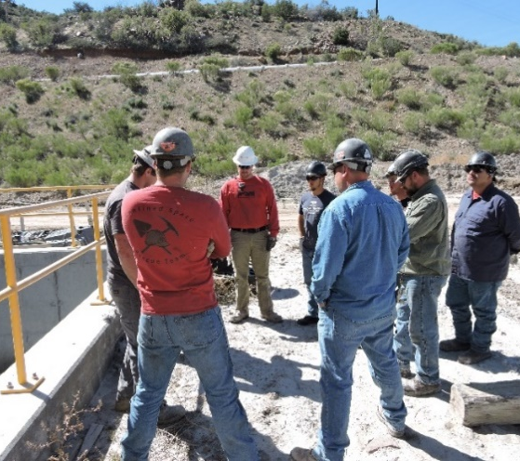
Communicate the Program
Manager
Am I identifying and communicating the Fatal Risks for my site?
Have I ensured the policies, procedures, and training are in place to support the Critical Controls?
Am I verifying these in the field?
Practice the message
Is there an opportunity for it to be received differently than intended?
Does it relate to increasing awareness around Fatal Risks and Critical Controls?
Can it be perceived as a production pressure message?
Notes:
Instruction
In Fatality Prevention, we learn about the power of the message, and how the sender and receiver can misinterpret the information
Body language and tone of voice can influence the strength or importance of the message
When preparing to speak with frontline employees, take the time to practice your message and interaction
Use of the icons and discussions about “what will kill you” are new. Consider the different ways they can be misinterpreted and keep those in mind as you speak about the program. More clear discussions should occur not to scare, but to encourage employees to speak freely and openly about hazards
It is important that employees understand the Fatal Risk Management program, in its entirety

Slide 66
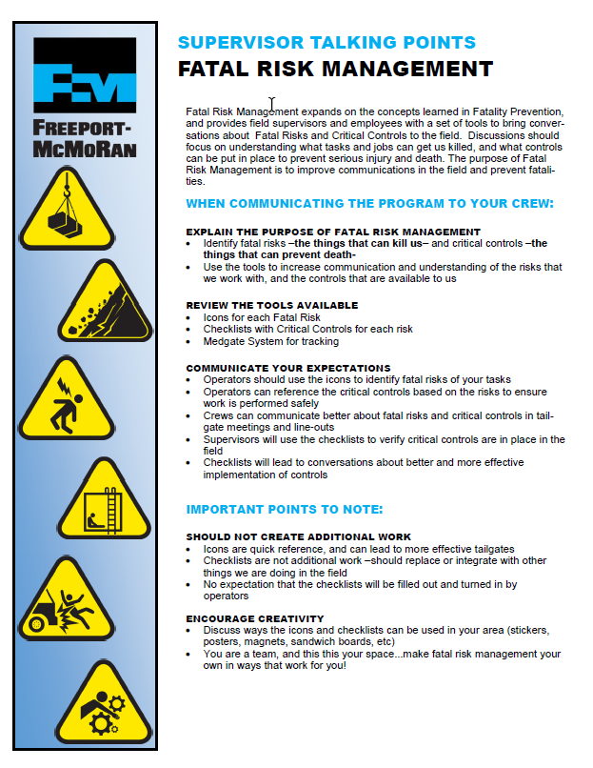
Communicate the Program
There are many ways that you can further develop the tools to maintain communication
Supervisor Talking Points
Overall summary of the training
Purpose of the training
Expectations for before/after employee attends
Notes:
Instruction
The Supervisor Talking Points is another tool available for use when communicating the program to employees.
Review the document prior to training and be available should questions arise.
By having the conversation both before and after the training, the employee is more likely to understand and retain what is expected of him/her.
Remind Supervisors:
Utilize the talking points to help educate your employees and utilize your resources.
Don’t attempt to push everything on crews all at once, consider starting small (one basic task) and building up from there.
Once employees and supervisors get comfortable with the materials and intent, the involvement and energy should build and expand.

Slide 67
Identifying Fatal Risks
Directions
Break into groups
Review each photo on the worksheet in the SG
Use the Fatal Risk icons in the SG, to determine which Fatal Risks are present for that job and choose the appropriate icon(s). Remember that tasks/jobs can have multiple Fatal Risks
You have 5 minutes to complete
Be prepared to share your responses
Activity 3
Notes:
Time
Approximately 20 minutes
Materials
Worksheet in the SG (pp. 35-37)
Pens/pencils
Purpose
This activity gives students the opportunity to identify Fatal Risks given specific scenarios.
Instruction
Break the class into groups of approximately 4-6 students
Direct them to review both photos on the worksheet
Ask them to use the Fatal Risk worksheet in the SG to determine which Fatal Risks are present for that job and choose the appropriate icon(s). Remind the class that tasks/jobs can have multiple Fatal Risks
Allow 5 minutes for them to complete
Discuss responses as a class
Clarify any confusion

Slide 68
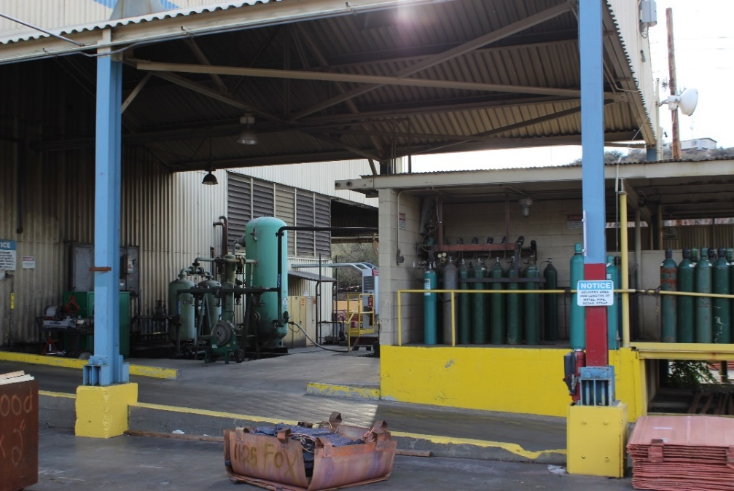
FRM Practice
1. Area Housekeeping
What are the potential Fatal Risks?
Notes:
Instruction
Task: Clean and organize the area
Tools: Forklift, hand dolly, other necessary tools for cleaning
Factors: Vendor is parked outside the working area and is using a dolly to replace empty cylinders in the background, no weather concerns
Discuss the job on the slide. Also in the SG.
Ask the question on the slide.
Review the responses provided.
Advance to the next slide.

Slide 69
FRM Practice
Area Housekeeping
Fatal Risks
Vehicle Impact on Person
Lifting Operations
Notes:
Instruction
Ask them to identify the icon.
Note on Fall from Heights
At the height presented, there is a greater likelihood of a minor injury than a fatality.
Note on Exposure to Hazardous Chemicals
Vendor is the one accessing the area with the bottles.
The likelihood of the bottles containing enough hazardous substance to be fatal is minimal.
Note on Vehicle Collision and Rollover
Likelihood of a fatality from forklift hitting a parked truck is extremely low, if even possible.

Slide 70
FRM Practice
2. Replace Building Panels
What are the potential Fatal Risks?
Notes:
Instruction
Task: Replace panels on top of the building
Tools: Crane, two manlifts, necessary hand and power tools
Factors: Not in a roadway, not exposed to other traffic or equipment, no weather concerns
Discuss the job on the slide.
Ask the question on the slide.
Review the responses provided.
Advance to the next slide.

Slide 71
FRM Practice
Replace Building Panels
Fatal Risks
Fall from Heights
Lifting Operations
Notes:
Instruction
Ask them to identify the icon.
Correct any incorrect responses, but encourage discussion around Fatal Risks.

Slide 72
Fatal Risks and Critical Controls Part Two
Directions
Continue working in groups
Review each photo on the worksheet in the SG
Use the Fatal Risk and Critical Control pages in the SG to determine which Fatal Risks are present for that job and choose the appropriate icon(s). Remember that tasks/jobs can have multiple Fatal Risks
List the Critical Controls
You have 10 minutes to complete
Be prepared to share your responses
Activity 4
Notes:
Time
Approximately 20 minutes
Materials
Worksheet in the SG (pp. 38-42)
Pens/pencils
Purpose
This activity gives students the opportunity to identify Fatal Risks given specific scenarios.
Instruction
Break the class into groups of approximately 4-6 students
Direct them to review both photos on the worksheet
Ask them to determine which Fatal Risks are present for that job and choose the appropriate icon(s). Remind the class that tasks/jobs can have multiple Fatal Risks
Ask them to list the appropriate Critical Controls for each Fatal Risk
Allow 10 minutes for them to complete
Discuss responses as a class
Clarify any confusion

Slide 73
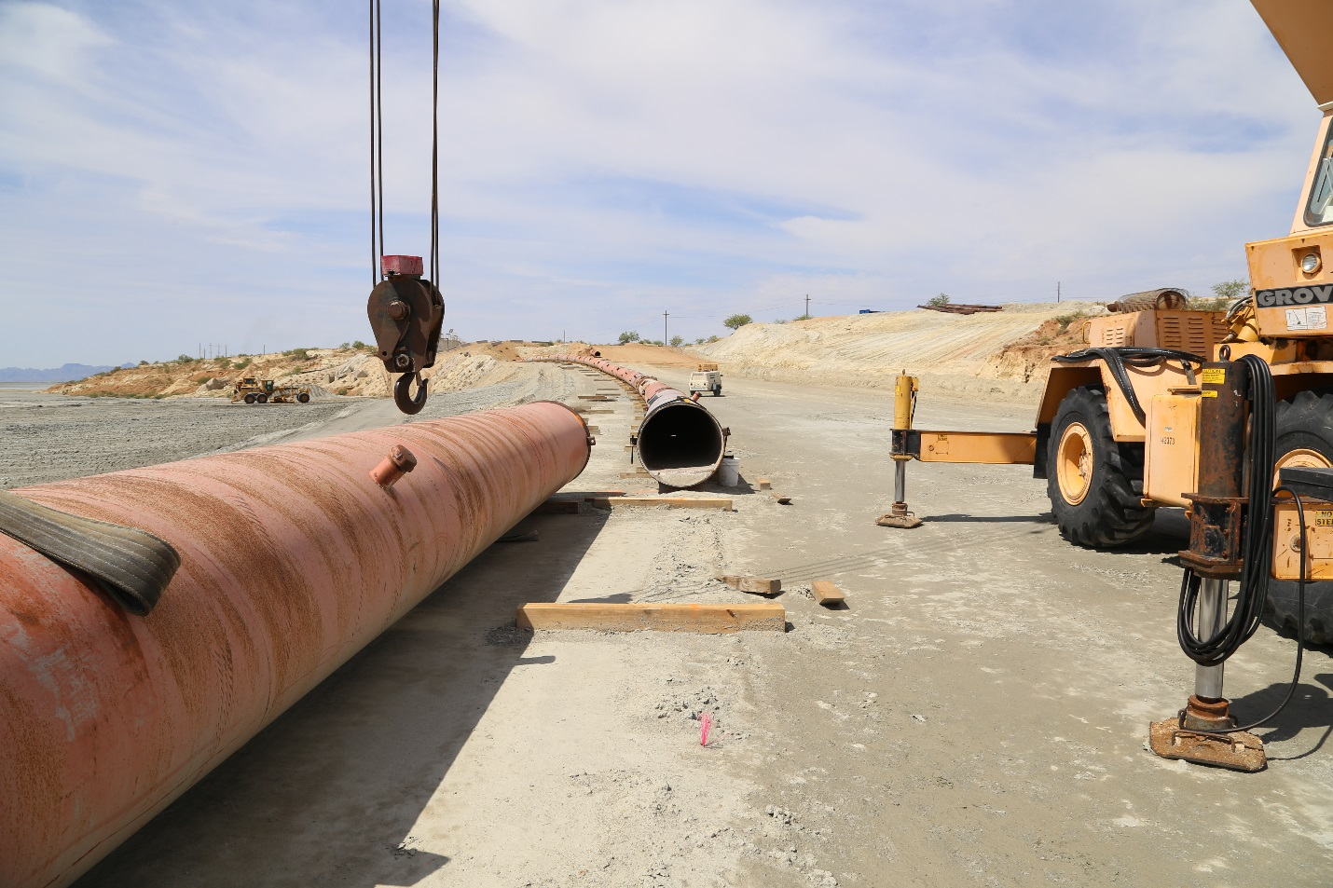
FRM Practice
3. Pipeline Repair / Inspection
What are the potential Fatal Risks?
What are the Critical Controls?
Notes:
Instruction
Task: Maintenance and repair on a pipeline
Work: Cut the pipe, enter the pipe to clear an obstruction, weld the pipe back together
Tools: Crane, necessary hand and power tools
Factors: Not in a roadway, not exposed to other traffic or equipment, no weather concerns
Discuss the job on the slide.
Ask the two questions on the slide.
Review the responses provided.
Advance to next slide.
Ask them to identify the icon and associated Critical Controls.

Slide 74
FRM Practice
Pipeline Repair / Inspection
Fatal Risks and Critical Controls
Confined Space
Critical Controls – ventilation, monitoring equipment
Lifting Operations
Critical Controls – proper rigging, perimeter security
Notes:
Instruction
Ask them to identify the icon and associated Critical Controls.

Slide 75
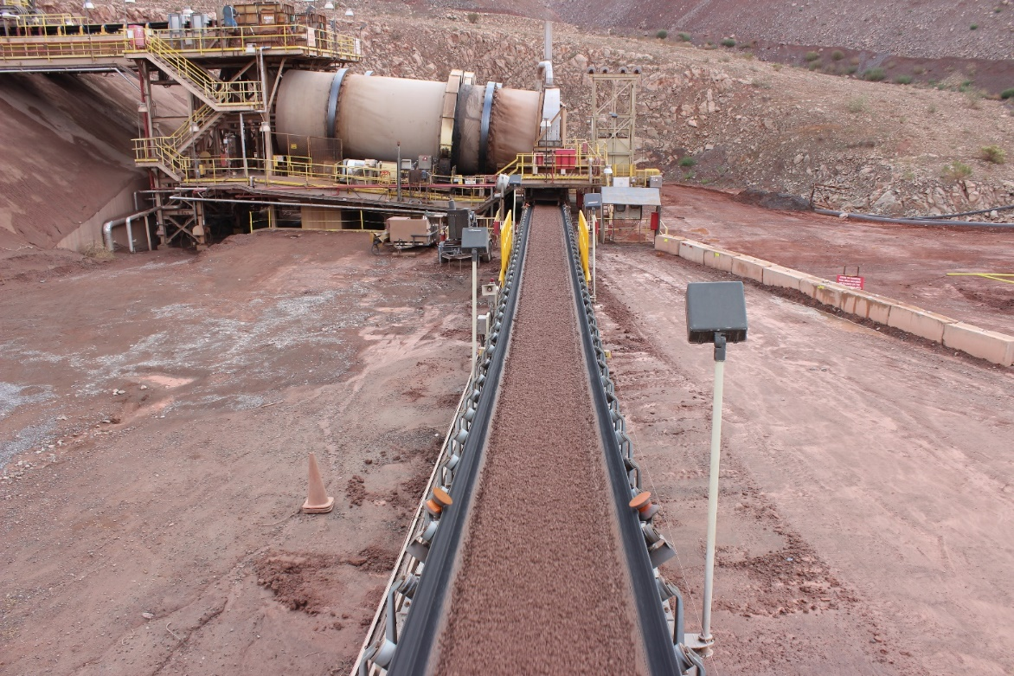
Identifying Fatal Risks
4. Clean-up and Inspection around Conveyor
What are the potential Fatal Risks?
What are the Critical Controls?
Notes:
Instruction
Task: Clean-up and inspection around conveyor
Work: Inspection, clean up and possibly minor maintenance
Tools: Required hand and power tools, including shovels
Factors: Not working at heights, no equipment or vehicles in the area, no weather concerns, and the conveyor is running
Discuss the job on the slide.
Ask the two questions on the slide.
Review the responses provided.
Advance to next slide.
Ask them to identify the icon and associated Critical Controls.

Slide 76
FRM Practice
Clean-up and Inspection Around Conveyor
Fatal Risks and Critical Controls
Entanglement and Crushing
Blocking for maintenance, energy isolation/LOTOTO, guards/barriers/ barricades
Exposure to Hazardous Substances
Access control, alarm systems, PPE
Uncontrolled Release of Energy
Guards/barriers/barricades, energy isolation/LOTOTO
Notes:
Instruction
Ask them to identify the icon and associated Critical Controls.

Slide 77
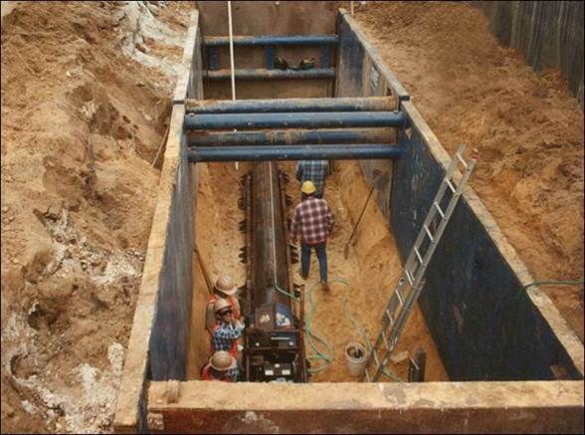
Identifying Fatal Risks
5. Underground Utility Repair
What are the potential Fatal Risks?
What are the Critical Controls?
Notes:
Instruction
Task: Underground utility repair
Work: Entering a trench, cutting a section of pipe, and welding the pipe back together
Tools: Crane and required hand and power tools
Factors: Not in a roadway or exposed to other traffic or equipment, and no weather concerns
Discuss the job on the slide.
Ask the two questions on the slide.
Review the responses provided.
Advance to next slide.
Ask them to identify the icon and associated Critical Controls.

Slide 78
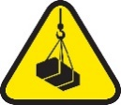
FRM Practice
Underground Utility Repair
Fatal Risks and Critical Controls
Confined Space
Atmospheric monitoring, entry permit execution, energy isolation/LOTOTO
Lifting Operations
Barriers and segregations, lifting execution, mechanical integrity of lifting equipment
Ground Failure
Excavation and trenching execution
Notes:
Instruction
Ask them to identify the icon and associated Critical Controls.

Slide 79
Fatal Risks and Critical Controls Part Two
Directions
In the same group, review each photo on the worksheet in the SG
Receive FRM Operator Reference Guide
Determine which Fatal Risks are present for that job and choose the appropriate icon(s). Remember that tasks/jobs can have multiple Fatal Risks
List the Critical Controls
You have 20 minutes to complete
Be prepared to share your responses
Activity 5
Notes:
Time
Approximately 20 minutes
Materials
Worksheet in the SG (pp. 43-46)
Pens/pencils
Purpose
This activity gives students the opportunity to identify Fatal Risks given specific scenarios.
Instruction
Break the class into groups of approximately 4-6 students
Direct them to review the photos on the worksheet
Hand out the FRM Operator Reference Guides (1 per student)
Ask them to now use the books to determine which Fatal Risks are present for that job and choose the appropriate icon(s). Remind the class that tasks/jobs can have multiple Fatal Risks
Ask them to list the appropriate Critical Controls for each Fatal Risk
Allow 10 minutes for them to complete
Discuss responses as a class
Clarify any confusion
Discuss how the books helped in the understanding of FRM and Critical Controls

Slide 80
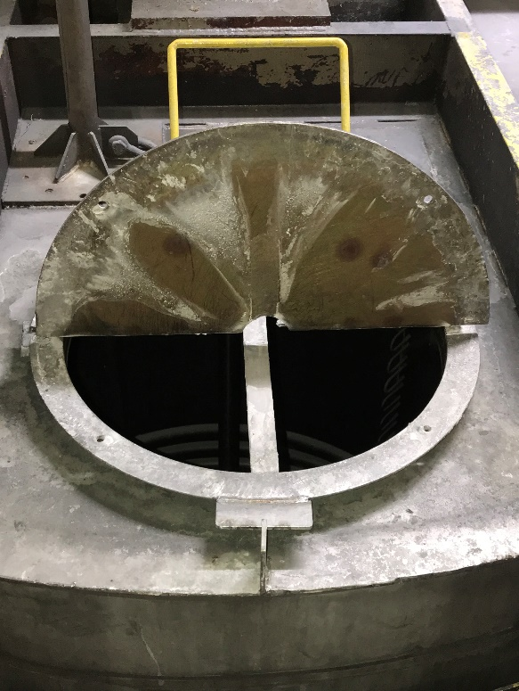
Identifying Fatal Risks
6. Process Tank Entry
What are the potential Fatal Risks?
What are the Critical Controls?
Notes:
Task: Process tank entry
Work: Entering tank to replace cover plate
Tools: Drop ladder, tripod rescue unit, torch/welder, and required hand/power tools
Factors: LOTOTO and required blocks and blinds performed; work communicated with affected individuals in the area; and proper flagging and barricading erected
Discuss the job on the slide.
Ask the two questions on the slide.
Review the responses provided.
Advance to next slide.

Slide 81
FRM Practice
Process Tank Entry
Fatal Risks and Critical Controls
Confined Space
Atmospheric monitoring, entry permit execution, energy isolation/LOTOTO
Fire
Alarm systems, evacuation plan, fire suppression systems, hot work permit execution, rescue systems, segregation and storage
Notes:
Instruction
Ask them to identify the icon and associated Critical Controls.

Slide 82
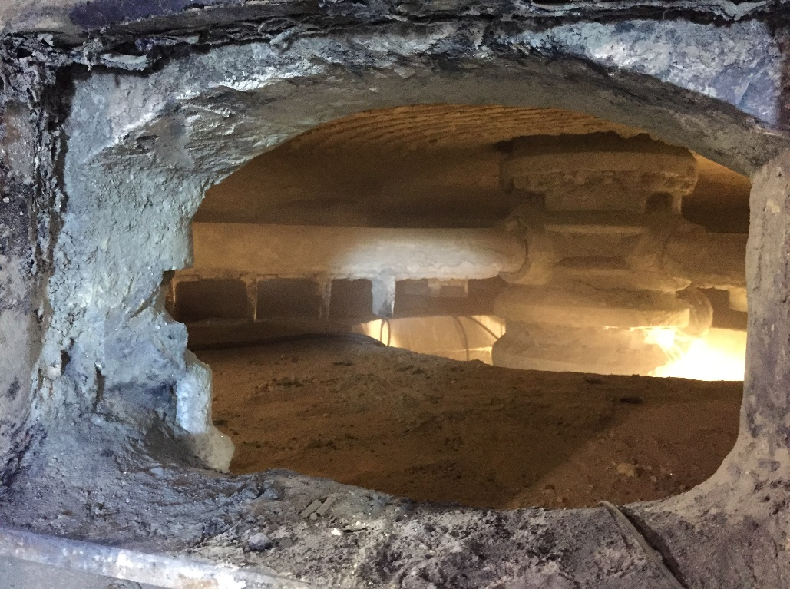
Identifying Fatal Risks
7. Remove Broken Roaster Arm
What are the potential Fatal Risks?
What are the Critical Controls?
Notes:
Task: Remove broken roaster arm
Work: Removing a broken arm out of the roaster while roaster is hot
Tools: Forklift, chains, and other rigging supplies
Factors: Draft valves are 100% open; area is properly flagged and barricaded; and work communicated with affected individuals in the area
Discuss the job on the slide.
Ask the two questions on the slide.
Review the responses provided.
Advance to next slide.

Slide 83
FRM Practice
Remove Broken Roaster Arm
Fatal Risks and Critical Controls
Lifting Operations
Barriers and segregation, mechanical integrity of lifting equipment, lifting execution
Vehicle Impact on Person
Vehicle pre-operational inspection, positive communication system, segregation, signage and demarcation, fundamentally stable parking
Notes:
Instruction
Ask them to identify the icon and associated Critical Controls.

Slide 84
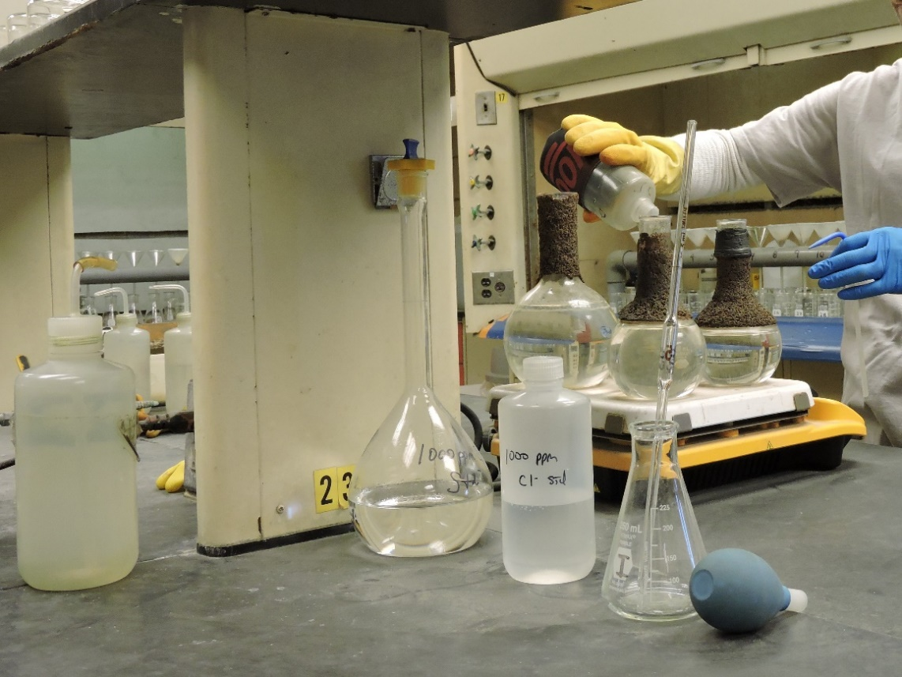
Identifying Fatal Risks
8. Sample Materials
What are the potential Fatal Risks?
What are the Critical Controls?
Notes:
Task: Sample materials
Work: Mix chemicals and sample resulting solutions
Tools: Acids, bases, beakers, hot plate, vent hood
Factors: Area is free of tripping hazards and housekeeping issues; limited employees working in the area on similar tasks
Discuss the job on the slide.
Ask the two questions on the slide.
Review the responses provided.
Advance to next slide.

Slide 85
FRM Practice
Sample Materials
Fatal Risks and Critical Controls
Exposure to Hazardous Substances
Access control, alarm systems, engineered controls, handling requirements, loading and unloading protection, mechanical integrity of storage and distribution, PPE
Fire
Alarm systems, evacuation plan, fire suppression systems, hot work permit execution, rescue systems, segregation and storage
Notes:
Instruction
Ask them to identify the icon and associated Critical Controls.

Slide 86
Debrief
How will these tools make you more efficient in discussing Fatal Risks and Critical Controls?
What are some other ways the tools can be used?
What do you need to help you be successful using this approach in the field?
Notes:
Instruction
Review the questions on the slide
The purpose of this is to help with the retention of the information by asking students these questions

Slide 87
FRM Implementation and Progression
Notes:
Instruction
This section contains introductory information about recommended timeframes for implementing the Fatal Risk Management Program

Slide 88
FRM Implementation and Progression
Sample road map for rolling out FRM
Weeks 1-2: Icon Introduction
Weeks 3-4: Critical Control Discussions
Weeks 5-6: Verification Question Overview
Weeks 7-8: Putting It Together
Notes:
Instruction
Fatal Risk Management is new and therefore will take time to implement
There are projected timelines for each segment of the deployment
These time frames are approximate and are intended to represent the length of time expected to train each property
As the number of employees vary per site, so will the timelines

Slide 89
FRM Implementation and Progression
Weeks 1 - 2: Icon Introduction
Use Supervisor Talking Points to introduce the program
Discuss applicable icons (2-3 per day)
Group discussions to incorporate icon use per job, task and reason for selection
Reinforce message on Fatal Risks and stopping the job
Notes:
Instruction
These actions are suggested for this time frame to get the employees used to the terminology and tools
Review each bullet on the slide

Slide 90
FRM Implementation and Progression
Weeks 3 - 4: Critical Control Discussions
Introduce Critical Control concepts
Group discussions around Critical Controls
Notes:
Instruction
These actions are suggested for this time frame to get the employees used to the terminology and tools
Review each bullet on the slide

Slide 91
FRM Implementation and Progression
Weeks 5 - 6: Verification Question Overview
Introduce verification questions
Continue discussions on Fatal Risks, icons, and Critical Controls
Notes:
Instruction
These actions are suggested for this time frame to get the employees used to the terminology and tools
Review each bullet on the slide

Slide 92
FRM Implementation and Progression
Weeks 7 - 8: Putting It Together
Each day, use one job or task to discuss all Fatal Risks, Critical Controls, and verification questions
Employees will lead further discussions
Notes:
Instruction
These actions are suggested for this time frame to get the employees used to the terminology and tools
Review each bullet on the slide

Slide 93
Tailgate Talk
Directions
Using the worksheet in the SG, create a tailgate or discussion explaining each of the tools
Propose at least one way that you would implement use of the icons for your crew
You have 10 minutes to complete
Be prepared to share your responses
Activity 6
Notes:
Time
Approximately 25 minutes
Materials
Worksheet in the SG (p. 53)
Pens/pencils
Purpose
This activity gives students the opportunity to practice speaking to their crew about Fatal Risk Management.
Instruction
Direct each student to complete the worksheet in the SG by creating a tailgate or discussion explaining each of the tools
Direct each student to then propose at least one way that he/she would implement use of the icons
Allow 10 minutes to complete
Ask for a couple of volunteers to conduct their tailgate talk, if time allows, ask for additional volunteers
Ask for a couple of other volunteers to share their proposed ideas; if time allows, ask for additional ideas

Slide 94
Conclusion
Notes:
Instruction
The conclusion covers:
Debrief
Student End of Course Questionnaire

Slide 95
Conclusion
Fatality Prevention is a living process
It needs to be nurtured to grow
It is owned by you, and it lives in the field with our frontline employees, supervisors, managers, and leaders
Take the concepts of Fatal Risk Management to your employees and work together to meet your needs
What questions do you have?
Notes:
Instruction
Review the bullets on the slide
Clarify any questions

Slide 96
Debrief
What information surprised you?
What are some key concepts from this course?
Notes:
Instruction
Review the debrief questions
Have students complete the Student End of Course Questionnaire (in SG)

