Slide 1
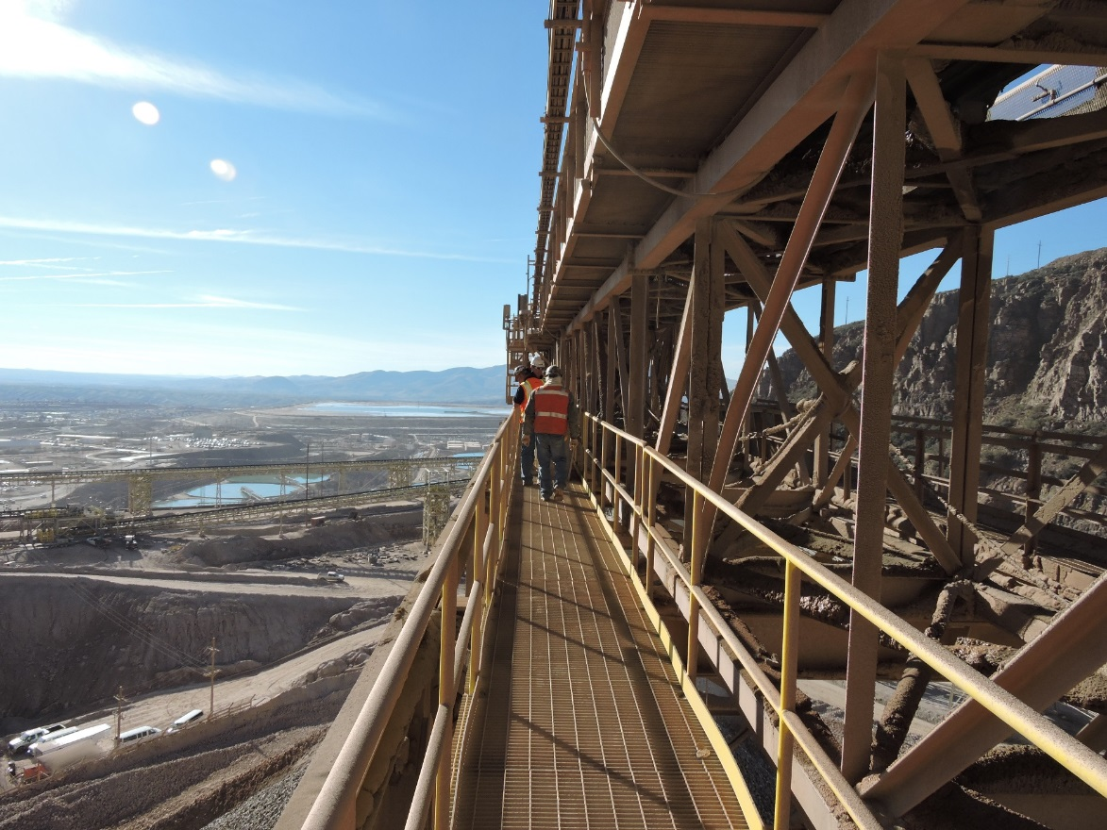
SFT FCX1012C
WORKING AT HEIGHTS
FOR USE BY FREEPORT-MCMORAN ONLY - DO NOT COPY OR DISTRIBUTE EXTERNALLY
VERSION 1.1 / August 2018
Notes:
Instruction
Welcome students to the class
Facilitator introduces self by stating your position at FMI, how long you’ve been with the company, and how long you’ve been in mining
This is a hands-on course with opportunities for students to apply what is learned. Students will work in small groups and be involved in discussions to learn from the knowledge and experience of others.
Remind students to sign the attendance sheet

Slide 2
Expectations
Before we start:
Safety
Breaks/Restrooms
Technology
Participation
Notes:
Instruction
Administrative/Classroom policies
Safety
Identify the appropriate evacuation procedures, gathering areas, and emergency exits and fire extinguisher locations, etc.
Breaks and Restrooms
Establish a break schedule and announce it to the class. Suggested break times are included throughout the FG and occur approximately every hour and often occur at the end of each module. Breaks should last 5-10 minutes to give students time to rest and relax before beginning the next learning session.
Identify the location of restrooms and smoking areas.
Technology policy
Review your expectations on cell phone and laptop use during the training.
Participation
This course requires significant participation. Students should be prepared for discussions and small group activities.
Set the class ground rules by verbalizing your expectations. Some suggestions are provided below.
Participate.
Be on time.
Stay on task.
Listen when others talk.
Respect the opinions and attitudes of others.

Slide 3
Activity 1
Icebreaker
Directions
Participate in an activity to get to know each other
Notes:
Time
Approximately 10 minutes
Purpose
Successful icebreakers encourage students to contribute their ideas and experiences thus increasing motivation and engagement in the class.
Below is an assortment of icebreakers that the facilitator can incorporate at the beginning of the course as well as after breaks.

Slide 4
Quote
“We start with looking after our workers’ welfare.”
-Richard C. Adkerson
What does this mean to you?
Notes:
SG page iv-v
Instruction
Introduce the SG as a resource.
Read or have a student read the quote by Richard Adkerson. Read it aloud.
As a class, discuss what the quote means.

Slide 5

Learning Modules & Objectives
Module 1: Fall Hazard Recognition
Demonstrate the ability to recognize fall hazards.
Describe fall hazards in routine and non-routine jobs.
Module 2: Hierarchy of Controls
Explain the differences in the hierarchy of controls.
Analyze a situation and recommend the most effective control.
Working at Heights / SFT FCX1012C
Notes:
SG page vi
Instruction
Before beginning these next four slides:
Ask the students what they would like to get out of this course?
Explain the objectives for each module.
Point out that the module objectives are also listed on the first page of each module.

Slide 6
Learning Objectives
Module 3: Component Identification and Systems
Identify the components of a fall protection system.
Module 4: Inspection and Storage
Define the different types of inspections.
Demonstrate a pre-use inspection and storage for a piece of fall protection equipment.
Working at Heights / SFT FCX1012C
Notes:
SG page vi
Instruction
Explain the objectives for each module.
Point out that the module objectives are also listed on the first page of each module.

Slide 7
Learning Objectives
Module 5: Fall Dynamics
Calculate the fall clearances for a given scenario.
Evaluate a situation and select the appropriate system to use.
Module 6: Fit, Donning, and Adjustment
Demonstrate proper fit, donning, and adjustment of full body harnesses and lanyards.
Working at Heights / SFT FCX1012C
Notes:
SG page vi
Instruction
Explain the objectives for each module.
Point out that the module objectives are also listed on the first page of each module.

Slide 8
Learning Objectives
Module 7: Other Working at Height Systems
Discuss the other types of equipment used to work at heights.
Module 8: Rescue
Describe the components of a rescue plan.
Demonstrate how to conduct a self-rescue.
Working at Heights / SFT FCX1012C
Notes:
SG page vi
Instruction
Explain the objectives for each module.
Point out that the module objectives are also listed on the first page of each module.

Slide 9

Fatal Risks and Critical Controls
Fall from Heights
Working at height where the danger of falling exists
Critical Controls
  Fall Protection System
  Fixed Work Platform
  Leading edge/Open Hole Protection
  Mobile Work Platform
  Scaffold
Notes:
Fatal Risk Management is a continuation of the Fatality Prevention Program.
Focus is placed on identifying Fatal Risks and Critical Controls in an attempt to safeguard all employees within the Company
Fatal Risks are based on safety issues that have resulted in catastrophic events such as severe injury or death
After identifying a Fatal Risk, Critical Control(s) are implemented to prevent death or mitigate the consequences of the Fatal Risk

Slide 10
Introduction
In 2013, 699 people were killed as a result of workplace falls, slips, or trips in the United States. Of those events, 574 (82%) were falls to a lower level.¹
Working at Heights / SFT FCX1012C
Notes:
SG page vii
Instruction
Review the statistics from the U.S. Department of Labor Bureau of Labor Statistics.
Falls continue to be a top contributor of workplace fatalities in general industry and a leading cause of fatalities in mining.
It is critical to focus on jobs that are performed at heights.
Unknown Author, “Census of Fatal Occupational Injuries Summary, 2013,” United States Department of Labor, 2014, http://www.bls.gov/news.release/cfoi.nr0.htm

Slide 11
Introduction
Corporate
Working at Heights Policy (FCX-HS02)
Site-Specific
Hazardous Recognition Program
Equipment- or
Scenario-Specific Procedures
Working at Heights / SFT FCX1012C
Notes:
SG page vii
Instruction
In alignment with Freeport-McMoRan’s Fatality Prevention Initiative, the Department of Health and Safety has identified Working at Heights as a “Fatal Risk” and the Working at Heights Policy (FCX-HS02) addresses the minimum requirements and procedures when performing jobs where fall hazards exist.
A Fatal Risk is considered anything that can kill you.
Many of the tragedies that occurred were the result of taking unnecessary short cuts and here at Freeport-McMoRan, the time to do the job safely is built into every job.
This course was designed to meet the minimum requirements for an authorized user.
If at any time you have a question, in this class or while you are working in the field, it is your responsibility to stop and seek clarification.

Slide 12

MODULE 1: Fall Hazard Recognition
Notes:
SG page 3
Instruction
Upon completion of Module One, the students will be able to:
Demonstrate the ability to recognize fall hazards.
Describe fall hazards in routine and non-routine jobs.

Slide 13

Fall Hazard Recognition
When you hear the words “Fall Hazard,” what comes to mind?
Are you confident that you can spot any fall hazard in your surroundings?
Notes:
SG page 5
Instruction
What is a fall hazard?
Any walking or working surface that is 4 ft. or more above the lower level must be provided with some sort of fall protection.
Walking or working surfaces that are less than 4 ft., but are above sharp objects, corrosive substances, entrapment hazards, moving machinery, or other significant hazards, must also be provided some sort of fall protection.
Working at Heights Policy (FCX-HS02) states that fall protection must be provided and used 100% of the time whenever persons are exposed to a fall hazard that could reasonably result in an injury to an employee working at height.
It is important that you are aware of any hazard above, below or around you, prior to beginning a job. Maintain that awareness throughout your shift.

Slide 14
Activity 2
Naming Fall Hazards
Directions
As a class, brainstorm a list of fall hazards present on our properties
The facilitator will ask for a volunteer to capture those responses on a flip chart
Notes:
Time
Approximately 5 minutes
Materials
Flip chart
Markers
Purpose
This activity draws out the students’ existing knowledge on fall hazards.
Instruction
Ask for a volunteer to record responses on the flip chart.
As a class, brainstorm a list of fall hazards that can be encountered on sites.
Discuss the responses as a class.
Proposed Responses
Leading edges
Grated walkways
Ladders
Open holes
Aerial work platform

Slide 15

Naming Fall Hazards
Example of a fall hazard
Notes:
Possible responses
There are a variety of hazards in the photo; it depends on the job being performed.
Are lights being repaired (ladder use)?
Are hand rails being repaired?
Are personnel entering chutes?
Is the structure being repaired (man lift)?

Slide 16
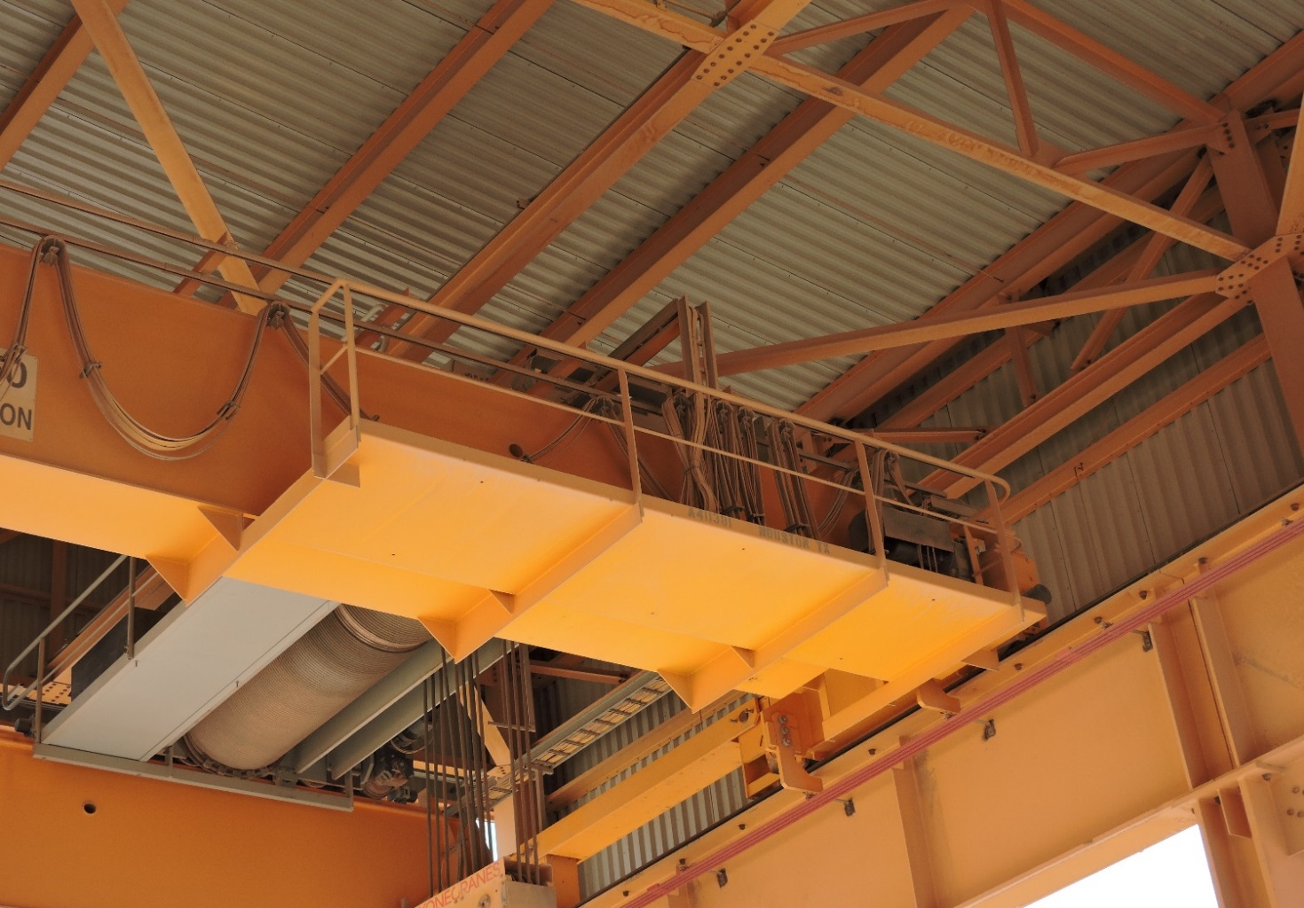
Naming Fall Hazards
Example of a fall hazard
Notes:
Possible response
Maintenance work on the crane may require the employee to work outside of the hand rail

Slide 17
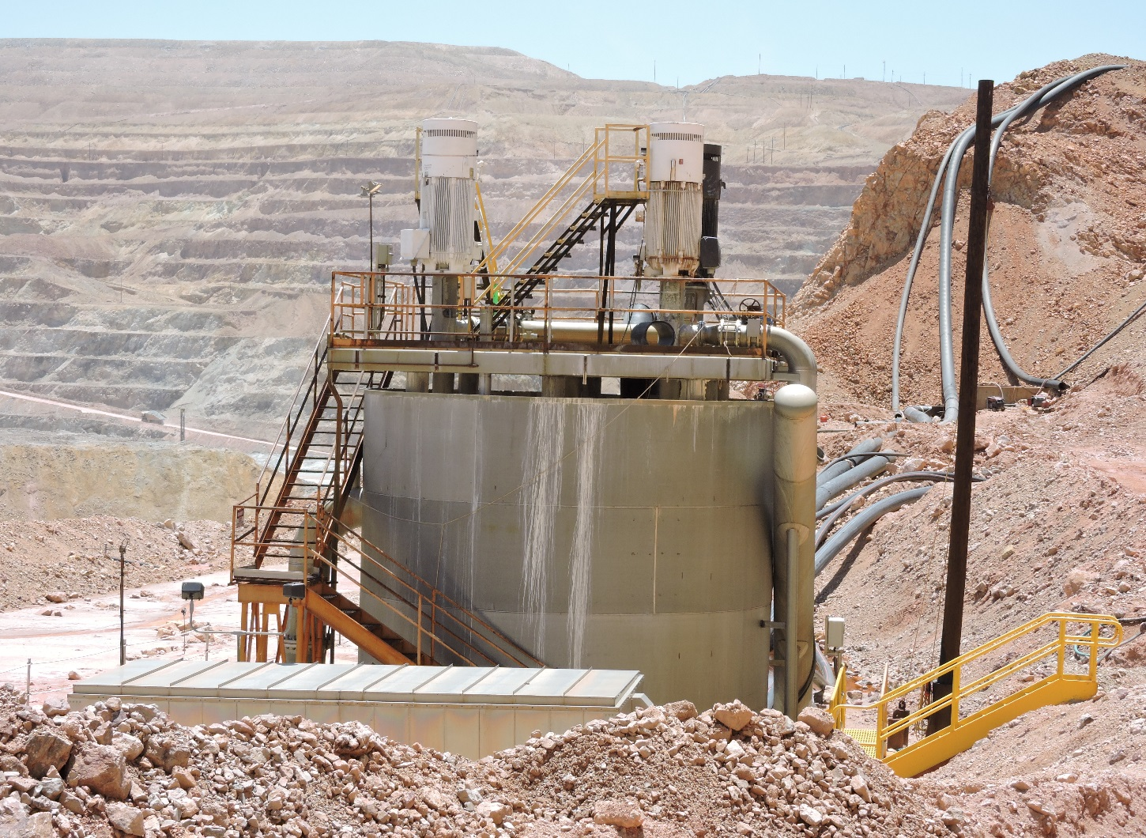
Naming Fall Hazards
Example of a fall hazard
Notes:
Possible responses
Repairs to the structure can pose a hazard
Also working near the open hole in the center of the structure requires fall protection, so an anchor and SRL have been installed.

Slide 18
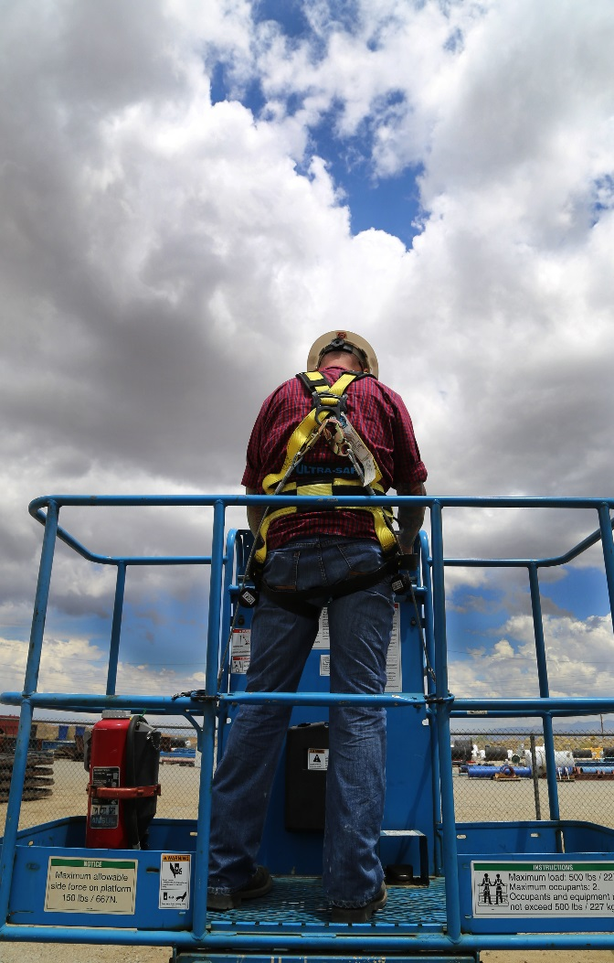
Naming Fall Hazards
Example of a fall hazard
Notes:
Possible response
Employees working in man lifts can be launched out of basket due to rough surfaces or improper use

Slide 19
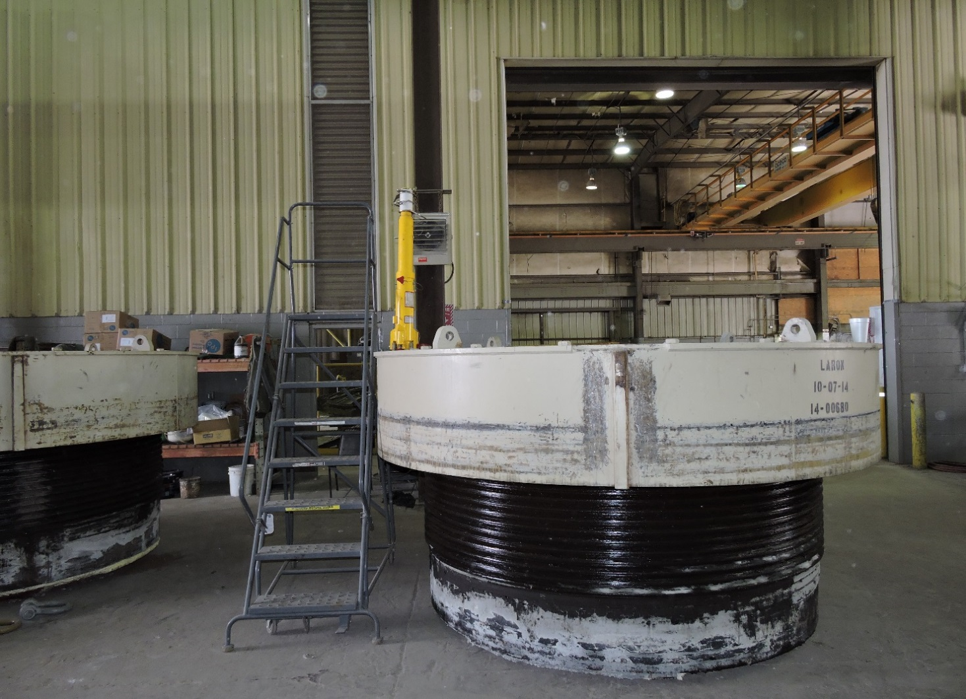
Naming Fall Hazards
Example of a fall hazard
Notes:
Possible response
It is possible to fall to the outside or inside of the crusher bowl while making entry

Slide 20
Fall Hazard Recognition
Fall Hazard Identification
Read the “Be on the Lookout” story (SG p.5)
What could have happened if no action was taken?
Notes:
SG page 5
Instruction
Direct the students to read the “Be on the Lookout” story
What could have happened if no action was taken that day?

Slide 21
Fall Hazard Recognition
Falls from Heights
Take a moment to read the “Learn from Others” (SG p. 7)
What was the hazard in this situation?
What should you do if you discover a hazard in your work area?
Notes:
SG page 6-7
Instruction
Discuss key facts about falls from heights
Unguarded falls from an elevation, which typically result in a serious injury or death.
Existing hazards must be identified prior to starting a job.
Make the right decisions and use the appropriate tools that are available to you.
Direct the students to the “Learn from Others”.
Answer the discussion question in the SG – “What was the hazard in this situation?”
What should you do if you discover a fall hazard in your work area?
Remove yourself from the hazard and contact your supervisor immediately.

Slide 22
Fall Hazard Recognition
Routine tasks
Non-routine tasks
Take a moment to read through the smelter examples (SG pp. 9-11)
How does hazard recognition vary in these types of tasks?
Notes:
SG pages 8-11
Instruction
Routine tasks – Work that is:
Regularly or frequently performed.
Repetitive and familiar.
Not different from day to day functions.
Documented through procedures (SOP)
Low level risk.
Non-routine tasks – Work that is:
Performed for the first time or on an irregular schedule.
Changed because of conditions.
Different from normal job duties.
Without a document process or differs from the documented process.
High level risk.
Conducted during an emergency situation.
Direct the students to the two smelter examples explaining a routine job turning into a non-routine job.
How does hazard recognition vary in routine and non-routine tasks?

Slide 23
Activity 3
Fall Hazard Detective
Directions
Refer to the activity (SG pp. 12-14)
Take five minutes to identify if there are any existing fall hazards present in each photo
Be prepared to share your findings
Review the answers as a class
Notes:
SG pages 12-14
Time
Approximately 10 minutes
Materials
Fall Hazard Detective Worksheet (SG pp. 12-14)
Purpose
This activity reinforces this module’s lesson on fall hazards.
Instruction
Direct students to the Fall Hazard Detective Worksheet.
Allow 5 minutes for students to identify if there are any existing fall hazards present in each photo.
Discuss the responses as a class.
The next 6 slides are the photos from the activity.

Slide 24
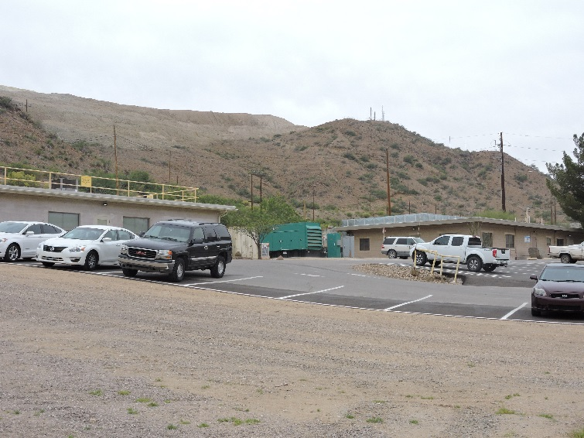
Fall Hazard Detective
1.
Notes:
Answer Key
One building has a guardrail on the roof. The other building does not.

Slide 25
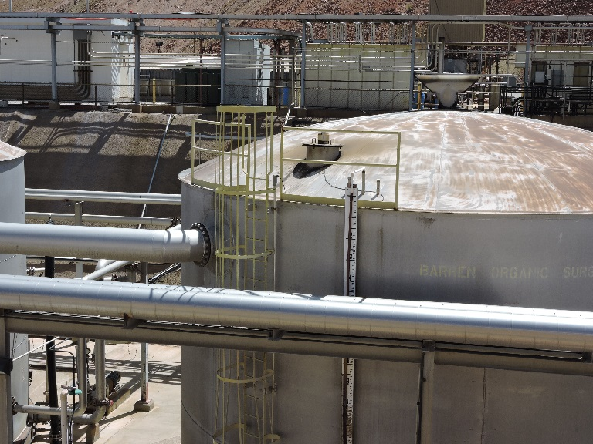
Fall Hazard Detective
2.
Notes:
Answer Key
Guardrail doesn’t go around entire tank.

Slide 26
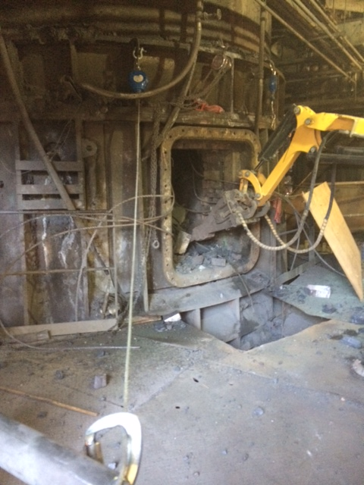
Fall Hazard Detective
3.
Notes:
Answer Key
Open hole in the ground. The tie-off is incorrect.

Slide 27
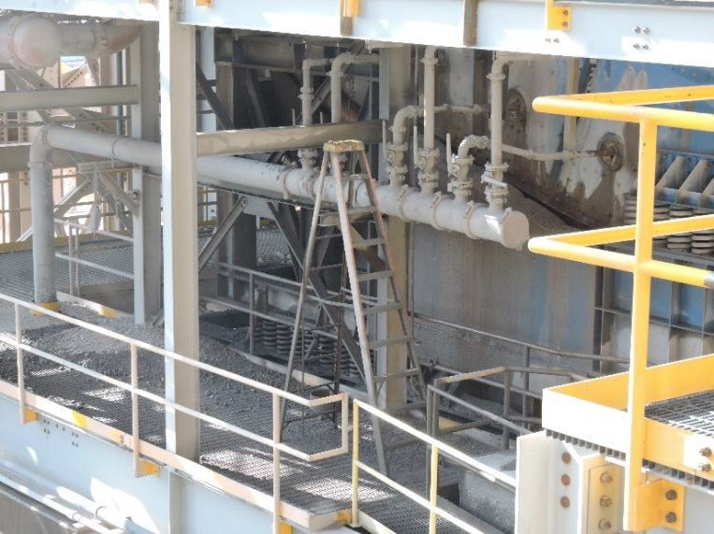
Fall Hazard Detective
4.
Notes:
Answer Key
Ladder above handrail. Could fall to platform or over the handrail.

Slide 28
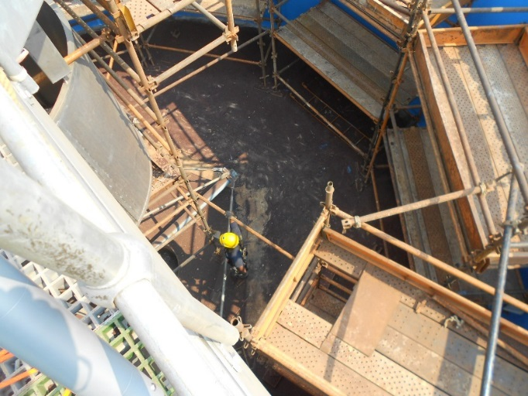
Fall Hazard Detective
5.
Notes:
Answer Key
There is an open hole in the scaffolding and it is not covered.

Slide 29
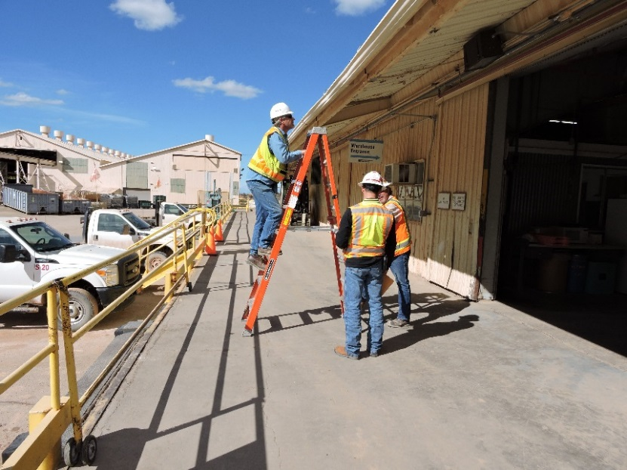
Fall Hazard Detective
6.
Notes:
Answer Key
No lanyard; employee can fall to platform or potentially over the handrail.

Slide 30
Debrief
How will you apply the skills learned in this module to your daily work activities?
Were there any fall hazards that surprised you?
Notes:
Instruction
Review the questions on the slide.

Slide 31
Quiz
Module 1 Quiz
Directions
Refer to the Quiz (SG p. 15)
Take five minutes to complete
Review the answers as a class
Notes:
SG page 15
Instruction
Students will complete the answers to the quiz questions in the SG.
Review the answers as a class.

Slide 32
Module 1 Quiz
Which of the following is a fall hazard? Circle all that apply.
  Open hole
  Scaffolding
  Retaining walls
  Aerial work platform
What should you do if you encounter a fall hazard?
  Tell your co-worker and continue with your work.
  Leave it alone. Someone must be working on it.
  Remove yourself from the hazard, secure the area, and contact your supervisor.
  Set up proper flagging and continue with your work.
Notes:
SG page 15
Quiz Answers
a, b, c, d, SG p. 5
c, SG p. 7

Slide 33
Module 1 Quiz
Select a couple of students to share their routine working at heights task and the factor(s) that can impact that task.
Notes:
SG page 15
Quiz Answers
Select a couple of students to share their routine working at heights task and the factor(s) that can impact that task.
Break
We recommend taking a 5 to 10 minute break after this module. Allow students to stand up, stretch, use the facilities, etc. Make sure you clearly communicate what time you expect them to return and start the next module.

Slide 34
MODULE 2: Hierarchy of Controls
Notes:
SG page 17
Instruction
Upon completion of Module Two, the student will be able to:
Explain the differences in the hierarchy of controls.
Analyze a situation and recommend the most effective control.

Slide 35
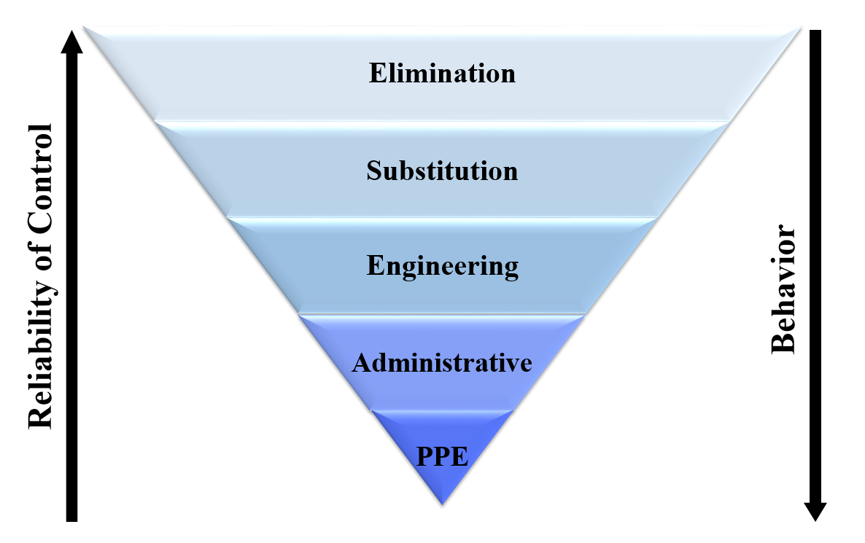
Hierarchy of Controls
Notes:
SG page 21
Instruction
Review the Hierarchy of Controls, explaining each level
As you move down the hierarchy (beginning with Elimination), behavior plays a larger role in the effectiveness of the control
As you move up the hierarchy (beginning with PPE), the reliability of each control increases

Slide 36
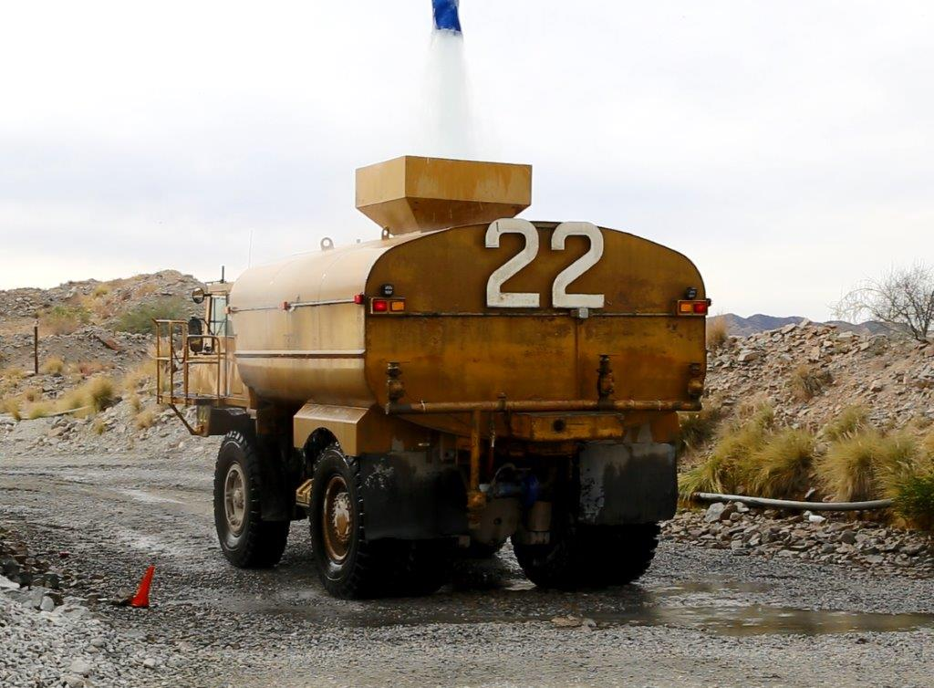
Hierarchy of Controls
Elimination
Removing the hazard entirely from the workplace
Notes:
SG page 22
Instruction
Most effective control as it gets rid of the hazard entirely
Review the elimination example
Why was this task a fall hazard?

Slide 37
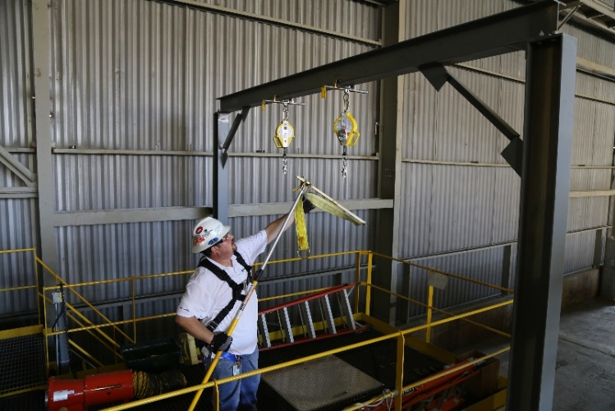
Hierarchy of Controls
Substitution
Using a less hazardous chemical, substance, or practice in place of a highly hazardous one
Notes:
SG page 22-23
Instruction
When elimination is not possible, substitution is the next recommended control
Uses a less hazardous chemical, substance, or practice in place of a highly hazardous one
Review the substitution example

Slide 38
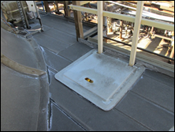
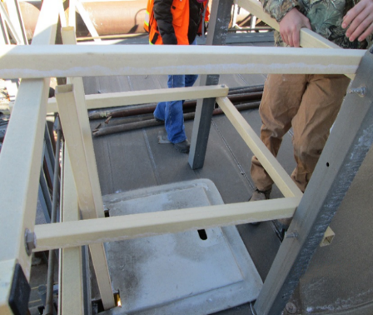
Hierarchy of Controls
Engineering
Creation of a device or barrier to prevent employees from coming in contact with the hazard
Notes:
SG page 23
Instruction
Devices can be permanent, semi-permanent or temporary
Such as guardrails, handrails, work platforms, or covers
Review the engineering example

Slide 39
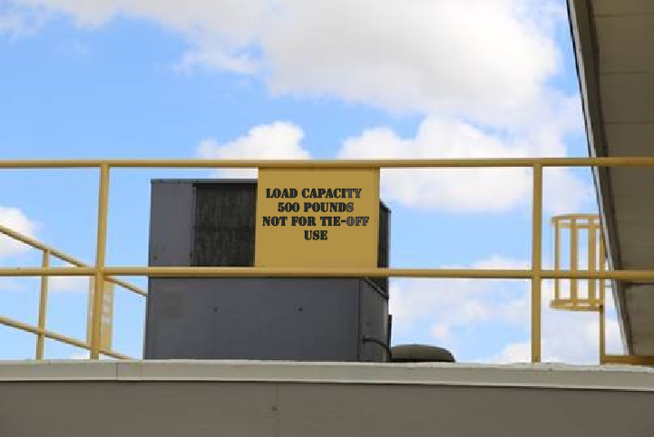
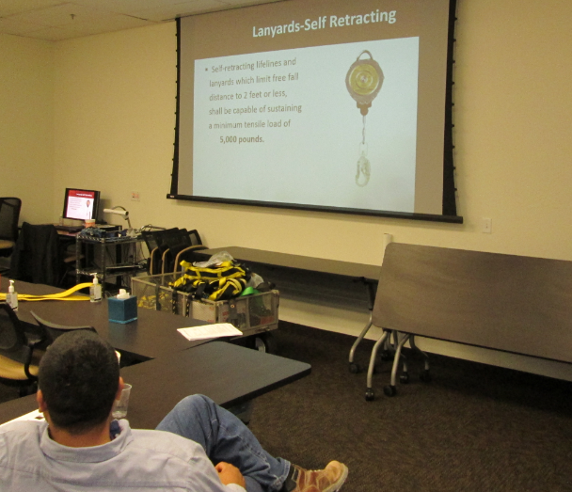
Hierarchy of Controls
Administrative
Form of communicating the hazard typically through policies, regulations, signage, JSAs, Risk Assessments, and SOPs
Notes:
SG page 24
Instruction
Less effective than elimination, substitution, and engineering
Not a physical barrier, so it is critical that employees pay attention to the information communicated
Review the administrative example

Slide 40
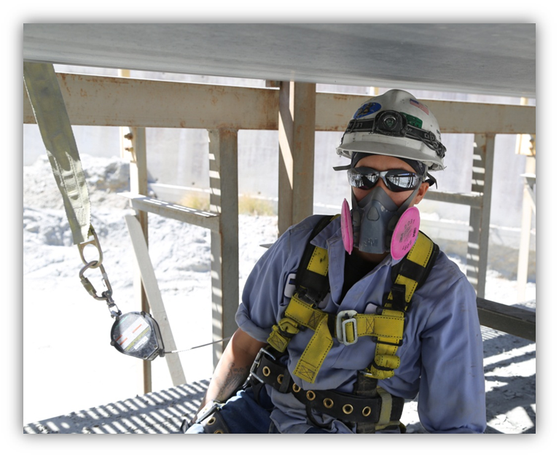
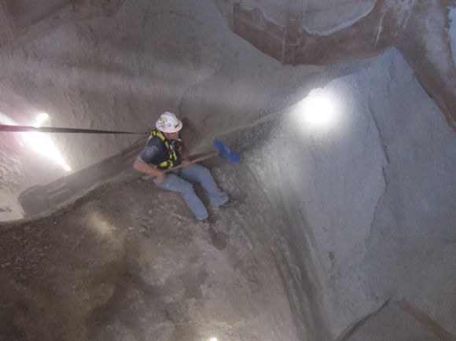
Hierarchy of Controls
PPE
Relies on the behavior of the employee to properly use it
Worn on the person’s body
Notes:
SG page 25
Instruction
Least effective control within the hierarchy
Review the PPE example

Slide 41
Hierarchy of Controls
Behavior
Plays a key role in the effectiveness of the established controls
Take two minutes to read the “Learn from Others” story (SG p. 26)
Notes:
SG page 25-26
Instruction
Emphasize how behavior, while not a control in the hierarchy, can impact the effectiveness of the established controls
Review the behavior example in SG p. 25
Allow two minutes for the class to read the “Learn from Others” PFE in SG p. 26
Discuss the PFE
What happened?
What is the point of the PFE?

Slide 42
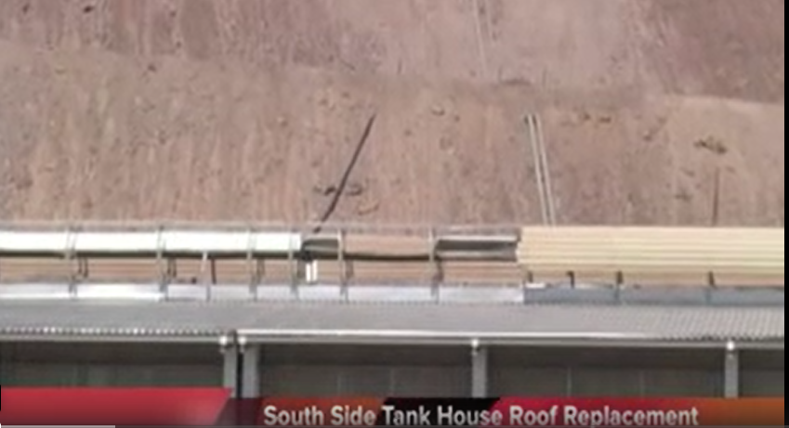
Hierarchy of Controls Video
Click here to play video
Notes:
Instruction
Play the three minute video
This video is from Morenci, where an employee fell off the roof. Their PPE saved their life.
After the video, discuss what happened
What is the message behind this video?
https://web.microsoftstream.com/video/d01c9d8a-2270-4dbe-8476-13f41e87a279

Slide 43
Activity 4
Applying the Hierarchy
Directions
Refer to the activity (SG p. 27)
Take five minutes to complete the scenarios by creating a solution for each control
Be prepared to share your results
Review the answers as a class
Notes:
SG page 25
Time
Approximately 5-7 minutes
Materials
Applying the Hierarchy Worksheet (SG p. 27)
Purpose
This activity reinforces this module’s lesson on the hierarchy of controls.
Directions
Direct students to the Hierarchy of Controls Activity Worksheet, located in the Student Guide p. 29.
Allow 5 minutes for students to complete the scenarios by creating a solution for each control.
Discuss the responses as a class. There are proposed answers available, but only to be used if the students are not providing their own.

Slide 44
Debrief
How will you apply the hierarchy of controls in your work area?
Any safety successes as a result of a control that you are willing to share?
Notes:
Instruction
Review the questions on the slide.

Slide 45
Quiz
Module 2 Quiz
Directions
Refer to the Quiz (SG p. 29)
Take five minutes to complete
Review the answers as a class
Notes:
SG page 29
Instruction
Students will complete the answers to the quiz questions in the SG.
Review the answers as a class (See the following page for answers)

Slide 46
Module 2 Quiz
Hierarchy of controls in order of effectiveness
Elimination, Substitution, Engineering, Administrative, PPE
You notice a grate missing in the catwalk that is 10 feet off the ground, but you are able to find assistance with putting a temporary guardrail around the hole. What control is this an example of?
  Substitution
  Elimination
  Engineering
  Administrative
Notes:
SG page 29
Quiz Answers
Elimination, Substitution, Engineering, Administrative, PPE, SG p. 21
c, SG p. 23

Slide 47
Module 2 Quiz
Your co-worker is using the top rung of a ladder to perform maintenance on a haul truck. You remember hearing at your tailgate meeting about ladder safety and suggest using a scissor lift (a form of mobile scaffolding that elevates employees in a vertical motion) to your co-worker. What control is this an example of?
  PPE
  Substitution
  Elimination
  Administrative
Notes:
SG page 29
Quiz Answers
b, SG pp. 22-23

Slide 48
Module 2 Quiz
At the safety meeting, they announce that handrails are being installed in the tankhouse to prevent employees from falling off the platform. What control is this an example of?
  PPE
  Substitution
  Engineering
  Administrative
You notice a sign stating “D-ring Tie-off Point.” What control is this an example of?
  PPE
  Elimination
  Engineering
  Administrative
Notes:
SG page 29
Quiz Answers
c, SG p. 23
d, SG p. 24
Break
We recommend taking a 5 to 10 minute break after this module. Allow students to stand up, stretch, use the facilities, etc. Make sure you clearly communicate what time you expect them to return and start the next module.

Slide 49
MODULE 3: Component Identification and Systems
Notes:
SG page 33
Instruction
Upon completion of Module Three, the student will be able to
Identify the components of a fall protection system.

Slide 50
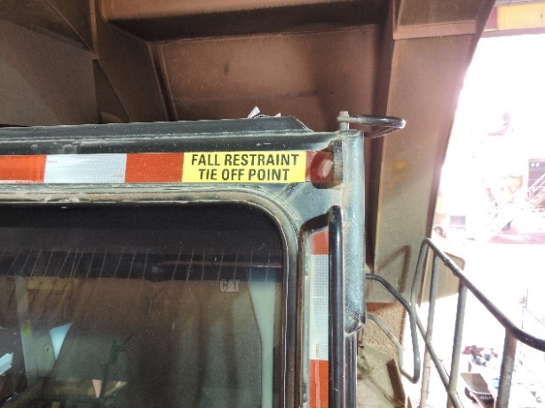
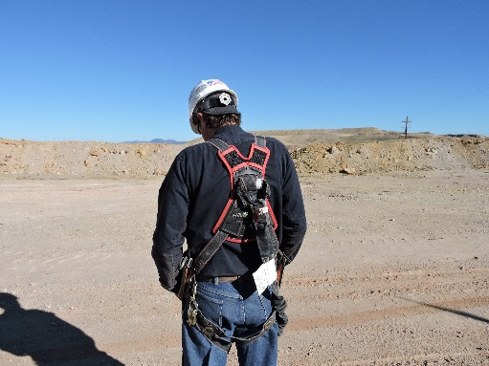
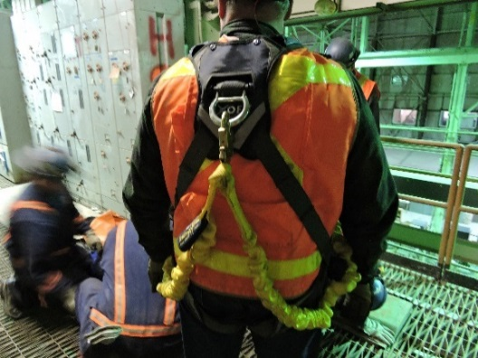
Component Identification and Systems
ABCs of fall protection
A = Anchors or Anchor points
B = Body wear (PPE)
C = Connecting devices
Notes:
SG page 36-37
Instruction
Review the ABCs of fall protection

Slide 51
Component Identification and Systems
ABCs
Take two minutes to read “Be on the Lookout” (SG p. 38)
Why was this a safety success?
Notes:
SG page 38
Instruction
Allow two minutes to read the “Using the Right Tools Correctly” story
Answer the Discussion Questions (SG p. 38) as a class
Why was this a safety success?
Have you ever seen others using a tool or method incorrectly? If so, did you take any action?

Slide 52
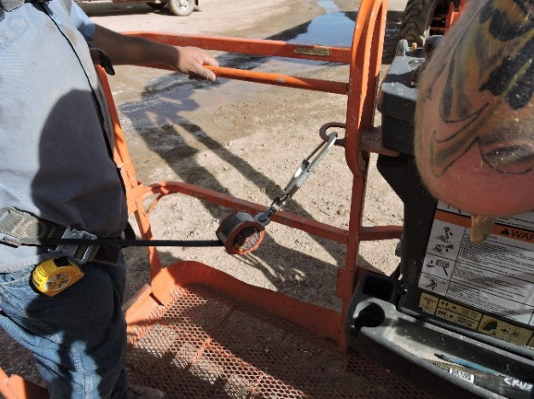
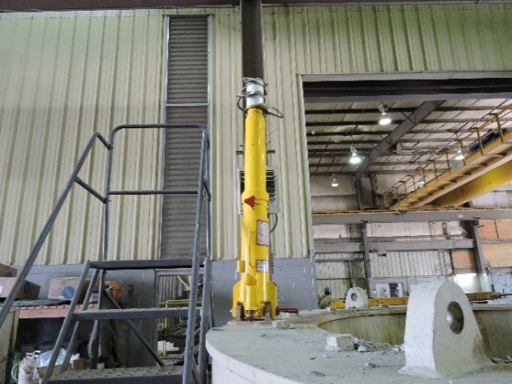
Component Identification and Systems
Anchor
Foundation of a fall protection system
Notes:
SG page 39
Instruction
Anchors are the foundation of your fall protection system
Handrails and scaffolding are never suitable anchor points, unless engineered by a qualified person to withstand 5000 lbs. of force

Slide 53
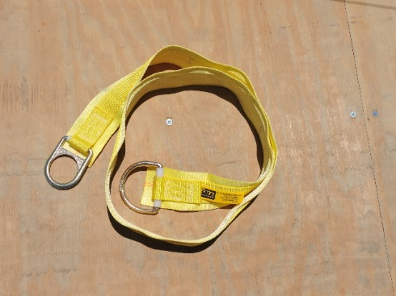
Component Identification and Systems
Beam Strap
Type of temporary anchorage connector
Notes:
SG page 39
Instruction
A type of temporary anchorage connector that is used as anchor points when working with structural supports, such as I-Beams.
The beam strap has a ring at each end, with one being slightly larger than the other. The strap is wrapped around the support beam, and the small ring is passed through the large ring. The small ring then becomes the anchor point for the lanyard.

Slide 54
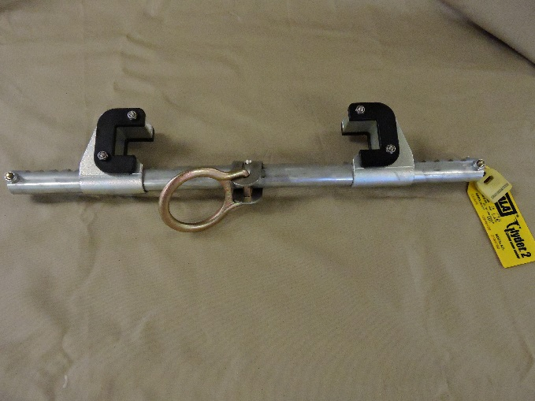
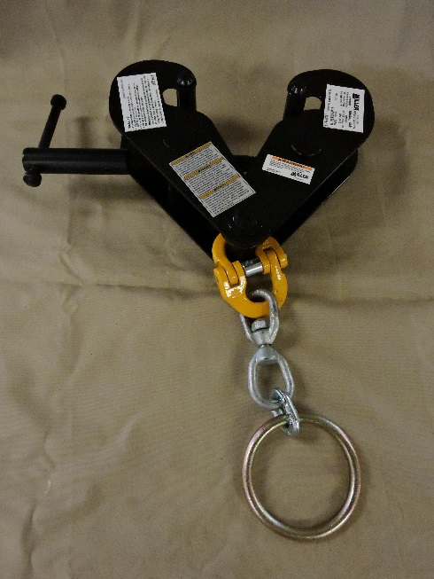
Component Identification and Systems
I-Beam Clamp
Another anchorage connector
Also known as a Fixed Beam Anchor
Notes:
SG page 40
Instruction
I-beam clamps can either be fixed in one place (when used with a vertical beam), or mobile (when used with a horizontal beam)

Slide 55
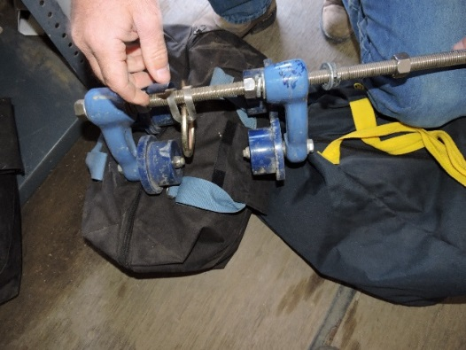
Component Identification and Systems
I-Beam Roller
Intended for use with a horizontal beam support
Also known as Beam Trolleys
Notes:
SG page 40
Instruction
Allows the worker to freely move in the direction of the beam, while still maintaining a secure anchor point.

Slide 56
Component Identification and Systems
Body Wear (PPE)
Connects the worker to the rest of the fall protection system
Notes:
SG page 41
Instruction
An improperly used, damaged, or ill-fitting harness can severely injure a worker during a fall

Slide 57
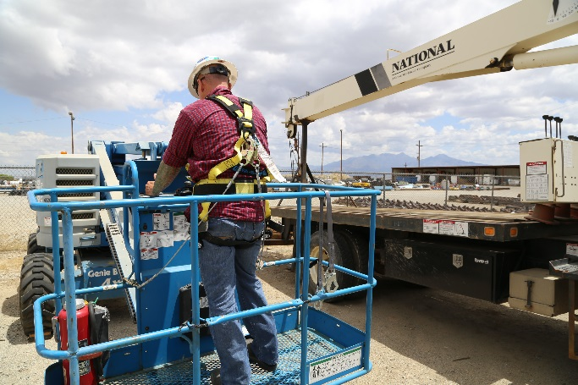
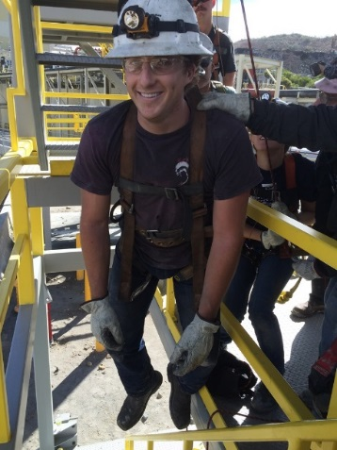
Component Identification and Systems
Full Body Harness
Protects the employee by supporting them in an upright position after a fall
Notes:
SG page 41
Instruction
Designed to distribute the shock from a fall evenly throughout the body.
Helps minimize the internal trauma that can result from a fall.

Slide 58
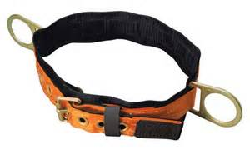
Component Identification and Systems
Body Belt
Only secure around the waist
Notes:
SG page 41
Instruction
May be used in conjunction with a fall positioning system, but never in a fall arrest system.
Not designed to distribute the force from a fall throughout the entire body.

Slide 59
Component Identification and Systems
Connecting Devices
Means of coupling and attaching components of a fall protection system to each other
Some connecting devices act as deceleration devices (i.e. lanyards and rope grabs)
Notes:
SG page 42
Instruction
A large variety of connecting devices exist in order to accommodate a wide array of working conditions.
Check with your site Health & Safety Specialist or Supervisor for available devices.

Slide 60
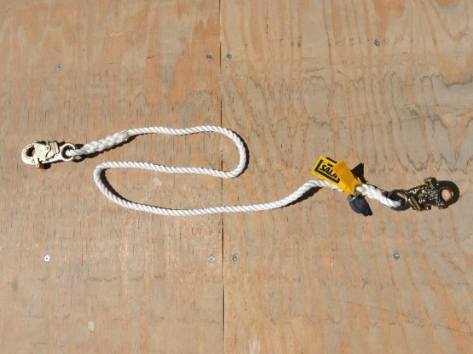
Component Identification and Systems
Lanyard
Connects the harness to the anchor point
Notes:
SG page 42
Instruction
They come in a variety of materials and lengths to accommodate the task being performed.
They may include an energy-absorber and connecting device.

Slide 61
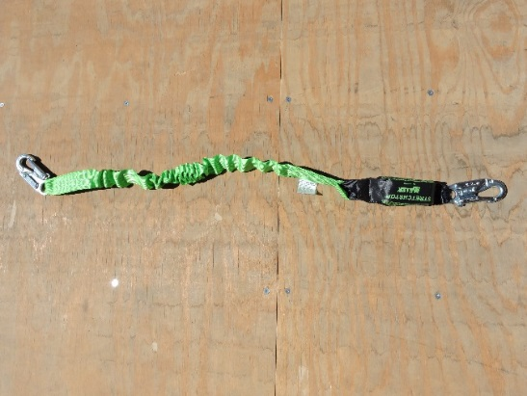
Component Identification and Systems
Shock-Absorbing Lanyard
Foundation of a fall protection system
Notes:
SG page 42
Instruction
This is a fixed length lanyard with a built-in shock absorber, the length of these lanyards can vary between two and four feet.
The shock-absorber protects the employee by minimizing the force transferred to the body in the event of a fall.
Best practice is to use the shortest length available to you.

Slide 62
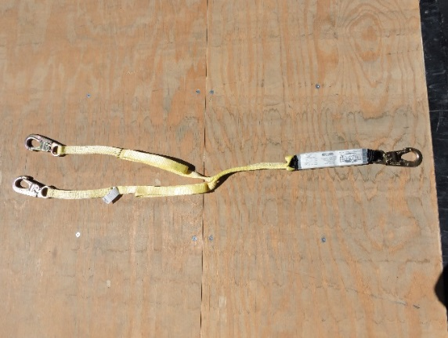
Component Identification and Systems
Y Lanyard
Fixed length lanyard that allows you to connect to two anchor points simultaneously
Notes:
SG page 43
Instruction
Has the ability to allow greater employee movement while still remaining anchored 100% of the time.
Both anchors do not need to be attached for the lanyard to arrest a fall.

Slide 63
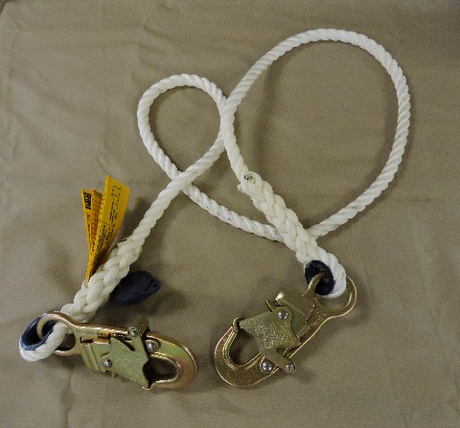
Component Identification and Systems
Positioning and Restraint Lanyard
Do not contain a shock-absorbing component
Should never be used in a fall arrest system
Notes:
SG page 43
Instruction
This can be a rope, webbing, or cable lanyard.

Slide 64
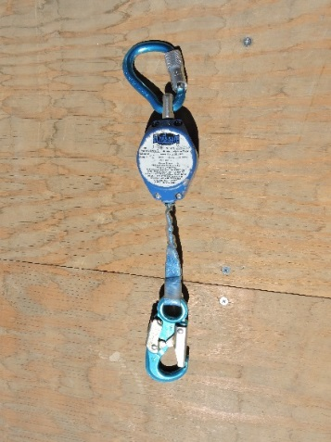
Component Identification and Systems
Self-Retracting Lanyard/Lifeline (SRL)
Variable length lanyard that employs a locking mechanism
SRL has a retracting line attaching to the D-Ring
Notes:
SG page 43
Instruction
The rapid deployment of the webbing will cause a braking mechanism in the housing to engage, which will arrest the fall.
SRL has a retracting line that attaches to the D-Ring.
Add three (3) additional feet to the calculation due to the need for the worker’s body to straighten out in the fall

Slide 65
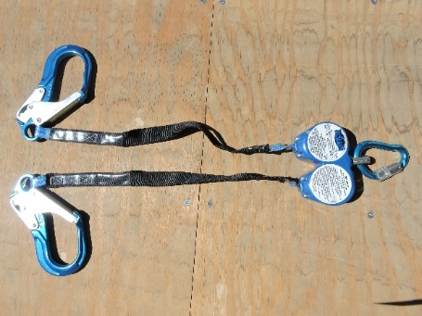
Component Identification and Systems
Personal Fall Limiter (PFL)
Allows for 100% anchoring
PFL has a retracting line that attaches to the anchor point
Notes:
SG page 44
Instruction
Both anchors with a double PFL do not need to be engaged for the system to arrest a fall
Some refer to these as SRLs
Preferred devices worn when working with an aerial work platform
Retracting line attaches to anchor point
Similar to Y Lanyards, double PFLs allow for 100% anchoring and otherwise function the same as a single PFL

Slide 66
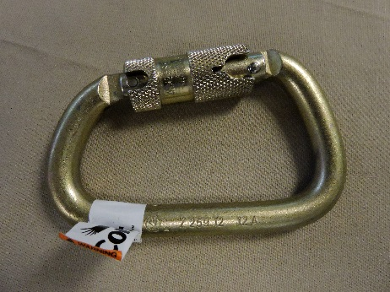
Component Identification and Systems
Carabiner and Snap Hook
Connectors used to secure lanyards both to anchor points and harness D-rings
Notes:
SG page 44
Instruction
Both of these devices are required to be able to withstand 5000 lbs. of force and 3600 lbs. of forced at the gate.

Slide 67
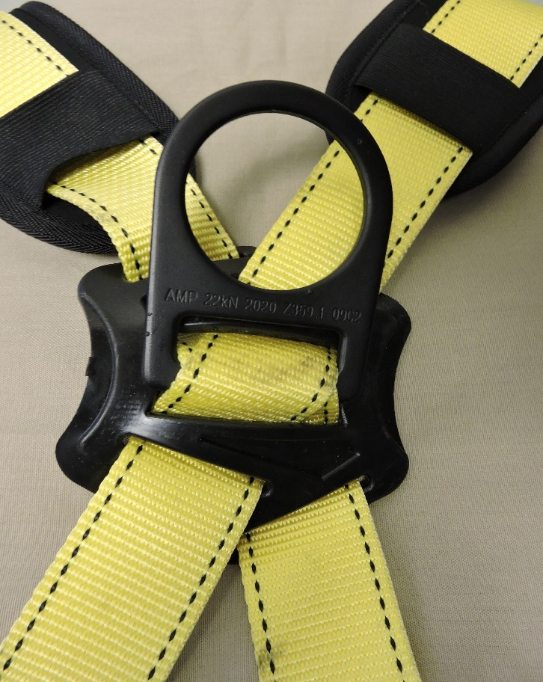
Component Identification and Systems
D-Ring
Connection point between the lanyard and harness
Notes:
SG page 44
Instruction
Certain harnesses may have D-rings located at the chest or hips, but the proper location for a fall arrest system is on the back.

Slide 68
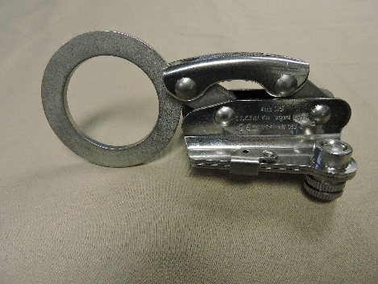
Component Identification and Systems
Rope Grab
Mobile anchor point that secures to a lifeline
Notes:
SG page 45
Instruction
This allows the worker to move either up or down the lifeline while still maintaining fall protection.

Slide 69
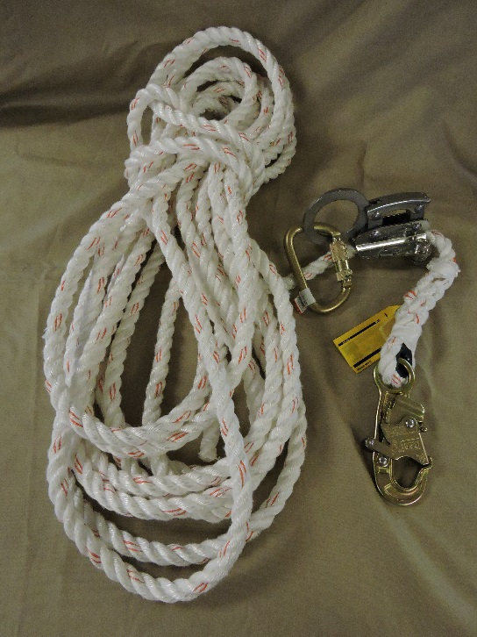
Component Identification and Systems
Vertical Lifeline
Pathway for a sliding rope grab
Horizontal Lifeline
Anchor point similar to a horizontal I-Beam
Notes:
SG page 45
Instruction
Lifelines come in a variety of materials and widths.
The lifeline is fixed between two anchor points and allows for movement by a worker.

Slide 70
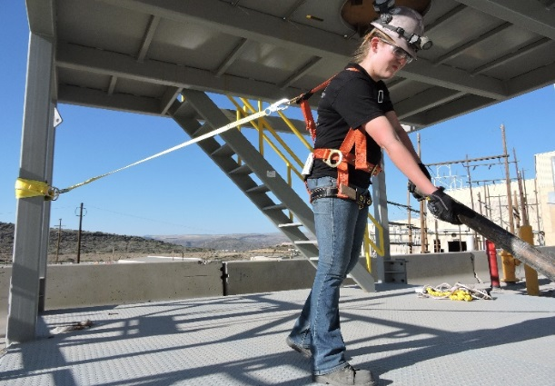
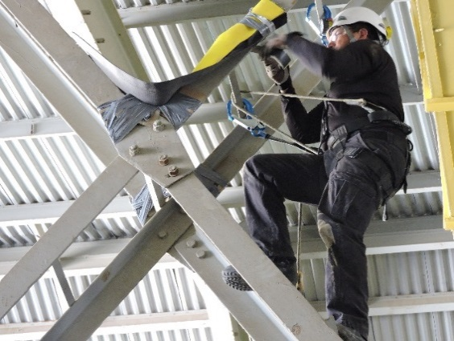
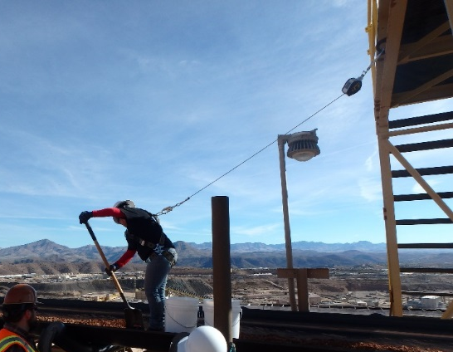
Component Identification and Systems
Discuss each system and its limitations
Fall restraint system
Fall positioning system
Fall arrest system
Notes:
SG pages 46-48
Instruction
Fall restraint – keeps the person at a specific distance from the hazard.
Limitations – mobility
Fall positioning – works in conjunction with fall arrest system and allows hands-free work.
Limitations – mobility, weak anchor points
Fall arrest – designed to stop a free fall in a controlled manner.
Limitations - Weak anchor points, free falling too far, insufficient fall clearance, not aware of swing falls, falling out of a harness, either not properly sized or donned

Slide 71
Activity 5
Name Those Components
Directions
Each group will receive a topic (anchors, body wear, or connecting devices)
Take five minutes to complete the worksheet (SG p. 50)
Identify the components on each item within that topic
Are there any limitations, or pros and cons for using these items?
Prepare to teach back to the class on your topic
Notes:
SG page 50
Time
Approximately 15 minutes
Materials
Components Identification Activity Worksheet (SG p. 50)
Purpose
This activity reinforces this module’s lesson on identifying the components of a fall protection system.
Directions
Direct students to the Components Identification Activity Worksheet.
Assign each table group one of the following topics:
Anchors
Body Wear
Connecting Devices
If there are more than three groups, give more than one group the same topic.
Allow 10 minutes for groups to complete the worksheet by identifying the components within their assigned topic, as well as any limitations, pros, or cons.
After the 10 minutes, have each group teach back their responses to the class. As a facilitator, ensure that the correct information is being taught to the class.

Slide 72
Debrief
Why is it important to know the components of the system you are using?
How can you apply this knowledge to your daily work activities?
Notes:
Instruction
Review the questions on the slide.

Slide 73
Quiz
Module 3 Quiz
Directions
Refer to the Quiz (SG p. 51)
Take five minutes to complete
Review the answers as a class
Notes:
SG page 51
Instruction
Students will complete the answers to the quiz questions in the SG.
Review the answers as a class.

Slide 74
Module 3 Quiz
Sometimes is equipped with an energy absorber
Only secure around the waist and cannot be used in a fall protection system
Temporary anchorage connector used as an anchor point when working on structural supports
Connection point between your lanyard and your harness
A mobile anchor point that secures to a lifeline
Self-closing or self-locking connectors that are able to withstand 5000 lbs. of force
Designed to distribute the shock evenly throughout the body and keep employee in an upright position once a fall has occurred
I: Lanyard
C: Body belt
A: Beam strap
L: D-ring
J: Rope grab
F: Carabiner
H: Full body harness
Notes:
SG page 51
Quiz Answers
I - Lanyard, SG p. 42
C – Body belt, SG p. 41
A – Beam strap, SG p. 39
L – D-ring, SG p. 44
J – Rope grab, SG p. 45
F - Carabiner, SG p. 44
H – Full body harness, SG p. 41

Slide 75
Module 3 Quiz
What are the ABCs?
  Anchor points, body wear, connecting devices
  Anchor points, body armor, communication plan
  Anchorage points, body harnesses, company policy
  Aerial platforms, body harnesses, connecting devices
Notes:
SG page 47
Quiz Answers
a, SG pp. 36-37
Break
We recommend taking a 5 to 10 minute break after this module. Allow students to stand up, stretch, use the facilities, etc. Make sure you clearly communicate what time you expect them to return and start the next module.

Slide 76
MODULE 4: Inspection and Storage
Notes:
SG page 55
Instruction
Upon completion of Module Two, the student will be able to:
Explain the differences in the hierarchy of controls.
Analyze a situation and recommend the most effective control.

Slide 77
Inspection and Storage
Inspections
Purpose: Inspections are a means of lengthening the life of equipment and proactively catching any issues before they occur.
Harness: What to look for
Review the table with components of a harness and what to inspect (SG p. 57)
Notes:
SG page 57
Instruction
Inspections are a means of lengthening the life of equipment and proactively catching any issues before they occur.
The next several slides will go through what to look for and the step by step inspection process on harnesses, lanyards, and SRLs.

Slide 78
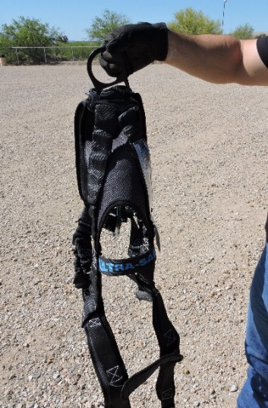
Inspection and Storage
Harness Inspection
Hold harness by the D-ring
Notes:
SG page 58
Instruction
Show how to inspect a harness.
Facilitator should demonstrate this process either during these slides or at the end of the slides.

Slide 79
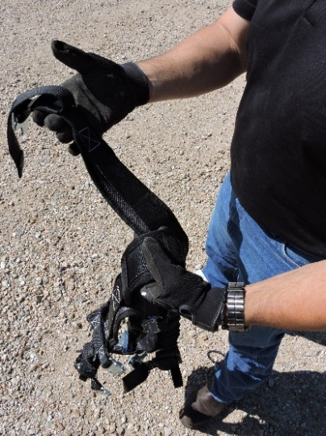
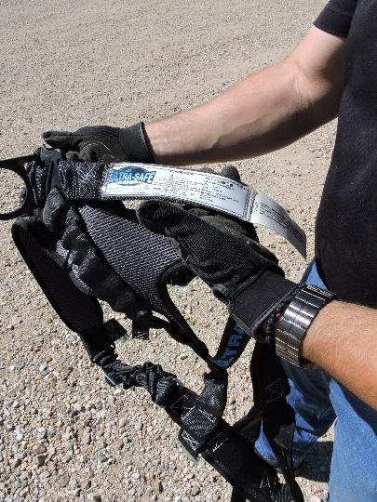
Inspection and Storage
Inspect for deterioration of webbing or hardware
Is the manufacturer label legible?
Notes:
SG page 58
Instruction
Show how to inspect a harness.
Facilitator should demonstrate this process either during these slides or at the end of the slides.

Slide 80
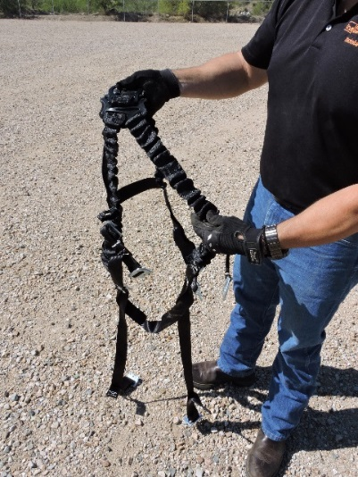

Inspection and Storage
Inspect straps for twists or knots
Document your inspection
Notes:
SG page 58
Instruction
Show how to inspect a harness.
Facilitator should demonstrate this process either during these slides or at the end of the slides.

Slide 81
Inspection and Storage
Harness Inspection
Take a moment to review the Full Body Harness Inspection Checklist / Log example (SG p. 59)
Lanyard: What to look for
Review the signs of damage to webbing, cable or wire, and rope lanyards (SG p. 60)
What can affect the life expectancy of lanyards?
Notes:
SG pages 59-60
Instruction
Review the Full Body Inspection Checklist / Log located in the SG. This is checklist/log may not be what is used on your site. Check with your Health & Safety Specialist or Supervisor to determine what is available to you.
Review the signs of damage to webbing and rope lanyards located in the SG.

Slide 82


Inspection and Storage
Lanyard Inspection
Inspect the connectors (visually and functionally)
Inspect the shock absorber and labeling
Notes:
SG page 61
Instruction
Show how to inspect a lanyard.
Facilitator should demonstrate this process either during these slides or at the end of the slides.

Slide 83


Inspection and Storage
Inspect the entire length of the webbing
Inspect the connectors on opposite end from the single connector
Notes:
SG page 51
Instruction
Show how to inspect a lanyard.
Facilitator should demonstrate this process either during these slides or at the end of the slides.

Slide 84
Inspection and Storage
Lanyard Inspection
Take a moment to review the Lanyard Inspection Checklist / Log example (SG p. 62)
SRL: What to look for
Review the table with components of an SRL and what to inspect (SG p. 63)
Notes:
SG pages 56-57
Instruction
Review the Lanyard Inspection Checklist / Log located in the SG. This is checklist/log may not be what is used on your site. Check with your Health & Safety Specialist or Supervisor to determine what is available to you.
Review the table with components of an SRL and what to inspect.

Slide 85

Inspection and Storage
SRL Inspection
Inspect the carabiner and SRL housing
Notes:
SG page 64
Instruction
Show how to inspect an SRL.
Facilitator should demonstrate this process either during these slides or at the end of the slides.

Slide 86


Inspection and Storage
Engage mechanism four times
Ensure that shock indicator has not been deployed
Notes:
SG page 64
Instruction
Show how to inspect an SRL.
Facilitator should demonstrate this process either during these slides or at the end of the slides.

Slide 87


Inspection and Storage
Inspect entire length of webbing
Inspect the connector
Notes:
SG page 64
Instruction
Show how to inspect an SRL.
Facilitator should demonstrate this process either during these slides or at the end of the slides.

Slide 88
Inspection and Storage
SRL Inspection
Take a moment to review the Self-Retracting Lifeline Inspection Checklist / Log example (SG p. 65)
Notes:
SG page 65
Instruction
Review the SRL Inspection Checklist / Log located in the SG. This is checklist/log may not be what is used on your site. Check with your Health & Safety Specialist or Supervisor to determine what is available to you.

Slide 89
Inspection and Storage
Inspection Frequency
Pre-use
Monthly
Annual
Notes:
SG page 66
Instruction
Inspections must be done by each employee prior to using any fall protection device or system.
Best Practice
Pre-use
Completed before each use, and according to manufacturer’s specifications
Monthly
Equally as important as a pre-use inspection
An opportunity for the qualified person to coach or retrain the employee on the appropriate ways to inspect, maintain, use, or store their equipment
Annually
Test all equipment, as well as permanently installed systems, to ensure they are in good working order.
It is up to each site to determine and communicate the expectation for their inspection criteria.

Slide 90

Inspection and Storage
Storage and Care
Cleaning components
Storage guidelines
Why are these important?
Notes:
SG pages 67-69
Instruction
Review the tables in the SG and FG for cleaning and storage guidelines

Slide 91
Activity 6
Is There an Issue?
Directions
Refer to the activity (SG pp. 70-72)
Take 5 minutes to determine if the photos show proper storage, or pass inspection
Be prepared to share your results
Review the answers as a class
Notes:
SG pages 70-72
Time
Approximately 5-7 minutes
Materials
Components Identification Activity Worksheet (pp. 70-72)
Purpose
This activity reinforces this module’s lesson on the proper inspection and storage procedures.
Directions
Direct students to the Is There an Issue Worksheet, located in the Student Guide.
Allow 5 minutes for students to complete the worksheet by determining if the photos show proper storage or pass inspection.
The next 8 slides are from this activity.
Discuss the answers for each photo.

Slide 92

Is There an Issue?
1.
Notes:
SG pages 70-72
Answer Key
Yes, there are tools on top of the equipment

Slide 93

Is There an Issue?
2.
Notes:
SG pages 70-72
Answer Key
No

Slide 94

Is There an Issue?
3.
Notes:
SG pages 70-72
Answer Key
Yes (unless the employee is on a break). The equipment is piled on top of itself.

Slide 95

Is There an Issue?
4.
Notes:
SG pages 70-72
Answer Key
No

Slide 96

Is There an Issue?
5.
Notes:
SG pages 70-72
Answer Key
No

Slide 97

Is There an Issue?
6.
Notes:
SG pages 70-72
Answer Key
Yes, the seal is broken (appears over the letters TOP)

Slide 98

Is There an Issue?
7.
Notes:
SG pages 70-72
Answer Key
Yes, there is visible damage on the belt

Slide 99

Is There an Issue?
8.
Notes:
SG pages 70-72
Answer Key
No

Slide 100
Activity 7
Passing Inspection
Directions
Proceed to the table(s) with the equipment
Take 5 minutes and individually determine if each item passes inspection
Be prepared to share your results
As a class, discuss the inspection of each item
Notes:
Time
Approximately 5 minutes
Materials
Components should be in either good, poor, or questionable condition
You will need all conditions represented in the variety of components
Students need the opportunity to handle and inspect these items
Purpose
This activity reinforces this module’s lesson on the proper inspection procedures.
Directions
Direct students to the table(s) with the equipment.
Allow 5 minutes for students to individually inspect each item.
As a class, discuss the inspection of each item.

Slide 101
Debrief
How can inspection or storage affect your PPE?
Were there any procedures or processes that surprised you?
Notes:
Instruction
Review the questions on the slide.

Slide 102
Quiz
Module 4 Quiz
Directions
Refer to the Quiz (SG p. 73)
Take five minutes to complete
Review the answers as a class
Notes:
SG page 73
Instruction
Students will complete the answers to the quiz questions in the SG.
Review the answers as a class.

Slide 103
Module 4 Quiz
Name the three types (frequencies) of inspections.
Pre-use, Monthly, Annual
After reading each sentence, decide if you would consider this defective by marking a yes or no in the boxes provided.
The SRL does not fully extend.
The body harness has not been used in 3 months.
The lanyard was left on the shop floor all night.
The shock indicator is visible.
Yes
No
No
Yes
Notes:
SG page 73
Quiz Answers
Pre-use, Monthly, Annual, SG p. 66
Yes, No, No, Yes

Slide 104
Module 4 Quiz
Carabiners do not need to be cleaned.
  True
  False
You should store equipment in a clean and dry location.
  True
  False
Notes:
SG page 73
Quiz Answers
b, SG p. 68
a, SG p. 69
Break
We recommend taking a 5 to 10 minute break after this module. Allow students to stand up, stretch, use the facilities, etc. Make sure you clearly communicate what time you expect them to return and start the next module.

Slide 105
MODULE 5: Fall Dynamics
Notes:
SG page 77
Instruction
Upon completion of Module Two, the student will be able to:
Explain the differences in the hierarchy of controls.
Analyze a situation and recommend the most effective control.

Slide 106
Fall Dynamics
Fall dynamics
The sum of events that occur during a fall
  Free fall distance
  Fall clearance distance
  Swing Fall, or pendulum effect
  For a knelling worker, add three (3) feet to the calculation of a fall to allow for the straightening out of the body
Notes:
SG page 79
Instruction
Fall dynamics is a combination of many things. It includes the fall clearance calculation, the fall protection system in use, selecting the proper harness, and the fit of the harness, to name a few. Fall dynamics is the sum of events that occur during a fall.
If the worker kneels, it is MSA policy to add three (3) additional feet to the calculation due to the need for the worker’s body to straighten out in a fall.

Slide 107
Fall Dynamics
Free fall distance
The distance a person falls before either reaching the next level (or ground) or before his/her fall arrest equipment engages
FCX-HS02 states the maximum allowable free fall distance is six feet
Fall clearance distance
The maximum vertical distance a person travels during a fall
Notes:
SG page 79 & 84
Instruction
Free fall distance is the distance a person falls before either reaching the next level (or ground) or before his/her fall arrest equipment engages.
FCX-HS02 states that the maximum allowable free fall distance is four feet.
Fall clearance distance is the maximum vertical distance a person travels during a fall

Slide 108

Fall Dynamics
Free Fall Formulas
 | Formulas | Use when anchor is
EQ 1 | $$Free Fall Distance=LL−(HA−HD)$$ | Above D-ring
EQ 2 | $$Free Fall Distance=LL+\left(HD−HA\right)$$ | Below D-ring
EQ 3 | $$Free Fall Distance=LL$$ | Level with D-ring
LL = Length of Lanyard
HA = Height of Anchor
HD = Height of D-ring
Notes:
SG page 80
Instruction
Explain the three formulas used for free fall distances.

Slide 109




Fall Dynamics
Anchor point is ABOVE the D-ring
$$EQ1 Free Fall Distance = LL −(HA−HD)$$
$$Free Fall Distance=6 ft. −\left(9 ft. − 5 ft.\right)$$
$$Free Fall Distance=6 ft. −\left(4 ft.\right)$$
$$Free Fall Distance=2 ft.$$
Notes:
SG page 81
Instruction
Show how this equation is solved from start to finish allowing the students to see the complete flow of the equation.
Point out that the math inside of the parenthesis must be completed first to get the correct answer.

Slide 110
Fall Dynamics
As a class, read the practice scenario (SG p. 81)
Fill in the known information
LL = _____
HA = _____
HD = _____
Use EQ 1 since the anchor point is above the D-ring
Fill in the equation and solve
Free Fall Distance = ft. – ( ft. – ft.)
Free Fall Distance = ft. – ( ft.) = ft.
6 ft.
8 ft.
4 ft.
6
8
4
6
4
2
Notes:
SG page 81
Instruction
Have the students provide each answer as they work with you to solve the equation.

Slide 111



Fall Dynamics
Anchor point is BELOW the D-ring
$$EQ 2 Free Fall Distance = LL+(HD−HA)$$
$$Free Fall Distance=6 ft. + \left(5 ft. − 3 ft.\right)$$
$$Free Fall Distance=6 ft. + \left(2 ft.\right)$$
$$Free Fall Distance=8 ft.$$
Notes:
SG page 82
Instruction
Show how this equation is solved from start to finish allowing the students to see the complete flow of the equation.
Point out that the math inside of the parenthesis must be completed first to get the correct answer.

Slide 112
Fall Dynamics
As a class, read the practice scenario (SG p. 82)
Fill in the known information
LL = _____
HA = _____
HD = _____
Use EQ 2 since the anchor point is below the D-ring
Fill in the equation and solve
Free Fall Distance = ft. + ( ft. – ft.)
Free Fall Distance = ft. + ( ft.) = ft.
6 ft.
2 ft.
4 ft.
6
4
2
6
2
8
Notes:
SG page 82
Instruction
Have the students provide each answer as they work with you to solve the equation.
Due to the free fall distance being greater than 6 ft., this is not an acceptable practice. Changes will need to be made in order to work safely.

Slide 113



Fall Dynamics
Anchor point is LEVEL with the D-ring
EQ 3$Free Fall Distance = LL$
$$Free Fall Distance=6 ft.$$
Notes:
SG page 83
Instruction
Show how this equation is solved from start to finish allowing the students to see the complete flow of the equation.

Slide 114

Fall Dynamics
Fall Clearance Formula
Five Variables
  Lanyard Length (LL)
  Deceleration Distance (DD)
  Height of the suspended worker (HW)
  Safety factor (SF)
 | Formulas
EQ 4 | $Fall Clearance Distance=LL+DD+HW+SF$
Notes:
SG page 84
Instruction
Explain the formula used for fall clearance.
Explain the five variables.
HW – For the purposes of calculating fall clearance distances, using the workers height accounts for D-ring slide.
SF – A minimum safety factor of 2 ft. is required for fall all fall clearance calculations.
TFD = Total Fall Distance (from anchor point to the next level or ground)

Slide 115


Fall Dynamics
$$Fall Clearance Distance=LL+DD+HW+SF$$
Fall clearance distance must be less than the height of the anchor to the lower level
Notes:
SG page 85-86
Instruction
Formula for fall clearance distance on a lanyard.

Slide 116

Fall Dynamics
Fall Clearance on a Lanyard
$$Fall Clearance Distance=LL+DD+HW+SF$$
$Fall Clearance Distance=6 ft. +3.5 ft. +6 ft. +2 ft$.
$Fall Clearance Distance=17.5 ft.$
Since 17.5 ft. is greater than 15 ft., this is not a safe working condition.
Notes:
SG page 86
Instruction
Show how this equation is solved from start to finish allowing the students to see the complete flow of the equation.

Slide 117

Fall Dynamics
As a class, read the practice scenario (SG p. 86)
Fill in the equation and solve
$$Fall Clearance Distance=LL+DD+HW+SF$$
6
3.5
2
$Fall Clearance Distance=____ ft. +_____ ft. +5 ft. +____ ft$.
16.5
$Fall Clearance Distance=_____ ft.$
Since 16.5 ft. is less than 20 ft., this is a safe working condition.
Notes:
Instruction
Showing calculation that needs to be completed prior to beginning a job. These factors need to be taken into consideration.
The calculation is from the anchor point to the lower level.

Slide 118

Fall Dynamics
What is swing fall?
How can it be avoided?
Is there a difference on a lanyard vs. an SRL?
Notes:
SG page 86
Instruction
Swing fall, or pendulum effect, is the horizontal movement that occurs during a fall.
The more you increase your lateral distance away from the anchor point, the greater the swing fall effect becomes.
Always monitor your anchor location and work below your anchor point.
Avoid swing fall events by staying under the anchor point as much as possible.

Slide 119
Fall Dynamics
SRL Equation:
You will be working on an elevated platform that is 15 ft. above the lower level. You have selected an SRL as the appropriate lanyard for the task. The deceleration distance of your SRL is 3.5 ft., and you are using a 2 ft. safety factor.
Deceleration distance + SF = Fall Clearance Distance < distance to next level
3.5 ft.
______ + Deceleration Distance of SRL
2 ft.
______ + Safety Factor
15 ft.
______ Working Height above Fall Surface
Notes:
SG page 87
Instruction
Have the students provide each answer as they work with you to solve the equation.
If the worker is kneeling, add three (3) additional feet to the calculation due to the need for the worker’s body to straighten out in the fall.

Slide 120
Fall Dynamics
SRL – Example 5: Pg. 87 in SG
3.5 ft.
__________ + Deceleration Distance
__________ + Safety Factor
2 ft.
5 ft.
__________ Working Height above Fall Surface
Notes:
SG page 87
Instruction
Have the students provide each answer as they work with you to solve the equation.

Slide 121
Activity 8
Calculate the Fall
Directions
Refer to the activity (SG p.89)
Take 5 minutes to complete the calculations for the scenario, and answer the questions
Be prepared to share your results
Review the answers as a class
Notes:
SG page 89
Time
Approximately 5-7 minutes
Materials
Fall Dynamics Activity Worksheet (SG p. 89)
Purpose
This activity reinforces this module’s lesson on fall dynamics.
Directions
Refer to the activity in the Student Guide.
Allow 5 minutes for students to complete the calculations for the scenario.
Review the answers as a class.

Slide 122

Calculate the Fall
6 ft.
______ + Lanyard Length
______ + Deceleration Distance
3.5 ft.
6 ft.
______ + Height of Suspended Worker
2 ft.
______ + Safety Factor
17.5 ft.
______ = Fall Clearance Distance
17 ft.
______ Height of Anchor Point above
Fall Surface
Notes:
Answers
Fall Clearance Distance
6 ft., 3.5 ft., 6 ft., 2 ft., 17.5 ft. and 17 ft.

Slide 123
Calculate the Fall
________: Height of Anchor Point above Working Surface
7 ft.
________: Height of D-ring
5 ft.
________: Free Fall Distance
4 ft.
Notes:
Answers
Height of Anchor Point – 7 ft.
Height of D-ring – 5 ft.
Free Fall Distance – 4 ft.

Slide 124
Calculate the Fall
Are you performing the work in a safe manner?
Is your free fall distance less than the maximum allowable distance?
What are at least two aspects of this job that you could change in order to better protect yourself?
  Raise the anchor point
  Use a shorter lanyard
  Use an aerial work platform (AWP)
  Switch to an SRL
No
Yes
Notes:
Answers
Not performing in a safe manner
Free fall distance is less than the maximum allowable distance
Four aspects that can be changed
Raise the anchor point
Use a shorter lanyard
Use an AWP
Switch to an SRL

Slide 125
Debrief
Why is it important to understand fall dynamics prior to working on a job?
How can the location of the anchor affect a fall?
How is a fall altered if you are connected to a lanyard versus an SRL?
Notes:
Instruction
Review the questions on the slide.

Slide 126
Quiz
Module 5 Quiz
Directions
Refer to the Quiz in the Student Guide (p. 90)
Take five minutes to complete
Review the answers as a class
Notes:
SG page 90
Instruction
Students will complete the answers to the quiz questions in the SG.
Review the answers as a class.

Slide 127
Module 5 Quiz
What can cause a swing fall?
  There is too much slack in the lanyard
  The body harnesses are not worn properly
  The anchor points are lower than the employee
  The anchor point is no longer above the employee
Notes:
SG page 90
Quiz Answers
d, SG p. 86

Slide 128
Module 5 Quiz
On a lanyard, how is fall clearance calculated?
  From the anchor point to the D-ring
  From the anchor point to the lower level
  From the anchor point to the higher level
  From the D-ring to the lower level
What is the maximum allowable free fall distance?
  3 feet
  5 feet
  6 feet
  8 feet
Notes:
SG page 90
Quiz Answers
b, SG p. 84
c, SG p. 79
Break
We recommend taking a 5 to 10 minute break after this module. Allow students to stand up, stretch, use the facilities, etc. Make sure you clearly communicate what time you expect them to return and start the next module.

Slide 129
MODULE 6: Fit, Donning, and Adjustment
Notes:
SG page 93
Instruction
Upon completion of Module Two, the student will be able to:
Explain the differences in the hierarchy of controls.
Analyze a situation and recommend the most effective control.

Slide 130
Fit, Donning, and Adjustment
Fit and Donning
Why is the harness fit important?
What should be done prior to donning the equipment?
Notes:
SG page 95
Instruction
Improper harness fit can result in injury, falling out of it, and suspension trauma.
Empty the pockets, inspect the equipment, and undo the buckles.

Slide 131


Fit, Donning, and Adjustment
Don the harness beginning with the leg strap
Connect the chest strap
Notes:
SG page 96
Instruction
Facilitator can demonstrate this process either during these slides or at the end of the slides if a competent person is available to check.
Otherwise, a video is provided during Activity 10 demonstrating the process.

Slide 132


Fit, Donning, and Adjustment
Make sure that the straps are snug
Position the D-ring on your back. Have a co-worker inspect your harness
Notes:
SG page 96
Instruction
Facilitator can demonstrate this process either during these slides or at the end of the slides if a competent person is available to check.
Otherwise, a video is provided during Activity 10 demonstrating the process.

Slide 133
Fit, Donning, and Adjustment
Adjusting
Shoulders
Chest strap
D-ring (on back)
Notes:
SG page 97
Instruction
Facilitator should demonstrate adjusting the harness if a competent person is available to check.
Otherwise, a video is provided during Activity 10 demonstrating the process.
A table is provided in the SG detailing how to adjust each area.

Slide 134
Activity 9
Proper Fit
Directions
Refer to the worksheet (SG pp. 98-99)
Take 5 minutes to determine if the fall protection equipment in the photos fit properly
Be prepared to share your findings
Review the answers as a class
Notes:
SG page 98-99
Time
Approximately 5-7 minutes
Materials
Proper Fit Worksheet (SG pp. 96-97 )
Purpose
This activity reinforces this module’s lesson on proper fitting
Practice
Refer to the activity in the SG.
Allow 5 minutes for students to determine if the equipment in the photos fit properly.
Review the answers as a class.

Slide 135

Proper Fit
1.
Notes:
SG page 98-99
Answers
No. The harness is loose and the D-ring is too low.

Slide 136

Proper Fit
2.
Notes:
SG page 98-99
Answers
Yes. D-ring is located in between her shoulder blades and harness appears to be properly fitted.

Slide 137

Proper Fit
3.
Notes:
SG page 98-99
Answers
Yes.

Slide 138

Proper Fit
4.
Notes:
SG page 98-99
Answers
No. Improper placement of back D-ring.

Slide 139

Proper Fit
5.
Notes:
SG page 98-99
Answers
Yes.

Slide 140

Proper Fit
6.
Notes:
SG page 98-99
Answers
Yes.

Slide 141

Proper Fit
7.
Notes:
SG page 98-99
Answers
No. Harness is loose and D-ring placement is low.

Slide 142

Proper Fit
8.
Notes:
SG page 98-99
Answers
Yes.

Slide 143
Activity 10
Test The Fitting
Directions
Watch video.
Proceed to the table with the harnesses and lanyards
Practice fitting, donning, and adjusting the harness
Pair up and have another student inspect your harness
The facilitator will suspend each student to check for effectiveness of the fitting, donning and adjustment
Notes:
Time
Approximately 5 minutes
Materials
Harnesses and lanyards (one per student)
Davit arm
Purpose
This activity reinforces this module’s lesson on proper fitting
Directions
Watch the video.
Facilitator will have a table set up with harnesses and lanyards.
Direct students to the table with the harnesses and lanyards. Ask them to pair up.
Each student should fit and don their harness. Then have their partner inspect the fit of their harness.
Facilitator will suspend each student momentarily with the Davit arm to determine if it was done correctly.

Slide 144

Test The Fitting Video
Click here to play video
Notes:
Instruction
Watch
the video then return to the previous slide.
https://web.microsoftstream.com/video/b9ee0b53-ebe5-4365-9747-d6713777df9f

Slide 145
Debrief
How does fit or adjustment affect your fall protection system?
How will you apply the skills learned in this module to any job you perform at heights?
Notes:
Instruction
Review the questions on the slide.

Slide 146
Quiz
Module 6 Quiz
Directions
Refer to the Quiz in the Student Guide (p. 100)
Take five minutes to complete
Review the answers as a class
Notes:
SG page 100
Instruction
Students will complete the answers to the quiz questions in the SG.
Review the answers as a class (See the following page for answers)

Slide 147
Module 6 Quiz
Harnesses are one size fit all.
  True
  False
The straps around the legs should be a snug fit; not too loose or too tight.
  True
  False
Notes:
SG page 100
Quiz Answers
b, SG p. 95
a, SG p. 95

Slide 148
Module 6 Quiz
When not in use, lanyard connections can be attached to which of the following?
  Jean pockets
  Unused D-rings
  Break-away connections
  Around the harness straps
Notes:
SG page 100
Quiz Answers
c, SG p. 95
Break
We recommend taking a 5 to 10 minute break after this module. Allow students to stand up, stretch, use the facilities, etc. Make sure you clearly communicate what time you expect them to return and start the next module.

Slide 149
MODULE 7: Other Working at Height Systems
Notes:
SG page 103
Instruction
Upon completion of Module Two, the student will be able to:
Explain the differences in the hierarchy of controls.
Analyze a situation and recommend the most effective control.

Slide 150
Other Working at Height Systems
Ladders
Improper use
Selection and care
Best practices
Notes:
SG pages 105-106
Instruction
Improper Use:
Using ladders in a manner for which they were not intended.
Leaning away from a ladder while working.
Failing to maintain three points of contact.
Placing ladders on an uneven surface causing it to become unstable and tip over.
Failing to barricade or secure the area where the ladder is in use.
Selection and care:
Based on the task and environmental conditions present at the time of use.
Cleaned after each use and stored properly.
Best practices:
Refer to the “Always/Never” list of best practices in the SG.

Slide 151

Other Working at Height Systems
General ladder safety and best practices
Take 2 minutes to read “Eliminating the Risk” (SG p. 107)
As a class, answer the Discussion Questions
Notes:
SG pages 107
Instruction
Discussion questions
Based on the Hierarchy of Controls and the critical controls that you have learned about, why would this be considered a major success?
What control was implemented?
How does this relate to the Hierarchy of Controls?
Using your knowledge of working at heights, what additional concerns do you have regarding the original method of accessing the grease fill port?

Slide 152
Other Working at Height Systems
Using ladders with fall protection
Review the questions for using fall protection with ladders(SG p.108)
Take a moment to read the “Learn from Others” story (SG p.108)
Notes:
SG page 108
Instruction
When to use ladders with fall protection.
Are your feet more than 4 feet from the lower level?
Is the ladder wet and dirty?
Is the ladder on an uneven surface?
Does the work require leaning or reaching away from the ladder?
Does the work include leaning over corrosive substances or sharp objects?
Note: If “yes” to any of the above questions, you will need fall protection.
Direct the students to read the PFE “Learn from others”.

Slide 153

Other Working at Height Systems
Extension ladders
4:1 rule
Notes:
SG page 109
Instruction
The horizontal distance should be ¼ the height of the point of contact.
For example, if your ladder is extended 20 feet high, the base should be approximately 5 feet from the wall.
If the extension ladder is used at a height of 20 feet or higher, either a second employee needs to steady the ladder or the top of the ladder needs to be tied off to a sound anchor point.

Slide 154


Other Working at Height Systems
Aerial Work Platforms (AWP)
Personal fall protection systems must be utilized when working from aerial lifts and mobile platforms
Notes:
SG page 110
Instruction
It is important to identify appropriate anchorage points on the platform. In most cases, guardrails are not engineered to withstand the forces required to restrain or arrest a fall.
Note: Reinforce the statement on the slide. It is important that students understand what is required when operating or riding in an AWP.

Slide 155

Other Working at Height Systems
Aerial Work Platforms (AWP)
The location of the anchor point will have a large impact on the appropriate lanyard selection.
Effective working length of the lanyard will be reduced if you are anchored inside the working platform, as it pertains to fall clearance.
Notes:
SG page 111
Instruction
Discuss AWPs.
If you are using a 6 ft. fixed length lanyard and the anchor point is 2 ft. below the top railing of the AWP, then the effective length of your lanyard is 4 ft. when calculating fall clearance distance.

Slide 156

Other Working at Height Systems
Scissor Lifts
When are fall protection systems not required?
Notes:
SG page 111
Instruction
Employees are not required to use fall prevention/protection systems in a scissor lift when the following conditions are met:
A complete handrail, mid-rail and toe board is present.
The lift is used according to manufacturer’s instructions.
Workers’ feet never leave the platform.
Some sites require the use of fall protection while working from scissor lifts. Check with your supervisor or safety representative for your site’s specific policies.

Slide 157

Other Working at Height Systems
Handrails
Permanent barriers 39-45 inches from working platform
Mid-rail supports 200lbs of horizontal/lateral force
Toe board on all exposed sides
Notes:
SG page 112
Instruction
Discuss Handrails.
Include a standard toe board on all exposed sides with the ability to withstand 75lb (34kg) of force outward, and no more than 1/4in (0.64 cm) gap between surface and lower edge to the top of the rail
Stair rail systems must be 42in (107cm) from the leading edge of the stair to the top of the rail

Slide 158
Activity 11
Understand Your System
Directions
Break into groups
Take 10 minutes and complete the Activity Sheet located in the Student Guide (p.113) based on your assigned system
  List the pros, cons, and limitations for your system
Be prepared to share your responses
Notes:
SG page 113
Time
Approximately 15 minutes
Materials
Understand Your System Worksheet (SG p. 113)
Purpose
This activity reinforces this module’s lesson on other working at heights systems
Directions
Break the class into small groups.
Facilitator will assign each group one of the following systems:
Ladders
Aerial work platforms
Scissor lifts
If there are more than three groups, give more than one group the same topic.
Refer to the activity in the SG.
Allow 10 minutes for students to complete the worksheet by listing the pros, cons and limitations for their assigned system.
Review the answers as a class.

Slide 159
Debrief
How will this knowledge affect how you plan a job at heights?
What jobs performed at heights do not require fall protection?
Notes:
Instruction
Review the questions on the slide.

Slide 160
Quiz
Module 7 Quiz
Directions
Refer to the Quiz in the Student Guide (p. 114)
Take five minutes to complete
Review the answers as a class
Notes:
SG page 114
Instruction
Students will complete the answers to the quiz questions in the SG.
Review the answers as a class

Slide 161
Module 7 Quiz
When working with ladders, always maintain ________ points of contact when or .
When working with ladders, never step above the indicated by the manufacturer.
What are some examples of aerial work platforms?
Man lifts, Bucket trucks
3
ascending
descending
highest
rung
Notes:
SG page 114
Quiz Answers
3, ascending, descending, SG p. 106
Highest rung, SG p. 106
Man lifts, bucket trucks, SG p. 110

Slide 162
Module 7 Quiz
Employees working in scissor lifts always need to use fall protection.
  True
  False
The 4:1 rule applies to aerial work platforms.
  True
  False
Notes:
SG page 114
Quiz Answers
b, SG p. 111
b, SG p. 109
Break
We recommend taking a 5 to 10 minute break after this module. Allow students to stand up, stretch, use the facilities, etc. Make sure you clearly communicate what time you expect them to return and start the next module.

Slide 163
MODULE 8: Rescue
Notes:
SG page 117
Instruction
Upon completion of Module Two, the student will be able to:
Explain the differences in the hierarchy of controls.
Analyze a situation and recommend the most effective control.

Slide 164
Rescue
Suspension trauma
As a worker hangs in the harness, blood begins to pool in the legs. This reduces the amount of blood that can reach the lungs and brain. As the brain is deprived of oxygen, the body is essentially suffocating.
Notes:
SG page 119
Instruction
As a worker hangs in the harness, blood begins to pool in the legs. This reduces the amount of blood that can reach the lungs and brain. As the brain is deprived of oxygen, the body is essentially suffocating. Additionally, the kidneys are very susceptible to blood oxygen levels. So even if the worker has not lost consciousness, renal failure may still be a concern. This scenario is known as suspension trauma.

Slide 165

Rescue
What should be included in a rescue plan?
Notes:
SG page 120
Instruction
An integral part of a well-developed fall protection program is conducting a successful rescue.
Be sure that any rescue plan includes the following:
Emergency response procedures. These are the steps to be followed during a rescue event.
General guidelines for methods used during rescue operations
Training requirements/competency measurements for rescue team members

Slide 166




Rescue
What is included in emergency response procedures?
Notes:
SG page 120
Instruction
Sounding a Mayday, reporting the location and type of emergency
Perform a quick hazard assessment to ensure that rescue personnel are not exposed to unnecessary dangers
Rescue the suspended worker; this will be accomplished with a full knowledge of:
Location and strength of the rescue anchor
Identification of the nearest safe working level
Equipment required to transport the suspended worker to a safe working level
Personnel required to operate the rescue equipment
Provide first aid or medical care only to your level of training

Slide 167
Rescue
Rescue techniques
  Self-rescue
  Assisted rescue
  When is each used?
  How is each implemented?
Notes:
SG page 121-122
Instruction
There are two types of rescue techniques that can be performed to help the suspended worker. These techniques are referred to as Self-Rescue or Assisted Rescue, and may be used independently or in conjunction with each other depending on the situation.
Assisted rescues are performed when the suspended worker cannot correct the situation after a fall. They involve trained rescuers and appropriate equipment.
Self-rescue should always be performed if an employee is capable of doing so.
Ask yourself:
Can you use a forklift with man basket, or an elevating platform to perform an assisted rescue? If not, do you need technical rescue equipment (such as pulley systems and winch systems)?
Will the equipment be available and ready to use when you need it?
Can rescuers always reach a suspended worker with the equipment?
Have rescue personnel been trained on the specific equipment available?
Note: If you answered “no” to any of these questions, then a new rescue plan should be developed prior to beginning the job.

Slide 168
Activity 12
Rescue Me
Directions
Correctly fit, don and adjust your harness
The facilitator will suspend each student
Conduct a self-rescue by relieving the pressure from your legs
  This should be accomplished within two minutes
Record any observations in the Student Guide (SG p. 122)
Notes:
Time
Approximately 30 minutes
Materials
Harnesses and lanyards – one per student
Stirrups (or the site specific self-rescue device used)
Purpose
This activity reinforces this module’s lesson on self-rescue techniques
Directions
Each student will correctly fit, don, and adjust their harness.
The facilitator will suspend each student.
While suspended, they will need to conduct a self-rescue by relieving the pressure on his/her legs. This should be accomplished within two minutes.
Note: The activity was filmed so that the facilitator does not need to rely on novice students to suspend him or her.

Slide 169

Rescue Me Video
Click here to play video
Notes:
Instruction
Watch the video then return to the previous slide.
https://web.microsoftstream.com/video/be5fb0ff-030c-4402-8ce6-56bfb850c03b

Slide 170
Debrief
How will you apply the rescue skills learned in this module to your daily work activities?
What was most surprising or interesting to you?
Notes:
Instruction
Review the questions on the slide.

Slide 171
Quiz
Module 8 Quiz
Directions
Refer to the Quiz (SG p. 123)
Take five minutes to complete
Review the answers as a class
Notes:
SG page 123
Instruction
Students will complete the answers to the quiz questions in the SG.
Review the answers as a class

Slide 172
Module 8 Quiz
What should be included in the written rescue plan?
  Response procedures
  General guidelines for methods used during rescue operations
  Training requirements/competency measurements for team members
  All of the above
Notes:
SG page 123
Quiz Answers
d, SG p. 120

Slide 173
Module 8 Quiz
What causes a suspended person to lose consciousness?
  Fear of heights
  Nerves are pinched
  Air flow is restricted
  Blood flow is restricted
When are assisted rescues necessary?
When the employee cannot perform a self-rescue
Notes:
SG page 123
Quiz Answers
d, SG p. 121
When the employee cannot perform a self- rescue, SG p. 122
Break
We recommend taking a 5 to 10 minute break after this module. Allow students to stand up, stretch, use the facilities, etc. Make sure you clearly communicate what time you expect them to return and start the next module.

Slide 174
Conclusion
Notes:
Instruction
Upon completion of Module Two, the student will be able to:
Explain the differences in the hierarchy of controls.
Analyze a situation and recommend the most effective control.

Slide 175
Debrief
What are some of the key concepts in each module?
  Module 1: Fall Hazard Recognition
  Module 2: Hierarchy of Controls
  Module 3: Component Identification and Systems
  Module 4: Inspection and Storage
  Module 5: Fall Dynamics
  Module 6: Fit, Donning, and Adjustment
  Module 7: Other Working at Height Systems
  Module 8: Rescue
Are there any additional questions, comments, or concerns?
Notes:
Instruction
As the objectives for each module are reviewed, ask if there are any lingering questions, comments, or concerns.
Module 1
Demonstrate the ability to recognize fall hazards.
Describe fall hazards in routine and non-routine jobs.
Module 2
Explain the differences in the hierarchy of controls.
Analyze a situation and recommend the most effective control.
Module 3
Identify the components of a fall protection system.
Module 4
Define the different types of inspections.
Demonstrate a pre-use inspection for a piece of fall protection equipment.
Module 5
Calculate the fall clearances for a given scenario.
Evaluate a situation and select the appropriate system to use.
Module 6
Demonstrate proper fit, donning, and adjustments of full body harnesses and lanyards.
Module 7
Discuss the other types of equipment used to work at heights.
Module 8
Describe the components of a rescue plan.
Demonstrate how to conduct a self-rescue.

Slide 176
Assessment
Knowledge Assessment
Directions
Complete the assessment
Return the completed assessment to the facilitator
Facilitator scores it
Notes:
Instruction
Have students complete the knowledge assessment.

Slide 177
Assessment
Performance Assessment
Directions
Read through the student directions
Complete the assessment while the facilitator observes
Notes:
Instruction
Have students complete the performance assessment in small groups (see the assessment for further details).
Note: For a portion of the performance assessment, you will need to have a table set-up with various site-specific equipment options. Be sure to include SRLs, double SRLs, double Y lanyards, I-beam clamps, lanyards, and fall restraint devices as options. It is recommended that additional equipment be provided, so that the answer is not obvious.

Slide 178
Questionnaire
End of Course Questionnaire
Directions
Complete the questionnaire (SG pp. 135)
  Your feedback is valuable to us
Return the completed form to the facilitator
Notes:
Instruction
Have students complete the Student End of Course Questionnaire (located in the SG)

