Slide 1
SFT FCX1015C
WORKPLACE EXAMINATIONS
FOR USE BY FREEPORT-MCMORAN ONLY – DO NOT COPY OR DISTRIBUTE EXTERNALLY
VERSION 1.1 / AUGUST 2018
Notes:
Instruction
Welcome students to the class.
Hands-on course with plenty of opportunities to apply what we are learning. Expect to be working in small groups and involved in many discuss ions. We all need to learn from the knowledge and experience of others.

Slide 2
Expectations
Safety
Breaks/Restrooms
Technology
Participation
Notes:
Instruction
Explain your expectations of them as students and how the breaks will be scheduled.
Administrative/Classroom policies
Safety
Identify the appropriate evacuation procedures, gathering areas, and emergency exits and fire extinguisher locations, etc.
Breaks and Restrooms
Establish a break schedule and announce it to the class. Suggested break times are included throughout the FG and occur approximately every hour and often occur at the end of each module. Breaks should last 5-10 minutes to give students time to rest and relax before beginning the next learning session.
Identify the location of the nearest restroom and smoking areas.
Technology policy
Please review your policy on the use of cell phones and laptops during the training.
Participation
This course requires significant participation. Students should be prepared for discussion and small group activities

Slide 3
Activity 1
Icebreaker
Directions
Participate in an activity to get to know each other
Notes:
Purpose
Utilize icebreakers to engage students at the onset of the course, especially quiet groups. When icebreakers are run successfully, students become more engaged and vested in the course, thus also contributing their ideas and thoughts. By the same token, icebreakers that are not successful can leave the students devaluing the course and the facilitator.
There is an assortment of icebreakers in the Facilitator Guide to choose from.

Slide 4
Quote
“We start with looking after our workers’ welfare.”
Richard C. Adkerson
What does this mean to you?
Notes:
Instruction
Introduce the student guide to the students as a resource.
Have them open up to the quote by Richard Adkerson. Read it aloud.
Discuss as a group what it means to them that safety lives in our conversations.

Slide 5
Learning Objectives
Module 1: Workplace Examination Compliance
Upon completion of this module, the student will be able to:
Explain the purpose of workplace examinations
Describe the qualifications and training necessary to conduct one
Module 2: General Hazard Identification
Upon completion of this module, the student will be able to:
Conduct a workplace examination by assessing a scenario for general hazards
7
Notes:
Instruction
Before beginning these next two slides:
Ask the Students what they would like to get out of this course, or what they think about it? Then go into each slide.
You will want to read the following two slides to explain the objectives for each module. This information can be found on p. vii in their Student Guides.
They may also find the module objectives listed on the first page of each module.

Slide 6
Introduction
Workplace examination is also known as:
Area inspection
Pre-shift inspection
Workplace inspection
9
Notes:
Instruction
A workplace examination is also referred to as an area inspection, pre-shift inspection, and workplace inspection. These procedures or processes are created by each site to identify hazards prior to the beginning of and throughout the shift. They are the first line of defense in protecting our most valuable asset – you.
Never assume that you are automatically aware of all the hazards around you. Changing environmental conditions can drastically impact the associated risk of existing workplace hazards. Temperature fluctuations, noise levels, illumination, and weather conditions are all environmental factors that can greatly alter your work area, and in turn, the associated hazards.

Slide 7
Introduction
Hazards generally fall under one of three categories
Chemical
Biological
Physical
Never assume you are automatically aware of all hazards around you
Hazard control begins with recognition
Fatal Risks can result in severe injuries or death
Critical Controls eliminate or reduce the risk of serious injury or death
10
Notes:
Instruction
A workplace examination is also referred to as an area inspection, pre-shift inspection, and workplace inspection. These procedures or processes are created by each site to identify hazards prior to the beginning of and throughout the shift. They are the first line of defense in protecting our most valuable asset – you.
Never assume you are automatically aware of all the hazards around you. Changing environmental conditions can drastically impact the associated risk of existing workplace hazards. Temperature fluctuations, noise levels, illumination, and weather conditions are all environmental factors that can greatly alter your work area, and in turn, the associated hazards.
Explain the first bullet
Even though there are specific processes in place for risk analysis, every employee must be able to evaluate the risks associated with any given hazard
It is difficult to be knowledgeable in all workplace hazards, so ask questions of your coworkers, supervisors, safety professionals, and other area experts
Explain the second bullet
Fatal Risks are listed on slide 5.
Explain the third bullet
Identify and inspect existing critical controls to see if they are in working order
If the effectiveness of any controls cannot be validated, take the necessary steps to control the risk before starting work

Slide 8
Fatal Risks and Critical Controls
Present at all sites
Present at many sites
Present at few sites
Notes:
Instruction
Fatal Risks are based on industry data, where specific risk exposure has resulted in catastrophic events such as severe injury or death.
While all risks have a degree of danger, Fatal Risks are those risks that, when left uncontrolled, will kill you.
After identifying a Fatal Risk, Critical Control(s) are implemented and verified with standard verification questions, to prevent death as a result of the exposure to the Fatal Risk.
In the event of an absent or failure of a Critical Control, the job must be stopped as it significantly increases the risk of severe injury or death despite the existence of other controls.
In short, Critical Controls help keep you from being killed.
Clarify that every Fatal Risk is not present at each site. However, during a workplace examination, the Critical Controls for relevant Fatal Risks should be assessed.
Remember, Fatal Risk Management assists in:
Identifying the risks that will kill you
Implementing the controls that will keep you safe
Verifying that Critical Controls are in place
Empowering you to stop the job if the Critical Controls are missing or not implemented correctly
Some examples of Critical Controls for various Fatal Risks that may be assessed during a workplace examination:
Entanglement and Crushing – guards, barriers, barricades
Exposure to Hazardous Substances - Acute – mechanical integrity of storage and distribution
Lifting Operations – mechanical integrity of equipment
Drowning – barriers and segregation
Contact with Molten Material – access integrity
Underground Hazardous Atmosphere – refuge chambers

Slide 9
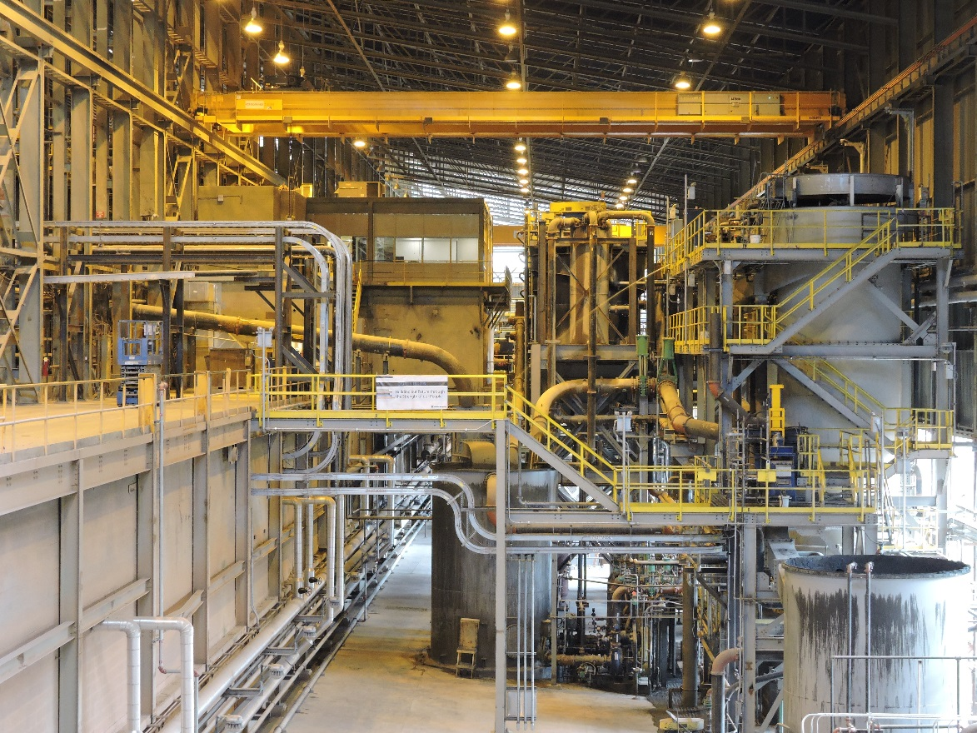
MODULE 1: Workplace Examination Compliance
Notes:
Instruction
Upon completion of Module 1, the students will be able to:
Explain the purpose of workplace examinations
Describe the qualifications and training level necessary to conduct one

Slide 10
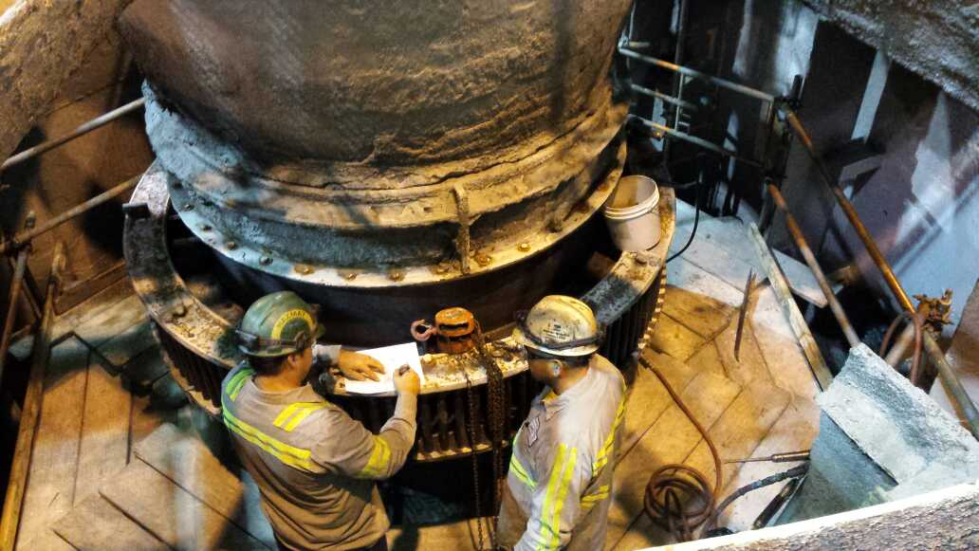
Purpose of Workplace Examination
What is the purpose for conducting a workplace examination?
Brings employees’ attention to recognized hazards in the working area and taking immediate action to mitigate or eliminate them
What is a workplace examination?
Practice to ensure the workplace is free of hazards and adequate for you to perform your regular job duties
Notes:
Instruction
Explain why workplace exams are conducted.
Explain what a workplace exam is.
Emphasize that doing workplace exams as a group or with coworkers strengthens the workplace exam.

Slide 11
Responsible Individuals
Who conducts them?
A competent person must perform a workplace exam
before work begins
as employees begin work in that area
How is a competent person defined?
A person who has demonstrated the capability of
identifying existing and predictable hazards in the surroundings
Identifying unsanitary, hazardous, or dangerous working conditions
Has authorization to take prompt corrective measures
Notes:
Instruction
Discuss the bullet points under each question.
Freeport-McMoRan requires a competent person perform the exam
Explain how someone is deemed competent
A workplace exam cannot be performed by just anyone

Slide 12
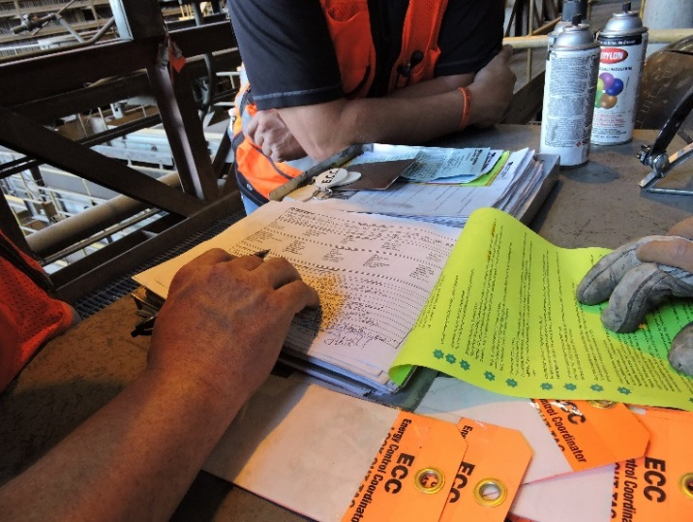
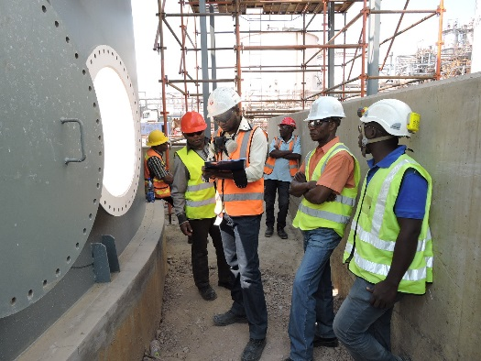
Responsible Individuals
What are some advantages to increased team involvement in workplace examinations?
Fresh set of eyes
Increased awareness of hazards
Different perspective on situations
Notes:
Instruction
Discuss the bullet points under each question.
Varied backgrounds will bring a new perspective to a workplace examination
Whether the additional person is a new hire, from a different culture, or even from a different industry, he or she can possibly note new hazards that were otherwise not noticed.

Slide 13
Record Keeping
What is included in a workplace exam record?
Date the examination was made
Examiner’s name
Work areas examined
Description of each adverse condition not corrected promptly
Date when the condition is corrected
Maintain records of each workplace examination in accordance with Freeport-McMoRan’s record retention policy
Notes:
Instruction
Discuss each bullet point.
It is important that students understand what is required, per MSHA, within their workplace examination record.
Records are retained for one year and must be made available upon request.

Slide 14
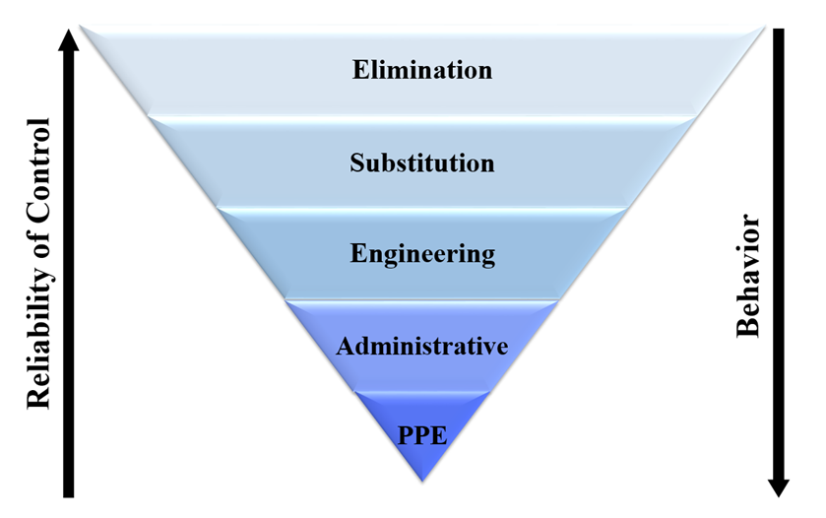
Mitigation of Findings
Mitigation of Findings
Preventing access to the hazard
Contact appropriate personnel
Read the “Learn from Others” story (SG p.7).
Notes:
Instruction
Discuss each bullet point.
It is important that students understand what is required, per MSHA, within their workplace examination record.
Records are retained for one year and must be made available upon request.

Slide 15
Activity 2
Stump Your Neighbor
Directions
Facilitator will divide the class into two teams.
Each team will designate a leader.
Take five minutes to create three questions and answers that you believe will stump the other team.
Each leader will take turns asking the other team one of their questions.
Review the answers as a class.
Notes:
Materials
Flip chart
Markers
Purpose
This activity draws out the students’ existing knowledge on workplace examination compliance.
Directions
Divide the class into two teams.
Each team will create five questions and answers about this module that they believe will stump the other team. Designate one person as the leader. Allow 10 minutes to complete.
After 10 minutes, teams will take turns with the leader asking the other team one question and allowing them to answer it. Rotate between the two teams until all 10 questions have been asked and answered.
The flip chart can be used to capture questions that generate a discussion.
Discuss the responses as a class.
Note: If there are not any questions generated regarding the qualifications of a competent person, be sure to include those questions on your own. It is important that this information is reiterated to the class.

Slide 16
Debrief
How will you apply the skills learned in this module to your daily work activities?
What information surprised you?

Slide 17
Quiz
Module 1 Quiz
Directions
Refer to the Quiz in the Student Guide (p.8).
Take five minutes to complete.
Review the answers as a class.
Notes:
Instruction
Students will complete the answers to the quiz questions in the SG.
Review the answers as a class (See the following page for answers)

Slide 18
Quiz
Module 1 Quiz
In accordance with FCX requirements, how often should a workplace examination occur?
Once per hour
At the end of each shift
Before work begins or as employees begin work in that area
Notes:
Quiz Answers
Answer: c, SG p. 5

Slide 19
Quiz
Module 1 Quiz
Why is it important to conduct a workplace examination?
To avoid MSHA fines
To recognize hazards prior to starting work
To ensure the previous shift was productive
None of the above
Notes:
Quiz Answers
Answer: b, SG p. vii, 5

Slide 20
Quiz
Module 1 Quiz
What defines someone as competent to conduct a workplace examination? (Circle all that apply)
Demonstrated capability of identifying existing and predictable hazards in working conditions
Understanding of operations in that work area
Authorized to promptly eliminate hazards in the work area
Notes:
Quiz Answers
Answer: a, c, SG p. 5

Slide 21
MODULE 2: General Hazard Identification
Notes:
Instruction
Upon completion of Module 1, the students will be able to:
Conduct a workplace examination by assessing a scenario for general hazards

Slide 22
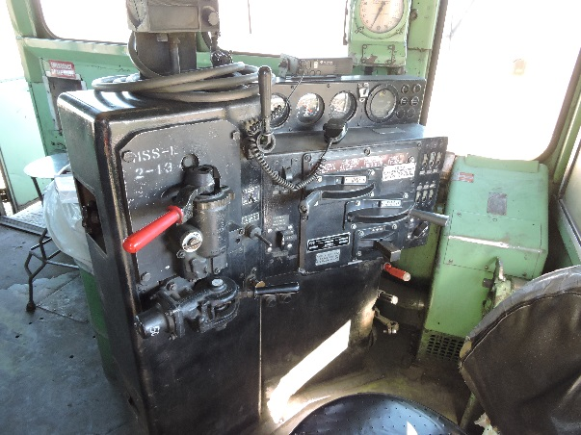
General Hazard Identification
What guidelines are necessary for performing an effective workplace examination?
Appropriate forms
Teamwork
Define boundaries
Discuss tasks being performed
Survey the area
From a distance
From a closer point
Examine specific equipment
Notes:
Instruction
Review the guidelines for performing an effective workplace examination.
Ensure the appropriate forms are being used
Include as many people from your team as possible
Begin by defining the boundaries of your work area
Talk through the tasks being performed in the defined work area
Survey the area from a distance and a closer point
Examine specific pieces of equipment pertinent to your job

Slide 23
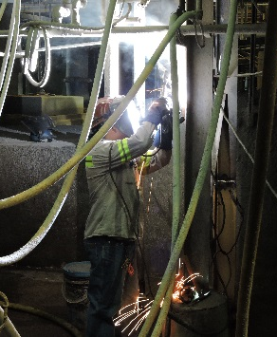
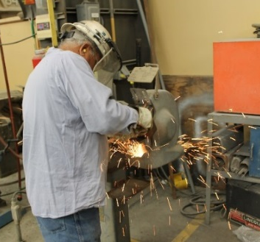
General Hazard Identification
Equipment
What hazards exist with each of these types of equipment?
Lifting equipment
Welding equipment
Grinding equipment
Review the list of questions in the Student Guide (pp. 14-15)
Notes:
Instruction
Review the list of questions in the SG you should ask yourself when lifting, welding, and grinding equipment are in your work area

Slide 24
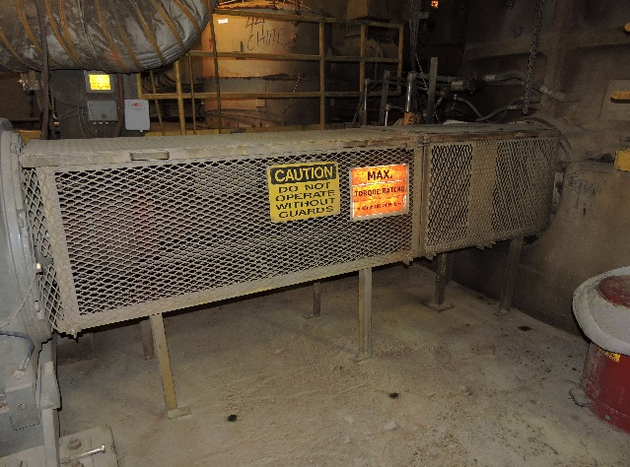
General Hazard Identification
Guarding
What is the purpose?
To prevent access into a hazardous area
Notes:
Instruction
Review the questions and bullets on the slide.
Emphasize that if guarding deficiencies are discovered through a workplace exam, stop working until the guarding is repaired or reinstalled.

Slide 25
General Hazard Identification
Guards
What types of hazardous areas are guarded?
Machinery with exposed moving parts
Chemical contact
Excessive heat
Excessive noise
Notes:
Instruction
Review the questions and bullets on the slide.
Emphasize that if guarding deficiencies are discovered through a workplace exam, stop working until the guarding is repaired or reinstalled.

Slide 26
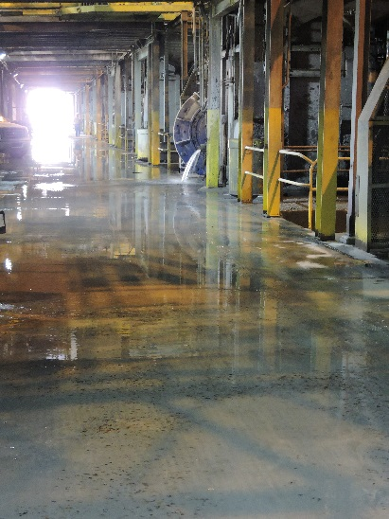
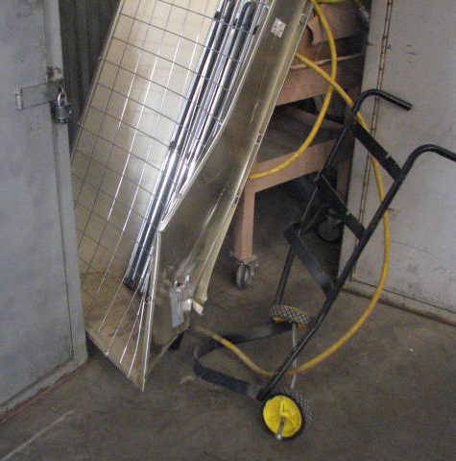
General Hazard Identification
Housekeeping
What is housekeeping?
Why are these considered hazards?
Standing liquids, uneven surfaces, stairs, or ladders
Trash and clutter
Improperly stored materials
Notes:
Instruction
Review the Important Questions boxes
Standing liquids, uneven surfaces, hoses or electrical cords, or stairs and ladders can result in slipping and tripping hazards.
Trash and clutter can impede escape routes and provide a fuel source, in the event of a fire.
Improperly stored materials can impede travelways, exceed the weight limits or a shelving system, or have illegible/missing labels.

Slide 27
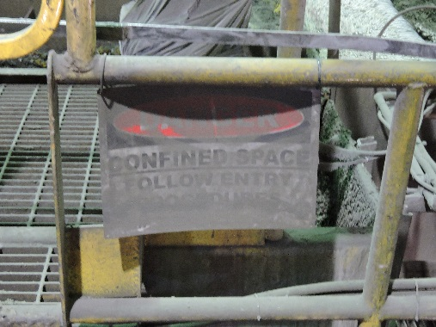
General Hazard Identification
Housekeeping
Signage
Why are signs needed?
What makes a sign effective?
Notes:
Instruction
Signs are needed to understand the hazards and adhere to proper precautions while working.
An effective sign must be positioned in a conspicuous location, be clean and legible, and oriented properly

Slide 28
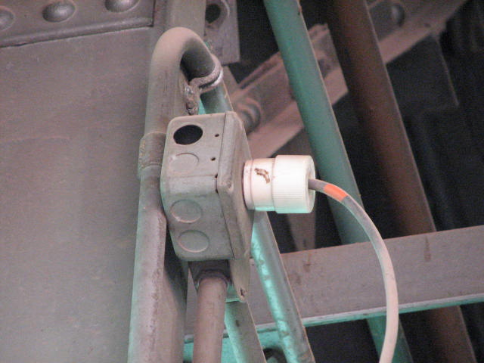
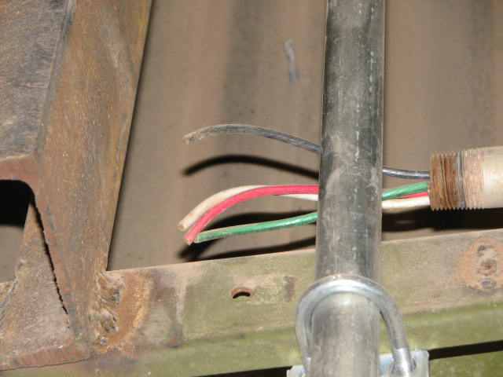
General Hazard Identification
Electrical
Missing knockout plugs
Why is this a hazard?
Broken or damaged conduits
What could happen if these were not repaired or replaced?
Notes:
Instruction
Conduit is attached to electrical boxes at small pre-cut holes. When a knockout plug is missing, it leaves the electrical box exposed to external elements.
Broken or damaged conduit can lead to exposed wiring, which is a shock/electrocution hazard.

Slide 29
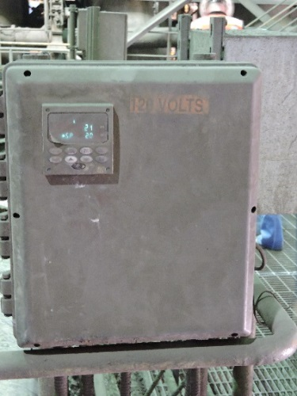
General Hazard Identification
Electrical
Improperly labeled and illegible panels
What should you ask yourself?
Expired ground checks
What is this year’s colored tape?
Notes:
Instruction
Review the Important Questions boxes
Proper labeling of all electrical panels is critical to the safety of personnel.
Ground checks test the continuity and resistance of the grounding system.

Slide 30
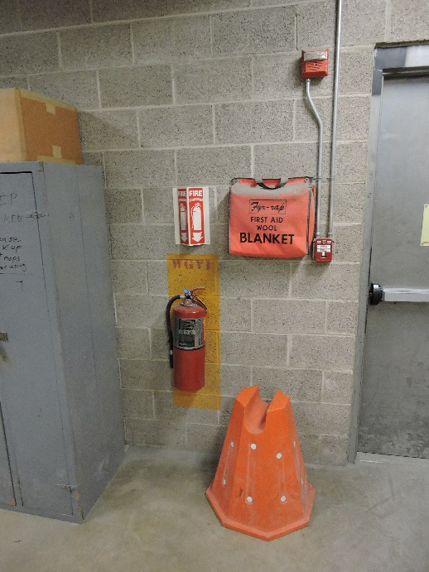
General Hazard Identification
Emergency Preparedness
Note the location of and working order for:
Fire extinguishers
AEDs
Do the locations have proper signage?
Are the first-aid kit supplies stocked and expiration dates are current?
Notes:
Instruction
Review the Important Questions box for fire extinguishers
Locating fire extinguishers, first-aid kits, and AEDs can be extremely important during a health emergency.

Slide 31
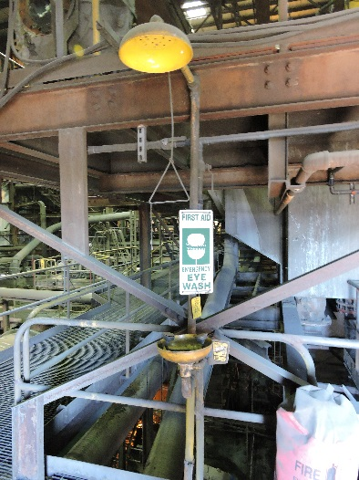
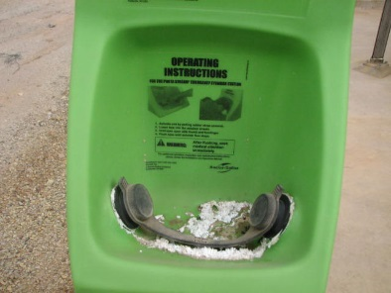
General Hazard Identification
Emergency Preparedness
Why is it important to include eyewash stations and showers in a workplace examination?
Notes:
Instruction
Emergency eyewash stations and showers are oftentimes the difference between life-altering exposure events and a recoverable injury.
Waiting for an event that requires the use of either an emergency eyewash station or shower, is not the time to learn where they are located or if they are operational.

Slide 32
General Hazard Identification
Emergency Preparedness
How do these affect a workplace examination?
Emergency lighting
Exit signs
Exit access
Notes:
Instruction
A successful evacuation is partially dependent upon emergency lighting, exit signs, and clear access to all routes.
Familiarize yourself with evacuation routes and location of exit signs.

Slide 33
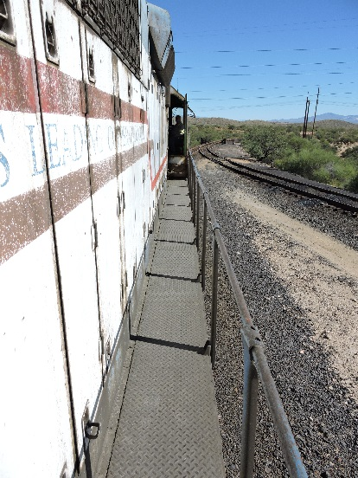
General Hazard Identification
Travelways/Escapeways
Allows employees to travel on foot from one area to another
Remain a safe route for any employee at all times
Notes:
Instruction
Safe access along any path that is traveled for work, repair or maintenance should be kept free of debris or obstruction, be easily accessible, and well lit.

Slide 34
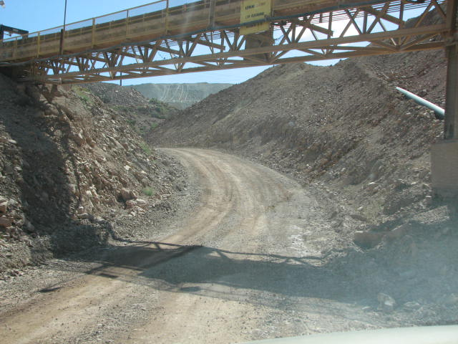
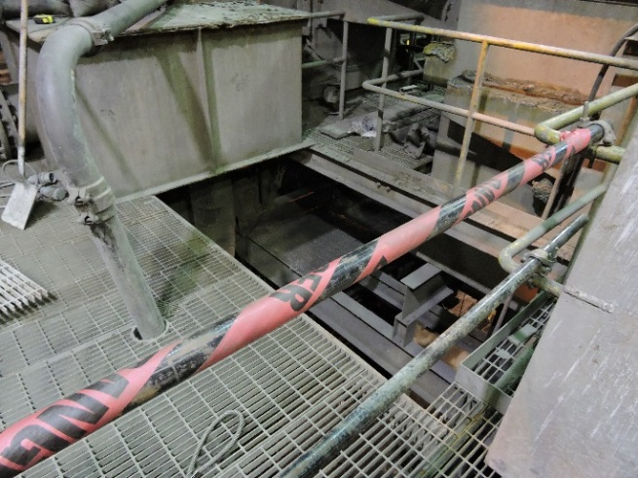
General Hazard Identification
When your travelway contains these items, what should you ask yourself?
Railings and toe boards
Overhead clearance
Open holes
Conveyors
Notes:
Instruction
Review the Important Questions box.
Handrails, midrails, and toe boards are provided to protect employees from falling to a lower level, or protect those working or traveling beneath the elevated walkway.
Be aware of any overhead hazards from infrastructure or equipment, as well as any associated warning devices.
The presence of an unguarded/non-barricaded open hole along any travelway or escape route is considered an imminent danger.
To be considered an open hole
A person can fall through the opening to a lower level
Horizontal opening must measure 12 inches (30 cm) or more in its least dimension
Vertical opening must be at least 30 inches (76 cm) tall and 18 inches (46cm) wide
If a person cannot accidentally walk to the hole due to fixed machinery, equipment, or walls, a secure cover that supports at least twice the expected load and leaves no more than 1 inch (2.5cm) openings must be used and labeled “Hole” or “Cover”
When examining travelway along conveyors, be sure to look for material build-up and any gaps that may exist in the guarding.

Slide 35
General Hazard Identification
Ground Control
Common hazards spotted during a visual examination
Cracks
Raveling
Erosion
Water seepage
Bulging
Notes:
Instruction
Review the list of common hazards noted with a visual examination.

Slide 36
General Hazard Identification
Ground Control
Some conditions that cause ground hazards
Burrowing wildlife
Weather
Root systems
Seismic activity
Change in slope stability
Notes:
Instruction
Review the conditions that may lead to the common hazards listed in the previous slide.

Slide 37
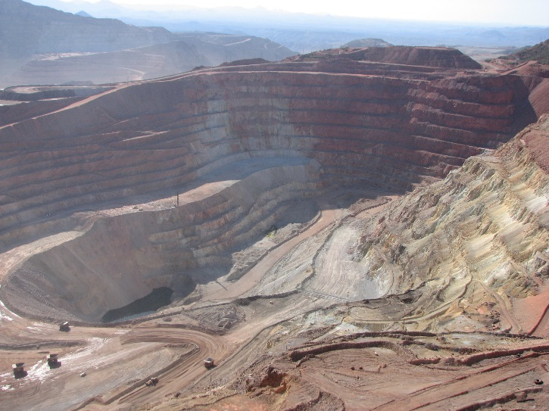
General Hazard Identification
Ground Control
Why inspect highwalls and benches?
Provide access routes throughout the mine
Benches catch rocks and other sliding materials
Notes:
Instruction
Maintaining highwalls and benches is critical to the stability of the pit.
When examining benches, begin by focusing on the level upon which you are standing or driving. Benches need to be clean of debris, rocks, and boulders.
When examining high walls, watch for rocks, boulders, or large masses of material that could loosen or dislodge from the face or crest.
Scan the levels above and below you.

Slide 38
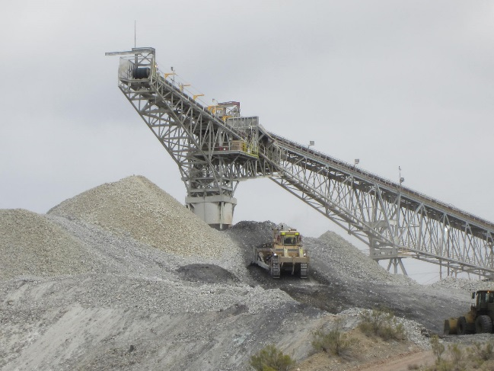
General Hazard Identification
Ground Control
What are some concerns with working near stockpiles?
Undercutting
Engulfment
Notes:
Instruction
Undercutting occurs when the ore is removed from the bottom of the pile, and will cause a change in the angle of repose. By changing the angle of repose (the natural angle at which the material settles when deposited), stockpiles are made substantially less stable.
If ore is being actively deposited, be aware of any personnel or equipment near the bottom of the pile that could be engulfed or crushed if a shift in the stockpile was to occur.

Slide 39
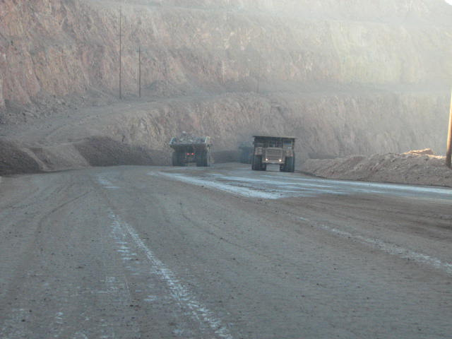
General Hazard Identification
Ground Control
Berms and guardrails
Any section of road that has a drop off large enough for a vehicle to overturn
Height of guardrail/berm must be equal to or greater than the mid-axle height of the largest vehicle that travels that road
Notes:
Instruction
While gaps are permitted for drainage purposes, they should not be large enough that a vehicle can pass through them.
If you see insufficient barriers while driving on any part of our properties, notify a supervisor immediately.

Slide 40
Activity 3
Hazards in the Workplace
Directions
Refer to the activity in the Student Guide (p.30).
Take five minutes to identify if there are any hazards in the workplace.
Be prepared to share your findings.
Review the answers as a class.
Notes:
Materials
Worksheet (located in the SG pp. 30-33)
Purpose
This activity reinforces this module’s lesson on workplace examinations.
Directions
Direct the class to the activity worksheet in the Student Guide (pp. 32-35).
Each student will identify if there are any hazards in the workplace photo. Allow 10 minutes to complete.
After 10 minutes, progress through the slides and review the answers as a class. Proposed answers are provided as a guideline.

Slide 41
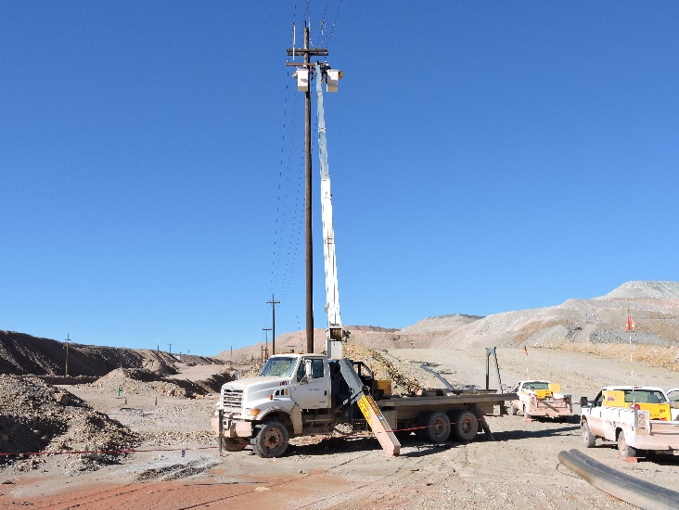
Hazards in the Workplace
#1
Notes:
Hazards:
Working with energized power lines
Fall out of bucket truck
Uneven ground
HDPE pipes on the ground (tripping hazard)
Potential for tools to fall from bucket
Pedestrians and light vehicle traffic

Slide 42
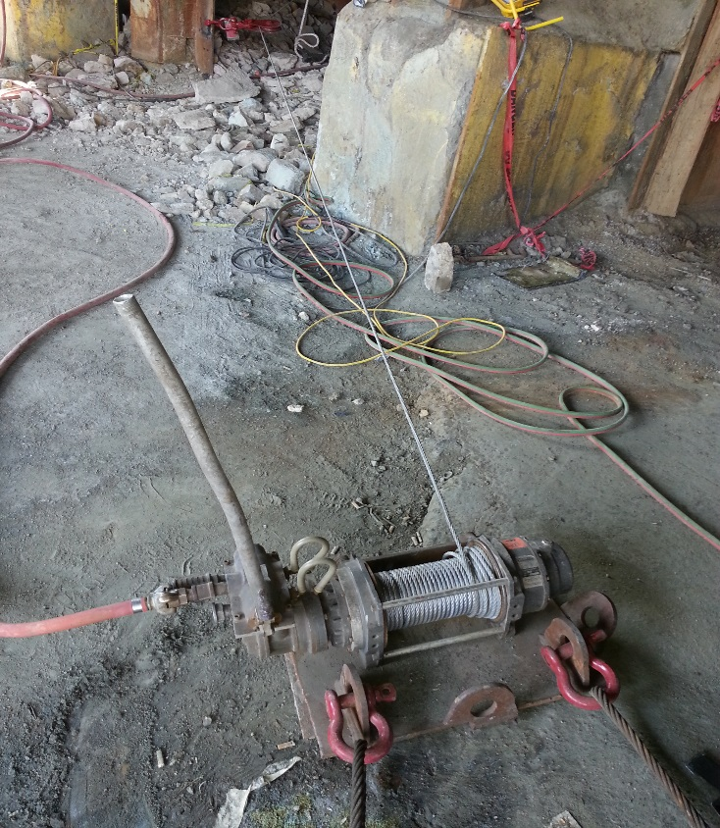
Hazards in the Workplace
#2
Notes:
Hazards:
Tripping
Uneven grounds, rock underfoot
Red flagging fallen down and why is it there?
Wench line under tension
Air lines under pressure
Broken handle, potential for cuts
Missing guarding on wench

Slide 43
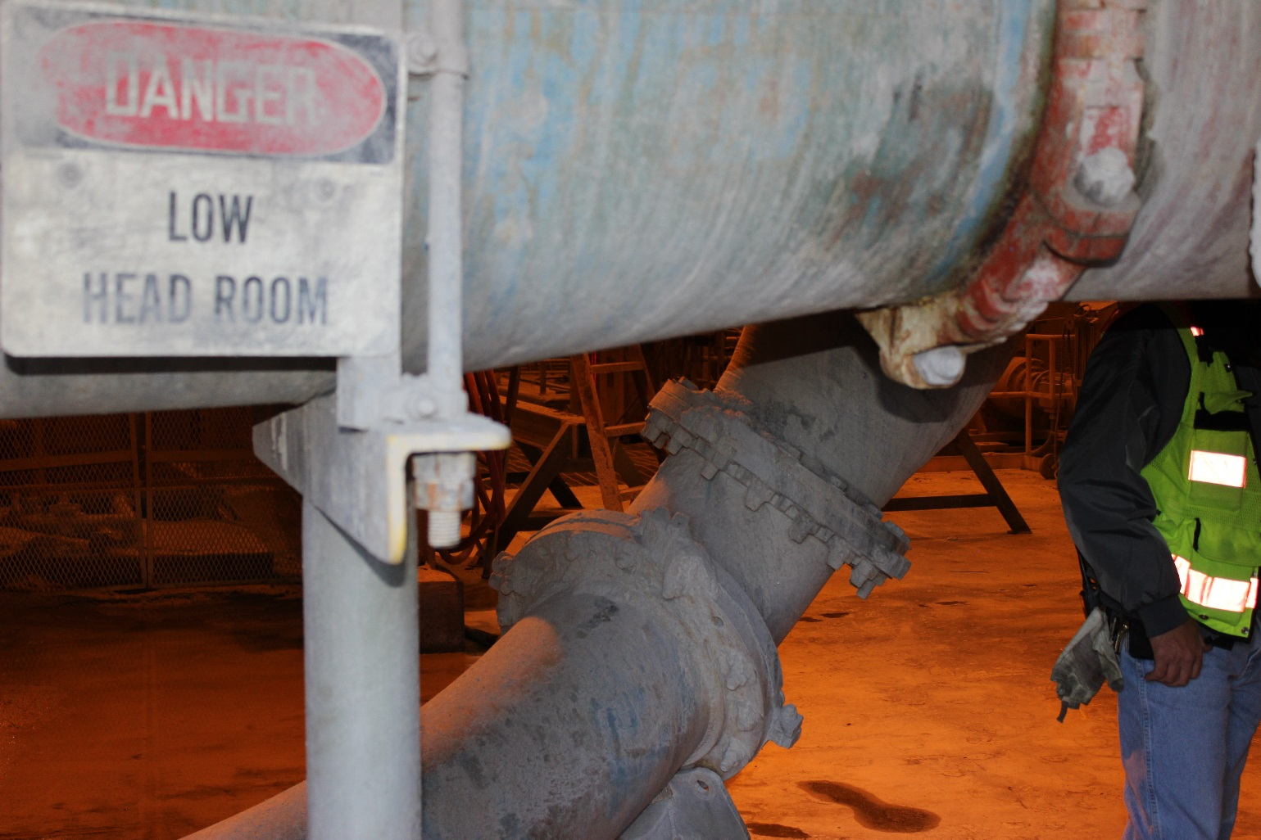
Hazards in the Workplace
#3
Notes:
Hazards:
Trip hazards
Low overhang or head clearance
Poor lighting

Slide 44
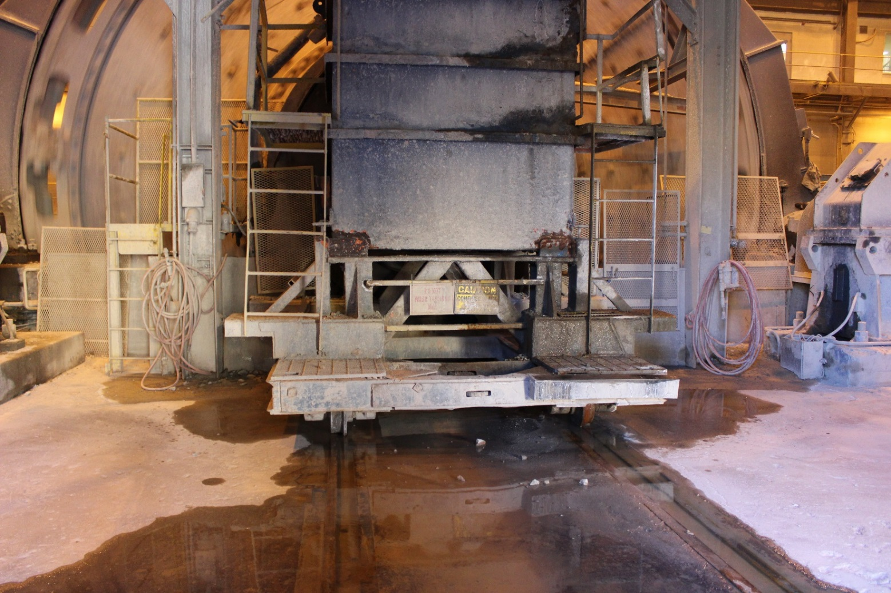
Hazards in the Workplace
#4
Notes:
Hazards:
Slipping hazards
Overhead clearance
Uneven surfaces
Missing mid-rail
Elevated platform
No catch chain visible

Slide 45
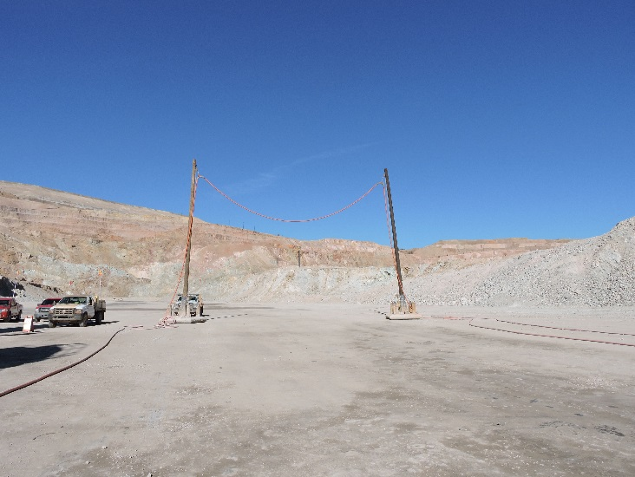
Hazards in the Workplace
#5
Notes:
Hazards:
Electrical lines on the ground
Sagging electrical lines (overhead clearance)
Loose material
Light trucks and heavy equipment in the same area
Pedestrian traffic

Slide 46
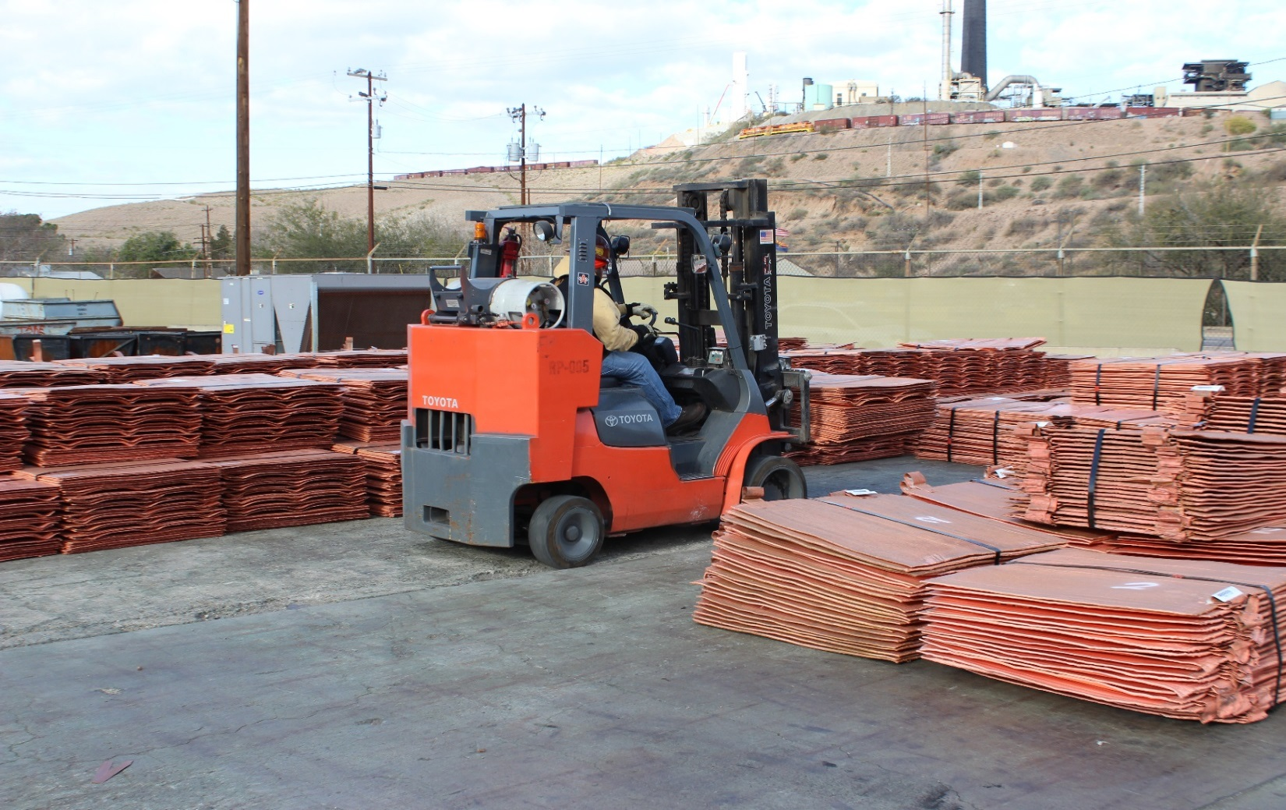
Hazards in the Workplace
#6
Notes:
Hazards:
Suspended load
Propane gas is highly flammable and displaces oxygen
Forklift and pedestrian traffic
Sharp edges and corners on cathodes

Slide 47
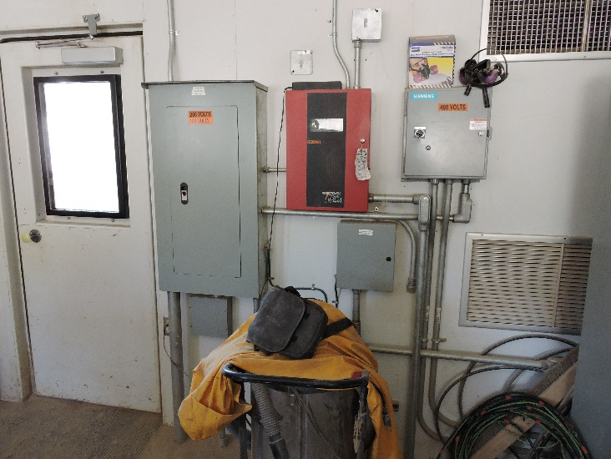
Hazards in the Workplace
#7
Notes:
Hazards:
Housekeeping issues
Shop vac stored less than 3 feet from electrical box

Slide 48
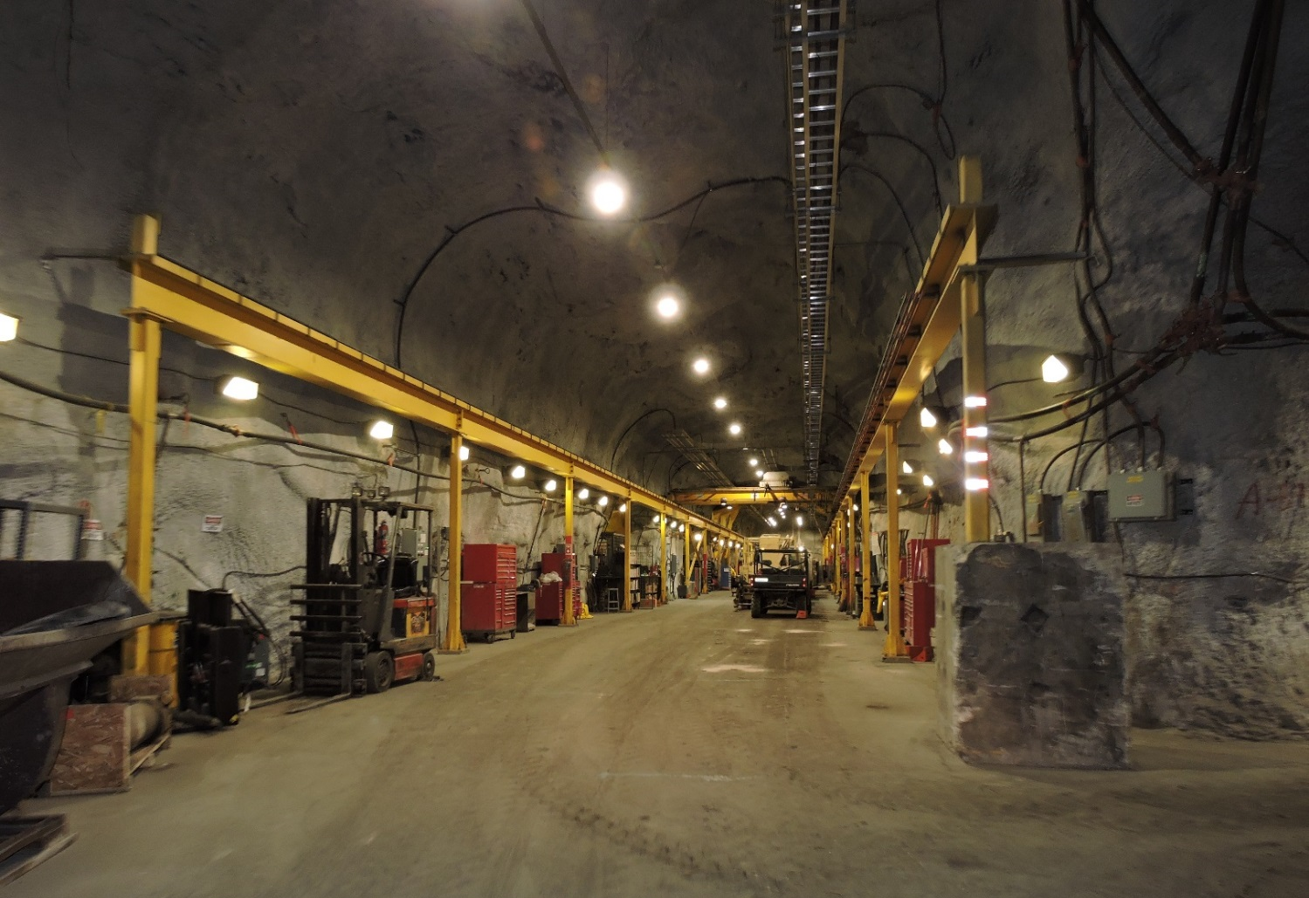
Hazards in the Workplace
#8
Notes:
Hazards:
Overhead crane
Vehicle and pedestrian traffic
Blind turn
Noise exposure

Slide 49
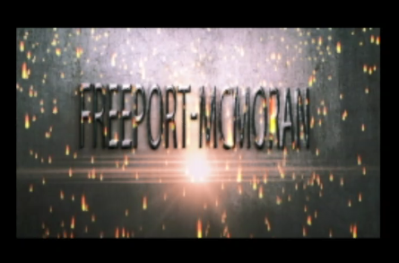
Video
Notes:
Instruction
Play the 5 minute video. This is a brief overview of this module and visually shows examples of areas across the mine that could be examined.
https://web.microsoftstream.com/video/c221ad5f-0a77-4561-a433-148be71ac758

Slide 50
Activity 4
Teach Me
Directions
Facilitator will divide the class into small groups.
Each group will receive an assigned hazard topic (Equipment, guards, housekeeping, electrical, emergency preparedness, travelways/escapeways, or ground control).
Take ten minutes to research and prepare talking points about your hazard topic. Use the worksheet in the Student Guide (p.34).
Teach your topic back to the class. What do you want your classmates to understand about this topic? What are some key concepts? How can you apply this topic to your workplace?
Notes:
Materials
Worksheet (located in the SG p. 34)
Purpose
This activity reinforces this module’s lesson on the different kinds of hazards present on our properties.
Directions
Divide the class into small groups.
Assign each group a hazard topic (Equipment, guards, housekeeping, electrical, emergency preparedness, travelways/escapeways, or ground control).
Direct each small group to the worksheet in the Student Guide. Allow ten minutes for each group to research and prepare talking points about their assigned topic.
They will teach back their topic to the class. Their presentation should cover the following questions: What do you want your classmates to understand about this topic? What are some key concepts? How can you apply this topic to your workplace?

Slide 51
Debrief
How will this module impact your future workplace examinations?
What information surprised you?
Notes:
Instruction
Review the questions on the slide.
This helps to review and refresh the information that was covered in this module.
By asking the students to apply the information, they are further retaining the lesson.

Slide 52
Quiz
Module 2 Quiz
Directions
Refer to the Quiz in the Student Guide (p.35).
Take five minutes to complete.
Review the answers as a class.
Notes:
Instruction
Students will complete the answers to the quiz questions in the SG.
Review the answers as a class (See the following page for answers).

Slide 53
Quiz
Module 2 Quiz
What is the purpose of guarding?
Prevent access into a hazardous area
Provide another location to store PPE
Protect equipment from dust and debris
Notes:
Answer: a, SG p. 15

Slide 54
Quiz
Module 2 Quiz
What are some examples of good housekeeping? (Circle all that apply)
Disposing of trash
Cleaning up puddles or leaks
Wearing the correct dust mask
Securing ladders in the tool shop
Notes:
Answer: a, b, d, SG pp. 16-18

Slide 55
Quiz
Module 2 Quiz
What determines the height of a berm?
The Supervisor
The depth of the pit
The type of ore body being mined
The height of the mid-axle of the largest vehicle
Notes:
Answer: d, SG p. 29

Slide 56
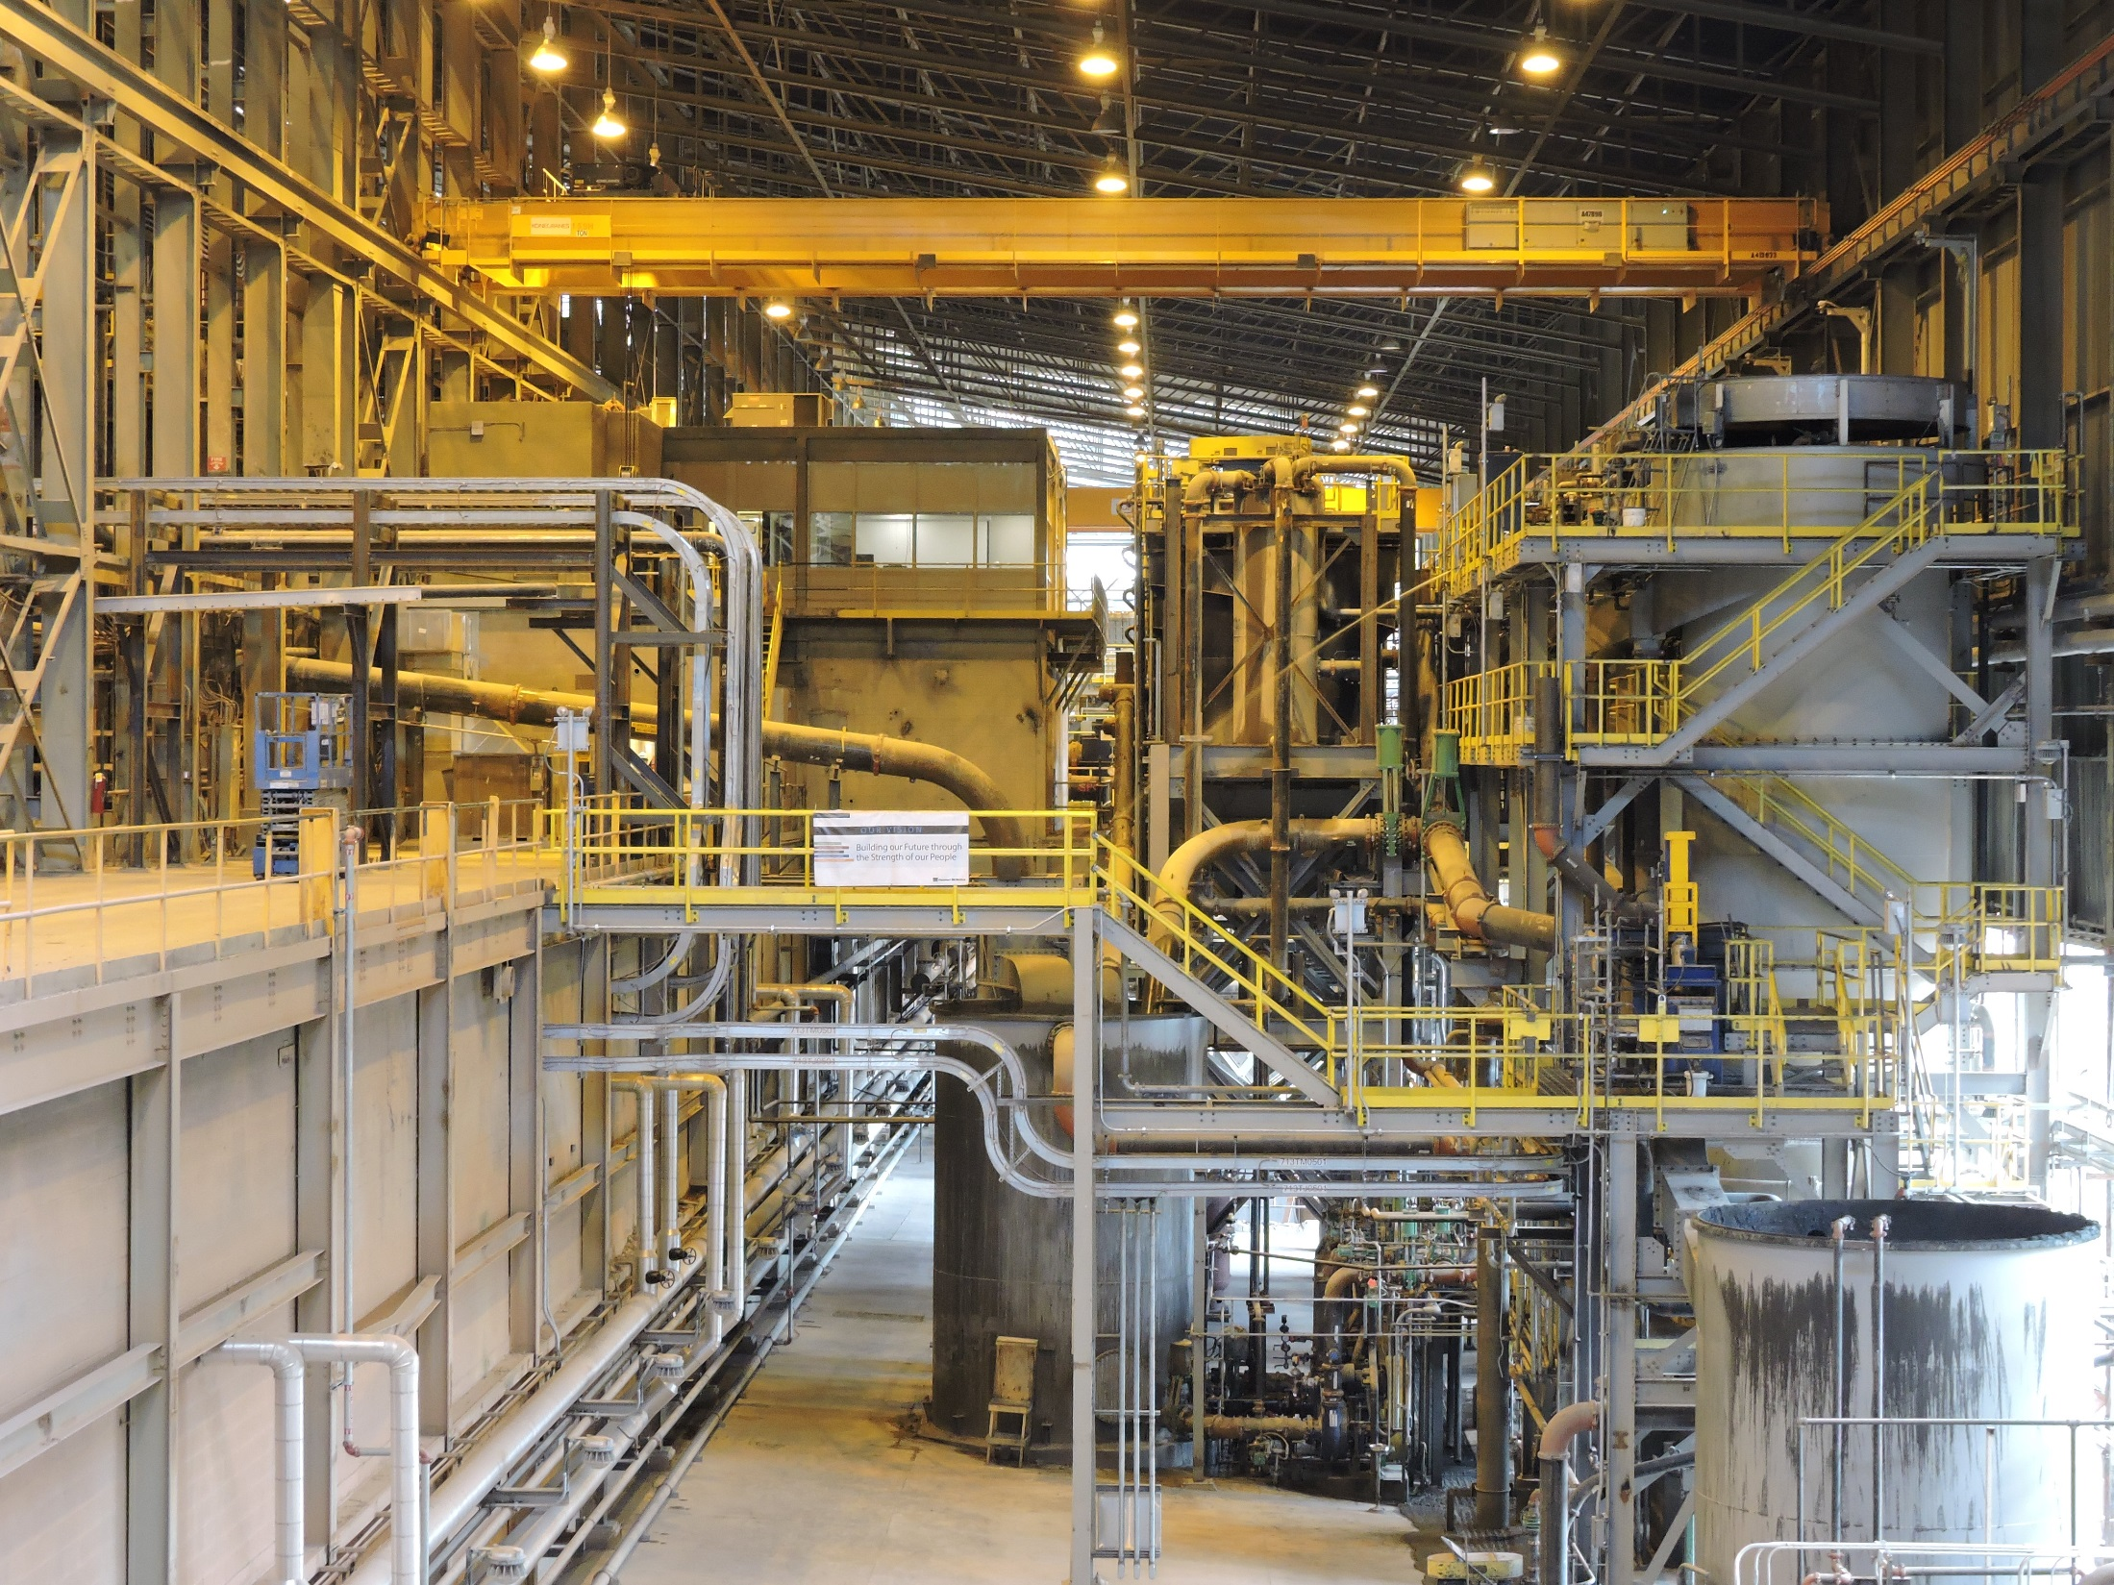
Conclusion
Notes:
Instruction
Complete a final review session

Slide 57
Debrief
What are some key concepts in each module?
Module 1: Workplace Examination Compliance
Module 2: General Hazard Identification
Are there any additional questions, comments, or concerns?
Notes:
Instruction
As the objectives for each module are reviewed, ask if there are any lingering questions, comments, or concerns.
Module 1
Explain the purpose of workplace examinations
Describe the qualifications and training level necessary to conduct one
Module 2
Conduct a workplace examination by assessing a scenario for general hazards

Slide 58
Assessment
Knowledge Assessment
Directions
Complete the assessment.
Return the completed assessment to the facilitator.
Facilitator scores it.
Notes:
Instruction
Have students complete the knowledge assessment.

Slide 59
Assessment
Performance Assessment
Directions
Read through the student directions.
Complete the assessment while the facilitator observes.
Notes:
Instruction
Have students complete the performance assessment in small groups (see the assessment for further details)
Note: For a portion of the performance assessment, you will need to have a workplace scenario set up, create posters of different workplaces, or be prepared to take the class to an actual workplace.

Slide 60
Evaluation
Student Course Evaluation
Directions
Complete the course evaluation (SG p. 47).
Your feedback is valuable to us.
Return the completed form to the facilitator.
Notes:
Instruction
Have students complete the Student Course Evaluation (located in the SG)

