Slide 1
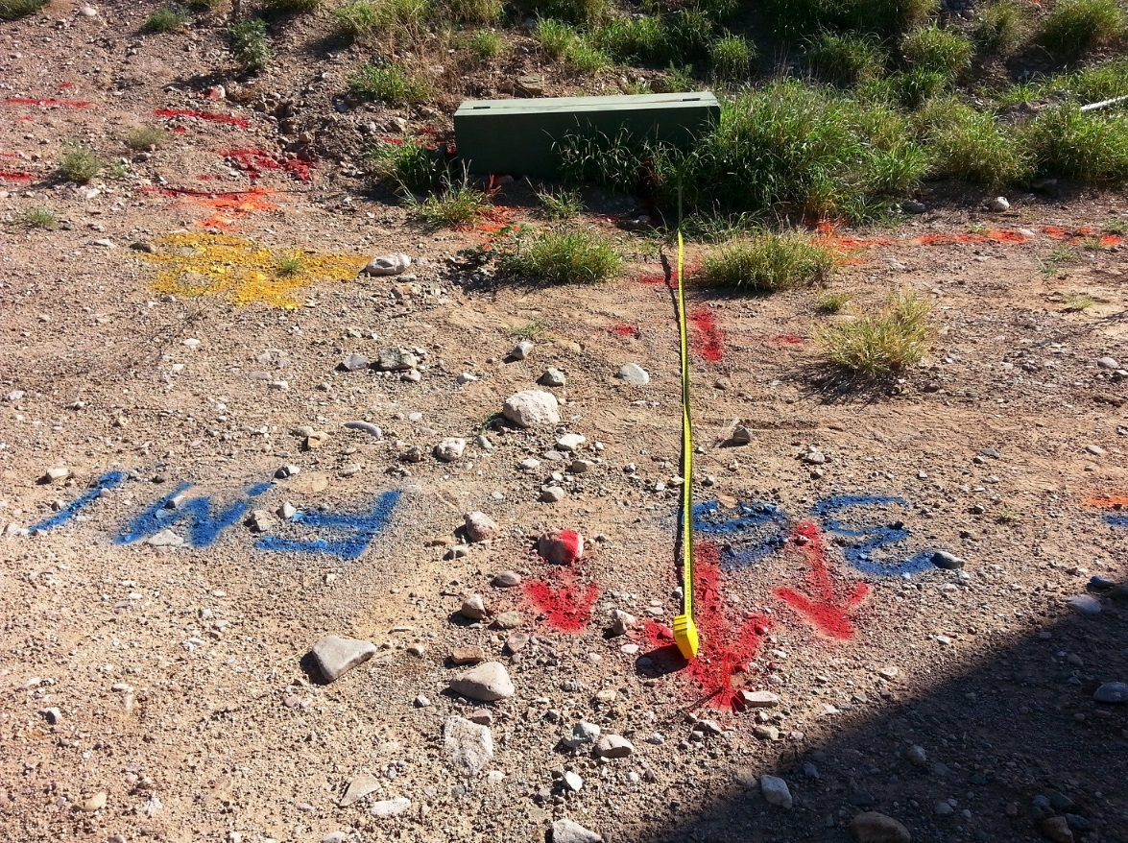
SFT FCX1019C
BLUE STAKE
VERSION 2 / APRIL 2019
Notes:
SG pg N/A
Instruction
Welcome students to class
Facilitator introduces self by stating
Your position at FMI
How long you have been with the company
How long you have been in mining

Slide 2
Course Expectations
Safety
Breaks/Restrooms/Smoking
Technology
Participation
Notes:
SG pg N/A
Instruction
Administrative/Classroom Policies
Safety
Identify the appropriate evacuation procedures, gathering areas, and emergency exits and fire extinguisher locations, etc.
Breaks and Restrooms
Establish a break schedule and announce it to the class. Suggested break times are included throughout the FG and occur approximately every hour and often occur at the end of each module. Breaks should last 5-10 minutes to give students time to rest and relax before beginning the next learning session
Identify the location of restrooms and smoking areas
Technology Policy
Review your expectations on cell phone and laptop use during the training
Participation
This course requires significant participation. Students should be prepared for discussions and small group activities
Set the class ground rules by verbalizing your expectations. Some suggestions are provided below
Participate
Be on time
Stay on task
Listen when others talk
Respect the opinions and attitudes of others

Slide 3
Icebreaker
Directions
Participate in an activity to get to know each other
Activity 1
Notes:
SG pg N/A
Time
Approximately 10 minutes
Materials
Choose an icebreaker and gather appropriate materials.
Purpose
Successful icebreakers encourage students to contribute their ideas and experiences thus increasing motivation and engagement in the class
In the Facilitator Guide is an assortment of icebreakers the facilitator can incorporate at the beginning of the course as well as after breaks

Slide 4
Safety Quote
Directions
Read the following quote
“No job will be considered so important, and no schedule so urgent, that time cannot be taken to perform work in a safe manner. Working safely is a condition of employment.”
-Freeport-McMoRan Inc. Safety and Health Policy
What does this mean to you?
Activity 2
Notes:
SG pg i
Time
Approximately 10 minutes
Materials
Poster sheets
Variety of color markers (at least 2)
Purpose
The quote spurs conversation that continues throughout the course. It also encourage students to contribute their ideas and experiences thus increasing motivation and engagement in the class.
Instruction
Read the safety quote
Discuss the quote’s meaning:
Agree/disagree?
Examples?
Deeper meanings?
Applications?
Write student ideas/answers on the poster paper
Note: This quote is revisited throughout the course, so keep the poster paper(s) visible and easily accessible

Slide 5
Learning Objectives
Module 1: Definitions and Explanations
Explain the purpose and process of hazard recognition
Explain the purpose of the Blue Stake Policy
Module 2: Permit Process
Define the roles and responsibilities of all Blue Stake process participants
Explain how to begin the request for a Blue Stake Permit
Notes:
SG pg v
Instruction:
Go over learning objectives for each module
Learning objectives are also located at the beginning of each module

Slide 6
Learning Objectives
Module 3: Permit Specifics
Describe the basics of excavation requirements as per the Blue Stake Policy
Describe the basics of floor, roof, ceiling, and wall penetration requirements as per the Blue Stake Policy
Module 4: Permit Exceptions
Describe what a variance is and when to request one
Describe what the exemptions are for using the Blue Stake process
Notes:
SG pg v
Instruction:
Go over learning objectives for each module
Learning objectives are also located at the beginning of each module

Slide 7
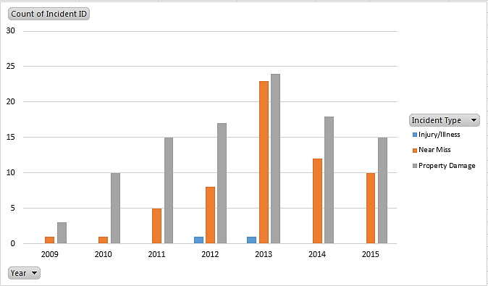
Introduction
Blue Stake Incidents at Freeport-McMoRan Properties from 2009-2015
Graph by Department of Occupational Health and Safety. Freeport-McMoRan. Phoenix, 2016.
Notes:
SG pg vii
Instruction
Ask students why they need to learn about Blue Stake
Discuss the chart
It shows trends pertaining to Property Damage, Near Miss, and Injury/Illness related to Blue Stake
It shows there is still a need to discuss Blue Stake
Blue Stake is a utility locating system
Course informs employees of the basics of a Blue Stake process so they can understand the necessity of the request and what happens after a Blue Stake request is submitted
FCX-13 DOHS Policy
Blue Stake request must be made when there will be a penetration of the earth’s surface, floors, roofs, ceilings, and walls of greater than one inch (1”) depth
Blue Stake process
Begins with request and includes location and marking of all buried/concealed utility lines
Goal – keep all employees safe from concealed dangers when penetrating
Safety
Without the correct information, operators cannot have a clear picture of the utilities buried within their work boundaries
Correct knowledge and communication allows workers to make sure the proper plans and controls are in place for the execution of a job
If we blindly dig, we could potentially create a situation where one or more of our employees is not able to return safely home after a job
Fatal Risk Management
No Fatal Risks with the act of requesting a Blue Stake; there are Fatal Risks associated with the tasks that require a Blue Stake permit
Consider the environment, any Fatal Risks, and whether the corresponding Critical Controls are in place
Present, accurate, and functioning Critical Controls help keep you from being killed and continuing without them puts you and coworkers at greater risk of severe injury or death
Personal stories and examples from your work experiences helps student connect to you and the content. This helps them transfer the knowledge to their long-term memory and see the relevancy to their job (i.e. What’s In It For Me?)
When working conditions change, stop the job immediately, reassess the job, and implement controls before continuing

Slide 8

Module 1: DEFINITIONS AND EXPLANATIONS
Notes:
SG pg 3
Instruction
This module informs students about the purpose for hazard recognition, as well as the purpose for having a Blue Stake process
Go over the learning objectives for the module
Upon completion of this module, the students will be able to:
Explain the purpose and process of hazard recognition
Explain the purpose of the Blue Stake Policy

Slide 9
Hazard Recognition
What is Hazard Recognition?
When does this take place?
What tools do we have to help us?
What happens if we don’t do a good inspection of our area and think through the job?
Notes:
SG pg 5
Instruction
Discuss the questions on the slide to define hazard recognition
Definition – identifying all items and situations that can cause someone to receive an injury
At work, observe the physical space where you work and recognize steps in job tasks that can create hazards or unintended consequences
Discuss hazards in the workplace
Crews complete adequate hazard assessments at the work site, look for potential hazards while planning a job, implement proper controls, and not skip steps
Students list examples of hazards they could find in the workplace in their SG

Slide 10
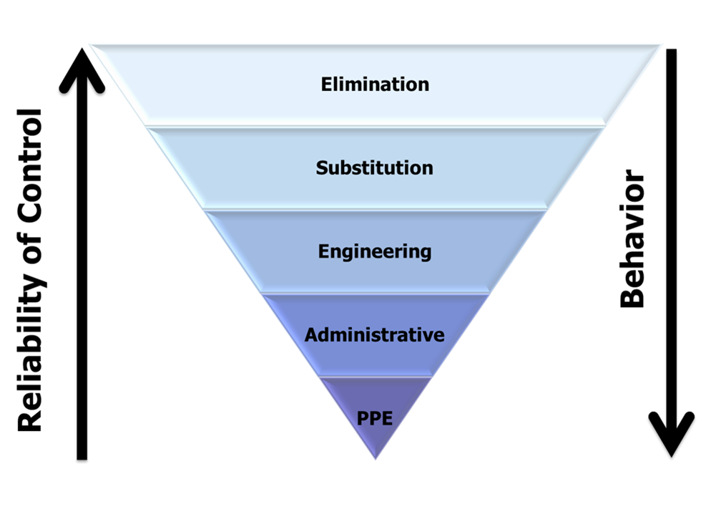
Hierarchy of Controls
Notes:
SG pg 6
Instruction
Discuss the Hierarchy of Controls
Elimination—most effective, as it takes the hazard away from the situation
Substitution—something that is not as hazardous or toxic to use instead
Engineering—engineered tools to help keep the employees from touching the hazards
Administrative—policies, SOPs, signage,
PPE—least effective, as it is fully dependent on human behavior
Below are possible questions to discuss
Which layer of the Hierarchy of Controls is the most effective at controlling for hazards? Why?
Which layer is the least effective? Why?
Is it always possible to control hazards using the most effective category? Why/Why not?

Slide 11
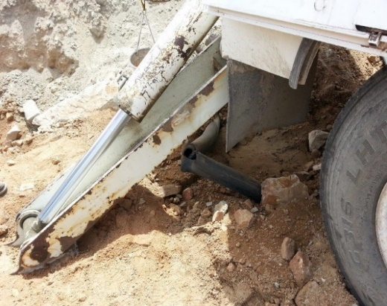
Learn from Others
Unintentional penetration more than 1 inch deep
Notes:
SG pg 7
Instruction
Read the Learn from Others – In 2013, a contractor ruptured a water line by placing an outrigger above a buried pipe. The weight of the crane caused pressure on that spot and resulted in an indentation in the earth greater than one inch (1”). The crew stopped the job, contacted the Blue Stake Team, and called the appropriate department to repair the damage.
Below are possible questions to discuss
What is an ‘outrigger’? Does anyone know how you normally place outriggers when setting up a crane?
How would they normally set up this job so that the outrigger would not dig into the ground?
Do you think they did an adequate job of examining their workplace and thinking ahead for potential consequences for doing the job the way that they did?
What did they forget to consider? (potential utility lines running beneath the earth’s surface)
If there was a potential that the outrigger would penetrate the earth, what could they do to determine what had been buried in this spot?
Do you think they thought through this job well enough?
Discuss potential consequences if the Policy is not followed by asking the following questions
Ask what happens if you do not plan ahead or follow the Blue Stake Policy?
From 2010-2015 there 162 Near Misses and Property Damages due to insufficient or incorrect application of the Blue Stake Policy and procedures
Why was this policy written? …to minimize risk for injuries, harm to the environment and production losses during such work
Read both Learn from Others at the bottom of the page
In 2010, contractors found a gas line while pot holing. The gas line did not follow a straight path, and no one had noted this situation
In 2012, an operator, digging outside a Blue Stake area, struck a water line unmarked on the Blue Stake permit. The production area ceased work until the completion of the repair to this line
According to the Law of Intensity, students learn best from the real thing vs substitutes. Take time to discuss these Learn from Others and apply them to other situations
Discuss stopping the job if you need to go beyond the approved boundaries

Slide 12

Blue Stake Permit Purpose
>1” (25.4 mm)
Notes:
SG pg 8
Instruction
When penetrating or excavating a building or earth’s surface, significant risk is involved
Risk is multiplied if employees do not know what is beneath the ground or behind a wall
Blue staking – “the act of identifying and marking utilities such as electric, gas, water, telephone, fiber optic, etc., so that they do not pose a risk of injury to workers or a risk of being damaged during penetration, excavation, trenching, or digging activities in buildings, surface excavations and underground workings”
All employees and contractors are responsible for following the policy
Ask when a Blue Stake permit is required
Click to reveal answer
Required if penetration is one inch or greater (>1”)
Ask who needs to be contacted prior to penetration
Site environmental representative
This task is often completed at Freeport-McMoRan sites through the Management of Change (MOC) process
Ask what the purpose of Blue Staking is
It helps ensure the right people look at the potential hazards
It allows operators to implement the correct controls to protect employees, property, and the environment

Slide 13
Module 1 Quiz
Directions
Complete the Quiz in the Student Guide (page 9)
Review the answers as a class
Note: Check your prior knowledge by attempting to answer the questions not taught yet.
Quiz
Notes:
SG pg 9
Instruction
Students write answers to the quiz questions in the SG
Review the answers as a class
Question 3 has some terms that have not been covered. Students should still attempt to answer to test their prior knowledge

Slide 14
Module 1 Quiz
Due to the high level of risk during excavations and penetrations of building surfaces, what was the Blue Stake Policy developed to minimize?
  Risk for injuries
  Harm to the environment
  Production losses
  All of the above
Notes:
SG pg 9
Instruction
Answer: D. All of the above. SG pg 7

Slide 15
Module 1 Quiz
How deep does an impending penetration of the earth’s surface need to be in order to warrant a Blue Stake request or survey?
  Greater than 1 inch
  1/2 inch or greater
  It is always required no matter the depth
Notes:
SG pg 9
Instruction
Answer: A. Greater than 1 inch. SG pg 8

Slide 16
Module 1 Quiz
Match these items with the correct description.
A. Requestor | ___ | Administrative control
B. Blue Stake Representative | ___ | Person who puts in the request
C. Excavation Operator | ___ | Items used to mark buried or concealed utilities
D. Temporary or Permanent Markings | ___ | Person who digs into the earth
E. FMI Blue Stake Policy | ___ | Investigates what is concealed in the walls or beneath the earth
E
A
D
C
B
Notes:
SG pg 9
Instruction
Answers: E, A, D, C, B. SG pgs 15-17
For this question, students may not know the material yet, but it will be covered in subsequent modules. They should still attempt to answer the question.

Slide 17
Debrief
What are some key concepts in this module?
What do you need to understand better?
What information surprised you?
Notes:
SG pg N/A
Instruction
Discuss questions on the slide.

Slide 18
Module 2: PERMIT PROCESS
Notes:
SG pg 13
Instruction
The policy describes responsibilities for several participants within the blue stake process
This module explains the roles and responsibilities of those involved in the process
Go over the learning objectives for the module
Upon completion of this module, the students will be able to:
Define the roles and responsibilities of all Blue Stake process participants
Explain how to begin the request for a Blue Stake Permit

Slide 19
Roles and Responsibilities
Directions
Each group is assigned one of four specific roles:
  Requestor
  Manager, Superintendent, Supervisor
  Representative
  Operator
Title the chart paper with your role and put it in the SG (page 18).
As a group, add responsibilities to the chart paper and in the SG.
Each group presents their role to the class while other groups take notes.
Add updates throughout the day as you learn additional responsibilities.
Activity 3
Notes:
SG pg 18
Time
15 minutes (ongoing through the rest of the course)
Materials
Student Guide (page 18)
Purpose
This activity helps the students learn the roles and responsibilities of all who are connected to a Blue Stake activity.
Instruction
Divide class into four groups and assign each group a role:
Requestor
Managers, Superintendents, Supervisors
Representative
Operator (all workers/employees who complete work that requires penetration of the earth, ceiling, wall, or floor)
Students write their role in the SG and on the chart paper
Groups read the “Roles and Responsibilities” section (starting on SG pg 15), writing the responsibilities of their assigned role
Each group presents their information to the class while the other groups take notes
Students add to their charts throughout the day when additional Responsibilities are discussed
Key points for each role, and the module to find the points, are listed in the FG.

Slide 20
Roles and Responsibilities
Requestor
Manager, Superintendent, Supervisor
Representative
Operators
Notes:
SG pgs 15-17
Instruction
Display this slide as students present
Each group presents their information to the class while the other groups take notes
Students add to the SG throughout the day when additional responsibilities are discussed

Slide 21
Blue Stake Process
MOC
Participants and Roles
Haz Rec
Request
Permit
Storage
Work
Completed Permit
Notes:
SG pgs 19-20
Instruction
Have the students follow along and underline important information in the SG as you discuss each step
Management of Change (MOC)
first step
corporate initiative required for ISO 14001
gives H&S and Environmental Departments sufficient opportunity to ensure changes are evaluated for potential impacts on safety, environment, production, and quality
when samples, permits, surveys, studies, notification may need to be performed they must be finished before any work begins
Check site-specific MOC requirements
Participants and Roles – previously discussed
Hazard Recognition
part of non-routine jobs (Blue Stake jobs)
includes workplace examinations and job safety analyses (JSAs)
Request
starts with Requestor filling in the needed information and submitting it to the Representative
review site-specific information for additional information
meet with necessary departments to go over request
Permit
Representative determines necessity for further investigation and Blue Stake Permit
a complete permit signifies that, to the best of the Representative’s knowledge, all concealed utilities have been identified and marked
each Permit is uniquely numbered
there is a 30-day limit to get the job done
Requestor must request renewal/extension if necessary
if the Permit expires before the renewal has been issued, all work must stop
if conditions change or the scope of work expands outside the permitted area, the Requestor must ask the Representative for a new permit
Representative must approve any deviations, additions, or changes to the permit
Storage
current Blue Stake Permit must be kept at the job site, and all Operators (and others directly connected to the job) must have read and understand the permit (and may need to sign the permit)
Operator must call the Representative for clarification if there is any missing, conflicting, or misunderstood information
Work – discussed later
Completed Permit
Operator must return the permit to the Representative when the job is finished
Completed permit with any attached drawings and documents will be filed according to the FCX- Records Retention Policy

Slide 22
Learn from Others
Discuss the “Learn from Others” on pages 17 and 19.
What went wrong?
What could have been done differently?
Notes:
SG pgs 17 and 19
Instruction
Have a student read the Learn from Others on page 17 and discuss – While performing demolition work on a drywall wall, a contractor sawed through a visible live 20 Amp, 277 Volt conduit which powered emergency lights. The wall was 80% demolished and the conduit was clearly visible from one side. A Blue Stake was performed but this conduit did not show on any of the reviewed drawings.
Ask students to describe what could have been done differently
Remind them if they were the Operators and if they were to find utility lines that had not been previously identified, they would need to stop work, clear the area, and contact the Blue Stake Representative
Have another student read the Learn from Others on page 19 and discuss – A crew was trying to expand an area in the bottom of an excavation to put HDPE pipe fuser in the excavation. To do this, they made the ramp into the excavated area longer and more gradual, digging into the earth in an area that had not been blue staked. The crew failed to look at the excavation plan and the Blue Stakes map for underground utilities. In the process of digging they struck a 6” gas line causing it to rupture.
Ask students to describe what went wrong
What could they have done differently had they been the Operators on the job? What should this crew have done once they knew they needed to expand the excavation area?
Always call the Blue Stake Representative and do not do more work outside the approved area until the area has been checked again and the expanded area has been approved

Slide 23
Blue Stake Process
Process
What if conditions change?
What if you find a utility line or conduit that was not marked on the ground or was not included on the Permit?
Notes:
SG pg 20
Instruction
Discuss the questions on the slide
Tell the Representative if you discover something that was not identified initially in the Blue Stake investigation
All employees have the right and the responsibility to stop work and clear the area if it becomes unsafe in any way
Immediately contact the area Supervisor, Project Manager, and Blue Stake Representative
Examples include rupture, break, or discovery of utility line during excavation
Contact Environmental Department representative, Industrial Hygienists and, as necessary, Safety Professional if situation includes a spill to the ground, or if it appears asbestos is present
If you are unsure of the presence of asbestos, contact your Supervisor or Environmental Representative
The Representatives bring blue prints to further investigate the situation
Further information regarding emergency work is discussed in Module 4

Slide 24
Digging Deeper
Directions
Break into small groups
Read the scenarios in the Student Guide and use the Blue Stake policy to answer the questions
Be ready to share your answers as a class
Note: Check your prior knowledge by attempting to answer question 4.
Activity 4
Notes:
SG pg 21
Time
Approximately 10 minutes
Materials
Student Guide
Blue Stake Policy (FCX-13)
Purpose
This activity gives students the opportunity to check prior knowledge and allow them to check their assumptions of the roles that are part of the Blue Stake process.
Instruction
Break the class into small groups
Give each group copies of the Blue Stake Policy
As a small group, read the scenarios, circle the answers and provide explanations
Click on each slide to reveal the answers
Discuss the scenarios and answers as a class
The last question has content that has not been covered. Students should still attempt to answer to test their prior knowledge

Slide 25
Digging Deeper
Scenario 1
Bob is about to hang a heavy picture in his office with several one and a quarter inch (1 1/4”) nails. Does he need to request a Blue Stake?
Yes
No
Explanation:
It has the potential to penetrate >1”/25.4 mm
Notes:
SG pg 21
Instruction
Answer: Yes; it has the potential to penetrate > 1”/25.4 mm.

Slide 26
Digging Deeper
Scenario 2
Jake is in charge of planning a job that will include digging a trench on the west side of the mill. Does he need to request a Blue Stake?
Yes
No
Explanation:
It has the potential to penetrate > 1”/25.4 mm
Notes:
SG pg 21
Instruction
Answer: Yes; it has the potential to penetrate >1”/25.4 mm.

Slide 27
Digging Deeper
Scenario 3
You are an equipment operator, and you have been told to dig a trench four feet (4’) deep and six feet (6’) long next to the Health and Safety building. Before transporting your equipment to the area, you decide to conduct a walk through.
What are you looking for?
  Items:
  Explanation:
What would keep you from doing this job?
ground conditions, hazards, proper tools/equipment available, ground markings, Blue Stake Permit
hazard recognition, Workplace Exam
wrong conditions or controls; missing or unclear ground markings; missing information on permit; not safe to move forward with job
Notes:
SG pg 21
Instruction
Answer:
Items: ground conditions, hazards, proper tools/equipment available, ground markings, Blue Stake permit
Explanation: hazard recognition, Workplace Exam
What would keep you from doing this job? Wrong conditions or controls; missing or unclear ground markings; missing information on permit; not safe to move forward with job

Slide 28
Digging Deeper
Following the Blue Stake Policy, when must a Blue Stake be requested?
  When a penetration is to be made in the earth’s surface of >1”
  When a penetration is to be made in a ceiling of >1”
  When a sawing penetration is to be made in a floor
  All of the above
Explanation:
  #s 1 & 2 have the potential to penetrate >1”/25.4 mm #3 sawing into a floor always requires a Blue Stake
  Per FCX-13
Notes:
SG pg 21
Instruction
The last question has content that has not been covered. Students should still attempt to answer to test their prior knowledge.
Answer: D. All of the above. Numbers 1 and 2 have the potential to penetrate >1”/25.4 mm; for number 3, sawing always requires a Blue Stake; per FCX-13.

Slide 29
Debrief
What are some key concepts in this module?
What do you need to understand better?
What information surprised you?
Notes:
SG pg N/A
Instruction
Discuss questions on the slide
Update quote chart
Update roles and responsibilities charts

Slide 30
Module 3: PERMIT SPECIFICS
Notes:
SG pg 25
Instruction
This module provides basic information on what happens after a permit is issued and when work is performed
This not intended to be formal training allowing equipment to be operated. Before using any equipment, training is required
Go over the learning objectives for the module
Upon completion of this module, the students will be able to:
Describe the basics of excavation requirements as per the Blue Stake Policy
Describe the basics of floor, roof, ceiling, and wall penetration requirements as per the Blue Stake Policy

Slide 31
Marking Utilities
Paint Color | Utility Type
Red | Electrical Power
Yellow | Gas-Oil-Product, and Air Lines
Orange | Communication Cable
Blue | Water Systems
Green | Sanitary Sewer Systems, Drains, Slurry Pipelines
White | Perimeter of Excavation/Boundary
Purple | All Solvent Extraction, Electro- winning
Notes:
SG pg 27
Instruction
Blue Stake must be requested and a survey for concealed utilities performed if penetrating one inch or more into the ground
Requestors use site-approved white paint to mark off the perimeter of the work area
Representatives investigate the requested area
Mark ground, roof, wall, etc. with the specific paint colors to label the type of utilities located below the ground’s surface
Colors should be visible

Slide 32
Colors
Directions
Look at the following images
Use the chart in the Student Guide (page 27) to identify what the Blue Stake Representatives have marked
Activity 5
Notes:
SG pg N/A
Time
Approximately 10 minutes
Materials
Student Guide, page 27
Purpose
This activity allows students the opportunity to apply their knowledge of the colors used to mark utilities.
Instruction
Go through each slide
Students use the chart in the SG to identify what has been marked

Slide 33
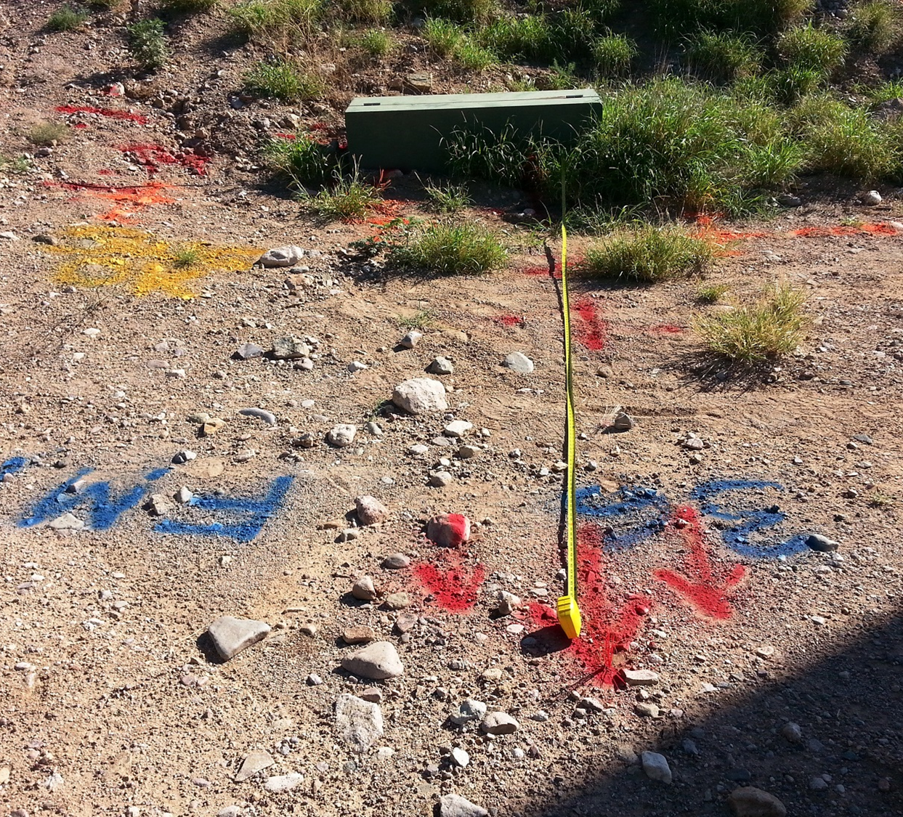
Colors #1
Notes:
Answers
Red = Electric
Blue = Water
Yellow = Gas
Orange = Communications

Slide 34
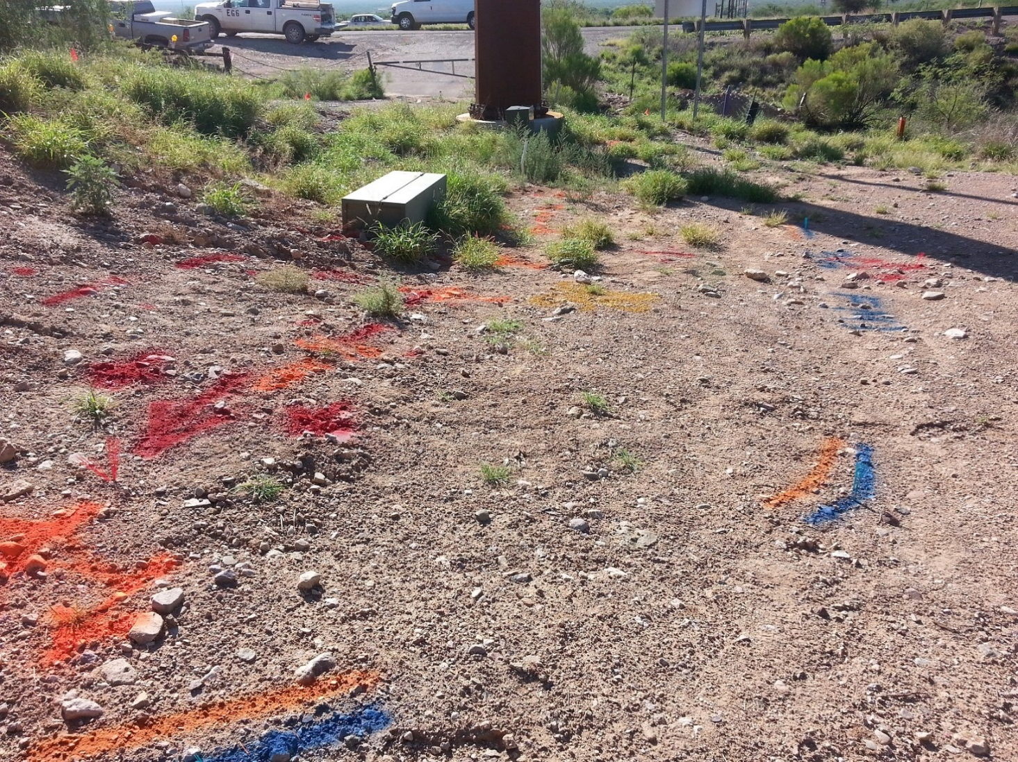
Colors #2
Notes:
Answers
Red = Electric
Blue = Water
Orange = Communications
Yellow = Gas

Slide 35
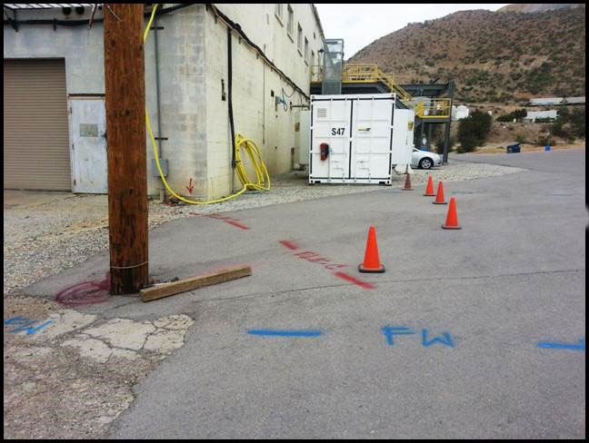
Colors #3
Notes:
Answers
Red = Electric
Blue = Water

Slide 36
Colors #4
Notes:
Answers
Orange = Communications
Blue = Water

Slide 37
Tracers/Indicators
Tracer/Indicator | Utility Type
Tracer wire | All new underground utilities
Yellow tape | Gas-Oil-Product, and Air Lines
Orange tape | Communications Cable
Red concrete/slurry (mortar-based concrete with red dye powder spread on top) | Electric (sites and best practice)
Notes:
SG pg 28
Instruction
Help communicate to workers
Indicate to Operators when they are close to lines (do not prevent contact)
Help Representatives when blue staking
Usually placed when installing underground utilities
Often used as tracers/indicators to warn workers, such as Representatives, of nearby utilities
Sometimes installed by Operators if they are part of the underground utility installation
Explain site-specific information
Note: The table is not a complete list of all tracers/indicators found
Describe each example on the following slides

Slide 38
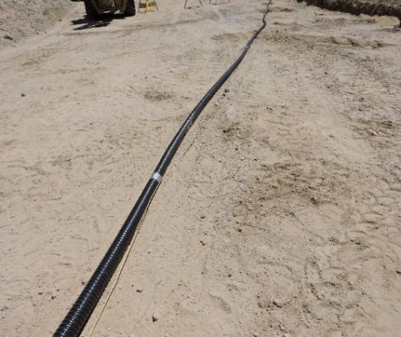
Tracers/Indicators #1
Notes:
SG pg 28
Instruction
Tracer/tracer wire on electric conduit or gas lines = electric

Slide 39
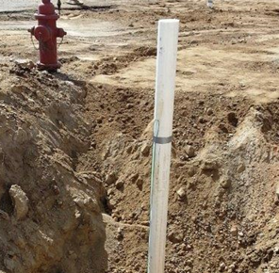
Tracers/Indicators #2
Notes:
SG pg 28
Instruction
Tracer wire taped to conduit above the ground level = electric

Slide 40
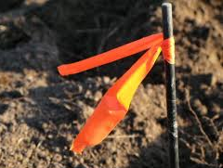
Tracers/Indicators #3
Notes:
SG pg 28
Instruction
Orange tape = communications
Note: This image is not included in the SG.

Slide 41
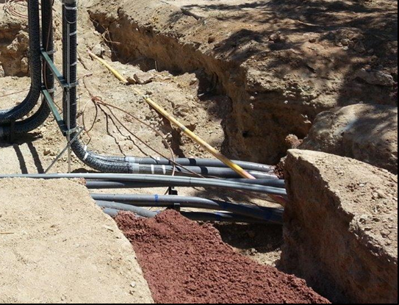
Tracers/Indicators #4
Notes:
SG pg 28
Instruction
Red concrete = electric (sites and best practice)
Note: This image is included in the SG on page 31.

Slide 42
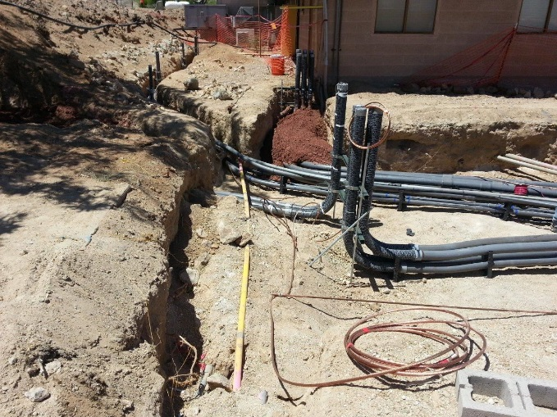
Trenching and Hand Digging
Notes:
SG pg 30
Instruction
Trenching
Excavations must comply with all FCX requirements which meet and/or exceed regulatory standards
When installing, rerouting, or repairing an underground utility, work must comply with local and regional buried utility/new installation requirements
Trenching and Excavating training
Provides specific information on these topics and the use of equipment
Must be taken before participating in trenching and excavation
Explain site-specific courses available
This class only teaches awareness
Hand digging/Pot holing
Must be done when within 24” (60.96 cm, or .61 m) of known utilities
Operators must use processes such as hand digging, vacuum extraction, or other impact minimizing techniques to prevent contacting and damaging underground utilities

Slide 43
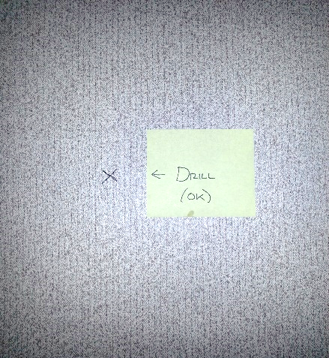
Floor, Roof, Ceiling, and
Wall Penetration
Sawing
Renovations and demolitions
Markings
Notes:
SG pgs 30-31
Instruction
FCX-13 expectations for inside work
Sawing
Requires a permit at all times
Must be trained
Renovations and Demolitions
May require coordination with site Environmental Department so they can test for airborne contaminants
Coordinate using MOC
Markings
When doubt exists regarding utility location within structure, Representative uses drawings or prints
Markings should be prominent and visible
Check site-specific procedures for types of markings used
Explain any other relevant site-specific information that meets or exceed FCX-13
Read and discuss the Learn from Others – On September 28, 2012, a contractor operating a track hoe contacted a two inch (2”) electrical cable while digging a test pit. This dig was one of 60 test pits surveyed and blue staked for the project. It appeared the cables were “not live” and everyone was OK. The Project Manager instructed the crew to shut down the job and secure the area for further investigation. The Blue Stake Team and Safety On-Call were contacted and a Near Miss Report was completed. The next morning, the Blue Stake Team confirmed to the Project Manager that the cable was not live. They also reported the operators were working outside the blue staked area by 270 feet. The Project Manager reinforced the Blue Stake Policy with the contractors, and work resumed.

Slide 44
Shift Changes
Communicate during Shift Change
  Follow site shift change procedures
  Correctly flag, barricade, and tag unattended hazards
Notes:
SG pg 31
Instruction
Time Limits
Permits are good for 30 days after issue date
Must have extension before continuing when the permit expires
Long-term permit is valid for 1 year
Explain site-specific information
Must meet or exceed FCX-13
Shift change
Explain site-specific SOP for handing over a job to the next shift
Must meet or exceed FCX-13

Slide 45
Module 3 Quiz
Directions
Complete the Quiz in the Student Guide (page 32).
Review the answers as a class.
Quiz
Notes:
SG pg 32
Time
Approximately 10 minutes
Materials
Student Guide, page 32
Blue Stake Policy (FCX-13)
Purpose
This activity gives students the opportunity to review the basic procedures for excavation as well as other areas of penetration.
Instruction
Tell students to get out the Blue Stake policy copy they were given earlier
Students should write answers to the quiz questions in the SG
Review the answers as a class

Slide 46
Module 3 Quiz
As the Requestor, what color paint would you use to mark the boundary of the area you are planning to dig?
  Red
  Yellow
  Blue
  White
Explanation:
As per FCX-13
Notes:
SG pg 32
Answer
D. White, per FCX-13 policy

Slide 47
Module 3 Quiz
How close to a known utility must you hand dig (pot hole)?
  12”
  24”
  6”
  36”
Explanation:
As per FCX-13
Notes:
SG pg 32
Answer
B. 24”, per FCX-13 policy

Slide 48
Module 3 Quiz
If you are not finished with the job at the end of your shift, how do you prepare the work area to be left until you and your crew return the next work day? (Choose the best answer.)
  Clean up your tools and leave the area neat and organized.
  Post a security guard to keep people out of the area.
  Properly flag, barricade, and tag as needed.
Explanation:
Communication to any who may be in that area
Notes:
SG pg 32
Answer
C. Properly flag, barricade, and tag as needed.
Note: Yes, you should clean up, and if there is an un-barricaded open hole, you need someone to watch it until you can barricade it, but the third answer is the BEST answer. It’s all about labeling and communication.

Slide 49
Debrief
What are some key concepts in this module?
What do you need to understand better?
What information surprised you?
Notes:
SG pg N/A
Instruction
Discuss questions on the slide
Update quote chart
Update roles and responsibilities charts

Slide 50
Module 4: PERMIT EXCEPTIONS
Notes:
SG pg 35
Instruction
Mining is a dynamic environment and exceptions are sometimes necessary
This module explains some of the exceptions and the proper actions to take when exceptions are necessary
Time frames, exemptions, and variances will be discussed
Go over the learning objectives for the module
Upon completion of this module, the students will be able to:
Describe what a variance is and when to request one
Describe what the exemptions are for when using the Blue Stake process

Slide 51
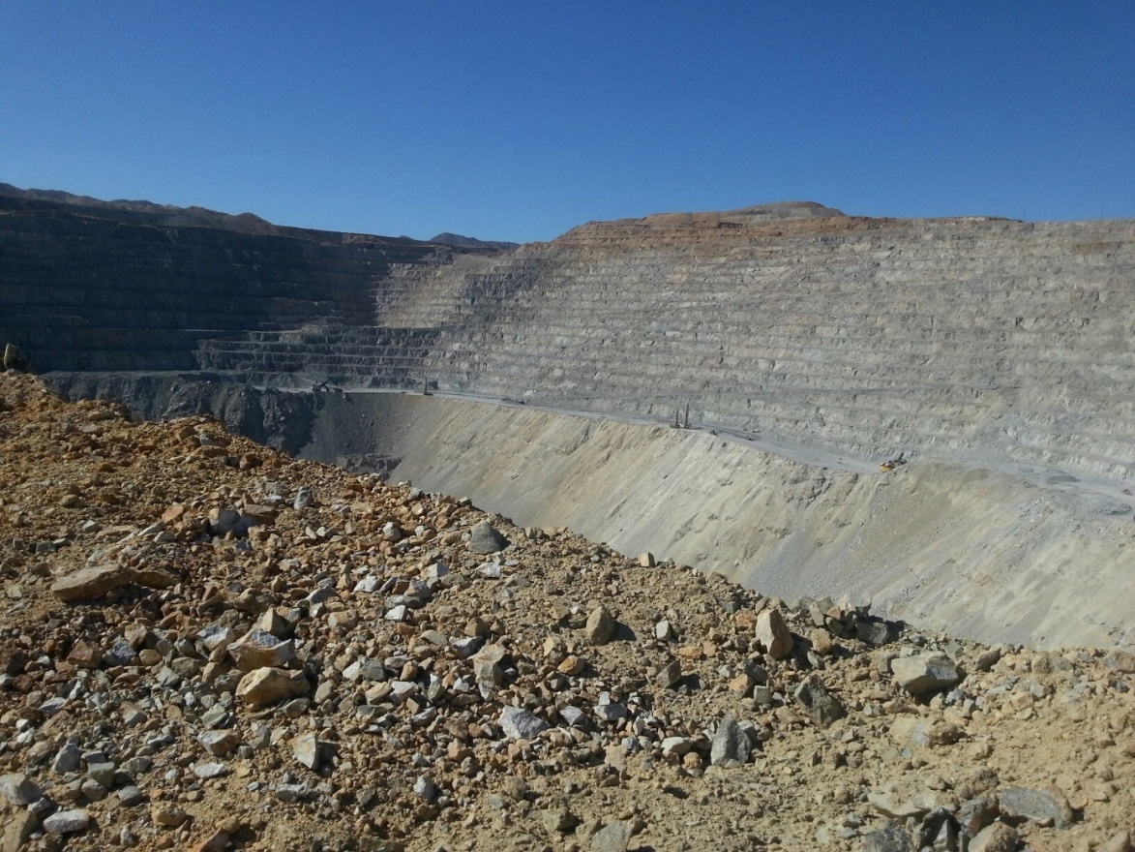
Blue Stake
Extensions and Expirations
Exemptions
Variances
Notes:
SG pgs 37-38
Instruction
Extensions and Expirations
30 days; 1 year (long-term)
Stop job until extension is in hand
Requestor contacts Representative for 30-day extension
Only one extension is allowed per permit
Representative may resurvey area if Requestor asks for an extension
Designated Operator(s) must be listed on the long-term permit at the time of initial request
Only designated Operator(s) can perform the excavation in accordance with the restrictions of the permit
This documentation on the permit is necessary for renewal as well
Operator(s) must have a copy of the current permit with them while they perform work
Exemptions – apply to mine sites only; other non-mining sites may need to call for local utility location services
Emergency procedures
If an excavation must begin due to a safety, environmental, or facility operation emergency, the area supervisor must visit the site and determine if the problem is an immediate hazard
If determined to be an emergency, the area supervisor must notify the Representative(s) or a manager
They, in turn, may authorize the area supervisor to proceed with the emergency excavation
If there is any doubt, the job must be stopped immediately
Native ground, top surface of active leach, waste stock piles, and active mining areas
Native Ground – Top surface of active leach and waste stockpiles, and active mining areas where utilities have never been present
The Blue Stake team does not issue a permit in these instances
Residential and commercial lessees of Freeport-McMoRan-owned town sites
No Freeport-McMoRan Blue Stake Permit will be issued
These individuals must contact the appropriate entities per the lease agreement and per local laws
Variance
Freeport-McMoRan GSR Variance Process Policy (FCX-21)
Must be filed with Health and Safety when full compliance of FCX-13 is not met
Fill in with site-specific material that meets or exceeds FCX-13 and FCX-21
Approved and completed variance form must be kept on file with an SOP or other work procedure established for future action
An engineer or other qualified individual must review the work to be performed, provide justification for the exemption, and give alternate safety controls to minimize or eliminate the risks
Check with your site Health and Safety Department for further information

Slide 52
Putting It All Together
Directions
Form groups of three.
Each group member is assigned a different job title.
Read your group’s scenario.
Using the Blue Stake Policy and speaking from the view point of your job title, discuss how to complete your scenario safely.
Write your plan in the Student Guide (page 39).
Complete the Permit on the back of the policy.
Give the completed permit to the Representative.
Discuss your plan as a class.
Activity 6
Notes:
SG pg 39
Time
Approximately 10 minutes
Materials
Student Guide, page 39
Job Title cards (1 of each job title per group)
Scenario cards (1 copy per group)
Blue Stake Policy
Purpose
This activity has students review content presented throughout the course.
Instruction
Students form groups of three.
Give each group member a different job title card (or just tell them their roles).
Explain that you (the facilitator) will be the Representative.
Give each group a scenario card.
Groups read their scenario.
Using the Blue Stake Policy and speaking from the view point of their job title, students discuss with their group how to complete their scenario safely.
Students write their plan and all responsibilities of their job role from in the SG.
Groups complete the permit at the back of the policy.
Give the students about 10 minutes to finish everything.
Students give the completed permit to the Representative (you, the facilitator).
Groups share their scenario and plan with the class.
If students miss something important, discuss what they are missing.
Possible Answers
All scenarios have variations of these answers, but students may have more information. Adjust to fit your site-specific procedures as needed.
Requestor
Submit MOC and wait for approval
Delineate area
Submit Blue Stake request and wait for completed Blue Stake Permit
Invite Supervisor (or designee), Representative, and Operators and run planning meeting
Manager, Superintendent, Supervisor
Assign Project Manager
Attend and participate in Planning Meeting
Supervise work being completed
Provide assistance if needed
Operator
Attend Planning Meeting and participate
Complete Workplace Exam and JSA
Bring all necessary tools and equipment to the area
Follow the steps of the job in the safest way possible
Communicate with others and stop the job if anything seems dangerous or missing
Call Representative and Project Manager for assistance if we need to stop the job

Slide 53
Debrief
What are some key concepts in this module?
What do you need to understand better?
What information surprised you?
Notes:
SG pg N/A
Instruction
Discuss questions on the slide
Update quote chart
Update roles and responsibilities charts

Slide 54
Conclusion
Notes:
SG pg 41
Instruction
Pass out certificates, if this is your site’s practice
Serious consequences can result for those who do not follow Freeport-McMoRan’s Blue Stake Policy, including potential termination of employment
More importantly, a violation could lead to death or injury
The health and safety of FMI Employees is a company core value
“Production and costs are critical to the well-being of the company, but these considerations must never take precedence over safety, employee health, or protection of the environment” (FCX Safety and Health Policy)
If you have further questions about this process, please contact a Blue Stake Representative, a Health and Safety professional, or your supervisor

Slide 55
Quote
“No job will be considered so important, and no schedule so urgent, that time cannot be taken to perform work in a safe manner. Working safely is a condition of employment.”
Freeport-McMoRan Inc. Safety and Health Policy
What does this mean to you?
Notes:
SG pg i
Instruction
Review the roles and responsibilities charts
Add anything that needs to be added
Ask if anyone has further thoughts about the safety quote now
Add anything to the chart hat needs to be added
Challenge them to make safety a priority by planning out their work
There is nothing you do that is worth someone getting hurt or dying over
You must plan jobs and execute them as safely as possible
Connect the Blue Stake policy to the quote

Slide 56
Debrief
What are some key concepts in each module?
  Module 1: Definitions and Explanations
  Module 2: Permit Process
  Module 3: Permit Specifics
  Module 4: Permit Exceptions
Are there any additional questions, comments, or concerns?
Notes:
SG pg N/A
Instruction
As the objectives for each module are reviewed, discuss the students’ lingering questions, comments, or concerns
Module 1: Definitions and Explanations
Explain the purpose and process of hazard recognition
Explain the purpose of the Blue Stake Policy
Module 2: Permit Process
Define the roles and responsibilities of all Blue Stake process participants
Explain how to begin the request for a Blue Stake Permit
Module 3: Permit Specifics
Describe the basics of excavation requirements as per the Blue Stake Policy
Describe the basics of floor, roof, ceiling, and wall penetration requirements as per the Blue Stake Policy
Module 4: Permit Exceptions
Describe what a variance is and when to request one
Describe what the exemptions are for using the Blue Stake process

Slide 57
Student Course Evaluation
Directions
Complete the Course Evaluation in the Student Guide (page 51).
Carefully tear out the evaluation.
Return the completed form to the facilitator.
Evaluation
Notes:
SG pg 51
Instruction
Students complete the Student Course Evaluation (in SG)
Collect and return evaluations (including the Facilitator Course Evaluation in the back of the FG) to the Mine Training Institute according to the directions on the form

