Slide 1
SFT FCX1020C
FLAGGING AND BARRICADING
VERSION 1.1 / APRIL 2019

Slide 2
Expectations
Before we start:
Safety
Breaks/Restrooms
Technology
Participation
Notes:
Instruction
Administrative/Classroom policies
Safety
Identify the appropriate evacuation procedures, gathering areas, and emergency exits and fire extinguisher locations, etc.
Breaks and Restrooms
Establish a break schedule and announce it to the class. Suggested break times are included throughout the FG and occur approximately every hour and often occur at the end of each module. Breaks should last 5-10 minutes to give students time to rest and relax before beginning the next learning session.
Identify the location of restrooms and smoking areas.
Technology policy
Review your expectations on cell phone and laptop use during the training.
Participation
This course requires significant participation. Students should be prepared for discussions and small group activities.
Set the class ground rules by verbalizing your expectations. Some suggestions are provided below.
Participate.
Be on time.
Stay on task.
Listen when others talk.
Respect the opinions and attitudes of others.

Slide 3
Icebreaker
Directions
Participate in an activity to get to know each other
Activity 1
Notes:
Time
Approximately 10 minutes
Purpose
Successful icebreakers encourage students to contribute their ideas and experiences thus increasing motivation and engagement in the class.
In the FG is an assortment of icebreakers that the facilitator can incorporate at the beginning of the course as well as after breaks.

Slide 4
Fatal Risks and Critical Controls
Fatal Risk Management Program
Fatal Risk – uncontrolled risk that will kill you
Critical Control – implemented to eliminate or reduce the risk for a task/job
Notes:
SG page v
Instruction
Fatal Risk Management
Continuation of the Fatality Prevention Program
Focus is placed on identifying Fatal Risks and Critical Controls in an attempt to safeguard all employees
Standardizes communication for twenty-three Fatal Risks by implementing icons, definitions, and Critical Controls.
Fatal Risks are based on safety issues that have resulted in catastrophic events such as severe injury or death.
For each identified Fatal Risk a list of necessary Critical Controls was developed to prevent or mitigate the most serious consequences of these risks. Once the Fatal Risk is identified, applying the most effective Critical Control is crucial.
A Critical Control is a device, system, or process implemented to eliminate or reduce the risk for a task/job, and if missing or overlooked has the potential to lead to catastrophic outcomes such as serious injury or death.
These Critical Controls are considered the most impactful on preventing a fatality or injury and have been previously established based on data.
The absence or failure of a Critical Control significantly increases the risk of severe injury or death despite the existence of other controls.
You will be exposed to potential fatal risks when flagging and barricading depending on the nature of the hazard being flagged
Always identify Fatal Risks before performing any task or job, and throughout the work.
Report unsafe conditions and only perform tasks that you are trained and authorized.

Slide 5
Learning Objectives
Module 1: Flagging and Tagging
Explain the purpose of flagging and tagging
Analyze a scenario and select the appropriate flagging
Module 2: Barricading
Explain the purpose of barricading
Analyze a scenario and select the appropriate barricading
Notes:
SG page vii
Instruction
Before beginning these next two slides:
Ask the students what they would like to get out of this course?
Explain the objectives for each module.
Point out that the module objectives are also listed on the first page of each module.

Slide 6
Learning Objectives
Module 3: Flagging and Barricading Application
Summarize the role of the attendant and spotter/safety watch
Explain the process of installing, maintaining, and removing the control
Notes:
SG page vii
Instruction
Explain the objectives for each module.
Point out that the module objectives are also listed on the first page of each module.

Slide 7
Course Introduction
Workplace examinations are conducted to identify hazards in the work area
Flagging, tagging and barricades are all methods of controlling hazards
By restricting access to the hazard, incidents can be avoided
Notes:
SG page viii
Instruction
Workplace examinations are conducted to identify any hazards in the work area. Once the hazards are identified, immediate action must take place. Depending on the type of hazard located, the course of action and control implemented vary. Always refer to the Hierarchy of Controls when selecting an appropriate control, keeping in mind the effectiveness and reliability of each level.
Flagging, tagging, and barricading are all recognized methods of controlling hazards. Each one involves limiting access to the hazard, but enforces the restriction differently. Flagging and tagging use a color-coded system with tags and tape to visually alert employees to a hazard or unsafe condition in the area. Barricades are physical obstacles restricting access to the identified hazard. By visibly identifying or blocking an area considered dangerous, incidents can be avoided.
Whether working near these restrictions, establishing them, or removing them, understanding their importance is critical. This course is intended for all Freeport-McMoRan employees. Employees are expected to refresh this training on an annual basis.

Slide 8
Module 1: Flagging and Tagging
Notes:
SG page 3
Instruction
Upon completion of this module, the students will be able to:
Explain the purpose of flagging and tagging.
Analyze a scenario and select the appropriate flagging.

Slide 9
Introduction
Why are we using flags or tags?
During a routine task, it is not uncommon for our attention to drift
The brain and eyes continue to scan the environment for triggers or signs perceived as threatening or dangerous
Flags and tags act as the cue to draw the employee’s attention to the hazard
Notes:
SG page 5
Instruction
There are times that you may become so focused on, or familiar with, a task that you fail to recognize the changing conditions around you. When involved in a routine task, it is not uncommon for attention to drift while the body continues the action. Most daily routine activities are performed automatically, without 100% focus as the brain and eyes continue to scan the environment for triggers or signs perceived as threatening or dangerous. When a unique or unusual cue is noticed, the brain then focuses and responds to the situation.
Throughout Freeport-McMoRan properties, flagging cues employees to a specific situation. The bright colors or placement of the flagging and tags are intended to draw attention to the location of and inform about the hazard. This method of communication relies on the employee’s behavior to notice, react, and adhere to the reason for the flagging. All of the moving components on the properties make it necessary to recognize and understand markings.

Slide 10
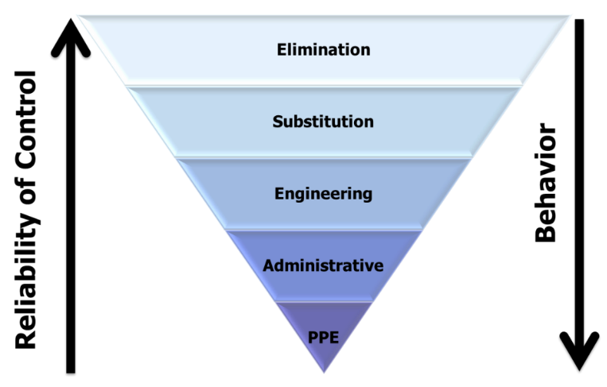
Hierarchy of Controls
How does flagging relate to the Hierarchy of Controls?
Notes:
SG page 5
Instruction
The Hierarchy of Controls offers a framework for implementing mitigation strategies from the most effective to least effective.
The five levels of the hierarchy (from the most effective to least effective) are elimination, substitution, engineering, administrative and PPE.
Flagging is considered an administrative control, in that it conveys a message to persons in the area.

Slide 11
Definition of Flagging
What is flagging?
A tape, similar to police tape
Available in different colors, with the color indicating the reason for flagging
In areas where there is a potential for falls, flagging alone is not sufficient (FCX-HS02)
Notes:
SG page 6
Instruction
Flagging is used as a warning to indicate that a hazard or unsafe conditions exists and also establishes the boundary of that area.
According to Freeport-McMoRan’s Working at Heights Policy and Technical Supplement (FCX-HS02), in areas where there is a potential for falls, flagging alone is not a sufficient means of restricting access.

Slide 12
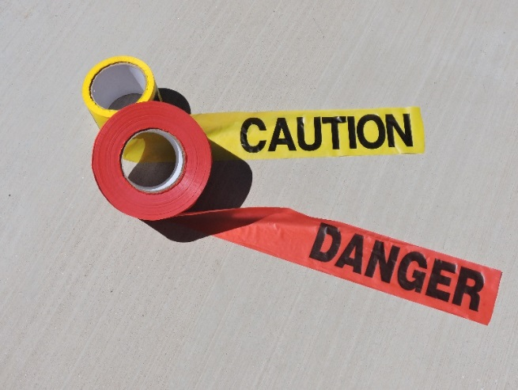
Acceptable Flagging Colors
What are the two acceptable colors used on our properties?
Red
Yellow
Additional flagging colors are used for non-safety purposes, such as surveying, environmental flagging, or promotional purposes
Notes:
SG page 6
Instruction
Flagging is used to warn or notify employees that a hazard or unsafe condition exists.
Based on the severity of the potential hazards, the color of and the placement for the flagging will vary.
There are two acceptable flagging colors used on our properties: red and yellow.
Each of these colors is used to convey separate messages and it is important to understand how they differ.
Note: Additional flagging colors are used for non-safety purposes, such as surveying, environmental flagging, or for promotional purposes.

Slide 13
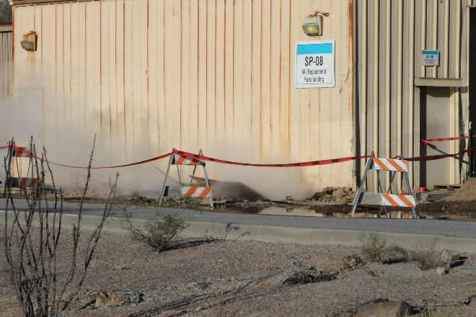
When to Flag with Red
When must you use red flagging?
To indicate an immediately hazardous condition that could cause death or serious injury
Unauthorized entry is prohibited
Notes:
SG page 7
Instruction
Red flagging is used to indicate an immediately hazardous condition that could cause death or serious injury.
Special additional precautions may be necessary.
Anyone encountering red flagging should stop and assess the danger.
Unauthorized entry is prohibited.
No one is allowed to enter a red flagged area unless you are performing work in the flagged area or with permission.

Slide 14
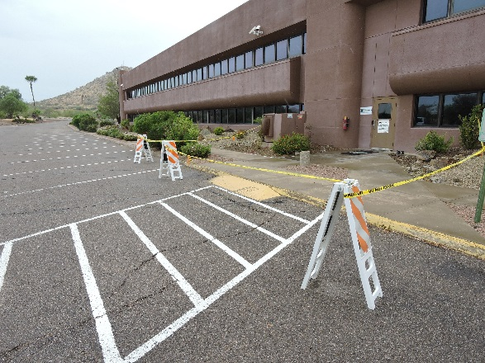
When to Flag with Yellow
When must you use yellow flagging?
To indicate a hazardous condition that may lead to moderate injury
When employees only need to maintain an awareness of the hazard, such as slips/trips, spills, maintenance work, or leaks
Notes:
SG page 7
Instruction
Yellow flagging is used to indicate a hazardous condition that may lead to moderate injury.
This color is suitable for situations where the employee only needs to maintain an awareness of the hazard.
Before entering a yellow flagged area, all employees are to read the corresponding tag as to understand and avoid the hazard that is present.
Employees not part of the hazard mitigation must only enter a yellow flagged area if business needs cannot be conducted anywhere else.
When either color of flagging is noticed in your work area or an area you are passing through, take notice and be sure to exercise caution.

Slide 15
Definition of Tagging
What are tags?
An item securely attached to flags or barricades that communicates key pieces of information
Attachment is substantial enough to prevent accidental removal
Tags remain legible within the environment
Tags can be different colors
Notes:
SG page 8
Instruction
Tags are used to communicate key pieces of information and are attached to the flagging or barricades. Per Freeport-McMoRan’s LOTOTO Policy (FCX-04), tags must:
Have a means of attachment that is substantial enough to prevent accidental removal.
Withstand a 50 lb. pulling force
Be capable of remaining legible while withstanding the environment to which they are exposed.

Slide 16
Tagging
Tags should include:
The nature of the hazard being flagged
Contact information for the responsible person
Any necessary PPE
The time and date installed
Notes:
SG page 8
Instruction
They can be different colors and should include:
The nature of the hazard being flagged
Contact information for the responsible person (consider shift and weekend work contacts)
Any necessary PPE required for entry or work in the area
The time and date installed

Slide 17
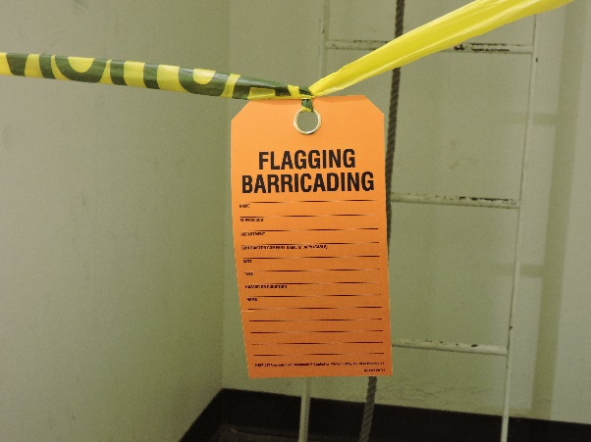
Flagging and Tagging
Notes:
SG page 8
Instruction
Regardless of the color, all tags need to be noticeable.
This includes hanging on all sides of the perimeter or all access points.
Individuals entering the area must first go directly to the tag to become informed of the hazards.
Call attention to the different line items on this tag (left blank for training purposes).

Slide 18
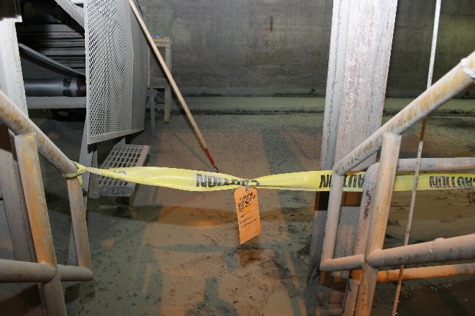
When to Tag
Any time an area or item is flagged or barricaded
To explain the reason for the marking
Tags must be posted on all sides of the perimeter or all access points
Notes:
SG page 8
Instruction
Any area or item that is flagged or barricaded needs a tag to explain the reason for the marking.
An employee coming across flagging without a tag may not be able to accurately determine what hazard is present.
Depending on the direction from which the employee approaches the flagged area, he or she may not be able to see the hazard at all from outside of the flagging.

Slide 19
Color Selection
Directions
Break into groups
Review each scenario on the worksheet in the SG (pp. 9-10). Determine if you would apply yellow or red flagging and provide a reason for your choice
You have 5 minutes to complete
Be prepared to share your responses
Activity 2
Notes:
Time
Approximately 10 minutes
Materials
Worksheet in the SG (pp. 9-10)
Pens, pencils
Purpose
This activity gives students the opportunity to test their knowledge by analyzing scenarios and selecting the correct color flagging.
Instruction
Break the class into small groups. Depending on the size of the class, this could be pair or groups of 3-4.
Direct the groups to review the scenarios and determine if they will apply red or yellow flagging. They then need to explain why they chose that color flagging.
Allow 5 minutes for groups to complete the worksheet.
Discuss responses as a class. Be sure to explain any incorrect responses.
Proposed Answers
Scenario 1
Yellow flagging – This will allow other people to continue work or use the walkway after they have read the tag.
Scenario 2
Yellow flagging – This will allow other people to continue work or use the travelway after they have read the tag.
Scenario 3
Yellow flagging – This will be for informational purposes only. There will not be mobile equipment in the area.
Scenario 4
Red flagging – No one should enter the area. There is a potential for falling objects and tools and there will be mobilization of the AWP.
Scenario 5
Red flagging – There is a suspended load over doors that could potentially have heavy foot traffic.

Slide 20
Module 2: Barricading
Notes:
Instruction
Upon completion of this module, the students will be able to:
Explain the purpose of barricading.
Analyze a scenario and select the appropriate barricading.

Slide 21
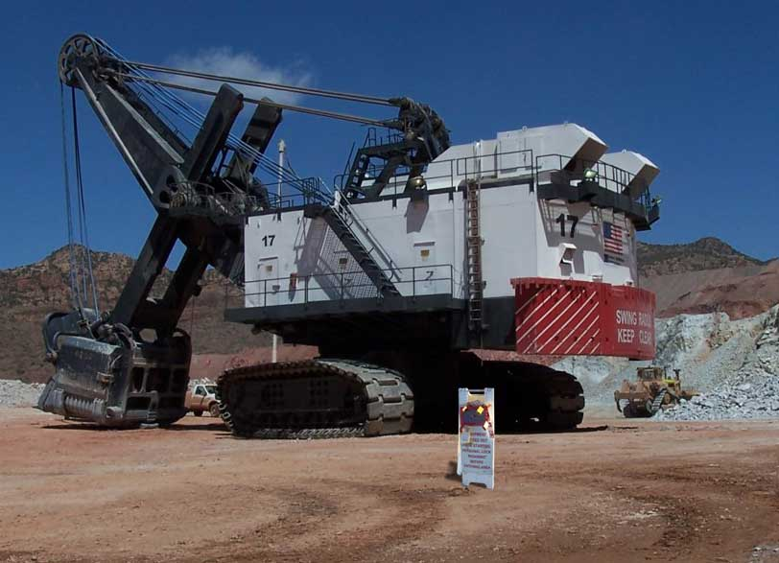
Introduction
Why barricades?
When flagging is not a secure enough method of restricting access, then the area must be barricaded
Barricades provide more protection for employees
Notes:
SG page 15
Instruction
When flagging is not a secure enough method of restricting access, then the area must be barricaded.
A barricade is used to physically prevent access to a fall or other serious hazards.
A barricade must be tall enough and of sufficient strength to bar access to the hazard.
For example, elevated platforms have handrails around the perimeter. Handrails are installed to prevent employees from falling over the edge. In this instance, the handrail is the physical barricade to the hazard.

Slide 22
Definition of Barricade
What is a barricade?
Used to physically prevent access to a fall or other serious hazards.
Used when permanent handrails and/or grating is removed, other openings are exposed, or to enclose hazardous areas
Notes:
SG page 15
Instruction
A barricade is used to physically prevent access to a fall or other serious hazards.
Per the Freeport-McMoRan Flagging and Barricading Policy (FCX-HS19), a barricade must be used when permanent handrails and/or grating have been removed, when other openings have been exposed in the workplace resulting in a fall hazard, or to enclose hazardous areas.
At our sites, barricades come in a wide assortment, depending on the hazard and environment.
A barricade must be tall enough and of sufficient strength to bar access to the hazard.

Slide 23
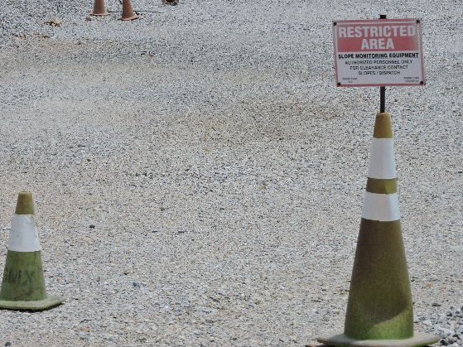
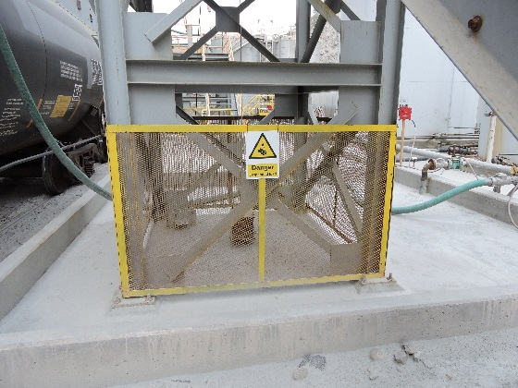
Using Barricades
How does barricading relate to the Hierarchy of Controls?
What are the two classifications of barricades?
Temporary
Permanent
When would each be used?
Notes:
SG page 15-16
Instruction
Barricades are considered an engineering control.
They are constructed and installed to physically prevent entrance into a hazard.
Flagging can be used in conjunction with barricades, but never in place of barricades.
As an engineering control, barricades are a reliable control for separating employees from a hazard, as long as they are installed and used properly.
Proper use of barricades means never entering a barricaded area, unless you are authorized to do so.
There are two types of barricades on our properties: temporary and permanent.
Whether or not a barricade is considered temporary depends on the hazard.
If the hazard is temporary, such as a floor opening that was made for maintenance activities, then the barricading will be temporary.
In circumstances where a hazard always exists, such as a confined space, then a permanent barricade will be installed.
Temporary barricades may also be used until a permanent barricade can be erected.

Slide 24
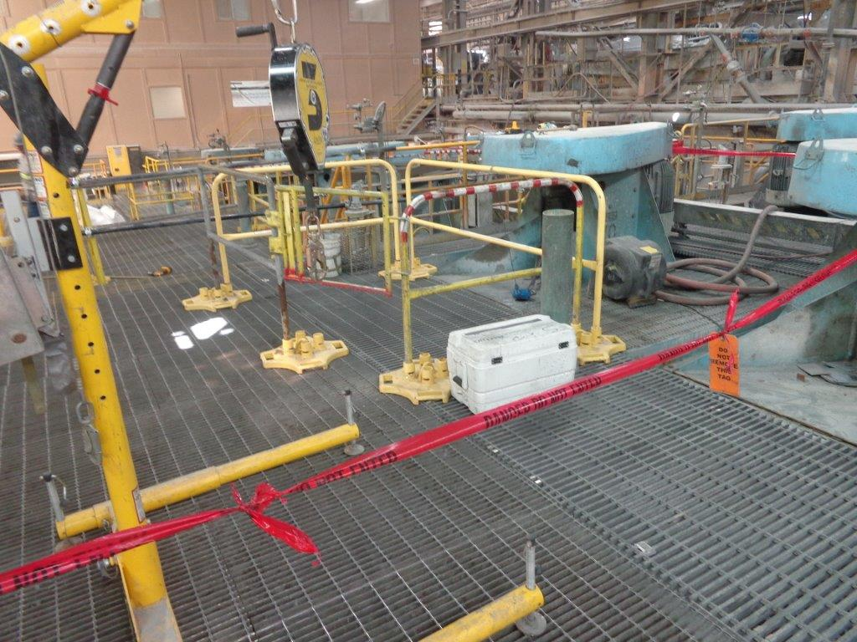
High Energy Hazards
What are “high energy hazards”?
What are some examples of this?
Notes:
SG page 16
Instruction
Due to the nature of our properties, employees may work in an area where the possibility of a high energy hazard exists.
High energy hazards exist when conditions are such that severe injury or death are likely to occur.
Some examples of these are:
Leading edge/Open holes
Confined spaces
Open trenches
Blasting operations
High hazard areas (substations)

Slide 25
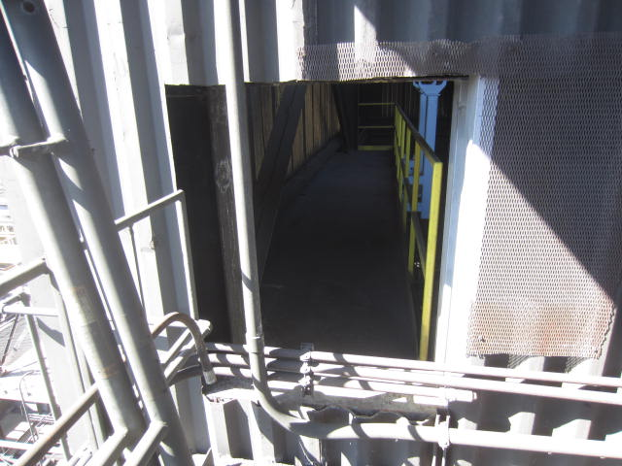
Open Holes
Floor openings
Opening 12 in (0.3 m) or more in its least dimension
Through which a person may fall
Wall openings
30 or more inches high and 18 or more inches wide
Through which a person can fall to a lower level
Notes:
SG page 17
Instruction
It is critical to include an examination of the walking surface.
Floor openings exist for a number of reasons, and can cause life-altering injuries, up to and including death.
These openings must be covered with appropriate materials for the hazard, or barricaded in such a way that impedes travel into the area.
Wall openings are just as important as floor openings because the potential for a fall still exists.
Refer to Working at Heights Policy and Technical Supplement (FCX-HS02) for information on expectations, regulations, and procedures when working in or around an open hole.

Slide 26
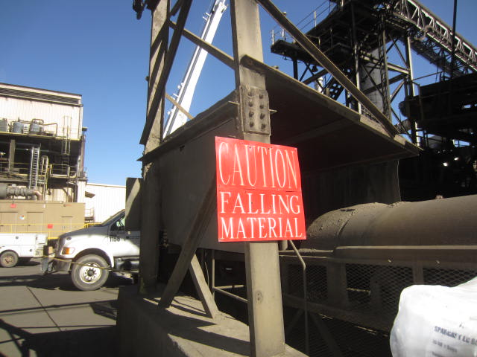
Using the Appropriate Tag
Permanent barricades commonly have danger or warning signs in place
Temporary barricades must always have a tag
Notes:
SG page 17-18
Instruction
If you are not using standard flagging around your barricade, or the barricade is not typical, it is a best practice to also include a tag.

Slide 27
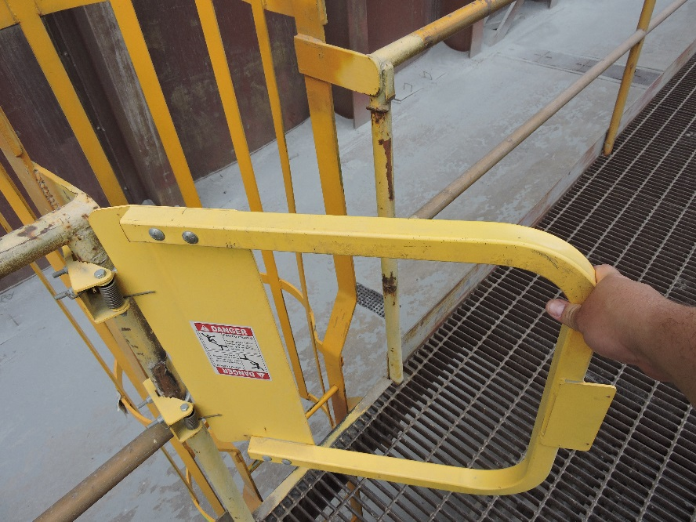
Ladderways and Gates
Railing systems have an access point for ramps, fixed ladders, or stairways
Use self-closing gates to prevent injury
When used for transition to a lower level, gates must swing towards the employee
Notes:
SG page 18
Instruction
Railing systems will have a break designed in their structure to allow for access, typically for ramps, fixed ladders, or stairways.
Any opening will need to have a swinging gate to prevent employees from walking through.
When gates are used for a change in floor height, they should be installed so that the gate swings toward the employee when the transition is to a lower level.
This requires the employee to stop, open the gate, and proceed through the opening at a slower pace.
If the gate opens in the direction of the change of height, the possibility for an employee to lean against and fall exists.

Slide 28
Types of Barricades
What are some of the types of barricades used on our properties?
Chain link fence
Snow fence (Construction fence)
Haul truck tires
Jersey barriers (K-Rails)
Berms
Notes:
SG page 19-20
Instruction
There are many types of barricades used to restrict access into hazardous areas.
They vary across sites and tasks.
Click for a list of barricade examples on the slide. This list is not all inclusive.
The next five slides are examples from of items used for barricading.

Slide 29
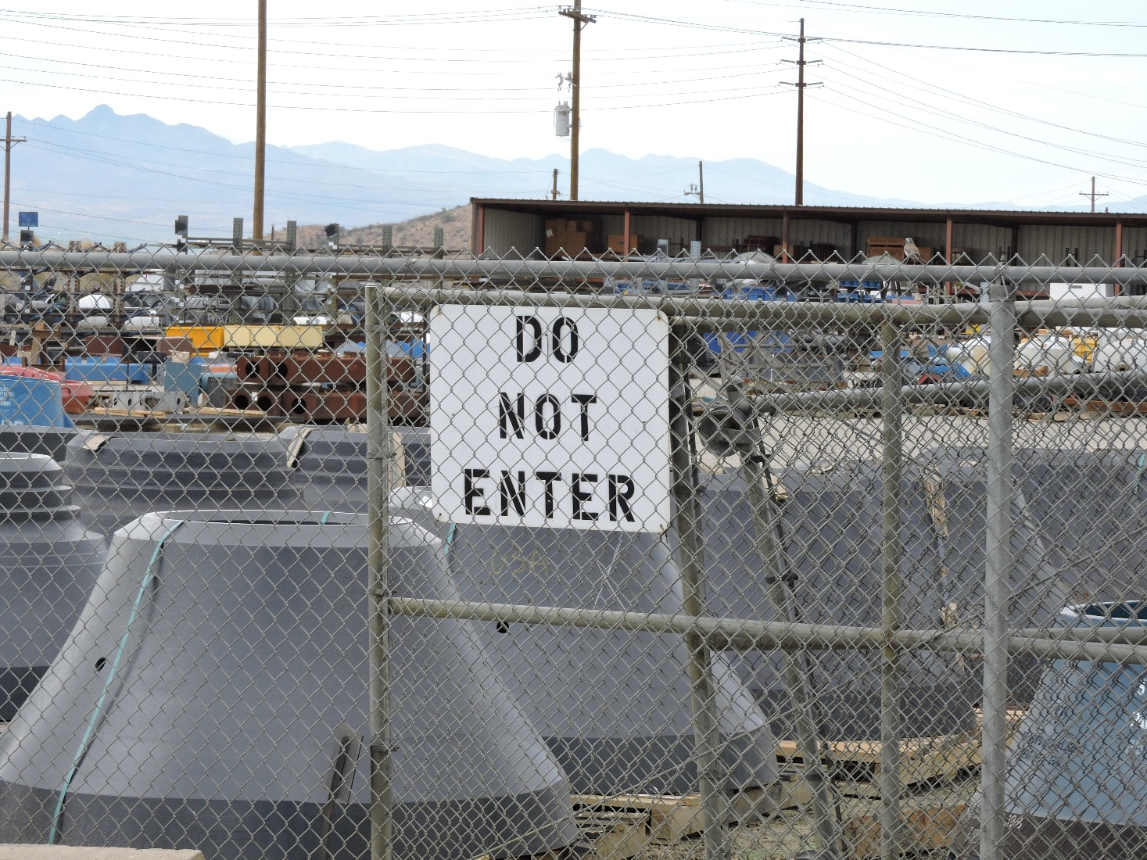
Chain Link
Notes:
SG page 20
Instruction
Chain link fencing around a perimeter.
Ask if anyone uses this barricade on their property. If so, how is it used and for what type of hazard?

Slide 30
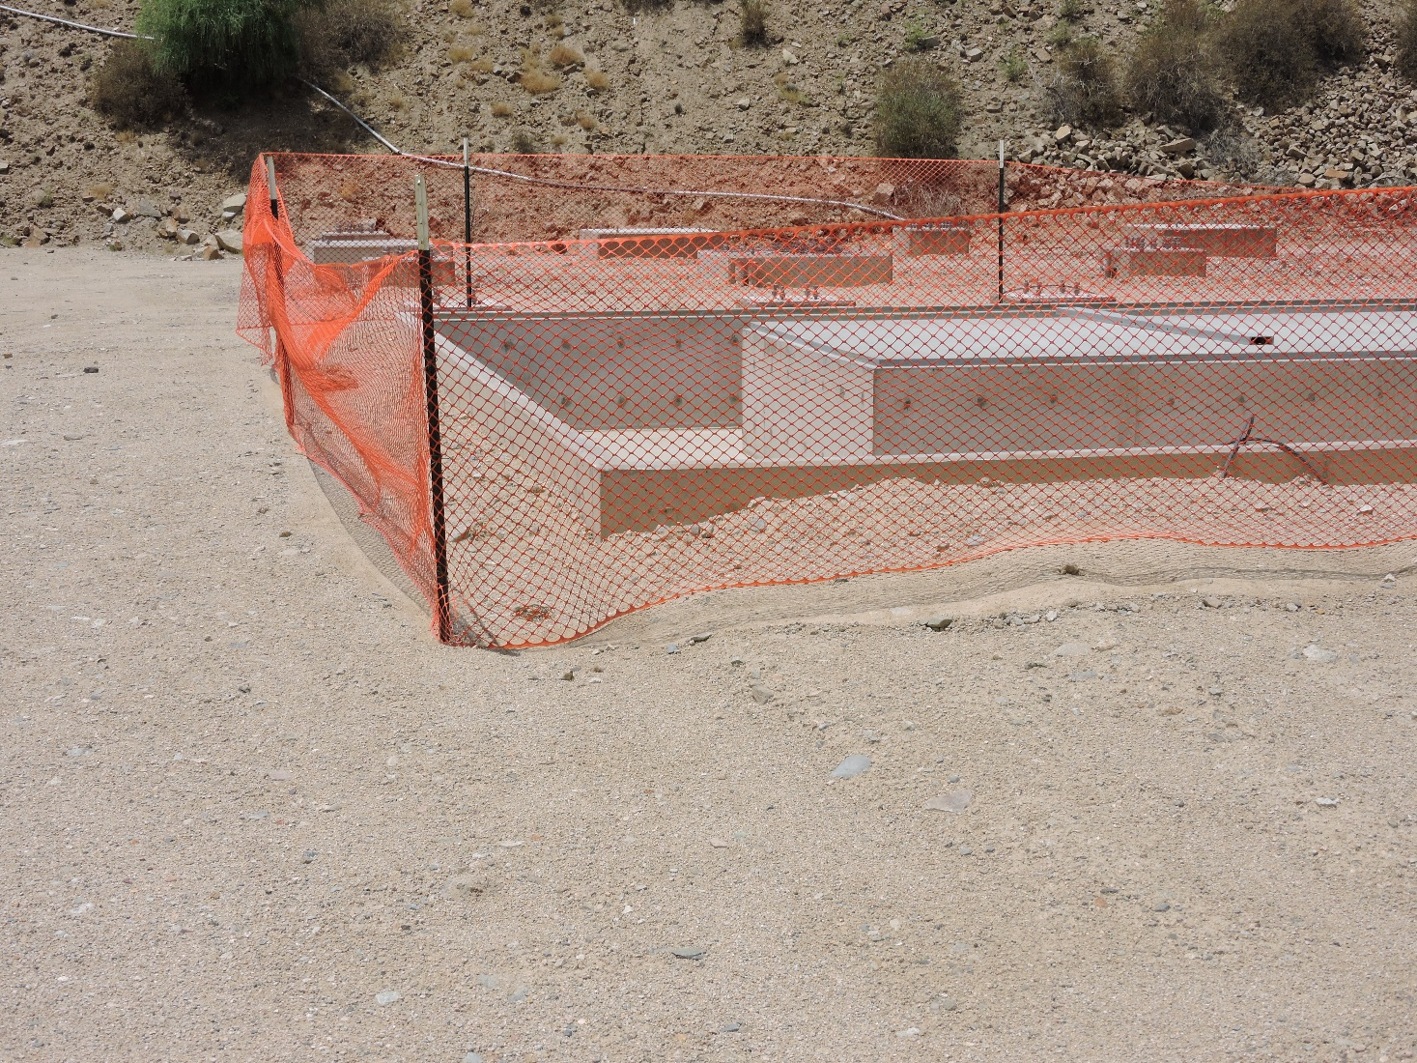
Snow Fence
Notes:
SG page 20
Instruction
Snow fencing in use
Ask if anyone uses this barricade on their property. If so, how is it used and for what type of hazard?

Slide 31
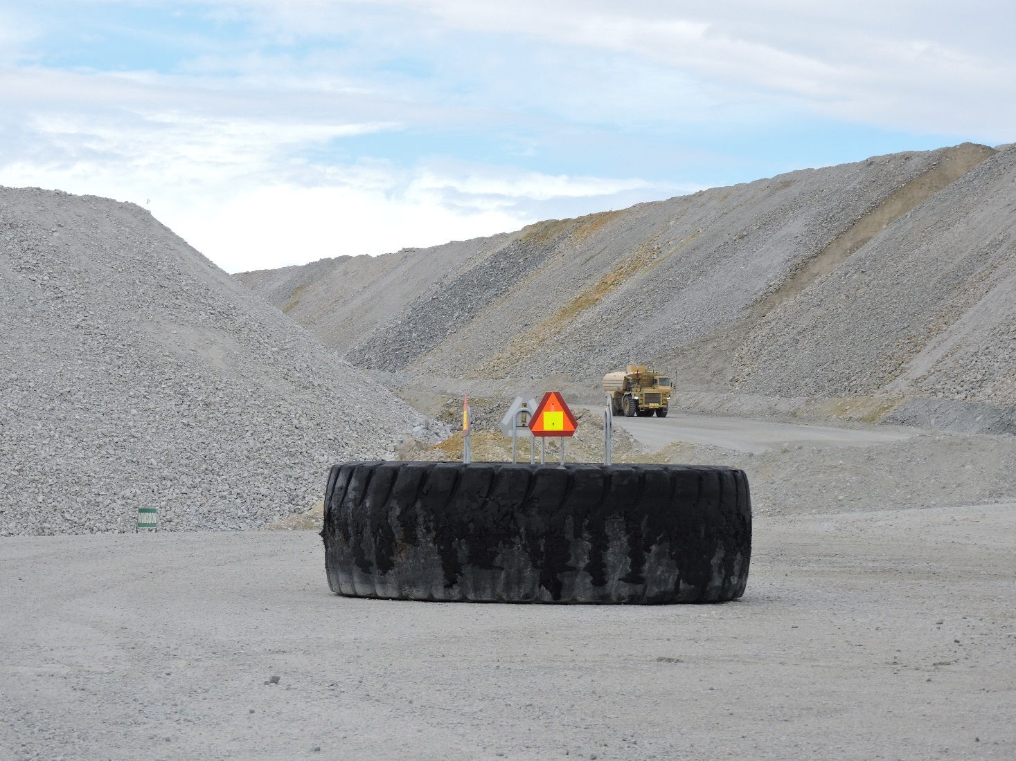
Haul Truck Tire
Notes:
SG page 20
Instruction
A haul truck tire used to block access for larger vehicles.
Ask if anyone uses this barricade on their property. If so, how is it used and for what type of hazard?

Slide 32
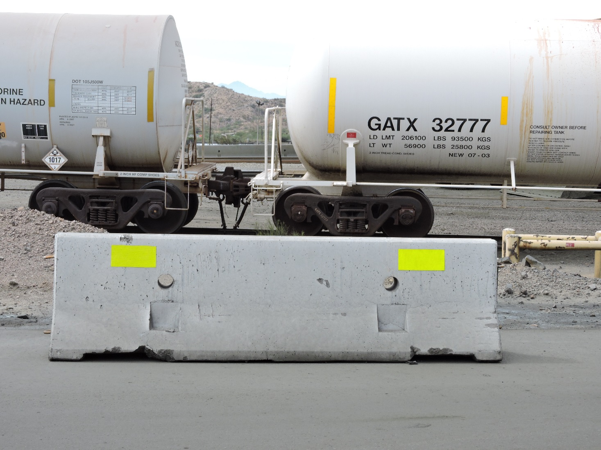
Jersey Barrier
Notes:
SG page 20
Instruction
An example of a jersey barrier.
Ask if anyone uses this barricade on their property. If so, how is it used and for what type of hazard?

Slide 33
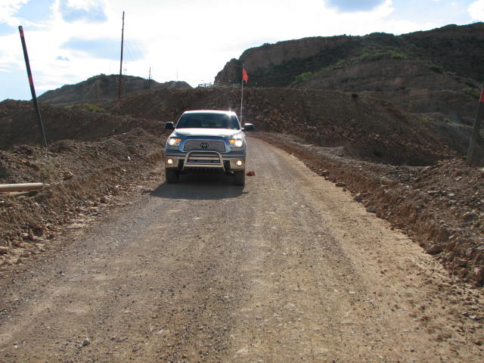
Berms
Notes:
SG page 20
Instruction
A berm as a barricade on a road
Ask if anyone uses this barricade on their property. If so, how is it used and for what type of hazard?

Slide 34
Learn from Others
Learn from Others
Take a moment to read the Learn from Others (SG p. 21)
Discuss as a class why this fatality occurred
Notes:
SG page 21
Instruction
Have the class read this silently to themselves or ask one student to read it out loud.
Discuss as a class why this fatality occurred.
The operator was not wearing fall protection.
Barricades were not in place.

Slide 35
Railing Systems
Railing systems
Must be installed on any open side or working surface where a fall hazard exists
Includes handrail, midrail, and a toe board
Toe boards protect the open area underneath and must be included if there is a possibility of:
Pedestrian traffic
Moving machinery
Hazards to equipment by falling objects
Review the criteria for railing specifications
Notes:
SG page 22
Instruction
Any working surface where a fall hazard exists, needs to have a railing system in place. The railing must be installed on any open sides, and typically consists of a handrail, a midrail, and a toe board. Modifications to the railing exist when access needs to be granted for a ramp, fixed ladder, or stairway.
Certain instances dictate the need for toe boards. Toe boards are in place to protect the open area underneath from materials or tools that may fall to the lower level. Toe boards must be included on any working surface or platform, if below the working surface there is a possibility of:
pedestrian traffic
moving machinery
hazards to equipment by falling objects
In these same instances, employees need to be aware of what is occurring above them. If there is a chance of employees conducting work overhead and endangering those on the lower level by dropping materials, then proper flagging and/or barricading is required.
Note: Per the Freeport-McMoRan Working at Heights Policy and Technical Supplement (FCX-HS02), railing systems installed around fall hazards must meet specific criteria.
Install nets or other barriers to prevent falling objects when necessary, and able to withstand 150lbs (68 kg) of force
39-45in (99-115 cm) from the walking surface to the top of the rail; not deflect lower than 39in (99 cm)
Able to withstand 200lbs (91 kg) of force in a downward/outward direction
Midrail installed halfway between top rail and walking surface
Vertical members every 8ft ( 2.6m) on center
Intermediate vertical members every 19in (48 cm) on center when installed
Toe boards a minimum of 4in (10 cm) nominal height, able to withstand 75lbs (34 kg) of force outward, and no more than ¼in (0.64 cm) gap between surface and lower edge of toe board
Stair rail systems must be 42in (107 cm) from the leading edge of the stair to the top of the rail
Guardrails around ladderways: self-closing gate that slides or swings away from the hole and top rail/midrail that meets guardrail requirements (unless opening is offset)

Slide 36
Criteria for Selecting Barricades
What factors impact the effectiveness of the barricade?
Terrain
Environment
Potential hazard(s)
Location
Weight requirements
Availability
Use
Construction/configuration of the barricade
Notes:
SG page 23
Instruction
The effectiveness of the barricade is dependent on many factors.
Discuss how each factor impacts the barricade or barricade selection.
Understanding how construction, configuration, and effectiveness relate to each other is critical when choosing which barricade should be implemented.

Slide 37
Criteria for Selecting Barricades
What are some examples of ineffective barricades?
When choosing a barricade, ask yourself these questions:
What hazard is being controlled?
How long is the barricade needed?
What traffic is in the area (vehicles, people, etc.)?
Are special tools/permissions required to install the barricade?
Can the barricade withstand environmental factors?
Notes:
SG page 23
Instruction
Ask the class for some examples of ineffective barricades.
For example, a haul truck tire should not be placed next to an open hole and a jersey barrier should not be used on a haul road.

Slide 38
Barricade Selection
Directions
Break into groups
Using the worksheet in the SG (pp. 24-25), review the questions, and select which barricade(s) you should use
You have 5 minutes to complete
Be prepared to share your responses
Activity 3
Notes:
Time
Approximately 10 minutes
Materials
Worksheet in the SG (pp. 24-25)
Pens, pencils
Purpose
This activity gives students the opportunity to test their knowledge by analyzing scenarios and selecting the correct barricade(s) for the hazard.
Instruction
Break the class into small groups. Depending on the size of the class, this could be pair or groups of 3-4.
Direct the groups to review the questions and determine the best barricade(s) to use. They then need to explain their choice(s).
Allow 5 minutes for groups to complete the worksheet.
Discuss responses as a class.
Proposed Answers
Scenario 1
Berm
This is the only barricade that can act as a long-term solution until the power line can be repaired or replaced.
Scenario 2
Jersey barrier, berm
Wire ropes and railing systems are not appropriate barricades for ramps and vehicle traffic.
Scenario 3
A-frame sign, berms
Excavation jobs usually result in a trench of some depth. These barricades will prevent employees from falls.
Sites will not typically erect chain link fences for an excavation job (time, material, etc.). Trucks need to be accessible so they cannot be placed as a barrier for a long-term job. Cones alone are not sufficient due to their size.
Scenario 4
Berm, truck
The truck is the most accessible at the time of the hazard until a berm can be built, or maintenance can be performed on the road.
Scenario 5
Railing system, scaffolding
Use these barricades temporarily, until the gate can be re-installed.
It is assumed that where the gate should be, there is a fall; therefore, snow fences and chain link fence are not suitable for a falling hazard.

Slide 39
Module 3: Application
Notes:
Instruction
Upon completion of this module, the students will be able to:
Summarize the role of the attendant and spotter/safety watch.
Explain the process of installing, maintaining, and removing the control.

Slide 40
Introduction
Working with flags and barricades
Determining the correct type of marking is critical when it comes to safeguarding an area
Understanding the purpose and limits to the specific method selected, as well as the hazard
Notes:
SG page 31
Instruction
Knowing which flagging, tagging, or barricading to install is critical when it comes to safeguarding an area.
Whether marking an unsafe area or preparing for a task, understand the purpose and limits to the specific method selected, as well as the hazard in the restricted area.

Slide 41
Roles and Responsibilities
What is your responsibility if you notice:
An unidentified low risk hazard?
An unidentified high energy hazard?
What are some situations that may require use of an assigned attendant?
Blasting operations
Confined Spaces
Open trenches
Leading edge/Open holes
Notes:
SG page 32
Instruction
Should you come across an unmarked hazard that requires flagging, it is your responsibility to ensure that this is performed. This can be done in one of two ways:
Install the appropriate flagging yourself. As long as the hazard does not constitute a high energy hazard, you may leave the area to acquire the necessary materials. If you are the person that installs the flagging and your name is on the tag, it is your responsibility to maintain and eventually remove it. Employees are not allowed to remove flagging/tagging that they did not install themselves, unless appropriate site-specific removal procedures have been performed.
Inform the appropriate personnel of the hazard and need for flagging/tagging, if you are not a part of the task being performed. For example, if you see someone working overhead and the area below has not been flagged, inform the working crew. This ensures that the personnel performing the task are responsible for the flagging/tagging associated with their work.
Should you come across an unmarked hazard that qualifies as a high energy hazard, you automatically become a spotter/safety watch.
In this instance, this individual stays near to, but at a safe distance from, the hazard until the area can be barricaded. This is true whether or not you are part of the team mitigating the hazard.
Once the exposure to the hazard has been controlled, you can continue with your regular duties.
Due to the level of risk involved, certain tasks may require the use of an assigned attendant or spotter/safety watch. The responsibilities of this individual may differ, depending on the task being performed and are not necessarily the same as an attendant who happens across an unmarked high energy hazard.

Slide 42
Installation
Why is it important to communicate your plan before installing either flagging or barricading?
How does each circumstance below impact the installation of flagging and/or barricading?
Opening a hole
Working overhead
Congested areas
Notes:
SG page 32
Instruction
Installation of any flagging or barricading should be performed in conjunction with proper communication to any affected parties.
This will potentially include your supervisor, health and safety professional, and any groups working in the area.
These individuals need to be aware of the hazard and the reason you are installing the flagging and/or barricading.
Leading Edge/Open Hole Work
When a fall hazard is created with the open hole, red flagging and tagging is installed a reasonable distance away at all entrances to the area.
Barriers are erected around the hole to protect employees from the fall; however, any employees working within the guarded area must wear fall protection.
If there is a lower level where employees are exposed to falling objects, flagging or barricading needs to be established indicating the hazard above.
Working overhead
When work is being performed overhead, pedestrian and vehicle traffic below needs to be informed.
Materials and/or tools can fall, resulting in injuries to those below or damage to equipment.
Proper flagging and/or barricading is used to establish a perimeter on the lower level. The perimeter needs to be large enough to keep all traffic at a safe distance.
When needed, a spotter/safety watch will help monitor the area, such as when hot work is being performed or suspended loads are being moved.
Congested Areas
In congested areas, such as in places of heavy foot and/or equipment traffic, it is a best practice to inform other work groups in the area before any flagging or barricading is established.
This is especially important if a barricade is going to impede an escape route. In circumstances like this, should an evacuation be required, personnel in the area need to be made aware of alternate escape routes.
This helps ensure that during an evacuation, employees are not exposed to any additional hazards.

Slide 43
Restrictions and Permissions
Marking | Description
Yellow Flagging (caution) | If entering a yellow flagged area, you must: Familiarize yourself with the hazards written on the tag. Don proper PPE. Proceed with caution, after the hazards and the work being performed are understood. Enter only when business needs cannot be performed elsewhere.
Red Flagging (danger) and barricaded | If entering a red flagged and barricaded area, you must: Be properly protected against falls and/or other hazards. Be performing work to mitigate the hazards or be an individual in charge of the work being performed. Be authorized by the responsible party listed on the tag.
Notes:
SG page 33
Instruction
The color of the flagging, the barricade, and the accompanying tag can communicate information regarding the severity of the hazard and the reason for the installation.
In addition to recognizing why these marking exists, it is critical that employees adhere to whom can and cannot enter the area, and what steps must be taken when entering.
Review the table detailing restrictions and permissions for each type of marking. This is also located in the SG.

Slide 44
Acceptable Distances
Acceptable Distance of Flagging and Barricading
Hazard | Acceptable Distance
Overhead work | Situated at a distance far enough away that if the largest possible object falls to the level below, no employee is impacted.
Fall hazards | Erected in a location that provides a safe place for footing for those employees working in the area.
Contact with equipment | Established at a boundary outside of any swing radius, dependent on the size of the equipment, to prevent impact with an employee or another piece of equipment.
Notes:
SG page 33
Instruction
Flagging and barricading needs to be installed a safe distance from the hazard.
This distance will vary depending on the job, hazard, and barricading/flagging system used.
Review the table detailing acceptable distances. This is also located in the SG.

Slide 45
Maintaining
What is involved in the maintenance of the flags, tags, and barricades?
All tags and flags must be visible
All tags must remain legible
Ensure that no changes are made to the flags, tags, or barricades
All flags, tags, and barricades must remain in good working order
Colors must remain applicable to the identified hazard
How do you transition between red and yellow flagging?
Notes:
SG page 34
Instruction
Review the bullets for the first question.
As long as a hazard exists, the flagging/barricading used to minimize employee exposure must be maintained.
In most instances, you will want to remedy any hazardous situation the same day that it is found. For projects that will last multiple days, it is your responsibility to ensure all flagging, tagging, and barricading is in good order.
The red flagging/barricading must be in place prior to the removal of any yellow flagging. Once the high energy hazard has been controlled, the area is free to return to yellow flagging conditions. When changing back, the yellow flagging must be installed prior to the removal of any red flagging/barricading.

Slide 46
Removal
What must occur prior to removing any flags, tags, or barricades?
Exposure to the hazard has been mitigated
Employees are utilizing the appropriate PPE
Work area is safe for re-entry
Afterwards, appropriate communications must be made to any affected parties, such as:
Supervision
Operations
Any teams impacted in the area
Notes:
SG page 35
Instruction
Flagging or barricading is removed at the completion of the job.
Once removal of all flagging/barricading is complete, be sure to either dispose of or properly store all materials in accordance with site-specific requirements.

Slide 47
Removal
Removing flags, tags, or barricades that you did not install yourself.
Make all attempts to contact the initial installer
Contact your supervisor
Consult with health and safety personnel
Notes:
SG page 35
Instruction
You should never remove flagging or barricading that you did not install.
If for some reason you find yourself having to remove flagging or barricading that you did not install, you must adhere to any site-specific procedures to do this.

Slide 48
Stump Your Neighbor
Directions
Break into 2 groups
Each group designates a leader
Using the SG, each group creates 5 questions and answers to stump the other team. A worksheet is located in the SG (pp. 36-37)
After 10 minutes, the groups take turns asking questions
Discuss responses as a class
Activity 4
Notes:
Time
Approximately 15 minutes
Materials
Worksheet in the SG (pp. 36-37)
Pens, pencils
Purpose
This activity gives students the opportunity to review the information in the SG and create questions to challenge the other team. In doing this, they are further retaining the knowledge.
Instruction
Break the class into two groups.
The two groups will use the SG to create 5 questions and answers that they believe will be challenging for the other group to answer.
Allow 10 minutes for groups to complete the worksheet.
Groups will take turns asking questions.
Discuss responses as a class, particularly those that were answered incorrectly or difficult for the group to answer.

Slide 49
Conclusion
Notes:
Instruction
The conclusion covers:
Review
Assessment
Student End of Course Questionnaire
With changing conditions on Freeport-McMoRan properties, no two situations may ever be alike. By familiarizing yourself with flagging, tagging, and barricading, you are equipped to understand the markings, mitigate the hazard, and notify others of an issue. When you encounter a hazard, use the hierarchy of controls to decide whether a more conservation control can be applied.
Prior to beginning a task that either involves or creates a hazard, determine the best course of action for restricting access. Evaluate multiple factors, such as the effectiveness of the flagging or barricading, the environment, the severity of the hazard, and the purpose. Ensure you are safeguarding the area with visible and appropriately placed barriers. Never attempt to mitigate a hazard for which you are not trained.
If you have questions or concerns, utilize the resources available to you, such as your supervisor, health and safety professional, and the Company policies.

Slide 50
Debrief
What are some key concepts in each module?
Module 1: Flagging and Tagging
Module 2: Barricading
Module 3: Application
Are there any additional questions, comments, or concerns?
Notes:
Instruction
As the objectives for each module are reviewed, ask if there are any lingering questions, comments, or concerns.
Module 1
Explain the purpose of flagging and tagging.
Analyze a scenario and select the appropriate flagging.
Module 2
Explain the purpose of barricading.
Analyze a scenario and select the appropriate barricading.
Module 3
Summarize the role of the attendant and spotter/safety watch.
Explain the process of installing, maintaining, and removing the control.

Slide 51
Knowledge Assessment
Directions
Complete the assessment.
Return the completed assessment to the facilitator.
Facilitator scores it.
Assessment
Notes:
Instruction
Have students complete the knowledge assessment.

Slide 52
Student Course Evaluation
DIRECTIONS
Complete the questionnaire SG p. 47
Return the completed form to the facilitator
Course Evaluation
Notes:
SG page 47
Instruction
Have students complete the Student Course Evaluation (in SG page 47).

