Slide 1
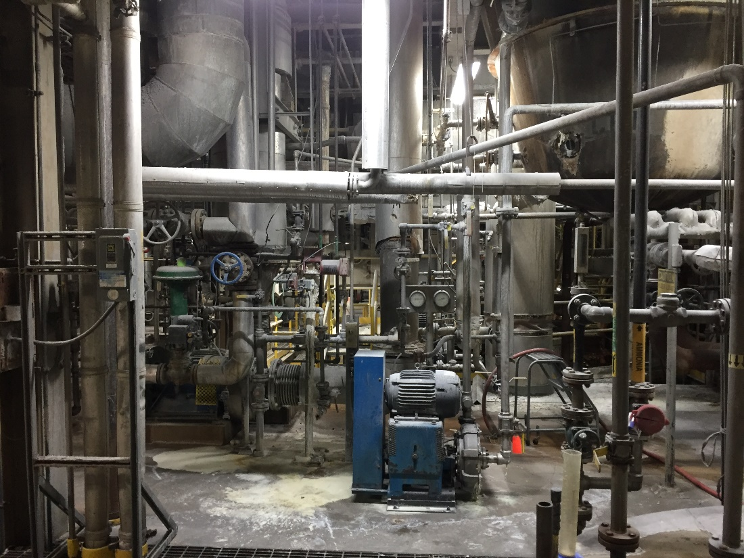
SFT FCX1025C
Control of Hazardous Energy
VERSION 1 / September 2019
Notes:
SG N/A
Instruction
Welcome students to class
Facilitator introduces self by stating
your position at FMI
how long you have worked for FMI
how long you have worked in mining
Ask students what they want from the course
Discuss what they want to gain from the course
WIFM – “What’s in it for me?”
This increase engagement by getting students vocalizing their opinions from the start of the course
This increases motivation by showing students their ideas matter
Option – Write down or remember what they want to learn; in a few slides, connect their responses to the learning objectives

Slide 2
Expectations
Before We Start
Safety
Breaks/Restrooms
Technology
Participation
Class Ground Rules
Notes:
SG N/A
Instruction
Safety: Identify the appropriate evacuation procedures, gathering areas, and emergency exits and fire extinguisher locations, etc.
Breaks and Restrooms
Establish and announce a break schedule to the class. Ten minute breaks are included throughout the FG and occur approximately every 50 minutes so students can relax, refocus, and re-engage
Identify the location of restrooms and smoking areas
Technology policy: Review your expectations on cell phone and laptop use during the training
Participation
This course requires significant participation
Students should be prepared for discussions and small group activities
Evaluations
Direct students to the course evaluation at the end of the SG
Students should fill in the evaluation as the class progresses rather than completing all at once at the end of the class
Set the class ground rules by verbalizing your expectations; some suggestions are provided below
Participate
Be on time
Stay on task
Listen when others talk
Respect the opinions and attitudes of others

Slide 3
Icebreaker
Directions
Participate in an activity getting to know each other
Activity 1
Notes:
SG N/A
Time
Approximately 10 minutes
Materials
Choose an icebreaker from the FG and gather appropriate materials
Purpose
Successful icebreakers encourage students to contribute ideas and experiences thus increasing motivation and engagement in the class
The FG has many icebreakers to use now, after breaks, or any other time

Slide 4
Learning Objectives
Module 1: Sources of Energy
Identify sources of energy, given a scenario or image
Module 2: Control of Energy Sources
Select the correct energy control device/type, given a scenario
Notes:
SG page v
Instruction
State objective(s) for each module
Learning objectives are also located at the beginning of each module
Option
If you wrote down or remember the student’s ideas of what they want to learn in the course, connect each response they gave to an objective (even if it is a vague connection)
This increases motivation by showing students their ideas matter

Slide 5
Learning Objectives
Module 3: Roles and Responsibilities
Determine the responsibilities of each individual, given a simple or complex lockout job
Module 4: Processes
Demonstrate the actions to stay safe, given a scenario
Notes:
SG page v
Instruction
State objective(s) for each module
Learning objectives are also located at the beginning of each module
Option
If you wrote down or remember the student’s ideas of what they want to learn in the course, connect each response they gave to an objective (even if it is a vague connection)
This increases motivation by showing students their ideas matter

Slide 6
Learning Objectives
Module 5: Energy Control in Practice
Demonstrate the application of hazardous energy control principles to various sources, given different examples
Notes:
SG page v
Instruction
State objective(s) for each module
Learning objectives are also located at the beginning of each module
Option – If you wrote down or remember the student’s ideas of what they want to learn in the course, connect each response they gave to an objective (even if it’s a vague connection). This increases motivation by showing students their ideas matter

Slide 7
Introduction
Corporate
Control of Hazardous Energy Policy
(FCX-HS04)
Site Hazardous Energy Control Program
Equipment- or
Scenario-
Specific Procedures
Notes:
SG pages vi-vii
Instruction
Freeport-McMoRan Control of Hazardous Energy Policy (FCX-HS04):
Addresses the practices and procedures necessary to disable machinery or equipment and to prevent the release of hazardous energy while employees perform service and maintenance activities
Establishes minimum, acceptable requirements to protect employees and contractors from injury
Requires that each site establish a written program for hazardous energy control
Specifies minimum requirements for identifying and developing controls for all hazardous energy types
Differences between policy, program, and procedures
Policy – broad and all-encompassing foundation; outlines minimum requirements as specified by Freeport-McMoRan
Program – somewhat broad in scope; outlines specific guidelines for how a policy is implemented at a specific site to meet the site’s unique needs
Procedures – very detailed; outline specific energy control steps to perform when working on specific equipment; ensure compliance with policy

Slide 8
Fatal Risk and Critical Controls
Fatal Risk Management Program
Fatal Risk – uncontrolled risk that will kill you
Critical Control – implemented to eliminate or reduce the risk for a task/job
Notes:
SG page viii
Instruction
Fatal Risk Management
Continuation of the Fatality Prevention Program
Focus is placed on identifying Fatal Risks and Critical Controls in an attempt to safeguard all employees
Standardizes communication for twenty-three Fatal Risks by implementing icons, definitions, and Critical Controls
Fatal Risks are based on safety issues that have resulted in catastrophic events such as severe injury or death
For each identified Fatal Risk a list of necessary Critical Controls was developed to prevent or mitigate the most serious consequences of these risks
Once the Fatal Risk is identified, applying the most effective Critical Control is crucial
A Critical Control is a device, system, or process implemented to eliminate or reduce the risk for a task/job, and if missing or overlooked has the potential to lead to catastrophic outcomes such as serious injury or death
These Critical Controls are considered the most impactful on preventing a fatality or injury and have been previously established based on data
The absence or failure of a Critical Control significantly increases the risk of severe injury or death despite the existence of other controls
The Fatal Risk(s) and Critical Controls relevant to this course are provided next

Slide 9

Uncontrolled Release of Energy
Stored energy from pressure
Items under tension or compression
Critical Controls
Notes:
SG page viii
Instruction
The Uncontrolled Release of Energy Fatal Risk is defined as exposure to stored energy from pressure (e.g., pneumatic systems, hydraulic systems, steam, tires, etc.); Items under tension or compression (e.g., mooring lines, springs, counterweights, etc.)
Discuss the Critical Controls
Energy Isolation/LOTOTO
Guards, Barriers, and Barricades
Hose Coupling Lock System
Pipe Management
Piping Hoses and Equipment Mechanical Integrity
Relief Valves
Tensioned Lines Management
Tire Management

Slide 10

Entanglement and Crushing
Contact with machinery/moving parts
Critical Controls
Notes:
SG page ix
Instruction
The Entanglement and Crushing Fatal Risk is defined as contact with machinery/moving parts (entanglement, crushing, pinching, penetrating and cutting forces)
Discuss the Critical Controls
Blocking for Maintenance Work
Energy Isolation/LOTOTO
Guards, Barriers, and Barricades

Slide 11

Exposure to Electrical Hazards
Electrical shock or arc flash
Critical Controls
Notes:
SG page ix
Instruction
The Contact with Electricity Fatal Risk is defined as exposure to electrical shock or arc flash
Discuss the Critical Controls
Access Control
Barriers and Segregation
Drawings and Labels
Electrical PPE
Energized Electrical Work Permit Execution
Energy Isolation/LOTOTO

Slide 12

Exposure to Hazardous Substances – Acute
Immediately toxic, asphyxiating, or corrosive substances
Critical Controls
Notes:
SG page x
Instruction
The Exposure to Hazardous Substances Acute Fatal Risk is defined as workplace exposure to substances that are immediately toxic, asphyxiating or corrosive (e.g. H₂S gas, NO₂ gas, CO gas, concentrated acids, caustics, etc.)
Discuss the Critical Controls
Access Control
Alarm Systems
Engineered Controls
Handling Requirements
Loading and Unloading Protection
Mechanical Integrity of Storage and Distribution
PPE

Slide 13

Exposure to Hazardous Substances – Chronic
Carcinogens and other substances
Can cause lethal disease over time
Critical Controls
Notes:
SG page x
Instruction
The Exposure to Hazardous Substances Chronic Fatal Risk is defined as workplace exposure to carcinogens and other substances that can cause lethal disease over time (e.g. silica, arsenic, lead, welding fumes, asbestos, acid mist, etc.)
Discuss the Critical Controls
Access Control
Engineered Controls
Handling Requirements
PPE

Slide 14

Falling Objects
Exposure to falling objects
Critical Controls
Notes:
SG page xi
Instruction
The Falling Objects Fatal Risk is defined as exposure to falling objects (e.g. tools, material, equipment, structures, etc.)
Discuss the Critical Controls
Barriers and Segregation
Integrity of Overhead Structures and Equipment
Securing Devices
Work Area Management

Slide 15

Lifting Operations
Loss of control of load suspended by lifting equipment
Critical Controls
Notes:
SG page xi
Instruction
The Lifting Operations Fatal Risk is defined as exposure to loss of control of a load suspended by a crane (fixed or mobile), hoist, forklift, boom or other lifting equipment
Discuss the Critical Controls
Barriers and Segregation
Lifting Execution
Mechanical Integrity of Lifting Equipment

Slide 16

Module 1: Sources of Energy
Notes:
SG pages 3 and 5
Instruction
Review learning objectives for the module
Upon completion of this module, students will be able to identify sources of energy, given a scenario or image
Most of the hazards in the work areas come from some form of energy
This module begins by describing some of the energy types that may be present in the work environment and then discusses how to identify the sources of energy

Slide 17
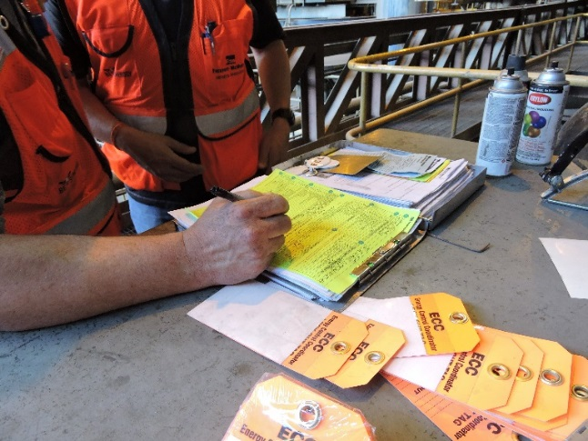
Hazardous Energy Control
Each site must establish written program
Primary purpose: protect personnel
De-energize equipment
Physically isolate equipment from power source
Notes:
SG page 5
Instruction
Maintenance or repair work may expose workers to hazardous energy sources
Each site must establish a written program (per Freeport-McMoRan Policy Administration Requirements (FCX-HS01))
Primary purpose of a Hazardous Energy Control Program: to protect personnel from injury
Hazardous Energy Control Program requires workers to do the following:
De-energize equipment
Physically isolate the equipment from power sources to avoid accidental re-energization or unexpected start up while performing work
Remind students to check with their Supervisor or Health and Safety Representative for their site’s specific Hazardous Energy Control Program

Slide 18
Hazardous Energy Control
Training
Required if perform work on potential energized equipment/machinery
Retraining required
  Policy or program changes
  Change in job assignment, machinery, equipment, or process, or change in energy control procedures
  Audit indicates deficiencies
Notes:
SG page 6
Instruction
Initial and annual refresher training required for all employees who may perform work on potential energized equipment/machinery
This course
Specific equipment, machinery, or process assigned to the individual at appropriate level according to his/her duties and responsibilities
Sites will provide retraining to all employees when one of the following occurs:
When policy or program changes
When there is a change in job assignment, a change in machinery, equipment, or process that presents a new hazard, or a change in energy control procedures
If auditing indicates that there are deficiencies in the application of hazardous energy control or a lack of employee understanding of the program

Slide 19
Hazardous Energy Control
Hierarchy of Controls
Notes:
SG pages 6-7
Instruction
Hierarchy of Controls: tool to determine type of control to use
Consider the effectiveness of each level
Most effective control: when they do not rely on individual worker behaviors as behaviors may vary from worker to worker
Controls at the bottom (such as PPE and Administrative) are less reliable because worker behaviors play a larger role than the controls at the top.
The diagram shows the five types in order from most effective (elimination) to least effective (PPE).
Elimination – physically removing the hazard from the workplace
Substitution – replace a chemical, substance, material, or practice with something less hazardous
Engineering – blocks an employee’s access to a hazard with a barrier so the employee cannot contact the hazard
Administrative – implementing rules that change the way employees do their job
Personal Protective Equipment (PPE) – offers the body a layer of protection from hazards
Most of the hazards in our work areas come from some form of energy
Stored energy (suspended loads, pressurized lines, etc.)
Energy in motion (moving machine parts, vehicles, etc.)
Thermal energy (furnaces, boilers, roasters, etc.)
Electrical energy or others
All have one thing in common
If workers can identify a potential hazard, then workers can control it

Slide 20
Energy Sources
Class Discussion
What are some different types of energy?
What are some examples of energy sources?
Notes:
SG page N/A
Instruction
Ask students what they know about types and sources of energy by asking the questions on the slide
Record student answers on a flipchart

Slide 21
Energy Sources
Electrical
Chemical
Gravitational
Hydraulic
Magnetic
Mechanical/kinetic
Nuclear sources/ionizing radiation
Pneumatic
Thermal
Not a complete list of all energy types
Notes:
SG page 7
Instruction
Identify any energy that could energize, startup, or release before work begins so that personnel can lock or block them out
Types of energy prevalent at most of Freeport-McMoRan’s operations: electrical, chemical, gravitational, hydraulic, magnetic, mechanical/kinetic, nuclear/radiation, pneumatic, and thermal
Note: Emphasize that this is not a complete list of all energy types

Slide 22
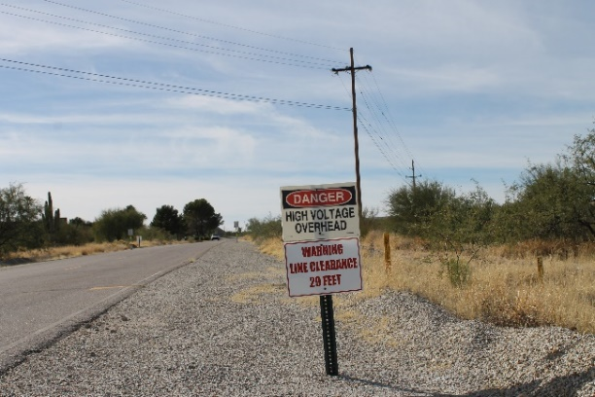

Energy Source: Electrical
Generated when current of electrons moves through conductor
Used to create light, heat, or motion
Notes:
SG page 7
Instruction
Generated when a current of electrons moves through a conductor
Used to create light, heat, or motion
Ask students for any examples of electrical energy (possible answers: images are a substation and overhead power lines)
Ask students what are some potential hazards of electrical energy (possible answers: arc flash, electric shock, burns, fires/explosions)
Ask students to name the Fatal Risk associated with electrical energy source (Answer: Exposure to Electrical Hazards)
Ask students to name the critical controls (Answer: Access Control, Barriers and Segregation, Drawings and Labels, Electrical PPE, Energized Electrical Work, Permit Execution, Energy Isolation/LOTOTO)

Slide 23
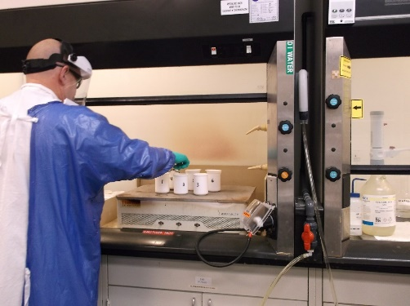

Energy Source: Chemical
Released when reaction breaks chemical bonds
Released as heat or pressure
Notes:
SG page 8
Instruction
Energy released when a reaction breaks the chemical bonds
Released as heat or other forms such as pressure
Ask students for any examples of chemical energy (possible answers: images are a sulfuric acid tank and perchloric acid added to samples)
Ask students what are some potential hazards of chemical energy (possible answers: fires/explosions, toxic, corrosive)
Ask students to name the Fatal Risks associated with chemical energy source (Answer: Exposure to Hazardous Substances (Acute and Chronic))
Ask students to name the critical controls
Answer: Exposure to Hazardous Substances (Acute) – Access Control, Alarm Systems, Engineered Controls, Handling Requirements, Loading and Unloading Protection, Mechanical Integrity of Storage and Distribution, PPE
Exposure to Hazardous Substance (Chronic) – Access Control, Engineered Controls, Handling Requirements, PPE

Slide 24
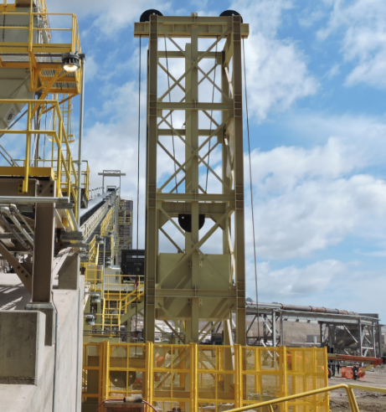


Energy Source: Gravitational
Result of object’s vertical position or height
Notes:
SG page 8
Instruction
Result of object’s vertical position or height
Ask students for any examples of gravitational energy (possible answers: images are a crane suspending a haul truck bed and a counterweight)
Ask students what are some potential hazards of gravitational energy (possible answers: falling object)
Ask students to name the Fatal Risks associated with gravitational energy source (Answer: Falling Objects and Lifting Operations)
Ask students to name the critical controls
Answer: Falling Objects – Barriers and Segregation, Integrity of Overhead Structures and Equipment, Securing Devices, Work Area Management
Lifting Operations – Barriers and Segregation, Lifting Execution, Mechanical Integrity of Lifting Equipment
Note: Whether suspended or not, objects still have hazardous energy

Slide 25
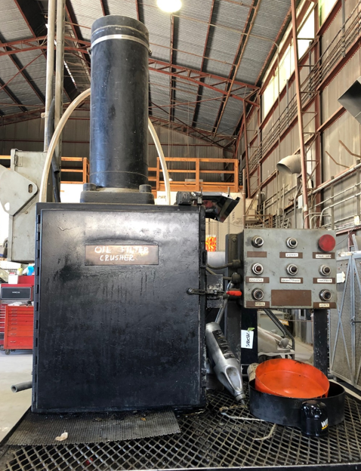
Energy Source: Hydraulic
Energy stored in pressured liquids used to move heavy objects
Notes:
SG page 9
Instruction
Energy stored in pressurized liquids frequently used to move heavy objects
Ask students for any examples of hydraulic energy (possible answers: images are a hydraulic cylinder and hydraulic filter press)
Ask students what are some potential hazards of hydraulic energy (possible answers: unexpected discharge of liquids)

Slide 26
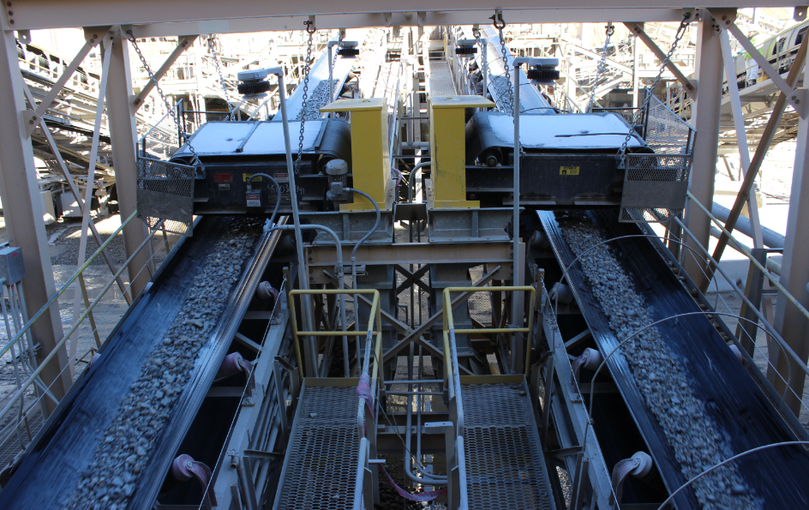
Energy Source: Magnetic
Energy with magnetic field, produced from moving electric charges
Various metals repelling/attracting each other
Notes:
SG page 10
Instruction
Energy within a magnetic field produced from moving electric charges
Various metals repelling or attracting each other
Individuals with pacemakers and implantable cardioverter defibrillators (ICDs): should avoid areas with high-powered magnets as these magnets may interfere with the function of the devices
Ask students for any examples of magnetic energy (possible answers: image is a metal detector on a conveyor belt)
Ask students what are some potential hazards of magnetic energy (possible answers: struck by moving objects)
Note: Additional information about magnets
Metal detector – an electronic instrument that senses the presence of metal on a belt conveyor but does not retrieve the metal
Any refined metal (magnetic or nonmagnetic) on belt contains higher conductivity than ore in conveyer belt
Metal detector transmits an electromagnetic signal from above the belt to the receiver below the belt
Presence of metal on the moving belt
Causes a change in this electromagnetic signal
Provides a signal to the control system to activate an alarm and, in most cases, to shut down the belt conveyor automatically
Tramp metal magnet – a powerful magnetic separator suspended over a belt conveyor
Removes magnetic iron (shovel teeth, drill bits, nuts, bolts, etc.) from the ore stream
Magnet has an iron core wound with wire
Alternating current passed through the windings generates a powerful magnetic field
Force of this magnetic field pulls the magnetic material in the ore off the conveyor belt and up to the electromagnet, where the magnet holds the metal in place until the operator decides to release it
Magnet typically hangs from a hoist or trolley, and the operator manually pushes it to the side of the conveyor and leaves it suspended over a bin before clearing the tramp metal
Workers de-energize the magnet, which breaks the magnetic force field and causes the tramp metal to fall into the bin

Slide 27
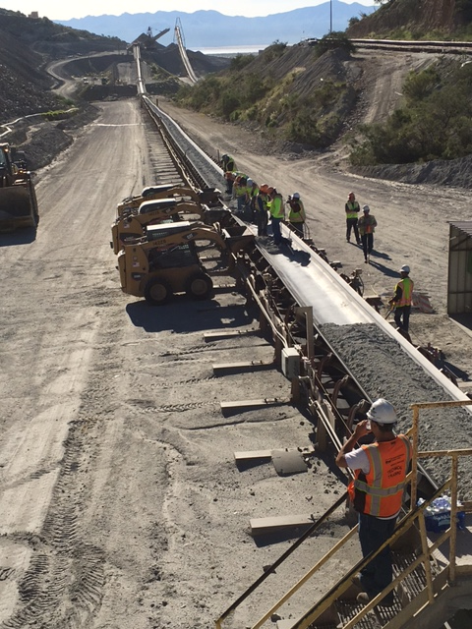

Energy Source: Mechanical/Kinetic
Sum of all kinetic and potential energy in a working system
Kinetic: energy of motion
Potential: energy stored in object based on its position
Notes:
SG page 11
Instruction
Sum of all kinetic and potential energy in a working system
Kinetic: energy of motion
Potential: energy stored in an object based on its position
Ask students for any examples of mechanical/kinetic energy (possible answers: kinetic – images are electric shovel and conveyor belt; potential – ball mill, rotating equipment, or a tensioned spring/line)
Ask students what are some potential hazards of mechanical/kinetic energy (possible answers: kinetic – people crushed or struck by moving object; potential – when released, becomes kinetic energy and has same potential hazards)
Ask students to name the Fatal Risk associated with mechanical/kinetic energy source (Answer: Entanglement and Crushing)
Ask students to name the critical controls (Answer: Blocking for Maintenance Work, Energy Isolation/LOTOTO, Guards, Barriers and Barricades)

Slide 28
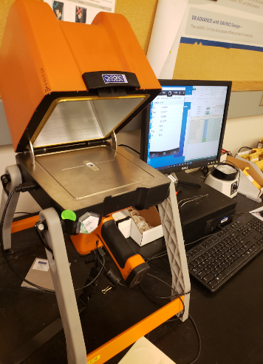
Energy Source: Nuclear Sources/ Ionizing Radiation
Electromagnetic or particulate radiation source
Enough energy to remove electrons from atom
Notes:
SG page 12
Instruction
Any electromagnetic or particulate radiation source with enough energy to remove electrons from an atom
Ask students for any examples of nuclear sources/ionizing radiation energy (possible answers: images are an X-Ray Fluorescence (XRF) machine and an On-Stream Analyzer (OSA))
Ask students what are some potential hazards of nuclear sources/ionizing radiation energy (possible answers: radiation)
Ask students to name the Fatal Risk associated with nuclear sources/ionizing radiation energy source (Answer: Exposure to Hazardous Substances – Chronic)
Ask students to name the critical controls (Answer: Access Control, Engineered Controls, Handling Requirements, PPE)

Slide 29
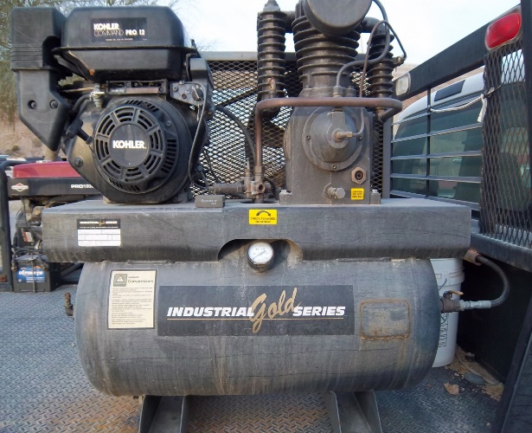
Energy Source: Pneumatic
Energy stored in pressured air or vacuum
Notes:
SG page 12
Instruction
Energy stored in pressured air as well as stored in a vacuum
Ask students for any examples of pneumatic energy (possible answers: images are a stationary compressed airline and an air compressor)
Ask students what are some potential hazards of pneumatic energy (possible answers: unexpected discharge of pressurized air)

Slide 30
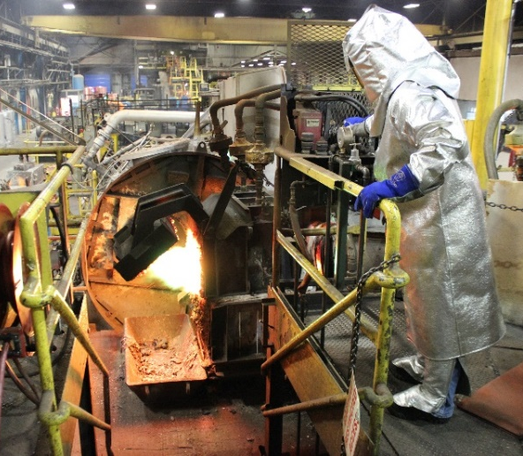
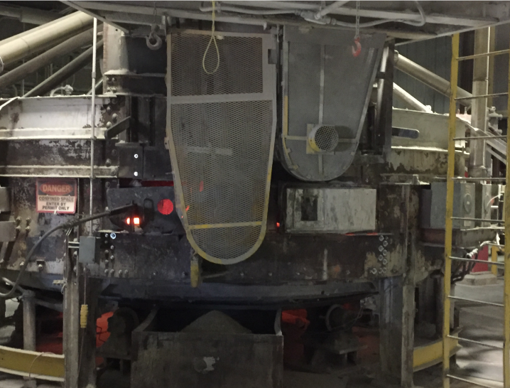
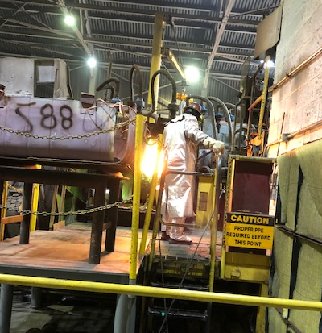
Energy Source: Thermal
Energy of system due to movement of molecules
Feel increased movement in form of released heat
Notes:
SG page 13
Instruction
Energy of a system due to movement of molecules
Greater amount of energy, faster the molecules move
Feel increased movement in form of released heat
Ask students for any examples of thermal energy (possible answers: images are a furnace/skim basin, roaster, and rod mill)
High levels of thermal energy: heat felt from an electrical cord, hot liquids or steam, or the surface of a motor
Low levels of thermal energy: ice, liquid propane, liquid oxygen, and liquid nitrogen
Ask students what are some potential hazards of thermal energy
Combustion, radiant heat applied by an outside force such as the sun, or friction between two moving objects in contact with each other
Burns to a person or damage a piece of equipment that can harm a person in the event of a failure
Note: Tell students that the table on page 14 provides a quick summary of various sources of energy
Can be used as a quick reference guide
Not an all-encompassing list of energy sources
Optional: have students take turns reading aloud the table for review

Slide 31
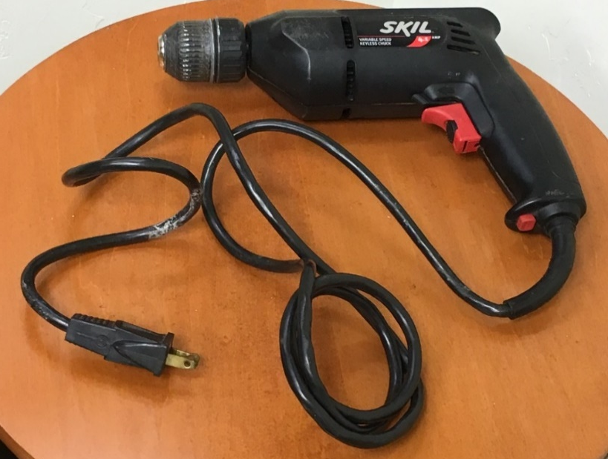
Equipment Excluded from the Standards
Cord and plug equipment if plug under direct control
Direct control: plugs within sight and reach during duration of work
Continuity test or ground check
Notes:
SG page 15
Instruction
Includes cord and plug equipment if the plug is under the direct control of the employee
“Direct control”: plugs that are within sight and reach during the duration of the work
Example – some sites use a mill inch drive, in which the operator has direct control using a remote control device
Continuity test or ground check – remind students to not use electrical equipment until it has been checked
Always check with site Health and Safety or leadership before performing work using this type of equipment

Slide 32
How to Identify Energy Sources
Hazardous Energy Survey
Determine all sources of energy
Determine how to isolate or control each source of energy and location of isolation points/devices
Be aware of multiple energy sources in single process/piece of equipment
Notes:
SG page 15
Instruction
Each Freeport-McMoRan site conducts a Hazardous Energy Survey
Serves two main functions:
Determine all sources of energy that service or maintenance activities may expose to an employee
Include all sources of electrical, chemical, gravitational, hydraulic, magnetic, mechanical/kinetic, nuclear/radiation, pneumatic, and thermal energy
Consider internal energy sources such as charged capacitors, batteries, wound springs, and raised loads
Note: Emphasize the importance of identifying all the energy sources as the first step of the process before beginning any work
Most Job Safety Analysis (JSA) asks you to identify the sources of energy
Some sites develop a switching plan as part of this planning before a shutdown
Determine how workers can isolate or control each source of energy and the location of the isolation points or devices (be aware of multiple energy sources in single process/piece of equipment)

Slide 33
Energy in the Workplace
Directions
Discuss the different energy sources shown in the poster
Label each energy source with the type of energy it produces using a sticky
Present your poster to the class
Activity 2
Notes:
SG page N/A
Time
Approximately 10 minutes
Materials
4 posters depicting various types and sources of energy
Several sticky notes for each group
Purpose
This activity gives students the opportunity to apply their knowledge of energy sources by identifying all of the energy sources they can find in a workplace photo
Instruction
Give each group several sticky notes
Give each group a different poster
Allow the groups 2-3 minutes to identify various energy sources
Discuss and label the type of energy each source produces
Have each group present their poster to the class

Slide 34
Identifying Sources of Energy
Directions
Choose 2 energy sources
Create an infographic poster for each energy source
  Name of the energy source
  Any associated FRM icons
  An image showing the energy source
  Examples of where you would encounter the energy source
Present the posters to the class
Activity 3
Notes:
SG page 16
Time
Approximately 30 minutes
Materials
Flip chart paper
Markers
Student Guide
Pens/Pencils
Purpose
This activity gives students the opportunity to identify examples of sources of energy in their work area
Instruction
Create an example infographic poster using the Electrical energy source
Create the infographic poster on a piece of flip chart poster
Use the example in the Facilitator Guide to create the poster – you can organize the information however you want
Include the following information:
Name of the energy source
Any associated FRM icons
An image showing the energy source
Examples of where you would encounter the energy source
*This is not an all-inclusive list – always follow site procedures
Give each group flip chart paper and markers
Groups can choose 2 energy sources (not Electrical)
Allow the groups 20 minutes to create an infographic for each energy source with the following information
Remind groups that they can use the Student Guide for reference
Allow 10 minutes for each group to present their posters – for each energy source, ask students what are some potential hazards for the energy source

Slide 35
Module 1 Quiz
Directions
Complete the quiz in the Student Guide
Discuss the answers as a class
Quiz
Notes:
SG page 17
Instruction
Give students time to write answers to the quiz questions in the SG
Tell students that some questions may have more than one answer
Review the answers as a class using the slides

Slide 36
Module 1 Quiz
Name the potential energy source(s) when using a crane to suspend a load over a work area.
  Hydraulic
  Pneumatic
  Gravitational
  Mechanical/Kinetic
Notes:
SG page 17
Instruction
Discuss answer as a class
Click to circle the answer
Quiz Answer
C, Gravitational (SG page 8)

Slide 37
Module 1 Quiz
Name the potential energy source(s) when using compressed gas cylinders.
  Thermal
  Hydraulic
  Pneumatic
  Mechanical/Kinetic
Notes:
SG page 17
Instruction
Discuss answer as a class
Click to circle the answer
Quiz Answer
C, Pneumatic (SG page 12)

Slide 38
Module 1 Quiz
Name the potential energy source(s) when adding perchloric acid to samples in a lab.
  Thermal
  Chemical
  Magnetic
  Pneumatic
Notes:
SG page 17
Instruction
Discuss answer as a class
Click to circle the answer
Quiz Answer
B, Chemical (SG page 8)

Slide 39
Module 1 Quiz
Name the potential energy source(s) when working around a conveyor belt.
  Magnetic
  Electrical
  Mechanical/Kinetic
  Nuclear Source/Ionizing Radiation
Notes:
SG page 17
Instruction
Discuss answer as a class
Click to circle the answer
Quiz Answer
A, Magnetic (SG page 10)
B, Electrical (SG page 7)
C, Mechanical/Kinetic (SG page 11)

Slide 40
Module 1 Quiz
All processes or pieces of equipment only have a single source of energy.
  True
  False
Notes:
SG page 17
Instruction
Discuss answer as a class
Click to circle the answer
Quiz Answer
B, False (SG page 15)

Slide 41

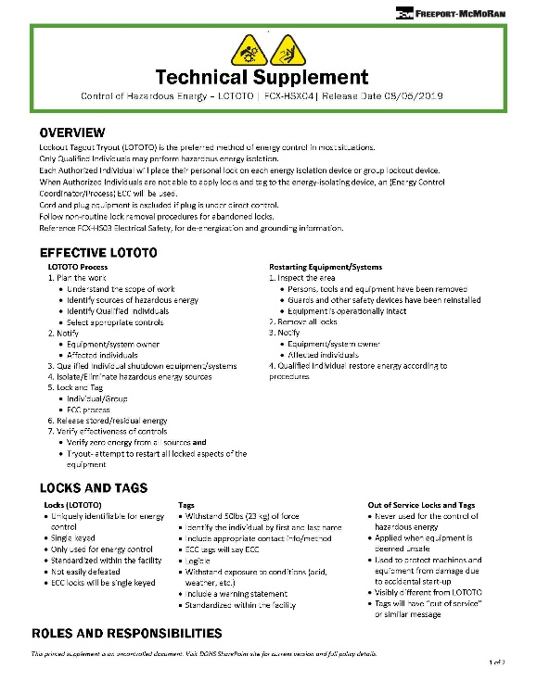
Debrief
What are some key concepts learned in this module?
What do you need to understand better?
What information surprised you?
Notes:
SG N/A
Instruction
Discuss questions on slide
Note: Ask students to turn to page 104 in the Resources section of the SG – tell students that much of the information we will cover is from the policy and its technical supplement and to use these documents as references

Slide 42
Module 2: Control of Energy Sources
Notes:
SG pages 22 and 23
Instruction
Review learning objectives for the module
Upon completion of this module, students will be able to select the correct energy control device/type, given a scenario
Control of hazardous energy process
Identify and isolate potential sources of energy when there is the possibility of exposure while performing work
Eliminate or control the sources of energy
Verify that controls are effective
This module discusses the various types of controls used at Freeport-McMoRan properties and the verification process

Slide 43
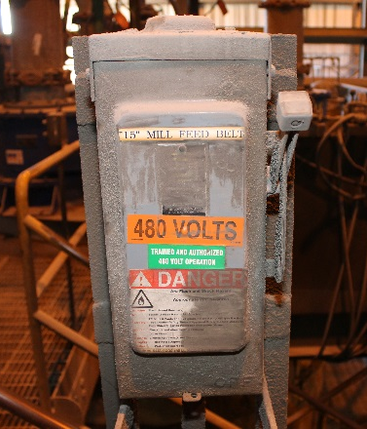
Types of Controls
Energy-isolating device: mechanical device that prevents transmission or release of energy
Energy isolation procedures
Notes:
SG page 23
Instruction
Energy-isolating device: a mechanical device that prevents the transmission or release of energy
Examples: circuit breakers, disconnect switches, line valves, and blocks
Each site must develop and document detailed energy isolation procedures for each unique piece of equipment, system, or process during service and maintenance activities
Clearly outline the requirements for energy isolation for machines, equipment, or processes
Include the following:
Identification of the machine, equipment, or process
Listing of all energy isolation devices and their locations
Specific procedural steps for shutting down, isolating, blocking, securing, and relieving stored or residual energy
Specific procedural steps for placement and removal of energy isolation devices
Specific procedural steps for verifying isolation and if a device has been properly de-energized

Slide 44
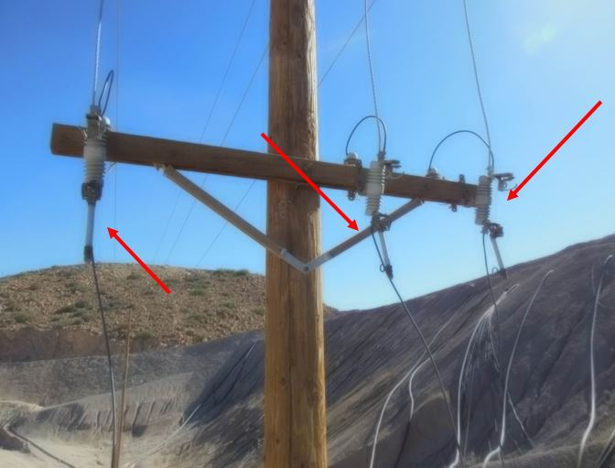
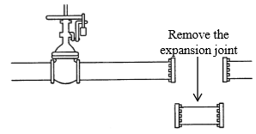
Energy Control: Air Gap/Line Break
Places space or gap of air between position of working employee and hazard
Removes spool section (expansion joint) of pipe/duct
Notes:
SG page 24
Instruction
After identifying potential sources of hazardous energy, use appropriate methods and devices for controlling the energy source
Next several slides describe the use of procedures, techniques, designs, and methods to protect personnel from injury from the unplanned release of energy
Air gap/line break: puts a space or gap in the system carrying the energy (e.g., wires, lines, or pipes)
Examples: removing a section of pipe or completely removing the fuses out of a power line system
Line breaking: removes a spool section (an expansion joint) of a pipe/duct
Close and lock all upstream valves – ensure that the material does not flow into whatever the line was attached to, such as a tank or pump
Place a lock through a bolt hole to prevent accidental re-sectioning – ensures that this control functions properly

Slide 45
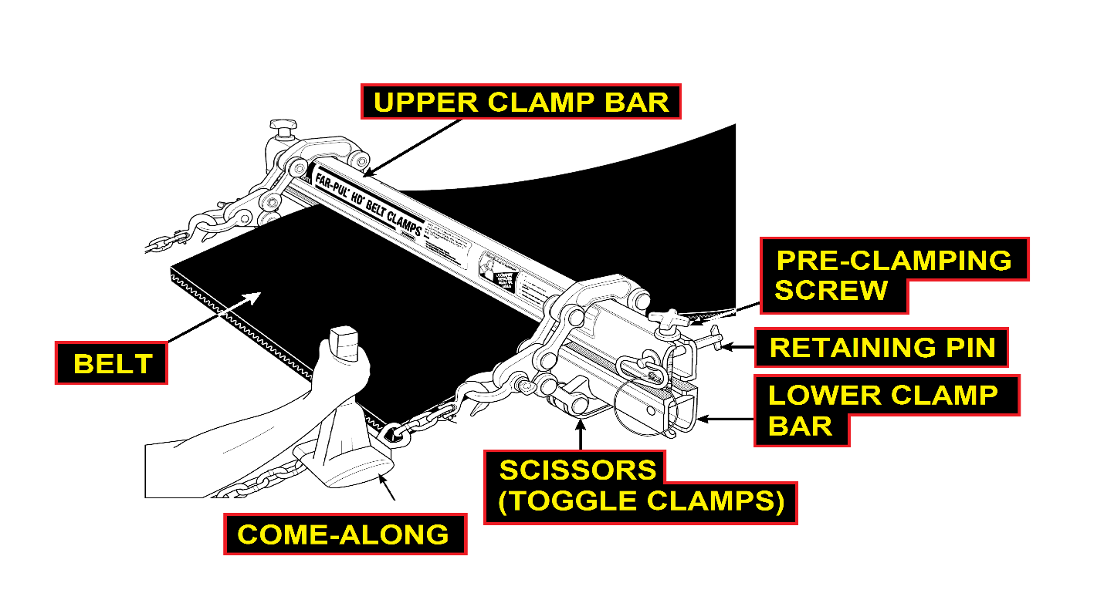
Energy Control: Belt Clamps
Restrain belt physically
Secure belt to substantial member of conveyor’s structure
Notes:
SG page 25
Instruction
Belt clamps and ratchet lever hoists: physically restrain the belt by securing it to a substantial member of the conveyor’s structure
Belt may move in either direction based on the conditions present at the time of the work and that conditions can and do change as the work progresses
Potential for accidents or fatalities even if properly locking out and tagging out the belt conveyor

Slide 46
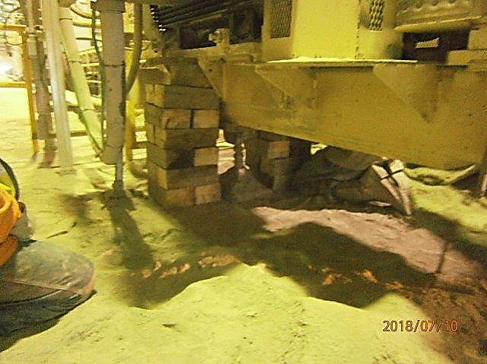
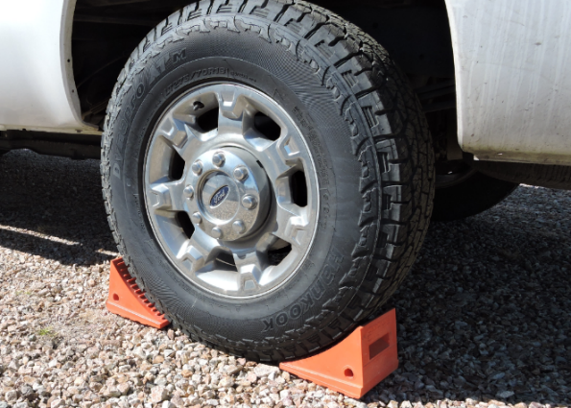
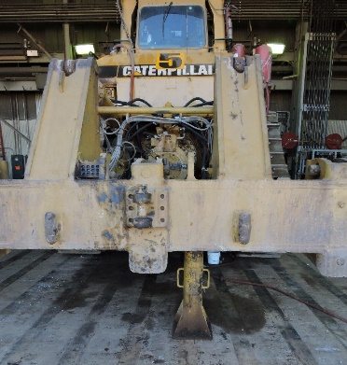
Energy Control: Blocking, Cribbing, and Chocking
All work to prevent movement of objects
Notes:
SG page 26
Instruction
Blocking, cribbing, and chocking: all work to prevent movement of objects
Cribbing: when workers stack material (normally wood) for stability, which helps to prevent movement
Blocking: protects the worker from potential energy inadvertently becoming kinetic energy
Chocking: prevents vehicles, rail cars, and rolling stock from moving unexpectedly

Slide 47
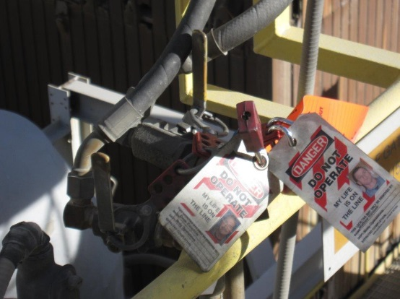
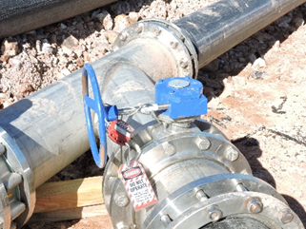
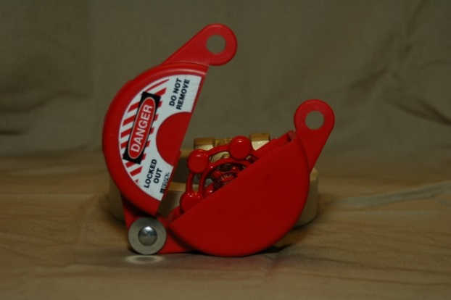

Energy Control: Clam Shells, Chains, and Valve Locks
Prevent valve movement after de-energizing system
Notes:
SG page 27
Instruction
Clam shells, chains, and valve locks: prevent valve movement after de-energizing a system
Valve lockout device: allows the placement of a personal lock and tag on a valve handle after de-energizing a system
Use wide variety of valves on Freeport-McMoRan properties
Use a lockout device that does not allow the valve to be moved or reopened without removal of the personal lock and tag – if the lockout device allows for valve movement, danger still exists

Slide 48
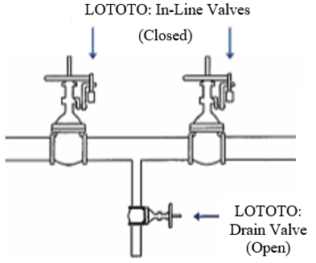
Energy Control: Double Block and Bleed
Uses a three-valve system when closing line, duct, or pipe leading to isolation
Prevents material from flowing and drains in case of valve leak
Notes:
SG page 28
Instruction
"Double block and bleed”
Uses a three-valve system when closing a line, duct, or pipe leading to the isolation
Prevents the material from flowing and drains in case of a valve leak
Close and lock the two in-line valves, then open and lock the drain valve in between the two closed valves
Lock out the valves, either opened or closed

Slide 49
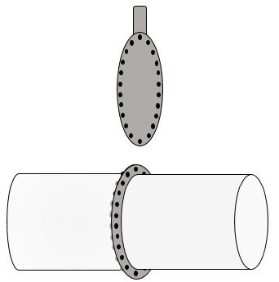
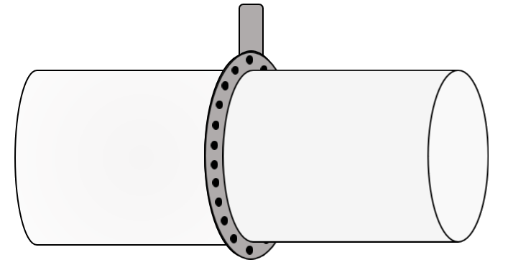
Energy Control: Blank or Blind
Place block into line or pipe at joint
Stops material in line from entering area
Lock out blank to inform others not to remove it
Notes:
SG page 28
Instruction
Blank or blind: the block put into the line or pipe at a joint
Stops whatever material is in the line from entering the area
Bleed the pipeline to relieve any pressure
Remove the flange bolts to separate the pipes
Insert the blank or slip blind between the two pipes and bolt the blank – ensure that the blanks fit tightly with all bolts in place
Lock out valve – make sure it does not move more than a one-quarter turn (tryout)
Lock out the blank to inform other workers not to remove it – clearly mark to indicate the presence of the blank or blind

Slide 50
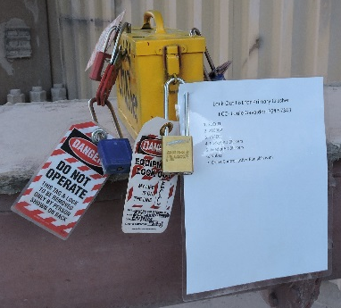
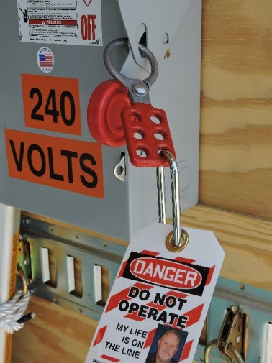
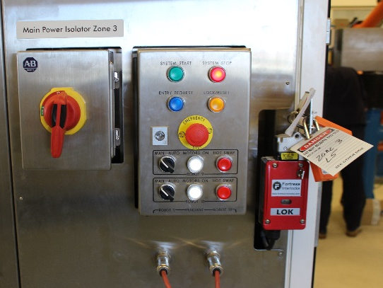
Energy Control: Lockout/Tagout/Tryout (LOTOTO)
Primary method used for hazardous energy control
Lockout/tagout: placement of lock and tag on energy-isolating device
Tryout: attempt to start or re-energize the locked-out system by normal means
Notes:
SG pages 29-30
Instruction
Lockout/Tagout/Tryout (LOTOTO): primary method used for hazardous energy control at Freeport-McMoRan
Required when performing service, maintenance, modification, or installation work
Lockout/Tagout: placement of a lock and tag on an energy-isolating device
Place the lock to prevent others from restarting the piece of equipment while workers perform the work
Use a tag in combination with a lockout device to identify the person who placed the lock and to warn others of the hazards of attempting to energize the equipment/machinery
Tryout: before beginning work, release or dissipate any stored energy and try out the machine or equipment
Ensure that all energy sources were effectively isolated
Attempt to start or re-energize the locked-out system by normal means to accomplish this verification

Slide 51
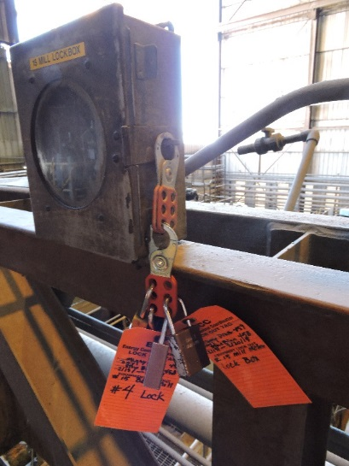
Energy Control: Lockout/Tagout/Tryout
Hasp
Allow multiple Authorized Individuals to place personal lock/tag on energy-isolating device that only accepts single lock
Removal of hasp requires removal of every personal lock first
Notes:
SG page 30
Instruction
Show your site specific hasp
Lockout hasps: allow multiple Authorized Individuals to place a personal lock and tag on an energy-isolating device that can only accept a single lock
Each Authorized Individual places his/her personal lock on one of the lock points on the hasp
Removal of the hasp requires the removal of every personal lock first
Note: additional hasp for installing more locks is permitted for lockout

Slide 52
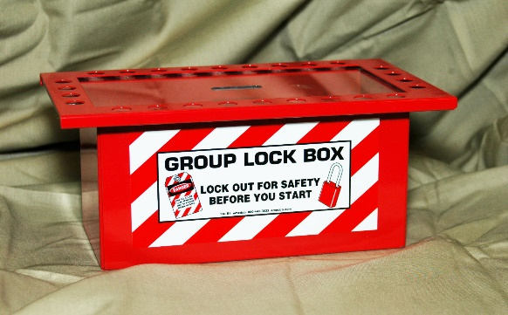
Energy Control: Lockout/Tagout/Tryout
Lockbox
Two or more Authorized Individuals need to perform service or maintenance
Energy isolation device cannot accept multiple locks
Service or maintenance work contains multiple energy isolation devices
Notes:
SG page 31
Instruction
Show your site specific lockbox
Lockbox: used for the following situations
Two or more Authorized Individuals need to perform service or maintenance
Energy isolation devices cannot accept multiple locks
Service or maintenance work contains multiple energy isolation devices
Comes in different sizes and varieties including portable, heavy-duty, and wall mountable
Holds multiple keys securely
Place lock(s) on the energy isolation device, then place the key(s) inside the lockbox
Place personal locks and tags on lockbox by all Authorized Individuals working in the affected area
Ensures that others cannot re-energize the energy isolation device until the removal of the final personal lock from the lockbox
Only way to remove the keys contained inside the box is if each worker removes his/her personal lock from the lockbox
Once the final worker removes his/her personal lock, the key inside becomes available to unlock the energy isolation device

Slide 53
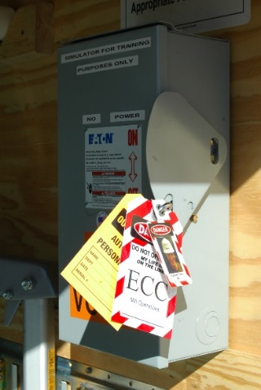
Energy Control: Lockout/Tagout/Tryout
Energy Control Coordinator (ECC) Lock and Tag
Meet same standardized requirements as personal locks and tags
Include method to identify ownership
Label with “ECC”
Single-keyed
Notes:
SG page 31
Instruction
Show your site specific ECC locks and tags
Energy Control Coordinator’s locks and tags: meet the same standardized requirements as personal locks and tags
Includes a method to identify ownership and has an ECC label
Are single-keyed

Slide 54
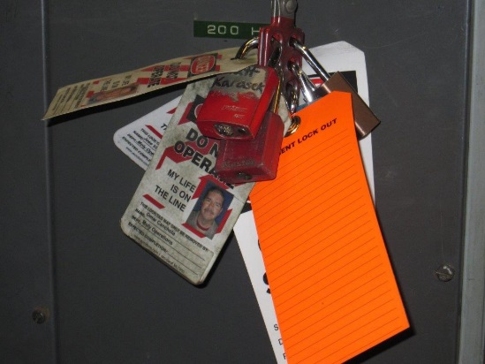
Energy Control: Lockout/Tagout/Tryout
Personal Locks and Tags
Issued to all Authorized Individuals
Keyed for each individual
Notes:
SG page 32
Instruction
Show your site specific personal locks and tags
Personal locks and tags
Issued to all Authorized Individuals
Standardized by facilities based on the needs of their facility
Personal lock:
Keyed for each individual
Only one key exists that can unlock a personal lock
Single key unlocks all multiple personal locks keyed alike
Single key under the exclusive control of the employee performing the service or maintenance
Only the owner of the personal lock can place and remove the lock
Personal tag:
Accompanies each lock
Includes a method of identifying the individual who placed the lockout device
Standardized (across sites) in color, shape, size, or specific markings, as well as print and format
Include a means of attachment that is substantial enough for the following:
Prevent inadvertent or accidental removal
Withstands 50 pounds of pulling force
Withstands the surrounding environment

Slide 55
Energy Control: Lockout/Tagout/Tryout
Locks | Tags
Uniquely identifiable for energy control | Withstand 50 pounds (23 kilograms) of force
Single-keyed | Identify individual by first and last name
Only used for energy control | Include appropriate contact information/method
Standardized within facility | Include “ECC” on ECC tag
Not easily defeated | Legible
 | Withstand exposure to conditions
 | Include warning statement
Notes:
SG page 32
Instruction
Go over the table for requirements for locks and tags
Ask what does “Uniquely identifiable for energy control” mean (Answer: does not look like other locks)
Examples of conditions are acid, weather, etc.

Slide 56
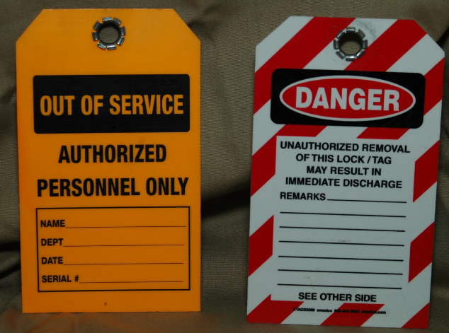
Energy Control: Lockout/Tagout/Tryout
Shop Locks vs. Out-of-Service Locks vs. Operation Locks
Do not use for control of hazardous energy
Apply to unsafe equipment
Use to protect machines/ equipment from damage
Ensure tag includes “Out of service” and visibly different from LOTOTO
Notes:
SG page 33
Instruction
May see these locks on Freeport properties
Do not use these locks these locks during Lockout/Tagout/Tryout applications – only Authorized Individuals using personal locks and tags may perform LOTOTO
Never use out-of-service locks and tags for the control of hazardous energy
Apply to unsafe equipment
Use to protect the machines and equipment from damage due to accidental start-up
Ensure that the tag includes “Out of service” or a similar message and that they are visibly different from LOTOTO locks and tags

Slide 57
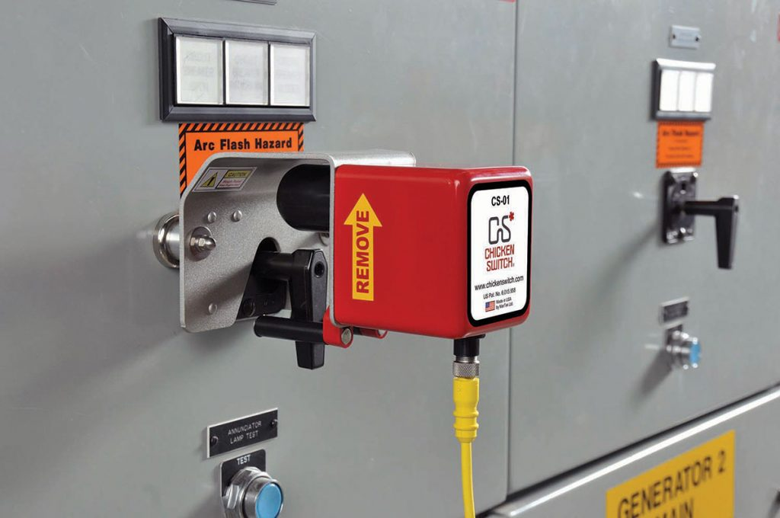
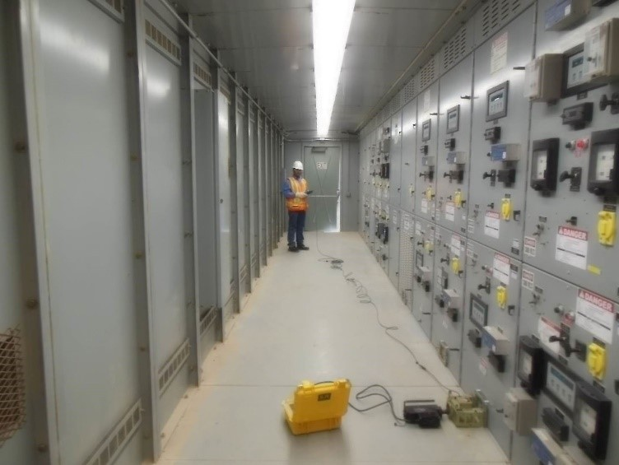
Exposure Control: Chicken Switches/ Remote Racking
Provide distance from operating switch/breaker
Notes:
SG page 34
Instruction
Use appropriate controls to eliminate the exposure to the energy source when unable to control the hazardous energy source completely
Chicken switches: remotely operated devices that can operate various electrical switches using a control motor operator externally applied to the switch; provides distance from operating switch
Remote racking: system used to remotely rack in a breaker; eliminates exposure to the breaker due to distance
Chicken Switch image credit: Chicken switch image credit: CBS ArcSafe, “Chicken Switch Joins the CBS ArcSafe Family”, cbsarcsafe.com, Accessed July 9, 2019, https://cbsarcsafe.com/chicken-switch/.

Slide 58
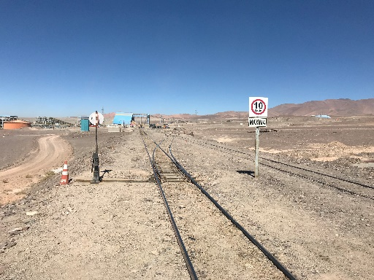
Exposure Control: Derailer
Causes train to derail upon activation
Prevents train from advancing on railroad
  Non-compliance with SOPs
  Mechanical failures
Notes:
SG page 35
Instruction
Derailer: device installed on railroad tracks
Causes the train to derail upon activation
Prevents the train from advancing on the railroad
Used to stop advancement of train
Non-compliance with the site’s Standard Operating Procedures (SOPs)
Any mechanical failures in the derailer or train machinery

Slide 59
Exposure Control: Descaling
Removes material build-up from equipment
Prevents clogs and jams
Uses chemicals or scrapes walls
Examples: hot rolling, heat treatment, welding
Notes:
SG page 35
Instruction
Descaling: removes material build-up from equipment
Boilers and heat exchangers: accumulation of layers of calcium on the surface; hinders function
Chutes: material build-up collects on walls
Remove material to prevent clogs and jams that not only can damage the machinery, but also could pose a hazard to employees who enter into the spaces for cleaning purposes
Descale equipment chemically or mechanically by scraping the walls of chutes
Example: remove tightly adhered layers of oxide formed by hot rolling, heat treatment, welding, and other high-temperature operations; remove layers by using sulfuric, nitric, and hydrofluoric acid

Slide 60
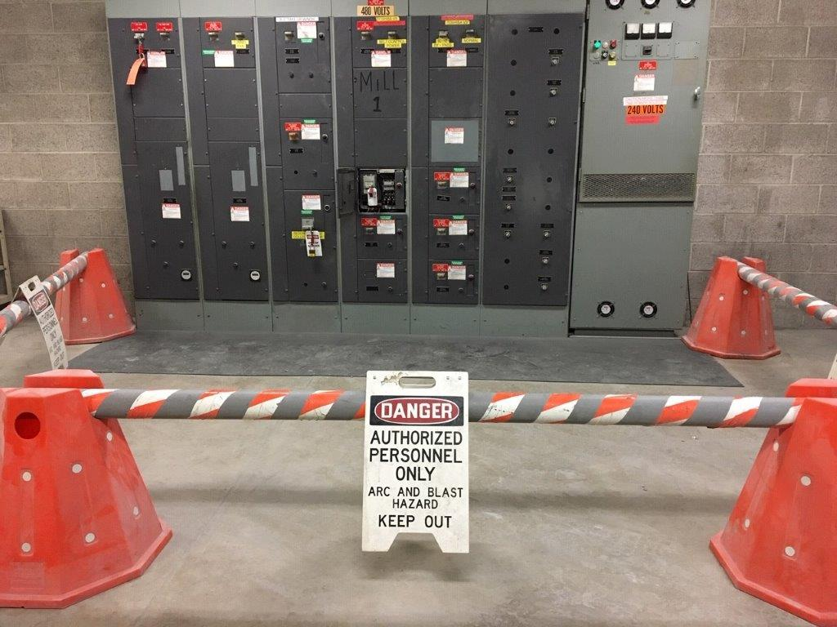
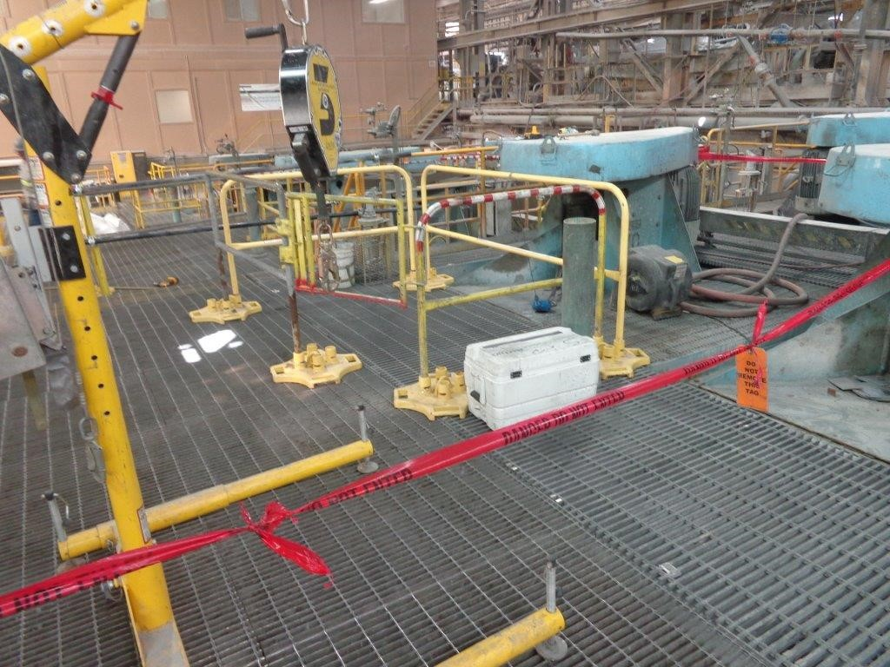
Exposure Control: Flagging and Barricading
Safeguards area
Install with proper communication to affected parties
Consult site-specific SOP
Notes:
SG page 36
Instruction
Flagging and Barricading: used to safeguard an area (e.g., mark an unsafe area or prepare for a task)
Install in conjunction with proper communication to any affected parties, including your supervisor, health and safety professional, and any groups working in the area
Consult your site specific SOP for further details

Slide 61
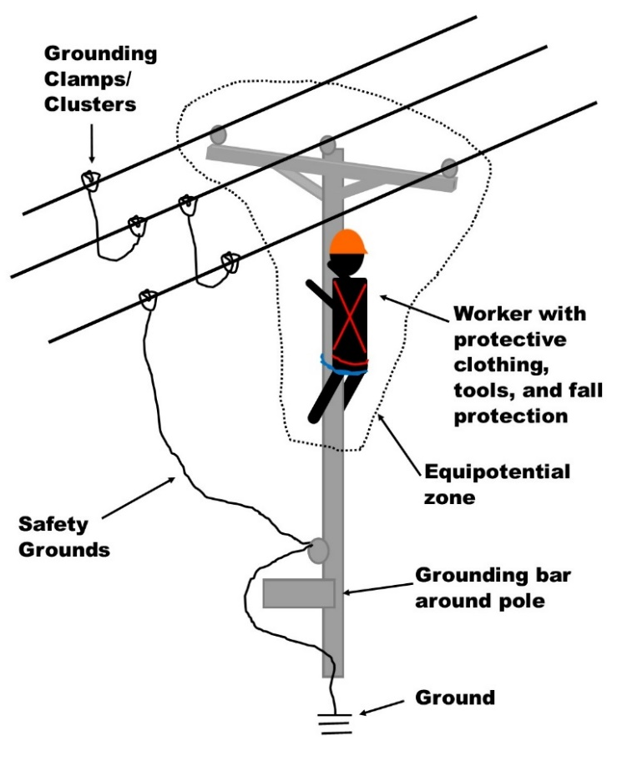
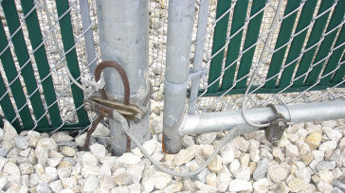
Exposure Control: Grounding
Structural grounding
Equipment grounding
Personal protective grounding
Place and arrange equipment to prevent exposure to shock hazard
Notes:
SG pages 36-37
Instruction
Grounding: place and arrange grounding equipment in a manner to prevent employees from exposure to a shock hazard
Three types of grounding:
Structural grounding: installs ground bonds to buildings, conveyors, fences, and other structures to provide a safe path to ground for residual electrical energy
Equipment grounding: installs ground bonds to equipment like welding machines, generators, or portable light plants to provide a safe path to ground for residual electrical energy
Personal protective grounding: install on equipment such as grounding clusters when working on electrical power systems that have a chance of inducing energy onto wire or while working on an electrical bus
Example: Working on power lines – install grounding clusters to remove any chance of induced energy
Example: Working on Motor Control Center (MCC) bus where there are energized electrical sources near the work area – grounding removes any stored energy and prevents any induced energy from injuring an employee working

Slide 62
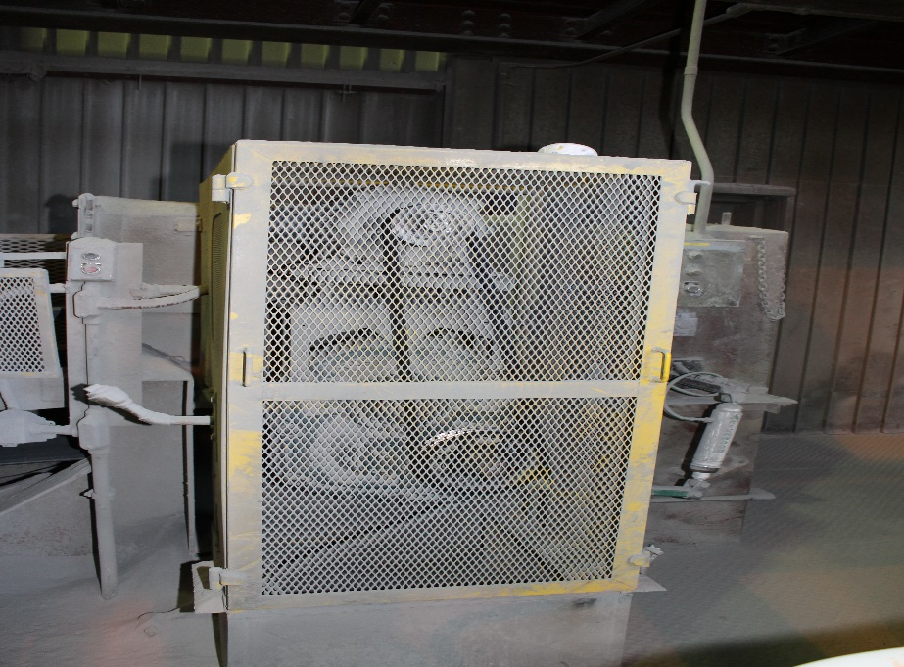
Exposure Control: Guarding
Places objects between personnel and hazards
Keeps any portion of body from contact with hazard
Notes:
SG page 37
Instruction
Guards: objects placed between personnel and hazards
Keeps any portion of the body from contact (intentional or inadvertent) with a hazard
Design examples: shielding, fencing, or enclosing hazards with covers, casings, shields, troughs, spillways, or railings
Examples of guarding methods: guarding by location (positioning hazards so they are inaccessible to employees) and point of operation guarding (using barrier guards, electronic safety devices, or other such devices)

Slide 63

Exposure Control: Insulators
Material with high resistance to flow of electrons
Notes:
SG page 38
Instruction
Insulator: material that has a very high resistance to the flow of electrons and is non-absorbing
Not good conductors of electricity
Example: using an insulating blanket when working near energized power line

Slide 64
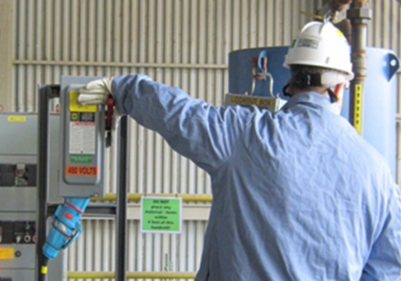
Exposure Control: Maintenance Switches
Take power away from whatever type of load they control
Notes:
SG page 38
Instruction
Maintenance switches: take power away from whatever type of load they are currently controlling

Slide 65
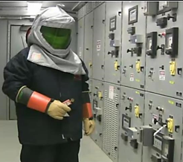

Exposure Control: Personal Protective Equipment
Help protect workers from items/situations that cause bodily harm
Inspect/test before use
Use only serviceable PPE without modifications
Notes:
SG page 39
Instruction
Personal Protective Equipment (PPE): help protect workers from items or situations that could cause bodily harm during their job performance
Inspect or test all PPE before use according to that equipment’s specific requirements, such as specific requirements for Cal suits or inspecting face shields, gloves, etc. for hot work.
Use only serviceable PPE that is free from modifications
Glove image credit: AVO Program, “Glove Air Test”, In Module 6: Personal Protective Equipment PowerPoint Presentation, (2014), slide 20.

Slide 66
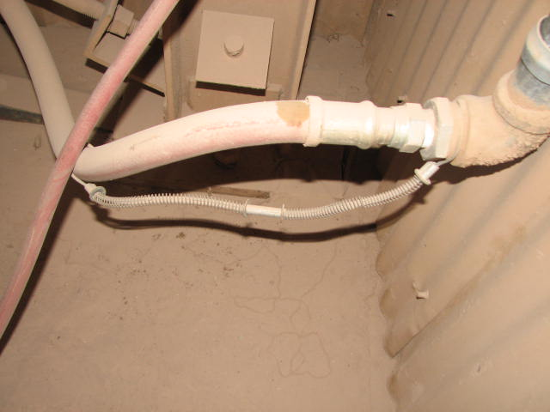
Exposure Control: Whip Checks
Connect air hoses across coupling
Prevent hoses from flying around if connection separates
Notes:
SG page 39
Instruction
Whip checks: connect air hoses across the coupling to prevent the hoses from flying around if the connection inadvertently separates
Required for air hoses ¾ inches (2 centimeters) or larger

Slide 67
Exposure Control: Preventative Maintenance (PM)
Ensures all systems/equipment in good working order
Ensure regular preventative maintenance procedures in place
Ensure workers do not operate equipment/systems until completion of repairs
Notes:
SG page 40
Instruction
Preventative Maintenance (PM): ensures that all systems and equipment are in good working order and that regular preventative maintenance procedures are in place
Ensures that systems and equipment meet and follow all manufacturer recommendations and engineering requirements
Ensures that workers do not operate the equipment and systems until completion of repairs when a defect or equipment issue does not allow safe operation
Troubleshooting: systematic way of problem-solving that looks at data, signs, and symptoms to determine what is happening to processes or equipment
Make changes based on the analysis to remedy any problems or constraints in the processes or equipment

Slide 68
Exposure Control: SOP or Work Instructions
Review written procedures for job
Include following in procedures
  Identification of machine, equipment, process
  Listing of all required energy-isolating devices and locations
  Specific procedural steps
  Specific requirements for verification of isolation and de-energization
Review site-specific written programs
Notes:
SG page 40
Instruction
Review any written procedures for the job before performing a hazardous energy control job
Review any written procedures and amend the procedures as necessary for the job when installing or upgrading new processes or systems
Include the following in procedures:
Identification of the machine, equipment, or process,
Listing of all required energy-isolating devices and their locations
Specific procedural steps for shutting down, isolating, blocking, securing, and relieving stored or residual energy
Specific procedural steps for the placement and removal of lockout devices
Specific requirements for verifying the accomplishment of isolation and de-energization
Review site written programs that detail the requirements for Lockout/Tagout/Tryout
Survey all hazardous energy sources
Identify complex or multiple source energy-isolating devices
Note: Tell students that the tables on pages 41-42 provide a quick summary of energy controls and exposure controls
Can be used as a quick reference guide
Not an all-encompassing list of examples/controls
Optional: have students take turns reading aloud the table for review

Slide 69
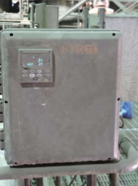
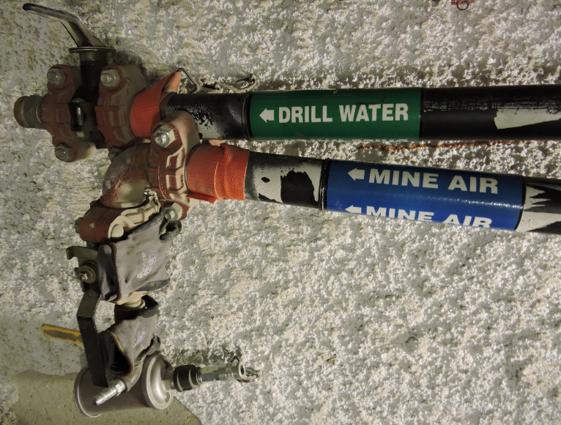
Labeling Standards
Proper labeling of electrical panels/gear
Inspections
Proper labeling of lines, breakers, valves, etc.
Labeling difficult to read
Proper labeling of lines
Notes:
SG page 43
Instruction
Label all electrical panels properly
Critical to the safety of personnel
Improper or nonexistent labeling – can contribute to major injuries or death during maintenance or emergencies
Inspect the labeling of electrical panels
Verify that all operational fuses are marked appropriately and accurately
Notify appropriate personnel of damaged, missing, or illegible labels
Do not open panels unless you are an authorized or qualified individual
Note whether adequate lighting is in place to read all labeling
Leave any items labeled “spare” or something similar in the open position
Label electrical gear (breakers, cabinets, switches, panels, etc.) with the following:
Voltage
Equipment being powered or fed
Label and identify all lines, breakers, valves, etc. properly
Contact responsible parties or consult the relevant documentation for more information if needed
Labeling includes contents, direction of flow, and rate of flow/pressure if necessary

Slide 70
Verification of Zero Energy
Zero energy: state of equipment verified by various methods
Tryout: one method to verify zero energy
Energy control devices/methods → result in zero energy
Exposure control devices/methods → do not result in zero energy
Notes:
SG page 44
Instruction
Before starting maintenance work:
Ensure that there is zero energy and attempt to restart the equipment
Do not confuse process interlocks with energy isolation or use for a tryout
Zero energy: refers to the state of equipment verified by various methods
Equipment does not have any hazardous energy
Employees may begin to perform service on the equipment safely
Tryout: one method to verify that there is zero energy
Employees attempt to restart the equipment
When the equipment does not restart, this verifies zero energy in the equipment
Energy control devices or methods result in zero energy of the equipment, exposure control devices or methods do not result in zero energy

Slide 71
Verification of the Effectiveness of Controls
Verify isolation of correct isolation points for each type of hazardous energy identified
Use appropriate verification devices and verification process
Follow all written procedures for de-energization
Notes:
SG page 44
Instruction
Verify isolation of correct isolation points for each type of hazardous energy identified
Use appropriate verification devices and the verification process to maintain safe working conditions; list below is not all encompassing
Single line drawings
Process diagrams
Piping and Instrumentation Drawings (P&IDs)
Pressure gauges
Flow meters/indicators
OHM/volt meter readings
Temperature
Tank levels
Atmospheric monitoring
Tryout
Follow all written procedures for de-energization

Slide 72
Verification of the Effectiveness of Controls
Verification Devices
NFPA requirements
NFPA 70E standard
Notes:
SG page 45
Instruction
Verify effectiveness of energy control – important action to stay safe while working around potential energy hazards
Use appropriate verification devices and the verification process to maintain safe working conditions
National Fire Protection Association (NFPA)
Requires the verification of zero-energy state
Requires voltage measurements of both phase-to-phase and phase-to-ground to ensure the removal of all power from the circuit
NFPA 70E standard – gives no voltage range for when this requirement starts or stops
Freeport-McMoRan compliance with NFPA 70E standards requires sites to use devices to verify zero-energy state
Note: Freeport-McMoRan follows NFPA 70E Standards
Cannot always test for zero voltage (for example, with local disconnects)
Can test for zero energy with live-dead-live tests (described in the Electrical Safety Policy, FCX-HS03)

Slide 73
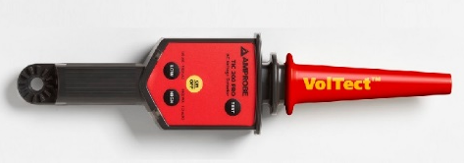
Verification of the Control of Energy
Verification Devices: Proximity Sensors/Testers
Detects presence of voltages above 600 volts of alternating current
Withstands electrical “pressure” exerted on them up to rated voltage
Danger of using higher voltage than rated
Notes:
SG page 45
Instruction
Proximity detectors: industry-accepted method for detecting the presence of voltages above 600 volts (electrical pressure) of alternating current (VAC)
Designed to withstand the electrical “pressure” exerted on them up to the rated voltage
Higher voltages cause damage
High enough voltage level cause catastrophic failure, resulting in possible worker injury or death
Note: proximity sensors work for Low Voltage (LV) and Medium voltage levels
Only use for rated voltage
Only trained employees (e.g., electricians) use these
For non-electrical personnel – try out the equipment to see if it turns on after turning it off at the system switch
Image credit: T&D PowerSkills Program, (T&D PowerSkills, LLC: 2019), 16.

Slide 74
Verification of the Control of Energy
Verification Devices: Visual Inspection
Visually confirm use of energy/exposure control devices
Non-routine energy isolation – field verification of application of control devices
  Emergency work
  Absence of SOPs
Notes:
SG page 45
Instruction
Visually confirm the use of energy or exposure control devices after isolating the energy source and before beginning work
For non-routine energy isolation – complete a field verification of the application of the control devices before performing work in these situations:
Non-routine energy isolation
Absence of Standard Operating Procedures (SOPs)
Note: remind students about the importance of verifying the control of energy – this is where they check to make sure the controls are effective

Slide 75

Energized Work Permit
Energized Work Permit
Required when repairing energized equipment
Routine work with SOP
  Valid for 1 year
  Kept with SOP
Not required for electrical troubleshooting and testing
Notes:
SG pages 46-47
Instruction
When de-energizing circuit is not possible when performing work
Ask for examples of energized work (possible answer: battery banks)
Require appropriate justifications
Must follow the processes and procedures defined in the Electrical Safety Policy – Energized Electrical Work Technical Supplement (FCX-HS03) document
Complete an Energized Work Permit: when possible exposure to hazardous energy exists and the equipment must remain energized to perform work
Routine work and where Standard Operating Procedure (SOP) exists:
Energized Work Permit valid for one year
Kept with the SOP as part of the record – review the SOP prior to performing work
Electrical troubleshooting and testing does not require a permit – refer to the Electrical Safety Policy Technical Supplement for Energized Electrical work
If there is no Superintendent on site, the delegate may authorize the work in his/her place
Have students look over the Energized Work Permit in their SG and ask them if they have any questions about the information requested

Slide 76
Identifying Energy Control Devices/Types
Directions
Choose 2 different infographic posters created during Activity 3
Write down (on the poster) how you would control the energy source
Present controls to the class
Activity 4
Notes:
SG page 48
Time
Approximately 20 minutes
Materials
Infographic posters from Activity 3
Markers
Student Guide
Pens/Pencils
Purpose
This activity gives students the opportunity to select the correct energy control device/type
Instruction
Ask students what are methods to control an Electrical energy source
Write these answers on the Electrical example poster created during Activity 3 – some examples are given in the Facilitator Guide
Remind students that controls may be site-specific and/or task-specific
Have groups rotate so that they are working with different energy sources
Allow groups 10 minutes to discuss and write down (on the poster) controls for each energy source
Allow groups 5 minutes to present the controls for each energy source

Slide 77
Module 2 Quiz
Directions
Complete the quiz in the Student Guide
Discuss the answers as a class
Quiz
Notes:
SG page 49
Instruction
Give students time to write answers to the quiz questions in the SG
Review the answers as a class using the slides

Slide 78
Module 2 Quiz
Which hazardous energy control device/method requires the placement of a personal lock and tag on an energy isolation device using an established procedure?
  Emergency-Stop
  Flagging and barricading
  Maintenance Switches
  Lockout/Tagout/Tryout (LOTOTO)
Notes:
SG page 49
Instruction
Discuss answer as a class
Click to circle the answer
Quiz Answer
D, Lockout/Tagout./Tryout (LOTOTO) (SG page 29)

Slide 79
Module 2 Quiz
Which hazardous energy control device/method keeps any portion of the body from contact (intentional or inadvertent) with a hazard?
  Guarding
  Insulators
  Grounding
  Chicken Switches
Notes:
SG page 49
Instruction
Discuss answer as a class
Click to circle the answer
Quiz Answer
A, Guarding (SG page 37)

Slide 80
Module 2 Quiz
Which of the following do sites include in written procedures for the job? Circle all that apply.
  Identification of the machine, equipment, or process
  List of all required energy-isolating devices and their locations
  Specific procedural steps for shutting down, isolating, blocking, securing, and relieving stored or residual energy and for placement and removal of lockout devices
  Specific requirements for verifying the accomplishment of isolation and de-energization
Notes:
SG page 49
Instruction
Discuss answer as a class
Click to circle the answer
Quiz Answer
A, B, C, D (SG page 40)

Slide 81
Module 2 Quiz
Which form is required when repairing energized equipment?
  ECC form
  Variance Request form
  Energized Work Permit form
  Non-Routine Lock Removal form
Notes:
SG page 49
Instruction
Discuss answer as a class
Click to circle the answer
Quiz Answer
C, Energized Work Permit form (SG page 46)

Slide 82
Module 2 Quiz
____________________ control devices or methods result in zero energy of the equipment.
  Energy
  Exposure
Notes:
SG page 49
Instruction
Discuss answer as a class
Click to circle the answer
Quiz Answer
A, Energy (SG page 44)

Slide 83
Debrief
What are some key concepts learned in this module?
What do you need to understand better?
What information surprised you?
Notes:
SG N/A
Instruction
Discuss questions on slide
Remind students to always refer back to the policy and technical supplements (located on page 104 in the Resources section of the SG)

Slide 84
Module 3: Roles and Responsibilities
Notes:
SG pages 53 and 55
Instruction
Review learning objectives for the module
Upon completion of this module, students will be able to determine the responsibilities of each individual, given a simple or complex lockout job
Various roles and responsibilities that come with controlling hazardous energy
Role determines responsibilities during the job
This module discusses the various roles and responsibilities of individuals involved with the job

Slide 85
Role: Affected Individuals
Job requires them to operate/use equipment where controlling hazardous energy source required to perform service/maintenance
Includes personnel in area not performing work on equipment
Notes:
SG page 55
Instruction
When controlling hazardous energy, the following roles may apply to the job or task
Affected Individuals: an employee whose job requires them to operate or use a machine or piece of equipment where controlling a hazardous energy source is required to perform service or maintenance
Includes personnel in the area who are not performing work on the equipment

Slide 86
Role: Authorized Individuals
Locks and tags isolation device
Performs work on locked-out equipment
Responsibilities:
  Place own locks/tags
  Maintain control of lock key
  Return equipment to serviceable condition before removing energy isolation device/lock
Notes:
SG page 55
Instruction
Authorized Individual: locks and tags the isolation device for equipment to perform service or maintenance
Performs work on the locked-out equipment
Must place their own locks and tags and must maintain control of the key to their lock
Responsible for returning the equipment to the serviceable condition before removing any energy isolation device or lock
Ask students what is the difference between an Affected Individual and an Authorized Individual
Possible answers: Affected Individual
Does not directly perform servicing or maintenance work
Does not implement lockout procedures or other hazardous energy controls
Have jobs that require them to perform tasks such as operating, cleaning, setting up, adjusting, monitoring, or otherwise interacting with or directly around systems and equipment that are under hazardous energy control
If performing maintenance is the responsibility of the Affected Individual, then that person becomes the Authorized Individual and he/she must place a personal lock and tag on the energy-isolating device or use an appropriate alternative device to control the energy source

Slide 87
Role: Qualified Individual/Personnel
Have qualifications to perform energy isolation and de-energize system
May or may not work on lockout
Responsibilities:
  Ensure workers follow safe procedures
  Verify effectiveness of energy isolation
  Conduct tryout
Notes:
SG page 56
Instruction
Qualified Individuals/Personnel: have the qualifications to perform energy isolation to de-energize the specific system, but they may or may not work on the lockout
Ensure workers follow safe procedures for the shutdown, isolation, and energy release
Responsible for verifying the effectiveness of energy isolation and conducting tryout
Example: electrician that operates a switchgear to de-energize a piece of equipment for mechanics to perform service

Slide 88
Role: Energy Control Coordinator (ECC)
Assigned by supervision
Has technical/working knowledge of isolated equipment
Has overall responsibility of energy isolation (supported by qualified and authorized individuals)
Has specific locks and tags
Has responsibility of completing ECC form
Notes:
SG page 56
Instruction
Energy Control Coordinator (ECC): assigned by supervision when one of the following occurs:
Authorized Individual is unable to place his/her lock and tag directly on the energy-isolating device(s) or is unable to use another control device directly
Use of multiple energy-isolating devices
Involvement of multiple Authorized Individuals
Extension of the period of energy isolation
Relatively inaccessible energy-isolating device(s)
Dependently connected multiple system components
Has technical and working knowledge of the equipment needing energy isolation
Has overall responsibility (with support of qualified and authorized individuals) of the energy isolation to ensure the identification, control, and tryout of energy sources from start to finish
Have their own specific and distinguishable locks and tags
Have responsibility of completing ECC form – keep with lockbox

Slide 89


Role: Energy Control Coordinator (ECC)
ECC Form
Notes:
SG pages 57-58
Instruction
Keep ECC form with the lockbox unless there is an active transfer of the ECC
Have students look over the ECC form in their SG and ask them if they have any questions about the information requested

Slide 90
Responsibilities Around the Job
Planning the Job
Create plan
Identify the following:
  Personnel roles and responsibilities
  Tools
  Hazards
  Isolation points
  Isolation devices
Consult SOPs and JSAs
Notes:
SG page 59
Instruction
Create a plan for the job or task before beginning any work – understand the full scope of the work and all associated tasks
Identify all personnel roles and responsibilities, tools, hazards, isolation points, and isolation devices
Consult relevant Standard Operating Procedures (SOPs) and Job Safety Analyses (JSAs) before performing work

Slide 91
Responsibilities Around the Job
Routine vs. Non-Routine
Non-routine job: requires JSA
SOP not available and during emergency work
  Identify hazardous energy sources
  Determine isolation/control devices
  Assign responsible persons
  Complete field verification
Documentation: JSA if no existing
Notes:
SG page 59
Instruction
Note: both routine and non-routine jobs follow the Actions to Stay Safe outlined in policy
Discussed in Module 4
Refer to policy in Resources section of SG (page 104)
Non-routine job: requires a Job Safety Analysis (JSA)
Allows the team to think forward
Identifies any potential hazards along with the critical controls to assist in completing work safely
Standard Operating Procedure (SOP) not available and during emergency work, planning for the energy control must include the following:
An inventory of identified hazardous energy sources
Determination of isolation/control devices
Assignment of responsible persons, including Qualified Individuals and ECC if necessary
Field verification of the application of the control devices
Document this information and evidence of the verification
No existing documentation in place, document this information by using a JSA completed before starting the job

Slide 92
Responsibilities Around the Job
Access and Verification
Join after isolation verification
  Contact other Authorized Individuals or ECC
  Confirm isolation
Right to verify isolation
Limited access to isolation device – escorted by Qualified Individual or use ECC process
Notes:
SG page 60
Instruction
If Authorized Individual joins after verification of isolation has taken place
Contact the other Authorized Individuals or the ECC (if used)
Confirm isolation of equipment and completion of verification/testing
Retain the right to verify isolation by clearing the area and attempting to start the equipment
Limited access to isolation devices (e.g., inside a restricted area): Qualified Individual escorts the Authorized Individuals or use the ECC process

Slide 93
Responsibilities Around the Job
Electrical Switching
Only qualified and authorized personnel can perform switching responsibilities
Difference in site policies
  Defining labeled devices
  Thresholds of voltage and current limit
  Required PPE
Notes:
SG page 60
Instruction
Most site policies: only qualified and authorized personnel can perform switching responsibilities
Must receive electrical safety training
Must receive task training
Note: non-electricians can only switch disconnect switches approved under 1000 volts (see Technical Supplement Switch for Non-Electrical Personnel)
Go over your site policies for defining labeled devices (e.g., switches, disconnects, breakers, etc.), the thresholds of voltage and current limit, and required PPE

Slide 94

Responsibilities Around the Job
Remote Locations
Location of isolation device in area not easily accessible
Provide equivalent protection for Authorized Individuals
Notes:
SG page 61
Instruction
Remote areas: location of isolation devices in areas that are not easily accessible
Example: equipment located miles from the energy isolation device
Provide equivalent protection for any Authorized Individual as he/she had placed his/her personal lock and tag under LOTOTO
Follow these steps:
ECC at remote location of an energy isolation device has a Qualified Individual perform the energy isolation and verify zero energy state of the equipment
ECC places ECC lock and tag on the energy isolation device, and ECC places the key to that lock in a group lockbox
ECC places representative personal lock and tag on the group lockbox for each Authorized Individual performing service or maintenance on the de-energized equipment – use ECC form
Once all Authorized Individuals have a personal lock and tag placed on the group lockbox, they may begin servicing or performing maintenance on the equipment/process
Note: Some areas (e.g., substations or Motor Control Center (MCC)) require an escort

Slide 95
Responsibilities Around the Job
Variance Process
Complete a variance request
  Specify reason cannot meet policy
  Outline alternative controls
  Document in MOC system located in Site Ops Call Center
Need review and approval from Site Division Management and site Health and Safety Management
Need approval from DOHS for long-term variances
Notes:
SG page 62
Instruction
Freeport recognizes that due to the diversity of operating conditions at each site, strict compliance with Control of Hazardous Energy policy may not always be feasible
Process to allow for justifiable variances from the Control of Hazardous Energy Policy
When workers cannot meet the Control of Hazardous Energy Policy
Complete a variance request
Need review and approval from site leadership and site Health and Safety
Need approval from the Department of Occupational Health and Safety (DOHS) for any long-term variances to ensure acceptable control of the risks
Variance request requirements:
Specify the reason why the work requirements cannot meet the Control of Hazardous Energy Policy
Outline the alternative controls that workers will implement to ensure the establishment of an equivalent level of protection for employees or contractors
Document the variance in the Management of Change (MOC) system located in the Site Ops Call Center
Site Ops Call Center is the archive for the MOC ticket and associated documents

Slide 96

Responsibilities Around Personnel
Audits
Performed by Qualified Individual, at least annually
Witness performance of at least one control procedure
Designed to correct deficiencies
Notes:
SG page 63
Instruction
Documented audits
Performed by a Qualified Individual (determined by site management)
Performed at least annually for every control of hazardous energy procedure in use
Qualified Individual must witness the performance of at least one control of hazardous energy procedure with the procedural details
Audit designed to correct deficiencies in the established control of hazardous energy procedure or in employee understanding through retraining

Slide 97
Responsibilities Around Personnel
Shift Change
Document procedures
Ensure integrity of isolation devices
Use ECC procedures if necessary
Remove personal locks/tags
  Work complete
  Equipment in safe condition
Notes:
SG page 64
Instruction
Ensure removal of personal locks when the Authorized Individual:
Receives another task assignment
Leaves at the end of the shift
Completes the work
Exception: when the removal of the lock exposes others to a hazard
Shift changes include the following procedures:
Document the procedures for shift changes
Ensure integrity of isolation devices before turnover
Use the ECC procedures if necessary
Remove personal locks and tags if work is complete and equipment is in a safe condition
Maintenance of hazardous energy control integrity and orderly shift/personnel transfers include the following examples:
On-coming employees apply their personal locks before the off-going employees remove their locks
The lockout sequence repeats for the on-coming shift
An ECC lock remains on the energy isolation device until completion of the job
Transfer of ECC locks or lock custody during shift change
Before commencing work at the beginning of each shift, each Authorized Individual has the right to verify the effectiveness of the hazardous energy control

Slide 98
Responsibilities Around Personnel
ECC Transfers
Incoming ECC adds information to ECC form
Outgoing/incoming ECC verbally confirm details
Incoming ECC assumes responsibility
Outgoing ECC removes personal lock
ECC transfer in process
  No new Authorized Individuals
  Current Authorized Individuals can continue work
Notes:
SG page 65
Instruction
For shift change with ECC
Incoming ECC adds their information to the ECC form
Outgoing and incoming ECC verbally confirms the details of the work and lockout and may visually confirm lockout devices in use
Incoming ECC assumes responsibility of the lockout process once they take possession of the key and they put their contact information on the ECC tag
Outgoing ECC removes their personal lock from the group lockout device before leaving the area
Keep ECC form with the lockbox unless there is an active transfer of the ECC
During the ECC transfer
No new Authorized individuals can join the LOTOTO in progress until the completion of the ECC transfer and the return of the form
Authorized Individuals who have already signed the Individual Lockout Roster can continue work while the ECC transfer is in process

Slide 99
Responsibilities Around Personnel
Joining Job in Progress
Read JSA and SOPs
Notify lead personnel or ECC
Verify all lockout points
Place lock in lockout control device and complete documents
Notes:
SG page 65
Instruction
Read the Job Safety Analysis (JSA) and any relevant Standard Operating Procedures (SOPs)
Note: remind students about the importance of reviewing provided drawings, prints, and other documentation of what was locked out
Notify the lead personnel or ECC
Remind students that it is an employee’s right to verify all lockout points for the potential hazardous energies involved with the job
Place their lock in the lockout control device and complete necessary documents once completing the verification of all lockout points

Slide 100
Responsibilities Around Personnel
Interaction with Contractors
Work together on complex lockout jobs
Evaluate full scope of work
  Cover project specific procedures
  Inform all parties
Notes:
SG page 65
Instruction
Contractors and FCX employees working together on complex lockout jobs
Contractors must evaluate the full scope of work to ensure job planning adequately covers project specific procedures so that all parties are informed

Slide 101
Responsibilities Around Equipment
Include commissioning, testing, calibrating, troubleshooting equipment
Complete Energized Work Permit if necessary
Complete safety analysis or risk assessment
Notes:
SG page 66
Instruction
Responsibilities around equipment include the commissioning, testing, calibrating, and troubleshooting of equipment
Complete an Energized Work Permit when possible exposure to hazardous energy exists and the equipment must remain energized to perform work.
Complete a safety analysis or risk assessment even though hazardous energy control may not apply
Understand the process for the start-up of the equipment and the potential for exposure to self and others
Develop a communication plan for these activities, evaluate new controls, and verify existing control
Keep in mind the following points:
When removing guards and barriers (or bypassing interlocks) for troubleshooting/testing and calibration, put in place other controls to prevent exposure
When performing work on energized equipment, follow specific documented guidelines and procedures
When installing other bypass devices and while performing work on energized equipment, follow specific documented guidelines and procedures for installation, use, and removal of bypass devices

Slide 102
Responsibilities Around Equipment
Conduct pre-operational inspection
Test or position machines/equipment
  Clear area
  Install flagging and barricading
  Remove energy control devices
  Energize and proceed with testing/positioning
De-energize, isolate from potential sources, reapply energy control devices
Notes:
SG page 66
Instruction
Always conduct a pre-operational inspection before starting up the equipment
Complete the following steps when testing or positioning machines or equipment:
Clear the area of unnecessary personnel, tools, and materials
Install flagging or barricading (refer to FCX-HS19)
Remove energy control devices as specified in procedures
Energize and proceed with testing or positioning
De-energize, isolate from potential sources, and reapply energy control devices before performing additional maintenance

Slide 103
Who is Who?
Directions
Each slide describes one role
Move to the sign that you feel is being described as each clue is shown
You may change your mind as more clues are shown
Activity 5
Notes:
SG page N/A
Time
Approximately 5 minutes
Materials
4 role signs (see attachments on following pages); pin or tape one sign in each corner of the room
4 role descriptions as presented in the PPT
Purpose
This activity gives students the opportunity to engage with the facilitator actively to ensure understanding of each duty
Instruction
Place a role sign in each corner of the room – carefully tear out from the FG or make copies of each role
Point out the four role signs located in each corner of the room
Explain that you will read one clue for each description at a time from the PPT and they must decide which duty was described
As soon as each student believes they have figured out which duty is being described, the student stands near the corresponding sign
Once all students have moved to a sign that they believe is the answer, discuss how they chose each answer
Repeat for each duty description
NOTE: As an alternative for large class sizes
Place copies of the four role signs at each table
Group at table work together to choose the role and hold up the appropriate sign when they believe they have figured out the answer

Slide 104
Who is Who?
Role 1 (5 clues)
Has technical and working knowledge of isolated equipment
Assigned by supervision
Called in when multiple locks and tags cannot be placed directly on an energy-isolating device
Ensures all energy sources are identified, controlled, locked, tagged, and tried out from start to finish
Has own specific lock and tag
ANSWER: Energy Control Coordinator (ECC)
Notes:
Answer Clarification:
ECC Key Points:
Assigned by supervision
Ensures all energy sources are identified and controlled from start to finish
Utilized when multiple Authorized Individuals are used, and the energy isolation device cannot accept multiple locks

Slide 105
Who is Who?
Role 2 (5 clues)
Has qualifications to perform energy isolation to de-energize specific system
May or may not work on lockout
Capable of recognizing hazards associated with work
Approved to perform energy isolation and dissipation
Approved to perform energy measurement/testing and/or tryout
ANSWER: Qualified Individual/Personnel
Notes:
Answer Clarification:
Qualified Individual Key Points
Approved to perform energy isolation, dissipation, and measurement
Often performs safe de-energization even though they may not be working on the process/equipment

Slide 106
Who is Who?
Role 3 (3 clues)
Aware of the purpose and use of hazardous energy control procedure
Does not directly perform servicing/maintenance work
Does not implement lockout procedures or other hazardous energy controls
ANSWER: Affected Individual
Notes:
Answer Clarification:
Affected Individual Key Points
Does not directly perform service/maintenance work
Does not implement lockout procedures

Slide 107
Who is Who?
Role 4 (3 clues)
Locks and tags isolation device
Performs work on locked-out equipment
Returns equipment to serviceable condition before removing energy isolation device or lock
ANSWER: Authorized Individual
Notes:
Answer Clarification:
Authorized Individual Key Points
Performs service/maintenance on equipment
Locks and tags isolation device

Slide 108
Module 3 Quiz
Directions
Complete the quiz in the Student Guide
Discuss the answers as a class
Quiz
Notes:
SG page 67
Instruction
Give students time to write answers to the quiz questions in the SG
Review the answers as a class using the slides

Slide 109
Module 3 Quiz
An Affected Individual can also be an Authorized Individual when:
  He/she performs a safe de-energization of a system
  He/she performs a hazard assessment for an SOP
  He/she is also servicing the de-energized equipment
  All of the above
Notes:
SG page 67
Instruction
Discuss answer as a class
Click to circle the answer
Quiz Answer
C, He/she is also servicing the de-energized equipment (SG page 55)

Slide 110
Module 3 Quiz
Who assigns an ECC to a lockout job?
  Supervision
  Qualified Individual
  Authorized Individual
  Health and Safety Department
Notes:
SG page 67
Instruction
Discuss answer as a class
Click to circle the answer
Quiz Answer
A, Supervision (SG page 56)

Slide 111
Module 3 Quiz
If an Authorized Individual joins after verification of isolation has taken place, they have the right to verify isolation by clearing the area and attempting to start the equipment.
  True
  False
Notes:
SG page 67
Instruction
Discuss answer as a class
Click to circle the answer
Quiz Answer
A, True (SG page 58)

Slide 112
Module 3 Quiz
If a Standard Operating Procedure (SOP) is not available during emergency work, workers must complete a Job Safety Analysis (JSA).
  True
  False
Notes:
SG page 67
Instruction
Discuss answer as a class
Click to circle the answer
Quiz Answer
A, True (SG page 59)

Slide 113
Module 3 Quiz
When there is a shift change that involves the ECC, the outgoing ECC can leave their personal lock in the group lockout device and exit the area.
  True
  False
Notes:
SG page 67
Instruction
Discuss answer as a class
Click to circle the answer
Quiz Answer
B, False (SG page 63)

Slide 114
Debrief
What are some key concepts learned in this module?
What do you need to understand better?
What information surprised you?
Notes:
SG N/A
Instruction
Discuss questions on slide

Slide 115
Module 4: Processes
Notes:
SG pages 71 and 73
Instruction
Review learning objectives for the module
Upon completion of this module, students will be able to demonstrate the actions to stay safe, given a scenario
This module discusses various processes that help workers to stay safe when performing work that involves potential exposure to hazardous energies

Slide 116
Actions to Stay Safe
Plan activity
Identify potential sources of hazardous energy
Eliminate, isolate, or control each energy source
Dissipate residual energy
Verify controls are effective and try out equipment
Notes:
SG page 73
Instruction:
Actions to stay safe when there is the possibility of exposure to hazardous energies while performing work
Planning the activity
Identifying the potential sources of hazardous energy
Eliminating, isolating, or controlling each energy source
Dissipating residual energy
Verifying controls are effective and try out the equipment
Follow hazardous energy control procedures for each piece of equipment, system, or process
Include steps for verification of control
Stop the job when the scope of work changes or controls are ineffective
Isolate at the source whenever possible, or use other methods to ensure zero energy

Slide 117

Planning and Executing
Planning
  Review SOPs
  Ensure everyone knows task
  Identify hazardous energies and how to control
Executing – lock out at correct points and control/isolate hazardous energies
Notes:
SG page 73
Instruction
Planning for the job
Review the appropriate Standard Operating Procedures (SOPs) – all sites must have a written process for energy control for each unique piece of equipment that incorporates equipment lockouts into the process
Ensure that everyone knows the task and that individuals have the correct equipment for the task
Identify all potential hazardous energies and identify how to control those energies or exposure to those energies
Note: Remind students that the Qualified Individual needs to understand the equipment they lock out
Look at drawings/schematics/Onelines, such as P&IDs or single line drawings – you will receive appropriate field training on these resources
Piping and Instrumentation Drawings (P&IDs) – see the example in the SG Resources section page 108
Indicate design intent for controls on the project and are a back check for installed mechanical and electrical equipment
Ensure pipes are built and installed correctly while used in tandem with the isometrics and plan designs
Used during commissioning to make sure the design intent was achieved during construction
Used post construction for the controllers to determine their lockout points and how the site should be controlled
Single line drawings – see the example in the SG Resources section page 110
Consult manuals and specifications of equipment
Walk area around work and identify sources
Executing the job: involves locking out at the correct points and controlling or isolating all potential hazardous energies

Slide 118

Formal Verification of the Process
Routine jobs
  Go over pre-job document and SOPs
  Ensure proper communication
Non-routine jobs/processes
  Perform walk-down
  Complete JSA
Notes:
SG page 74
Instruction
Routine jobs
Go over the pre-job document and associated Standard Operating Procedures – identify the potential hazardous energies involved with the job, necessary safety equipment, and all lockout points
Ensure proper communication with anyone working in the area
Non-routine jobs or processes
Perform a walk-down of the job
Ensure that everyone knows the tasks involved for the job and the work that each person will perform
Ensure that each individual understands the potential hazardous energies involved with the job and has the proper training (e.g., working at heights, confined space)
Verify the lockout points involved in the job
Complete the Job Safety Analysis (JSA) before beginning work

Slide 119
LOTOTO Procedures
Plan the work
Notify
Shutdown equipment/systems by Qualified Individual
Isolate/eliminate hazardous energy sources
Lock and tag
Release stored energy/residual energy
Verify effectiveness of controls
Notes:
SG pages 74-75
Instruction
All Freeport-McMoRan LOTOTO procedures must address seven critical steps that safeguard employees from the unexpected startup or release of hazardous energy during service or maintenance activities
Course outlines the MINIMUM requirements for LOTOTO procedures
Individual properties may have individual requirements, but all procedures include following 7 steps (as you go through each step, model the step on the lockout simulator)
Plan the work – Authorized Individuals must understand the scope of the work, identify sources of hazardous energy, identify Qualified Individuals, and select appropriate controls
Notify – notify the equipment/system owner and individuals affected by a shutdown of a machine, piece of equipment, or process before the application and after the removal of any lockout/tagout devices (Note: emphasize the importance of ensuring that the area is clear of all personnel)
Shutdown equipment/systems by Qualified Individual – Qualified Individual(s) performs the shutdown of the equipment/systems using the established hazardous energy control procedures
Isolate/eliminate hazardous energy sources – Qualified Individual(s) operates the switch, valve, or other energy-isolating devices to disconnect or isolate the energy source(s) from the equipment
Lock and tag
Each Authorized Individual or Energy Control Coordinator places personal lock and tag on each energy-isolating device that controls the energy source(s) to the area in which the individual is working
Approved tag accompanies each lock
Release stored/residual energy – relieve, disconnect, restrain, or otherwise control all potentially hazardous stored, residual, or potential energy
Verify the effectiveness of controls
Authorized Individual or Energy Control Coordinator verifies zero energy from all sources and tryouts the machine or piece of equipment prior to working on a machine, piece of equipment, or process
Tryout refers to attempting to restart all locked aspects of the equipment

Slide 120
LOTOTO Procedures
Safely Release Energy
De-energized equipment: potential for stored energy
Release/remove stored energy from system
  Manufacturer’s recommendations
  Site’s written procedures
Notes:
SG page 76
Instruction
De-energized equipment: still has potential for stored energy including kinetic, pressure, residual, electrical, and fluid that the system has not released
Follow the manufacturer’s recommendations and the site’s written procedures to carefully release and remove this stored energy from the system

Slide 121



LOTOTO Procedures
Emergency-Stops (E-Stops)/ Pull Cords
Shuts down or disables machines when operators cannot shut down machine in usual manner
Notes:
SG page 76
Instruction
Emergency-stops (e-stops), pull cords, or kill switches: safety mechanisms used to shut down or disable machines when operators cannot shut down the machine in the usual manner
Mounted along both sides of the conveyor
Note: Emphasize that these are used to stop equipment in an emergency – these devices are not substitutes for a proper energy isolation
Examples: pumps, conveyors, rectifiers, and fuel stations

Slide 122

LOTOTO Procedures
Simple vs. Complex: Simple LOTOTO
Authorized Individual
Performs service/maintenance on piece of equipment with one energy source
Follows specific procedural steps
Notes:
SG page 77
Instruction
Three types of LOTOTO situations encountered on a routine basis: Simple LOTOTO, Complex LOTOTO, ECC LOTOTO
Simple LOTOTO: Authorized Individual(s) performing service or maintenance on a piece of equipment having one energy source
Authorized Individual: responsible for following the specific procedural steps to safely de-energize and isolate the equipment they will be servicing

Slide 123
LOTOTO Procedures
Simple LOTOTO
Notes:
SG page 77
Instruction
Simple LOTOTO – In this scenario, an Authorized Individual places a personal lock and tag on a single energy isolation device
One energy source

Slide 124

LOTOTO Procedures
Simple vs. Complex: Complex LOTOTO
Involves more than one energy source
Every Authorized Individual must place personal lock on energy-isolating device
Use group lockout device
Notes:
SG page 77
Instruction
Group/Complex LOTOTO: any LOTOTO procedure that involves more than one energy source
Every authorized individual must place his/her personal lock on the energy-isolating device
Use some form of group lockout device, such as a hasp or lockbox

Slide 125
LOTOTO Procedures
Complex LOTOTO
Notes:
SG page 77
Instruction
Complex LOTOTO – In this scenario, 10 Authorized Individuals need to each place personal locks and tags on 5 different energy isolation devices
Require 2 hasps to be used with each energy isolation device and a total of 50 personal locks and tags

Slide 126

LOTOTO Procedures
Simple vs. Complex: ECC LOTOTO
Multiple Authorized Individuals not able to place locks directly to energy-isolating device
ECC places ECC lock/tag energy-isolating device
Notes:
SG page 78
Instruction
ECC LOTOTO: multiple Authorized Individuals are not able to place their personal locks and tags directly to the energy-isolating device(s)
ECC places ECC lock and tag on energy-isolating device
Provides full protection to all Authorized Individuals working on the same project
Stores the ECC lock’s key and allows all Authorized Individuals to place a personal lock while conducting work
ECC use: for complex, large-scale lockout situations, such as jobs that require multiple departments, shifts, or systems

Slide 127
LOTOTO Procedures
ECC LOTOTO
Notes:
SG page 78
Instruction
ECC LOTOTO – This is the same scenario from the previous slide (10 Authorized Individuals need to each place personal locks and tags on 5 different energy isolation devices)
Difference: in this scenario, use an ECC
ECC places an ECC lock and tag onto each of the five energy isolation devices
ECC’s places key in a lock box where each of the 10 Authorized Individuals will hand a personal lock and tag
Repeat that the primary reason for ECC use is to provide protection to all Authorized Individuals working on the same project

Slide 128
Abandoned Locks
Non-routine lock removal: when personnel removes someone’s personal lockout device
Process ensures employee protected by lockout device not exposed to hazardous energy
Notes:
SG page 79
Instruction
Non-routine lock removal
When another personnel removes device if Authorized Individual not available to remove a device or personnel unable to identify the owner of a lockout device
Only time removal of personal lockout device by another person permitted
Ensure that the employee protected by the device is not exposed to hazardous energy once another employee removes the lock
Non-Routine Lock Removal Process requires all of the following:
All reasonable efforts have been made by a member of management to contact the individual of the pending lock removal, and determine why the equipment was locked out
If personnel cannot notify or identify the lock’s owner, the Area Supervisor, a Qualified Individual, and a Safety Representative must verify the completion of a thorough inspection and certify that the machine or equipment is safe to re-energize
Area Supervisor requesting the lock removal completes the Non-Routine Lock Removal Authorization Form
Before resuming work at that facility, personnel informs the individual about the removal of his/her lockout/tagout device

Slide 129

Abandoned Locks
Follow non-routine lock removal procedure
Complete non-routine lock removal form
Notes:
SG pages 79-80
Instruction
For abandoned locks, follow non-routine lock removal procedures and complete the non-routine lock removal form
Have students look over the Non-Routine Lock Removal form in their SG and ask them if they have any questions about the information requested

Slide 130

Restarting Equipment/Systems
Inspect the area
Remove all locks
Notify
Qualified Individual restores energy according to procedures
Notes:
SG page 81
Instruction
Four basic steps to restarting equipment/systems:
Inspect the area
Remove all locks
Notify
Qualified Individual restores energy according to procedures
Performed by authorized employees using specific control of hazardous energy procedures before the re-energization of any equipment
Ensure removal of any maintenance/service items that may impact the operation of equipment
Ensure that all guarding is in place and secured properly
Ask students what do they think is the most important step? (Answer: Make sure all personnel are accounted for and in a safe location)

Slide 131
Restarting Equipment/Systems
1. Inspect the area
Ensure machine/equipment returned to operating condition
Ensure removal of maintenance/service items
Check location/area
Verify all employees removed from area and in safe position
Notes:
SG page 81
Instruction
Ensure that the workers have returned the machine/equipment to operating condition and that it is safe to re-energize after the maintenance is complete
Inspect work area prior to returning machine/equipment to service
Inspection completed by Authorized Individual or Energy Control Coordinator (ECC)
Ensure that workers have removed all maintenance/service items and that the machine, equipment, or process is operationally intact
Ensure the proper installation of all safety equipment
Check the location/area
Verify that all employees were removed from the area and are in a safe position
Model the step on the lockout simulator

Slide 132

Restarting Equipment/Systems
2. Remove all locks
Simple/complex: Authorized Individual(s) removes personal locks/tags
ECC with lockout:
  Access to ECC lock key after all Authorized Individuals remove their personal lock/tag
  ECC removes ECC lock and tag
Notes:
SG page 82
Instruction
Removal of lock/tag/other device by Authorized Individual that applied device
Simple or complex control of hazardous energy: isolated energy source free to be unlocked once the Authorized Individual(s) has completed the task and the inspection
ECC situation with the use of a lockbox
ECC not able to access the key for the ECC lock before the removal of all Authorized Individuals’ personal locks and tags from the lockbox
ECC removes the ECC lock and tag from the energy isolation device once the ECC key is accessible
Model the step on the lockout simulator

Slide 133
Restarting Equipment/Systems
3. Notify
Notify equipment/system owner and any Affected Individuals
Notify release of equipment for service
Notes:
SG page 82
Instruction
Authorized Individual or ECC notifies the equipment/system owner and any Affected Individuals that they have released the equipment for service
Equipment/process now ready to begin the start-up process using the SOP
Model the step on the lockout simulator

Slide 134
Restarting Equipment/Systems
4. Qualified Individual restores energy according to procedures
Verify all energy sources connected
Verify guards properly in place
Re-energize isolated energy source
Utilize systematic start-up procedure
Notes:
SG page 82
Instruction
Qualified Individual verifies the following:
All energy sources are connected to the equipment and no longer isolated before equipment start-up
All guards properly in place
May need to charge pressurized systems to accomplish this
Qualified Individual re-energizes isolated energy sources
Start equipment by using the standard start-up procedures and best management practices
Utilize systematic start-up procedure to avoid any additional or increased hazards to employees as a result of the machine or equipment start-up
Model the step on the lockout simulator

Slide 135
Lockout Simulation
Directions
Each student receives a copy of both SOPs (simple and complex)
Facilitator models proper lockout procedure
Student approaches lockout simulator
Class guides student through a simple lockout using the SOP
Repeat for a complex lockout and an ECC lockout using small groups of students
Activity 6
Notes:
SG page N/A
Time
Approximately 30 minutes
Materials
Lockout Simulator (use your site simulator)
Copies of lockout SOPs (1 simple and 1 complex)
Purpose
This activity gives students the opportunity to demonstrate the actions to stay safe during a lockout procedure
Instruction
Give each student a copy of the simple SOP and the complex SOP
Facilitator models the lockout procedure and restoring equipment on the simulator as one complete process
Clarify that the simulator is a prop and not what would actually be seen in a work setting
Role play a simple lockout and restore equipment
Set up a brief scenario to orient the students (Example: Work needs to be done on an overhead crane)
Have one student go to the simulator
The class will guide the student through a simple lockout and restoring equipment to service using the SOP
Role play a Complex lockout
Set up a brief scenario to orient the students
Have a group of 3-4 students go to the simulator and assign each student a role (Authorized, Qualified, ECC, etc.).
The class will guide the students through a complex lockout and restoring equipment to service using the SOP
Role play an ECC lockout
Set up a brief scenario to orient the students
Have a group of 3-4 students go to the simulator
Identify 1 student as the ECC
The class will guide the students through an ECC lockout and restoring equipment to service using the SOP
Summarize and discuss the activity as a class by asking questions such as:
What went wrong?
What went right?
How does this apply on the job? In your work area?

Slide 136
Creating a Plan
Directions
Choose 2 different infographic posters created during Activity 3
Create a plan on how to work safely with the energy source
Be prepared to discuss your ideas with the class
Activity 7
Notes:
SG page 83
Time
Approximately 20 minutes
Materials
Infographic posters from Activity 3
Student Guide
Pens/pencils
Purpose
This activity gives students the opportunity to create a plan to work safely with an energy source that demonstrates the actions to stay safe
Instruction
Ask students how would they work safely with an Electrical energy source – some suggested answers are below
Job Safety Analysis (JSA) and/or Job Hazard Analysis (JHA)
Workplace Exam (WPE)
LOTOTO
Proximity
Am I trained?
Notify affected individuals
Walk through the job Identify, implement, and verify controls
Review Standard/Safe Operating Procedures (SOP)
Have groups rotate so that they are working with different energy sources
Allow groups 10 minutes to discuss and write down (in their Student Guide) how they would work safely with that energy source
Allow 10 minutes for whole group discussion on the energy sources – ask the other groups if they can add anything to the individual group’s ideas

Slide 137
Module 4 Quiz
Directions
Complete the quiz in the Student Guide
Discuss the answers as a class
Quiz
Notes:
SG page 84
Instruction
Students write answers to the quiz questions in the SG
Review the answers as a class using the following slides

Slide 138
Module 4 Quiz
Which of the following do workers identify when planning a job? Circle all that apply.
  All potential sources of energy
  Correct equipment needed for the job
  Responsibilities of each individual working on the job
  How to control the energies or exposure to the energies
Notes:
SG page 84
Instruction
Discuss answer as a class
Click to circle the answer
Quiz Answer
A, B, C, D (SG page 73)

Slide 139
Module 4 Quiz
What do workers need to complete for non-routine jobs? Circle all that apply.
  ECC form
  Variance Request form
  Job Safety Analysis (JSA)
  Walk-down of the application of the control devices
Notes:
SG page 84
Instruction
Discuss answer as a class
Click to circle the answer
Quiz Answer
C, Job Safety Analysis (JSA) and D, Walk-down of the application of the control devices (SG page 74)

Slide 140
Module 4 Quiz
Which form must workers complete for abandoned locks?
  ECC form
  Variance Request form
  Energized Work Permit form
  Non-Routine Lock Removal form
Notes:
SG page 84
Instruction
Discuss answer as a class
Click to circle the answer
Quiz Answer
D, Non-Routine Lock Removal form (SG page 79)

Slide 141
Module 4 Quiz
Before restoring energy to equipment/systems, what does the Authorized Individual or Energy Control Coordinator (ECC) need to inspect? Circle all that apply.
  The work area
  Removal of all maintenance/service items
  Proper installation of all safety equipment
  The machine, equipment, or process is operationally intact
Notes:
SG page 84
Instruction
Discuss answer as a class
Click to circle the answer
Quiz Answer
A, B, C, D (SG page 81)

Slide 142
Module 4 Quiz
When restoring equipment to service, who notifies the equipment/system owner and any Affected Individuals that they have released the equipment for service? Circle all that apply.
  ECC
  Supervisor
  Qualified Individual
  Authorized Individual
Notes:
SG page 84
Instruction
Discuss answer as a class
Click to circle the answer
Quiz Answer
A, ECC and D, Authorized Individual (SG page 82)

Slide 143
Debrief
What are some key concepts learned in this module?
What do you need to understand better?
What information surprised you?
Notes:
SG N/A
Instruction
Discuss questions on slide

Slide 144
Module 5: Energy Control in Practice
Notes:
SG pages 87 and 89
Instruction
Review learning objectives for the module
Upon completion of this module, students will be able to demonstrate the application of hazardous energy control principles to various sources, given different examples
Module discusses an incident where an employee was unable to verify zero energy of the system, resulting in an injury to the employee
Verifying zero energy of the equipment or system before tryout is an important step in ensuring the safety of employees when performing work that involves potential exposure to hazardous energies

Slide 145

Releasing Energy in Hydraulics
Use required safety equipment
Do not use fingers/hands to check for leaks
Use extreme caution when disconnecting hydraulic lines
Notes:
SG page 89
Instruction
Review the equipment manuals and all chemical Safety Data Sheets (SDS) before beginning work on hydraulic systems
Maintain a clean work area free of slipping hazards and debris
Use all required safety equipment
Block, secure, or lower to the ground any components that may move, rotate, or fall
Use test equipment designed for higher pressures than the system in repair
Use of gauges, lines, connectors, or other equipment designed for lower pressures can result in bursting or equipment damage
Start with higher gauges and work down (e.g., start with using equipment rated at twice the expectation)
Check for leaks using a piece of cardboard or wood – do not use fingers or hands to find leaks when relieving system pressures
Always use safety glasses
Use extreme caution when disconnecting hydraulic lines
Severe burns can result from hot fluids unintentionally released from the lines
Avoid heating near pressurized fluid lines
Clean up any spills immediately, as hydraulic fluid can cause slips or falls and result in injuries
Do not work under equipment supported by hydraulics – place stops, safety pins, or other safety devices before beginning repairs

Slide 146
Overall Process Example
Mill maintenance technician unable to verify hydraulic system at “zero energy state”
Locked power unit out according to lockout protocol
“Jet” of oil unexpectedly discharged from loosened connector
Struck technician in face and caused injury
Notes:
SG page 90
Instruction
Injury occurred when a mill maintenance technician was unable to verify if the hydraulic system he was working on was at "zero energy state"
Mill maintenance technician removing cylinder from machine to replace gland seals
Found the cylinder mounted in the vertical position and the rod-end connected to a relatively heavy structure
Started the pump and lowered the load (retracted the cylinder rod) to the rested position to remove the pressure – no means of verifying the depletion of the pressure
Locked the power unit out in accordance with his company’s lockout protocol
Proceeded with the task of removing the cylinder
Loosened the connector and a “jet” of oil unexpectedly discharged from the connector, struck him in the face, and caused the injury

Slide 147
Events of Failures
Loosened hose-end connector to remove hose
Unexpected discharge of stream of oil
Struck employee in cheek and spilled into mouth
Continued to work and did not report incident
Reported later still had taste of oil in mouth for 3 days
Notes:
SG page 90
Instruction
Employee in the process of removing a hydraulic cylinder from a production machine to replace leaking gland seals
Loosened the hose-end connector to remove the hose from the closed-end of the cylinder, a stream of oil unexpectedly discharged from the connector at extreme velocity and struck him in the face
Oil penetrated his cheek and spilled into his mouth
Employee continued to work and did not report the incident to his supervisor
Later reported that the taste of the hydraulic oil remained in his mouth for approximately three days after the accident, as it secreted into his mouth from the pinhole-sized wound in his cheek

Slide 148
False Sense of Security For Tryout
Certain no pressure in transmission line/system because cylinder lowered to rested position
Hydraulic hoses + hydraulic oil → accumulator (device that stores energy)
Notes:
SG page 90
Instruction
Employee certain that there would be no pressure in the transmission line/system because he had lowered the cylinder to the rested position
Critical to de-energize and verify in hydraulic system
Hydraulic hoses – flexible and can expand with pressure
Hydraulic oil – compressible to a limited degree
Combining flexible hydraulic hoses with compressible hydraulic oil creates an accumulator or a device that stores energy

Slide 149
Preventing Incidents
Directions
Read each scenario
Identify the potential energy source(s)
Determine any missing controls
Answer the question: What would you have done differently to prevent the incident from happening?
Discuss scenarios as a whole group
Activity 8
Notes:
SG pages 91-92
Time
Approximately 20 minutes
Materials
Student Guide
Pens/pencils
Purpose
This activity gives students the opportunity to demonstrate the application of hazardous energy control principles to various sources, given different examples
Instruction
Have students work in pairs or small groups
Go over the directions on the slide
After 15 minutes, go over the scenarios as a group
The Answer Key provides suggested answers intended to guide student discussions
Students may come up with alternative information that would be adequate in answering the question

Slide 150
Module 5 Quiz
Directions
Complete the quiz in the Student Guide
Discuss the answers as a class
Quiz
Notes:
SG page 93
Instruction
Give students time to write answers to the quiz questions in the SG
Review the answers as a class using the slides

Slide 151
Module 5 Quiz
Workers should use their hands to check for leaks?
  True
  False
Notes:
SG page 93
Instruction
Discuss answer as a class
Click to circle the answer
Quiz Answer
B, false, Do not use hands to check for leaks.

Slide 152
Module 5 Quiz
When releasing energies in hydraulics, which of the following are possible hazards? Circle all that apply.
  Bursting or equipment damage from over-pressured lines
  Severe burns from the release of hot fluids
  Puncture wounds from discharge of fluids
  Slips or trips from spilled fluids
Notes:
SG page 93
Instruction
Discuss answer as a class
Click to circle the answer
Quiz Answer
A, B, C, D (SG page 89)

Slide 153
Module 5 Quiz
In the example with the mill maintenance technician (on page 90), what was the cause of the injury?
  He did not pre-plan the job well.
  He forgot to lockout the energy source.
  He removed the cylinder at the incorrect time.
  He did not verify if the hydraulic system he was working on was at “zero energy state.”
Notes:
SG page 93
Instruction
Discuss answer as a class
Click to circle the answer
Quiz Answer
D, He did not verify if the hydraulic system he was working on was at “zero energy state.” (SG page 90)

Slide 154
Module 5 Quiz
In the example with the mill maintenance technician (on page 90), the employee had correctly locked out the power unit out in accordance with his company’s lockout protocol, which had created a “false sense security” that it was safe to begin work on the machine.
  True
  False
Notes:
SG page 93
Instruction
Discuss answer as a class
Click to circle the answer
Quiz Answer
A, True (SG page 90)

Slide 155
Module 5 Quiz
It is important to de-energize and verify zero energy in hydraulic systems because the combination of flexible hydraulic hoses and compressible hydraulic oil can store energy.
  True
  False
Notes:
SG page 93
Instruction
Discuss answer as a class
Click to circle the answer
Quiz Answer
A, True (SG page 90)

Slide 156
Debrief
What are some key concepts learned in this module?
What do you need to understand better?
What information surprised you?
Notes:
SG N/A
Instruction
Discuss questions on slide

Slide 157
Conclusion
Notes:
SG N/A
Instruction
The conclusion covers
Course review
Assessments
Student Course Evaluation
Facilitator Course Evaluation

Slide 158
Conclusion
Protect employees and contractors
Establish minimum, acceptable requirements
Prevent release of hazardous energy while perform service/maintenance activities
Specify each site establish written program for hazardous energy control
Notes:
SG page 95
Instruction
There is no shortcut worth your life or the lives of your coworkers
Freeport-McMoRan designed the rules, regulations, equipment, and guidelines to keep you safe and ensure that you return home in the same way you reported to work
Maintaining an awareness of your surroundings, as well as being knowledgeable about current policies and procedures, is an integral part of your job
Control of Hazardous Energy Policy (FCX-HS04)
Protect employees and contractors by establishing minimum, acceptable requirements for the practices and procedures necessary to disable machinery or equipment
Prevent the release of hazardous energy while employees perform service and maintenance activities
Specify that each site establishes a written program for hazardous energy control – written program allows the sites to create guidelines with more detail and to develop guidelines to meet the unique needs of their site and further ensure employee safety
Note: remind students to refer to the policy and technical supplement (located in the SG Resources section page 104) for any questions
You are a valuable asset to this company
Measures exist to protect you and allow you to work with minimal exposure to risk
FCX Department of Occupational Health and Safety policies are available online and in print
Speak with your supervisors and health and safety representatives to ensure you know and understand how these policies apply to you and your work areas
Failure to follow regulations can result in termination, but more importantly, it can result in you or your coworker’s death
No production deadline is more important than any one of our lives

Slide 159
Debrief
What are some of the key concepts in each module?
  Module 1: Sources of Energy
  Module 2: Control of Energy Sources
  Module 3: Roles and Responsibilities
  Module 4: Processes
  Module 5: Energy Control in Practice
Are there any additional questions, comments, or concerns?
Notes:
SG N/A
Instruction
As objectives for each module are reviewed, discuss the students’ lingering questions, comments, or concerns
Module 1: Identify sources of energy, given a scenario or image
Module 2: Select the correct energy control device/type, given a scenario
Module 3: Determine the responsibilities of each individual, given a simple or complex lockout job
Module 4: Demonstrate the actions to stay safe, given a scenario
Module 5: Demonstrate the application of hazardous energy control principles to various sources, given different examples

Slide 160
Knowledge Assessment
Directions
Complete the assessment
Return the completed assessment to the facilitator
Facilitator scores the assessment
Assessment
Notes:
SG N/A
Instruction
Students complete the knowledge assessment
Use the Answer Key to score each assessment

Slide 161
Performance Assessment
Directions
Read through the student directions
Complete the assessment while the facilitator observes
Assessment
Notes:
SG N/A
Instruction
Students complete the performance assessment according to the directions on the Performance Assessment documents
Score the performance assessment according to the directions on the Performance Assessment documents

Slide 162
Student Course Evaluation
Directions
Complete the Course Evaluation in the Student Guide
Carefully tear out the evaluation
Return the completed form to the facilitator
Evaluation
Notes:
SG page 119
Instruction:
Students complete the Student Course Evaluation (in SG)
Collect and return evaluations (including the Facilitator Course Evaluation in the back of the FG) to the Mine Training Institute according to the directions on the form

