Slide 1
SFT FCX2003C
Confined Space Refresher
VERSION 1.1 / October 2018
Notes:
Welcome students to class.
Remind students to sign the attendance sheet.
Facilitator introduces self by stating:
position at FMI
length of service with the company, and
length of service in mining industry.
Tell students this is a hands-on course with opportunities to apply what is learned. Group work and discussions help them learn from the knowledge and experience of others.

Slide 2
Expectations
Before we start
Safety
Breaks/Restroom
Technology
Participation
Notes:
Administrative/Classroom policies
Safety
Identify the appropriate evacuation procedures, gathering areas, and emergency exits and fire extinguisher locations, etc.
Breaks and Restrooms
Establish a break schedule and announce it to the class. Suggested break times are included throughout the FG and occur approximately every hour and often occur at the end of each module. Breaks should last 5-10 minutes to give students time to rest and relax before beginning the next learning session.
Identify the location of restrooms and smoking areas.
Technology policy
Review your expectations on cell phone and laptop use during the training.
Participation
This course requires significant participation. Students should be prepared for discussions and small group activities.
Set the class ground rules by verbalizing your expectations. Some suggestions are provided below.
Be on time.
Stay on task.
Listen when others talk.
Respect the opinions and attitudes of others.

Slide 3
Icebreaker
Directions
1. Participate in an activity to get to know each other
Activity 1
Notes:
Choose an icebreaker from the FG and gather appropriate materials
Successful icebreakers encourage students to contribute their ideas and experiences thus increasing motivation and engagement in the class.
Below is an assortment of icebreakers that the facilitator can incorporate at the beginning of the course as well as after breaks.

Slide 4
Learning Objectives
Module 1: Evaluating a Confined Space
Categorize confined spaces based on the three criteria
Analyze the characteristics of a permit-required confined space
Module 2: Permit-Required Confined Space Hazards
Evaluate hazards associated with permit-required confined spaces
Notes:
Before beginning the next slide:
Ask students what they would like to get out of this course and record their responses on a flip chart.
This gives the facilitator insight into what the students would like out of the course and helps guide the facilitators focus while teaching.
Show the objectives for each module.
Tie each recorded response to the course objectives (even if it is a vague connection).
This shows students their ideas help direct the course.

Slide 5
Learning Objectives
Module 3: Controlling Confined Space Hazards
Analyze a scenario, evaluate the hazards, and recommend controls
Module 4: Entering a Confined Space
Demonstrate the process for entering a confined space
Notes:
Continue showing the objectives for each module.
Tie each recorded response to the course objectives (even if it is a vague connection).
This shows students their ideas help direct the course.

Slide 6
Introduction
Every year, many workers are needlessly injured or killed when confined space guidelines are not properly followed
An average of 92 fatalities per year over ten years (1990-2000) involving confined space entries
Notes:
Instruction
Read the statistic with the class.
Many workplaces contain areas which are defined as “confined” due to the constraints that limit the employee’s ability to enter, exit, or perform their job.
In addition, confined spaces may be more difficult to evacuate in an emergency, or they can make access to life-saving equipment more difficult.
The words “confined space” should trigger a concern for added caution whenever any activity or task is performed.
We should all have the necessary knowledge and skills to recognize the hazards and select the safe work practices necessary to deal with these hazards.

Slide 7
Fatal Risks and Critical
Controls
FATAL RISK MANAGEMENT
Fatal Risks
Entanglement and Crushing
Exposure to Hazardous Substance – Acute
Uncontrolled Release of Energy
Critical Controls
Notes:
Explain Fatal Risk Management and Critical Controls
Fatal Risk Management is a continuation of the Fatality Prevention Program. Focus is placed on identifying Fatal Risks and Critical Controls in an attempt to safeguard all employees within the Company.
The Fatal Risk Management Program standardizes Fatal Risk communication by implementing icons, definitions, and Critical Controls for twenty-three Fatal Risks.
Fatal Risks are based on safety issues that have resulted in catastrophic events such as severe injury or death. While all risks have a degree of danger, Fatal Risks are those risks that, when left uncontrolled, will kill you.
After identifying a Fatal Risk, Critical Control(s) are implemented to prevent death or mitigate the consequences of the Fatal Risk. The absence or failure of a Critical Control significantly increases the risk of severe injury or death despite the existence of other controls. In short, Critical Controls help keep you from being killed. The Fatal Risk(s) and Critical Controls relevant to this course are provided below.
ENTANGLEMENT AND CRUSHING
The Entanglement and Crushing Fatal Risk is defined as contact with machinery/moving parts (entanglement, crushing, pinching, penetrating, and cutting forces)
Critical Controls
•Blocking for Maintenance Work
•Energy Isolation/LOTOTO
•Guards, Barriers and Barricades
EXPOSURE TO HAZARDOUS SUBSTANCES - ACUTE
The Exposure to Hazardous Substances Acute Fatal Risk is defined as workplace exposure to substances that are immediately toxic, asphyxiating, or corrosive (e.g. H2S gas, NO2 gas, CO gas, concentrated acids, caustics, etc.).
Critical Controls
•Access Control
•Alarm Systems
•Engineered Controls
•Handling Requirements
•Loading and Unloading Protection
•Mechanical Integrity of Storage and Distribution
•PPE
UNCONTROLLED RELEASE OF ENERGY
The Uncontrolled Release of Energy Fatal Risk is defined as exposure to stored energy from pressure (e.g., pneumatic systems, hydraulic systems, steam, tires, etc.); Items under tension or compression (e.g., mooring lines, springs, counterweights, etc.).
Critical Controls
•Energy Isolation/LOTOTO
•Guards, Barriers, and Barricades
•HDPE Management
•Hose Coupling Lock System
•Piping Hoses and Equipment Mechanical Integrity
•Relief Valves
•Tensioned Lines Management
•Tire Management
Follow your site’s procedures for identifying and controlling risks involved with the specific task you are performing.
Discuss site specific Fatal Risk Management and Critical Controls.

Slide 8
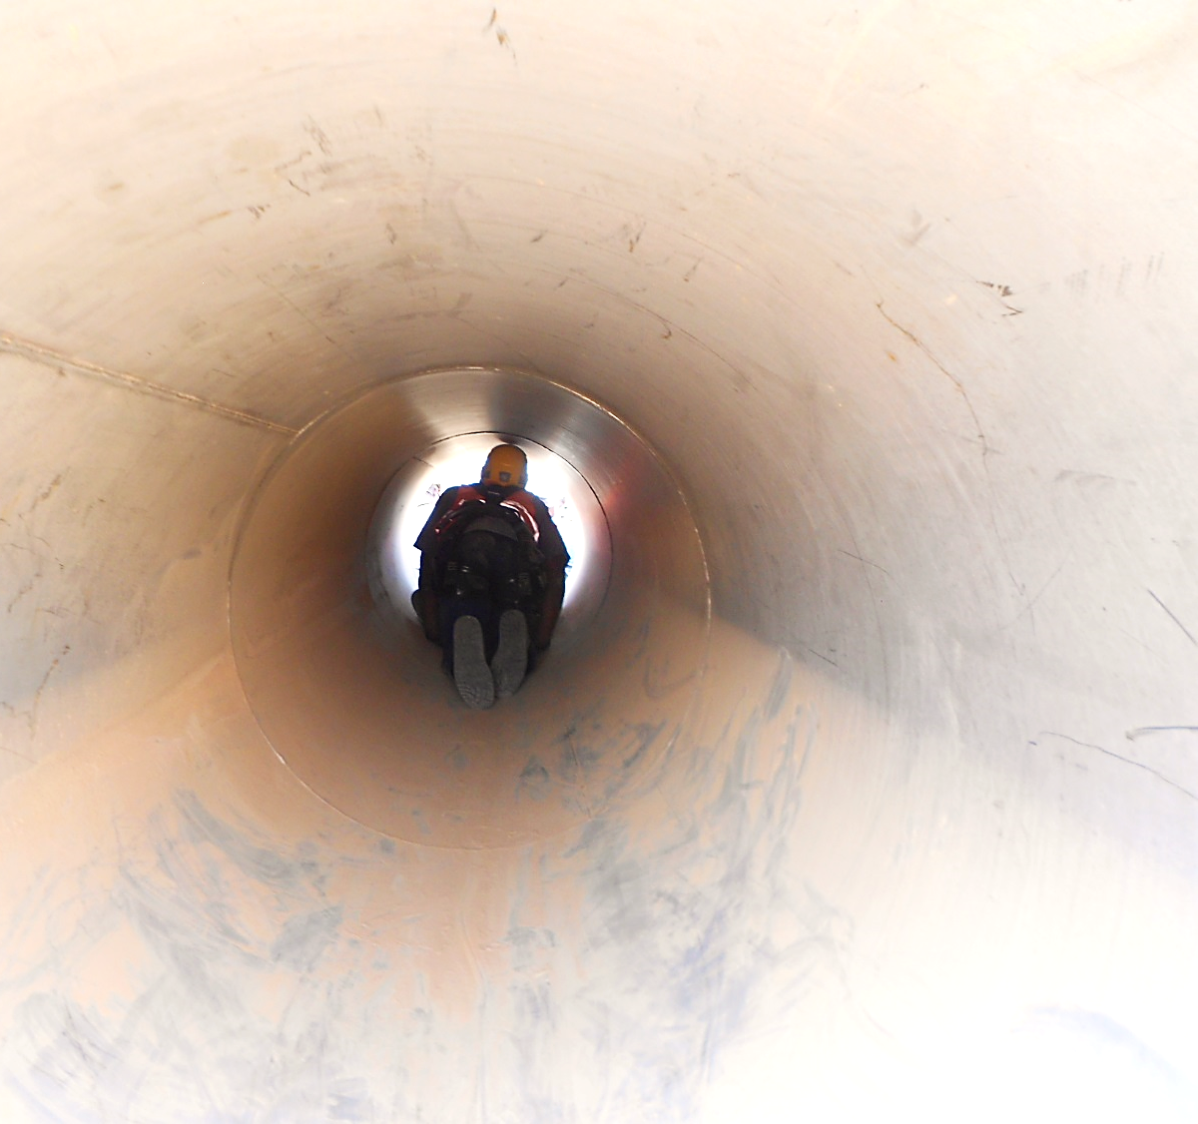
Module 1: Evaluating a Confined Space
Notes:
Upon completion of this module, the students will be able to:
Categorize confined spaces based on the three criteria.
Analyze the characteristics of a permit-required confined space.
Hand out the Confined Space Policy FCX-HS05, Technical Supplement and Permit (FG pages 109-114). These will be referred to in this module and throughout the course.

Slide 9
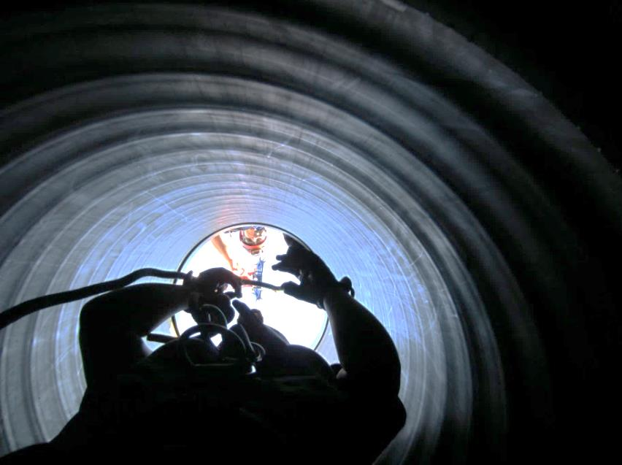
Evaluating a Confined Space
To be considered a confined space, all three criteria must be met
What confined spaces do you encounter?
Confined Space Criteria
Large enough to bodily enter | Limited or restricted means of entry/exit | Not designed for continuous occupancy
Notes:
All three criteria listed must be met to be considered a confined space.
Refer to the Confined Space Policy FCX-HS05 (FG page 21-22) while progressing through this slide.
Ask students to interpret what each criteria means then review the criteria below.
Large enough to enter guideline:
Once any portion of the body crosses the plane of the space, entry has occurred.
Limited or restricted means of entry/exit includes:
When the entrant’s ability to escape or be rescued is hindered.
When the entrant must bend, stoop, crawl, or climb to access the space.
An area with two exits where both are hard to get through or one is blocked by construction/debris.
Not designed for continuous occupancy guidelines:
The presence of a door does not eliminate the space as a confined space.
Spaces designed for continuous occupancy include offices and walkways.
Ask students what confined spaces they encounter in their specific work areas.
Each site inventories and labels all recognized confined spaces.
Some confined spaces may not be formally recognized or signs may be damaged, faded, or missing so students need to be able to recognize a confined space.
Contact a supervisor, management, or a Health and Safety Professional when a confined space is discovered or suspected.

Slide 10
Evaluating a Confined Space
There is no such thing as NPRCS with a hazard
If any danger exists, the space is permit-required
Non-Permit Required Confined Space (NPRCS) | Permit-Required Confined Space (PRCS)
No potential or existing hazard that may cause death or serious injury Includes atmospheric and physical hazards | At least one of the following hazards exists/potentially exists: Atmospheric Engulfment Configuration Other serious hazards
Notes:
Review the conditions that make up a NPRCS.
Review the conditions that make up a PRCS.
Refer to the Confined Space Policy FCX-HS05 (FG page 21-22) while progressing through this slide.
Only one of the following is needed to be a PRCS:
Contains or has potential to contain a hazardous atmosphere,
Contains material with the potential to engulf an entrant, or
Has an internal configuration that could trap or asphyxiate an entrant (i.e. inwardly converging walls or floor sloping down that tapers to a smaller area)
Contains other serious safety or health hazards.
Each hazard will be explained in depth in the next module.

Slide 11
Guess the Space
Directions
As a small group, choose a specific confined space (or non-confined space) and think of 4-5 clues that describe it
Groups have 5 minutes to write the clues on the front of the 3x5 card and the answer on the back
Rotating through all of the cards, a volunteer reads the clues to the class
The other members of the class guess the confined space or non-confined space described
The volunteer reveals the correct answer and the class discusses how it does or does not meet the three criteria of a confined space
Activity 2
Notes:
Time
Approximately 15 minutes
Materials
3x5 cards (at least 1 per group)
Pen (at least 1 per group)
Purpose
This activity gives students the opportunity to classify a space based on the three criteria for a confined space. This is accomplished as students analyze spaces in small groups to choose a confined space (or non-confined space) and then create clues that describe the space. This is further accomplished as students evaluate the clues they hear to identify the confined space described and discuss how each answer meets the three criteria of a confined space.
Note: If the facilitator uses this activity in place of the PPT slides rather than as an activity after presenting the module’s PPT slides, make sure all talking points provided in the FG are discussed according to the level needed by the students/sites. Talking points are found in the FG alongside the corresponding slides.
Instruction
Break the class into groups of approximately five students.
Groups of students choose a specific confined space (or non-confined space) and think of 4-5 clues to describe it.
Give the groups 5 minutes to write the clues on the front of a 3x5 card and the answer on the back (If the class is small, have them create a card for more than one confined space or non-confined space).
Rotating through all of the cards, have a volunteer read the clues to the entire class.
After reading each clue on a card, the other members of the class (except the group who’s card is being read) guess the confined space or non-confined space described.
The volunteer reveals the correct answer and the class discusses how it does or does not meet the three criteria of a confined space.

Slide 12
On the Fence
Directions
Line up one behind the other in the middle of the room facing forward
Note the signs on each side of the room: “Confined Space” and “Not a Confined Space”
After the facilitator displays a photo, decide if it is a confined space or not
Step to the left or right toward the sign that matches the answer
Facilitator reveals the correct answer and the classes discusses the characteristics
Line back up and repeat the process for the remaining photos
Activity 3
Notes:
Time
Approximately 10 minutes
Materials
Confined Space and Not a Confined Space signs, FG p.33-34
Tape to affix signs to wall
Purpose
This activity gives students the opportunity to classify a space based on the three criteria for a confined space. This is accomplished as students decide if the space shown in each photo is a confined space or not a confined space.
Note: If the facilitator uses this activity in place of the PPT slides rather than as an activity after presenting the module’s PPT slides, make sure all talking points provided in the FG are discussed according to the level needed by the students/sites. Talking points are found in the FG alongside the corresponding slides.
Instruction
Use the two signs on pages 31 and 33 to label one side of the room “Confined Space” and the other “Not a Confined Space”.
Line students up one behind the other in the middle of the room facing forward.
Show students one PPT slide at a time and have them decide if each photo shown is a confined space or not.
Tell students to take a step to the left or right toward the sign that matches their answer.
Advance through the animations on each slide to discuss the confined space criteria(s) that is met/not met and the correct answer.
Line students back up and repeat the process for the remaining photos.

Slide 13
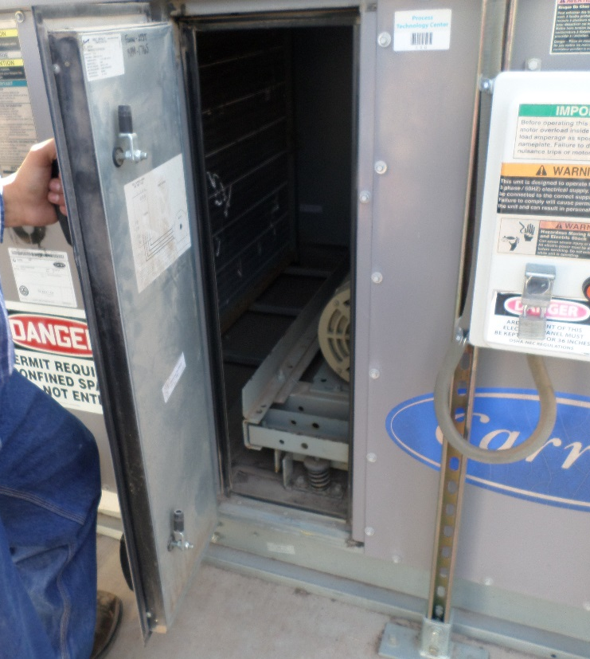
On the Fence
AC Unit
Large enough to enter
Limited or restricted means of entry or exit
Not designed for continuous occupancy
Confined Space
Notes:
AC Unit
Meets all criteria.

Slide 14
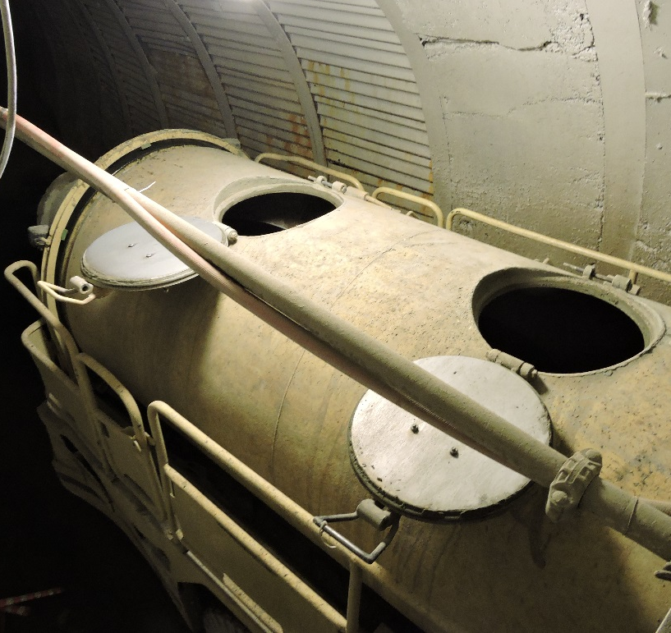
On the Fence
Boiler Tank
Large enough to enter
Limited or restricted means of entry or exit
Not designed for continuous occupancy
Confined Space
Notes:
Boiler Tank
Meets all criteria.

Slide 15
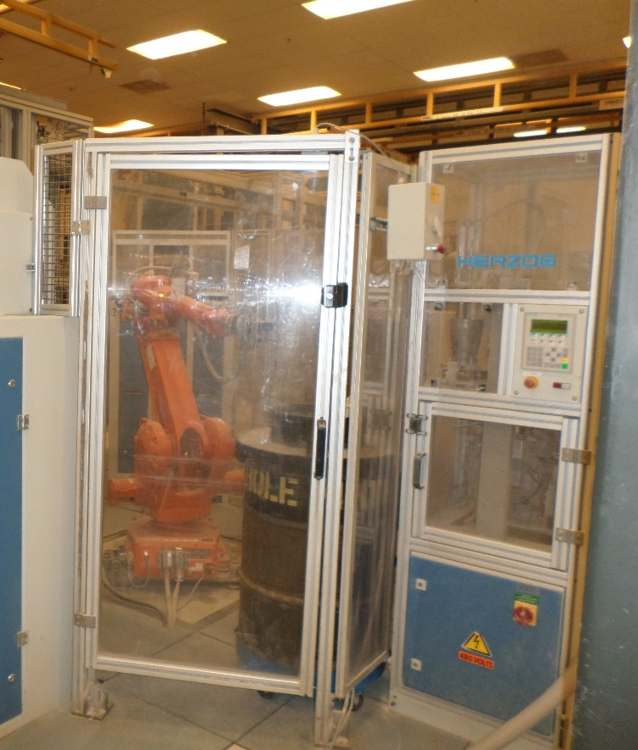
On the Fence
Robotics Enclosure
Large enough to enter
Not a Confined Space
Notes:
Robotics Enclosure
The enclosure is designed for continuous occupancy.
The enclosure does not have limited means of entry or exit.

Slide 16
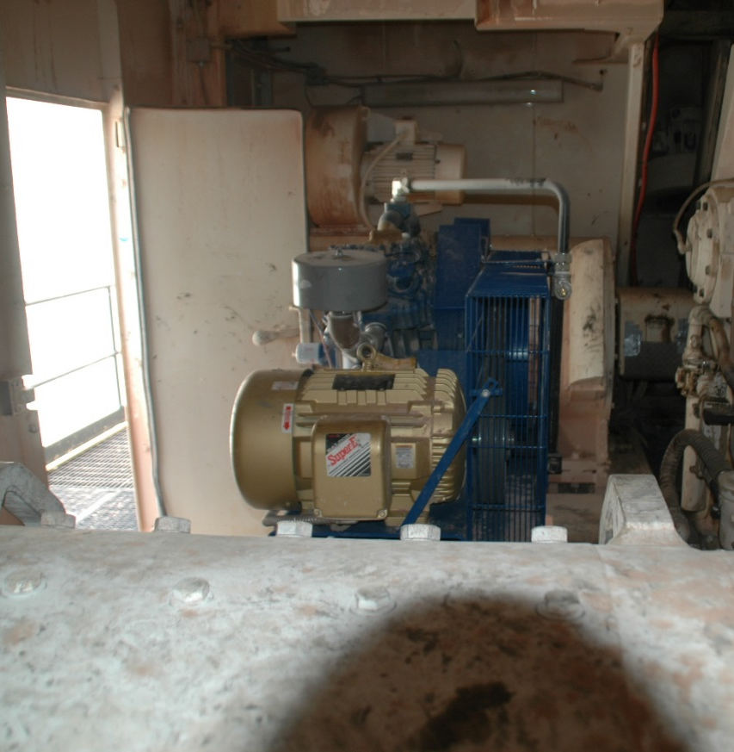
On the Fence
Mechanical Room for a Shovel
Large enough to enter
Not a Confined Space
Notes:
Mechanical room for a shovel
Not a Confined Space
Mechanical room does not have a limited or restricted means of entry or exit.
Mechanical room is designed for continuous human occupancy.

Slide 17
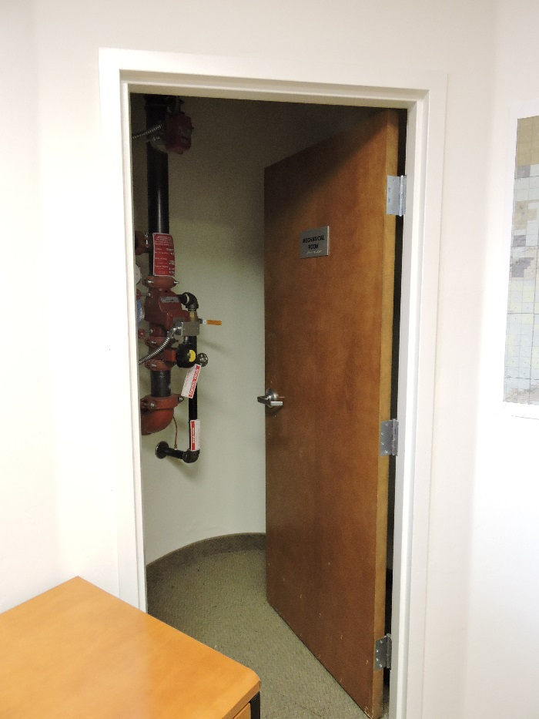
On the Fence
Fire Riser Room
Large enough to enter
Not a Confined Space
Notes:
Mechanical room for a shovel
Not a Confined Space
Mechanical room does not have a limited or restricted means of entry or exit.
Mechanical room is designed for continuous human occupancy.

Slide 18
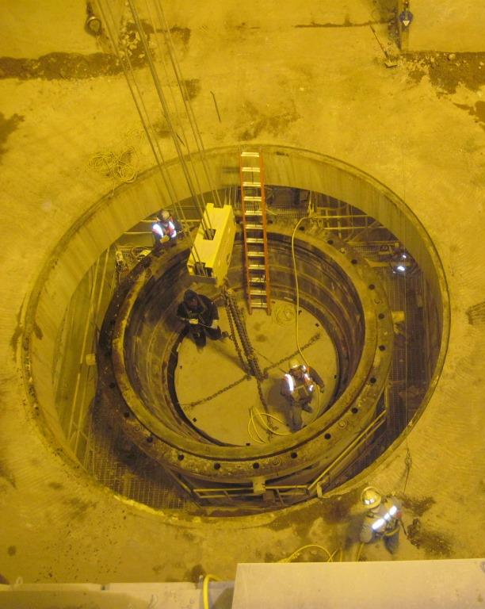
On the Fence
Crusher Three Dump Pocket
Large enough to enter
Limited or restricted means of entry or exit
Not designed for continuous occupancy
Confined Space
Notes:
Dumpster
Meets all criteria.

Slide 19
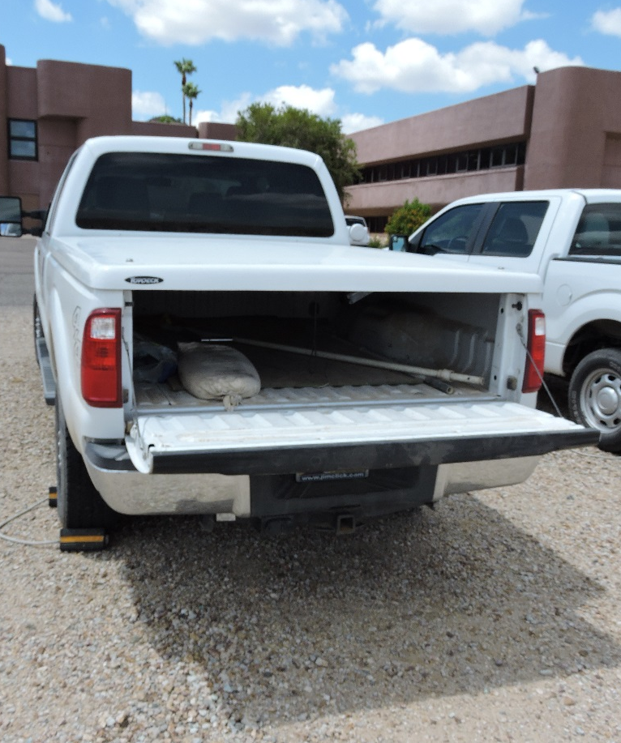
On the Fence
Truck Bed with Cover
Limited or restricted means of entry or exit
Large enough to enter
Not designed for continuous occupancy
Confined Space
Notes:
Mill Walkway
This walkway does not have a limited or restricted means of entry/exit.
This walkway is designed for continuous occupancy.

Slide 20
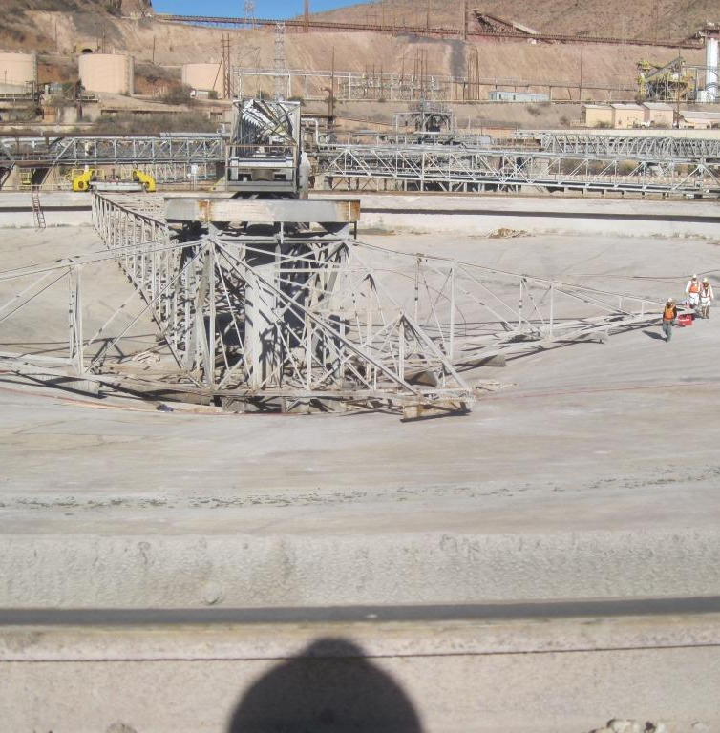
On the Fence
Thickener
Large enough to enter
Limited or restricted means of entry or exit
Not designed for continuous occupancy
Confined Space
Notes:
Sewer
Meets all criteria.

Slide 21
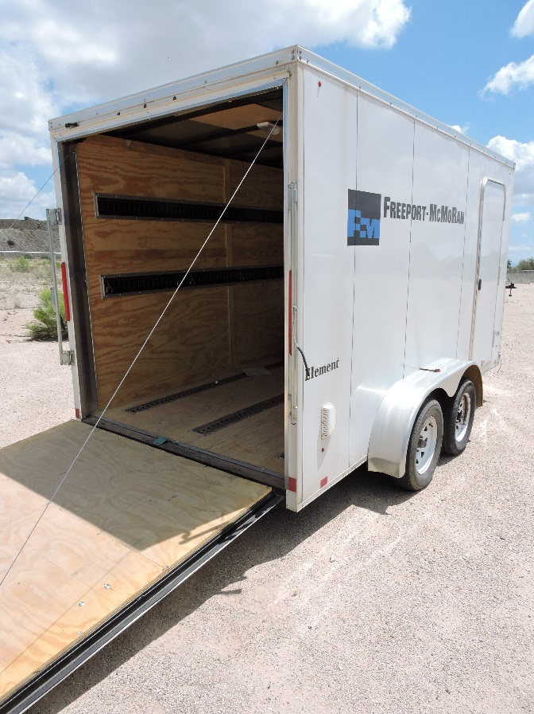
On the Fence
Trailer
Large enough to enter
Not a Confined Space
Notes:
Tunnel Way
This tunnel way does not have a limited or restricted means entry/exit.
This tunnel way is designed for continuous occupancy.

Slide 22
Flash Cards
Directions
As a small group, choose a person to be the clue-giver
The clue-giver uses physical and verbal clues to get the rest of the group to guess the confined space written on a card
Once a card is guessed correctly, immediately start the next card
You may “pass” to the next card and return to it after attempting the remaining cards
After 5 minutes, the group with the most correct answers wins
As a class, discuss how the cards meet the three criteria of a confined space
Activity 4
Notes:
Time
Approximately 10 minutes
Materials
Flash Cards, pp.39-41 (1 copy of all cards for each group, cut cards before class begins)
Purpose
This activity gives students the opportunity to classify a space based on the three criteria for a confined space. This is accomplished as students evaluate the confined spaces given on the card to create clues to describe the space. The students then discuss how each answer meets the three criteria of a confined space.
Note: If the facilitator uses this activity in place of the PPT slides rather than as an activity after presenting the module’s PPT slides, make sure all talking points provided in the FG are discussed according to the level needed by the students/sites. Talking points are found in the FG alongside the corresponding slides.
Instruction
Break the class into groups of approximately five students.
Give a stack of all the Flash Cards to one person in each group.
Each group chooses one person to look at the Flash Cards and be the clue-giver.
The clue-giver uses physical and verbal clues to get the rest of the group to guess the confined space written on the card.
Once the group guesses correctly, the clue-giver immediately starts the next card.
If a group cannot guess the card, they may say “pass” to skip to the next card. Once the remaining cards are attempted, the group may return to any passed cards.
Give the group 5 minutes to guess as many of the words as possible.
The group with the most correct guesses wins.
As a class, discuss how the cards meet the three criteria of a confined space.
Note: There are many alternate ways to play this game. Groups can be smaller or larger than the recommended size or the time limit can be longer or shorter. Also, instead of using physical and verbal clues, the clue-giver could draw pictures on a flipchart. Another possibility is to switch the clue-giver after each correct answer. The facilitator should decide what will work best for the students.

Slide 23
Twenty Questions
Directions
Working in a small group, one person thinks of a specific PRCS or NPRCS
The other group members ask questions that can be answered “yes” or “no”
After hearing the answer, the questioner may guess the confined space
The group may ask a total of 20 questions
If no one guesses correctly in 2 minutes, the answer is revealed
Repeat the steps with another group member answering the questions
As a class, discuss how each answer meets the characteristics of a PRCS or NPRCS
Activity 5
Notes:
Time
Approximately 10 minutes
Materials
None
Purpose
This activity gives students the opportunity to analyze the characteristics of a PRCS. This is accomplished as students determine an appropriate PRCS or NPRCS for the activity and as they question and evaluate the answers given to identify the correct PRCS or NPRCS.
Note: If the facilitator uses this activity in place of the PPT slides rather than as an activity after presenting the module’s PPT slides, make sure all talking points provided in the FG are discussed according to the level needed by the students/sites. Talking points are found in the FG alongside the corresponding slides.
Instruction
Break the class into groups of approximately five students.
One student in each group thinks of a specific confined space (PRCS or NPRCS)
The other students in the group ask questions about the confined space that can be answered with a simple “yes” or “no”.
After hearing the answer, the questioner is allowed to guess the confined space.
If the guess is correct, the questioner now thinks of a new confined space. If the answer is incorrect, the next member of the group asks a yes or no question.
The group is allowed to ask a total of twenty questions.
If no one guesses correctly in 2 minutes, the student thinking of the confined space reveals the answer.
Repeat the steps until all students have had a chance to answer the questions or until time is up.

Slide 24
PRCS vs NPRCS
Directions
Review the directions on the worksheet
Complete the worksheet
After 5 minutes, the class discusses the correct characteristics listed in each category
Activity 6
Notes:
Time
Approximately 10 minutes
Materials
PRCS vs NPRCS worksheet, FG p.43 (1 per student)
Pen (1 per student)
Purpose
This activity gives students the opportunity to analyze the characteristics of a PRCS. This is accomplished as students compare and contrast a PRCS and a NPRCS.
Note: If the facilitator uses this activity in place of the PPT slides rather than as an activity after presenting the module’s PPT slides, make sure all talking points provided in the FG are discussed according to the level needed by the students/sites. Talking points are found in the FG alongside the corresponding slides.
Instruction
Give each student a PRCS vs NPRCS worksheet.
Review the directions on the worksheet.
Use the Venn diagram to chart the similarities/differences between PRCS & NPRCS.
Characteristics are assigned a letter in the box at the bottom of the page.
Place the letters that describe a PRCS in the circle on the left and those that describe a NPRCS on the right. Letters that describe both belong in the center
Give students approximately five minutes to complete individually or as a small group.
Discuss the correct answers as a class.
Answer Key
PRCS
B – Engulfment hazard
C – Any serious hazard
D – Atmospheric hazard
E – Configuration hazard
J – Hazard that may cause death or serious injury
NPRCS
A – No physical hazard
F – No atmospheric hazard
K – No potential hazard that may cause death or serious injury
L – No existing hazard that may cause death or serious injury
Both
G – Large enough to bodily enter
H – Not designed for continuous occupancy
I – Limited or restricted means of entry or exit

Slide 25
Face-Off
Directions
Three scribes are needed to write down the traits of a PRCS, a NPRCS, and traits that describe both on the charts
Stand in small, equal numbered groups
The facilitator points to a group that quickly shouts out the title of a chart and a trait that belongs there
The facilitator quickly points to another group that does the same thing
If a group repeats an answer, puts a trait in the wrong category, or does not answer in 5 seconds, one player must sit out for the rest of the activity
Continue until only one group remains or no groups can come up with an answer
Discuss the characteristics as a class
Activity 7
Notes:
Time
Approximately 10 minutes
Materials
Markers (3)
Flipchart paper (3 pieces)
Purpose
This activity gives students the opportunity to analyze the characteristics of a PRCS. This is accomplished as students work in a group to develop a list of characteristics for a PRCS and a NPRCS.
Note: If the facilitator uses this activity in place of the PPT slides rather than as an activity after presenting the module’s PPT slides, make sure all talking points provided in the FG are discussed according to the level needed by the students/sites. Talking points are found in the FG alongside the corresponding slides.
Instruction
Write PRCS, NPRCS, and Both each on a separate sheet of flipchart paper and hang the sheets in the front of the room.
Have three volunteers act as scribes as the students list identifying traits of a PRCS, identifying traits of a NPRCS, and traits that describe both a PRCS and a NPRCS on the corresponding paper.
Break the remaining students into small, equal numbered groups and have each group stand.
The facilitator points to a group and the group quickly shouts out the title of any chart and a trait that belongs in that category.
The facilitator quickly points to another group that does the same thing
If a group fails to shout out an answer within 5 seconds, repeats an answer, or puts an answer in the wrong category, one player must sit down and can no longer help the group.
Continue until only one group remains or until no groups can think of additional traits.
Discuss each flipchart pointing out any interesting or vital ideas recorded.

Slide 26
Module 2: Permit-Required Confined Space Hazards
Notes:
Upon completion of this module, the students will be able to:
Evaluate hazards associated with permit-required confined spaces.

Slide 27
PRCS Hazards
General Considerations
Never assume a space is safe for entry each time
Take into account existing hazards
Consider the effects of the work being performed
Initially treat all confined spaces as a PRCS
Common hazards
Poor ventilation
Limited size
Restricted access
Notes:
Confined spaces present unique safety challenges because the hazards are not always apparent.
Review the general considerations on the slide pointing out the following:
Poor ventilation
Leads to hazardous atmosphere
Limited size
Closer to hazards
Less movement
Restricted access
Difficult entry and exit
Affects timely emergency rescue

Slide 28
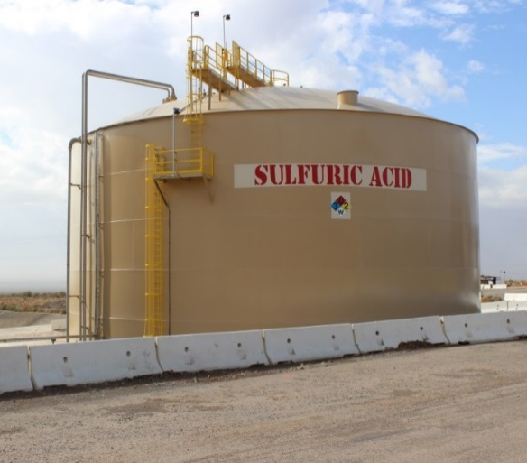
PRCS Hazards
Atmospheric Hazards
Atmospheric conditions that do not sustain life
Risk of death, incapacitation, impairment of self-rescue, injury, or acute illness
Notes:
Review the slide.
More specific atmospheric hazards will be discussed on the following slides.
Refer to “Step 1 – Hazard Identification and Recognition” on the Confined Space Entry Permit while progressing through this slide.

Slide 29
PRCS Hazards
Oxygen concentration
What are the differences between Normal, Oxygen Enriched, and Oxygen Deficient Air?
What risks are associated with each and how can they be mitigated?
Notes:
Refer to “Step 1 – Hazard Identification and Recognition” and “Step 2 – Assessing the Space” on the Confined Space Entry Permit while progressing through this slide.
Ask the question and use the chart to discuss the differences between the three types of air.
Normal Air
21% oxygen.
78% nitrogen.
1% other gases including argon, carbon dioxide, and methane.
Oxygen levels must stay between 19.5% and 23.5% for a safe atmosphere.
Oxygen Enriched Air
When oxygen in greater than 23.5%.
Not a risk by itself but is prone to accelerated and explosive combustion.
Materials not normally a fuel source can become one.
Mitigate risk by doing the following:
Calmly and carefully evacuate (do not drop metal tools or use electrical equipment).
Remove welding lines when taking a break from the space.
Never bring compressed gas in a space (except breathing air).
Never ventilate with pure oxygen.
Oxygen Deficient Air
When oxygen is less than 19.5%.
Person cannot breathe and suffocates (even without toxic materials present).
Consumption – Oxygen is removed from air through usage.
Displacement – Oxygen is moved by another gas to a different location.
Risks can include accelerated heartbeat, impaired thinking and coordination, convulsive movements, and death.
Mitigate risk by leaving the space and notifying supervision.

Slide 30
PRCS Hazards
Flammable gases and vapors
What elements are needed to start a fire?
What are some common guidelines for protection against this hazard?
What are UELs and LELs?
100% Flammable gas by volume
Too Rich for Combustion
UEL
Combustible Mixture
100% LEL
Too Lean for Combustion
0% LEL / Flammable gas by volume
Notes:
Refer to “Step 1 – Hazard Identification and Recognition” and “Step 2 – Assessing the Space” on the Confined Space Entry Permit while progressing through this slide.
Ask the question and discuss the three ingredients needed to start a fire (fire triangle).
Heat (ignition source)
Fuel (combustible gas such as methane or acetylene, or vapors of solvents/fuels such as gasoline, kerosene, or toluene)
Oxygen
Ask the question and discuss common guidelines for protection against this hazard.
Follow appropriate Hot Work procedures and guidelines.
Prohibit tanks/cylinders of compressed gases (other than breathing air) in confined spaces.
Only use welding leads, cutting torch hoses, hose extensions, etc. when required and remove from the space when not in use.
Ask the question and discuss the differences between LELs and UELs.
Lower Explosive Limit (LEL)
Lowest concentration (air-fuel mixture) at which a gas ignites.
Precautionary standard – remain below 10%.
Below this limit, mixtures are too lean to burn.
Upper Explosive Limit (UEL)
Highest concentration at which a gas ignites.
Above this limit, mixtures are too rich to burn.

Slide 31
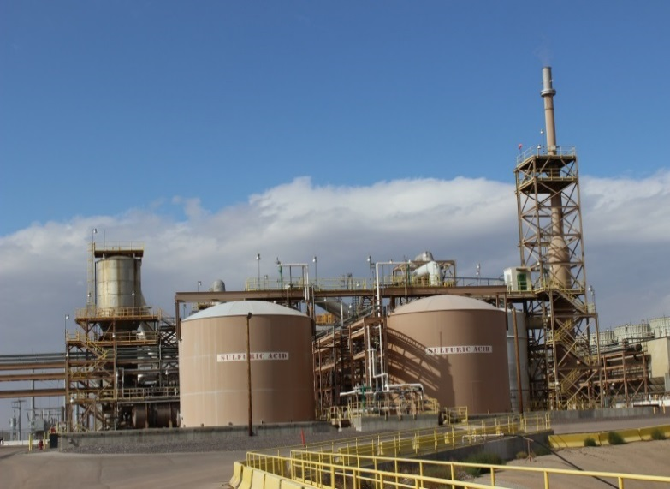
PRCS Hazards
Potentially toxic air contaminants
Atmospheres containing known poisonous gases, vapors, or fumes
Can produce immediate and delayed effects
What situations can create toxic atmospheres?
Notes:
Refer to “Step 1 – Hazard Identification and Recognition” and “Step 2 – Assessing the Space” on the Confined Space Entry Permit while progressing through this slide.
Review the slide.
Ask the question and discuss situations that can create toxic atmospheres. Examples are provided below.
Toxic products stored in the space.
Absorbed into vessel walls and released when work is performed.
Example – removing sludge or crust.
Areas adjacent to the space.
Toxins produced can enter/accumulate in a confined space
Example – engines producing carbon monoxide.
Type of work being performed.
Vapors can build up to toxic or explosive levels.
Examples – welding, cutting, brazing, painting, scraping, sanding, using cleaning solvents

Slide 32
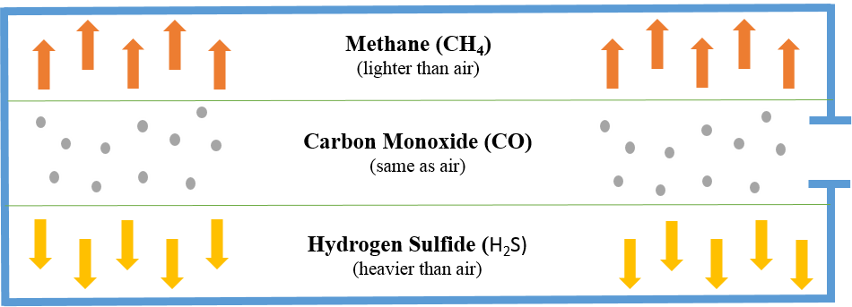
PRCS Hazards
Potential hazardous gases
Understand how gases layer
Monitor top, middle, and bottom of a space
Notes:
These are three examples of toxic gases found in confined spaces.
Gas type effects how it mixes with normal air.
Methane
Lighter than air.
Can gather at the top of a space.
Displaces oxygen resulting in oxygen deficient atmosphere.
Causes dizziness, unconsciousness, and asphyxiation.
Carbon Monoxide
Mixes evenly with normal air.
Prevents oxygen absorption in the blood stream.
Causes dizziness, unconsciousness, asphyxiation, and death.
Hydrogen Sulfide (H₂S)
Heavier then air and settles at the bottom of a space.
Byproduct from some Molybdenum and Mill processes.
Blocks respiration causing odor fatigue, rapid loss of consciousness, and death.
Test top, middle, and bottom of spaces.

Slide 33
PRCS Hazards
IDLH (Immediately Dangerous to Life or Health)
Poses immediate or delayed threat to life
Causes irreversible adverse health effects
Interferes with escape
What three atmospheric conditions require immediate evacuation?
What are the requirements for an IDLH entry?
Notes:
IDLH spaces should not be entered except by properly trained and equipped emergency personnel or when entry is specifically required to follow detailed procedures.
Ask the first question and discuss the conditions requiring immediate evacuation:
There is an oxygen rich/deficient atmosphere
LEL/LFL (lower explosive or flammable limit) is greater than 10%
Toxic gases reach the IDLH limits found in the following locations:
Safety Data Sheets (SDS) and Health and Safety (H&S)
Regulatory agencies
U.S. National Institutes of Occupational Safety (NIOSH) online Pocket Guide to Chemical Hazards
If IDLH is discovered, immediately evacuate and evaluate.
Re-entry can occur after the source of the hazard is identified and controlled.
Ask the second question and discuss the requirements for IDLH entry:
Use intrinsically safe electrical equipment.
Use respiratory protection.
Station one or more trained attendants outside the space.
Maintain visual, voice, or signal communication between entrants and attendants.
Station a rescue team immediately outside the space.

Slide 34
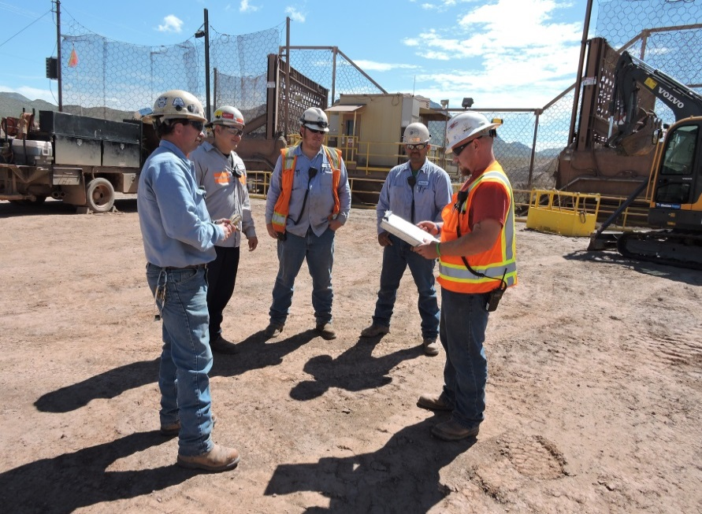
PRCS Hazards
To protect yourself from hazardous atmospheres:
Utilize the SDS (Safety Data Sheet)
Contact a Health and Safety Professional or Industrial Hygienist with any questions
Notes:
Read product labels and use SDSs to:
Determine appropriate PPE.
Understand the exposure symptoms of the chemicals being used or generated such as carbon monoxide, sulfur dioxide, hydrogen sulfide, and residue remaining in vessels.
Know what emits dangerous fumes such as cleaning solvents, epoxies, and paint.

Slide 35
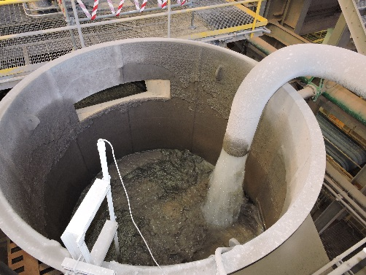
PRCS Hazards
Engulfment Hazards
Material surrounds and/or buries an entrant
Risk of asphyxiation by inhaling materials or surrounding materials compressing the chest
What are some examples of materials that pose a risk and where they can be found?
Notes:
Refer to “Step 1 – Hazard Identification and Recognition” and “Step 2 – Assessing the Space” on the Confined Space Entry Permit while progressing through this slide.
One of the leading causes of death from physical hazards.
Material can move quickly and unexpectedly as it is drawn in a funnel-shaped path down the outlet.
Compression can lead to strangulation, and constriction/crushing.
Ask the question and discuss examples of materials that pose a risk (such as sand, gravel, dust, grain, and water), and where they can be found.
Mitigate risk by:
Releasing material through lines (Disconnect, blank, or double block and bleed).
Build sufficient retaining walls for trenching and excavating.

Slide 36
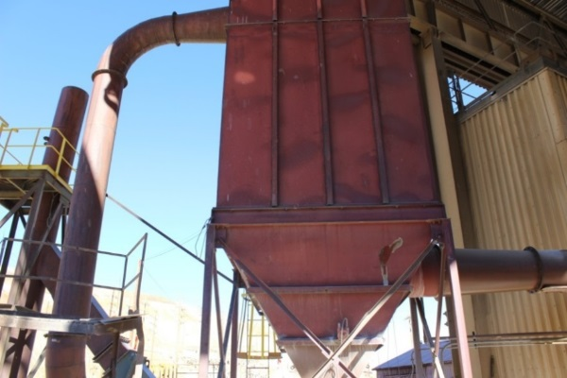
PRCS Hazards
Configuration Hazards
Inwardly converging walls or downward sloping floor that tapers to a smaller area
Risk of slipping/falling, entrapment, asphyxiation, and hazardous atmospheres
What are some examples of entrapment?
Notes:
Refer to “Step 1 – Hazard Identification and Recognition” and “Step 2 – Assessing the Space” on the Confined Space Entry Permit while progressing through this slide.
Employees could fall and be trapped by the inwardly converging walls resulting in suffocation due to pressure on the upper torso.
Ask the question and discuss examples of entrapment hazards. Usually fall into one of three categories below:
Cone trap
Found at the bottom of cyclones and precipitators.
Cylinder trap
A pipe or similar opening big enough to fall in at the bottom of a space.
Example – a pipe leading to an elevated water tower.
Wedge trap
Converging walls that entrap someone who falls in.
Example – commonly found in bins, large boilers, and sand hoppers.
Examples of where other configuration hazards are found – dust collectors, thickeners, flotation cells/tanks, feed chutes, ball bins, sumps large enough to enter.

Slide 37
PRCS Hazards
Other Serious Hazards
Hazards that cause irreversible health effects, pose a threat to life, or interfere with unaided escape
What risks are associated with the following hazards and how can each be mitigated or eliminated?
Electrical
Mechanical
Fluid pressure
Chemical
Bridging
Slips, trips, falls
Temperature extremes
Heat-related illnesses
Notes:
Review the definition of other serious hazards.
Refer to “Step 1 – Hazard Identification and Recognition” and “Step 2 – Assessing the Space” on the Confined Space Entry Permit while progressing through this slide.
Ask the question and discuss risks associated with the hazards and how each can be mitigated.
Electrical
Electrical vaults and structures (especially areas below ground) with poor air quality.
Electric power tools – inadequate grounding system, no GFCI, or low-voltage.
Mitigate hazards by following LOTOTO procedures.
Mechanical
Can be struck by moving parts such as agitators, pumps, and conveyors
Mitigate hazards by following LOTOTO procedures.
Fluid pressure
Create the potential for drowning and chemical exposure.
Mitigate hazards by following LOTOTO procedures.
Chemical
Residual material & cleaning solutions can cause chemical reactions/volatilization
Bridging
Hollow space beneath the surface may collapse.
Storage vessel size and amount of moisture contribute to bridging.
Mitigate hazards by using safety lines, solving problems remotely, and evaluating/ removing potential hazards before continuing.
Slips, trips, and falls
Injury or death may occur when employees fall or something falls on him/her.
Follow FMI’s Open Hole, Flagging/Barricading, and Working at Heights policies.
Mitigate hazards with adequate lighting, good housekeeping (no wet, oily, or greasy surfaces), and proper inspection of equipment, hoses, and internal structures.
Temperature extremes
Environmental and man-made heat and cold
Examples – cold reducing hand mobility and the risk of steam.
Heat-related illnesses
Jobs become more dangerous in the heat and/or humidity of summer.
Examples – heat rash, heat cramps, heat exhaustion, or heat stroke
Mitigate hazards by staying in the best possible health, acclimatizing, working at a steady pace, replenishing water and electrolytes before feeling thirsty, monitoring self and others, and acting quickly when symptoms appear.
Break
We recommend taking a 5-10 minute break after the activities for this module are completed. Give students time to stand up, stretch, use the facilities, etc. Clearly communicate what time you expect them to return to start the next module.

Slide 38
PRCS Poster
Directions
As a small group, create a poster for your assigned PRCS hazard
Include brief informational text and at least one drawing
Communicate the following:
Definition of your hazard
Risks associated with it
Examples of the hazard and/or locations where it is found
After 5 minutes, present the poster to the class and discuss the characteristics you listed
Activity 8
Notes:
Time
Approximately 15 minutes
Materials
A variety of markers
Flipchart paper (1 per group)
Purpose
This activity gives students the opportunity to evaluate hazards associated with permit-required confined spaces. This is accomplished by having students create a poster that communicates the hazards of a PRCS.
Note: If the facilitator uses this activity in place of the PPT slides rather than as an activity after presenting the module’s PPT slides, make sure all talking points provided in the FG are discussed according to the level needed by the students/sites. Talking points are found in the FG alongside the corresponding slides.
Instruction
Break the class into groups of approximately five students. Create at least four groups.
Give each group some markers and a piece of flipchart paper.
Assign each group one of the hazards of a PRCS. If there are more than four groups, more than one group may be assigned the same hazard.
Atmospheric
Engulfment
Configuration
Other serious hazards
Groups discuss their assigned hazard and create an informational poster on the hazard that includes at least one drawing with text and communicates the following:
Definition of the hazard
Risks associated with it
Examples of the hazard and/or locations where it is found
After 5 minutes, each group presents their poster to the class.

Slide 39
PRCS Summaries
Directions
As a small group, write a 32 word summary of the hazards of a PRCS
Read the summary to the class.
As a small group discuss and write a 16 word summary of the hazards of a PRCS
Read the summary to the class and explain how you narrowed down the original
Repeat the process with an 8 word summary
Repeat the process with a 4 word summary
As a class, discuss and write a 2 word summary of the hazards of a PRCS
Activity 9
Notes:
Time
Approximately 15 minutes
Materials
Writing paper (1 per group)
Pen
Purpose
This activity gives students the opportunity to evaluate hazards associated with permit-required confined spaces. This is accomplished by having students create written summaries of the hazards of a PRCS.
Instruction
Break the class into groups of approximately five students.
Groups of students work together to discuss their combined understanding of the hazards of a PRCS and write a 32 word summary of the topic.
After 3 minutes, each group reads their summary to the class.
Working in the small groups, students create a 16 word summary for the same topic by discussing what is most important.
After 2 minutes, each group reads their summary to the class and explains how they narrowed down their original summary.
Working in the small groups, students create an 8 word summary for the same topic by discussing what is most important.
After 1 minute, each group reads their summary to the class and explains how they narrowed down their original summary.
Working in the small groups, students create a 4 word summary for the same topic by discussing what is most important.
After 30 seconds, each group reads their summary to the class and explains how they narrowed down their original summary.
As a class, discuss and come up with a two word summary for the hazards of a PRCS.

Slide 40
Hazard Detective
Directions
Review the directions on the worksheet
Complete the worksheet
After 5 minutes, discuss the PRCS hazard answers as a class
Activity 10
Notes:
Time
Approximately 10 minutes
Materials
Hazard Detective worksheet, FG pp.59-608 (1 per student)
Pen (1 per student)
Purpose
This activity gives students the opportunity to evaluate hazards associated with permit-required confined spaces. This is accomplished as students discuss and write about the hazards shown in several photos of PRCSs.
Note: If the facilitator uses this activity in place of the PPT slides rather than as an activity after presenting the module’s PPT slides, make sure all talking points provided in the FG are discussed according to the level needed by the students/sites. Talking points are found in the FG alongside the corresponding slides. Also, the facilitator should demonstrate air monitor use with a site air monitor as appropriate during the activity. If possible, let students practice using air monitors.
Instruction
Give each student a Hazard Detective worksheet.
Review the directions on the worksheet.
Evaluate each photo for potential and existing confined space hazards.
Record the hazards you find in the appropriate column.
Give students approximately five minutes to complete individually or as a small group.
Discuss the correct answers as a class.
Answer Key
Engulfment
Configuration (Inwardly converging walls
Other serious hazards – Falls, rescue would be difficult
Atmospheric
Engulfment
Other serious hazards – Limited entry and exit, electrical, chemical
Atmospheric
Engulfment
Other serious hazard – Electrical
Engulfment
Configuration (Inwardly converging walls)
Other serious hazards – Electrical, mechanical, rescue would be difficult

Slide 41
Around the Room
Directions
As a small group, record key words and concepts on your group’s hazard chart for 2 minutes
Rotate to the next chart
Read the previously written content and add additional ideas for 2 minutes
Repeat until the groups have visited each hazard chart around the room
Discuss each poster and the hazards listed
Activity 11
Notes:
Time
Approximately 15 minutes
Materials
Flipchart paper (4 sheets)
Markers (4)
Purpose
This activity gives students the opportunity to evaluate hazards associated with permit-required confined spaces. This is accomplished by having students work in groups to discuss and record key words and concepts for each PRCS hazard category.
Note: If the facilitator uses this activity in place of the PPT slides rather than as an activity after presenting the module’s PPT slides, make sure all talking points provided in the FG are discussed according to the level needed by the students/sites. Talking points are found in the FG alongside the corresponding slides. Also, the facilitator should demonstrate air monitor use with a site air monitor as appropriate during the activity. If possible, let students practice using air monitors.
Instruction
Write each PRCS hazard category (Atmospheric, Engulfment, Configuration, and Other Serious Hazards) on a separate sheet of flipchart paper and hang the sheets in different areas around the room.
Break the class into four groups.
Station each group at a different hazard flipchart paper with a marker.
Groups have two minutes at each station to discuss and record key words and concepts associated with the hazard at which they are stationed.
Rotate the groups through each station every two minutes. Have them read the previously written content and add additional information.
After visiting all of the stations, discuss each poster as a class pointing out any interesting or vital ideas recorded.

Slide 42
PRCS Categories
Directions
Review the directions on the worksheet
Complete the worksheet
As needed, discuss how the word fits the category
The player with the most points at the end of all three rounds wins
Activity 12
Notes:
Time
Approximately 15 minutes
Materials
PRCS Categories worksheet, FG p.63 (1 per student)
Pen (1 per student)
Purpose
This activity gives students the opportunity to evaluate hazards associated with permit-required confined spaces. This is accomplished by having students identify key terms associated with the hazards of a PRCS.
Instruction
Break the class into groups of approximately five students.
Give each student a PRCS Categories worksheet.
Review the directions on the worksheet.
Choose and announce a letter before each round of play.
Tell players to write one word that begins with that letter and is associated with the appropriate PRCS hazard/category listed.
Give students three minutes to write down one word for each category. Tell them to stop writing as soon as the time is up.
Have the players take turns reading their answers to their group, crossing out any answers that match another player’s.
If necessary, have students explain/discuss how the word fits the category.
Creative answers are allowed but can be challenged. If the answer is challenged, all players vote and the majority rules.
Players score one point for each answer not crossed out.
Repeat the process with a new letter for each round.
The player in each group with the most points at the end of all three rounds wins. It is up to the facilitator if a prize is awarded.

Slide 43
Module 3: Controlling Confined Space Hazards
Notes:
Upon completion of this module, the students will be able to:
Evaluate the hazards and controls in a confined space.

Slide 44
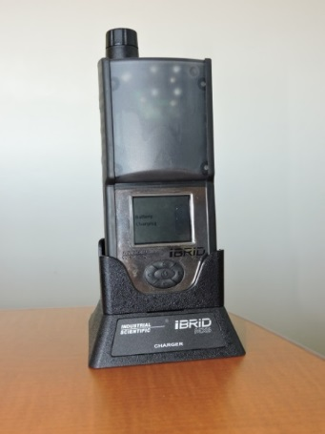
Controlling Confined Space Hazards
Monitoring the Atmosphere
Why is the correct type of air monitor important?
How do you inspect an air monitor?
Notes:
Materials
Air monitor(s) used at your site (Either 1 for the facilitator to demonstrate OR 1 for the facilitator to demonstrate and 1 per group so students can follow along and practice).
Instruction
Ask the first question and discuss why the correct type of air monitor is important.
Air monitors are designed to detect one or more specific gases.
Choose air monitor based on the gases most likely to occur in your workplace.
Ask the second question. As each step to the inspection is discussed, use a site air monitor to demonstrate how it is done. If groups have their own air monitors, demonstrate the step then have them practice on their air monitor.
Calibration – Calibrate the monitor monthly and record completion on a sticker.
Battery check – Ensure the monitor turns on and the battery is charged.
Zero – Confirm all sensors operate at normal levels in non-polluted air.
Clear the peaks – Erase history of the previous use to avoid false readings.
Bump test – Verify the monitor responds correctly by exposing it to a gas.
If an air monitor does not function properly or you are not trained/signed-off on a specific air monitor, do not proceed with the work.
Monitors sound an alarm when a small amount of an atmospheric hazard is detected.
Speak with a Health and Safety professional if you have questions about the type of air monitor to use, how to use it, or acceptable entry conditions.

Slide 45
Controlling Confined Space Hazards
Why is it important to pretest the space?
Oxygen
Flammable gases and vapors
Potential hazardous atmospheres
Pre-Entry Monitoring
How do you test the space?
Notes:
Ask the first question and discuss why the air is tested in this order.
Oxygen – Most air monitors are oxygen-dependent and do not work correctly in oxygen deficient air.
Flammable gases and vapors – Fire and explosion are often more immediate than exposure to toxic vapors/gases
Potential air contaminants – Exercise caution in the environment by knowing the potential materials in the air and their hazards.
Refer to “Step 4 – Pre-entry Air Sampling” on the Confined Space Entry Permit while progressing through this slide.
Ask the second question and discuss how you test a space.
Test around the opening then slowly open the access-way while testing.
Put a probe in the small cover openings or by cracking open the cover to test several feet in front of you without entering.
Test the top, middle, and bottom since gases layer based on their properties.

Slide 46
Controlling Confined Space Hazards
Monitoring the Space
Test four feet around yourself as you move/work
Move slowly so the monitor completes the testing
Be aware of layering/pocketing behind obstructions and in remote or low-lying areas
Test the top, middle, and bottom
What do you do if the monitor indicates a danger or the alarm sounds?
Notes:
Review the guidelines for monitoring a space.
If work stops for any amount of time, repeat air monitoring procedures before resuming work.
Re-entry and pre-entry testing are performed the same way.
Ask the question and discuss what to do if the monitor indicates a danger or the alarm sounds.
Do not enter the space or evacuate immediately.

Slide 47
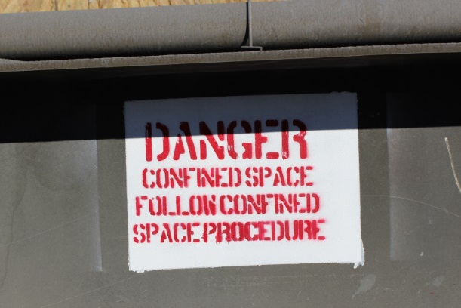
Controlling Confined Space Hazards
Continuous Monitoring
Why should you continue to monitor?
When is continuous monitoring necessary?
Notes:
Ask the question and discuss why continuous monitoring is needed.
Atmospheres can change rapidly.
Refer to “Step 4 – Pre-entry Air Sampling” on the Confined Space Entry Permit while progressing through this slide.
Ask the question and discuss that continuous monitoring is necessary when atmospheric hazards might:
Not be completely eliminated.
Result from the task being performed.
Move to the space from nearby activities or processes.
Be greater than 10% of the LEL/LFL.
Include oxygen rich, oxygen deficient, or toxic air.

Slide 48
Controlling Confined Space Hazards
Ventilating
Removing a contaminated atmosphere and replacing it with clean, fresh air
Often occurs before entering and can continue while performing work
Factors to consider:
Chemicals/residues
Type of work performed
Amount of air being supplied
Size/dimensions of the space
Notes:
Lack of adequate ventilation is a primary reason why confined spaces are hazardous.
Removing the harmful atmosphere through ventilation is an engineering control.
New contaminants can enter through a change in conditions or work being performed so ventilation needs to be continuous.
Refer to “Step 3 pre-entry Preparation” on the Confined Space Entry Permit while progressing through this slide.

Slide 49
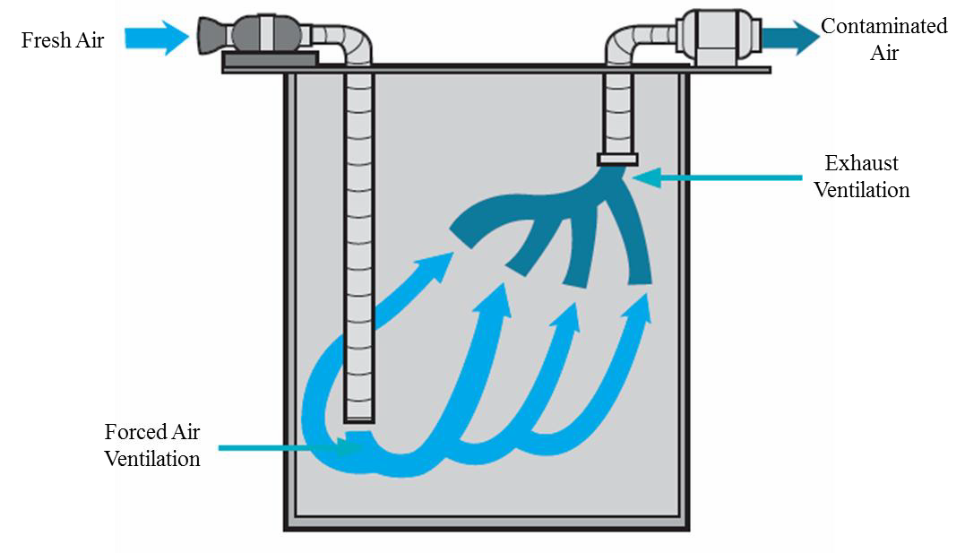
Controlling Confined Space Hazards
Ventilating
Ventilation types
Forced Air (Dilution)
Local Exhaust
Push-Pull Systems
Notes:
Forced Air (Dilution) Ventilation
Pushes fresh air into the space using blowers and flexible ducts.
Turbulence dislodges pockets of contaminants.
Local Exhaust Ventilation
Pulls air out of the space which removes the contaminants.
Intake port must be close to the contaminant and discharged outside of the confined space.
Fans that blow air (forced air) 30 feet only pull air (local exhaust) within 1 foot.
Push-Pull Systems
Pushes fresh air into the space and pulls contaminants out.
More efficient than using any one system.

Slide 50
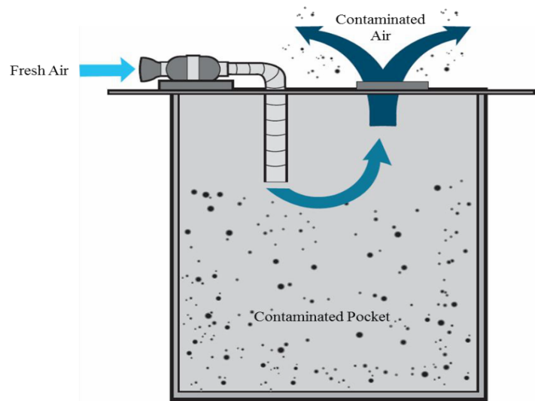
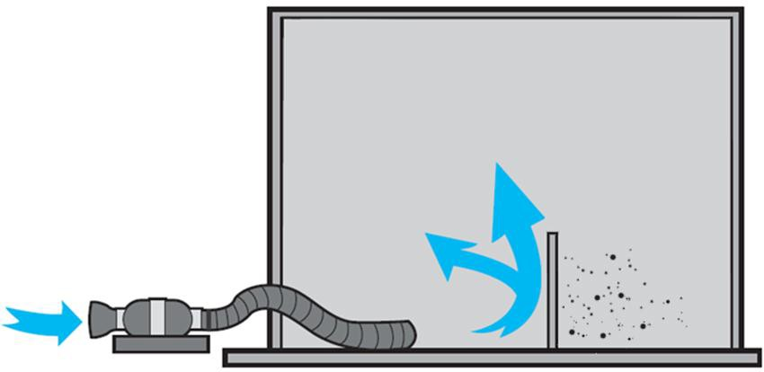
Controlling Confined Space Hazards
Ventilating
How can the size and configuration of a space affect how you ventilate?
How do you prevent pocketing and short-circuiting?
Notes:
Ask the question and discuss how the size and configuration can effect ventilation.
Blow fresh air into one end (top, bottom, sides) of long or deep spaces
Allow contaminated air to exhaust out of the other side.
Ask the question and discuss how to prevent pocketing and short-circuiting.
Pocketing – Ventilate the space thoroughly so no pockets will be left, and then test the space
Short-circuiting – Use a powerful blower to blow clean air into the entire space or a long duct to reach the bottom of the space

Slide 51
Controlling Confined Space Hazards
Ventilating
Ventilate with uncontaminated sources using systems that:
Do not locate air inlets near outlets
Do not draw contaminated air past workers
Do not impede access
Use explosion-proof fans
Verify contaminated air discharged is not a hazard or is redirected
Verify entrances cannot be accidentally closed
Do not use oxygen for ventilation
Notes:
Review the guidelines for ventilation systems.

Slide 52
Controlling Confined Space Hazards
LOTOTO (Lockout/Tagout/Tryout)
What is LOTOTO and why is it performed?
Notes:
Refer to “Step 3 – Pre-Entry Preparation and Controls” on the Confined Space Entry Permit while progressing through this slide.
Ask the question and briefly discuss what LOTOTO is and why it is performed.
Isolate or eliminate all energy sources that can enter a space.
De-energize all equipment before performing work
Follow Freeport-McMoRan’s LOTOTO policy (FCX-04).

Slide 53
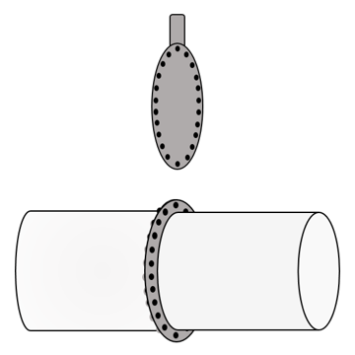
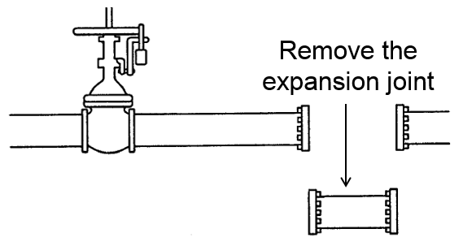
Controlling Confined Space Hazards
LOTOTO (Lockout/Tagout/Tryout)
How are blank/blind, double block and bleed, and a line break different?
Notes:
Refer to “Step 3 – Pre-Entry Preparation and Controls” on the Confined Space Entry Permit while progressing through this slide.
Ask the question and discuss how blank/bleed, double block and bleed, and a line break are different.
Each stops material from flowing into the confined space.
Blank/bleed (image on left) – Bleeding a pipeline, removing the flange bolts, and putting a block into the line or pipe at the joint.
Double block and bleed (image on top right) – Locking closed and draining two in-line valves, locking open a third valve (between the first two).
Line break (image on bottom right) – Removing a spool section (expansion joint) of a pipe/duct after LOTOTO has been performed.

Slide 54
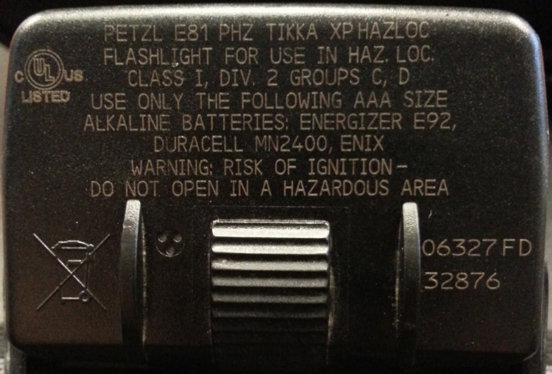
Controlling Confined Space Hazards
Intrinsically Safe (IS) Devices
When are IS devices needed?
Why are IS devices needed?
Notes:
Refer to “Step 3 – Pre-Entry Preparation and Controls” on the Confined Space Entry Permit while progressing through this slide.
Ask the question and discuss when IS devices are needed.
When working with electrical equipment in areas with flammable chemicals or vapors (Ignition source cannot be present).
Ask the question and discuss why an IS is needed.
When working with electrical equipment where a flammable atmosphere could exist, IS rated equipment decreases the hazard and must be used.
IS rated equipment is designed to not introduce an ignition source.

Slide 55
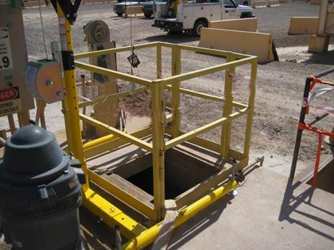
Controlling Confined Space Hazards
Barricading and Preventing Unauthorized Entry
What controls are put around a space to help secure it?
Who controls access to the space?
Notes:
Refer to “Step 3 – Pre-Entry Preparation and Controls” on the Confined Space Entry Permit while progressing through this slide.
Ask the question and discuss controls that help secure a space.
Barriers separating workers & hazards.
Examples include barricades, warning signs, temporary railings, and cones.
Follow Freeport-McMoRan’s Flagging and Barricading Policy (FCX-HS19).
Ask the question and discuss who controls access to the space and why.
Attendants control access to prevent unauthorized entry, notably in emergencies.

Slide 56
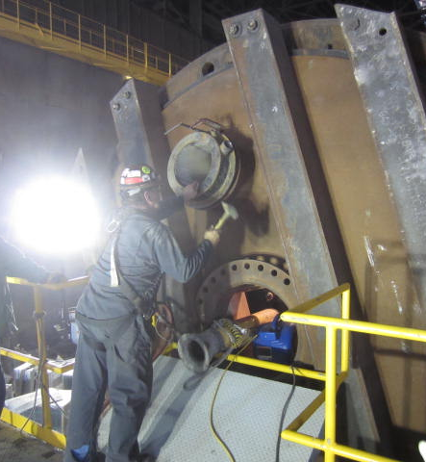
Controlling Confined Space Hazards
Light and Electrical Equipment
What precautions need to be considered if lights or other electrical equipment are added to a space?
Notes:
Refer to “Step 2 – Assessing the Space – Any other recognized hazards” on the Confined Space Entry Permit while progressing through this slide.
Ask the question and discuss the precautions needed when lights or other electrical equipment are added to a space.
Enough light to safely perform the job.
Low-voltage lighting.
IS classified and rated equipment if a potential explosive atmosphere exists.
GFCI protected and tested equipment if wet or damp conditions exist.

Slide 57
Team Quiz
Directions
As a small group, write three questions about controlling confined space hazards on the paper
Two factual questions with specific answers
One open-ended question with an opinion-based answer
After 3 minutes, each team presents their factual questions
Discuss the controlling confined space hazards answers as a class
Each team presents their open-ended question
Discuss the controlling confined space hazards answers as a class
Activity 13
Notes:
Time
Approximately 10 minutes
Materials
Flipchart paper (1 per group)
Marker (1 per group)
Purpose
This activity gives students the opportunity to evaluate the hazards and controls in a confined space. This is accomplished by having students work in groups to develop factual and open-ended questions to ask and discuss with the class.
Instruction
Break the class into teams of approximately five students.
Each team writes three questions about controlling confined space hazards on the flipchart paper.
Two questions are factual with a specific correct answer.
One question is open-ended and intended to lead to a discussion. These questions are generally answered with opinions and do not have right and wrong answers.
After 3 minutes, each team presents their factual questions to the class.
Discuss the answers as a class.
Each team presents their open-ended question to the class.
Discuss the answers as a class.
Question Examples
Factual
What ventilation type pulls air out of the space to remove contaminants? Local exhaust ventilation
True or False. Air monitors take a few moments to analyze the atmosphere. True
Open-ended
What do you think is the most important control when in a confined space? Why?
What hazards are most difficult to control? What makes them difficult?
Was there a time when you felt unsafe before entering a confined space? Why did you feel unsafe?

Slide 58
Test the Space
Directions
Review the directions on the worksheet
Complete the worksheet for the three scenarios
After 10 minutes, discuss the hazards and controls answers in each scenario as a class
Activity 14
Notes:
Time
Approximately 15 minutes
Materials
Test the Space worksheet, FG pp.75-78 (1 per student)
Pen (1 per student)
Purpose
This activity gives students the opportunity to evaluate the hazards and controls in a confined space. This is accomplished by having the students evaluate several scenarios to identify and record potential atmospheric hazards, monitoring techniques, and possible controls.
Instruction
Three scenarios and worksheets have been written for class use. A blank scenarios template has been provided so the facilitator can fill in a site-specific scenario/topic, if desired.
Give each student a Test the Space worksheet.
Review the directions on the worksheet.
Evaluate each of the three scenarios as if you were expected to complete the job described.
Use the scenario and list of chemical properties to answer the questions provided.
Give students approximately ten minutes to complete individually or as a small group.
Discuss the correct answers as a class.

Slide 59
Find Your Match
Directions
Break the class into two groups
Each person in one groups gets a Question Card and each person in the other group gets a matching Answer Card
You have 3 minutes to find the person with the card that matches your answer or question
When everyone has found their match, each partnership reads and discusses the hazards and/or controls on their cards with the class
Activity 15
Notes:
Time
Approximately 10 minutes
Materials
Find Your Match Questions and Answers Cards, pp.81-87 (1 copy of each page cut apart before class)
If used in place of the PPT – Air monitor(s) used at your site (Either 1 for the facilitator to demonstrate OR 1 for the facilitator to demonstrate and 1 per group so students can follow along and practice).
Purpose
This activity gives students the opportunity to evaluate the hazards and controls in a confined space. This is accomplished by reading questions related to evaluating hazards and controls in a confined space and figuring out the answers.
Note: If the facilitator uses this activity in place of the PPT slides rather than as an activity after presenting the module’s PPT slides, make sure all talking points provided in the FG are discussed according to the level needed by the students/sites. Talking points are found in the FG alongside the corresponding slides. Also, the facilitator should demonstrate air monitor use with a site air monitor as appropriate during the activity. If possible, let students practice using air monitors.
Instruction
Break the class into two groups.
Give everyone in one of the groups a Question Card and everyone in the other group a matching Answer Card. If there is an odd number of students, give one student two cards or the facilitator may also participate.
Give students 3 minutes to find the person with the answer/question that matches their card.
After all matches have been made, have each partnership read their question and answer to the class and discuss as necessary.
If time permits, repeat the process.
Answer Key
Why is the correct type of air monitor important?
Air monitors are designed to detect one or more specific gases and must be chosen based on the gases most likely to occur in your workplace
What steps are involved in an air monitor inspection?
Calibration, battery check, zero, clear the peaks, and bump test
What does it mean to “clear the peaks” on an air monitor?
Erasing the history of the previous use to avoid false readings
Why do you need to bump test your air monitor before use?
Verifies the monitor responds correctly by exposing it to the gas.
In what order is the atmosphere pre-tested?
Oxygen, flammable gases and vapor, potential air contaminants
Why is the oxygen in a space tested first?
Most air monitors are oxygen dependent and do not work properly in oxygen deficient air
What areas in the space do you test during pre-entry?
Around the opening, several feet in front of you, the top, middle, and bottom
What should be done if work stops for any amount of time?
Repeat the air monitoring procedures before resuming work
What do you do if the monitor indicates a danger or the alarm sounds? Do not enter or evacuate the space immediately
Why is continuous monitoring needed?
Atmospheres can change rapidly
When is continuous monitoring needed?
When atmospheric hazards might not be completely eliminated, result from the task being performed, move to the space from nearby activities, be greater than 10% of the LEL/LFL, or include oxygen rich, deficient, or toxic air
What factors should be considered when ventilating?
Chemicals/residues, type of work to be performed, amount of air being supplied, and size/ dimensions of the space
What is the difference between Forced Air (Dilution) Ventilation and Local Exhaust Ventilation?
Forced Air pushes fresh air into the space and the turbulence dislodges pockets of contaminants. Local exhaust pulls air out of the space and discharges contaminants outside of the space.
How does a Push-Pull Ventilation system work?
It pushes fresh air into the space and pulls contaminants out.
How do you prevent pocketing?
Ventilate the space thoroughly so no pockets will be left, and then test the space
How do you prevent short-circuiting?
Use a powerful blower to blow clean air into the entire space or a long duct to reach the bottom of the space
What are some guidelines when using ventilation systems?
Don’t locate air inlets near outlets, Don’t draw contaminated air past workers, don’t impede access, don’t use oxygen for ventilation, verify entrances can’t be closed, use explosion proof fans
Why is LOTOTO performed?
De-energize all equipment before work is performed to isolate/eliminate all energy sources
What can be used to stop material from flowing into a confined space?
Blank/bleed, double block and bleed, line break
Why are IS devices needed?
Eliminates an ignition source and decreases the hazard when working with electrical equipment where a flammable atmosphere could exist
What controls help secure a space?
Barriers, barricades, warning signs, temporary railings, cones, Attendants
What precautions need to be considered if lights or other electrical equipment are added to a space?
Enough light to safely perform the job, low-voltage lighting, IS classified and rated equipment used when needed, GFCI protected and tested equipment in wet conditions

Slide 60
Reflection
Directions
Review the directions on the worksheet
Complete the worksheet
After 10 minutes, discuss the hazards and controls reflections as a class
Activity 16
Notes:
Time
Approximately 10 minutes
Materials
Reflection worksheet, FG p.91 (1 per student)
Pen (1 per student)
Purpose
This activity gives students the opportunity to evaluate the hazards and controls in a confined space. This is accomplished by reflecting on a real-life confined space entry and answering questions about the hazards and controls encountered.
Instruction
Give each student a Reflection worksheet.
Review the directions on the worksheet.
Reflect on a confined space entry you experienced or know of that could have been performed more safely.
Answer the questions provided.
Give students approximately ten minutes to complete individually.
Ask for volunteers to discuss their reflections with the class.

Slide 61
Secure the Scene
Directions
Review the directions on the worksheet
Complete the worksheet
After 5 minutes, discuss the hazards and controls answers as a class
Activity 17
Notes:
Time
Approximately 10 minutes
Materials
Secure the Scene worksheet, FG pp.95-96 (1 per student)
Pen (1 per student)
Purpose
This activity gives students the opportunity to evaluate the hazards and controls in a confined space. This is accomplished as students discuss and write about the hazards shown in several photos of PRCSs and determine the controls that mitigate the hazards.
Instruction
Give each student a Hazard Detective worksheet.
Review the directions on the worksheet.
Evaluate each photo for potential and existing confined space hazards.
Record the hazards you find in the appropriate column.
Determine the controls that will mitigate the hazard.
Record the controls in the appropriate column.
Give students approximately five minutes to complete individually or as a small group.
Discuss the correct answers as a class.
Answer Key
Open-top tank
Hazards – Engulfment, Configuration, Atmospheric
Controls – Energy control/LOTOTO, Air monitoring, Access
Crusher discharge screen
Hazards – Atmospheric, Engulfment, Configuration
Controls – Energy control/LOTOTO, Air monitoring
Dumpster (NPRCS)
Hazards – Atmospheric (possible)
Controls – Dispose products properly
Sewer
Hazards – Atmospheric, Engulfment, Configuration
Controls – Air monitoring, Energy control, Fall protection

Slide 62
Module 4: Entering a Confined Space
Notes:
Upon completion of this module, the students will be able to:
Demonstrate the process for entering a confined space.
Refer to the appropriate sections of the “Confined Space Policy FCX-HS05, Technical Supplement and the Confined Space Entry Permit” while reviewing slides 63-68.

Slide 63
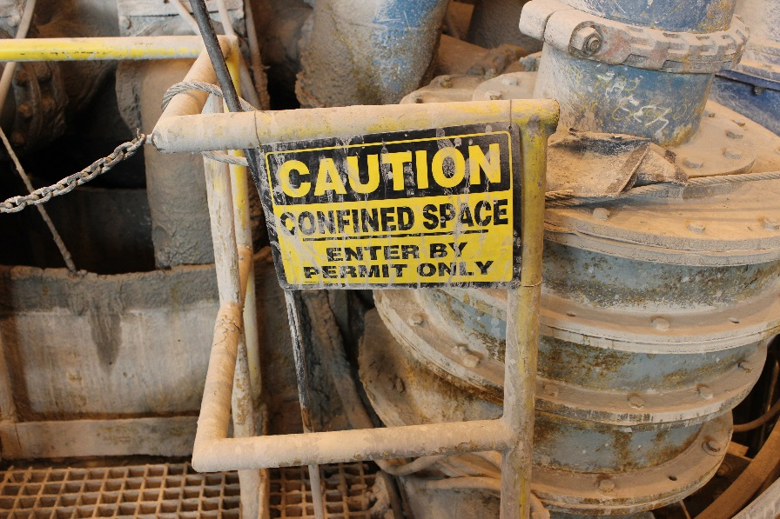
Entering a Confined Space
Before entering a confined space, ask yourself:
Is it necessary to enter?
Is it possible to complete the task from the outside?
If possible, avoid entering a confined space
Notes:
Ask the first question and discuss the necessity of entering a space.
Every consideration should be given to completing the task from the outside.
Ask the second question and discuss the possibility of completing a task without entering.
Consider using other methods to do the job without entering.
Entry is a last resort.

Slide 64
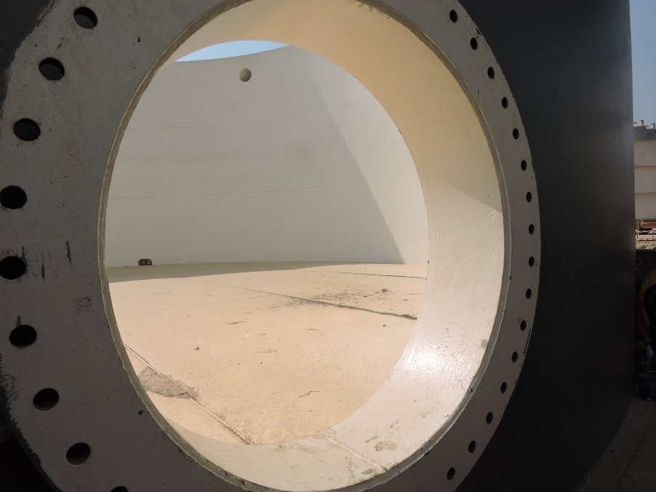
Entering a Confined Space
Permit Process
Determination of confined space
Hazard identification/evaluation
Define hazard controls
Notes:
All members of the confined space entry team must be trained on confined spaces.
Treat all confined spaces as permit-required until it has been determined otherwise.
Determination of confined space
Review SOPs, HIRADC (Risk Register), and tasks to perform while in the space.
Hazard identification/evaluation
Identifies existing hazards and documents that hazards have been eliminated (NPRCS) or controlled to a suitable level (PRCS).
Define hazard controls
Isolate or eliminate all energy sources that could enter the space.
Mark off the area placing temporary railing, cones, or other devices around the space to help prevent unauthorized entry.
If the space is determined to be NPRCS, you can begin entry.
If conditions change, evacuate and re-evaluate.

Slide 65
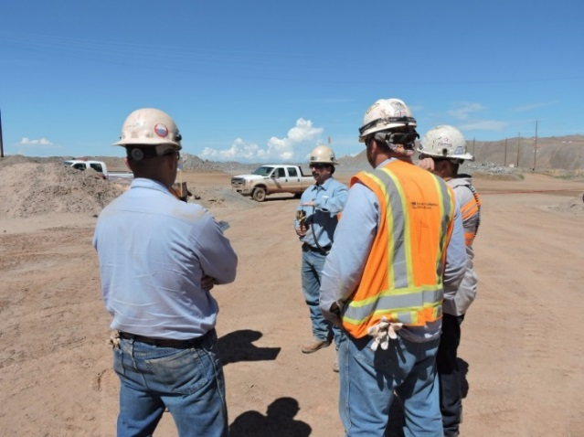
Evaluating a Confined Space
Permit Process
Assignment of roles
Entrant
Attendant
Entry Supervisor
What responsibilities does each have?
Notes:
Ask the question and discuss the responsibilities of each role
Confined space entry cannot be done alone.
Review the three roles using the Confined Space Policy FCX-HS05 (Policy page 2) found in FG p. 23

Slide 66
Entering a Confined Space
Notification of Rescue Services
Pre-task meeting
Issue equipment
Complete the permit
Evacuate the Space
Closeout and notify departments
Review
Notes:
Notification of rescue services
Ensure their availability prior to entry.
Tell them the locations and hazards.
Pre-task meeting
Involve Attendants, Entrants, and all other affected employees.
Explain the hazards (signs/symptoms and routes of exposure), acceptable entry conditions, required PPE, testing, and all communication procedures.
Issue equipment
Provide all necessary PPE.
Make sure all equipment functions properly (including communication systems).
Complete the permit
Lasts one shift.
Posted at entrance.
Updated, if conditions change.
Evacuate the space
Attendant activates emergency response process and may attempt non-entry rescue using the retrieval system.
All personnel must remain outside the space.
Only properly trained and equipped responders may enter the space.
Closeout and notify departments
Notify appropriate departments and rescue services operation completion.
Review
Determine if entry measures were adequate to protect employees.
If evacuations were necessary, communicate the issues with management and a health and safety professional immediately.
If hazards are eliminated, have a qualified individual reclassify the space from PRCS to NPRCS.

Slide 67
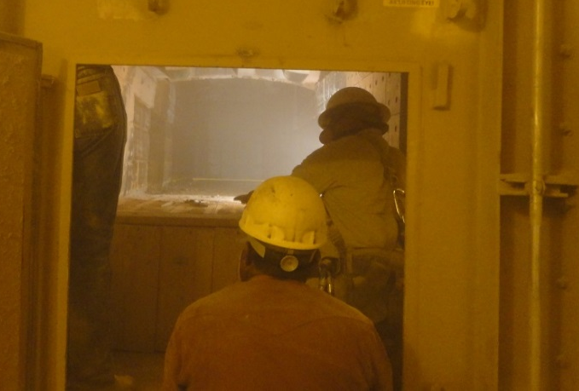
Entering a Confined Space
Emergency Response Team (ERT)
Rescue considerations
Summon emergency services
Prevent unauthorized entry
Initiate non-emergency rescue
Maintain contact with entrants
Gather information
Notes:
In an emergency, the attendant implements the rescue plan but does not personally rescue the victim(s).
Review the rescue considerations.
Summon emergency services – Attendant calls for help as soon as the potential emergency is discovered.
Prevent unauthorized entry – Stop others from entering the space.
Initiate non-emergency rescue - When possible, perform a non-entry rescue using tripods, davit arms, rope, pulley systems, rescue harnesses, or wristlets.
Maintain contact with entrants – Keep them calm. Tell them help is on the way.
Gather information – Know the hazards in the space, number and condition of entrants, and any related mechanical/system information.

Slide 68
Confined Space Entry
Directions
Review the directions on the worksheet
After breaking into groups of 3, record your entry team role on the worksheet
Listen to and take notes on the confined space scenario
Complete the worksheet with your group
After 10 minutes, discuss the completed confined space entry process and permits as a class
Activity 18
Notes:
Time
Approximately 15 minutes
Materials
Confined Space Entry worksheet, FG p.103 (1 per student)
Pen (1 per student)
Confined Space Entry Permit (1 per student)
Facilitator created confined space scenario
Purpose
This activity gives students the opportunity to demonstrate the process for entering a confined space. This is accomplished as the students use a scenario to simulate a confined space entry as part of an entry team.
Instruction
Give each student a Confined Space Entry worksheet.
Review the directions on the worksheet.
After breaking the class into groups of three, the facilitator assigns each group member an entry team role (Entrant, Attendant, and Entry Supervisor).
Write your role on the appropriate line below then listen to the scenario given to you by the facilitator. Take notes in the space provided.
The facilitator provides additional air monitor readings throughout the activity.
With your assigned confined space entry team, complete all of the tasks listed in the table below.
Break the class into groups of three and assign each group member an entry team role (Entrant, Attendant, and Entry Supervisor). If there are groups with two students, assign two roles to one of the group members.
Describe a brief confined space scenario as the students take notes. Make sure pre-entry air monitoring readings are included.
Give students approximately ten minutes to complete the worksheet/entry permit. As students complete the permit, occasionally provide air monitor readings for them to record for their continuous atmospheric readings.
Discuss the completed confined space entry process and permits as a class.

Slide 69
Conclusion
Notes:
The conclusion covers:
Review

Slide 70
Conclusion
What are some key concepts in each module?
Module 1: Evaluating a Confined Space
Module 2: Permit-Required Confined Space Hazards
Module 3: Controlling Confined Space Hazards
Module 4: Entering a Confined Space
Are there any additional questions, comments, or concerns?
Notes:
Ask for and discuss any lingering questions, comments, or concerns.

