Slide 1
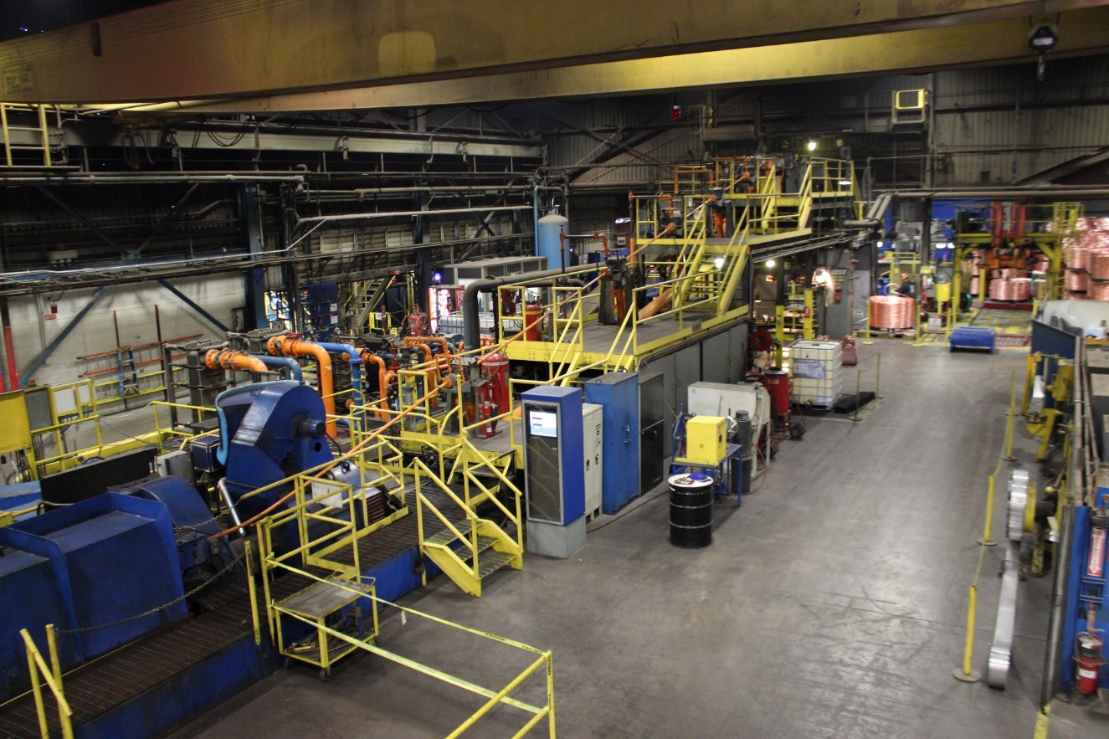
SFT FCX2015C
Workplace Examinations for Downstream Processing
VERSION 1.1 / AUGUST 2018
Notes:
Instruction
Welcome students to class
Remind students to sign the attendance sheet
Facilitator introduces self by stating:
position at FMI
length of service with the company
length of service in mining industry
Explain this is a hands-on course with opportunities to apply what is learned. Group work and discussions help them learn from the knowledge and experience of others

Slide 2
Expectations
Before we start
Safety
Breaks/Restroom
Technology
Participation
Notes:
Instruction
Review the following administrative/classroom expectations
Safety
Identify the appropriate evacuation procedures, gathering areas, and emergency exits and fire extinguisher locations, etc.
Breaks and Restrooms
Establish a break schedule and announce it to the class. Suggested break times are included throughout the FG and occur approximately every hour and often occur at the end of each module. Breaks last 5-10 minutes to give students time to rest and relax before beginning the next learning session
Identify the location of restrooms and smoking areas
Technology policy
Review your expectations on cell phone and laptop use during the training
Participation
This course requires significant participation. Students should be prepared for discussions and small group activities
Set the class ground rules by verbalizing your expectations. Some suggestions are provided below
Be on time
Stay on task
Listen when others talk
Respect the opinions and attitudes of others

Slide 3
Icebreaker
Directions
1. Participate in an activity to get to know each other
Activity 1
Notes:
Time
Approximately 10 minutes
Materials
Choose an icebreaker and gather appropriate materials.
Purpose
Successful icebreakers encourage students to contribute their ideas and experiences thus increasing motivation and engagement in the class
Instruction
In the Facilitator Guide (pages 11-13) is an assortment of icebreakers that the facilitator can incorporate at the beginning of the course as well as after breaks

Slide 4
Quote
“The safety of the men and women in our workforce continues to be our highest priority.”
-Richard C. Adkerson
What does this mean to you?
Notes:
SG p. i
Instruction
Introduce the SG as a resource
Read or have a student read the quote
As a class, discuss what the quote means

Slide 5
Learning Objectives
Module 1: Roles and Responsibilities
Describe the purpose of a workplace examination
Discuss the roles and responsibilities of those involved in a workplace examination
Module 2: Conducting a Workplace Examination
Review appropriate procedures and forms for conducting a workplace examination
Module 3: Workplace Hazards
Identify the hazards associated with a workplace exam and the controls that can be implemented
Notes:
SG p. v
Instruction
Before beginning the next slide:
Ask students what they would like to get out of this course
Discuss and record their responses on a flip chart
This gives the facilitator insight into what the students would like out of the course and helps guide the facilitators focus while teaching
Show the objectives for each module
Point out that the module objectives are also listed in the SG (p. v)
Tie each recorded response to the course objectives (even if it is a vague connection).
This shows students their ideas help direct the course

Slide 6
Introduction
Workplace examinations are also known as
Area Inspections
Pre-shift Inspections
Workplace Inspections
Workplace Exams
Workplace exams are used to
Identify and control hazards before work begins and throughout a shift
Audit
Notes:
SG p. vi
Instruction
Review the different terms listed
Mention other terms the employees may hear
Identify the common term used at your site
A workplace exam is not an audit - if necessary, briefly explain what an audit is
Emphasize the final bullet

Slide 7
Introduction
Hazards often fall under these categories
Chemical
Biological
Physical
Do not assume you are automatically aware of all hazards around you
Notes:
SG p. vi
Instruction
Hazards vary by work area
Explain the first three bullets and give examples of the three hazard categories listed (include examples specific to your site):
Chemical – H2S, lime, solvents
Biological – bacteria, animal waste, venom
Physical – noise, radiation, impact injuries
Explain the final statement on the slide and explain the following:
Being skilled at recognizing hazards associated with work areas is a lifelong pursuit
Receiving appropriate training (such as participating in this course) helps build the skills to identify, avoid, and mitigate hazards

Slide 8
Fatal Risks and Critical Controls
Present at all sites
Present at many sites
Present at few sites
Notes:
Instruction
Fatal Risks are based on industry data, where specific risk exposure has resulted in catastrophic events such as severe injury or death.
While all risks have a degree of danger, Fatal Risks are those risks that, when left uncontrolled, will kill you.
After identifying a Fatal Risk, Critical Control(s) are implemented and verified with standard verification questions, to prevent death as a result of the exposure to the Fatal Risk.
In the event of an absent or failure of a Critical Control, the job must be stopped as it significantly increases the risk of severe injury or death despite the existence of other controls.
In short, Critical Controls help keep you from being killed.
Clarify that every Fatal Risk is not present at each site. However, during a workplace examination, the Critical Controls for relevant Fatal Risks should be assessed.
Remember, Fatal Risk Management assists in:
Identifying the risks that will kill you
Implementing the controls that will keep you safe
Verifying that Critical Controls are in place
Empowering you to stop the job if the Critical Controls are missing or not implemented correctly
Some examples of Critical Controls for various Fatal Risks that may be assessed during a workplace examination:
Entanglement and Crushing – guards, barriers, barricades
Exposure to Hazardous Substances - Acute – mechanical integrity of storage and distribution
Lifting Operations – mechanical integrity of equipment
Drowning – barriers and segregation
Contact with Molten Material – access integrity
Underground Hazardous Atmosphere – refuge chambers

Slide 9
Module 1: Roles and Responsibilities
Notes:
SG p. 3
Instruction
Review the learning objectives for the module
Upon completion of this module, the students will be able to:
Describe the purpose of a workplace examination
Discuss the roles and responsibilities of those involved in a workplace examination

Slide 10
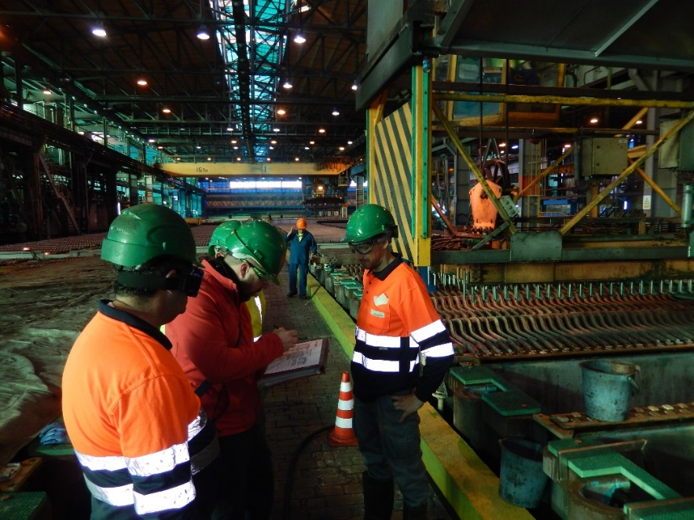
Purpose of Exam
Promotes safer work areas
Bring employees attention to hazards in the area, so he/she can take immediate action to mitigate or eliminate the risk posed
Keeps safety a priority
Notes:
SG p. 5
Instruction
Everyday people are exposed to hazards at work and home
Merging on the freeway
Turning on the oven
Eating a meal
Hazard management determines the level of risk
Workplace exams help decrease risk in the workplace
Explain each bullet under purpose of Workplace Exam (Quiz question)

Slide 11
Responsible Individuals
Supervision ensures exams are performed before starting a task
Individual may be designated to conduct the exam
Everyone properly trained is responsible for maintaining hazard awareness in the workplace
Notes:
SG p. 6
Instruction
Explain the first bullet and explain Supervision needs to make sure exams are performed but do not always perform the exams themselves
Explain the second bullet
Supervision sometimes designates an individual or sites have special expectations when it comes to who must perform a workplace exam
Explain your site’s expectations for who is responsible for conducting a workplace exam
Emphasize the final bullet (Quiz question)
Regardless of whether or not you are designated to conduct a workplace exam, everyone is responsible for safety

Slide 12
Employee Accountability
Hold yourself and coworkers accountable for safety
How can you hold yourself accountable?
How can you hold others accountable?
Notes:
SG p. 6
Instruction
Keys to an effective workplace exam are strong hazard recognition skills and personal accountability to the task
Someone well-versed in the hazards who chooses not to perform a proper workplace exam, decreases the effectiveness of the exam
Explain the first bullet
Ask the first question and discuss possible answers
Have a proactive attitude
Take appropriate actions
Consider the consequences of your choices
Set clear expectations
Check for understanding
Give feedback
Follow through
Ask the second question and discuss possible answers
Expect others to do the same as the answers from the first question

Slide 13
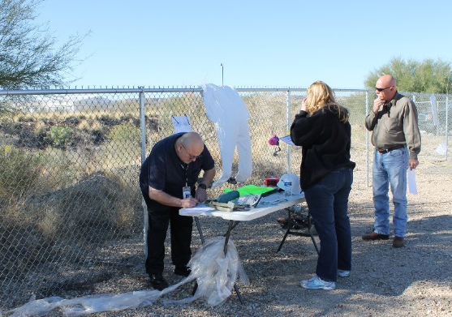
Qualifications and Training
Know your site expectations
Hazard Communication training
Use the resources already available to you
Experience and length of service
Whether on the job for one month or 25 years, everyone’s input is valued and expected
How does increased team involvement enhance a workplace exam?
Notes:
SG p. 7
Instruction
Explain the first bullet
In general, employees must be capable of identifying existing and predictable hazards in the surroundings or working conditions which are unsanitary, hazardous, or dangerous to employees, and have authorization to take prompt corrective measures to eliminate them.
Explain your site’s expectations for qualifications and trainings before conducting a workplace exam
Explain the second set of bullets
Some resources already available include SOPs, JSAs, Risk assessments, chemical labels, container labels, fire triangles, and SDSs
Explain the third set of bullets (Quiz question)
Ask the final question and discuss possible answers:
Increased hazard recognition
Different individuals are trained/experienced in recognizing different hazards
New hires offer a fresh set of eyes
Seasoned employees know what has historically needed attention

Slide 14
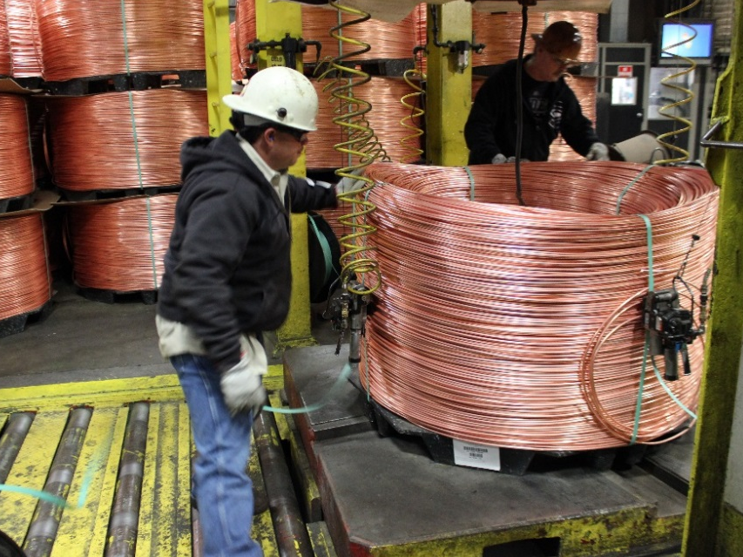
Workplace Exam Frequency
Document a formal exam at least once per shift
Formal and informal exams occur before, during, and after work
Not limited in frequency
Anytime one is appropriate
Anytime the work area or task changes
Follow your site’s expectations
Notes:
SG p. 8
Instruction
Explain each bullet and address the following points as appropriate
Formal vs. informal exams
Document the formal workplace exam conducted before work begins on a site-specific workplace exam form
Informal exams are on-going as employees re expected to be on the lookout for hazards while work is performed
Before (Quiz question)
Establish a safe work area before putting yourself or others at risk
During (Quiz question)
Stay alert to and aware of changing conditions that could affect your safety, or the safety of others
Changing environmental conditions such as temperature changes, noise levels, illumination, and weather conditions, or changing the task or location of a task, can significantly alter a work area and, in turn, the associated hazards
After (Quiz question)
Establish a safe area for the next shift or others who could enter the area
Explain your site’s expectations for workplace exam frequency

Slide 15
Reflection
Directions
Review the directions on the worksheet in the Student Guide (p. 9)
Complete the worksheet
After five minutes, discuss the workplace exam reflections as a class
Activity 2
Notes:
Time
Approximately 15 minutes
Materials
Reflection worksheet, SG p. 9 (1 per student)
Purpose
This activity gives students the opportunity to discuss the purpose of a workplace exam, and the roles and responsibilities of those involved in a workplace exam.
Instruction
Have each student open the Student Guide to the Reflection worksheet (p. 9)
Review the directions on the worksheet
Reflect on your personal knowledge of one of the following, then answer the questions. If you cannot answer a question, write “Unknown”
A workplace examination that discovered a hazard and led to a safer work area
A workplace examination that re-evaluated a hazard and led to a safer work area
A workplace examination that missed a hazard and could have resulted in an incident
A workplace examination that missed a hazard and did result in an incident
A time a workplace examination should have been performed but was not
Give students approximately five minutes to complete individually
Ask for volunteers to discuss their reflections with the class

Slide 16
Module 1 Debrief
How will you apply the skills learned in this module to your daily work activities?
Was there anything surprising about the purpose of a workplace exam?
Were there any roles or responsibilities that surprised you?
Notes:
Instruction
Review and discuss the questions on the slide

Slide 17
Module 1 Quiz
Directions
Complete the quiz in the Student Guide (p. 10)
Review the answers as a class
Quiz
Notes:
SG p. 10
Instruction
Students complete the answers to the quiz questions in the SG
Review and discuss the answers as a class (See the following slides for answers)

Slide 18
Module 1 Quiz
Why are workplace examinations performed?
To check the productivity of the previous shift
To recognize hazards in the work area
To assign fault for missed hazards
To avoid fines
Who can conduct and document a workplace examination?
Everyone who is properly trained
A specifically designated individual
The shift supervisor
All of the above
Quiz
Notes:
SG p. 10
Answers
1. b, See SG p. 5
2. d, See SG p. 6

Slide 19
Module 1 Quiz
Employees with more years of experience are more likely to perform a thorough workplace exam than someone new to the job.
True
False
When are workplace examinations performed?
At the start of each shift
When environmental conditions change
When a task changes
All of the above
Quiz
Notes:
SG p. 10
Answers
3. b, See SG p. 7
4. d, See SG p. 8

Slide 20
Module 2: Conducting a Workplace Examination
Notes:
SG p. 13
Instruction
Review the learning objective for the module
Upon completion of this module, the students will be able to:
Review appropriate procedures and forms for conducting a workplace examination

Slide 21
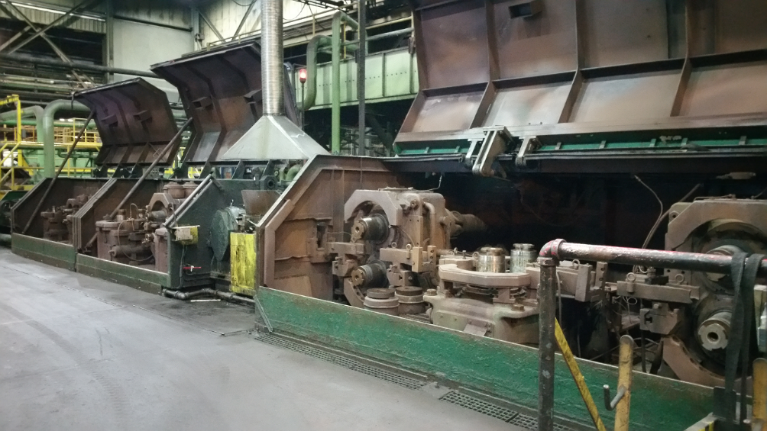
Before Conducting an Exam
Take the time to manage risk through pre-job planning and evaluating
Use exams as a piece of pre-job planning and evaluating
How long does it take to complete a workplace exam?
Notes:
SG p. 15
Instruction
Explain the first two bullets and explain that exams help with pre-job planning and evaluating by helping employees:
Work together
Employ the senses to identify hazards
Think about possible consequences
Review controls that are/can be put in place
Remain vigilant for changing conditions
Ask the final question and discuss how long a workplace exam takes. Possible answers include:
Varies depending on many factors including size of area, hazards encountered, and controls needed
Do not rush through an exam because you feel limited by time
Set enough time aside to conduct a thorough exam

Slide 22
Pre-Job Meeting
Discuss significant/high risks to which employees may be exposed when performing the day’s task
Opportunity to communicate specific focal points for a workplace exam (See table on Student Guide page 16)
Help employees become aware of the hazards and don the proper PPE before beginning an exam
Notes:
SG p. 16
Instruction
Mention that pre-job meetings are sometimes called pre-task meetings or tailgates
Identify the common term used at your site
Explain the first two bullets
Refer students to SG p. 16 and briefly discuss the table (table is shown in FG)
Explain the final bullet

Slide 23
Required Documentation
Keep written records of formal workplace exams on a site-specific workplace examination form
What is included on a Workplace Examination form?
Notes:
SG p. 17
Instruction
Explain the first bullet
Note and report defects immediately
Give each student a site-specific workplace examination form
Discuss the importance of completing a quality report with legible handwriting and concise but accurate descriptions
Ask the question and use the site-specific workplace exam form to explain what is included (Quiz question)
Date of the examination
Examiner’s name
Work areas examined
Description of each adverse condition not corrected promptly
Date when the condition is corrected

Slide 24
Conducting a Workplace Examination
What could happen if conditions change?
Have you and your coworkers been trained to perform the tasks you have been given?
Are there hazards that could originate from outside of your work area?
Are your activities creating hazards for you and others in the area?
Notes:
SG p. 17
Instruction
Consider these questions when conducting a workplace exam
Explain the first question
For example, it starts to rain or the sun sets
Explain the second question
Do not perform tasks on which you have not been trained
Explain the third question
For example, dust or gas, like vehicle exhaust, migrate into the work area from somewhere else
Explain the last question
For example, working with open holes, welding above people who are walking, or using chemicals that could splash or need specialized gloves or equipment to handle

Slide 25
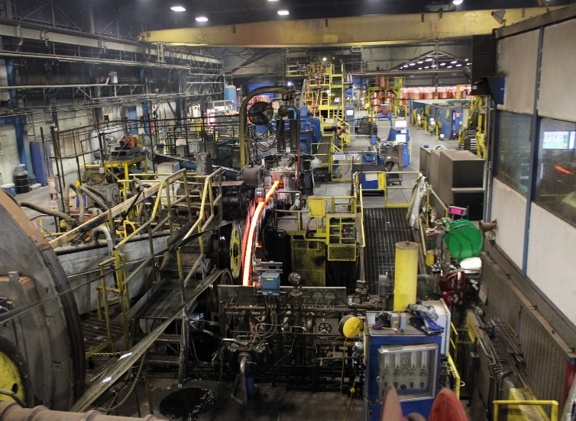
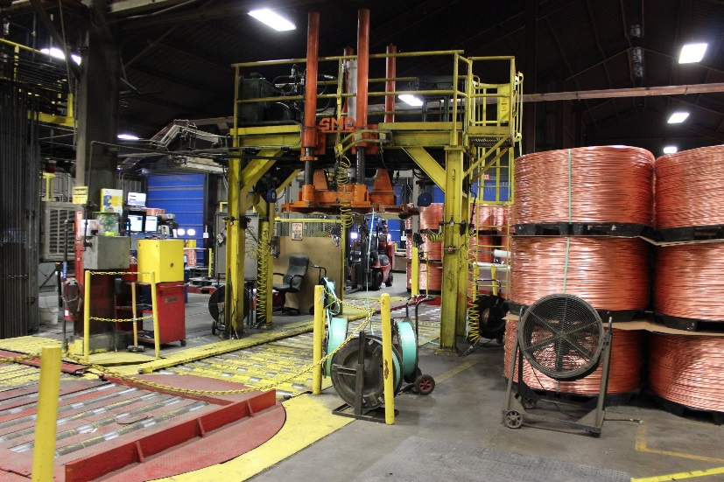
Conducting a Workplace Examination
Observation (sight, sound, touch, smell, taste)
Surveying the area
From a distance
From a closer vantage point
Notes:
SG p. 17-18
Instruction
Observation
Employ all of your senses as you observe the work area
When more people are involved in a workplace exam, there are more opportunities to observe hazards
Sight – Often see problems first but do not only focus on a visual inspection
Sound - Identify unusual sounds encountered as they may indicate a hazard such as malfunctioning equipment
Touch - Do not intentionally touch equipment to check for motion, gaps, or extreme temperatures, but do evaluate hazards such as loose handrails or grating
Smell and Taste - Some chemicals or particles in the air have noticeable smells or tastes that need to be addressed but, in general, avoid intentionally smelling or tasting as part of your workplace exam. Use specialized equipment instead
Surveying the Area
Different hazards can be seen from different vantage points
Survey the area from multiple vantage points (near, far, high, low, left, right)
From a distance (Quiz question)
Take a step back to view the area from a broad vantage point
Additional hazards such as open holes, suspended loads, moving equipment come into view
From a closer vantage point
Talk through the task in the defined work area
Take the time to inspect the specific pieces of equipment closely
Look for common hazards such as housekeeping, slips, trips, falls, electrical issues (the next module provides more information on how to inspect common hazards)

Slide 26
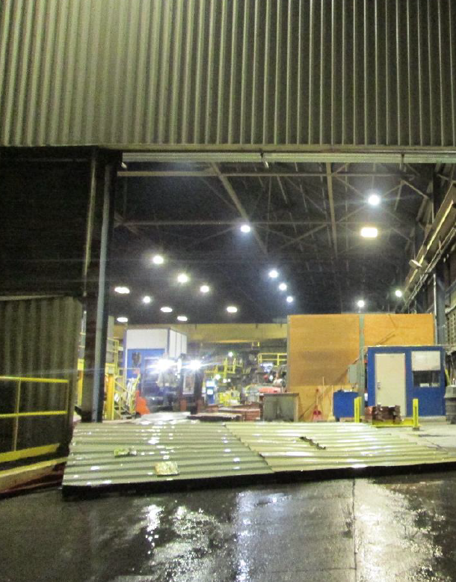
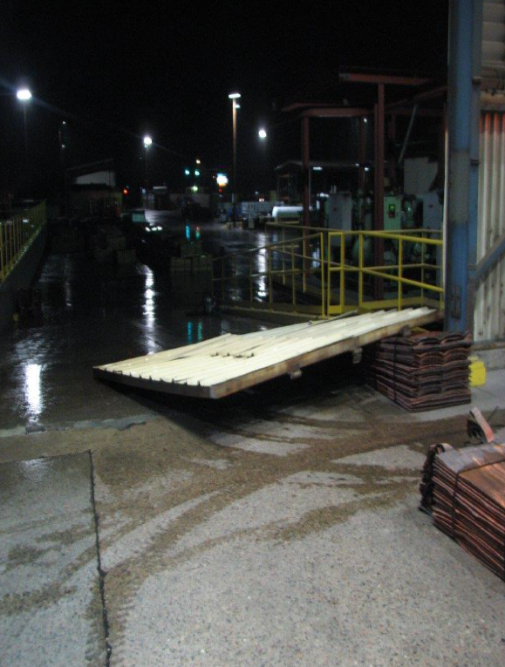
Learn from Others
Student Guide page 19
Notes:
SG p. 19
Instruction
Read aloud or have a student read aloud the Learn from Others in their Student Guide (also written below)
“On October 21, 2015, an employee was closing a 1000 pound (453 kilograms) door to keep the rain out. In the process, the welds that held the three hinges in place broke causing the door to fall off. The door struck the employee on the back of his hard hat and across his shoulder blade causing him to fall to the ground. He suffered a contusion to the head, shoulder, and knee and was given a return to work release with climbing restrictions. A thorough workplace examination helps find areas in need of welding.”
Point out the fallen door in the images
Read or have a student read the directions (also written below)
“Choose whether a distant survey or close vantage point could have helped identify the issue that led to this incident. Explain your choice.”
Give the students 2 minutes to complete their answers
Discuss the incident and the students’ answers. Do not emphasize a correct answer. Instead encourage a discussion about the incident

Slide 27
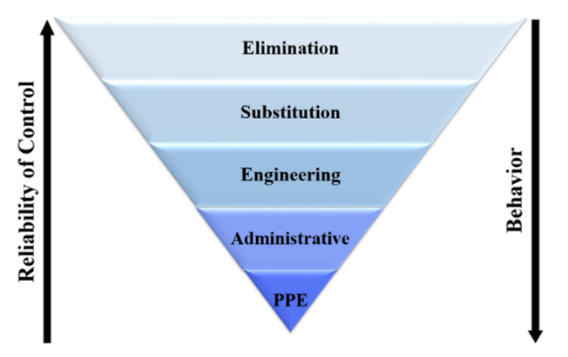
Mitigating the Hazard
When you identify a hazard, it is your responsibility to take appropriate actions immediately
Qualify the Level of Risk
Mitigation Procedures
Notes:
SG p. 20-21
Instruction
Explain the first bullet (Quiz question)
Specific steps required to initiate hazard control varies depending on your site, the department you are in, and the work performed
However, procedures must include preventing access to the hazard and contacting your Supervisor or Health and Safety Professional
Explain Qualify the Level of Risk
The potential of a hazard’s risk must be evaluated
When specific tasks are evaluated regarding the probability of a hazard resulting in an incident and the severity of the consequences if the incident occurs, this is called a “risk rating”
The FCX Risk Matrix helps determine the risk rating for each task, identifying it as high, medium, or low
The adequacy of existing controls is also taken into account and regularly evaluated to double-check that they are working properly
Explain Mitigation Procedures
If a hazardous condition is found while performing an examination, immediate action to resolve the issue must occur
Mitigate the hazard based on the level of the risk
If a hazard is discovered that poses an immediate risk to personnel, stop production until the appropriate controls are in place
Posting a spotter until proper flagging or barricading occurs may also be necessary
Depending on the level of risk, additional training may be required before starting the task
Hazards rated as a high risk are actioned through the Incident Management System (IMS)
When attempting to control a hazard, refer to the Hierarchy of Controls outlined in Fatality Prevention
Elimination, substitution, and engineering controls are more effective than administrative controls and PPE (Quiz question)
Apply the controls that keep the employee as safe as possible

Slide 28
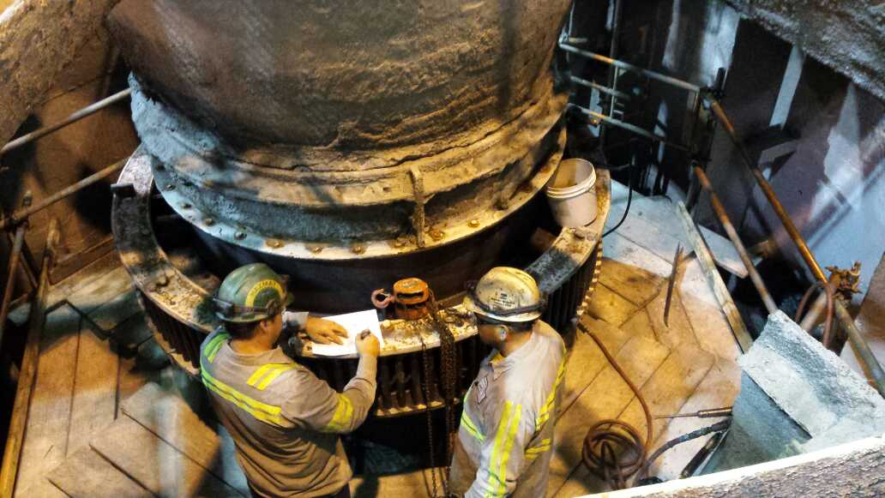
After Completing an Exam
Maintain the appropriate records and ensure deficiencies and hazards are adequately addressed
Records Retention
Follow-up
Notes:
SG p. 22
Instruction
Explain the first bullet
Supervision reviews the workplace exam forms to aid in this process
Explain Records Retention
Depending on your site and department, the maintenance and storage of examination records varies but must be retained for a minimum of one year
Whenever a workplace examination is conducted, the form is given to a supervisor and filed according to Freeport-McMoRan’s Records Retention Policy
The timing for when a workplace examination form needs to be submitted to supervision usually falls into one of two options
Submit the form once the examination is completed, or
Maintain your workplace examination form as a working document throughout your shift and submit your examination form at the end of your shift
Speak with your site supervisor to determine your department and site expectations
Discuss and have the students record your site’s records retention requirements in the space provided in the Student Guide
Explain Follow-up
The workplace examination form includes a section for listing the corrective actions taken to mitigate/eliminate each hazard found
The individual assigned to the corrective action is ultimately responsible for following up on the action to determine whether or not it is effective
However, everyone aware of the corrective action has some responsibility to confirm the action is carried out and the hazard is mitigated
If the same hazard is found while on the job or during a later workplace exam, speak to your Supervisor or site Health and Safety Professional

Slide 29
Team Quiz
Directions
Review the directions on the worksheet in the Student Guide (p. 23)
As a team, complete the worksheet
After three minutes, each team presents their factual questions
Discuss the answers as a class
Each team presents their open-ended question
Discuss the answers as a class
Activity 3
Notes:
Time
Approximately 15 minutes
Materials
Team Quiz worksheet, SG p. 23 (1 per student)
OR
Flipchart paper (1 per group)
Marker (1 per group)
Purpose
This activity gives students the opportunity to review appropriate procedures and forms for conducting a workplace examination
Instruction
Break the class into teams of approximately five students
Review the directions on the worksheet
With your team, use the space on the Team Quiz worksheet (p. 23) or the flipchart to write three questions about conducting a workplace examination
Write two factual questions with specific correct answers
Write one open-ended question that could lead to a class discussion. Open-ended questions can be opinion-based with no clear, correct answer
After all teams finish writing three questions, each team presents their questions to the class
After 3 minutes, each team presents their factual questions to the class
Discuss the answers as a class
Each team presents their open-ended question to the class
Discuss the answers as a class
Question Examples
Factual
What forms and documents are often reviewed in a pre-job meeting?
True or False: Workplace examination forms do not need to be stored
Open-ended
Which is more important, surveying a work area from a distance or from a closer vantage point? Why?
Why are workplace examination forms completed and stored?

Slide 30
Module 2 Debrief
How will you apply the skills learned in this module to your daily work activities?
Were there any procedures or forms for conducting a workplace exam that surprised you?
Notes:
Instruction
Review and discuss the questions on the slide

Slide 31
Module 2 Quiz
Directions
Complete the quiz in the Student Guide (p. 24)
Review the answers as a class
Quiz
Notes:
SG p. 24
Instruction
Students complete the answers to the quiz questions in the SG
Review and discuss the answers as a class (See the following slides for answers)

Slide 32
Module 2 Quiz
What information is documented on a workplace examination form? (List Freeport-McMoRan expectations as well as any additional site expectations)
________________________________________
________________________________________
________________________________________
________________________________________
________________________________________
Why do you survey the work area from a distance while conducting a workplace exam? (Provide a short answer)
______________________________________________________________________________________
___________________________________________
Date of the examination
Examiner’s name
Work areas examined
Description of each adverse condition not corrected promptly
Date when the condition is corrected
Quiz
Answer may vary. Possible Answer – Additional hazards come into view that might otherwise have gone unnoticed
Notes:
SG p. 24
Answers
1. Name of examiner, area examined, date/time of examination, deficiency/hazard discovered, corrective actions to mitigate/eliminate the hazard, other site expectations, See SG p. 17
2. Answers may vary. Possible answers – Additional hazards come into view that might otherwise have gone unnoticed, See SG p. 18

Slide 33
Module 2 Quiz
When you identify a hazard, it is your responsibility to take appropriate actions.
True
False
What two controls are generally least effective for mitigating a hazard?
Substitution and Engineering
Administrative and PPE
Elimination and Substitution
Engineering and PPE
Quiz
Notes:
SG p. 24
Answers
3. a, See SG p. 20
4. b, See SG p. 21

Slide 34
Module 3: Workplace Hazards
Notes:
SG p. 28
Instruction
Review the learning objective for the module
Upon completion of this module, the students will be able to:
Identify the hazards associated with a workplace exam and the controls that can be implemented

Slide 35
Workplace Hazards
Other than Fatal Risks, what hazards might be encountered during a workplace exam?
General Workplace Hazards
Notes:
SG p. 29-30
Instruction
Explain the first bullet
Identify and inspect existing critical controls to see if they are in working order
If the effectiveness of any controls cannot be validated, take the necessary steps to control the risk before starting work
Explain the second bullet
Hazards presented in this module are not an all-encompassing list of hazards found in your work area
If you see anything posing a risk to you or others, report it immediately
Communicate all potential improvements to a Health and Safety Professional and a Supervisor
Determine if there are ways to improve the controls
Refer to your site’s Health and Safety Professional or Supervisor for further clarification on site- and department-specific hazards to evaluate

Slide 36
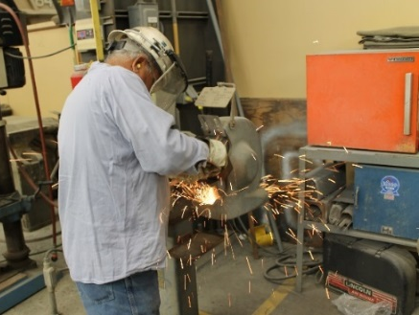
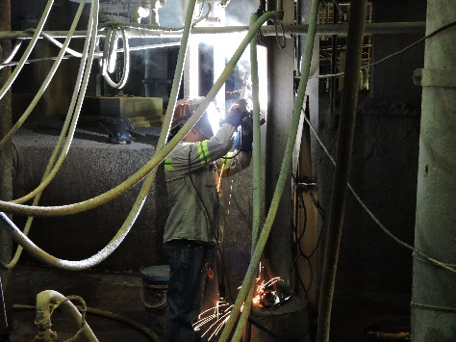
Equipment
A pre-op must be performed before operating any vehicle or equipment
What hazards exist with each of the following types of equipment?
Lifting
Welding
Grinding
Notes:
SG p. 29-31
Instruction
A wide variety of equipment is used on Freeport-McMoRan properties and includes stationary, mobile, rental, and job-specific equipment, as well as tools
A thorough workplace exam identifies and evaluates all equipment in the workplace for potential hazards
Know the common hazards you may encounter, so you can be safe and mitigate hazards before the job begins
If the workplace examination reveals areas where hazards exist and improvements are possible, contact your Supervisor or Health and Safety Professional
Explain the first bullet
Workplace exam helps identify what equipment needs to have a pre-op performed
Pre-operation inspection (pre-op) is performed by employees trained to inspect the vehicle/equipment
If defects are found that result in unsafe vehicles or equipment:
Place a “Do Not Operate” tag on the vehicle/equipment and list the defect on the tag
Record defects that limit safe usage
Do not operate the vehicle until repaired
Ask the question and discuss possible answers
Advance through the slide to see images of each piece of equipment listed
Lifting
Potential to cross someone’s travel path at any time during the shift
Operator’s position in relation to the travel path of the equipment
Determine if the operator can see pedestrians crossing the route
Inspect the rigging and slings for wear, tears, and proper use
Welding
Welding equipment is mobile or in a fixed location
Potential to be exposed to spatter
All materials (stinger, bottles, or lines) stored/secured properly
Flammable materials stored near the welding equipment
Welder uses a flash screen
Grinding
Noise level produced by the grinder that could impact those in the area
Sparks generated that could affect a travel way or flammable materials used
Know the specific requirements of the grinder used, so you know what to look for during a workplace exam

Slide 37
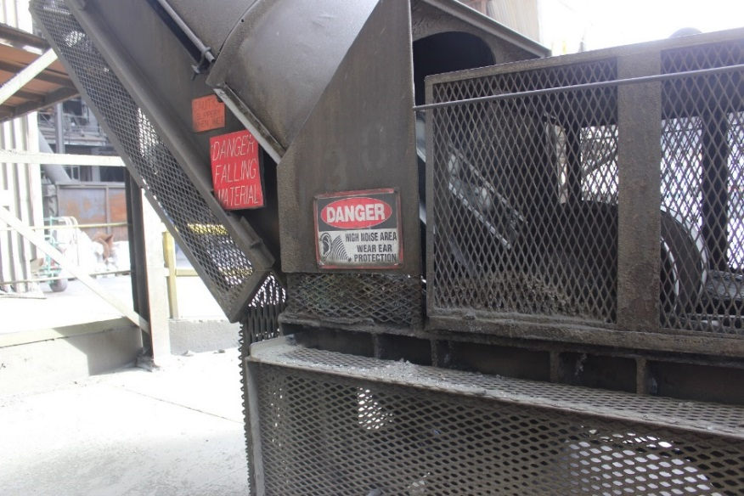
Moving Machine Parts
What hazards do potential energy and the energy of motion pose?
How does guarding protect you?
What should you look for when inspecting guarding?
Look for pinch points
Notes:
SG p. 32-33
Instruction
Mechanical energy is the sum of potential and kinetic energy (the energy of motion) in a working system
Ask the first question and discuss possible answers
When a mechanical object is in motion (kinetic), moving machine parts pinch, crush, strike, pull objects in
Potential energy is also hazardous because, when released, it becomes kinetic energy
Ask the second question and discuss possible answers (Quiz question)
Guarding prevents contact with hazards such as machinery with exposed moving parts, shielding to protect against chemical contact, heat shielding, and noise dampening
The image on the left shows guarding in use
Ask the third question and discuss possible answers
All forms of guarding must be maintained at all times
Note all areas where guarding needs to be installed including
If guarding deficiencies are discovered through a workplace examination, stop working until the guarding is repaired or reinstalled
Unguarded areas must have a spotter until the hazard is mitigated
If the workplace examination reveals areas where guarding needs to be installed, contact your Supervisor or Health and Safety Professional to begin the process
Explain the last bullet
The image on the right shows a pinch point warning sign
A pinch point is a place where the body or part of the body can be trapped between objects
Common causes are machine parts, tools, moving materials, container lids, and doors/hinges
Identify possible places where the body or a body part could be pinched
Ensure the necessary precautions (such as guarding, LOTOTO, or planning the job away from the pinch points) are taken to eliminate or mitigate pinching hazards

Slide 38
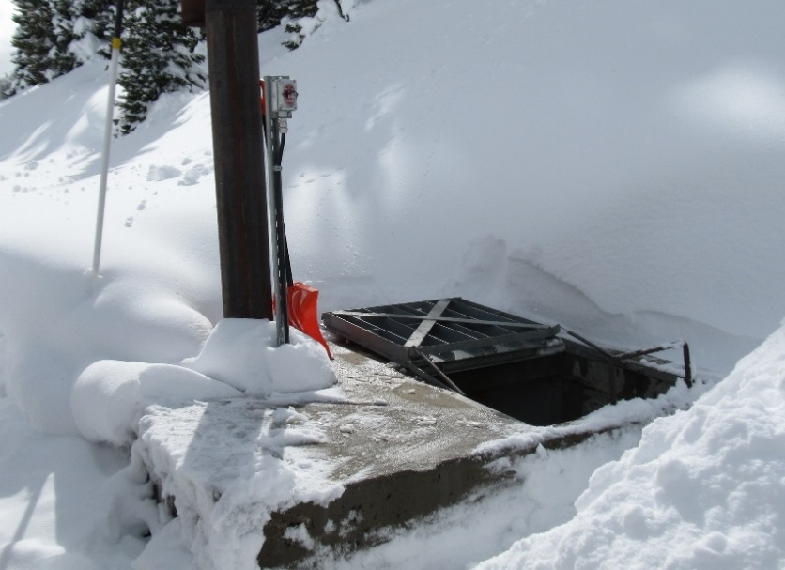
Open Holes
An unguarded/non-barricaded open-hole along any travel way or escape route is considered an imminent danger
What must be done to mitigate the hazard?
Notes:
SG p. 33
Instruction
Explain the first bullet
Open holes present fall risks
An open hole exists in either a horizontal or vertical plane that can result in a fall to a lower level or objects falling from above
A Horizontal opening must measure 12 inches (30 cm) or more in its least dimension
A Vertical opening must be at least 30 inches (76 cm) tall and 18 inches (46 cm) wide
An opening of less than 12 inches (30 cm) in a walking surface still poses a trip/fall hazard and must be mitigated
Ask the question and discuss possible answers
In the event a workplace examination reveals an open hole, production stops immediately
Health and Safety Professionals and Supervision are notified
Proper barricading is installed

Slide 39
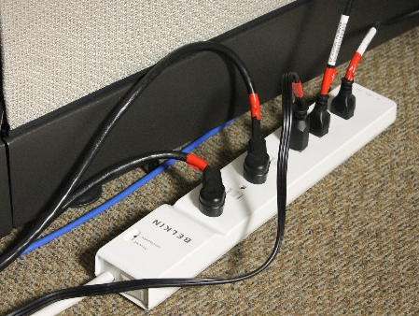
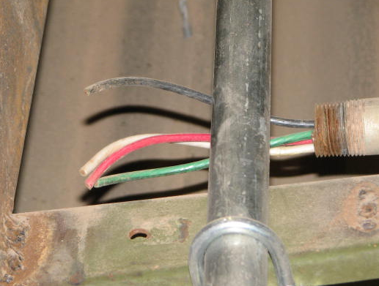
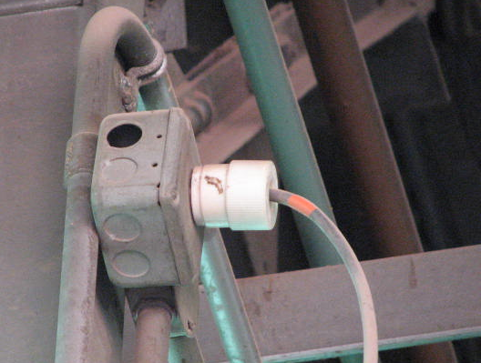
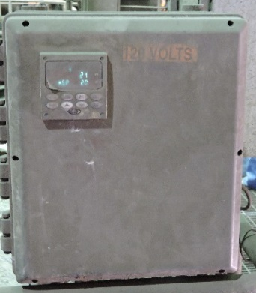
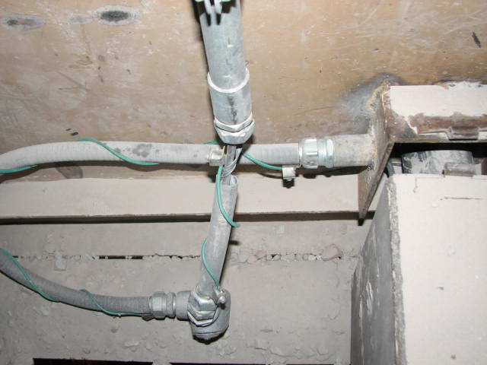
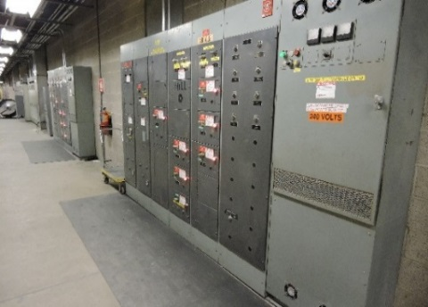
Electrical
What should you look for when inspecting the following electrical hazards?
Conduits
Cords
Wires
Knockouts
Ground Checks
Panel Labeling
GFCIs
Notes:
SG p. 34-37
Instruction
Electricity is a serious hazard that exposes employees to electrical shock, electrocution, burns, explosions, and fires
Note defects and immediately report them when completing a workplace exam helps find hazards before injuries occur
Immediately remove items posing a risk and contact your supervisor
Ask the question and discuss possible answers
Advance through the slide to see images of each electrical hazard listed (Quiz question)
Conduits (Housing for live electrical lines and intended to prevent personnel from coming into direct contact with live systems)
Visually inspect for any physical damage to conduit
Broken conduits can lead to exposed wiring, which is a shock/electrocution hazard
Pay attention to any junctions or access points along the conduit
Cords (insulated to protect users from electricity)
Before inspecting electrical cords (including extension cords) and the equipment to which they are attached, remove the cord from the power source
A break in an electrical cord’s insulation can cause a tool or machine's metal parts to conduct electricity and result in an electrical shock, burn, or electrocution
Inspect for
Broken or missing prongs
Exposed wires or other electrical parts
Physical damage to jackets
Worn, frayed, cut, or broken cords
Damaged, defective, or deformed insulation on electrical tools or appliances
Exposed electrical terminals in motors, appliances, and electronic equipment
Appropriate covering on cords running temporarily across the floor
Tripping hazards created by the cord
Extension cords used on a temporary basis only
Wires
Broken wiring creates shock/electrocution and fire hazards
Broken wiring is found in conduits, cords, and other areas
Look for worn, frayed, cut, or broken wiring
Knockouts
Electrical boxes are designed to allow for either single or multiple conduits
Conduit is attached to the electrical box at small pre-cut holes
Holes are covered with small knockout plugs that are intended to be broken away when the conduit is attached
When an electrical box is modified in a manner that eliminates the need for a conduit, the remaining hole cannot be left open
A new knockout plug is used to mitigate this hazard and confirm no open holes exist in the electrical box
Examine all electrical boxes for broken or missing knockout plugs
If trained, verify all electrical box access doors are working and can be adequately secured
Do not access an electrical box through an unused opening
Ground Checks
Test the continuity and resistance of the grounding system
Electrical equipment requires a ground check upon installation and after repairs or modifications
Some sites require annual ground checks and use a specific color-coded tape system to allow employees to determine at a glance if the equipment is in compliance
Discuss your sites ground check expectations
Establish that all electrical equipment has been tested and is current
Panel Labeling
Look for improper or missing labeling
Verify all operational circuit breakers are marked appropriately and accurately
If labels are damaged, missing, not legible, or their view is obstructed, the appropriate personnel needs to be notified to implement corrective action
Only authorized and qualified individuals may open panels
Note whether or not adequate lighting is in place to read all labeling
Any items labeled “spare”, or something similar must remain in the open position
GFCIs
Ground-fault circuit interrupters (GFCIs) protect workers from electrocution by tripping (opening the circuit) when electrical equipment is not working correctly
Located on all outdoor outlets and any outlets within six feet of a water source
Press the test button to verify the power disconnects
If a GFCI does not pass the test, continues to trip, or is damaged/defective, stop use, tag-out, and contact the Electrical Department

Slide 40
Ergonomics
Design the job to fit the worker rather than physically forcing the worker’s body to fit the job
What can you look for during a workplace exam to help reduce body fatigue?
Notes:
SG p. 38
Instruction
Explain the first bullet
Adapt tasks, workstations, tools, machines, and equipment to fit the worker
Reduce physical stress on a worker’s body and eliminate many potentially serious, disabling work-related musculoskeletal disorders (MSDs)
Evaluate a work area for ergonomics-related hazards during a workplace exam
Ask the question and discuss possible answers
Varying tasks
Working at a slower pace
Supplying anti-fatigue mats
Supplying the right tool for the job
Providing ergonomic chairs or stools
Adjusting the height of working surfaces
Providing an increased number of short breaks
Reducing the weight and size of items to be lifted
Putting supplies and equipment within easy reach of the worker

Slide 41
Inclement Weather
Weather plays a key role in day-to-day operations
How can a workplace exam be helpful with extreme temperatures?
How can a workplace exam be helpful with precipitation?
Notes:
SG p. 39-40
Instruction
Explain the first bullet
Pay attention to weather-related hazards such as the freeze-thaw cycle (ice and run-off), precipitation (snow and rain), high speed winds, extreme heat, lightning
If a possible risk is associated with any of these hazards, report them to your Health and Safety Professional or Supervisor immediately
Ask the question and discuss possible answers
Extreme heat and cold alter work areas and hazards while performing tasks
Pay attention to the unique hazards created by extreme weather conditions such as hot or cold metal surfaces, intensified heat in some PPE, and the need for additional warmth in cold conditions
Prepare for extreme conditions during a workplace exam
If heat is a factor, confirm plenty of water and a cool area are available for breaks and identify periods of the day when it is safest to perform heavy work
If cold is a factor, confirm warm areas are available for breaks and have changes of clothes available in case clothes get wet
Ask the question and discuss possible answers
Precipitation such as runoff, flooding, and rainy conditions can detrimentally affect walking and driving conditions throughout each site as they result in wet travel ways
Wet travel ways increase the possibility of vehicle accidents and employee slips, trips, and falls
Minimize the hazards of wet weather conditions by checking travel ways for debris, wiping up wet areas, and inspecting vehicles for safety

Slide 42
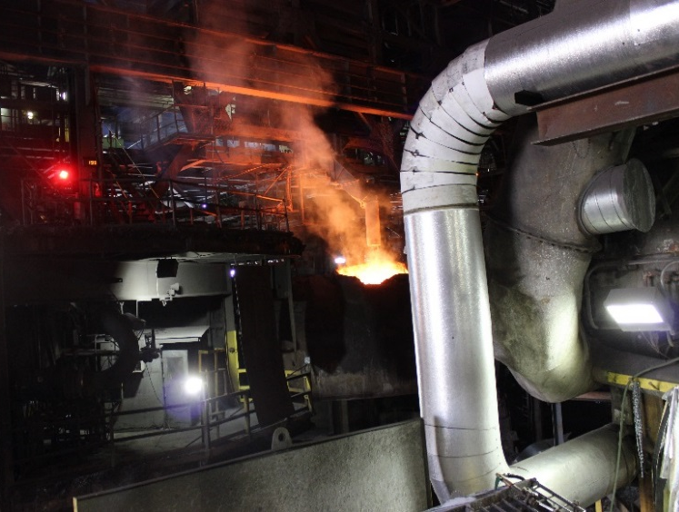
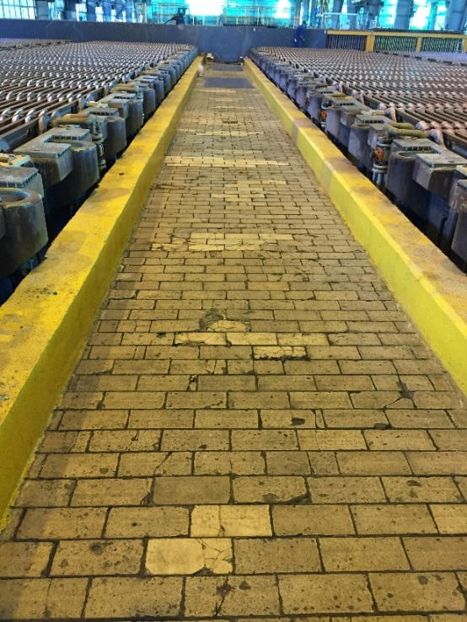
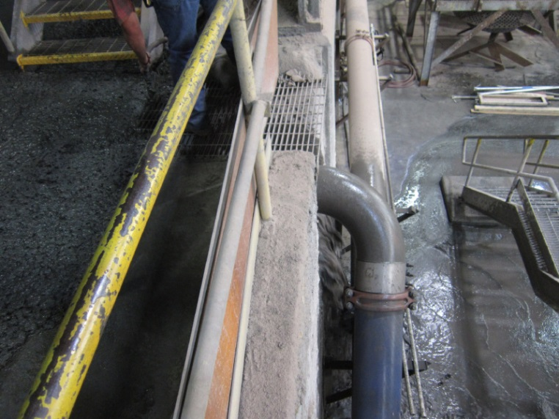
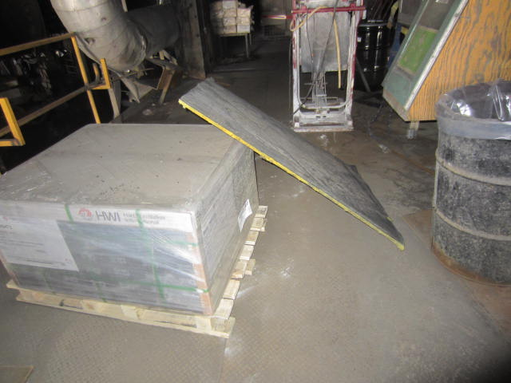
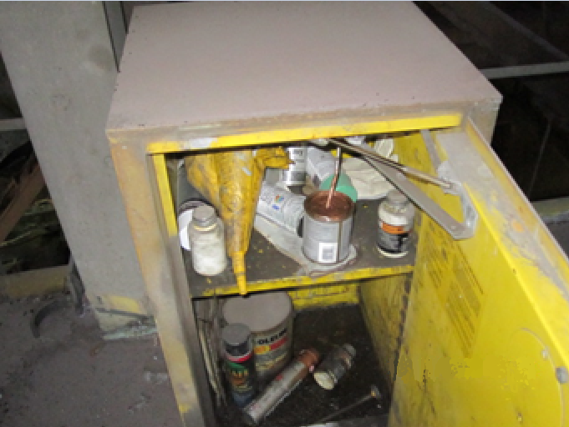
Housekeeping
Housekeeping is more than just picking up after yourself
How can a workplace exam help mitigate hazards for each of the following housekeeping issues?
Slips, trips, and falls
Travel ways
Lighting
Storage
Notes:
SG p. 40-42
Instruction
Explain the first bullet
Trash, debris, spills, and miscellaneous equipment/tools become a safety hazard when they obstruct walkways or working surfaces
Fine materials such as sawdust and silica, along with biological hazards such as improperly stored food or animal waste, create a wide array of health hazards
Establish housekeeping habits by cleaning your area while performing a workplace exam and while you work, and encouraging others to do the same
Ask the question and discuss possible answers
Advance through the slide to see images of each piece of equipment listed
Slips, trips, and falls
Determine the travel path of the area
Identify any conditions that could lead to slips and trips
Slips and trips are caused by a wide variety of conditions including standing liquids, uneven surfaces, hoses, electrical cords, stairs, and ladders
If you happen to see standing liquids or puddles, avoid walking through it, establish appropriate barricading, and contact your Health and Safety Professional or Supervisor
Travel ways
Travel ways and escape ways allow employees to travel from one area to another
Whether traveled frequently or rarely, they must remain safe routes for all employees at all times.
Safe access along any path traveled for work, repair, or maintenance must be free of debris or obstructions, easily accessible, and well-lit (Quiz question)
Lighting
Whether working at night or in a darkened area during the day, provide adequate lighting in walkways and work areas
Ensure there is enough illumination to let you work safely
Permanent and temporary lighting can be used but either way, the lighting components must be safe for the location and task
Storage
Improperly stored materials become a hazard when obstructing travel ways
The risk of this hazard increases dramatically in the event of an emergency
Note if all materials are stored according to Freeport-McMoRan standards as well as manufacturers’ instructions
Materials may be stored in the proper containers but, if their weight exceeds the limits of the shelving system, they are improperly stored
If containers are stacked, make sure they are balanced

Slide 43
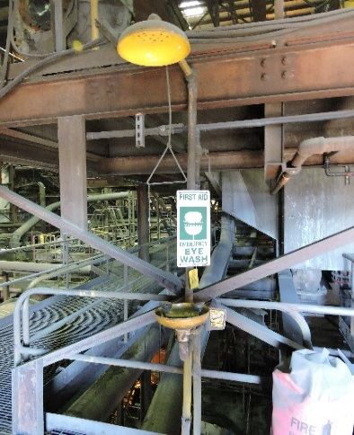
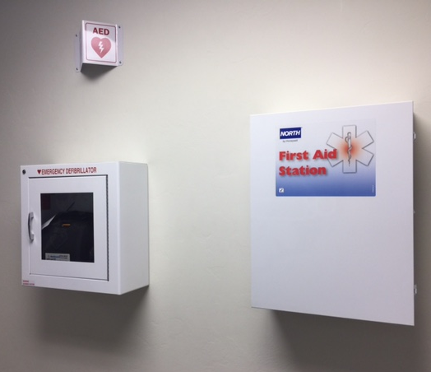
Emergency Equipment
Proactive workplace exams performed routinely aid in emergencies
How can a workplace exam help mitigate hazards for each of the following types of emergency equipment?
Eyewash stations and showers
Fire Extinguishers
First-Aid Kits and AEDs
Emergency Alarms
Emergency Lighting and Signs
Notes:
SG p. 43-45
Instruction
Explain the first bullet
In emergency situations, timing is critical
Use the workplace exam as an opportunity to check all emergency equipment
Ask the question and discuss possible answers
Advance through the slide to see images of each piece of equipment listed
Eyewash stations and showers
Emergency eyewash stations and showers are often the difference between life-altering exposure events and a recoverable injury
In situations where eye contamination occurs, the longer you wait for treatment, the worse your condition may become
While skin is much more resistant to damage than eyes, there are still certain exposures that require immediate treatment
Locate all emergency eyewash stations and showers
Ensure they are functioning, clean, and free from debris
Eyewashes and showers must have signage near them
The area around them must be clear of obstructions
Fire extinguishers
Ensure you are trained on how to use a fire extinguisher
Note the location of all fire extinguishers
Ensure an identifying sign is posted above each one
Is there any damage to the handle, nozzle, or hose?
Is the safety pin correctly in place?
Does the needle in the pressure gauge fall in the “Good” or green range?
Are the inspection tag and sticker current?
When was the last time the fire extinguisher was inverted to mix the chemicals inside? Is the area three feet around the extinguisher free from obstructions?
Is it the correct type of extinguisher for the hazards in the area?
First-Aid kits and AEDs
First-aid kits and automated external defibrillators (AEDs) can be critical during a health emergency
Locate all first-aid kits and AEDs
Ensure first aid supplies are fully stocked, and any items with an expiration date are current
Emergency Alarms
Emergency alarms reduce the severity of incidents by warning employees of a danger and alerting them to follow the proper procedures when the alarm sounds
In the event of an emergency, the alarms need to function properly
Locate all alarms
Check that they were recently tested
Alarms are often tested on a regular basis by sites and may not need to be tested during a workplace exam
Check with your site supervision if you have any questions
Emergency lighting and signs
Each work area has a detailed evacuation plan
The success of the plan in an emergency is partially dependent upon emergency lighting and exit signs
Locate and test the emergency lighting
Locate and verify that all exit signs are illuminated
Test emergency lighting by pressing the “Test” button or unplugging it and plugging it back in

Slide 44
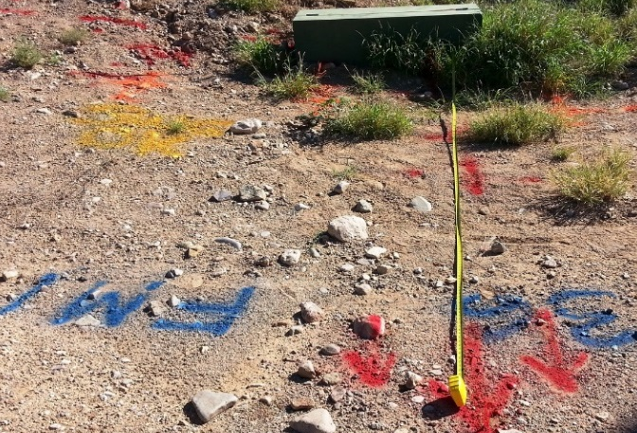
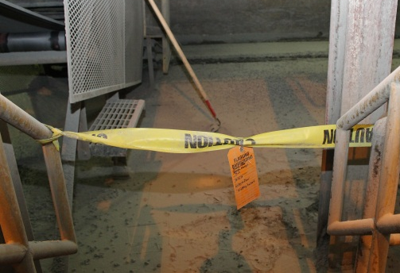
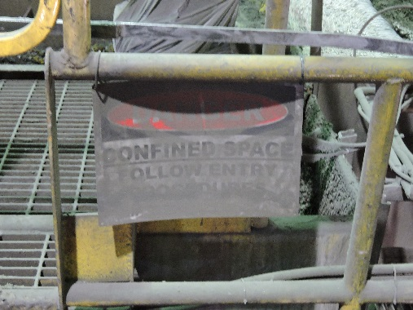
Communication
Ensure the appropriate forms of communication are present, correct, and legible
How can a workplace exam help mitigate hazards for each of the following types of communication?
Signage
Flagging and tagging
Blue Stake markings
Notes:
SG p. 46-47
Instruction
Explain the first bullet
Freeport-McMoRan sites strive to keep everyone informed throughout the workday by communicating in multiple ways such as signage, flagging, tagging, and blue stake markings
Communication can draw attention to potential hazards when performing a task and must, therefore, be clearly conveyed and precisely understood
Ask the question and discuss possible answers
Advance through the slide to see images of each piece of equipment listed
Signage
Signs are classified as administrative controls
When immediate or potential health and safety hazards exist in a work area, warning signs must be posted at all approaches
Recognizing these signs enables you to easily understand the hazards and adhere to proper precautions while working
Ensure they are positioned in an obvious location, oriented properly, and are clean and legible
Post them in the common language of the property
Stopping to focus on a sign that does not meet these standards wastes valuable time in an emergency
Note signs that do not meet these standards, and take the time to correct the problem, or notify Supervision, so they can resolve the issue
Flagging and Tagging
Indicates a hazard or unsafe condition exists
Flagging color (red or yellow) identifies the level of danger associated with the hazard
The tag describes the hazardous condition/reason for flagging, time and date installed, PPE requirements to enter, and employee that placed the tag’s information (name, contact number, supervisor, department)
Check that all necessary areas are flagged, and the correct color is used
Tag colors vary but must be noticeable and hang from all sides of the perimeter or all access points
Blue Stake/Utility Location Markings
Markings indicate the location and type of buried/hidden utility lines
They are intended to prevent disturbing unseen utilities and keep all employees safe when penetrating more than 1 inch (2.5 cm) into floors, roofs, ceilings, walls, and the earth’s surface.
Check that the color is easily identifiable and legible – if markings are faded or damaged, notify the appropriate personnel to have them re-painted
Specific paint colors are used to identify the type of utilities hidden from view – if you see or suspect markings are inaccurately labeled, incorrectly located, or missing, follow the required procedures so that the correct personnel can investigate further
Ensure all temporary markings such as whiskers and permanent markings such as colored flags or stakes are in good enough condition to communicate the intended message

Slide 45
Hazardous Material Handling
Pay attention to hazardous chemicals
How can a workplace exam help mitigate hazards for each of the following?
Container labels
Chemical storage
Waste generation and management
Notes:
SG p. 48-49
Instruction
Explain the first bullet
Accidents with hazardous chemicals can happen quickly and be quite severe
Before using any chemical, review a Safety Data Sheet (SDS) or other appropriate resource
SDSs direct your attention to the conditions of use that pose a potential hazard and identify controls such as handling requirements and PPE that need to be implemented
Performing a workplace exam offers an opportunity to ensure the Safety Data Sheet (SDS) requirements are sufficient for keeping you and your coworkers as safe as possible
Ask the question and discuss possible answers
Container Labels
All containers must be labeled (Quiz question)
Labels contain immediate warnings about a chemical’s most serious hazard and should be the first thing referenced before beginning work
A label is an employee’s first source of information about a chemical
Check your SDS sheets to confirm all containers are labeled appropriately and contain the correct pictogram
The manufacturer’s label must be intact and legible
If any chemical delivered to your site is missing a label, or a label is lost or damaged, let your supervisor, global sourcing representative, Environmental Professional, or Health and Safety Professional know immediately so that they can replace the label
Chemical storage
Understand the expectations of chemical storage before beginning a workplace exam
Evaluate the chemicals and determine whether or not the proper controls are in place
SDSs provide proper storage recommendations and compatibility with other chemicals
If your work area contains liquids stored under pressure, verify the vessels are secured properly and no valves are leaking
If you are storing liquid waste, verify all containers are compatible with the product, free from leaks, labeled (describes contents), and secured
If your work area contains various hazardous or reactive chemicals, confirm that there is no possibility of the chemicals mixing
Store materials in a rated flammable materials safety storage cabinet. All containers stored in a cabinet, regardless of the content, need to be properly labeled
Do not store items such as rags, cardboard containers, paper, or anything else with the potential to become a fuel source for a fire
Make sure all containers are clean and the lids are closed
Waste generation and management
Before anyone brings a new chemical onto a site, the Health and Safety and Environmental departments need to be notified so they can evaluate chemical hazards and communicate new chemical hazards introduced in your work area to you and your coworkers
If unknown products, used containers, outdated products, or any contaminated PPE are found during a workplace exam, contact your site’s hazardous waste coordinator to ensure the proper disposal method

Slide 46
PPE
PPE is only beneficial when correctly selected, thoroughly inspected, and properly worn
How can a workplace exam help mitigate hazards during each of the following?
PPE selection
PPE inspection
Notes:
SG p. 49-50
Instruction
Explain the first bullet
When you have questions about wearing, using, or caring for PPE, ask a supervisor or Health and Safety Professional
Ask the question and discuss possible answers
PPE Selection
Verify the correct PPE for the hazard/task is selected
Verify it fits properly
Check the JSAs, SOPs, and Safety Data Sheets (SDSs) to identify specific PPE selection for the hazards you may encounter and the tasks you may perform
Ensure the correct size is chosen so PPE fits you well enough to prevent dangerous gaps in protection – If PPE does not fit properly, resolve the issue before entering areas where it is required
PPE Inspection
PPE only protects you when in good condition
Before you put on gloves, goggles, clothing, or any piece of PPE, clean and inspect it carefully
Ensure it does not have any rips, tears, disintegration, or other damage
If you find damaged equipment notify your supervisor and dispose of and replace the equipment

Slide 47
Teach Me
Directions
Review the directions on the worksheet in the Student Guide (p. 51)
As a team, complete the worksheet
After ten minutes, each team leads a discussion about their topic
Activity 4
Notes:
Time
Approximately 20 minutes
Materials
Teach Me worksheet, SG p. 51 (1 per student)
OR
Flipchart paper (1 per group)
Marker (1 per group)
Purpose
This activity gives students the opportunity to identify the hazards associated with a workplace exam and the controls that can be implemented
Instruction
Break the class into teams of approximately five students
Review the directions on the worksheet
Write your assigned workplace examination hazard on the line provided
Use your student guide to research answers to the questions provided
Assign each group one of the hazards discussed in this module (General Workplace Hazards, Housekeeping, Emergency Equipment, Communication, Workplace Material Handling, or PPE)
After 10 minutes, each team leads a discussion about their topic
*For larger classes, assign the subheadings underneath each hazard heading in the Student Guide. This creates more specific hazards that the students can research and present

Slide 48
Secure the Scene
Directions
Review the directions on the worksheet in the Student Guide (p. 52)
As a team, complete the worksheet
After ten minutes, each image will be shown on the PowerPoint to discuss as a class
Activity 5
Notes:
Time
Approximately 10 minutes
Materials
Secure the Scene worksheet (located in the SG pp. 52-55)
Purpose
This activity gives students the opportunity to identify the hazards associated with a workplace exam and the controls that can be implemented
Instruction
Break the class into teams of approximately five students
Review the directions on the worksheet
Identify the existing/potential hazards in each image
Record the hazards you find, then determine and record controls that can mitigate the hazards
After ten minutes, progress through each image on the PowerPoint and discuss the hazards and controls as a class. Possible answers are provided but other answers may be valid

Slide 49
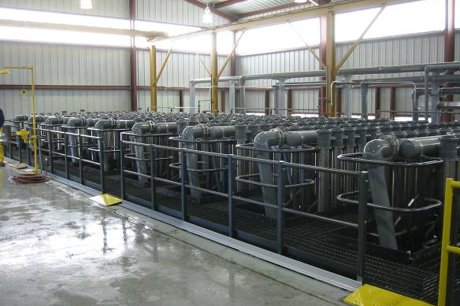
Hazards in the Workplace
1.
Notes:
Possible answers/hazards:
Slipping
Tripping
No clearance around eyewash station
Hazardous substance exposure

Slide 50
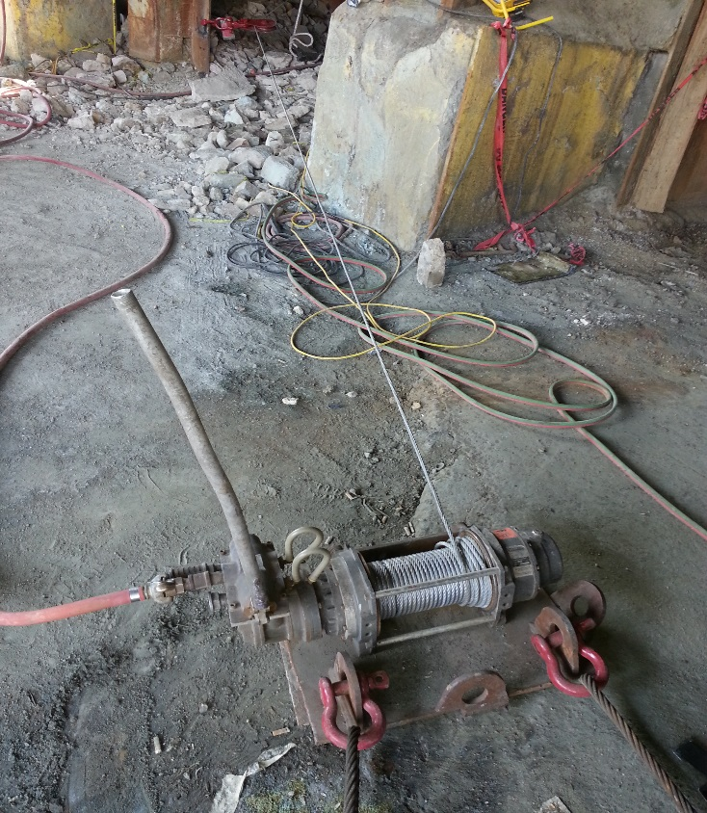
Hazards in the Workplace
2.
Notes:
Possible answers/hazards:
Tripping
Uneven grounds, rock underfoot
Red flagging fallen down and why is it there?
Wench line under tension
Air lines under pressure
Broken handle, potential for cuts
Missing guarding on wench

Slide 51
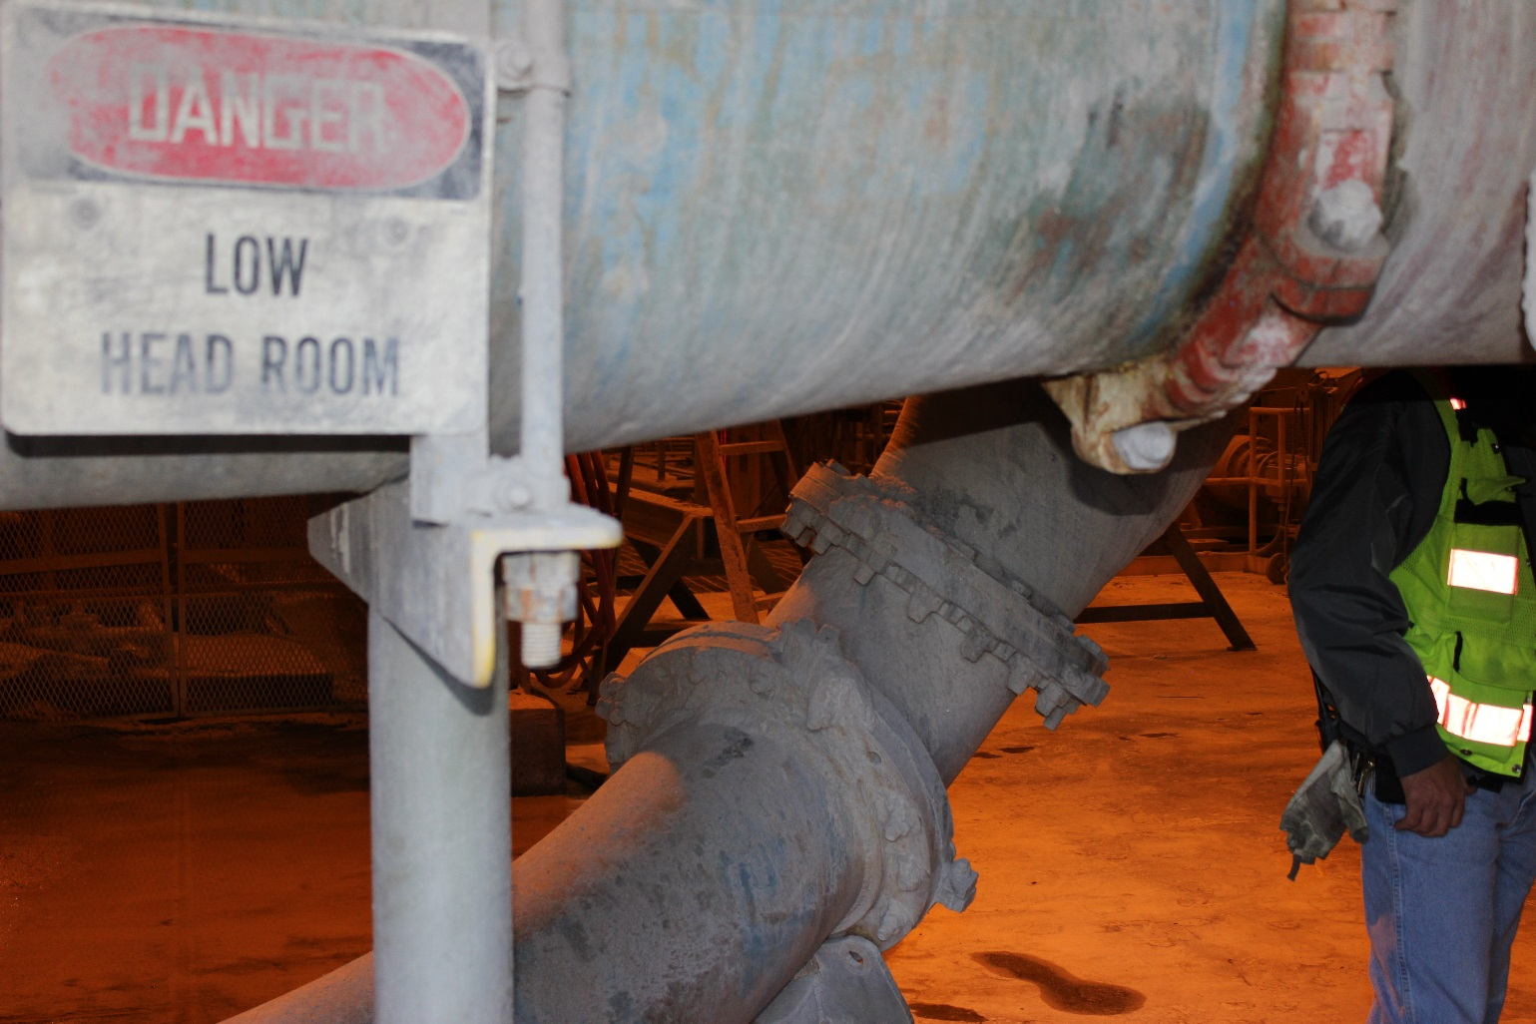
Hazards in the Workplace
3.
Notes:
Possible answers/hazards:
Trip hazards
Low overhang or head clearance
Poor lighting

Slide 52
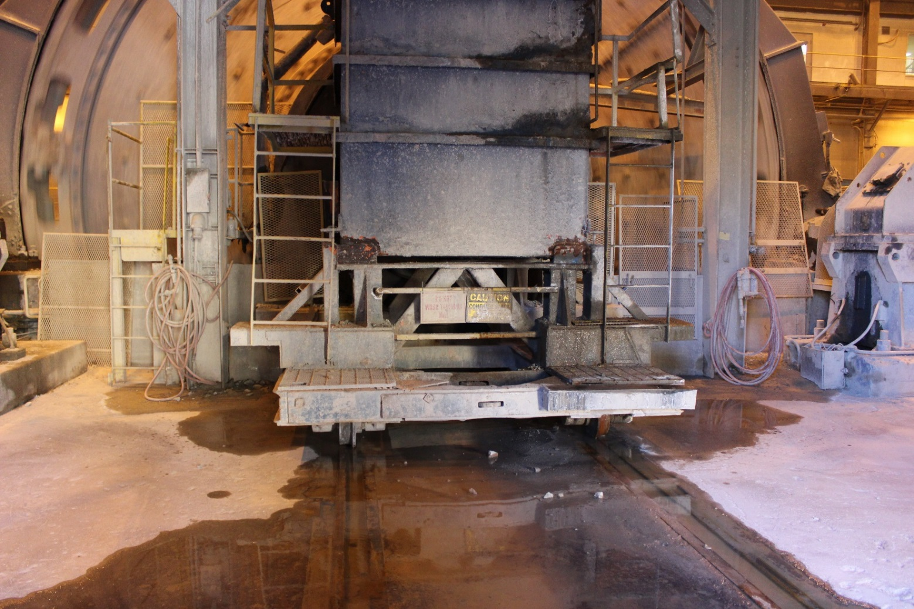
Hazards in the Workplace
4.
Notes:
Possible answers/hazards:
Slipping hazards
Overhead clearance
Uneven surfaces
Missing mid-rail
Elevated platform
No catch chain visible

Slide 53
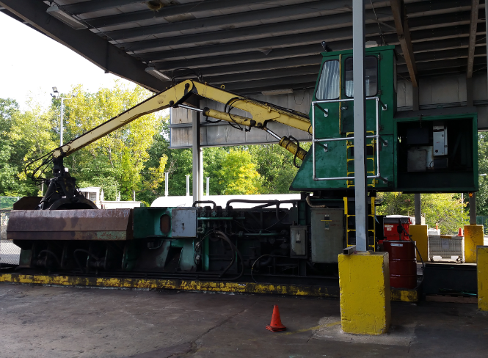
Hazards in the Workplace
5.
Notes:
Possible answers/hazards:
Moving machine parts/equipment
Hazardous substance exposure
Fall from heights
Electrical

Slide 54
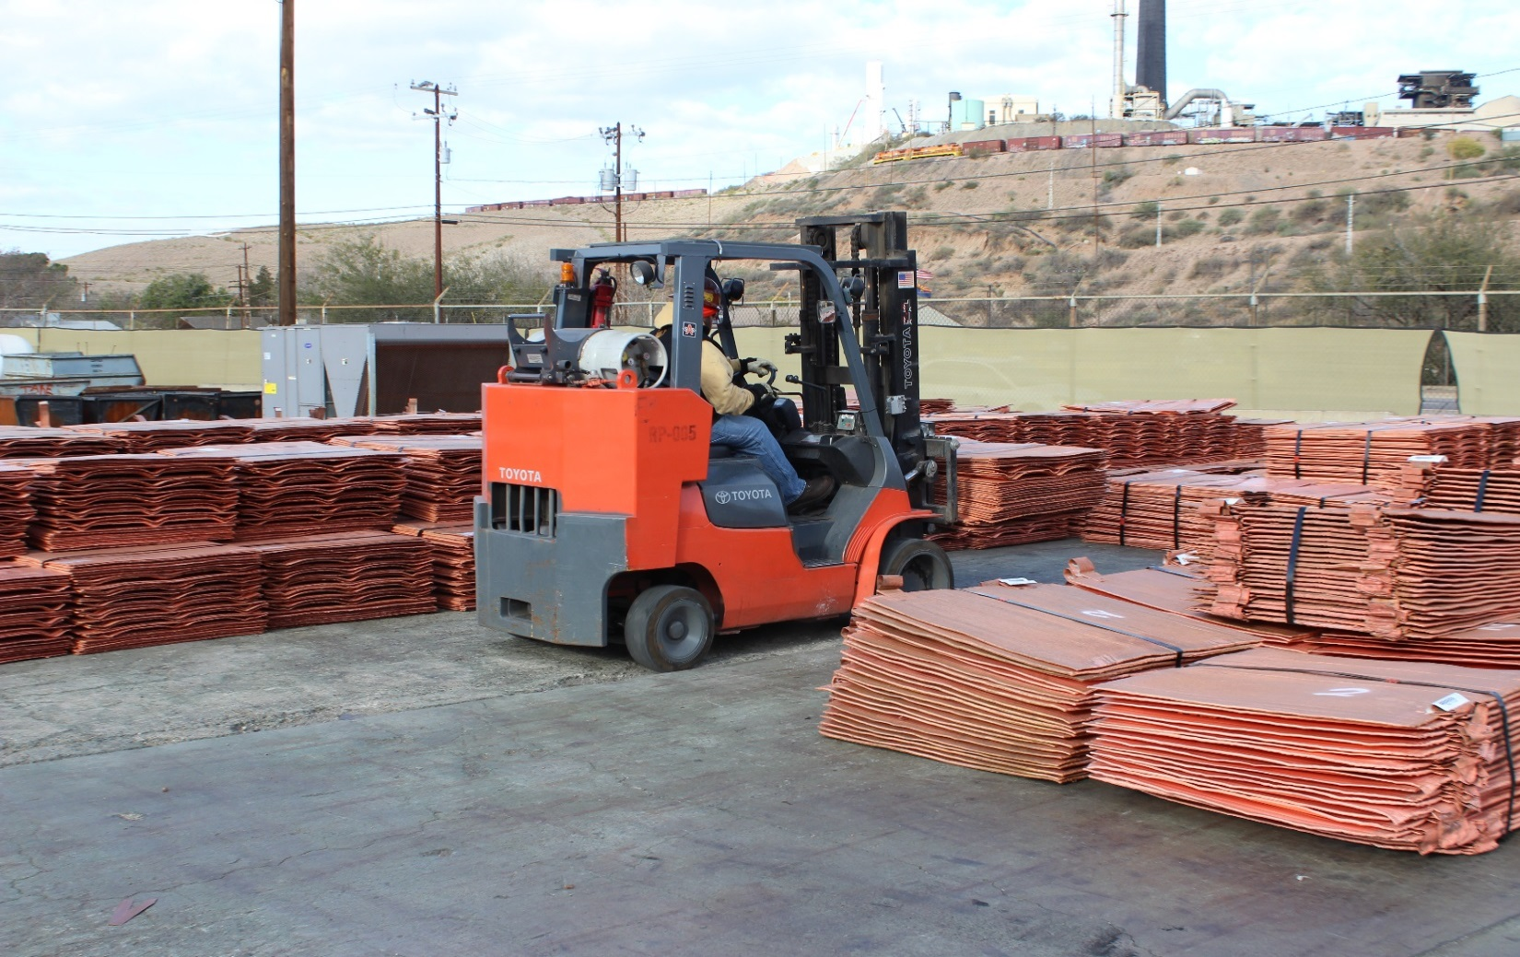
Hazards in the Workplace
6.
Notes:
Possible answers/hazards:
Suspended load
Propane gas is highly flammable and displaces oxygen
Forklift and pedestrian traffic
Sharp edges and corners on cathodes

Slide 55
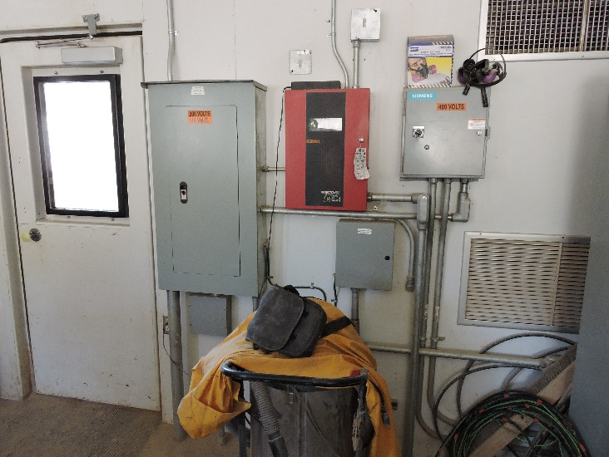
Hazards in the Workplace
7.
Notes:
Possible answers/hazards:
Housekeeping issues
Shop vac stored less than 3 feet from electrical box

Slide 56
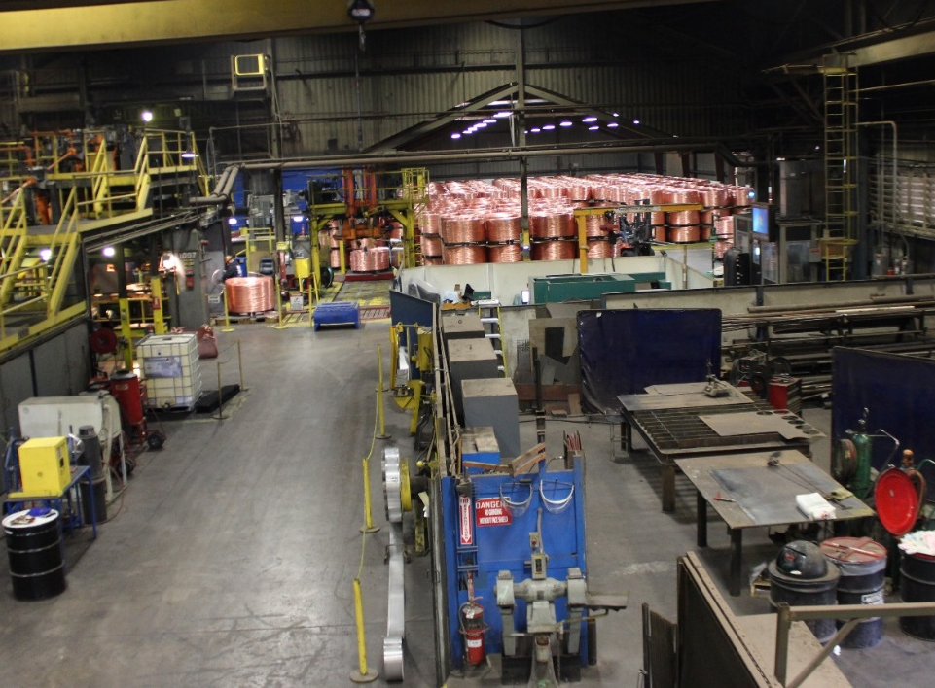
Hazards in the Workplace
8.
Notes:
Possible answers/hazards:
Hazardous substance exposure
Oxygen/acetylene tanks
Grinding equipment
Suspended loads
Housekeeping
Material storage

Slide 57
Module 3 Debrief
How will you apply the skills learned in this module to your daily work activities?
Were there any hazards or controls associated with a workplace exam that surprised you?
Notes:
Instruction
Review and discuss the questions on the slide

Slide 58
Module 3 Quiz
Directions
Complete the quiz in the Student Guide (p. 56)
Review the answers as a class
Quiz
Notes:
SG p. 56
Instruction
Students complete the answers to the quiz questions in the SG
Review and discuss the answers as a class (See the following slides for answers)

Slide 59
Module 3 Quiz
What is the purpose of guarding?
To prevent access to a hazardous area
To protect equipment from dust and debris
To provide an alternative location for PPE storage
To act as an administrative control against hazards
List three electrical hazards and how to mitigate the risks they pose
________________________________________
________________________________________
________________________________________
Quiz
Answers vary.
Notes:
Answers
1. a, See SG p. 32
2. Answers vary, See SG p. 34-37

Slide 60
Module 3 Quiz
Travel ways should be:
Free of debris
Easily accessible
Well-lit
All of the above
All containers must be labeled.
True
False
Quiz
Notes:
Answers
3. d, See SG p. 41
4. a, See SG p. 48

Slide 61
CONCLUSION
Notes:
Instruction
The conclusion covers:
Review
Assessments
Student Course Evaluation

Slide 62
Conclusion
What are some key concepts in each module?
Module 1: Roles and Responsibilities
Module 2: Conducting a Workplace Examination
Module 3: Workplace Hazards
Are there any additional questions, comments, or concerns?
Notes:
Instruction
Ask for and discuss any lingering questions, comments, or concerns

Slide 63
Knowledge Assessment
Directions
Complete the assessment
Return the completed assessment to the facilitator
Facilitator scores the assessment
Assessment
Notes:
Instruction
Have students complete the knowledge assessment

Slide 64
Performance Assessment
Directions
Read through the student directions.
Complete the assessment while the facilitator observes.
Assessment
Notes:
Instruction
Have students complete the performance assessment in small groups (see the assessment for further details)
Note: For a portion of the performance assessment, you need to be prepared to take the class to an actual workplace, have a simulated workplace set up, or create posters of different workplaces

Slide 65
Student Course Evaluation
Directions
Complete the Course Evaluation in the Student Guide (p. 67)
Carefully tear out the evaluation
Return the completed form to the facilitator
Evaluation
Notes:
SG p. 67
Instruction
Have students complete the Student Course Evaluation

