Slide 1
SFT FCX2016C
WORKPLACE EXAMINATIONS REFRESHER
FOR USE BY FREEPORT-MCMORAN ONLY – DO NOT COPY OR DISTRIBUTE EXTERNALLY
VERSION 1.1 / August 2018
Notes:
Instruction
Note: Briefly speak to this slide if content is being taught in conjunction with an OSHA Refresher.
Welcome students to class
Remind students to sign the attendance sheet
Facilitator introduces self by stating your position at FMI, how long you’ve been with the company, how long you’ve been in mining
Explain this is a hands-on course with opportunities to apply what is learned. Group work and discussions help them learn from the knowledge and experience of others

Slide 2
Expectations
Safety
Breaks/Restrooms
Technology
Participation
Notes:
Instruction
Note: Hide this slide if content is being taught in conjunction with an MSHA Refresher.
Review the following administrative/classroom policies
Safety
Identify the appropriate evacuation procedures, gathering areas, and emergency exits and fire extinguisher locations, etc.
Breaks and Restrooms
Establish a break schedule, if appropriate, and announce it to the class.
Identify the location of restrooms and smoking areas
Technology policy
Review your expectations on cell phone and laptop use during the training
Participation
This course requires significant participation. Students should be prepared for discussions and small group activities
Set the class ground rules by verbalizing your expectations. Some suggestions are provided below
Be on time
Stay on task
Listen when others talk
Respect the opinions and attitudes of others

Slide 3
Learning Objectives
Upon completion of this course, the student will be able to:
Explain the purpose of workplace examinations
Conduct a workplace examination by assessing a scenario for general hazards
7
Notes:
Instruction
Before beginning the next slide:
Ask students what they would like to get out of this course
Discuss and record their responses on a flipchart
This gives the facilitator insight into what the students would like out of the course and helps guide the facilitators focus while teaching
Show the objectives for the course
Tie each recorded response to the course objectives (even if it is a vague connection)
This shows students their ideas help direct the course

Slide 4
Introduction
Workplace examination is also known as:
Area inspection
Pre-shift inspection
Workplace inspection
Never assume you are automatically aware of all hazards around you
Hazard control begins with recognition
Fatal Risks can result in severe injuries or death
Critical Controls eliminate or reduce the risk of serious injury or death
9
Notes:
Instruction
Review the different terms listed
Mention other terms the employees may hear
Identify the common term used at your site
Created by each site to identify and immediately control any hazards prior to the beginning of and throughout the shift (Debrief question)
Ensures workplace is adequate for performing regular job duties.
First line of defense in protecting Freeport-McMoRan’s most valuable asset – you.
Explain the last statement
Changing environmental conditions (i.e. temperature changes, noise levels, illumination, and weather condition) can alter the work area and affect the risk of existing workplace hazards
Explain the first bullet
Even though there are specific processes in place for risk analysis, every employee must be able to evaluate the risks associated with any given hazard
It is difficult to be knowledgeable in all workplace hazards, so ask questions of your coworkers, supervisors, safety professionals, and other area experts
Explain the second bullet (Fatal Risks are listed on slide 5)
Explain the third bullet
Identify and inspect existing critical controls to see if they are in working order
If the effectiveness of any controls cannot be validated, take the necessary steps to control the risk before starting work

Slide 5
Fatal Risks and Critical Controls
Present at all sites
Present at many sites
Present at few sites
Notes:
Instruction
Fatal Risks are based on industry data, where specific risk exposure has resulted in catastrophic events such as severe injury or death.
While all risks have a degree of danger, Fatal Risks are those risks that, when left uncontrolled, will kill you.
After identifying a Fatal Risk, Critical Control(s) are implemented and verified with standard verification questions, to prevent death as a result of the exposure to the Fatal Risk.
In the event of an absent or failure of a Critical Control, the job must be stopped as it significantly increases the risk of severe injury or death despite the existence of other controls.
In short, Critical Controls help keep you from being killed.
Clarify that every Fatal Risk is not present at each site. However, during a workplace examination, the Critical Controls for relevant Fatal Risks should be assessed.
Remember, Fatal Risk Management assists in:
Identifying the risks that will kill you
Implementing the controls that will keep you safe
Verifying that Critical Controls are in place
Empowering you to stop the job if the Critical Controls are missing or not implemented correctly
Some examples of Critical Controls for various Fatal Risks that may be assessed during a workplace examination:
Entanglement and Crushing – guards, barriers, barricades
Exposure to Hazardous Substances - Acute – mechanical integrity of storage and distribution
Lifting Operations – mechanical integrity of equipment
Drowning – barriers and segregation
Contact with Molten Material – access integrity
Underground Hazardous Atmosphere – refuge chambers

Slide 6
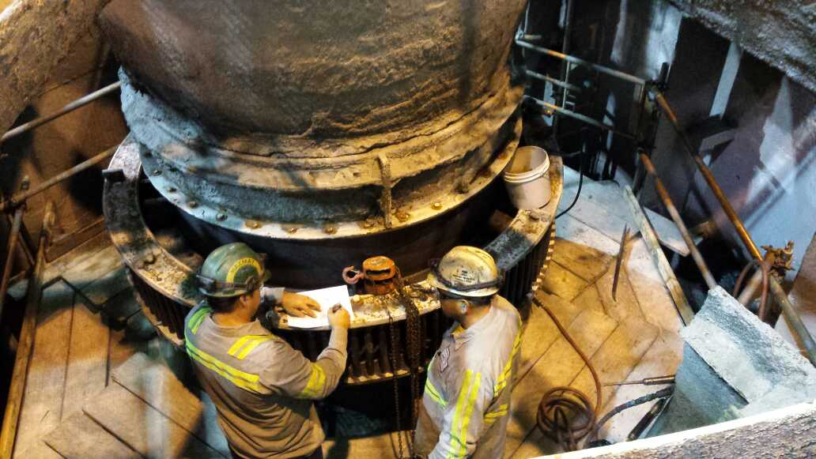
Purpose of Workplace
Examination
What is the purpose for conducting a workplace examination?
Brings employees’ attention to recognized hazards in the working area and taking immediate action to mitigate or eliminate them
What is a workplace examination?
Practice to ensure the workplace is free of hazards and adequate for you to perform your regular job duties
Notes:
Instruction
Discuss the first question
Discuss the second question
Policies, guidelines, and procedures are typically created as a result of an incident or near miss
Performing a job in a safe manner is not only a matter of compliance to regulations, but is your means of returning home safely

Slide 7
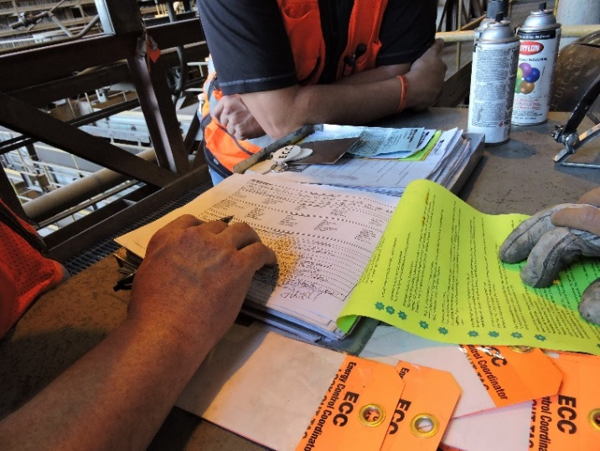
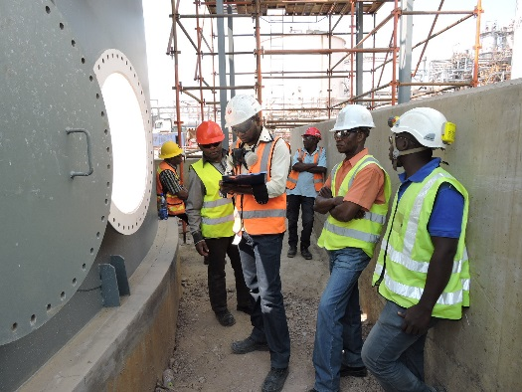
Responsible Individuals
What are some advantages to increased team involvement in workplace examinations?
Fresh set of eyes
Increased awareness of hazards
Different perspective on situations
Notes:
Instruction
Discuss the bullet points under the question
Varied backgrounds will bring a new perspective to a workplace examination
Whether the additional person is a new hire, from a different culture, or even from a different industry, he or she might note new hazards that were otherwise unnoticed

Slide 8
Record Keeping
What is included in a workplace exam record?
Date examination was made
Examiner’s name
Work areas examined
Description of each adverse condition not corrected promptly
Date when condition is corrected
Records of each workplace examination will be maintained in accordance with Freeport-McMoRan’s record retention policy.
Notes:
Instruction
Discuss the bullet points under the question
Explain what is required in a workplace examination record
Records are retained in accordance with Freeport-McMoRan’s record retention policy

Slide 9
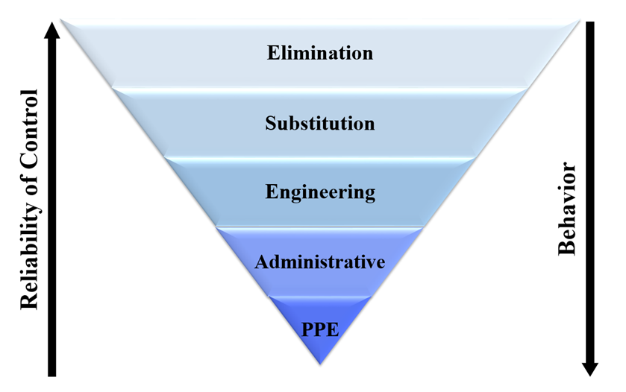
Mitigation of Findings
Preventing access to the hazard
Contact appropriate personnel
Notes:
Instruction
If a hazardous condition is found while performing an examination, immediate action to resolve the issue must occur
Prevent access to the hazard
If a hazard is discovered that poses an immediate risk to personnel, halt production until the appropriate controls are in place
Posting a spotter until proper flagging or barricading occurs may also be necessary
Contact appropriate personnel
Due to the variety of work performed at our sites, specific steps required to initiate hazard control vary
Always prevent access to the hazard and contact your Supervisor or Health and Safety Professional
When attempting to control a hazard, always refer back to the Hierarchy of Controls outlined in Fatality Prevention
Elimination, substitution, and engineering controls are more effective than administrative controls and PPE
Apply the controls that keep the employee as safe as possible

Slide 10
Debrief
In accordance with FCX requirements, how often should a workplace examination occur?
Once per hour
At the end of each shift
Before work begins or as employees begin work in that area
Why is it important to conduct a workplace examination?
To avoid MSHA fines
To recognize hazards prior to starting work
To ensure the previous shift was productive
None of the above
Notes:
Answers
c
b

Slide 11
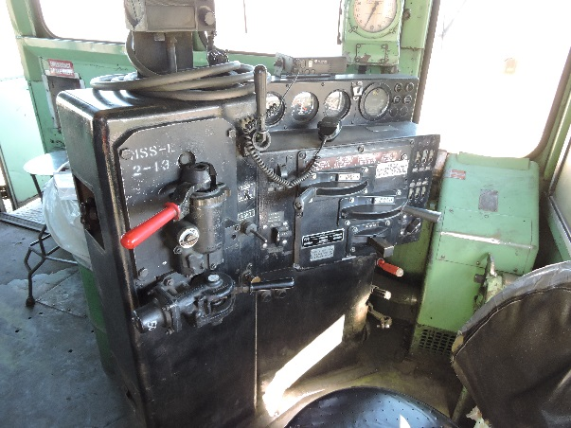
General Hazard Identification
What guidelines are necessary for performing an effective workplace examination?
Use appropriate forms
Include team members
Define boundaries
Discuss tasks being performed
Survey the area
From a distance
From a closer point
Examine specific equipment
Notes:
Instruction
Keys to an effective workplace examination
Strong hazard recognition skills
Personal accountability to the task
While the workplace examination is the first line of defense against hazards, it is only as effective as the person conducting it
Someone may be well versed in the hazards of a job, but if they do not take the time to perform a proper examination, then the workplace exam becomes ineffective
Discuss the question on the slide (Bullets revealed one at a time)
Ensure the appropriate form is used
Different tasks/departments at your site may require a different form
Include as many people from your team as possible
Begin by defining the boundaries of your work area
Talk through the tasks being performed in the defined work area
Survey the area
From a distance
Large hazards can be identified, such as an open-hole, a suspended load, or moving equipment
May be easier from an elevated vantage point
From a closer standpoint
Look for housekeeping issues, tripping hazards, electrical issues, etc.
Examine specific pieces of equipment relative to your job

Slide 12
Activity 1
The Long List
Directions
Facilitator will divide the class into small groups
Designate a leader
Take five minutes to list as many items as possible that you inspect during a workplace examination
Each leader reads their list
Every group with that item listed, crosses the item off their list
The group with the highest number of items not crossed off wins
Notes:
Time: Approximately 10 minutes
Materials
Flip chart
Markers
Purpose
This activity draws out the students’ existing knowledge on workplace examinations.
Instruction
Divide the class into small groups of 3-5 people and give each a flip chart (or provide pens and paper)
Each group designates one person as the leader
Allow five minutes for each group to list as many items as possible that they may inspect during a workplace examination (such as, berms, fire extinguishers, emergency lighting, etc.)
Each leader takes a turn reading the items off of the list
For every item that another group has, that item is crossed off everyone’s list
After all leaders read their list, the group with the highest number of items remaining wins

Slide 13
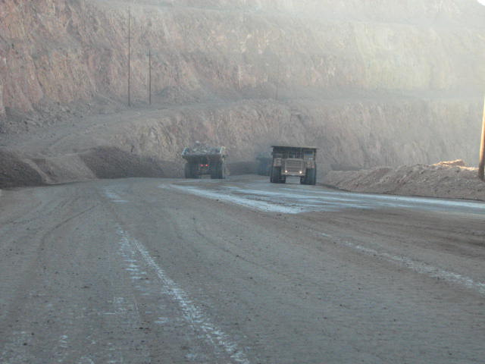
General Hazard Identification
What are some items you inspect during a workplace examination?
Equipment
Guarding
Housekeeping
Signage
Electrical
Berms
Emergency lighting
Escape routes/exits
Walking surface
Highwalls/benches
Notes:
Instruction
Ask the question
Discuss any items that were not mentioned in the previous activity

Slide 14
Activity 2
Skill Check
Directions
Facilitator will divide the class into small groups and direct each group to an area
Each group will designate a leader
Take ten minutes to conduct a workplace examination in the assigned area
Facilitator will direct groups to leave their workplace examination form in their area and rotate clockwise to the next group’s area
Take five minutes to review and note any issues not previously found
As a class, discuss what was found and what might have been overlooked
Notes:
Time: Approximately 20 minutes
Materials
Workplace examination forms (site-specific), one per group
Staged area, posters, or access to other rooms in the vicinity
Pens
Purpose
This activity draws out the students’ existing knowledge on workplace examinations
Instruction
Divide the class into small groups of 3-5 students
Direct groups to the pre-determined area
Staged area
Posters
Other rooms in the general vicinity
Allow ten minutes for all groups to conduct their workplace examination
Direct the groups to leave their workplace examination form in their area and rotate clockwise to the next group’s area
Allow 5 minutes to review and note any issues not previously found
As a class, discuss what was found and what might have been overlooked

Slide 15
Debrief
What are some of the key concepts from this refresher training?
Are there any additional questions or comments?
Notes:
Instruction
Complacency
Most people have witnessed complacency in the workplace
For some, the behavior resulted in an incident where an injury occurred
For others, perhaps luck was on their side, and no injuries resulted
The work you perform every day does not lend itself to relying on luck
Safety is an actively achieved task that starts with a workplace examination
The importance of a quality workplace examination cannot be understated
It is a continuous process that helps lead to a safe return home
Good hazard recognition skills, a strong understanding of how to implement critical controls, and knowledge of the processes performed are the backbone of a successful exam
Even the most experienced employee needs to take the examination seriously
Having a proactive approach to your work area or one you are passing through, and taking the time to mitigate hazards, creates a safer workplace for you and those around you
Discuss the questions
Let students ask clarifying questions
If needed, revisit the content from this refresher course

