Slide 1
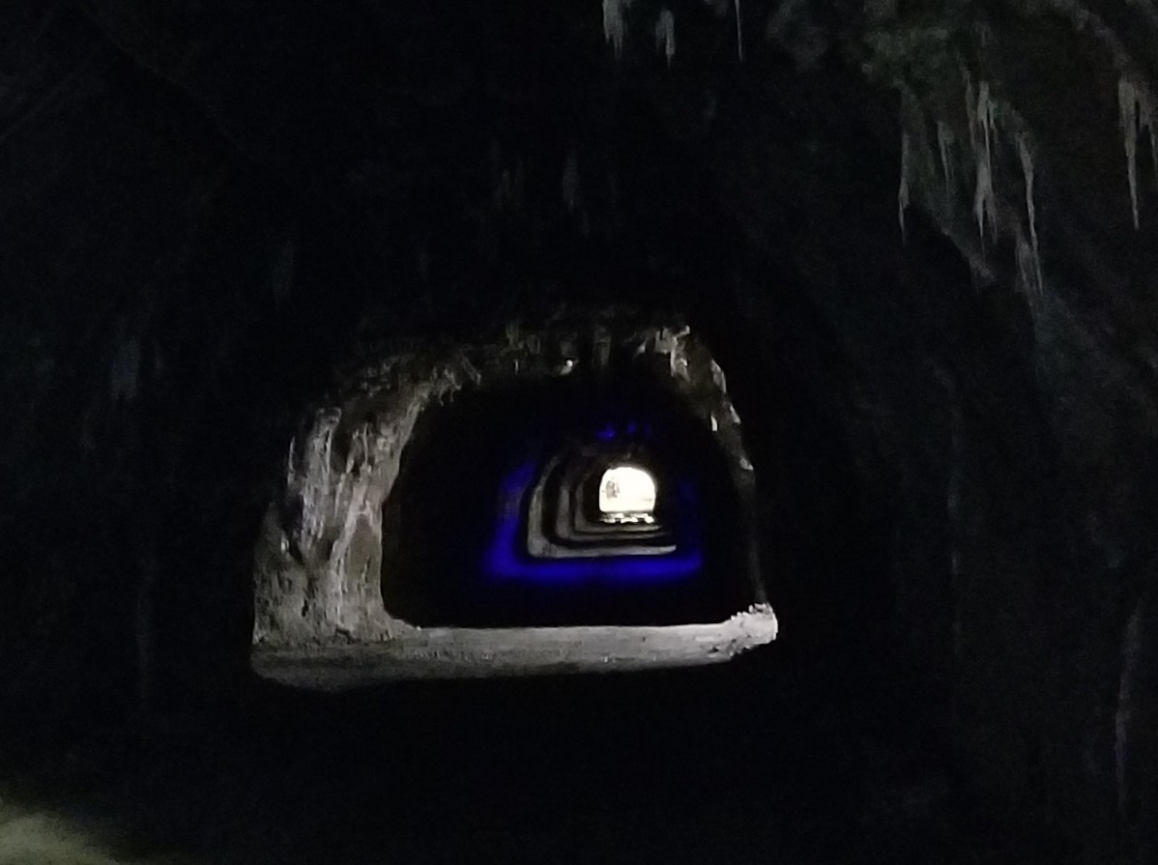
SFT FCX2018C
WORKPLACE EXAMINATIONS
UNDERGROUND
FREEPORT McMoRan INC USE ONLY / PROPRIETORY AND CONFIDENTIAL / DO NOT COPY OR DISTRIBUTE EXTERNALLY
VERSION 1 / March 2018
Notes:
Instruction
Welcome students to the class
Facilitator introduces self by stating position at FCX, how long you’ve been with the company and how long you’ve been in mining.
This is a hands-on course with plenty of opportunities to apply what we are learning. Expect to be working in small groups and involved in many discussions. We all need to learn from the knowledge and experience of others.

Slide 2
Expectations
Safety
Breaks/Restrooms
Technology
Participation
Notes:
Instruction
Explain your expectations of them as students and how the breaks will be scheduled.
Administrative/Classroom policies
Safety
Identify the appropriate evacuation procedures, gathering areas, and emergency exits and fire extinguisher locations, etc.
Breaks and Restrooms
Establish a break schedule and announce it to the class. Suggested break times are included throughout the FG and occur approximately every hour and often occur at the end of each module. Breaks should last 5-10 minutes to give students time to rest and relax before beginning the next learning session.
Identify the location of the nearest restroom and smoking areas.
Technology policy
Please review your policy on the use of cell phones and laptops during the training.
Participation
This course requires significant participation. Students should be prepared for discussion and small group activities.

Slide 3
Activity 1
Icebreaker
Directions
Participate in an activity to get to know each other
Notes:
Purpose
Utilize icebreakers to engage students at the onset of the course, especially quiet groups. When icebreakers are run successfully, students become more engaged and vested in the course, thus also contributing their ideas and thoughts. By the same token, icebreakers that are not successful can leave the students devaluing the course and the facilitator.
There is an assortment of icebreakers in the Facilitator Guide to choose from.

Slide 4
Quote
“We start with looking after our workers’ welfare.”
Richard C. Adkerson
What does this mean to you?
Notes:
Instruction
Introduce the student guide as a resource.
Read or have a student read the quote by Richard Adkerson. Read it aloud.
As a class, discuss what the quote means.
You will want to discuss with the class the Corporate Health and Safety Policy. Let them know where they can find it and that it has been recently updated.

Slide 5
Course Modules
Module 1: Workplace Examination Compliance
Module 2: Underground Hazard Identification
Module 3: Underground Critical Controls
Module 4: Chemical Storage
Notes:
Instruction
Review the module topics. This allows the students to understand the path of the course.

Slide 6
Learning Objectives
Module 1: Workplace Examination Compliance
Explain the purpose of workplace examinations
Describe the qualifications and training necessary to conduct one
Module 2: Underground Hazard Identification
Conduct a workplace examination by assessing a scenario for general hazards
7
Notes:
Instruction
Before beginning these next two slides:
Ask the Students what they would like to get out of this course, or what they think about it? Then go into each slide.
You will want to read the following two slides to explain the objectives for each module. This information can be found on p. vii in their Student Guides.
They may also find the module objectives listed on the first page of each module.

Slide 7
Learning Objectives
Module 3: Underground Critical Controls
Describe how critical controls affect the underground environment
Module 4: Chemical Storage Identification
Describe the process for managing chemical identification, storage, and handling
8
Notes:
Instruction
You will want to read the slide to explain the objectives for each module. This information can be found on p. vii in their Student Guides.
They may also find the module objectives listed on the first page of each module.

Slide 8
Introduction
Fatal Risks
Fatal Risk Management program implemented icons, definitions, and critical controls for twenty-three fatal risks
Fatal risks are risks that, when left uncontrolled, will kill you
Critical Controls
Absence or failure of a critical control significantly increases the risk of severe injury or death (helps keep you from being killed)
Implemented to prevent death or mitigate the consequences of the fatal risk
9
Notes:
Instruction
Fatal Risk Management is a continuation of the Fatality Prevention Program. Focus is placed on identifying Fatal Risks and Critical Controls in an attempt to safeguard all employees within the Company. The Fatal Risk Management Program standardizes Fatal Risk communication by implementing icons, definitions, and Critical Controls for twenty-three Fatal Risks.
Fatal Risks are based on safety issues that have resulted in catastrophic events such as severe injury or death. While all risks have a degree of danger, Fatal Risks are those risks that, when left uncontrolled, will kill you. After identifying a Fatal Risk, Critical Control(s) are implemented to prevent death or mitigate the consequences of the Fatal Risk. The absence or failure of a Critical Control significantly increases the risk of severe injury or death despite the existence of other controls. In short, Critical Controls help keep you from being killed. The Fatal Risk(s) and Critical Controls relevant to this course are provided below.

Slide 9
Introduction
Fatal Risk Icons
Review the fatal risks for this course
What are the critical controls?
9
Notes:
Instruction
For workplace examinations underground, there are five identified fatal risks.
Review the critical controls for each fatal risk with the class.

Slide 10
Introduction
Workplace examination is also known as:
Area inspection
Pre-shift inspection
Work area inspection
Workplace inspection
9
Notes:
Instruction
These procedures or processes are created by each site to identify and immediately control any hazards prior to the beginning of and throughout the shift.
Make sure that the workplace is adequate for you to perform your regular job duties.
Workplace examinations are the first line of defense in protecting our most valuable asset – you.

Slide 11
Introduction
Hazards generally fall under one of three categories:
Chemical
Biological
Physical
Never assume that you are automatically aware of all the hazards around you.
10
Notes:
Instruction
Depending on your work area, the hazards to which you are exposed can fall under one or all three of these categories.
Being skilled at recognizing hazards associated with your work area is a lifelong pursuit.
Changing environmental conditions can affect the associated risk of existing workplace hazards.
Temperature changes, noise levels, and illumination are factors that can greatly alter your work area, and in turn, the associated hazards.

Slide 12
Module 1: WORKPLACE EXAMINATION COMPLIANCE
Notes:
Instruction
Upon completion of Module 1, the students will be able to:
Explain the purpose of workplace examinations
Describe the qualifications and training level necessary to conduct one

Slide 13
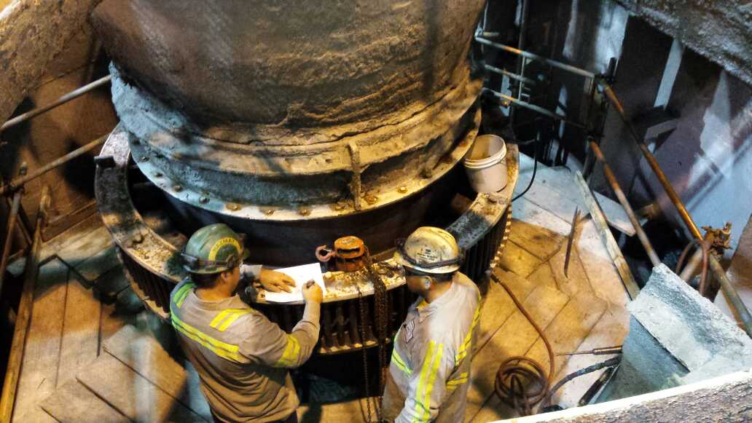
Compliance
What is the purpose for conducting a workplace examination?
What is a workplace examination?
Notes:
Instruction
Explain purpose for conducting a workplace examination - Brings employees’ attention to recognized hazards in the working area and taking immediate action to mitigate or eliminate them
Explain what a workplace exam is - Practice to ensure the workplace is free of hazards and adequate to perform regular job duties

Slide 14
Compliance
Who conducts them?
Freeport-McMoRan requires that a competent person examine each working place before work begins or as miners begin work in that area
How is a competent person defined per Freeport-McMoRan?
Having abilities and experience to perform the assigned duty
Designated by supervision
Knowledgeable in all operational areas of the working area
Notes:
Instruction
Discuss the bullet points under each question.
It is important that students understand how someone is deemed competent. A workplace examination cannot be performed by just anyone.

Slide 15
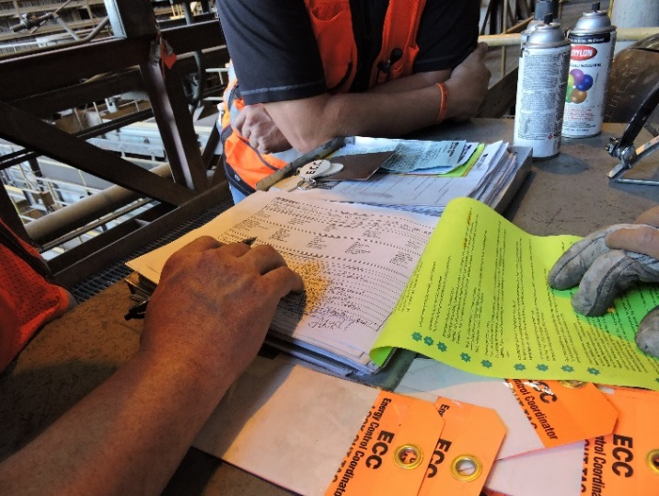
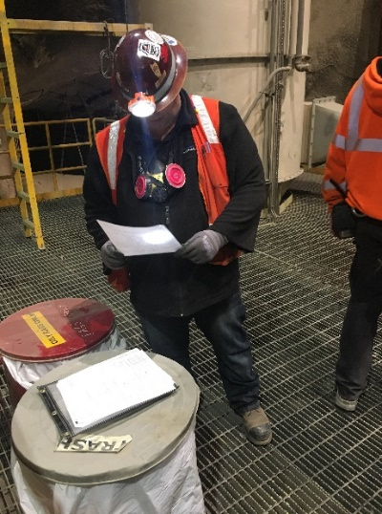
Compliance
What are some advantages to increased team involvement in workplace examinations?
Fresh set of eyes
Increased awareness of hazards
Different perspective on situations
Notes:
Instruction
Discuss the bullet points under each question.
Varied experiences can contribute to an increased awareness of hazards and result in a more effective workplace examination.
Whether you have been on the job for one month or 25 years, your input is valued. Even though Supervision may not specifically designate you, it is still ultimately your responsibility to maintain a level of awareness of hazards in your workplace or surrounding areas. The Department of Health and Safety (DOHS) team strongly encourages additional workplace examinations whenever environmental conditions change or when you start a new task.

Slide 16
Compliance
What is included in a workplace exam record?
The date the examination was made
The examiner’s name
The work areas examined
Any safety related conditions found
Any corrective measures taken
Description of each adverse condition not corrected promptly
Records of each workplace examination will be maintained in accordance with Freeport-McMoRan’s record retention policy.
Notes:
Instruction
Discuss each bullet point.
It is important that students understand what is required within their workplace examination record.
When an adverse condition that was not promptly corrected is subsequently correct, the record needs to include or be supplemented to include the date of the corrective action.
Maintaining and storing records of all workplace examinations may vary depending on your site and department. Regardless of your department-specific handling policies, whenever a workplace examination is performed, it needs to be given to a Supervisor for review.
Once your workplace examination has been reviewed by your Supervisor, you should use it as a working document throughout your shift. Any new hazards found during the work shift should be documented on the form and submitted to your Supervisor.
Records of each workplace examination will be maintained according to Freeport-McMoRan’s record retention policy. These records are maintained in either hardcopy or electronic form and made available for inspection or copy upon request by MSHA or a miners’ representative.

Slide 17
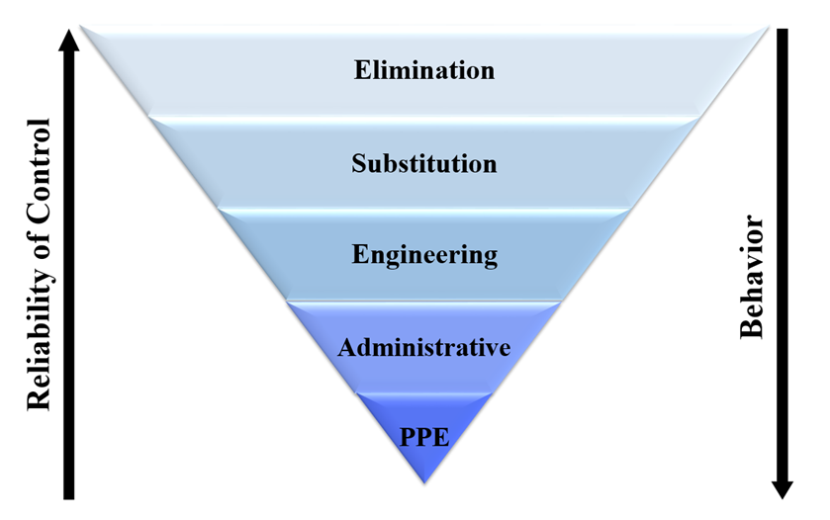
Compliance
Mitigation of Findings
Preventing access to the hazard
Contact appropriate personnel
Read the “Learn from Others” story (SG pg. 8)
Notes:
Instruction
Discuss each bullet point.
Effective communication of hazards is very important. This can be in the form of signs and other administrative controls. Ensure you are aware of the different forms of communication when working underground. Promptly notify miners in the affected area.
As the control becomes more reliant on behavior, it becomes less reliable at protecting the employee.
If a hazardous condition is found while performing an examination, immediate action to resolve the issue must occur. If a hazard is discovered that poses an immediate risk to personnel (depending on the level or risk to personnel), work activities will be halted until the appropriate controls are in place. This may also include the need to post a spotter until proper flagging/ribboning or barricading can occur.
Due to the variety of work performed at our sites, specific steps required to initiate hazard control can vary. Nonetheless, it should always include preventing access to the hazard and contacting your Supervisor or Health and Safety Professional. Only secure or isolate a hazard to the appropriate level of your training.
When attempting to control a hazard, always refer back to the Hierarchy of Controls outlined in Fatality Prevention. Remember that elimination, substitution and engineering controls are almost always more effective than administrative controls and PPE. Whenever possible, apply the controls that keep the employee as safe as possible.
Direct students to the “Learn from Others” story on p. 8 of the SG.
Discuss the incident
What could have been done to prevent this?

Slide 18
Quiz
Module 1 Quiz
Directions
Refer to the Quiz in the Student Guide.
Take five minutes to complete.
Review the answers as a class.
Notes:
Instruction
Students will complete the answers to the quiz questions in the SG (p. 9).
Review the answers as a class (See the following page for answers).

Slide 19
Quiz
Module 1 Quiz
In accordance with FCX requirements, how often should a workplace examination occur?
Once per hour
At the end of each shift
Before work begins or as miners begin work in that area
Notes:
Quiz Answers
Answer: c, SG p. 5.

Slide 20
Quiz
Module 1 Quiz
Why is it important to conduct a workplace examination?
To avoid MSHA fines
To ensure the previous shift was productive
To recognize hazards and ensure critical controls are in place prior to starting work
None of the above
Notes:
Quiz Answers
Answer: c, SG pp. xi, 5

Slide 21
Quiz
Module 1 Quiz
What defines someone as competent to conduct a workplace examination? (Circle all that apply)
Assigned by a co-worker
Designated by supervision
Understanding of operations in that work area
Notes:
Quiz Answers
Answer: b, c, SG p. 5

Slide 22
Debrief
How will you apply the skills learned in this module to your daily work activities?
What information surprised you?
Notes:
Instruction
Review the questions on the slide.
This helps to review and refresh the information that was covered in this module.
By asking the students to apply the information, they are further retaining the lesson.

Slide 23
Module 2: UNDERGROUND HAZARD IDENTIFICATION
Notes:
Instruction
Upon completion of Module Two, the student will be able to:
Conduct a workplace examination by assessing a scenario for general hazards.

Slide 24
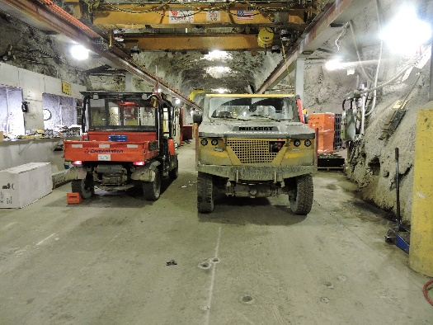
Hazard Identification
What guidelines are necessary for performing an effective workplace examination?
Discuss tasks being performed
Use appropriate forms
Teamwork
Define boundaries
Survey the area
From a distance
From a closer point of view
Examine specific equipment
Notes:
Instruction
The keys to an effective workplace examination are strong hazard recognition skills along with personal accountability to the task.
While the workplace examination is the first line of defense against hazards, it is only as effective as the person conducting it.
Someone may be well versed in the hazards of a job, but if they do not take the time to perform a proper examination, then the workplace exam becomes ineffective.
Talk through the tasks being performed in the defined work area.
Ensure the appropriate forms are being used.
Include as many people from your team, if possible.
Begin by defining the boundaries of your work area.
Survey the area from a distance and a closer point of view.
Examine specific pieces of equipment pertinent to your job.

Slide 25
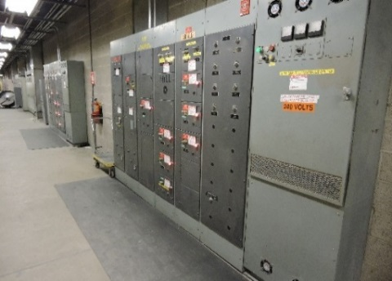
Hazard Identification
How do you determine air or water leaks?
What are some of the requirements for workplace examinations around blasting or explosives?
What are the three most common MSHA violations pertaining to electrical violations?
Notes:
Instruction
Air leaks, unlike water leaks, will be detected audibly. Report the air or water leak to the correct qualified person. Never try to resolve or mitigate an issue that is beyond your skill level or training.
Using explosives to blast rock is a necessary function of mining, especially in an underground mine. As you conduct a workplace examination, check your work area for misfires or leftover explosives. Immediately barricade the area, if any are found. It is important to remain observant even in areas where work is no longer being performed, as misfires can be present or explosives might have dropped in the drift.
All vehicles that transport explosives must have all explosives removed when not actively blasting. They should be cleaned and inspected prior to going into the shop/lube bay. Employees trained to handle explosives are responsible for the storage of them. Per Freeport-McMoRan, there are specific requirements for storage of explosives, such as:
Must be in stable or supported ground so that a fire or explosion will not prevent escape from the mine or cause detonation of the contents of another storage facility
Out of the line of blasts and protected from vehicular traffic
At least 200 feet from work places or shafts
At least 50 feet from electric substations
At least 25 feet from detonator storage facilities
Posted with warning signs that indicate the contents and are visible from any approach
Provided with unobstructed ventilation openings
Electrical related citations from MSHA are also some of the most common. For the 2016 year, three of the top ten MSHA violations pertained to electrical violations:
Electrical conductors
Not of sufficient size or current-carrying capacity and/or conductors exposed to mechanical damage
Identification of the power switches
Cover plates missing on electrical equipment or junction boxes
Correction of dangerous conditions
Failure to provide proper records of resistance measurements and continuity checks
All three types of violations should be covered in a comprehensive workplace examination.

Slide 26
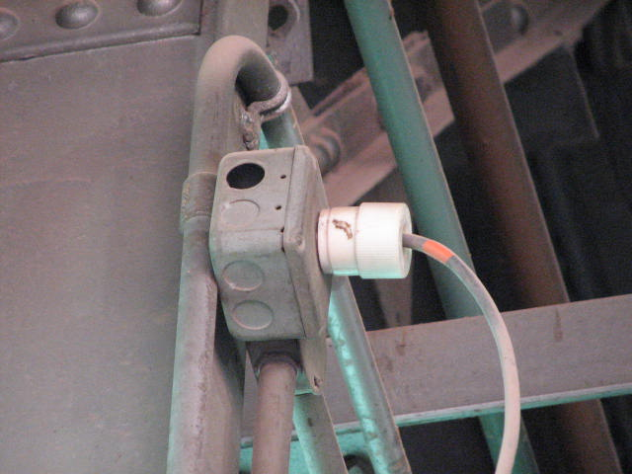
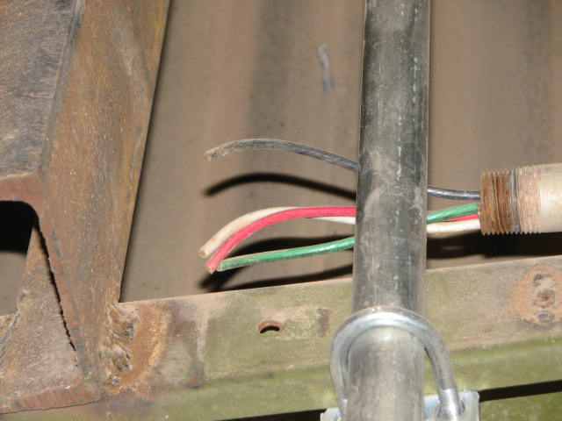
Hazard Identification
Missing knockout plugs
Why is this a hazard?
Broken or damaged conduits/cords
What could happen if these were not repaired or replaced?
Notes:
Instruction
Electrical boxes are designed to allow for either single or multiple conduits. The conduit is attached to the electrical box at small pre-cut holes. These holes are covered with small knockout plugs that are intended to be broken away when the conduit is attached.
Whenever an electrical box is modified in a manner that eliminates the need for a conduit, the remaining hole cannot be left open. A new knockout plug is used to mitigate this hazard. This is to ensure that no open holes exist in the electrical box.
As you perform your workplace inspection, be sure to examine all electrical boxes for broken or missing knockout plugs. You also want to ensure that all electrical box access doors are working and can be properly secured. Electrical boxes should be free from any unused knockout plugs. Never access an electrical box through a knockout plug.
Electrical conduits are housing for live electrical lines. They are intended to prevent personnel from coming into direct contact with live systems. Broken conduits can lead to exposed wiring, which is a shock/electrocution hazard. While conducting your workplace examination, inspect any sections of conduit to which you have access. Pay close attention to any junctions or access points along the conduit, as these sections are where wire exposure can commonly occur.
Check cords and prongs on power tools and extension cords for damage, including cracks, frays, missing prongs, or loosened connections. Any damaged cords shall be taken out of service. Extension cords cannot be used for permanent use.

Slide 27
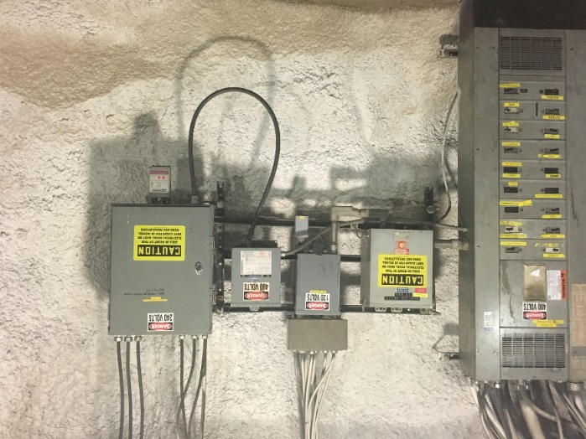
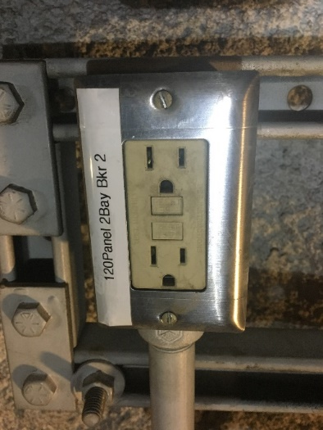
Hazard Identification
Electrical panels - what should you ask yourself?
Ground checks and GFCIs
Why is a workplace examination important for ground checks?
How do you test an outlet?
Notes:
Instruction
Review the questions in the SG
Proper labeling of all electrical panels is critical to the safety of personnel.
When inspecting the labeling of electrical panels, verify that all operational fuses are legibly marked appropriately and accurately.
If labels are damaged, missing, or not legible, the appropriate personnel needs to be notified so immediate corrective action can be taken.
Only authorized and qualified individuals should open any panels. Additionally, note whether or not adequate lighting is in place to read all labeling. Any items labeled “spare” or something similar, must remain in the open/off position. If doors to the electrical panel are left open, notify an electrician for further assistance.
Ground checks test the continuity and resistance of the grounding system.
Ground Fault Circuit Interrupters (GFCIs) protect people by detecting current flowing outside the normal path or circuit. All 120-volt outlets at Henderson must be GFCI protected.
Always test the outlet before use by pushing the “test” button, which should de-energize the outlet. If it does not trip or will not reset, do not use the outlet. Tag the outlet as “BO” and get a work order generated to replace the outlet.

Slide 28
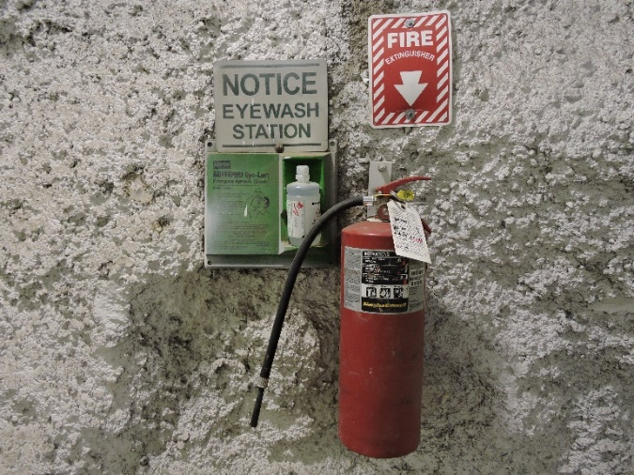
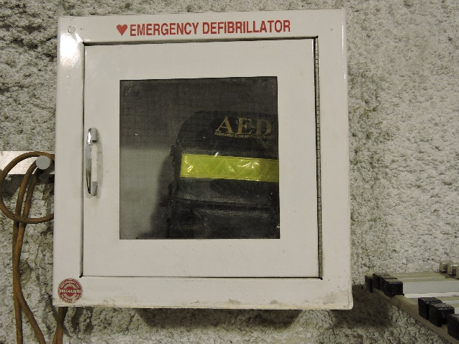
Hazard Identification
Note the location of and working order for:
Fire extinguishers
AEDs
Do the locations have proper signage?
Are the first-aid kit supplies stocked and expiration dates are current?
Notes:
Instruction
First-aid kits and automated external defibrillators (AEDs) can be extremely important during a health emergency. During your workplace inspection, pay attention to the location of all first-aid kits and AEDs. Ensure first aid supplies with an expiration date, such as eye wash solution and AED pads, are current.
Verify AED is charged and operational by visually confirming with the display screen or flashing green light, if applicable.
When working with fire extinguishers, ask yourself:
Is there any damage to the handle, nozzle, or hose?
Is the safety pin correctly in place?
Does the needle in the pressure gauge fall within the green range, and not above or below this area? That would indicate an over or under pressurized extinguisher.
Is the annual and monthly inspection tag current?

Slide 29
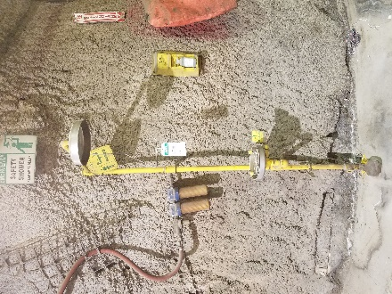
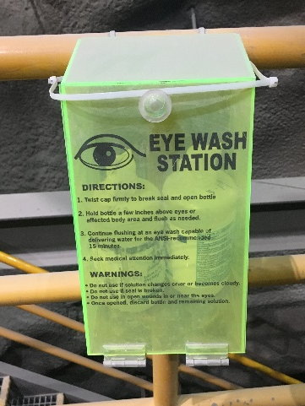
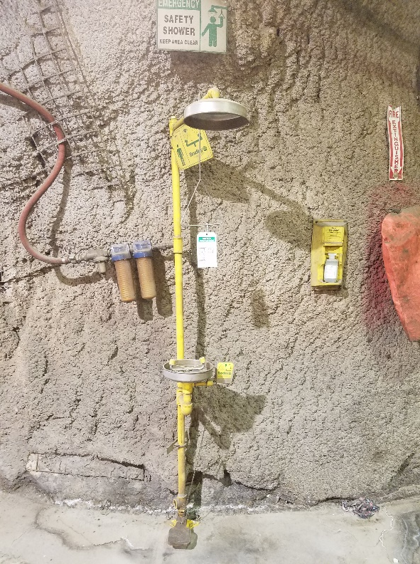
Hazard Identification
Why is it important to inspect eyewash stations and showers?
How do you inspect these areas?
Notes:
Instruction
Emergency eyewash stations and showers are often the difference between life-altering exposure events and a recoverable injury.
Your eyes are especially susceptible to injury. In situations where contamination of the eye has occurred, the longer you wait for treatment the worse off your condition may become.
While skin is much more resistant to damage than eyes, there are still certain exposures that will require immediate treatment.
Waiting for an event that requires the use of either an emergency eyewash station or shower is not the time to learn where they are located or if they are operational. As you enter your workplace, locate all emergency eyewash stations and showers.
Inspect them to ensure they are functioning, clean, and free from debris. In addition, eyewashes and showers must have signage near them and the area around them must be clear of obstruction. Eyewash water streams should cross when turned on.

Slide 30
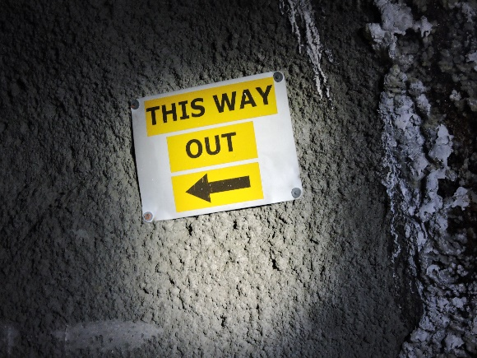
Hazard Identification
How do these affect a workplace examination?
Emergency lighting
Exit signs
Exit routes
Notes:
Instruction
Each work area has a detailed evacuation plan. Prior to working underground, familiarize yourself with your primary and secondary routes of escape and nearest refuge chamber.
Ensure exit signs are clean and legible.
Part of the workplace examination will include locating and testing the emergency lighting, locating all exit signs, and ensuring that access to all exits are free of obstructions. Emergency lighting can be tested by pressing the “Test” button or simply unplugging it.

Slide 31
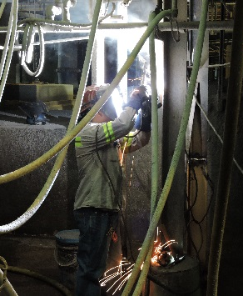
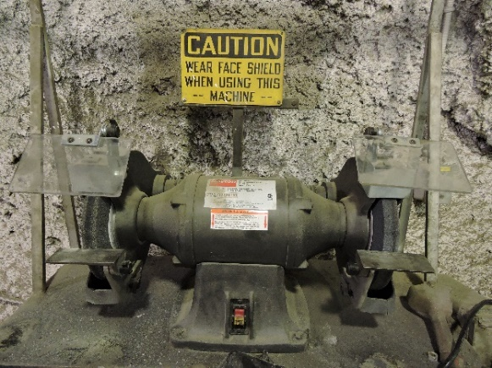
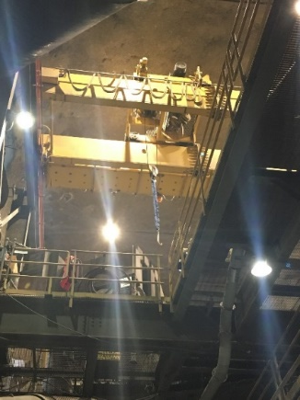
Hazard Identification
What hazards exist with each of these types of equipment?
Lifting equipment
Fabrication equipment
Grinding equipment
Review the list of questions in the Student Guide
Notes:
Instruction
If lifting equipment is in your work area, note the travel path of the equipment and if it may cross your travel path at any time during your shift. Check for proper flagging/ribboning and tagging in the work area. Look for the operator’s position in relation to the travel path of the equipment, and whether the operator will be able to see if a pedestrian were to cross the route.
Important questions to ask yourself when working in an area where welding or fabrication is occurring are:
Is the welding equipment mobile or in a fixed location?
If welding is scheduled to be performed during your shift, is there a likelihood of being exposed to spatter?
Are all materials (stinger, bottles, or lines) stored/secured properly? Are clamshells in place on all valves?
Are there any flammable materials stored near the welding equipment?
Is the welder utilizing a flash screen?
Is a Hot Work Permit required?
If grinders are in your work area, ask yourself:
Is use of the grinder going to produce noise levels that could impact other people in the area?
Are any generated sparks likely to affect a travelway?
Are you using any flammable materials that may come into contact with sparks from the grinder?
If you are working with grinders, ask yourself:
Has a Hot Work permit been completed (if required)?
Are you turning off the grinder when not in use?
Is there a 1/8” gap between the tool rest and grinding wheel and is the tongue guard in place?
Is the grinding wheel rpm rated for the grinder?
Is the peripheral hood capable of withstanding a bursting wheel and enclosing not less than 270º?

Slide 32
Hazard Identification
What are some of the ground control/supports hazards to look for during a visual examination?
Cracks
Raveling
Spalling
New water seepage
Shotcrete damage
What is the hazard with seismic activity?
Notes:
Instruction
It is just as important to be aware of conditions that may lead to the listed hazards. Some of these seismic activity conditions include, but are not limited to:
Blasting
Vehicle movement/impact
Earthquakes
As a best practice, follow these guidelines:
Working under unsupported ground is prohibited
Perform ground inspections
Do take action in reporting altered ground conditions and/or mitigate the issue to the best of your skill level or training
Maintain communication about changing ground conditions
Loose rocks need to be barred or scaled down
When an unsafe condition is noted and cannot be safely mitigated, stop work activities immediately and contact your Supervisor or Health and Safety Professional.

Slide 33
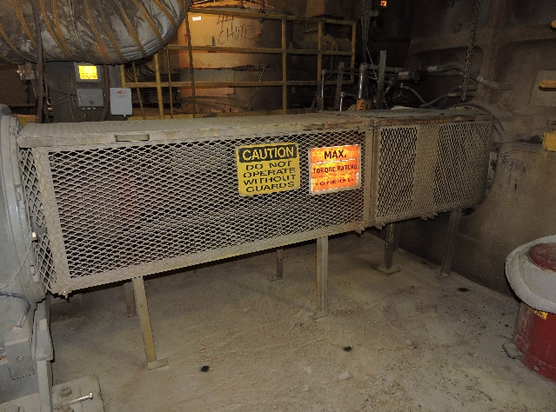
Hazard Identification
What is the purpose of guarding?
What types of hazardous areas are guarded?
What actions should be taken for missing or damaged guarding?
Notes:
Instruction
Guarding is intended to prevent access into a hazardous area. Some forms of guarding are intended to prevent whole person access, while other forms only eliminate access into smaller areas.
When performing a workplace examination, note all areas where guarding should be installed. This can include, but is not limited to, machinery with exposed moving parts, shielding to protect against chemical contact, heat shielding, and fan silencing.
If guarding deficiencies are discovered through a workplace examination, stop working until the guarding is repaired or reinstalled. These unguarded areas should be barricaded, flagged/ribboned, and/or include a spotter until the hazard can be mitigated or eliminated. If the workplace examination reveals areas where guarding was never installed, but should have been, contact your Supervisor or Health and Safety Professional to begin the process.

Slide 34
Hazard Identification
What are some of the critical controls in your area intended for hazardous atmospheres?
What questions should you ask yourself when inspecting critical controls?
Notes:
Instruction
Generate a discussion around the critical controls in the area.
Critical controls are in place to maintain a safe working environment. Without these controls in place and in operating order, the atmosphere can become hazardous with high levels of carbon monoxide and nitrogen dioxide. It is critical that workplace examinations include checking on the functionality of these controls.
Questions to ask yourself:
Are the fans on before entering the drift?
Are the fixed monitors operating? Fixed monitors are located throughout the underground mine.
After a blast, has enough time passed (minimum 30 minutes) before employees are allowed to enter the area?
Are oxygen levels safe to begin or resume work?

Slide 35
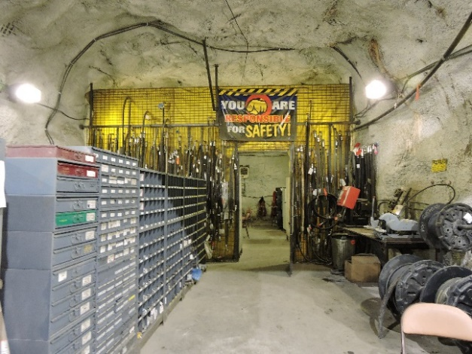
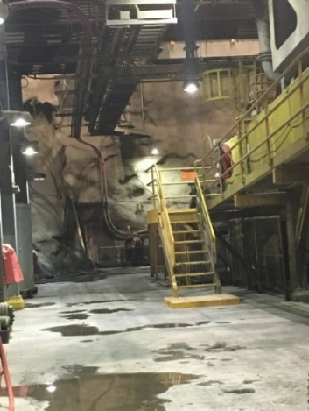
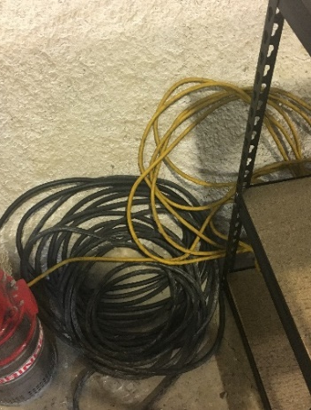
Hazard Identification
Why are these considered hazards and how do they affect inspections?
Trash and clutter
Drainage
Slipping and tripping
Notes:
Instruction
Trash and clutter can be a tripping hazard and, depending on the material, can cause cuts and scrapes. If the trash happens to be food waste, biological hazards may also be present. Trash and clutter can block escape routes, in the event of an emergency or evacuation. In the event of a fire, excess trash can provide an additional fuel source allowing the fire to spread quickly and easily.
While inspecting the drainage areas underground, it is important to observe the water level. If the drain is not properly emptying, utilize a scaling bar to loosen the material to restart the flow.
Slips and trips can be caused by a wide variety of conditions. Some of these may include standing liquids, uneven surfaces, hoses, electrical cords, or stairs and ladders. If you happen to see standing liquids or puddles, and cannot avoid walking through it, make sure to shuffle your feet. Once you establish appropriate barricading, contact your Supervisor or Health and Safety Professional.

Slide 36
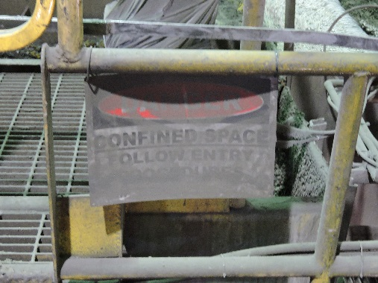
Hazard Identification
Why are signs needed?
What makes a sign effective?
Notes:
Instruction
According to the Hierarchy of Controls, signs are classified as administrative controls. When immediate, potential health, or not easily recognized safety hazards exist in a work area, warning signs must be posted at all approaches. Recognizing these signs enables you to easily understand the hazards and adhere to proper precautions while working. Pay attention to signs in your work area as they are intended to:
Direct
Warn
Inform
Some of the signs encountered are:
Danger - Indicates a hazardous situation that, if not avoided, will result in death or serious injury. The signal word "DANGER" is to be limited to the most extreme situations. DANGER [signs] should not be used for property damage hazards unless personal injury risk appropriate to these levels is also involved. Shall be used in major hazard situations where an immediate hazard presents a threat of death or serious injury to employees. Danger tags shall be used only in these situations..
Warning - Indicates a hazardous situation that, if not avoided, could result in death or serious injury. WARNING [signs] should not be used for property damage hazards unless personal injury risk appropriate to this level is also involved.
Caution - Indicates a hazardous situation that, if not avoided, could result in minor or moderate injury. Shall be used in minor hazard situations where a non‐immediate or potential hazard or unsafe practice presents a lesser threat of employee injury.
All signs must be in good health, meaning they must be properly anchored, legible, and visible. If you notice signs that are falling or are not easily visible, either resolve the issue or notify your Supervisor to take further action.
For a sign to be effective in a working area, it must be positioned in an obvious location, be clean and legible, posted in the common language for that property, and oriented properly. During an emergency situation, you do not want to lose time by having to stop and focus on a sign that does not meet these standards.
If during a workplace examination it is noted that there are signs that do not meet these standards, take the time to correct the problem, or notify Supervision so that the issue can be resolved. Remember, signage is designed to notify you of a hazard; it is understanding and adhering to the information that will protect you.

Slide 37
Hazard Identification
Lighting
What is inspected on fixed lighting?
What is inspected on portable lighting?
Shafts and Cages
Who conducts these inspections?
What is included in the inspection?
Shop Area
What are some of the hazards?
Notes:
Instruction
In areas where lights are installed, such as shops, warehouses, substations, or lunchrooms, lighting must be maintained and working. Portable construction lights which are equipped with guards must have the guards installed on them and in working order. Emergency lighting, where applicable, must be functional. High visibility lamps are part of the required PPE for entrants underground and must be fully functional.
Shafts and cages are not commonplace in most employees’ workplace examinations. There is a formal process for inspecting these areas using specially trained crews; however, ensure the entrance is clear of debris and tripping hazards.
Shop areas are painted white in an effort to brighten the area. Illumination is found most often in these work areas. Some of the shops are designated “safe areas” for hot work and do not require a permit. Ensure all materials are properly stored in appropriate areas within the shop area; this includes flammables, combustibles, hazardous waste, trash, and universal waste. Clear any tripping hazards. Confirm that all signage is not only clean and legible but also current, valid and adequate.

Slide 38
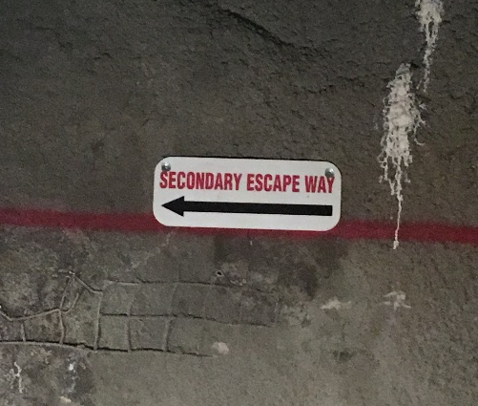
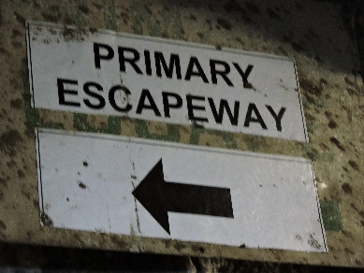
Hazard Identification
Travelways/escapeways allow employees and equipment to travel from one area to another
Maintain a safe route for any employee at all times
Who inspects these?
Notes:
Instruction
They may be traveled frequently or rarely, but it is important that they remain a safe route for all employees at all times. Always be aware of your primary and secondary escapeway, as well as the nearest refuge chamber.
While working underground, ensure you know where the primary and secondary escapeways are located. At Henderson, the primary escapeway is 2 shaft, which is a fresh air intake. The secondary escapeway is the conveyor tunnel, which can only be used in the event 2 shaft is not accessible. Note: the conveyor tunnel is also a fresh air intake.
Safe access along any path that is traveled for work, repair, or maintenance should be kept free of debris or obstruction, and easily accessible.
Travelways and escapeways are everyone’s responsibilities and are scaled/barred down accordingly.
Inspections should be occurring whether employees travel via equipment or on foot. During the Quarterly Scaling Program, each department devotes a day near the end of each quarter to complete additional inspections.

Slide 39
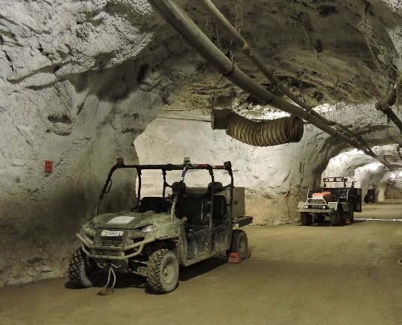
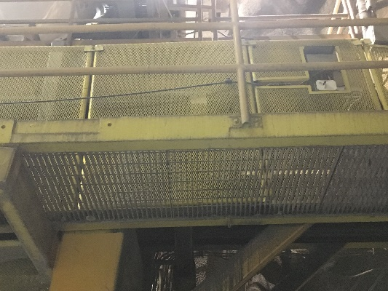
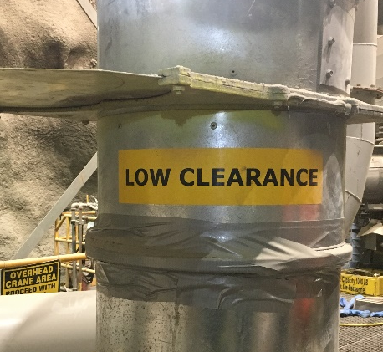
Hazard Identification
When your travelway contains these items, what are the hazards?
Vehicle traffic
Railings and toe boards
Overhead clearance
Conveyors
Notes:
Instruction
Follow these traffic/parking procedures whenever you are underground:
All uphill traffic has the right of way
All mobile equipment in your work area must have the emergency brake set and the tires chocked, when not in use
All unattended equipment should be turned off
Make sure vehicles are not blocking access ways to shafts
When working near or walking through an area with railings and toe boards, ask yourself:
Are there any missing bolts, hardware, grating, or bent stairs/tread?
Is there an installed toe board along all areas that have midrails and handrails?
If a fall hazard exists, do you need to be wearing fall protection?
Overhead clearance is another integral part of safe access along travelways or escapeways. Some of our infrastructures and equipment may require employees to duck as they pass.
The presence of an overhead crane can add another hazard to the workplace when in use. Alarms and lights are used to warn employees of a moving crane. During a workplace exam, be aware of any overhead hazards, as well as any associated warning devices.
Conveyors along travelways can present multiple hazards. Material can fall from the conveyor and collect along the travelway. If left uncontrolled, the build-up of material can present a trip hazard, or can completely impede travel along the path. Unguarded conveyors can project material, as well as expose employees to moving machinery.
Also, be aware of conveyance systems overhead. When guards are installed, look carefully for any gaps that may exist in the guarding and build-up of excess material, as it can easily fall and strike workers below.

Slide 40
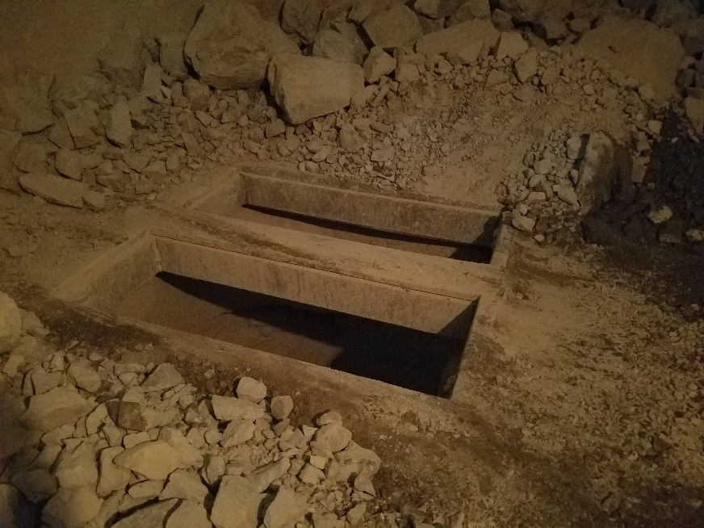
Hazard Identification
When ore passes are not in use, what would you inspect?
What should you see for ore passes in operation?
Notes:
Instruction
Discuss site-specific procedures around open holes or ore passes not in use.
The presence of an unguarded/non-barricaded open-hole, other than ore passes, along any travelway or escape route is considered an imminent danger.
In the event a workplace examination reveals an open hole other than an active ore pass, work activities should immediately stop, Supervisor or Health and Safety Professional should be notified, and proper barricading must be installed.
All open holes must be marked, and either barricaded or physically guarded at both the collar and bottom. This includes all raises, access in grating floors, manholes and vaults, ladder ways, etc.
In inactive areas, all ore passes must be covered or barricaded from access; a single flag/ribbon is not adequate.
Any ore passes in operation must have a light or yellow flasher.

Slide 41
Activity 2
Hazards in the Workplace
Directions
Refer to the activity in the Student Guide (pp. 35-36).
Take five minutes to identify if there are any hazards in the workplace.
Be prepared to share your findings.
Review the answers as a class.
Notes:
Materials
Worksheet (located in the SG pp. 35-36)
Purpose
This activity reinforces this module’s lesson on workplace examinations.
Directions
Direct the class to the activity worksheet in the Student Guide.
Each student will identify if there are any hazards in the workplace photo. Allow five minutes to complete.
After five minutes, progress through the slides and review the answers as a class. Proposed answers are provided as a guideline.

Slide 42
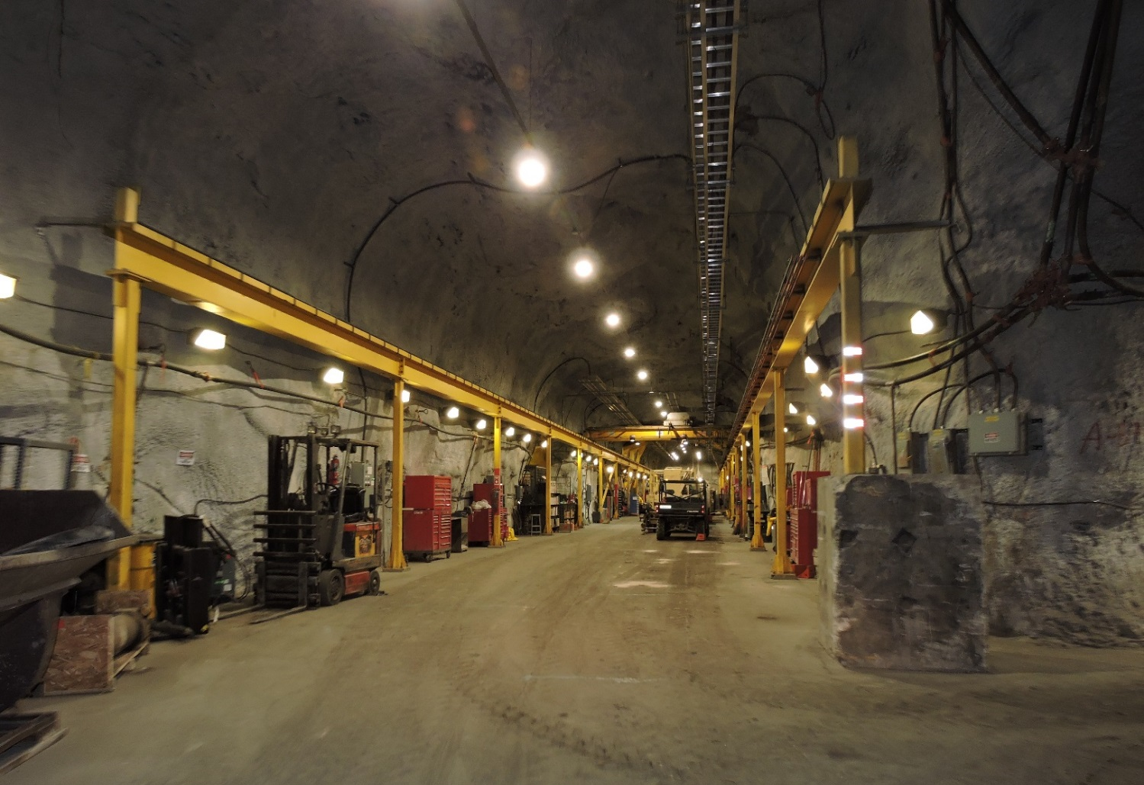
Hazards in the Workplace
#1
Notes:
Hazards:
Overhead crane
Vehicle and pedestrian traffic
Blind turn
Noise exposure

Slide 43
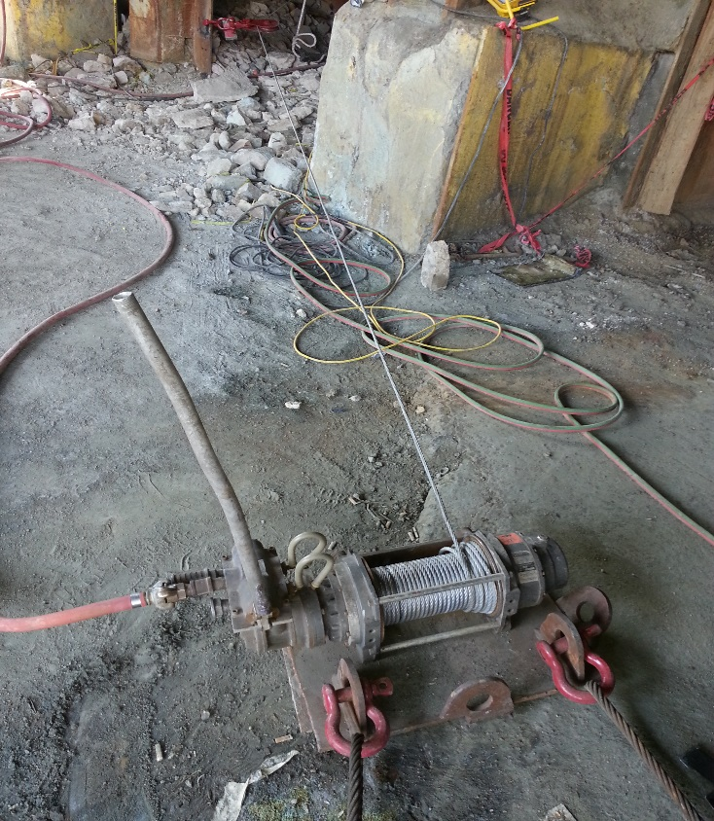
Hazards in the Workplace
#2
Notes:
Hazards:
Tripping
Uneven grounds, rock underfoot
Red flagging fallen down and why is it there?
Winch line under tension
Air lines under pressure
Broken handle, potential for cuts
Missing guarding on winch

Slide 44
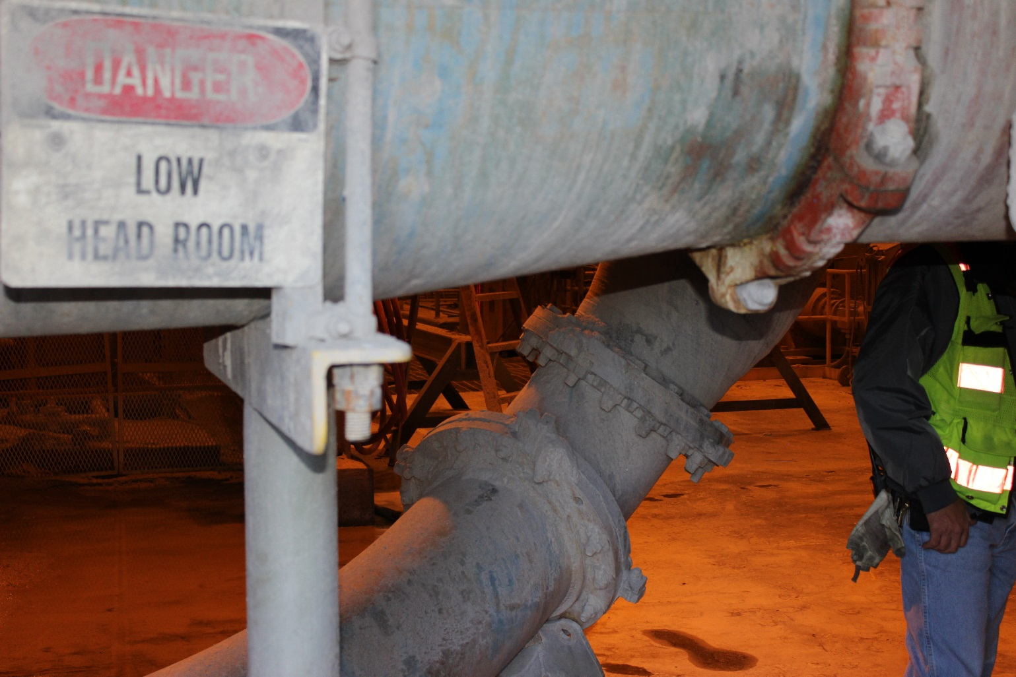
Hazards in the Workplace
#3
Notes:
Hazards:
Trip hazards with the stand leg on the right side
Slip hazards
Low overhang or head clearance
Poor lighting

Slide 45
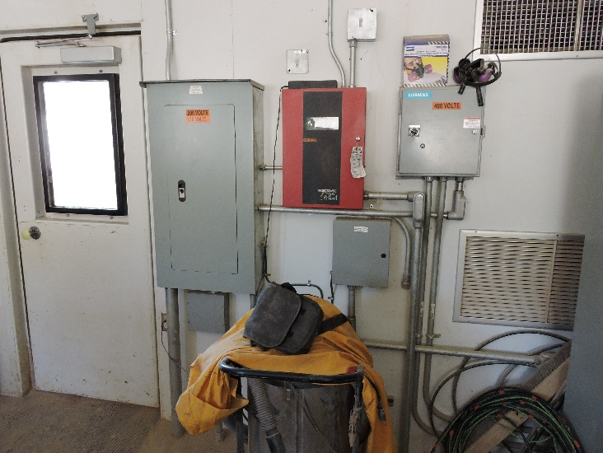
Hazards in the Workplace
#4
Notes:
Hazards:
Housekeeping issues
Shop vacuum stored less than 3 feet from electrical box
Improper storage of the respirator

Slide 46
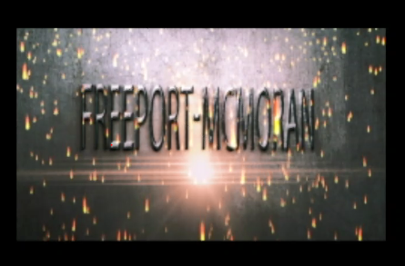
Video
Notes:
Instruction
Play the 4 minute video.
This is a brief overview of this module and visually shows examples of areas across the mine that could be examined.
Encourage students to relate this video to their process for conducting a workplace examination. While it is filmed above ground, ask for similarities in the process.
Ask students what is missing from the video for an underground workplace examination. They should respond with checking ground conditions.
https://web.microsoftstream.com/video/c221ad5f-0a77-4561-a433-148be71ac758

Slide 47
Activity 3
Teach Me
Directions
Facilitator will divide the class into small groups.
Each group will receive an assigned hazard topic (Equipment, guards, housekeeping, electrical, emergency preparedness, travelways/escapeways, or ground control/support).
Take ten minutes to research and prepare talking points about your hazard topic. Use the worksheet in the Student Guide (p.37).
Teach your topic back to the class. What do you want your classmates to understand about this topic? What are some key concepts? How can you apply this topic to your workplace?
Notes:
Materials
Worksheet (located in the SG p. 37)
Purpose
This activity reinforces this module’s lesson on the different kinds of hazards present on our properties.
Directions
Divide the class into small groups.
Assign each group a hazard topic (Equipment, guards, housekeeping, electrical, emergency preparedness, travelways/escapeways, or ground control).
Direct each small group to the worksheet in the Student Guide. Allow ten minutes for each group to research and prepare talking points about their assigned topic.
They will teach back their topic to the class. Their presentation should cover the following questions: What do you want your classmates to understand about this topic? What are some key concepts? How can you apply this topic to your workplace?

Slide 48
Quiz
Module 2 Quiz
Directions
Refer to the Quiz in the Student Guide.
Take five minutes to complete.
Review the answers as a class.
Notes:
Instruction
Students will complete the answers to the quiz questions in the SG.
Review the answers as a class (See the following page for answers).

Slide 49
Quiz
Module 2 Quiz
What is the purpose of guarding?
Prevent access into a hazardous area
Provide another location to store PPE
Protect equipment from dust and debris
Notes:
Answer: a, SG p. 26

Slide 50
Quiz
Module 2 Quiz
What are some examples of good housekeeping? (Circle all that apply)
Disposing of trash
Cleaning up oil spills
Wearing the correct dust mask
Securing ladders in the tool shop
Notes:
Answer: a, b, d, SG pp. 27-28

Slide 51
Quiz
Module 2 Quiz
What should you include in your workplace examination when working with grinders? (Circle all that apply)
Drainage
Hot work permit
The tongue guard
The peripheral hood
Notes:
Answer: b, c, d, SG p. 24

Slide 52
Debrief
How will this module impact your future workplace examinations?
What information surprised you?
Notes:
Instruction
Review the questions on the slide.
This helps to review and refresh the information that was covered in this module.
By asking the students to apply the information, they are further retaining the lesson.

Slide 53
Module 3: UNDERGROUND CRITICAL CONTROLS
Notes:
Instruction
Upon completion of Module Three, the student will be able to:
Describe how critical controls affect the underground environment.

Slide 54
Critical Controls
What is a critical control?
Review the fatal risk/critical control table in the SG
What are some examples of critical controls for underground?
Refuge chambers
Ventilation
Air doors
Dust control
Notes:
Instruction
After identifying a Fatal Risk, Critical Control(s) are implemented to prevent death or mitigate the consequences of the Fatal Risk.
The absence or failure of a Critical Control significantly increases the risk of severe injury or death despite the existence of other controls. In short, Critical Controls help keep you from being killed.
Direct students to review the fatal risk/critical control table in the SG. Discuss items they would inspect from the critical controls list. This table is to drive the conversation around critical controls, as those critical controls are in place to prevent employees from being killed.
Review the examples of critical controls for underground.

Slide 55
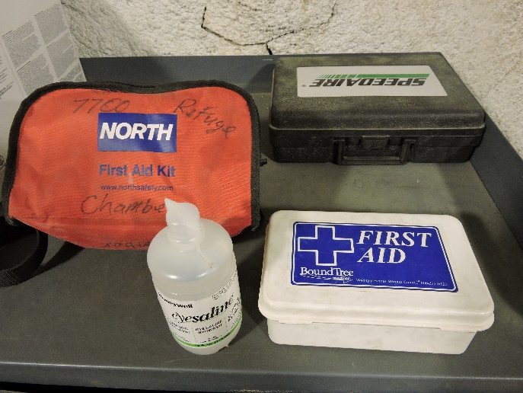
Critical Controls
Why are refuge chambers in place?
What do you inspect in a refuge chamber?
Tools
Emergency supplies
Integrity of floors and walls
Notes:
Instruction
In addition to primary and secondary escapeways, refuge chambers are located throughout the underground mind.
This critical control is provided for every employee who cannot reach the surface within one hour from his/her working area using either escapeway. The refuge chambers are specifically located so that employees can reach one of them within 30 minutes from leaving their workplace.
Refuge chambers are designed with fire-resistant construction and can be sealed to be gas-tight. Each chamber is equipped with compressed air lines, waterlines, suitable hand tools, stopping materials, and first aid supplies.
Ensure that the proper tools and supplies are maintained and readily available, should an emergency occur. Even though refuge chambers are not active working areas, it is critical to check the integrity of the walls and ceilings (ribs and back).

Slide 56
Critical Controls
How does airflow affect the underground environment?
Who conducts the inspection of the airflow system?
What should you inspect when traveling through or working near air doors?
Notes:
Instruction
It is critical for airflow to be constantly moving within the underground mine. Maintaining proper airflow within the underground mine is required to introduce fresh air into work areas and reduce hazardous atmospheres to workers. Airflow also controls temperatures, environments, and provides oxygen.
With the combination of fresh air intakes and exhaust fans (return airshafts), air has the ability to safely move throughout the various drifts to provide a safe working environment.
There are qualified individuals who are responsible for completing a more in-depth inspection of the ventilation system; however, it is important to inform Supervision or a Health & Safety Professional if you notice a change in the environment, the airflow or defects in the ventilation equipment (e.g. torn vent bag, gap between fan and vent bag).
Throughout the underground mine, air doors are specially designed and placed in areas to control ventilation of the mine between intakes and return airways. The doors create an air-lock. With the use of sensors at Henderson, the doors will automatically open when equipment and/or machinery are detected or in proximity. It is critical that all doors are fully operational and free from obstructions.

Slide 57
Critical Controls
What are some of the dust controls in use?
Dust suppression sprayers
Dust collection systems at transfer stations
Water trucks
Wash down hoses
Water sprayers on conveyors
What other areas may have excessive amounts of dust?
What actions should you take if a critical control is not working or not in place?
Notes:
Instruction
When bulk material is altered or moved by equipment or at transfer station via chutes, dust is generated. Not all dust particulates are visible to the eye, which is why dust suppression measures are critical underground.
Dust suppression sprayers in draw points must be fully functional and running.
Dust collection systems at transfer points must be free from damage and running.
Water trucks are utilized to control dust for main access and travel ways.
Wash down hoses must be fully functional for dust suppression near exhaust ends.
Transfer points on conveyors utilized water sprayer to suppress dust while equipment and machinery are dumping/crushing ore.
Roadways need to be maintained with minimal amounts of water to reduce dust. Look for non-functioning/disabled sprayers.
If you notice an excessive amount of dust or an area that needs maintenance, notify Supervision or a Health & Safety professional. Mitigate the issue to the best of your skill level or training.

Slide 58
Quiz
Module 3 Quiz
Directions
Refer to the Quiz in the Student Guide.
Take five minutes to complete.
Review the answers as a class.
Notes:
Instruction
Students will complete the answers to the quiz questions in the SG.
Allow five minutes to complete.
Review the answers as a class (See the following page for answers).

Slide 59
Quiz
Module 3 Quiz
What does airflow control? (Circle all that apply)
Temperature
Illumination
Environment
Oxygen levels
Notes:
Answer: a, c, d, SG p. 46

Slide 60
Quiz
Module 3 Quiz
Refuge chambers are intentionally located how many minutes from each workplace?
15 minutes
30 minutes
45 minutes
60 minutes
Notes:
Answer: b, SG p. 46

Slide 61
Quiz
Module 3 Quiz
Which of the following are critical controls for Underground Hazardous Atmosphere? (Circle all that apply)
Air doors
Ventilation
Refuge chambers
Dust control systems
Notes:
Answer: a, b, c, d, SG pp. 46-47

Slide 62
Debrief
How will this module impact your future workplace examinations?
What information surprised you?
Notes:
Instruction
Review the questions on the slide.
This helps to review and refresh the information that was covered in this module.
By asking the students to apply the information, they are further retaining the lesson.

Slide 63
Module 4: CHEMICAL STORAGE
Notes:
Instruction
Upon completion of Module Four, the student will be able to:
Describe the process for managing chemical identification, storage, and handling.

Slide 64
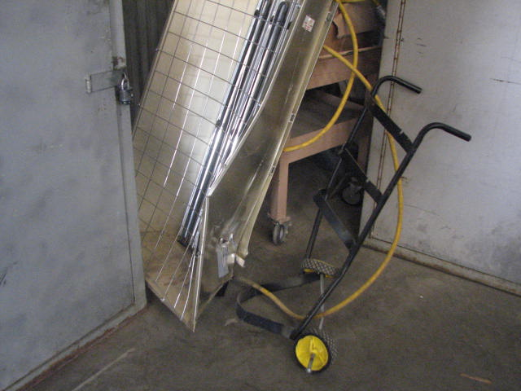
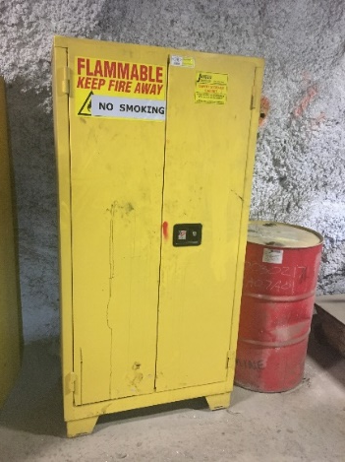
Chemical Storage
Why would you inspect these items in a chemical containment area?
SDS
Tank/container labels
Secondary containment
Why is the storage location important for combustible and non-combustible items?
Notes:
Instruction
Check your work area for any chemicals and liquids. Identify the hazards of each by reading the corresponding SDS for each. If they do not belong in the area, take appropriate action to remove safely or notify your Supervisor or Health and Safety Professional.
All tanks/containers must have clear, legible labels. All oil totes and drums require secondary containment. Totes will most likely be double walled for containment purposes. Examine all totes for proper containment and make sure they are stored in their appropriate areas.
In areas where combustible materials are stored, signage must be present and legible stating “No Smoking” and “No Open Flame.” All containers must be properly labeled and legible. Containers should be clean and in good condition (no dents, broken caps, or stoppers, unclean, etc.)
Ensure that combustible liquids are stored separately from explosives or blasting agents, shaft stations, and ignition sources. This includes any electric equipment that could create sufficient heat or sparks. This helps minimize the spread of fire. In the event of a combustible liquid spill such as oil or grease, actions must be taken to clean up the spill as quickly and safely as possible. Establish good housekeeping habits and ensure this area is free of debris.
Similar to trash/clutter, improperly stored materials can become a hazard when obstructing travelways. The risk of this hazard increases dramatically in the event of an emergency. When looking around your work area, note if all materials are stored in accordance with Freeport-McMoRan standards as well as manufacturers’ instructions. While materials may be stored in the proper containers, if their weight exceeds the limits of the shelving system, then they are improperly stored.
If your work area contains liquids stored under pressure, ensure that the vessels are secured properly and that no valves are leaking. If you are storing liquid waste, verify that all containers are properly labeled (describing contents), secured, and free from leaks. If your work area contains various hazardous or reactive chemicals, make sure that there is no possibility of the chemicals mixing.
When storing materials, ensure that you utilize a rated flammable materials safety storage cabinet. All containers stored in the cabinet, regardless of the content, need to be properly labeled. Do not store items in the cabinet such as rags, cardboard containers, paper, or anything else that could become a fuel source, should a fire occur. Keep in mind that some cardboard containers are used for organizational purposes.

Slide 65
Chemical Storage
How should universal waste be stored and disposed?
Segregated
Only stored with like items
Disposed of in a timely manner
Why?
Universal waste is considered hazardous and handled with care
Disposed in such a manner as to reduce and/or prevent release to the environment
Notes:
Instruction
This waste should be segregated and never stored in a container with an unlike item.
Accumulation areas are located throughout the underground mine for aerosol, battery, lamp/bulb, and electronics.
All material must be properly disposed of in a timely manner. For example, empty aerosol cans should be properly stored in containers labeled with the words “Universal Waste Aerosol Cans” while BO batteries should be stored in containers that are appropriately labeled “Universal Waste Batteries” with the leads insulated.

Slide 66
Chemical Storage
Where are spill kits located?
What do you inspect on a spill kit?
Notes:
Instruction
All shops and surface areas are supplied with spill kits.
The kit contains absorbent materials and pads.
Check each spill kit during your inspection and refill supplies accordingly.
If you see a spill, clean it up immediately.
Discard oil absorbent pads into the proper disposal container after each use.

Slide 67
Activity 4
Stump Your Neighbor
Directions
Facilitator will divide the class into two teams.
Each team will designate a leader.
Take five minutes to create three questions and answers that you believe will stump the other team.
Each leader will take turns asking the other team one of their questions.
Review the answers as a class.
Notes:
Materials
Flip chart
Markers
Purpose
This activity draws out the students’ existing knowledge on workplace examination compliance.
Directions
Divide the class into two teams.
Each team will create three questions and answers about this course that they believe will stump the other team. Designate one person as the leader. Allow 5 minutes to complete.
After 5 minutes, teams will take turns with the leader asking the other team one question and allowing them to answer it. Rotate between the two teams until all questions have been asked and answered.
The flip chart can be used to capture questions that generate a discussion.
Discuss the responses as a class.
Note: If there are not any questions generated regarding the qualifications of a competent person, be sure to include those questions on your own. It is important that this information is reiterated to the class.

Slide 68
Quiz
Module 4 Quiz
Directions
Refer to the Quiz in the Student Guide.
Take five minutes to complete.
Review the answers as a class.
Notes:
Instruction
Students will complete the answers to the quiz questions in the SG.
Allow five minutes to complete.
Review the answers as a class.

Slide 69
Quiz
Module 4 Quiz
What document provides hazards, proper handling, and storage information for each chemical?
JSA
SDS
Hot Work Permit
Workplace Examination
Notes:
Answer: b, SG p. 55

Slide 70
Quiz
Module 4 Quiz
Combustible materials should always be stored near open flames and smoking areas.
True
False
Notes:
Answer: b, SG p. 55

Slide 71
Quiz
Module 4 Quiz
When storing liquid waste, what should be verified with all containers? (Circle all that apply)
Secured
Free from leaks
Properly stored
Properly labeled
Notes:
Answer: a, b, c, d, SG pp. 55-56

Slide 72
Debrief
How will this module impact your future workplace examinations?
What information surprised you?
Notes:
Instruction
Review the questions on the slide.
This helps to review and refresh the information that was covered in this module.
By asking the students to apply the information, they are further retaining the lesson.

Slide 73
Conclusion
Notes:
Instruction
Complete a final review session

Slide 74
Debrief
What are some key concepts in each module?
Module 1: Workplace Examination Compliance
Module 2: Underground Hazard Identification
Module 3: Underground Critical Controls
Module 4: Chemical Storage
Are there any additional questions, comments, or concerns?
Notes:
Instruction
As the objectives for each module are reviewed, ask if there are any lingering questions, comments, or concerns.
Module 1
Explain the purpose of workplace examinations
Describe the qualifications and training level necessary to conduct one
Module 2
Conduct a workplace examination by assessing a scenario for general hazards
Module 3
Describe how critical controls affect the underground environment
Module 4
Describe the process for managing chemical identification, storage, and handling

Slide 75
Questionnaire
End of Course Questionnaire
Directions
Complete the questionnaire.
Your feedback is valuable to us.
Return the completed form to the facilitator.
Notes:
Instruction
Have students complete the Student End of Course Questionnaire (located in the SG p. 69)

