Slide 1
Fatal Risk Management

Slide 2
What is Fatal Risk Management
A set of tools to enhance our Fatality Prevention Program
Fatal Risk Management is a simple set of symbols, questions, and mobile software to help us further enhance our Fatality Prevention Program.
A set of visual symbols of the 25 fatal risks faced by our employees
Through analysis of company and industry incidents we have identified 25 fatal risks that are present in our operations. For each fatal risk we created a symbol to represent the presence of that hazard.
For each fatal risk we identified, there is a list of the critical controls necessary to prevent a serious injury or fatality. We also provided a set of short verification questions to facilitate discussion about the best way to implement each control.
A standardized set of critical controls to help keep you safe
Empowerment for operators and supervisors to “Stop the Work”
Safety is the responsibility of every employee. Fatal Risk Management is about empowering everyone to “Stop the Work” if a critical control is missing or ineffective.
Notes:
Ask for examples of Fatal Risks and the critical controls associated with the identified Fatal Risk.

Slide 3
Why FRM is Important
It has been over 13 years since we’ve had a year with ZERO fatalities
47
Incidents with a fatality
82
People Fatally Injured
Fatal Incidents
2
4
4
8
4
3
6
5
1
2
5
2
1
People Fatally Injured
2
6
6
35
7
3
6
5
1
3
5
2
1
2010 | 2011 | 2012 | 2013 | 2014 | 2015 | 2016 | 2017 | 2018 | 2019 | 2020 | 2021 | 2022
1/1/2010 – 12/21/2021, counts from IMS including all active and divested sites.
Notes:
This data was collected between January 2010 thru December of 2021
One of the major points here is that while most of us are aware of fatalities as they happen, it is often not recognized how many people have lost their lives in the last several years. This slide illustrates that we as a company have not gone a single year without a fatality in over 12 years.
Draw the distinction that not every fatal event is equal to one fatality. We have had several incidents over the years where more than one employee lost their life.
In 2013, the collapse of the underground training room at PTFI cost the lives of 27 miners in one incident. The other 7 incidents resulted in the death of 8 other miners.
In the most recent years of 2020 & 2021, we have experienced 7 incidents with 7 individual fatalities.
2020
PTFI – Vehicle Collision and Rollover - A light vehicle was transporting material, slid and rolled over.
PTFI – Fall from heights - During safety mesh installation on a slope stabilization project, an employee was found to have fallen onto the road from approximately 50 meters height.
PTFI – Fire - Fuel Tank Burst info Flame onboard a boat.
PTFI – Vehicle Collision and Rollover – A truck and trailer went over a cliff approximately 50 meters while transporting material.
PTFI – Vehicle Impact on Person - An employee was found pinched in between the door and the cabin structure of the Loader.
2021
PTFI – Vehicle Collision & Rollover - An employee was missing for a long period of time. His crew discovered his wrecked vehicle with the employee 20 meters from the vehicle.
Morenci – Hazardous Substances Acute - Contractor employees were welding a section of stainless-steel pipe (~80â€™) to the main feed line when issues with the welding process occurred. The welders began to trouble shoot the argon system and bladder when one welder went missing and was later found inside the 30â€œ pipe. Emergency services were dispatched, CPR and other life saving measures were provide by Paramedics and first responders on site before transporting via ambulance to local clinic where doctor pronounced death.
FRM is one of the ways to help prevent fatalities. Do not let your site, department, team be another statistic. Take action and set the standard that FRM is to be used on every job!

Slide 4
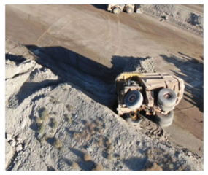
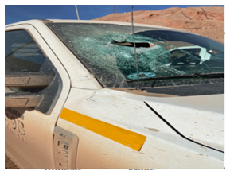
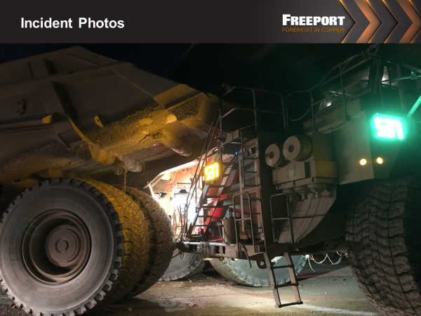
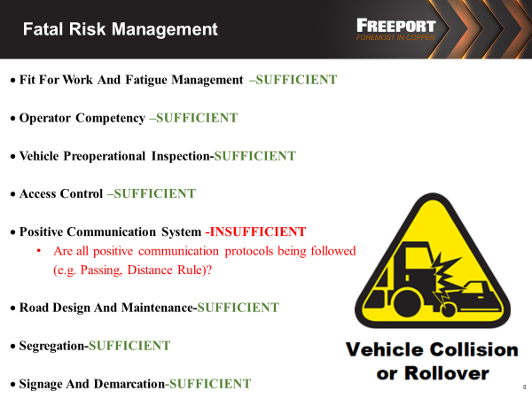
Why FRM is Important
2021-2022
89 high-risk RCAs were conducted by specialists, 4 similar themes were discovered:
Fatal Risk management tools were not used
All critical controls were not implemented
Lack of supervision involvement during the task/lineout
Policies & Procedures were not followed or reviewed
Notes:
2022 RCA’s (Root Cause Analysis) high-risk incidents that were missing identified critical controls.
Morenci Haul Truck Incident
Metal to Metal
Incident Date: March 16th, 2022
Fatal Risk: Vehicle Collision or Rollover
Short Description: Haul Truck was not following at the proper distance for the speed that the truck was traveling.
All critical controls but one were found to be in place and effective. Missing just one critical control could result in serious injury or death.

Slide 5


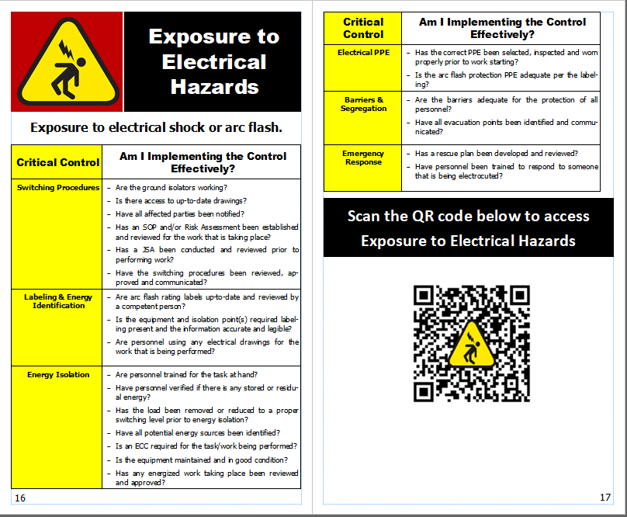
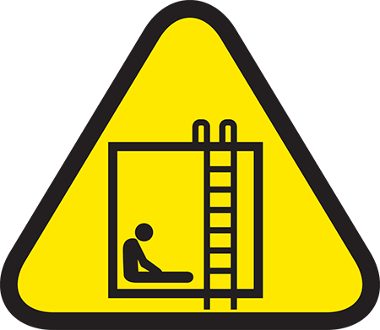
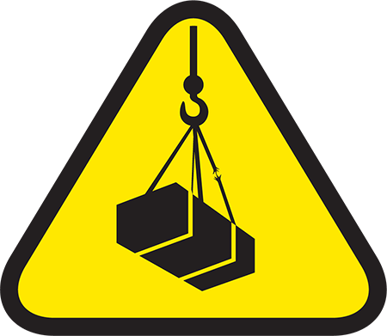


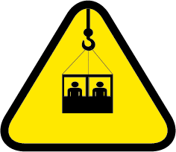
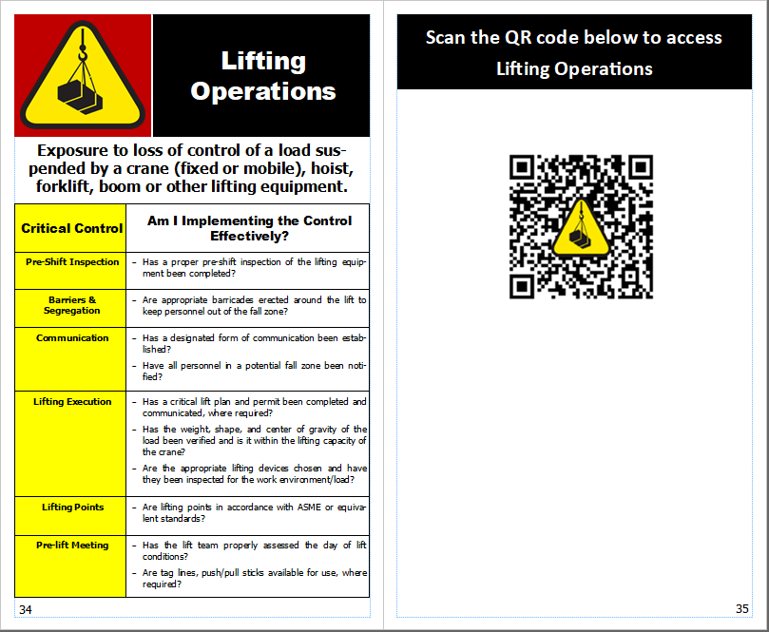
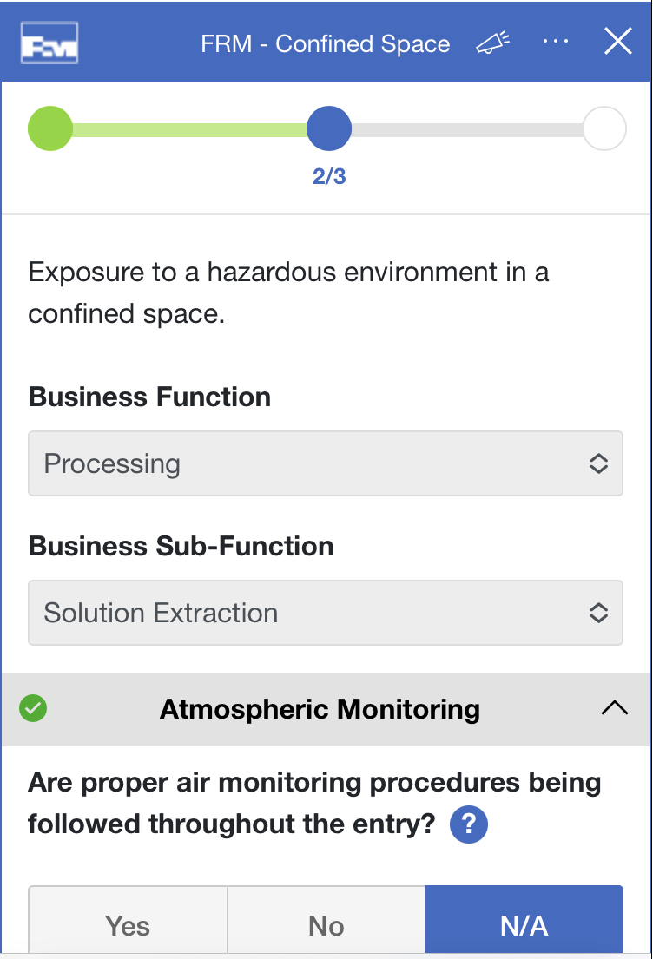

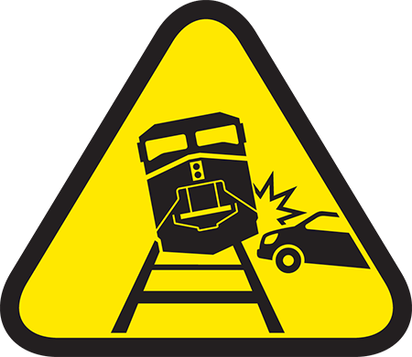

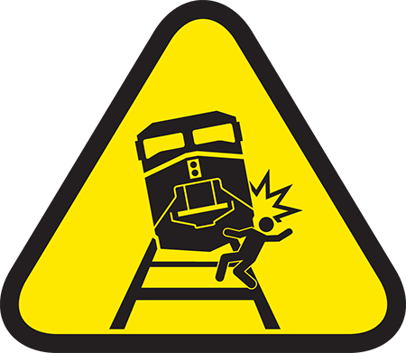
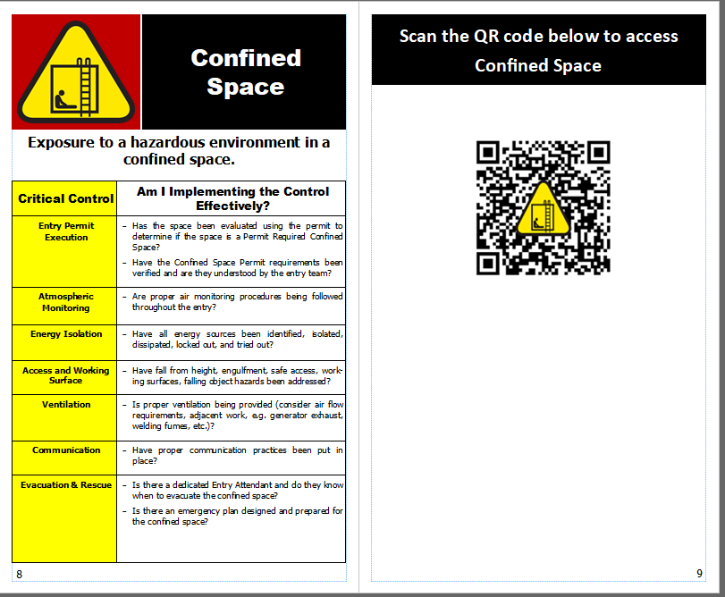



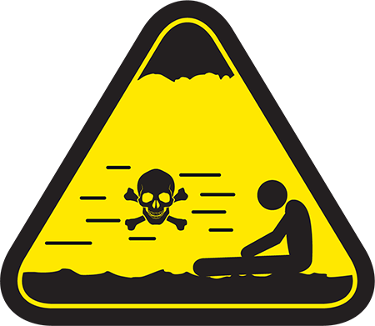

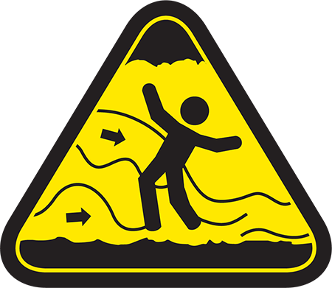

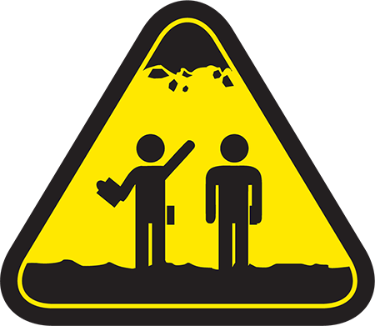





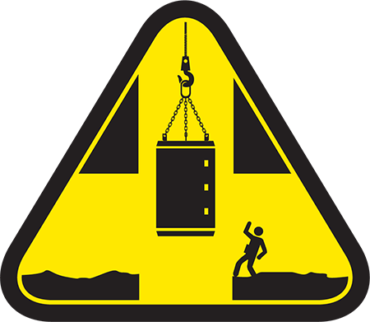
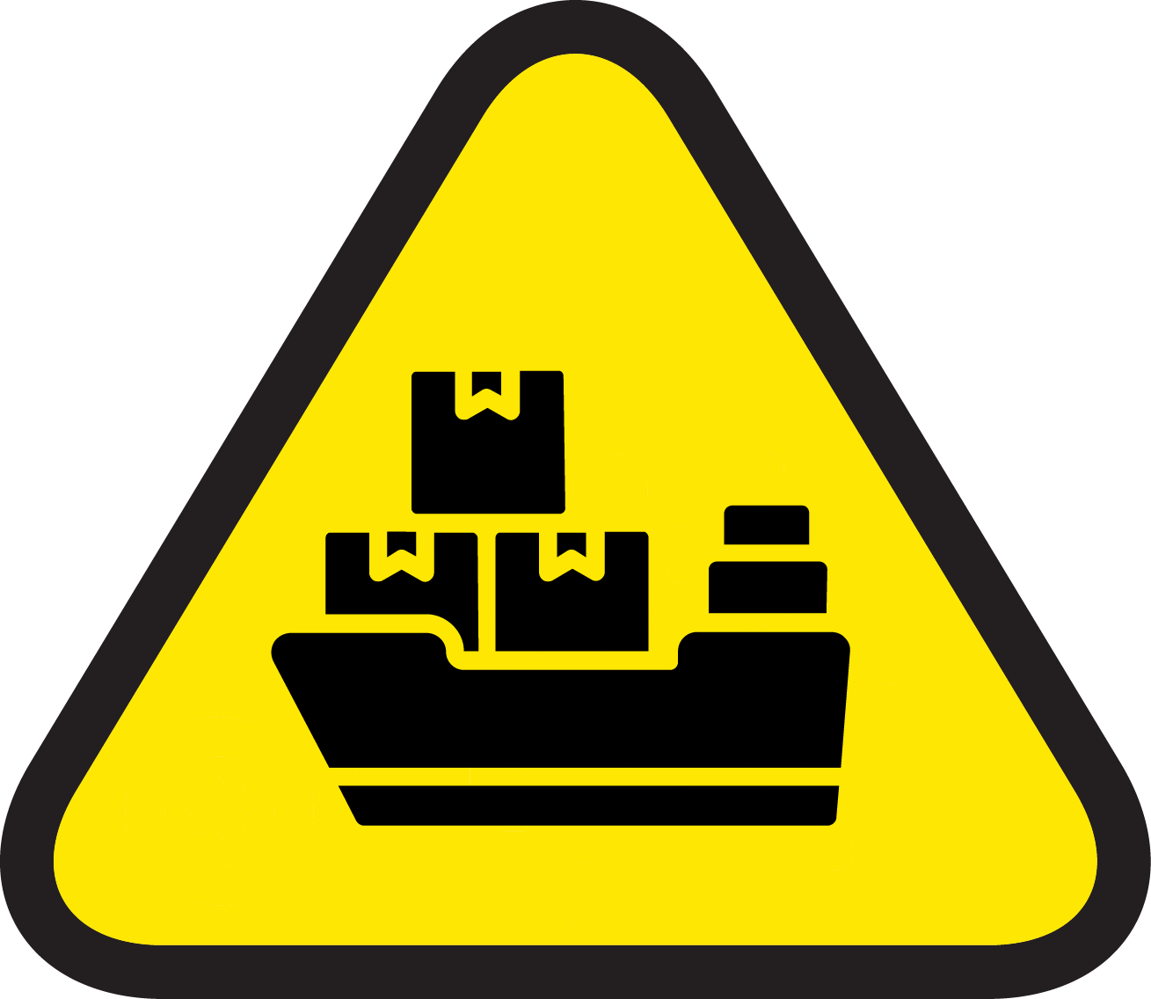
FRM Tools
Fatal Risk Icons
Visual representation of the 25 fatal risks for use in signs, documents, tailgate meetings
FRM field books with critical controls, verification questions and QR codes
Used to promote good safety conversations and improve implementation of critical controls in the field
Digital Workspace FRM Verification
Digital Workspace FRM verifications allows for the collection of data in the field and data trending
Blasting
Interaction w/ Aircraft
Confined Space
Lifting Operations
Contact with Molten Material
Personnel Hoisting
Drowning
Rail Collision
Entanglement and Crushing
Rail Impact on Person
Exposure to Electrical Hazards
Uncontrolled Release of Energy
Fall from Heights
Underground Hazardous Atmosphere
Falling Objects
Underground Inrush
Fire
Underground Rock Fall
Ground Failure
Vehicle Collision or Rollover
Hazardous Substances—Acute
Vehicle Impact on Person
Hazardous Substances—Chronic
Underground Shaft Hoisting
What other FRM tools are available?
Maritime
Notes:
These are some of the tools that are available today. More tools are being added and upgraded every day.
Scan the QR code to see a live example of what the tool does; Directs user to the Digital Verification form, Relevant Policies and other forms if applicable to the Fatal Risk e.g., confined space entry permits, pipe pulling permits etc.
What are examples of other tools that leverage FRM? E.g., JSA/JRA’s, Safety communications, SOP’s & work instructions etc.

Slide 6
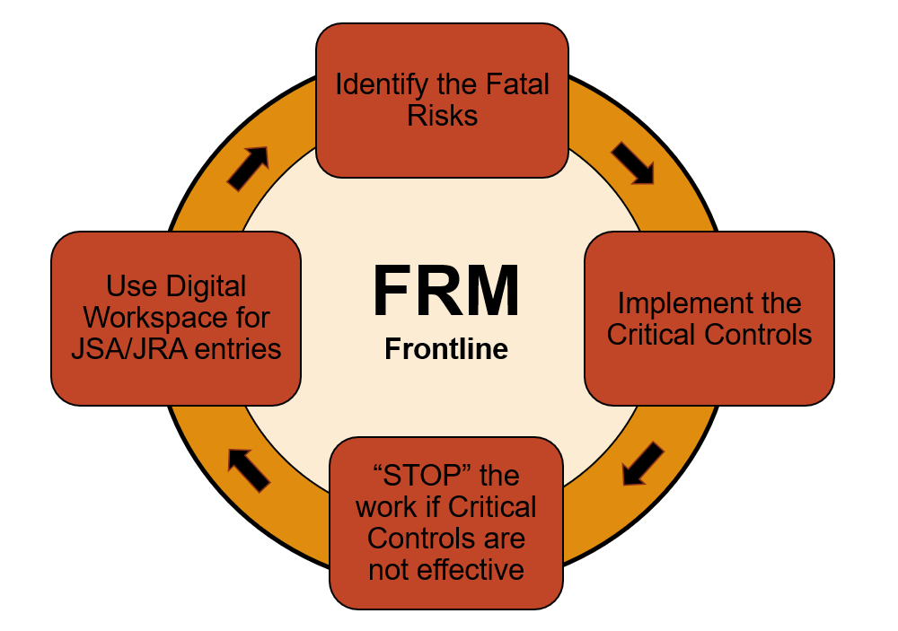
Expectations of the Frontline
Set the Standards
Identify any Fatal Risks prior to starting work.
Ensure that all the correct critical controls are in place
STOP WORK if critical controls are not effective
Incorporate into your JSA/JRA entries!
Ensure that the appropriate Fatal Risks are selected for your job and the correct critical controls are in place
Take the opportunity and use the digital work forms to help streamline your day
Notes:
The basic expectations of the frontline, no matter the mine or department.
Workflow diagram that displays an overview of how the frontline should use and drive FRM in the workplace.

Slide 7
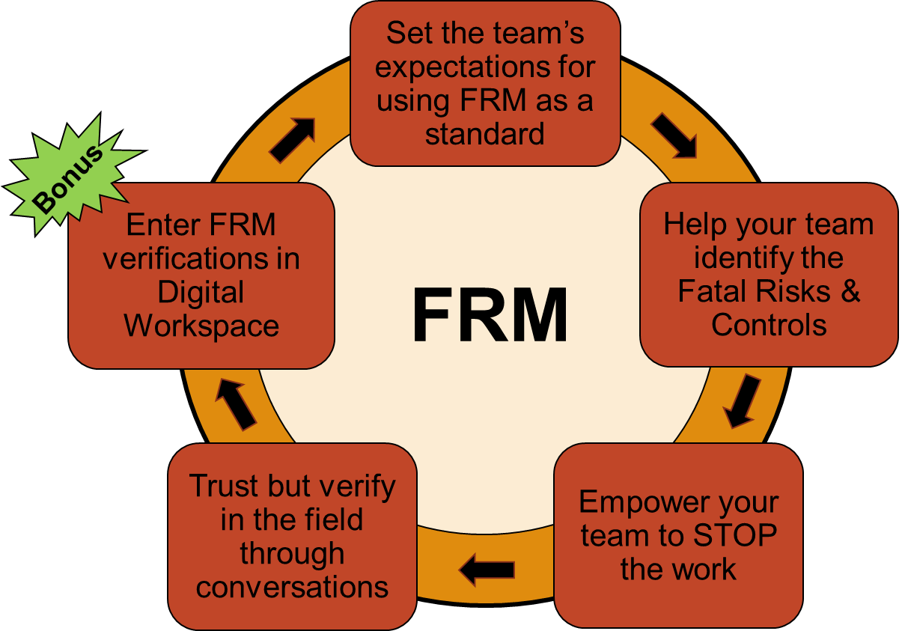
Expectations of Supervision
Set the Standards
Set expectations with crews that FRM is to be used for every job
Help employees identify Fatal Risks and what controls to implement
Empower employees to STOP work if critical controls are not effective
Trust but verify each job in the field
STOP WORK if critical controls are not effective
Complete an FRM verification
Verify your expectations are being met by going into the field and conducting a verification using the critical control questions
Have a conversation about the fatal risks, and when critical controls are missing, use it as coaching opportunity
Notes:
The basic expectations of each front-line supervisor, no matter the mine or department.
FRM does not require verification entries in digital workspace, but if entered, it helps Freeport sites and departments pinpoint opportune areas to focus on.

Slide 8
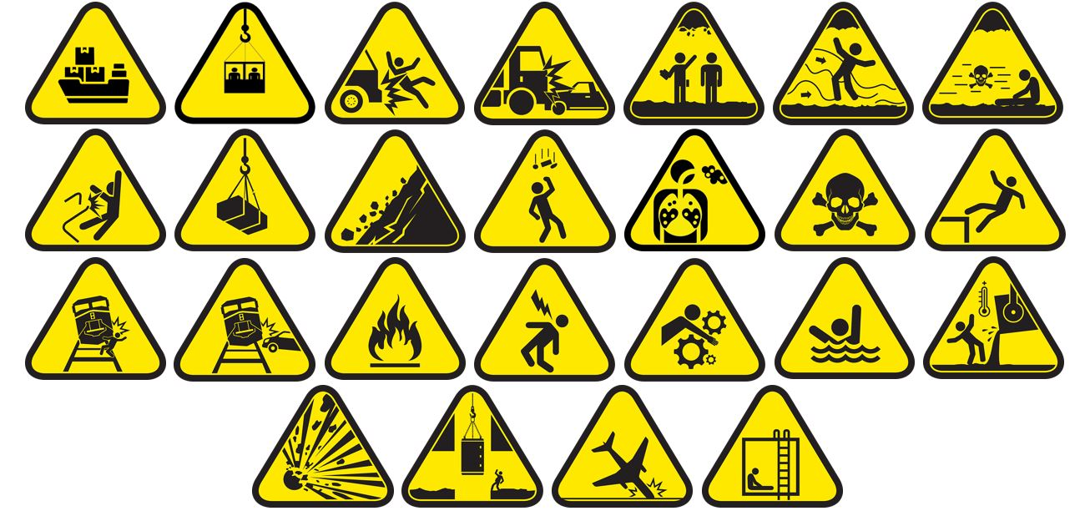
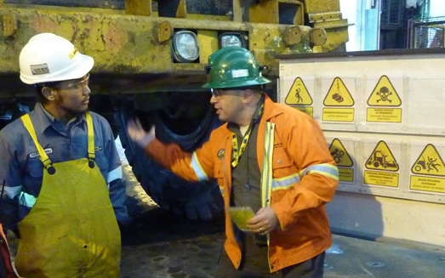
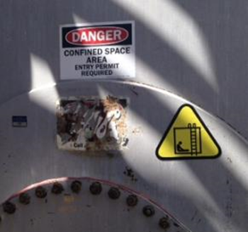
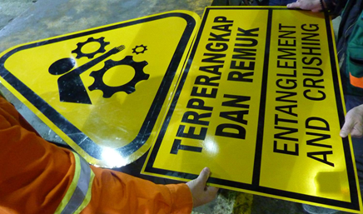
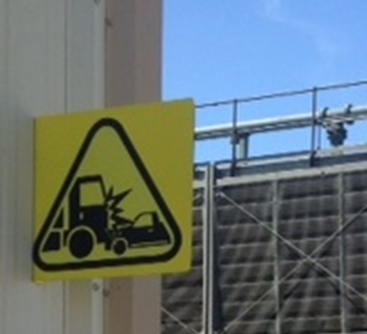
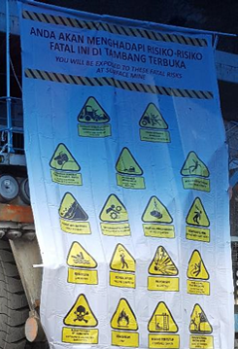
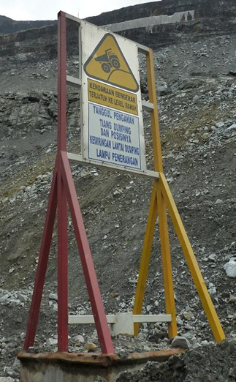
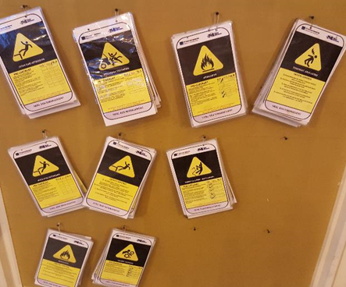
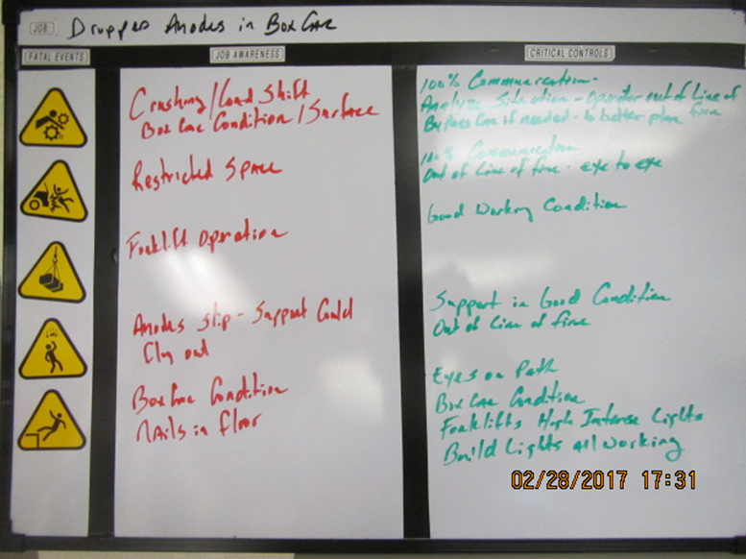
FRM Field Implementation Examples
8
Notes:
A few examples from across the company on ways to use FRM in the field.
Booklets, sandwich boards, white boards magnets, digital workspace, etc., are all great ways to bring awareness to the hazards in the area and most importantly to drive the right conversations and critical controls.

