Slide 1
Freeport Monthly Safety Content
The following slides have been provided to aid in compiling content for monthly Health and Safety meetings, tailgates, etc. with Freeport employees and contractors.
Please keep in mind - some of this information is preliminary and may be pending complete investigations.
Best Practices
Be familiar with content prior to presenting
Hide/unhide incidents that are relevant to your team
Interact with your audience, relate information to your specific work
Update dashboards to share meaningful data (Incident Summary - Power BI, FRM - Power BI). Contact your local Health and Safety staff for site-specific dashboards or external access.
1

Slide 2
Freeport Safety Updates
March 2024
(Incidents and Communications from February 2024)
fcx.com

Slide 3
Freeport Safety Incidents, Successes and Alerts
February 2024
fcx.com
3

Slide 4
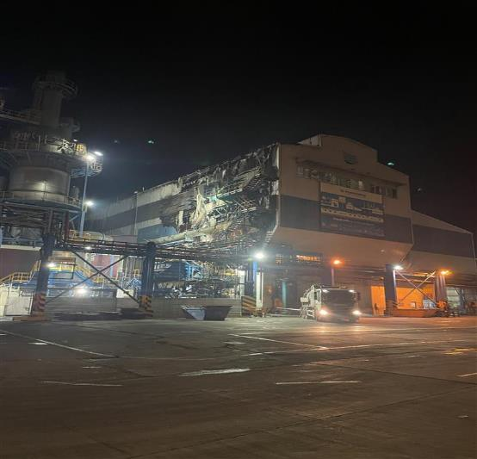
Anode Barrel Fire
ID # 2024-3 Event ID # 20013221
Contact with Molten Material
Preliminary Incident Details
Operation | Atlantic Copper
Date / Time | February 3, 2024 / 10:15 p.m.
Event Type | Property Damage
Summary | Copper matte combined with slag oxide during the transfer of materials from the PS Convertor to the anode barrel. This resulted in a violent reaction that blew material from the barrel onto nearby platforms, fiberglass panels and plant control wires. A fire started and lasted about 10 minutes before it was extinguished. No employees were in the area per standard of procedure guidelines.
Risk Category | Actionable – Significant (3) Likely (3)
Findings / Missing Controls | Communication failure between crane operators and foreman Failure to follow Material Transport standard operating procedure
Applicable Policies / Procedures | Material Transport standard operating procedure
Employee Condition | N/A
Contact | Ignacio Romero, Health and Safety Manager

Slide 5
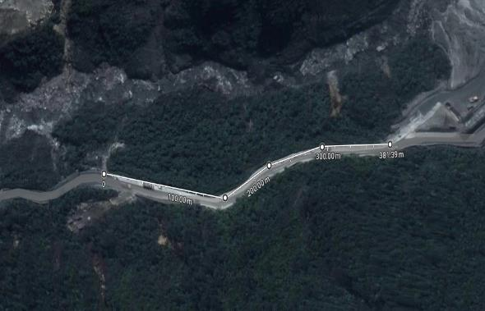
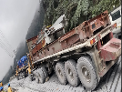
H-Beams Fall from Trailer during Transport
Falling Objects
Actionable # 2024-1 Event ID # 20013522
Preliminary Incident Details
Operation | PTFI
Date / Time | February 16, 2024 / 2:15 p.m.
Event Type | Near Miss
Summary | During transportation, two steel H-beams, and six purlins fell from a trailer and slid approximately 320 meters passing two LVs and one Bus. The steel was tied with a cargo strap to the flat track. The truck operator immediately parked and notified a supervisor.
Risk Category | Actionable – Significant (3) Likely (3)
Findings / Missing Controls | Site lacking loadmaster Maintenance road crews not present
Applicable Policies / Procedures | Material Mobilization Checklist (MOC) KPI-CTR-011: Truck Operation of Flatbed, Trailer, and Lowboy
Employee Condition | No personnel were injured.
Contact | Harriadi Rasidi, Project Safety Manager Mill Optimization Construction (MOC)
Steel uncontrolled movement

Slide 6
Truck Collision
Actionable # 2024-2 Event ID # 20013522
Vehicle Collision
Preliminary Incident Details
Operation | PTFI
Date / Time | February 19, 2024 / 10:55 p.m.
Event Type | Property Damage
Summary | During transport, a trailer truck had brake failure leading to a collision with a second trailer truck. Damage resulted to both vehicles.
Risk Category | Actionable – Significant (3) Likely (3)
Findings / Missing Controls | Overuse of brakes caused the truck to continue moving after brakes were applied.
Applicable Policies / Procedures | KPI-CTR-011: Truck Operation of Flatbed, Trailer, and Lowboy
Employee Condition | No personnel were injured.
Contact | Lucky Hermawan, VP Maintenance Support
Final position of trucks
Geotab Speed Information – 021086
10:09 PM to 10:12 PM

Slide 7
Potentially Fatal Events
February 2024
fcx.com
8

Slide 8
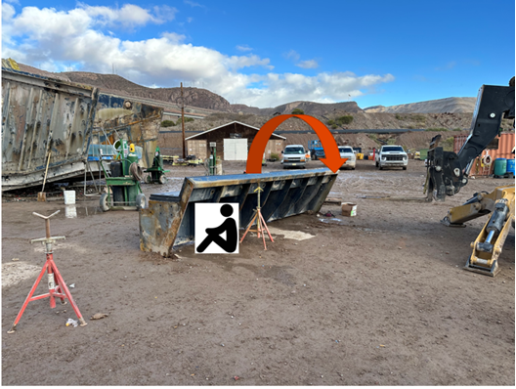
Feed Box Rollover Onto Contract Worker
PFE # PFE-2024-2 Event ID #20013230
Preliminary Incident Details
Operation | Morenci
Date / Time | February 6, 2024 / 12pm
Type | Injury
Summary | A contractor was installing liners on a wet screen feed box that had been placed on the ground for maintenance. As the liners were added, the two-ton box rolled over onto the worker, who was trapped underneath. After unsuccessful attempts to move the box by hand, a forklift was used to free the worker.
Fatal Risk | Uncontrolled Release of Energy
Risk Category | Actionable
Risk Rating | Significant (3) Likely (3)
Findings / Missing Controls | Blocking for maintenance work and energy isolation Inadequate risk assessment Pipe stands were BO and not intended for this use Pipe stands were used instead of cribbing or engineered cradle Placement of the stand cradle was not secure to the feed box Ground was not level/potentially soft
Applicable Policies / Procedures | Control of Hazardous Energy
Employee Condition | Minor injuries resulting in restricted duty
Contact | Chris Seick, Metcalf Mill Manager Jacob Sweet, Health and Safety Manager
Position of employee, placement of pipe stands and direction the feed box tipped.

Slide 9
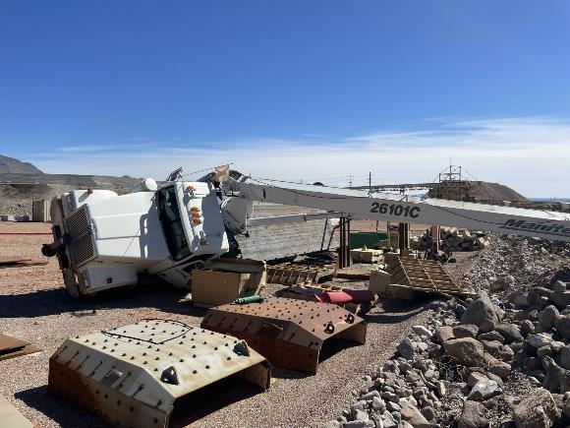
26-ton Boom Truck Tipped Over
PFE # 2024 - 3 Event ID # 20013448
Lifting Operations
Preliminary Incident Details
Operation | Safford
Date / Time | February 15, 2024 / 11:55 a.m.
Event Type | First Aid
Summary | Two mechanics and an apprentice were using a 26-ton boom truck to offload a bangboard (feed plate distributor) at the C4 laydown. As the load swung to the driver’s side, the truck tipped over. The mechanic operating the boom and another mechanic standing on the bed of the truck jumped out of the way to avoid being in the line of fire. The apprentice was standing on the ground and out of the line of fire.
Risk Category | Actionable – Significant (3) Likely (3)
Findings / Missing Controls | Only the rear stabilizers had been deployed No footpads were placed under the rear stabilizers The main outriggers were not used
Applicable Policies / Procedures | Lifting Operations Mobile Crane/Boom Truck Training
Employee Condition | The mechanic who jumped from the bed of the truck experienced first-aid level injuries to the ankle, wrist and neck (strains/sprains).
Contact | Drew Borcherding, Manager-Health and Safety; Richard Sanchez, Manager Crush/Convey
The boom truck tipped onto the driver’s side when the load swung.

Slide 10
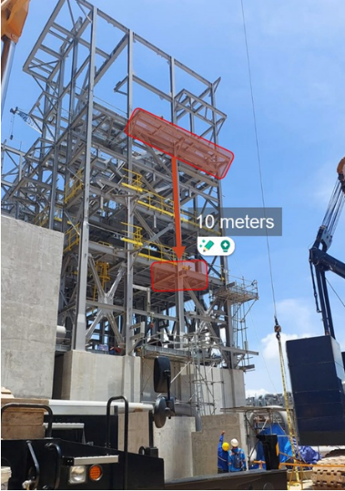
Falling Grating
PFE # 2024-4 Event ID # 20013614
Falling Objects
Preliminary Incident Details
Operation | Manyar Smelter Project
Date / Time | February 22, 2024 / 8:42 PM
Event Type | Injury- Restricted Duty
Summary | While moving steel, a crane’s cable contacted a piece of scaffold grating weighing 20 kilograms. The grating fell 10 meters and struck one of two employees performing structural steel work from a man basket at a height of 15 meters.
Risk Category | Falling Objects – Significant (3) Possible (2)
Findings / Missing Controls | Failure to identify unsecured grating during installation and inspection Falling objects were identified as a fatal risk on completed FRM verification but did not distinguish grating as potential risk Failure to prevent crane cable contact with structure
Applicable Policies / Procedures | Chiyoda Grating Installation Method Statement Chiyoda Permit to Work Procedure
Employee Condition | Employee sustained a sprained shoulder.
Contact | Zach Scrivner, Manager-Corporate Project Engineering Safety Chris McCoy, Project Director
Scaffold grating weighing 20 kilograms fell 10 meters, striking an employee in a man basket.

Slide 11
Agency Shares
February 2024
fcx.com
15

Slide 12
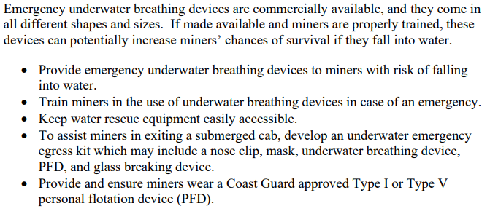
MSHA Safety Alert – Operating Equipment Near Water
PDF LINK

Slide 13
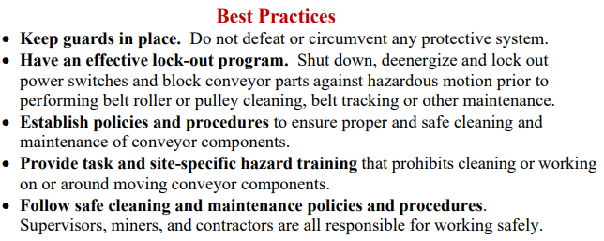
MSHA Safety Alert – Rotating Conveyor Rollers
PDF LINK

Slide 14
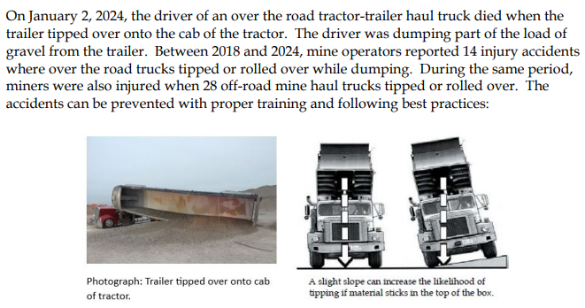
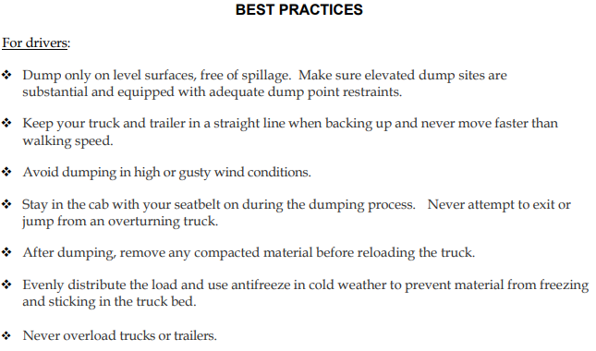
MSHA Safety Alert – Truck Dumping Safety
PDF LINK

Slide 15
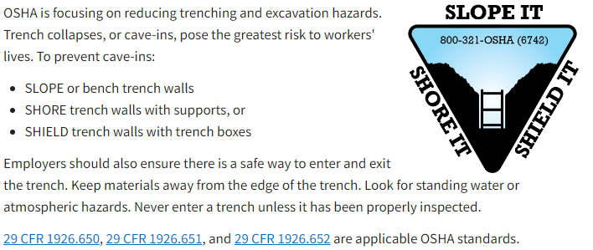
OSHA Share – Trenching and Excavation
Resources LINK

Slide 16
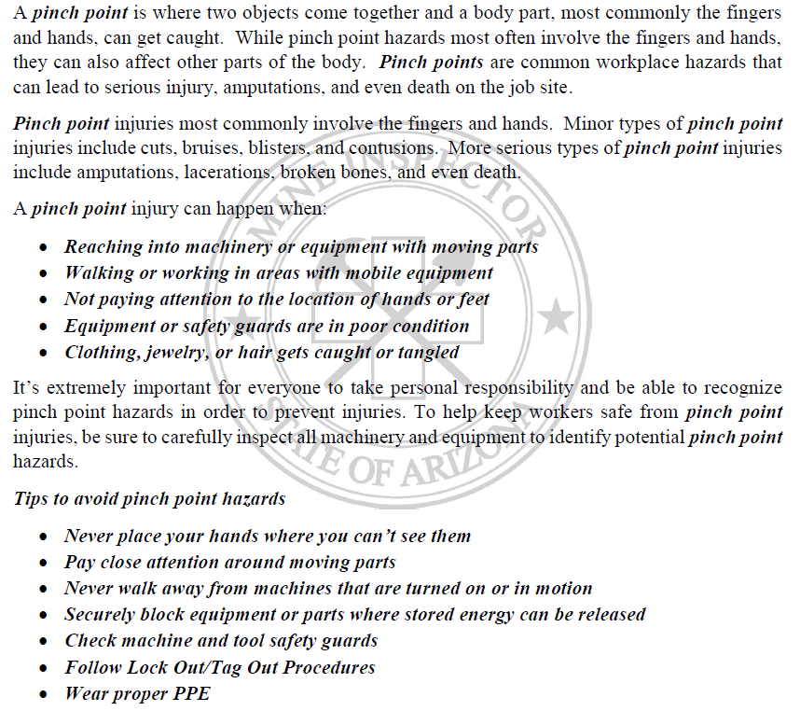
ASMI – Pinch Point Safety Awareness

Slide 17
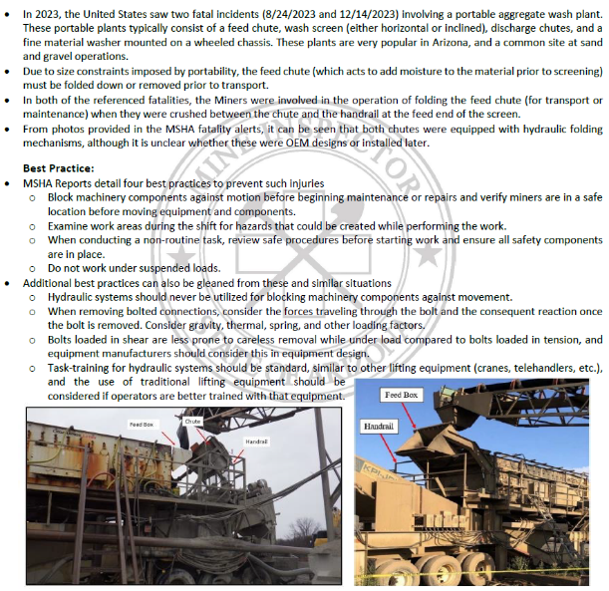
ASMI – Mechanisms and Hydraulics

