Slide 1
Freeport Safety Updates
April 2024
(Incidents and Communications from March 2024)
fcx.com

Slide 2
Freeport Monthly Safety Content
The following slides have been provided to aid in compiling content for monthly Health & Safety meetings, tailgates, etc. with Freeport employees and contractors.
Please keep in mind - some of this information is preliminary and may be pending complete investigations.
Best Practices
Be familiar with content prior to presenting.
Hide/unhide incidents that are relevant to your team.
Interact with your audience, relating information to your specific work.
Update dashboards to share meaningful data (Incident Summary - Power BI, FRM - Power BI). Contact your local Health and Safety staff for site-specific dashboards or external access.
1

Slide 3
Freeport Safety Incidents, Successes, & Alerts
March 2024
fcx.com
3

Slide 4
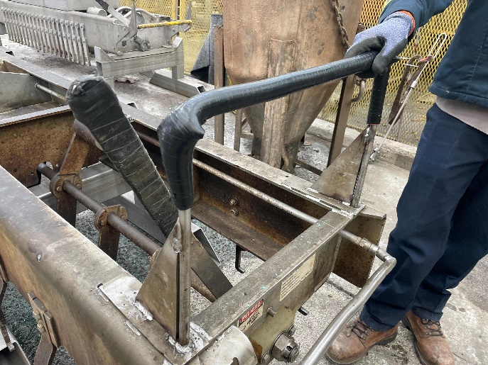
Operator Electrical Shock
Actionable ID # 2024-6 Event ID # 20013950
Exposure to Electrical Hazards
Preliminary Incident Details
Operation | Chino
Date / Time | March 6, 2024 / 12:30 p.m.
Event Type | Injury, first aid – electrical shock
Summary | A crane operator was harvesting cathodes from cell 8 inside a jumper frame. The employee was removing the second pull when a wet pantleg came into contact with the jumper frame above the boot. The operator sustained a minor shock.
Risk Category | Actionable – Significant (3) Likely (3)
Findings / Missing Controls | The insulator on the crane hook was wet and offered no insulating value (showed no resistance) The insulating material on the strongback was worn
Applicable Policies / Procedures | FCX Policy - EW ER Electrical Safety Rev. 2.pdf
Employee Condition | Employee was evaluated and released to full duty.
Contact | Jim Cook, Manager-Health and Safety
Strongback handle
Area the operator’s leg contacted the jumper frame
Handle with replaced insulation

Slide 5
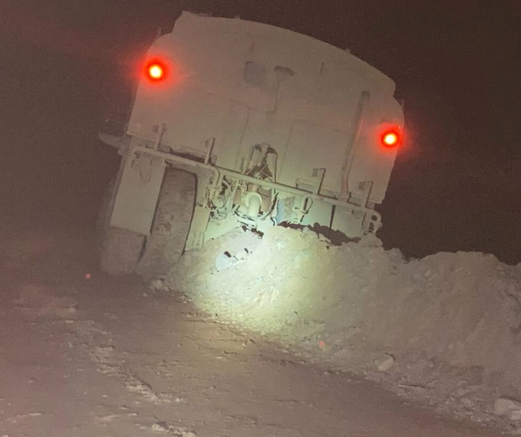
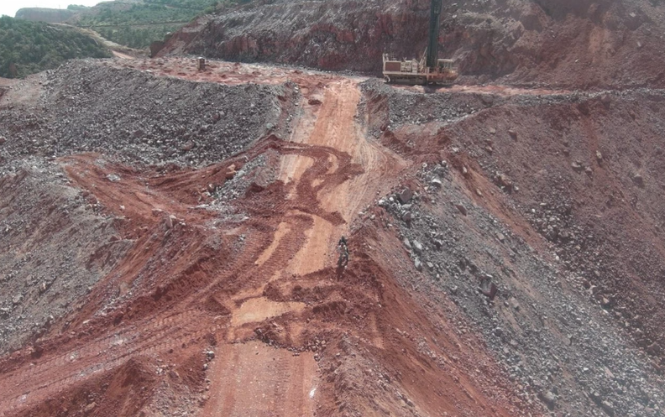
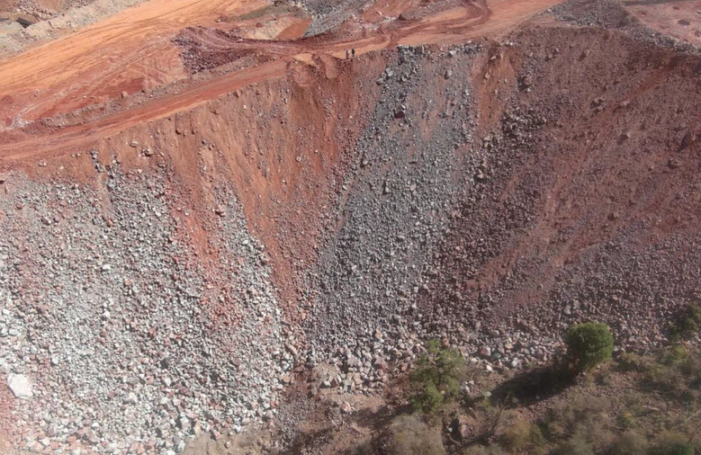
Water Truck Hits Berm
Actionable ID # 2024-7 Event ID # 20014011
Vehicle Collision
Preliminary Incident Details
Operation | Morenci
Date / Time | March 10, 2024 / 2:05 a.m.
Event Type | Property Damage
Summary | During a second run to water drills, a water truck was travelling on a ramp with approximately 10,000 gallons of water in the tank. At the top of the ramp, the operator identified the area was no longer adequate to safely turn around without running over drill holes. The operator decided to back down the ramp to exit the work area. While backing down, the truck drove through a berm and was high centered at a 45-degree angle. On the other side of the berm was an approximate 180-foot drop.
Risk Category | Actionable – Significant (3) Likely (3)
Findings / Missing Controls | Berms were sufficient height and width Operator failed to follow operating procedure inhibiting reverse travel with water load
Applicable Policies / Procedures | Applicable Morenci SOP
Employee Condition | No injuries
Contact | Rassie Ras, Manager-Health and Safety
Water truck on berm
Water truck tire marks on ramp and impacted berm
Arrow points to location of water truck on berm

Slide 6
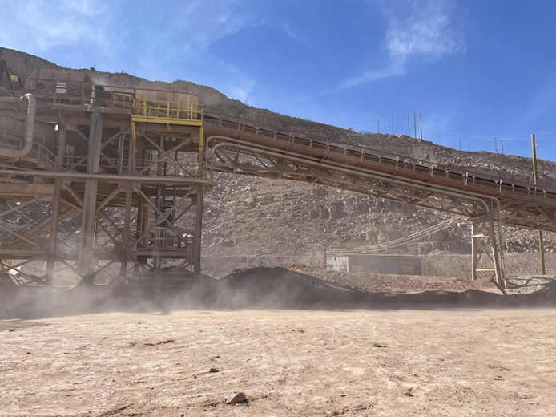
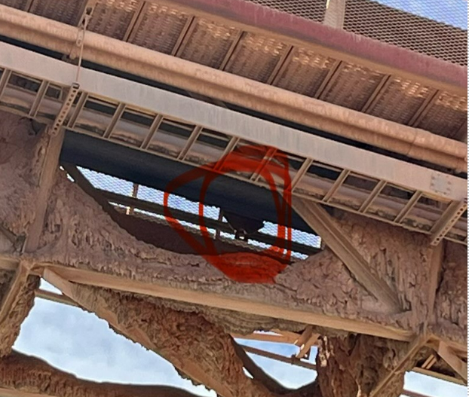
Fallen Idler
Actionable ID # 2024-8 Event ID # 20014041
Falling Objects
Preliminary Incident Details
Operation | Morenci
Date / Time | March 11, 2024 / 1:15 p.m.
Event Type | Near Miss
Summary | A contractor crew was cleaning buildup underneath the head end of a conveyor near the transfer tower. While on their lunch break and stationed across the street, the crew witnessed a return idler that fell 20 feet down from the conveyor. The idler landed close to the crew’s working area. The conveyor was running, the idler was mounted and in use at the time of the event.
Risk Category | Actionable – Significant (3) Likely (3)
Findings / Missing Controls | Conveyor was left on while unattended Need to set up segregation or turn off belt while unattended No baskets or guarding were used under the idler
Applicable Policies / Procedures | N/A
Employee Condition | No injuries
Contact | Corina Rodriguez- Senior Supervisor-Health and Safety
Location where idler fell
Worn idler that fell from conveyor
Idler fell from section of conveyor circled in yellow

Slide 7
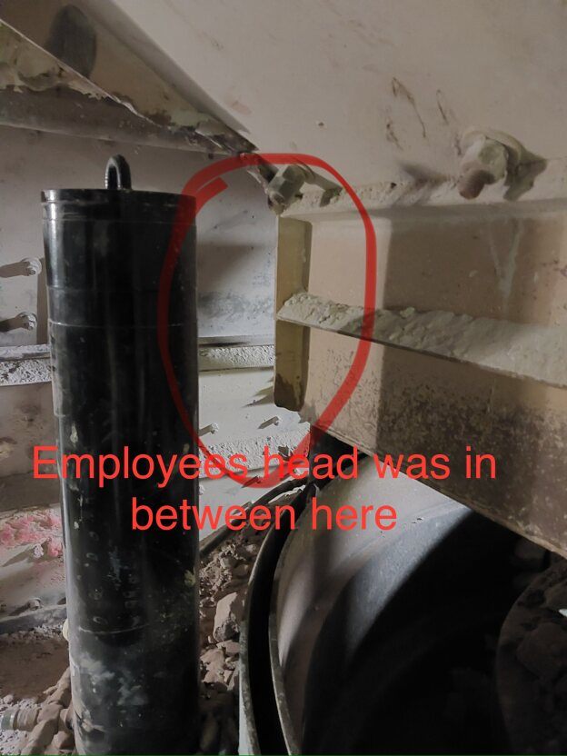
Morenci Crusher
ID # 2024-9 Event ID # 20014323
Entanglement & Crushing
Preliminary Incident Details
Operation | Morenci
Date / Time | March 22, 2024 / 9:20 p.m.
Event Type | Injury – First Aid
Summary | While attempting to clean out material in a 2B shorthead, an employee’s head became stuck between the mill locking post and discharge chute. When the employee realized they were stuck, they tapped a supervisor’s shoulder. The equipment was backed off, and the employee was released.
Risk Category | Actionable – Significant (3) Likely (3)
Findings / Missing Controls | Control of Hazardous Energy
Applicable Policies / Procedures | FCX HS04 Control of Hazardous Energy
Employee Condition | Employee was treated by first aid
Contact | Jacob Sweet, Manager-Health & Safety Jason Bartlett, Manager-Mill
Pinch Point – Hydraulic ram and feeder
Hover over image for animation of incident

Slide 8
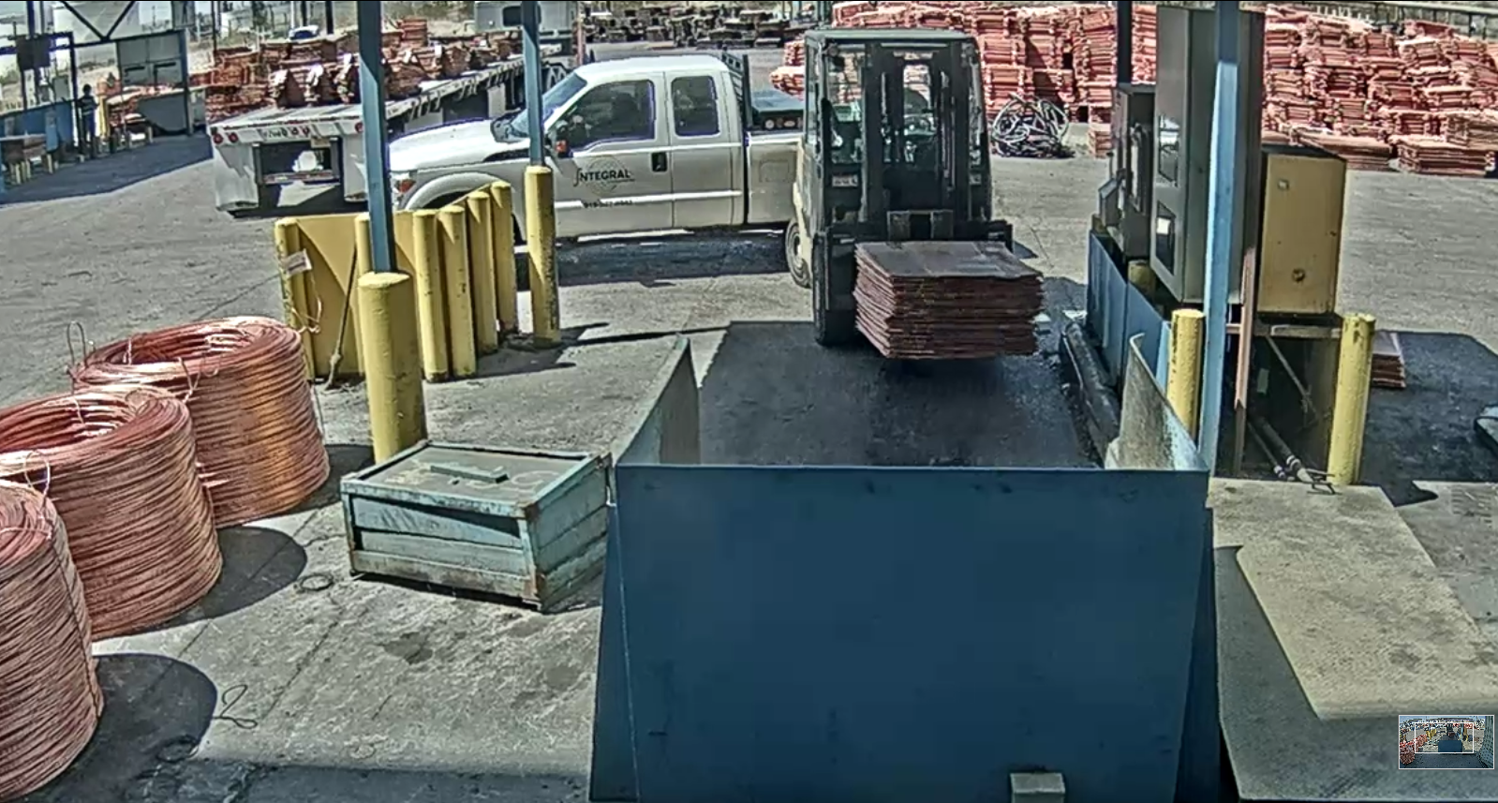
Forklift and Truck Collision
ID # 2024-11 Event ID # 20014372
Vehicle Collision
Preliminary Incident Details
Operation | El Paso
Date / Time | March 22, 2024 / 1:32 p.m.
Event Type | Property Damage
Summary | A forklift operator was weighing a cathode bundle at the scale. When complete, the operator reversed and struck a travelling pickup truck. Both operators failed to look in the direction of travel and identify other mobile equipment in the area. Both continued work without stopping.
Risk Category | Actionable – Significant (3) Likely (3)
Findings / Missing Controls | Failure to make eye contact with equipment operators Failure to yield to moving equipment Failure to look in direction of travel Failure to utilize horn signals for movement notification
Applicable Policies / Procedures | SAF-0220 Powered industrial equipment operations
Employee Condition | No employees were injured.
Contact | Roland Ruybe, Manager-Health & Safety
Position of forklift and truck upon collision.

Slide 9
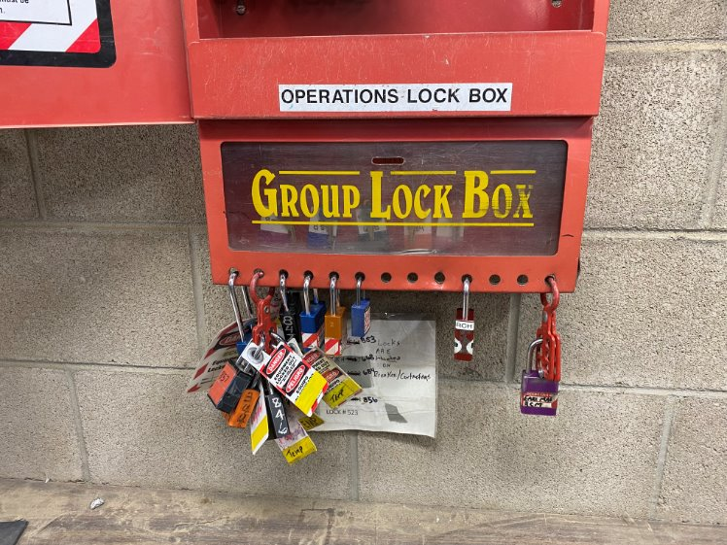
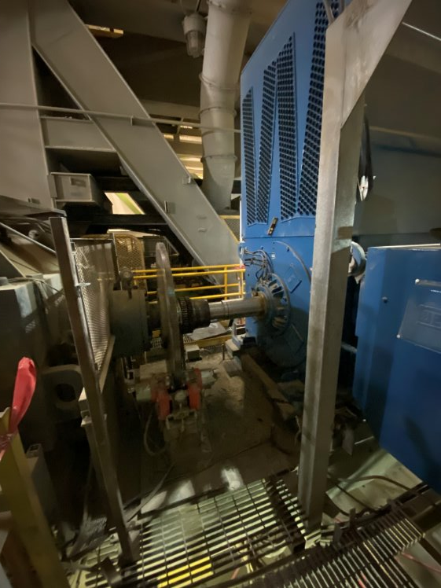
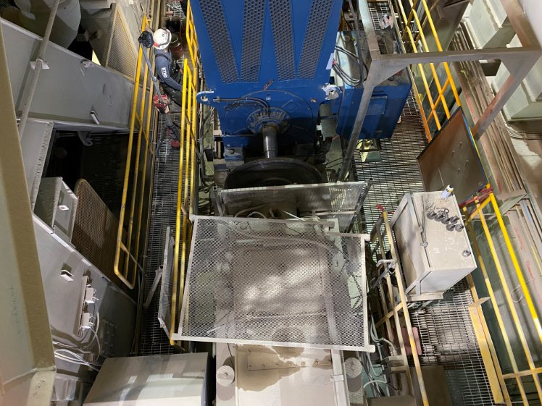
Invalid Motor Lockout
Entanglement & Crushing
ID # 2024-10 Event ID # 20014325
Preliminary Incident Details
Operation | Henderson
Date / Time | March 22, 2024 / 8:20 a.m.
Event Type | Near Miss
Summary | Four contractor employees were working to align a belt system motor next to a gear box and break disk with removed guarding. The energy control coordinator (ECC) released the belt brake to initiate the lock out process which caused the belt to move one foot. Contractor employees recognized the system was not locked out and notified site supervision.
Risk Category | Actionable – Significant (3) Likely (3)
Findings / Missing Controls | Lack of lock out, tag out, try out (LOTOTO) Contractor missed ECC radio notification
Applicable Policies / Procedures | Henderson Operations LOTOTO Program FCX HS04 Control of Hazardous Energy
Employee Condition | No employees were injured.
Contact | Benjamin Goertz, Manager-Health & Safety
Operations lock box. Contractor was locked on this box without the ECC lock.
Contractor work area

Slide 10
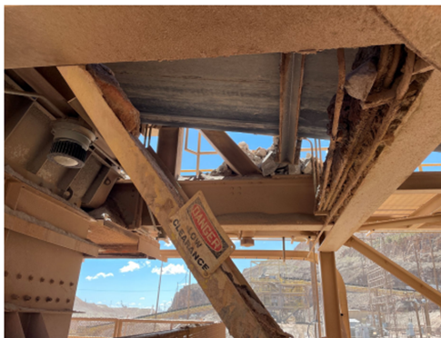
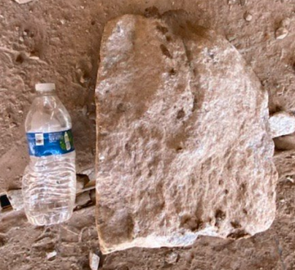
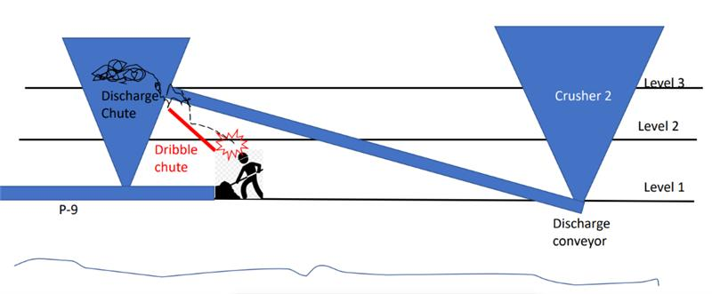
Rock Impact to Head
ID # 2024-12 Event ID # 20014444
Falling Objects
Preliminary Incident Details
Operation | Morenci
Date / Time | March 27, 2024 / 9 a.m.
Event Type | Injury – First Aid
Summary | A contractor employee was cleaning a tail pulley belt on crusher level one when struck on the head by a rock weighing about 30 pounds. The rock fell from an upper-level dribble shoot where other crews were actively working nearby.
Risk Category | Actionable – Significant (3) Likely (3)
Findings / Missing Controls | Failure to conduct line out prior to task start. Failure to identify loose material. Failure to identify employee work locations. Crews should not be working directly above other workers.
Applicable Policies / Procedures | FCX-HS19 Flagging and Barricading FCX-HS02 Working at Heights
Employee Condition | The employee was transported for evaluation and was released for full duty.
Contact | Jacob Sweet, Manager-Health and Safety
Area where rock fell.
Spillage on edge of support beams over dribble chute on second level.
Rock size.
Illustration of work area and location of affected contractor.

Slide 11
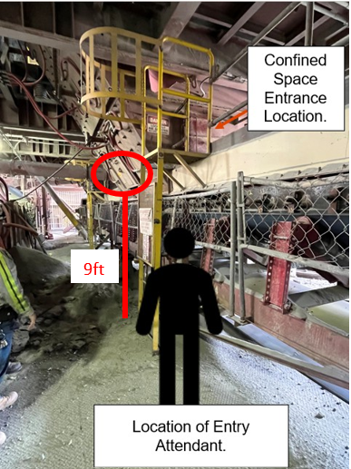
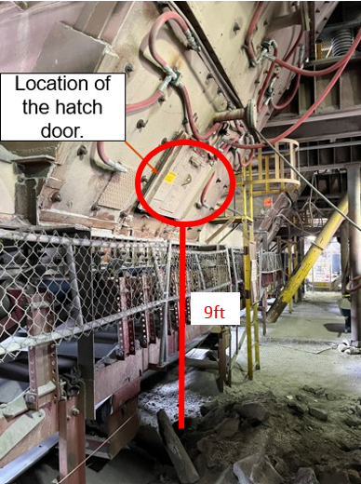
Actionable Event: Fall from Height in Chute Hatch
ID # 2024-13
Event ID # 20014496
Fall from Heights
Preliminary Incident Details
Operation | Sierrita
Date / Time | March 28, 2024 / 8:30 a.m.
Event Type | Near Miss
Summary | Three employees were clearing deadbed material stuck on catch bars in the secondary chute. The confined space attendant opened a hatch on the north side of the chute to help improve access to the material. An employee inside the chute, unaware of the opened hatch, stepped on deadbed material covering the hatch, pushing one foot through the opening, and was exposed to a nine-foot fall.
Risk Category | Actionable – Significant (3) Likely (3)
Findings / Missing Controls | Lack of risk assessment Failure to communicate Failure to initiate stop work authority
Applicable Policies / Procedures | FCX-HS05 Confined Space FCX-HS02 Working at Heights FCX-HS04 Control of Hazardous Energy
Employee Condition | No injuries
Contact | Procopio Gonzales, Superintendent-Crush/Convey Cara Forbregd, Manager-Health and Safety
Photos / Links
Notes:
`

Slide 12
Potential Fatal Events
March 2024
fcx.com
8

Slide 13
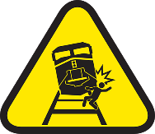
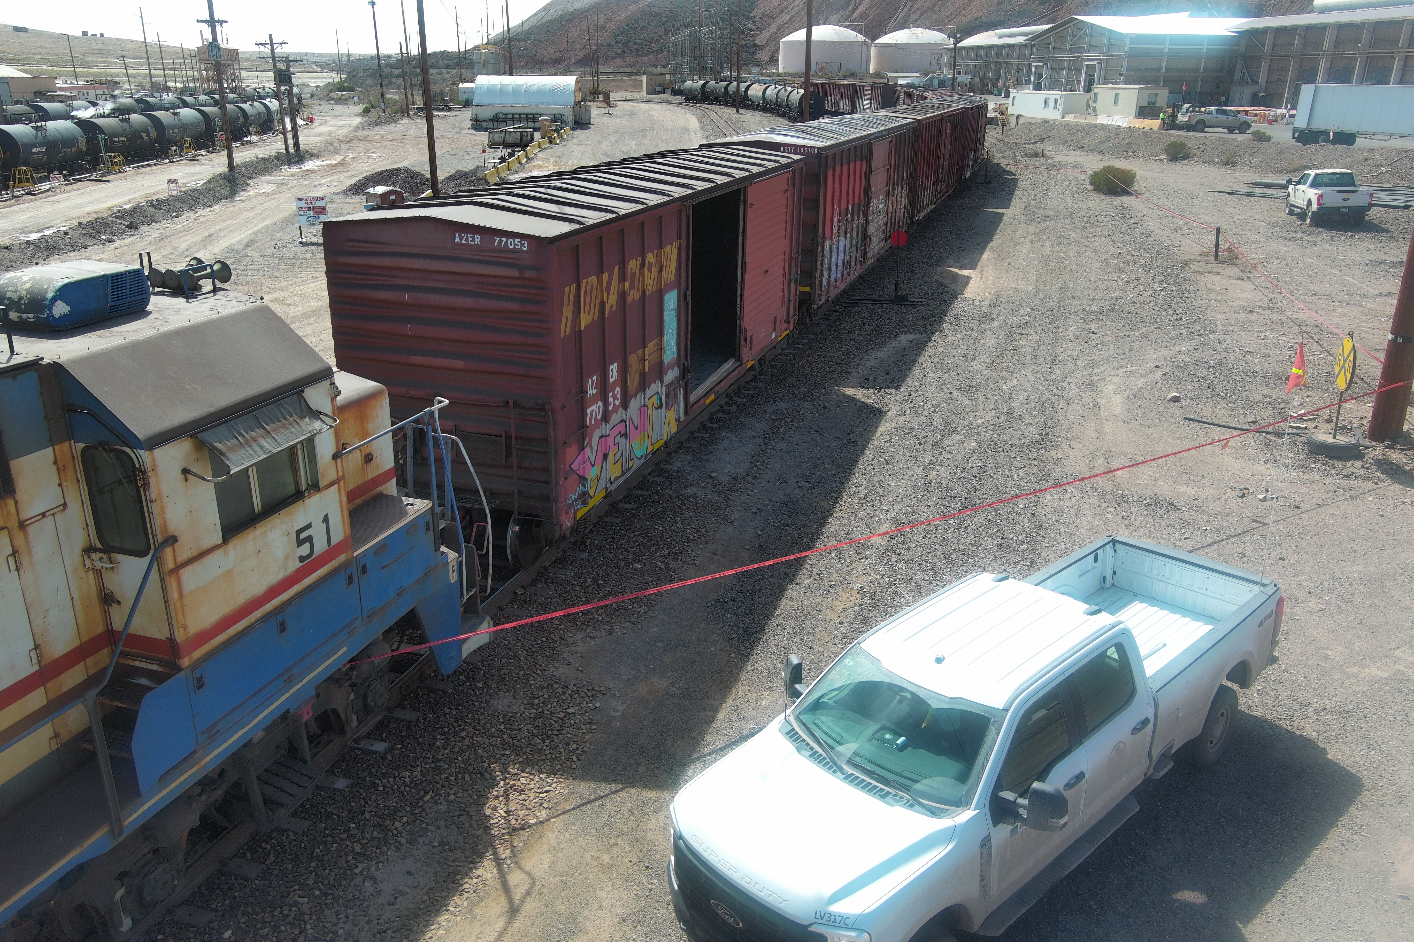
Rail Impact to Person
PFE # 2024-5 Event ID # 20013894
Rail Impact to Person
Preliminary Incident Details
Operation | Morenci
Date / Time | March 5, 2024 / 11:00 a.m.
Event Type | Injury with Medical Treatment
Summary | The Industrial Railroad crew was switching out boxcars at the south side of a copper dock. The locomotive operator and a trainee were standing on the engine stairs and leaned out facing away from the direction of travel. While doing so, the operator’s body struck a rail switch guard sign. The operator flipped over the handrail, landing face down on the ground. The operator’s right arm landed on the track and was run over. A Mayday was called, and emergency services were dispatched to the area.
Risk Category | Actionable – Significant (3) Likely (3)
Findings / Missing Controls | Employee leaned out of moving train while standing on stairs At least 30 inches of continuous clearance from the farthest projection of moving railroad equipment was not maintained with rail switch guard sign placement
Applicable Policies / Procedures | FCX-22 Industrial Railroad Policy Site Standard Operating Procedure – Riding Trains and Locomotives
Employee Condition | Injury resulted in amputation of employee’s right forearm
Contact | Dale Patterson, Manager-GSC Dana Wise, Manager-Health and Safety
Employees were riding on the stairwell of the 51 locomotive when event occurred

Slide 14
PFE LESSONS LEARNED: Rail Impact to Person
Causal Factors
Rail Impact to Person
Locomotive operator and trainee leaned out from the engine stairs while facing away from the direction of travel.
Clearance from the rail switch lever to the outside of rail cars was minimal.
Incident Overview
Morenci, March 5, 2024
The Industrial Railroad crew was switching out boxcars at the south side of a copper dock. The locomotive operator and a trainee were standing on the engine stairs and leaned out facing away from the direction of travel. While doing so, the operator’s body struck a rail switch guard sign. The operator flipped over the handrail, landing face down on the ground. The operator’s right arm landed on the track and was run over. A Mayday was called, and emergency services were dispatched to the area.
Site Specific Actions
Administrative Control – Re-create a Global Railroad Steering Team to share best practices, standards, and findings amongst all sites. All relevant standard operating procedures, work standards and training records will be reviewed for deficiencies, then corrected.
Administrative Control – Within 30 days, evaluate the Morenci rail system for unidentified impaired clearance situations (any distance under 30 inches) and high-risk areas (i.e., switches on steep grades).
Engineering Control – Within 60 days, identify impaired distances that can be mitigated by extending switches, lowering switches or clearly marking impaired distances and mapping those switches (i.e., docks and unloading stands).
Elimination Control – Conduct an assessment as outlined in the Freeport Industrial Railroad Policy section 3.4. Determine alternative means to minimizing or eliminating the need for train ground crews to mount/dismount a train in motion.
We Champion a Work Environment Where Everyone Goes Home Safely

Slide 15
Steps YOU Can Take to Prevent Repeat Incidents
Rail Impact to Person
Railroad operators and employees working near railroads
Be aware of the Industrial Rail Policy
Do not ride on train stairs
Complete site assessment to determine alternate means to minimize or eliminate the need for train ground crews to mount/dismount a train in motion
Train crew may only ride on the platform of the leading end of railcars, if necessary to perform duties
Switch personnel may only ride on leading end of railcars for spotting during pushing/shoving operations
Do not work on or around rail or trains unless trained to do so
Incident Overview
Morenci, March 5, 2024
The Industrial Railroad crew was switching out boxcars at the south side of a copper dock. The locomotive operator and a trainee were standing on the engine stairs and leaned out facing away from the direction of travel. While doing so, the operator’s body struck a rail switch guard sign. The operator flipped over the handrail, landing face down on the ground. The operator’s right arm landed on the track and was run over. A Mayday was called, and emergency services were dispatched to the area.
Morenci Leadership
Review and audit critical components of Rail Fatal Risks according to the Industrial Rail Policy and Fatal Risk Management program.
Reinforce execution of policies. Regularly check for understanding and adequate training.
Hold our employees and ourselves accountable when policies aren’t followed.
Ensure that site standard operating procedures are in line with corporate policy requirements
All of Us
Review field training programs.
Confirm mentors fully understand policies and procedures. Mentors should reinforce correct behaviors while training in the field.
Utilize knowledge checks to regularly confirm understanding of training.
Utilize stop work obligation when processes or procedures are not being followed, or control improvements are identified.
Turning Our Commitment into Action

Slide 16
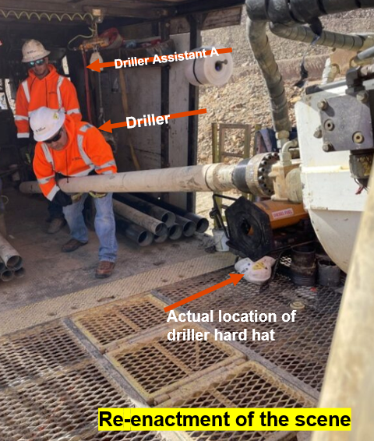
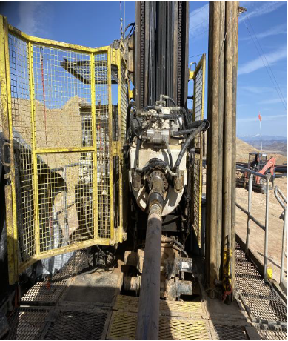
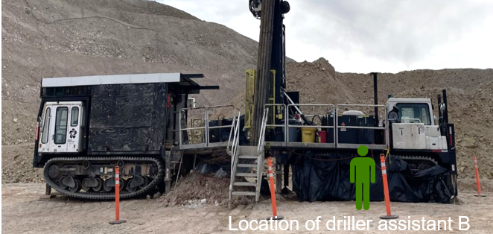
Caught on Drill
Entanglement & Crushing
PFE # 2024-6 Event ID # 20014033
Preliminary Incident Details
Operation | Tyrone
Date / Time | March 10, 2024 / 1:43 p.m.
Event Type | Lost Time Injury
Summary | A contractor driller became bound and entangled when their jacket snagged on a 4-inch core barrel as they tried to remove it from a running sonic drill. The assistant on deck and the one on the ground were unable to reach the emergency stop button based on their positions. The driller rotated with the core barrel until becoming unbound and sustained multiple injuries.
Risk Category | Actionable – Significant (3) Likely (3)
Findings / Missing Controls | Failure to follow contractor standard operating procedure for barrel removal Improper/missing tool for the task Rotation Barrier Interlock was bypassed
Applicable Policies / Procedures | FCX-HS04 Control of Hazardous Energy Policy
Employee Condition | The driller sustained multiple injuries to the left leg requiring surgery as well as minor cuts and scrapes. They are expected to make a full recovery.
Contact | Rachel Adams, Manager-Health and Safety
Re-enactment of the scene
Drill head with 4-inch core barrel
Location of Driller Assistant B
Location of Driller Assistant B

Slide 17
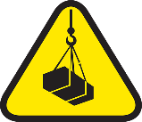
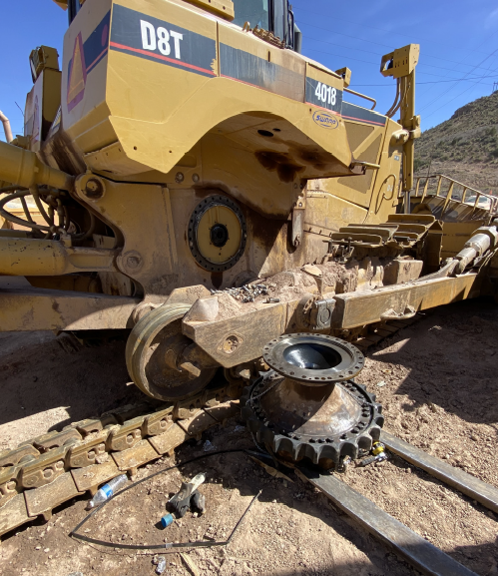
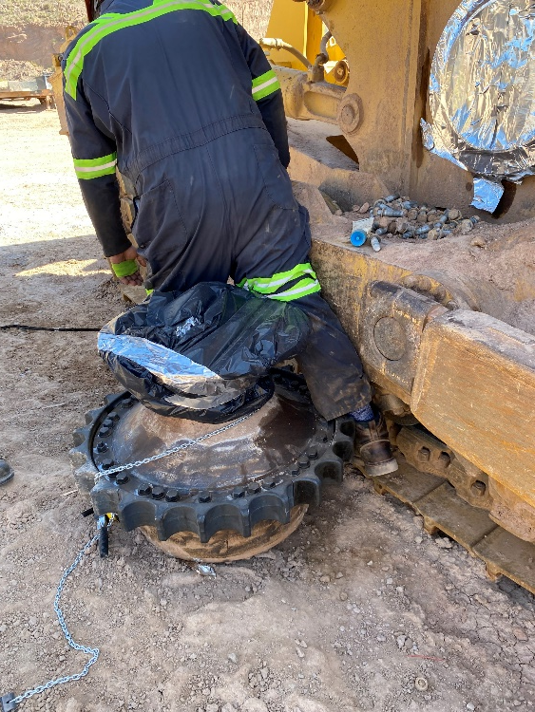
Employee Pinned by Drive
PFE # 2024-7 Event ID # 20014069
Lifting Operations
Preliminary Incident Details
Operation | Morenci
Date / Time | March 12, 2024 / 11:45 a.m.
Event Type | Injury – First Aid
Summary | Two contractor mechanics were replacing a 1600-pound final drive on a D8 dozer with the assistance of a forklift. One mechanic was operating the forklift while the other mechanic was greasing the mounting seal. The loaded forklift, positioned 6 to 10 feet behind the mechanic, began to roll forward. The operator applied the brakes which caused the final drive to roll off the forklift. The ground mechanic’s leg became pinned between the final drive and the dozer.
Risk Category | PFE - Significant (3) Likely (3)
Findings / Missing Controls | Engineered lifting device was not used Forklift parking brake was not set Forklift load was not properly secured
Applicable Policies / Procedures | Lack of forklift applicable policies and procedures
Employee Condition | Mechanic – knee injury Forklift Operator – hand laceration from helping lift the final drive off the pinned mechanic
Contact | Dale Patterson, Manager-GSC Dana Wise, Manager-Health and Safety
Re-enactment of employee’s leg pinned between final drive and D8
Final resting place of final drive after rotating off the forklift

Slide 18
Agency Shares
March 2024
fcx.com
15

Slide 19
Safety Share
Overexertion in the Workplace
Employees who do physically demanding work may be working too hard and putting themselves at risk of injuries from overexertion. Overexertion injuries are costly because there are so many of them and because they often involve days away from work. Estimates place the total cost to employers at over $10 billion annually. Another important fact about overexertion injuries is that they are preventable. It takes training, policies, procedures, and employee involvement to make an overexertion prevention program work.
IDENTIFY OVEREXERTION RISKS - Once you have pinpointed the risks, you can modify workstations, job procedures, and the work environment to minimize the risks. Storing heavy items low to avoid excessive reaching and strain; reducing the depth of shelves to reduce overreaching; and modifying the work environment to reduce the need for twisting, bending, and other awkward postures.
PROVIDE LIFTING AIDS - Manual and powered lifting aids reduce the strain on human bodies and greatly reduce the risk of overexertion in many material handling tasks. Examples would be forklifts.
PROHIBIT SOLO LIFTING OF HEAVY LOADS - Recommend a 50-pound limit for solo lifting. More than that and employees should be required to get help or use a lifting aid. Lifting or carrying loads that weigh 50 pounds or more increases a person’s risk for a serious back injury.
INCLUDE LIFTING POLICIES IN JOB DESCRIPTIONS - Include lifting requirements in the job description so that these requirements will be taken into account when hiring new workers.
REQUIRE FREQUENT SHORT BREAKS - A study conducted by NIOSH indicates that workers who do a lot of lifting should take frequent breaks to relax tired, tense muscles and reduce the risk of injury, particularly back injury.
PERFORM REGULAR AUDITS - Studies show that frequent and unannounced audits by management and supervisors will greatly reduce safety issues like overexertion. Review audit results with team supervisors and create a “Critical Risk Assessment” document for high-risk jobs and tasks
Resources LINK

Slide 20
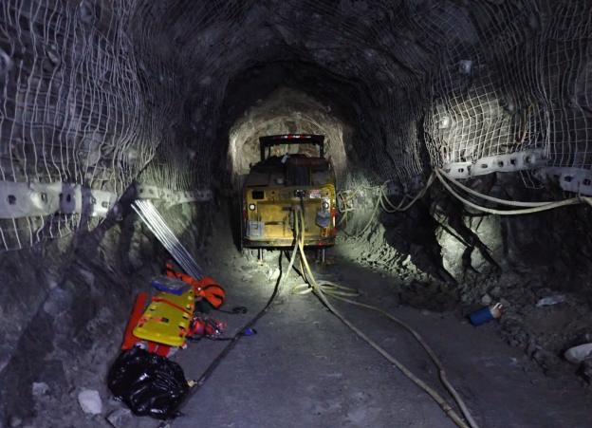
MSHA Fatality Alert
MINE FATALITY – On November 13, 2023, a rotating drill steel of a roof bolting machine entangled a miner, causing fatal injuries.
Eliminate hazards and prevent injuries:
Always follow manufacturer recommendations when conducting maintenance on equipment, including:
Turn off or de-energize the machine.
Secure the equipment against hazardous motion.
Never touch or hold the drill steel, wrench, or bolt while it is rotating.
Do not wear loose-fitting or bulky clothing when working around any machinery with rotating parts.
PDF LINK

Slide 21
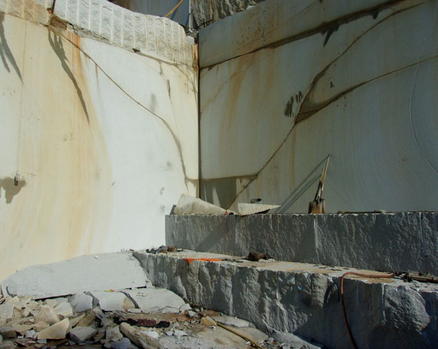
MSHA Fatality Alert
MINE FATALITY – On August 5, 2023, a piece of granite fell, striking two miners, killing one and seriously injuring the other.
Eliminate hazards and prevent injuries:
Examine work areas to identify loose ground or unstable conditions before work begins and as conditions change. Report hazards and do not work in unsafe conditions.
Correct unsafe conditions or barricade areas to prevent access before beginning work.
Consider mining methods that do not require miners to work or travel near the base of a highwall.
PDF LINK

Slide 22
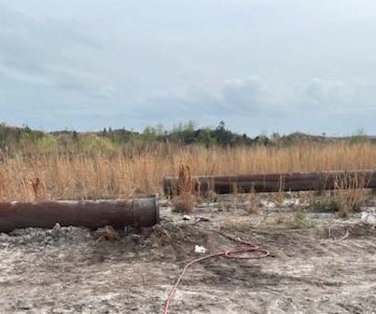
MSHA Fatality Alert
MINE FATALITY – On March 1, 2024, a miner died after a metal slurry pipe struck him. The miner was removing the last bolt connecting two metal slurry pipes when the pipe broke free and swung in his direction.
Eliminate hazards and prevent injuries:
Prevent miners from positioning themselves in a manner that will expose them to hazards while performing a task.
Examine work areas before and during the shift for hazards.
Ensure that blocking material is competent, substantial, and adequate to stabilize the load.
Train miners in safe work procedures and hazard recognition. Monitor personnel routinely to ensure they follow safe work procedures.
PDF LINK

Slide 23
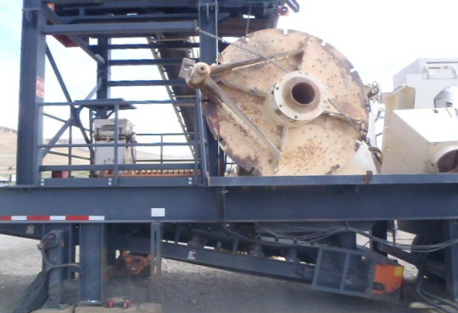
MSHA Fatality Alert
MINE FATALITY – On August 21, 2023 a crusher lid that was being moved into place struck a miner when the rigging broke. The miner died from his injuries on August 23, 2023.
Eliminate hazards and prevent injuries:
Do not work under suspended loads.
Use properly rated lifting equipment and ensure that the load is well secured.
Attach tag lines to suspended loads to steady or guide the load.
Communicate lift plans to all persons working in the lift zone. Follow manufacturer's recommended work procedures.
PDF LINK

Slide 24
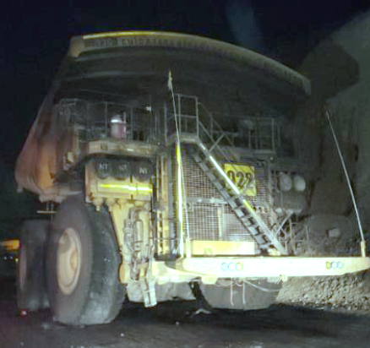
Industry Fatality Alert – Codelco
MINE FATALITY – On March 8, 2024, a haul truck driver was killed after the vehicle caught fire. The driver was unable to evacuate the truck and could not activate the manual fire suppression equipment.
Eliminate hazards and prevent injuries:
Inspect and maintain fire suppression equipment
Know procedures for fire suppression activation
Perform fire drills on equipment
Practice equipment evacuations
Check for leaks
Take equipment out of service if needing repair

