Slide 1
FCX Monthly Safety Content
The following slides have been provided to aid in compiling content for monthly Health & Safety meetings with FCX employees and contractors.
Please keep in mind - some of this information is preliminary and may be pending complete investigations.
Best Practices
Be familiar with content prior to presenting
Hide/Unhide incidents that are relevant to your team
Interact with your audience, relating information to your specific work
Update dashboards to share meaningful data

Slide 2
FCX Safety
August 2023

Slide 3
Relevant Dashboards
Incident Summary - Power BI
FRM - Power BI
ESG Metrics Summary - Power BI
For additional site-specific dashboards, please reach out to your local H&S team

Slide 4
FCX Safety Incidents, Successes, & Alerts

Slide 5
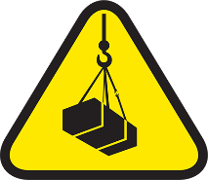
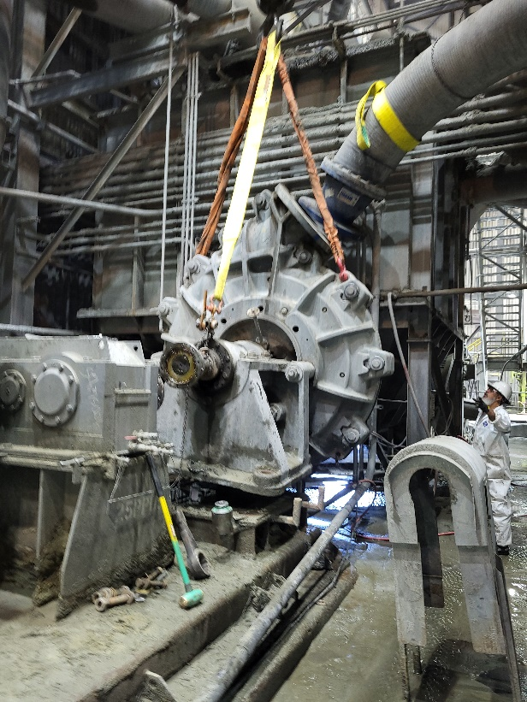
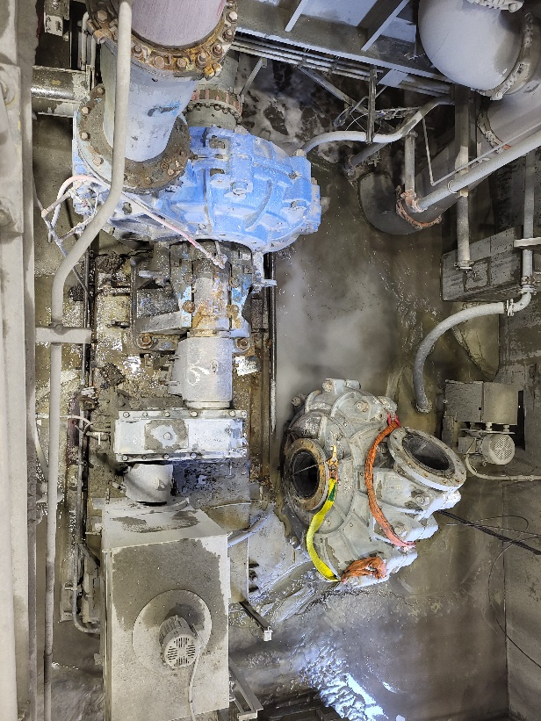
Feed Pump Lifting Operation
Incident Details
Operation | Chino
Date / Time | June 10, 2023
Type | Best Practice
Success Summary | Planning and executing a safe lifting operation that resulted in zero injuries and no significant plant damage despite crane brake failure.
Description | A team was preparing to lift a feed pump with a crane. Before beginning the operation, the team created a plan that included possible safety maneuvers in the event of potential crane brake failure and to help ensure all employees were out of the line of fire. During the test lift and regular brake test, the crane held the load. However, as the operator began to move the load, the crane experienced brake failure. This prompted the operator to engage the pre-plan maneuver and move the crane to an open area where it fell without a risk to employees or other equipment.
Fatal Risk | Lifting Operation
Tools for Sharing Learning | Pre-planning before a lifting operation to mitigate potential safety hazards.
Additional Information | N/A
Contact | Sean Maddock, Superintendent-Mill Maintenance
Test lifting operation
At right is where the pump fell, clearing the other equipment to the left

Slide 6
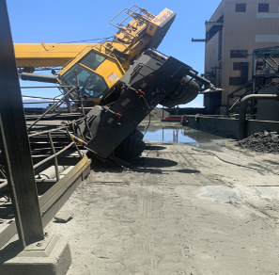
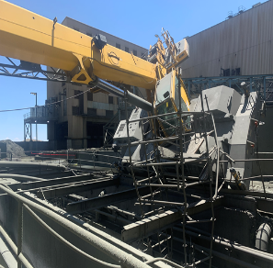
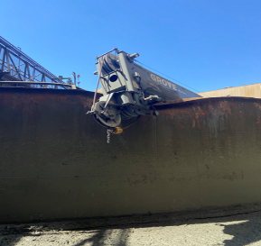
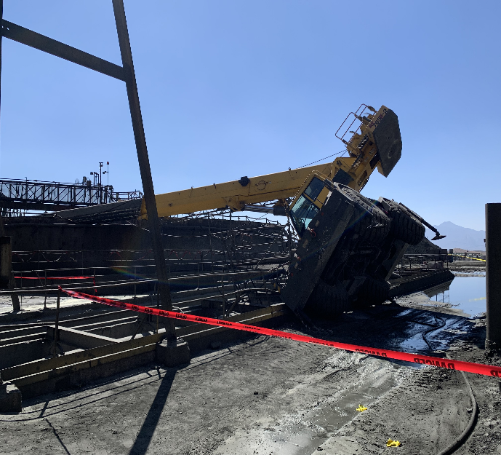
Crane Tip Over
Event ID #20007982
Incident Details
Operation | Sierrita
Date / Time | June 29, 2023 / 9:15 a.m.
Type | Property Damage
Summary | A Grove crane tipped over while installing a door to a copper/molybdenum thickener.
Fatal Risk | Vehicle Collision or Rollover
Risk Category | Actionable
Pre / Post Rating | Significant (3) Likely (3)
Absent / Insufficient Controls | Inadequate/Incorrect Lift Plan
Applicable Policies / Procedures | Crane and Rigging Policy
Employee Condition | No Injury
Contact | Kyle Silvester, Mill Superintendent

Slide 7
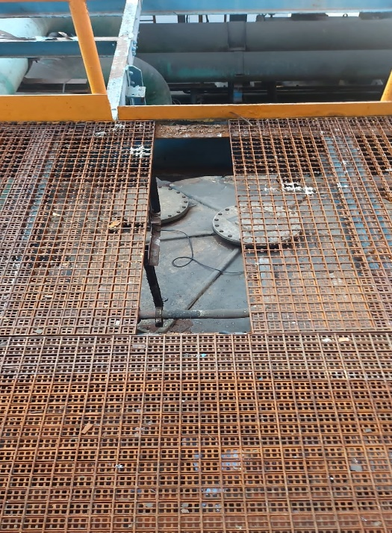
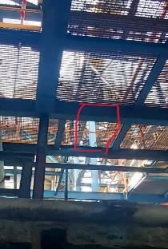
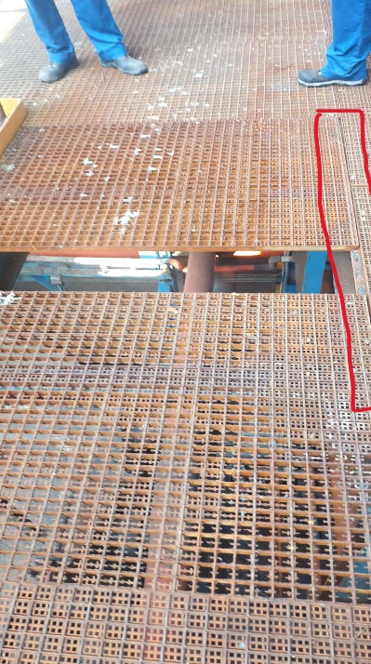
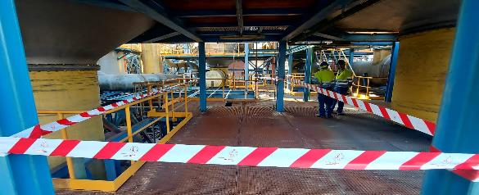
Fall of Loose Tramex to Lower Level
Event ID #20008348
Incident Details
Operation | Atlantic Copper
Date / Time | July 1, 2023 / 8 p.m.
Type | Near Miss
Summary | An operator was performing pressure-taking tasks at the washing plant, when he found a piece of Tramex steel that had fallen to the level below. The panel was not fastened with grating clamping staples. No other employees were in the area at the time of the incident.
Fatal Risk | Falling Objects
Risk Category | Actionable
Pre / Post Rating | Significant (3) Likely (3)
Absent / Insufficient Controls | Fastening pieces of grating missing
Applicable Policies / Procedures | FCX-HS02 Working at Heights
Employee Condition | No Injury
Contact | Alejandro Paz Garcia, Head of Acid Factories

Slide 8
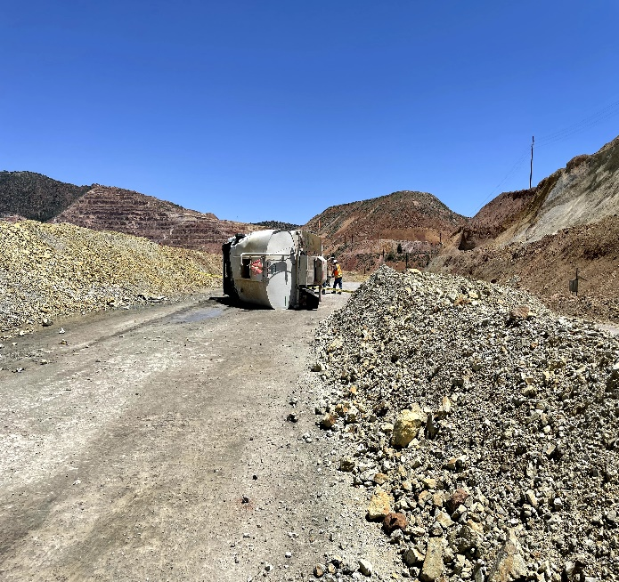
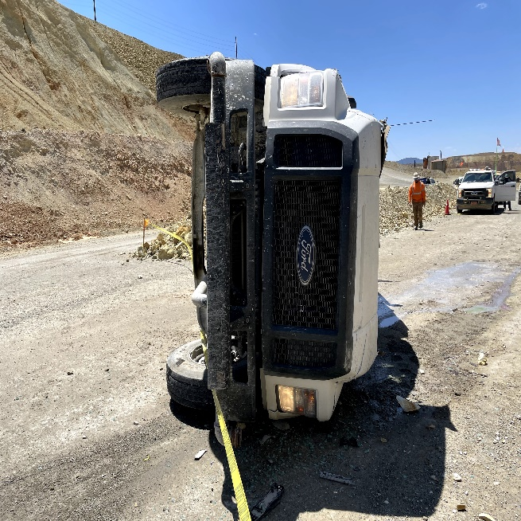
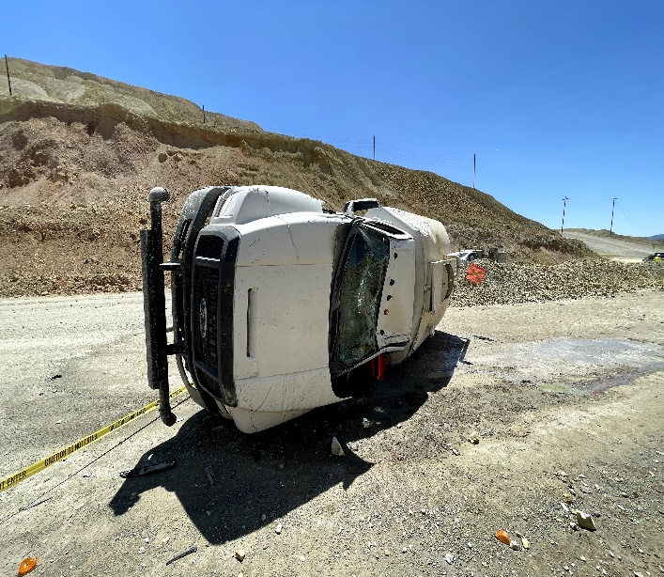
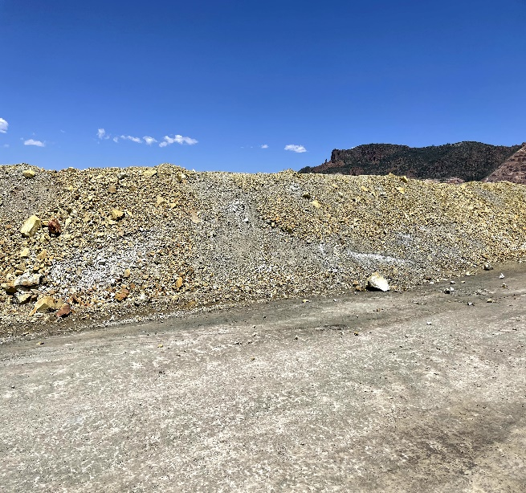
Employee Rolled Water Truck
Event ID #20008017
Incident Details
Operation | Chino
Date / Time | July 1, 2023 / 1 p.m.
Type | Injury
Summary | A drilling contractor went to get some water from the south dump. On his way from the south-dump, he suddenly realized he was down with the water tank. All he could remember was seeing the center berm in the middle of the road by the water stand from the hill. He woke up, climbed out, and realized he could not find his radio. He reached out to the driller via cell phone, and driller came and helped him find his radio on which they called a mayday. EMT and O4 arrived at the incident location and took the helper to Gila Regional hospital for medical examination.
Fatal Risk | Vehicle Collision or Rollover
Risk Category | Monitor
Pre / Post Rating | Significant (3) Possible (2)
Absent / Insufficient Controls | Fatigue Management Fit for Duty
Applicable Policies / Procedures | Fatigue Management Policy Interaction with Heavy Mobile Equipment
Employee Condition | No Injury
Contact | Jim Cook, Manager Health and Safety

Slide 9
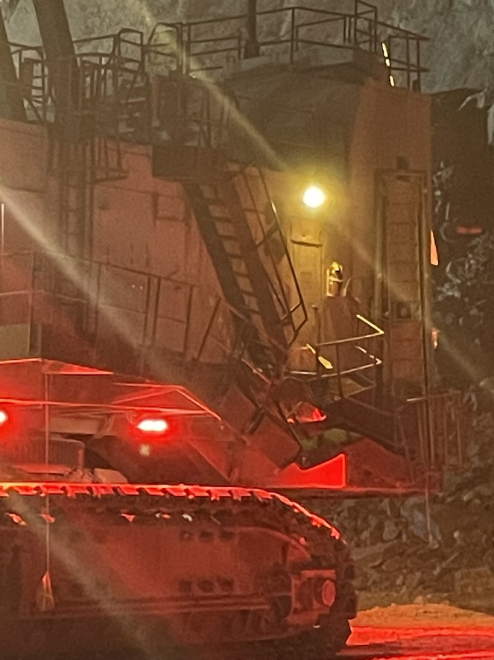
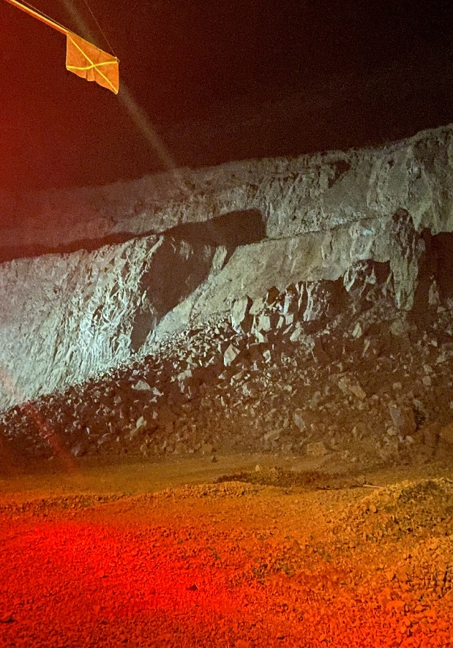
Proper Shovel Cab Placement
Incident Details
Operation | Safford
Date / Time | July 5, 2023 / 1:45 a.m.
Type | Best Practice
Summary | A shovel operator was working to complete a final double bench wall in a pit when a failure occurred. The shovel was properly positioned, with the cab facing away from the highwall when the failure occurred, resulting in the operator’s safety. The catwalk on the non-cab side facing the highwall was damaged, requiring repairs. No radar alarms sounded indicating movement before the failure happened. A similar incident occurred in 2017 at Cerro Verde. However, the cab was not properly positioned, resulting in a fatality and highlighting the critical importance of proper shovel operations when cleaning or digging finals while double benching.
Fatal Risk | Ground Failure
Probable Direct Causes | Proper placement of cab away from highwall resulted in no physical harm to shovel operator
Immediate Corrective Action(s) | The area was closed to allow engineers to evaluate it. Once secure, maintenance crews will enter to evaluate shovel damage and timeline to repair.
Required Action(s) | Reinforce the critical importance of proper shovel operations while double-benching, including placement of cab away from highwalls, to help ensure operator safety in the event of a failure. Review and adjust radar monitoring to ensure full coverages, including appropriate overlapping at radar limits.
Contact | Gary McKinney, Superintendent Mine Operations
Damage to the shovel (left) and view of the bench failure.

Slide 10
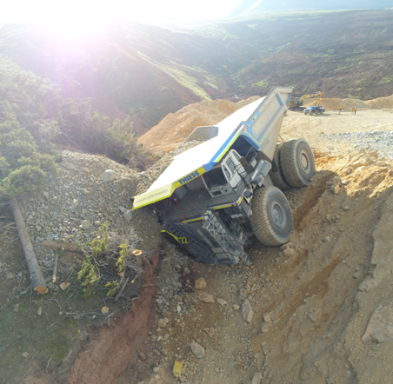
Haul Truck Drives through Berm
PFE # 20008069 Event ID # 2023-13
Preliminary Incident Details
Operation | Climax
Date / Time | July 5, 2023 / 5:18 a.m.
Type | Property Damage
Summary | A fully loaded haul truck was traveling downhill on a haul road and failed to make a turn. The truck went through two berms before coming to a stop against the face of a hill near a steep drop off. The contractor driver was assessed at the clinic and released without any injuries.
Fatal Risk | Vehicle Collision or Rollover
Risk Category | Monitor
Pre / Post Rating | Significant (3) Possible (2) / TBD
Findings / Missing Controls | Failure to engage downhill speed control
Applicable Policies / Procedures | Interaction with Heavy Mobile Equipment (2.6)
Employee Condition | No injury
Contact | Tanner Thetford, Superintendent-Mine Operations
Final location of haul truck

Slide 11
Brush Fire Caused By Dozer Spark
Event ID # 20008113
Incident Details
Operation | Bagdad
Date / Time | July 6, 2023 / 2:15 p.m.
Type | Property Damage
Summary | A brush fire started with a spark from a CAT dozer track while the contractor operator was dressing the slope of an access road to a new work area. The water truck was enroute to refill the tank, and no replacement truck was available. A call to 911 was placed immediately and the local fire department dispatched to site. The contractor company then dispatched multiple vehicles to help contain and disperse the fire. The fire department arrived and monitored the contractor’s response. About two hours later, the fire was extinguished. Smoldering vegetation was covered with soil. A fire watch began and was maintained throughout the night.
Fatal Risk | Fire
Probable Direct Causes | Failure to follow fire prevention plan Water truck was not present and available Dedicated spotter was not at work location
Immediate Corrective Action(s) | Held safety stand down
Required Action(s) | Update fire prevention plan to better specify water availability requirements Require additional 50-foot prewetting buffer Construct additional water ponds and piping Consider fire prevention training with local department for select personnel
Contact | Daniel Olave, Senior Health and Safety Lead

Slide 12
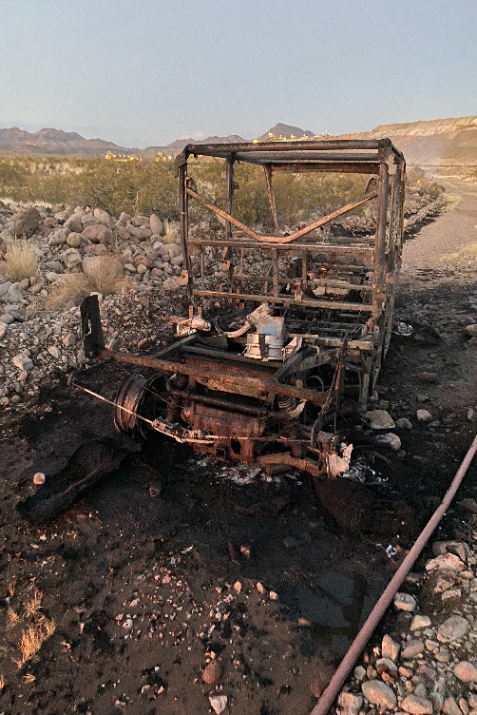
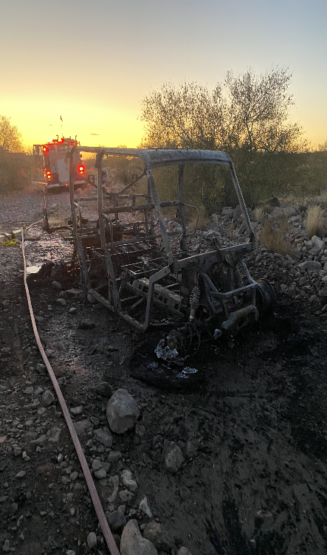
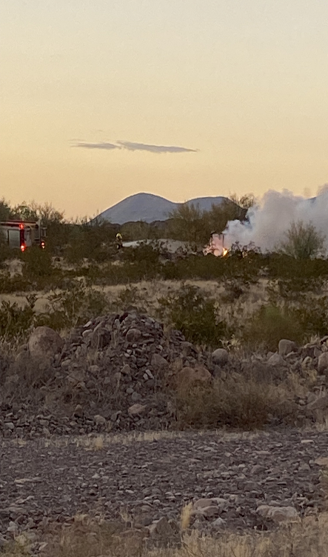
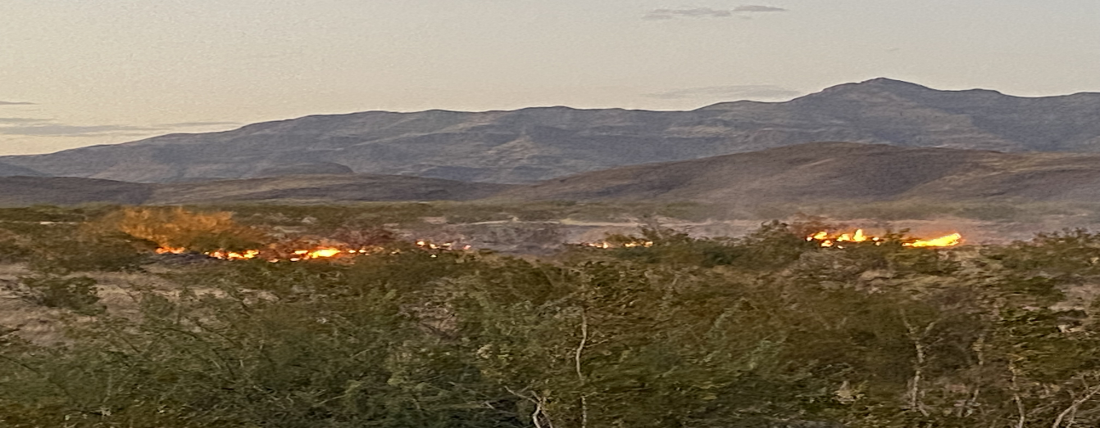
UTV Caught Fire
Event ID #20008187
Incident Details
Operation | Safford
Date / Time | July 10, 2023 / 9:15 a.m.
Type | Property Damage
Summary | Two mechanics in a utility terrain vehicle were driving to get replacement BO idlers at the C4 yard. While enroute, they heard a popping noise from the rear end and felt heat from the back seat. The mechanics pulled over and immediately exited the vehicle, safely evacuating the area. A mayday was called, and the emergency response team arrived within minutes. The UTV was engulfed in flames, and a small brush fire had started. Both fires were extinguished. A water truck was assigned to a two-hour fire watch. The UTV inspection card was burned in the fire. Nothing was noted in the BO order.
Fatal Risk | Fire
Risk Category | Monitor
Pre / Post Rating | Significant (3) Possible (2) / TBD
Absent / Insufficient Controls | N/A
Applicable Policies / Procedures | Strong Mayday Response Equipment Readiness/Emergency Procedures
Employee Condition | No Injury
Contact | Drew Borcherding, Manager Health and Safety

Slide 13
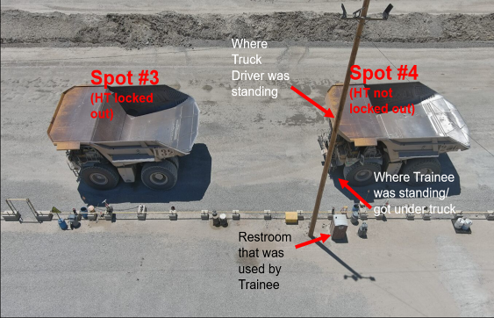
Employee in Wrong Spot at Fuel Dock
Event ID #20008258
Incident Details
Operation | Bagdad
Date / Time | July 12, 2023 / 6:15 a.m.
Type | Near Miss
Summary | Haul truck driver (A) on spot three at the Lucy Fuel Dock had the truck locked out to perform a pre-shift inspection. Driver A needed to use the brown hose, then resumed the inspection but returned to spot four instead of spot three. Haul truck driver (B) on spot four stepped out to clean the driver’s side mirror and saw Driver A step under the truck. Driver B yelled to get the attention of Driver A, who realized the error and called for a supervisor.
Fatal Risk | Vehicle Impact on Person
Risk Category | Monitor
Pre / Post Rating | Significant (3) Possible (2)
Absent / Insufficient Controls | N/A
Applicable Policies / Procedures | N/A
Employee Condition | No Injury
Contact | Zach Maughan, Superintendent-Mine Operations

Slide 14
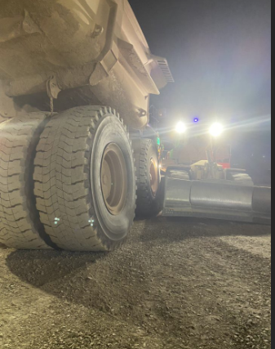
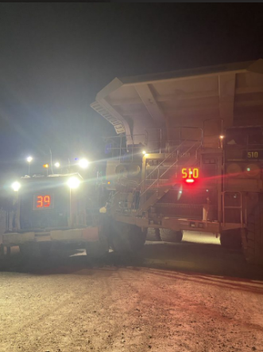
Dozer Contacts Haul Truck
Event ID #20008459
Incident Details
Operation | Morenci
Date / Time | July 19, 2023 / 11:30 p.m.
Type | Property Damage
Summary | While waiting for a truck to clear the left dump pocket, the 39 RTD was aware of the 510 which was on the right dump pocket trying to dump out and was overloaded. The operator on the HT510 proceeded to pull out of the dump pocket and travel to the stockpile. The operator on the 39RTD thought that the HT510 had gone by as they backed up to clean the opposite dump pocket and contacted the front right side of the HT510, causing damage to the rear fender and bending the walkway frame on the 39RTD. There was no damage to the HT510 other than scuff marks to the #2 tire.
Fatal Risk | Vehicle Collision or Rollover
Risk Category | Monitor
Pre / Post Rating | Significant (3) Possible (2)
Absent / Insufficient Controls | Adequate Radio Communication Awareness of Surroundings
Applicable Policies / Procedures | Interaction with Heavy Mobile Equipment
Employee Condition | No Injury
Contact | Tony Lujan, Senior Supervisor-Health and Safety

Slide 15
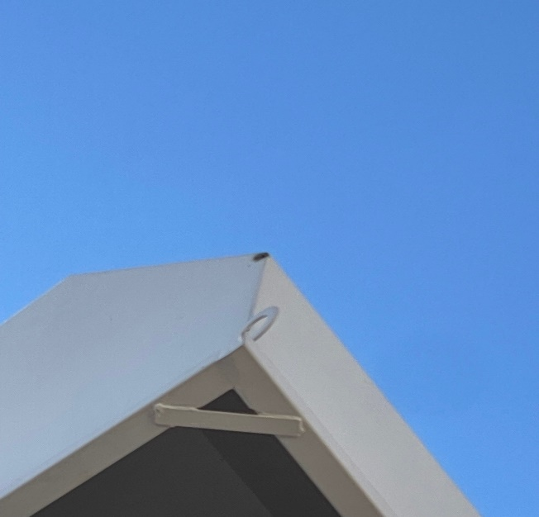
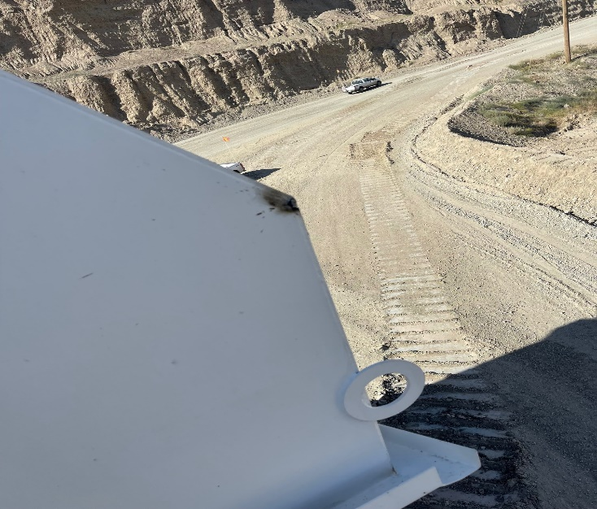
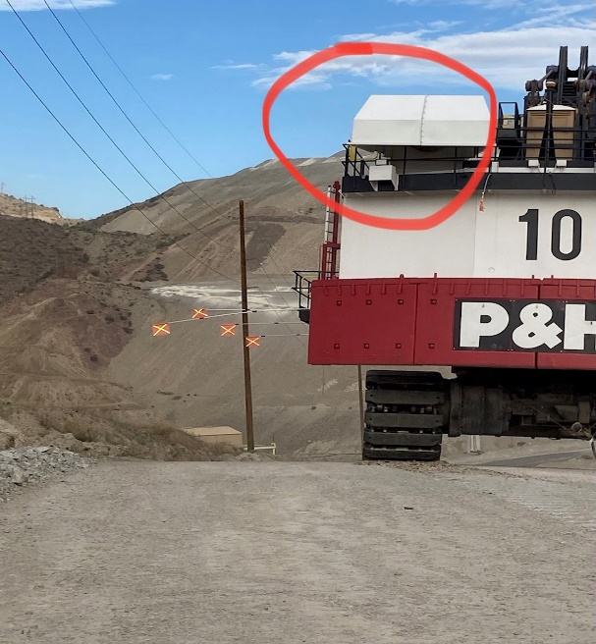
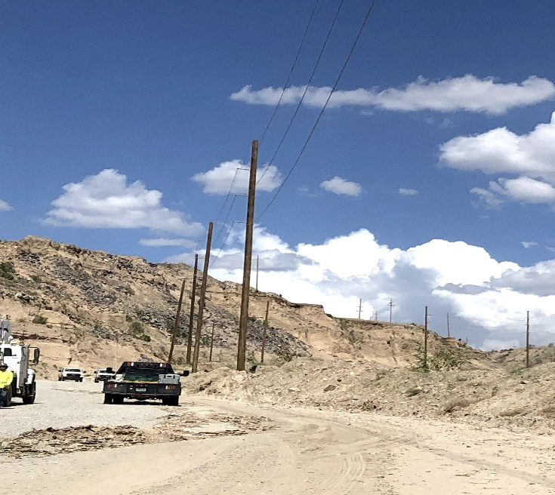
Shovel Contacts Power Lines
Event ID #20008576
Incident Details
Operation | Bagdad
Date / Time | July 24, 2023 / 2:30 p.m.
Type | Near Miss
Summary | While moving the 10 Shovel to the North 3 pushback the shovel interacted (came into contact/proximity, unsure of which) with powerlines on the ramp causing the lines to go to ground and the other shovels 8,11, & 22 to lose power. Berm was moved so the drillers could operate and was not moved back to original location.
Fatal Risk | Exposure to Electrical Hazards
Risk Category | Monitor
Pre / Post Rating | Significant (3) Possible (2)
Absent / Insufficient Controls | Failure to perform spotting expectations Berm was not moved back to original location
Applicable Policies / Procedures | Shovel Move Policy FCX 20
Employee Condition | No Injury
Contact | Zach Maughan, Mine Superintendent

Slide 16
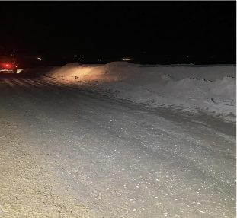
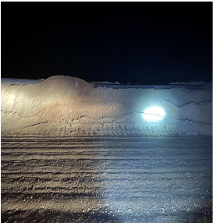
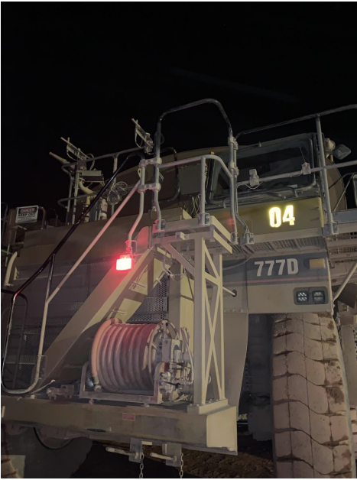
Water Truck Hits Berm
Event ID #20008619
Incident Details
Operation | Morenci
Date / Time | July 25, 2023 / 10:19 p.m.
Type | Injury/Illness
Summary | #4 Water Truck Operator was headed towards the intersection between Coronado, AMT/Bebo and noticed a haul truck slow down in front of them. The operator mentioned applying the retarder and stated that they felt there was no response and tried to foot brake and felt the same lack of response. They went around the haul truck to avoid collision and rode the berm and felt pain and called for assistance. Brake systems on the water truck were tested after the incident and found to be mechanically sound.
Fatal Risk | Vehicle Collision or Rollover
Risk Category | Monitor
Pre / Post Rating | Significant (3) Possible (2)
Absent / Insufficient Controls | Maintaining an unsafe distance from other vehicles
Applicable Policies / Procedures | Pre-Op Inspection Interaction with Heavy Mobile Equipment
Employee Condition | Injury to neck and shoulder Restricted duty, awaiting follow up
Contact | Tony Lujan, Senior Supervisor-Health and Safety

Slide 17
Employee Injured By Skid Steer
PFE # 20008657 Event ID # 2023-14
Preliminary Incident Details
Operation | Morenci
Date / Time | July 26, 2023 / 11 a.m.
Type | Injury/Illness
Summary | An employee was bringing water to the operator of a skid steer when the vehicle abruptly moved forward, knocking the employee to the ground and running over the employee’s leg. The employee sustained minor injuries.
Fatal Risk | Vehicle Impact on Person
Risk Category | Actionable
Pre / Post Rating | Significant (3) Likely (3) / TBD
Findings / Missing Controls | Positive Communication System, Segregation
Applicable Policies / Procedures | Fatal Risk Management Handbook Skid Steer Task Training (Green Carding) Skid Steer Training
Employee Condition | Minor Injuries (First Aid)
Contact | Jacob Sweet, Manager-Health and Safety Jody Beck, Manager-Crush and Convey
An employee was injured when a skid steer lurched forward, knocking the employee to the ground and running over the employee’s leg.

Slide 18
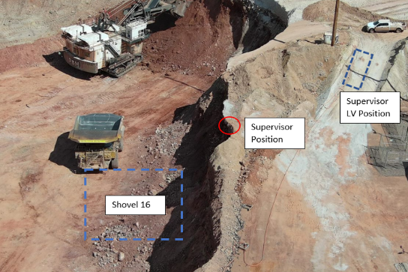
50-Foot Highwall Sloughed Off
PFE # 2023-9 Event ID # 20007047
Preliminary Incident Details
Operation | Morenci
Date / Time | May 15, 2023 / 9 p.m.
Type | Injury
Summary | A supervisor was standing at the edge of a highwall overlook to check on a shovel’s progress when the 50-foot highwall sloughed off underneath. The supervisor slid down with the soft material and landed near the shovel. The shovel operator saw the supervisor's flashlight as it slid down and stopped digging. The supervisor received medical care for minor injuries.
Fatal Risk | Ground Failure
Risk Category | Actionable
Pre / Post Risk Rating | Significant (3) Likely (3) / TBD
Absent / Insufficient Controls | Missing Crest Indicator (trench) for fill material
Applicable Policies / Procedures | HEO-FCX1081C Shovel Operation
Employee Condition | Minor abrasion to the left hand and minor puncture wound on the left palm requiring two stitches.
Contact | Haris (Kudir) Kudadiri, Manager-Fragmentation & Loading
Supervisor
Light Vehicle
Supervisor Position
Shovel
Highwall and location of supervisor and shovel at time of event.

Slide 19
50-Foot Highwall Sloughed Off
Potential Fatal Event Learnings:
PFE # 2023-9 Event ID # 20007047
Causal Factors
Mine plan did not include a safety berm to protect personnel and equipment above the active shovel pit crest line No designated safe distance between the employee and the crest of the active shovel pit
Fatal Risk Management Controls
Verification Systems/Monitoring System – SUFFICIENT Visual Inspections and Reporting – INSUFFICIENT Are berms at adequate heights and thickness to keep equipment from going through? Have area inspections for ground conditions been conducted prior to work commencing? Slope Planning and Building – INSUFFICIENT Do personnel understand the construction methods and design parameters that will maintain ground stability in order to prevent ground hazards from developing? Excavation and Trenching – SUFFICIENT
Action Items | Hierarchy of Controls
Dig line will be visible by the shovel runner by having a trench in place | Engineering
When mining fill or tailings material and access to the bench is needed, a safety berm will need to be a minimum of 13 feet (based off a 50-foot bench) from an active mining crest to keep miners safe from bench failures. If no access is required, access will be restricted. Global Action Item | Engineering
Document the safety berm requirement in administrative controls (i.e., SOP, Site Policy, etc..) and communicate requirement with Mine Operations. No personnel will be allowed access past the safety berm | Administrative
Additional Learnings / Opportunities
N/A

Slide 20
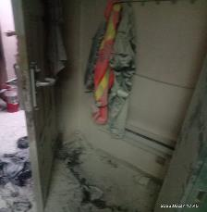
Fire Incident at Barracks
Event ID #20007947
Incident Details
Operation | PTFI
Date / Time | March 27, 2023 / 5:28 p.m.
Type | Property Damage
Summary | A barrack occupant placed a T-shirt against the element of a room heater, and it caught fire. PTFI Command Center called Fire Rescue for immediate response.
Fatal Risk | Fire
Risk Category | Actionable
Pre / Post Rating | Catastrophic (4) Unlikey (1)
Absent / Insufficient Controls | Placement of combustible material near heat source
Applicable Policies / Procedures | GDL-4.02-PTFI-004​ - Housekeeping GDL-4.04.30-PTFI-003 - Fire Protection​
Employee Condition | No Injury
Contact | Maranata Tobing – Safety PT RUCCI

Slide 21
FCX Critical Control Improvements

Slide 22
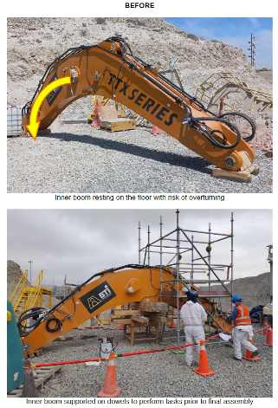
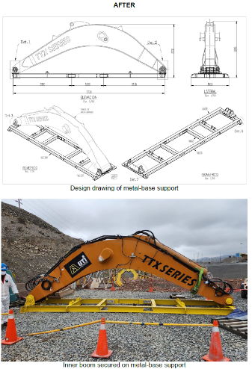
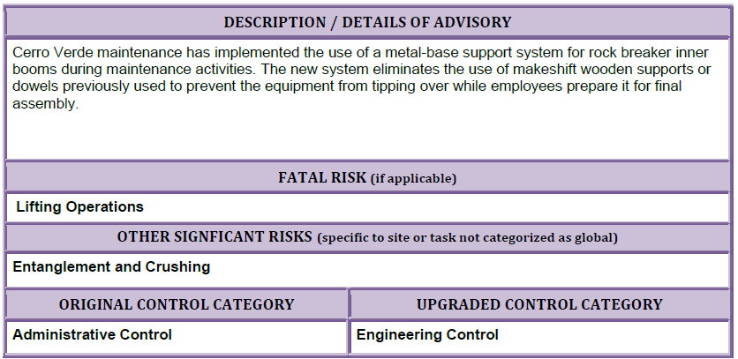
CCI – Baes for Rock Breaker Inner Boom

Slide 23
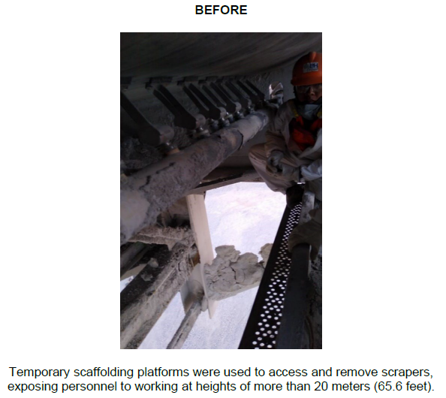
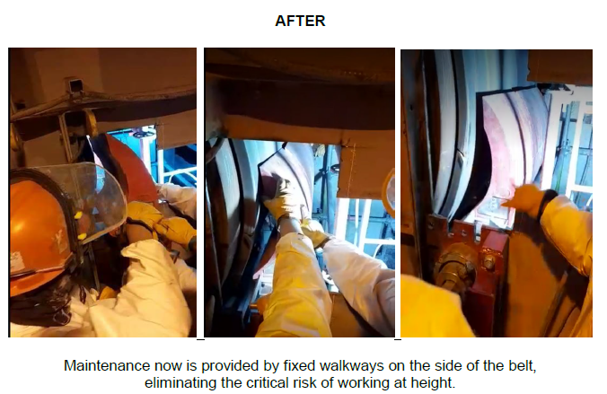
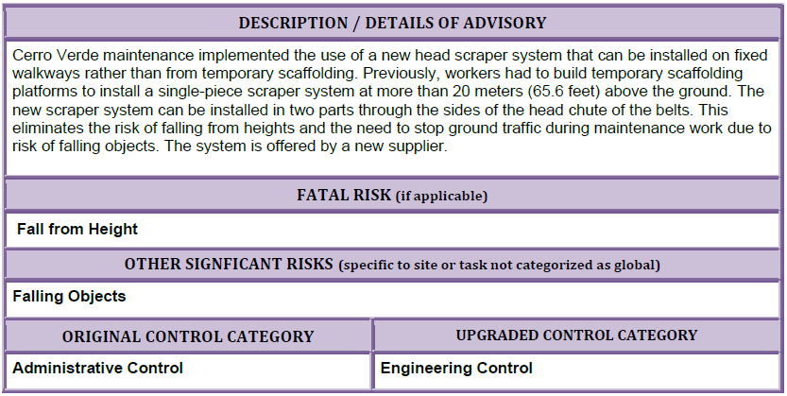
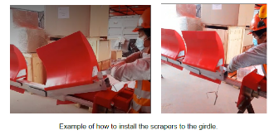
CCI – Head Scraper System

Slide 24
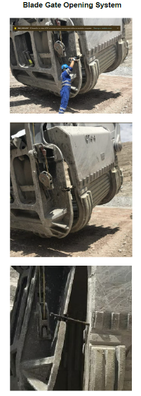
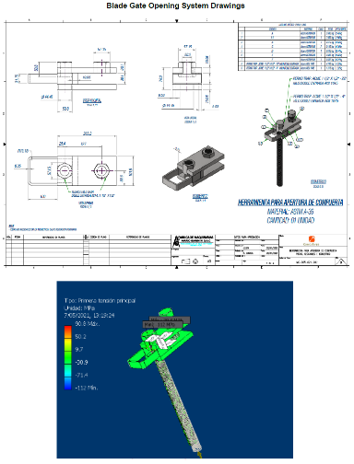
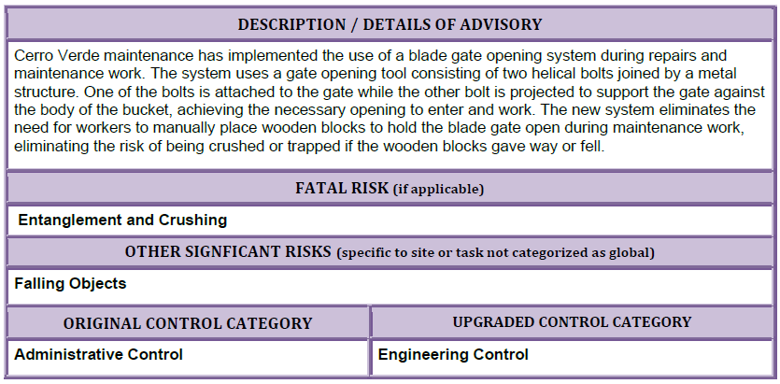
CCI – Blade Gate Opening System

Slide 25
Agency Shares

Slide 26
MSHA – July Share

