Slide 1
FCX Monthly Safety Content
The following slides have been provided to aid in compiling content for monthly Health & Safety meetings, tailgates, etc. with FCX employees and contractors.
Please keep in mind - some of this information is preliminary and may be pending complete investigations.
Best Practices
Be familiar with content prior to presenting
Hide/Unhide incidents that are relevant to your team
Interact with your audience, relating information to your specific work
Update dashboards to share meaningful data (Incident Summary - Power BI, FRM - Power BI). Contact your local H&S staff for site-specific dashboards or external access.
1

Slide 2
FCX Safety Updates
December 2023
(Incidents and Communications from November 2023)
fcx.com

Slide 3
FCX Safety Incidents, Successes, & Alerts
November 2023
fcx.com
3

Slide 4
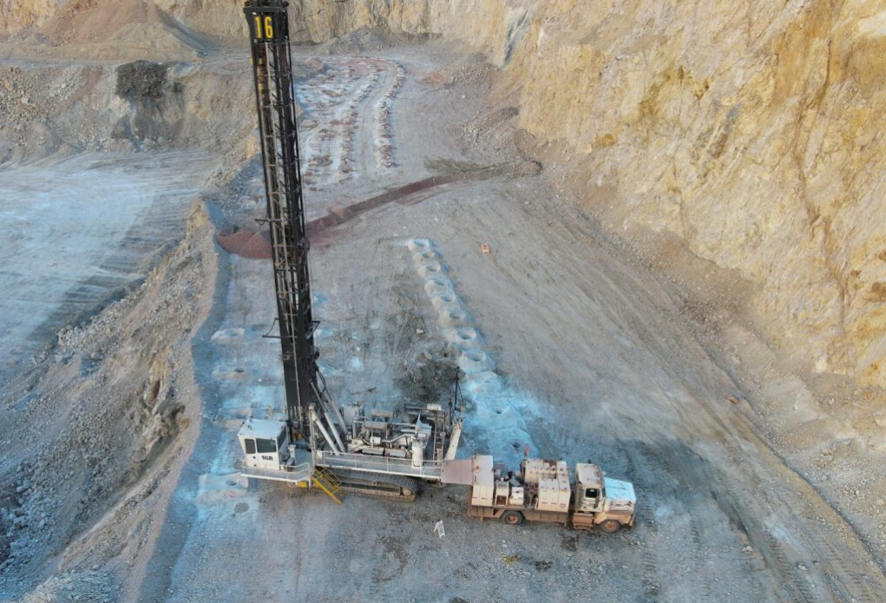
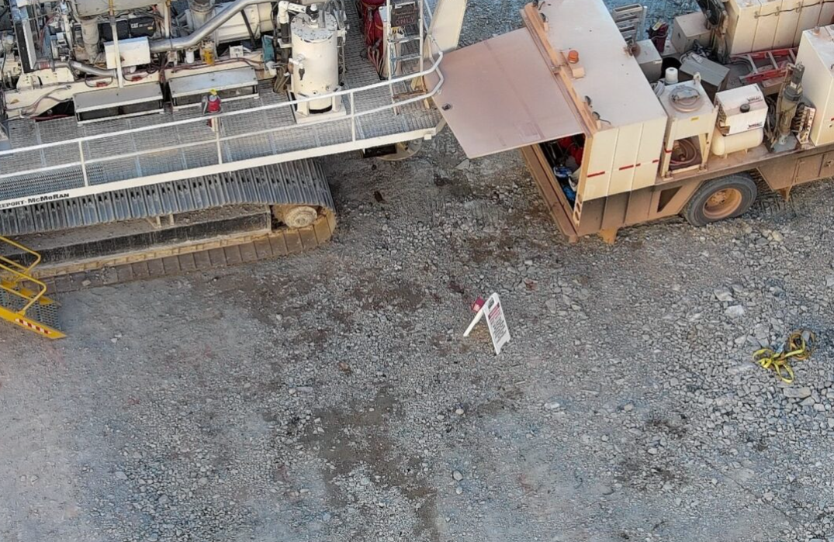
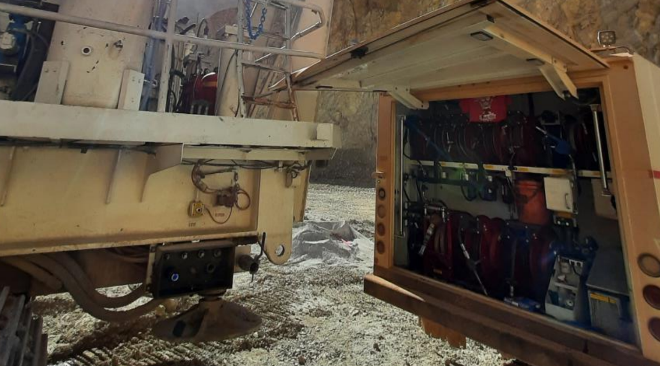
Drill Contact with Lube Truck
Event ID #20010781
Incident Details
Operation | Morenci
Date / Time | October 27, 2023 / 1 p.m.
Type | Property Damage
Summary | A mechanic in a lube truck approached a drill that was supposed to be down for protec. The mechanic parked 15-20 feet behind the drill to wait for it to finish a hole. The driller lifted a drill bit and started to back up. The mechanic was standing 20-30 feet from the cab side and tried to get the driller’s attention but was neither seen nor heard. The mechanic moved to the rear of the drill and hit the emergency stop to keep it from striking the truck, but contact was still made.
Fatal Risk | Vehicle Impact on Person
Risk Category | Monitor
Pre / Post Rating | Significant (3) Possible (2) NOT A PFE
Absent / Insufficient Controls | Lack of positive communication with drill operator
Applicable Policies / Procedures | FCX-23 Heavy Equipment Interaction
Employee Condition | No Injury
Contact | Keith Barnett, Superintendent-Shovel and Drill

Slide 5
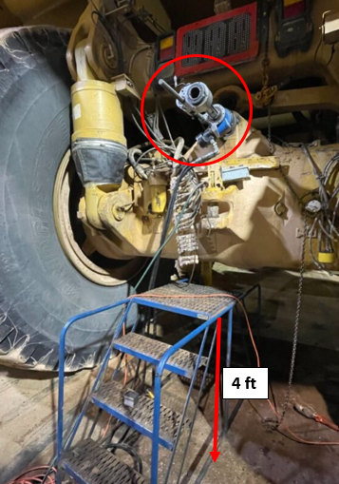
Fall from Ladder Platform
Event ID #20011111
Incident Details
Operation | Morenci
Date / Time | November 2, 2023 / 10:40 p.m.
Type | Injury
Summary | An employee fell off a 4-foot ladder platform while machine boring behind a haul truck. The employee sustained a head injury.
Fatal Risk | Fall from Heights
Risk Category | Monitor
Pre / Post Rating | Significant (3) Possible (2) NOT A PFE
Absent / Insufficient Controls | Failure to use correct working platform for the specific task
Applicable Policies / Procedures | Working at Heights Policy
Employee Condition | After the fall, the employee was unconscious for about a minute, then came too but was not fully coherent. The employee was transported to the local health clinic and later to the regional medical center for further care. The employee sustained a bruise to the back of the head.
Contact | Willie Biggs, Superintendent-Mine Maintenance

Slide 6
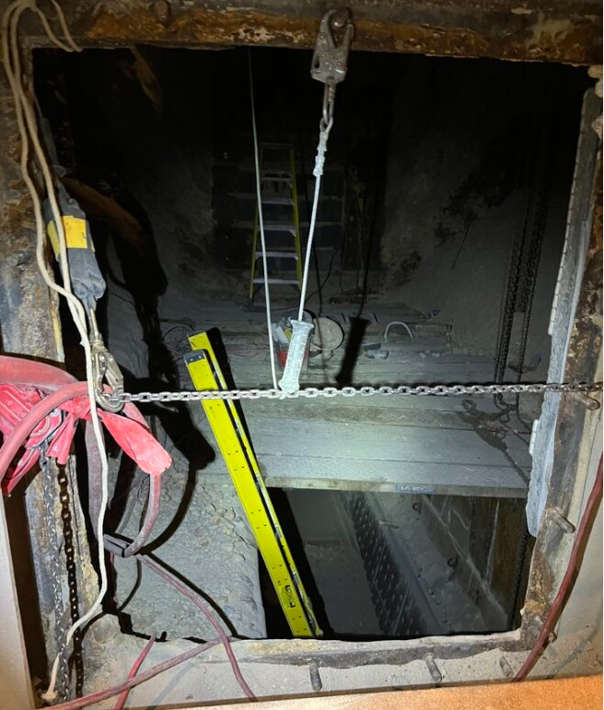
Liner Fell Off Wall
Event ID #20011250
Incident Details
Operation | Morenci
Date / Time | November 8, 2023 / 10:00 p.m.
Type | Near Miss
Summary | Contract were working in the 8a and 8b feeders. The employee above was on an 8-foot A frame ladder that was leaning on the wall and employee was tied off cutting the liner with a grinder. As the employee was cutting the liner, it fell off the wall towards them and deflected off their hard hat, face shield and left hand of the employee. The ladder tipped back, causing the employee to fall and their harness to catch them. The liner fell through a small opening to the lower level ~10ft below where the other employee was working on the opposite side of the bin approximately 20ft away.
Fatal Risk | Fall from Heights, Falling Objects
Risk Category | Monitor
Pre / Post Rating | Significant (3) Possible (2) NOT A PFE
Absent / Insufficient Controls | Scaffolding-Ladder inappropriate due to the nature of the work
Applicable Policies / Procedures | Working at Heights Policy FCX-HS02
Employee Condition | No Injury
Contact | Chris Seick-Manager Metcalf Mill

Slide 7
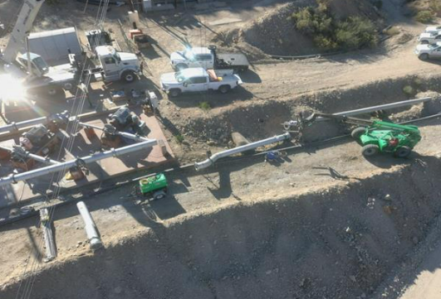
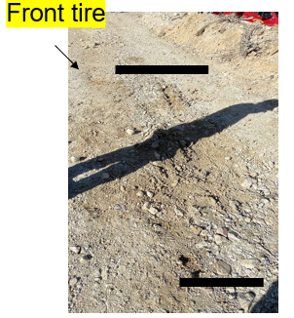
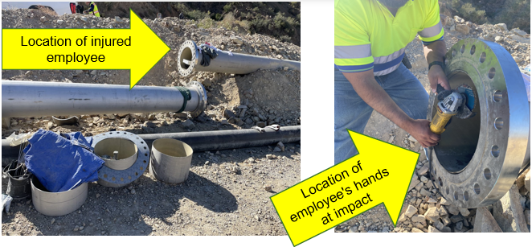
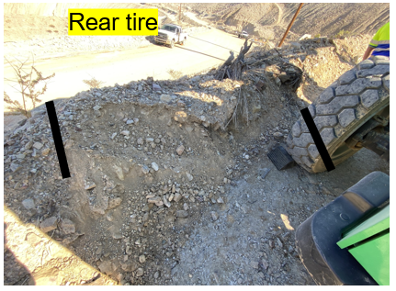
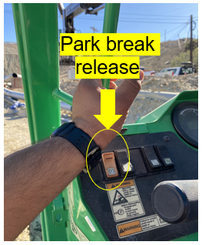
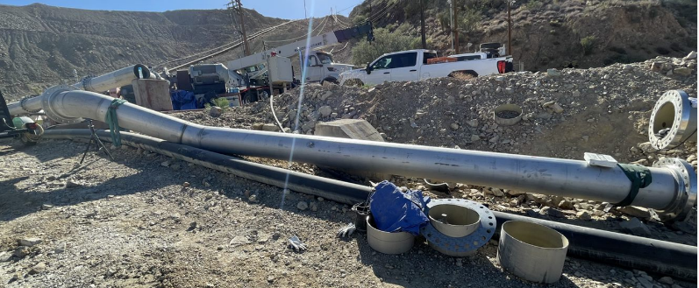
Contractor’s Arms Were Pinned Between Steel Pipes
Event ID #20011272
Incident Details
Operation | Bagdad
Date / Time | November 9, 2023 / 1:00 p.m.
Type | Injury
Summary | Employee was fitting connection from the intake pipe to new intake manifold. The pipe was put in place and the flange was adjusted. They moved the pipe away with the crane and tele-handler and rested it on pipe stands. The second operator inadvertently released the park brake. The original operator then jumped into the tele-handler to step on the brake. The tele-handler had rolled back several feet into the berm, pulling the pipe into the welder performing the pipe fitting. The welder was grinding on intake pipe and connector’s flange impacted their hands.
Fatal Risk | Uncontrolled Release of Energy
Risk Category | Monitor
Pre / Post Rating | Significant (3) Possible (2) NOT A PFE
Absent / Insufficient Controls | Employee in the forklift dismounted without setting the suspended load on the ground
Applicable Policies / Procedures | COHE Policy/FCX Contractors H&S & Environmental Manual
Employee Condition | No Injury
Contact | Denise Frankum, Health and Safety

Slide 8
PFE Events
November 2023
fcx.com
8

Slide 9
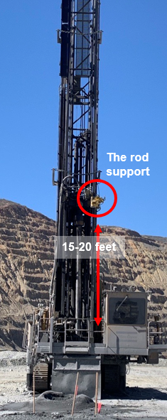
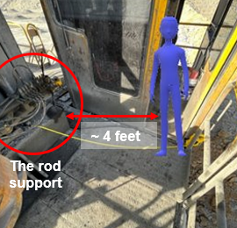
Falling Rod Support on Drill
PFE # 2023-29 Event ID # 20010673
Preliminary Incident Details
Operation | Sierrita
Date / Time | October 21, 2023 / 3:20 a.m.
Type | Property Damage
Summary | A drill operator was in position to start a new hole and stepped out of the cab onto the platform. As the employee was looking away, the rod support mechanism – estimated to weigh approximately 500 pounds – fell 15 to 20 feet and landed on the deck about four feet away. The operator was struck on the shoulder with a hydraulic hose attached to the rod support.
Fatal Risk | Falling Objects
Risk Category | Actionable
Pre / Post Rating | Significant (3) Likely (3)
Findings / Missing Controls | Operator competency Safety cable failed
Applicable Policies / Procedures | Drill SOP
Employee Condition | No Injury
Contact | Allen Bruce Kinney, Superintendent-Mine Operations
The rod support in place around the drill shaft.
The employee’s position when the rod support fell.

Slide 10
Contractor Falls from Shovel Ladder
PFE # 2023-28 Event ID # 20010807
Preliminary Incident Details
Operation | Climax
Date / Time | October 25, 2023 / 11:30 a.m.
Type | Injury
Summary | A contractor employee used the emergency egress ladder to access the track below the operator’s cab to clean the front of the shovel. After cleaning, the employee began to ascend the ladder, which had retracted. While part way up the ladder, it descended, causing the contractor to fall an estimated 5 to 10 feet below onto the tracks.
Fatal Risk | Fall From Heights
Risk Category | Monitor
Pre / Post Rating | Significant (3) Possible (2)
Findings / Missing Controls | Contractor fall protection was not connected Onsite personnel lift was in use on the other side, so not used for this task Job walk was not performed prior to starting task
Applicable Policies / Procedures | Working at Heights
Employee Condition | Contractor is recovering from a fractured patella
Contact | Greg Gerloff, Senior Supervisor-Industrial Hygiene
Ladder Extended
Ladder Retracted
Scene Overview

Slide 11
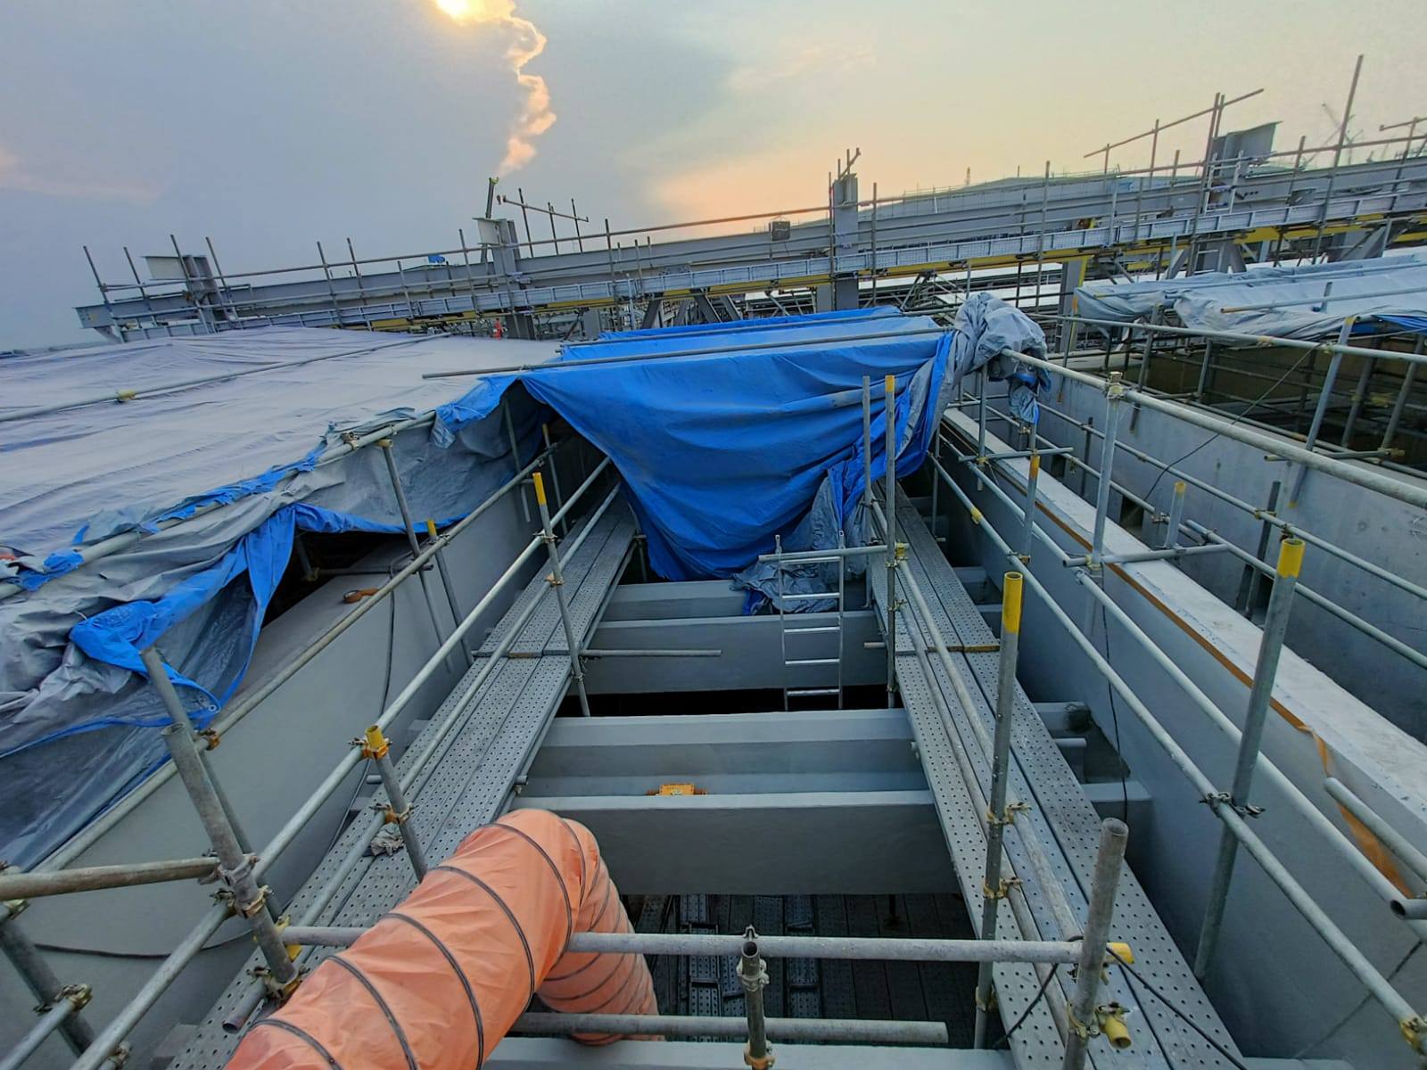
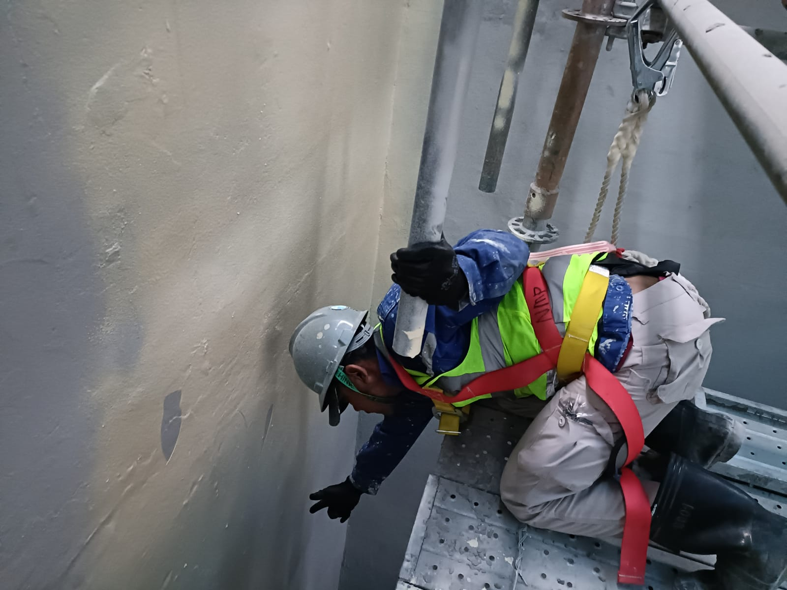
Fall from Heights
PFE # 2023-32 Event ID # 20011245
Preliminary Incident Details
Operation | Manyar Smelter – Desalination Plant
Date / Time | October 31, 2024 / 3:30 p.m.
Type | Injury
Summary | A subcontractor employee was applying coating on a tank from scaffolding and was reminded to tie off by a Health and Safety specialist. While attempting to stand up to tie off, the employee lost balance and fell through the gap about 4 meters (13 feet) to the ground.
Fatal Risk | Fall from Heights
Risk Category | Monitor
Risk Rating | Significant (3) Possible (2)
Findings / Missing Controls | Employee was not tied off
Applicable Policies / Procedures | Working at Heights policy Work procedures and training
Employee Condition | The employee received a laceration requiring eight stitches above the right eye and was cleared to return to work.
Contact | Zach Scrivner, Manager-Corporate Project Engineering Safety
The scaffolding where the worker fell.
Reenactment – The worker fell about four meters to the ground.

Slide 12
Agency Shares
November 2023
fcx.com
15

Slide 13
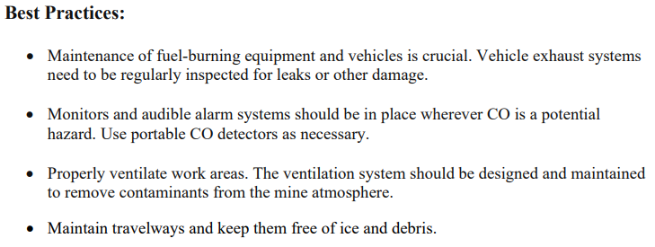
MSHA Safety Alert – Safety in Cold Weather
PDF LINK

Slide 14
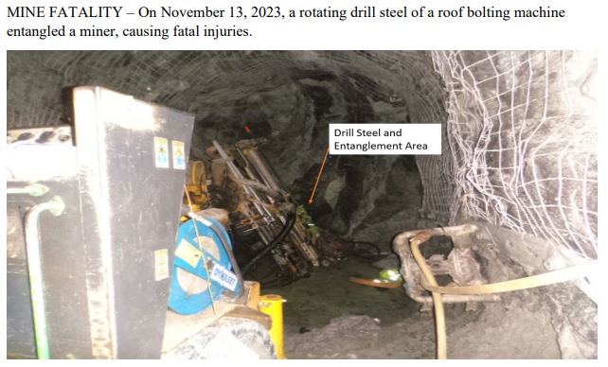
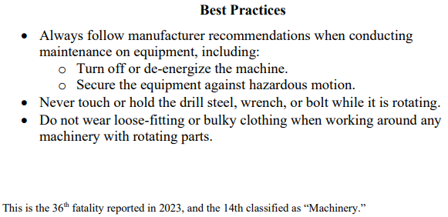
MSHA Fatality Alert – November 13, 2023
PDF LINK

