Slide 1
FCX Monthly Safety Content
The following slides have been provided to aid in compiling content for monthly Health & Safety meetings, tailgates, etc. with FCX employees and contractors.
Please keep in mind - some of this information is preliminary and may be pending complete investigations.
Best Practices
Be familiar with content prior to presenting
Hide/Unhide incidents that are relevant to your team
Interact with your audience, relating information to your specific work
Update dashboards to share meaningful data (Incident Summary - Power BI, FRM - Power BI). Contact your local H&S staff for site-specific dashboards or external access.
1

Slide 2
FCX Safety Updates
February 2024
(Incidents and Communications from January 2024)
fcx.com

Slide 3
FCX Safety Incidents, Successes, & Alerts
January 2024
fcx.com
3

Slide 4
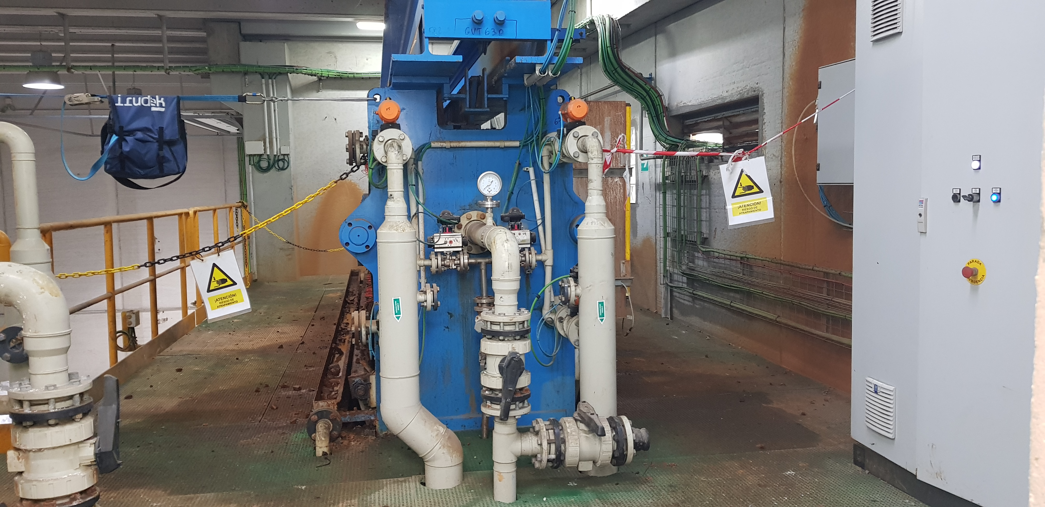
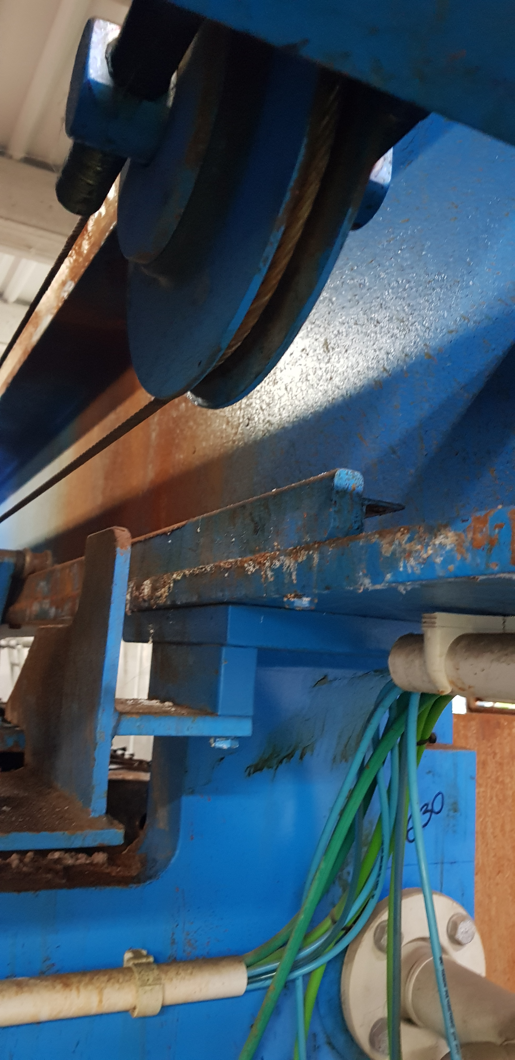
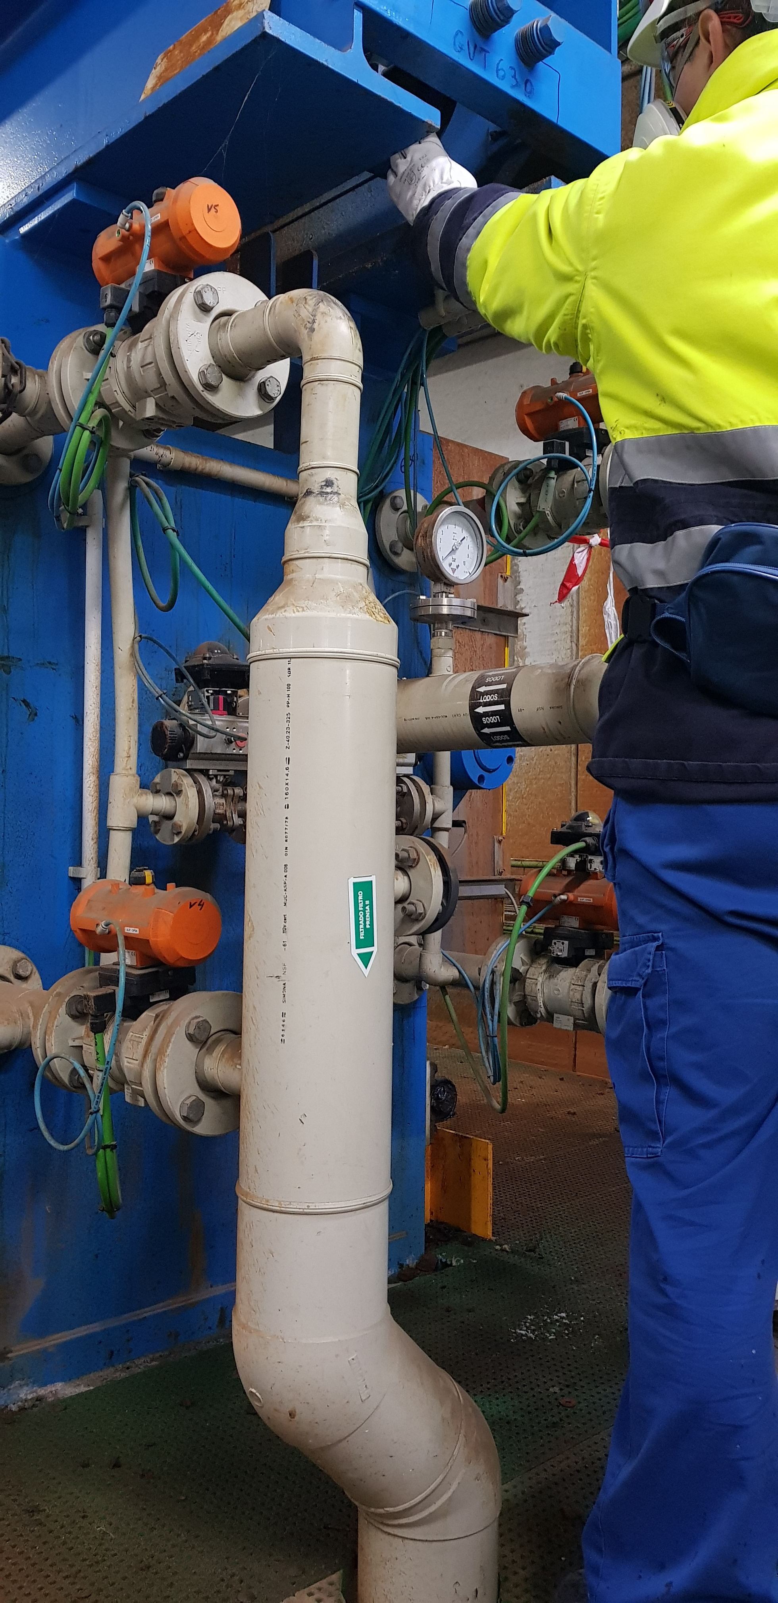
Atlantic Copper – Overhead Filter Presses
Event ID # 20012570
Incident Details
Operation | Atlantic Copper
Date / Time | January 4, 2024 / 12:43 p.m.
Type | Injury
Summary | When an operator was carrying out the cake discharger operation from the overhead filter presses, he detected a failure in the plate system. While looking for possible causes, the employee tried to check the pulley of the plate transport system. During the inspection, he tripped and rested his right hand between the pulley and cable of the transport system, which trapped his fingers, resulting in amputation of the 2nd and 3rd fingers on his right hand.
Fatal Risk | Entanglement and Crushing
Risk Category | Actionable
Pre / Post Rating | Significant (3), Likely (3)
Absent / Insufficient Controls | Engineering Controls: Moving Machinery not guarded
Applicable Policies / Procedures | Control of Hazardous Energy Sources (LOTOTO)
Employee Condition | Amputation of 2nd and 3rd fingers on employee’s right hand
Contact | Ignacio Romero Martin, H&S Manager

Slide 5
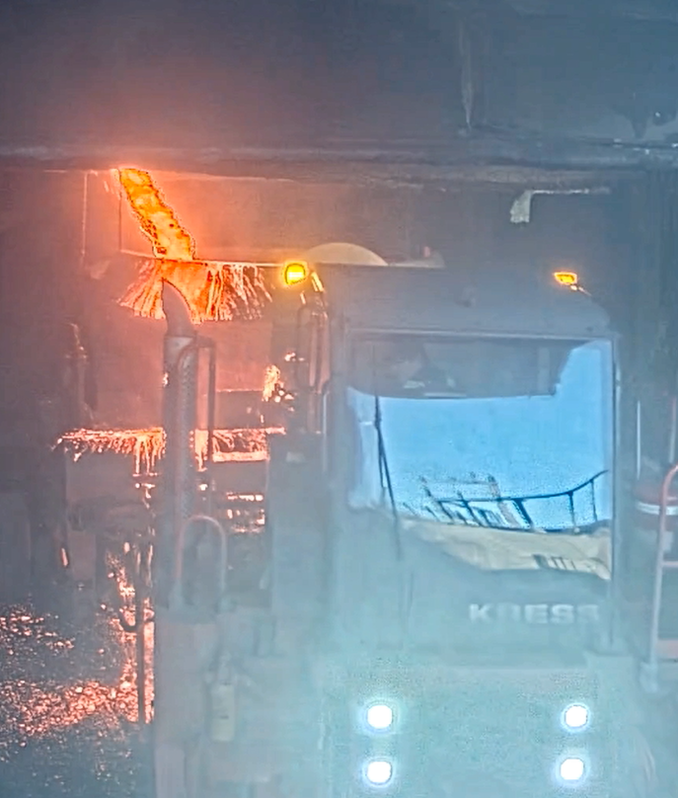
Miami Smelter – Slag Launder
Event ID # 20012772
Incident Details
Operation | Miami Smelter
Date / Time | January 14, 2024 / 12:43 p.m.
Type | Near Miss
Summary | Smelter Operator Trainee gave clearance to the slag hauler operator to set the pot in place to receive slag from the east slag launder. Without confirming that the pot was in place, the operator opened the launder and it spilled on the ground and slag hauler. The slag hauler operator quickly moved the hauler and pot away from the pouring slag. No damage to the hauler was reported.
Fatal Risk | Contact with Molten Material
Risk Category | Actionable
Pre / Post Rating | Significant (3), Likely (3)
Absent / Insufficient Controls | Communication between slag skimmer and hauler operator Visual verification
Applicable Policies / Procedures | Slag Skimming SOP Communication expectations
Employee Condition | No injuries
Contact | Justin Taylor, H&S Manager

Slide 6
PFE Events
January 2024
fcx.com
8

Slide 7
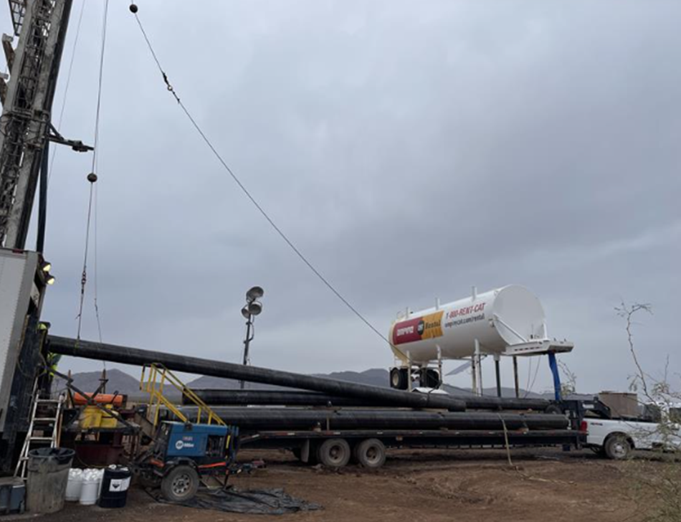
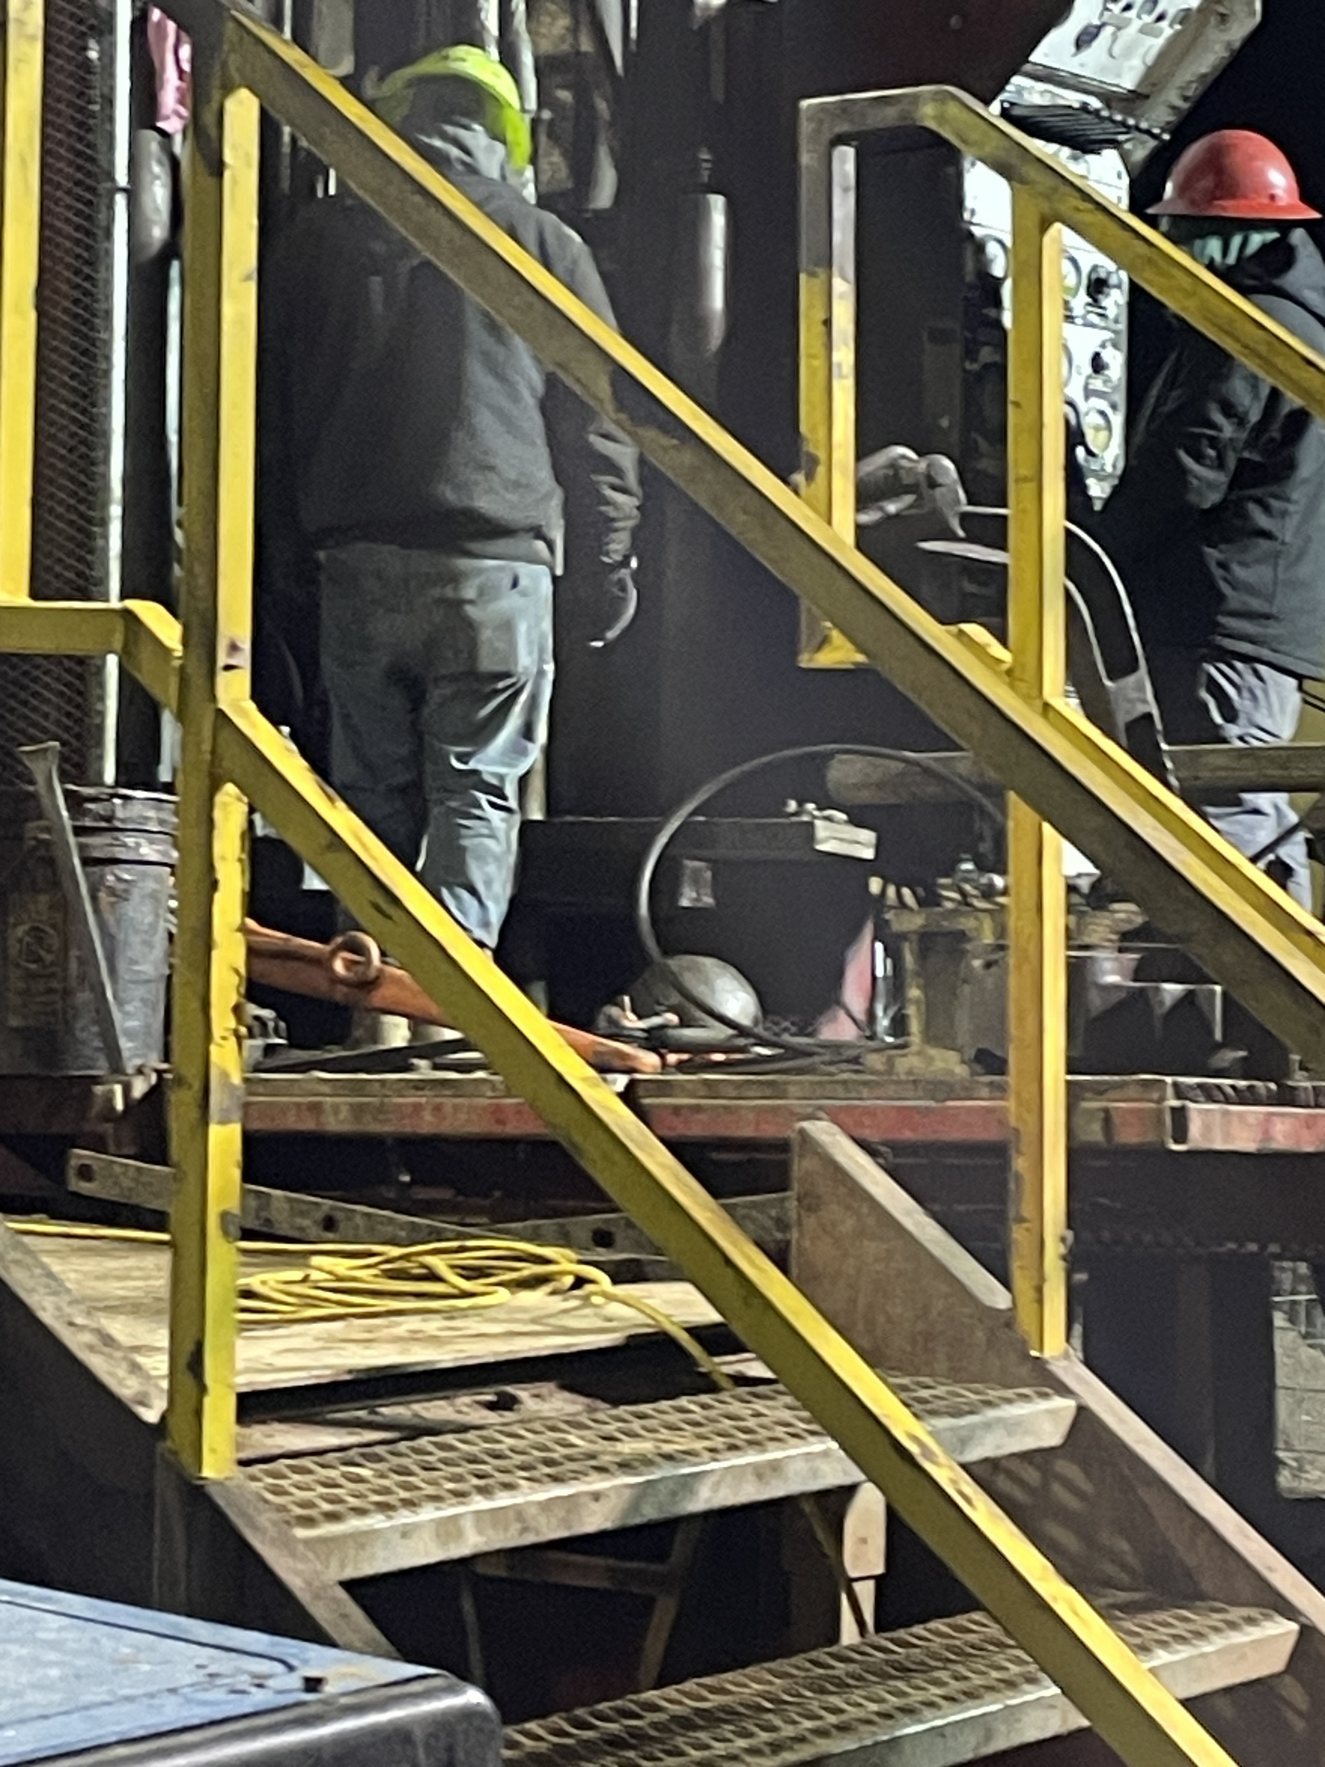
Drill Rig Cable Failed
PFE # 2023 - 45 Event ID # 20012538
Preliminary Incident Details
Operation | Whitlock Valley Test Well-Land and Water
Date / Time | December 28, 2023 / 6:10 a.m.
Type | Near Miss
Summary | A contractor had successfully completed the drilling and construction of one of three test production wells southeast of Safford and was installing a gravel filter pack using a 3-inch tremie pipe. Throughout the process, there was clogging in the pipe. The contractor lifted the pipe with a crane to clear debris when the main cable snapped, causing a 100-pound steel ball to fall approximately 12 feet to the drilling platform below, where a driller and helper had been working moments earlier.
Fatal Risk | Falling Objects
Risk Category | Medium
Risk Rating | Significant (3), Possible (2)
Findings / Missing Controls | Flagging and Barricading Equipment Inspections Manufacturer Specifications for Replacement
Applicable Policies / Procedures | Flagging and Barricading Drill Rig Pre-use Inspections
Employee Condition | N/A
Contact | Michael Lacey, Manager-Hydrogeology. Bill Schneider, Health & Safety Manager
The drill rig cables used during the pipe installation process.
Circled in red is the 100-pound steel ball that fell 13 feet to the drilling platform where two contractor employees had been working.

Slide 8
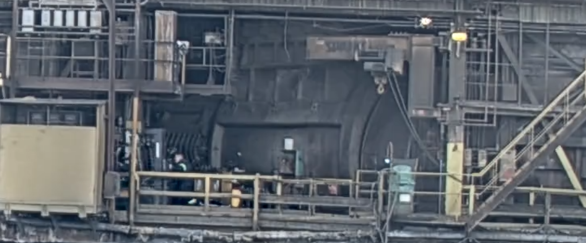
Employee Struck By Forklift
PFE # 2023-43 Event ID # 20012496
Preliminary Incident Details
Operation | Miami Smelter
Date / Time | December 30, 2023 / 3:30 p.m.
Type | Injury
Summary | An employee stepped from behind a converter into an aisle and was struck by a forklift. The employee was knocked to the ground.
Fatal Risk | Vehicle Impact on Person
Risk Category | Monitor
Pre / Post Rating | Significant (3) Possible (3)
Findings / Missing Controls | Forklift operator did not sound horn when traveling past openings in structure Pedestrian did not yield when entering roadway Operating speed
Applicable Policies / Procedures | Equipment Interaction SOPs
Employee Condition | First aid – Released back to work on full duty
Contact | Louie Barreras, Senior Supervisor-Health and Safety / Michael Cross, Manager – Downstream Ops
The red X marks where the forklift struck the employee.

Slide 9
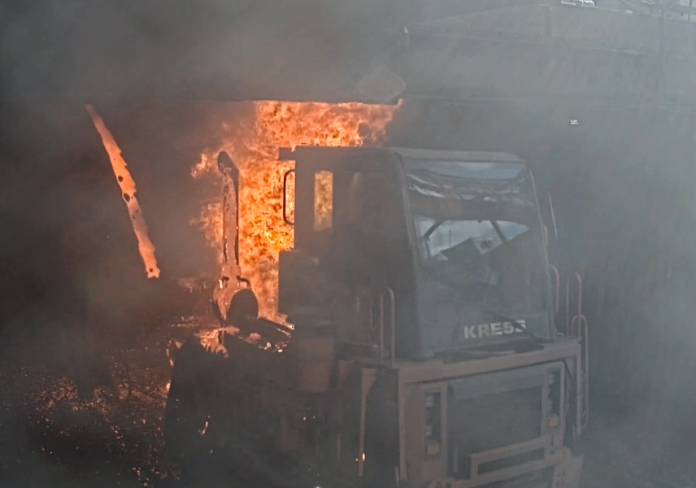
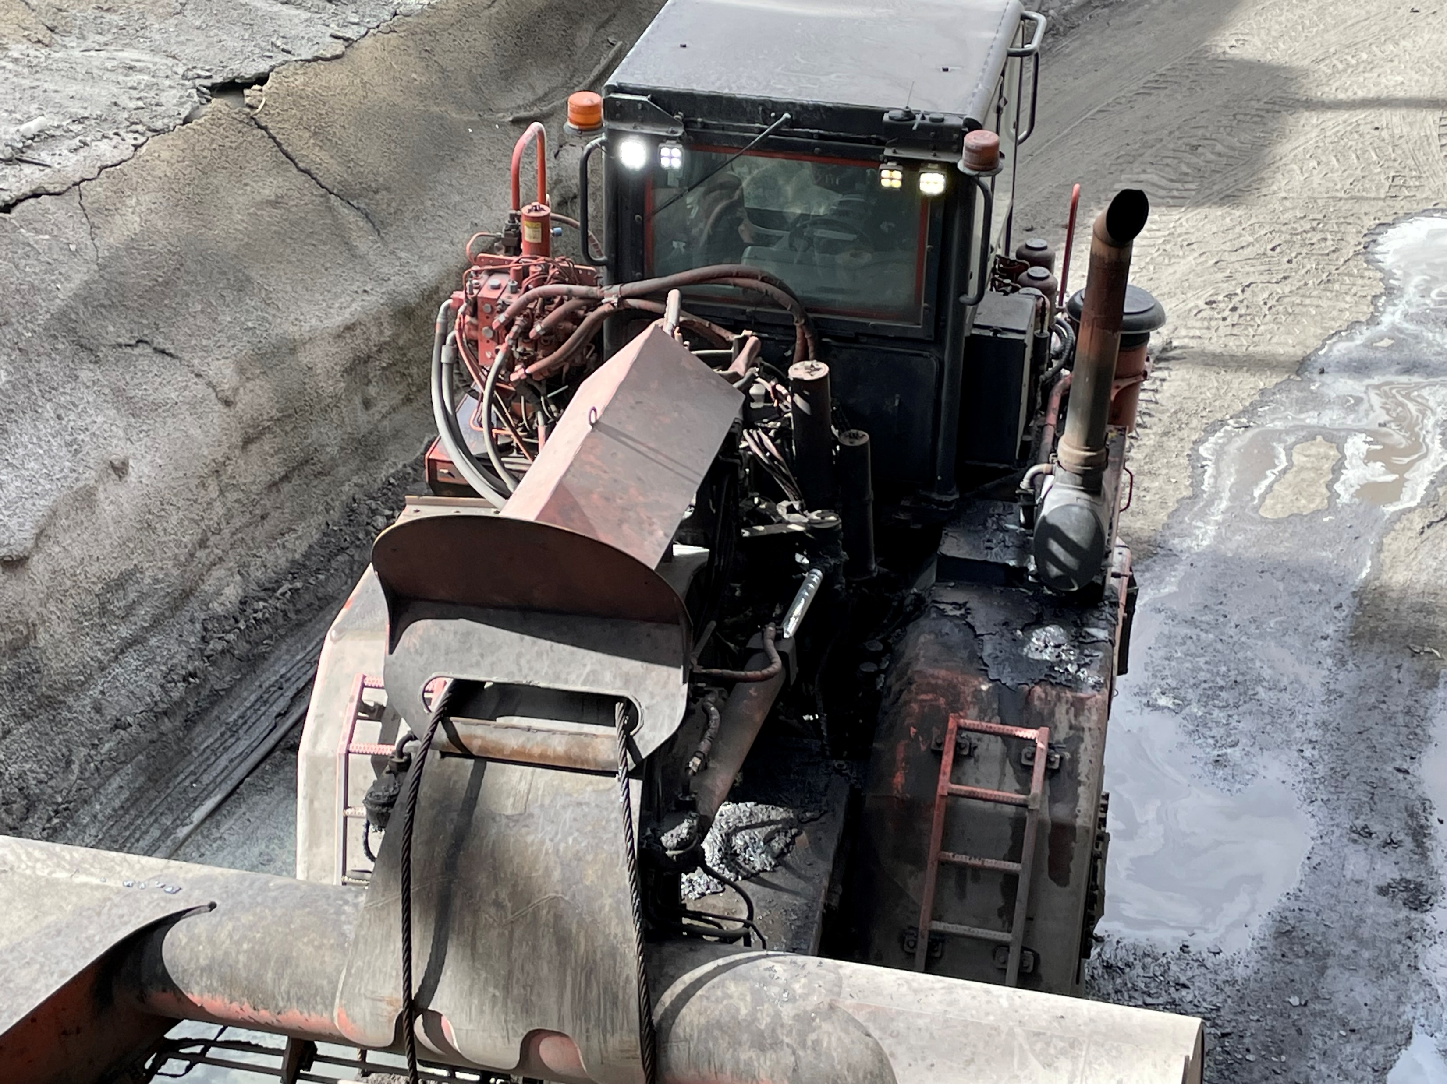
Slag Poured on Hauler
PFE # 2023-44 Event ID # 20012503
Preliminary Incident Details
Operation | Miami Smelter
Date / Time | December 31, 2023 / 12:15 p.m.
Type | Injury
Summary | An employee who was opening the slag tap hole requested the slag hauler operator move the pot from the east hole to the west hole. While the hauler operator was picking up the pot from the east hole, the tapper, thinking the pot was already in place, opened the west hole. Molten material flowed out onto the slag hauler. The operator moved the slag hauler forward away from the slag and immediately pulled the pin to activate the fire suppression system, and safely escaped without injury. The slag hauler caught fire and was damaged.
Fatal Risk | Contact With Molten Material
Risk Category | Monitor
Pre / Post Rating | Significant (3) Possible (3)
Findings / Missing Controls | Failure to follow SOP Lack of communication between operators
Applicable Policies / Procedures | Slag Tapping SOPs
Employee Condition | No Injury
Contact | Louie Barreras, Senior Supervisor-Health and Safety/ Michael Cross, Manager-Downstream Ops
The slag hauler caught fire after molten material flowed onto it.
Damage to the slag hauler.

Slide 10
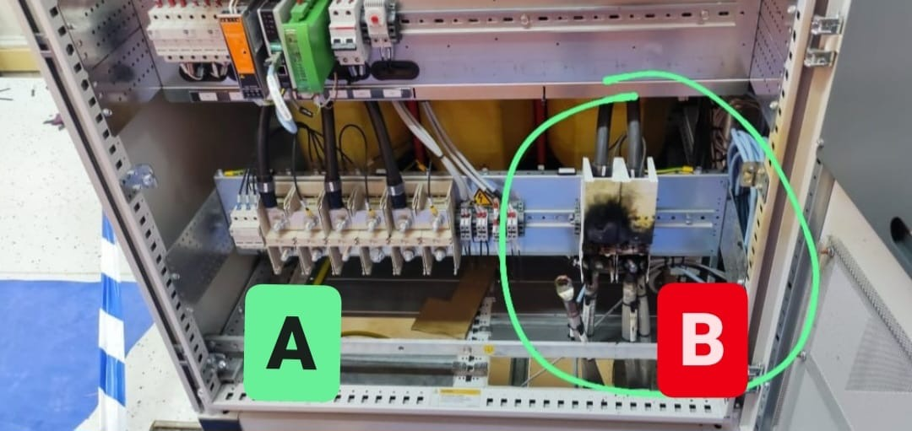
Contact with Energized Cable
PFE # 2024 - 1 Event ID # 20012857
Preliminary Incident Details
Operation | Manyar Smelter Project – Slag Concentrator Substation 2
Date / Time | January 17, 2024 / 10:30 a.m.
Type | Injury
Summary | Contractors were working on the left side of an electrical panel, which had been de-energized. Without testing for current, a worker removed a 400-volt cable from the right side, which remained energized, and contacted another cable, causing a spark.
Fatal Risk | Exposure to Electrical Hazard
Risk Category | Monitor
Risk Rating | Significant (3) Possible (2)
Findings / Missing Controls | Failure to isolate energy with LOTOTO procedure Wrong tool for the job Inadequate training; worker was not authorized to perform this work
Applicable Policies / Procedures | LOTOTO Isolation/De-Isolation Certification Process Energy Isolation Survey Form
Employee Condition | Worker sustained minor burns, was evaluated and released back to work.
Contact | Zach Scrivner, Manager-Corporate Project Engineering Safety
The de-energized portion of the panel (A) and the energized portion (B), which shows damage.

Slide 11
Agency Shares
January 2024
fcx.com
15

Slide 12
OSHA Share – Workplace Stress
Resources LINK

Slide 13
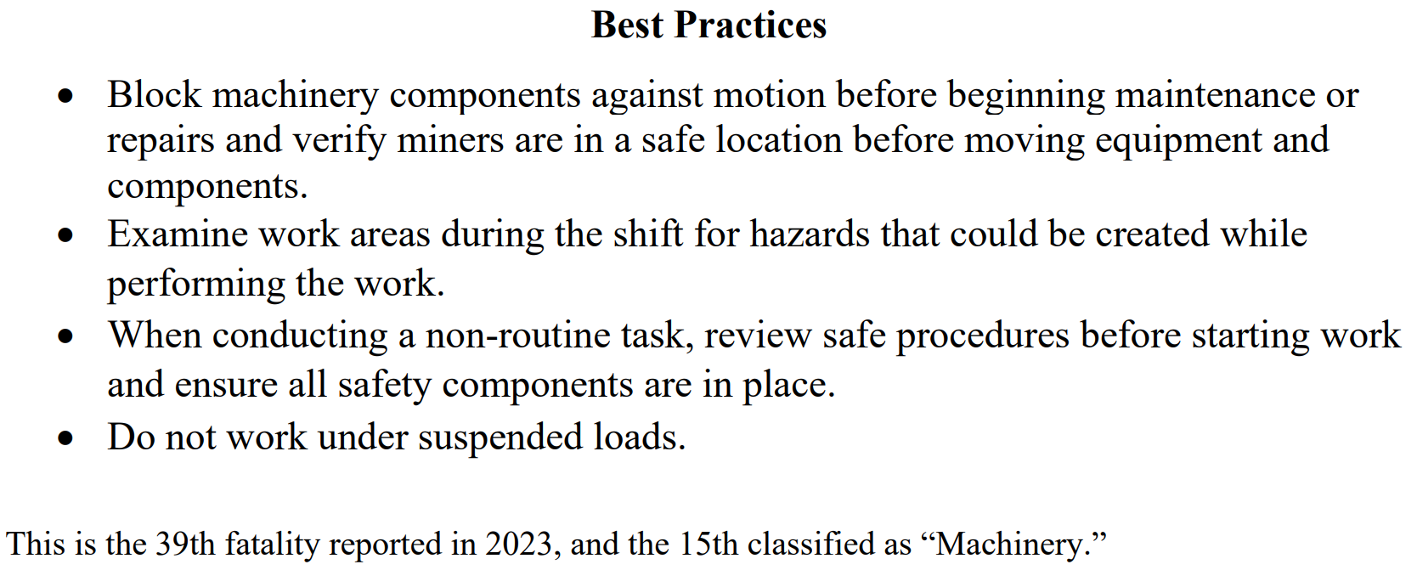
MSHA Fatality Alert – Bison No.1
PDF LINK

Slide 14
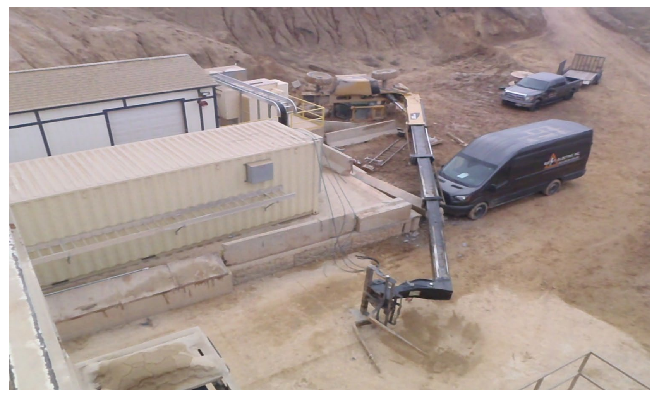
MSHA Fatality Alert – Beck Street
PDF LINK

